Slide 1
EIC Project News
E.C. Aschenauer (BNL), R. Ent (JLab)
Co-Associate Directors for the Experimental Program
EIC Detector Leads
ePIC Bi-Weekly
April 18th, 2024

Slide 2
Outline
Schedule/Budget Update
Detector R&D Day and R&D Planning
DAC Planning Update
Design Review 2024 Plans – Update
RRB Update
Planning for the Production Phase – Collection of Test Setups & Quality Assurance Plans
Infrastructure and Installation Complications

Slide 3
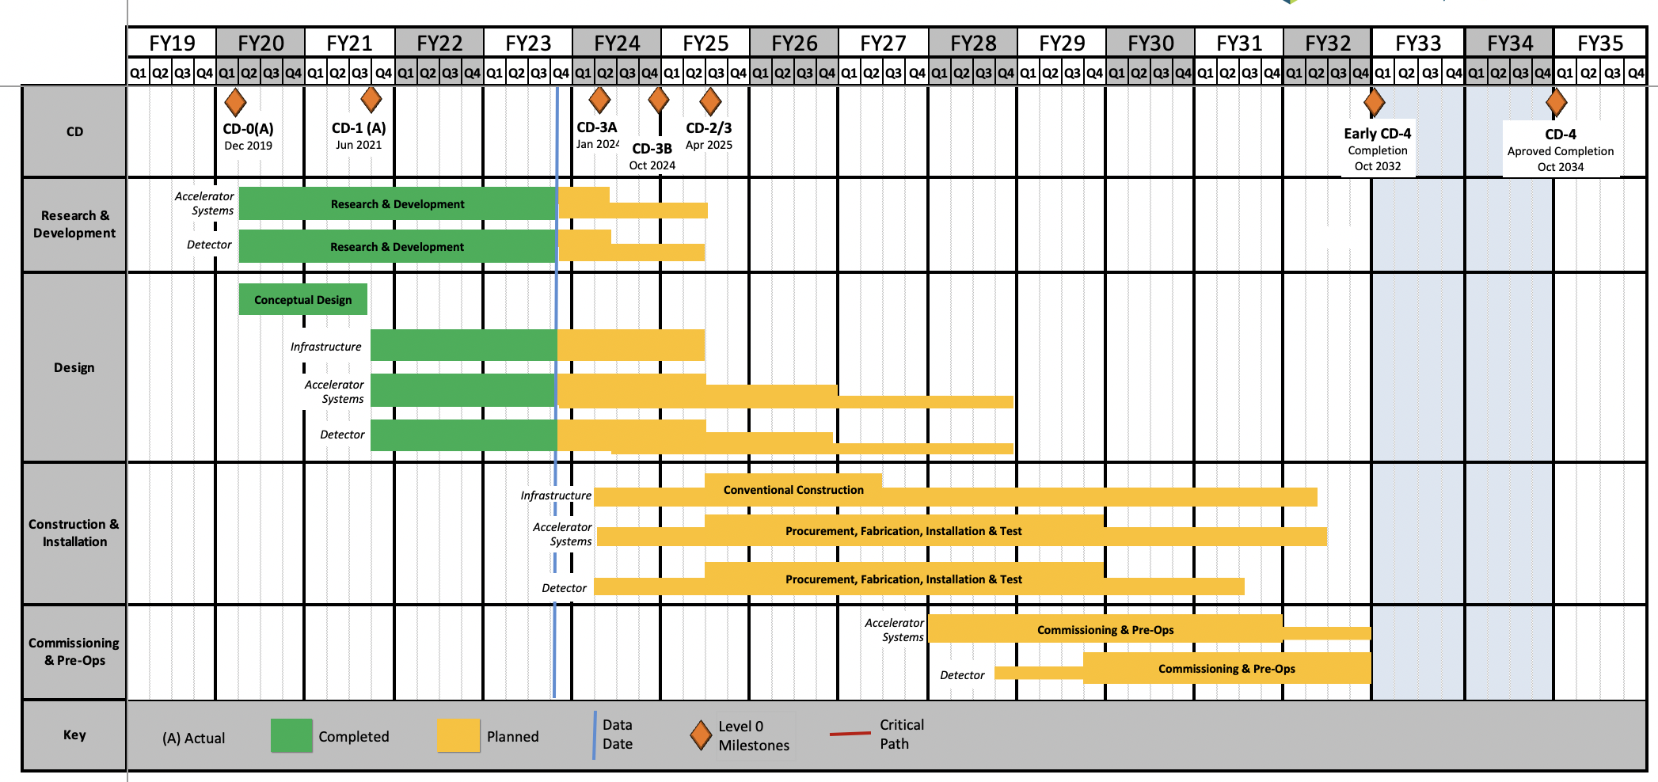
EIC Schedule
CD-3A:
Approve start of long-lead procurements
CD-3A items passed final design review
All interfaces related to them are frozen
Waiting for ESAAB meeting for authorization
Construction Phase
Conclusion of
RHIC Operation
Science Phase
CD-2:
Approve prelim. design for all subdetectors
Design Maturity: >60%
Need “pre-”TDR (or draft TDR)
Baseline project in scope, cost, schedule
The thinner bars indicate that R&D and design
can continue at a small level beyond CD-2 and CD-3
CD-3:
Approve final design for all subdetectors
Design Maturity: ~90%
Need full TDR
    Current EIC Critical Decision Plan
    CD-0/Site Selection December 2019 ✓
    CD-1 June 2021 ✓
    CD-3A ESAAB March 25th 2024
    CD-3B October 2024
    CD-2/3 April 2025
    early CD-4 October 2032
    CD-4 October 2034
Updated speculation based on EIC accelerator project status, on the actual appropriated FY24 funding ($98M), on uncertain FY25 budget scenarios (President’s Budget is only ~$113M) and the projected RHIC FY24 run:
January 7 – 9, 2025 Path to CD-2/CD-3 status review, possible CD-3B Approval spring 2025?
RHIC operations will conclude at end of FY25, in September 2025
CD-2 Approval Late 2025?, Possibility of CD-3C as needed.
CD-3 one year later?

Slide 4
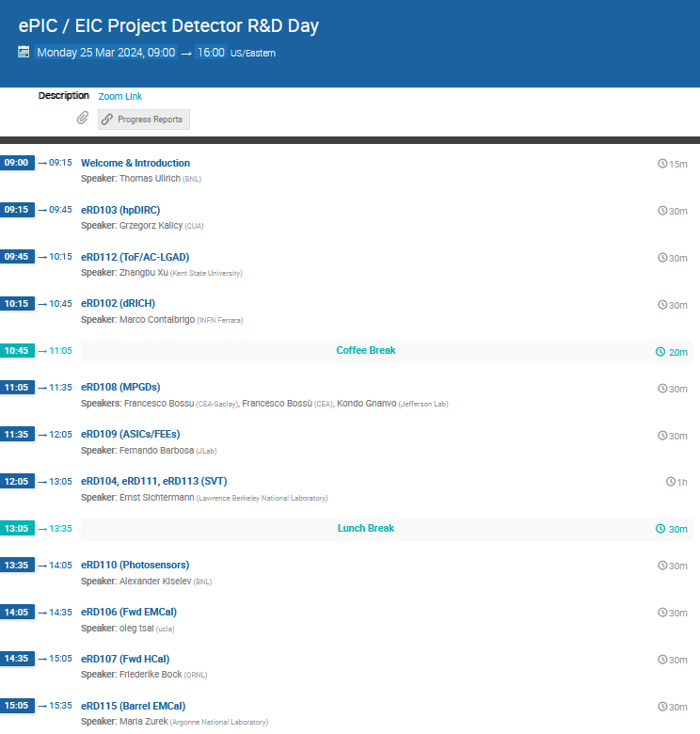
Detector R&D Day
https://indico.bnl.gov/event/22388/
Commonly organized by ePIC and EIC Project
Many thanks to all for reports and presentations
Good progress towards R&D milestones
Some of the eRDxxx Si/ASICs engineering readiness runs may need to be done as PED-funded activities in FY25 due to lack of “OPC” funds in the President’s Budget outlook – we plan to still follow the detector R&D plan.
Call for updates and follow-up plans will come in about one month with due date of July 1.

Slide 5
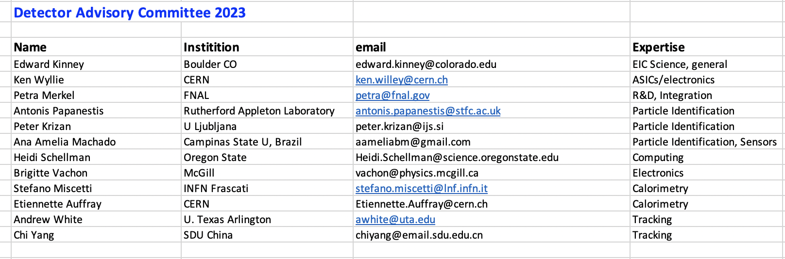
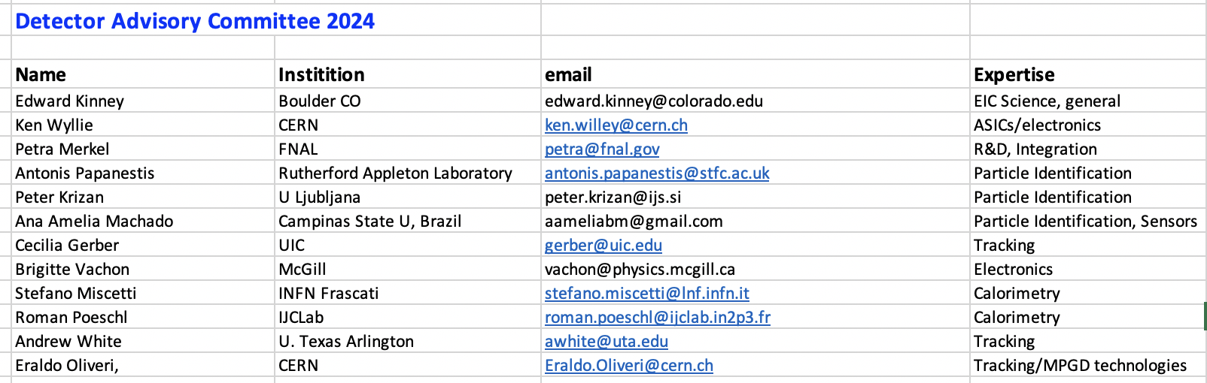
DAC Update
In the process of doing the DAC rotations, four out of twelve DAC members roll off per the charter
  One comes back as incoming chair → transition from Ed Kinney to Andy White as chair
This year we plan to have the 8th and 9th DAC meeting. In the 8th DAC meeting you will hear about the overall progress and status of the EIC Project, the technical baseline of the detector and ePIC collaboration contributions, and the planning for the construction phase of the Detector. Mid-Summer there will be a further two-day 9th DAC meeting dedicated to the review of the ongoing EIC project detector R&D and advise on possible continuations.
For the 8th DAC meeting, the DAC is asked to answer the following charge questions:
  The progress and status of the ePIC detector.
  The adequacy of the ePIC detector scope to achieve the key physics goals.
  The technical readiness of the detector for CD-2 baselining by Fall of 2025.
  The number of detector technologies in the EIC detector, their risk and opportunities.
  The adequacy of the resources – people and infrastructure for production and testing.
  Gaps or opportunities the labs and project should pursue for further international outreach.
  We welcome any other suggestions you can make that will improve the success of delivery for the ePIC detector.

Slide 6
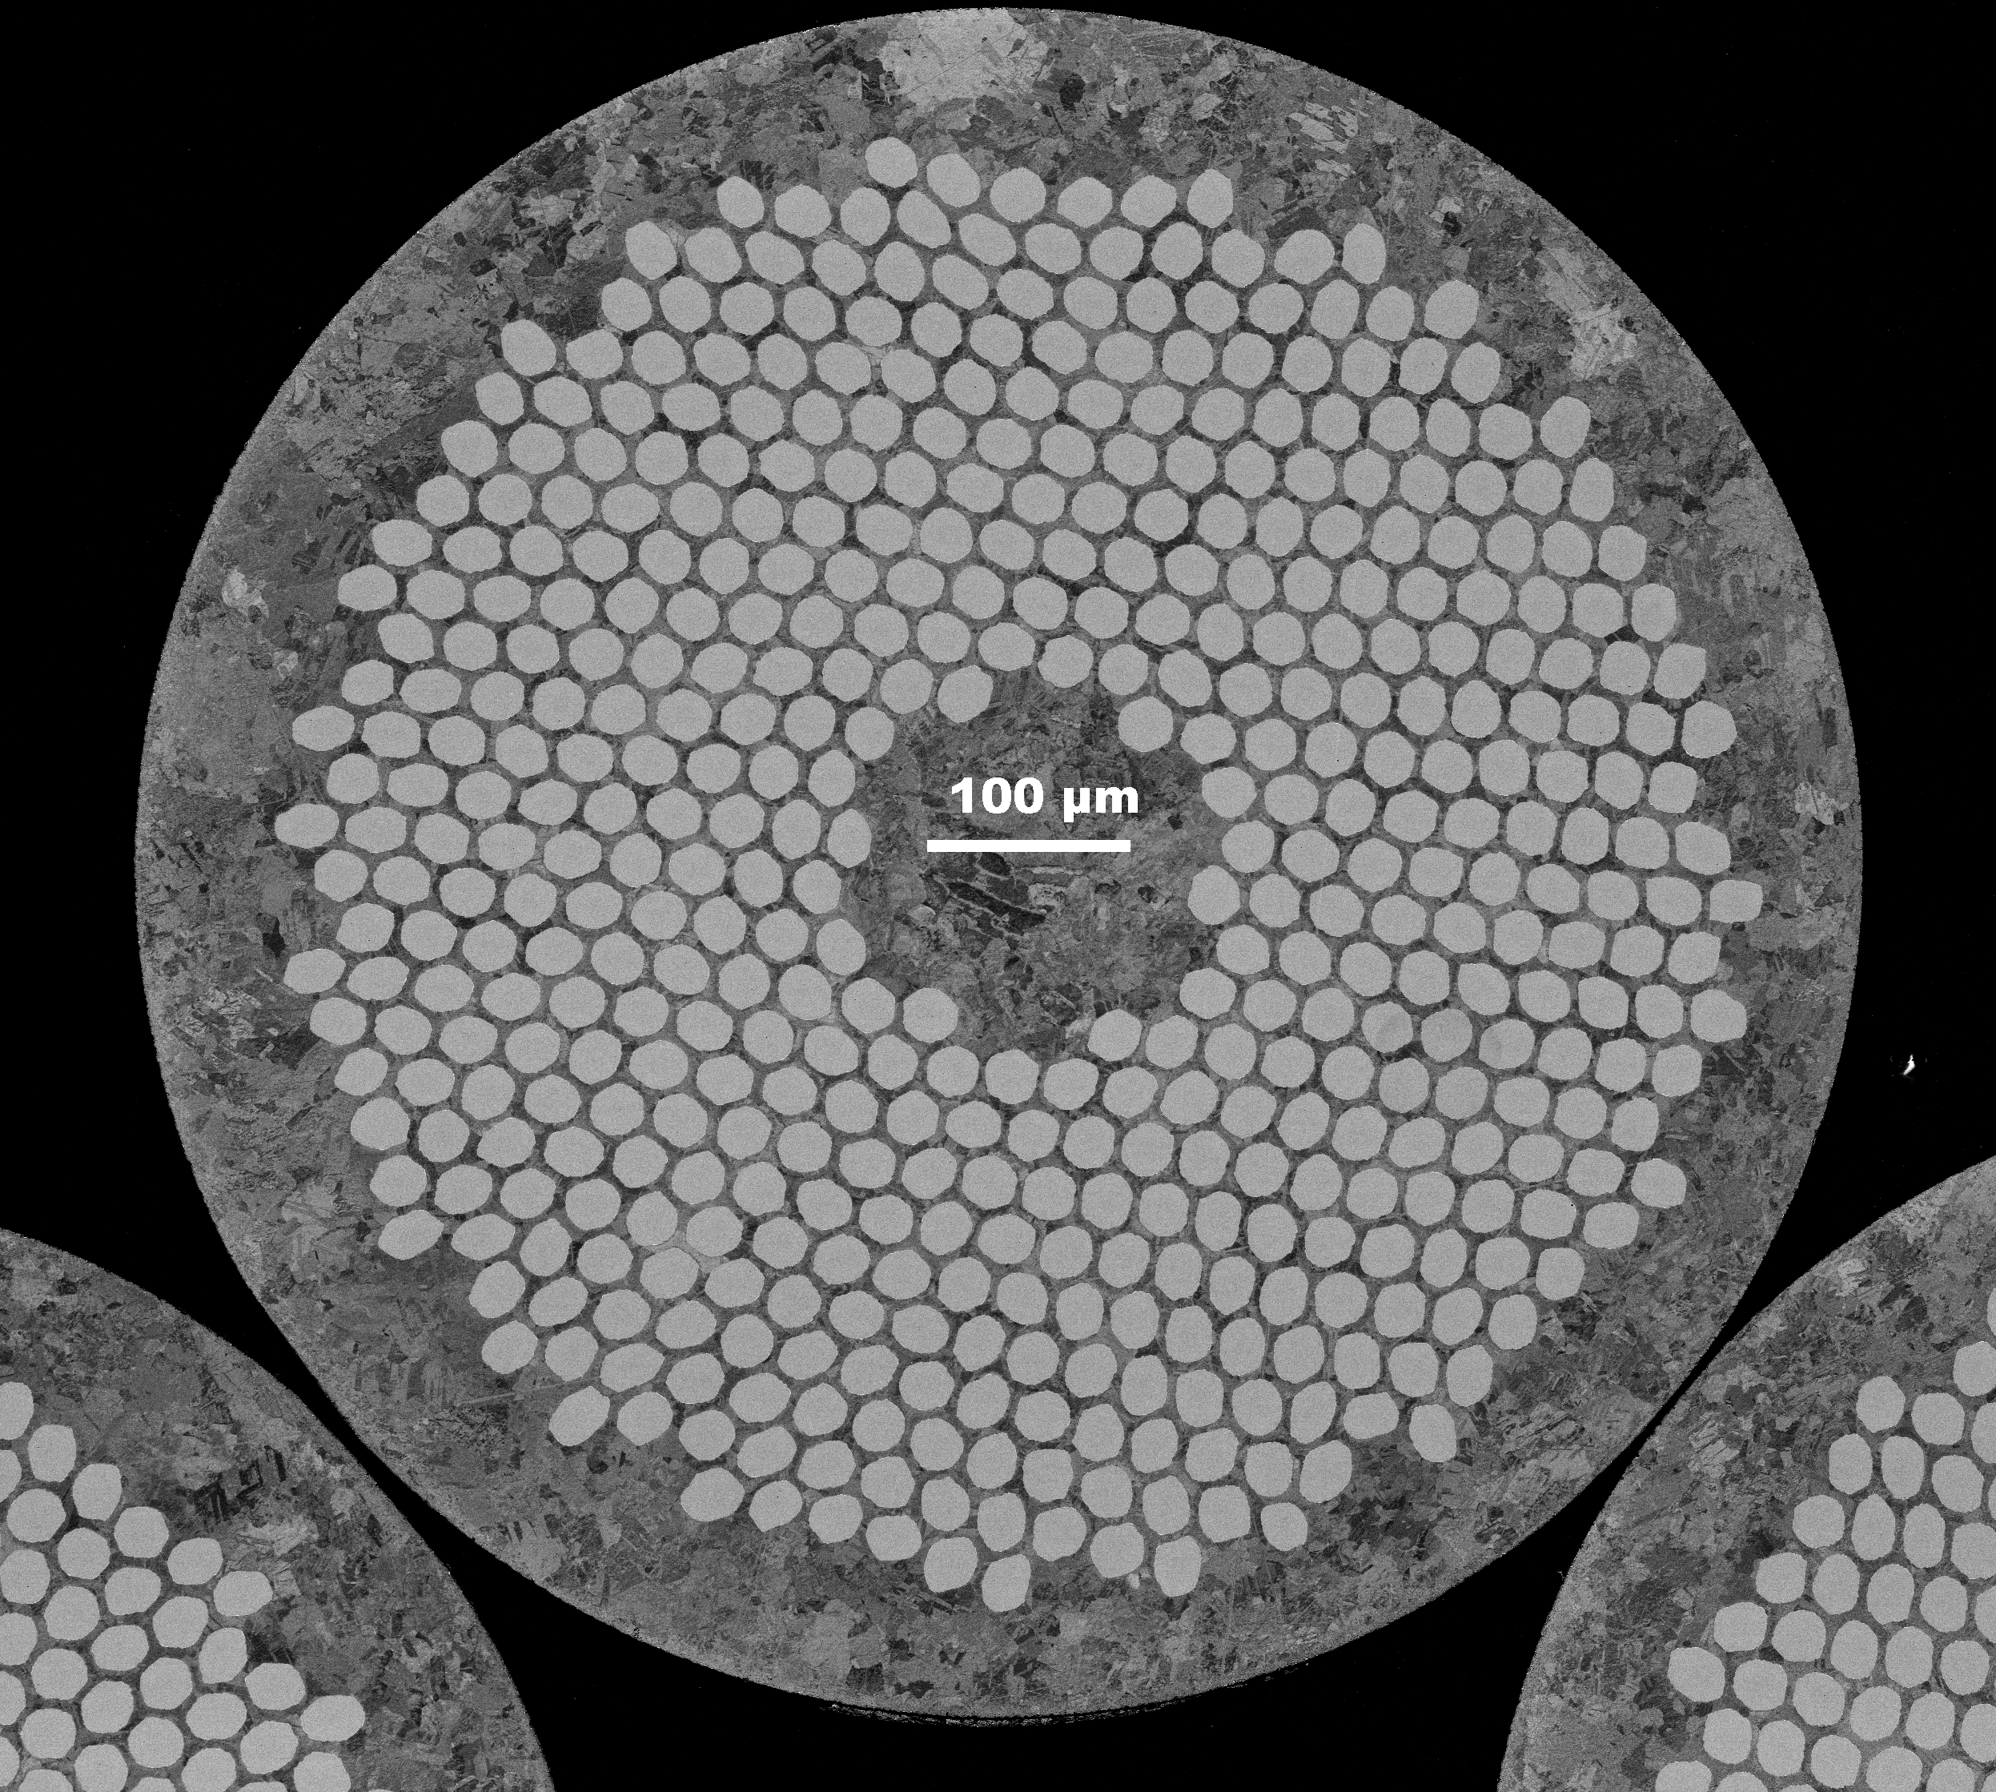
Progress on Long-Lead Procurement CD-3A Scope
Detector Systems CD-3A Scope
  WBS 6.10.05: Lead Tungstate Crystals for the Detector Backward EM Calorimeter
    CD-3A scope is first two years of procurements (1500 pieces) – READY TO GO (BNL), 2nd YEAR PENDING NSF PROPOSAL
  WBS 6.10.05: Scintillating Fibers for the Detector Barrel and Forward EM Calorimeters
    CD-3A scope is 1875 km first of four phases – READY TO GO (BNL)
  WBS 6.10.06: Silicon Photomultipliers for the Detector Forward Hadronic Calorimeter
    CD-3A scope is one phase (320K SiPMs) out of two for the forward Hadron Calorimeter – READY TO GO (BNL)
  WBS 6.10.06: Steel and Tungsten Plates for the Detector Forward Hadronic Calorimeter
    CD-3A scope is first of two phases (~50%) – RECORD OF DECISION ONGOING TO ONLY USE STEEL AND OMIT TUNGSTEN
  WBS 6.10.07: Detector Solenoid Magnet Design and Fabrication and Conductor
    CD-3A scope is for the conductor and the full magnet construction.
– MAGNET HAD RFP IN 2023
– MAGNET CONSTRUCTION CONTRACT PAYMENT BY INFN, OVERSIGHT/COMMISIONING BY JLAB AND CEA-SACLAY
– MAGNET CONDUCTOR CONTRACT BY JLAB, READY TO GO AFTER SAMPLE TESTS COMPLETED
6.10.07 Magnet – strands that are sent from Luvata to Twente for sample tests, the filaments are beautifully arranged – These are the final quality assurance tests before starting the long-lead procurement for conductor.
6

Slide 7
Path to CD-2/CD-3B and to CD-3
Design Reviews
  PDR2: IR Integration and Auxiliary Detectors – February 12, 2024 – main emphasis on baseline choices and progress
  Reviewers: Fulvia Pilat (ORNL), Gerrit Van Nieuwenhuizen (BNL), Wolfram Zeuner (CERN), Eugene Chudakov (JLab)
  PDR1: Tracking Detectors – March 20-21, 2024 – main emphasis on baseline tracking layout, if we are on track and plans
  Reviewers: Andy White (UTA), Michael Begel (BNL), Maxim Titov (CEA), David Lynn (BNL), Piotr Gasik (GSI)
  FDR: Magnet Power Supply – aim for May 28, 2024 – final design review for possible CD-3B scope
  PDR2: Electronics/DAQ – aim for week of June 10-14, 2024 – continuation of PDR1 to ensure we are on track and show progress
  FDR: VTRx+/lpGBT – included as ½ day in Electronics/DAQ review of early June 2024, possible CD-3B scope
  PDR2: Particle Identification Detectors – Summer 2024?
  PDR1: Integration, Infrastructure and Installation – September 2024 – includes detector support structures
  FDR: Magnet flux return steel – September 2024 – included as final specifications in above PDR for possible CD-3B scope
  PDR2: Barrel EM Cal – Summer/Fall 2024 – emphasis on mechanical design & AstroPix readiness (needs {PDR before CD-2)
  FDR: Backward & Forward EM Calorimetry, Barrel & Forward HCAL – Fall 2024
  PDR2: Polarimetry – timescale TBD (but before CD-2)
Detector R&D Day – March 25 – check R&D progress and outlook to FY25
DAC-Meetings 2024 under planning:
  ~May 2024: Project Status, Baseline Detector, International Engagement, Detector R&D progress (expect 1+ day)
  ~August 2024: Detector R&D annual review (expect 2 days) – deadline for submission July 1, 2024
Next ePIC Computing & Software review by host labs – ~October 2024?
7

Slide 8
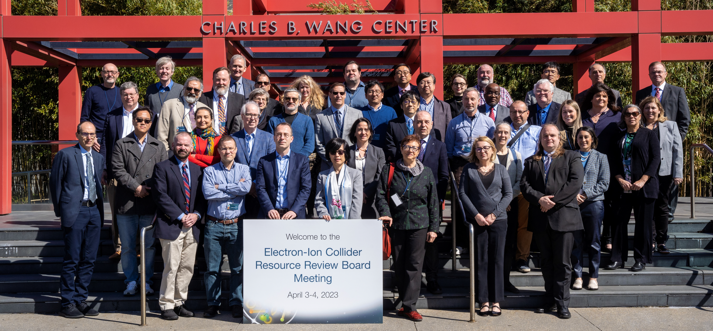
International Engagement: Resource Review Board (RRB) Meetings
DOE and the host labs promoting the EIC as a facility “fully international in character.”
Initial RRB Co-Chairs:
Haiyan Gao (BNL)
Diego Bettoni (INFN)
https://www.bnl.gov/eic-rrbmeeting/
1st RRB meeting on April 3-4, 2023 at Stony Brook University.
2nd RRB meeting on December 7 + 8 at Catholic University of America.
3rd RRB meeting planned for May 6 + 7 hosted by INFN/Italy
8

Slide 9
Planning for Production Phase
We plan to collect information on all test setups for component quality assurance
In consultation with ePIC leadership (John and Sylvia), we will set up directories on a public sharepoint organized by detector with some examples.
We will also add the quality assurance plans as were part of the Final Design Reviews for CD-3A components (PbWO4, SciFi, SiPM, …)
These naturally are part of future Preliminary and Final Design Reviews
  Quality assurance is a standard charge element
  We are interested to find strengths, weaknesses and gaps in the planning for the production phase
  Fold in that we have 25+ different detector technologies, so we have to assume this is a risk.

Slide 10
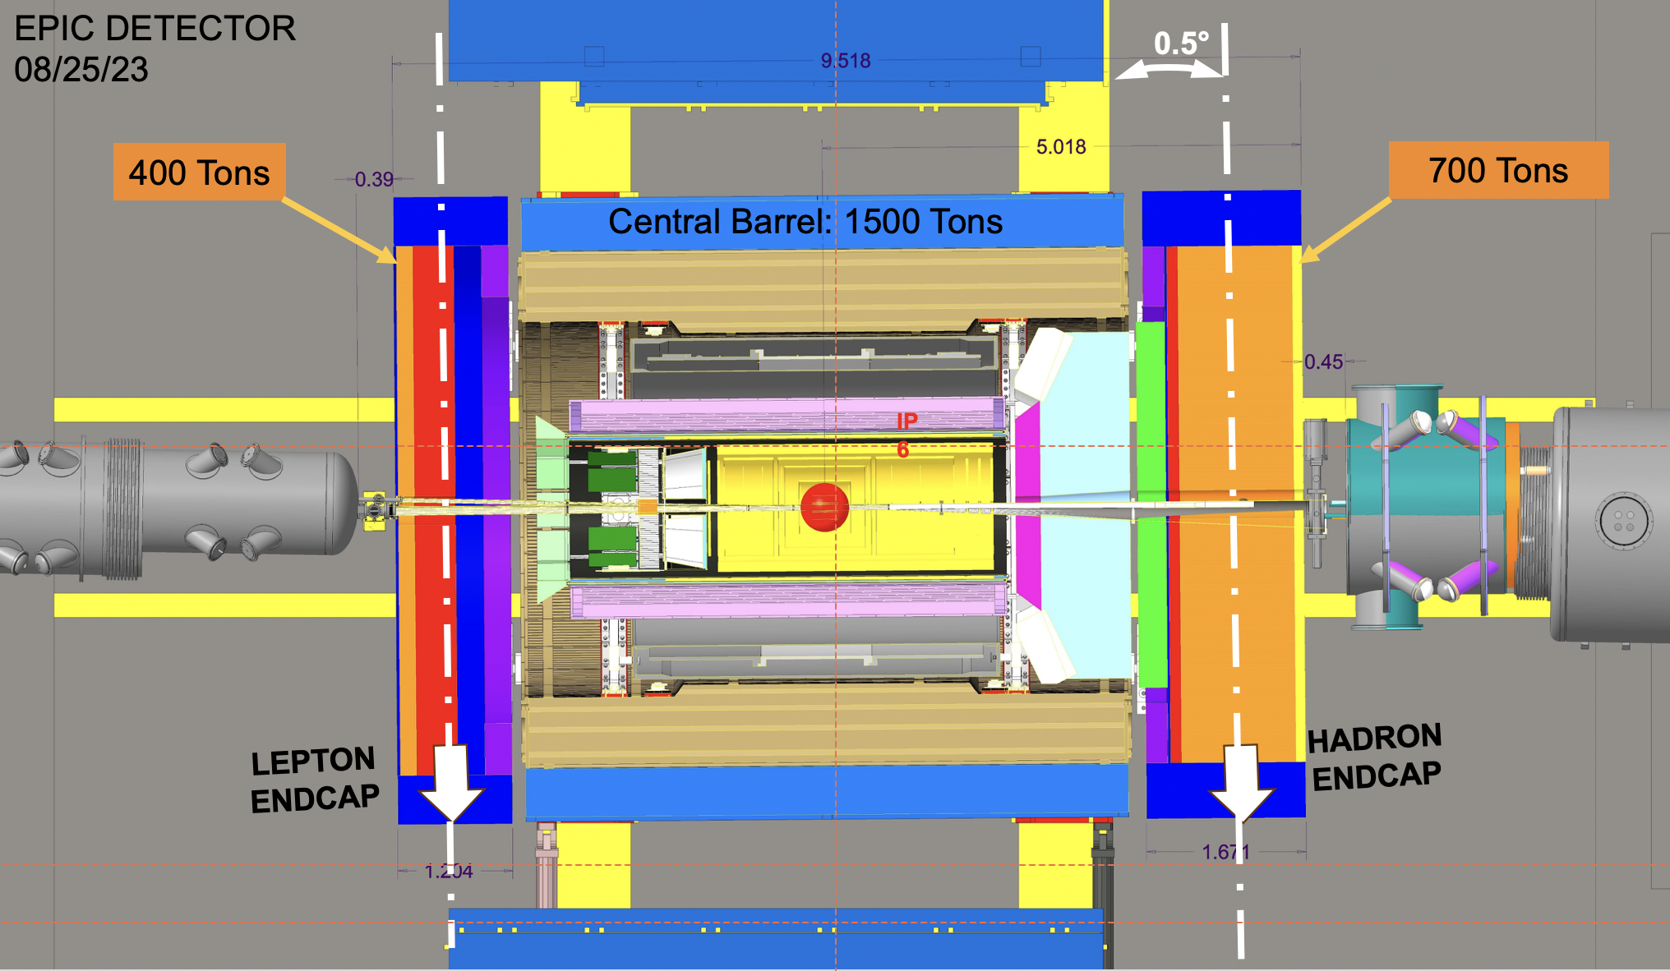
Pending/ Potential Project Change Requests (PCR)
Potential PCRs:
strengthen the floor load in the wide angle and assembly hall
Preparations to do the needed measurements are going on
ePIC Barrel weight is estimated as 1500 Tons.
Hadron Endcap will weigh around 700 Tons
Lepton Endcap will weigh 400 Tons.
North and South platform will weigh approximately additional 100 Tons (estimate).
These weights are significantly higher than current STAR detector weights.
Concrete floor analysis should be done to see whether floor can hold the weights.
Also its very important to know the concrete floor thickness at various spots.
  Amman and Whitney document describes 3 options that were proposed for modification of Wide Angle Hall concrete floor to accommodate 1200 Tons weight of STAR.
  We are not able to find documentation of what was chosen. Bill Christie and Jim Mills have conflicting memory about whether option 1 or option 2 was chosen.

Slide 11
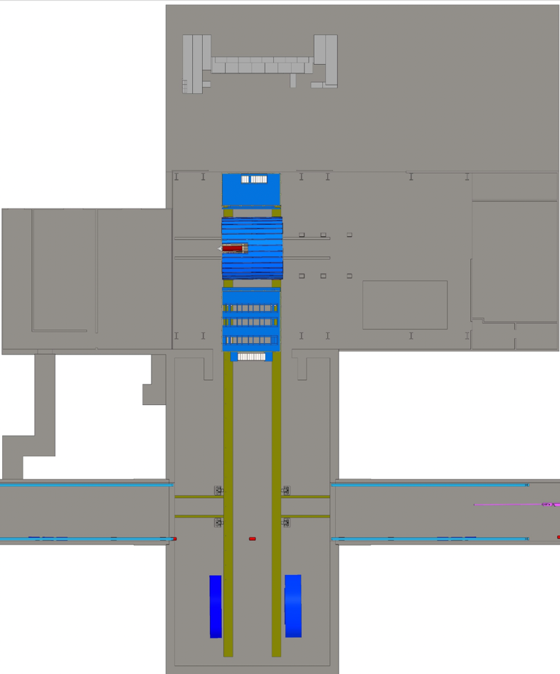
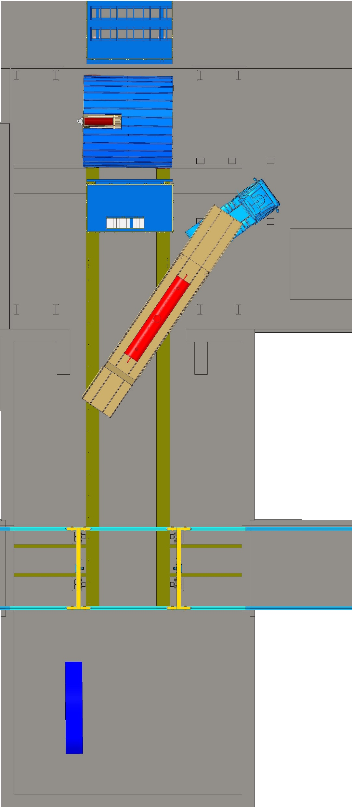
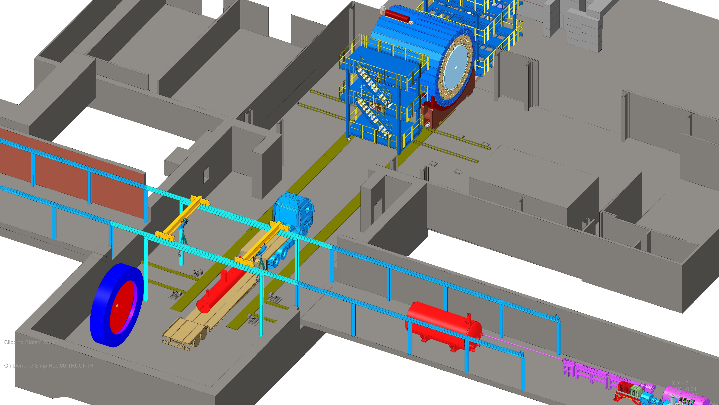
Pending/ Potential Project Change Requests (PCR)
Potential Change Request:
possible1006 building extension to accommodate the late installation of the IR equipment with detector already sitting close to fully assembled in the assembly hall blocking the entrance to the wide-angle hall.
Alternative is digging new service tunnels to IP-6 tunnel area
→ had a meeting discussing will all parties and get a cost estimate for both options.
After extending building and swapping platforms
Now

Slide 12


Slide 13


Slide 14
Goals for 2024 (towards CD-2!)
DAC meetings in ~April (topics: detector status, international engagement, R&D status) and ~August (topic: Detector R&D advise)
  Completion of Non-Si R&D
  Advise on follow-up of MAPS/ITS3, ASICs, and AC-LGAD
Quantify (time, cost, performance) and document, before CD2, mitigation plans for the possibility that some R&D components will not meet expectations
  Tracking layout with branching points defined and documented
  HRPPD backup option documented, etc.
Ensure good project progress
  Implement procurements for CD-3A scope and manage progress
  Continue work on design maturity for all (non-CD-3A) systems.
  Define CD-3B needs: next phases of CD-3A, magnet power supply, perhaps VTRx+ optical transceivers, perhaps magnet steel
  PDRs of Tracking, Far-Forward/Far-Backward, Electronics/DAQ, Particle Identification
  FDRs of Magnet Power Supply, Calorimetry
Continue work on integration aspects, e.g., service needs of various detectors, cable routing, electronic rack layouts, survey & alignment planning, monitoring systems, controls needs.
  System engineering for electrical and services (per DOE/OPA recommendation)
  Document controls needs
  Collect interfaces beyond CD-3A scope, and document towards ICDs
Simulations with Full Materials, Background and Reconstruction
Draft Technical Design Report in collaboration with ePIC
Formalize in-kind agreements in form of high-level agreements and project planning documents, as appropriate: Italy/INFN (Detector, Magnet), France/IN2P3, France/IRFU, UK/STFC, perhaps NSF, other

