Slide 1

ePIC Collaboration News
J. Lajoie, S. Dalla Torre
April 18, 2024

Slide 2
Hey John, start the recording….

Slide 3
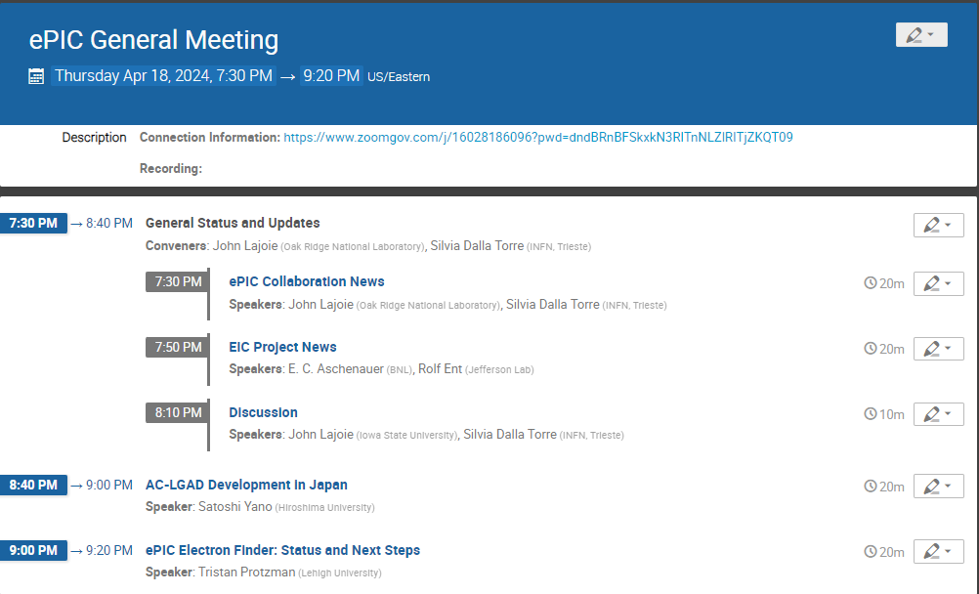
Today’s
Agenda

Slide 4


Slide 5

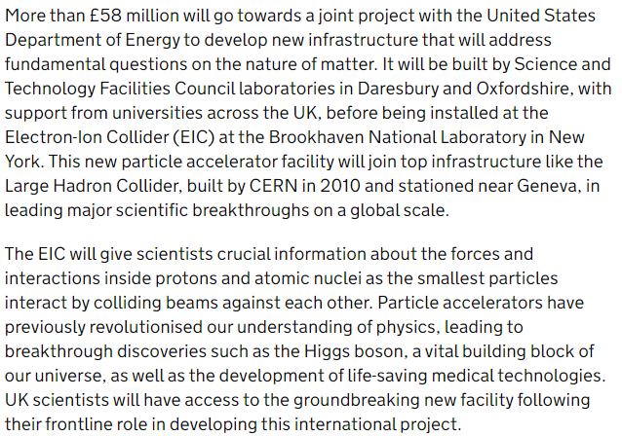
Major Announcement on UK Funding!
March 27, 2024
This funding will help build the SVT outer barrel layers, low-Q² tagger, and luminosity pair spectrometer calorimeters, as well as two cryomodules for the ERL cooler.
Congratulations to our UK collaborators!

Slide 6
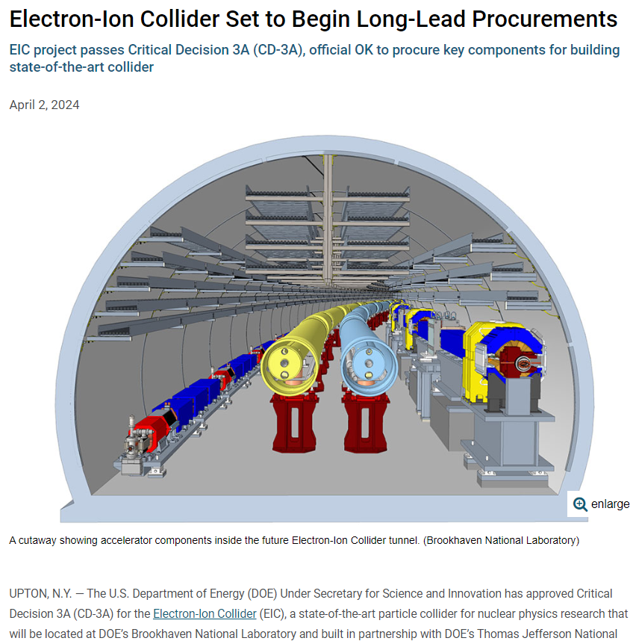
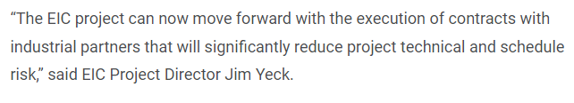
CD-3A Approval!
https://www.bnl.gov/newsroom/news.php?a=121812

Slide 7

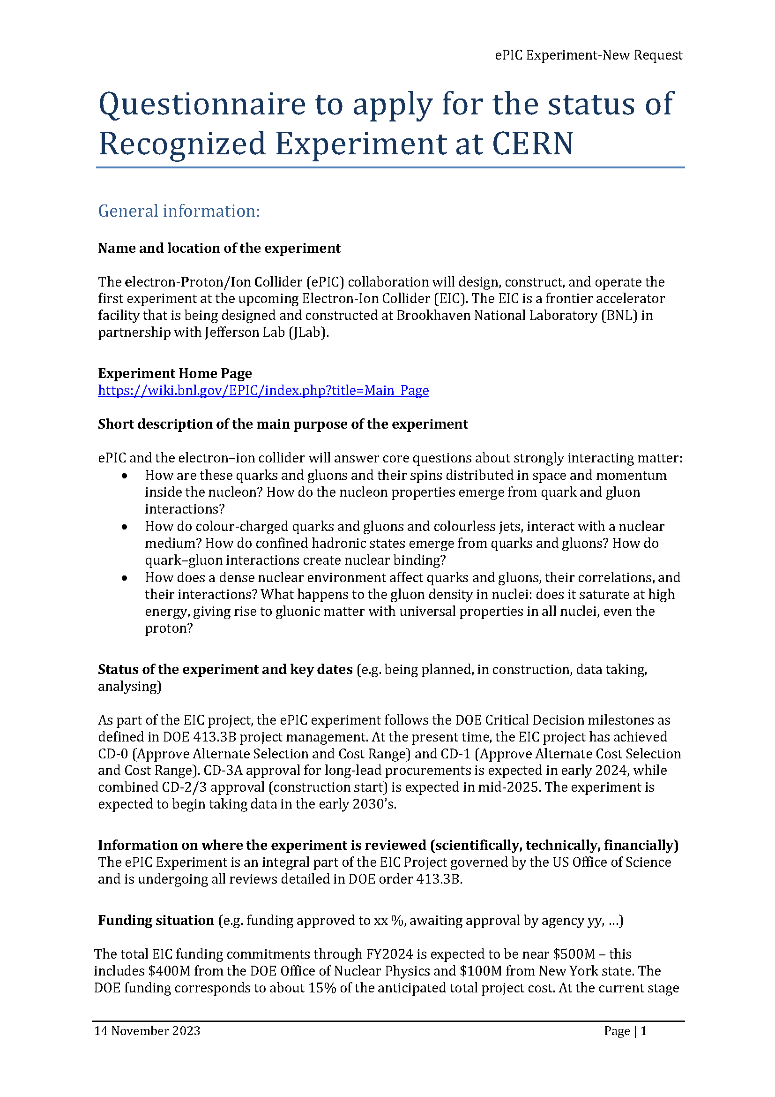
CERN Recognized Experiment
ePIC Application for CERN Recognized Experiment:
  ePIC leadership has submitted an application to become a CERN Recognized Experiment
  Strong synergies between CERN and EIC
  Important for access to CERN resources (test beams, …)
  Increase visibility in the European community
ePIC presentation Thursday, Feb 8th at 1:15M @ CERN
  Well received!
Next CERN Council Meeting March 21-22nd
From Helge Meinhard @ CERN on 4/4/2024:
Dear John,
Yes - the Research Board confirmed the positive recommendation of the
Recognized Experiments Committee. I'll get back to you for the next steps
when back from holidays.
Best regards,
Helge

Slide 8

NuPECC 2024 LRP – Town Meeting
Bucharest, Apr. 15-17th - https://indico.ph.tum.de/event/7593/
Draft of full document and separate chapters available.
EIC and ePIC are mentioned in the executive summary
EIC mentioned in chapters on Hadronic Physics and Nuclear Physics Tools – Detectors and Experimental Techniques, dedicated paragraph in chapter on Research Infrastructures Outside Europe (with related specific recommendations)
Lots of involvement from the EIC community:
  Pietro Antonioli is a member of the hadron WG
  Marco Radici and Carlos Munoz Camacho are members of the infrastructure WG
  Silvia Dalla Torre is a convenor of the detector WG
  Papers submitted in support of European involvement in EIC/ePIC
(page 223)

Slide 9
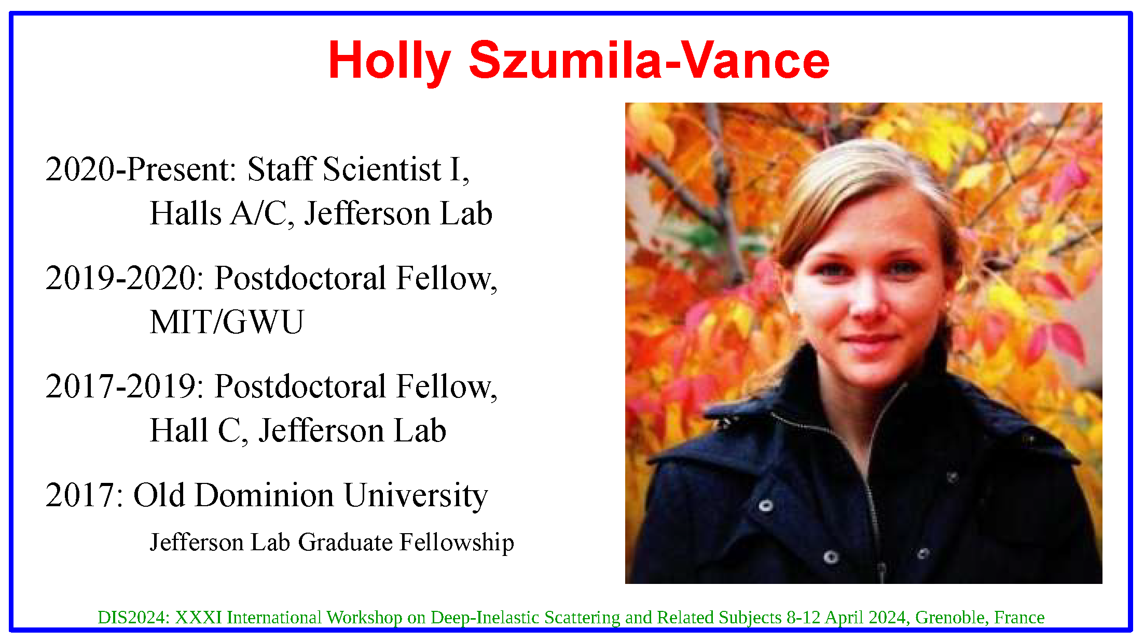

Congratulations!
Please join us in congratulating Holly Szumila-Vance on being awarded the Guido Altarelli Award 2024 at DIS2024.
Holly is one of the ePIC User Learning WG Conveners

Slide 10

And in other news….

Slide 11
Follow up on TDR effort at the TIC meetings
April 8 : Electronics/read-out/DAQ WG
  Very complete report, good progress
  To be underlined:
    PDR is now moved to early June;
      It has to be final for lPGbt / vtrx+ (LLP items);
    Progress on data volume estimation,
      Still pending: synchrotron radiation, information from far detectors,
      realistic implementation of thresholds in the FEEs
    RDO Pre-prototype design progressing rapidly (expect: 6 boards by the end of April).
April 15 : Tracking
  SVT DSC
    For the SVT LAS, specification document and technology choice for the Ancillary IC are being finalized.
  MPGD DSC
    CyMBaL geometry updated following the design of the project engineers and imported in CAD
    Ongoing tracking software updates:
      Track reconstruction performance also in background embedded DIS events (at present p beam-gas)
      Primary Vertex Reconstruction
      Tuning the Tracking Covariance Error Matrix
      Updated material budget of CyMBaL

Slide 12
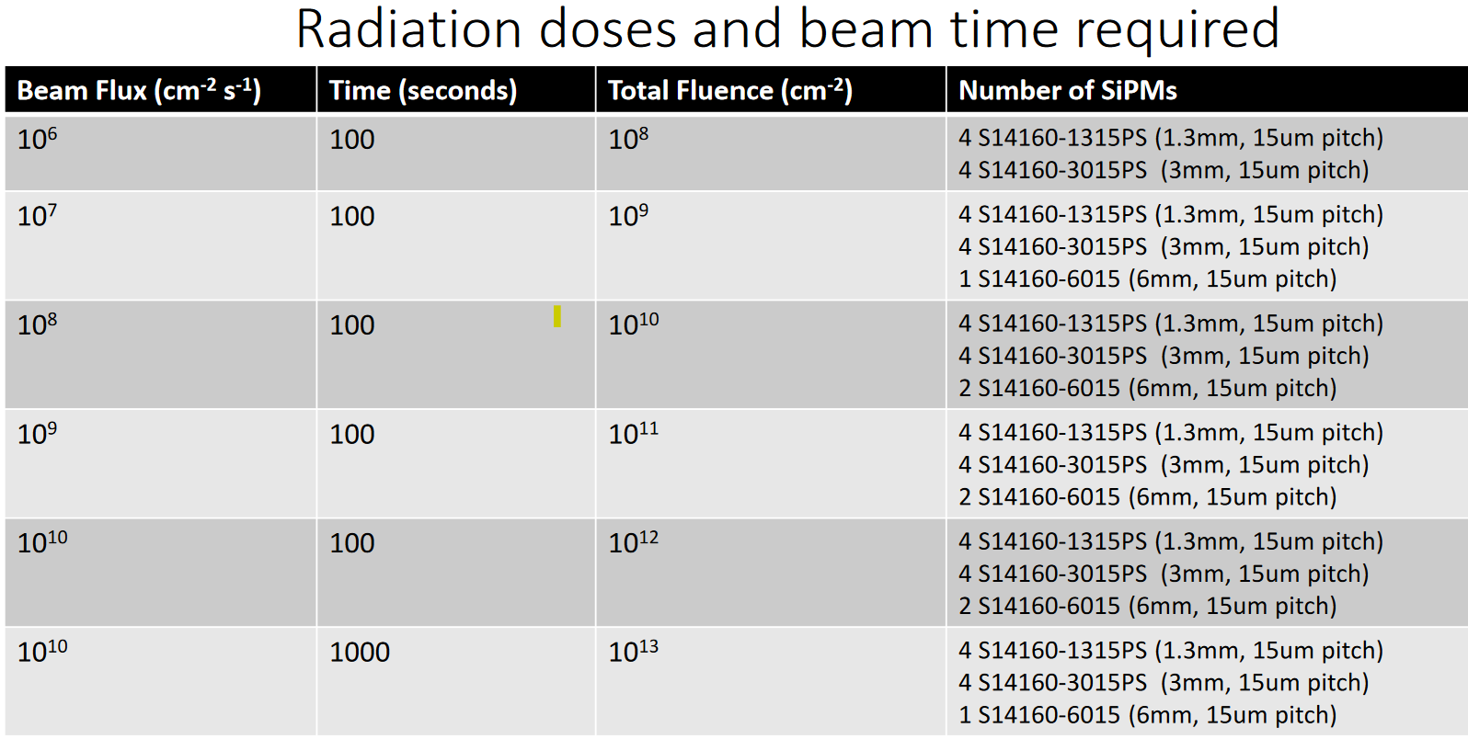
Radiation campaigns (from TIC meeting on April 8) 1/2
SiPMs for forward HCal calorimeter insert
Campaign @ UC Davis Cyclotron on August 15th-16th 2024;
Details about the irradiation facility, the handling and “paperwork” provided;
Goal : studies of the radiation damage; A detailed irradiation program presented
Complementary consideration: the outcome can be extrapolated to other SiPM by the same technology with different size parameters (pixel size, sensor surface).

Slide 13
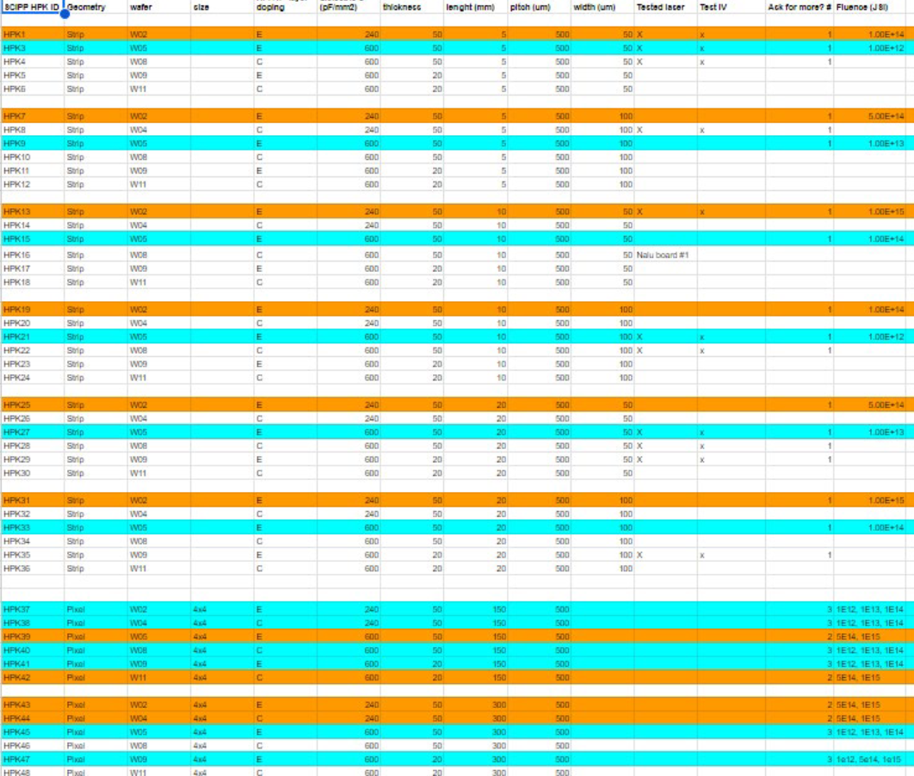
Radiation campaigns (from TIC meeting on April 8) 2/2
AC-LGADs
Campaign @ IJS Ljubljana
For LGADs and AC-LGAD sensors, radiation damage can result in reduced gain and deteriorated time resolution after a substantial irradiation dose
A detailed irradiation program was presented
Further studies are considered:
  Plans for irradiation at UC Davis (high energy neutrons, protons, ions) in summer
  TBD plans for irradiation at UC Berkely (high energy neutrons, protons, ions)

Slide 14
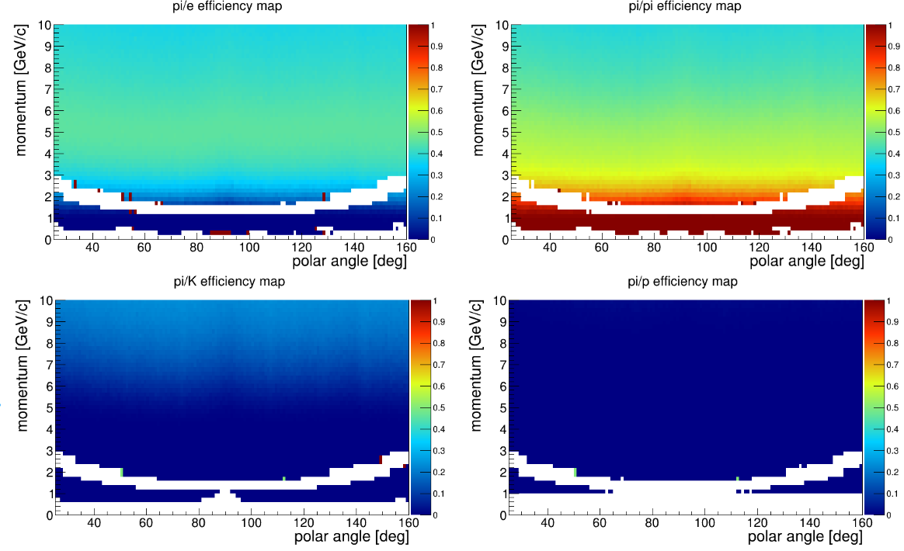
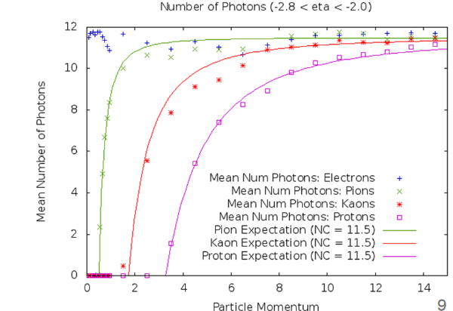
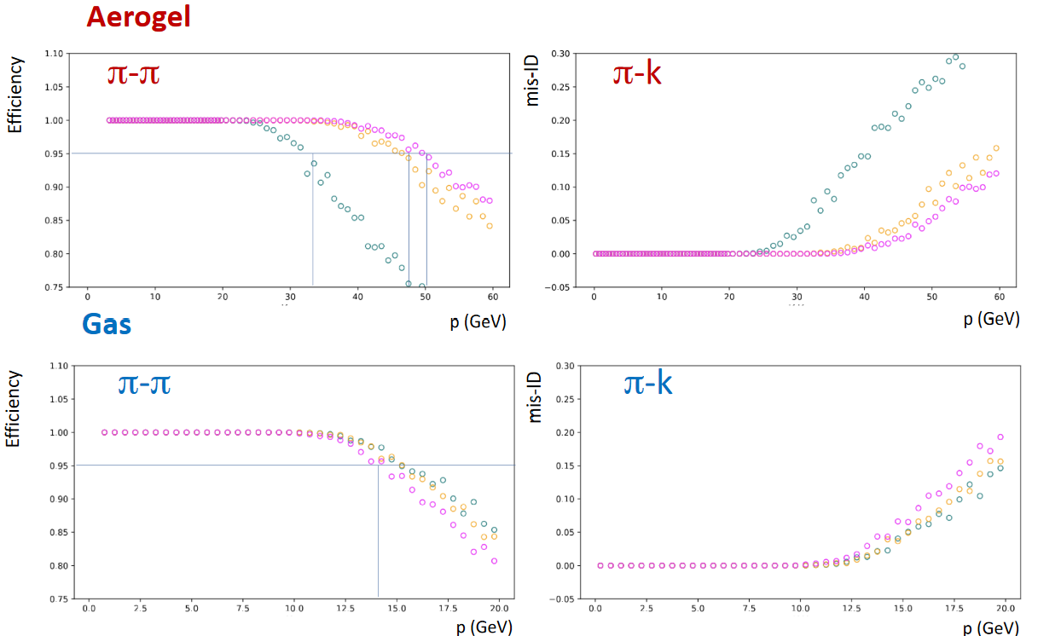
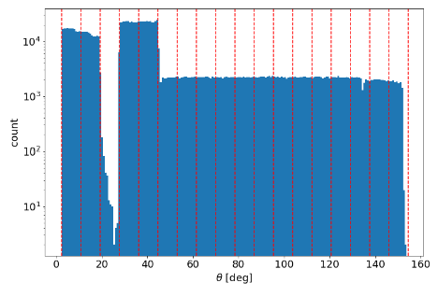
PID-LUTs (from TIC meeting on April 15)
Lookup Table status
The status of the LUTs by the 4 PID DSCs is summarized in detail.
  The level of maturity of the available LUTs is different for the 4 subsystems and updated versions are been worked out.
  Tables dedicated to e/h discrimination (that will not be used in the short term) and tables for the h identification have been provided.
  dRICH is providing, at the moment, separate tables for aerogel and gas and it is requested to have them merged in a single table.
  The effort of the DSCs in providing the tables under PID CC WG coordination is appreciated.
The hadron LUTs will not be available in the April production. They are expected to be available in nightly builds well in advance of the May simulation campaign to facilitate debugging.
A working version of the PID LUTs is imperative for the May simulation campaign.
hpDIRC
pfRICH
dRICH
ToF

Slide 15
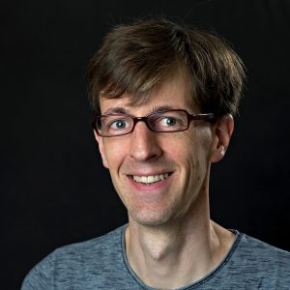
Improve Software for Tracking Studies
Tracking studies in ePIC are critical to achieving CD-2 milestones.
Many people involved in building up ACTS-based track reconstruction to the point of initial functionality, including most recently when J. Osborn integrated the ACTS orthogonal track seeding.
Need to ensure continuity in ACTS expertise, now that these people are pre-occupied with sPHENIX, BIC, family responsibilities, and other endeavors.
Also, need to enhance track reconstruction to facilitate time-critical tracking studies.
Wouter Deconinck has the necessary expertise, and the S&C Coordinators are willing to help redistribute his workload to make this possible.
Suggestion was to make this a specific charge:
Charge to Wouter Deconinck: Within your role as a Deputy Software and Computing Coordinator, you are charged with the overall integration of ACTS software within the ePIC software stack and the development of the data structures, relations and associations needed to continue the performance and physics studies with the ePIC tracking system. These studies, which are guided by the Reconstruction WG and Tracking CC WG, are necessary for the next EIC project stages and reviews and your efforts should align with these timescales. In addition, you should seek to broaden the expert user base within ePIC for ACTS to ensure the longevity of this knowledge within ePIC.

Slide 16
Next ePIC Collaboration Meeting
Lehigh University
Bethlehem, PA
July 22-28
Jointly organized with the EICUG
Planning a joint session with talks of common interest
ePIC Meeting
July 24-28th
In contact with Tim Hallman regarding DOE meeting limits
https://indico.bnl.gov/event/20727/
Still working on this!

Slide 17
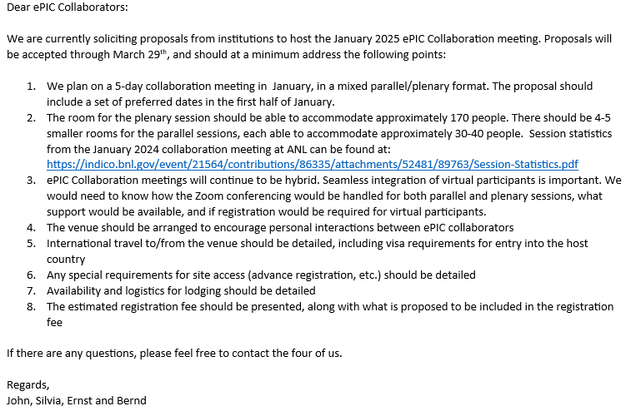
Higher Order Collaboration Meeting (NNCM)
Call sent Feb. 6th:
  We realize that a lot of time is needed to plan these events
  Call will be open through Mar. 29th
  Expect a decision a few weeks after call closes
Looking forward to many exciting proposals!
One proposal received, several others still in preparation and expected soon.
Stay tuned…

Slide 18
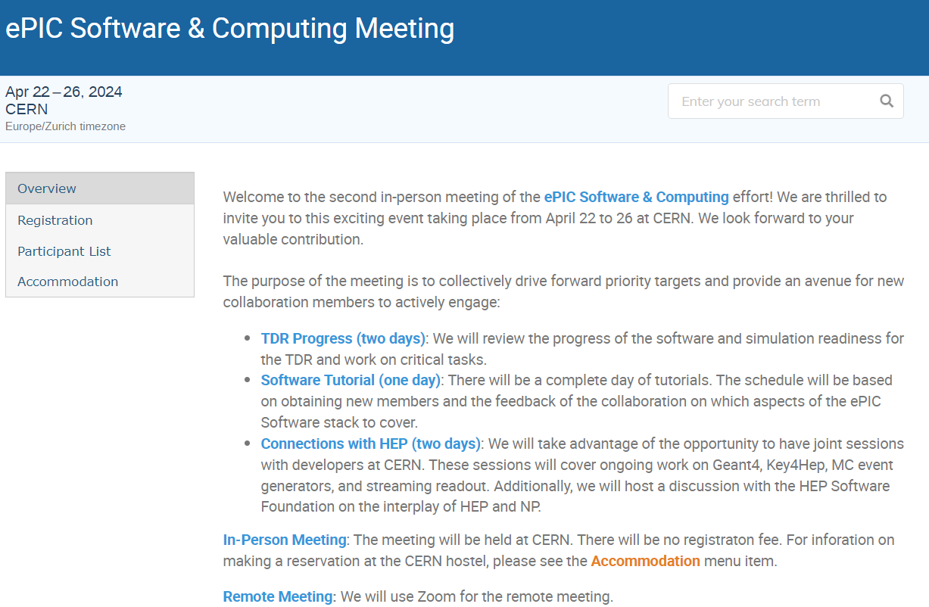
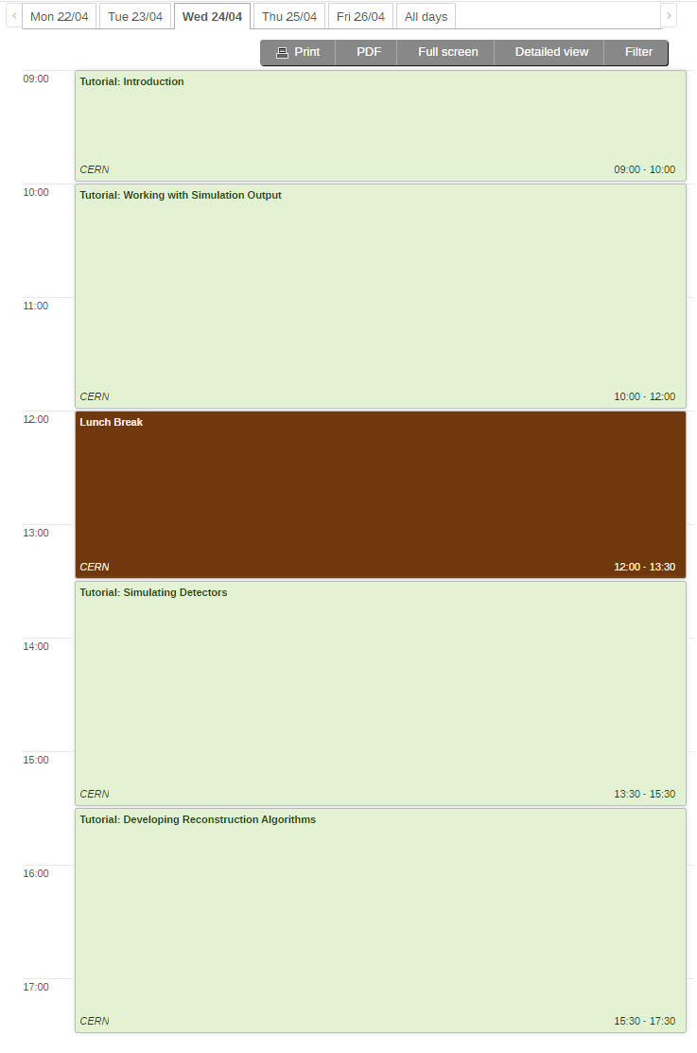

Software and Computing
Meeting
@ CERN
Software Tutorial on April 24: A day-long event at CERN, offering in-depth training for detector and physics studies.
Encouraged to attend on-site at CERN; remote access is available.
Scheduled in the CEST time zone, ideal for attendees from Africa, Asia, and Europe.
Introductory Session: Guidance on software essentials for new participants in DSCs, PWGs, or SWGs.
Analysis and Simulation: Three sessions focused on developing analyses from simulation outputs, starting with detector simulations, and exploring reconstruction algorithms.
Practical Learning: A combination of instructional content and hands-on tasks.
Registration:
https://indico.cern.ch/event/1343984/registrations/102560/

Slide 19
SCC/AC Shared Reconstruction Priorities
Slide from ePIC Physics, Software and Computing Discussion April 17th :
https://indico.bnl.gov/event/22709/

Slide 20
Upcoming Review Schedule
Expanded from March 21st
GM Project News Presentation
Design Reviews
  PDR2: IR Integration and Auxiliary Detectors – February 12, 2024 – main emphasis on baseline choices and progress
  PDR1: Tracking Detectors – March 20-21, 2024 – main emphasis on baseline tracking layout, if we are on track and plans
  ePIC/EIC Detector R&D Day – March 25 – check R&D progress and outlook to FY25
  PDR2: Electronics/DAQ – June 2024 – continuation of PDR1 to ensure we are on track and show progress
  PDR: Integration, Infrastructure and Installation – Summer/Autumn 2024? – includes detector support structures
  PDR2: Particle Identification Detectors – Summer 2024?
  PDR2: Barrel EM Cal – Summer/Fall 2024 – emphasis on mechanical design & AstroPix readiness
  FDR: Backward & Forward EM Calorimetry, Barrel & Forward HCAL – Fall 2024
  PDR2: Polarimetry – timescale TBD (but before CD-2)
  FDR for any potential CD-3B scope: Magnet Power Supply, perhaps VTRx+/lpGBT, perhaps magnet steel – see NOTE
  FDR Magnet Power Supply – Spring 2024; Magnet Steel perhaps Summer 2024; VTRx+/lpGBT add ½ day to electronics/DAQ PDR2
DAC-Meetings 2024 under planning:
  ~April 2024: Project Status, Baseline Detector, International Engagement, Detector R&D progress (expect 1+ day)
  ~August 2024: Detector R&D annual review (expect 2 days) – deadline for submission July 1, 2024
Next ePIC Computing & Software review by host labs: ~October 2024?
EIC Project Review ~ November 2024
  Collaboration goal is to have a draft of the pre-TDR ready for this review

Slide 21
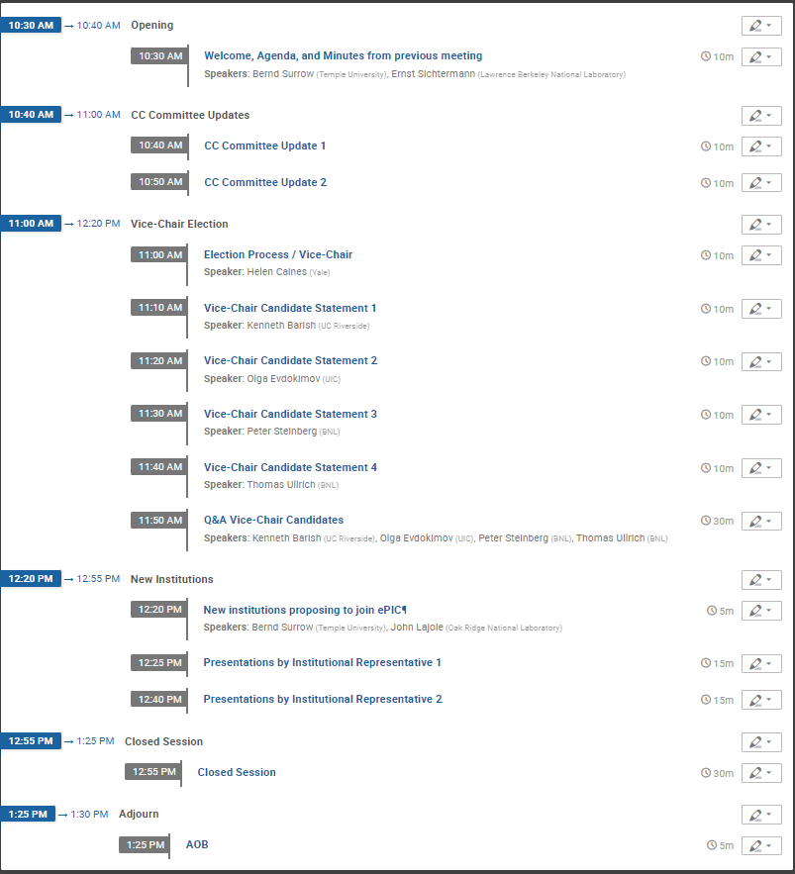
Upcoming Collaboration
Council Meeting
April 26th @ 10:30AM ET
https://indico.bnl.gov/event/23006/
Vice-Chair Candidate Statements:
https://indico.bnl.gov/event/22972/

Slide 22
Summary
Hard work by the ePIC Collaboration, the EIC Project, EICUG and the EIC International Community is paying off!
Lots of hard work in 2024 to keep up the momentum!
Next ePIC CC Meeting: Friday, April 26th @ 10:30AM
Next ePIC General Meeting:
Friday, May 3rd @ 10:30AM ET

Slide 23


Slide 24
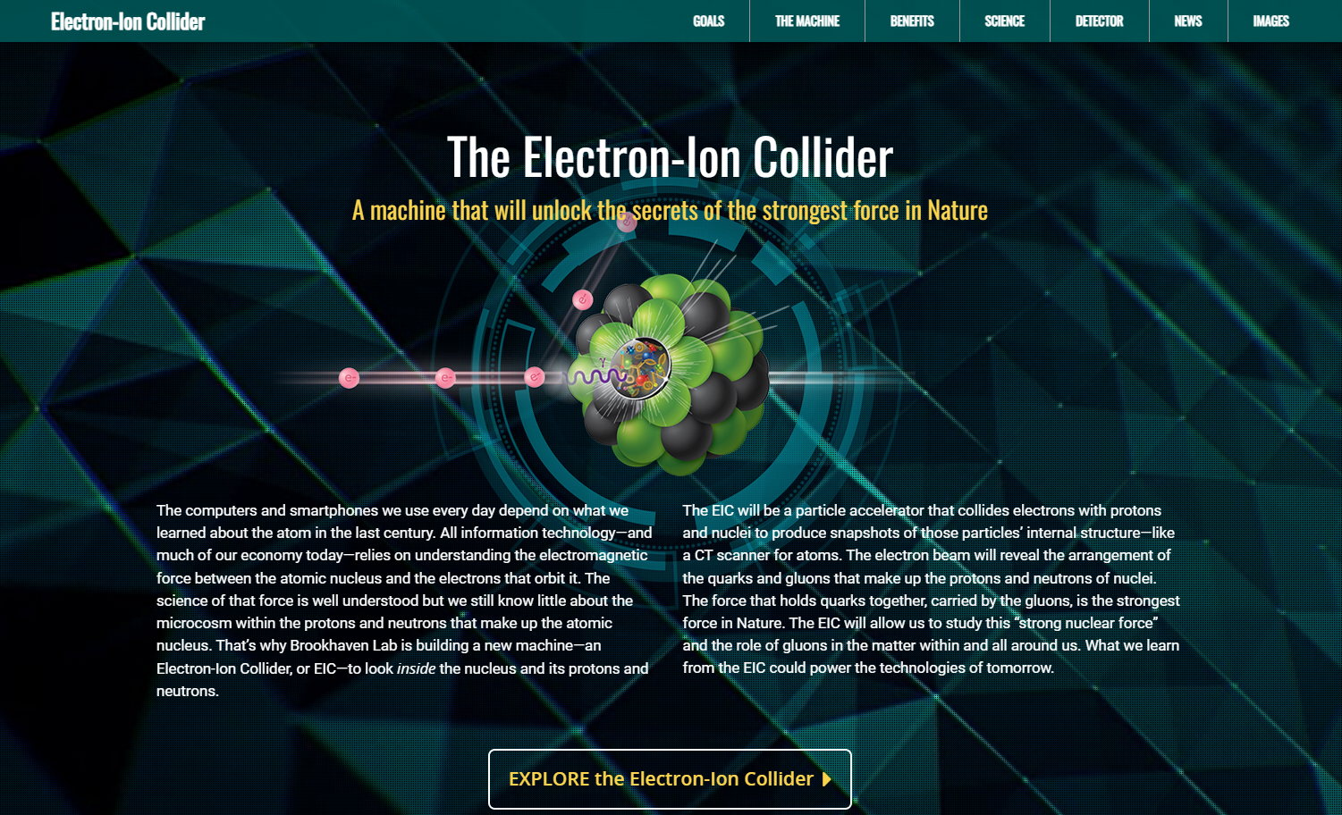
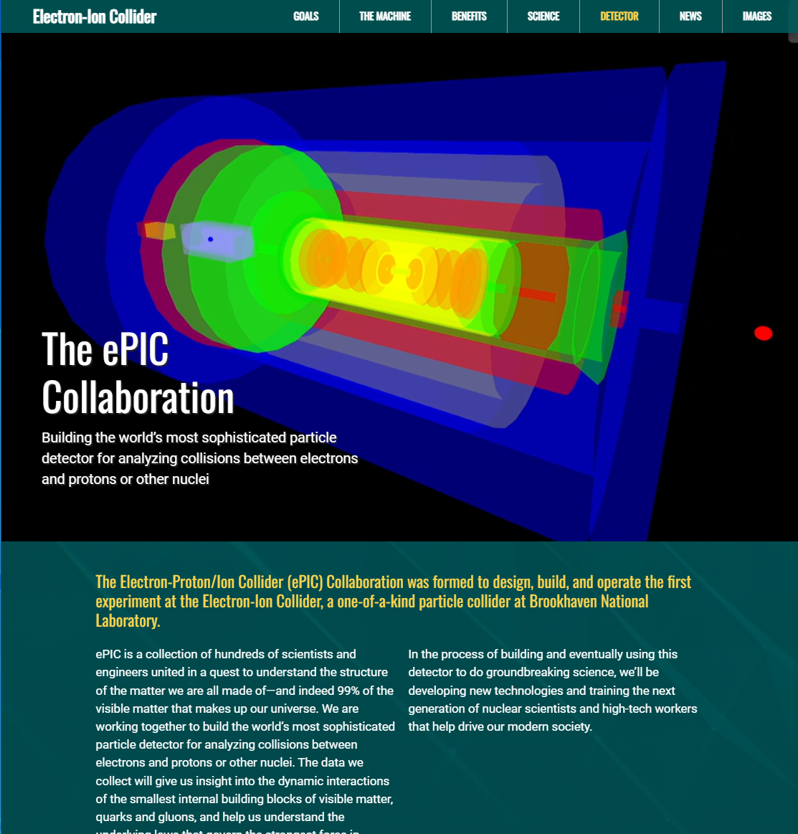
ePIC Collaboration Web Presence
Integrated into the main EIC website through the top navigation. Page contains contact information and link to the ePIC Wiki.
Gary Schroeder, Karen McNulty Walsch, Thomas Ullrich, JGL
Animations courtesy of UC Riverside group.
Continuing to update and improve.
https://www.bnl.gov/eic/epic.php

Slide 25
ePIC Resources
Public Website - https://www.bnl.gov/eic/epic.php
Mailing Lists – https://lists.bnl.gov/mailman/listinfo
Indico Agenda - https://indico.bnl.gov/category/402/
  ePIC Software and Computing: https://indico.bnl.gov/category/435/
Wiki - https://wiki.bnl.gov/EPIC
ePIC Software Training:
  Landing Page: https://eic.github.io/documentation/landingpage.html
  Tutorials: https://eic.github.io/documentation/tutorials.html
Mattermost: https://chat.epic-eic.org

Slide 26


EICUG Membership
The EICUG is a vital organization to promote the interests of the EIC community!
  Without the EICUG we would never have gotten far enough to form ePIC!
Please register your institution!
Check with your EICUG IB representative to get registered as a member
https://www.eicug.org/content/join.html

Slide 27
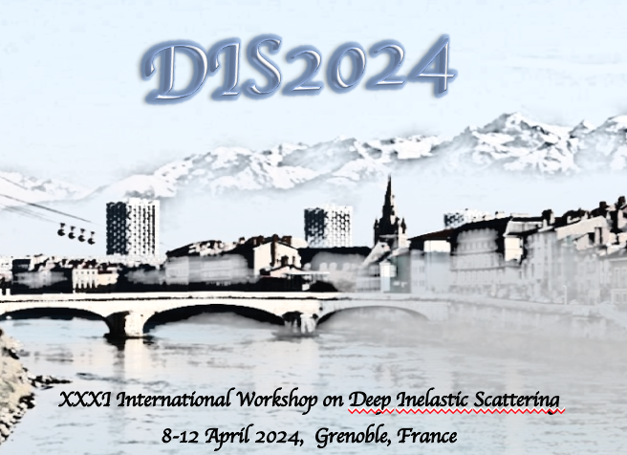

Upcoming Notable Events…
DIS 2024 in Grenoble, France April 8-12th , 2024
  https://lpsc-indico.in2p3.fr/event/3268/
ePIC Software and Computing meeting
@ CERN April 22nd-26th
  https://indico.cern.ch/event/1343984/
EIC RRB Meeting – May 6-7th in Italy
MC4EIC @ Durham University June 5-7th
  https://conference.ippp.dur.ac.uk/event/1292/
JLab Users Meeting, June 8-12th
  https://www.jlab.org/conference/2024-jluo
4th EIC-Asia Workshop in Shanghai July 1-5, 2024
  https://indico.cern.ch/event/1361239/
Joint EICUG/ePIC Collaboration Meeting
@ Lehigh University July 22nd-28th
  https://indico.bnl.gov/event/20727/

Slide 28
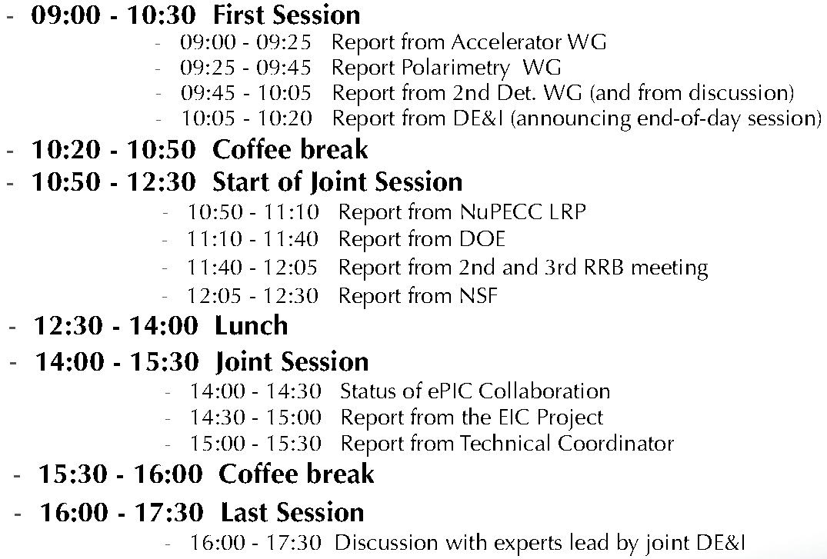
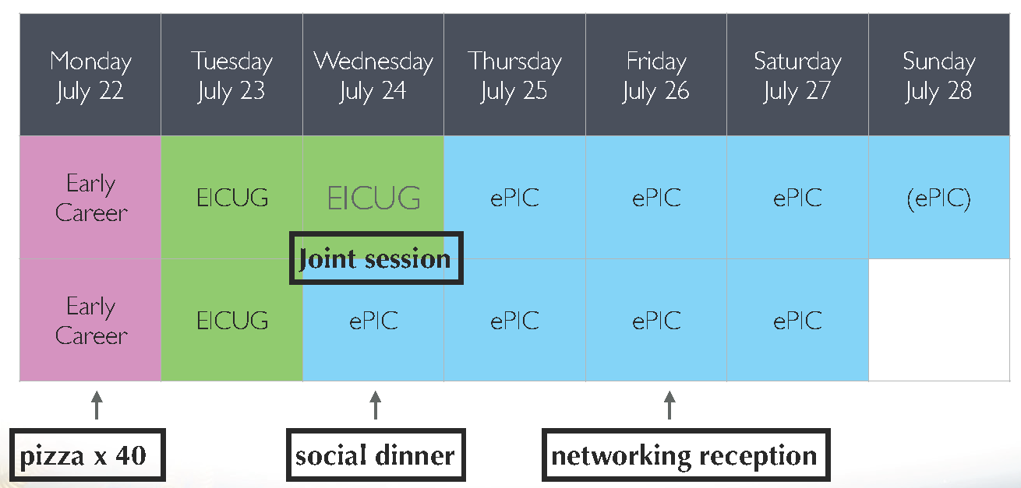
High-Level Agenda July 22-28 (DRAFT)

Slide 29
TDR Strategy and Publications
In 2024 the ePIC collaboration will produce:
  The ePIC contributions to the EIC TDR
    The EIC TDR is the top priority
      Chapters on Physics Goals and Requirements and Experimental Systems
      Not just the document, but the simulations and detector R&D that form the basis
      Requires close cooperation between the collaboration and the project!
An ePIC Detector Design paper:
    Derived and expanded from the Experimental Systems TDR chapter
An ePIC Physics Performance paper:
    Derived and expanded from the Physics Goals and Requirements TDR chapter
Both to be published in a scientific journal (such as NIMA, JINST, or PRC)
These publications will serve as a focus in developing the ePIC Membership and Publication policies.
Focused activity in the TIC:
Report by Silvia to follow
AC Report in last General Meeting:
https://indico.bnl.gov/event/21562/
process design phase
structuring the
effort
draft ePIC pre-TDR
ePIC pre-TDR (CD-2)
writing
(TDR/notes)
Preparing papers for
publication
Mid Jan.24
Mid Mar.24
End July 24
Late 2024
Early/Mid 2025

Slide 30
Rotation of PWG Conveners
SIDIS:
Charlotte - 1 year
Stefan - 2 years
BSM:
Michael - 1 year
Ciprian - 2 years
Inclusive:
Claire - 1 year
Tyler - 2 years
Exclusive:
Rachel - 1 year
Raphael - 2 years
Jets/HF:
Brian - 1 year
Olga - 2 years
Physics WG’s
  Conveners were originally endorsed for 1 yr/2 yr terms
  Half of the existing PWG conveners due to rotate off
  Do not want to create disruption at a time when we are trying to ramp up efforts for the TDR
  Plan to present new PWG conveners to the CC for endorsement at July Collaboration meeting
    Follows split of CC elections
    Allows time for AC’s to consider/develop candidates
    This is an opportunity to rotate experienced ePIC members
    to new roles!
Contact the Analysis Coordinators (Rosi and Sal) with suggestions and nominations!

Slide 31
Collaborative Tools I
In mid-2023 we formed a small group to look at options for collaborative tools:
  Technical support: Implementation of the technical solutions and interface with the host labs, in particular with BNL (Maxim Potekhin)
  Website design: The overall structure and navigation within the website and integration with external resources (Thomas Ullrich)
  Document management: An initial solution to archive talks, images, technical notes, etc. in a way that they can be easily accessed by the collaboration (Peter Steinberg)
  User-centered design: Ensure that web resources are properly organized and can be navigated in a way that is useful and straightforward, both to existing and new collaborators (Markus Diefenthaler)
There has been substantial progress in developing options, as well as a broadening of the discussion to include database needs as well.
  Some BNL resources have been allocated to this effort as well.
We are nearing the point where decisions will need to be made on the implementation of some of the collaborative tools.
The SP and CC Offices have discussed this, and see a need to re-organize these efforts so there is a decision-making process that:
  Offers the opportunity for all relevant stakeholders in the collaboration to have input
  Makes clear to the collaboration how important decisions will be made
  No “one size fits all” solution
What follows was discussed with EB (3/14) and Coordinators (3/15)

Slide 32
Collaborative Tools II
For the “phone book” or collaboration database:
  Requirements document developed
  Existing solution based on sPHENIX/EICUG phonebook, with extensions for ePIC
  Overseen by CC Office and Membership Committee
  This arrangement will continue
Databases
  This spans an enormous range – from simple parts-tracking DB up to real-time DB to interact with Streaming Readout
  No yet at the implementation stage
    Requirements document for detector construction DB needs being developed (Prakhar Garg)
  TC Office and Software and Computing will work together to develop requirements and implementation options

Slide 33
Collaborative Tools III
Website and Document Management
  Requirements documents developed, including access requirements
  Proposal for website framework (Maxim and Thomas)
  Competing ideas for document repository and management (Zenodo, InvenioRDM, Glance…)
    Key issues are search and document review workflow
  SP/CC Offices have formed a joint ad-hoc Committee charged to make implementation recommendations:
    Original four (Maxim, Thomas, Peter and Markus)
    Conferences and Talks Committee chair Maria Zurek has agreed to serve
    CC/SP Office are ex-office
  Will report to General and/or CC Meetings
  Recommendations to be presented to CC
Charge to ad-hoc committee:
  The Collaborative Tools ad-hoc committee is charged to examine implementation options that have been developed for (i) an ePIC Collaboration website and (ii) a document database and to make specific recommendations to the CC and SP Offices for implementation of these important collaboration tools. The committee should carefully consider the previously developed requirements documents for the website, document database, and document handling when making their recommendations. Issues surrounding the hosting of these services, the level of support provided by the host laboratories, access and usability for collaboration members, and the workforce required by the collaboration to maintain these resources should also be considered.

Slide 34
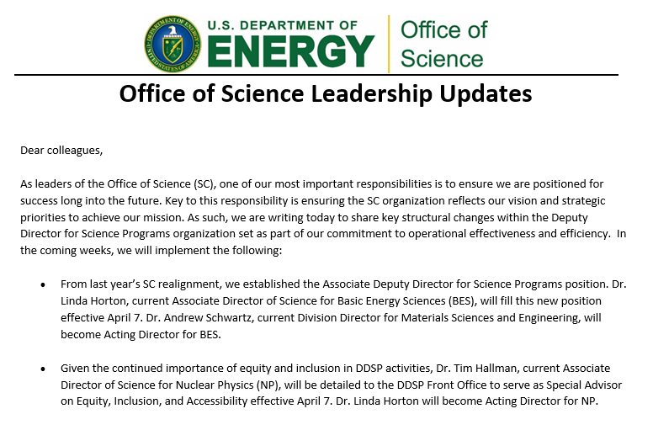
Changes at DOE
March 22, 2024
Tim Hallman ->
Special Advisor to Deputy Director for Science Programs on Equity, Inclusion and Accessibility
Linda Horton -> Acting Director for NP

Slide 35
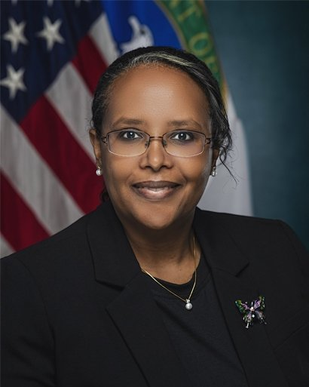
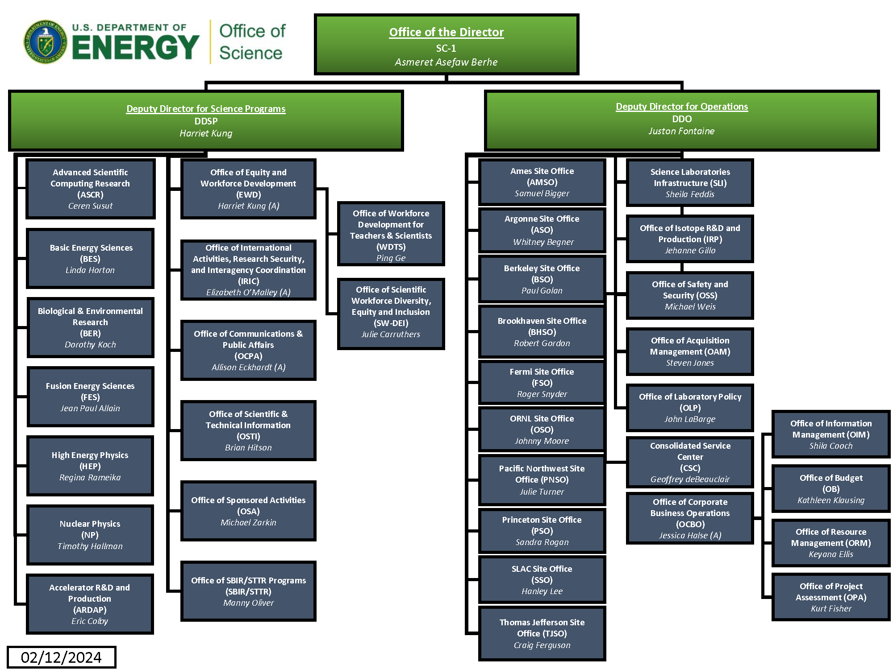
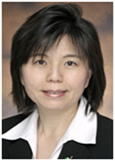
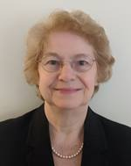
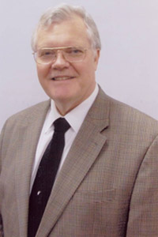
Changes in DOE SC:
Dr. Asmeret Berhe stepped down March 28th
Dr. Linda Horton will move from AD for BES to Associate Deputy Director for Science Programs
Dr. Tim Hallman will be detailed to the DDSP Front Office to serve as Special Advisor on Equity, Inclusion, and Accessibility effective April 7th
Dr. Linda Horton will become Acting Director
for NP

