Slide 1

ePIC Collaboration News
J. Lajoie, S. Dalla Torre
May 17, 2024

Slide 2
Hey John, start the recording….

Slide 3
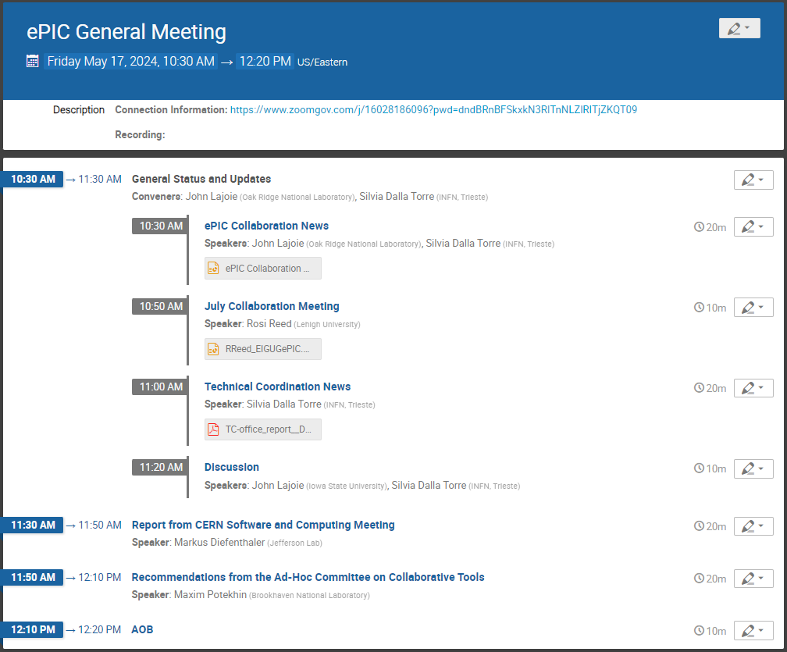
Today’s
Agenda

Slide 4

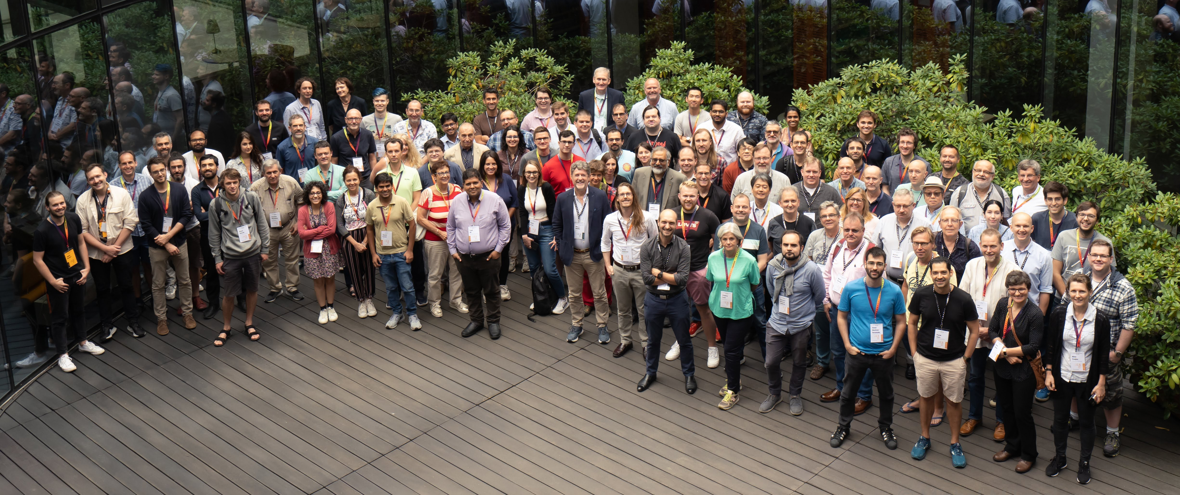
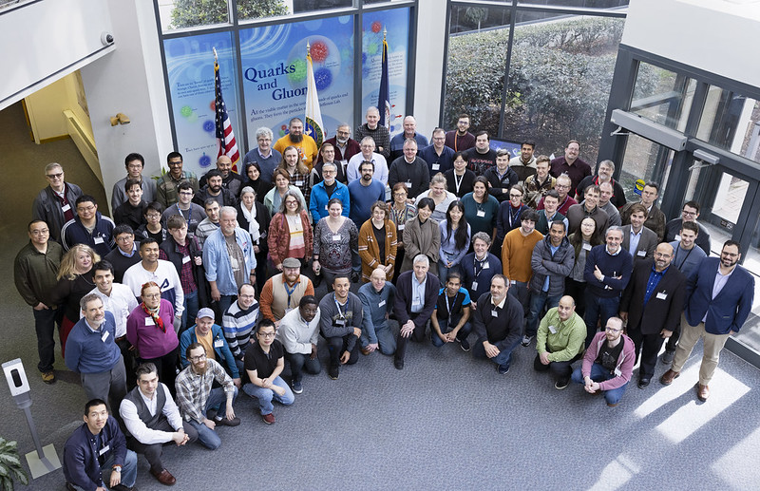
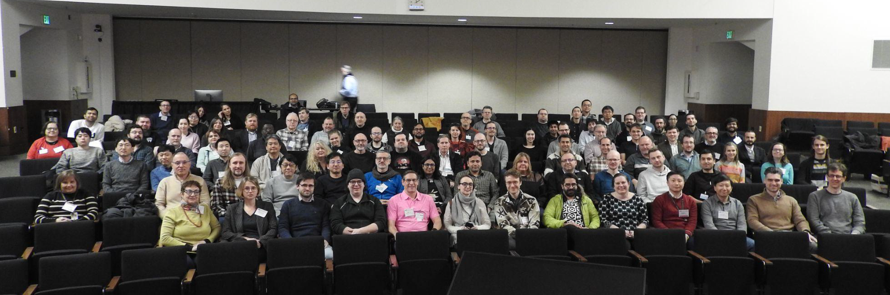
What is
Warsaw, July 2023
JLab, Jan. 2023
ANL,
Jan. 2024
ePIC is a community of scientists dedicated to realizing the EIC science mission.
The ePIC Collaboration is as unique as the ePIC detector.

Slide 5
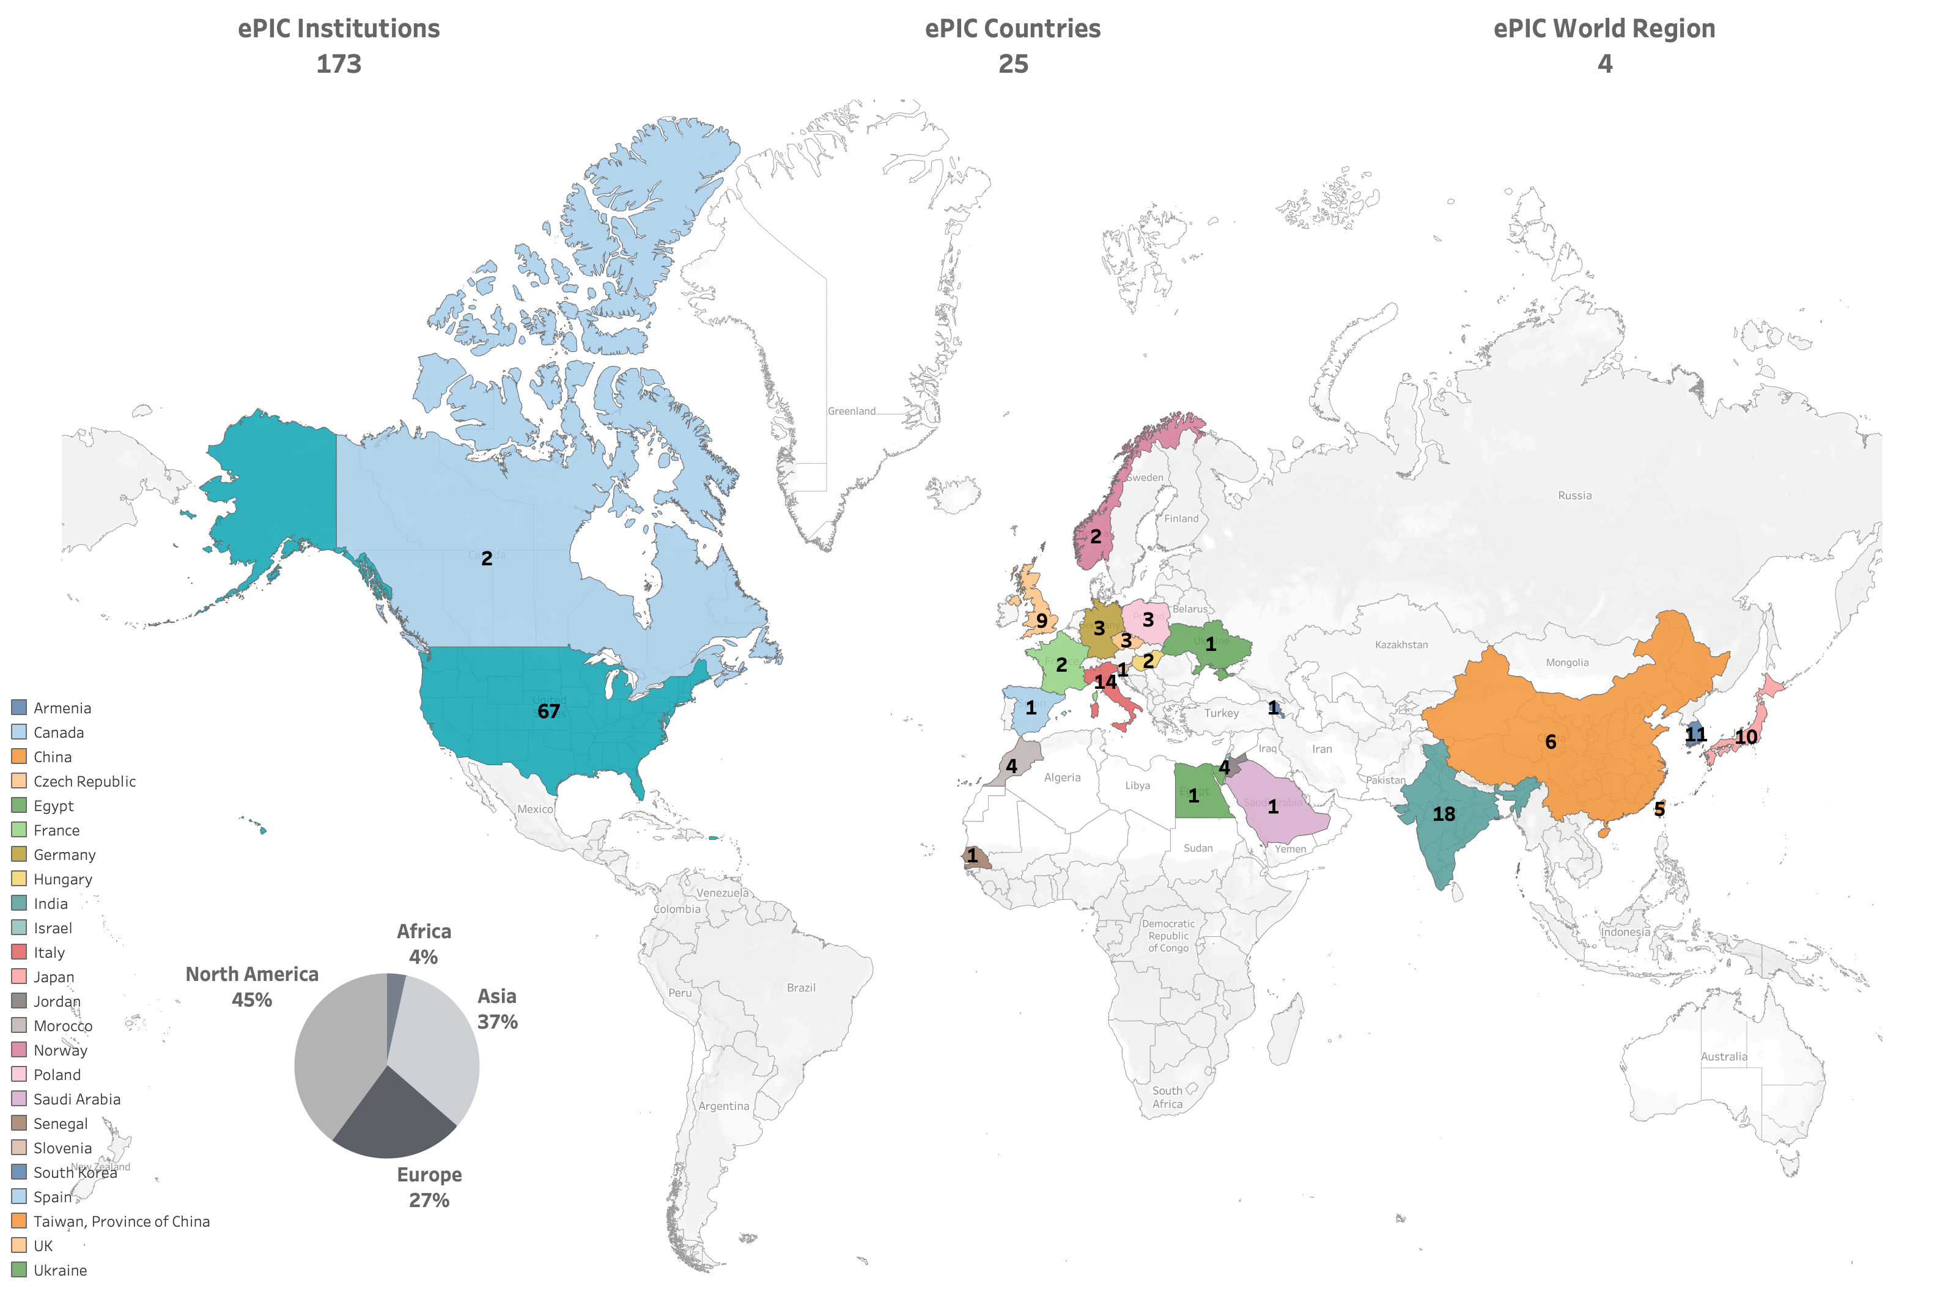
International
ePIC Initiated in
July 2022
Currently:
>850 collaborators (from 2024 Institutional Survey)
>650 members
active in ePIC activities

Slide 6
Timeline
process design phase
structuring the
effort
draft ePIC pre-TDR
ePIC pre-TDR (CD-2)
writing
(TDR/notes)
Preparing papers for
publication
Mid Jan.24
Mid Mar.24
End Oct. 24
Late 2024
Early 2025
Putting the tools in place:
Progress on Overleaf/Github for TDR
Recommendaion for Document Database Solution

Slide 7
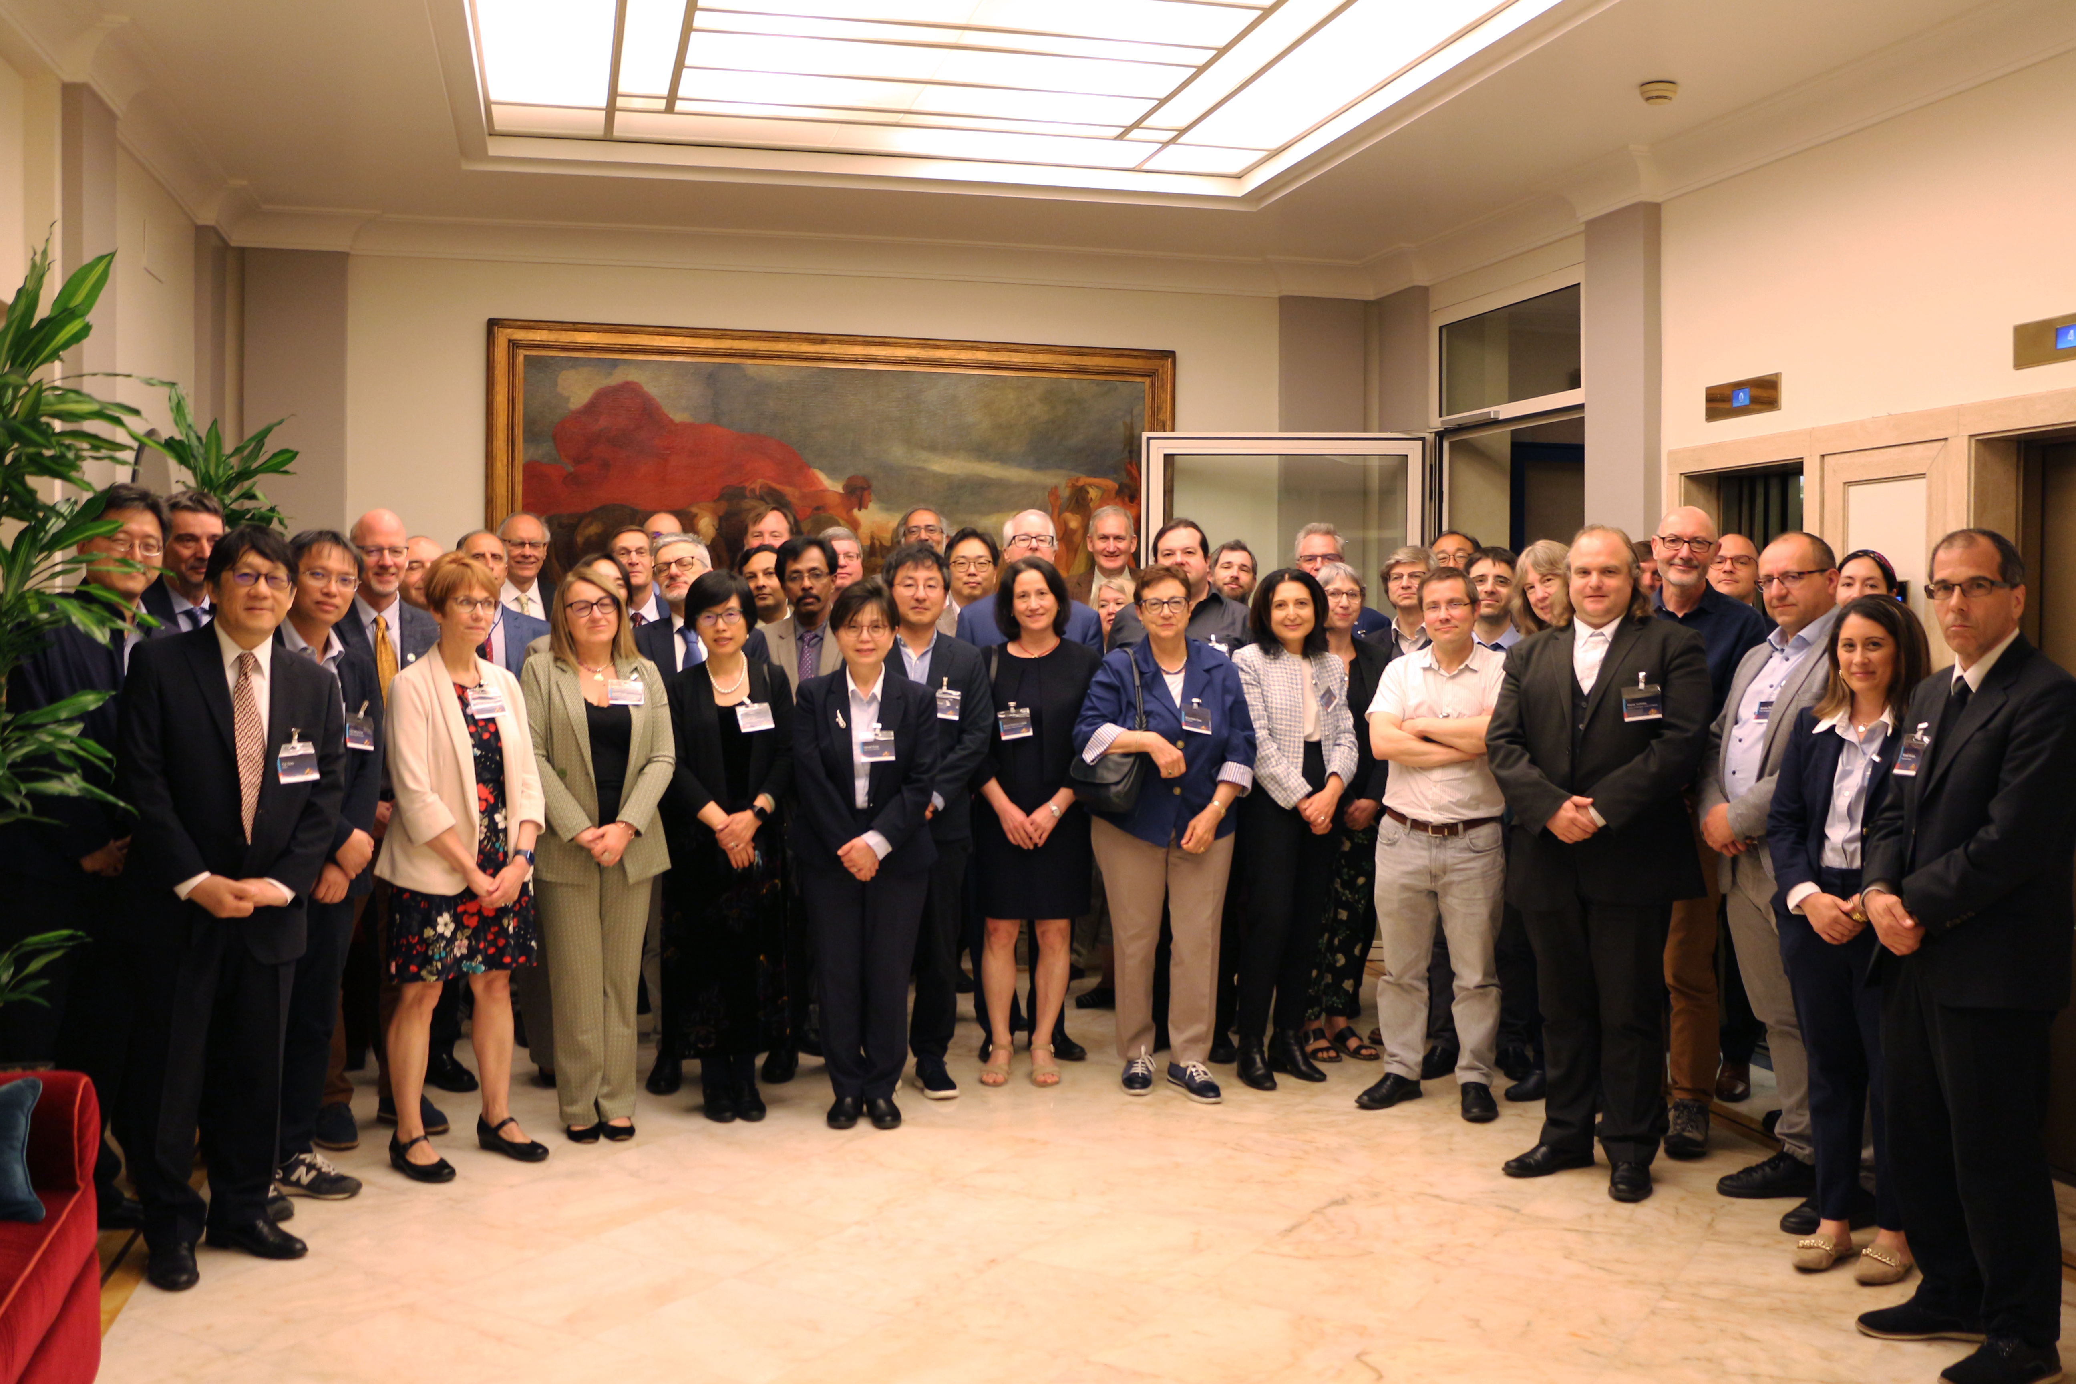

Third EIC RRB Meeting
Hosted by INFN May 6-7th in Rome
Comprised of the representatives of the international funding agencies supporting institutions collaborating on the EIC detector(s) and representatives from the two host labs.
  The EIC-RRB will provide coordination during detector development, construction, and operations.
Agenda included presentations by ePIC Spokesperson, TC and SCC

Slide 8
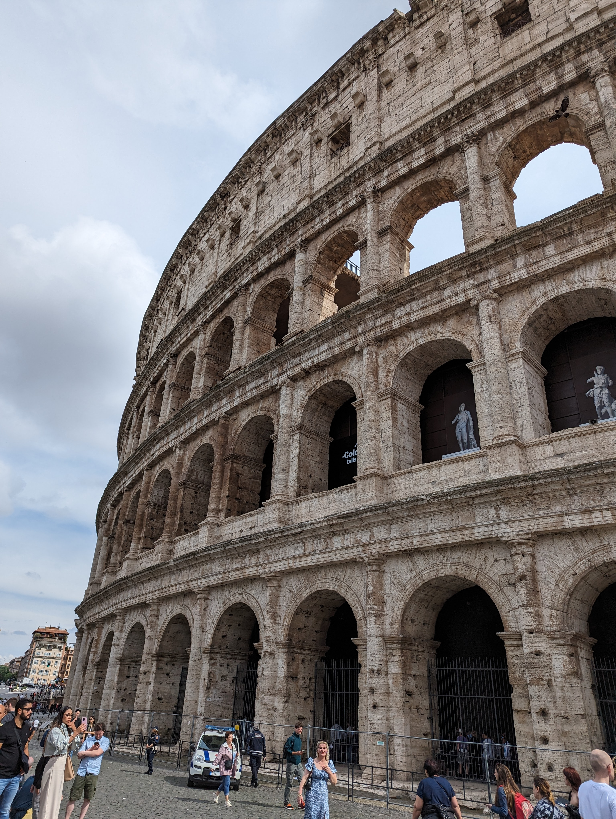
RRB Recap
EIC Project:
  Project status and CD-3B Review – January 7-9, 2025 (approval March 2025)
  CD-2/3 approval end of 2025 (note: two in one year!)
  Discussion of breaking up CD-2/3 into subprojects
  NOTE: None of this affects the collaboration’s schedule!!
  iCRADA/PPD’s progressing
EIC Collaboration:
  Delivered the message that the collaboration is strong, growing and engaged
In-kind contributions to computing:
  Still some confusion over the relationship between the ECSJI and RRB
Common Funds:
  Presented common funds proposal, little discussion
  Explicitly includes category to fund collab positions, visiting scientists
Comments by Members and Observers:
  Plans for in-kind more concrete than in past, advancing
  Significant advances in schedules for Japan, Taiwan, Korea
Global Engagement Strategy
  Build on efforts from HEP community?

Slide 9
EIC Common Funds
Following the Dec. 2024 RRB a Common Funds Working Group was formed:
  Rolf Ent, Rosario Nania, Abhay Deshpande, John Lajoie
WG returned to the RRB May 6-7th with a draft for discussion:
  Starting point was CERN LHC document “Commissioning, Maintenance and Operations of Experiments at the LHC” (CERN/RRB-D 2001-04 14 March 2001)
  Modifications necessary to account for differences between CERN and a DOE Project/Facility, but this provides a starting point many in the RRB are familiar with.
  Working draft document for discussion. The document provides the framework for agreements with funding agencies.
  Next steps will include clarifying integration of computing in-kind contributions

Slide 10
Funding Categories
Category A concerns equipment built using Common Funds e.g. magnets, or services and operations common to the whole experiment e.g. software licences.
  Cost-sharing typically by scientists (authors)
Category B concerns maintenance of equipment built by a sub-set of the collaboration, mainly sub-detectors.
  Cost sharing typically by capital investment
Category C concerns collaboration support using Common Funds, e.g., support for travel and as-needed time for key Collaboration functions, local co-support of travel for visiting scientists, and general support for a global strategy to allow for underprivileged scientists to participate in EIC science.
  Cost sharing TBD (new category)
Category D concerns items for which the DOE and US host laboratories would naturally assume responsibility for, e.g. costs to run the accelerator which sets the weeks of operations and schedule, infrastructure for the experimental areas and experiments and infrastructure operations costs, survey and alignment, and the overall Environmental, Health, and Safety aspects for detector operations.
Category A, B very similar to LHC. Category D (EIC) is the same in spirit as Category C (LHC). Category C (EIC) is new and was created explicitly to support visiting scientists, etc.

Slide 11
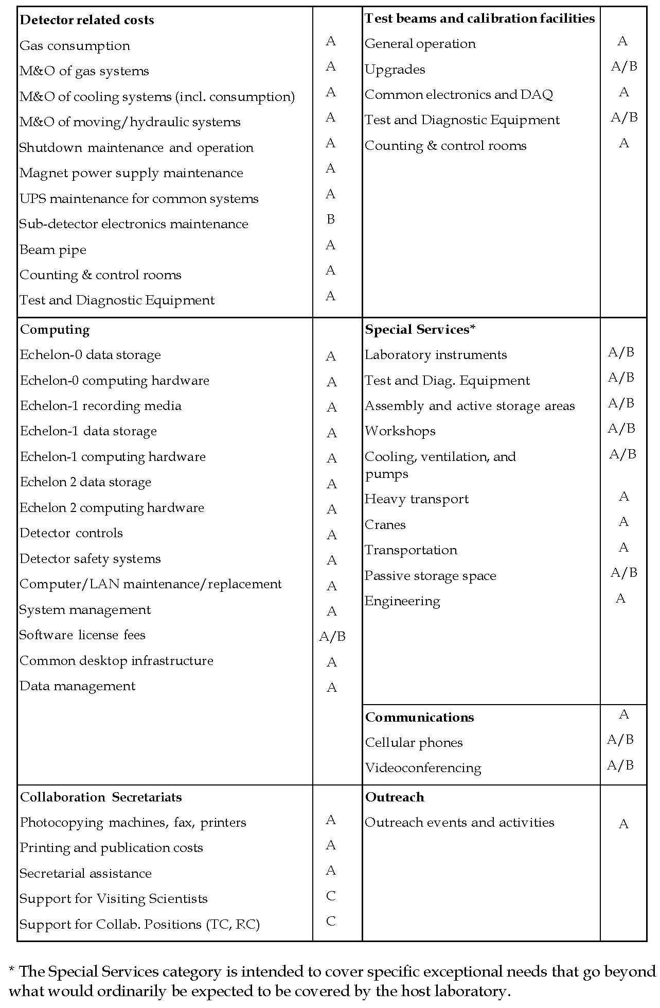
M&O Categories
Categories are substantially updated from LHC document. One of the main differences is that operations are covered by the host laboratory, so anything that might look like operations here is only above and beyond what the host lab would be expected to contribute.
Changes also made to account for ePIC Streaming Computing Model and new Category C support, including support for paid positions in the collaboration.

Slide 12
Next ePIC Collaboration Meeting
Lehigh University
Bethlehem, PA
July 22-28
Jointly organized with the EICUG
Joint session with talks of common interest
ePIC Meeting
July 24-28th
Have clarity on the status of this meeting for Lab personnel
https://indico.bnl.gov/event/20727/

Slide 13
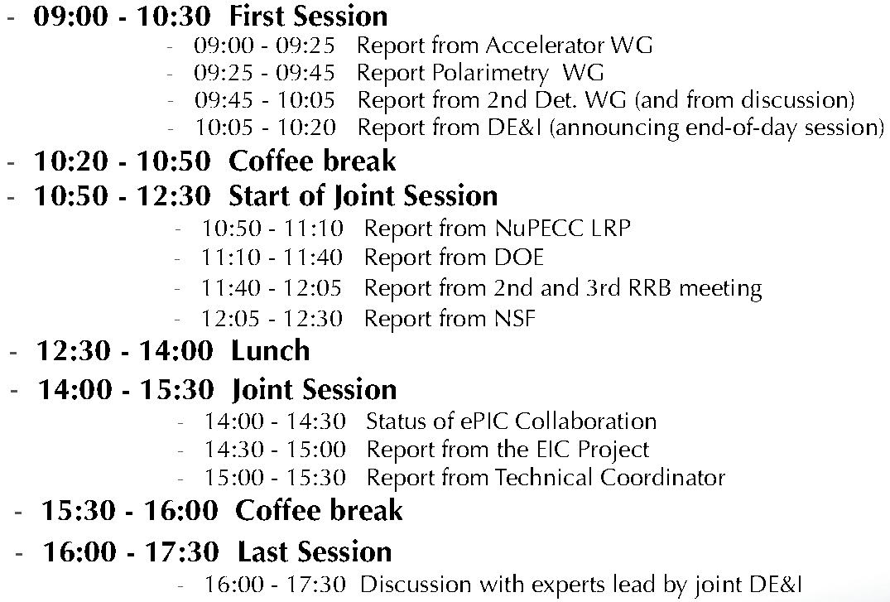
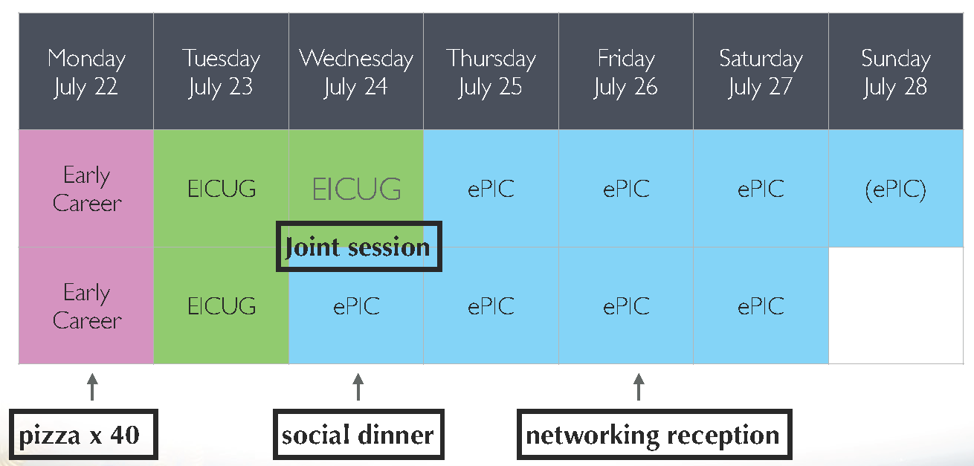
High-Level Agenda July 22-28

Slide 14
Draft Structure of the ePIC Collab. Meeting
Thursday July 25th | Friday July 26th | Saturday July 27th
Workfests/Parallel Sessions | Collaboration Council* | Plenary Session
Workfests/Parallel Sessions | Workfests/Parallel Sessions | Plenary Session
Workfests/Parallel Sessions (if needed) | Networking Reception
*CC agenda TBD, may not use the whole time block
Morning
Afternoon
Evening

Slide 15

Call for Workfest Proposals!
Open call to the collaboration:
  Please work with WG and DSC leadership
  Please consider overlaps with other WG’s and DSC’s – talk to each other!
  Take advantage of the opportunity presented by having so many people in-person
Strongly encourage CC WG’s to organize cross-cutting sessions!
  This is more efficient than multiple DSC meetings
Deadline: Friday, May 31st
  Send proposals to CC and SP leadership
  Include information on:
    Names of organizers
    Time required and requested days
    Number of people expected (space required)
    Is this more of a parallel session, “workfest”, hybrid?
The SP Office, CC Office and Coordinators will work out a schedule in concert with the local organizing committee
  Depending on the number if requests, we may need to combine sessions, or push some sessions into the evening. We will talk with the proposal organizers before doing this.
Email to collaboration will follow this General Meeting

Slide 16
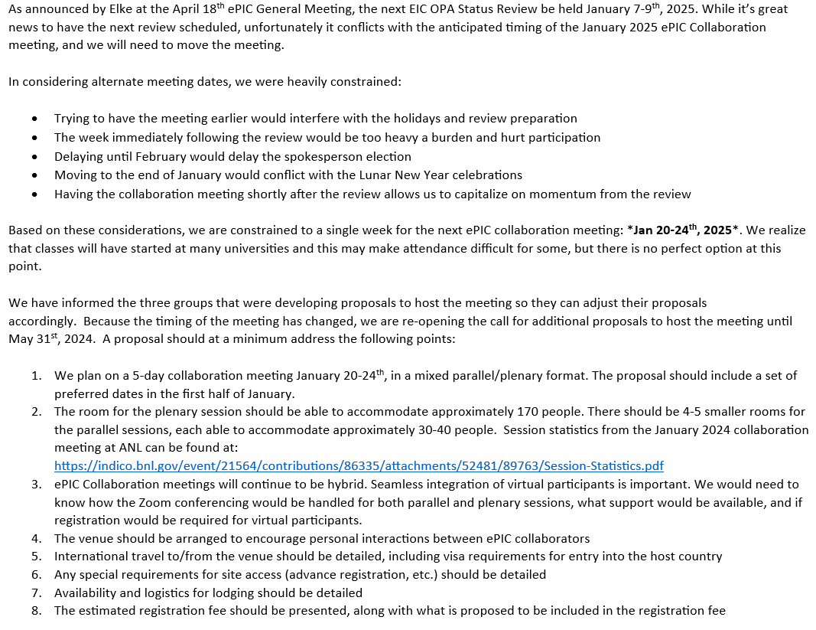
Higher Order Collaboration Meeting (NNCM)
Revised call sent to collaboration April 29th
  Change of dates due to CD-3B review
Jan 20-24th , 2025
Two proposals received so far
Deadline May 31st

Slide 17
Call for Talk Nominations: https://forms.gle/HV7x14n726QCqtrNA
Diffraction and Low-x 2024
Palermo, Sicily, Italy, September 8-14, 2024, https://indico.cern.ch/event/1354173/
"eA diffraction at the EIC with ePIC"
"Exclusive lepton pair production and BSM prospects with ePIC"
DNP meeting in Boston, workshop "QCD Towards the EIC"
October 7th at the fall DNP meeting in Boston, MA, https://web.mit.edu/dnp2024/index.html
"ePIC - Exploiting the EIC on Day 1"

Slide 18
CTC Policy Draft Feedback:
Deadline Extended to May 22nd
Given the very limited responses received thus far, we kindly urge all member institutions of our collaboration to collectively review the draft policy.
Your input is invaluable to us, and we welcome any questions, comments, or suggestions you may have.
Please communicate these through your designated CC representative(s) at your earliest convenience. Ideally, feedback should be submitted using the following form: https://forms.gle/WQcsMMp4XbCv8ADL7

Slide 19
Summary
Making progress on draft TDR development timeline
RRB shows strong international support
The ePIC Collaboration is strong, engaged and growing!
Next ePIC General Meeting:
Friday, May 30th @ 7:30PM ET
Register now for the Joint EICUG/ePIC
meeting at Lehigh July 24-28th

Slide 20


Slide 21
Upcoming Review Schedule
Design Reviews
  PDR2: IR Integration and Auxiliary Detectors – February 12, 2024 – main emphasis on baseline choices and progress
  PDR1: Tracking Detectors – March 20-21, 2024 – main emphasis on baseline tracking layout, if we are on track and plans
  ePIC/EIC Detector R&D Day – March 25 – check R&D progress and outlook to FY25
  PDR2: Electronics/DAQ – June 10-11, 2024 – continuation of PDR1 to ensure we are on track and show progress; FDR for VTRx+/lpGBT
  PDR: Integration, Infrastructure and Installation – Summer/Autumn 2024? – includes detector support structures
  PDR2: Particle Identification Detectors – Summer 2024?
  PDR2: Barrel EM Cal – Summer/Fall 2024 – emphasis on mechanical design & AstroPix readiness
  FDR: Backward & Forward EM Calorimetry, Barrel & Forward HCAL – Fall 2024
  PDR2: Polarimetry – timescale TBD (but before CD-2)
  FDR for any potential CD-3B scope: Magnet Power Supply, perhaps VTRx+/lpGBT, perhaps magnet steel – see NOTE
  FDR Magnet Power Supply – Spring 2024; Magnet Steel perhaps Summer 2024
DAC-Meetings 2024 under planning:
  ~April 2024: Project Status, Baseline Detector, International Engagement, Detector R&D progress (expect 1+ day)
  ~August 2024: Detector R&D annual review (expect 2 days) – deadline for submission July 1, 2024
Next ePIC Computing & Software review by host labs: ~October 2024?
EIC Project Review ~ November 2024
  Collaboration goal is to have a draft of the pre-TDR ready for this review

Slide 22
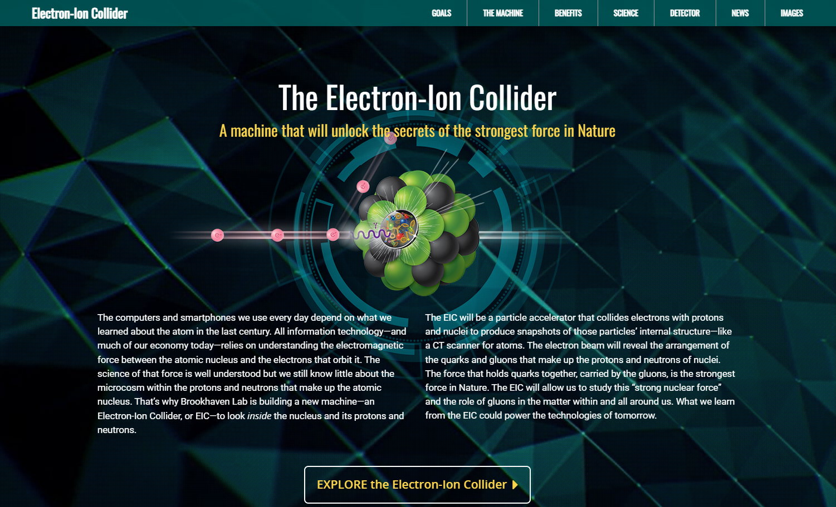
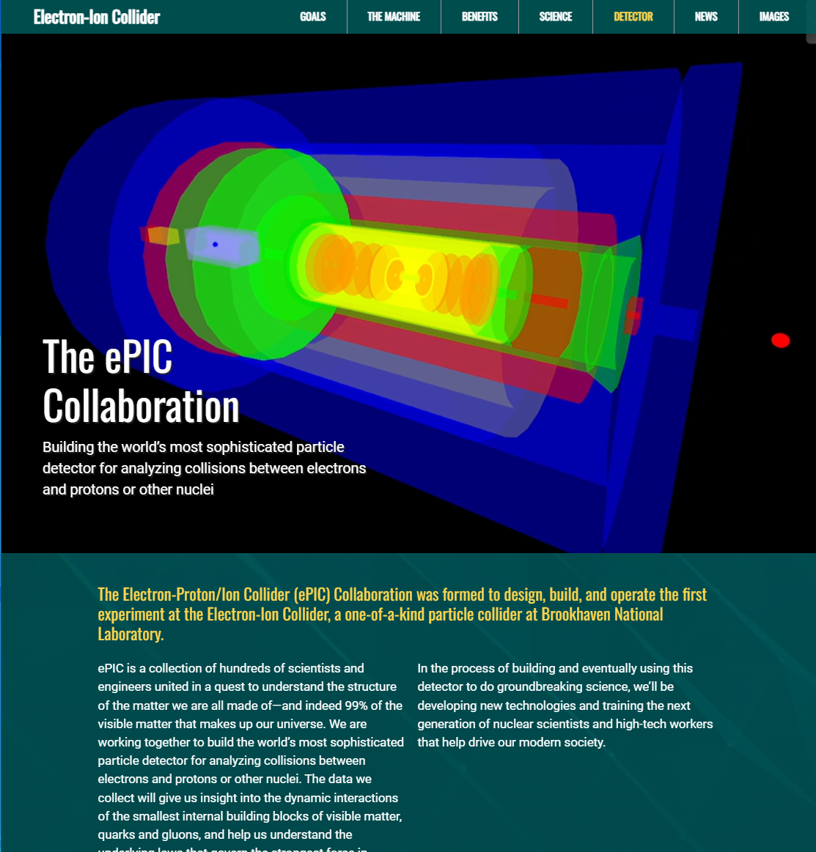
ePIC Collaboration Web Presence
Integrated into the main EIC website through the top navigation. Page contains contact information and link to the ePIC Wiki.
Gary Schroeder, Karen McNulty Walsch, Thomas Ullrich, JGL
Animations courtesy of UC Riverside group.
Continuing to update and improve.
https://www.bnl.gov/eic/epic.php

Slide 23
ePIC Resources
Public Website - https://www.bnl.gov/eic/epic.php
Mailing Lists – https://lists.bnl.gov/mailman/listinfo
Indico Agenda - https://indico.bnl.gov/category/402/
  ePIC Software and Computing: https://indico.bnl.gov/category/435/
Wiki - https://wiki.bnl.gov/EPIC
ePIC Software Training:
  Landing Page: https://eic.github.io/documentation/landingpage.html
  Tutorials: https://eic.github.io/documentation/tutorials.html
Mattermost: https://chat.epic-eic.org

Slide 24


EICUG Membership
The EICUG is a vital organization to promote the interests of the EIC community!
  Without the EICUG we would never have gotten far enough to form ePIC!
Please register your institution!
Check with your EICUG IB representative to get registered as a member
https://www.eicug.org/content/join.html

Slide 25


Upcoming Notable Events…
DIS 2024 in Grenoble, France April 8-12th , 2024
  https://lpsc-indico.in2p3.fr/event/3268/
ePIC Software and Computing meeting
@ CERN April 22nd-26th
  https://indico.cern.ch/event/1343984/
EIC RRB Meeting – May 6-7th in Italy
MC4EIC @ Durham University June 5-7th
  https://conference.ippp.dur.ac.uk/event/1292/
JLab Users Meeting, June 8-12th
  https://www.jlab.org/conference/2024-jluo
4th EIC-Asia Workshop in Shanghai July 1-5, 2024
  https://indico.cern.ch/event/1361239/
Joint EICUG/ePIC Collaboration Meeting
@ Lehigh University July 22nd-28th
  https://indico.bnl.gov/event/20727/

Slide 26
High-Level Agenda July 22-28 (DRAFT)

Slide 27
TDR Strategy and Publications
In 2024 the ePIC collaboration will produce:
  The ePIC contributions to the EIC TDR
    The EIC TDR is the top priority
      Chapters on Physics Goals and Requirements and Experimental Systems
      Not just the document, but the simulations and detector R&D that form the basis
      Requires close cooperation between the collaboration and the project!
An ePIC Detector Design paper:
    Derived and expanded from the Experimental Systems TDR chapter
An ePIC Physics Performance paper:
    Derived and expanded from the Physics Goals and Requirements TDR chapter
Both to be published in a scientific journal (such as NIMA, JINST, or PRC)
These publications will serve as a focus in developing the ePIC Membership and Publication policies.
Focused activity in the TIC:
Report by Silvia to follow
AC Report in last General Meeting:
https://indico.bnl.gov/event/21562/
process design phase
structuring the
effort
draft ePIC pre-TDR
ePIC pre-TDR (CD-2)
writing
(TDR/notes)
Preparing papers for
publication
Mid Jan.24
Mid Mar.24
End July 24
Late 2024
Early/Mid 2025

Slide 28
Rotation of PWG Conveners
SIDIS:
Charlotte - 1 year
Stefan - 2 years
BSM:
Michael - 1 year
Ciprian - 2 years
Inclusive:
Claire - 1 year
Tyler - 2 years
Exclusive:
Rachel - 1 year
Raphael - 2 years
Jets/HF:
Brian - 1 year
Olga - 2 years
Physics WG’s
  Conveners were originally endorsed for 1 yr/2 yr terms
  Half of the existing PWG conveners due to rotate off
  Do not want to create disruption at a time when we are trying to ramp up efforts for the TDR
  Plan to present new PWG conveners to the CC for endorsement at July Collaboration meeting
    Follows split of CC elections
    Allows time for AC’s to consider/develop candidates
    This is an opportunity to rotate experienced ePIC members
    to new roles!
Contact the Analysis Coordinators (Rosi and Sal) with suggestions and nominations!

