Slide 1
EICUG/ePIC Collaboration Meeting
Details and Registration at: Indico
Early Career Day - Mon July 22nd – Free
EICUG - Tues July 23rd - Wed July 24th - $70
ePIC Collaboration Meeting - Wed July 24th - Sat July 27th - $100
Social Dinner at Zest - Wednesday July 24th - $60
Networking Reception - Friday July 26 - Free
The registration fee will cover 2x coffee breaks, lunch, and coffee/small snacks prior to start-of-conference each day
Reduced fee for EC members

Slide 2
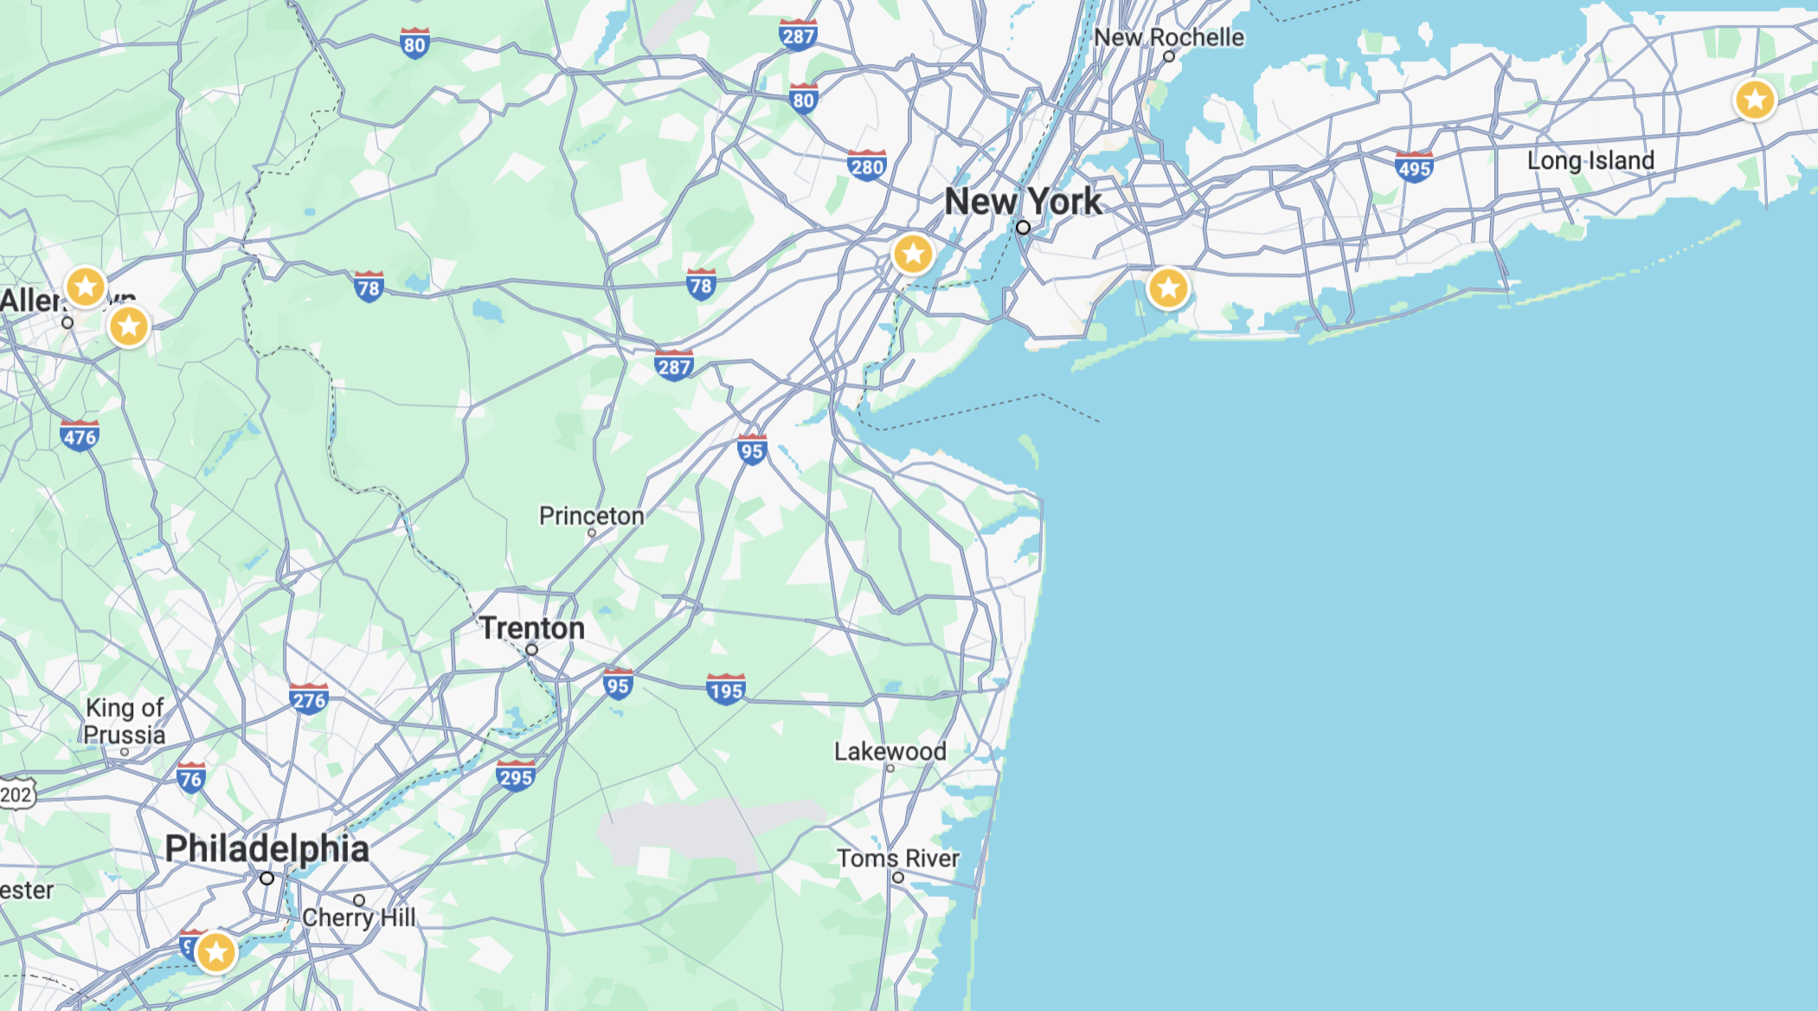
Multiple Airports
We will arrange some shuttles from Newark Airport (EWR) depending on arrival and departure times. Perhaps PHL depending on need.
Shuttle Request Form
Please let us know by June 7 so we can plan (and let you know if we can pick you up/drop you off)
Once shuttle arrangements are done, forms for people to rideshare will be provided.
EWR
BNL
ABE
Lehigh
JFK
PHL

Slide 3
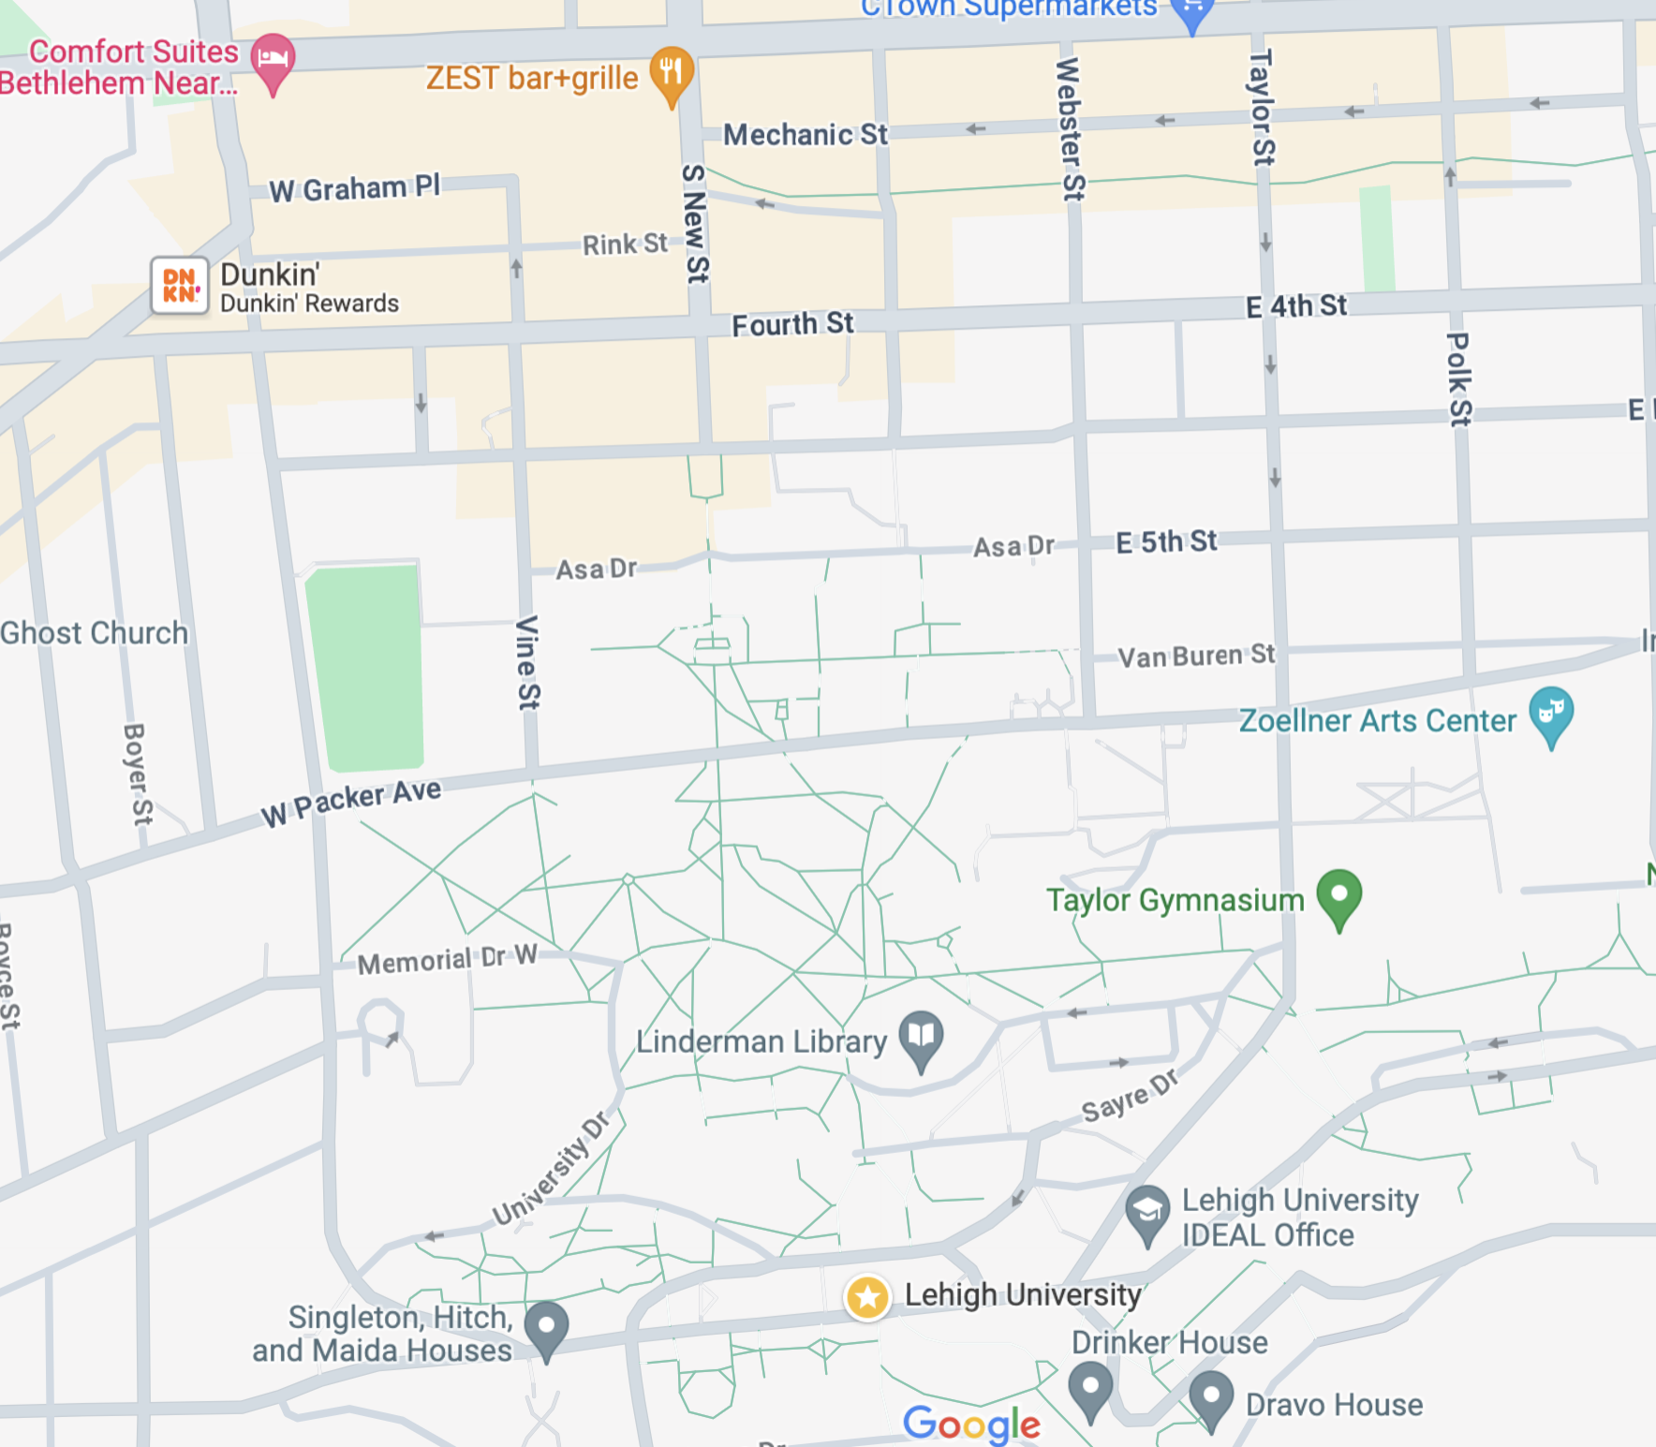
Getting around Bethlehem
All conference events are a convenient walk from one another, nothing is further than 0.5 miles (0.8 km).
Parking is free at the Comfort Suites
Parking at the Event Venue can be arranged
Comfort Suites Hotel cost → $85/day (free breakfast)
Trembley Apartments cost → $55/day
Social Dinner
Recommended Hotel
Saxby’s
Event Venue
Physics
Parking
Priority for Trembley Apartments will be given to Early Career Scientists – however there is room for others
3 Bedroom, 1 bath + kitchen/living room
Housing Form
Virtual Tour
Trembley Apartments

Slide 4
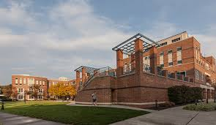
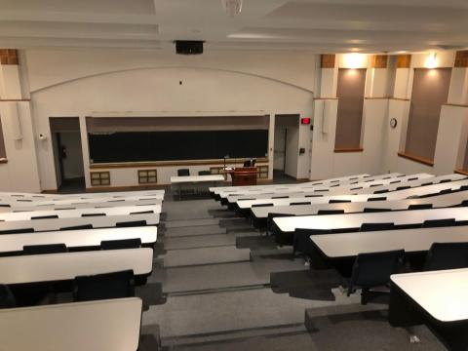
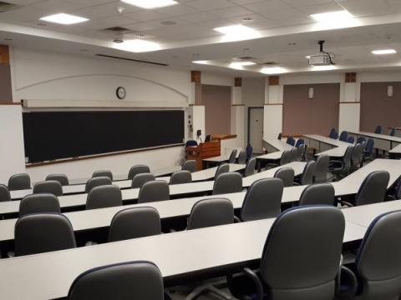
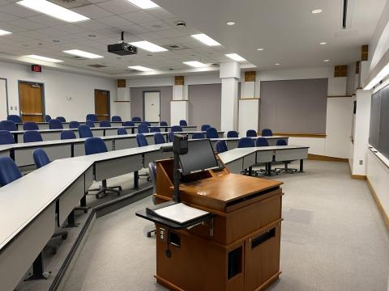
Venue – Rauch Business Center
Outdoor Eating Area
Rauch has indoor collaborative seating
Coffee shop open from 9 am – 3 pm
Outdoor eating area
Indoor eating area
Additional classroom spaces available, let me know your needs! (Day/Time + number of people, resources)
Room 184
Room 91
Room 85
200 people, built in mics, cameras
95 people
65 people

Slide 5
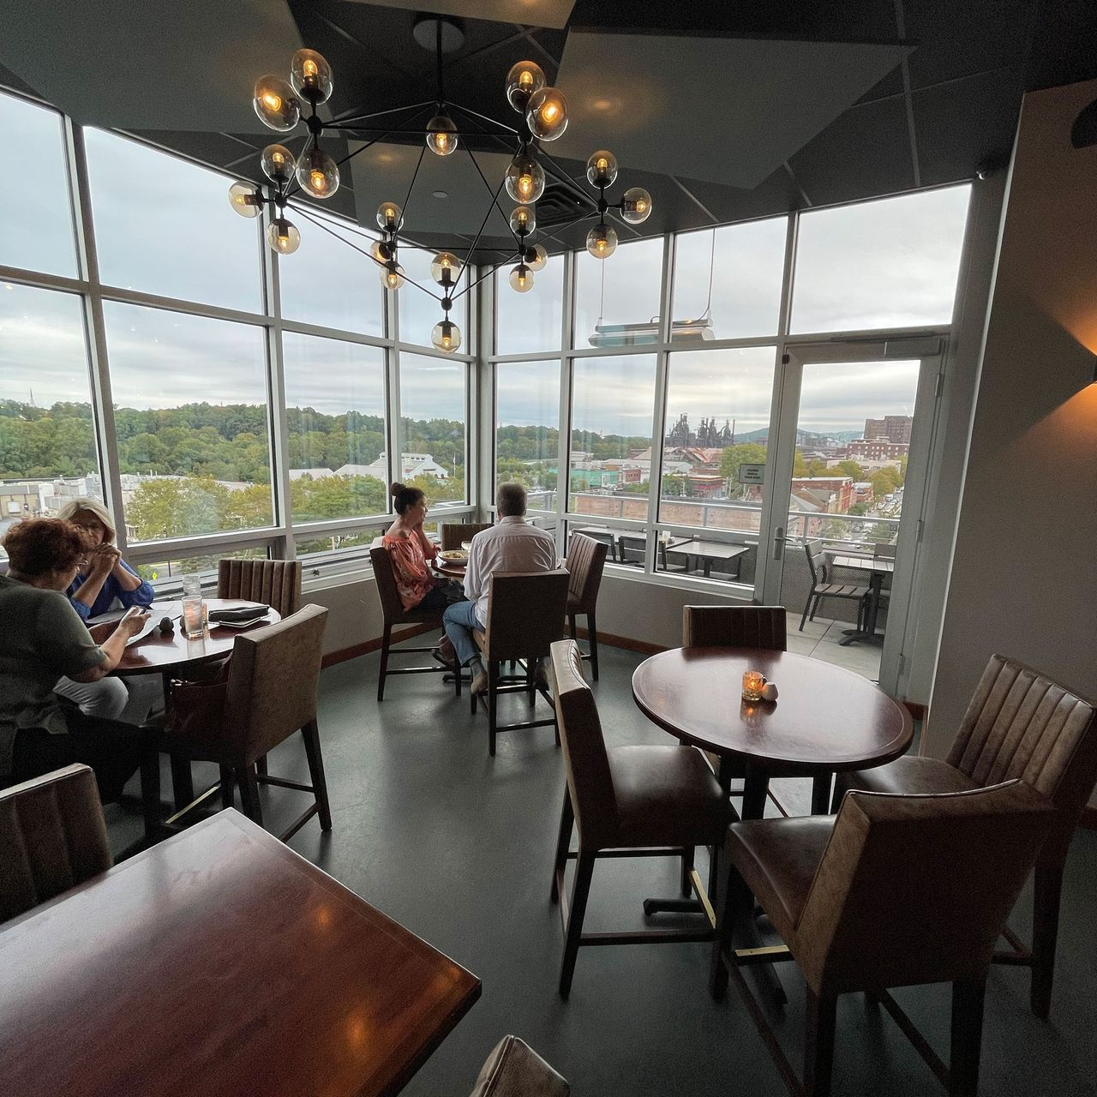
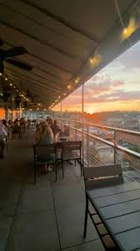
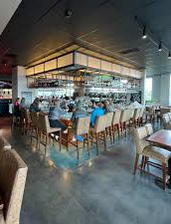
Social Dinner – Zest Restaurant

