Slide 1
EIC Project News
E.C. Aschenauer (BNL), R. Ent (JLab)
Co-Associate Directors for the Experimental Program
EIC Detector Leads
ePIC Bi-Weekly
May 30th, 2024

Slide 2
Outline
Schedule/Budget Update
Reviews Planned
International RRB meetings (beyond John’s slides)
Monthly May Progress to give a feel of what is ongoing

Slide 3
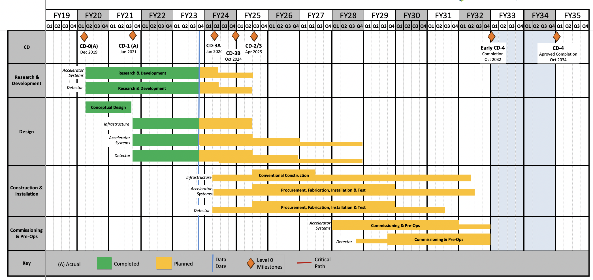
EIC Schedule – slide as shown on April 18, 2024
CD-3A:
Approve start of long-lead procurements
CD-3A items passed final design review
All interfaces related to them are frozen
Waiting for ESAAB meeting for authorization
Construction Phase
Conclusion of
RHIC Operation
Science Phase
CD-2:
Approve prelim. design for all subdetectors
Design Maturity: >60%
Need “pre-”TDR (or draft TDR)
Baseline project in scope, cost, schedule
The thinner bars indicate that R&D and design
can continue at a small level beyond CD-2 and CD-3
CD-3:
Approve final design for all subdetectors
Design Maturity: ~90%
Need full TDR
    Current EIC Critical Decision Plan
    CD-0/Site Selection December 2019 ✓
    CD-1 June 2021 ✓
    CD-3A ESAAB March 25th 2024
    CD-3B October 2024
    CD-2/3 April 2025
    early CD-4 October 2032
    CD-4 October 2034
Updated speculation based on EIC accelerator project status, on the actual appropriated FY24 funding ($98M), on uncertain FY25 budget scenarios (President’s Budget is only ~$113M) and the projected RHIC FY24 run:
January 7 – 9, 2025 Path to CD-2/CD-3 status review, possible CD-3B Approval spring 2025?
RHIC operations will conclude at end of FY25, in September 2025
CD-2 Approval Late 2025?, Possibility of CD-3C as needed.
CD-3 one year later?

Slide 4
EIC Schedule – best guess, filled in some dates
CD-3A:
Approve start of long-lead procurements
CD-3A items passed final design review
All interfaces related to them are frozen
Waiting for ESAAB meeting for authorization
Construction Phase
Conclusion of
RHIC Operation
Science Phase
CD-2:
Approve prelim. design for all subdetectors
Design Maturity: >60%
Need “pre-”TDR (or draft TDR)
Baseline project in scope, cost, schedule
The thinner bars indicate that R&D and design
can continue at a small level beyond CD-2 and CD-3
CD-3:
Approve final design for all subdetectors
Design Maturity: ~90%
Need full TDR
    Current EIC Critical Decision Plan
    CD-0/Site Selection December 2019 ✓
    CD-1 June 2021 ✓
    CD-3A ESAAB March 25th 2024
    CD-3B October 2024
    CD-2/3 April 2025
    early CD-4 October 2032
    CD-4 October 2034
September 2022 EIC received $138M DOE Inflation Reduction Act funding → CD3A
Updated Project Schedule: based on the actual appropriated FY24 funding ($98M), on uncertain FY25 budget scenarios (President’s Budget is only ~$113M)
    Updated EIC Critical Decision Plan
    CD-0/Site Selection December 2019 ✓
    CD-1 June 2021 ✓
    CD-3A ESAAB March 25th 2024
    CD-3B January 7-9 2025
    CD-2 Review 4Q 2025
    CD-3 Review 4Q 2026
    early CD-4 October 2033
    CD-4 October 2035

Slide 5
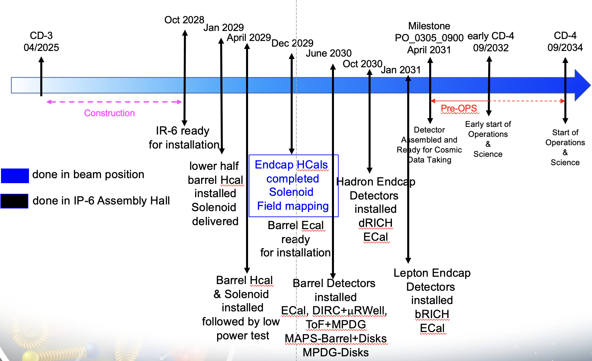
Detector Assembly Schedule
Assumptions:
RHIC stops operation October 2025
The STAR detector deconstruction needs to be fully finalized by August 2027
Assuming a start of R&R by January 1st 2026, it will take 6 month to have access to the IR through the assembly hall
IR-6 is ready for installation by October 2028
The sPHENIX detector R&R needs to be fully finalized by August 2027
03/2030 connect south platform to detector → need alternative solution how to bring big equipment in the tunnel
Solenoid PS
operational
dates need to be adjusted for CD dates as soon they are finalized
Note: Based on next schedule revision folding in the January 7-9 DOE review on path to CD-2 and CD-3B, and FY25 budget outlook, dates are all expected to shift with 1 year+

Slide 6

Reviews planned for 2024
Design Reviews
  PDR2: IR Integration and Auxiliary Detectors – February 12, 2024 – main emphasis on baseline choices and progress
  PDR1: Tracking Detectors – 20th-21st March 2024 – main emphasis on baseline tracking layout, if we are on track and plans
  PDR2: Electronics/DAQ – June 10 -11 – continuation of PDR1 to ensure we are on track and show progress
  PDR: Integration, Infrastructure and Installation – Summer/Autumn 2024? – includes detector support structures
  PDR2: Particle Identification Detectors – Summer 2024?
  PDR2: Barrel EM Cal – Summer/Fall 2024 – emphasis on mechanical design & AstroPix readiness
  FDR: Backward & Forward EM Calorimetry, Barrel & Forward HCAL – Fall 2024
  PDR2: Polarimetry – timescale TBD (but before CD-2)
  FDR for any potential CD-3B scope:
  FDR Magnet Power Supply – May 28th 2024
  Magnet Steel September 2024;
  FDR VTRx+/lpGBT add ½ day to electronics/DAQ PDR2 on June 11th 2024
DAC Meetings 2024 under planning:
  ~June 2024: Project Status, Baseline Detector, International Engagement, Detector R&D progress (expect 1 day – trying to find dates with DAC chairs)
  ~August 2024: Detector R&D annual review (expect 2 days) – deadline for submission July 1, 2024

Slide 7
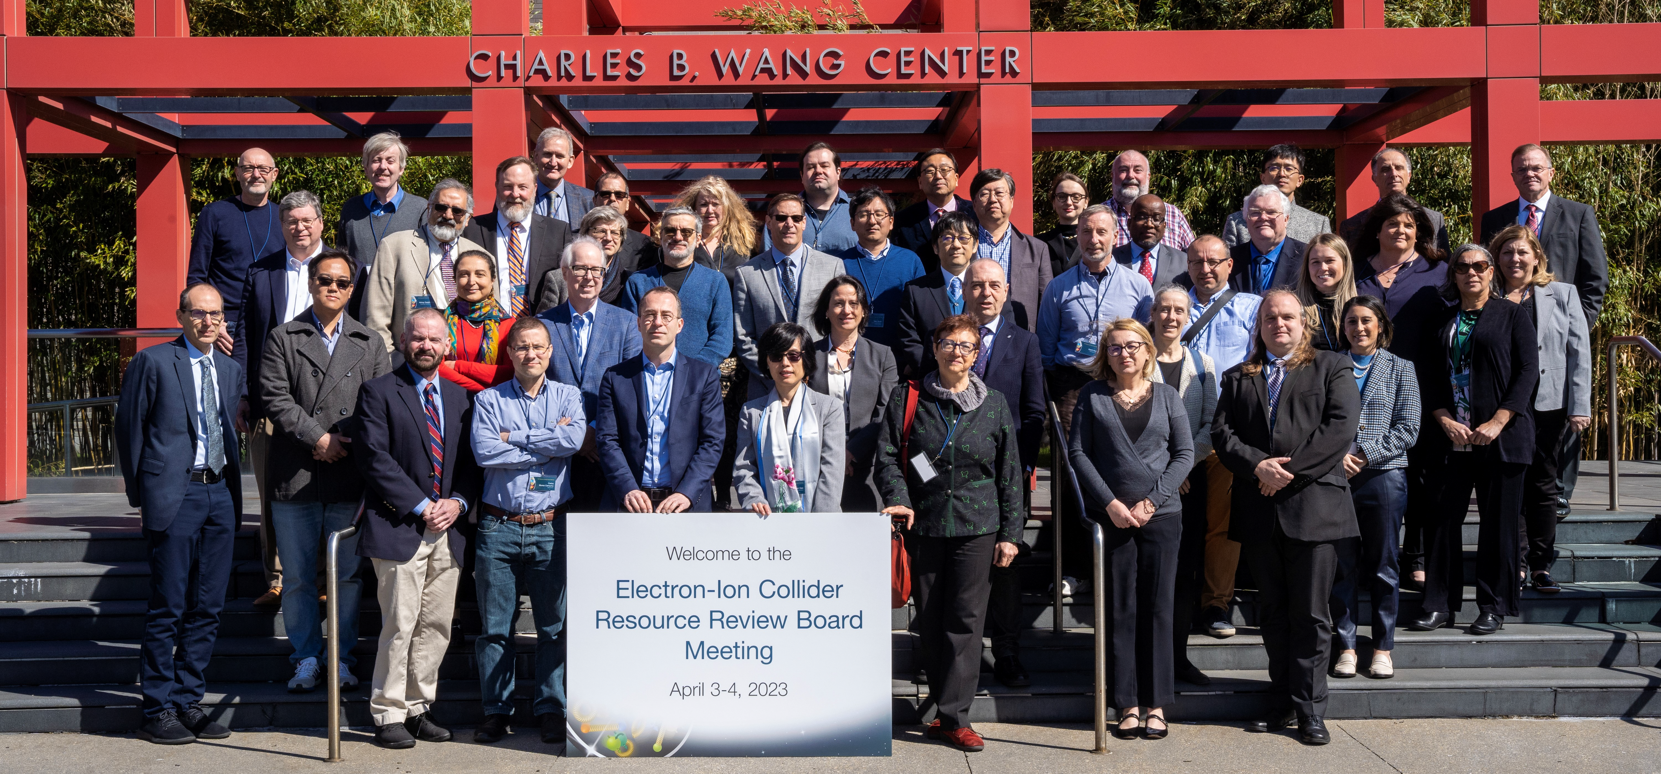
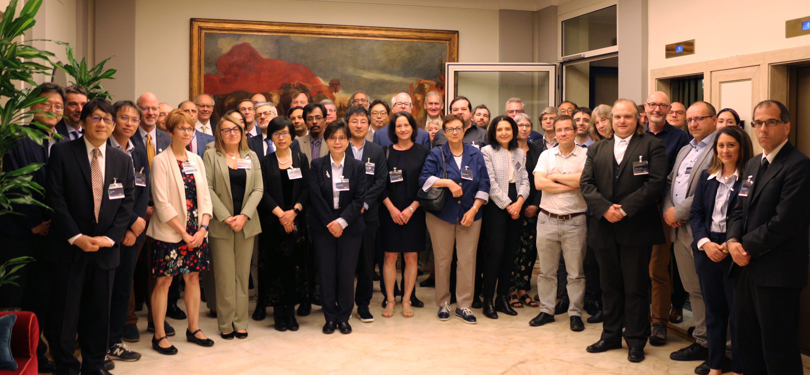
International Engagement: Resource Review Board (RRB) Meetings
DOE and the host labs promoting the EIC as a facility “fully international in character.”
Initial RRB Co-Chairs:
Haiyan Gao (BNL)
Diego Bettoni (INFN)
https://www.bnl.gov/eic-rrbmeeting/
1st RRB meeting on April 3-4, 2023 at Stony Brook University.
2nd RRB meeting on December 7 + 8, 2023 at Catholic University of America.
3rd RRB meeting on May 6 + 7, 2024 in Rome hosted by INFN/Italy
4th RRB meeting will be at BNL on November 12 + 13, 2024

Slide 8











May 2024 RRB Meeting Participants
CANADA
TRIUMF
Israel
Ben-Gurion University
Taiwan
National Central University
National Taiwan University
Czech Republic
Ministry of Education, Youth and Sports
Italy
INFN
United Kingdom
STFC
University of Birmingham
University of Glasgow
France
IN2P3/CNRS
CEA Saclay
Japan
Tokyo University
RIKEN
United States
DOE
BNL
JLAB
ORNL
India
Department of S&T
South Korea
MIST
UConn
Yonsei University
Working together to support the EIC research program!

Slide 9
Technical Status per L3Ms WBS
Note these are all for the month of May
EIC Detector and ePIC Collaboration General Status Update:
The 3rd Resources Review Board meeting was hosted May 6-7 by INFN in Rome. Main discussion points were the progress towards international agreements, the computing planning, and a discussion of common funds. Attendants include Canada, Czech, France, India, Israel, Italy, Japan, South Korea, Taiwan, UK and US.
Beyond the RRB agenda, we discussed three draft iCRADAs we had mailed beforehand to share with UK/STFC, Italy/INFN and France/IN2P3 based on the information we had collected from them on the detector scope. The main goal is to define high-level responsibilities and estimated up-to P6-equivalent dollar amounts. The drafts were discussed. Overall, the foreign agency representatives and primary contact scientists felt these were on very good track, and they will submit written comments.
Later in the month, we did receive initial feedback on the draft iCRADA for the Italy/INFN detector in-kind scope. This feedback will be folded into a revised draft. We also need to set up a follow-up meeting to further clarify what INFN will assume as DOE project scope for the INFN-led dual Ring-Imaging Cherenkov detector in their detector proposal.
Together with the earlier magnet-related draft iCRADAs (INFN and CEA), all the first-phase in-kind expected contributions have now draft iCRADAs apart from the non-magnet scope for France/CEA which we will draft in June.
During the RRB, the Korea attendants (the ministry representative and two scientists) also indicated they would like to start given where they are in the proposal process. We discussed examples and will also start work on a draft iCRADA with Korea soon.
We also exchanged examples of high-level responsibilities with the Japan scientists. They shared what they expected to be part of a MEXT proposals but that they were not in the formal proposal phase yet. They indicated an initial meeting with their ministry in May.
On May 15, an article appeared stating that the education ministry in Japan announced plans to contribute to the EIC detector construction, see https://japannews.yomiuri.co.jp/science-nature/science/20240515-186185/ .
Taiwan and Israel are working on what is possible for proposals with their agencies.

Slide 10
Technical Status per L3Ms WBS
Note these are all for the month of May
WBS 6.10.02:
The annual call to the community for the detector R&D progress reports and potential continuation detector R&D requests for FY25 went out, with a deadline for submission of July 1, 2024. We explicitly asked to include an outlook towards completion of the formal P6 project milestones.
WBS 6.10.03:
For the silicon tracking detector scope, we are waiting for further detailed information on activities, cost and schedule to ensure consistency with P6. The information we have is still that of “pre-ePIC times”.
We asked the sensor characterization working group of the silicon tracking team to investigate what exists within the ePIC collaboration and what potential further needs are for project engineering and design, before initiating a procurement with MIT. The latter contract would follow the same model we have for the ITS3 sensor work, to establish a presence at CERN on the sensor characterization activities and have a development setup for ePIC.
Work continues to find a path forward for the draft ITS3-related agreement between CERN and BNL (on behalf of ePIC collaborating institutions). A solution may have been found to name this a Memorandum of Intent that will be accompanied by a procurement. This is bounced off CERN.

Slide 11
Technical Status per L3Ms WBS
Note these are all for the month of May
WBS 6.10.04:
Work is ongoing this month on planning strategies for the DIRC bar box disassembly, with users at Jefferson Lab site to help develop the best strategies and possible setups to do this.
Much progress has been made to mature the design and correlated refine the cost and schedule for both the barrel and forward AC-LGAD systems. The forward AC-LGAD would have more electronics readout card flexibility if the allotted space increases from 5 to 8 cm, and we confirmed we can accommodate this. The labor estimates were discussed with the collaboration, and what could already be seen as in-kind. (Note that further in-kind may come from the proposals of Japan, Taiwan and India). The flex cable scope was found to be missing between the particle identification and electronics areas and has been added to the estimates. We are now doing the final checks in P6.
We are working on small contracts with UC Santa Cruz and Purdue for project engineering and design activities towards the Barrel Module AC_LGAD/TOF Assembly. This will be done in phases with the first phase to concentrate on the thermal mechanical loads with as main goal the thermal characterization of mockup modules.
WBS 6.10.05:
Progress was made on the CD-3A fiber procurement. For the forward electromagnetic calorimeter, only one vendor was found willing to deliver the fiber in canes (rather than spools), as is preferred and was recommended per the scintillating fiber Final Design Review. For the barrel electromagnetic calorimeter, we are doing follow-up with the vendors.

Slide 12
Technical Status per L3Ms WBS
Note these are all for the month of May
WBS 6.10.07:
A document on “EIC Central Detector (ePIC) - RCS Stray Field Reduction” saw a final readthrough. In the document we illustrate how the detector solenoid fringe fields can be successfully mitigated below the RCS requirements, and also below the requirements for the closest IR superconducting focusing magnets, all with relatively simple means. The signature process starts now to submit this as technical document.
We hosted the Magnet Power Supply Final Design Review on May 28 with three reviewers – Ju Wang (ANL), Onish Kumar (JLab), Howie Pfeffer (FNAL). See https://indico.bnl.gov/event/23354/ (Password: SolenoidPSFDR2024). The Magnet Power Supply is possible CD-3B scope.
WBS 6.10.08/09:
We will host an electronics/DAQ incremental design review on June 10 followed by a Final Design Review of the VTRx+/lpGBT scope on June 11. The latter is possible CD-3B scope. Four reviewers are confirmed – Ken Wyllie (CERN/LHCb), Filippo Costa (CERN/ALICE), Prahansha Mukim (BNL) and Mitch Newcomer (U Penn). Page turns are scheduled for this week (May 31), and dry runs for the following week. We are working on adding the prebrief information.

Slide 13
Technical Status per L3Ms WBS
Note these are all for the month of May
WBS 6.10.10:
We are participating in a mechanics workshop hosted by Purdue (with many of our engineers remote). This workshop recognizes the synergy of CERN-envisioned detector systems and ePIC. There is a dedicated all-day discussion meeting scheduled at the start of the workshop that goes over the mechanics of all inner EIC detector systems – the proximity-focusing RICH, the silicon detectors, the AC-LGAD time-of-flight systems, and rhe micro-pattern gaseous detectors. All of these are envisioned to share a global carbon-based support tube and support systems,
We have a space conflict of a few centimeters of the forward electromagnetic calorimeter and the service systems that are around them. Resolution of this few-cm conflict is ongoing with several solutions under study.
WBS 6.10.11:
We have completed verification that the scope of the far-forward and far-backward detectors and the electronics is properly delineated in P6 between 6.10.11 and 6.10.08. As part of this verification, we have checked consistency of all numbers for required electronics and data acquisition channels.
We are working on a small contract to construct a first engineering test article of the ZDC with UC Riverside.
WBS 6.10.14:
There has been good progress on diamond detector and ASIC development for the envisioned high-precision Compton Polarimetry at Jefferson Lab. This ASIC is compatible with streaming readout and applicable for the EIC. We are investigating now further follow-up project engineering and design studies aimed at EIC electron polarimetry – nothing may be required and we can “use as is”.

