Slide 1

ePIC Collaboration News
J. Lajoie, S. Dalla Torre
June 14, 2024

Slide 2
Hey John, start the recording….

Slide 3
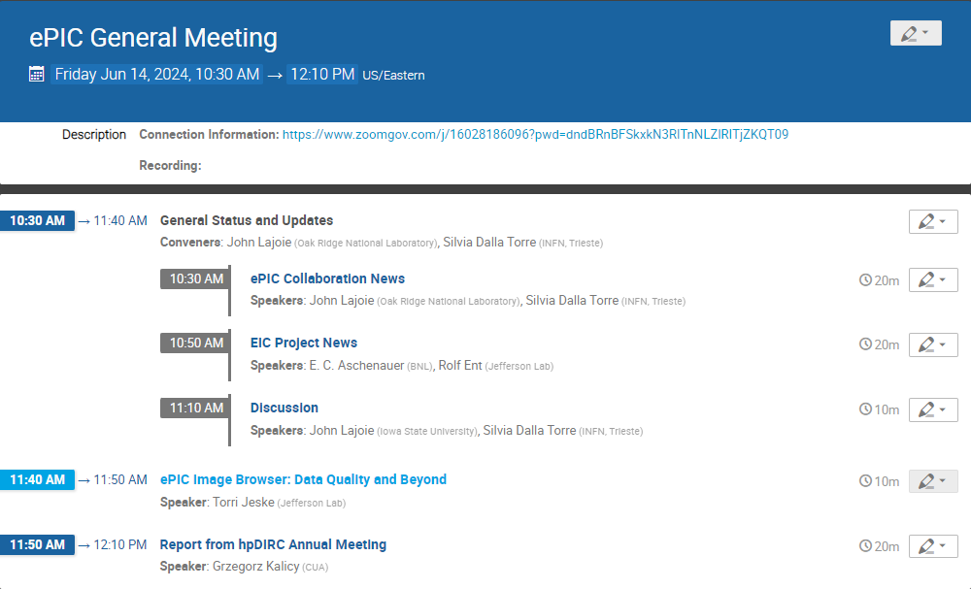

Today’s
Agenda
“Give us your damn plots”
- B. Page

Slide 4
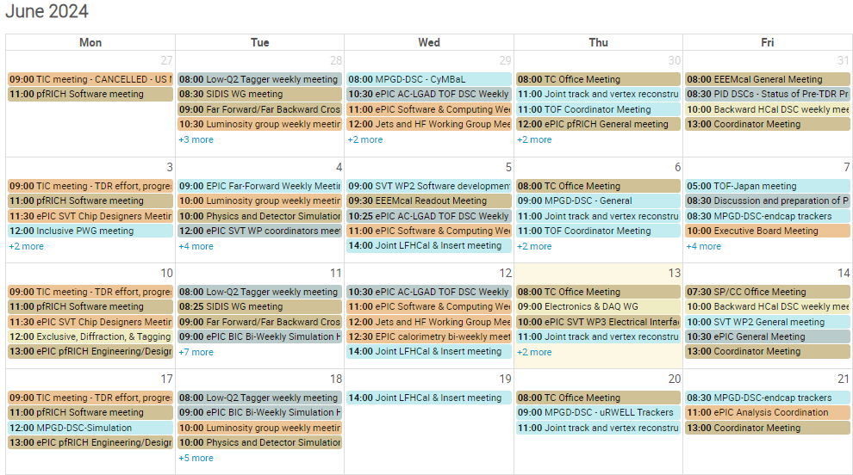
The summer is off to a busy start!
Incremental Preliminary Design and Safety Review of the EIC Detector DAQ and Electronics *AND*
Final Design Review for lpGBT/VTRX+
8th Detector Advisory Committee Meeting
More in the Project News talk…

Slide 5
Current TC-office Activities
Requirements for the Detector DB finalized (after collecting community inputs and two passes at TIC meetings); they can be read at: https://docs.google.com/document/d/1ow1nfy8dsrI1CfTBkG6kUJ0Oy2MZONhAktLy-zevJ1E/edit
  Next step initiated: identification and selection of the technical tool
  (together with SCC)
Pre-TDR activities
  Monitoring the DSC progress with periodic reports at the TIC meetings
  Structuring the overleaf document where the DSC inputs will be collected
  Follow-up on main TC-office priorities for simulation studies (pre-TDR oriented)

Slide 6
TC-office Priorities for Simulation Studies (pre-TDR oriented)
Studies for subsystems where there are technical aspects still open:
  Simulations dedicated to soft gamma and to vector meson production in order to optimize the ZDC configuration
  Motivation and requirements for the backward HCal
  Needs in term of spatial resolution for the outer MPGD
  Impact on physics of dRICH with single vessel vs dRICH with split vessel
  B0 calorimetry performance: LYSO vs PbWO₄

Slide 7
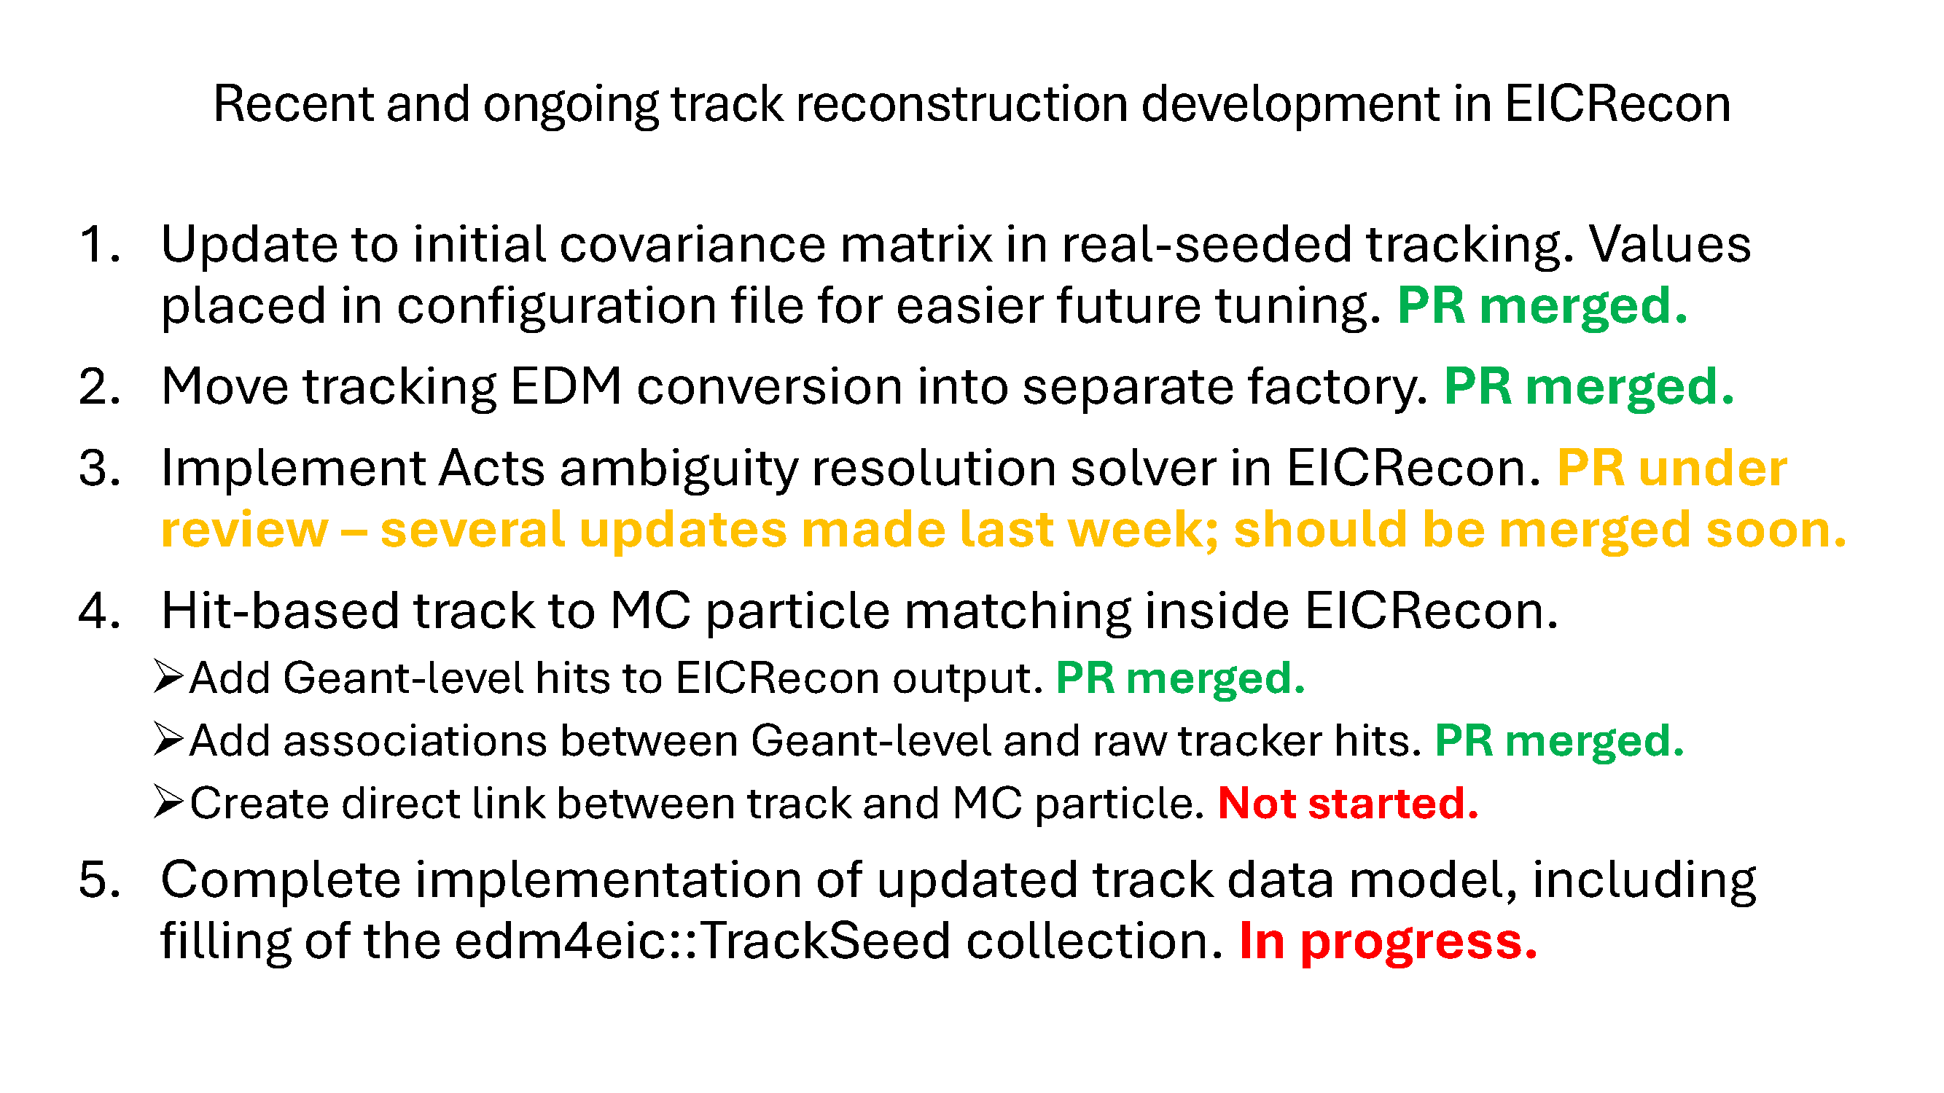
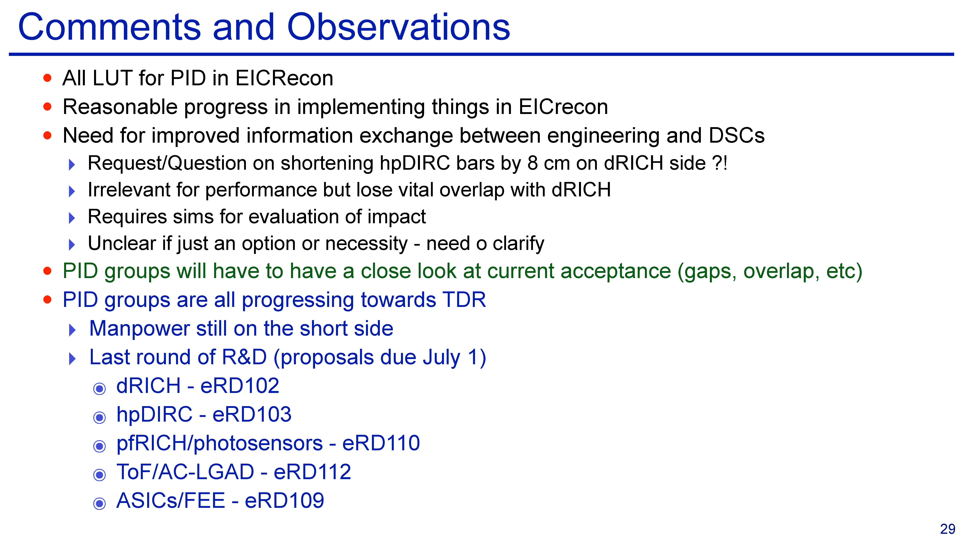
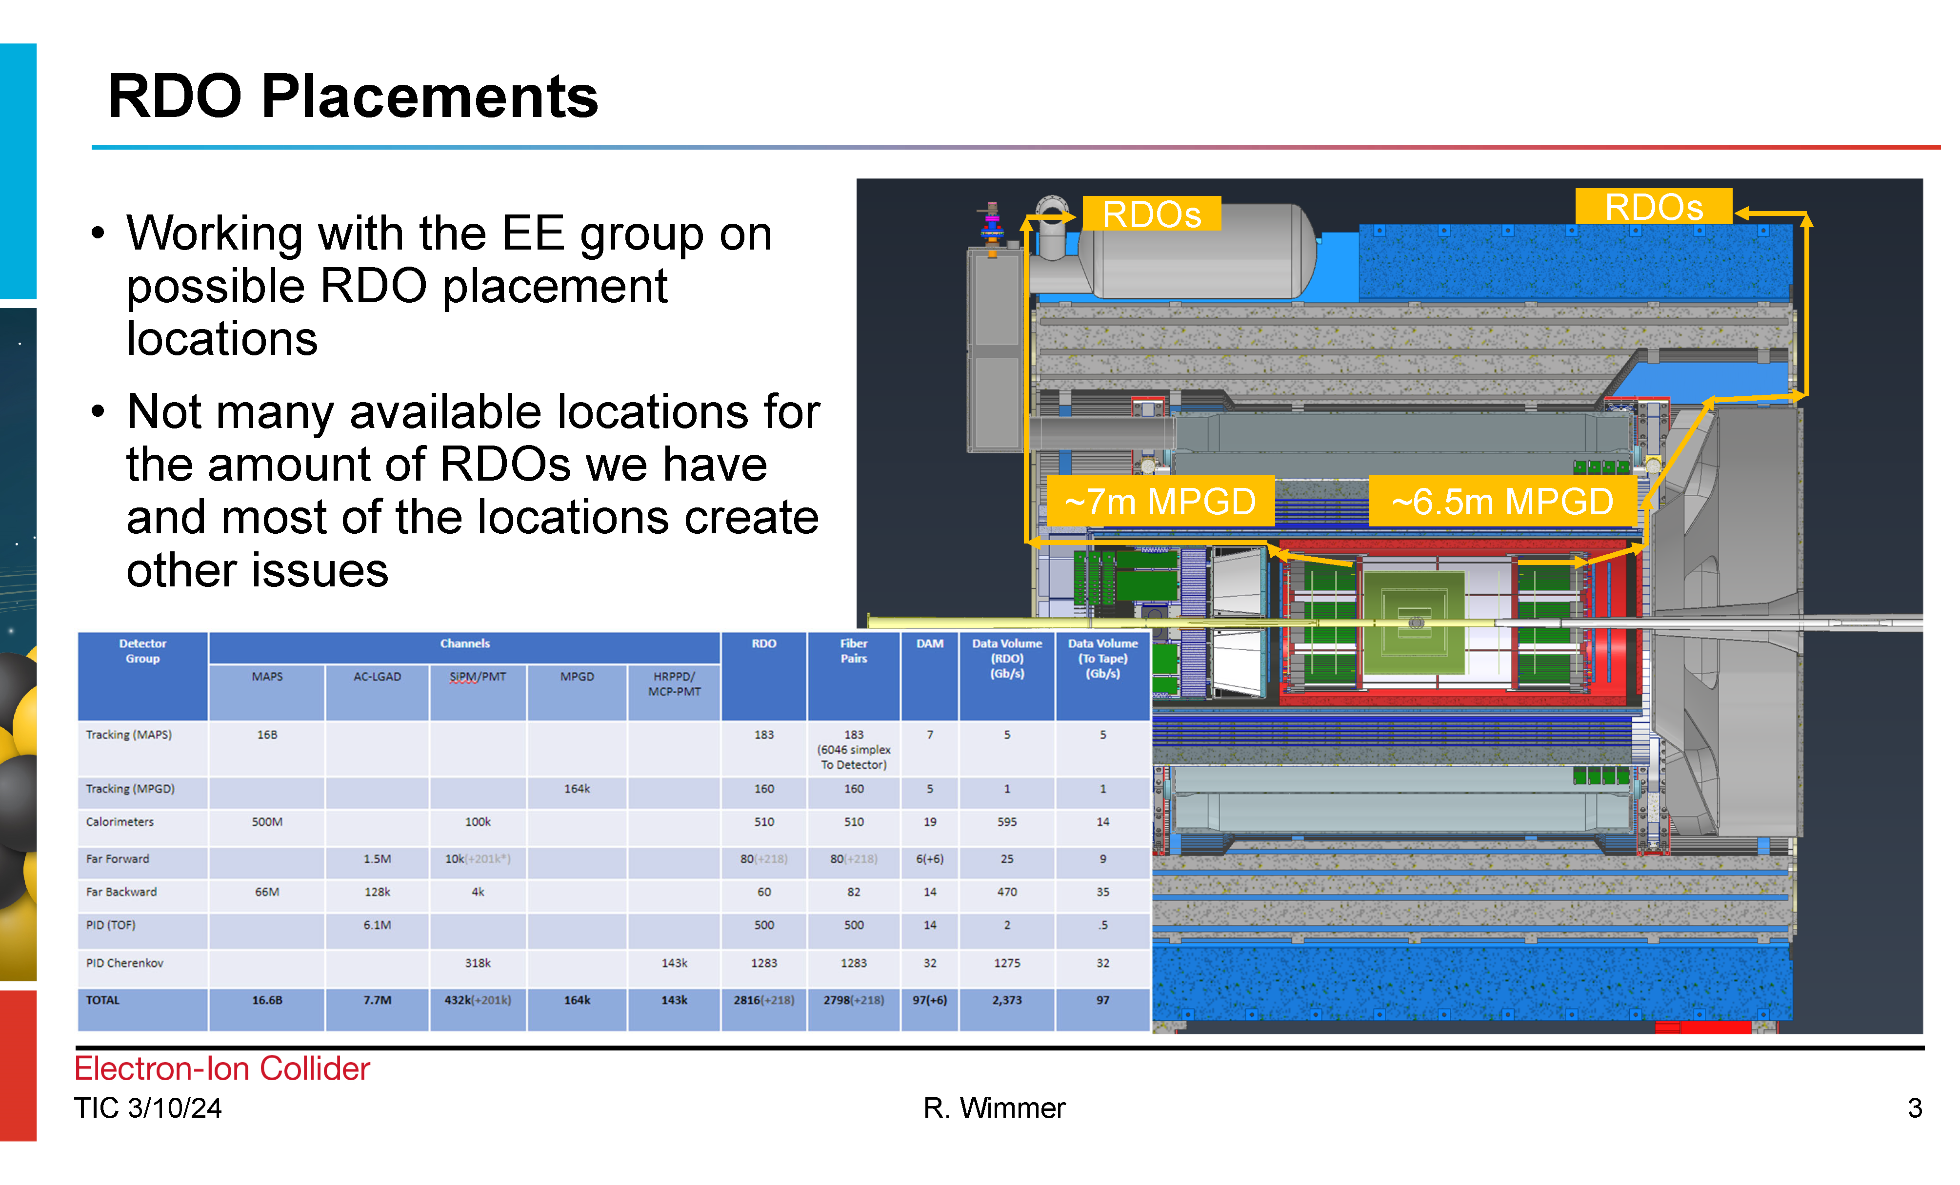
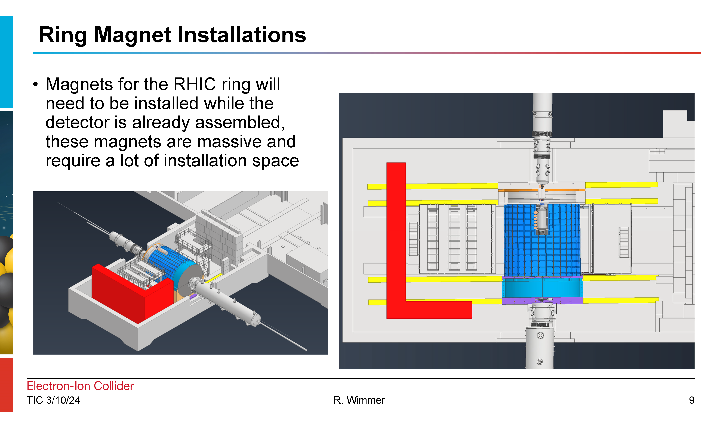
Recent TIC meetings (June 3rd, 10th) Highlights
Pre-TDR effort:
  Progress on Tracking (B. Schmookler):
  hPDIRC News (G. Kalicy):
  PID CC WG Report (T. Ullrich):
Detector Integration:
  Presentation from project engineers:

Slide 8

Timeline
process design phase
structuring the
effort
draft ePIC pre-TDR
ePIC pre-TDR (CD-2)
writing
(TDR/notes)
Preparing papers for
publication
Mid Jan.24
Mid Mar.24
End Oct. 24
Late 2024
Early 2025
Putting the tools in place:
Overleaf/Github for TDR (TBA RSN)
Zenodo.org selected as document database solution

Slide 9
What is Zenodo.org for?
We will use Zenodo.org as a document database:
  It is a database where we can easily and efficiently store ePIC documents
  It is searchable, so you can quickly find specific documents or groups of documents for WG’s, DSC’s, conference presentations, etc.
  It allows us to store documents both for private (ePIC internal) and public availability
  Low overhead and easy to use are key features!
Zenodo.org is not a document workflow solutions
  Documents are developed and reviewed outside of Zenodo.org
  Will make Overleaf/GitHub available soon for TDR, technical notes, etc.
  A document goes into Zenodo when an ePIC collaborator determines that it’s ready to be shared within a DSC, WG or the collaboration
    This doesn’t mean that the document must be “finished”! Revisions and versions are OK!
This is the ePIC Document Database going forward:
  Indico is still the right place for weekly meeting presentations, etc.
  No more Google Drive, Dropbox, etc., please – too much gets lost this way
  Examples of documents – conference presentations, test beam notes, images, diagrams,…
    Low overhead – there is no “penalty” for putting something in Zenodo.org!

Slide 10
How to Get Started…(I)
Create a Zenodo.org account
  If you have an ORCID iD, consider linking the Zenodo account to ORCID
Email a request to eic-software-l-owner@lists.bnl.gov to join the “ePIC”
community on Zenodo:
  Send your Zenodo username/id
  Be sure to note if you are in DSC, WG, or CC Committee leadership
  New people can request GitHub, Mattermost access at the same time
  This will be streamlined in the future when the phone book is deployed
Zenodo documentation: https://help.zenodo.org/docs/

Slide 11
How to Get Started…(II)
Collaborative Tools Ad-Hoc Committee documenting policy
for Zenodo use:
  Any member of the ePIC community can submit documents:
    Available to ePIC Community after review
    Documents can be revised (all revisions are kept)
  DSC/WG/CC Comm. leaders approve documents and can promote documents to public (world viewable) after review
  Use of standard keywords necessary for efficient search!
    Required keyword “epic-eic”
    Predefined keywords for standard topics and groups, special keywords for conferences
    List to be kept on website, updated and curated by DSC/WG/CC Comm. leaders
Instructions page in Wiki/Website coming very soon….

Slide 12
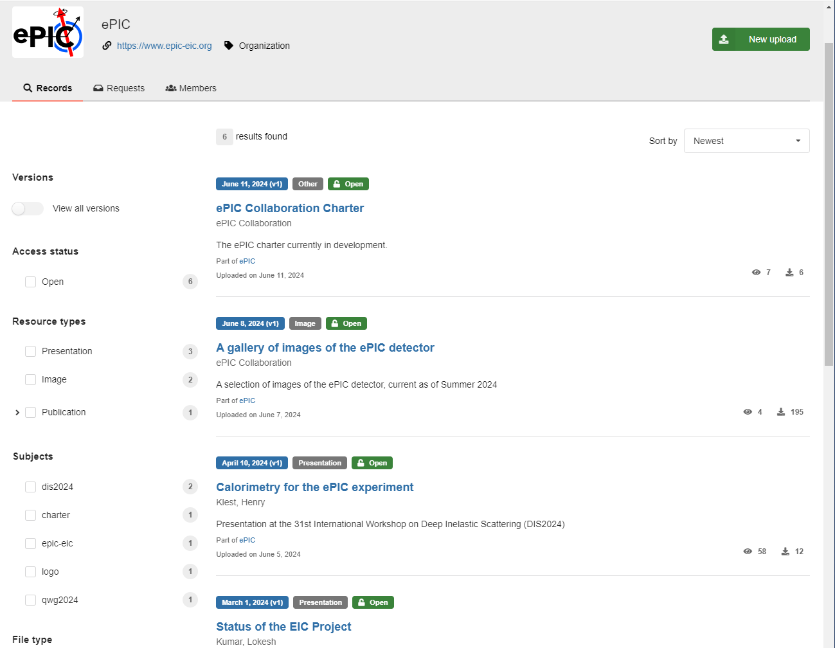
ePIC Zenodo Community
There’s already stuff in there!
The lightweight policy is meant to not only encourage adoption but to allow the collaboration to evolve how to best use this tool.

Slide 13
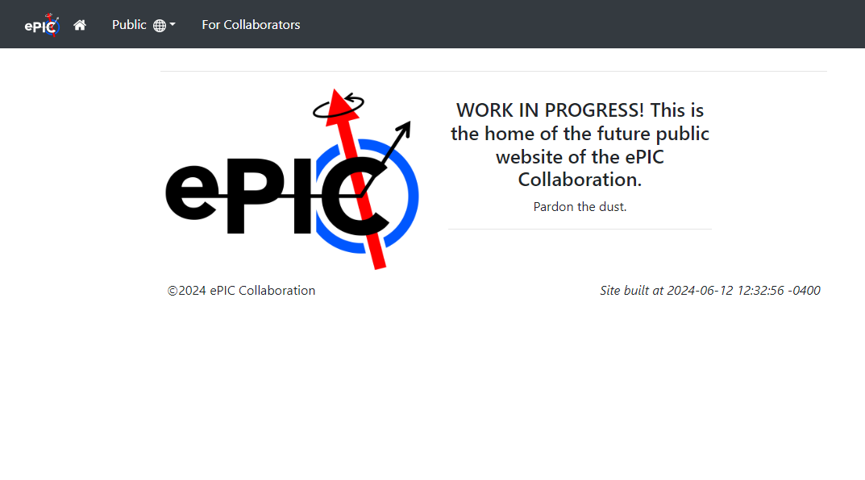
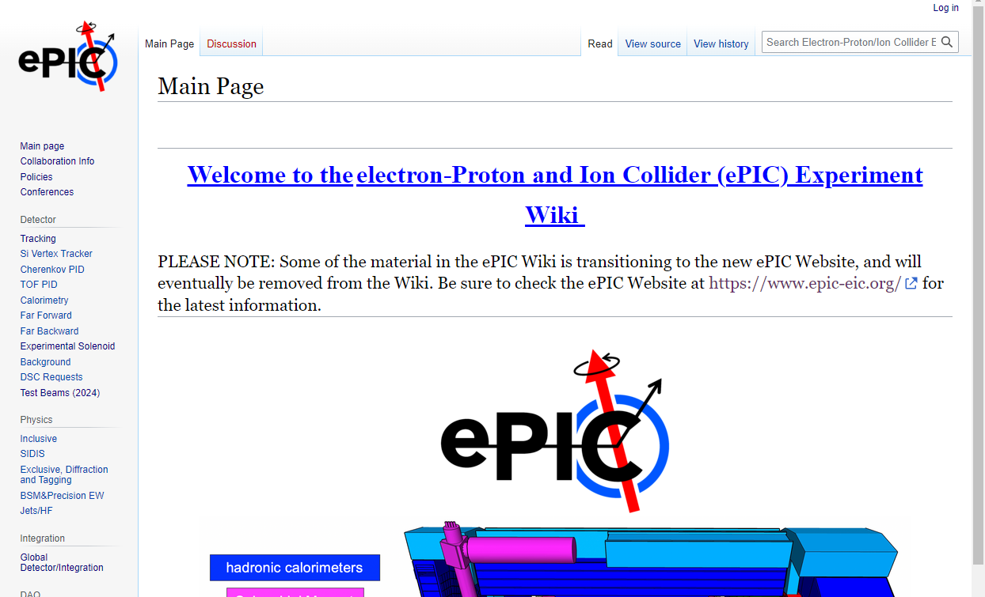
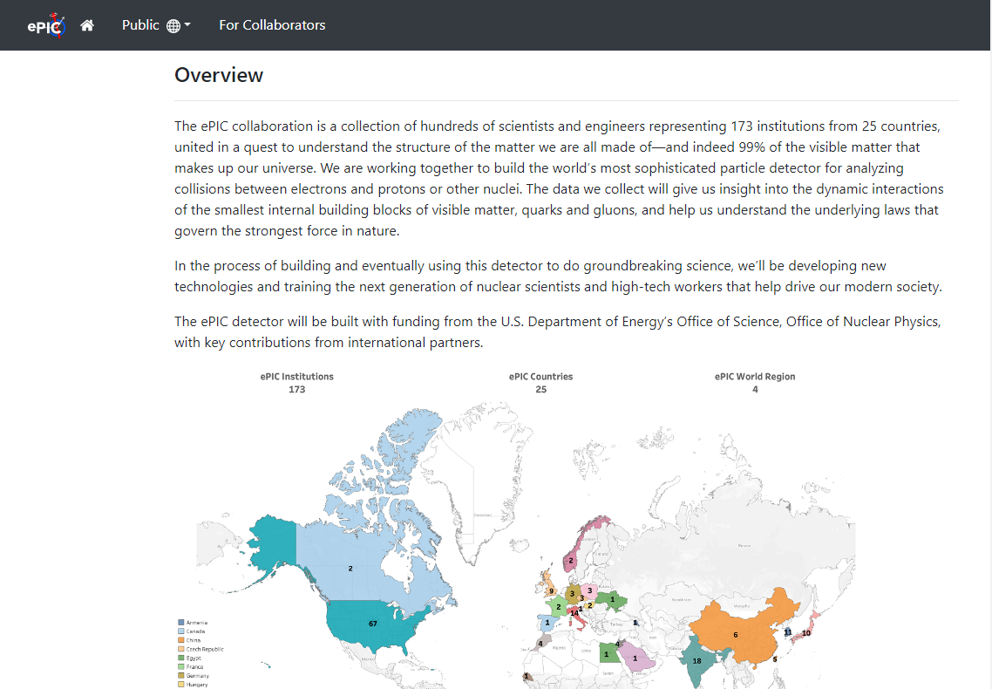
ePIC Website Progress
https://www.epic-eic.org/

Slide 14
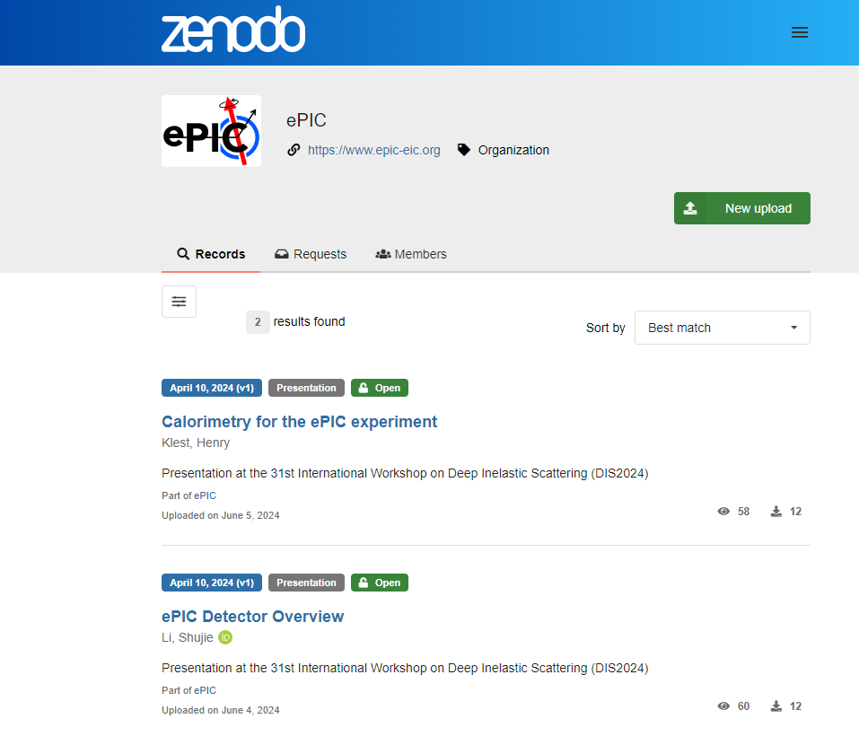
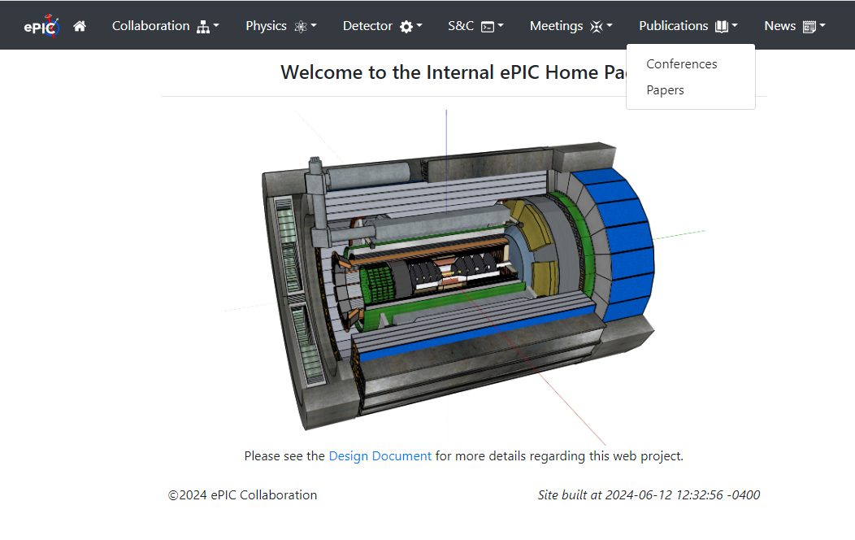
Website/Zenodo Integration
Record of conference presentations updated automatically through use of Zenodo keywords

Slide 15
Next ePIC Collaboration Meeting
Lehigh University
Bethlehem, PA
July 22-28
Jointly organized with the EICUG
ePIC Meeting
July 24-28th
Registration is OPEN!
https://indico.bnl.gov/event/20727/

Slide 16
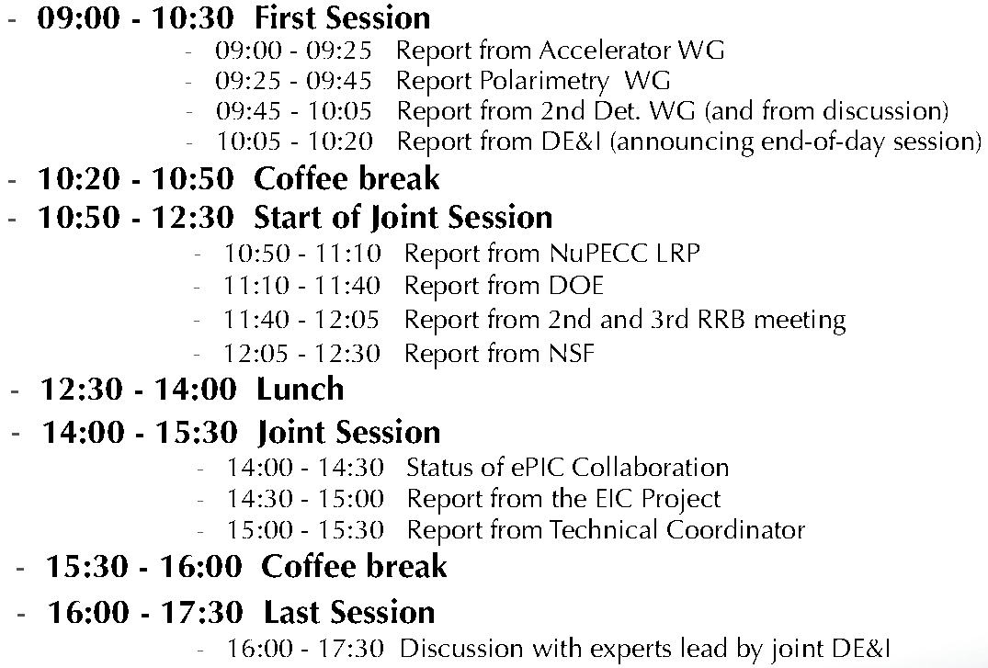
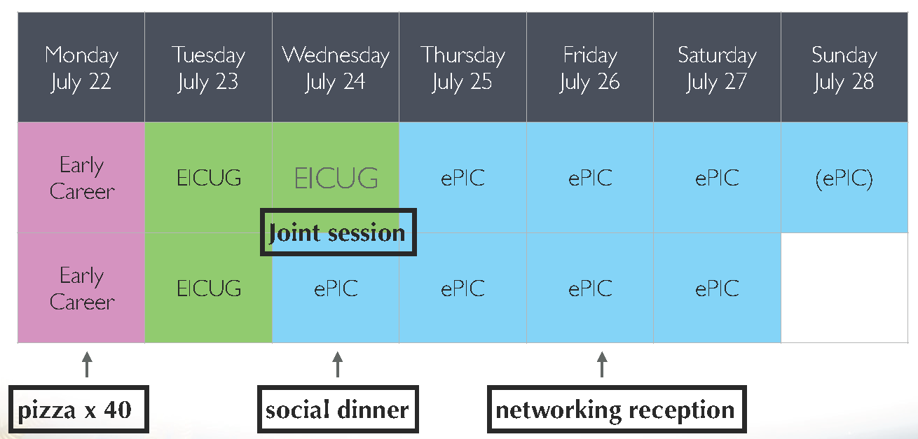
High-Level Agenda July 22-28

Slide 17
Rev 7 – 6/14/2024
July 25
July 26
July 27
Notes:
morning
afternoon
evening
morning
afternoon
morning
afternoon
MPGD DSC Workfest
TOF and AC-LGAD Workfest
SRO+DAQ
Integration and Installation
Calos before end of day to allow LFHCAL workfest
Electron ID & Reconstruction +
Path Towards Holistic Reco.
CC Meeting
Combine two workfest proposals
plus software part of CC PID
Plenary
(+ Self-Proposed)
Vertex Finding and HF Reco.
+ TDR Plots for Vertex and Reco.
Combine two workfest proposals
SVT DSC
Requested half-day morning
PID CC WG
Parallel Session but no auditorium
Half combined with holistic reco
HGCROC
LFHCAL + Backwards HCAL
Calo Reconstruction Hackathon
Blocks represent ~2hrs, a morning or afternoon session is ~4hrs

Slide 18
Workfest/Parallel Session Organizers
MPGD DSC:
  K. Gnanvo, F. Bossu, A. D’Angelo, M. Posik
TOF and AC-LGAD:
  Zhangbu Xu, Satoshi Yano and Alex Jentsch
SRO + DAQ
  Jeff, Marco, David, Fernando, Jin
Integration and Installation:
  TC Office (Prakhar Garg)
Electron ID & Reconstruction +
Path Towards Holistic Reco.
  Daniel Brandenburg, Tyler Kutz, Derek Anderson, Dmitry Kalinkin, Shujie Li, Umberto Tamponi
Vertex Finding and HF Reco.+ TDR Plots for Vertex and Reco.
  Xin Dong, Olga Evdokimov, Brian Page, S. Li, B. Schmookler, E. Sichtermann
SVT DSC:
  E. Sichtermann
PID CC WG:
  Thomas Ullrich, Umberto Tamponi
LFHCAL + Backwards HCAL/Hackathon
  F. Bock, L. Kosarzewski
HGCROC
  N. Novitzky

Slide 19
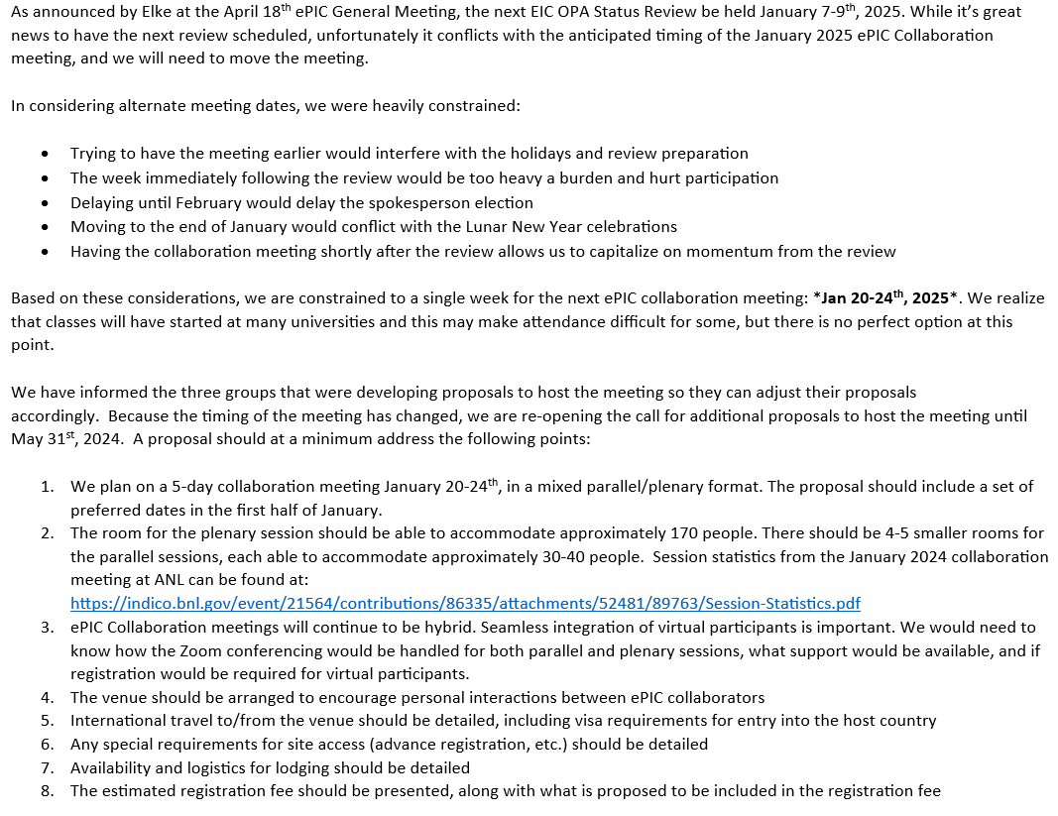
Higher Order Collaboration Meeting (NNCM)
Revised call sent to collaboration April 29th
  Change of dates due to CD-3B review
Jan 20-24th , 2025
Deadline May 31st
Two proposals received

Slide 20
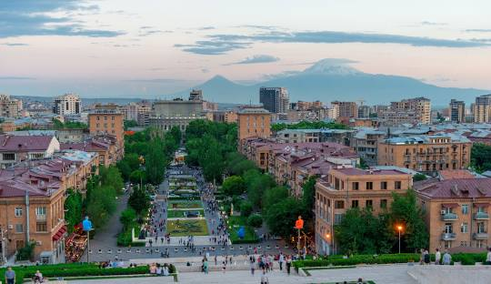
Jan 2025 Collaboration Meeting Proposal
A.I. Alikhanyan National Science Laboratory (AANL)
  Yerevan, Armenia
Hosted at the Armenia Marriott Yerevan
  Rooms also available at surrounding hotels
  Registration fee includes coffee
  breaks, welcome reception,
  conf. dinner and excursion
  Large auditorium 170-500
  5 Parallel Session rooms (40 people)
  AV Support
Extensive budget provided

Slide 21
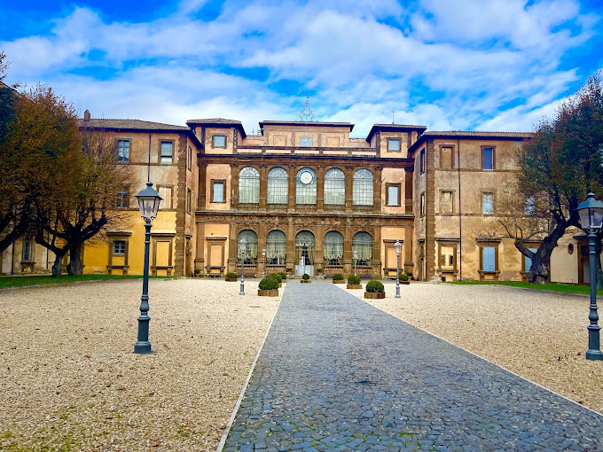
Jan 2025 Collaboration Meeting Proposal
University of Rome Tor Vergata & INFN
  Via Frascati (Roman Hills)
    Trains from Fiumicino Airport and Roma Termini
Villa Mondragone
  Rooms available at 3-4 star hotels in Frascati
  Conference fee covers coffee breaks, lunches,
  shuttle buses:
    Remote participants and students fee waived (up to 20%)
    Minimum 100 in-person attendees
    Social dinner (additional cost)
  Plenary Room (160 people)
  3 parallel session rooms
  AV support

Slide 22
January 2025 Collaboration Meeting
After very careful consideration by the CC Office, Executive Board, and the Coordinators, we have decided to accept the proposal from University of Rome Tor Vergata & INFN to host the January 2025 ePIC Collaboration Meeting.
The ePIC Leadership would like to specifically compliment AANL for an excellent proposal, and we hope to be able to visit Yerevan in the future.

Slide 23
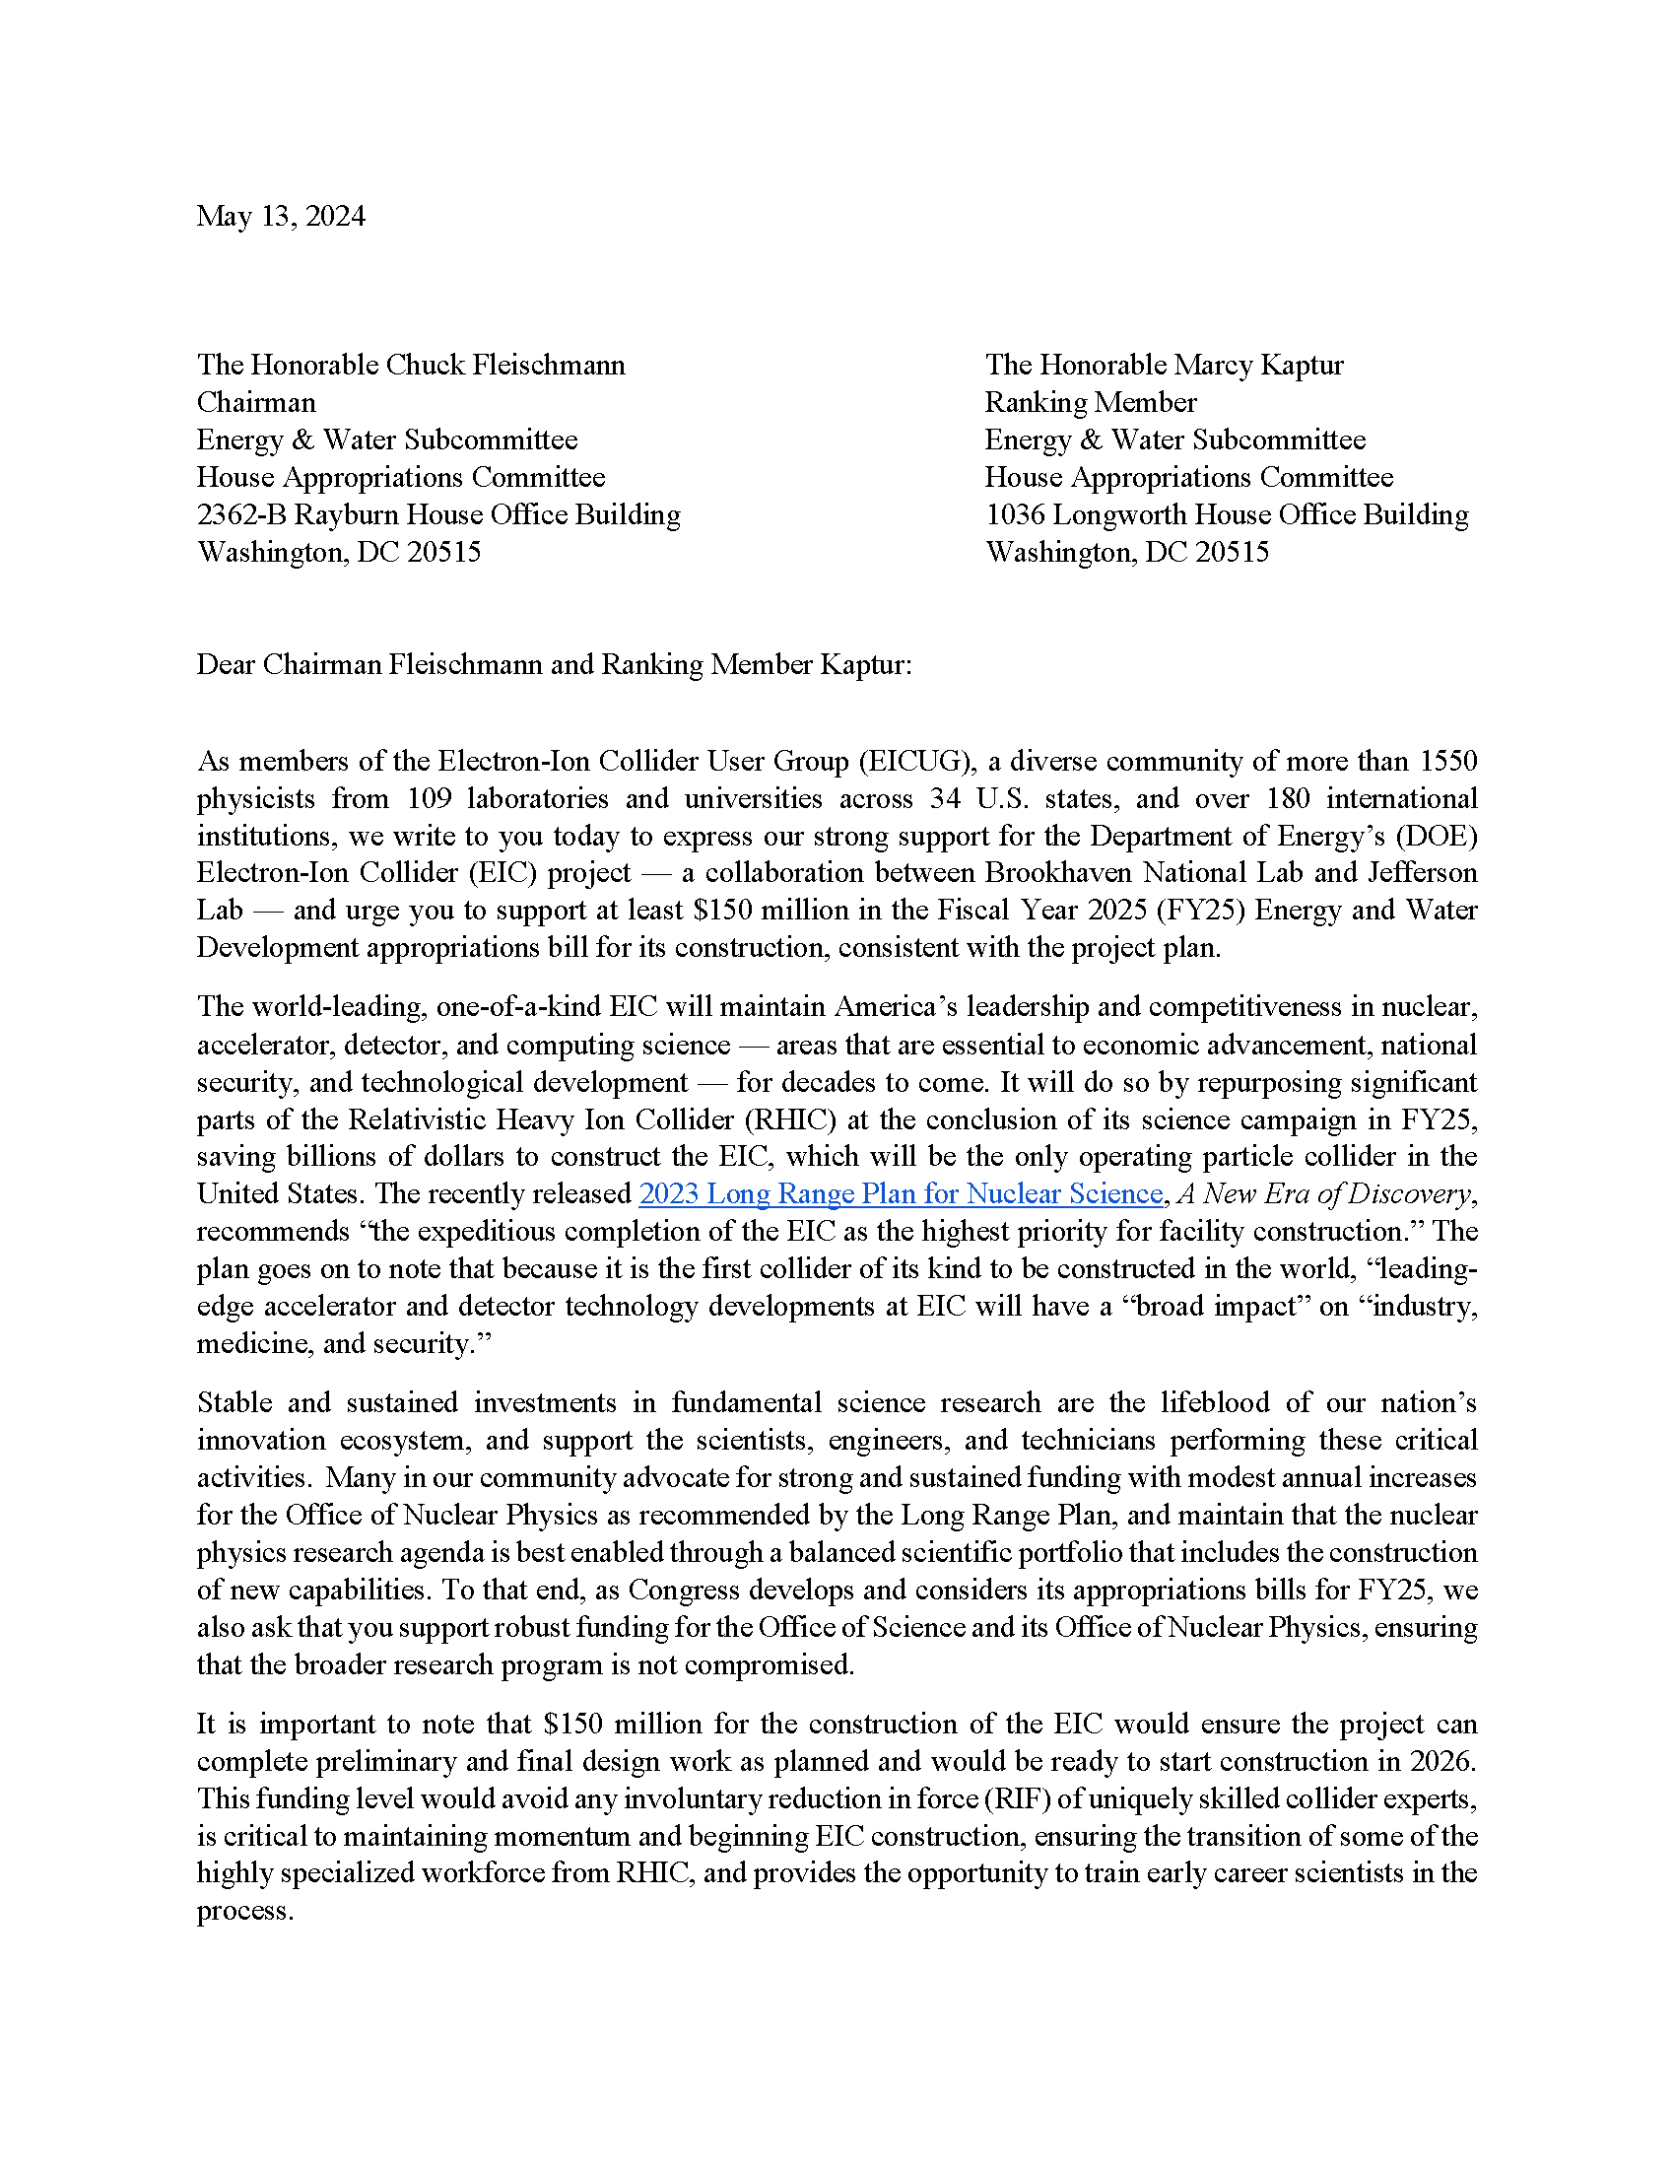
EIC Advocacy Letter
Advocacy letter to Energy and Water Committee leadership.
Organized by EICUG
Sent to EICUG non-.gov/.org email list
Letter available here
Consider expressing your support by signing the letter
https://forms.gle/rxEXdNiogx6pSYnT8

Slide 24

ePIC Speaking Opportunity!
Via the Talks and Conferences Committee:
We have received an invitation for an ePIC member to give a plenary talk (25+5 minutes) on an experimental overview of ePIC with a focus on capabilities for BSM physics at the Workshop on Investigating Physics Beyond the Standard Model at the Electron-Ion Collider (EIC), at Brookhaven National Laboratory, Upton, NY, November 20-22, 2024.
As we are asked to provide the speaker's name pretty soon, please send your nominations by June 17 via this form: https://forms.gle/RfpkNsv8PwkKwbxt5.
Self-nominations are encouraged!

Slide 25
Working at BNL
The new website has a “Coming to BNL” section:
  https://www.epic-eic.org/collaboration/coming.html
In addition, please email Thomas (thomas.ullrich@bnl.gov) and Elke (elke@bnl.gov) if you are sending people to BNL to do ePIC work
  Do this even if they are coming primarily for something else and ePIC
  is just a small part
Make sure that people are trained, and all BNL regulations are followed
  This is important! When at BNL doing work on ePIC you and your people are representing the collaboration.

Slide 26
Summary
Making progress on draft pre-TDR development timeline
Getting stoked for the July Collaboration Meeting!
Next ePIC General Meeting:
Thursday, June 27th @ 7:30PM ET
Sign the EICUG advocacy letter
Register now for the Joint EICUG/ePIC
meeting at Lehigh July 24-28th

Slide 27


Slide 28
ePIC Resources
Public Website - https://www.bnl.gov/eic/epic.php
Mailing Lists – https://lists.bnl.gov/mailman/listinfo
Indico Agenda - https://indico.bnl.gov/category/402/
  ePIC Software and Computing: https://indico.bnl.gov/category/435/
Wiki - https://wiki.bnl.gov/EPIC
ePIC Software Training:
  Landing Page: https://eic.github.io/documentation/landingpage.html
  Tutorials: https://eic.github.io/documentation/tutorials.html
Mattermost: https://chat.epic-eic.org
ePIC Zenodo Community: https://zenodo.org/communities/epic

Slide 29


EICUG Membership
The EICUG is a vital organization to promote the interests of the EIC community!
  Without the EICUG we would never have gotten far enough to form ePIC!
Please register your institution!
Check with your EICUG IB representative to get registered as a member
https://www.eicug.org/content/join.html

Slide 30


Upcoming Notable Events…
DIS 2024 in Grenoble, France April 8-12th , 2024
  https://lpsc-indico.in2p3.fr/event/3268/
ePIC Software and Computing meeting
@ CERN April 22nd-26th
  https://indico.cern.ch/event/1343984/
EIC RRB Meeting – May 6-7th in Italy
MC4EIC @ Durham University June 5-7th
  https://conference.ippp.dur.ac.uk/event/1292/
JLab Users Meeting, June 8-12th
  https://www.jlab.org/conference/2024-jluo
4th EIC-Asia Workshop in Shanghai July 1-5, 2024
  https://indico.cern.ch/event/1361239/
Joint EICUG/ePIC Collaboration Meeting
@ Lehigh University July 22nd-28th
  https://indico.bnl.gov/event/20727/

Slide 31
Rotation of PWG Conveners
SIDIS:
Charlotte - 1 year
Stefan - 2 years
BSM:
Michael - 1 year
Ciprian - 2 years
Inclusive:
Claire - 1 year
Tyler - 2 years
Exclusive:
Rachel - 1 year
Raphael - 2 years
Jets/HF:
Brian - 1 year
Olga - 2 years
Physics WG’s
  Conveners were originally endorsed for 1 yr/2 yr terms
  Half of the existing PWG conveners due to rotate off
  Do not want to create disruption at a time when we are trying to ramp up efforts for the TDR
  Plan to present new PWG conveners to the CC for endorsement at July Collaboration meeting
    Follows split of CC elections
    Allows time for AC’s to consider/develop candidates
    This is an opportunity to rotate experienced ePIC members
    to new roles!
Contact the Analysis Coordinators (Rosi and Sal) with suggestions and nominations!

