Slide 1
EIC Project News
E.C. Aschenauer (BNL), R. Ent (JLab)
Co-Associate Directors for the Experimental Program
EIC Detector Leads
ePIC Bi-Weekly
June 13th, 2024

Slide 2
Outline
Schedule Speculations
Reviews Planned
Electronics/DAQ review(s)
Upcoming Detector Advisory Committee meeting

Slide 3
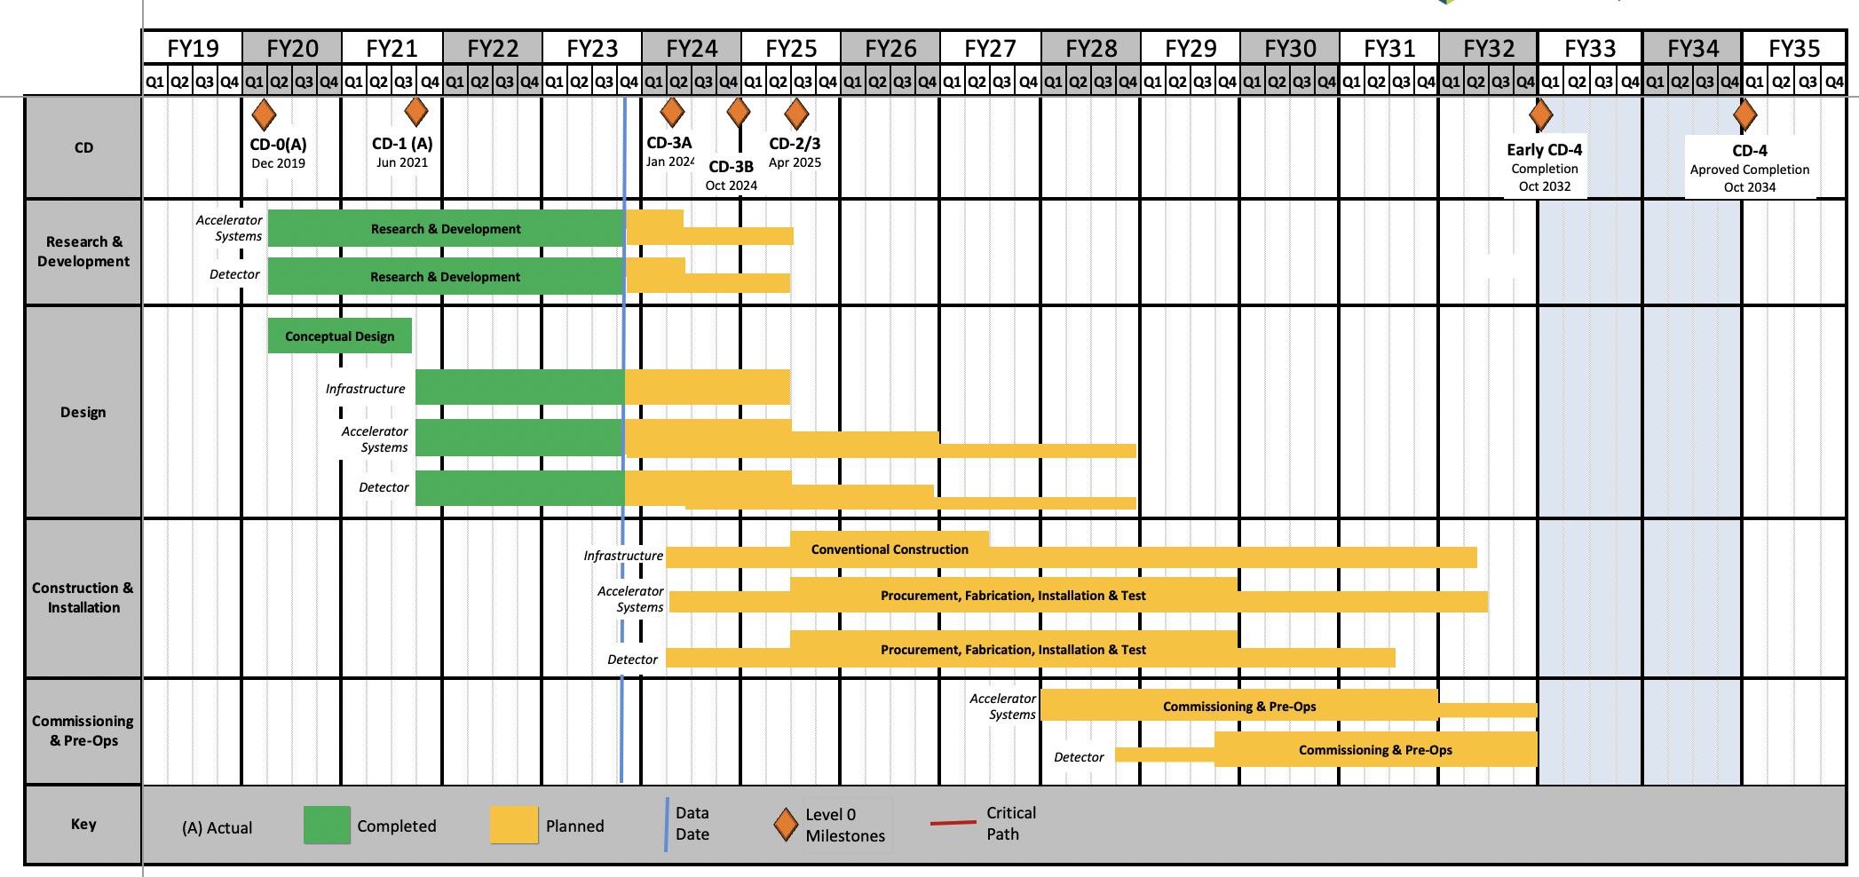
EIC Schedule – best guess, dates still under discussion
CD-3A:
Approve start of long-lead procurements
CD-3A items passed final design review
All interfaces related to them are frozen
Waiting for ESAAB meeting for authorization
Construction Phase
Conclusion of
RHIC Operation
Science Phase
CD-2:
Approve prelim. design for all subdetectors
Design Maturity: >60%
Need “pre-”TDR (or draft TDR)
Baseline project in scope, cost, schedule
The thinner bars indicate that R&D and design
can continue at a small level beyond CD-2 and CD-3
CD-3:
Approve final design for all subdetectors
Design Maturity: ~90%
Need full TDR
Current EIC Critical Decision Plan
CD-0/Site Selection December 2019 ✓
CD-1 June 2021 ✓
CD-3A ESAAB March 25th 2024
CD-3B October 2024
CD-2/3 April 2025
early CD-4 October 2032
CD-4 October 2034
September 2022 EIC received $138M DOE Inflation Reduction Act funding → CD3A
Updated Project Schedule: based on the actual appropriated FY24 funding ($98M), on uncertain FY25 budget scenarios (President’s Budget is only ~$113M)
Updated EIC Critical Decision Plan
CD-0/Site Selection December 2019 ✓
CD-1 June 2021 ✓
CD-3A March 2024 ✓
CD-3B Review January 7-9 2025
CD-2/3 Review End of 2025
early CD-4 December 2034?
CD-4 December 2036?

Slide 4
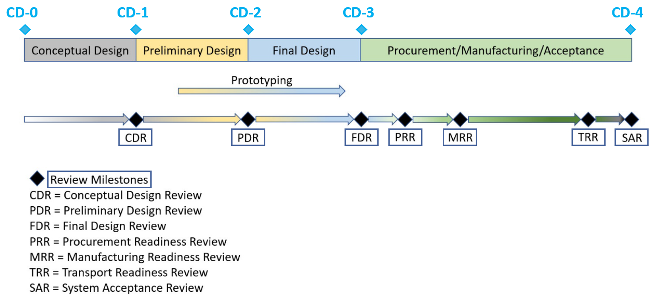
2024 Review Calendar
Preliminary and Final Design Reviews
PDR2: IR Integration and Auxiliary Detectors – February 12, 2024 – main emphasis on baseline choices and progress
PDR1: Tracking Detectors – March 20-21, 2024 – main emphasis on baseline tracking layout, if we are on track and plans
PDR2: Electronics/DAQ – June 10-11, 2024 – continuation of PDR1 to ensure we are on track and show progress
PDR1: Integration, Infrastructure and Installation – June 27, 2024? – includes detector support structures
PDR2: Particle Identification Detectors – Summer 2024?
PDR2: Barrel EM Cal – Summer/Fall 2024 – emphasis on mechanical design & AstroPix readiness (needs {PDR before CD-2)
PDR2: Polarimetry – timescale TBD (but before CD-2)
FDR: Magnet Power Supply – May 28, 2024 – final design review for possible CD-3B scope
FDR: VTRx+/lpGBT – included as ½ day in Electronics/DAQ review, June 11, 2024, possible CD-3B scope
FDR: Magnet flux return steel – September 2024 – included as final specifications in above PDR for possible CD-3B scope
FDR: Backward & Forward EM Calorimetry, Barrel & Forward HCAL – Fall 2024
Detector Advisory Committee
8th DAC meeting – June 21, 2024 – strategic advice on the planning for the construction phase of the ePIC detector
9th DAC meeting – August 2024 – Annual advice on detector R&D status and FY25 completion needs
Next ePIC Computing & Software review by host labs – September 26-27, 2024

Slide 5
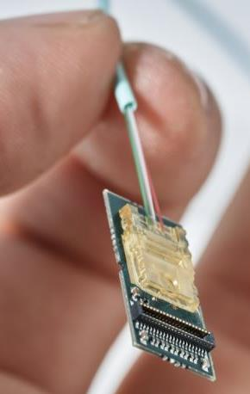
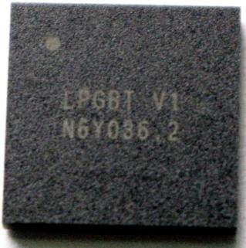
Possible Long-Lead Procurement CD-3B Scope
Continuation of CD-3A Scope
WBS 6.10.05: Lead Tungstate Crystals for the Detector Backward EM Calorimeter
Remaining 1500 pieces to complete need
WBS 6.10.05: Scintillating Fibers for the Detector Barrel and Forward EM Calorimeters
2nd phase of 4 phases → 1875 km
WBS 6.10.06: Silicon Photomultipliers for the Detector Forward Hadronic Calorimeter
Remaining 300k SiPMs
WBS 6.10.06: Steel Plates, Casing Steel and Electron-Welding for the Detector Forward Hadronic Calorimeter
Remaining 50% of equipment
New Items:
WBS 6.10.07: Detector Solenoid Magnet Power Supply
WBS 6.10.10: Flux Return Steel for the Electron and Hadron Endcaps
WBS 6.10.08/09: Readout Chips needed for MAPS tracker and dRICH - VTRx+/lpGBT

Slide 6
Incremental Preliminary Design and Safety Review of the EIC Detector DAQ and Electronics – Context
We had an earlier incremental preliminary design and safety review (“PDR-1”) of the EIC detector DAQ and Electronics in August 2022. There were many useful comments and two recommendations:
The collaboration should investigate the potential for high data rates from the RICH detectors, which could significantly impact the concept and feasibility of a streaming detector readout.
Given the requirement for a backup triggered readout for RICH, it is necessary to carefully define the physics trigger rate, trigger conditions, and trigger latency in order to facilitate design of the RICH front-end.
The present review has two parts:
June 10th and part of June 11th is the incremental preliminary design and safety review (“PDR-2”) of the EIC detector DAQ and Electronics scope. This is a status review to solicit input from experts (i.e., you). We plan to have the final “Preliminary Design and Safety Review” of the EIC Detector DAQ and Electronics in CY 2025 (this corresponds to 60% design maturity) and a Final Design Review (~90% design maturity) one year later.
June 11th includes a session that serves as the Final Design Review (“FDR”) of the VTRX+ and lpGBT electronics components. These are considered as possible CD-3B scope. The main reason is to be aligned with a last production run planned by CERN. We need your input on if the needs and specifications for these components are finalized. We also welcome your advise on the suitability of these as CD-3B scope.

Slide 7
Closeout Report
Ken Wyllie (CERN), Mitch Newcomer (UPenn), Prashansa Mukim (BNL), Filippo Costa (CERN)
Incremental Preliminary Design and Safety Review of the EIC Detector DAQ and Electronics and Final Design Review of Electronics Components for the ePIC Detector
June 10-11, 2024

Slide 8
Conclusion
We appreciate the great effort to prepare for this review.
We congratulate the ePIC community on the enormous progress in the electronics and data-acquisition.
We are satisfied with the answers to the charge questions provided by the contributors
We have provided comments and made recommendations which we believe will be beneficial to the ePIC community.

Slide 9
Charge Questions (for the Incremental Preliminary Design Review of the Electronics/DAQ)
Are the technical performance requirements appropriately defined and complete for this stage of the project?
Are the plans for the various detector electronics and data acquisition systems appropriately documented and complete for this stage of the project?
Are the current plans from front-end electronics to data acquisition for the detector likely to achieve the technical performance requirements, with a low risk for cost increases, schedule delays, and technical problems?
Are the schedule assumptions for the fabrication of the various electronics and data acquisition systems and assembly plans reasonable and consistent with the overall detector schedule?
Have ES&H and QA considerations been adequately incorporated into the plans at their present stage?
All charge questions were answered with yes
The review committee noted that the specifications and documentation for the ASICs/front-end are well defined and mostly complete but those for the DAQ/RDO/controls are still less mature.
The committee wants in the next review also to hear about the controls and the MAPS, as for the latter the sensor and electronics have strong physical overlap.
The committee gave many valuable comments and 13 recommendations – these are mainly aimed at what needs to be done to further mature the design and what they expect to be in a Technical Design Report.

Slide 10
Comments (for the Final Design Review of the VTRx+/lpGBT)
VTRX+ pigtail lengths must be defined at least 6 months in advance of VTRX+ production. The mechanical designs of both sub-systems are well on track to allow this definition on schedule.
We advise that the Inner Tracker fully test the lpGBTs (230) to be sure of full operation at 39.4 MHz.
On their suitability as 'long-lead procurement’ components
These components are a unique and cost-effective solution which requires financial commitment now to allow purchase of near-to-obsolete components and formally close a manufacturing contract with the assembly company.
There will be no alternative available on the time-scale of ePIC which meets the technical specifications.

Slide 11
Detector Advisory Committee
DAC founded in 2020
Per the charter, 1/3 of the committee replaced every year
Transition Chair from Ed Kinney to Andy White as chair
2020 - 2022
2023
2024
Edward Kinney (Chair) | Boulder CO
Ken Wyllie | CERN
Petra Merkel | FNAL
Antonis Papanestis | Rutherford Appleton Laboratory
Peter Krizan | U Ljubljana
Ana Amelia Machado | University of Campinas, Brazil
Heidi Schellman | Oregon State
Brigitte Vachon | McGill
Stefano Miscetti | INFN Frascati
Etiennette Auffray | CERN
Andrew White | U. Texas Arlington
Chi Yang | SDU China
Edward Kinney | Boulder CO
Ken Wyllie | CERN
Petra Merkel | FNAL
Antonis Papanestis | Rutherford Appleton Laboratory
Peter Krizan | U Ljubljana
Ana Amelia Machado | University of Campinas, Brazil
Cecillia Gerber | UIC
Brigitte Vachon | McGill
Stefano Miscetti | INFN Frascati
Roman Poeschl | IJCLab
Andrew White (Chair) | U. Texas Arlington
Eraldo Oliveri | CERN
DAC-Meetings 2024 under planning:
June 21, 2024: Project Status, Baseline Detector, International Engagement, Next Phases
August 2024: Detector R&D annual review (expect 2 days) – deadline for submission July 1, 2024

Slide 12
8th Detector Advisory Committee Meeting June 21 - Charge
The 8th and 9th DAC meetings are planned for 2024. The 8th DAC meeting in June 2024 will focus on the overall progress and status of the EIC Project, the technical baseline of the detector and ePIC collaboration contributions, and the planning for the construction phase of the ePIC detector. A two-day 9th DAC meeting will be scheduled in August 2024 and will be dedicated to the review of the ongoing EIC project detector R&D and advice on further R&D.
For the 8th DAC meeting, the DAC is asked to address the following charge questions:
The progress and status of the ePIC detector.
Is the ePIC detector scope appropriate for achieving the key physics goals?
Will the detector be ready for CD-2 baselining in the Fall of 2025?
Are the detector technologies appropriate and are their risks and opportunities adequately understood?
Are the resources planned, including people and infrastructure for production and testing, adequate?
Are there critical areas where further collaboration engagement and international outreach should be pursued?
We welcome any other suggestions you can make that will improve the success of delivery for the ePIC detector.
The committee is requested to organize their assessment in terms of findings, comments, and recommendations and provide a written report by July 3, 2024.

Slide 13
8th Detector Advisory Committee Meeting June 21 - Agenda
(Eastern Daylight Savings Time)
09:00 – 09:30 DAC Executive Session
09:30 – 10:00 EIC Status and Plans – Jim Yeck
10:00 – 10:30 ePIC Collaboration, Detector, and EIC Science – John/Silvia
10:30 – 10:45 Break
10:45 – 11:30 ePIC Technical Baseline and Collaboration Contributions – Elke/Rolf
11:30 – 12:00 EIC Detector Organization and Management in Next Phases – Elke/Rolf
12:00 – 12:30 ePIC Detector Integration Planning Status – Rahul Sharma
12:30 – 13:00 ePIC Electronics/DAQ Planning Status – Dave Abbott/Jeff Landgraf (for Fernando Barbosa)
13:00 – 13:30 Lunch Break
13:30 – 14:00 Planning for Production Phases – Elke/Rolf
14:00 – 14:15 Planning for Early Physics Phases – Elke/Rolf
14:15 – 14:45 Discussion on Strengths/Weaknesses
14:45 – 15:00 Break
15:00 – 16:15 DAC Executive Session
16:15 – 16:45 Closeout

