Slide 1
Initial photon detector sim G4
Ciprian Gal

Slide 2
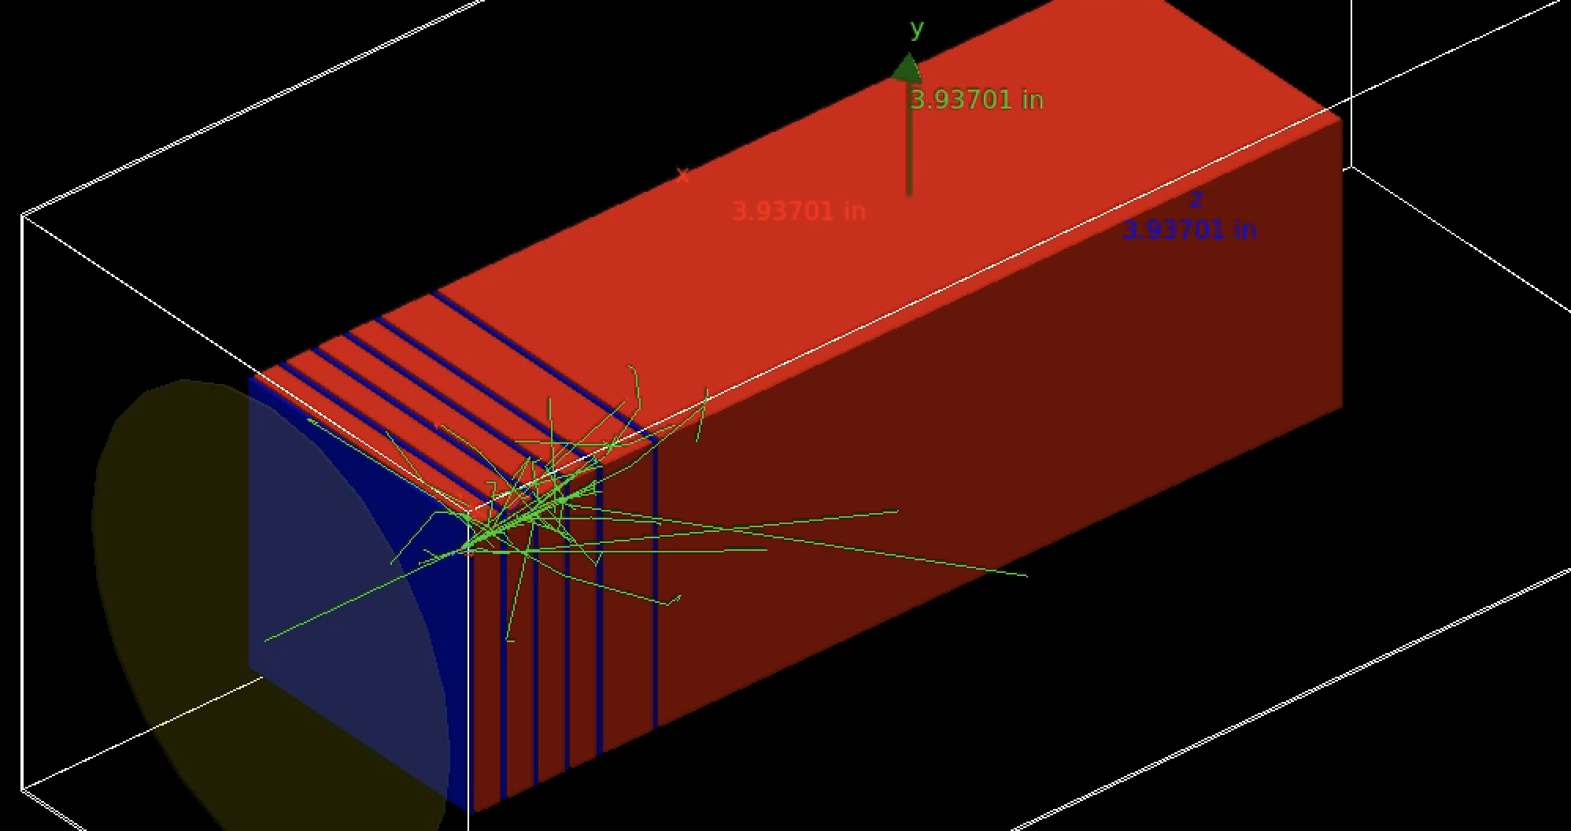
Setup
initial information (vacuum det)
1 vacuum detector to select the initial photon information
“Calorimeter”: material PbWO4
4 x 9mm (~1 radlen) + 1 x 18mm + 1 x 256mm = 310mm
SiO2 1mm planes in between the calorimeter blocks (with 1mm of air on each side) to mock up the material for a tracker
Two simulations were run with two transverse sizes 10x10 cm and 5x5 cm
The photons are randomly sampled up to 8 GeV in energy and thrown in a square 3x3 mm square transversely at the center of the block
Momentum direction is (0,0,1)
Total of 10k events

Slide 3
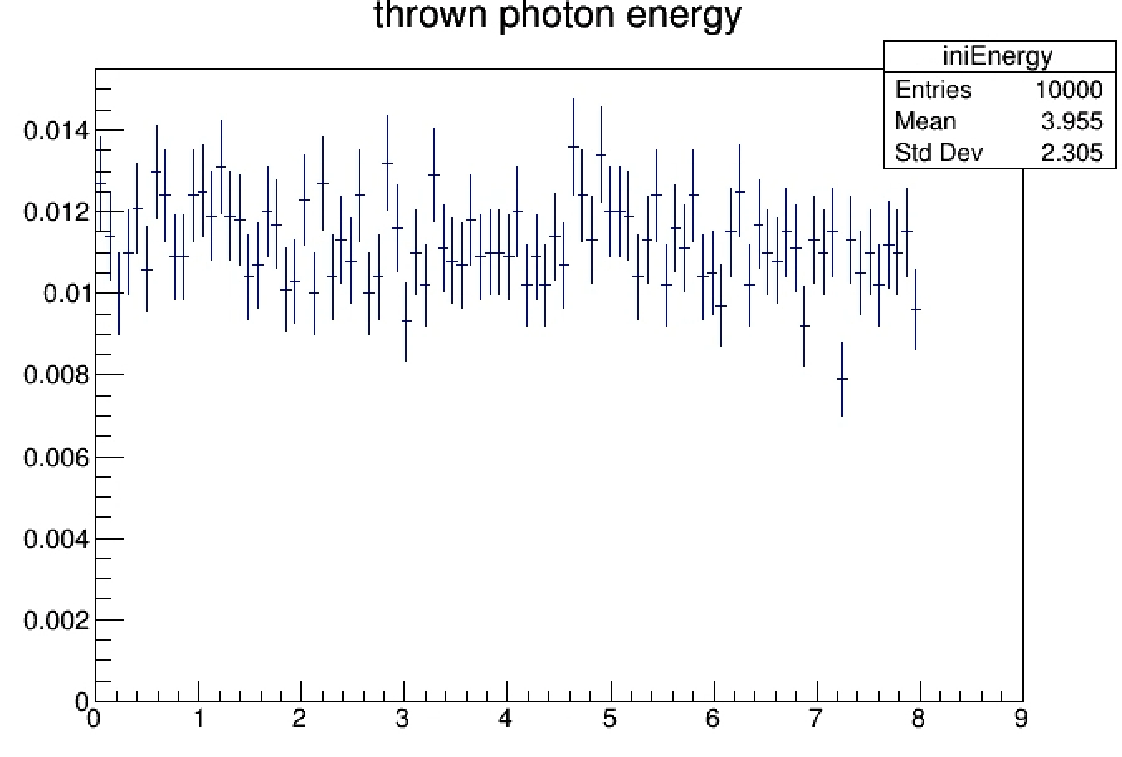
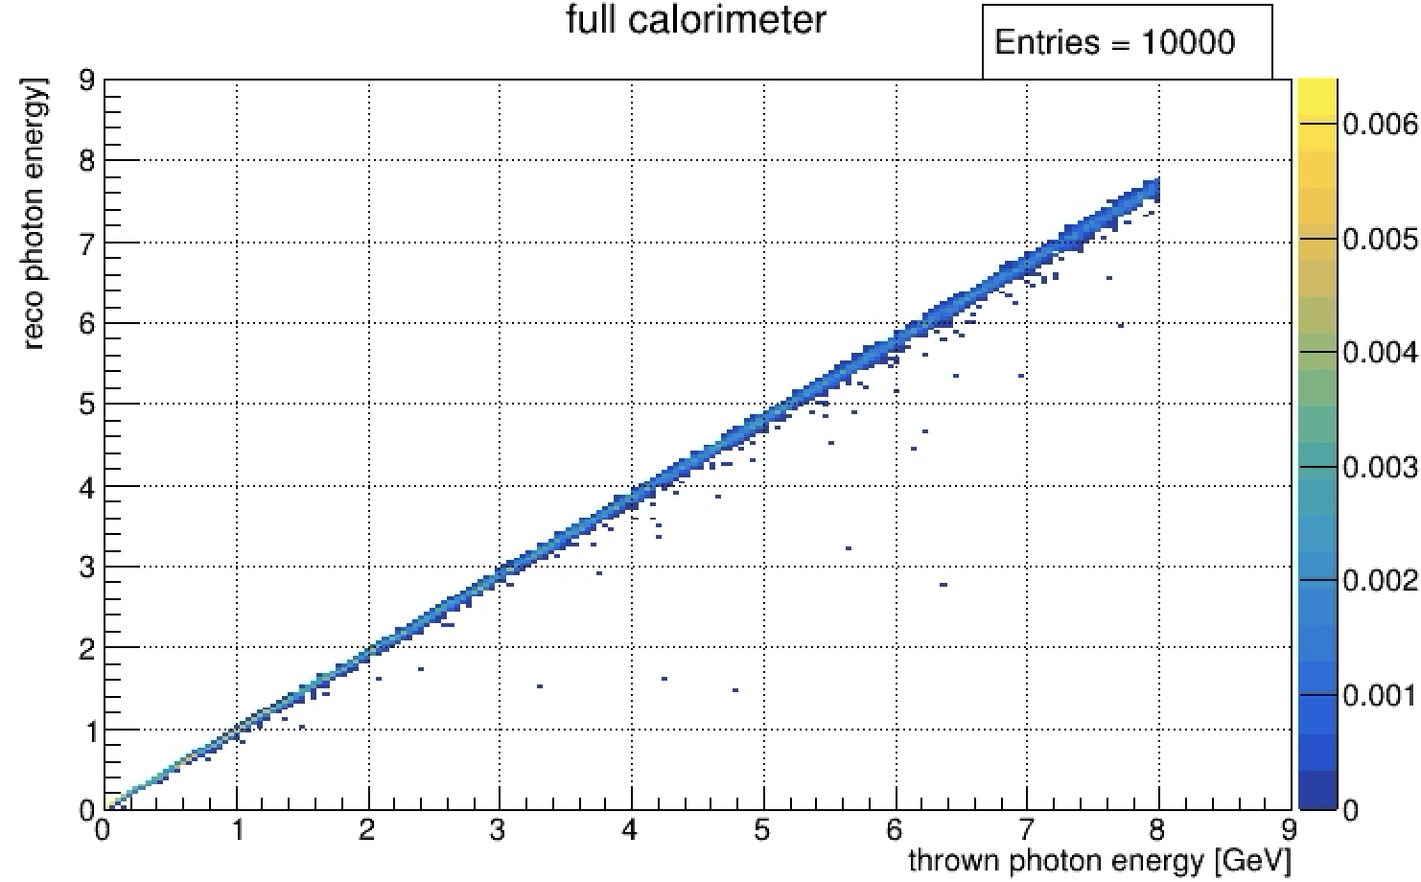
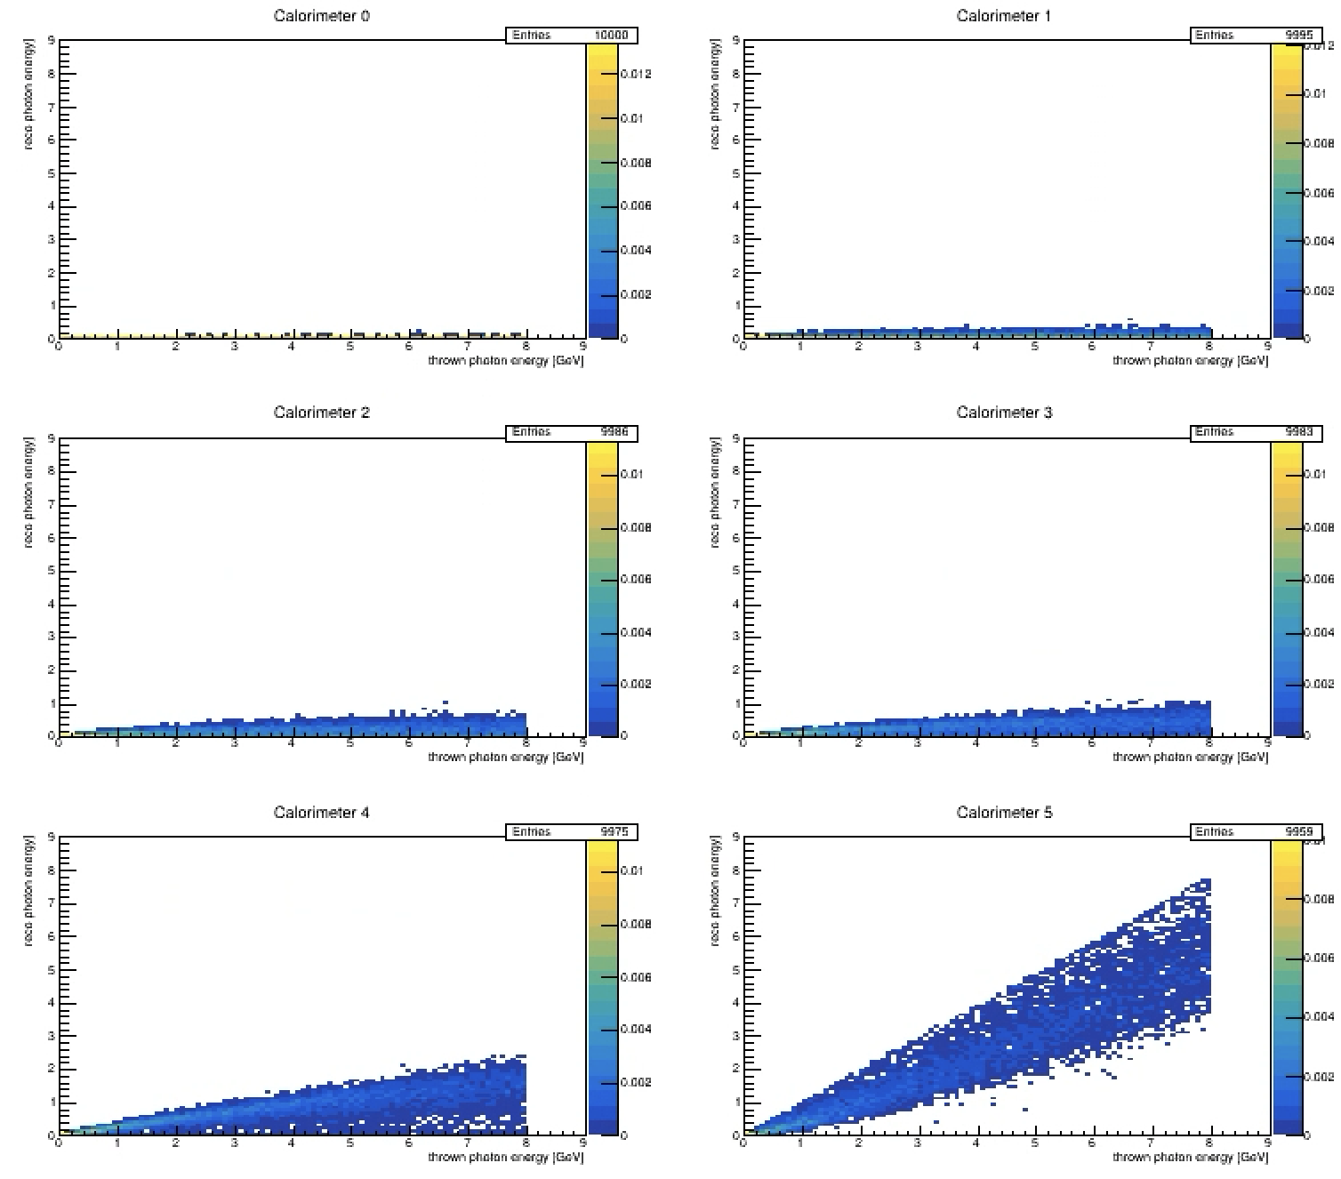
Energy reconstruction PbWO4 (10x10cm2)
1 (1radlen)
2 (1radlen)
3 (1radlen)
4 (1radlen)
The first few segments of the calorimeter don’t offer much here but summing all the deposited energy gives some decent energy reconstruction
5 (2radlen)
6 (28radlen)

Slide 4
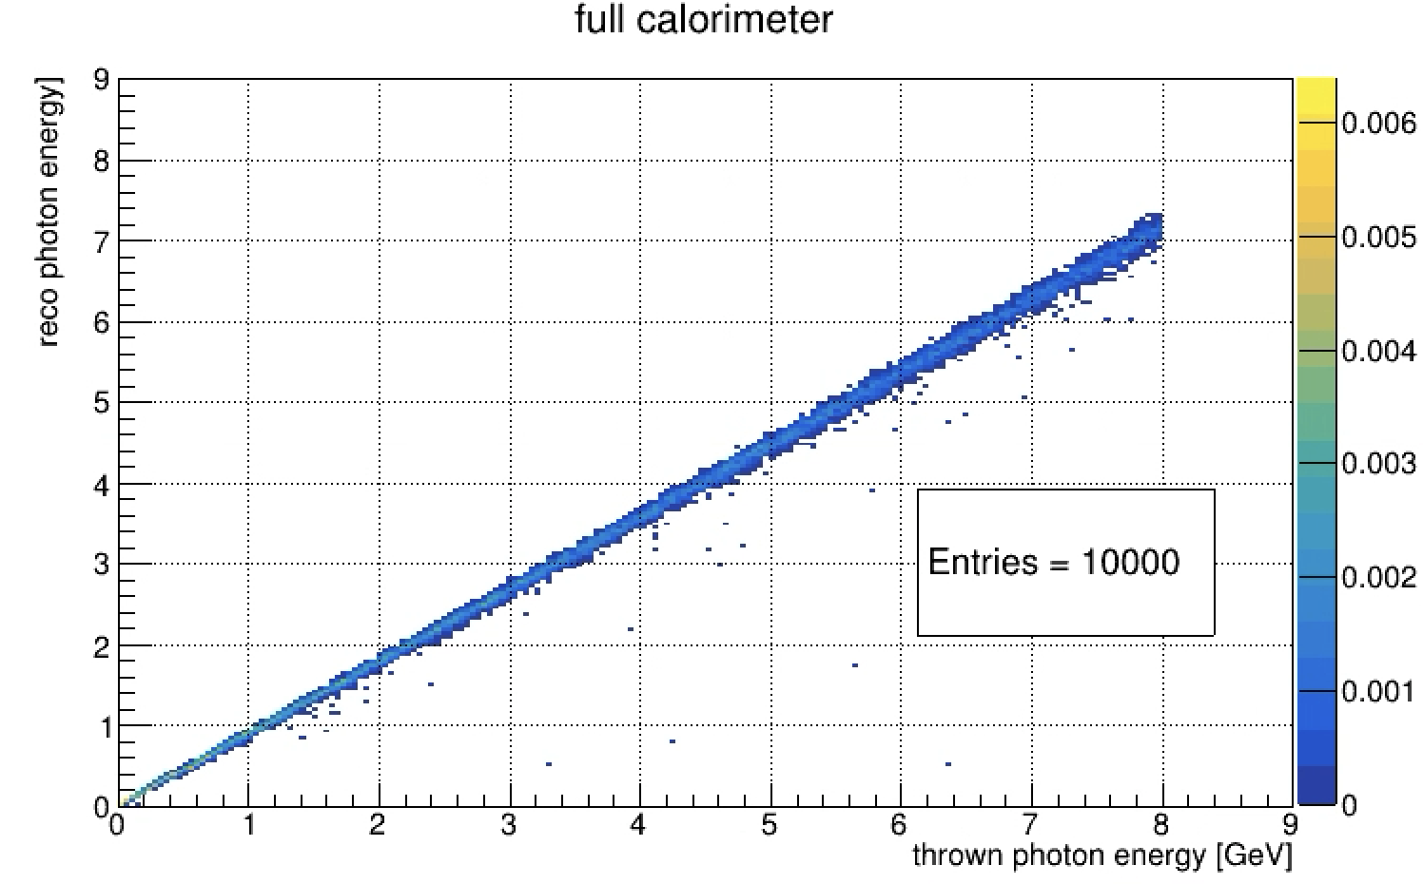
Energy reconstruction (5 vs 10 cm) PbWO4
10 x 10 cm
5 x 5 cm
The 5x5 cm2 blocks still have linearity up to 8 GeV however we can certainly see a worse energy resolution

Slide 5
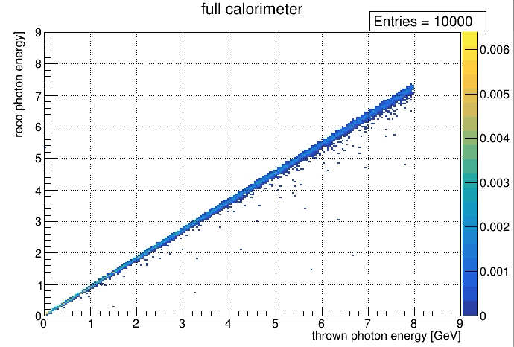
Energy reconstruction (5cm PbWO4 vs 10cm BaF)
10 x 10 cm BaF
5 x 5 cm PbWO4
The BaF doesn’t look much worse than the PbWO4

Slide 6
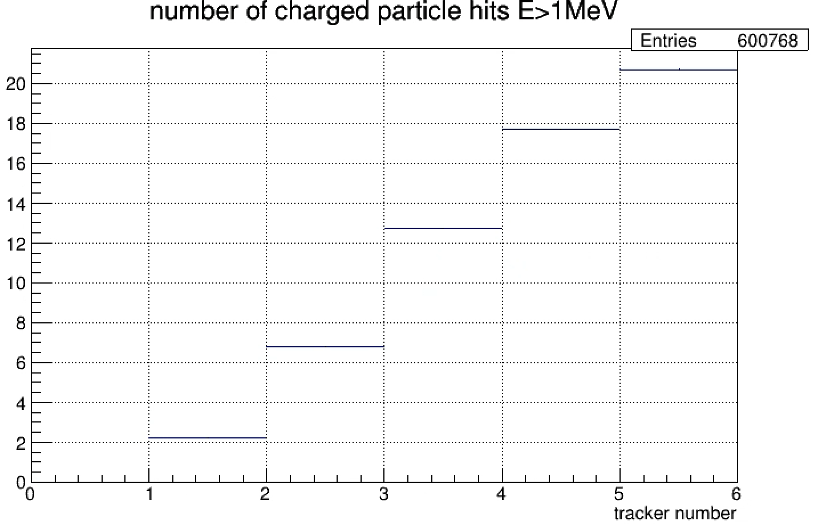
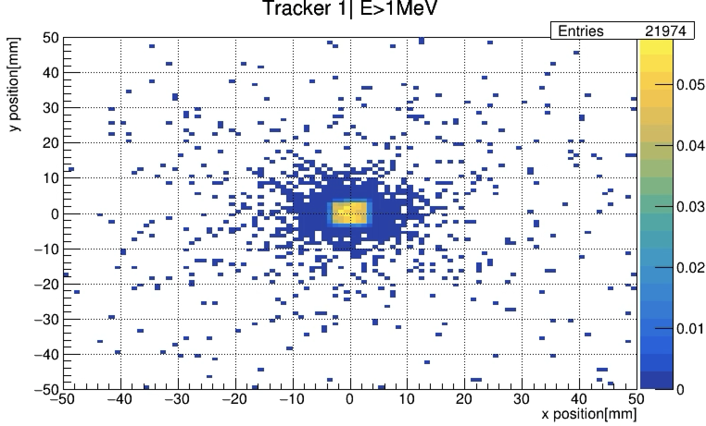
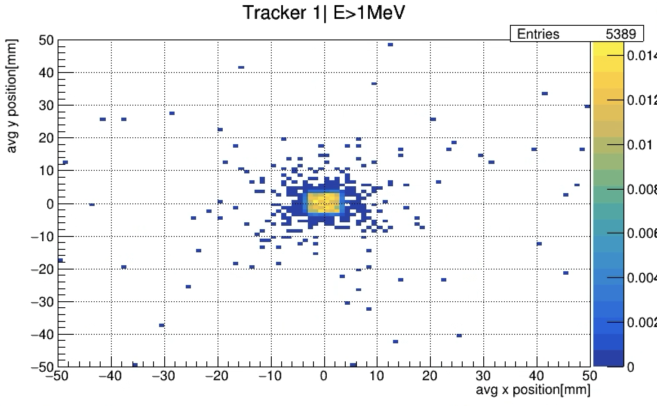
Position reconstruction (PbWO4)
All hits
Looking at the different “tracking” planes for e+/- with energies larger than 1 MeV we can see that even the first layer has on average more than 2 particles
We can calculate the position average per event for each of these layers
For tracker 1 only ~54% of events has events to do the averaging
Averaging is done by calculating average X, average Y and the getting R from the sqrt(<X>^2 + <Y>^2)
Avg hits

Slide 7
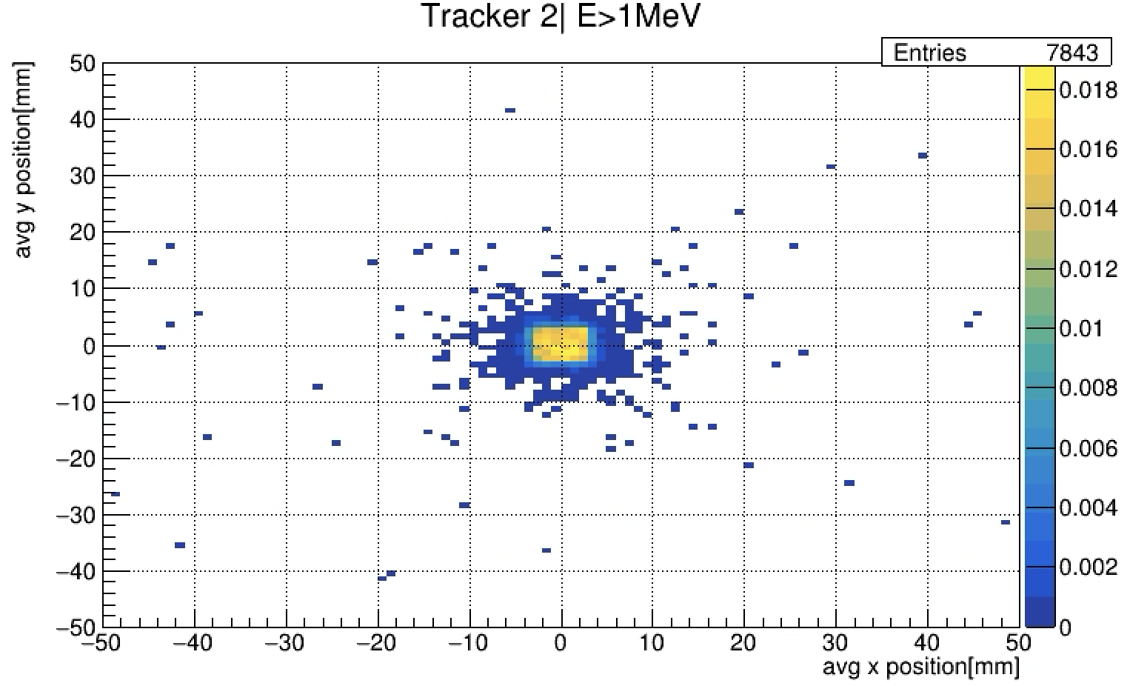
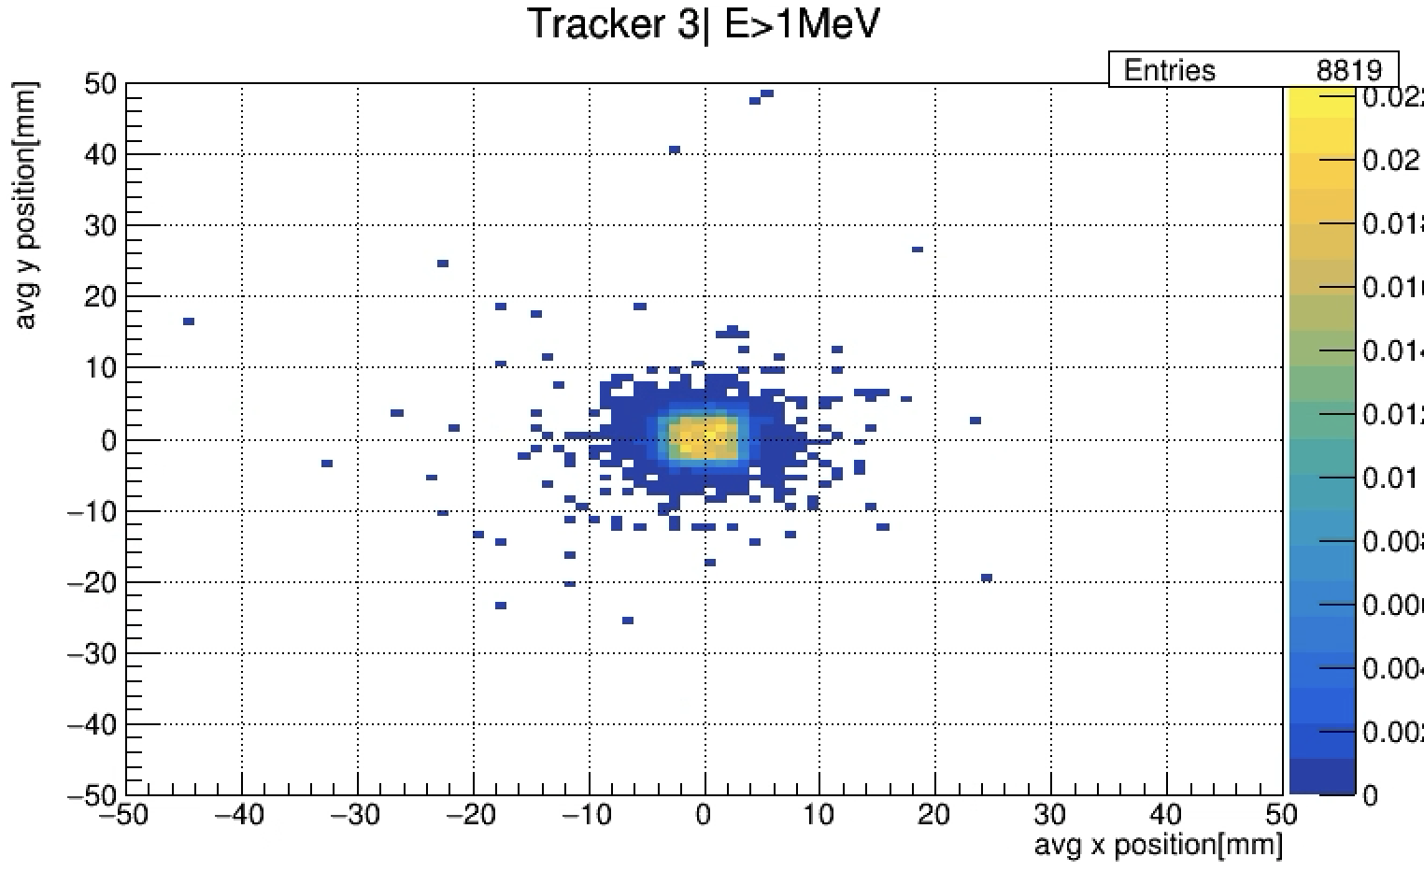
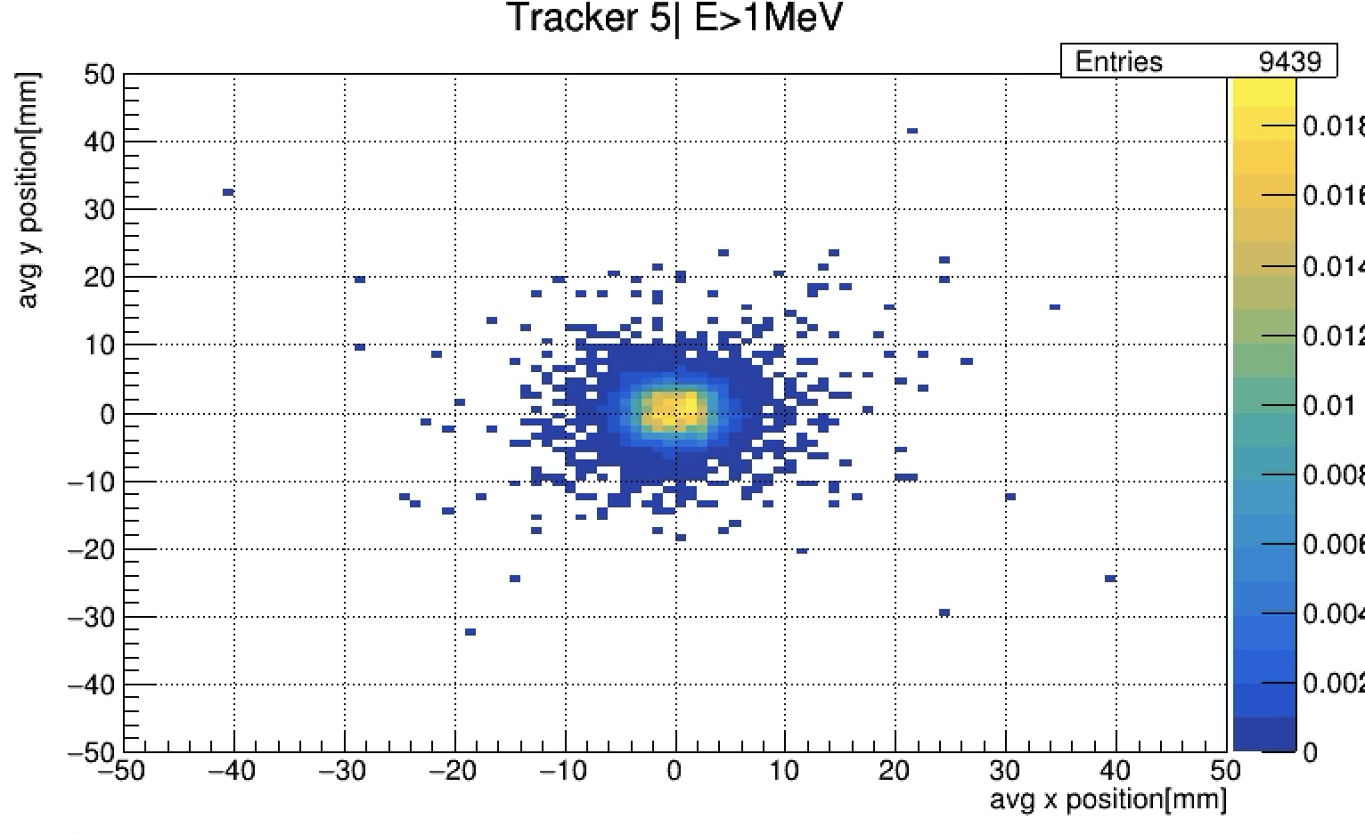
Averaging tracking layers (PbWO4)
By the 3rd layer (after ~3radlen) we have about 90% of the events being able to properly average

Slide 8
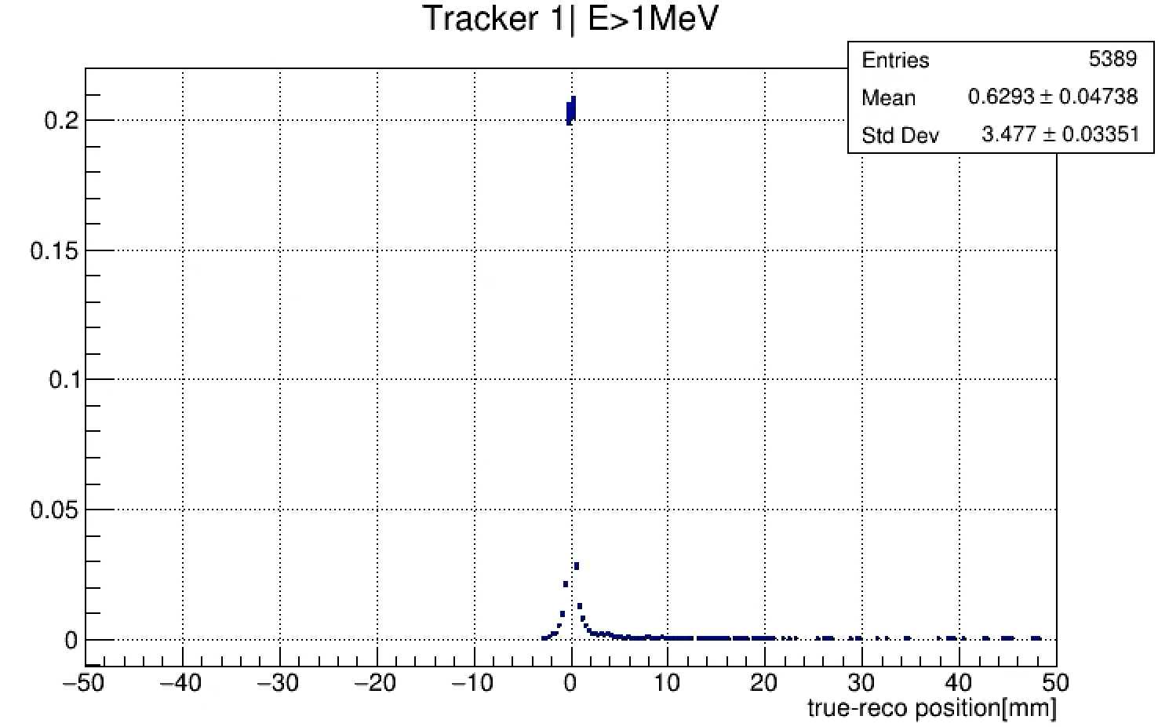
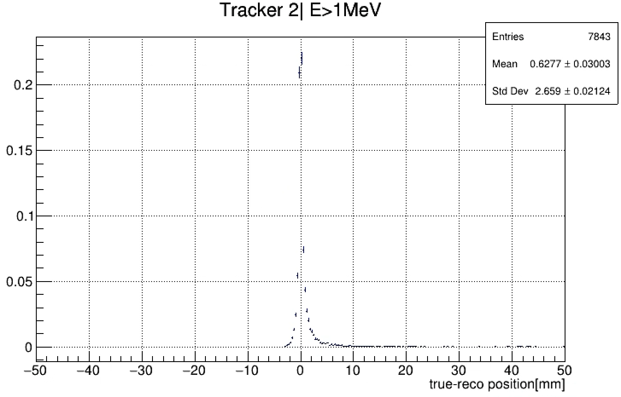
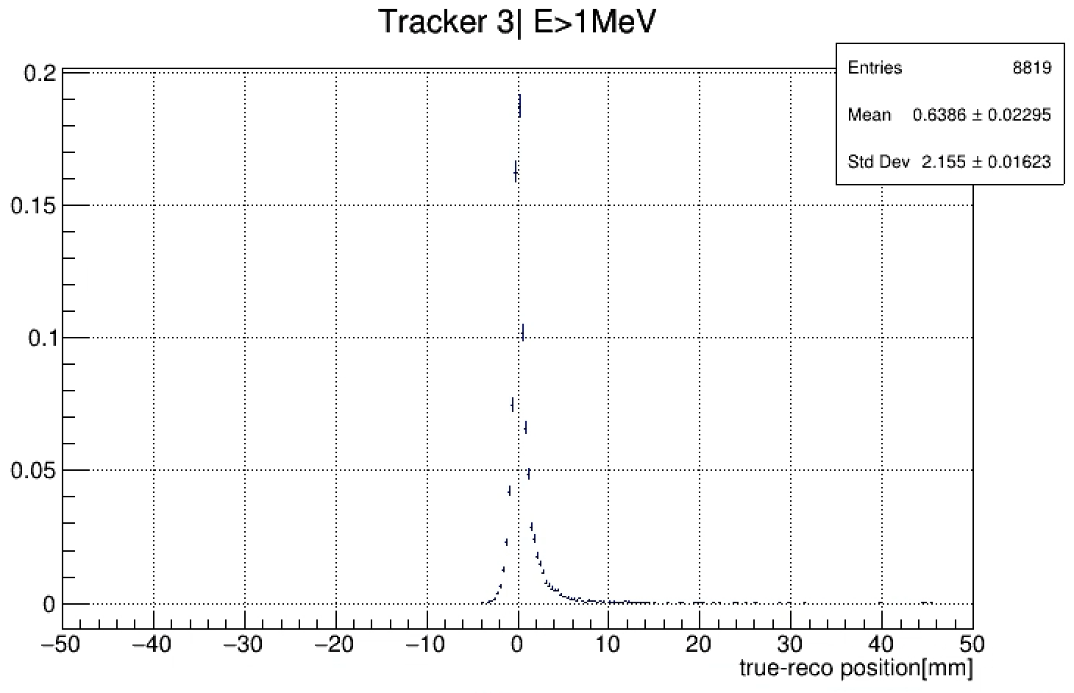
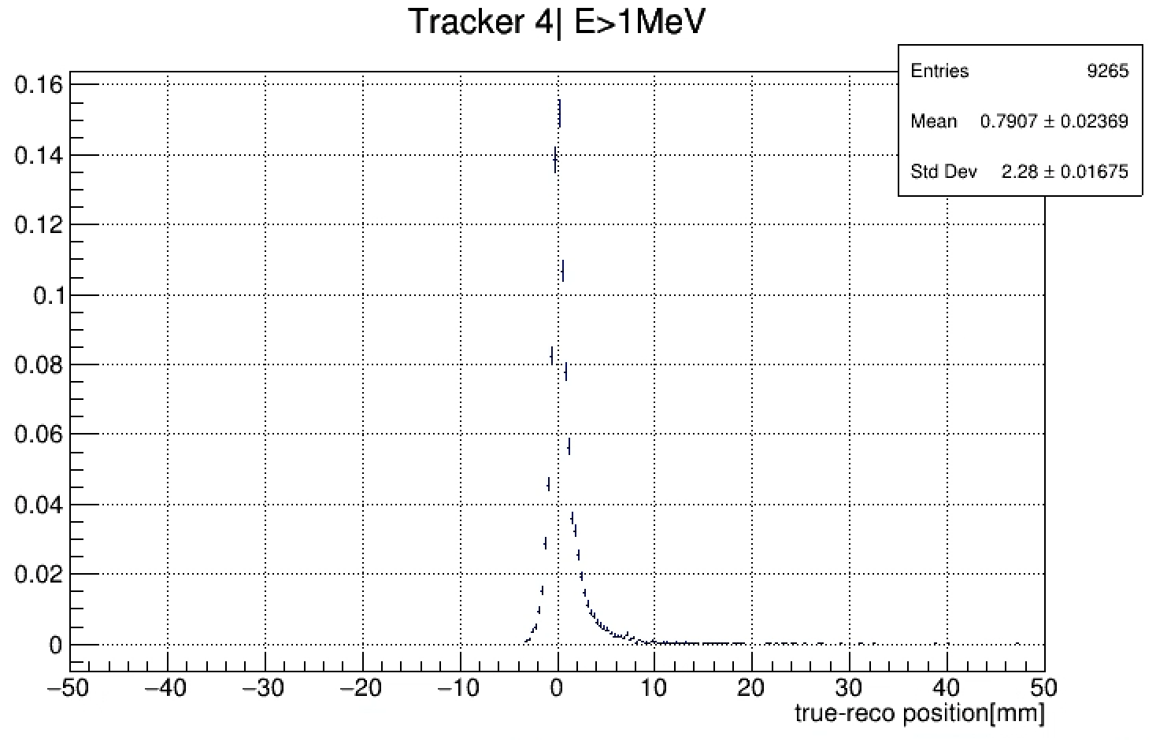
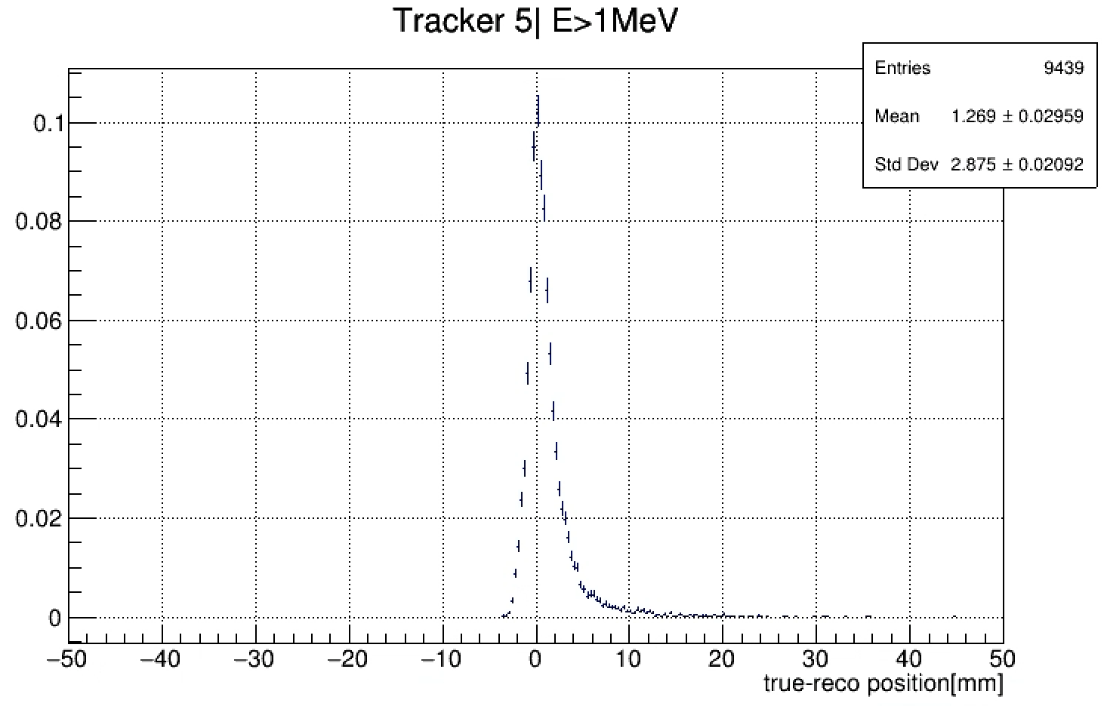
Averaging tracking layers – initial position (transversely) (PbWO4)
It looks like the best resolution comes after about 3 radiation lengths
The positive side tail may be due to the averaging method -> will do a proper averaging in the future
However we don’t get much worse if we go to 4 or 6 radlens

Slide 9
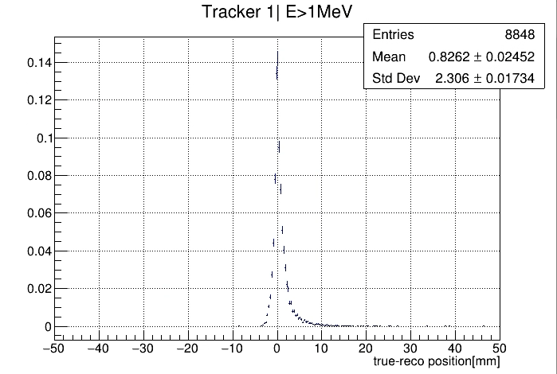
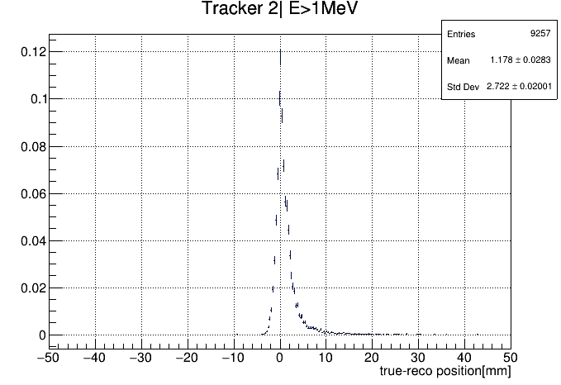
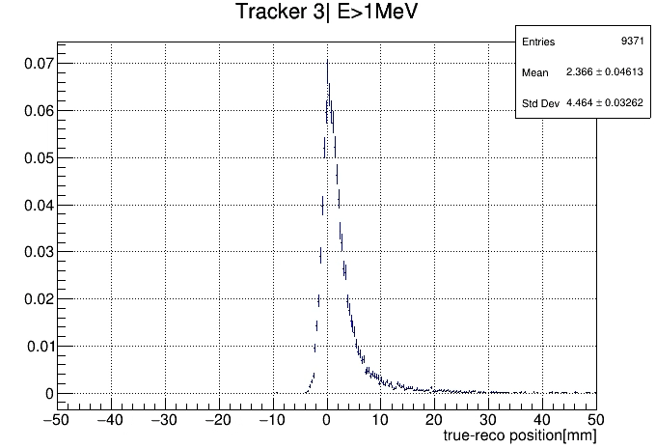
Averaging tracking layers – initial position (transversely) (BaF)
4radLen
3radLen
6radLen
BaF simulation was ran with smaller number of tracking layers based on the results from the PbWO4
It looks like the best resolution comes after about 3 radiation lengths
After 4 we get more of the events and similar resolution

Slide 10
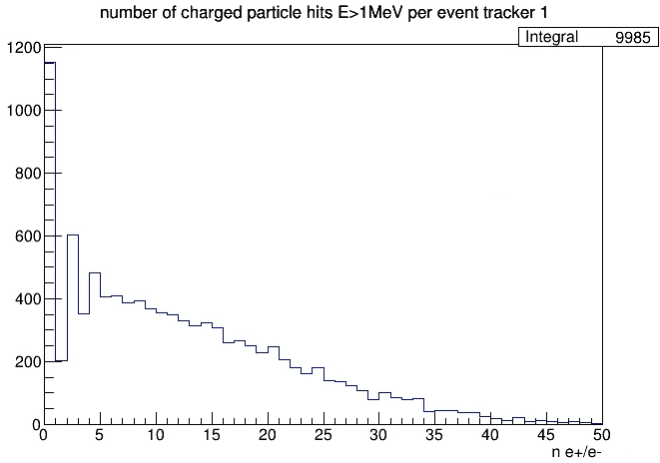
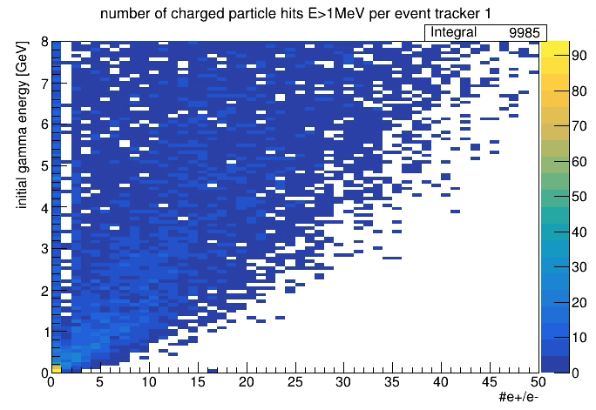
Averaging tracking layers – initial position (transversely) (BaF)
3radLen
The events with single or no tracks after 3 radLens are mostly for low energy photons -> we probably will have some energy cutoff in the analysis anyway so this problem is probably going to be less significant

Slide 11
Todos
update averaging by calculating average R from individual R positions
fold in the asymmetry information and look at the resolution impacts on asymmetry extractions

