Slide 1
Report from the EIC Advisory Board
Stuart Henderson
Director, Jefferson Lab
3rd EIC Resource Review Board Meeting
May 6-7, 2024

Slide 2
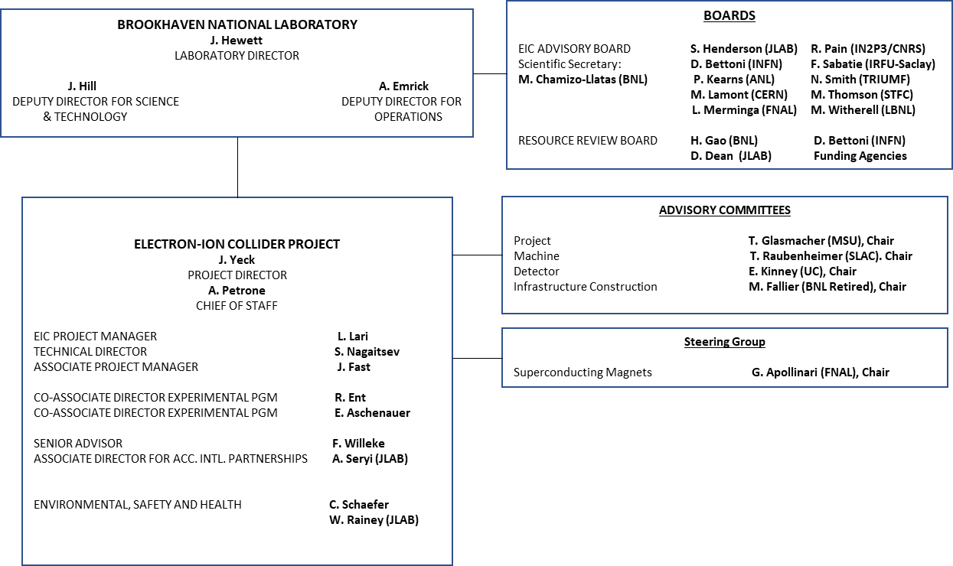
EIC Advisory Boards and Committees
DOE, BNL, and JLab envision an EIC facility that is “fully international in character.”
EIC Advisory Board provides oversight and advice on the construction of the facility, focusing on the accelerator (BNL, TJNAF, LBNL, ANL, FNAL, TRIUMF, IN2P3, CEA, STFC, INFN, CERN).
EIC RRB to provide oversight of the experiments

Slide 3
EIC Advisory Board Members
Stuart Henderson, Director, TJNAF (Chair)
Helen Beadman, Assoc. Director, STFC, UK Research & Innovation
Diego Bettoni, Vice President of INFN
Marcella Grasso, Deputy Scientific Director, IN2P3
Paul Kearns, Director of ANL
Mike Lamont, Director of Accelerators & Technology-CERN
Arnaud Lucotte, Director of IN2P3/CNRS
Lia Merminga, Director of Fermilab
Natalie Roe, Assoc. Lab Director, LBNL
Franck Sabatié, Director of IRFU-Saclay
Nigel Smith, Director of TRIUMF
Mark Thomson, Executive Chair, STFC, UK Research & Innovation
Mike Witherell, Director of LBNL
Scientific Secretary: Maria Chamizo-Llatas, EIC In-Kind Manager/Deputy ALD, BNL
EIC Advisory Board reports to JoAnne Hewett, Director of BNL

Slide 4
EIC Advisory Board Charter (Excerpt; approved June 29, 2023)
Purpose
The purpose of the Electron Ion Collider Advisory Board (EAB) is to provide guidance and advice to the BNL Director on the design and construction of the EIC accelerator facility and on the efforts to establish partnerships, international and domestic, with institutions collaborating on the facility. The EAB provides a forum for high-level planning, communication, coordination, and resolution of issues affecting the EIC facility, appropriate at the level of the Laboratory Directors. The EAB will consider issues affecting the scope and/or resource allocations at BNL and the participant institutions.
The EAB Charter will be reviewed as the EIC moves from construction into operations, and as the needs of the program evolve.
Membership
Membership includes Laboratory Directors (or senior leadership) of institutions participating in the design and construction of the EIC accelerator facility. Board members may also include leaders of institutions with common accelerator Science and Technology interests. EAB members may delegate participation for a given meeting.
The BNL Laboratory Director will appoint the members of the EAB, and the EAB chair.
The EIC Project Director will be an ex-officio member of the EAB.
Chair
The EAB Chair, supported by the scientific secretary, shall convene meetings, set meeting agendas, and determine objectives for the EAB. The Chair shall report to the BNL Laboratory Director on the activities and recommendations of the EAB and keep the EIC Resources Review Board informed of significant issues and developments.

Slide 5
Recent Activities
EIC Advisory Board Meeting January 25, 2024
EIC Project status, EIC CD-3A Review, progress on international engagement, December 2023 RRB Meeting, Technical Director Update, Domestic Partnerships. EIC Advisory Board Recommendations
Actions:
Develop EIC Accelerator Collaboration Charter
Update on EIC Funding Plans
IR SC Magnet Production and Testing Plans
EIC Advisory Board Meeting April 19, 2024
EIC Project status, progress on international engagement, domestic partnerships, Accelerator Collaboration Charter, Technical Director and Project Manager Updates
Actions:
Update on funding scenarios and mitigation plans
Review feedback from EIC Accelerator collaboration kick-off meeting
Review high level milestones and risks
“…I am particularly pleased that today’s announcement will strengthen the UK’s collaboration with the U.S. Department of Energy, in the development and delivery of a major new scientific facility.”
-Mark Thomson, Executive Chair for the Science and Technologies Facilities Council and Infrastructure Champion for UKRI

Slide 6
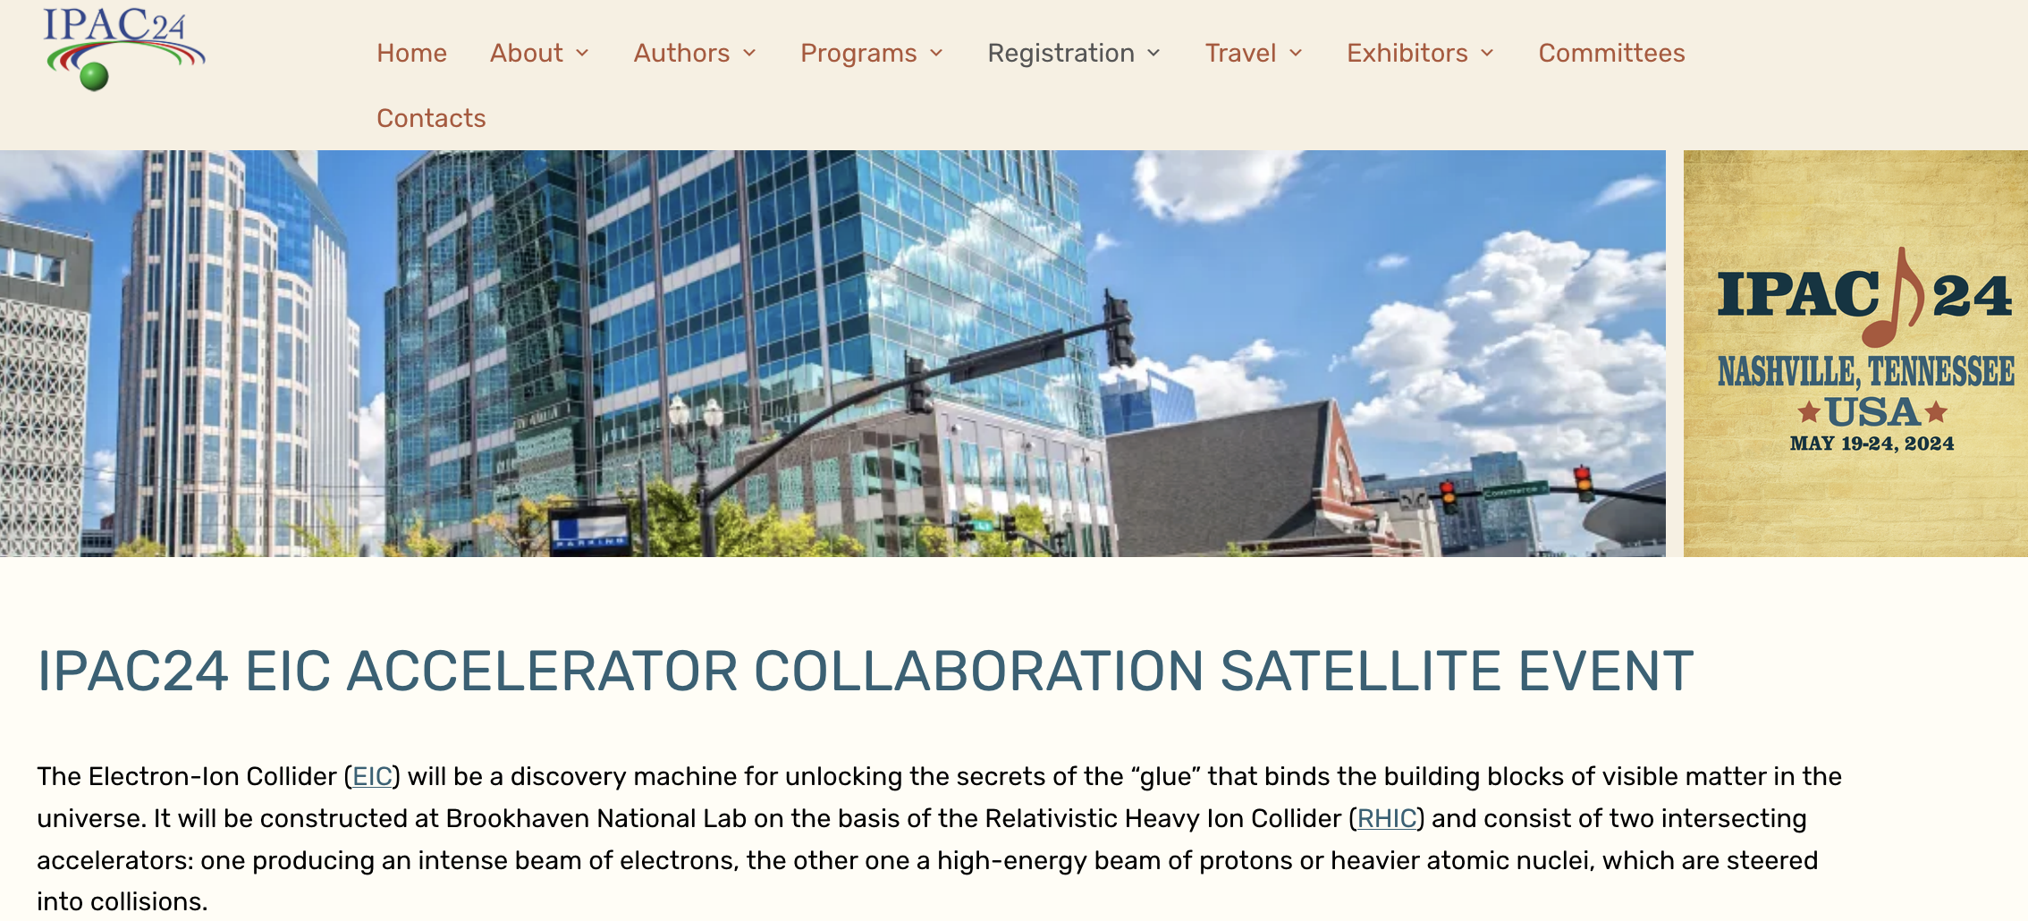
EIC Accelerator Collaboration
The EIC design, construction, and future upgrades have many exciting scientific and technical challenges, creating opportunities for a worldwide accelerator collaboration to become part of this exciting endeavor
The EIC Accelerator Collaboration co-chairs
Prof. Carsten Welsch (Univ. of Liverpool, UK) and Prof. Andrei Seryi (JLAB and Old Dominion University)
The collaboration kick-off meeting will be held as a satellite meeting at the IPAC2024 conference in May 2024 in Nashville, TN, USA

Slide 7
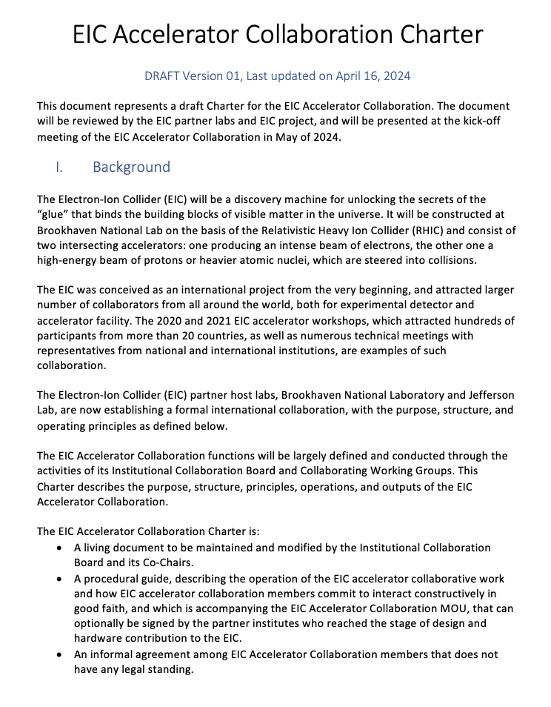
EIC Accelerator Collaboration Charter
The Charter describes the Collaboration structure and general rules
Accompanied by the MoU, which is non-binding (staff matters, legal duties, IP, etc.), highly flexible when it comes to the Parties involved and the R&D covered, and easy to sign
Collaborative Working Groups are topical groups that are established to cover variety of activities related to EIC. Activities of the Working Groups are coordinated by leaders, who are appointed by Co-Chairs of Accelerator Collaboration in coordination with ICB and EIC project Technical Director:
Beam dynamics, beam optics
Beam-beam effects
Beam cooling at collisions
Beam polarization generation, preservation and diagnostics
Second IR
EIC commissioning
EIC upgrades
In-kind accelerator contributions
Synergies with other projects (e.g. FCC, MC)

Slide 8
Status of Accelerator Scope Discussions
This table does not imply any commitment. It reflects discussions with international partners
Country/Institution Funding Agency | Scope | Lead Lab
CERN | FCC-EIC areas for collaboration
Canada | SRF / Cryomodules | JLAB-TRIUMF
France - IN2P3 ¹⁾ | SRF / Cryomodules | JLAB-IJCLAB
France – CEA ¹⁾ | Superconducting magnets spin rotators | BNL-CEA/IRFU
Italy ²⁾ | Vacuum coating measurements | BNL-INFN/LNF
United Kingdom ³⁾ | SRF / Cryomodules | JLAB-UK
¹⁾ France-IN2P3-CEA plan joint request to Ministry
³⁾ In March, UKRI announced to support EIC with £58.8/$74.2M to develop new accelerator and detector infrastructure. See article here.
²⁾ Covered with INFN funds

Slide 9
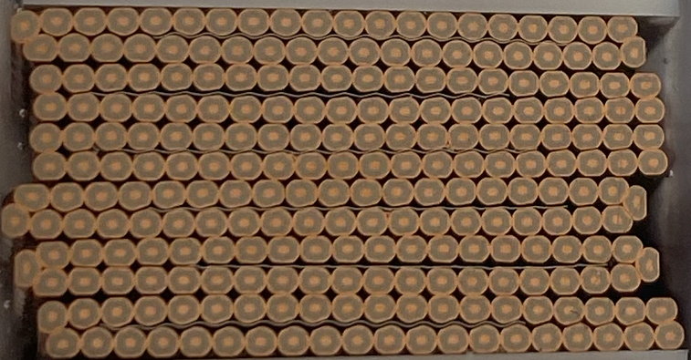
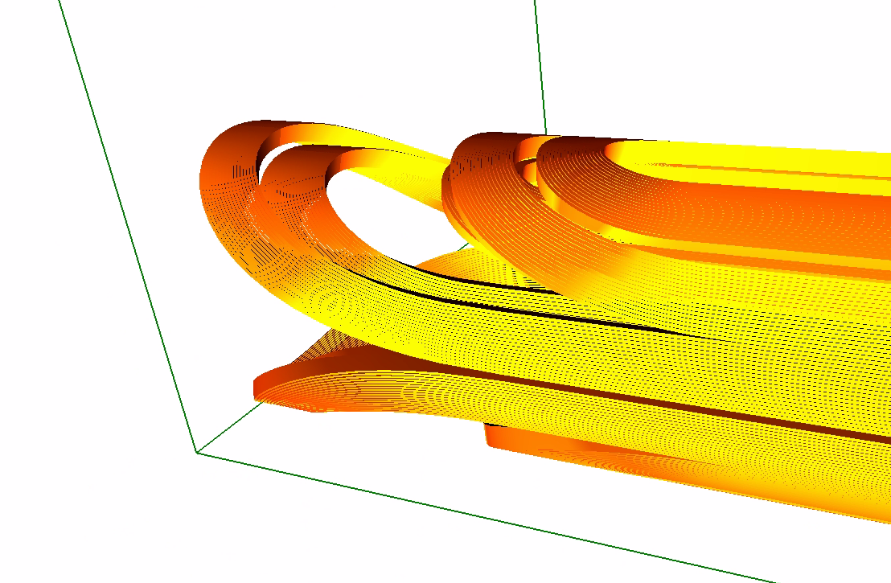
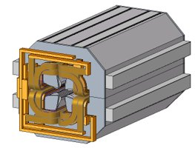
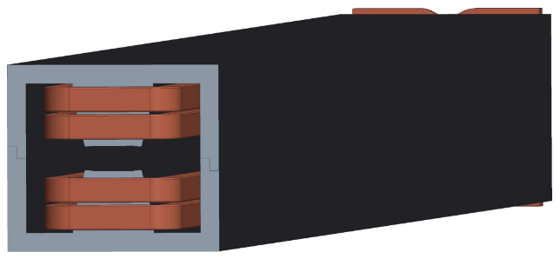
Partnerships with DOE Labs & US Universities
Partner | Scope | Status
SLAC | Beam dynamics, IR, and crab cavity simulations | Ongoing
LBNL | Beam dynamics simulations, SC cable production, design of SC “matching” magnets | Ongoing
ANL | Design of RCS quadrupole, APS quadrupoles and sextuples | Ongoing Complete
FNAL | Beam dynamics (e-polarization), design of RCS dipole magnets, SC IR magnet quench protection, collaboration on design and manufacturing of collared SC IR magnets | Ongoing Under discussion
ORNL | Beam dynamics | Ongoing
Cornell | Spin and beam dynamics | Ongoing
MSU | Beam-beam dynamics | Ongoing
ODU | Ga-As cathodes, crab cavity Design | Ongoing
CalPoly | Beam dynamics | Ongoing
SBU | Electron gun R&D support | Ongoing

Slide 10
Outlook
We appreciate the significant interest and engagement from the international scientific community, international funding agencies and laboratories
Considerable progress on defining potential accelerator-related contributions from partners and defining roles (both domestic and international)
EIC Advisory Board is a valuable group to help ensure open communication and a forum to develop relationships, strengthen engagement and learn from members
EIC AB focus will inevitably evolve from initial focus on partnership formation, toward execution and delivery
Next meeting in July 2024

