Slide 1
EIC Project Status
Jim Yeck
EIC Project Director
EIC 3rd Resource Review Board Meeting
May 6-7, 2024

Slide 2
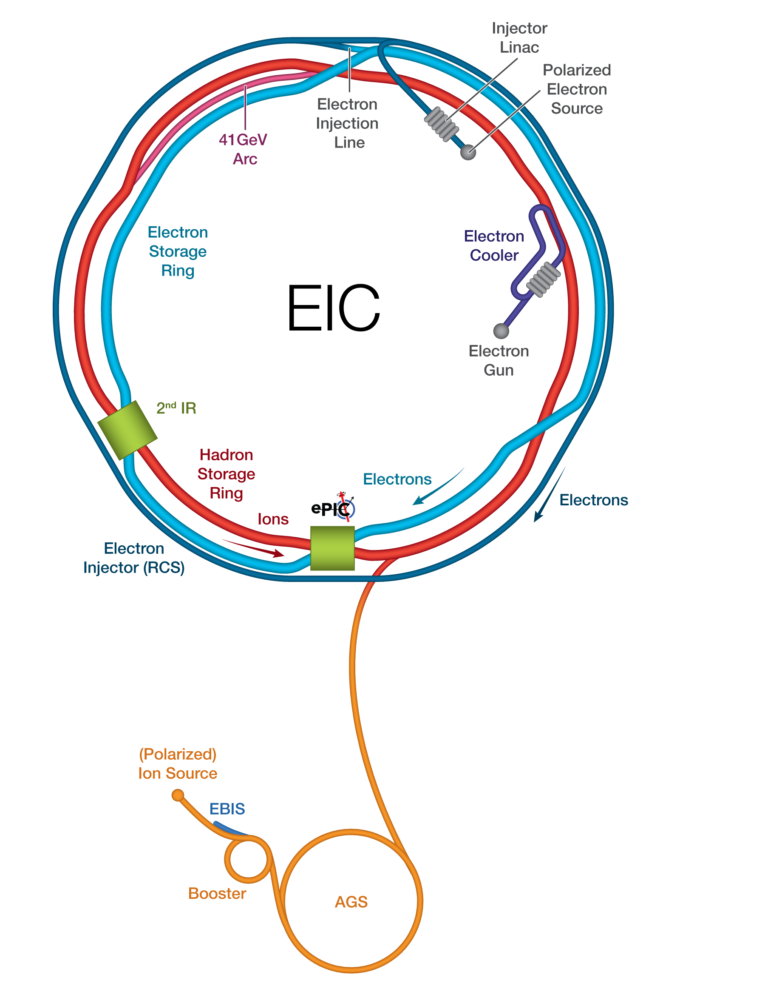
Outline
Introduction
EIC Requirements
Recent Highlights
Critical Decisions and Milestones
Funding and Schedule Update
Organization
Summary

Slide 3
May 2024 RRB Meeting Participants
CANADA
TRIUMF
Israel
Ben-Gurion University
Taiwan
National Central University
National Taiwan University
Czech Republic
Ministry of Education, Youth and Sports
Italy
INFN
United Kingdom
STFC
University of Birmingham
University of Glasgow
France
IN2P3/CNRS
CEA Saclay
Japan
Tokyo University
RIKEN
United States
DOE
BNL
JLAB
ORNL
India
Department of S&T
South Korea
MIST
UConn
Yonsei University
Working together to support the EIC research program!

Slide 4
EIC Facility Requirements
EIC Facility Performance Goals
High Luminosity: L= 10³³ – 10³⁴cm⁻²sec⁻¹, 10 – 100 fb⁻¹/year
Highly Polarized Beams: 70%
Large Center of Mass Energy Range: E_{cm} = 20 – 140 GeV
Large Ion Species Range: protons – Uranium
Large Detector Acceptance and Good Background Conditions
Accommodate a Second Interaction Region (IR)
Conceptual design scope and expected performance satisfy the U.S. Nuclear Science Advisory Committee (NSAC) Long Range Plan (2015 & 2023) and the requirements endorsed by the U.S. National Academy of Sciences (2018).

Slide 5
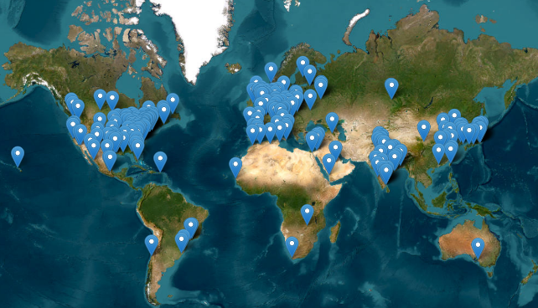
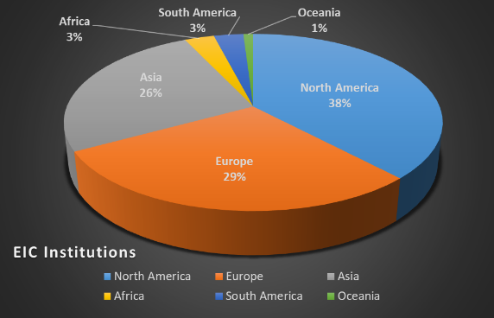
Engaged International Community
Currently, 291 institutions from 40 countries participate in the EIC User Group.
The EIC scientific community is rapidly growing with more than 1,454 members.
The EIC collaborators will contribute to the frontiers of nuclear physics and accelerator science technology for decades to come.
5

Slide 6
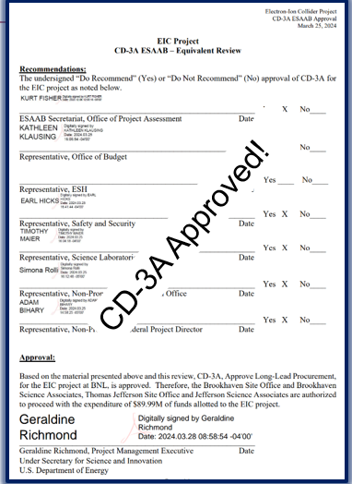
EIC Project Highlights (after Dec ‘23 RRB)
EIC Technical Director transition. Sergei Nagaitsev took over for Ferdinand Willeke. Thank you, Ferdinand!
Consolidated Appropriations Act 2024 included $97.85M for EIC in FY2024 ($95M TEC, $2.85M for OPC). This is consistent with expectations.
U.S. DOE Under Secretary for Science and Innovation approved the CD-3A package for $89.988M in long-lead procurements! This will use Inflation Reduction Act funding.
New York State awarded a $100M grant for constructing EIC buildings. EIC conventional construction is underway.
DOE confirmed plans to conduct an Independent Project Review for CD-3B and Project Status on Jan 7-9, 2025.

Slide 7
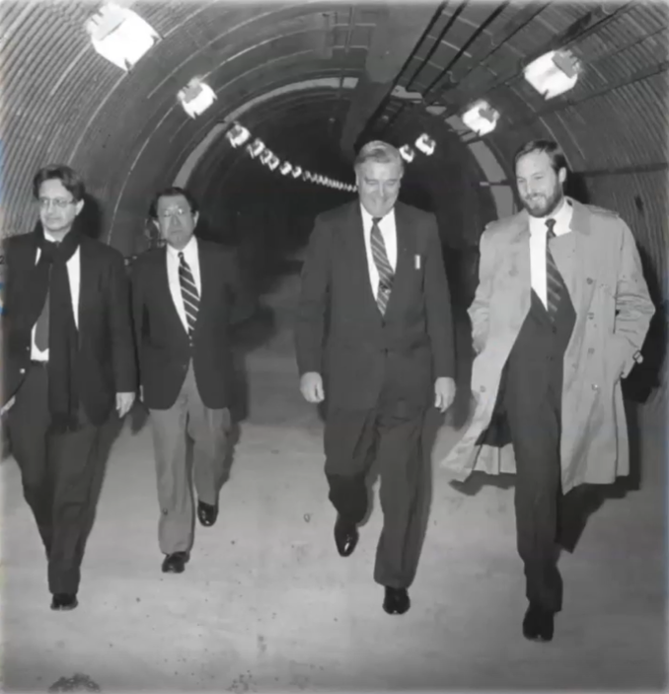
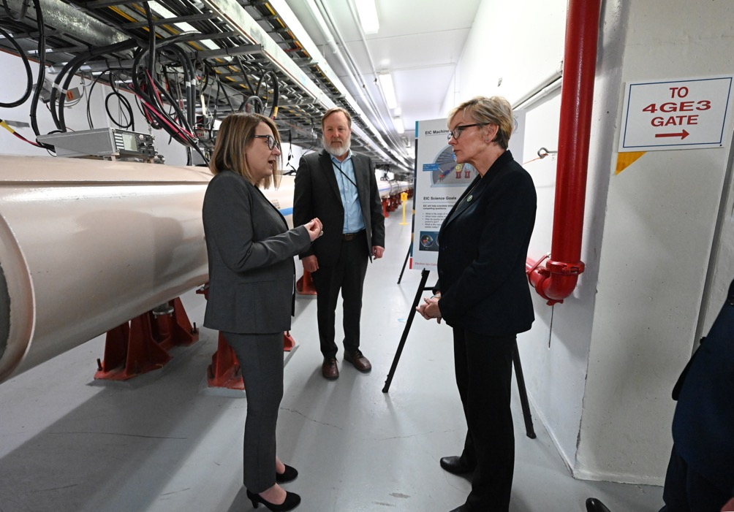
AGS → RHIC → EIC
DOE Secretary of Energy Visit February 1991
DOE Secretary of Energy Visit
April 2024
Leveraging existing infrastructure to deliver a new facility
Enabling the next generation of professionals

Slide 8
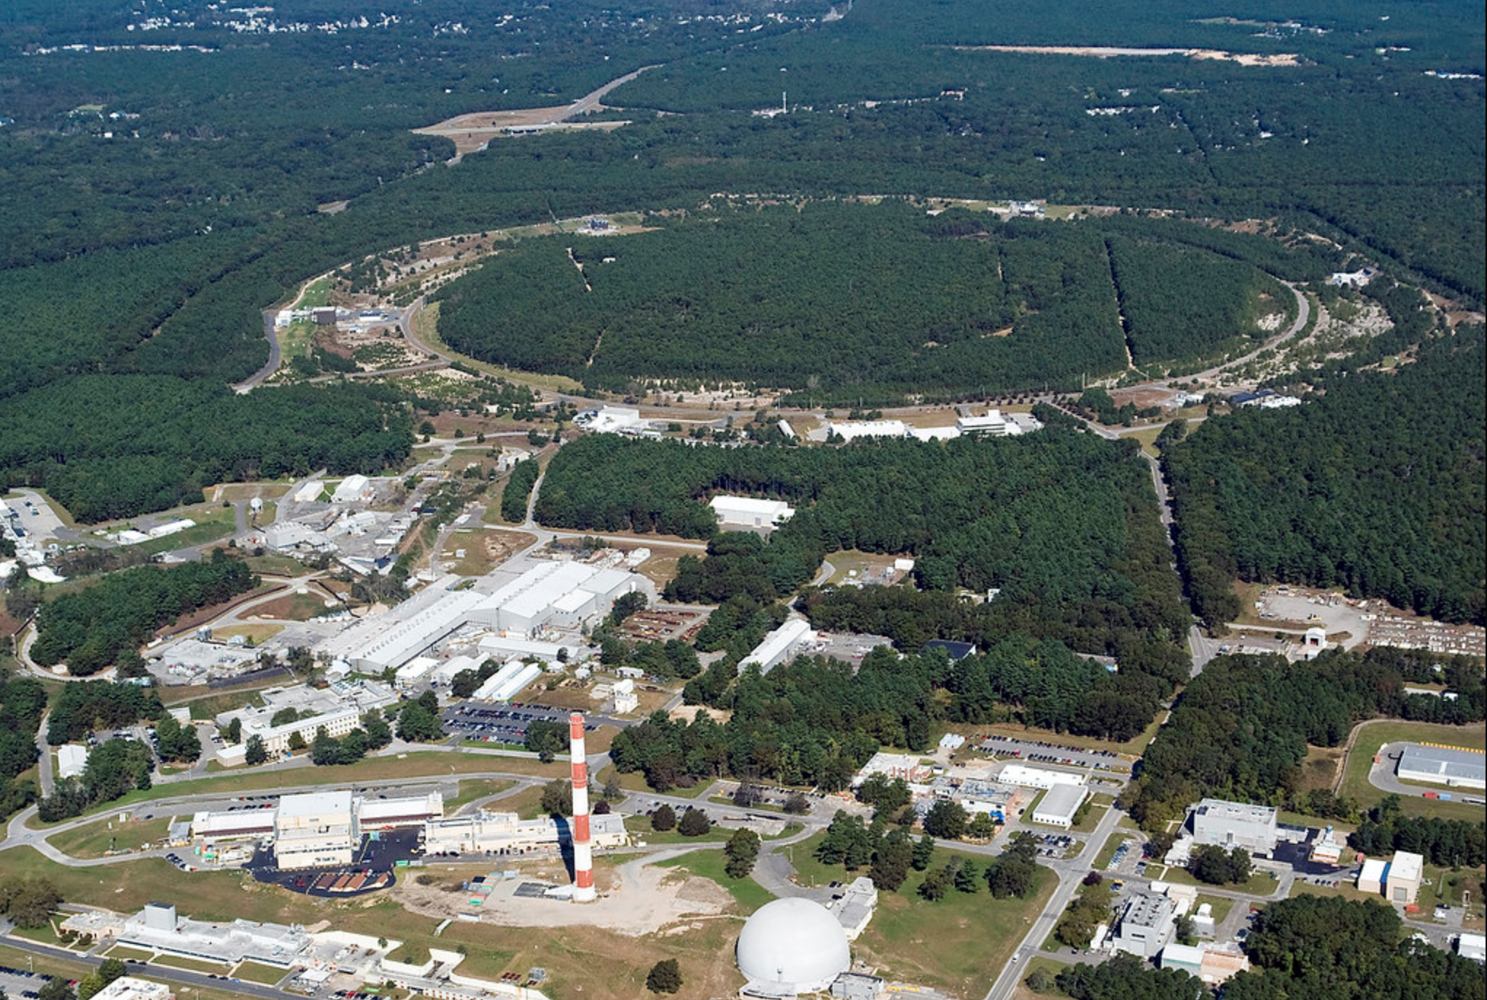
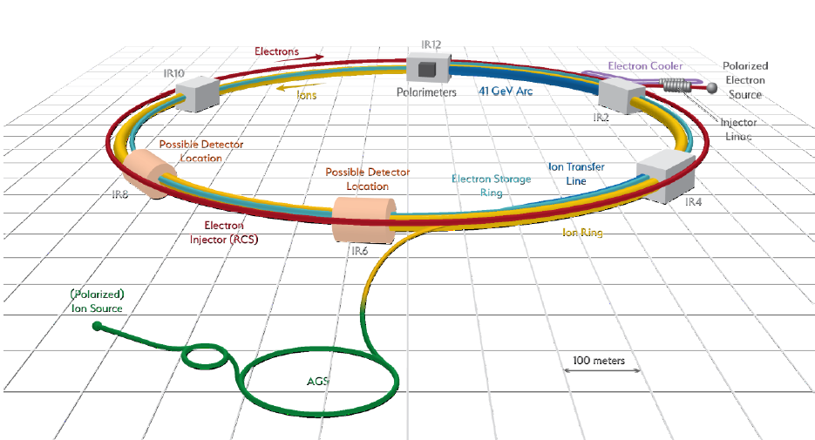
EIC Design Overview
Hadron Storage Ring (RHIC Rings) 40-275 GeV
Superconducting magnets (existing)
1160 bunches, 1A beam current (3x RHIC)
Bright vertical beam emittance 1.5 nm (“flat beams”)
Strong cooling (coherent electron cooling)
Electron Storage Ring 5–18 GeV
Large beam current, 2.5 A, 9 MW S.R. power, S.C. RF
Need to inject polarized bunches
Electron rapid cycling synchrotron, 1Hz, 0.4 -> 18 GeV
Spin transparent due to high quasi-periodicity
High luminosity Interaction Region(s)
Superconducting final focus magnets
25 mrad crossing angle with crab cavities
Spin Rotators (longitudinal spin)
Forward hadron instrumentation

Slide 9
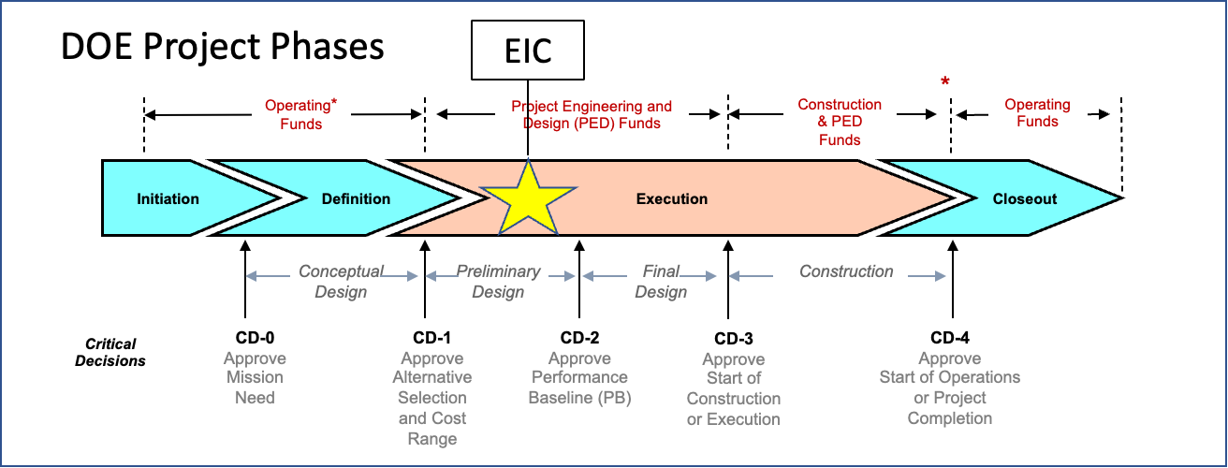
EIC Project Critical Decisions and Plans
CD-0, Mission Need Approved | December 2019
DOE Site Selection Announced | January 2020
CD-1, Alternative Selection and Cost Range Approved | June 2021
CD-3A, Long-Lead Procurement Approved | March 2024
CD-3B, Long-Lead Procurement Planned Approval | March 2025
CD-2/3, Performance Baseline/Construction Start Plan | End 2025

Slide 10
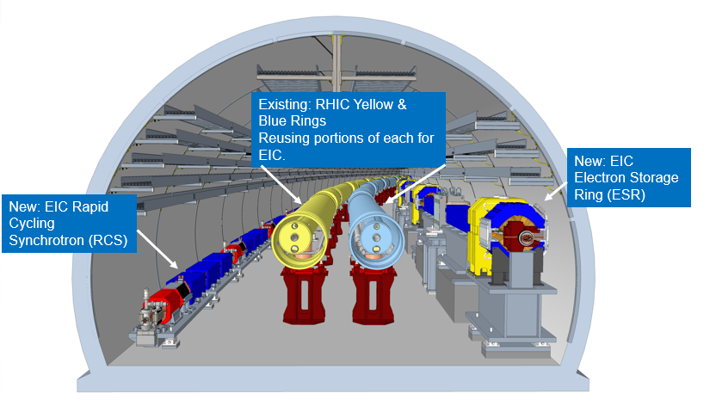
EIC Project Planning Snapshot
CD-1 Alternative Selection and Cost Range= $1.7-2.8B
Current TPC Point Estimate = $2.78B
Plan for Critical Decision Approval Milestones (Funding Dependent)
Mar 2025 CD-3B, Long-Lead Procurement (Plan)
End 2025 CD-2/3, Performance Baseline/Construction Start (Target)
The goal is CD-2/3 before RHIC concludes in 2025
CD-3A,B,C,...enables procurement, not construction
2026 CD-3 Start of Construction
2033 CD-4 Start of Operations (Early Finish)
2035 CD-4 Start of Operations
EIC Machine in the RHIC Tunnel

Slide 11
Funding and Plans for CD-2
The EIC project evaluates funding scenarios in support of the development of the project baseline. Scenarios include FY2025 funding ranging from $98M - $219M.
The FY2025 President’s Budget Request released in March included EIC at $112.85M ($110M TEC, $2.85M OPC). While the request is below expectations, the priority remains to secure CD-2 before the end of the calendar year 2025 and to pursue CD-3B, and CD-3C as needed to sustain technical progress.
Funding Scenarios – Ramp to $300/yr

Slide 12
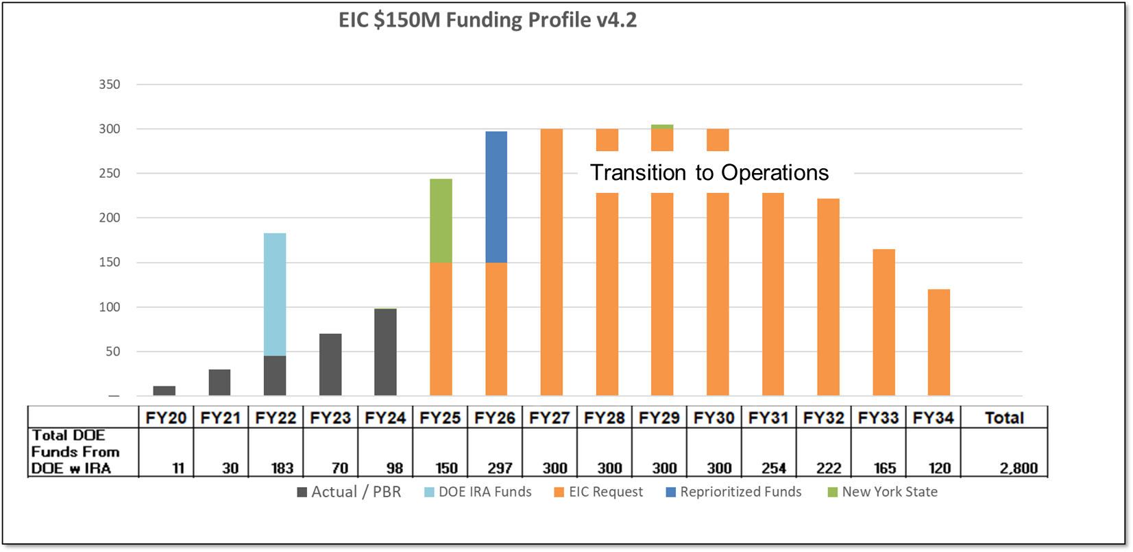
Funding Profile – V4.2
Cumulative Funding
DOE = $390 M, including $138M IRA.
NYS $100 M.
FY25 PBR $113M
135
235
Funding Profile Scenarios
Version 4 was based on actuals through FY23 (PBR) and forecasts.
RHIC ops funding starts to be repurposed to EIC in FY2026.

Slide 13
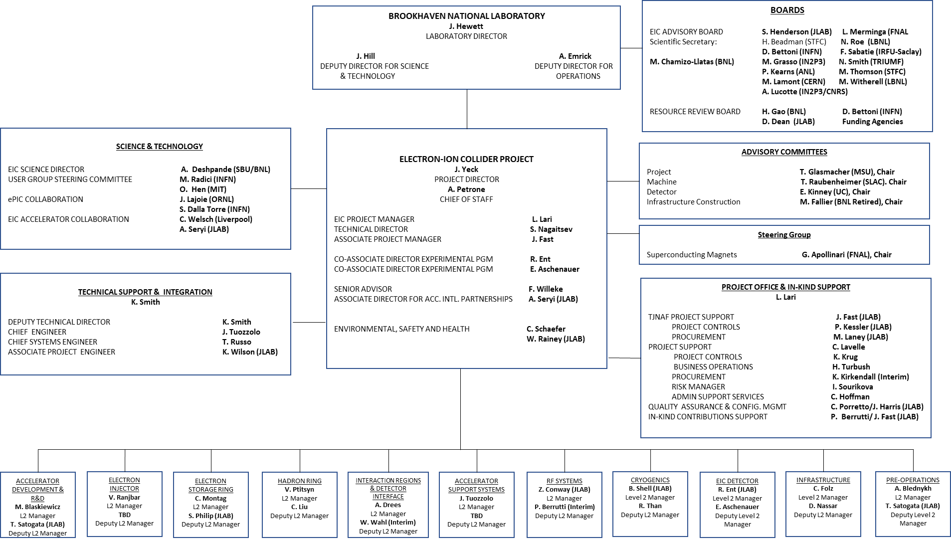
Project Organization
BNL/JLab Partnership
Science & Collaboration Advice and Input
International Governance
Technical and Project Support

Slide 14
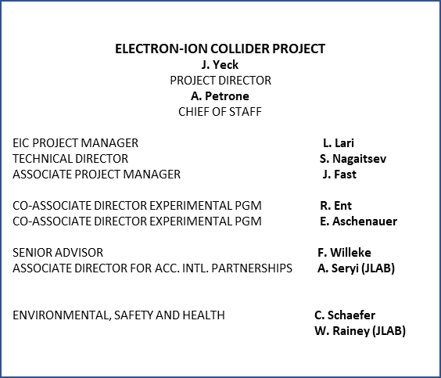
Project Organization – Integrated BNL/JLAB
Integrated BNL/JLab organization established in 2020.
Continues to evolve and strengthen with the support of the host labs.
An effective framework for developing execution strategies and identifying and resolving issues.
Executive Management Team meetings include additional participants.
New Technical Director after the Nov-2023 CD-3A review.

Slide 15
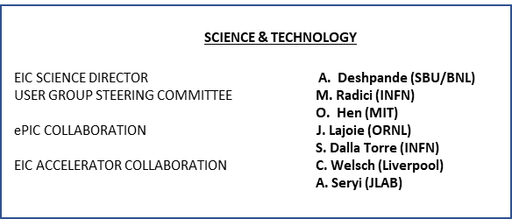
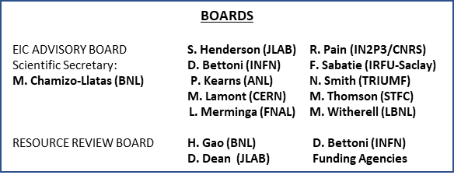
Governance, Advice, and Support
Strong connections to the S&T communities.
DOE, BNL, and JLab envision an EIC facility that is “fully international in character.”
The International Advisory Board provides oversight and advice on the construction of the facility, focusing on the accelerator.
International Resource Review Board provides oversight of experiments.
International Advisory Committees provide advice on the Project, Infrastructure, Machine, and Detector.
Superconducting Magnet Steering Group

Slide 16
Summary
EIC is a unique, high-energy, high-luminosity, polarized beam collider that will be one of the most challenging and exciting accelerator complexes ever built -- only new collider in the next decades.
DOE approved CD-3A and supports the preparation of CD-3B procurements.
Strong support for EIC in the scientific community and increasing international engagement.
Major partners participated in preparing the EIC governance model and support the development of a facility that is international in character.
EIC RRB meeting this week, graciously hosted by INFN and supported by international partners, provides an opportunity to jointly make progress towards our common goals.
The priorities this year include:
Execution of the CD-3A baseline;
Clarifying the technical baseline, cost, schedule, partnerships, and project organization;
Preparing the CD-3B procurements for approval; and,
Preliminary design (final design for CD-3B items) and preparation for CD-2.

