Slide 1
EIC Project Detector Overview
E.C. Aschenauer (BNL), R. Ent (JLab)
Co-Associate Directors for the Experimental Program
EIC Resource Review Board Meeting
May 6-7, 2024

Slide 2
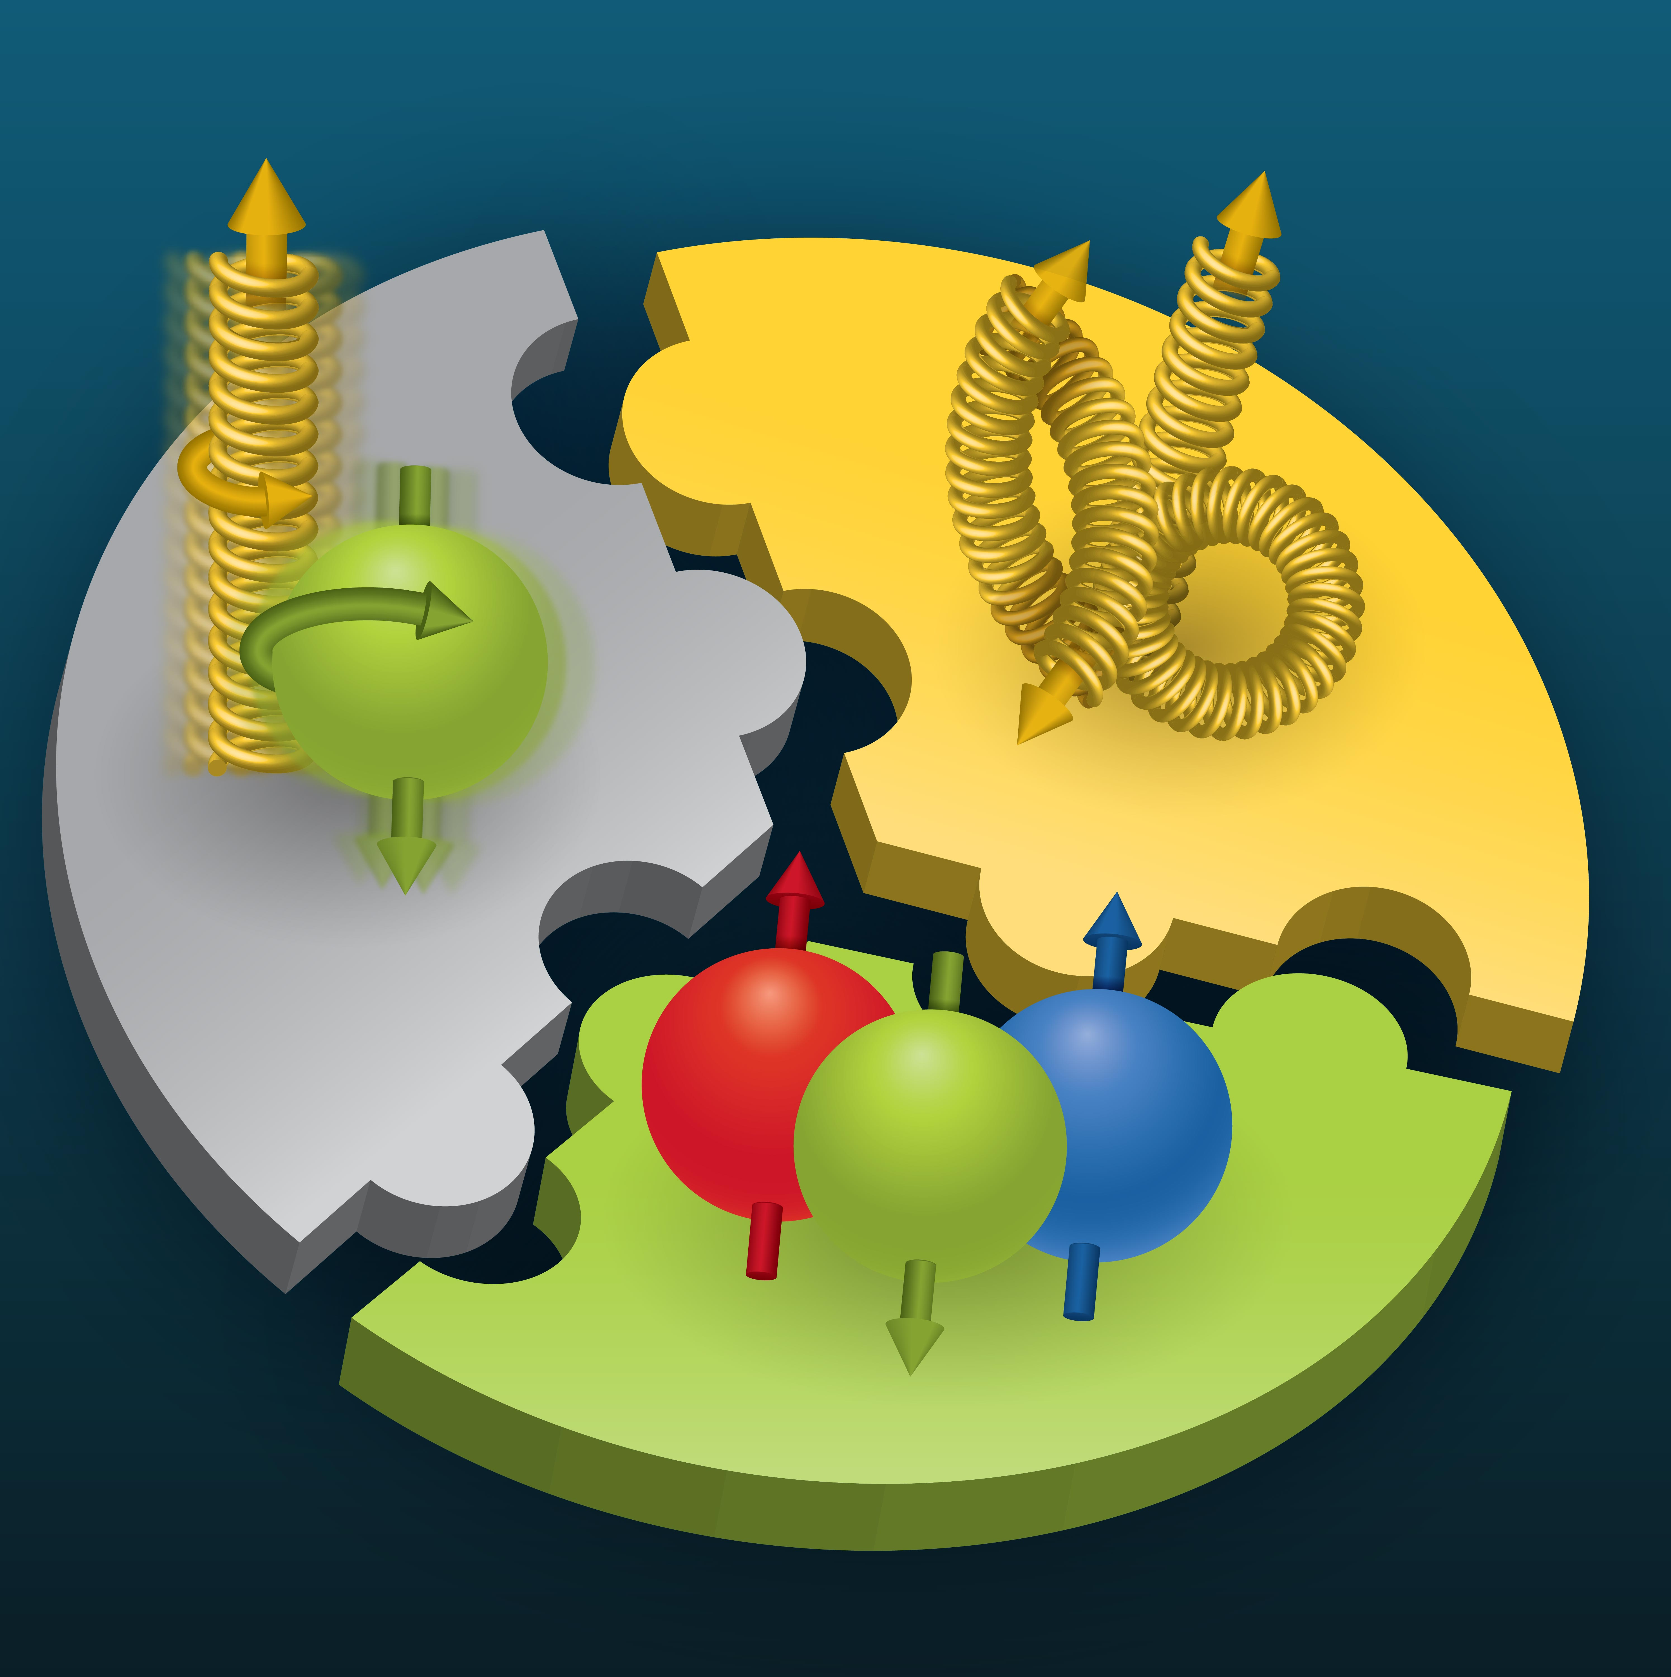

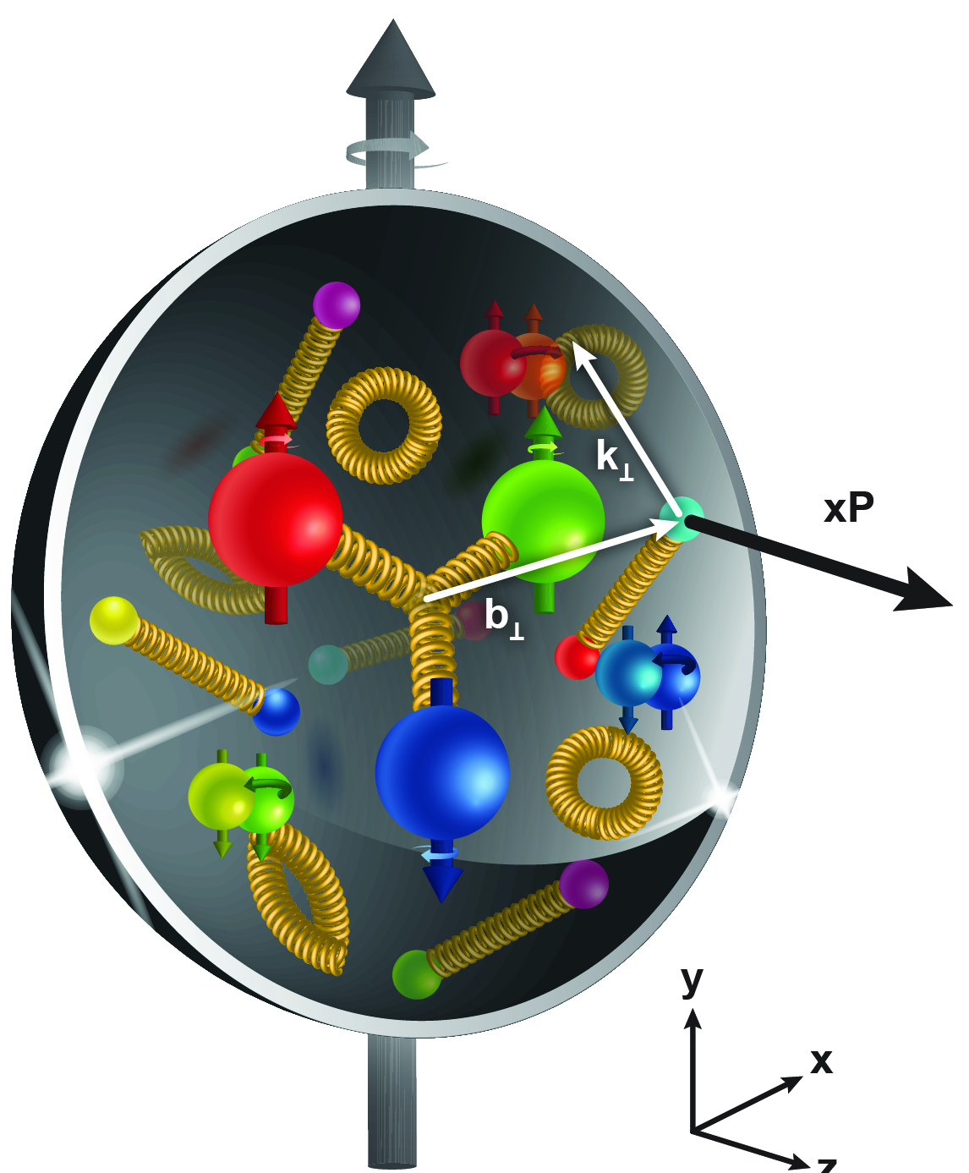
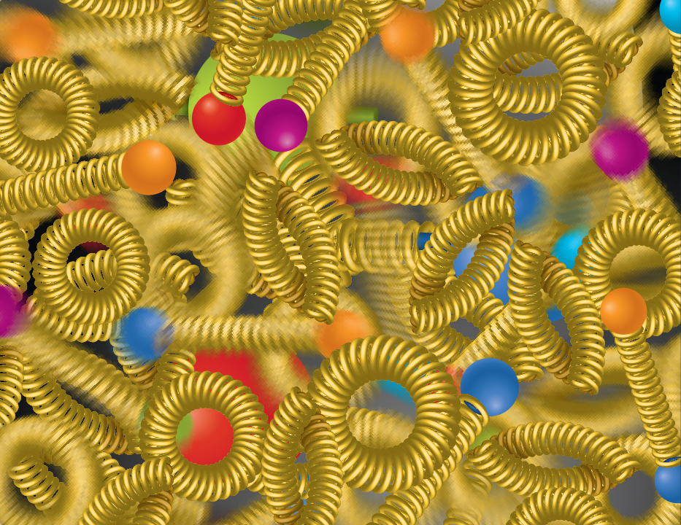
EIC NAS Science Highlights
SPIN is one of the fundamental properties of matter.
All elementary particles, but the Higgs carry spin.
Spin cannot be explained by a static picture of the proton
It is the interplay between the intrinsic properties and interactions of quarks and gluons
The EIC will unravel the different contribution from the quarks, gluons and orbital angular momentum.
Does the mass of visible matter emerge from quark-gluon interactions?
Atom: Binding/Mass =
0.00000001
Nucleus: Binding/Mass =
0.01
Proton: Binding/Mass =
100
For the proton the EIC will determine an important term contributing to the proton mass, the so-called “QCD trace anomaly
How are the quarks and gluon distributed in space and momentum inside the nucleon & nuclei?
How do the nucleon properties emerge from them and their interactions?
How can we understand their dynamical origin in QCD?
What is the relation to Confinement
Is the structure of a free and bound nucleon the same?
How do quarks and gluons, interact with a nuclear medium?
How do the confined hadronic states emerge from these quarks and gluons?
How do the quark-gluon interactions create nuclear binding?
How many gluons can fit in a proton?
How does a dense nuclear environment affect the quarks and gluons, their correlations, and their interactions?
What happens to the gluon density in nuclei? Does it saturate at high energy?
?
gluon
splitting
=
gluon
recombination

Slide 3
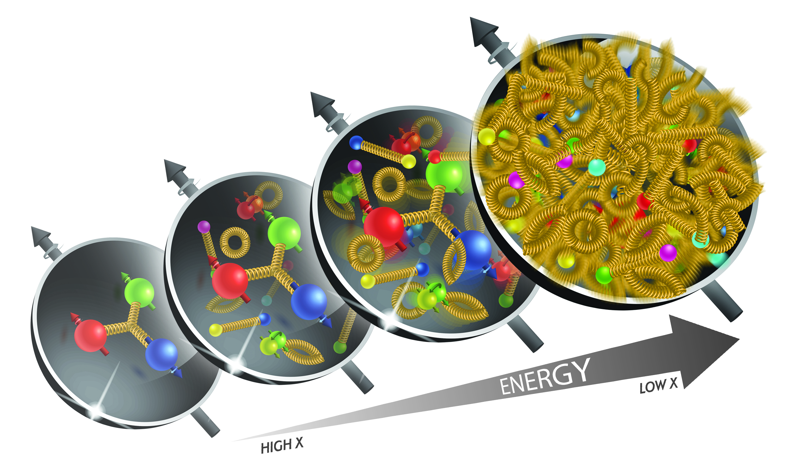
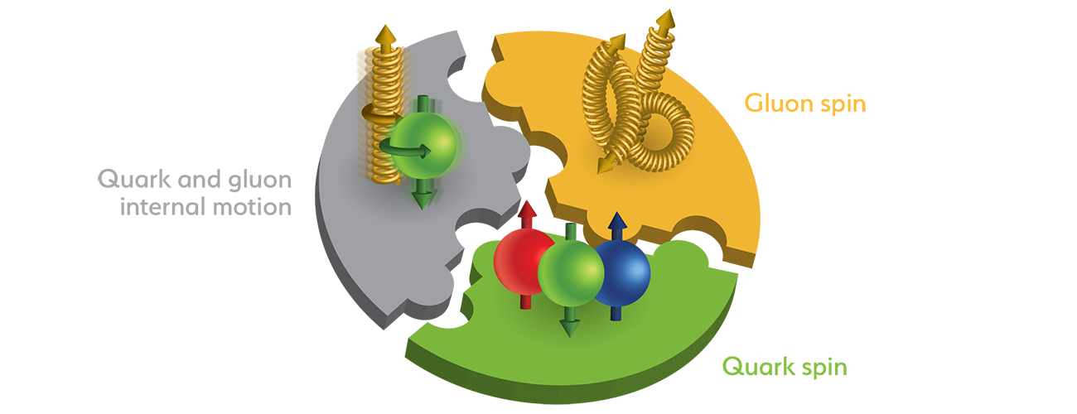
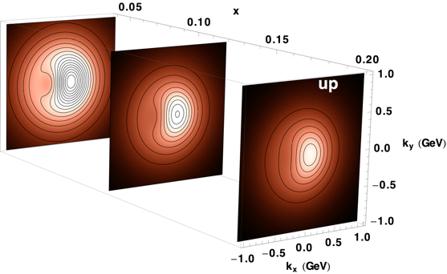
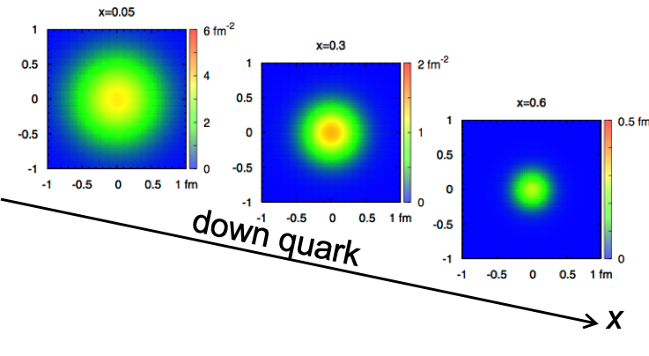
Accelerator Performance and NAS Science
wide center-of-mass energy √s: ~20 – 140 GeV :
map the out nucleon and nuclei structure from high to low x
polarized electron and hadron (p, He-3) beams:
access to spin structure of nucleons and nuclei
Spin vehicle to access the spatial and momentum structure of the nucleon in 3d
Full specification of initial and final states to probe q-g structure of NN and NNN interaction in light nuclei
nuclear beams: d to Pb
accessing the highest gluon densities → saturation
quark and gluon interact with a nuclear medium
high luminosity 10³³-10³⁴ cm⁻²s⁻¹ :
mapping the spatial and momentum structure of nucleons and nuclei in 3d
access to rare probes, i.e. Ws
large acceptance (0.2 – 1.3 GeV) through forward focusing IR magnets
spatial imaging of nucleons and nuclei
gluon emission
gluon recombination
?
=

Slide 4
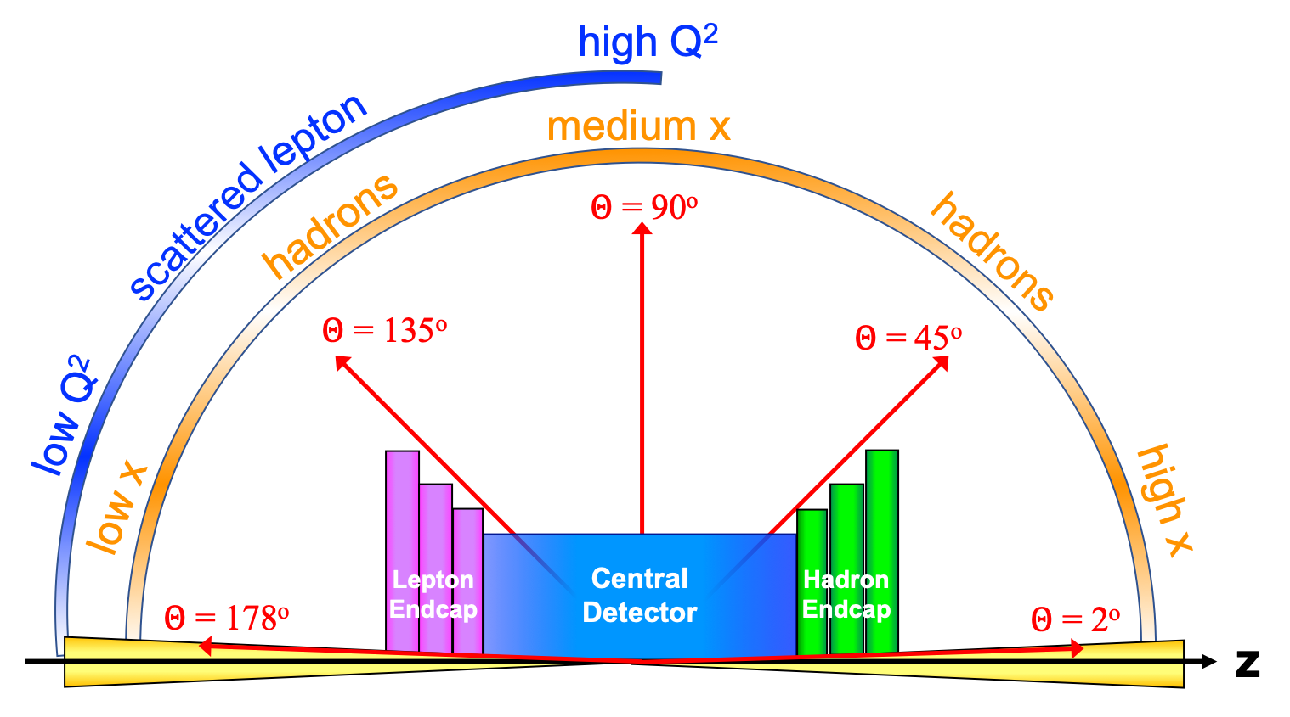
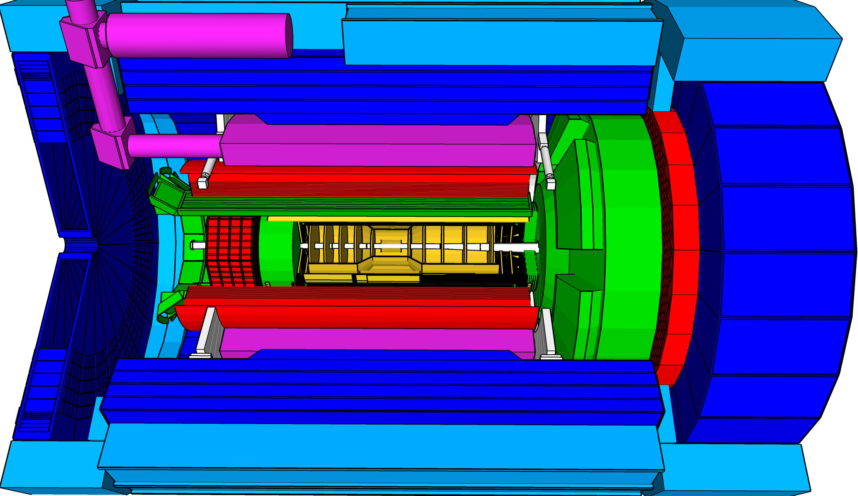
Experimental Equipment Scope
Imaging science program with protons and nuclei
  requires specialized detectors integrated in the IR over 80 m
Momentum resolution for EIC science
  requires a large bore (⌀ 2.4 m) 2T magnet
    (1.7 T magnet operation point, stretch goal 2T
Highest scientific flexibility
  requires Streaming Readout electronics model
Asymmetric beam energies
  requires an asymmetric detector with electron and hadron endcap → 9.5 meter
  tracking, particle identification, EM and hadronic calorimetry functionality in all directions, covering equal rapidity area: (-4 < η < 4)
  very compact Detector, Integration will be key
Highly Polarized Beams: 70%
→ requires high precision electron and hadron polarimetry
25 Subsystems incl. high-precision Polarimetry
local hadron polarimeter
hadronic calorimeters
Time.of.Flight,
DIRC,
RICH detectors
MPGD trackers
Solenoidal Magnet
MAPS tracker
e/m calorimeters
Luminosity
Monitor
low Q² electron-tagger
off-Momentum
taggers
Roman
Pots
Zero-Degree
Calorimeter
p: 41 GeV, 100 to 275 GeV
p/A beam
e beam
e: 5 GeV to 18 GeV
lepton and hadron polarimeters not shown

Slide 5
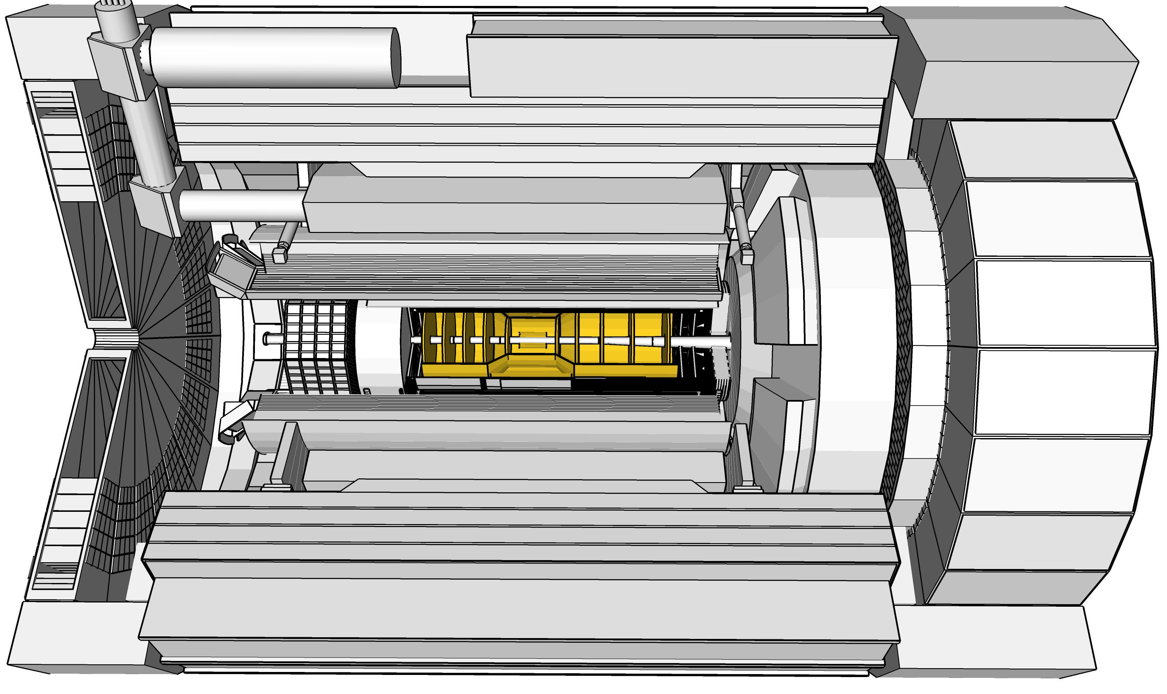
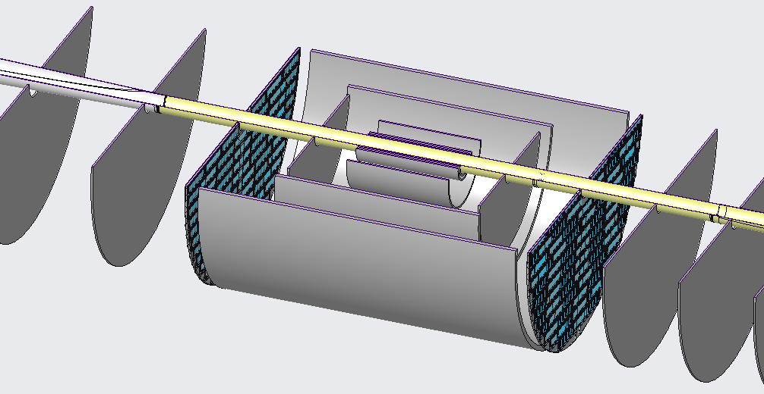
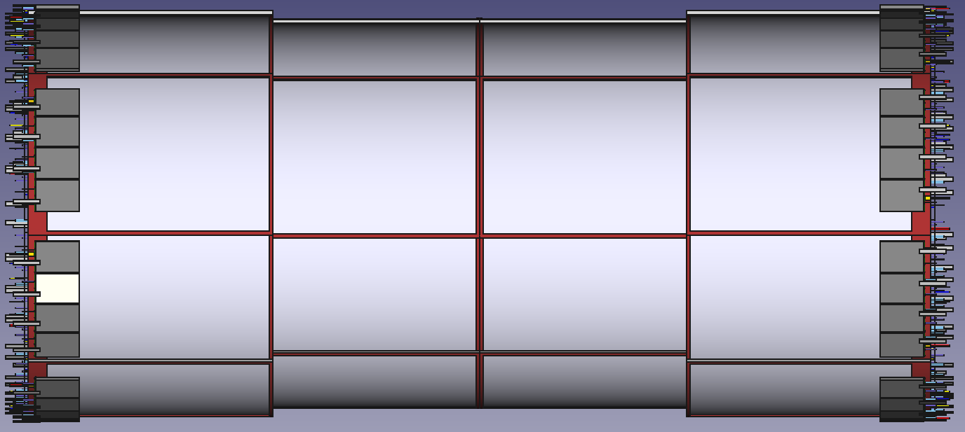
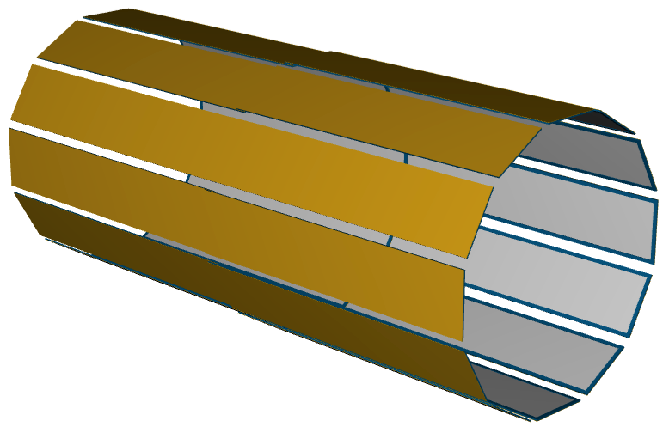
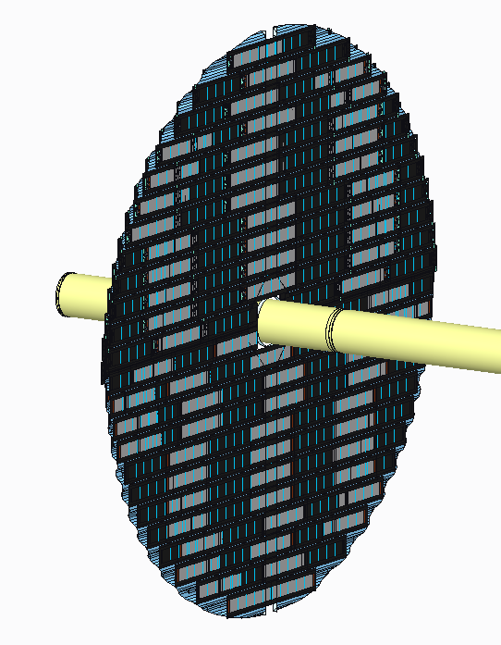
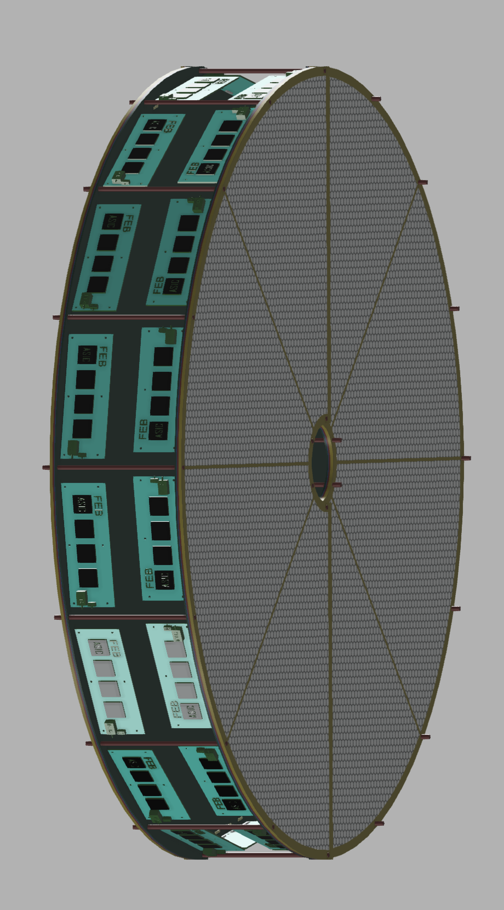

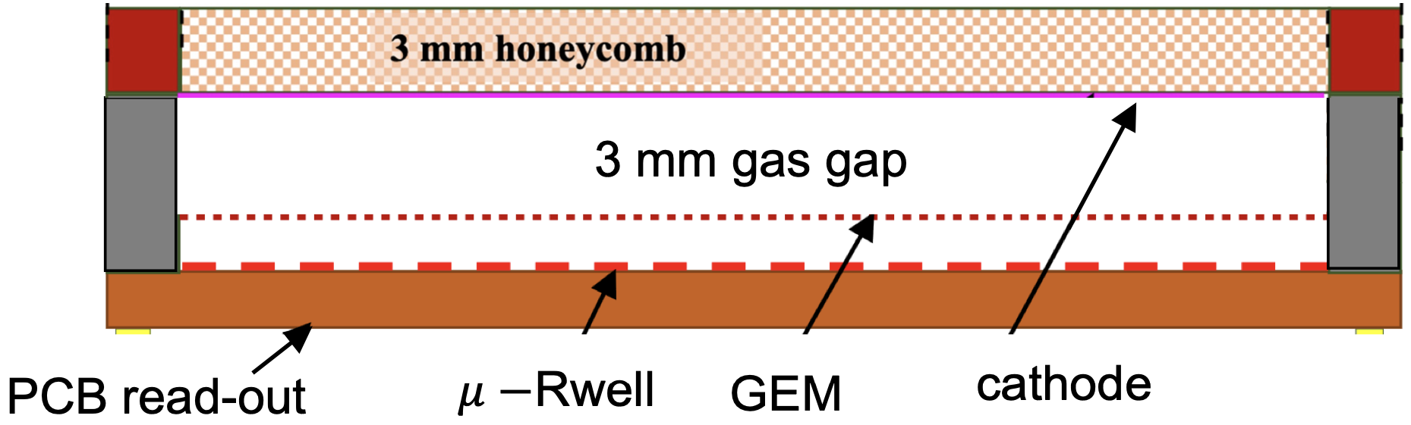
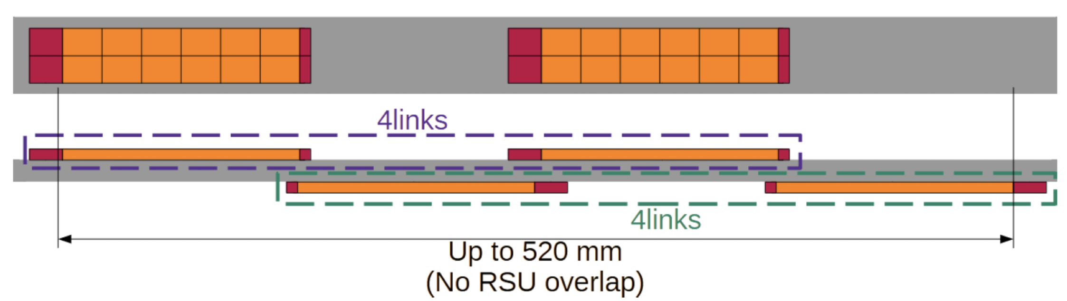
ePIC Tracking Detectors
μVertex Tracker
Barrel Tracker
Outer Barrel MPGD Tracker
EndcapTracker
MicroMegas Tracker
μRWELL Tracker
MAPS
Disks
μRWELL
Disks
Main Function
Excellent momentum 0.05%pT⊕0.5%
and spatial resolution 20μm/pT⊕ 5μm
Provide redundancy and pattern recognition for tracking
Tracking close to hpDIRC detector to improve angular and space point resolution.
Redundancy and pattern recognition for tracking
Excellent momentum 0.05 (0.10)% pT⊕1.0 (2.0)%
and spatial resolution
30μm/pT⊕ (20 – 40) μm
Provide redundancy and pattern recognition for tracking
Displaced vertex reconstruction
Proven Technology
Monolithic Active Pixel Sensor → ALICE ITS3 MOSAIX sensor (65 nm)
small pixels (~18 mm) and power consumption (<20 mW/cm²)
Cylindrical resistive Micromegas technology Used: ATLAS NSW, CLAS12, SPHENIX, MINOS& T2K TPC
EIC Large Area Sensor (LAS), modification of ITS3 sensor with 5 or 6 RSU forming staves as the basic building elements for the Outer Barrel
world’s first at
EIC Large Area Sensor (LAS), staves as the basic building elements for the MAPS disks
GEM- 𝜇Rwell hybrid configuration with increased gain
24 planar Thin-gap & double amplification (GEM & μRWELL) modules &
2D-strip readout

Slide 6
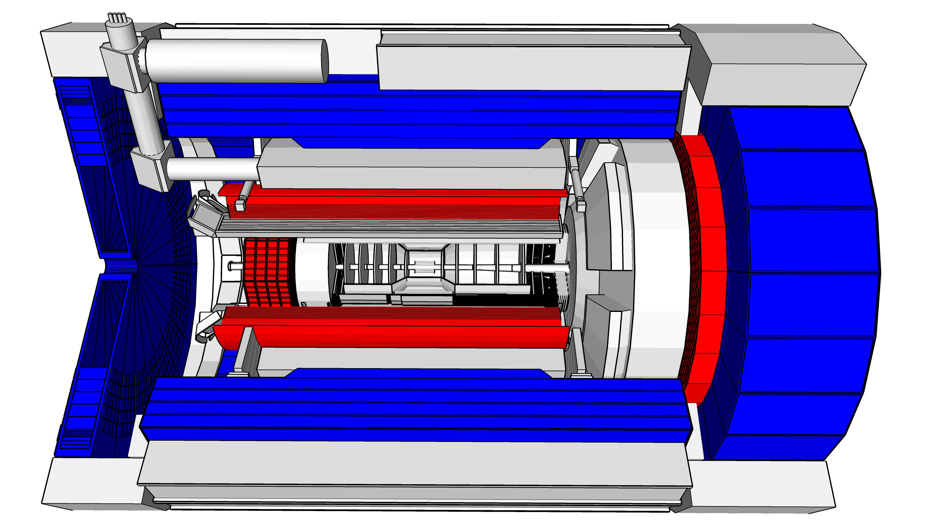
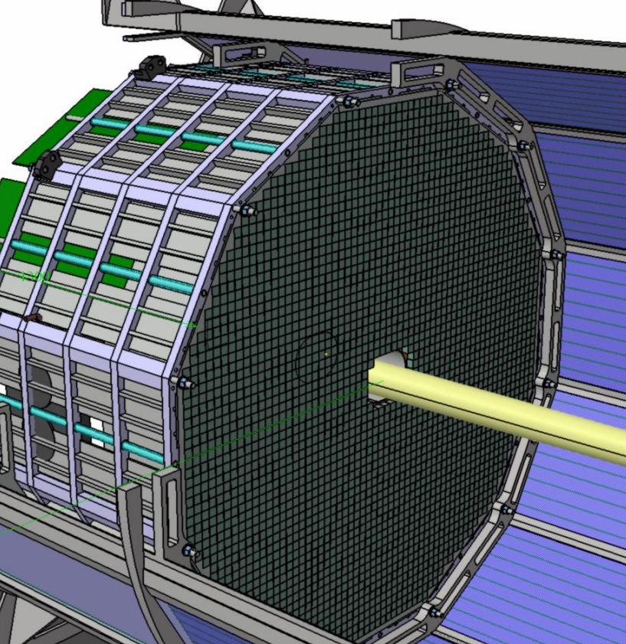
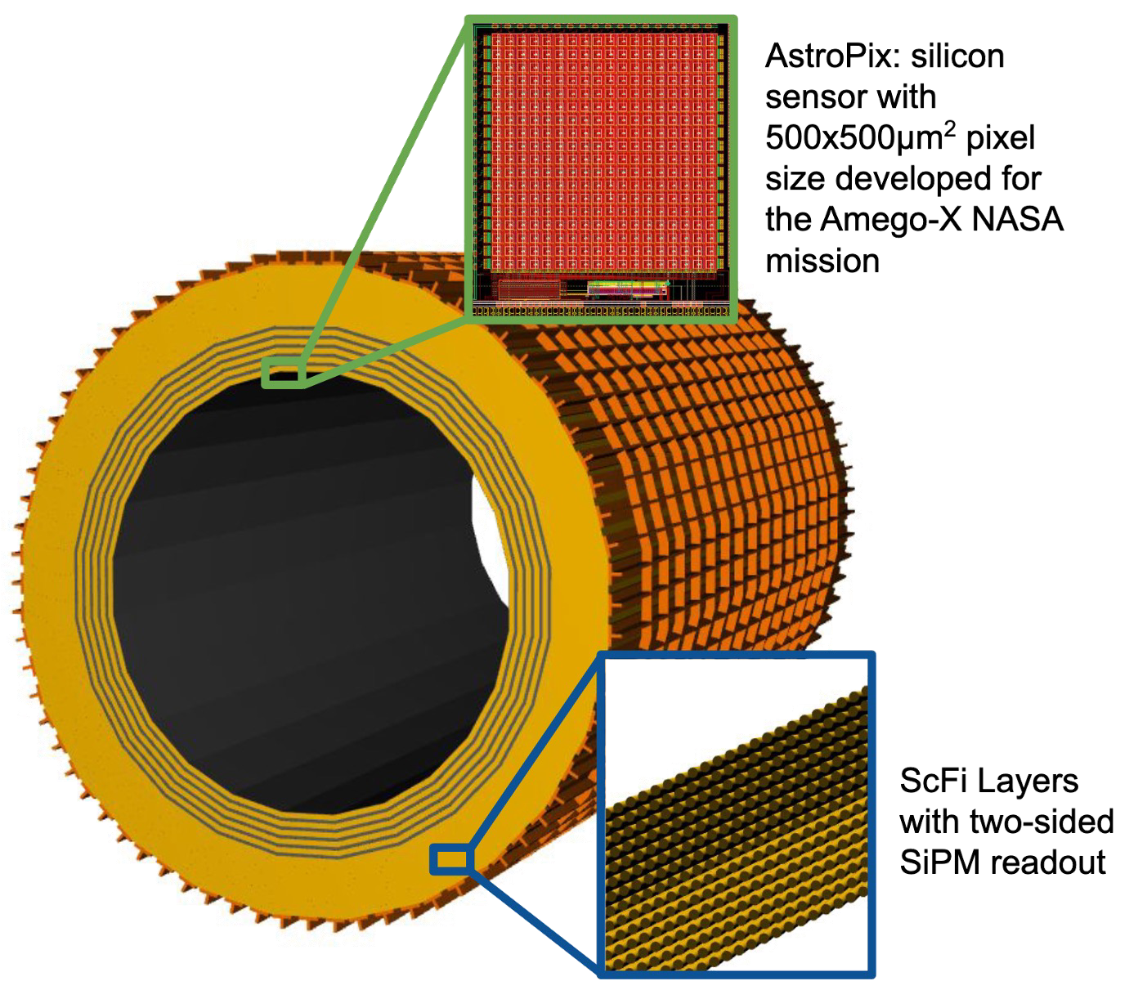
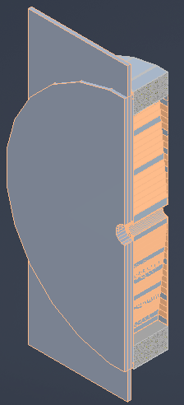
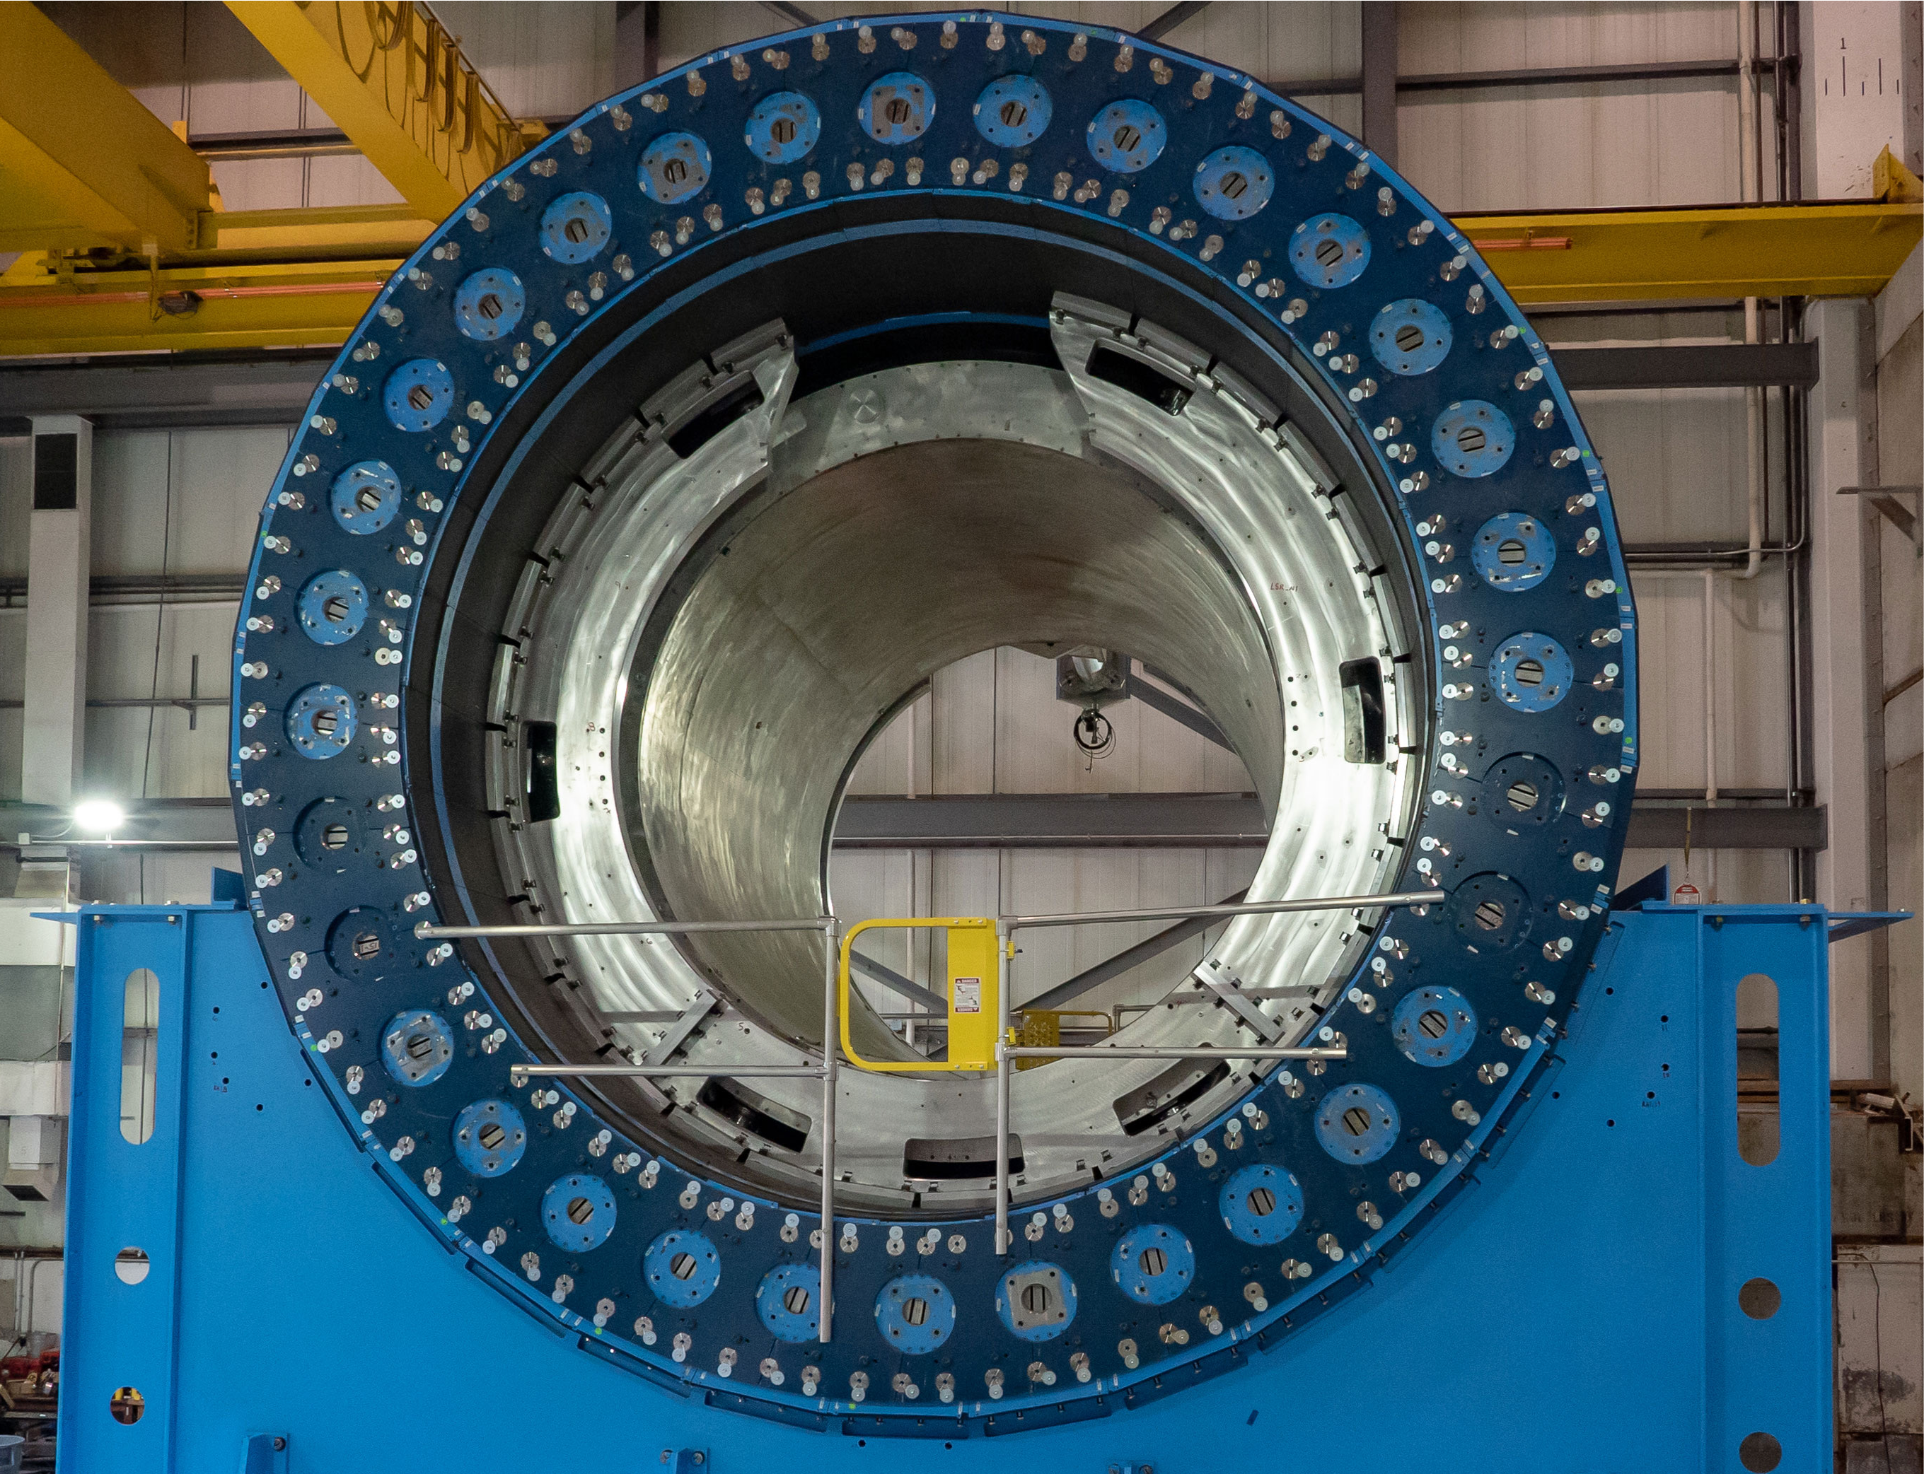
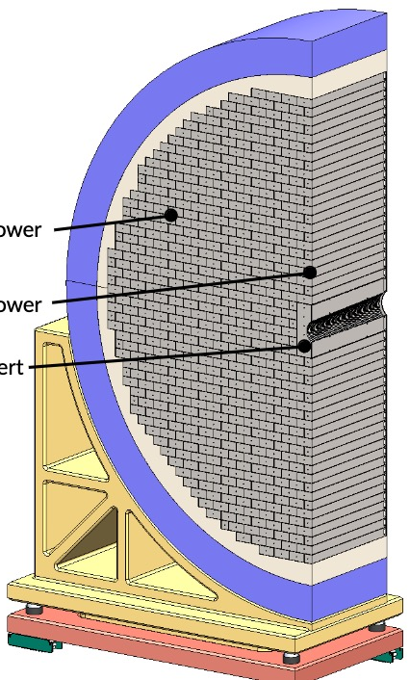
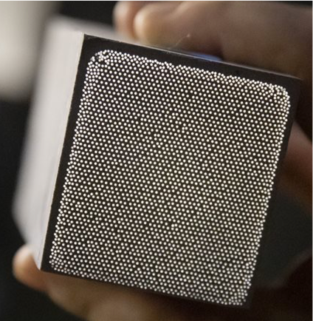
ePIC Calorimetry
Backward ECal
Barrel ECal
Forward ECal
Backward HCal
Barrel HCal
Forward HCal
Main Function
lepton and γ detection, hadronic final state characterization → π⁰, γ
separation
muon and
neutral detection
→ improved jet Energy reconstruction
muon and neutral detection
→ improved jet Energy reconstruction
scattered lepton detection
→ very high-precision
scattered lepton and γ detection, hadronic final state characterization
particle-flow measurements
Proven Technology
longitudinal segmented Steel + Scintillator SiPM-on-tile
Pioneered by CALICE analog HCal
High resolution insert next to beam-pipe
PbWO4 – crystals
→ long lead procurement
Pb/SciFi sampling part using SiPMs combined with imaging section (6 layers) interleaving Pb/SciFi with ASTROPIX
Tungsten-powder + SciFi SPACAL design
Developed through EIC R&D and applied successfully in sPHENIX
Steel + Scintillator SiPM-on-tile
Steel + Scintillator design
re-used from sPHENIX
world’s first at
first-time full-size CALICE like calorimeter in collider experiment
SiPM as Photonsensors
Use of ASTROPIX in Calorimetry

Slide 7
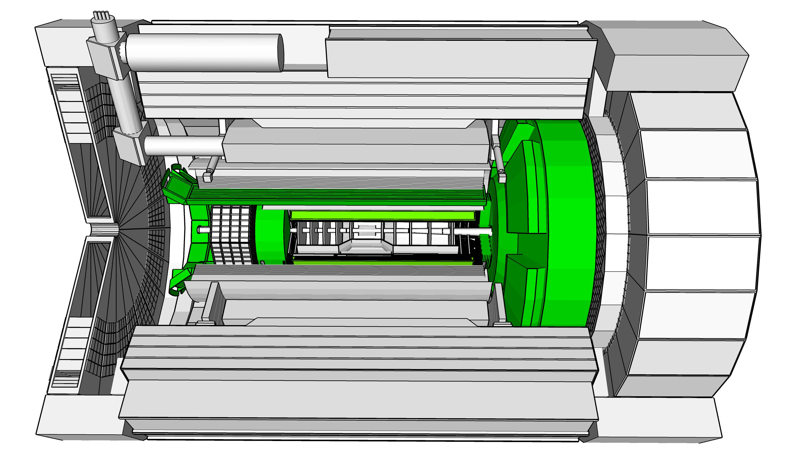
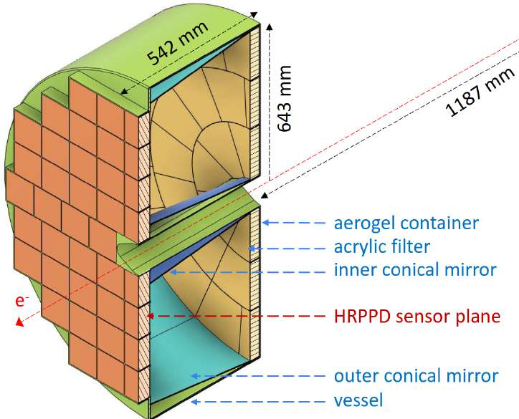
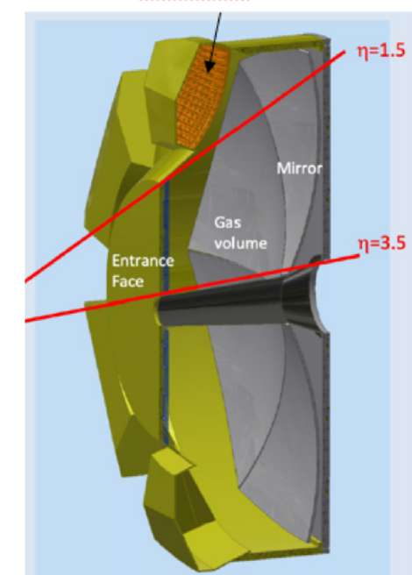
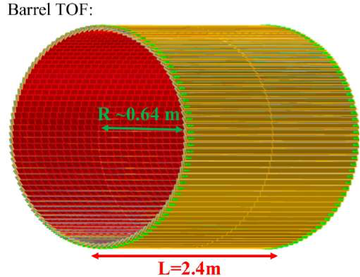
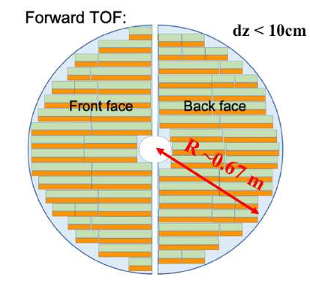
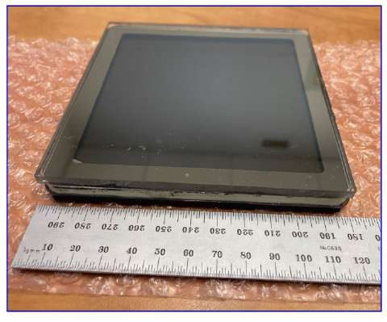
ePIC Particle Identification Detectors
Backward RICH
Barrel DIRC
Forward RICH
Time-of-Flight (Barrel, Forward)
Main Function
e, π, K, p separation
→ π/K 3σ sep. up to 9 GeV/c
and 10-20 ps timing → ToF
e, π, K, p separation
→ π/K 3σ sep. at 6 GeV/c
e, π, K, p separation
→ π/K 3σ sep. up to 50 GeV/c
e, π, K, p separation through 20-35 ps ToF
Barrel: 0.15 < p_{T} < 1.5 GeV/c
Forward: 0.15 < p_{T} < 2.5 GeV/c
Accurate space point for tracking
Proven Technology
Classical single volume proximity focusing aerogel RICH with long proximity gap (~30 cm)
High Performance DIRC
Quartz bar radiator
→ Reuse of BaBAR DIRC bars
light detection with MCP-PMTs
Fully focused
Dual Radiator RICH
Aerogel and C₂F₆ gas
Spherical Mirrors (6 Azimuthal Sectors)
Photon-Sensors tiled on spheres
world’s first at
First time use of
AC-LGAD (Low Gain Avalanche Detector)
in collider detector
Photonsensors:
HRPPDs for Time-of-Flight
First use of SiPMs as Photonsensors in a RICH

Slide 8
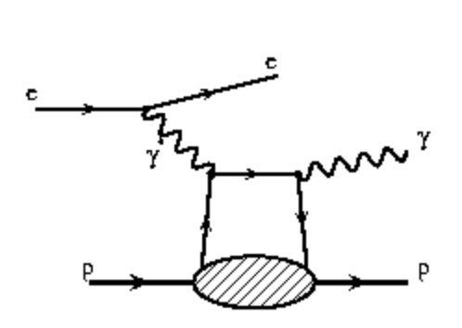
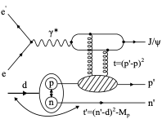
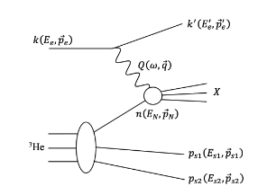
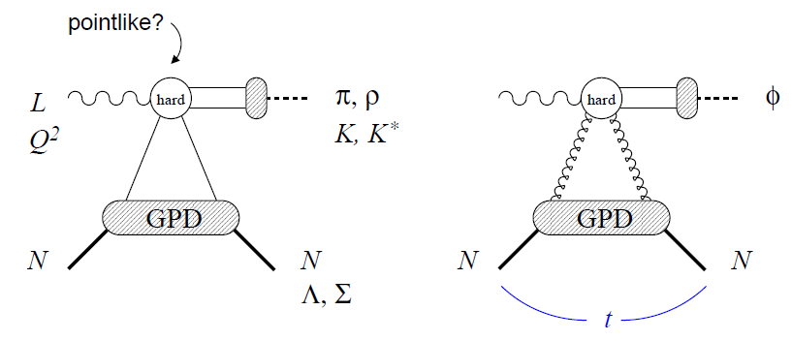
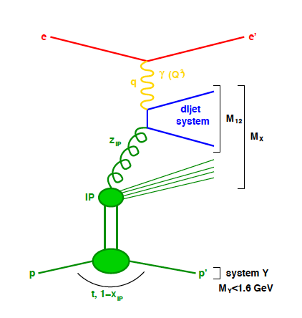
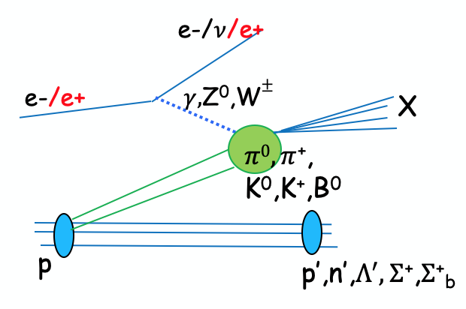
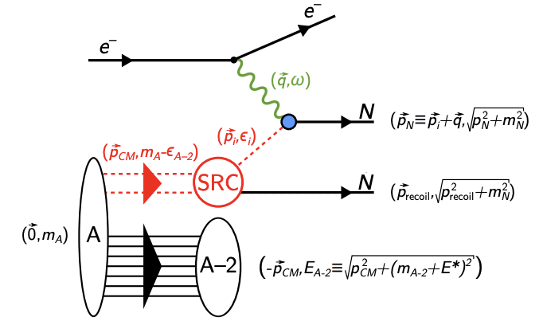
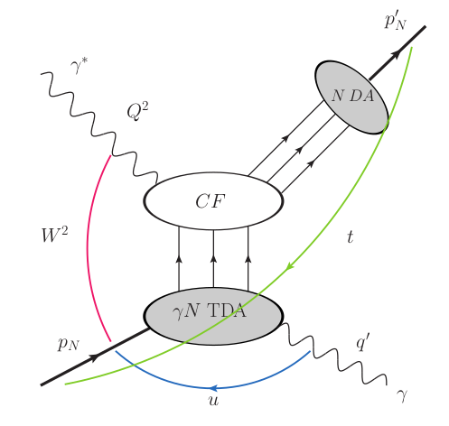
Far-Forward Physics at EIC
e+d exclusive J/Psi
with p/n tagging
spectator tagging in light nuclei
coherent/incoherent
VM production in eA
e+p DVCS
VM
Proton spin: orbital angular momentum; imaging
Short-Range Correlations
Free neutron structure, EMC effect, etc.
Saturation
Sullivan process
Quasi-elastic electron scattering
u-channel backward exclusive electroproduction
Diffraction
𝜋/K form factors and structure functions
Short-Range Correlations
Backward-angle collinear factorization
Saturation
Nucleon/Nuclei Structure
Rapidity
gap
All these processes require the detection of protons, neutrons, photons and hadrons at small scattering angles → MAJOR EIC science and detector emphasis

Slide 9
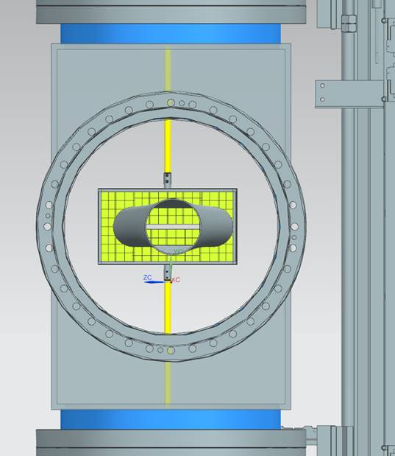
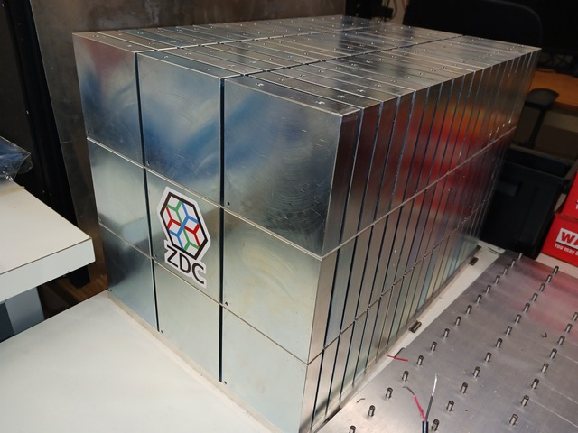

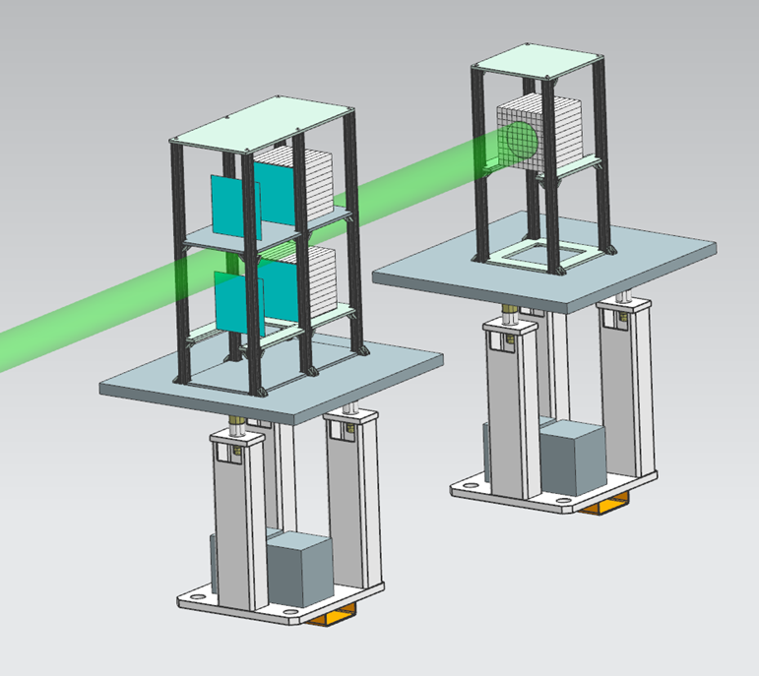
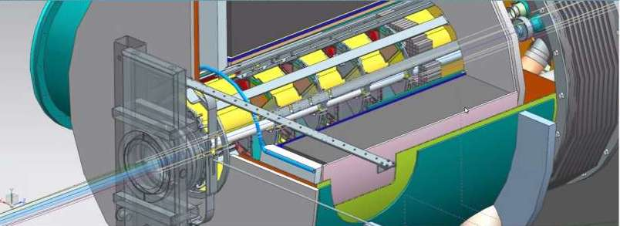
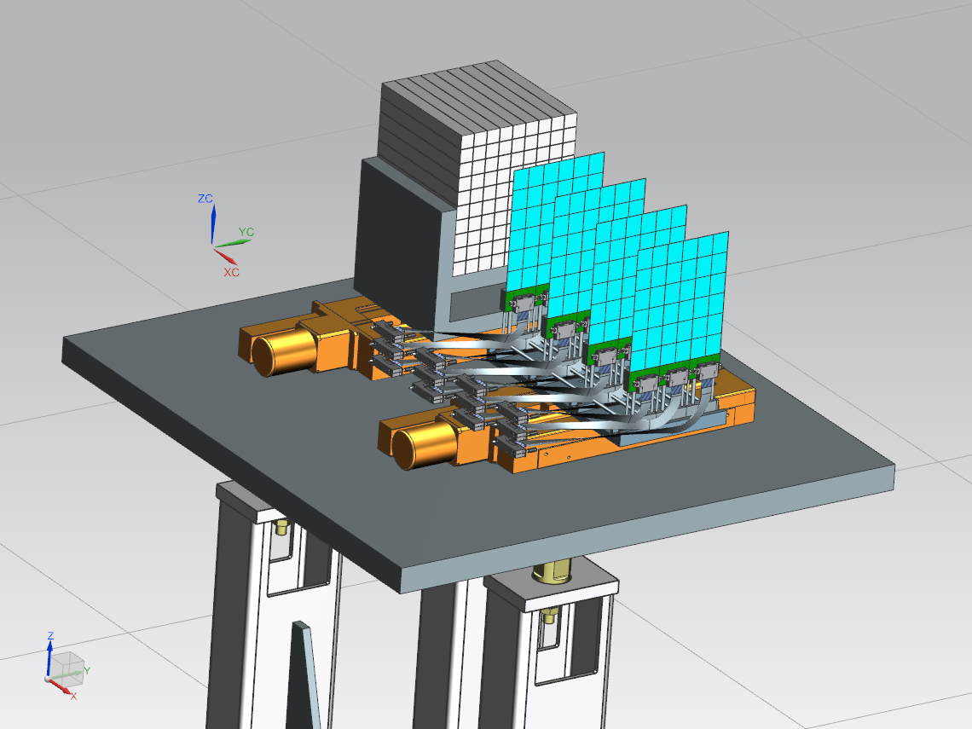
ePIC Far-Forward/Far-Backward Detectors
Main Function:
detection of forward scattered neutrons and γ
Technology:
EMCAL: 2x2x20 cm³ PbWO₄ calorimeter
Synergy with backward ECal
HCAL: Steel-SiPM-on-Tile
Synergy with forward HCal
Zero Degree Calorimeter
e beam
Main Function:
measure bunch-by-bunch luminosity through Bethe-Heitler process
Technology:
Pair-spectrometer: each with
2 tracking layers of AC-LGAD / FCFD
Synergy with Barrel-ToF
Calorimeter: Tungsten-powder + SciFi SPACAL
Synergy with forward ECal
Roman Pots and
Off-Momentum Detectors
Main Function:
detection of forward scattered protons and nuclei
Technology:
2 stations with 2 tracking layers each
AC-LGAD / EICROC ( 500x500 μm² pixel)
Synergy with forward ToF
B0 Magnet Spectrometer
p/A beam
Main Function:
detection of forward scattered protons and and γ
Technology:
4 tracking layers each
AC-LGAD / EICROC ( 500x500 μm² pixel)
Synergy with forward ToF
EMCAL: 2x2x20 cm³ PbWO₄ calorimeter
Synergy with backward ECal
Luminosity System
Low-Q2 Taggers
Main Function:
detection of scattered electrons
Technology:
2 stations with 4 tracking layers each (16x18cm²)
Si / Timepix4
Calorimeter: Tungsten-powder + SciFi SPACAL
Synergy with forward ECal

Slide 10
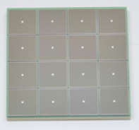
Streaming - Detector, Electronics, DAQ, Computing
Global Timing Unit (GTU)
Echelon 1
(BNL)
On Detector
ASIC
SMT BGA
Echelon 0
Echelon 1
(JLAB)
Name
Sensor
Adapter
Front End Board
(FEB)
Readout Board
(RDO)
Data Aggregation Module (DAM)
Echelon 0
Computing
Detector Groups
Electronics
DAQ
BNL/JLab Joint Institute
Electronics and DAQ WG
DSCs &
Integration
Software WG
SRO WG
No External trigger
All collision data digitized but aggressively zero suppressed at FEB
Low / zero deadtime
Collision data flow is independent and unidirectional-> no global latency requirements
Avoiding hardware trigger avoids complex custom hardware and firmware
Data volume is reduced as much as possible at each stage ensuring that biases are controlled
Integrate AI/ML as close as possible to subdetectors → cognizant Detector

Slide 11
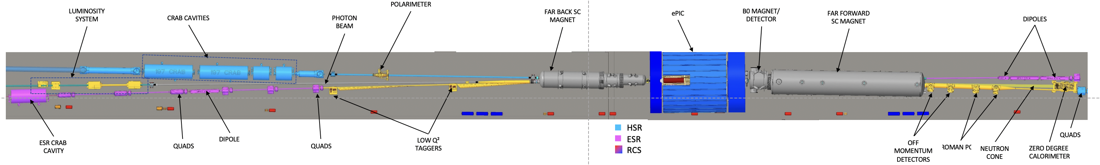
Detector Technical Baseline
Central Detector Baseline Technology choices were completed in 2023 before the Comprehensive Design Review by the Detector Advisory Committee and folded into the CD-3A review
  Baseline choices are in project schedule but continuously improving schedule
Far-Forward/Far-Backward Baseline Technology choices were completed and presented at a recent February 12th IR Integration and Auxiliary Detectors preliminary design review
  These were more to align the international ePIC collaboration than technical-driven
  Updating project schedule to reflect baseline choices (there is no impact on cost, schedule and risk)
There are no outstanding technology decisions; emphasis has shifted to documenting what-if alternate detector choices to mitigate risk caused by R&D delays and/or dependencies.
There may be later the possibility for baseline technology changes might in-kind opportunities arise, if and only if
  The alternate detector technology meets the requirements
  There is no impact on schedule and risk, including those on possible interfaces
  There is a positive cost impact due to the in-kind agreement

Slide 12
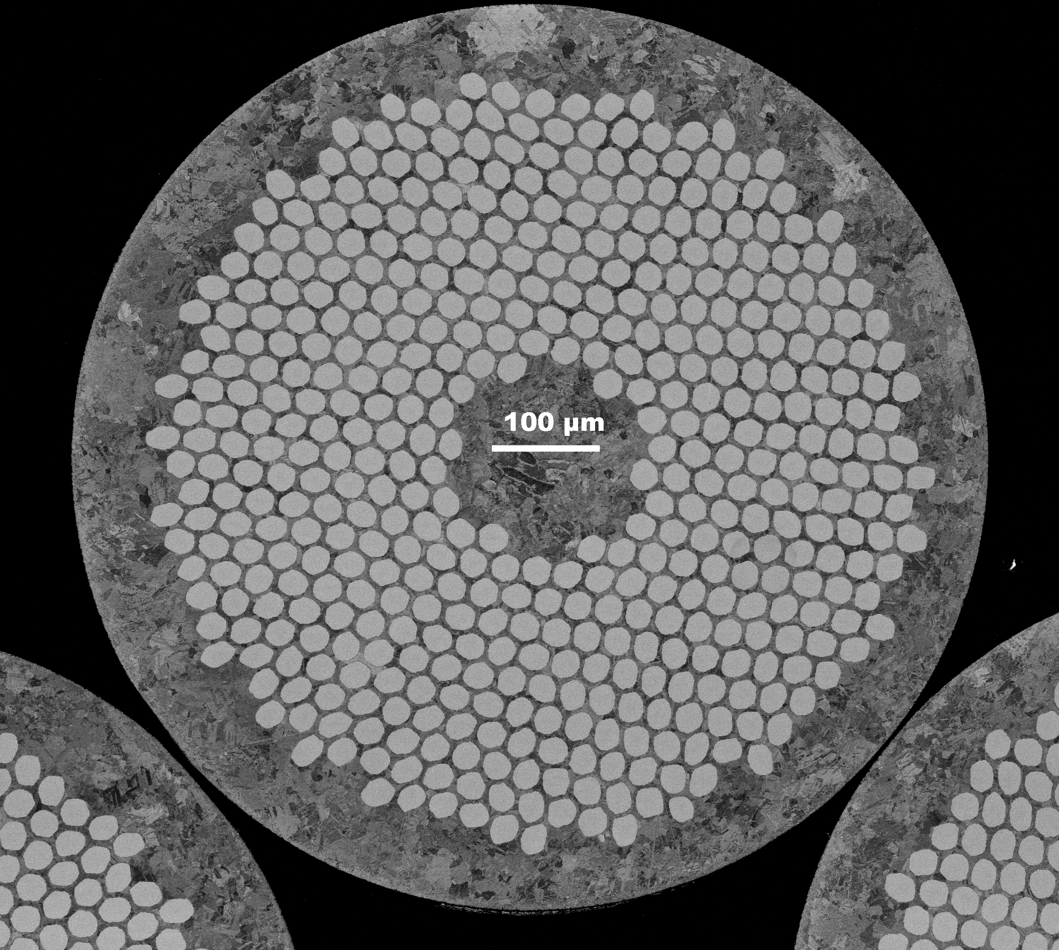
Progress on Long-Lead Procurement CD-3A Scope
Detector Systems CD-3A Scope
  WBS 6.10.05: Lead Tungstate Crystals for the Detector Backward EM Calorimeter
    CD-3A scope is first two years of procurements (1500 pieces) – READY TO GO (BNL), 2nd YEAR PENDING NSF PROPOSAL
  WBS 6.10.05: Scintillating Fibers for the Detector Barrel and Forward EM Calorimeters
    CD-3A scope is 1875 km first of four phases – READY TO GO (BNL)
  WBS 6.10.06: Silicon Photomultipliers for the Detector Foward Hadronic Calorimeter
    CD-3A scope is one phase (320K SiPMs) out of two for the forward Hadron Calorimeter – READY TO GO (BNL)
  WBS 6.10.06: Steel and Tungsten Plates for the Detector Forward Hadronic Calorimeter
    CD-3A scope is first of two phases (~50%) – RECORD OF DECISION ONGOING TO ONLY USE STEEL AND OMIT TUNGSTEN
  WBS 6.10.07: Detector Solenoid Magnet Design and Fabrication and Conductor
    CD-3A scope is for the conductor and the full magnet construction.
– MAGNET HAD RFP IN 2023
– MAGNET CONSTRUCTION CONTRACT PAYMENT BY INFN, OVERSIGHT/COMMISIONING BY JLAB AND CEA-SACLAY
– MAGNET CONDUCTOR CONTRACT BY JLAB, READY TO GO AFTER SAMPLE TESTS COMPLETED
6.10.07 Magnet – strands that are sent from Luvata to Twente for sample tests, the filaments are beautifully arranged – These are the final quality assurance tests before starting the long-lead procurement for conductor.

Slide 13
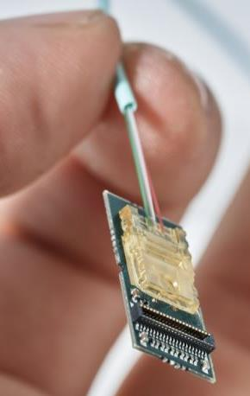
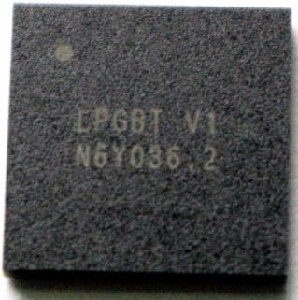
Possible Long-Lead Procurement CD-3B Scope
Continuation of CD-3A Scope
  WBS 6.10.05: Lead Tungstate Crystals for the Detector Backward EM Calorimeter
    Remaining 1500 pieces to complete need
  WBS 6.10.05: Scintillating Fibers for the Detector Barrel and Forward EM Calorimeters
    2nd phase of 4 phases → 1875 km
  WBS 6.10.06: Silicon Photomultipliers for the Detector Foward Hadronic Calorimeter
    Remaining 300k SiPMs
  WBS 6.10.06: Steel Plates, Casing Steel and Electron-Welding for the Detector Forward Hadronic Calorimeter
    Remaining 50% of equipment
New Items:
  WBS 6.10.07: Detector Solenoid Magnet Power Supply
  WBS 6.10.10: Flux Return Steel for the Electron and Hadron Endcaps
  WBS 6.10.08/09: Readout Chips needed for MAPS tracker and dRICH - VTRx+/lpGBT

Slide 14
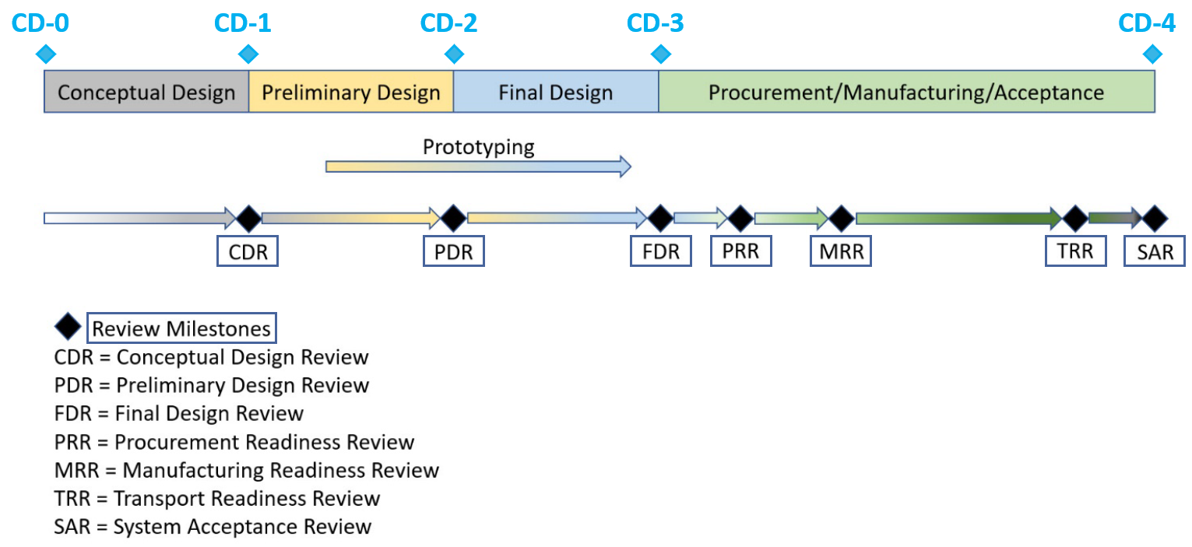
Path to CD-2/CD-3B and to CD-3
Preliminary and Final Design Reviews
  PDR2: IR Integration and Auxiliary Detectors – February 12, 2024 – main emphasis on baseline choices and progress
  Reviewers: Fulvia Pilat (ORNL), Gerrit Van Nieuwenhuizen (BNL), Wolfram Zeuner (CERN), Eugene Chudakov (JLab)
  PDR1: Tracking Detectors – March 20-21, 2024 – main emphasis on baseline tracking layout, if we are on track and plans
  Reviewers: Andy White (UTA), Michael Begel (BNL), Maxim Titov (CEA), David Lynn (BNL), Piotr Gasik (GSI)
  PDR2: Electronics/DAQ – Early June 2024 – continuation of PDR1 to ensure we are on track and show progress
  PDR2: Particle Identification Detectors – Summer 2024?
  PDR1: Integration, Infrastructure and Installation – September 2024 – includes detector support structures
  PDR2: Barrel EM Cal – Summer/Fall 2024 – emphasis on mechanical design & AstroPix readiness (needs {PDR before CD-2)
  PDR2: Polarimetry – timescale TBD (but before CD-2)
  FDR: Magnet Power Supply – aim for May 28, 2024 – final design review for possible CD-3B scope
  FDR: VTRx+/lpGBT – included as ½ day in Electronics/DAQ review of early June 2024, possible CD-3B scope
  FDR: Magnet flux return steel – September 2024 – included as final specifications in above PDR for possible CD-3B scope
  FDR: Backward & Forward EM Calorimetry, Barrel & Forward HCAL – Fall 2024
Next ePIC Computing & Software review by host labs – ~October 2024
14

Slide 15
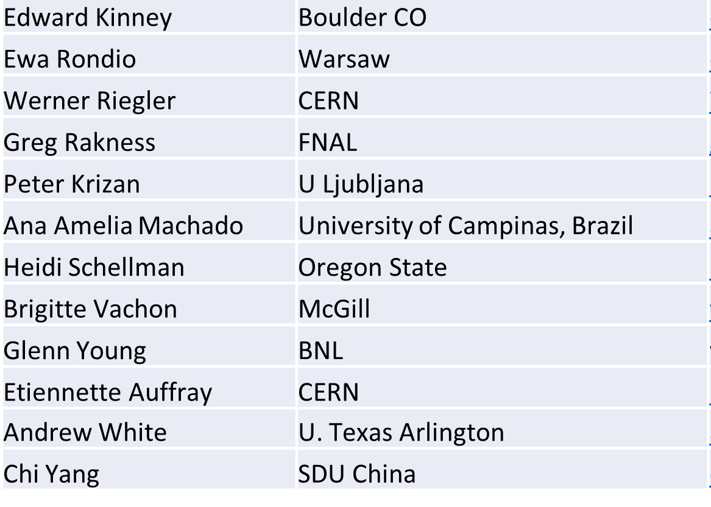
Detector Advisory Committee
DAC founded in 2020
Per the charter, 1/3 of the committee replaced every year
  Transition Chair from Ed Kinney to Andy White as chair
2020 - 2022
2023
2024
Edward Kinney (Chair) | Boulder CO
Ken Wyllie | CERN
Petra Merkel | FNAL
Antonis Papanestis | Rutherford Appleton Laboratory
Peter Krizan | U Ljubljana
Ana Amelia Machado | University of Campinas, Brazil
Heidi Schellman | Oregon State
Brigitte Vachon | McGill
Stefano Miscetti | INFN Frascati
Etiennette Auffray | CERN
Andrew White | U. Texas Arlington
Chi Yang | SDU China
Edward Kinney | Boulder CO
Ken Wyllie | CERN
Petra Merkel | FNAL
Antonis Papanestis | Rutherford Appleton Laboratory
Peter Krizan | U Ljubljana
Ana Amelia Machado | University of Campinas, Brazil
Cecillia Gerber | UIC
Brigitte Vachon | McGill
Stefano Miscetti | INFN Frascati
Roman Poeschl | IJCLab
Andrew White (Chair) | U. Texas Arlington
Eraldo Oliveri | CERN
DAC-Meetings 2024 under planning:
  May 2024: Project Status, Baseline Detector, International Engagement, Detector R&D progress (expect 1+ day)
  August 2024: Detector R&D annual review (expect 2 days) – deadline for submission July 1, 2024

Slide 16

Detector R&D
https://indico.bnl.gov/event/22388/
Two tier Detector R&D program is critical for success of the EIC facility
Generic EIC Detector R&D program (2011 – 2021)
  Excellent experience (https://wiki.bnl.gov/conferences/index.php/EIC_R%25D)
  Reduced the overall Risk level of EIC detector technology to Low/Moderate
  Engaged 75 institutions (50% domestic, 50% international) from 10 countries
DOE/NP has restarted generic detector R&D program (2022 - now) (https://www.jlab.org/research/eic_rd_prgm)
R&D under EIC Project
https://wiki.bnl.gov/conferences/index.php?title=Proposals
  Commonly organized Detector R&D Day by ePIC and EIC Project
  Excellent reports and presentations documenting good progress towards R&D milestones
  Call for updates and follow-up plans will come in about one month with due date of July 1

Slide 17
Goals for 2024 (path to CD-2)
Quantify (time, cost, performance) and document, before CD2, mitigation plans for the possibility that some R&D components will not meet expectations
  Tracking layout with branching points defined and documented
  HRPPD backup option documented, etc.
Ensure good project progress
  Implement procurements for CD-3A scope, manage progress and track progress through EVMS
  Continue work on design maturity for all (non-CD-3A) systems.
  Define CD-3B needs: next phases of CD-3A, magnet power supply, perhaps VTRx+ optical transceivers, flux return steel
  PDRs of Tracking, Far-Forward/Far-Backward, Electronics/DAQ, Particle Identification
  FDRs of Magnet Power Supply, Calorimetry, Flux return steel
Continue work on integration aspects, e.g., service needs of various detectors, cable routing, electronic rack layouts, survey & alignment planning, monitoring systems, controls needs.
  System engineering for electrical and services (per DOE/OPA recommendation)
  Document controls needs
  Collect interfaces beyond CD-3A scope, and document towards ICDs
Simulations with Full Materials, Background and Reconstruction
Formalize in-kind agreements in form of high-level agreements and project planning documents, as appropriate: Italy/INFN (Detector, Magnet), France/IN2P3, France/IRFU, UK/STFC, perhaps NSF, other
2024: Year-long ePIC driven activity to draft a Technical Design Report – plan to be published as were the earlier EIC White Paper (as of now 1587 citations) and the Yellow Report (as of now 788 citations).

Slide 18


Integrating Collaboration in Project WBS
DSL:
Detector Subsystem Leader
DSTC:
Detector Subsystem Technical
Coordinator
Detector
Subsystem
Work Packages
need to be
integrated in WBS

Slide 19











Integrating Collaboration in Project WBS
Work packages are implemented at L5 or lower

Slide 20








Central Detector Non-DOE Interest & In-Kind
Superconducting
Solenoid
Dual-radiator
RICH
Forward Electromagnetic
Calorimeter
Barrel
Electromagnetic
Calorimeter
Tracking
Detectors
Backward
Electromagnetic
Calorimeter
Time-of-Flight
Backward Hadronic
Calorimeter
Data-Acquisition
Electronics

Slide 21
Far-Forward/Far-Backward Detectors Non-DOE Interest & In-kind
B0 Magnet Spectrometer
Zero Degree Calorimeter
e beam
Roman Pots and
Off-Momentum Detectors
p/A beam
Luminosity System
Low-Q2 Taggers
IR vacuum – crucial interface for detectors

Slide 22
Detector Non-DOE Interest & In-Kind
Entity | Interest and Important Facts
NSF | NSF-MSRI pre-proposal submitted by 10 US universities – aims at full scope of backward EM calorimetry (eECal). Armenia, Czech, France/IN2P3 as unfunded contributors. Invited to submit proposal. Moved within NSF to consider in MPS directorate. Internal NSF review completed. Pending funding decision.
CERN | MAPS sensor design developed by CERN/ITS-3 Group providing synergy with ALICE. Synergy of gaseous-based Cherenkov detectors and photon-sensors with ALICE & LHCb. Synergy of Forward AC-LGAD design with CMS endcap timing layer.
Armenia | Contributions, mainly labor to eECal and many EM calorimetry and particle id detectors component tests.
Canada | EIC included in 2022 Canadian Subatomic Physics Long-Range Plan; Interested in Barrel Electromagnetic Calorimetry, Electron Polarimeter and Software. Working on 2024 proposal.
China | Interested in Forward EM Calorimeter – working on NSF-China proposal.
Czech | Working with funding agency; Interested in eECal (PbWO4 crystals and glass), Silicon Vertex Tracker sensors and characterization, and collaboration on low-Q2 electron tagger.
France/IRFU | Interested in MPGD/racking and readout electronics including ASICs for MPGDs. Provided in-kind contributions to SC magnet design and interested to continue labor oversight during magnet construction.
France/IN2P3 | International contribution to backward EM calorimetry (including in-kind design) and to readout electronics (in-kind design of two ASICs for AC-LGAD detectors and Calorimetry). IRFU & IN2P3 discussing together for higher-level contributions.
India | EIC included in 2023 Mega Science Vision Plan. Consortium is working with Funding agency; Interested in detector software (non-project scientific contribution), contributions to DAQ/slow controls and forward dRICH. Investigating further hardware contributions – forward EM Calorimeter, forward AC-LGAD, maintain possible links with Si groups and plants.
Italy/INFN | Commitment to EIC detector magnet construction scope. Aims at major scope of forward particle identification detector (dRICH) including ASICs development, at (part of) the Si/MAPS tracker scope, and at photo-sensor contributions as well as contributions to the μRwell. Tracker (forward disks)..
Israel | B0 Detectors (Si tracking and PbWO4)
Japan | Interested in a US-Japan agreement; Aims at full scope of Zero-Degree Calorimeter in collaboration with Taiwan/Korea. Pursuit of full scope of barrel AC-LGAD detector as EIC-Asia consortium. Contribution to DAQ/streaming.
Korea | Aims at major scope for fiber-based barrel EM calorimeter, Also interest in barrel AC-LGAD and Si-based hadronic calorimetry for ZDC.as part of EIC-Asia consortium (includes also Japan,Taiwan), Si tracking detector and GEM-based detectors. Proposal submitted to MSIT.for M&S for barrel EMCal and support for labor for all interests. In policy review stage.
Poland | Actively working with ministry/funding agency; Interested in detectors along the beam line (luminosity detector, Roman Pots)
Taiwan | Pursuit of full scope of barrel AC-LGAD as part of EIC-Asia consortium. LYSO-based EM calorimeter for ZDC, Also optical readout/fiber. Possible later interest in PCBs. Computing. Also investigating if AC-LGAD sensors can be produced by Taiwan industry, if so these sensors could be in-kind.
UK | STFC seed funding for UK detector R&D (3M£). Large STFC/UKRI research infrastructure proposal approved, includes the two outer barrel layers of the silicon vertex tracker, two tracking stations for the low-Q2 electron tagger, and components for the luminosity monitor. Also includes accelerator component.

Slide 23
Summary
EIC science has worldwide endorsement (Canada Long-Range Plan, NSAC Long-Range Plan, India MegaScience Vision Plan, NuPECC recommendation, …).
Successful transition to ePIC detector collaboration.
  Excellent working mode.
Project detector R&D started Q3/FY22. Benefits from large in-kind component.
  Milestones defined and included in P6. DAC reviews annual progress. FY24 contracts (nearly all) in place.
  All non-Si/ASICs related detector R&D on track to complete in FY24.
  DOE initiated generic EIC detector R&D program in FY22, hosted by JLab.
Excellent progress on Project Engineering and Design (PED)
  Designs are maturing with help from our many domestic and international collaborators.
  This constitutes a ~$5M in-kind non-DOE PED contribution.
Detector technically baselined.
  Central detector baseline technologies chosen July 2023.
  Far-forward/far-backward baseline technologies chosen February 2024.
Recent emphasis on CD-3A, CD-3B, path to CD-2
  Preparing for detector CD-3A item contracts.
  CD-3B for detector includes a phase continuation for CD-3A scope and select other items.
  On path to reach CD-2 required design maturity in 2025.

Slide 24




and the Interaction Region are built

Slide 25


Slide 26


What composes Visible Matter
atom
if you look through a
higher and higher
resolution microscope
you discover a
femto Universe
size scale
3.2 10⁻¹⁵ feet = 1 femto m (fm)
Quark
Big Question:
can we understand
how the visible matter is formed
from the smallest
elementary building blocks
quarks and gluons
Quark
Quark
Quark
Gluon
proton
Gluon
All elementary building blocks can be characterized by their mass, spin and charge

Slide 27




EIC Science Goals
Proton spins are used to image the structure and function of the human body using the technique of magnetic resonance imaging
Are gluons in the proton like cancer cells in an organism ?
Their number is growing – growing - growing
Nobel Prize 2003:
Paul C. Lauterbur & Sir Peter Mansfield
for discovery concerning magnetic resonance imaging
What makes up the spin of the Proton?
EIC
will tell us the growth gets tamed
and if gluons saturate into a new state of matter
The Color Glass Condensate
EIC will tell us

Slide 28



The Mystery about Visible Matter
Atom 10⁻¹⁰ m
Nucleus few x 10⁻¹⁵ m
Proton <10⁻¹⁵ m
Iron atom
Ionization Energy = 7.9 eV/electron
Binding/Mass = 0.00000001
Iron = Set of 56 protons/neutrons
Binding Energy = 310 MeV/quark*
Binding/Mass = 100
Iron nucleus
Binding Energy = 8.8 MeV/nucleon
Binding/Mass = 0.01
*Binding Energy = ∞/gluon

Slide 29





EIC Science Highlights
Proton:
momentum
space
3d-Imaging
coordinate space
Spin
Mass
Nuclei:
3d-Imaging
of nuclei
nPDF
√s < 90 GeV
non-linear QCD effects → Saturation

Slide 30






The Scientific Foundation for an EIC was Built Over Two Decades
2002
“a high-energy high-luminosity polarized EIC [is] the highest priority for new facility construction following the completion of FRIB.”
2007
The science questions that an EIC will answer are central to completing an understanding of atoms as well as being integral to the agenda of nuclear physics today.”
2009
2010
Gluons and the Quark Sea at High Energies
2012
2013
2015
Science Requirements and Detector Concepts for the EIC – Drives the requirements of EIC detectors
Major Nuclear Physics Facilities for the Next Decade
2018
2021
“…essential accelerator and detector R&D [for EIC] should be given very high priority
in the short term.”
NSAC
2023
We recommend the expeditious completion of the EIC as the highest priority for facility construction.
“We recommend the allocation of resources …to lay the foundation for a polarized Electron-Ion Collider…”
“..a new dedicated facility will be essential for answering some of the most central questions.”
March 14, 2013
“The quantitative study of matter in this new regime [where abundant gluons dominate] requires a new experimental facility: an Electron Ion Collider..”
Electron-Ion Collider..absolutely central to the nuclear science program of the next decade.
arXiv:2103.05419

Slide 31


Integration, Integration, Integration
Integrate main detector and ancillary detectors into the IR and electron and hadron beam lattice
All subdetectors and services into the main
detector volume
Installation of detector and accelerator components

Slide 32

Detector Domestic Interest in EIC and Diverse Workforce Development
The growing EIC user community currently comprises 99 US institutions including 9 National Laboratories
13 of these are MSIs:
  Dillard University
  Florida A&M University
  Florida International University
  Georgia State University
  Hampton University
  New Mexico State University
  Texas A&M
  Texas Southern University
  Univ. of California, Riverside
  University of Illinois Chicago
  University of Houston
  University of Puerto Rico, Rio Piedras
  Virginia Union University
The broad US interest in EIC provides opportunities for further diverse workforce development
32

Slide 33







US National Laboratory (Main) Involvement – not including BNL and JLab
Barrel
Electromagnetic
Calorimeter
Forward Hadron Calorimeter
(ORNL also large involvement in DAQ/electronics)
Backward
Electromagnetic
Calorimeter
Silicon/MAPS
Tracking Detectors
US University
Consortium
Barrel Time-of-flight

Slide 34
Detector US University Partnerships
Barrel Electromagnetic
Calorimeter
Baruch College, NY
Columbia University
Iowa State University
BNL
Rutgers University
University of Connecticut
Georgia State University
Forward Electromagnetic
Calorimeter
Indiana University
UCLA
UCR
Barrel Hadron
Calorimeter
ANL
NASA Goddard Space Flight Center
Oklahoma State University
The Ohio State University
UC Santa Cruz
University of Connecticut
Dual-radiator
RICH
Duke University
Temple University
LBNL
LANL
UC Berkeley
Purdue University
Florida Institute of Technology
JLab
Temple University
BNL
BNL
Rutgers University
Georgia State University
UIUC
The Ohio State University
Backward
Hadronic Calorimeter
Tracking
Detectors
Backward Electromagnetic Calorimeter
Forward Hadron Calorimeter
Abilene Christian University
Catholic University of America
Florida International University
JLab
Lehigh University
MIT
University of Kentucky
William & Mary
Ohio University
Backward
RICH
ORNL
Georgia State University
Yale University
ISU
Indiana University
UCR
University of Tennessee Knoxville
Valparaiso University
UT Austin
Time-of-Flight
DIRC
BNL
Duke University
Purdue University
Temple University
Georgia State University
Yale University
UIC
BNL
Purdue University
RICE University
UC Santa Cruz
Kent State
Catholic University of America
Old Dominion Univ.
SBU
JLab
University of South Carolina
Wayne State University

Slide 35
Detector US University Partnerships – cont.
Data Acquisition, Slowcontrol, Quality Assurance of different components, Software
Augustana University
BNL
California Polytechnic State University, San Luis Obispo
Canisius College
Christopher Newport University
College of William and Mary
Creighton University
George Washington University
Hampton University
JLab
Lawrence Livermore National Laboratory
Mississippi State University
Morehead State University
New Mexico State University
Ohio University
Southern Methodist University
University of California, Davis
University of Colorado Boulder
University of Illinois Urbana-Champaign
University of Massachusetts, Amherst
Detectors along the beamline
BNL
JLab
MIT
Pacific Northwest National Laboratory
Temple University
University of Houston
University of Kansas

Slide 36

WBS 6.10 EIC Detector & 6.10.01 Management
How We Work:
The highest-level detector management consists of:
Elke & Rolf L2 Leads
Walt Akers 6.10 Systems Engineer
Fernando Barbosa Chief Electrical Engineer
Rahul Sharma Chief Mechanical Engineer
Do not use this CAM responsibility organization as Black and White, we work together as a scientific collaboration and use expertise from each lab as it fits independent of high-level responsibility
We include user efforts where it makes sense, and lean to more
We have
Weekly meetings with ePIC spokesperson and deputy
Weekly meetings with the mechanical engineering team
Biweekly meetings with the electrical engineering team
Weekly meetings with the Detector Control Account Managers
As needed meetings with various detector subsystems
Walt, Fernando and Rahul have also separate meetings, for Walt with the Systems Engineering Group, for Rahul with also various non-BNL/non-Jlab engineers/designers, etc.
We report at the biweekly ePIC meetings and many other meetings on general detector progress or requested topics
Blue/Green show nominal BNL/JLAB responsibility

