Slide 1
Status of International Agreements and Engagement
Luisella Lari
EIC Project Manager
EIC 3rd Resource Review Board Meeting
May 6-7, 2024

Slide 2
Outline
EIC Reference Dates & IKC goals
International Agreements: a reminder
EIC Organization support
First Phase of Milestones for Accelerator
First Phase of Milestones for Detector
Summary

Slide 3
EIC Reference Dates
Title | Event Type | Topic | Dates
2nd Resource Review Board | Advisory | PM | Dec 7-8, 2023
Advisory Board Meeting | Advisory | PM | Jan 25, 2024
Infrastructure Construction Advisory Committee Meeting | Advisory | Infra | Jan 30-31, 2024
Project Advisory Committee Meeting | Advisory | PM | Feb 29, 2024
DOE CD-3A ESAAB Approval | Milestone | PM | Mar 28, 2024
Virtual Machine Advisory Committee Meeting | Advisory | Acc | Apr 15,17, 2024
Advisory Board Meeting | Advisory | PM | Apr 19, 2024
3rd Resource Review Board | Advisory | PM | May 6-7, 2024
Project Advisory Committee Meeting | Advisory | PM | Summer 2024
Detector Advisory Committee Meeting | Advisory | Det | Summer 2024
Machine Advisory Committee Meeting | Advisory | Acc | Sep 2024
Advisory Board Meeting | Advisory | PM | Sep 2024
Infrastructure Construction Advisory Committee Meeting | Advisory | infra | Oct 2024
CD-3B and Status Director’s Review | Review | PM | Oct 2024
4th Resource Review Board | Advisory | PM | Late Nov 2024
DOE CD-3B and Status OPA Review | Review | PM | Jan 7-9, 2025
DOE CD-3B ESAAB Approval | Milestones | PM | Mar 2025
DOE CD-2 and Status OPA Review | Review | PM | Late 2025
CD-2 Target
Late 2025

Slide 4
EIC IKC CD-2 expectations
Validate IKC EIC goals.
IKC goals are currently : (1) 5% of the scope for the accelerators and (2) 30% of the scope for the detector.
2. Sign binding (contractual) agreements.
3. Develop & sign IKC not legally binding detailed project planning support documents, where necessary
((1)Technical complex items; (2) Critical technical items; (3) High risk items; (4) High-cost items),
to align the IKC deliveries to the project scope expectation and schedule.

Slide 5
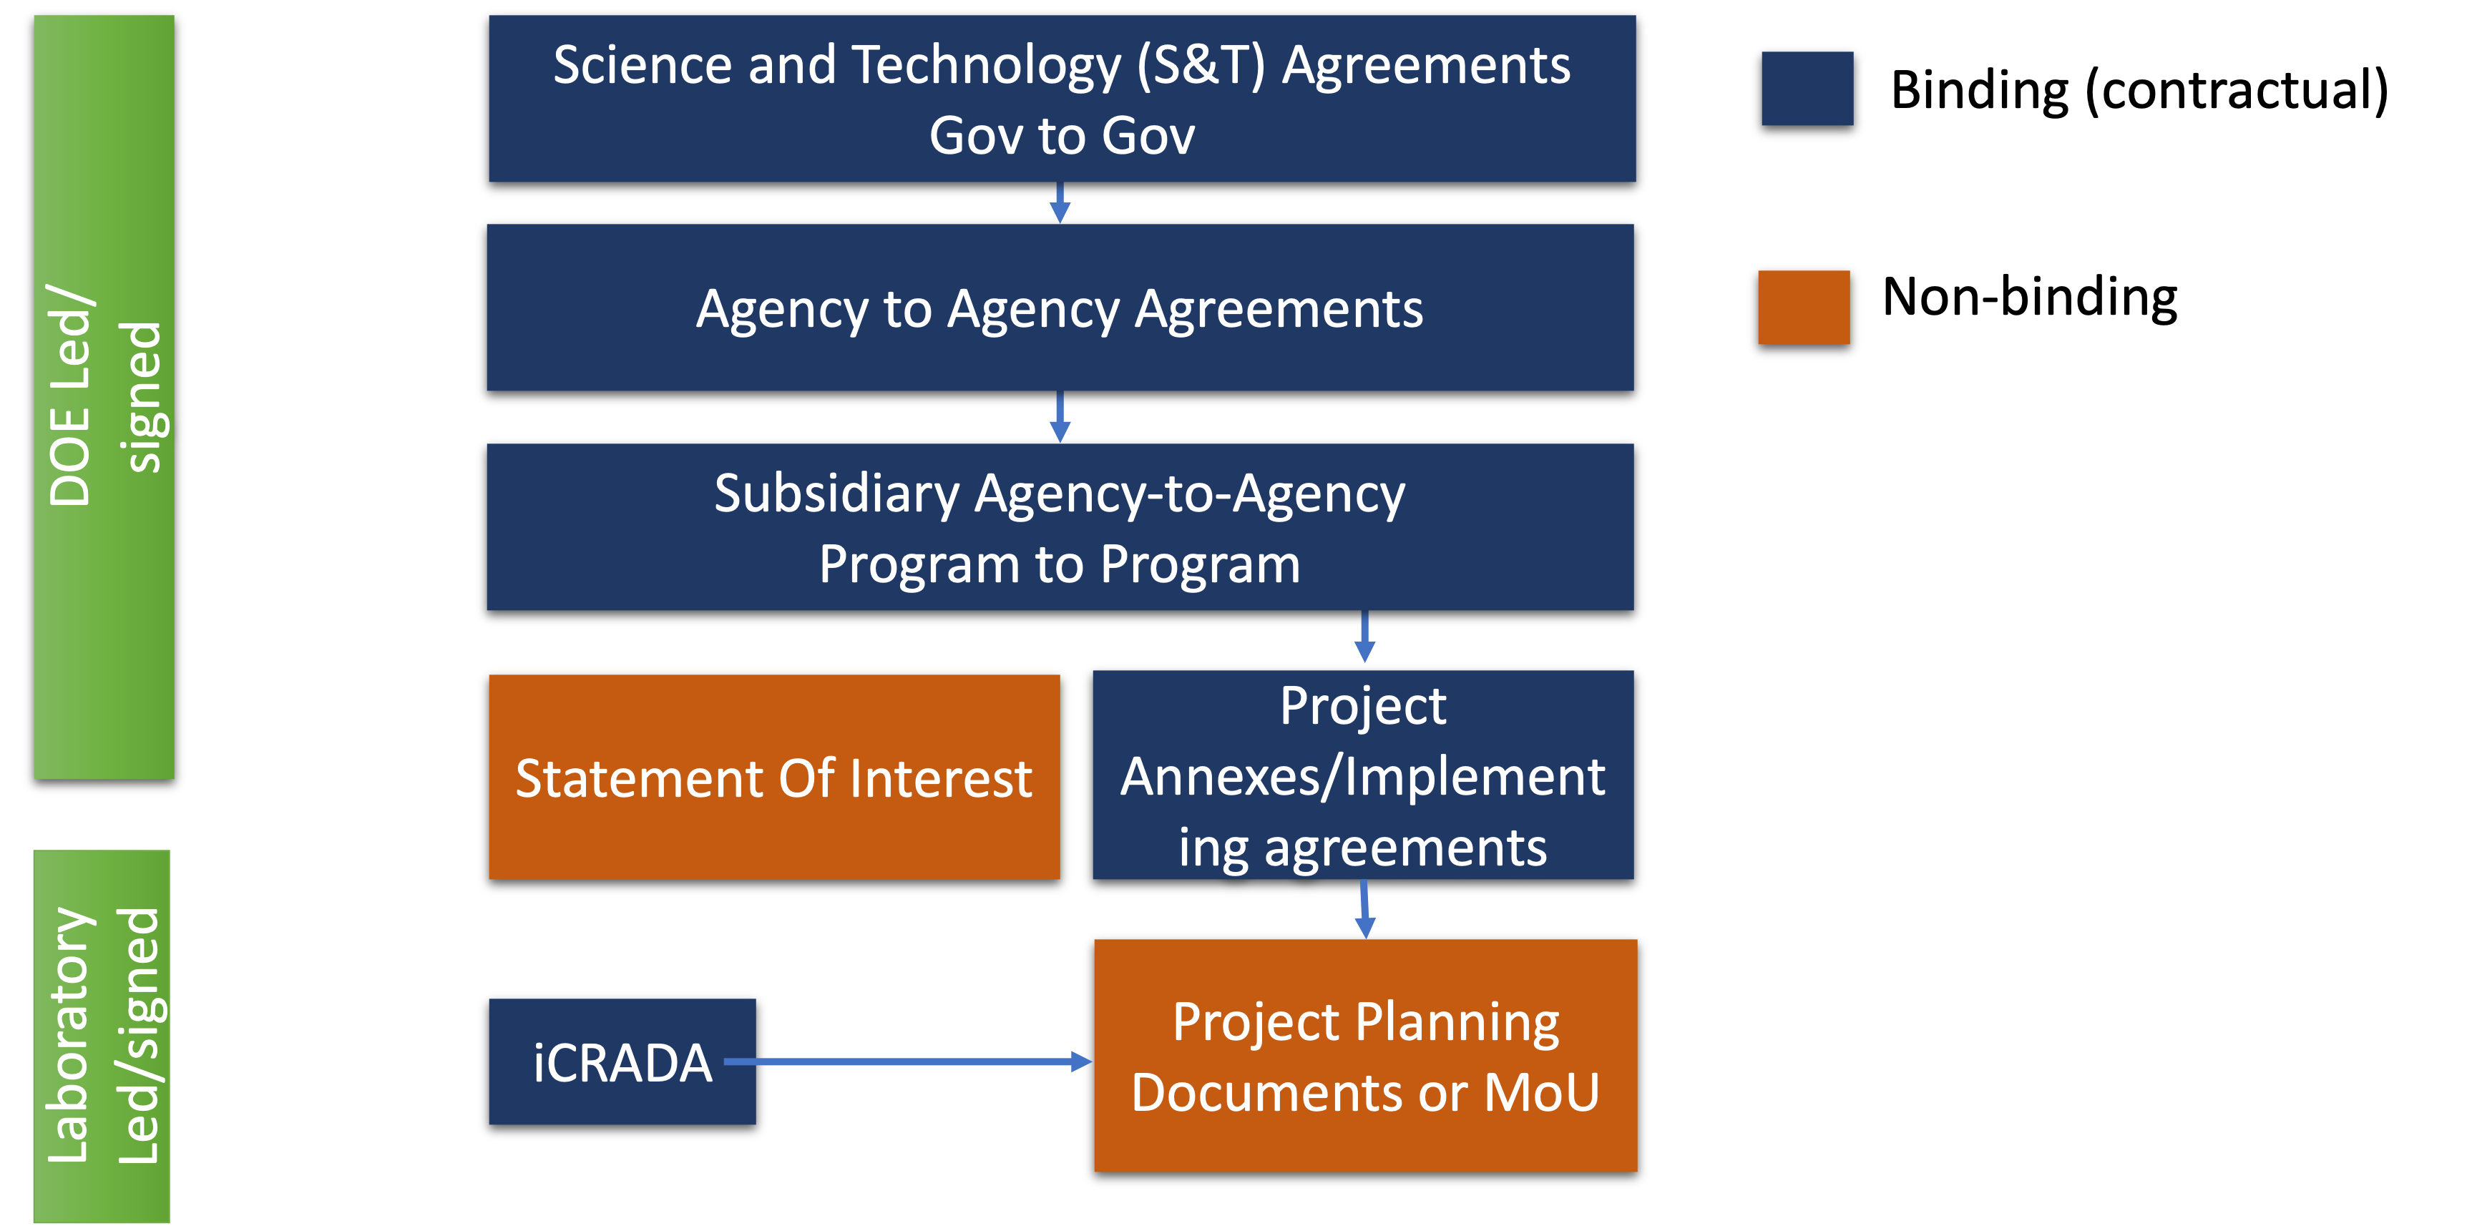
International Agreements Overview
DOE level agreements are not containing details on EIC IKC scope.
For this reason, it is suggested to pursue iCRADA (laboratory level) binding agreement for all the IKC items for which the development of Project Planning Document (PPDs) are requested.

Slide 6
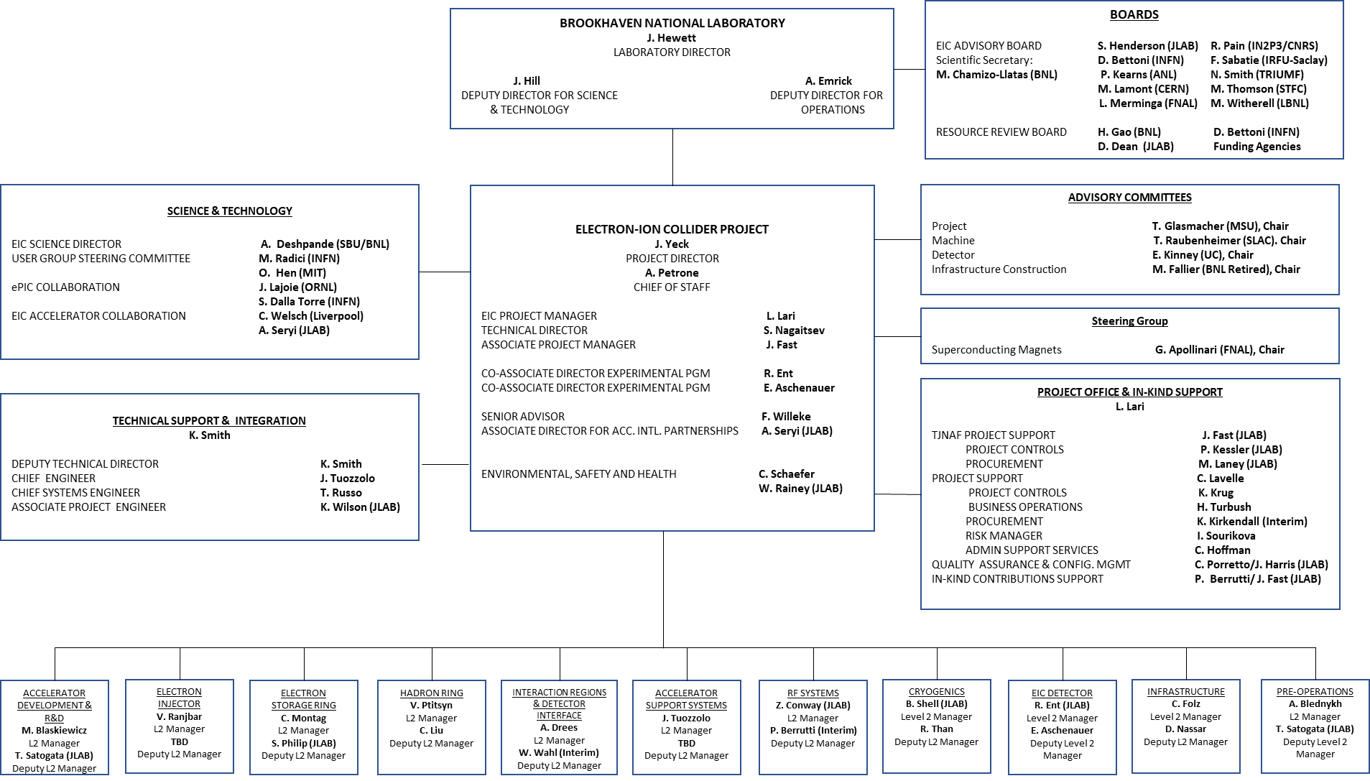
Project Organization- Level 1
BNL/JLab Partnership
Science & Collaboration Advice and Input
International Governance
Technical and Project Support
Directly Involved in the Agreements preparation
Advisory boards
*
*
*
*
First Phase of EIC IKC identified areas

Slide 7
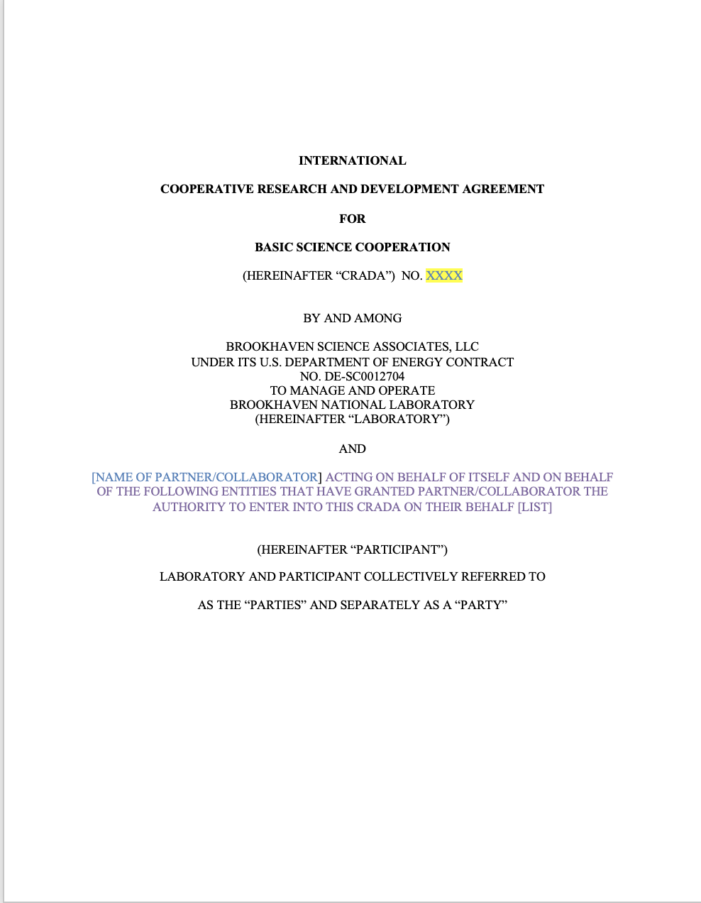
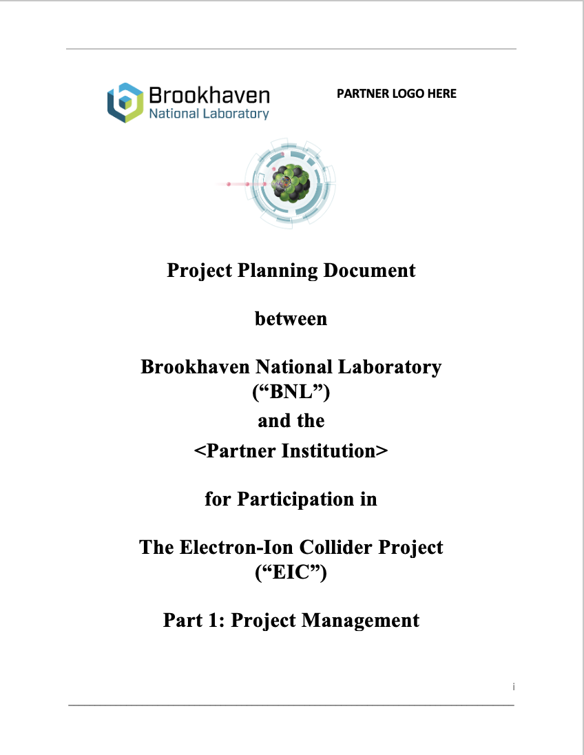
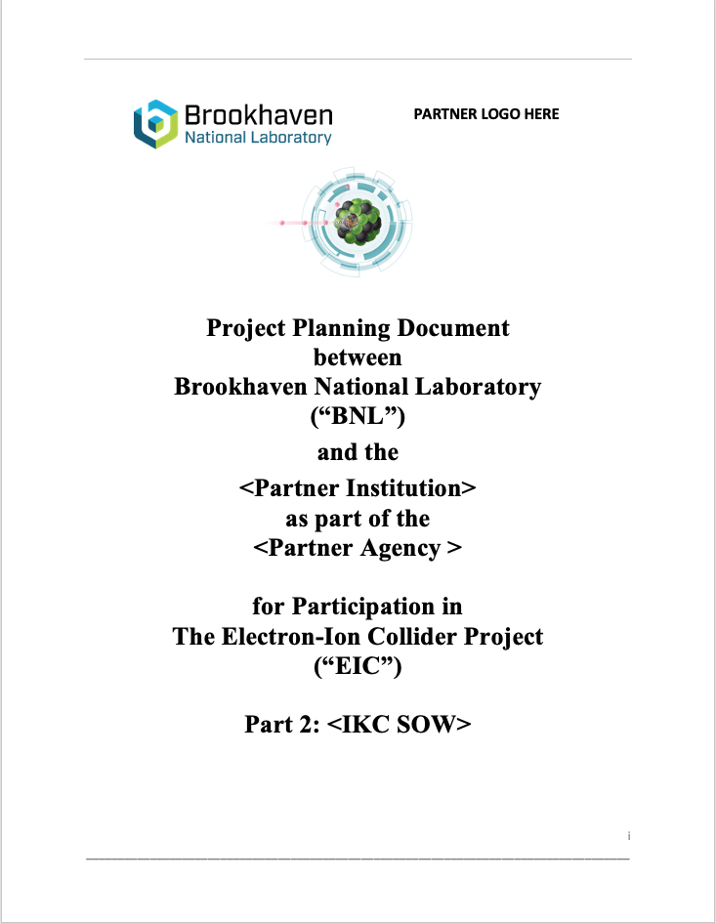
First Phase of EIC IKC identified areas
IKC Area | Activity ID and Name
Accelerator | 6.06.02.02 IR Spin Rotator Magnets
Accelerator | 6.08.04.03 1773 MHz 5-Cell Elliptical Cavity Cryomodule
Accelerator | 6.08.04.05 394 MHz Crab Cryomodule
Accelerator | 6.08.04.02 591 MHz 5-Cell Cryomodule
Detector | 6.10.04.02 dRHIC Dual ring Cherenkov Detector
Detector | 6.10.07 Detector Magnets Procurement
Detector | 6.10.07 Detector Magnets Labor
Detector | 6.10.03.01 Silicon Trackers (UK)
Detector | 6.10.03.01 Silicon Trackers (INFN)
Detector | 6.10.03.02 Micro Pattern Gaseous Detector (MPGD) Trackers
Detector | 6.10.11.04 Low-Q2 Detectors
Detector | 6.10.05.01 Backward Electromagnetic Calorimetry
The process of formalize the IKC is started.

Slide 8
First Phase of EIC IKC identified areas
IKC Area | Activity ID and Name | iCRADA BNL | iCRADA JLAB | PPD BNL | PPD JLAB
Accelerator | 6.06.02.02 IR Spin Rotator Magnets | ? | NONE | ? | NONE
Accelerator | 6.08.04.03 1773 MHz 5-Cell Elliptical Cavity Cryomodule | X | X | X | NONE
Accelerator | 6.08.04.05 394 MHz Crab Cryomodule | X | X | X | NONE
Accelerator | 6.08.04.02 591 MHz 5-Cell Cryomodule | X | X | X | NONE
Detector | 6.10.04.02 dRHIC Dual ring Cherenkov Detector | NONE | X | ? | X
Detector | 6.10.07 Detector Magnets Procurement | NONE | X | NONE | X
Detector | 6.10.07 Detector Magnets Labor | NONE | X | NONE | X
Detector | 6.10.03.01 Silicon Trackers (UK) | X | NONE | X | ?
Detector | 6.10.03.01 Silicon Trackers (INFN) | X | ? | X | ?
Detector | 6.10.03.02 Micro Pattern Gaseous Detector (MPGD) Trackers | NONE | X | ? | ?
Detector | 6.10.11.04 Low-Q2 Detectors | X | NONE | X | ?
Detector | 6.10.05.01 Backward Electromagnetic Calorimetry | X | NONE | X | ?
The Table shows the draft current needs for iCRADAs and PPDs per scope areas. Some of them marked with “?” are under discussion.

Slide 9
First Phase of Milestones for Accelerator IKC
Country - Agency | Milestone | Target Date
Canada – TRIUMF | JLab iCRADA (for Crab CMs) drafted | Since end 2023
Canada – TRIUMF | BNL iCRADA (for Crab CMs) drafted | Jun 2024
UK | JLab iCRADA (for 1773 MHz 5-Cell CMs) drafted | Aug 2024
UK | BNL iCRADA (for 1773 MHz 5-Cell CMs) drafted | Aug 2024
France – IN2P3 | JLab iCRADA (for 591 MHz 5-Cell CMs) drafted | Sep 2024
France – IN2P3 | BNL iCRADA (for 591 MHz 5-Cell CMs) drafted | Sep 2024
Canada – TRIUMF | iCRADAs signed | Dec 2024
UK | iCRADAs signed | Dec 2024
France – IN2P3 | iCRADAs signed | Dec 2024
 | PPDs preparation could start at the end of drafting the iCRADA and completed in 2025 | Mar 2025 Ready to be signed
 | CD-2 Director’s Review / All ICRADA and PPDs signed | Sep or Oct 2025
 | DOE CD-2 and Status OPA Review | Late 2025

Slide 10
First Phase of Milestones for Detector IKC
Agency | Milestone | Target Date
Italy-INFN | JLab iCRADA (for dRICH, Si/ITS3, GEM-muRwell) drafted* | Apr 2024
UK | JLab iCRADA (for Si/LAS, Low-Q2, Lumi) drafted** | Apr 2024
UK | BNL iCRADA (for Si/LAS) drafted | Jun 2024
Italy-INFN | JLab iCRADA (for solenoid) drafted | March 2024
France-CEA | JLab iCRADA (for solenoid) drafted | March 2024
France-IN2P3 | JLab iCRADA (for EEEmCAL, RPs, ASICs) drafted** | May 2024
France-CEA | JLab iCRADA (for MicroMegas, SALSA) drafted | June 2024
 | PPDs preparation could start at the end of drafting the iCRADA and completed in 2025 | Mar 2025 Ready to be signed
 | CD-2 Director’s Review / All ICRADA and PPDs signed | Sep or Oct 2025
 | DOE CD-2 and Status OPA Review | Late 2025
* JLab iCRADA draft to start process, Si scope moves to BNL iCRADA
**JLab iCRADA draft to start process, then move to BNL iCRADA
Plan to start Second Phase of draft iCRADAs once scope is clear and as aligned with time scales of foreign agencies, e.g., Korea, Canada, Japan, India, Israel…

Slide 11
Summary
To baseline (CD-2) the EIC Project the IKC scope needs to be properly documented, in particular in the area of complex deliveries:
iCRADA legally-binding agreement are proposed to be prepared and signed.
PPDs not legally binding document are proposed to be prepared and signed.
iCRADA and PPDs templates were distributed at the last RRB.
Work on preparing draft iCRADA is started in several areas.
Many drafts ICRADAs are circulating and under discussion in this meeting.
PPDs are not-legally binding documents but are important used to manage properly the IKC scope & acceptance.
Ancillary doc templates are posted on the RRB indico page
The EIC Project is set to support the IKC Partners at each level
In case of complex deliveries, an ad-hoc structure need to be put in place on both side to properly manage the IKC until acceptance.

