Slide 1
In-Kind Documentation Path Forward
Paolo Berrutti
EIC IKC Specialist Engineer
EIC 3rd Resource Review Board Meeting
May 6-7, 2024
Notes:
Support to IKCs and working with PM, PD and Tech leaders

Slide 2
Outline
EIC IKCs documentation for In-Kind overview
Update since last RRB on IKC documentation
Project Planning Documents (PPDs) overview
Timeline for EIC IKC documentation execution
Summary

Slide 3
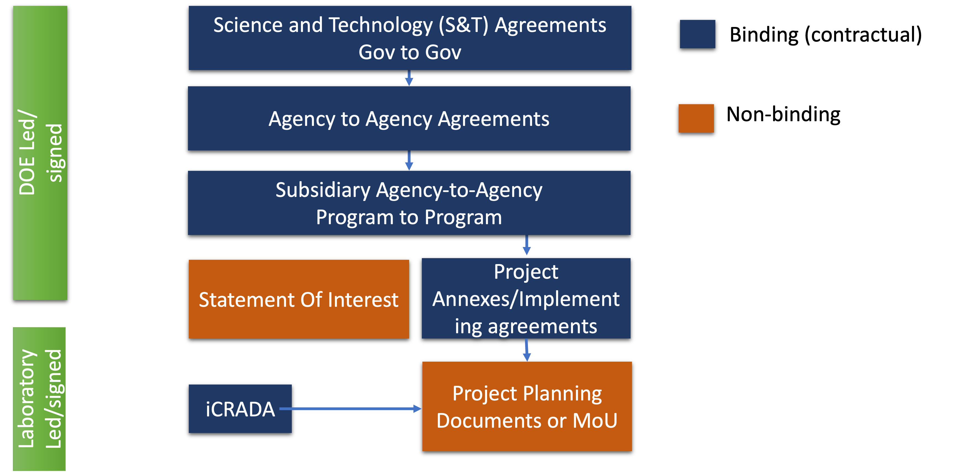
EIC IKC documents overview
Laboratory level agreements agreements provide Project Management and Technical details.
Project Planning Documents (PPDs) are in place to describe Project Management Principles and IKC Deliverables (documentation included)

Slide 4
1st Phase of IKCs since last RRB I
EIC first phase of Accelerator and Detector IKC Milestones presented at the 2nd RRB meeting (Dec-2023) and updated for this RRB meeting (L. Lari’s talks).
PPDs were identified as “must have” for several deliverables.
PPD target date is set to March 2025 to account for 3-6 months approval for Foreign Engagement National Laboratories (DOE P 485.1).
The Project is planning to baseline by the end of calendar year 2025, depending on funding availability for Q4 of 2025.

Slide 5
1st Phase of IKCs since last RRB II
PPDs (non-binding) will require an iCRADA (binding).
EIC project is targeting 1 set of PPDs for each Partner Laboratory.
PPD preparation can start when iCRADA annex is in advanced stage of work.
Dates have been reassessed based on new CD2 date at end of 2025, PPDs timeline will be presented in the following slides.
PPDs needed for CD2!!!
IKC Area | Activity ID and Name | iCRADA BNL | iCRADA JLAB | PPD BNL | PPD JLAB
Accelerator | 6.06.02.02 IR Spin Rotator Magnets | ? | NONE | ? | NONE
Accelerator | 6.08.04.03 1773 MHz 5-Cell Elliptical Cavity Cryomodule | X | X | X | NONE
Accelerator | 6.08.04.05 394 MHz Crab Cryomodule | X | X | X | NONE
Accelerator | 6.08.04.02 591 MHz 5-Cell Cryomodule | X | X | X | NONE
Detector | 6.10.04.02 dRHIC Dual ring Cherenkov Detector | NONE | X | ? | X
Detector | 6.10.07 Detector Magnets Procurement | NONE | X | NONE | X
Detector | 6.10.07 Detector Magnets Labor | NONE | X | NONE | X
Detector | 6.10.03.01 Silicon Trackers (UK) | X | NONE | X | ?
Detector | 6.10.03.01 Silicon Trackers (INFN) | X | ? | X | ?
Detector | 6.10.03.02 Micro Pattern Gaseous Detector (MPGD) Trackers | NONE | X | ? | ?
Detector | 6.10.11.04 Low-Q2 Detectors | X | NONE | X | ?
Detector | 6.10.05.01 Backward Electromagnetic Calorimetry | X | NONE | X | ?
Areas under discussion are marked with “?”

Slide 6
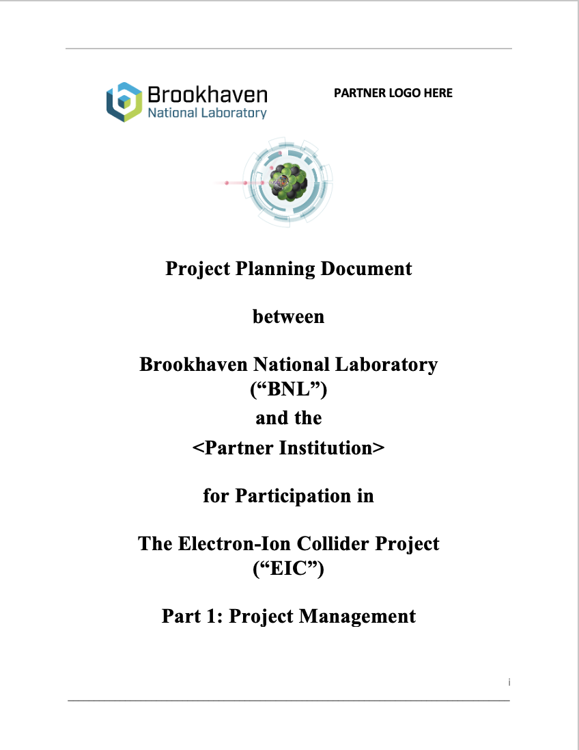
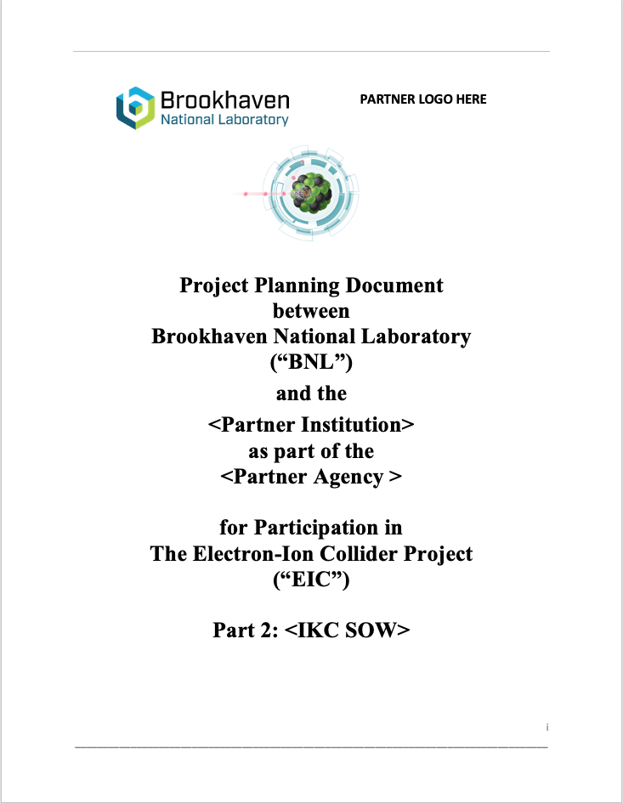
PPDs Overview – Reminder
PPDs are used to establish and manage the EIC Project baseline and construction.
The EIC Project will pursue PPDs with International Partners, for complex or critical technical items, or when high cost or high risk is identified.
PPDs will be updated, as necessary, to maintain consistency with the legally binding agreements.
PPDs are:
PPD – Part 1: describes EIC Project Management Principles applicable to the Partner IKC.
PPD – Part 2: describes IKC Deliverables, including the scope of work, schedule milestones, description of supporting documentation and activities required to enable EIC to meet DOE Order 413.3b requirements, abide by BNL & TJNAF policies and procedures, and conform to the principles established in the EIC Systems Engineering Management Plan.
Notes:
Part2 is the most important for defining technical scope and organization of the partner institution.

Slide 7
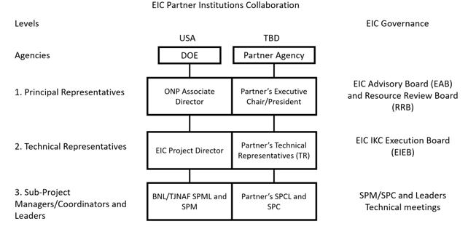
PPD Part 1: Project Management – Reminder
EIC Project overview
Communication, Management, Governance
EIC Technical Review Process
EIC Project Phases
Project Management Principles for IKC Statement of Work (SOW)
Project Management and Controls
Risk Management
Configuration Management
Safety
Quality Assurance
System Acceptance
Transportation and Delivery
Handling Changes and Nonconformances
Financial Matters
Transfer of Title
Independent Project Reviews
Roles of Partners During Onsite Work
Modification, Commencement and Discontinuation
PPD - Part 1 describes EIC Project Management Principles applicable to the IKC Partner.
From the Project to IKC Partners.

Slide 8
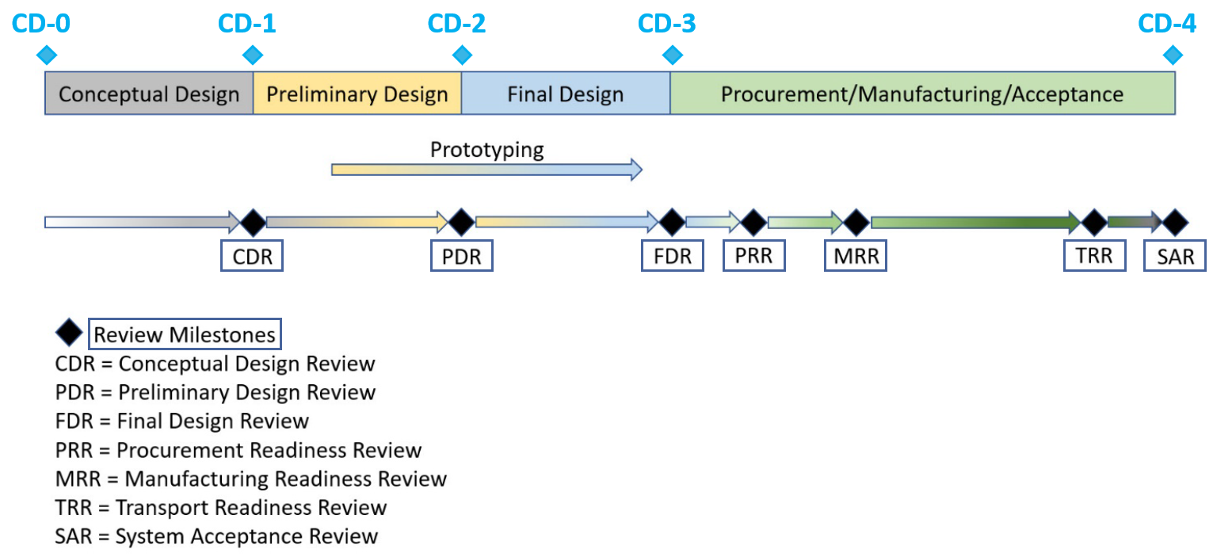
PPD Part 2: IKC Deliverables – Reminder
Project Definition
Technical Description of Deliverable Components
Project Activities per Project Phase
Project Schedule and Key Milestones
There are two broad categories of milestones:
Technical Achievement milestones: measuring quantities associated with component or system;
Reviews milestones.
Both kind of milestones are used to define/monitor progress using the EIC System Engineering & Integration processes/approach.
Project Deliverables
Component Deliverables
Documentation Deliverables
Tasks Applicable to All Project Phases
Project Management and Controls
Risk Management
Quality Assurance & Safety
Organization and Sub-project Managers/Coordinators
Transportation
System Acceptance
Appendix I: Document Deliverables
PPD – Part 2 describes IKC Deliverables, including scope of work, schedule milestones, description of supporting documentation and activities required to enable EIC to meet DOE O 413.3b requirements and to place the contributed equipment into service, and for BNL to maintain and operate the equipment, in conformance with the laboratory internal policies and procedures.
From the IKC Partners to the Project

Slide 9
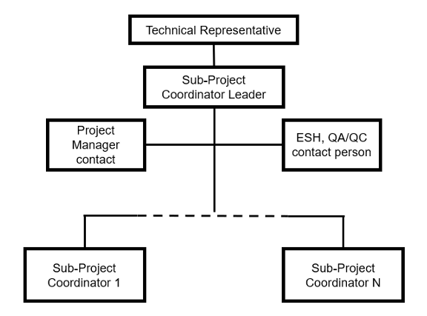
PPDs Summary
PPDs templates are available. https://indico.bnl.gov/event/20635/
PPDs are expected to baseline the Project in Q4 of 2025.
Technical Representatives (TR) need to be nominated/identified at Partner Institutions (responsible for coordination of the EIC IKCs) before starting to work on the PPDs.
The TR role and responsibilities are defined in the Governance document available here (Dec. 2023)
Please do not underestimate the time to develop the PPDs. Based on previous experience it will take at least 6 months to develop a set of PPDs ready to be signed!!!

Slide 10
PPD preparation timeline
PPDs templates have been developed and are available to Partners here
Tight timeline between today and CD-2, urgent to identify point of contacts (Technical Representatives) at each Partner Institution.
PPD part 1 preparation will require minimal effort, PPD part 2 will require about 6 months for preparation.
PPDs Templates
IKC Scope Definition
IKC Technical description
Project Activities
Schedule
Ready!
2 weeks
3 weeks
3 weeks
1 week
PPD part 2 prep: 6 months total
Components Table
Project Mnagement
Project Control
Risk Management
Quality Assurance and Safety
4 weeks
2 weeks
2 weeks
1 week
1 week
Transportation
System Acceptance
Appendix I
2 weeks
2 weeks
1 week

Slide 11
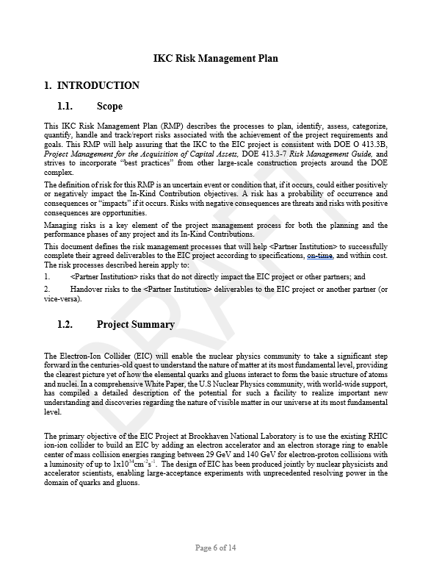
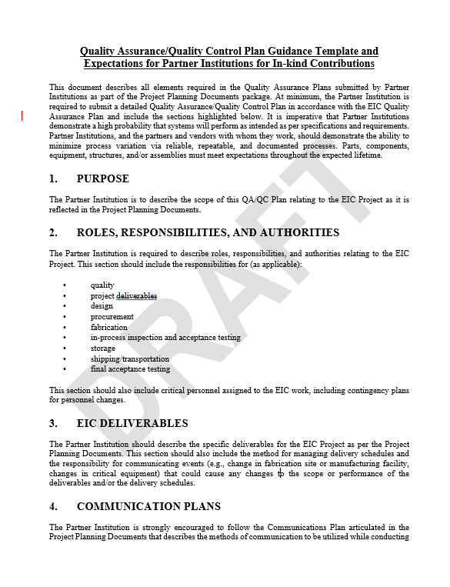
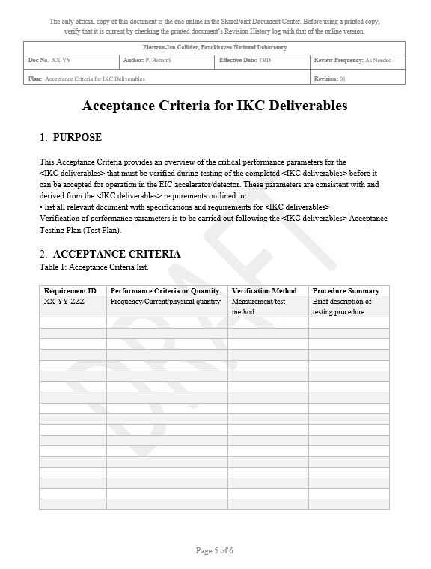
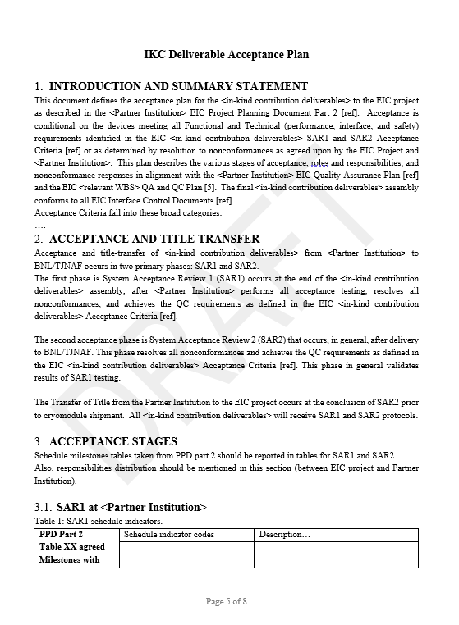
PPDs Ancillary Docs
These documents are required by each set of PPDs: Quality Assurance Plan (QAP), Acceptance Plan, Acceptance Criteria and Risk Management Plan (RMP).
QAP and RMP assure compliance with EIC project procedures and principles
Acceptance Criteria and Plan for each deliverable are necessary for System Acceptance Review (SAR) and acceptance testing

Slide 12
Summary
EIC IKC timeline is tight, work on PPDs should start soon.
Preparation of PPDs can overlap with late stages of iCRADAs preparation.
Meetings will be scheduled soon with all partners ready to start working with EIC project, TR nomination should start as soon as possible.
PPDs templates are available.
Ancillary documentation templates are available at the RRB meeting link.

