Slide 1
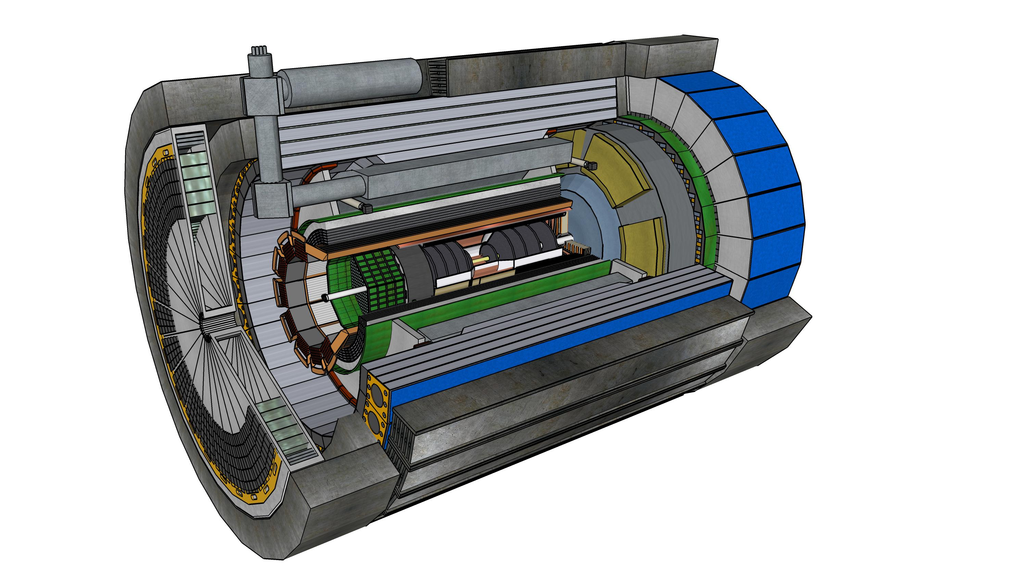



Report from the ePIC Collaboration Spokesperson
John Lajoie
Oak Ridge National Laboratory

Slide 2
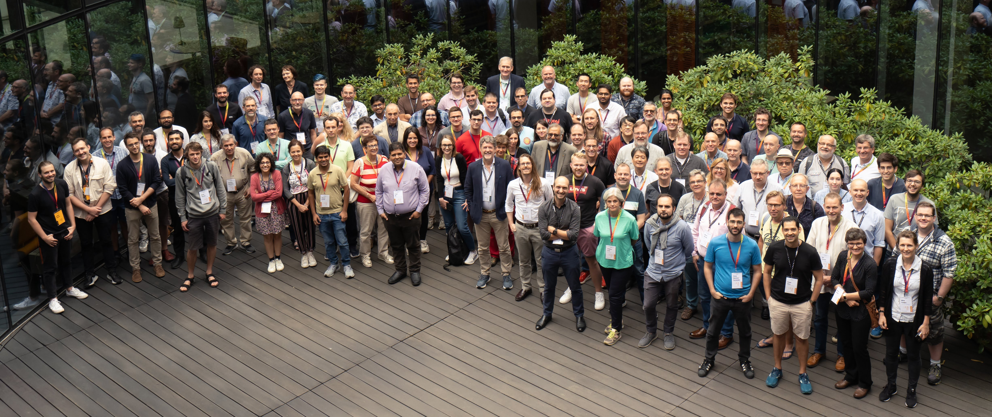
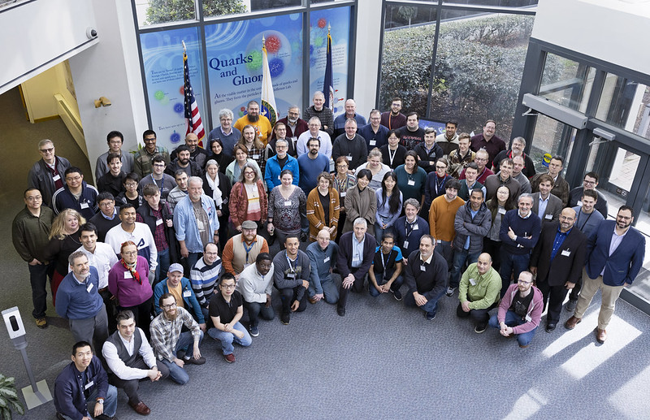
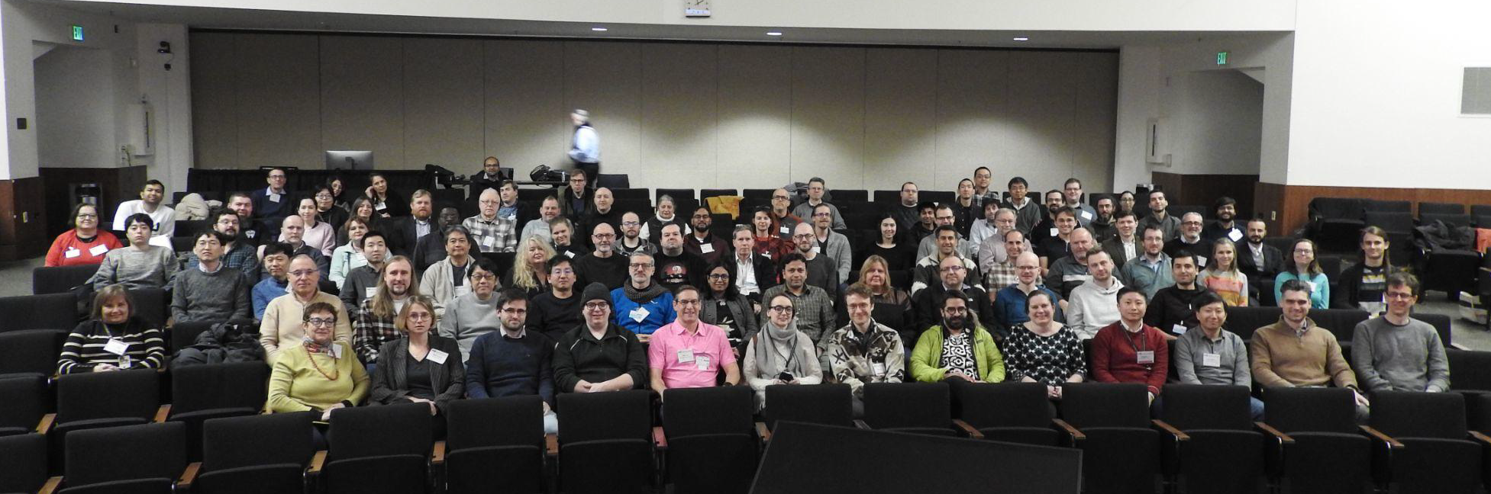
What is
Warsaw, July 2023
JLab, Jan. 2023
ANL,
Jan. 2024
ePIC is a community of scientists dedicated to realizing the EIC science mission.
The ePIC Collaboration is as unique as the ePIC detector.

Slide 3
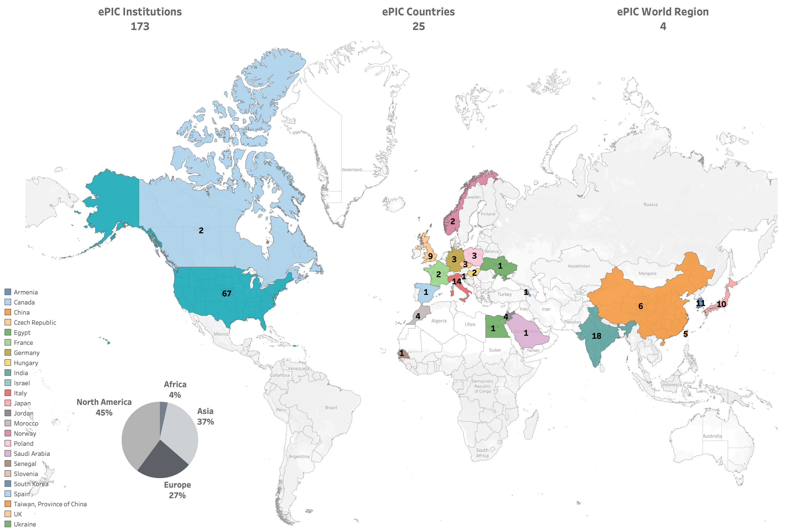










International
New Institutions Joining ePIC in 2024:
University of Texas at Austin
University Mohammed V in Rabat
University Ibn Tofail in Kénitra
University Mohammed Premier in Oujda
University Mohammed VI in Bengurir
Kent State University
ePIC Initiated in
July 2022
Currently:
>850 collaborators (from 2024 Institutional Survey)
>650 members
active in ePIC activities
New Proposals for ePIC Membership:
Laboratoire
Leprince-Ringuet (LLR)
American University
in Cairo
Central University
of Haryana
Indian Institute of
Technology Mandi

Slide 4
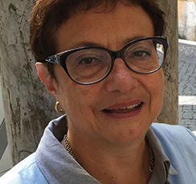

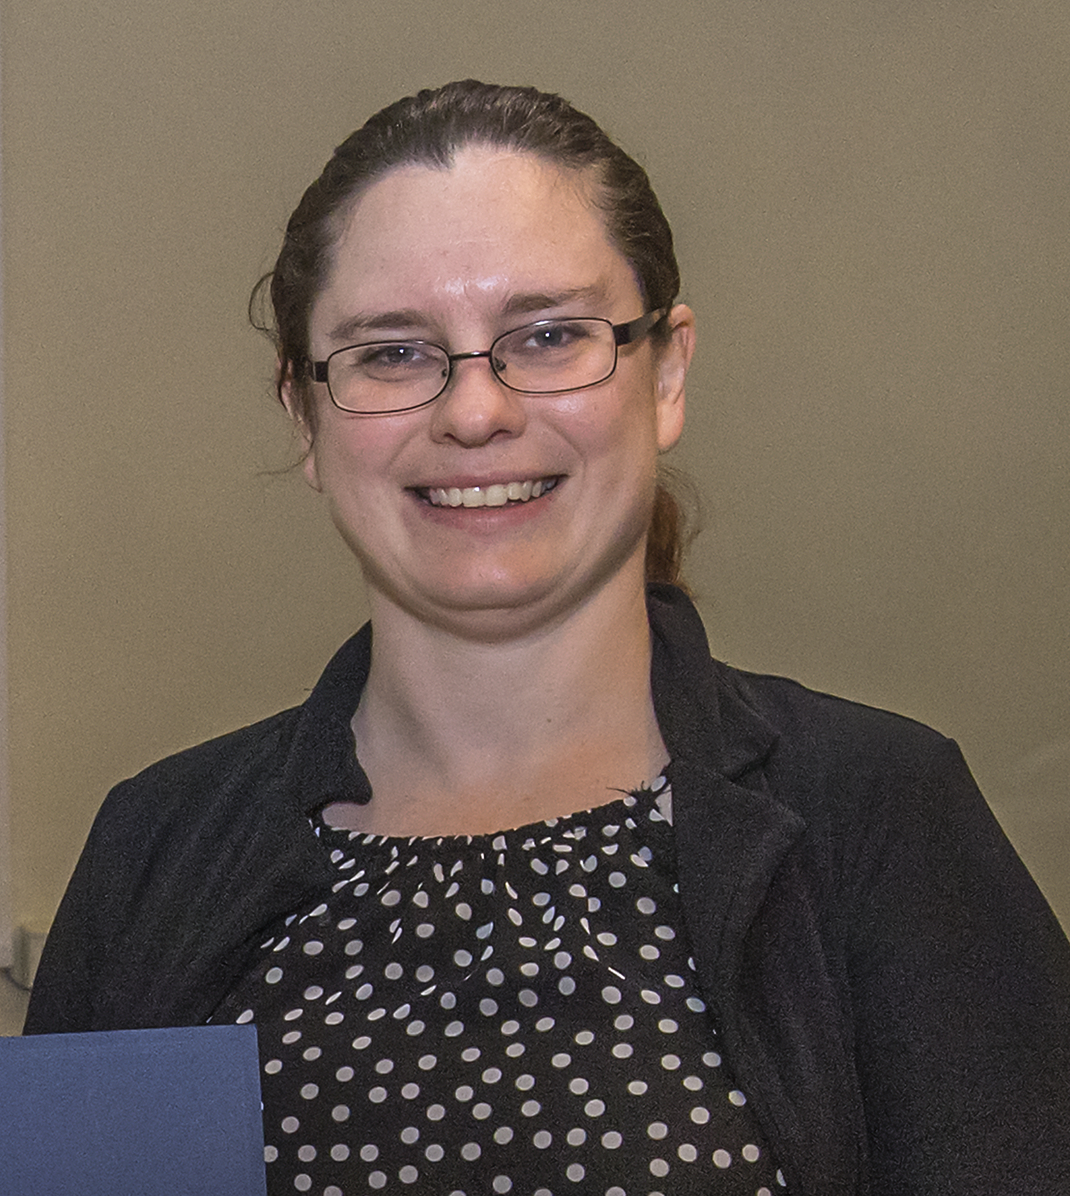
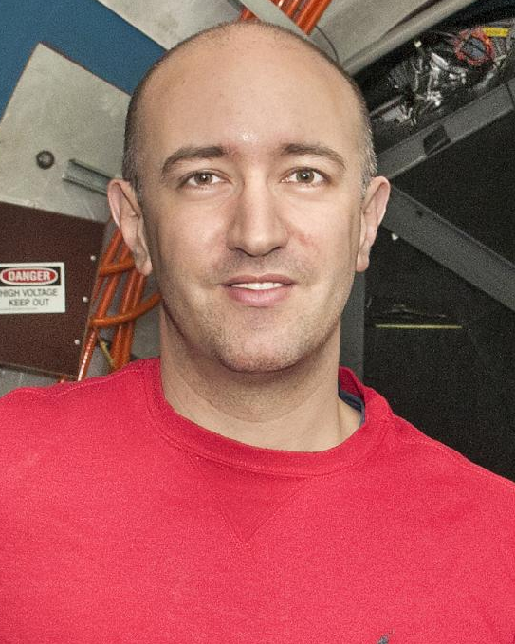
ePIC Collaboration Structure
Collaboration Council
Institutional Representatives
Spokesperson’s Office
Spokesperson (SP)
Deputies
EIC Project
Executive Board
Standing Committees
DE&I
Conferences and Talks
Membership
Elections
Publications
Ad-Hoc Committees
Technical Coordinator (TC)
Software and Computing Coordinator (SCC)
Analysis Coordinator
(AC)
Technical Coordinator (Acting)
• Silvia Dalla Torre (INFN)
Deputy TC’s:
Prakhar Garg (Yale)
Oskar Hartbrich (ORNL)
Matt Posik (Temple)
SCC Coordinator
• Markus Diefenthaler (JLab)
Dmitry Kalinkin
(Kentucky, Deputy SCC for Development)
Torre Wenaus
(BNL, Deputy SCC for Infrastructure)
Wouter Deconinck
(U. Manitoba, Deputy SCC for Operations)
Analysis Co-Coordinators
• Rosi Reed (Lehigh Univ.)
• Salvatore Fazio (Univ. Calabria)

Slide 5
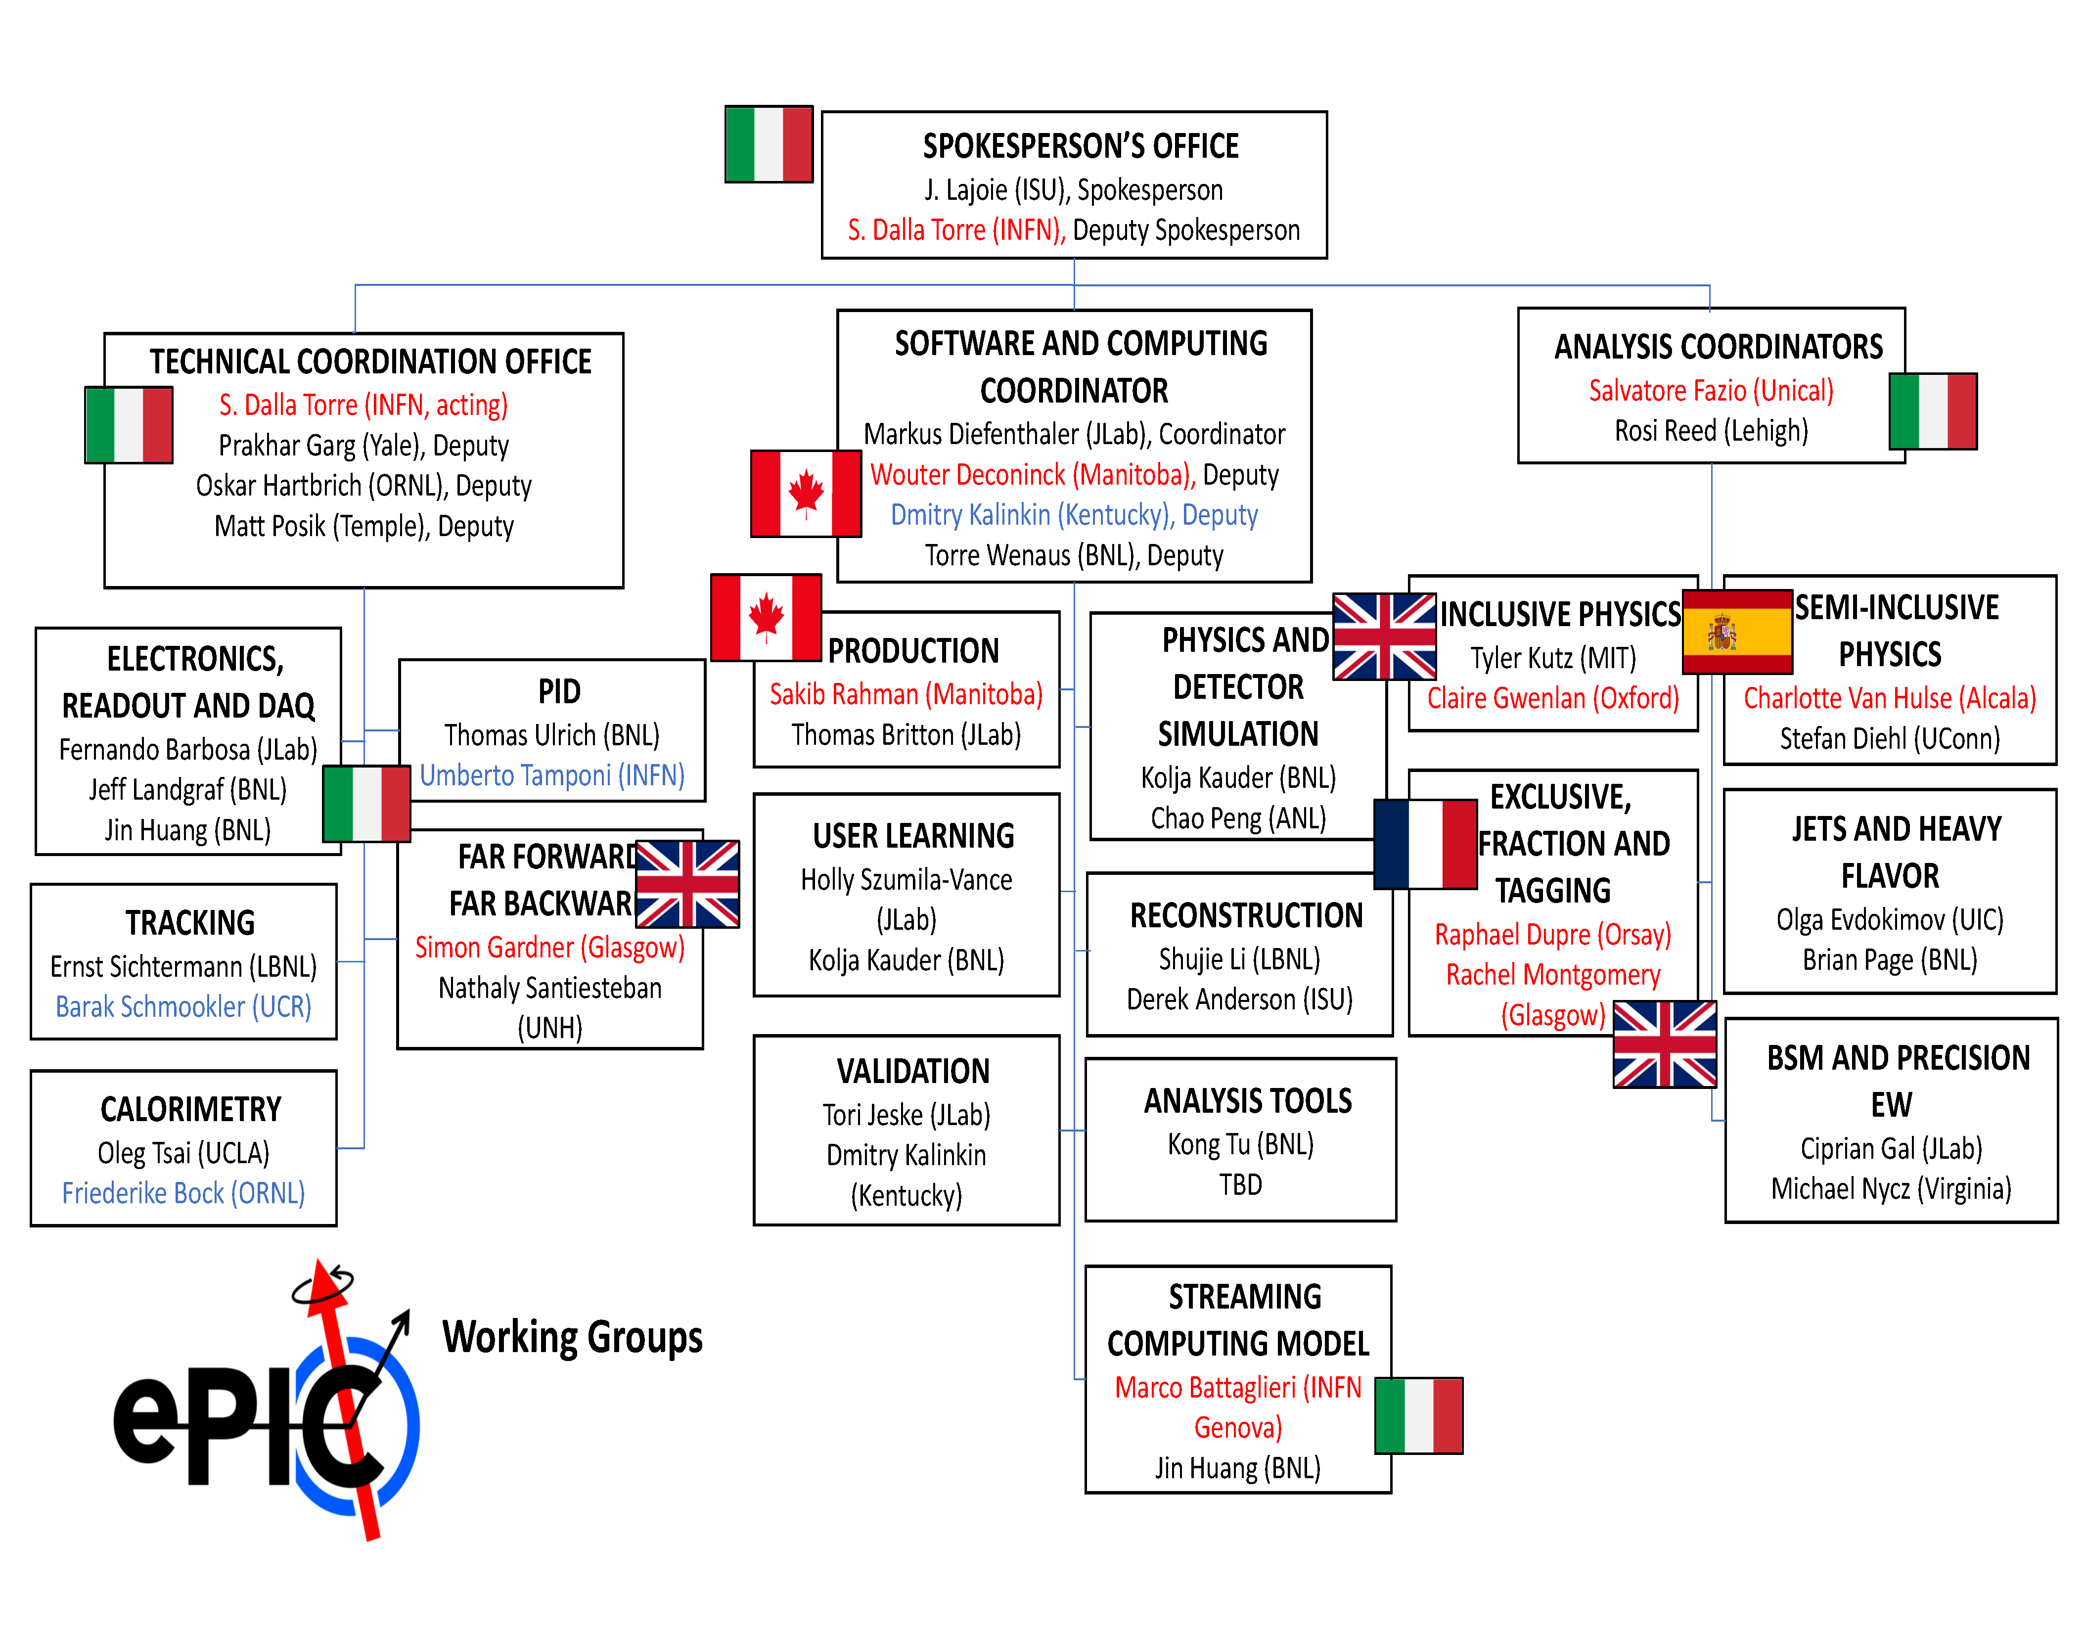
ePIC Working Group Structure
Red: International
Blue: New since last RRB
New Cross-Cutting WG Co-Conveners

Slide 6
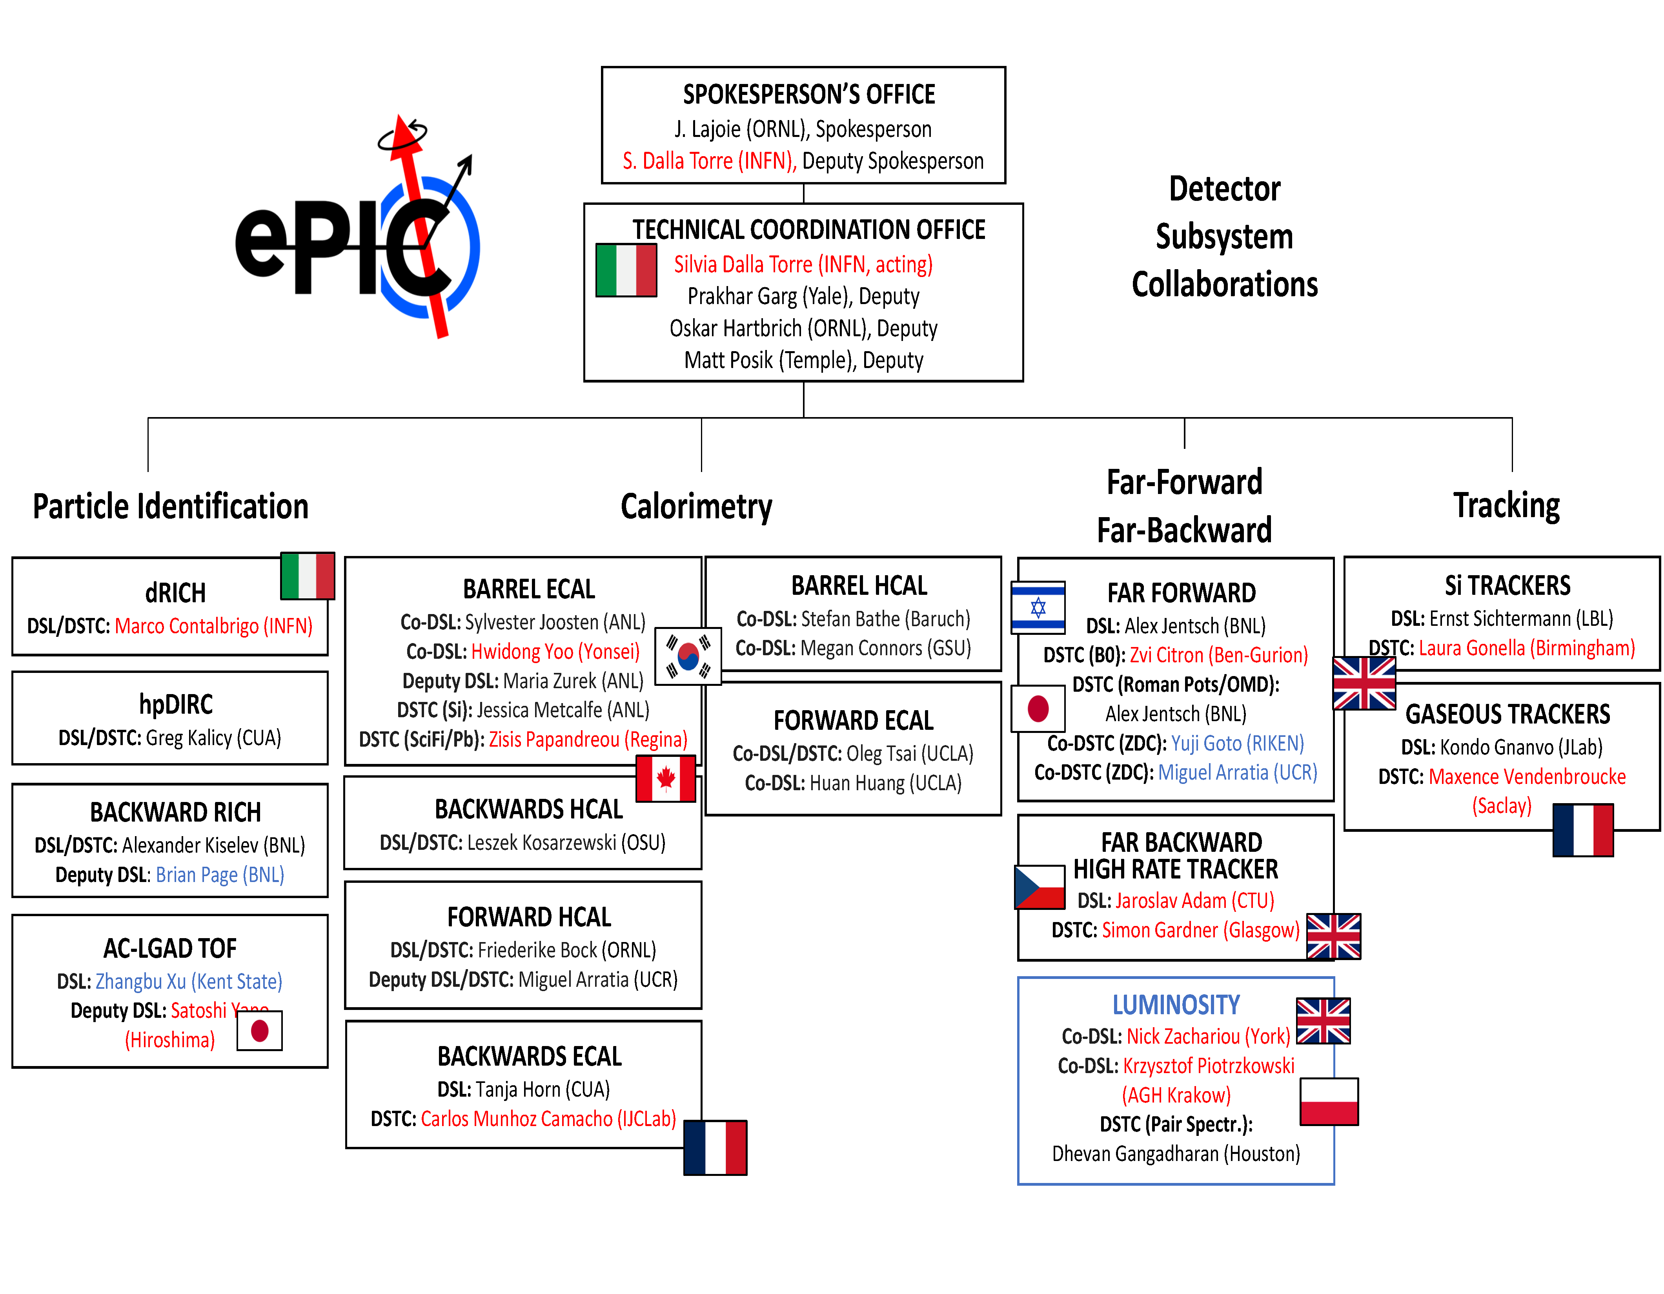
ePIC DSC Structure
Red: International
Blue: New since last RRB

Slide 7






ePIC Committees
DE&I Committee:
Chair: Megan Connors (GSU)
Vice-Chair: Christine Nattrass (UTK)
Francesco Bossù (CEA-Saclay), Wouter Deconinck (University of Manitoba), Narbe Kalantarians (Virginia Union University) , Iris Ponce Pinto (Yale University) , Maya Shimomura (Nara Women’s University) , Allison Zec (University of New Hampshire)
Collaboration Council
Institutional Representatives
Conferences and Talks:
Chair: Maria Zurek (ANL)
Vice-Chair: Brian Page (BNL)
Barbara Jacak (Berkeley), Daniel Brandenburg (OSU), Dmitry Kalinkin (Kentucky), Nick Zachariou (York), Xuan Li (LANL), Nicola Rubini (Bologna), Wouter Deconinck (Manitoba)
Standing Committees
DE&I
Conferences and Talks
Membership
Elections
Publications
Ad-Hoc Committees
Membership Committee:
Chair: Peter Steinberg (BNL)
Vice-Chair: Pietro Anontioli (INFN-Bologna)
Friederike Bock (ORNL), Helen Caines (Yale), Doug Higinbotham (JLab), Bedhangas Moharty (NISER), Silvia Niccolai (IJCLAB), Marzia Rosati (ISU)
Elections Committee:
Chair: Helen Caines (Yale)
Vice-Chair: Ken Barish (UCR)
Past-Chair: John Arrington (LBNL)
Maria Stefaniak (OSU), Domenico Elia (INFN)
Publications Committee:
Chair: Rene Bellwied (U. Houston)
Vice –Chair: Annalisa Mastroserio (INFN Bari)
Lokesh Kumar (Panjab U.), Michela Chiosso (Torino), Prithwish Tribedy (BNL), Markus Diefenthaler (JLab), Sevil Salur (Rutgers),
ex-officio w. Conferences and Talks Committee:
Daniel Brandenburg (OSU)
All ePIC Standing Committees now formed and at work.

Slide 8
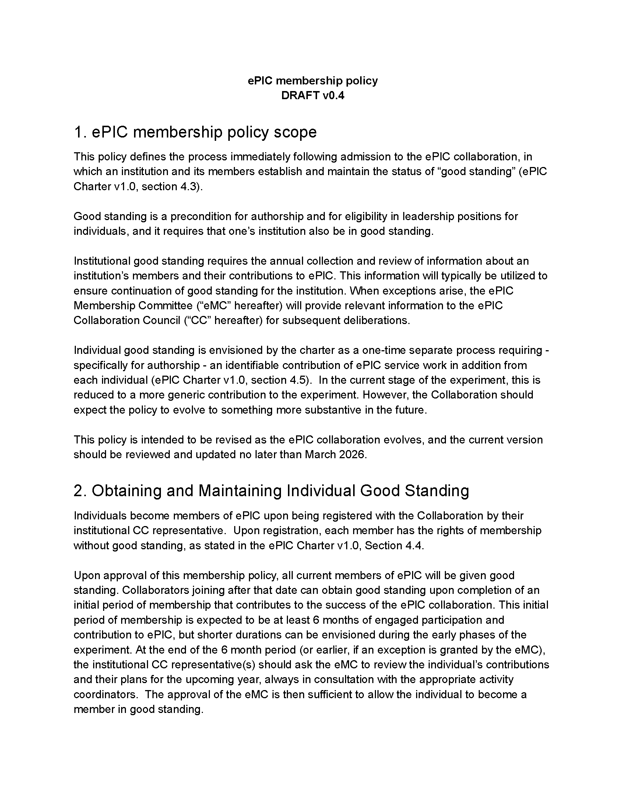
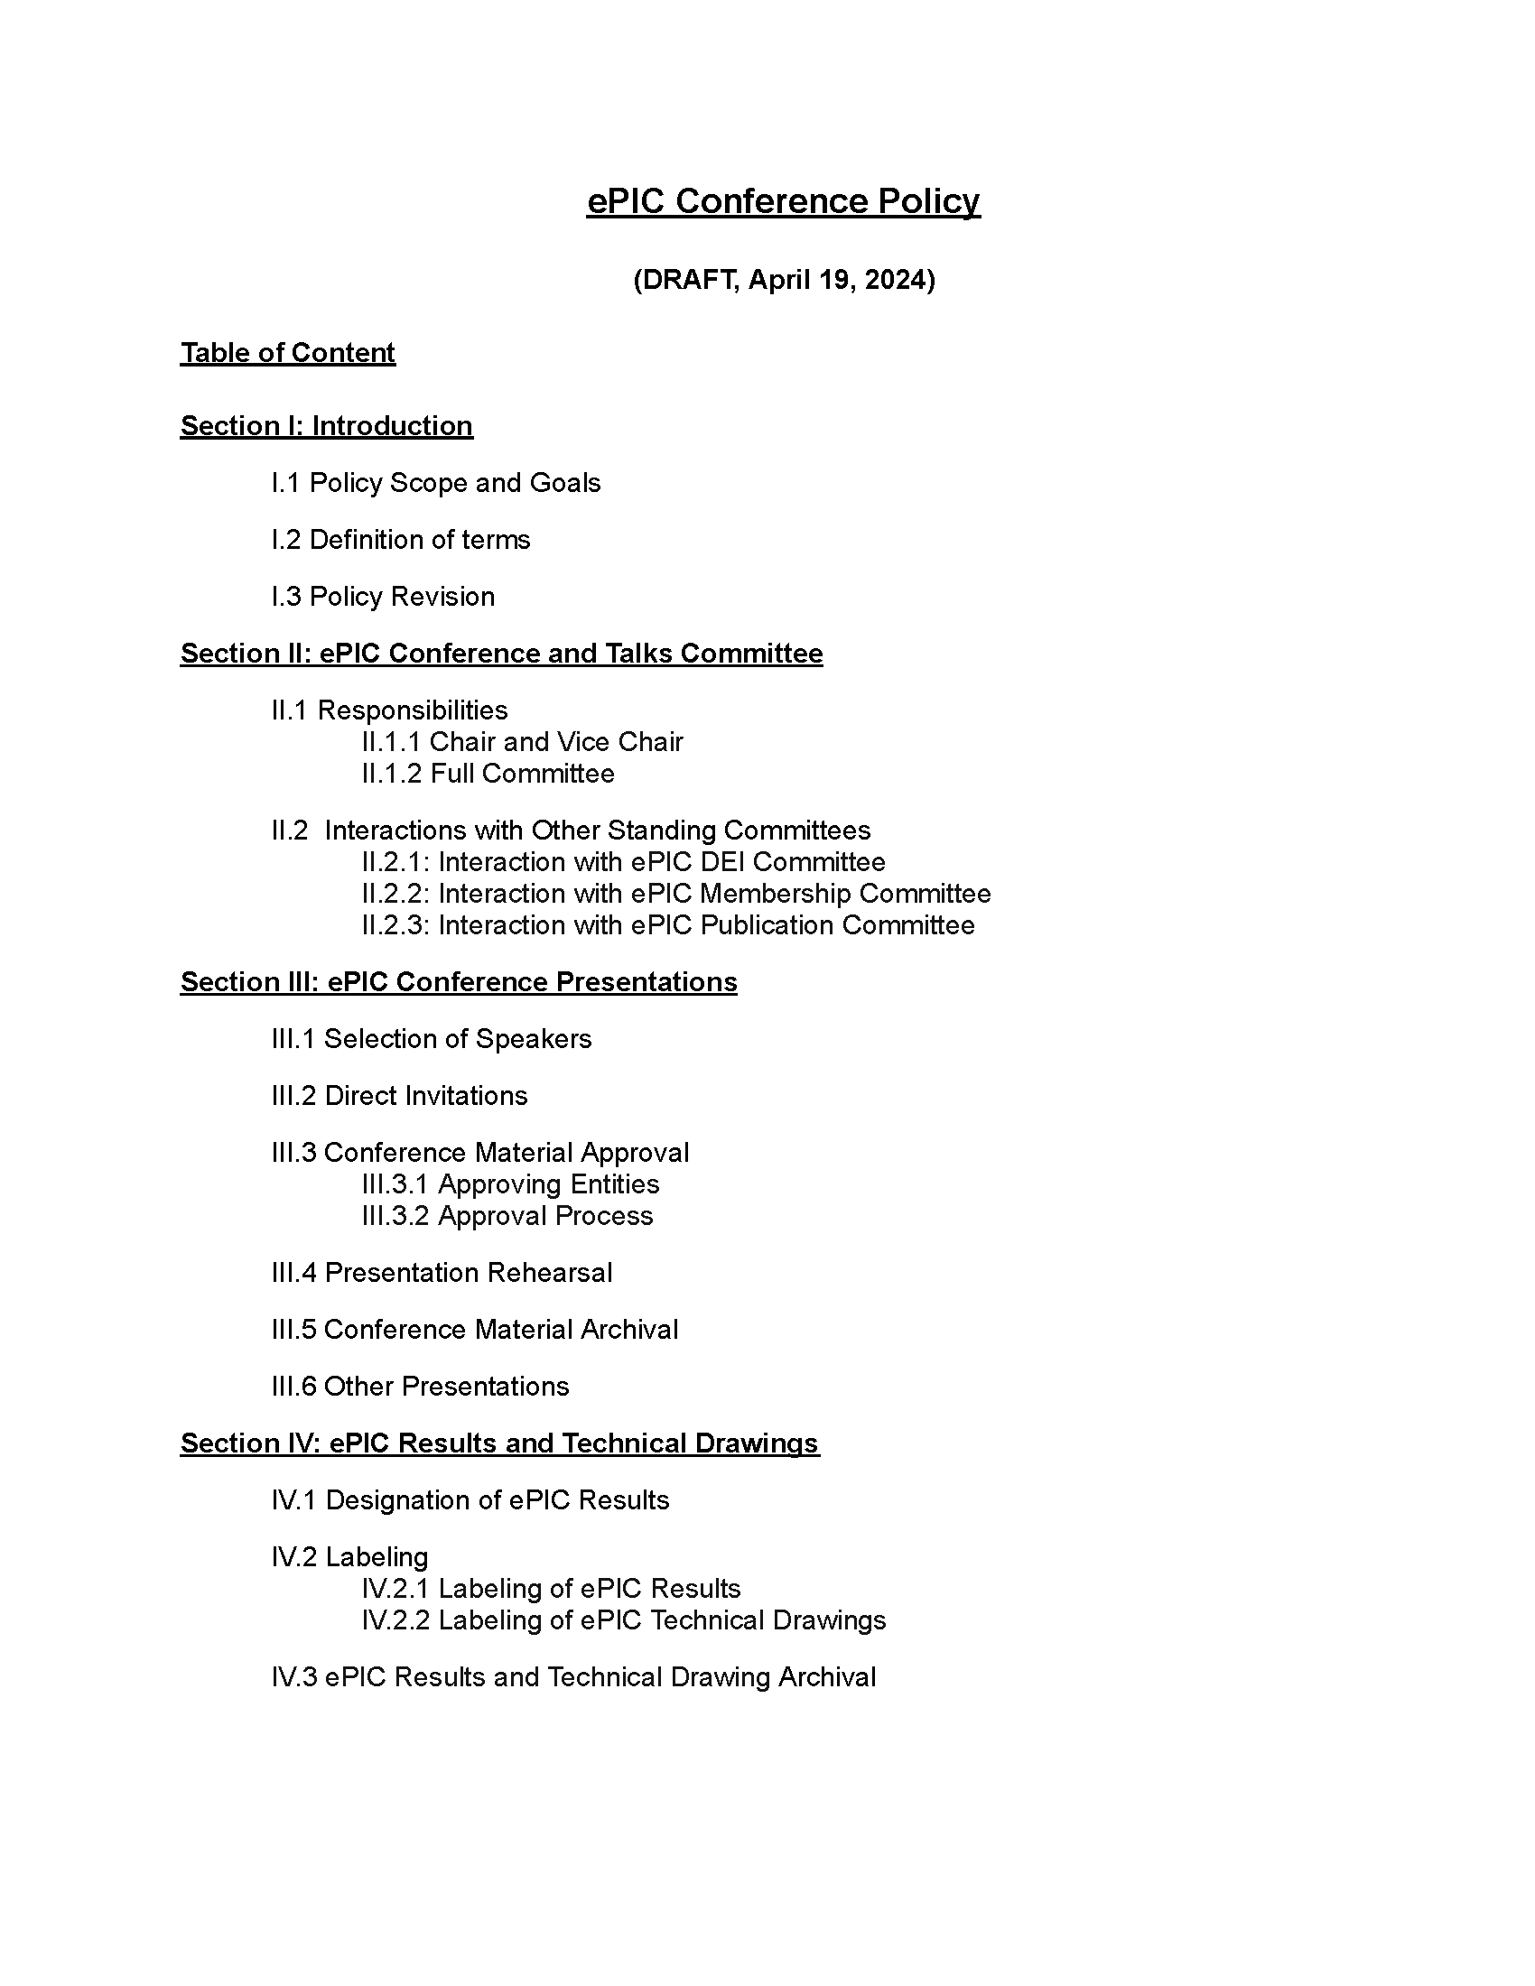
Formation of ePIC Policies
Latest drafts of Membership and Conference and Talks Policies presentated to Collaboration Council on April 26th.
The Membership Policy defines the process by which individuals and institutions establish “good standing” – from the current draft:
Individual “good standing” requires a one-time identifiable contribution to ePIC
Institutional “good standing” requires an annual “Statement of Service”
  Threshold for combined service to ePIC
The Conference and Talks Policy defines the processes governing the speaker selection, quality assurance, approval, and archiving of conference abstracts and oral and poster presentations delivered at scientific conferences, workshops, etc.
The Membership and Conference and Talks Policies drafts are fairly advanced and potentially could be put to the Collaboration Council for approval at the July 2024 collaboration meeting. The Membership Committee anticipates the first review of collaboration institutions “Statements of Service” in 2025.
A Code of Conduct and Publications Policy are in development by the DE&I and Publications committees. It is hoped that drafts will be available for the collaboration by the July 2024 collaboration meeting.

Slide 9
Regular Cadence of the Collaboration
New CC WG co-convenors submitted for Collaboration Council for endorsement
New DSC Leaders and Technical Coordinators
Collaboration Council Vice-Chair Elections:
  Candidates: Ken Barish (UCR), Olga Evdokimov (UIC), Peter Steinberg (BNL) Thomas Ullrich (BNL)
    Candidate statements at the April 26th Collab. Council Meeting, election coming soon
Physics Working Group Convener Rotations
  PWG Co-conveners serve staggered two-year terms
  SP Office will submit new PWG conveners for CC endorsement at July collaboration meeting
Spokesperson election in February 2025

Slide 10
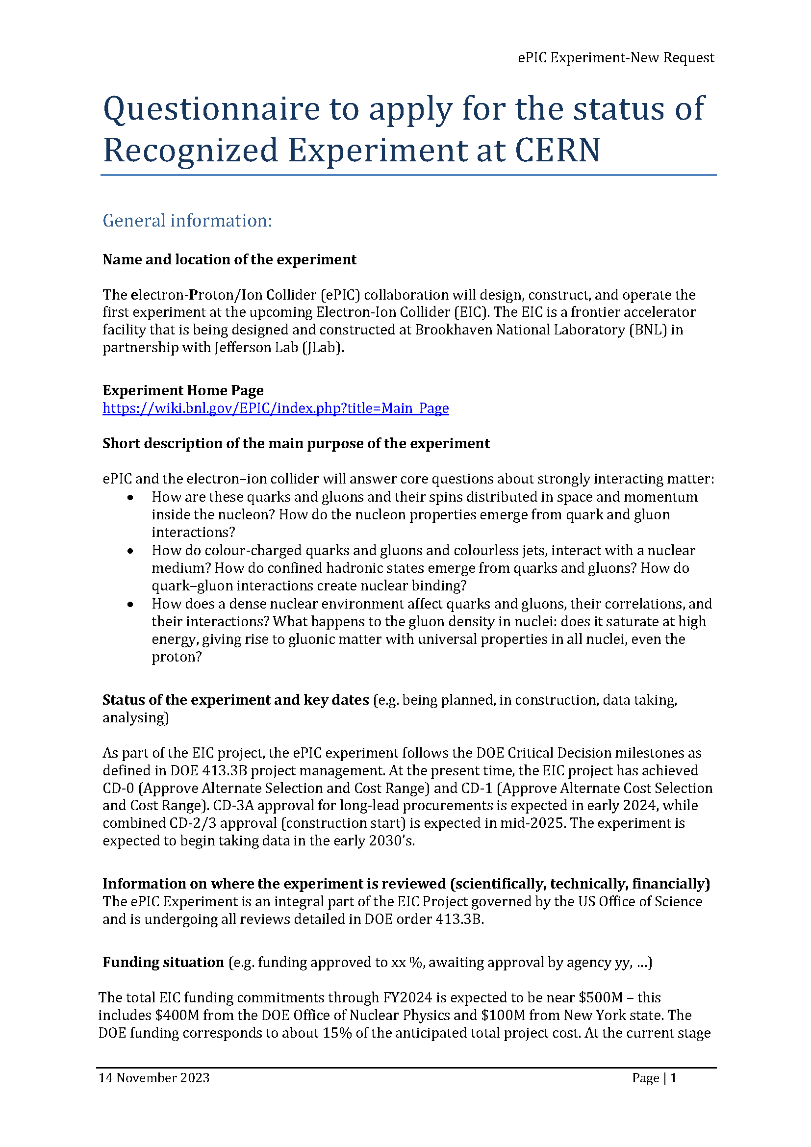
CERN Recognized Experiment
ePIC Application for CERN Recognized Experiment:
  ePIC leadership has submitted an application to become a CERN Recognized Experiment
  Strong synergies between CERN and EIC
  Important for access to CERN resources (test beams, …)
  Increase visibility in the European community
ePIC presentation to CERN Recognized Experiments Committee (REC) Feb 8th
Research Board confirmed the positive REC recommendation at CERN Council Meeting March 21-22nd
Working with Helge Meinhard on next steps

Slide 11









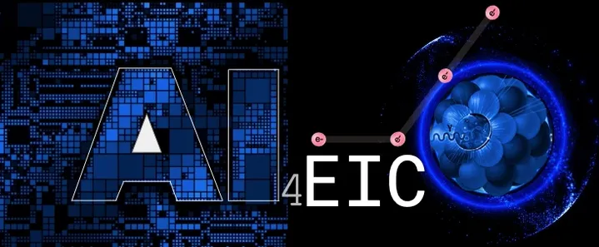


ePIC Conference Presentations
Three invited talks
SESAPS 2023: invited talk
2nd workshop on advancing the understanding of non-perturbative QCD using energy flow
A selection of ePIC presentations at conferences in the past year:
Invited talk
Two invited talks
Two invited talks
Six contributed talks
Forward Physics and QCD at the LHC and the EIC - 798 WE-Heraeus Seminar
Invited talk
Spin 2023:
two invited talks
Six contributed talks
Two invited, two contributed
invited talk
Multiple contributed,
posters
EPIPHANY 2024: invited talk
Invited talk
AI4EIC: four talks
23rd Zimanyi School Winter Workshop
Invited talk
invited talk
Invited talk

Slide 12

ePIC Talks @ DIS 2024
https://lpsc-indico.in2p3.fr/event/3268/
Invited Talks:
  ePIC Detector Overview - Shujie Li
Contributed Talks:
  Overview of the ePIC Calorimetry –
  Henry Klest
  Silicon Vertex Tracker for the ePIC experiment at the Electron-Ion Collider –
  Gian Michele Innocenti
  Particle Identification with the ePIC detector at the EIC –
  Chandradoy Chatterjee
  Physics Perspectives with the ePIC Far-Forward and Far-Backward detectors -
  Michael Pitt

Slide 13


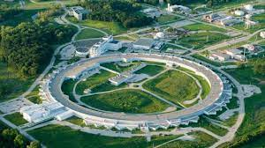
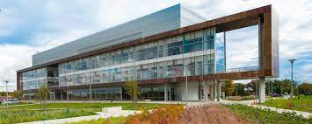
Jan 2024 ePIC Collaboration Meeting
Jan 9-13th, 2024 @ ANL
Three days of parallel workfests followed by two days of plenary sessions:
  https://indico.bnl.gov/event/20473/
175 in-person participants
Strong participation by early-career scientists:
  Student support available
  29% of registered attendees early-career
Updates and status reports
Discussion of ePIC strategy for 2024

Slide 14
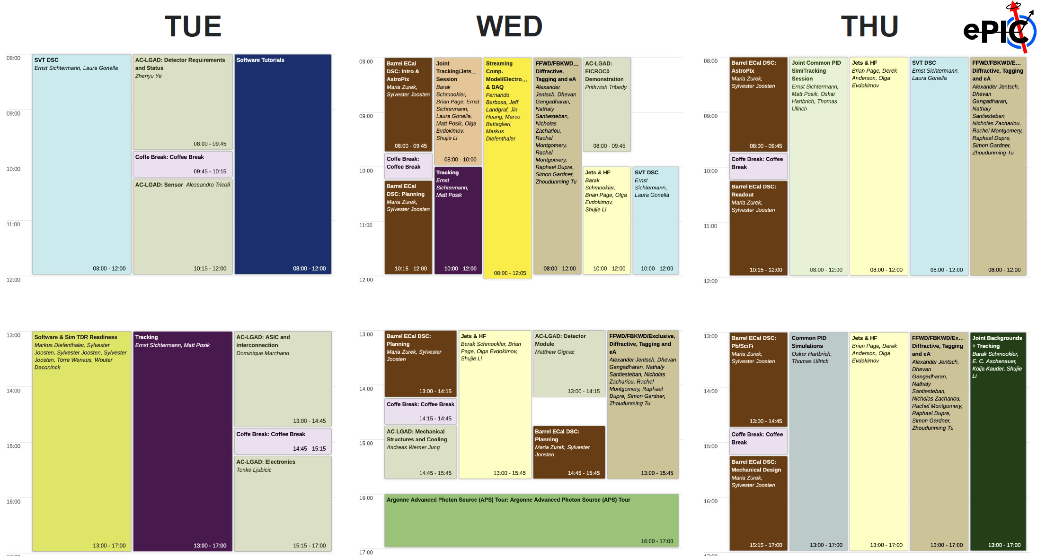
Workfests!

Slide 15
TDR Strategy and Publications
In 2024 the ePIC collaboration will produce:
  A draft of the ePIC contributions to the EIC TDR
    The EIC TDR is the top priority
      Chapters on Physics Goals and Requirements and Experimental Systems
      Not just the document, but the simulations and detector R&D that form the basis
      Requires close cooperation between the collaboration and the project!
An ePIC Detector Design paper:
    Derived and expanded from the Experimental Systems TDR chapter
An ePIC Physics Performance paper:
    Derived and expanded from the Physics Goals and Requirements TDR chapter
Both to be published in a scientific journal (such as NIMA, JINST, or PRC)
These publications will serve as a focus in developing the ePIC Membership and Publication policies.
Focused activity in the Technical and Integration Council: Report by Silvia to follow
process design phase
structuring the
effort
draft ePIC pre-TDR
ePIC pre-TDR (CD-2)
writing
(TDR/notes)
Preparing papers for
publication
Mid Jan.24
Mid Mar.24
End Oct. 24
Late 2024
Early 2025

Slide 16
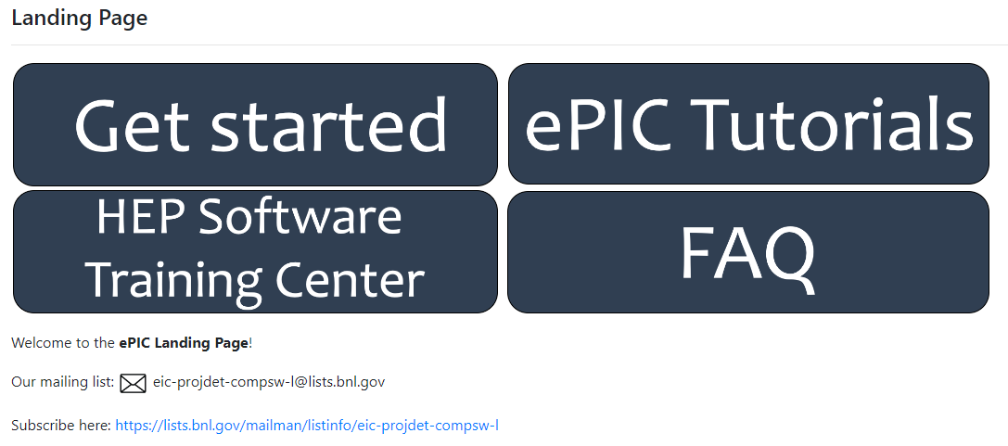
Broadening Engagement in ePIC
The ePIC collaboration must be a welcoming environment for people to
pursue their science
Established procedures to welcome new institutions and integrate them into the collaboration
  Meeting with SP Office and establish contacts within the collaboration
User Learning WG established landing page as a one-stop location for onboarding with ePIC Software and Computing (https://eic.github.io/documentation/landingpage.html)
Well-attended tutorials held at Jan. Collaboration Meeting and April. ePIC Software and Computing Meeting @ CERN
AC’s organized meeting to onboard EIC-India Institutions (Feb.)
…

Slide 17
Next ePIC Collaboration Meeting
Lehigh University
Bethlehem, PA
  July 22-28th
  Hybrid format
Jointly organized with the EICUG
Joint EICUG/ePIC session with talks of common interest
Mixed workfest and plenary sessions
https://indico.bnl.gov/event/20727/

Slide 18
What’s Coming Next…
Collaboration Council
Institutional Representatives
Spokesperson’s Office
Spokesperson (SP)
Deputies
EIC Project
Executive Board
Standing Committees
DE&I
Conferences and Talks
Membership
Elections
Publications
Ad-Hoc Committees
Technical Coordinator (TC)
Software and Computing Coordinator (SCC)
Analysis Coordinator
(AC)
More on technical coordination coming in Silvia’s talk.
More on software and computing coming in the talk from Markus
Just a few words on the next
slide…

Slide 19
Analysis Coordination in ePIC
Analysis Coordination is responsible for the simulations that demonstrate the ability of ePIC to do EIC science
  A critical part of the TDR development process
  Organizing physics “benchmark” plots for the TDR
  Sets priorities for reconstruction development in conjunction with Software and Computing
DRAFT pre-TDR Plots In Development

Slide 20
Take-Away Message
The ePIC Collaboration is strong, active and growing!
  New member institutions bring new strengths
  International participation is key to the success of ePIC!
    International collaborators play key roles in collaboration leadership
  Collaboration committees are fully formed
  ePIC policies for Membership and Conferences and Talks are in draft form, Code of Conduct and Publication policy drafts are expected soon
  The collaboration is establishing a regular election schedule and convener rotation
  ePIC members are active in promoting ePIC and EIC science to the worldwide Nuclear Physics community
  ePIC leadership is focused on welcoming new institution and improving engagement in the collaboration

Slide 21


Slide 22
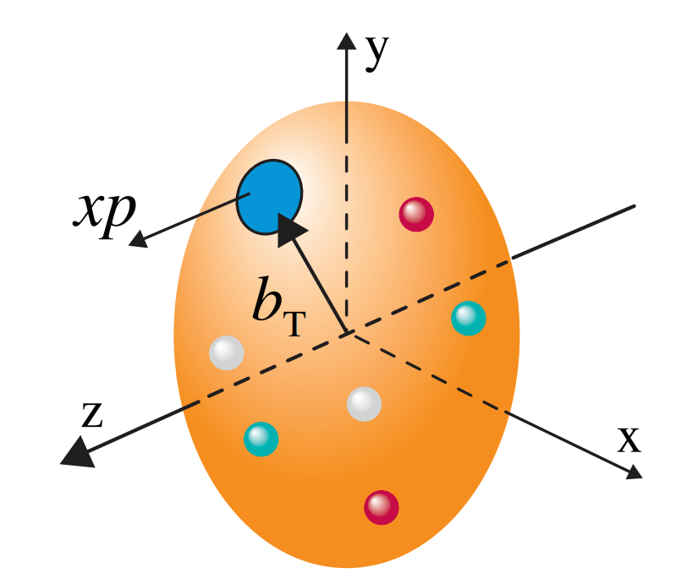
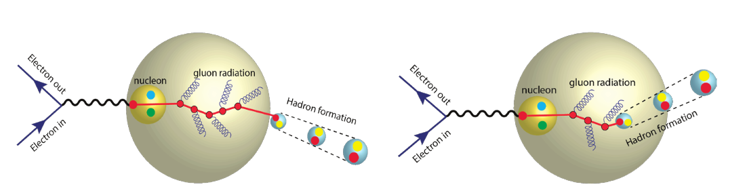
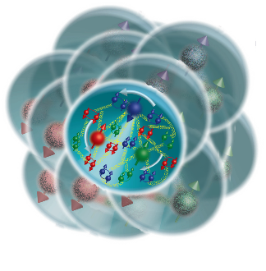
The Collaboration Pursues the Science
How do the nucleon properties like mass and spin emerge from quarks and their interactions?
How are the sea quarks and gluons distributed in space and momentum inside the nucleon? How is spin dynamically generated?
s
What is the mechanism through which quark-gluon interactions give rise to nuclear binding?
Is there a saturation point for the density of gluons in nuclei at high energies, and does this lead to the formation of gluonic matter with universal properties across all nuclei, including the proton?
In what manner do color-charged quarks and gluons, along with colorless jets, interact with the nuclear medium? And how do the confined hadronic states emerge from these quarks and gluons?
What impact does a high-density nuclear environment have on the interactions, correlations, and behaviors of quarks and gluons?
22

Slide 23
ePIC Meetings in 2024
ePIC Collaboration Meeting (ANL)
  Jan 9-13, 2024
3rd EIC-Asia Meeting (Taiwan)
  Jan 29-31, 2024
ePIC Software and Computing Meeting (CERN)
  April 22nd-26th, 2024
Joint EICUG/ePIC Collaboration Meeting (Lehigh)
  July 22-28, 2024
4th EIC-Asia Meeting (China)
  Aug. 12-16th, 2024

Slide 24
Jan 2024 ePIC Meeting Workfests
Workshop Title | Organizers
Barrel ECAL DSC | Maria Zurek, Sylvester Joosten
SVT DSC | Laura Gonella, Ernst Sichtermann
Tracking | Ernst Sichtermann, Matt Posik
Jets & HF (Particle Flow) | Brian Page, Olga Evdokimov, Derek Anderson
Jets & HF (Vertex) | Brian Page, Olga Evdokimov, Shujie Li, Barak Schmookler
Streaming Computing Model / Electronics & DAQ | Fernando Barbosa, Jin Huang, Jeff Landgraf, Marco Battaglieri, Markus Diefenthaler
FFWD, FBKWD & Exclusive, Diffractive and Tagging, eA | Raphael Dupre, Rachel Montgomery, Alex Jentsch, Kong Tu, Simon Gardner, Nathaly Santiesteban, Dhevan Gangadharan, Nick Zachariou
Backgrounds | Kolja Kauder, Elke-Caroline Aschenauer, Shujie Li, Barak Schmookler
AC-LGAD DSC | Alessandro Tricoli, Alex Jentcsh, Wei Li, Zhenyu Ye
Common PID | Thomas Ullrich, Oskar Hartbrich
Software & Sim TDR Readiness | Markus Diefenthaler, Sylvester Joosten, Wouter Deconinck, Torre Wenaus

Slide 25
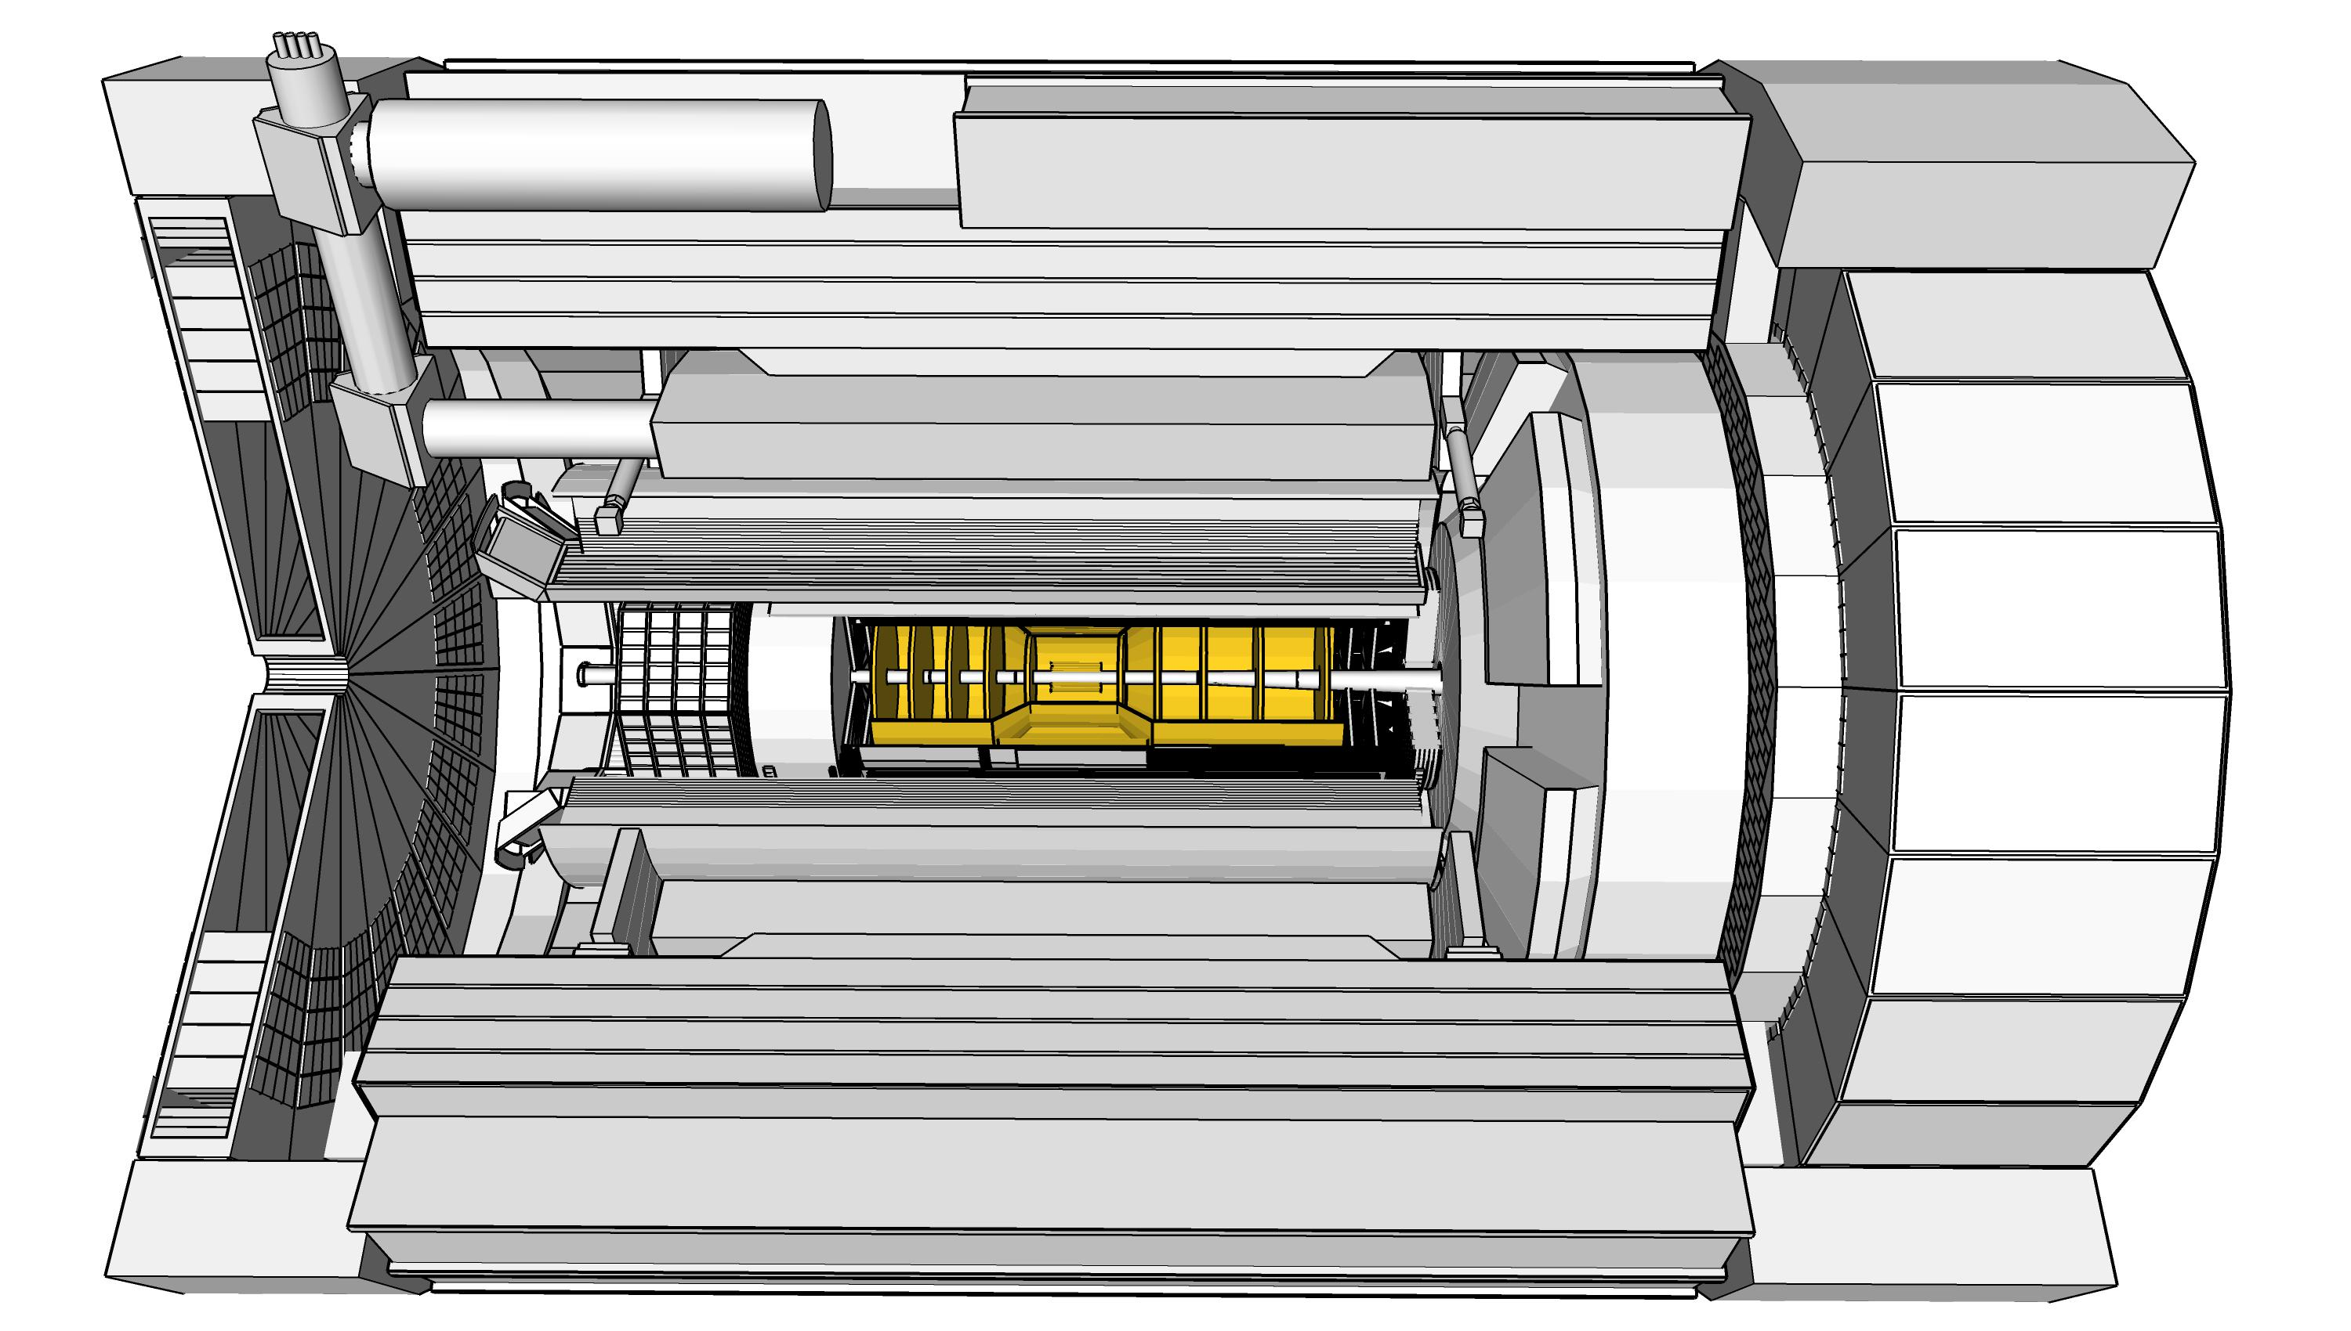
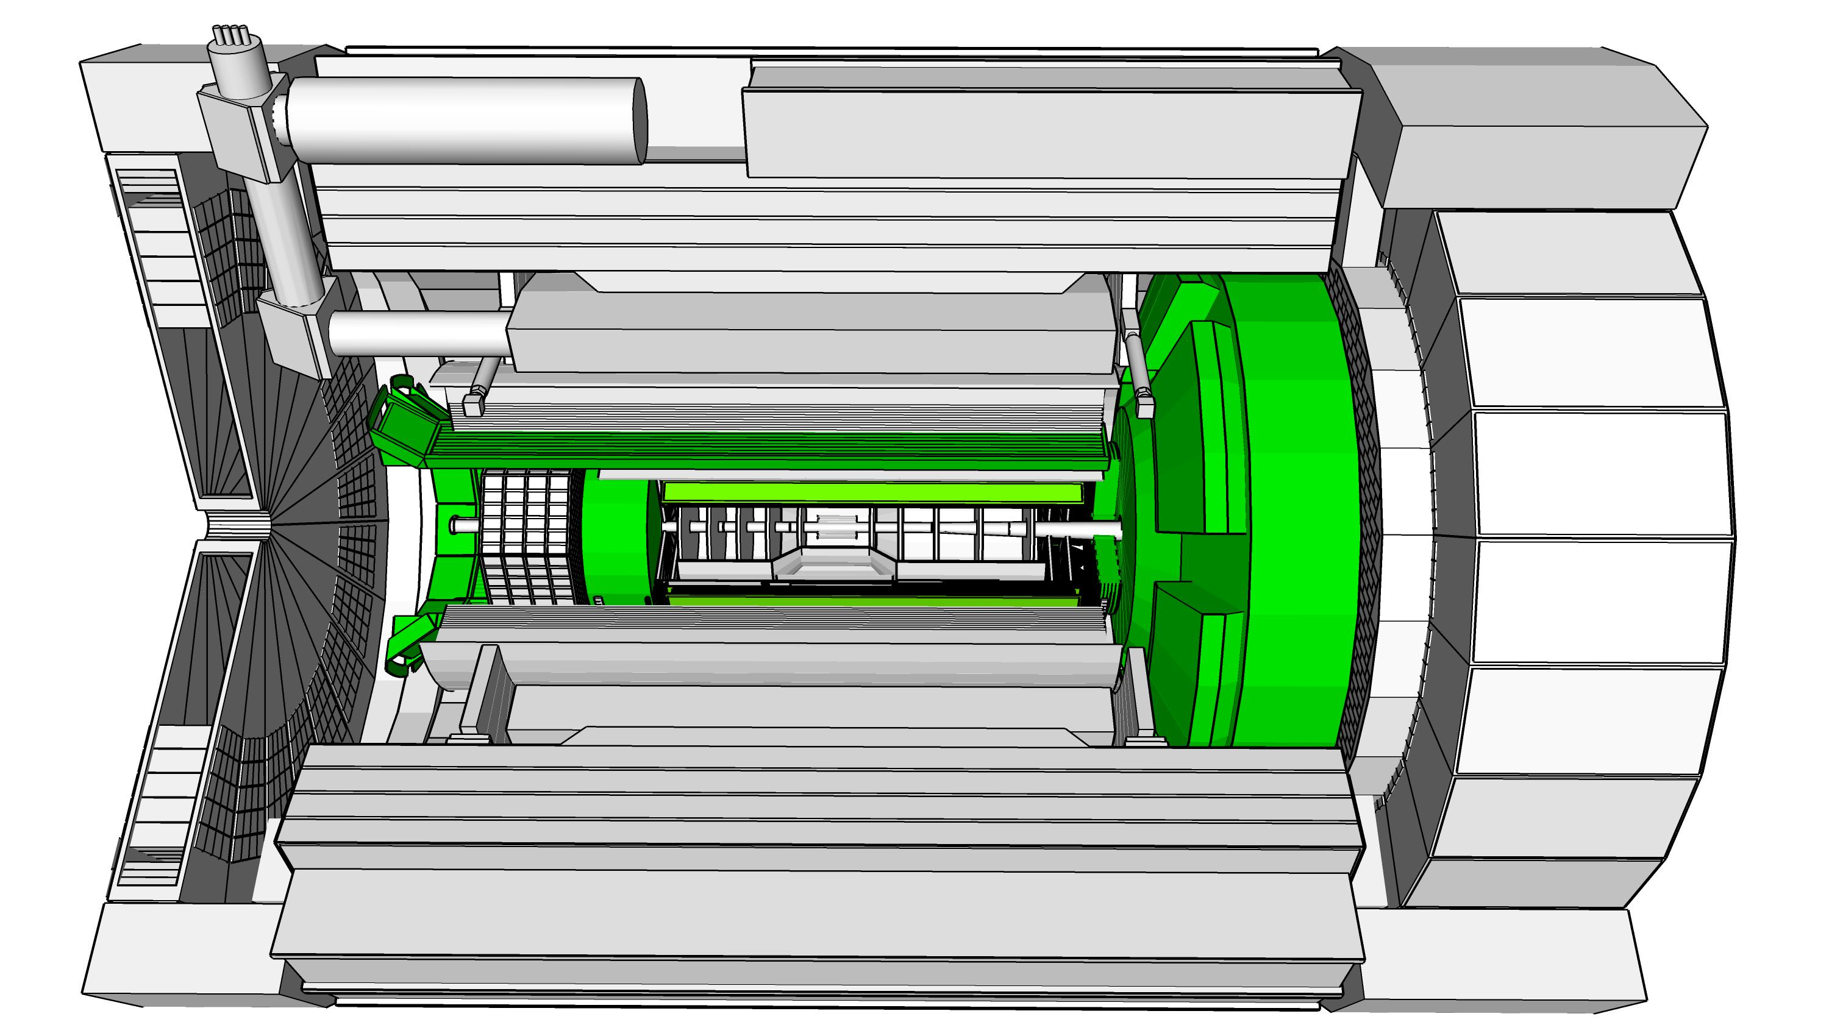
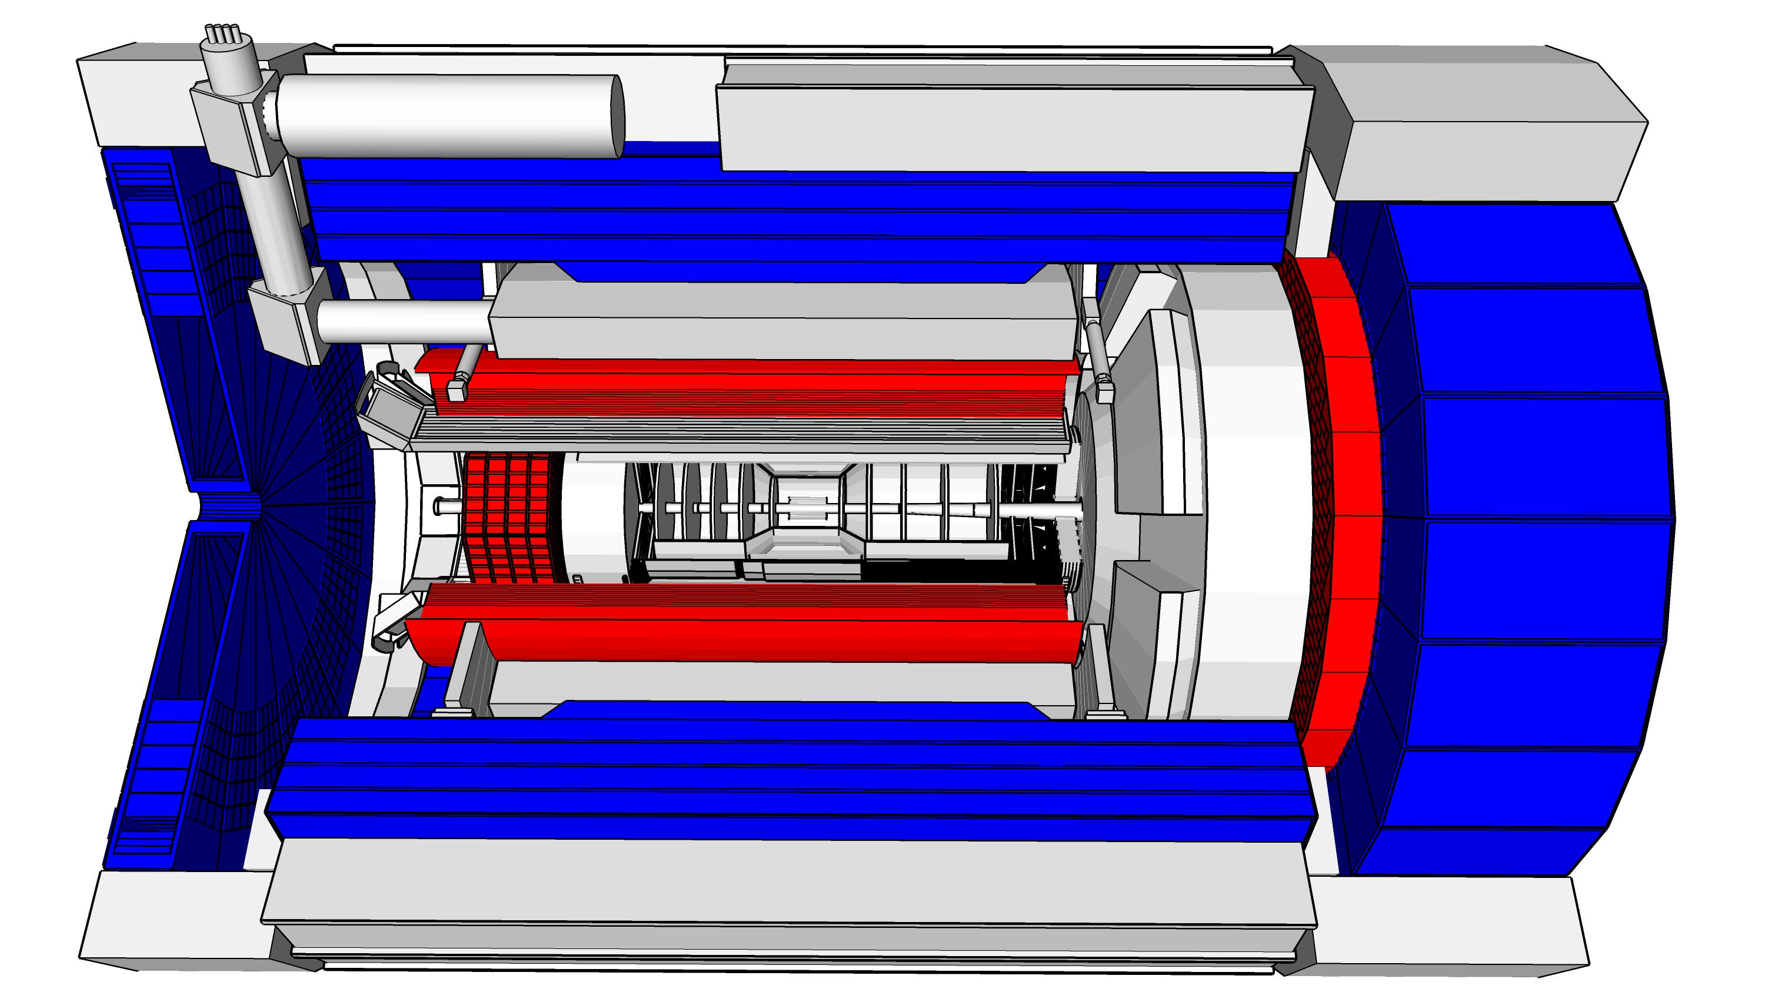
ePIC Detector Design
3.5m
η=0
5.0m
3.2m
Tracking:
  New 1.7T solenoid
  Si MAPS Tracker
  MPGDs (μRWELL/μMegas)
PID:
  hpDIRC
  pfRICH
  dRICH
  AC-LGAD (~30ps TOF)
Calorimetry:
  Imaging Barrel EMCal
  PbWO4 EMCal in backward
  direction
  Finely segmented EMCal +HCal
  in forward direction
  Outer HCal (sPHENIX re-use)
  Backwards HCal (tail-catcher)
5.34m
hadrons
electrons

Slide 26
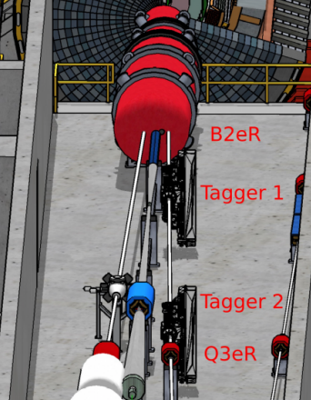
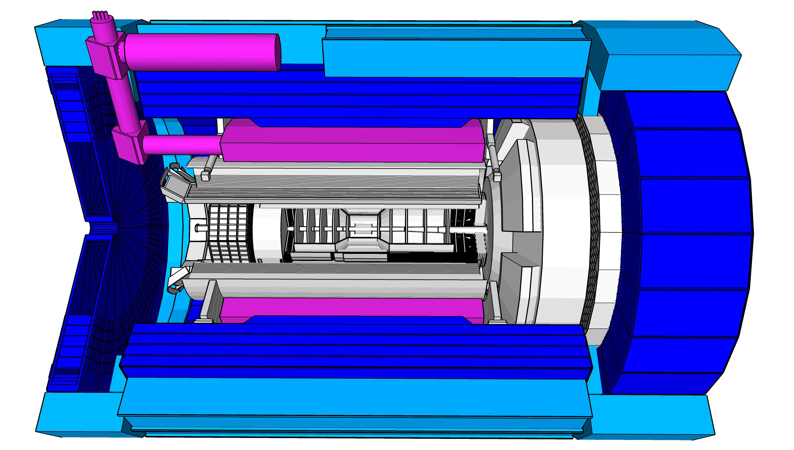
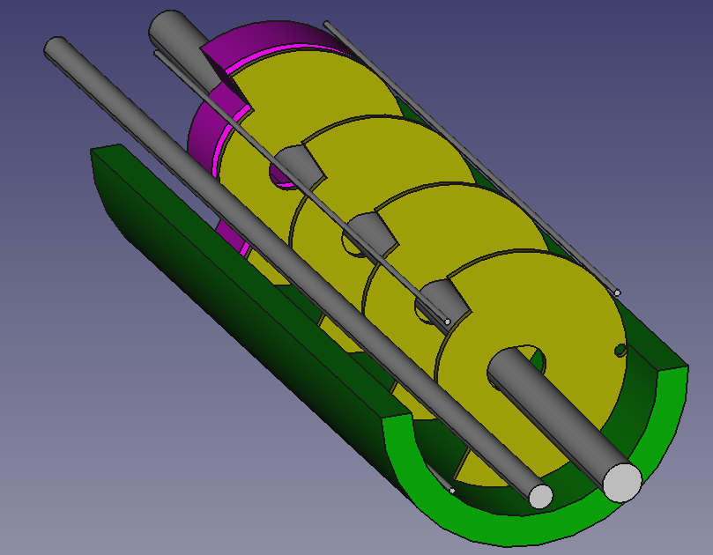
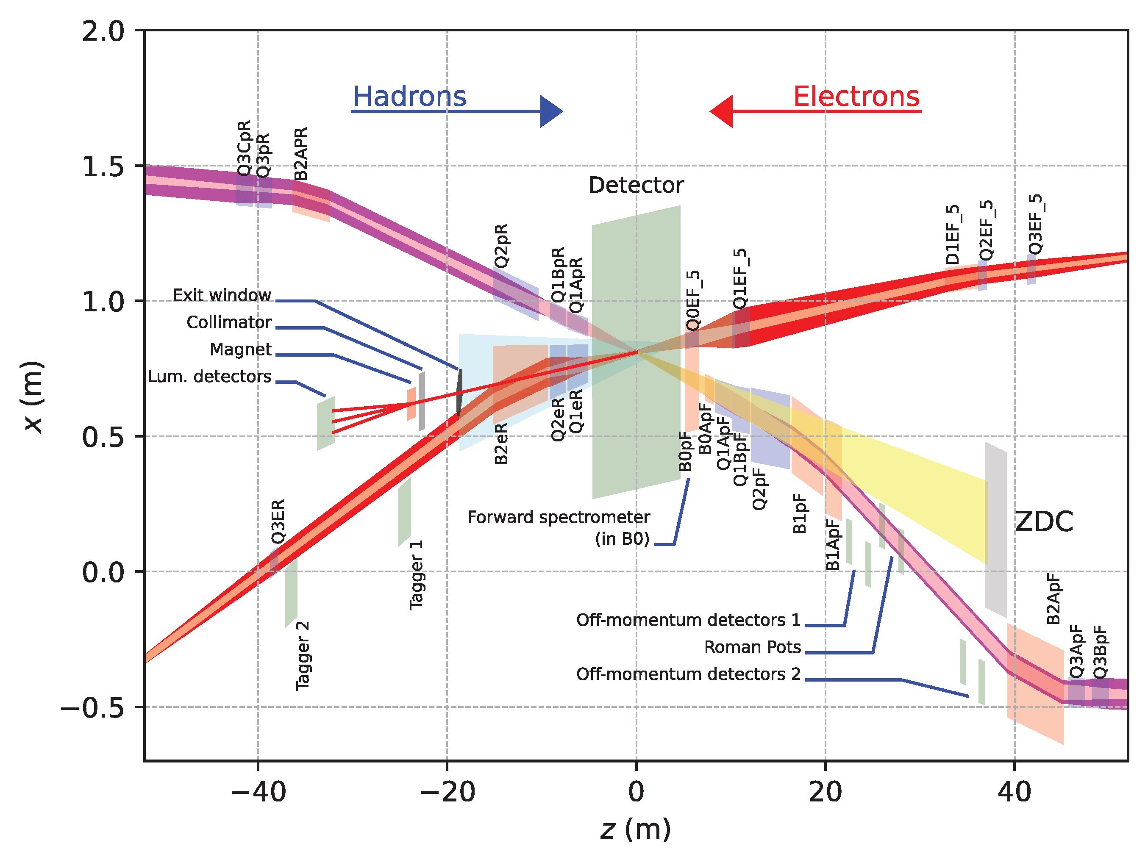
Far-Forward and Far-Backward Detectors
8.5m
PbW04 EMCAL
Si Tracking
Far-Backward Detectors
Luminosity monitor
Low-Q² Tagging Detectors
Far-Forward Detectors
B0 Tracking and Photon Detection
Roman Pots and Off-Momentum Detectors
Zero-Degree Calorimeter

Slide 27
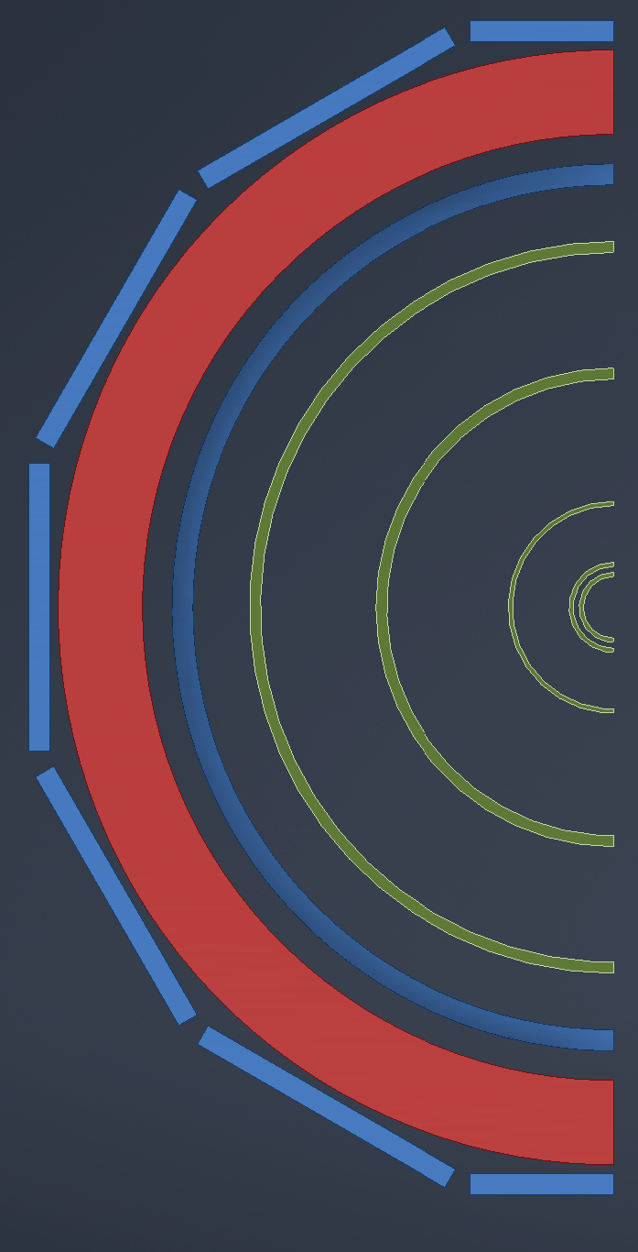

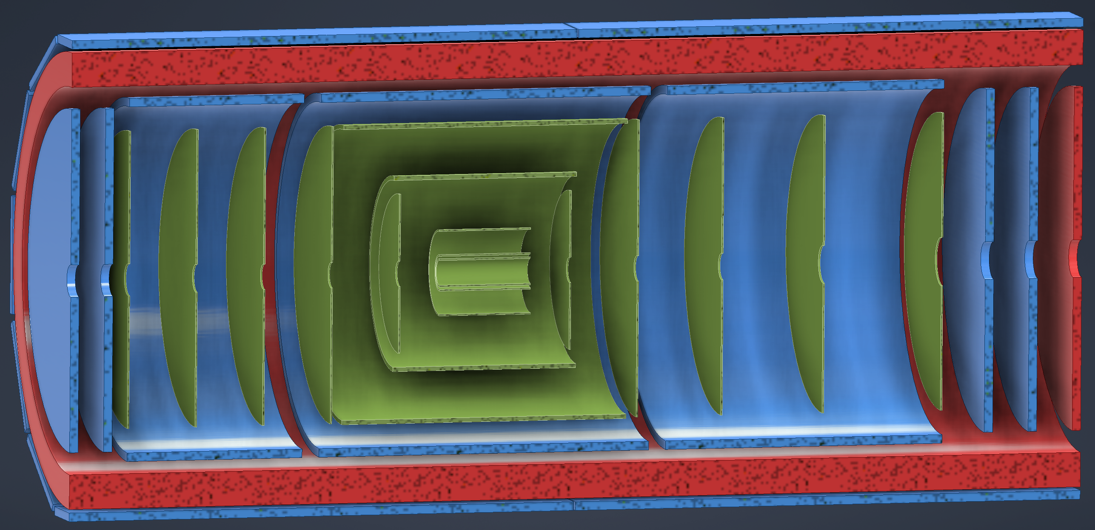
ePIC Tracking Detectors
MAPS Tracker:
  Small pixels (20 μm), low power consumption (<20 mW/cm²) and material budget (0.05% to 0.55% X/X₀) per layer
  Based on ALICE ITS3 development
  Vertex layers optimized for beam pipe bakeout and ITS-3 sensor size
  Barrel layers based on EIC LAS development
  Forward and backwards disks
MPGD Layers:
  Provide timing and pattern recognition redundancy
  Cylindrical μMEGAs
  Planar μRWell’s before hpDIRC
    Impact point and direction for ring seeding
AC-LGAD TOF and AstroPix (BECAL)
  Additional space point for pattern recognition / redundancy
world’s first
at
world’s first
at
MAPS Barrel + Disks
MPGD Barrels + Disks
AC-LGAD based ToF

Slide 28
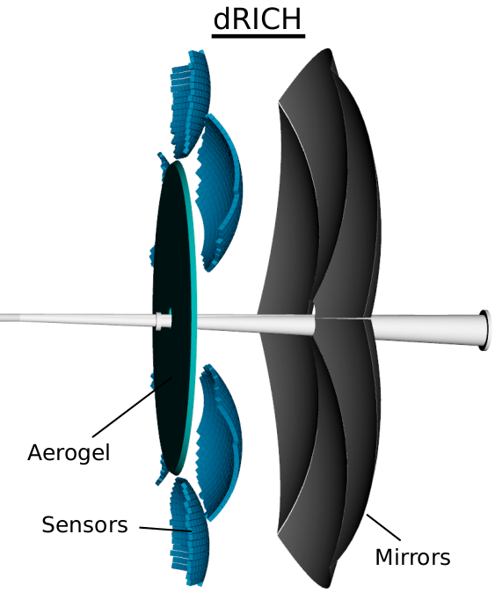
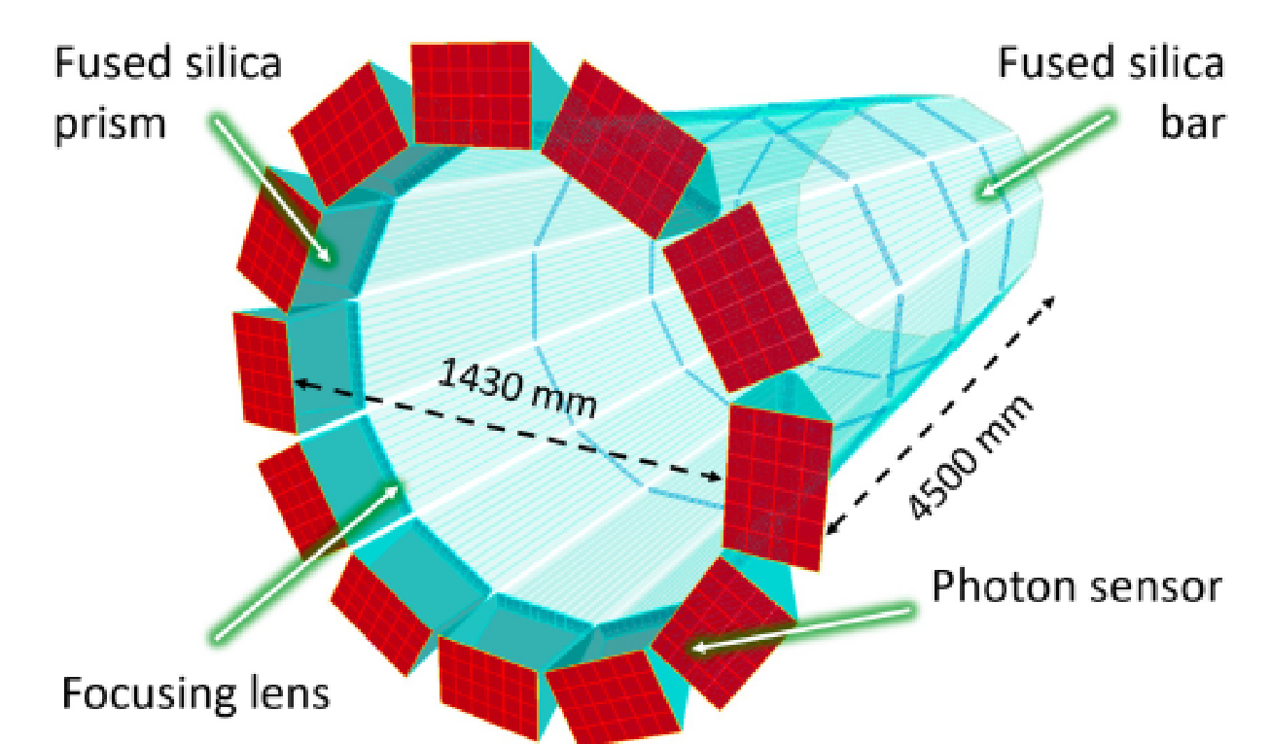
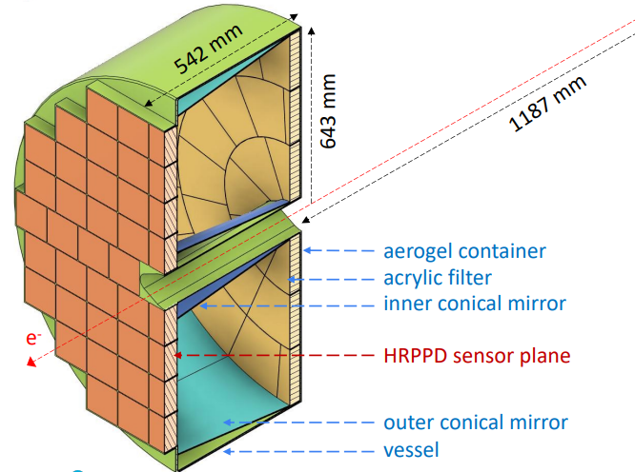
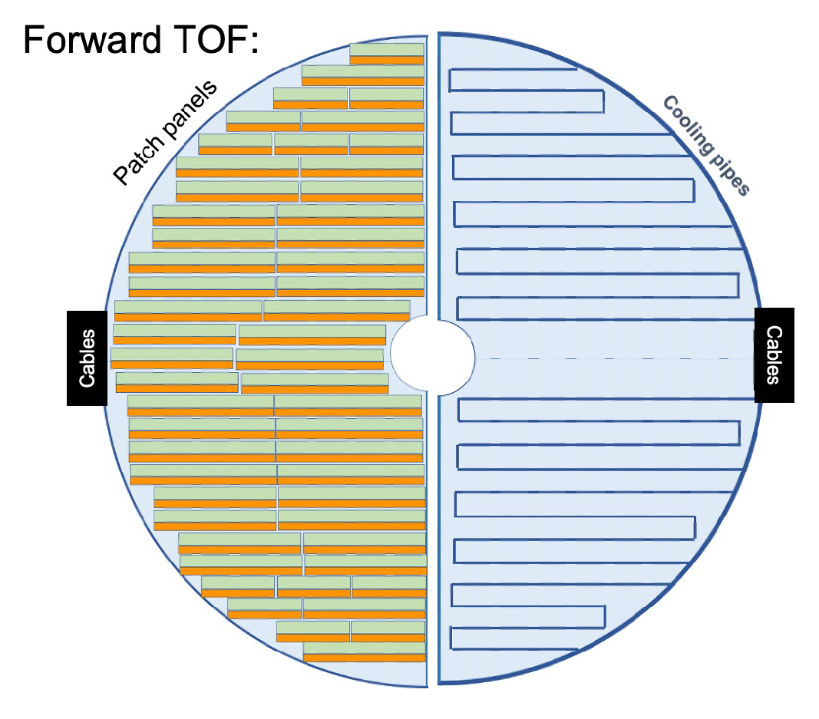
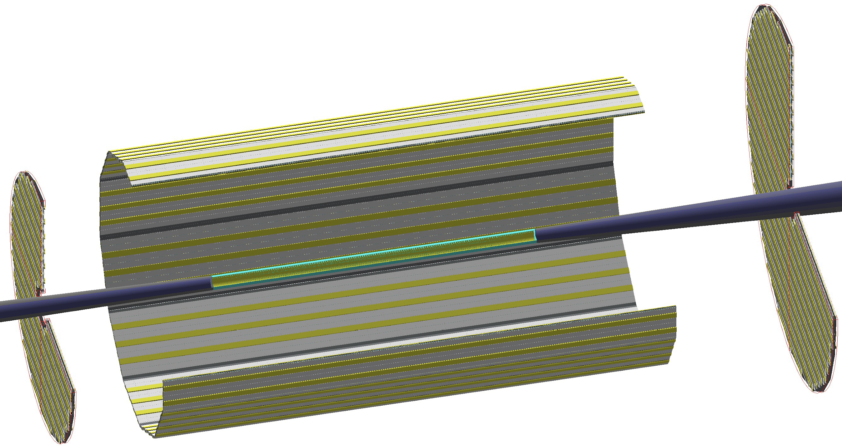
Particle ID
Dual-Radiator RICH(dRICH)
High-Performance DIRC
Quartz bar radiator (BaBAR bars)
light detection with MCP-PMTs
Fully focused
π/K 3σ separation at 6 GeV/c
Proximity Focused (pfRICH)
Long proximity gap (~40 cm)
Sensor: HRPPDs
up to 9 GeV/c 3σ π/K sep.
world’s first
at
C₂F₆ Gas Volume and Aerogel
Sensors tiled on spheres (SiPMs)
π/K 3σ sep. at 50 GeV/c
AC-LGAD
TOF (~30ps)
world’s first
at
world’s first
at
hadrons
electrons
Accurate space point for tracking
forward disk and central barrel

Slide 29
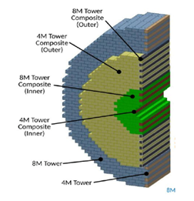
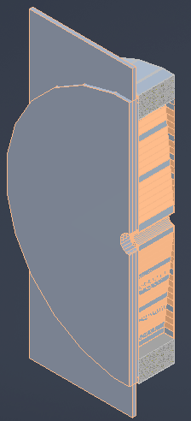
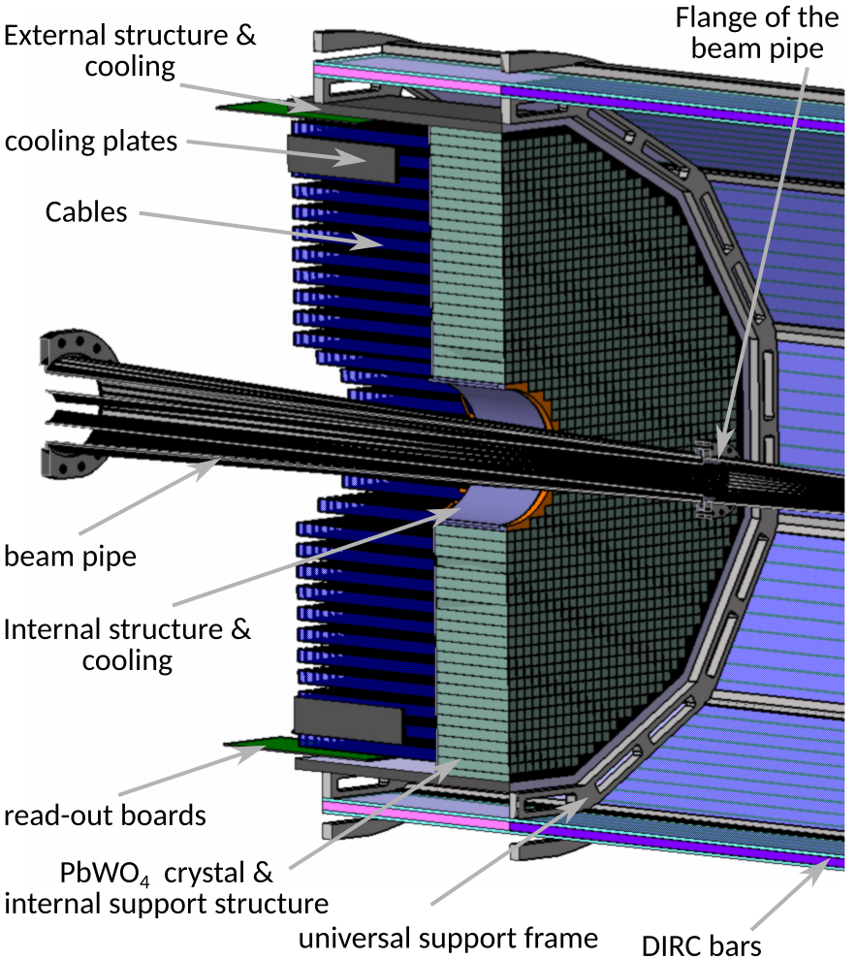
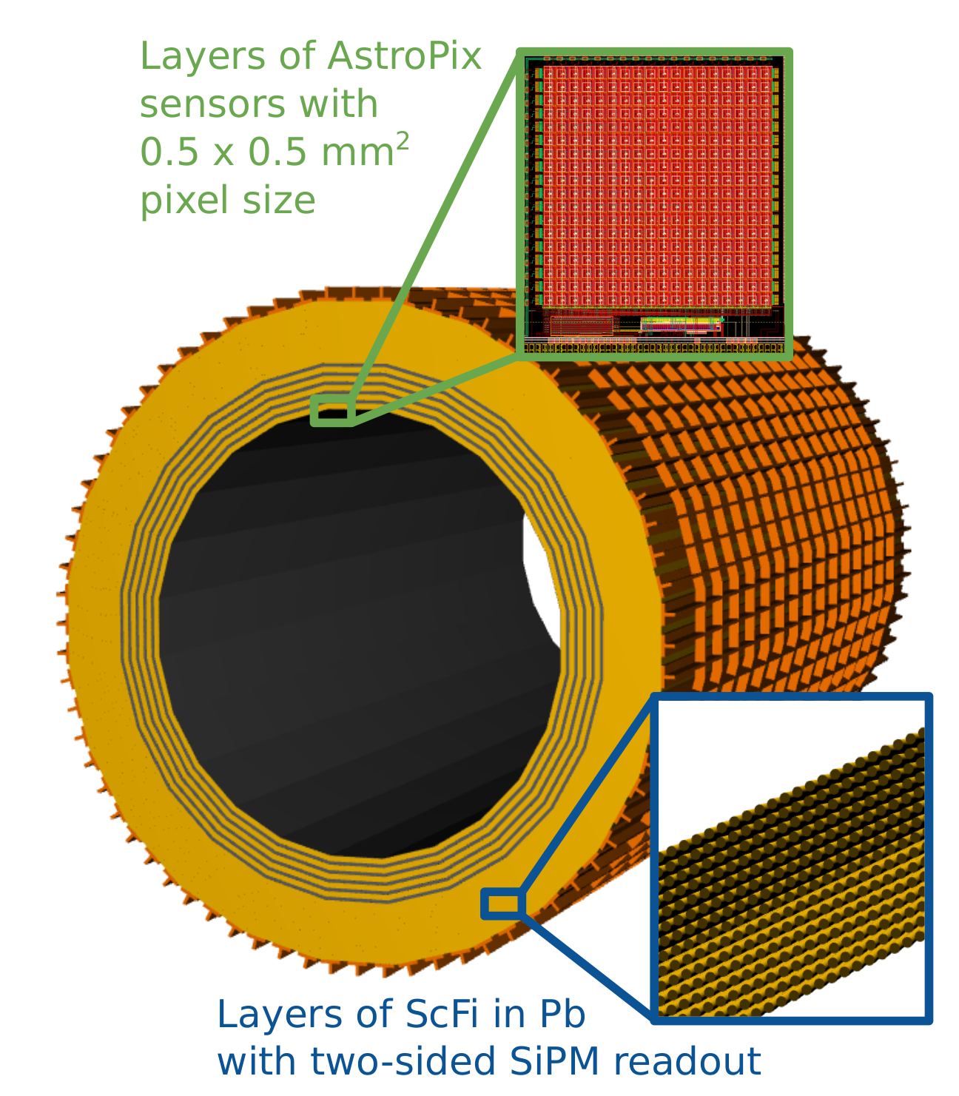
Calorimetry
hadrons
electrons
Backwards HCal
Steel/Sc Sandwich
tail catcher
world’s first
at
High granularity
W/SciFi EMCal
Longitudinally separated HCAL with high-η insert
world’s first
at
Backwards EMCal
PbW04 crystals, SiPM photosensor
Barrel HCAL
(sPHENIX re-use)
world’s first
at

Slide 30
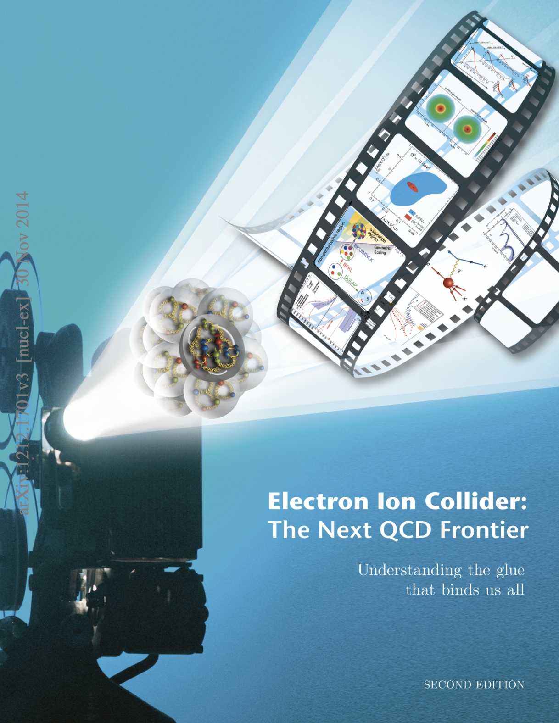




Detector Design Process Timeline
Detector and machine design parameters driven by physics objectives
2012
2015
2018
2020
2023
Call for proposals issued jointly by BNL and JLab in March 2021 (Due Dec 2021)
  ATHENA, CORE and ECCE proposals submitted
DPAP review Dec 2021 – Jan 2022, closeout March 2022
  ECCE proposal chosen as basis for first EIC detector reference design
Spring/Summer 2022 – ATHENA and ECCE form joint leadership team
  Joint WG’s formed and consolidation process undertaken
  Coordination with EIC project on development of technical design
Collaboration formation process started July 2022
Charter ratified & elected ePIC Leadership Team February 2023
EIC/ePIC endorsed as highest priority for new facility construction in 2023 LRP.
Working towards TDR and CD-3A (review Nov. 2023) and CD-2/3 (2025)

