Slide 1


Host Labs’ Computing Support Status
Alexei Klimentov
aak@bnl.gov
Amber Boehnlein
amber@jlab.org

Slide 2
EIC Computing and Software Joint Institute
Brookhaven National Laboratory (BNL) and Thomas Jefferson National Accelerator Facility (JLab), as Electron-Ion Collider host labs, have established a collaborative entity, the EIC Computing and Software Joint Institute (ECSJI).
  This joint institute is designed to support the computing and software needs and activities of the EIC.
  The Institute was created fall of 2023
ECSJI will leverage complementary expertise at the two labs and provide needed visibility to the respective lab management and stakeholders.
  The advantages of such a structure also include increased reliability and availability of resources for the ePIC collaboration and other future collaborations.
The success of the EIC, an international scientific endeavor, will benefit from contributions from international partners towards its computing effort.
To facilitate efficient coordination, the Institute will administer the EIC International Computing Organization (EICO), which will include all the contributors to the EIC computing effort.

Slide 3
ESCJI : Scope
The Institute will provide for EIC computing and software matters:
A single entity to interface with the EIC project, the ePIC collaboration, theoreticians, and future collaborators.
Execution of host lab technical computing responsibilities (slide 5).
Maintenance of service level agreements and statements of work outlining the host labs’ contribution to the ePIC collaboration concerning computing resources, services, and personnel assigned to work on ePIC computing and software deliverables.
A coordinating body for interacting with international partners, providing computing resources as in-kind contributions, including:
  Assessing resources.
  Managing the agreements with the sites delivering resources (including service levels).
  Facilitating and assessing the delivery against the agreements.
The scope may evolve over time and the organization of the institute as well

Slide 4
EIC Computing Organization & Governance
EIC Project
[& EIC Committees]
EIC Computing Council
EIC Resources Review Board
BNL and Jlab Mgmt & ePIC spokesperson
Funding Agencies
EIC Computing & Software
Joint Institute
ePIC SW&Computing
Computing & Software Advisory Committee
Management
M.Al-Turany (FAIR, GSI)
D.Brown (LBNL)
S.Campana (WLCG, CERN)
P.Mato (CERN)
C.Paus (MIT)
H.Schellman (U Oregon)
F.Wuerthwein (OSG, UCSD)
Two ECSJI co-directors
[nominated by BNL and JLAB]
EIC International Computing Organization
A.Boehnlein (JLab)
A.Klimentov* (BNL)
The proposed governance structure designed to facilitate communication, coordination, escalation of issues, and conflict resolution.
EICO Management Board
Set Up
ePIC (Experiments) & Computing Centers
TBD
Activity areas & Forums
Technical Experts and Areas Coordinators
*) A.Klimentov took over from E.Lancon on 1 April’24
Many thanks to Eric for his excellent work and his crucial role in setting up the Institute.

Slide 5
The primary technical responsibilities of host Labs
Oversight for ePIC software and computing designs and execution to provide assurance functions for the host labs and DOE.
Provisioning and operating standard infrastructure solutions consistent with supported lab infrastructures and community best practices.
Support for the EIC International Computing Organization.
Interface for local resources and policies at the respective labs.
On-going computing operations in support of the accelerator and detector design and construction.
Operational support functions for:
Experimental data curation.
First-pass processing.
Data analysis.
Support of collaboration(s) and users.
Accelerator and detector simulations .

Slide 6
EIC Computing Organization & Governance II
Computing Council (ECC)
  Review the ECSJI strategic direction and support leadership in managing effective interfaces of the ECSJI to the EIC project and ePIC collaboration.
  Authority: Approve the ECSJI strategic direction, leadership changes, annual budgets, resource allocations, and performance milestones.
The Institute Management [two co-directors, each nominated by one lab]
  Regular meetings are organized with
    ePIC management and ePIC software & computing coordinator
    EIC co-directors of the experimental program
  Duties and accountability:
    The management is responsible for organizing the Institute to deliver defined responsibilities.
    The management will maintain a multi-year operation plan for the host labs, providing matrixed staff members to support activities.
    Institute management will provide a yearly report to the host labs’ management.

Slide 7


EIC Computing Organization. Computing and Software Advisory Committee
Computing and Software Advisory Committee (ECSAC)
  The ECSAC’s role is to provide advice, guidance, and counsel on the strategy and
  objectives of the Institute and of the EIC International Computing Organization.
  Strong connection to International Computing and Software community
    ECSAC has members from US Laboratories, US Universities and International
    Laboratories (CERN, GSI)
  The first review by ECSAC was held in October 2023, the second one will be organized by fall of 2024 to review ePIC computing model
    ECSAC October 2023 review recommendations
M.Al-Turany (FAIR, GSI)
D.Brown (LBNL)
S.Campana (WLCG, CERN)
P.Mato (CERN)
C.Paus (MIT)
H.Schellman (U Oregon)
F.Wuerthwein (OSG, UCSD)
LHC

Slide 8
EIC Computing Organization & Governance. International Computing Organization
International Computing Organization (EICO)
The EICO is still to be established, jointly with the international partners that are getting involved in EIC Computing (no significant progress since December 2023). The EICO is led by the Institute's co-directors and administered by the ECSJI. Its purpose is to provide computing resources and infrastructure to the ePIC collaboration and potentially address other computing needs related to the EIC.
    EICO Management board composition : Reps from ePIC and International Partners
      EICO Management Board provides the main technical directions for EIC Computing Technical Activity Areas
    EICO organizes AHM and other meetings
    EICO defines activity areas and technical forums
    EICO collects ePIC requirements, produce accounting reports and supervises SLA
LHC

Slide 9
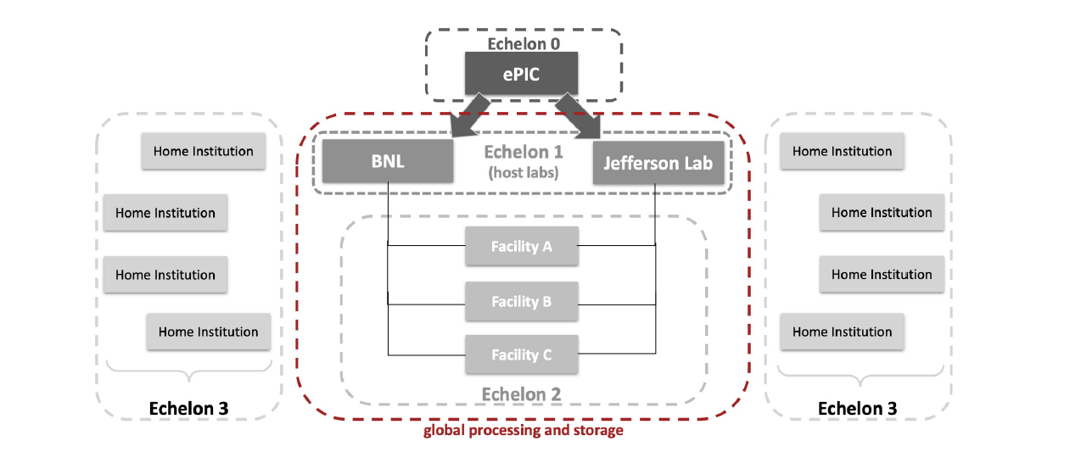
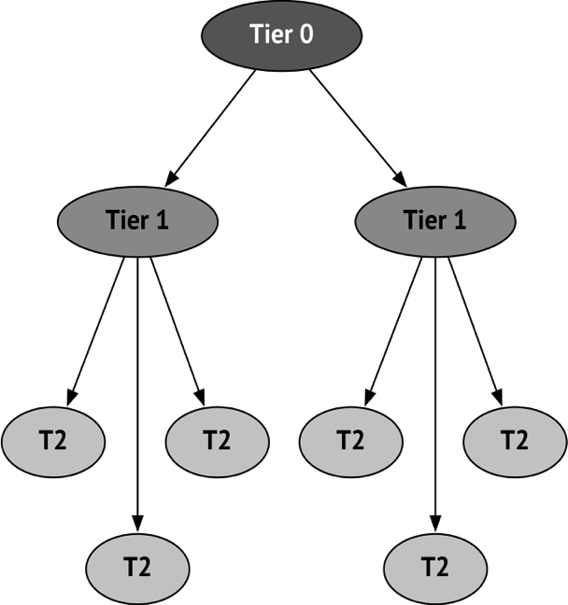
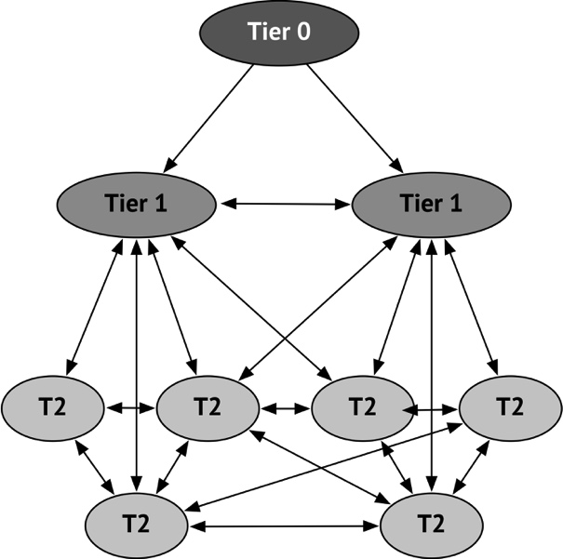
EICO and ePIC Streaming Computing Model
  ePIC streaming computing model* is a primary document for preparing MoUs with International partners (and to define roles for Computing Centers)
    Role of Echelon 2 and 3 centers may evolve with time
    Data placement and number of data replicas (data distribution between sites is TBD)
    ESCJI will organize ePIC Computing Model review by fall of 2024
2010
2015
LHC
LHC Computing Model Evolution from Run1 to Run2 [reducing complexity. WAN bandwidth increased by x10 in 10 years and federated, network-centric computing is even more important for the future]
ePIC Streaming Computing Model (M.Diefenthaler talk)
*) ePIC collaboration streaming model doc

Slide 10
EIC International Computing Organization Status
ECSJI and ePIC management are collaborating to define 'external partners' for inclusion in the drafting EICO charter.
The ECSJI plans to apply for observer status to the WLCG
    discussions with WLCG are in progress
      ECSJI can get observer status at WLCG Management Meeting in May
      Evolution of the WLCG towards a federation of autonomous computing institutes (LHC, DUNE, Belle II, EIC, SKA,…) is under discussion [WLCG long-term strategy and evolution will be discussed at DESY next week]
    Utilization of WLCG network infrastructure by EIC computing is one of the first topics to be addressed
      Relations with network providers are very important for NP&HEP computing (and bi-directional)
HEP experiments are at the same scale as EIC computing, we must co-exist
Cooperation and collaboration with WLCG (and FAIR) is beneficial and natural
    It will let all experiments not to reinvent existing solutions
      LCF/HPC and clouds integration into Computing Model
      Use accelerators or/and co-processors for specific workflows
      In addition new models of compute and storage provisioning may be arriving
        e.g. dynamic composability of hardware and software systems, cluster co-processors etc., storage in the network (ESnet proposed R&D to evaluate data caching in the network)
          Not forgetting quantum computing …
      All of this requires significant investment in software and training, as well as policy, scheduling, infrastructure and service adaptations
Infrastructures & centres likely to be common between HEP & NP (WLCG and EIC)

Slide 11



EIC International Computing Organization Status. Cont’d
In the fall of 2023 contacts with international partners in Italy, Canada and UK
  Canada: Wouter Deconinck
  Italy: Pietro Antonioli, Andrea Bressan, Domenico Elia
  UK: Peter Jones, David Britton (GridPP)
So far discussions covered the following points:
  Organization of funding for Nuclear Physics (NP) computing at the national level.
  Structure of computing for the EIC and for ePIC within each respective country.
  Existing support and commitment for EIC computing.
  Schedule and the specified level of contribution for formalizing contributions to EIC computing through agreements.
  Follow-up discussions will be organized (aligned with EIC-RRB cadence)
Computing centers of Italy, Canada and UK were already included in large-scale simulation efforts for the EIC.

Slide 12
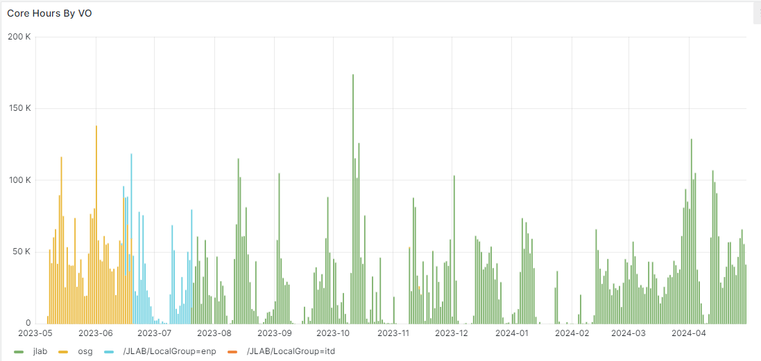
Status and Computing Resources for EIC
Presently, support and computing resources
for the EIC at BNL and JLab are provided
mostly opportunistically
  at Jefferson Lab, 2000 job slots and 1PB of
  storage allocated for the EIC, at BNL HPC cluster
  is set up to support EIC project
Local funding (at limited scale) is available
at both Labs for computing and software
development
The EIC is using the Open Science Grid (OSG) and
anticipating the inclusion of partners from
WLCG-affiliated institutions and DOE ASCR Facilities
  EIC will use WLCG networking infrastructure : LHCOPN/LHCONE - one of areas where we need a discussion and collaboration with WLCG
EIC core hours per month 2023-2024 (US Facilities)

Slide 13


Status and Computing Resources for EIC. Cont’d
We started to integrate and leverage software, tools, and services developed by the WLCG community for EIC
  Data Management and workflow management
    Rucio for data management adopted by ePIC, de facto standard for HEP experiments @LHC and Belle II
    PanDA for workflow management in use for AI based EIC detector design project funded by DOE NP, will be evaluated by ePIC
    EIC Rucio instances are installed at BNL and JLab, PanDA instance is installed at BNL (available to ePIC and EIC project)
Very promising discussion about AI/ML for EIC at BNL in April (AI/ML for detector design, DAQ, accelerator, analysis)
    AI/ML for EIC is a well-developed activity area (cf. AI4EIC workshop series) with promising recent discussions to grow AI/ML activities further and provide support
Ongoing discussion and prototyping of collaborative tools for ePIC (including comanage features)
  User Database, Document Database, Document Development Platform, Web Hosting
    ePIC collaboration needs many collaborative tools to function that have to be realized and maintained. Since few of the available solutions fulfill all of ePICs requirement, the development of collaborative tools is required. These items are the responsibility of the hosting labs.
Ongoing discussion between the ePIC (DAQ, SW&C) and the Institute about computing model

Slide 14
Summary
Strong support for EIC and ePIC computing in host laboratories
Strong interest in EIC and ePIC computing in the scientific community (US and international).
  This week's EIC RRB meeting, kindly hosted by INFN, gives us the opportunity to discuss the international aspects of EIC computing with our colleagues from many countries.
BNL and JLab, as Electron-Ion Collider host labs, have established a collaborative entity, the EIC Computing and Software Joint Institute.
  The Institute is an active participant in EIC and ePIC computing.
The ECSJI Computing and Software Advisory Committee (with strong international participation) has been formed and conducted the first ePIC SW&C review in fall 2023.
The first version of the ePIC streaming computing model is ready and will be reviewed by the ECSJI computing and advisory committee in fall 2024.
  ePIC streaming computing model is a primary document for preparing MoUs with International partners (and to define roles for Computing Centers)
The priorities for this year :
Organise ePIC computing model review
Identify possible international contributors
Work on the EIC International Computing Organization Charter
Work on agreements legal content, identify signing authorities in various countries
Establish accounting mechanism for contributions to EIC computing

Slide 15
Backup Slides

Slide 16
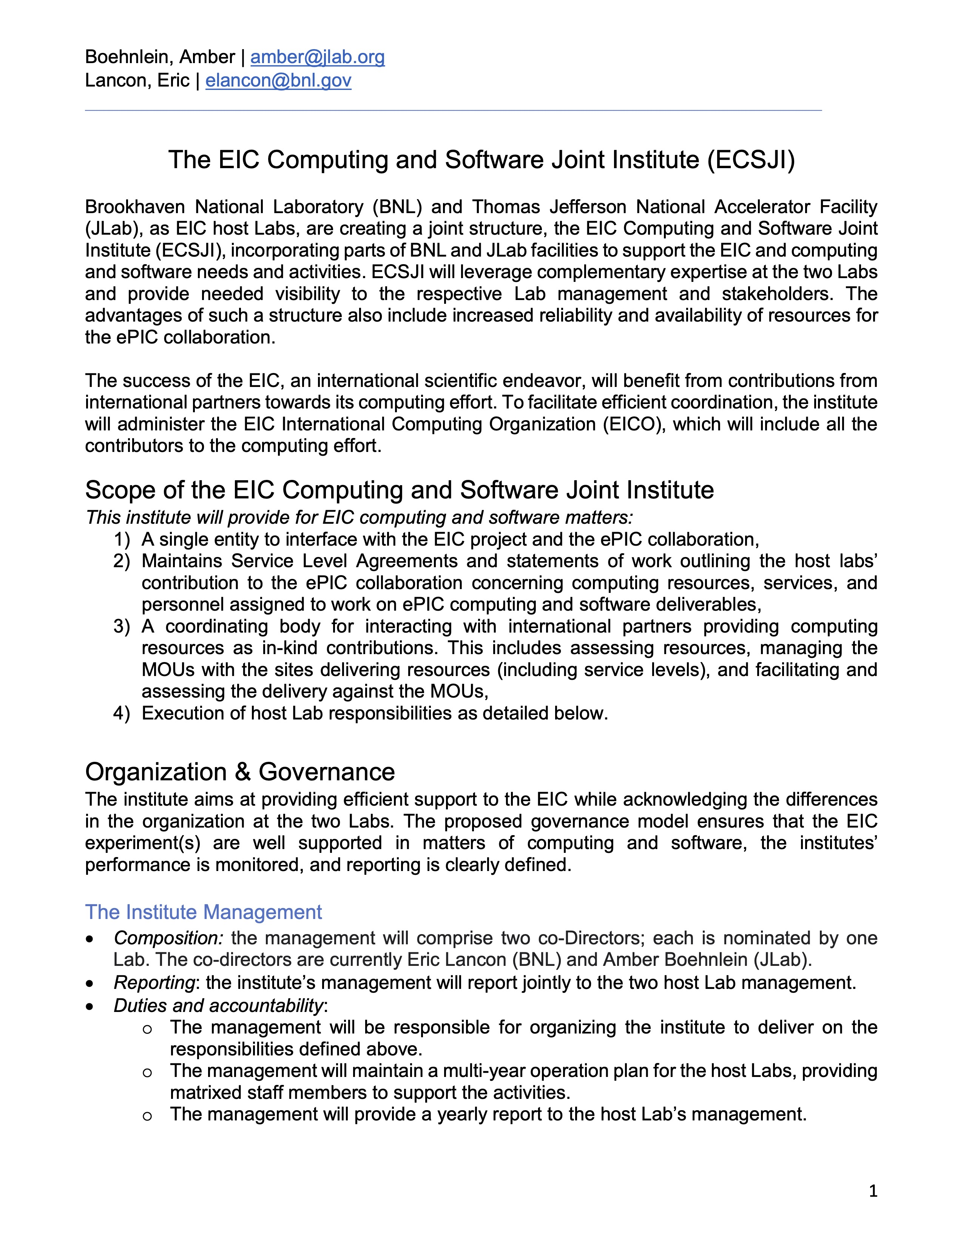
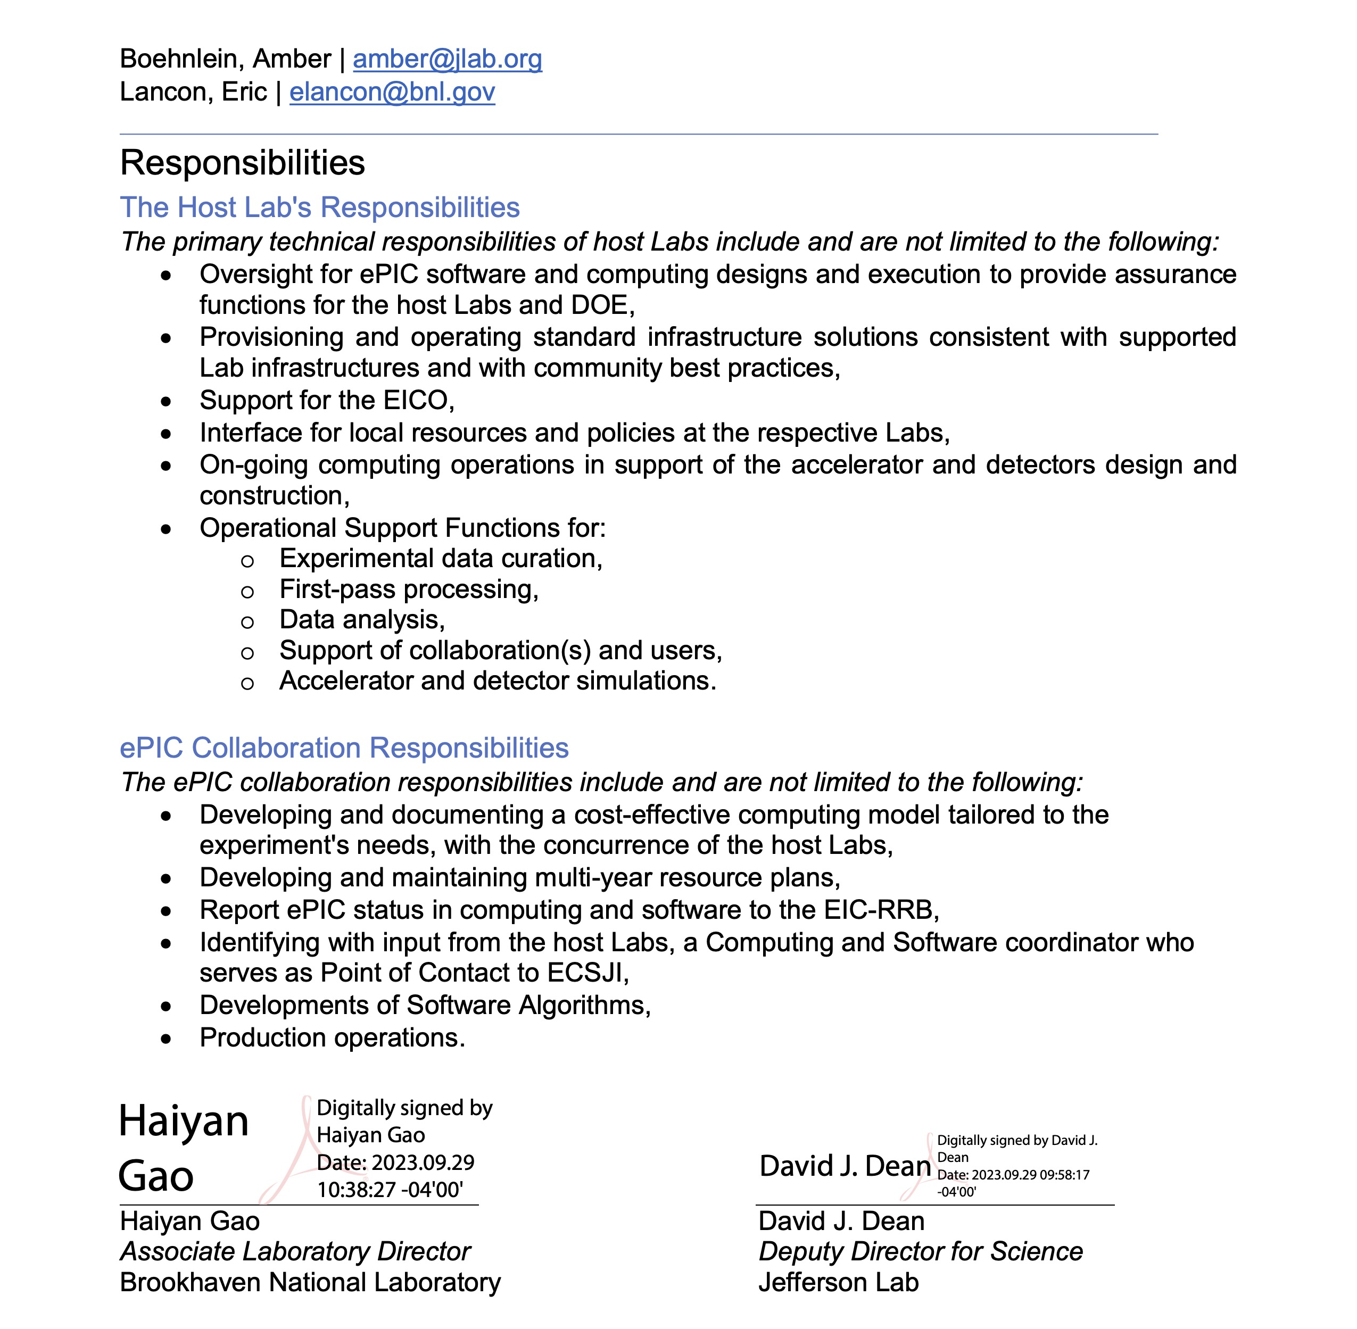
The EIC Computing and Software Joint Institute was created fall of 2023

Slide 17
The recommendations from the fall 2023 ECSAC review

Slide 18
Canadian infrastructure available for the EIC
Wouter Deconinck
Digital Research Alliance of Canada: National computing resources supporting both HPC and HTC workflows
  Operated through regional consortia
  EIC Canada's computing contribution is operated by staff from Prairies, one of the five regional organizations
Annual resource allocation competitions (with fast-track continuance option), Peer review process of access
EIC Canada has held active allocation for 4 years
  ~50 core-years/year, 100 TB during proposal and initial ePIC development phase
  Supported majority of ATHENA simulations until Open Science Grid (5k-10k core-years)
  Primary use for EIC Canada researchers and for international contribution proof of concepts

Slide 19
Future? - Canadian infrastructure available for the EIC
Wouter Deconinck
Canada aims for approximately 10% of the U.S. contribution to EIC computing.
In the future, EIC Canada could have the opportunity to make a contribution through dedicated infrastructure.
  Precedent exists in ATLAS Canadian Tier-1 located at Simon Fraser University (SFU).
  SFU leads a consortium of Canadian institutions, including TRIUMF, operating the Tier-1 Data Centre, which receives funding from the Canada Foundation for Innovation (CFI).
For EIC Canada to expand with dedicated “Tier-1”-like resources, a formal proposal is anticipated after the completion of detector subsystem construction (also requested of CFI).

Slide 20

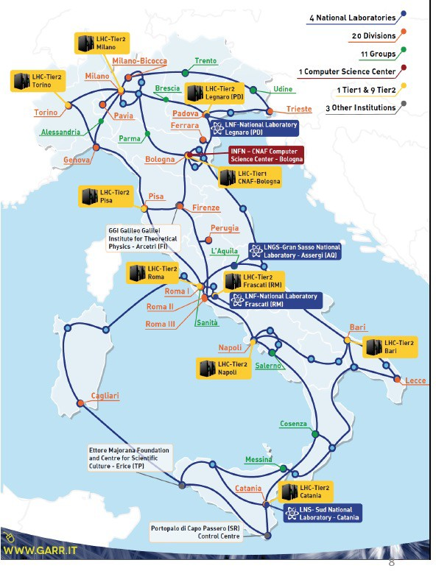
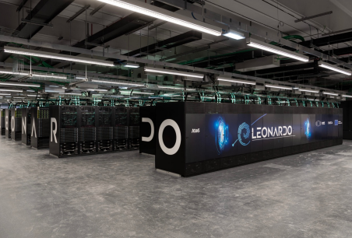
Italian infrastructure available for the EIC
Andrea Bressan
INFN operates its own Grid and Cloud services:
  Nine medium-sized centers
  One large national center at CNAF (Bologna) collocated with LEONARDO (pre-exascale supercomputer)
  Successfully contributing to the WLCG for two decades and will support the LHC in the High Luminosity area
A major national initiative has recently been approved: ICSC
  National Research Centre
  for High-Performance Computing, Big Data, and Quantum Computing
  The EIC could benefit from this global infrastructure
Modest resources are available for EIC until detector construction is completed
Italian EIC community has been yearly applying (and getting approved) for a share at CNAF since 2020
Aiming at contributing at the level of ~10% to EIC computing effort

Slide 21


UK infrastructure available for the EIC
Peter Jones
Science and Technology Facilities Council (STFC)
  Part of UK Research and Innovation (UKRI)
  Supports research in Nuclear Physics, Particle Physics and Astronomy
  IRIS project set up in 2018 to improve federation of STFC digital infrastructure
  Infrastructure partners include GridPP (High Throughput Computing) and DiRAC (High Performance Computing), amongst others
  GridPP supports HTC needs of nuclear and particle physics, in particular the UK’s contribution to the WLCG but also non-LHC experiments
www.ukri.org/councils/stfc/
www.iris.ac.uk
www.gridpp.ac.uk

Slide 22
UK contribution to the EIC
Peter Jones
10% of GridPP resources are available to non-LHC experiments – EIC can request a share for development
The resource is allocated through IRIS
Future planning assumes EIC will apply for funding for its own allocation potentially starting in FY28/29, to be implemented by GridPP (e.g., as an extension of the Tier-1 site at RAL)
Exploiting synergies with WLCG data management is highly desirable
Aiming to provide a fair share percentage of EIC computing resources (TBD)
  GridPP federates the Rutherford Appleton Laboratory (RAL) Tier-1 site and 16 Tier-2 sites

Slide 23
Proposed computing agreements timeline
2024
Identify possible international contributors
2027+
Finalize agreements legal content
Start agreements signing process
2029+
agreements are signed
International contributions included in eventual EIC Full dress rehearsals
Work on agreements legal content, Identify signing authorities in various countries
Year-0
Data Taking
ePIC to develop a comprehensive quantitative computing model
Establish accounting mechanism for contributions to EIC computing
Work on the EICO Charter
2025 -2026
Resource planning for the short and long-term
Refinement of ePIC computing model and requirements

Slide 24
Glossary and Abbreviations
AHM – All Hands Meeting
AI4EIC --- Artificial Intelligence for the Electron Ion Collider
ECC - EIC Computing Council
EICO – EIC International Computing Organization
ESCJI – EIC Software and Computing Joint Institute
LHCONE – LHC Virtual Overlay on national academic networks – managed by NRENs
  Also used by many other “HEP & related” experiments
LHCOPN – LHC Optical Private Network (connects CERN and WLCG T1 centers)
OSG – Open Science Grid
PanDA – Workflow Workload Management System (Production and Distributed Analysis)
Rucio – Scientific Data Management System
SLA – Service Level Agreement
WLCG – World LHC Computing Grid

