Slide 1
Global Strategy Proposal
E.C. Aschenauer (BNL), Marta Ruspa (INFN Torino)
with input from EIC-UG and ePIC DEI groups
EIC Resource Review Board Meeting
May 6-7, 2024

Slide 2
What is the Goal of the Global Strategy Proposal
expand EIC experimental community
built up a STEM pipeline
provide opportunities for early career scientist especially from developing countries
Develop a truly diverse workforce
Make the EIC a real international facility

Slide 3
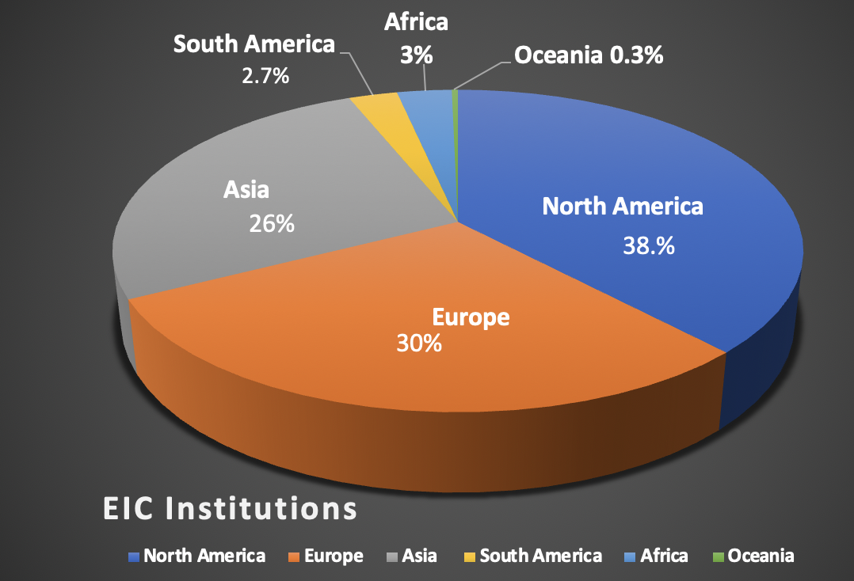
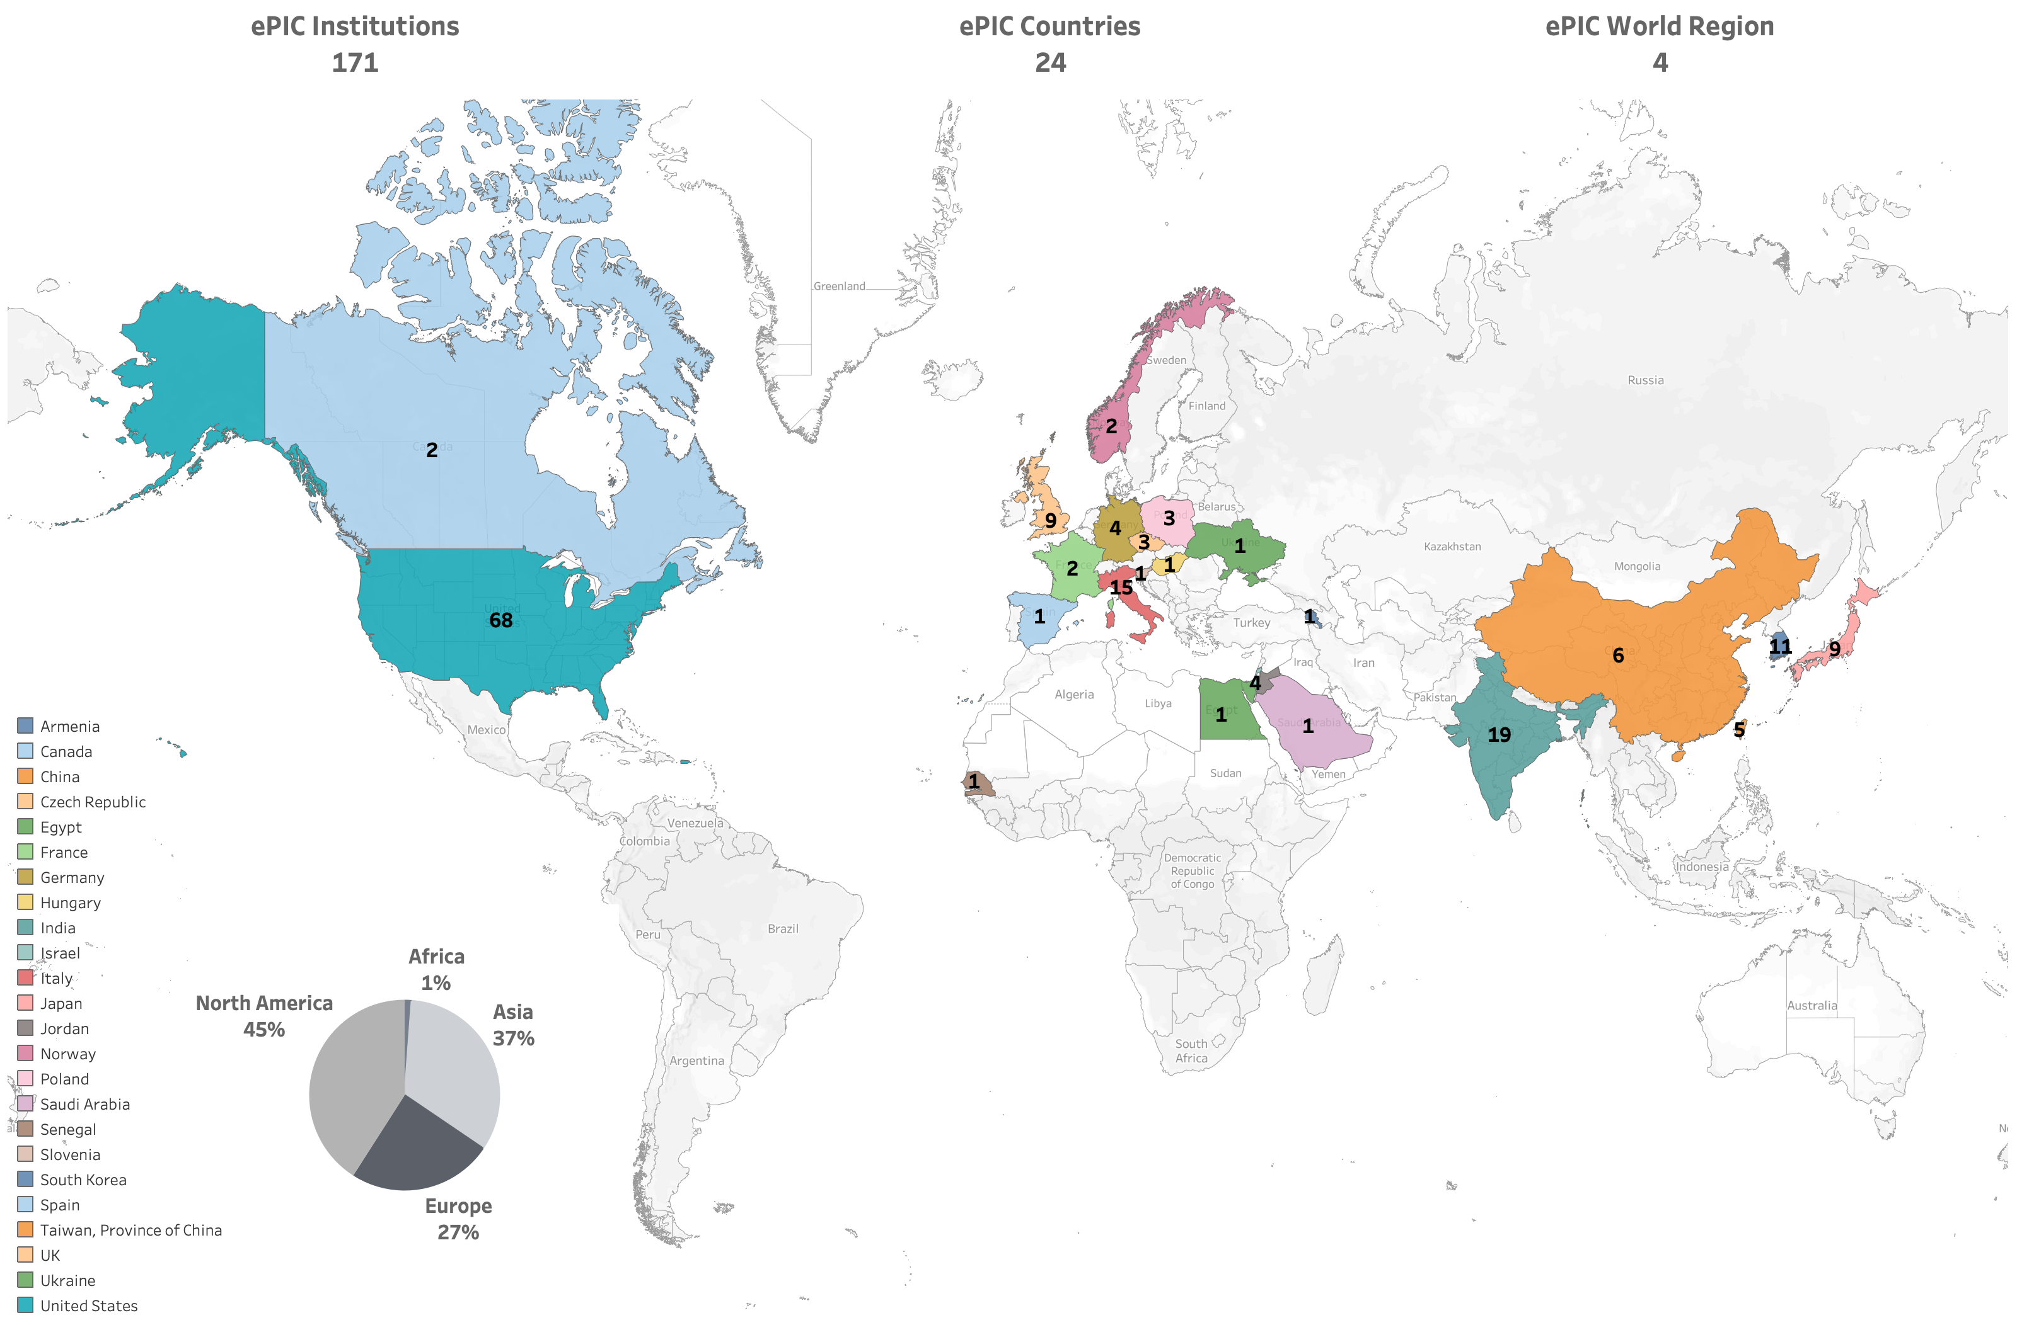
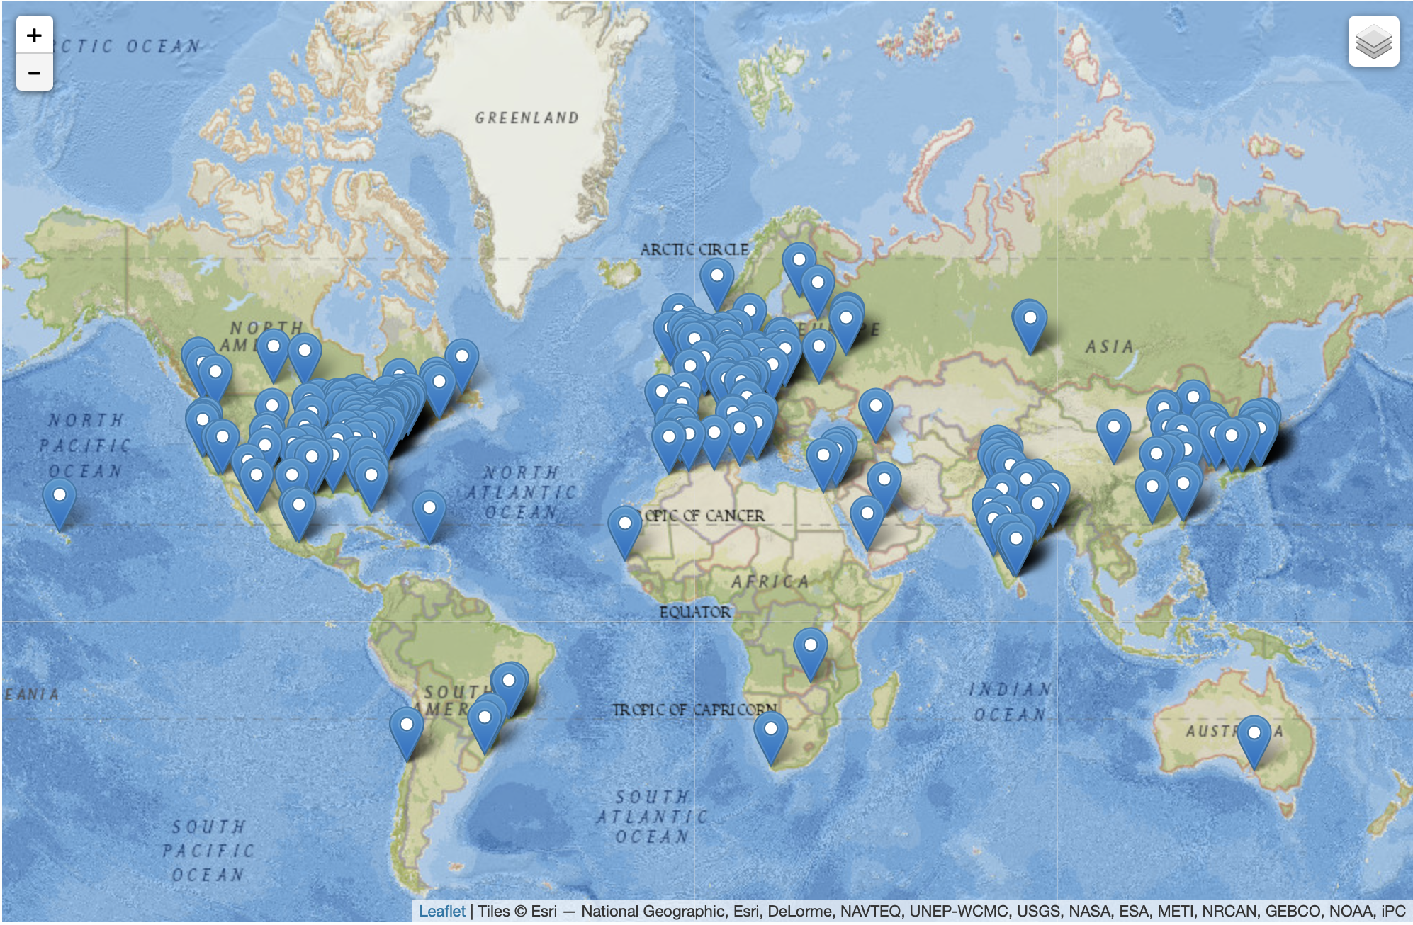
World-Wide Interest in EIC and ePIC
The EIC Users Group: EICUG.ORG
Formed 2016 400 Users → Now
1483 collaborators, 40 countries, 291 institutions
(Experimentalists 966, Theory 368, Acc. Sci. 133)
Collaboration
https://wiki.bnl.gov/EPIC/index.php?title=Main_Page
Formed in 2022 → Now
~600 collaborators, 24 countries, 171 institutions
(including 13 new institutions since July 2023)
Location of Institutions

Slide 4
What BNL & Jlab already do (Examples)
The Hampton University Graduate Studies (HUGS) Summer Program at Jefferson Lab (Yearly) https://www.jlab.org/education/hugs
CNFS Summer School on the Physics of the Electron-Ion Collider (Yearly) https://www.stonybrook.edu/cfns/activities/summerschools.php
Participate actively in:
FAIR: Accelerated, Inclusive Research (FAIR) aims to build research capacity, infrastructure, and expertise at institutions historically underrepresented in the Office of Science portfolio, including minority serving institutions (MSIs) and emerging research institutions (ERIs). https://science.osti.gov/Initiatives/FAIR
RENEW: Initiative leverages DOE's unique National Laboratories, user facilities, and other research infrastructure to provide training opportunities for undergraduate and graduate students, postdoctoral researchers, and faculty at academic institutions currently underrepresented in the U.S. science and technology https://science.osti.gov/Initiatives/RENEW
Inter-American Network of Networks of QCD challenges: Dr. Daniel Tapia Takaki, PI
This initiative focuses on designing and establishing a network of networks across the United States, Canada and Latin America to accelerate the process of tackling QCD challenges. https://www.iann-qcd.org
Collaboration with historically black colleges and universities (HBCU)
NuSTEAM This is a new collaborative effort by four Texas-based universities that will run an undergraduate traineeship project under the guidelines of the Department of Energy TBD- NP (Research Traineeships to Broaden and Diversify the Nuclear Physics community) program. http://nsmn1.uh.edu/cratti/NuSTEAM.html
NuPUMAS https://nupumas.physics.uh.edu/index.html

Slide 5
Ideas for Global Projects
Summer Programs for Undergrads and PhD students both Scientists and Engineers
US: most DOE sponsored programs like SULI are only for US nationals & green card holders
establish an exchange program to spend a summer at a US national lab involved in EIC
Develop a Mobility Program Student from Country A participates in project at Country B
hardware / engineering projects might be beneficial to students from developing countries
2025 DIS – Conference in South Africa
possibility to organize a DIS school in Africa in collaboration with the organizers of African School of Physics (https://africanschoolofphysics.org)
Opportunities for Scientist at all career stages
Support for visiting scientist program has long tradition both at BNL and JLab

Slide 6
Ideas for Global Projects
Getting inspired by the LHC outreach activities
could join the International Particle Physics Outreach Group (IPPOG)
a recognized pillar for HEP → integrated in European Strategy for Particle Physics
2013: Outreach and communication in particle physics should receive adequate funding and be recognized as a central component of the scientific activity. EUROPEAN PARTICLE PHYSICS COMMUNICATION NETWORK (EPPCN) and IPPOG should both report regularly to the Council
EPPCN: https://espace.cern.ch/EPPCN-site/_layouts/15/start.aspx#/EPPCN%20Web%20Page/Home.aspx
IPPOG: https://ippog.org

Slide 7
IPPOG International Master-Classes
Masterclasses promoted by the International Particle Physics Outreach Group (IPPOG) https://physicsmasterclasses.org/
Different topics related to
various experiments
Each year
33000 high school students
60 countries
225 universities
The students attend a full day
event in a nearby university
What about to organize a Masterclass on EIC & ePIC?

Slide 8
Masterclass format
The Masterclass format is typically based on
a few seminars on basic physics and on the concerned experiment
in the morning
a hands-on session in the afternoon
a joint discussion of the results in video conference with all the participating institutes at the end of the day
The hands-on session is carried out on a desktop or laptop computer, ideally one for each student. A simulation/reconstruction software allows the students to perform an exercise – based on real or simulated data.

Slide 9
ICTP Physics Without Frontiers
ICTP: The Abdus Salam International Centre for Theoretical Physics
Follow: @ictpPWF
Twitter Facebook and Instagram Website: ictp.it/home/physics-without-frontiers Email us: pwf@ictp.it

Slide 10
ICTP Physics Without Frontiers
Info Thank to
Dr Kate Shaw The Abdus Salam International Centre for
Theoretical Physics & The University of Sussex

Slide 11
Examples of Outreach Programs from LHC Experiments

Slide 12
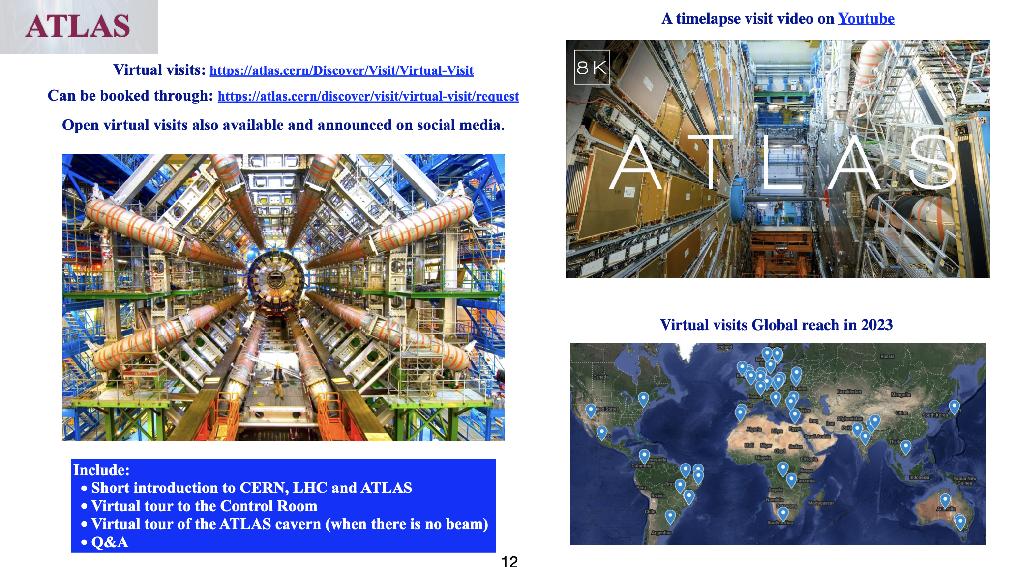
Examples of Outreach Programs from LHC Experiments
All CERN experiments do similar things
all initiatives coming from the experiments themselves
Info thanks to Hassnae El Jarrari
https://indico.marwan.ma/event/1/contributions/528/attachments/129/225/Hassnae%20-Outreach%20ACHEP23%20Rabat.pdf

Slide 13
Beamlines for Schools

Slide 14
Contest / slam / pitch / TED like Talk
There are various formats based on competition between the participants
The idea is to have an informal speech, short (3-5 minutes), clear,
scientific sound but at the same time understandable to non-experts
Could serve as a satellite event in our meetings. Participants could be either our early-carrier students or local students.

Slide 15
What is needed
Real Engagement and doing Real Work by all of us
and
fraction of common fund money (~10%) should be earmarked
towards these outreach activities

