Slide 1
Synchrotron Radiation (SR) background simulation for the EIC
Andrii Natochii
natochii@bnl.gov
Outline
Introduction
Past background studies
New simulation tool
Benchmark
SR mask implementation
Latest findings
Summary

Slide 2
Introduction: Tasks
Estimate SR background rates in ePIC and auxiliary detectors at different machine and beam settings (i.e., machine lattice, beam currents, etc.).
If the detectors have a high SR background (t.b.d.), develop a mitigation strategy through machine lattice adjustment, SR mask implementation, and/or additional shielding installation.
Why SR is a concern?
SR photons produce background hits in vertex detectors that hard or even impossible to filter from the physics signal hits
In addition, the radiation damages sensitive equipment, affecting detector components' longevity.

Slide 3
Introduction: Issues
So far, we did not have a reliable tool to properly model the SR background in the detectors, including:
high statistics SR photon production;
SR photon propagation through the vacuum beam pipe with reflection;
consistent beam pipe geometry modeling in different frameworks.
The final machine lattice is not fixed, and hence, highly dynamic changes in the magnetic field were not reflected in all simulation frameworks in a timely manner.

Slide 4
Introduction: Solution
A dedicated Monte-Carlo simulation code based on the Geant4 framework was developed to:
generate high statistics SR photon flux from machine magnets in the interaction region (IR), including the detector solenoid;
accurately propagate the photons through the vacuum beam pipe following reflection mechanisms on the vacuum-metallic border;
produce files with absorbed SR photon coordinates within the region of interest.
The beam pipe geometry modeling was made consistent between different background simulation frameworks.

Slide 5
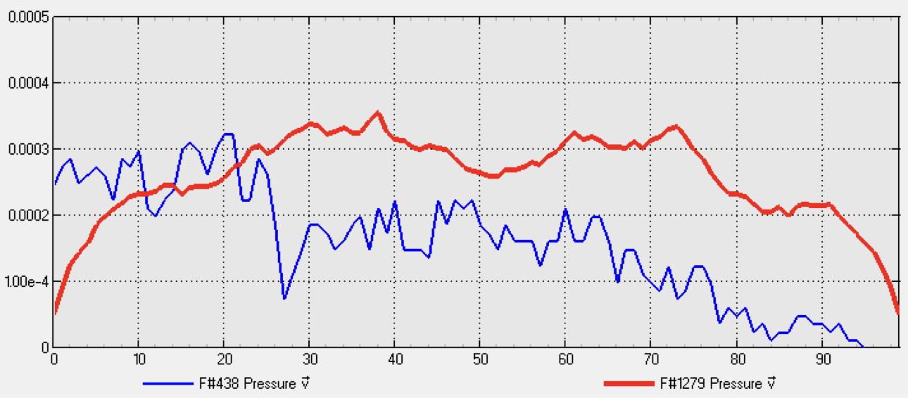
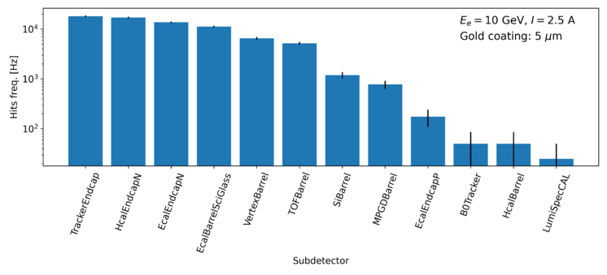
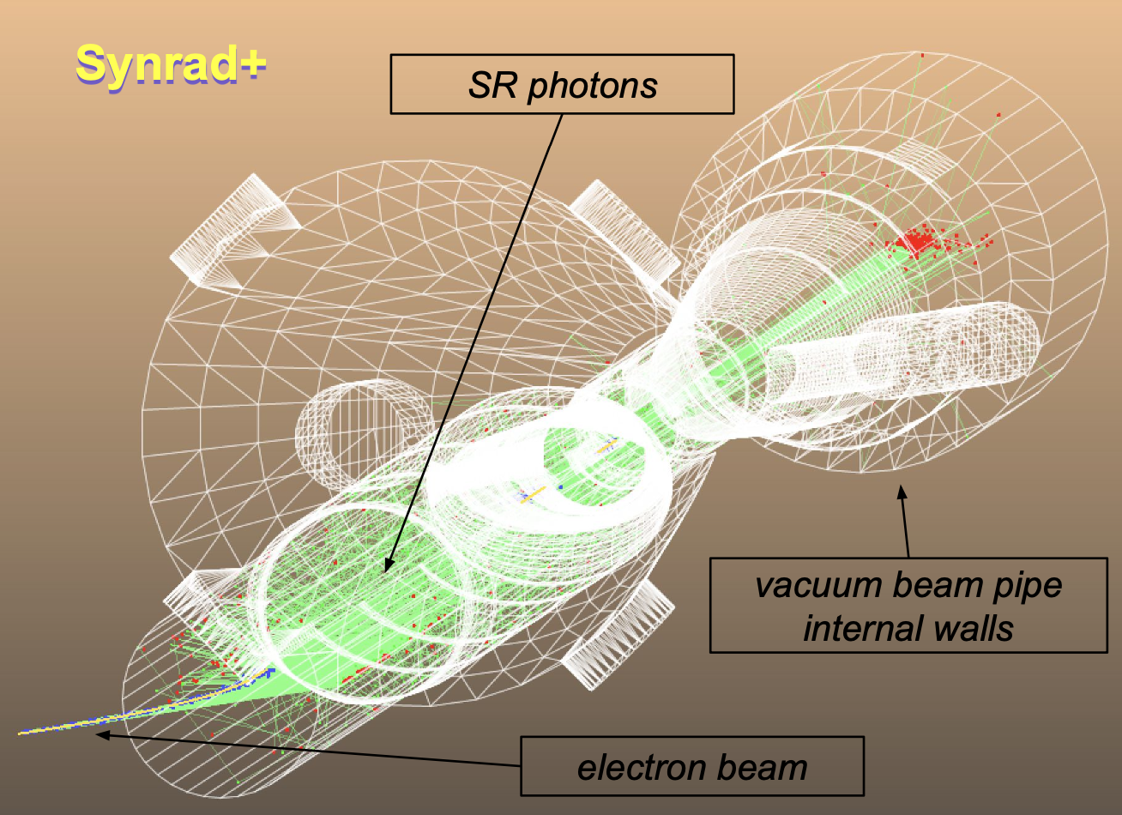
Past path for SR background data production
Vacuum pressure
Machine lattice and beam parameters
Molflow+
Synrad+
Detector SR background rates
Sampling
Eic-Shell
Eic-Recon

Slide 6
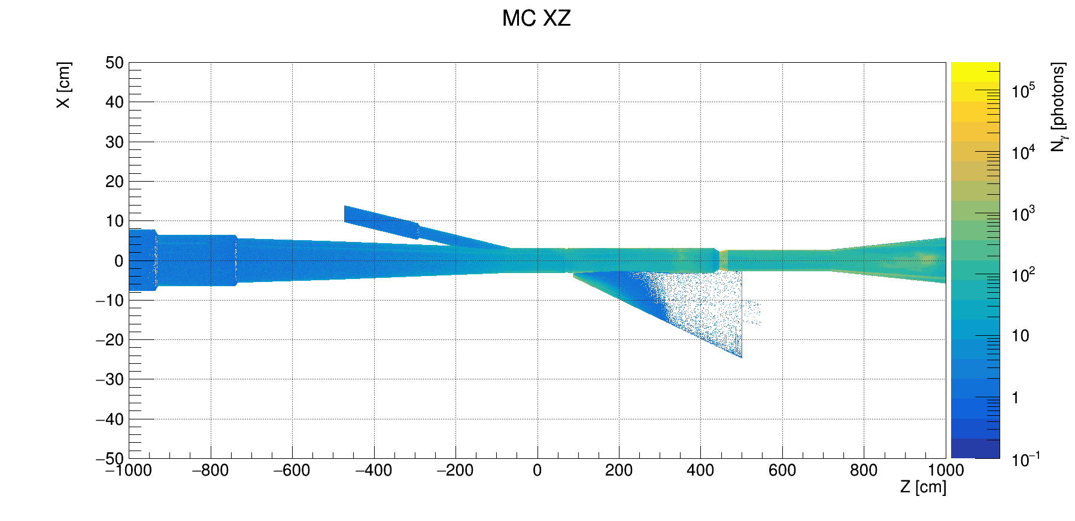
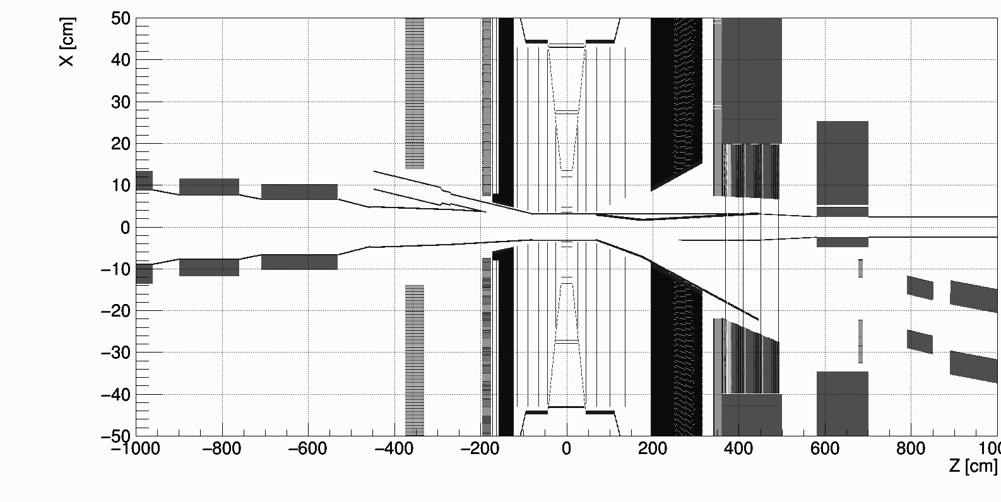
Past path for SR background data production
Bugs and software limitations
The outdated eic-shell beam pipe geometry does not match the absorbed SR photon distribution generated with one of the latest beam pipe geometries used in Synrad+/Molflow+.
Therefore, the eic-shell modeling was modified to match the central beam pipe (~10 m around the IP).
h beam
e– beam
Absorbed SR photons (color)
Eic-shell material scan (black)
Synrad+
Sampling
Eic-Shell
Eic-Recon

Slide 7
Past path for SR background data production
Bugs and software limitations
Before v1.4.33 (Dec 2023), Synrad+ did not have the functionality to store absorbed SR photons on the surface of the vacuum beam pipe.
In addition, a few minor bugs were recently detected in old versions.
For more details, see the discussion with Synrad+ developers here.
Furthermore, Synrad+ still cannot store the information of absorbed photons for all facets at a time.
A user must go through each facet, run the simulation for about one minute, and store the data.
Since the current beam pipe model contains ~30k facets, this approach does not work for our tasks.
Therefore, we propose the adoption of a new framework – Geant4.
Synrad+
Sampling
Eic-Shell
Eic-Recon

Slide 8
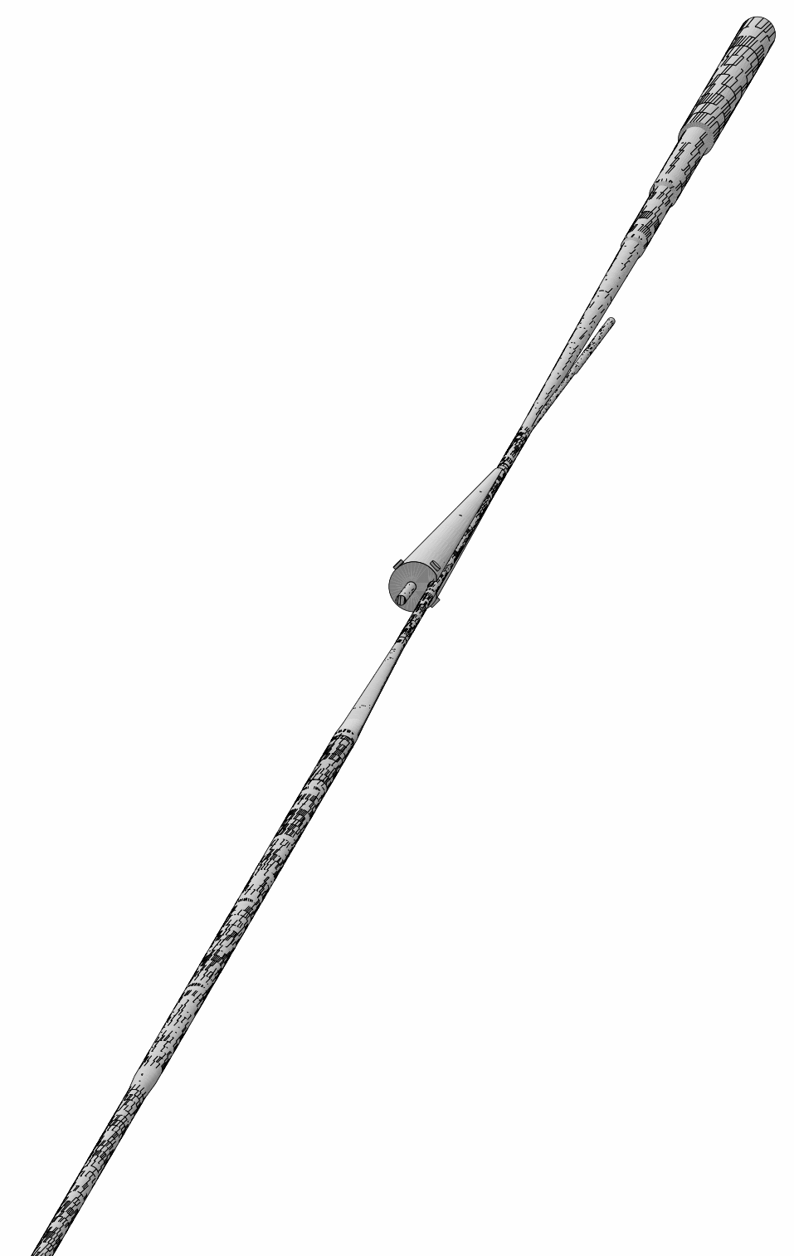
New SR simulation code
~50 m
A dedicated Geant4-based code was developed to
generate SR photons in the magnetic field of the interaction region, including the detector solenoid;
track SR photons through the vacuum beam following the photon reflection process;
generate a high statistics MC sample of absorbed SR photons.
The code was benchmarked against Synrad+ and contains the same geometry of the vacuum beam pipe using an STL file of 3D CAD drawings.
IP6
~30 m
e– beam direction
Geant4
Synrad+
Sampling
Eic-Shell
Eic-Recon

Slide 9
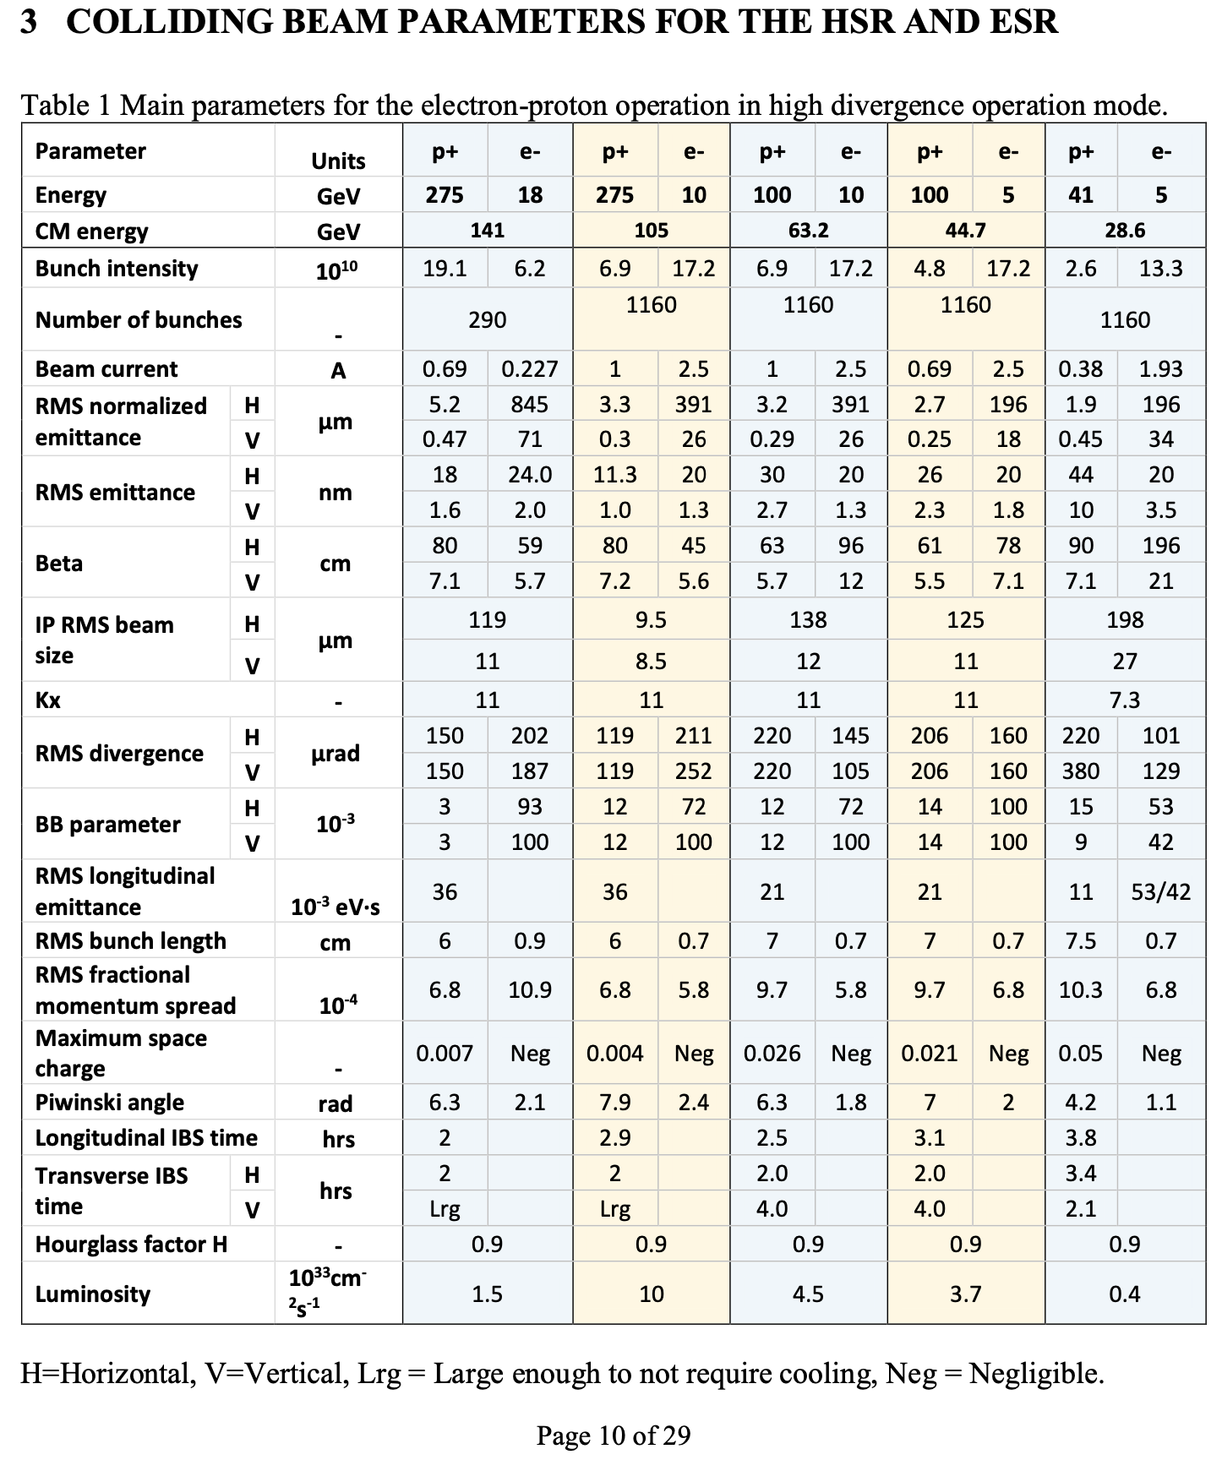
Machine lattice and beam parameters
There are three lattice files available for the simulation:
Sep-2023 (so-called “new lattice”)
Jan-2024 (v6.2)
Mar-2024 (not simulated yet)
The magnet arrangement is the same for all of them:
Upstream: 3 dipoles (D1eF, D2eF1/2), 2 quads (Q0/1eF)
Central: solenoid 1.7 T (MARCO)
Downstream: 2 quads (Q1/2eR), 1 dipole (B2eR)
All simulations were performed for 18 GeV electrons.

Slide 10
X-ray reflection process in Geant4
Since X-ray reflection as a standard gamma process was missing in Geant4, the Geant4 developers have recently (Dec. 2023) implemented it; see #50 FCC-ee MDI meeting.
They use the same material reflection database (like Synrad+) prepared by B.L. Henke et al.
Unfortunately, they consider only specular (mirror-like) reflection with an attenuation factor to include surface roughness.
However, for the EIC, custom-built Geant4 simulation, more advanced models were implemented and compared against available codes:
Synrad+ (after recent discussions, bugfixes and new features have been implemented by the developers; see Synrad+/Molfow+ Forum) – diffuse reflection
old reflection model (Synrad [R.Kersevan, SSC 1993, 10.1109/PAC.1993.309821])
new reflection model (Synrad3D [G.Dugan, D.Sagan, Cornell 2013, 10.5170/CERN-2013-002.117] )
Custom-built Geant4
with the Debye-Waller attenuation factor (similar to the geant4-release) – specular reflection
with the reflection surface normal random tilt (similar to the old model in Synrad+) – diffuse reflection
with the reflection direction random offset (similar to the new model in Synrad+) – diffuse reflection
Geant4 release with the Névot-Croce attenuation factor – specular reflection
set as
default

Slide 11
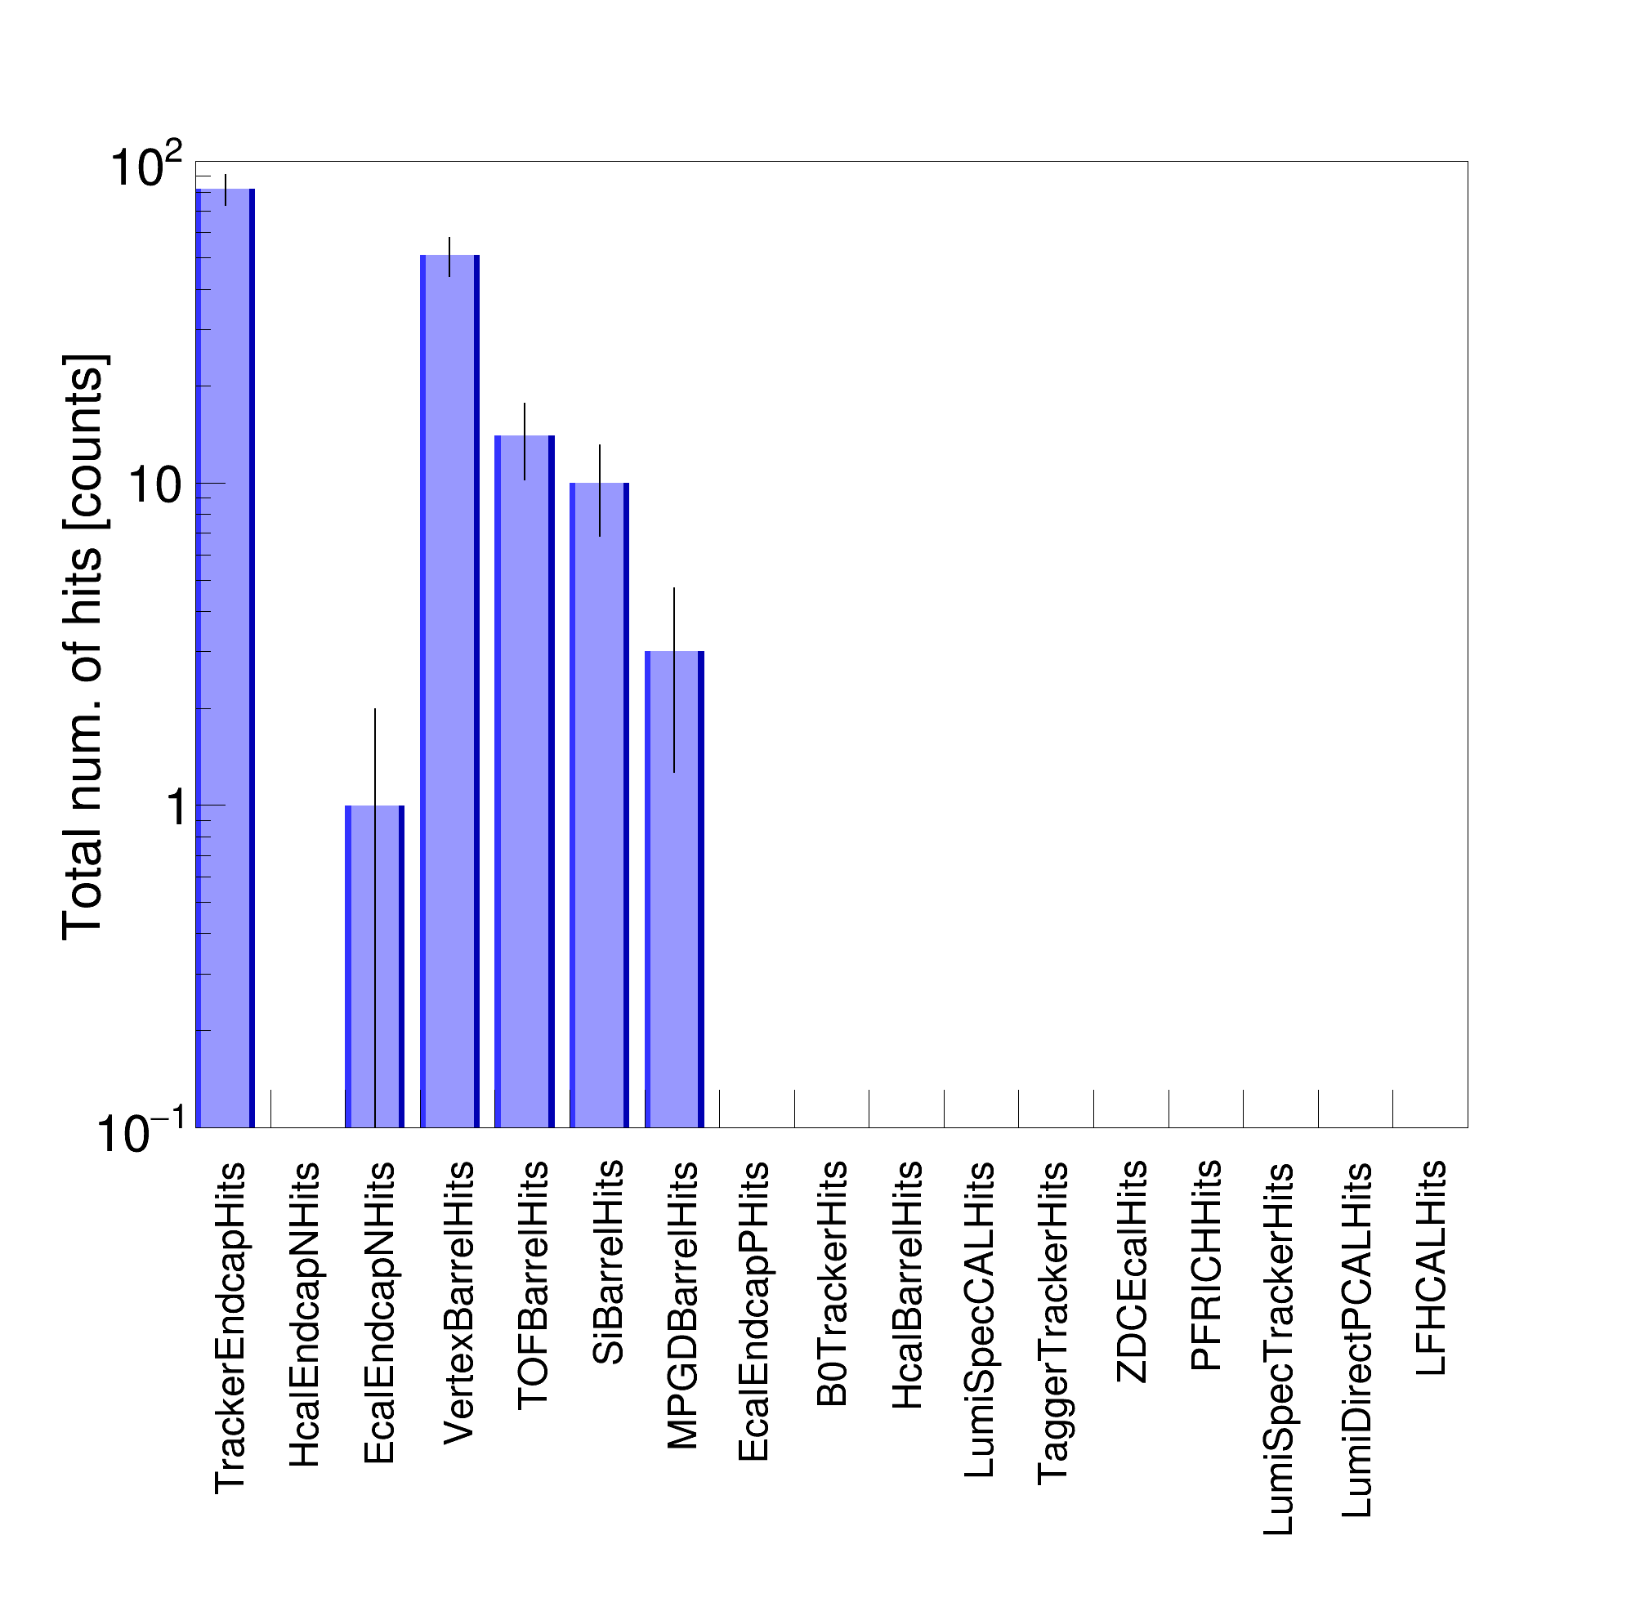
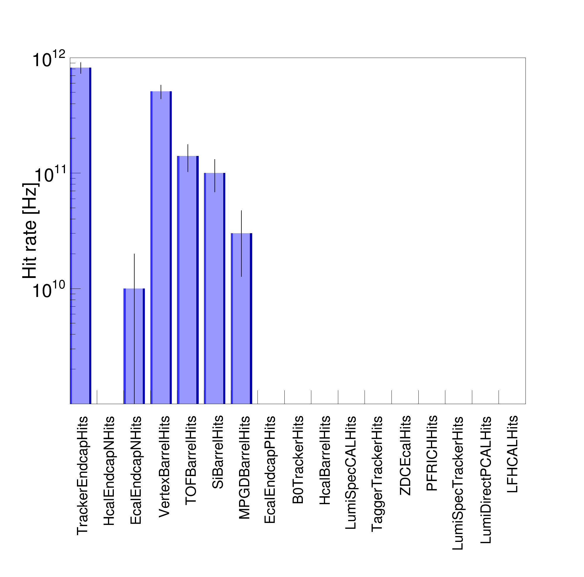
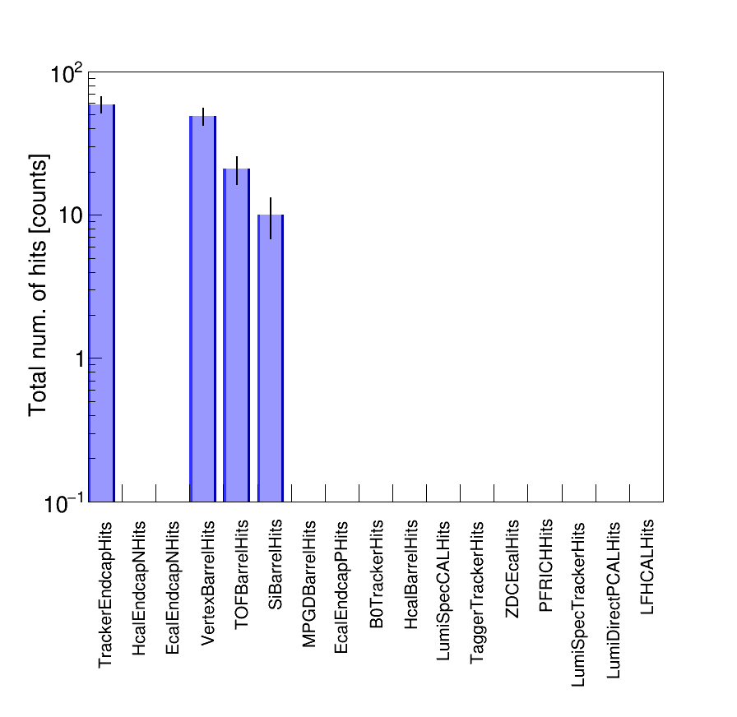
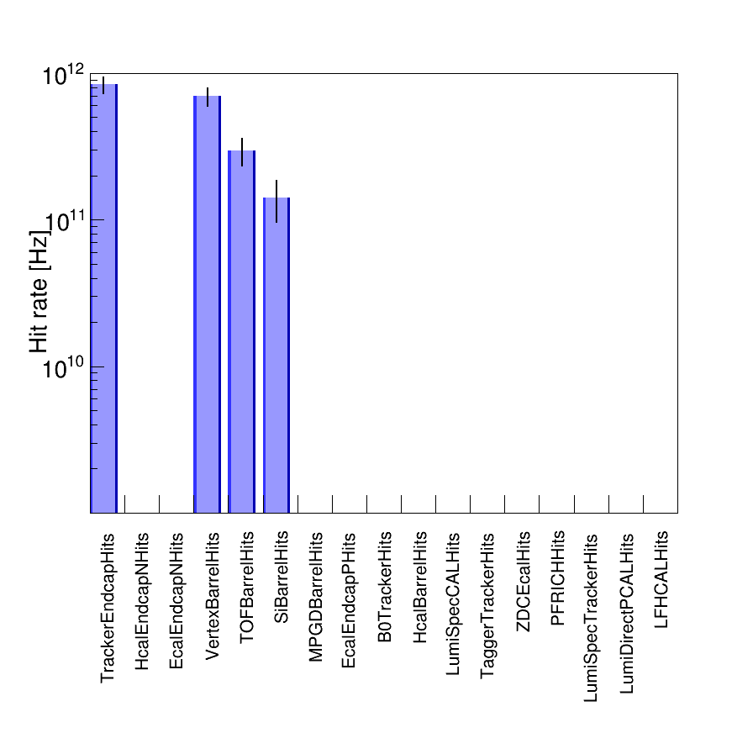
Background rate scaling
IP beam pipe only
150 facets of the IP beam pipe
~3 hours of data collection
~1 hour for sampling
Event sampling (T_{int}): 10 fs/event
# of events (N_{evt}): 10⁴
Generator:
Synrad+
Generator:
Synrad+
Good agreement between Synrad+ and Geant4 results for the v6.2 lattice file.
Extremely high SR background rates in all sub-detectors
Indicating there is direct SR hitting the detector beam pipe
Scaling:
Counts / (N_{evt} x T_{int})
~9 hours of simulation for the entire IR region
Beam current (I_{beam}): 0.227 A
Elementary charge (Q_{e}): 1.6e-19 C
# of jobs (N_{job}): 10⁴
# of electrons per job (N_{e}): 10⁴
Generator:
Geant4
Generator:
Geant4
Scaling:
Counts x I_{beam} / (Q_{e} x N_{e} x N_{job})

Slide 12
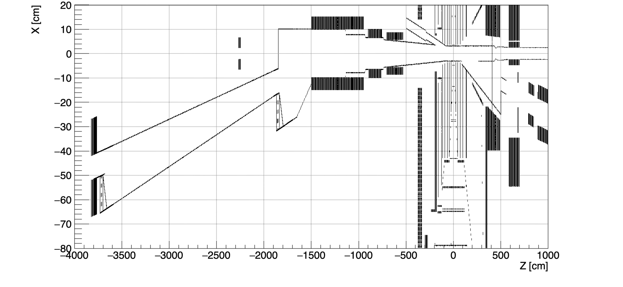
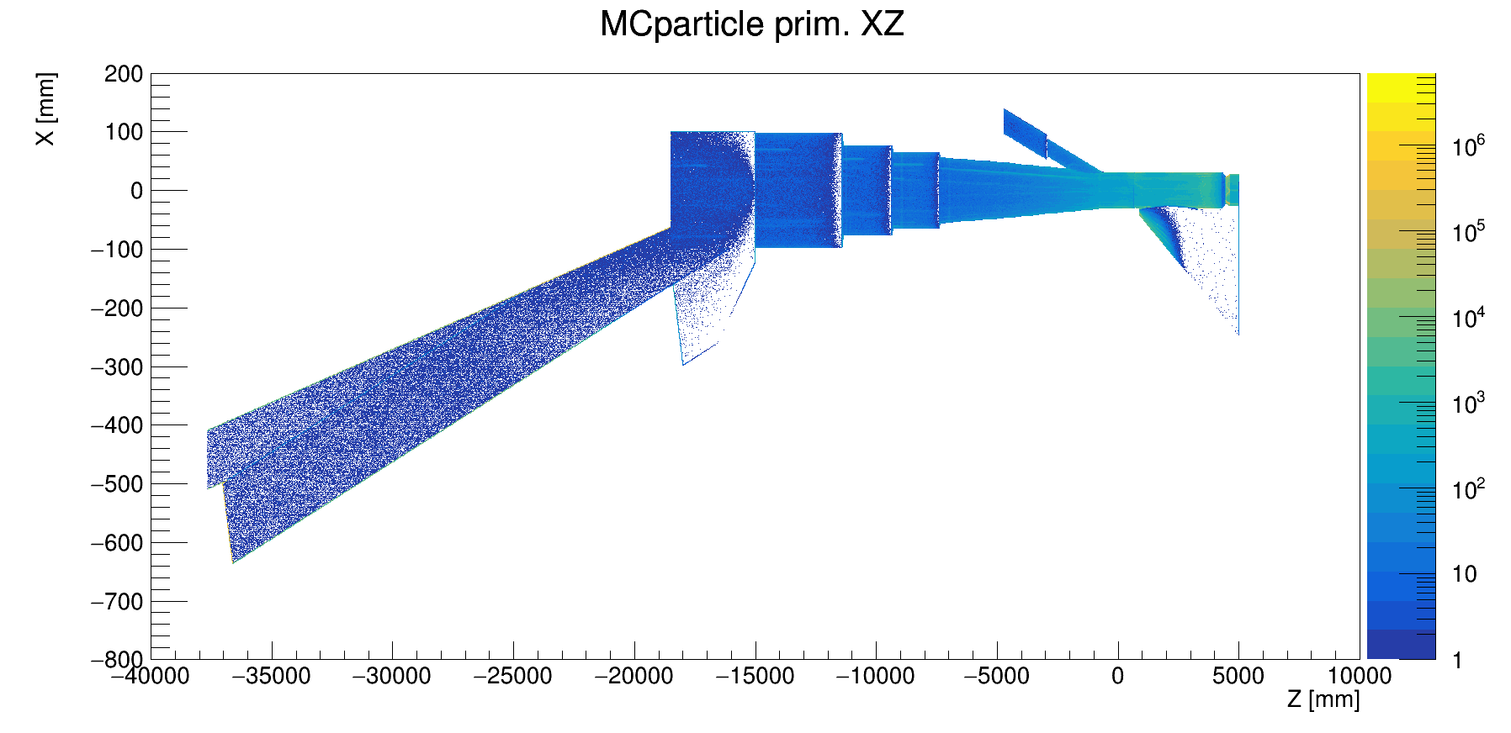
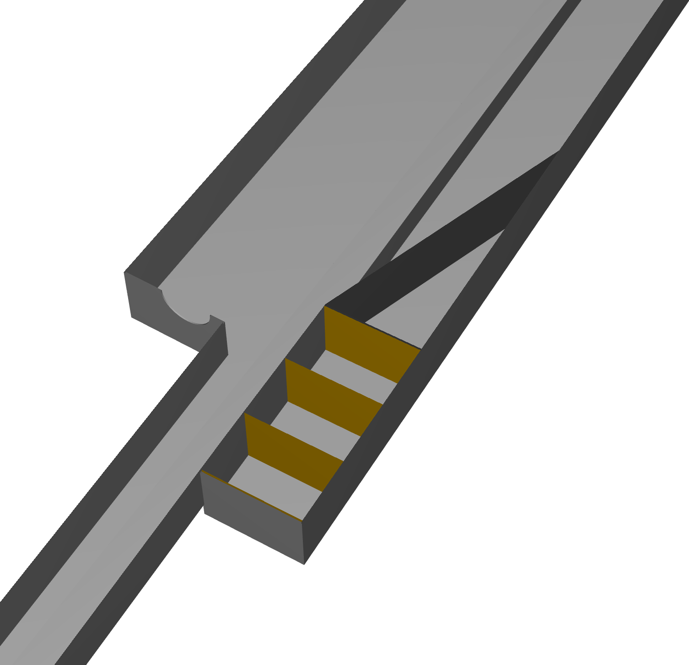
Improved eic-shell and Geant4 beam pipes on the far-BWD side
Lumi exit window
(for Lumi monitor)
e– beam
eic-shell material scan
Tagger-1
Geant4 simulated absorbed SR photons
Tagger-2

Slide 13
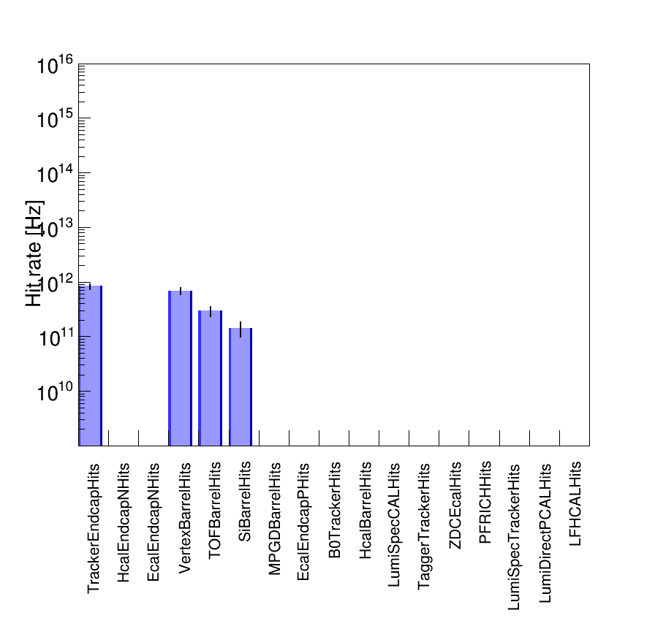
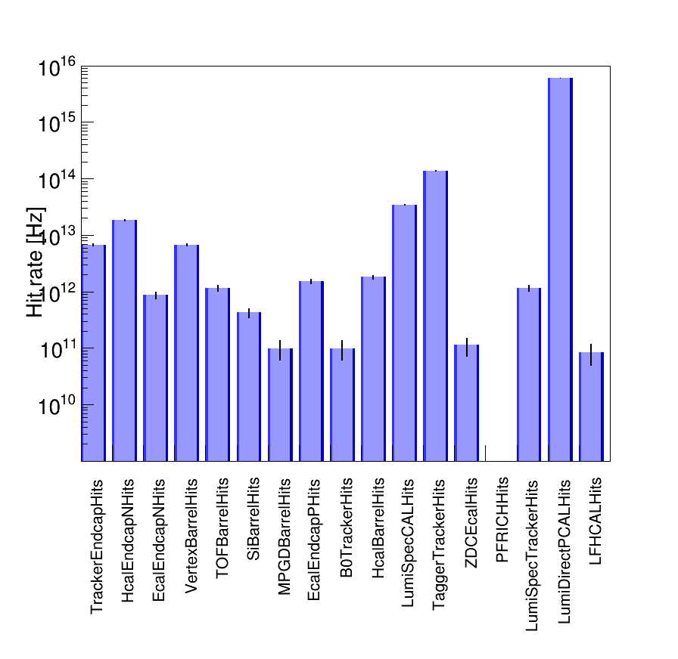
Detector hit rates: Electron beam lattice v6.2 (Jan. 2024)
The majority of background rates are caused by the absorbed SR photons outside the IP beam pipe.
The SR background rates are very high in all sub-detectors.
Can we reduce these rates?
Interaction Point
Interaction Region
I = 0.227 A
-65cm < z < 65cm
E_{𝛄} > 30 eV
I = 0.227 A
-37m < z < 5m
E_{𝛄} > 30 eV

Slide 14
SR photon tracks: E > 10 keV, hit the IP beam pipe
Indeed, there is direct SR hitting the IR beam pipe and reflected SR hitting the IP beam pipe
→ predominantly from the closest dipole magnets.
D2EF1
D2EF2
Q1EF
Q0EF
D1EF
IP6
e– beam
Nᵧ = 7469 ph.

Slide 15
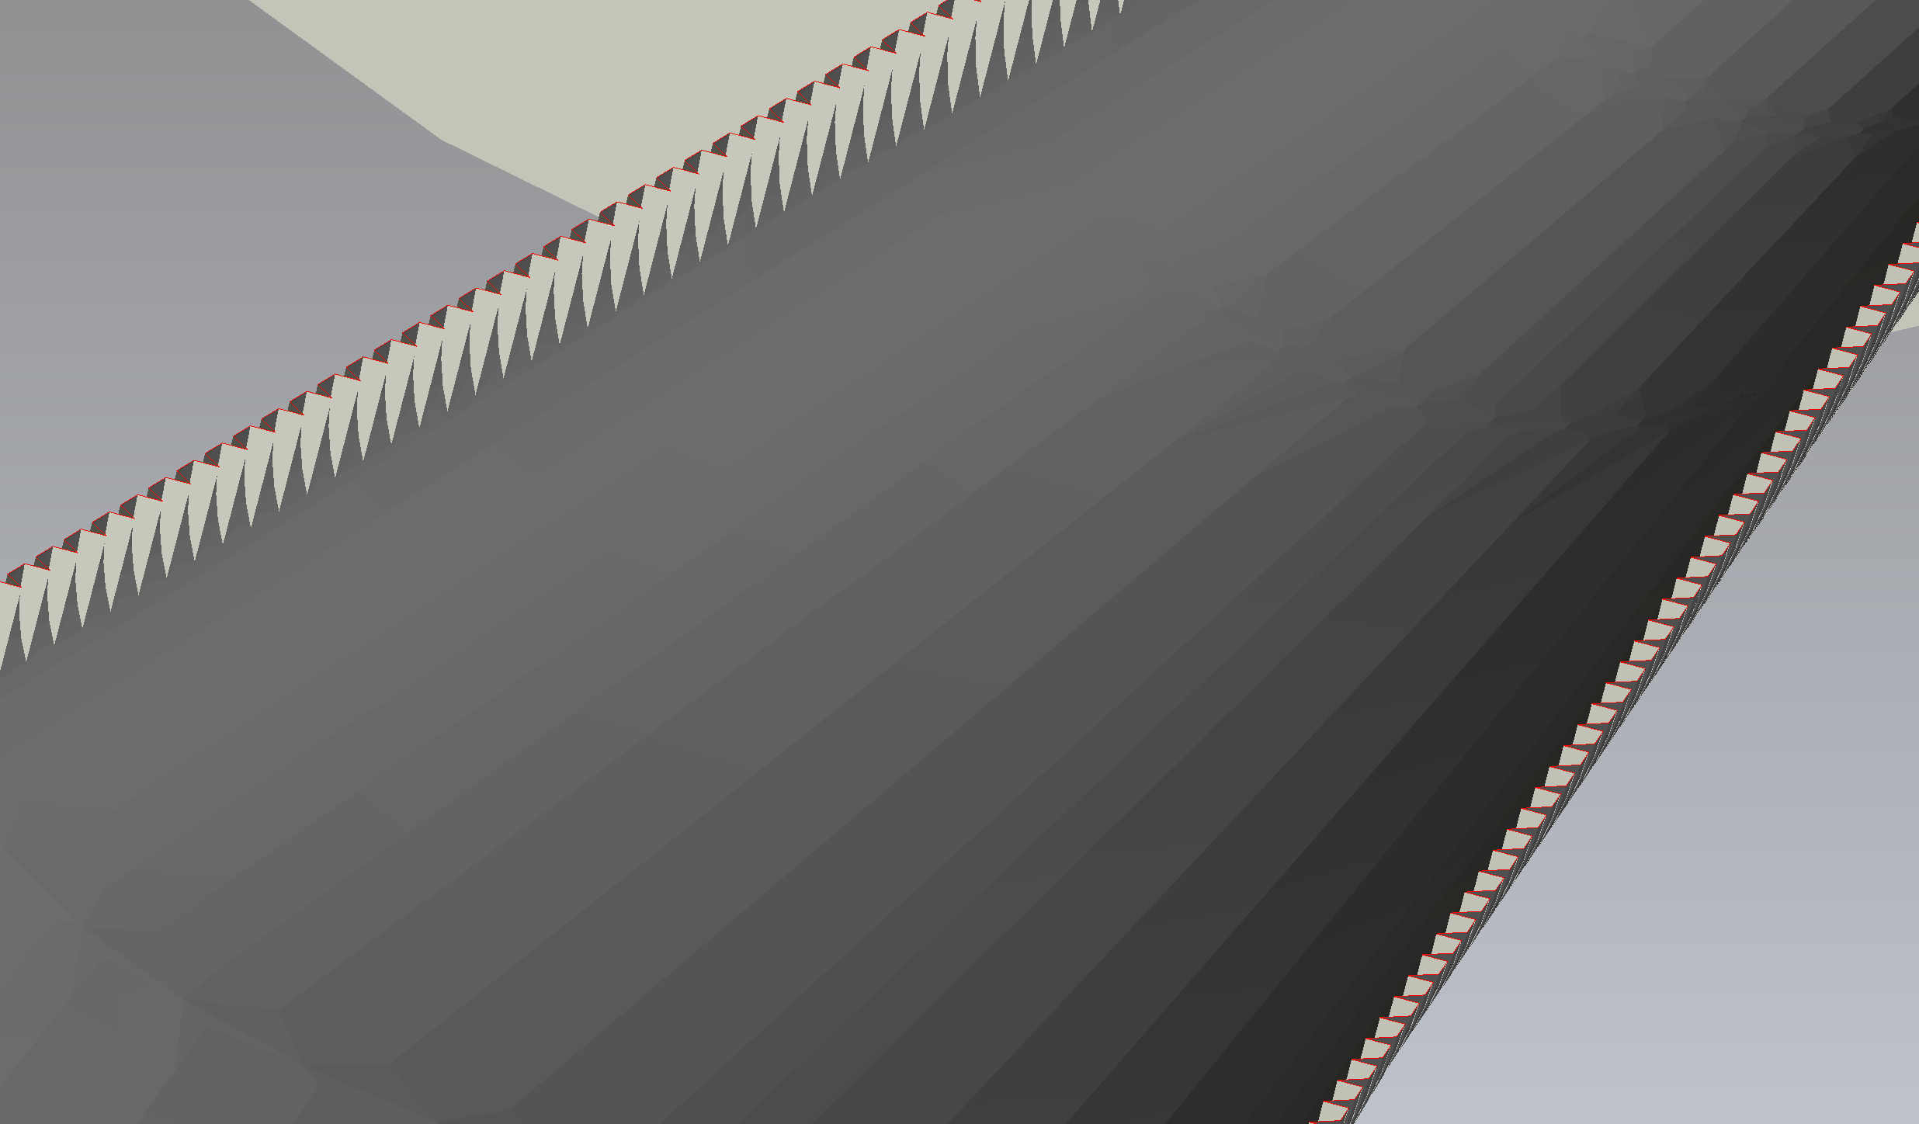
SR photon tracks: E > 10 keV, hit the IP beam pipe
With the two simple masks, the flux of SR photons hitting the IP beam pipe is reduced by a factor of ~40
The best option would be this mask →
D2EF1
D2EF2
Q1EF
Q0EF
D1EF
IP6
e– beam
Nᵧ = 185 ph.

Slide 16
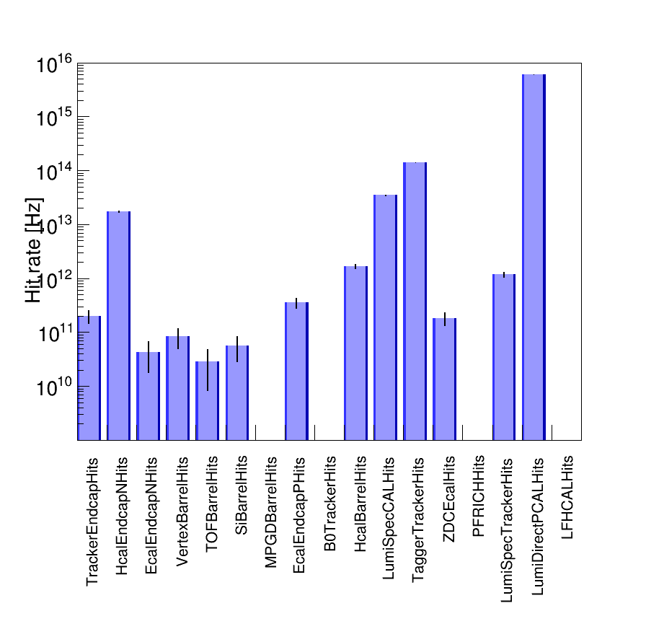
Detector hit rates: Electron beam lattice v6.2 (Jan-2024)
A simple SR mask promises to reduce SR background rates for innermost detectors by up to 2 orders of magnitude.
Designing a more sophisticated mask, taking into account wakefields and impedances, is essential.
Interaction Region, w/o the SR mask
Interaction Region, w/ the SR mask
I = 0.227 A
-37m < z < 5m
E_{𝛄} > 30 eV
I = 0.227 A
-37m < z < 5m
E_{𝛄} > 30 eV

Slide 17
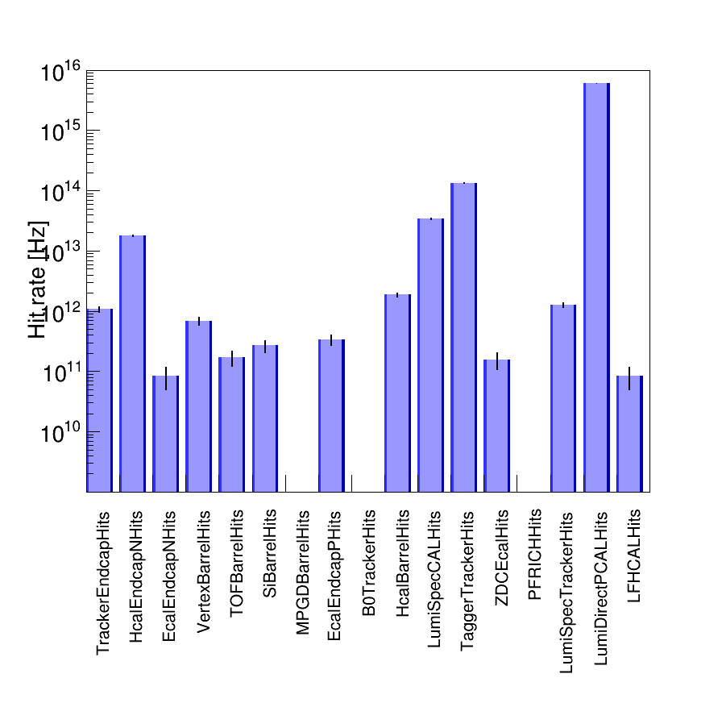
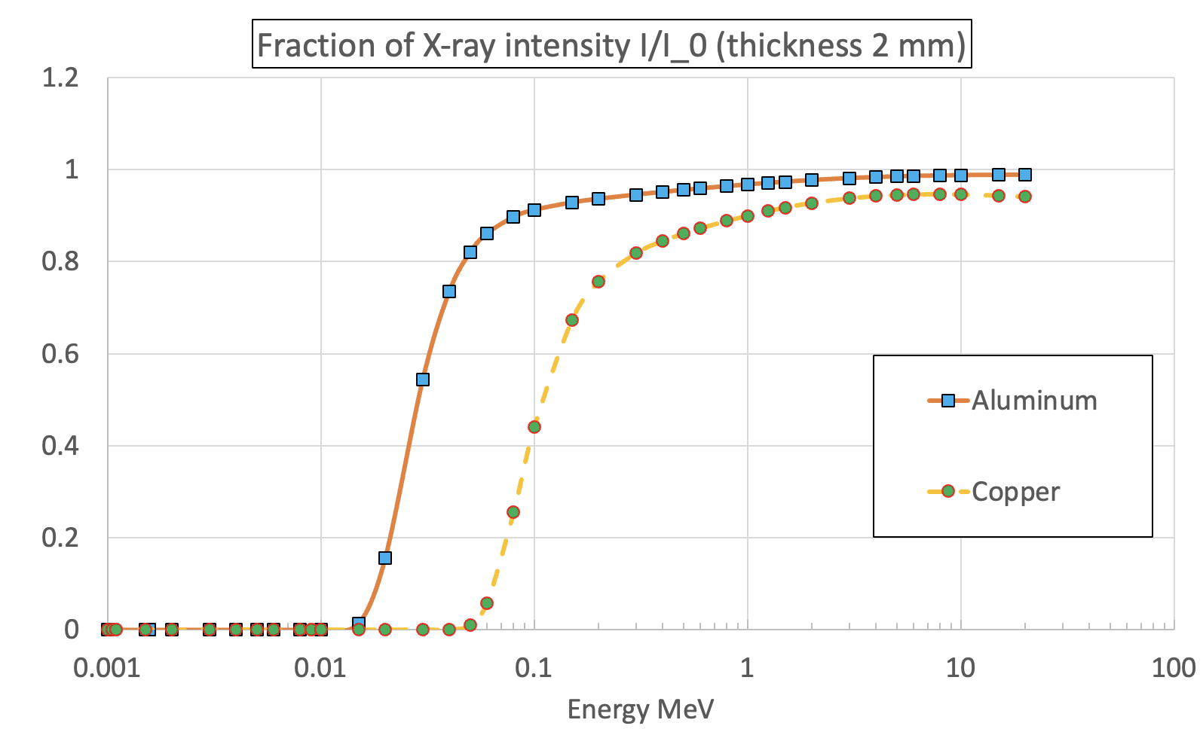
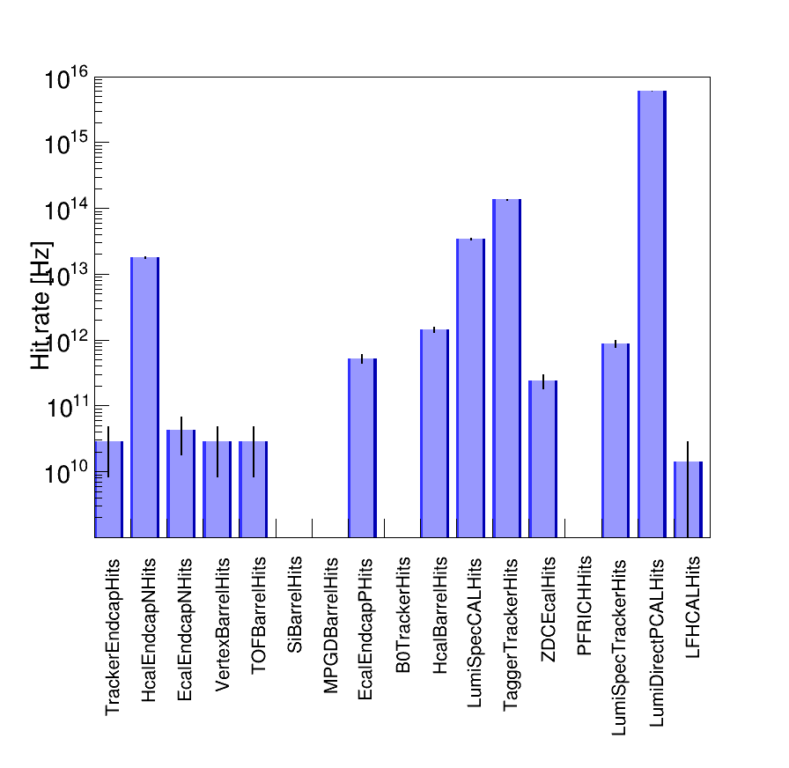
IR beam pipe material
Aluminum beam pipe
Copper beam pipe
Recently, it was discovered that the IR beam pipe material in the eic-shell is aluminum, not copper.
Is it a bug or outdated code?
Meanwhile, in the Synrad+/Molflow+, the beam pipe is made of copper.
For the region of interest (0.01-0.1 MeV), this discrepancy affects the final background rates.
Copper reduces the rates by a factor of ~10.
w/o the SR mask
w/o the SR mask
w/ the SR mask
w/ the SR mask

Slide 18
Summary (1)
The past method to generate absorbed SR photons on the internal surface of the electron beam pipe does not provide reliable results.
Corresponding codes (Synrad+ and Event-sampling) were updated with bugfixes and new features.
Therefore, to make the simulation process easier and faster, a dedicated custom-built code based on the Geant4 framework was developed.
The code was successfully benchmarked against i) the well-known software (Synrad+) and ii) analytical calculations.
The new code contains several SR photon reflection models and uses the most recent and available beam pipe geometry.
The eic-shell code was modified to study the SR background in the ePIC and auxiliary detectors.
The default code contained outdated beam pipe geometries and materials, as well as magnet arrangement.

Slide 19
Summary (2)
The latest simulation with the Jan-2024 (v6.2) lattice shows:
for the aluminum beam pipe, the majority of ePIC rates originate from the region outside the IP beam pipe;
for the copper beam pipe, the majority of ePIC rates originate from the IP beam pipe;
the copper beam pipe effectively stops SR photons in the energy region of interest (10-100 keV);
the overall rate of the SR background in all sub-detectors is extremely high (THz);
by placing a simple SR mask, we can reduce the background rates by at least two orders of magnitude;
we need a more sophisticated SR mask to reduce the rate further;
adding additional shielding around the IR beam pipe could be another option to mitigate the SR background;
auxiliary detectors will be exposed to the ultrahigh rate of SR (PHz);
however, the geometry of the far-backward beam pipe needs revision.

Slide 20
Next steps
We can continue using the manual approach of the beam pipe geometry description in Geant4 and eic-shell.
However, we should consider the advantages of transitioning to a unified 3D CAD drawing used in both frameworks.
We have to implement a new SR mask and check its impact on the detector background and machine impedance.
Also, it is essential to revisit the entire IR beam pipe used in Geant4 and eic-shell.
To ensure the accuracy of the beam pipe geometry description.
Close collaboration with the ePIC software group is desirable.
For more details and materials regarding the custom-built Geant4 simulation code, please refer to backup slides and past EIC IR Synrad meetings [SupplementaryMaterials].
Thanks for your attention!

Slide 21
Backup

Slide 22
Past path for SR background data production
Bugs and software limitations
For visualization purposes only, not accurate
Since Synrad+ SR photons are stored with assigned weights (flux), an additional step to sample these photons is required.
During the sampling, the absorbed photons are re-generated with no weights grouping within the specified time window (typically 100 ns) to shoot the vacuum beam pipe one by one.
However, this approach ignores the fact that multiple photons from the same electron bunch can hit the pipe simultaneously.
Therefore, the sampling script was modified to provide the correct SR photon distribution before the eic-shell simulation.
1/s
2/s
4/s
Old sampling
New sampling
Synrad+
Sampling
Eic-Shell
Eic-Recon

Slide 23
Past path for SR background data production
Bugs and software limitations
BEFORE
AFTER
Absorbed SR photons (color)
Eic-shell material scan (black)
Synrad+
Sampling
Eic-Shell
Eic-Recon

Slide 24
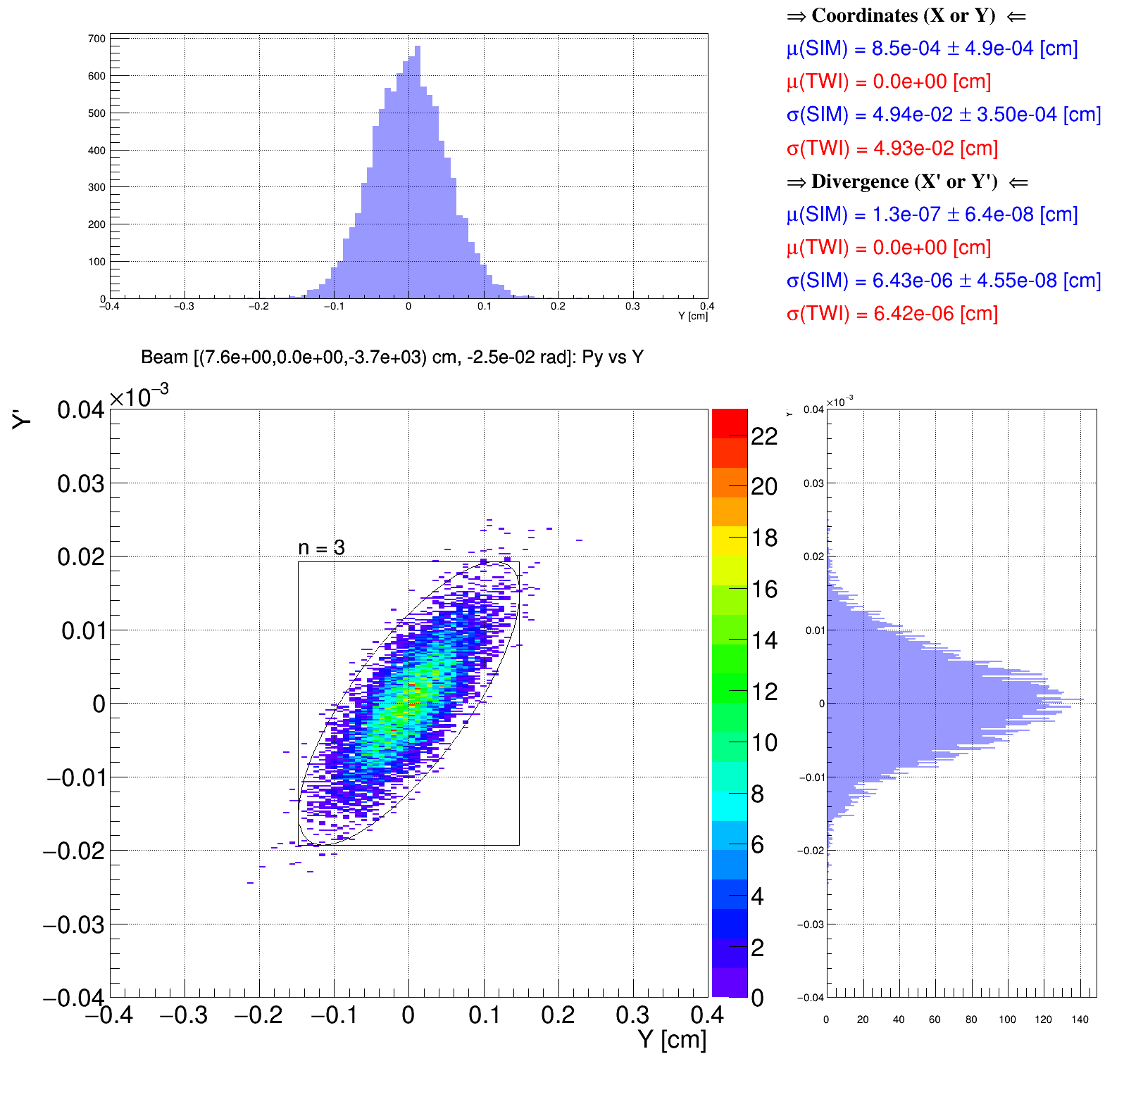
Benchmark: Generated e-beam
D2EF1
D2EF2
D1EF
Q1EF
Q0EF
A set of electron beam tracking campaigns in Geant4 was performed to cross-check the implementation of magnets (position, orientation).
Courant–Snyder (a.k.a. Twiss) parameters were used to calculate the expected distributions.
There is a good agreement between generated and expected initial beam distributions upstream of the first dipole magnet.

Slide 25
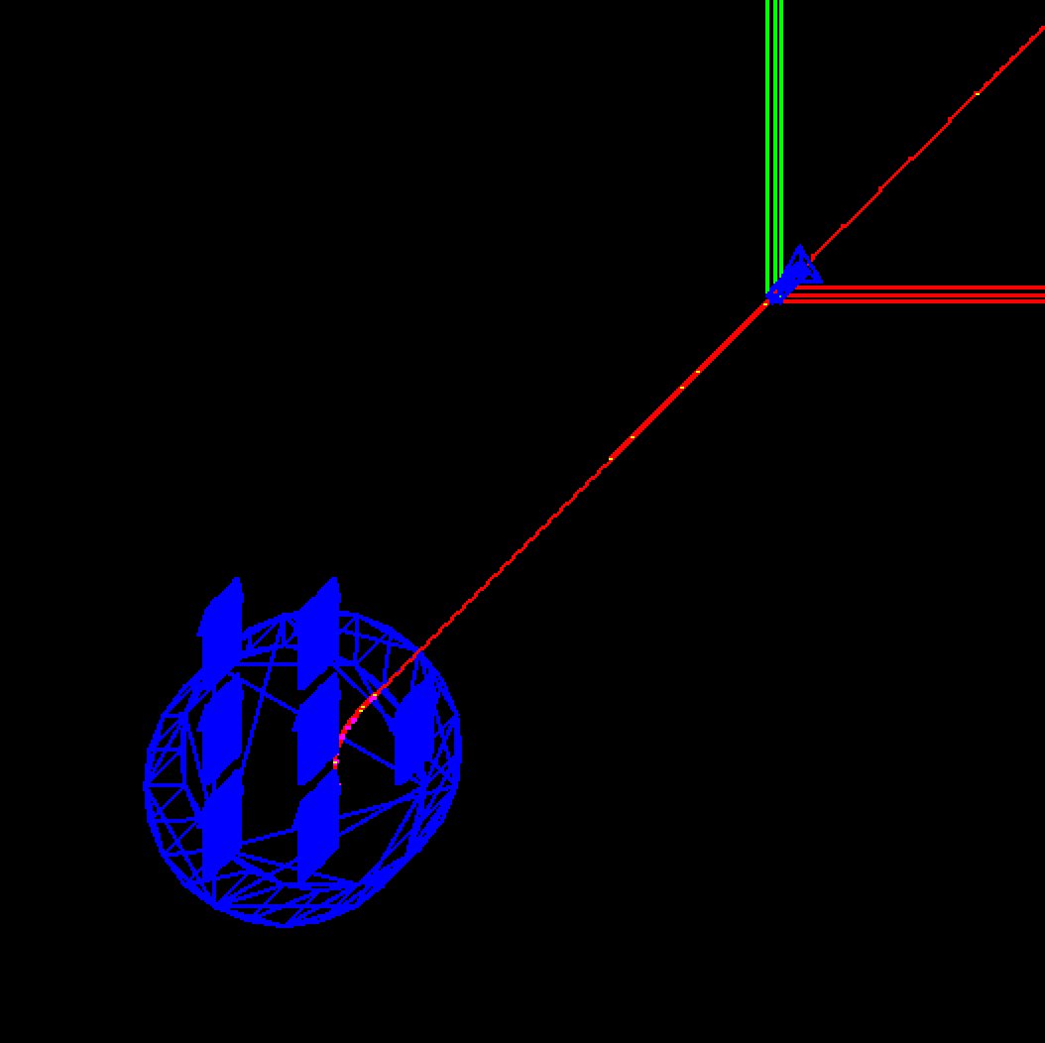
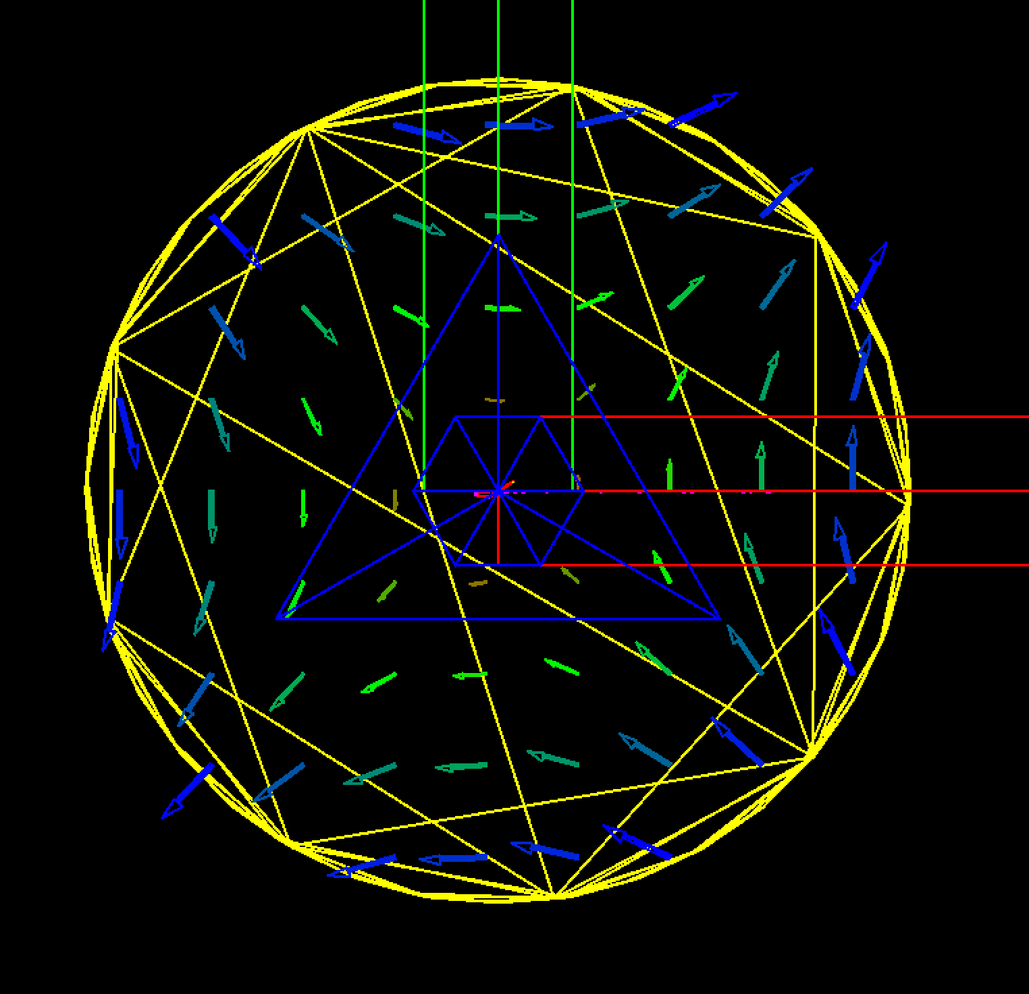
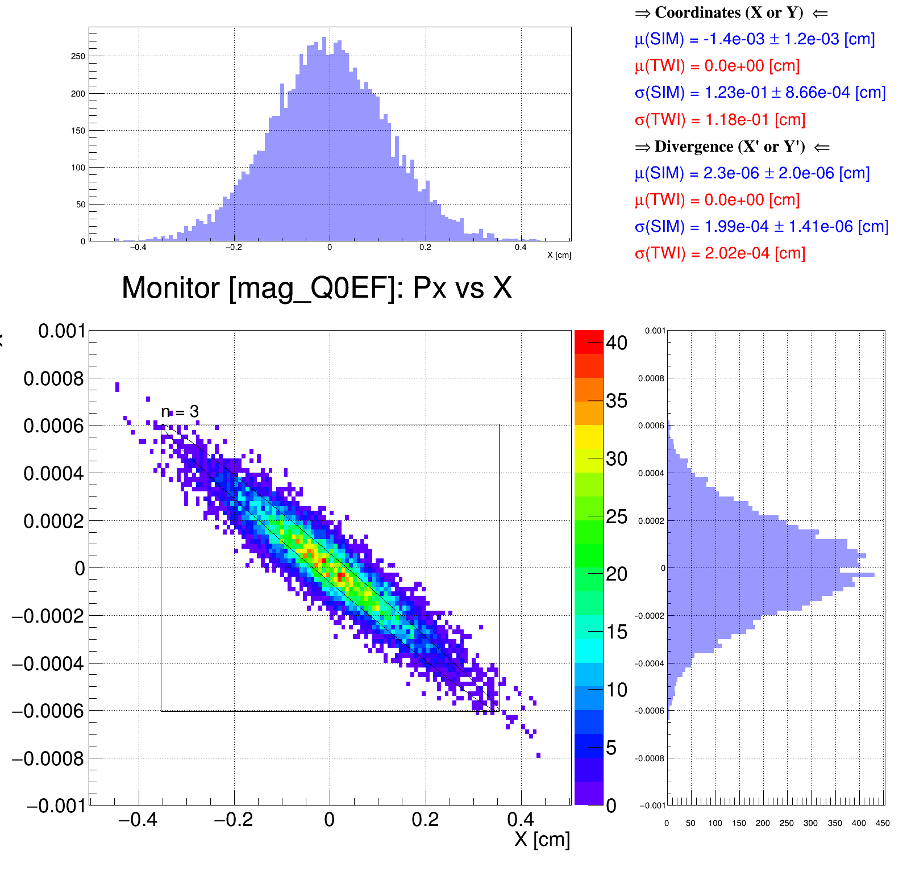
Benchmark: Dipole and Quad fields
D2EF1
D2EF2
D1EF
Q1EF
Q0EF
A correctly set magnetic field map gives the expected beam distribution at any location along the IR beamline.
Y
Y
Q0EF
Z
X
Z
X
D2EF1
visualization is left-handed
visualization is left-handed

Slide 26
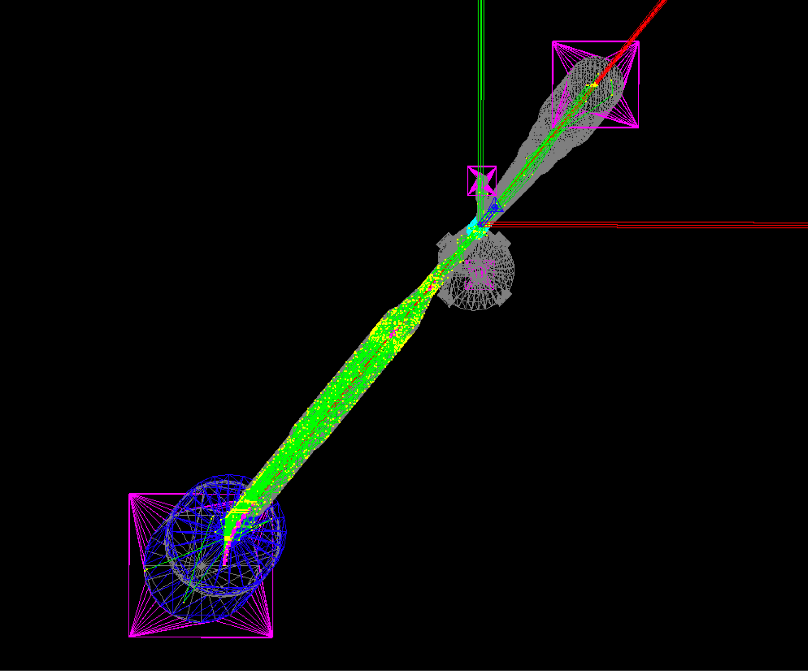
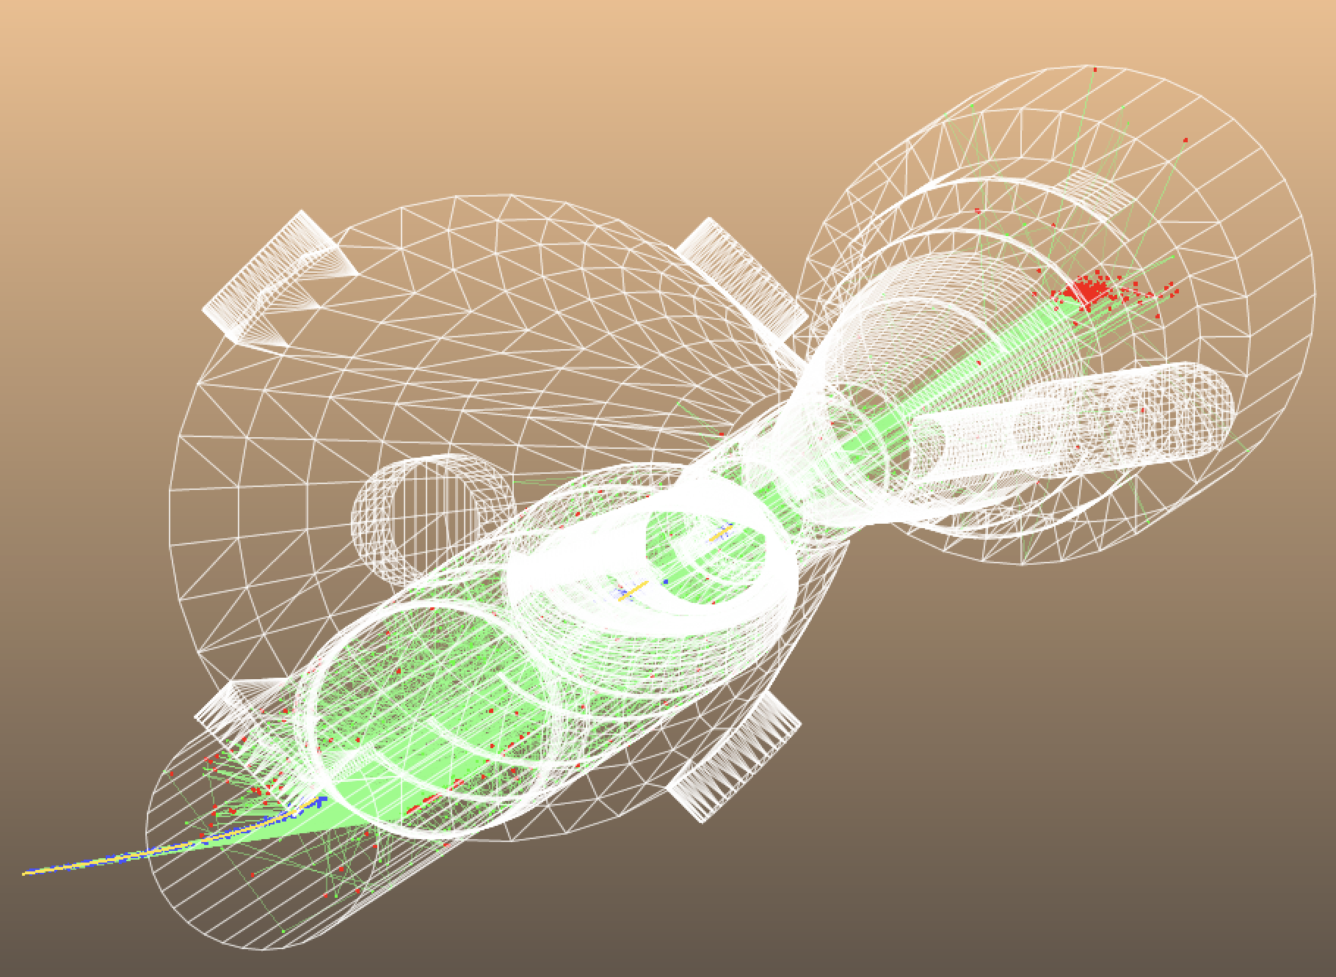
Photon generator
Turn on the SR production process using a dedicated Geant4 class.
Geant4
Synrad+
SR photons
SR photons
vacuum beam pipe internal walls
vacuum beam pipe internal walls
electron beam
electron beam
visualization is left-handed
visualization is right-handed

Slide 27
X-ray reflection process benchmark: Synrad+ (v1.4.33/v1.4.34 bugfix) vs Geant4 (Gamma, custom-built) vs Geant4 (Xray, adobted from geant4-release-11.2.0)
Surface roughness RMS = 0 nm
Good agreement between all codes and models

Slide 28
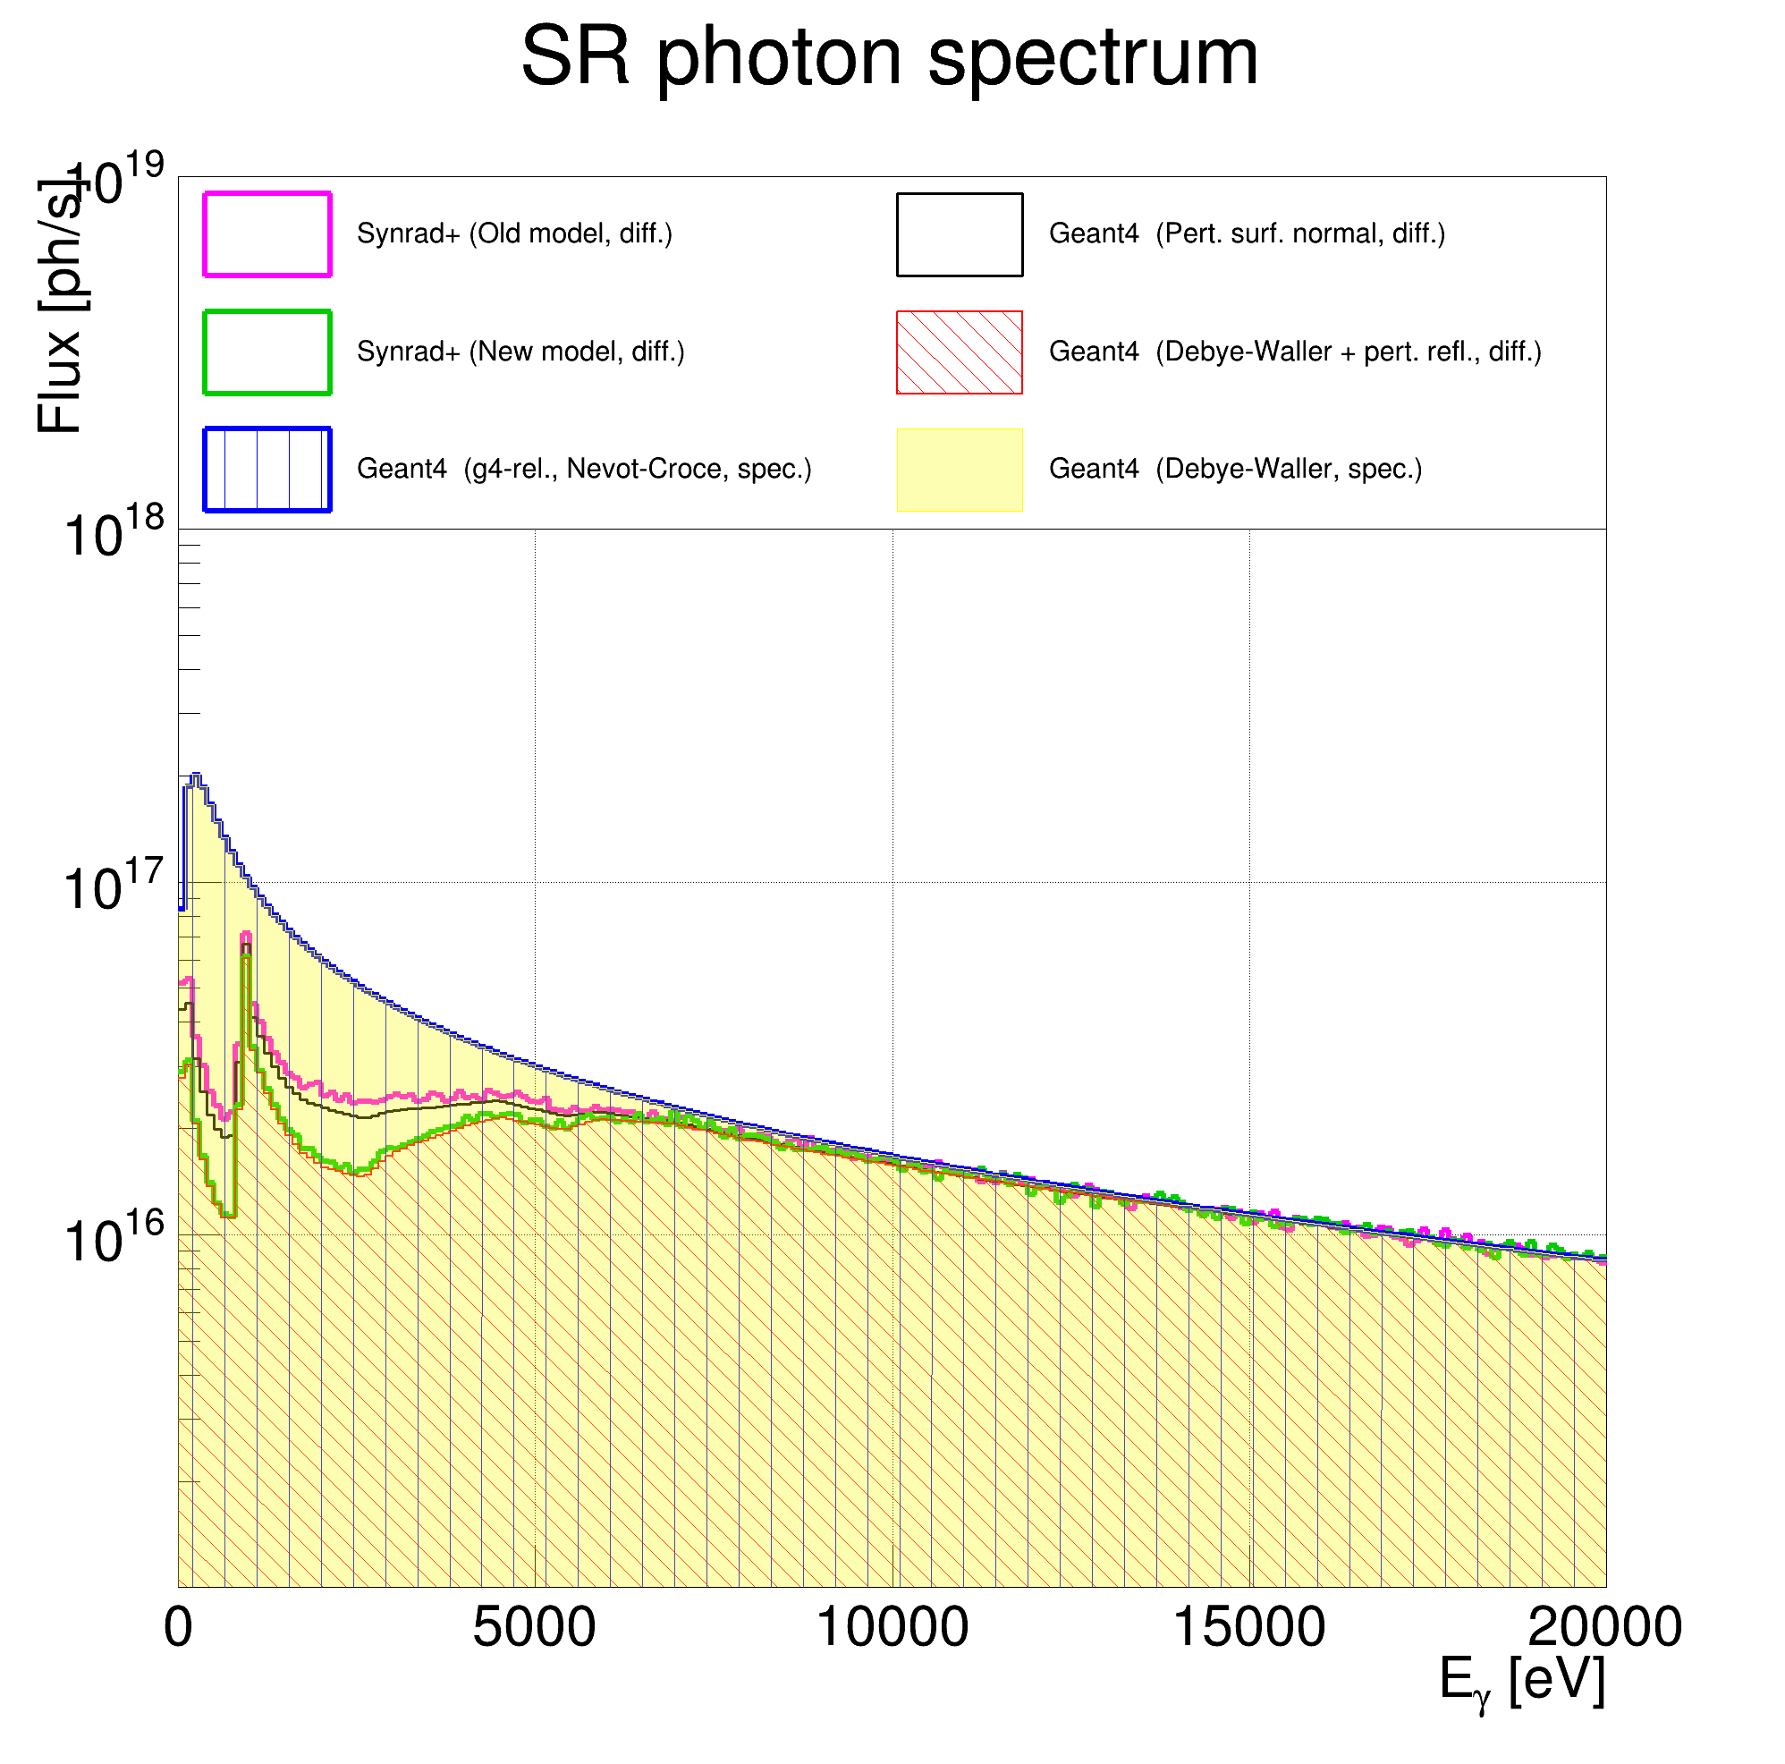
X-ray reflection process benchmark: Synrad+ (v1.4.33/v1.4.34 bugfix) vs Geant4 (Gamma, custom-built) vs Geant4 (Xray, adobted from geant4-release-11.2.0)
Surface roughness RMS = 50 nm
Good agreement
between Geant4 codes for specular reflection
(blue and yellow)
old model Synrad+ vs Geant4 code for diffuse reflection
(magenta vs black)
new model Synrad+ vs Geant4 code for diffuse reflection
(green vs red)
Now, we have a reliable and convenient tool for studying the SR background.

Slide 29
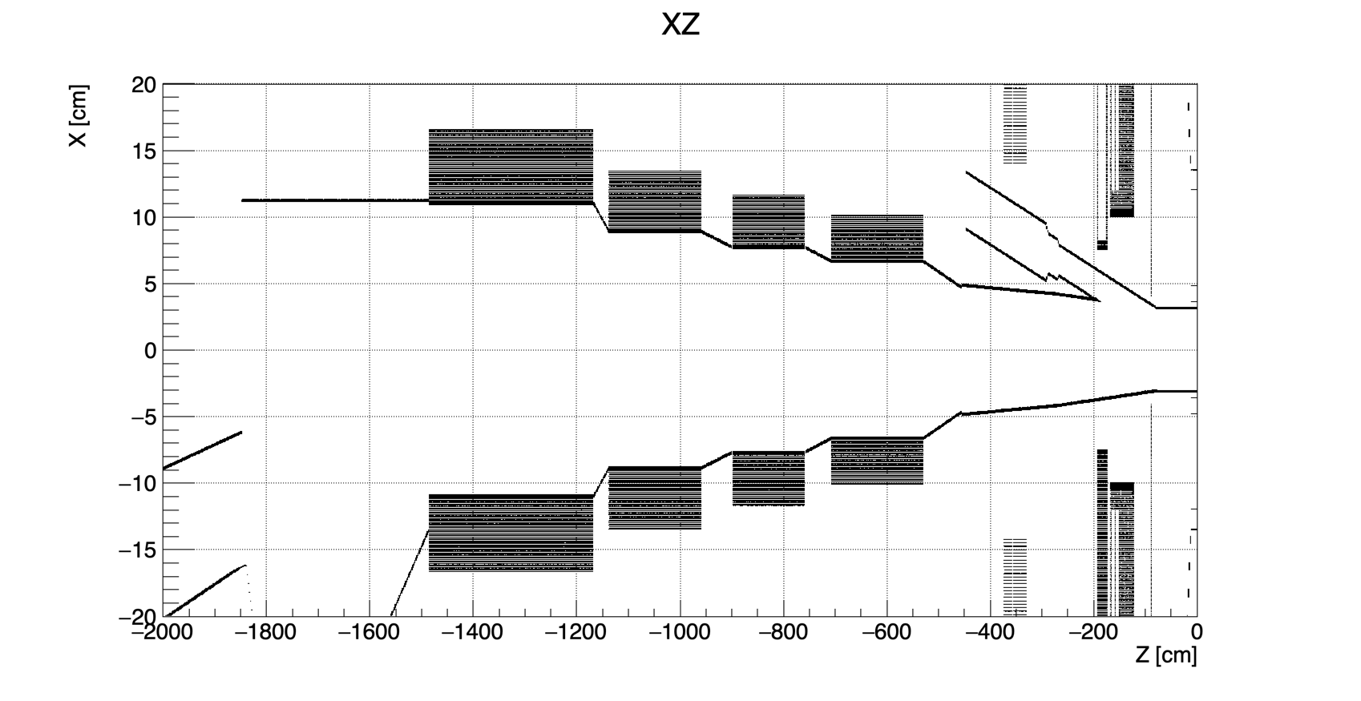
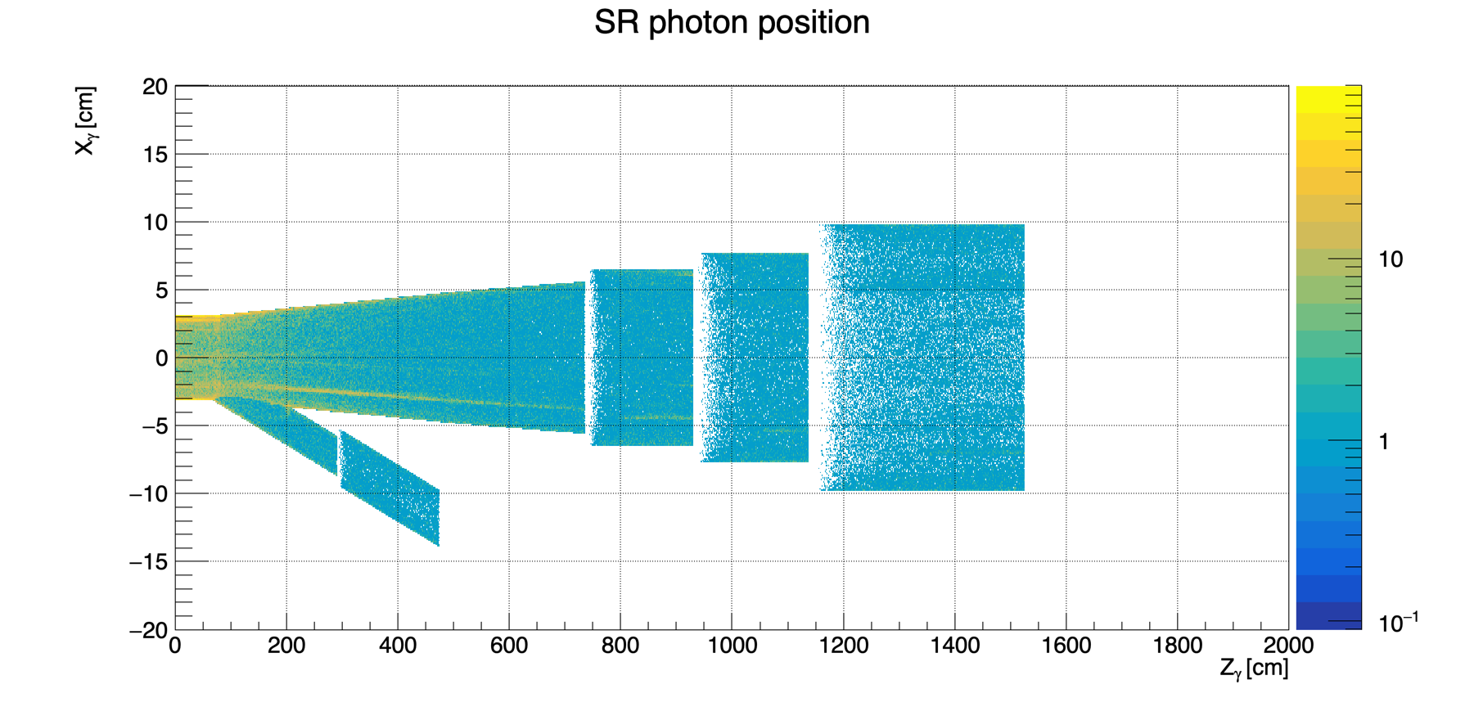
BWD beam pipe (before)
eic-shell material scan
B2BeR
B2AeR
Q2eR
Q1eR
e– beam
Geant4 simulated absorbed SR photons

Slide 30
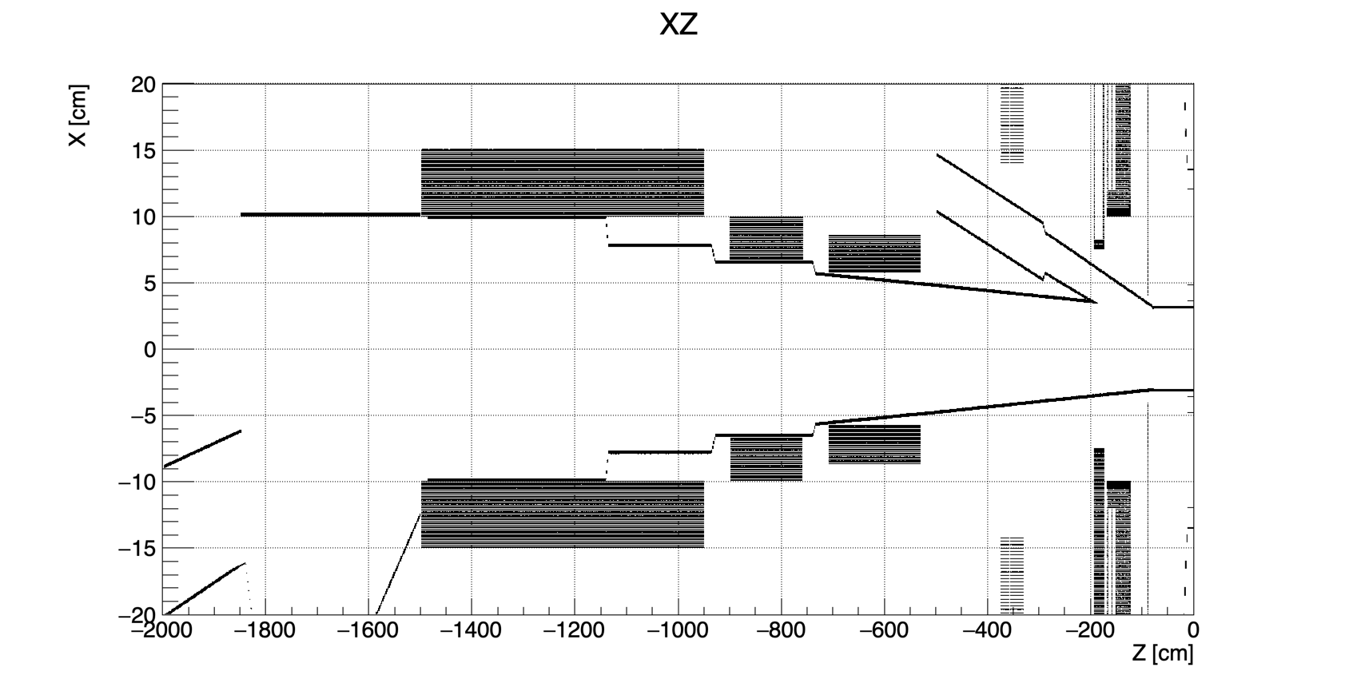
BWD beam pipe (after)
eic-shell material scan
B2BeR
Q2eR
Q1eR
e– beam
Geant4 simulated absorbed SR photons

Slide 31
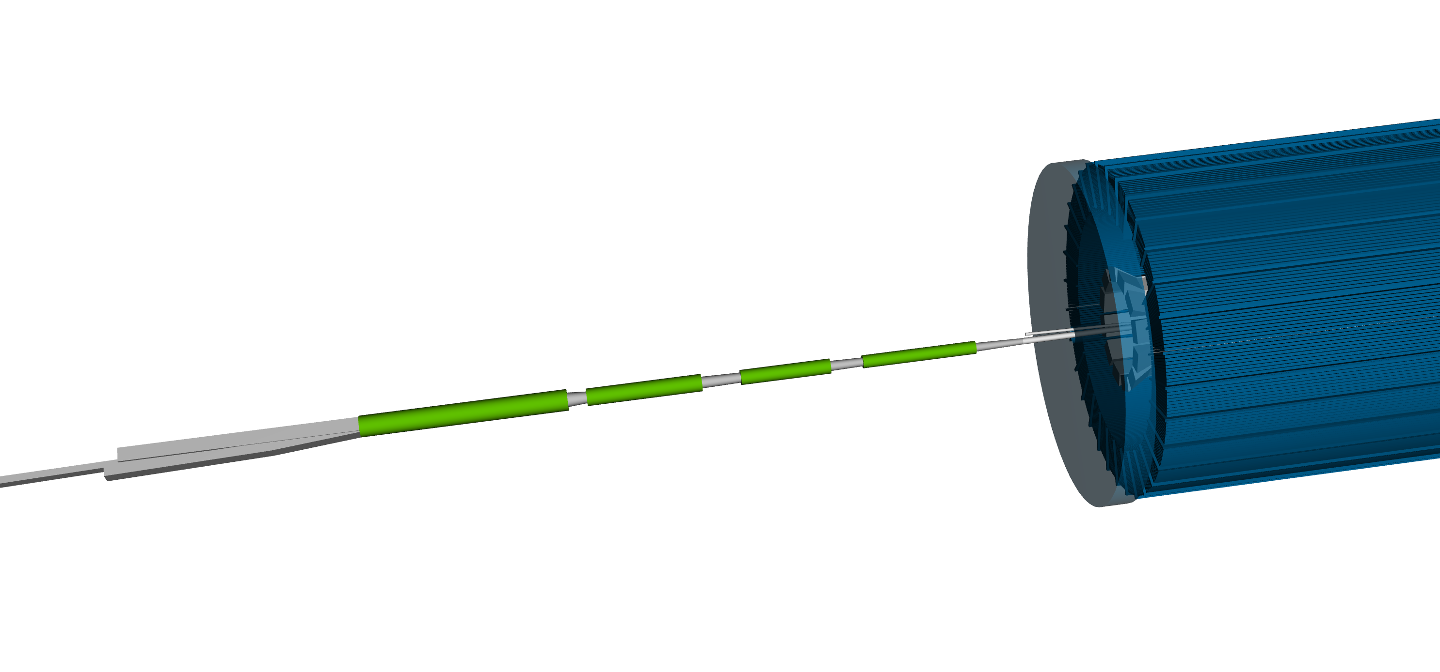
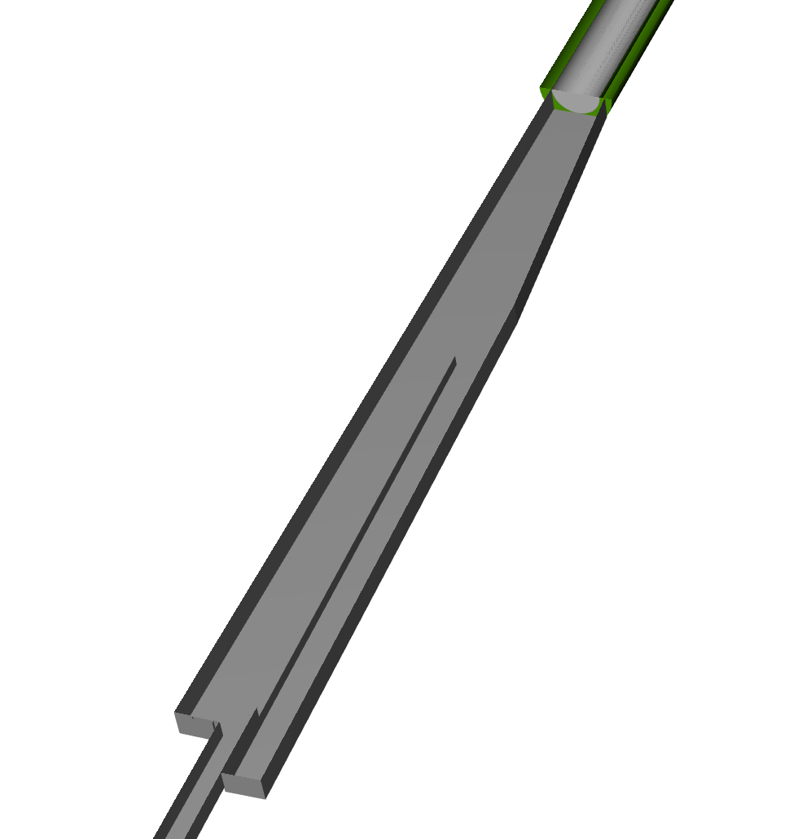
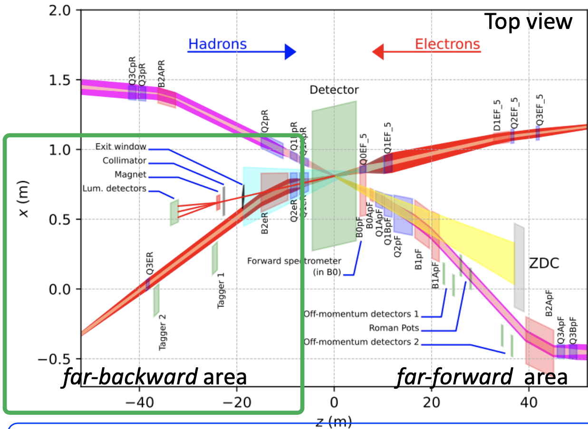
Beam pipe and magnets
The electron beam pipe geometry in the STL file (used in Synrad+) extends to only 33.5m and 15.3m in the forward (hadron-going) and backward (electron-going) directions, respectively.
Further steps to updated geometry:
An extended far-BWD electron beam pipe in the SR generator code (use the eic-shell modeling as a reference)
Improved BWD beam pipe geometry in the eic-shell and custom-built Geant4 (make them consistent)
The new lattice file contains only the B2eR magnet
There is no B2A/BeR
Q1eR
Q2eR
B2AeR
B2BeR

Slide 32
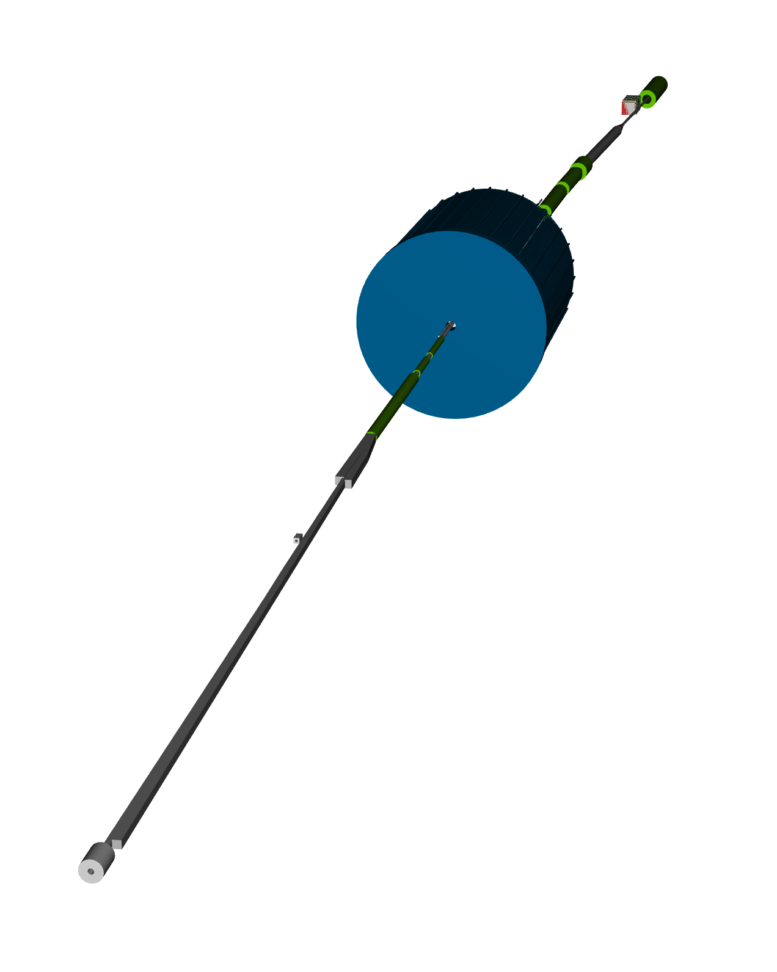
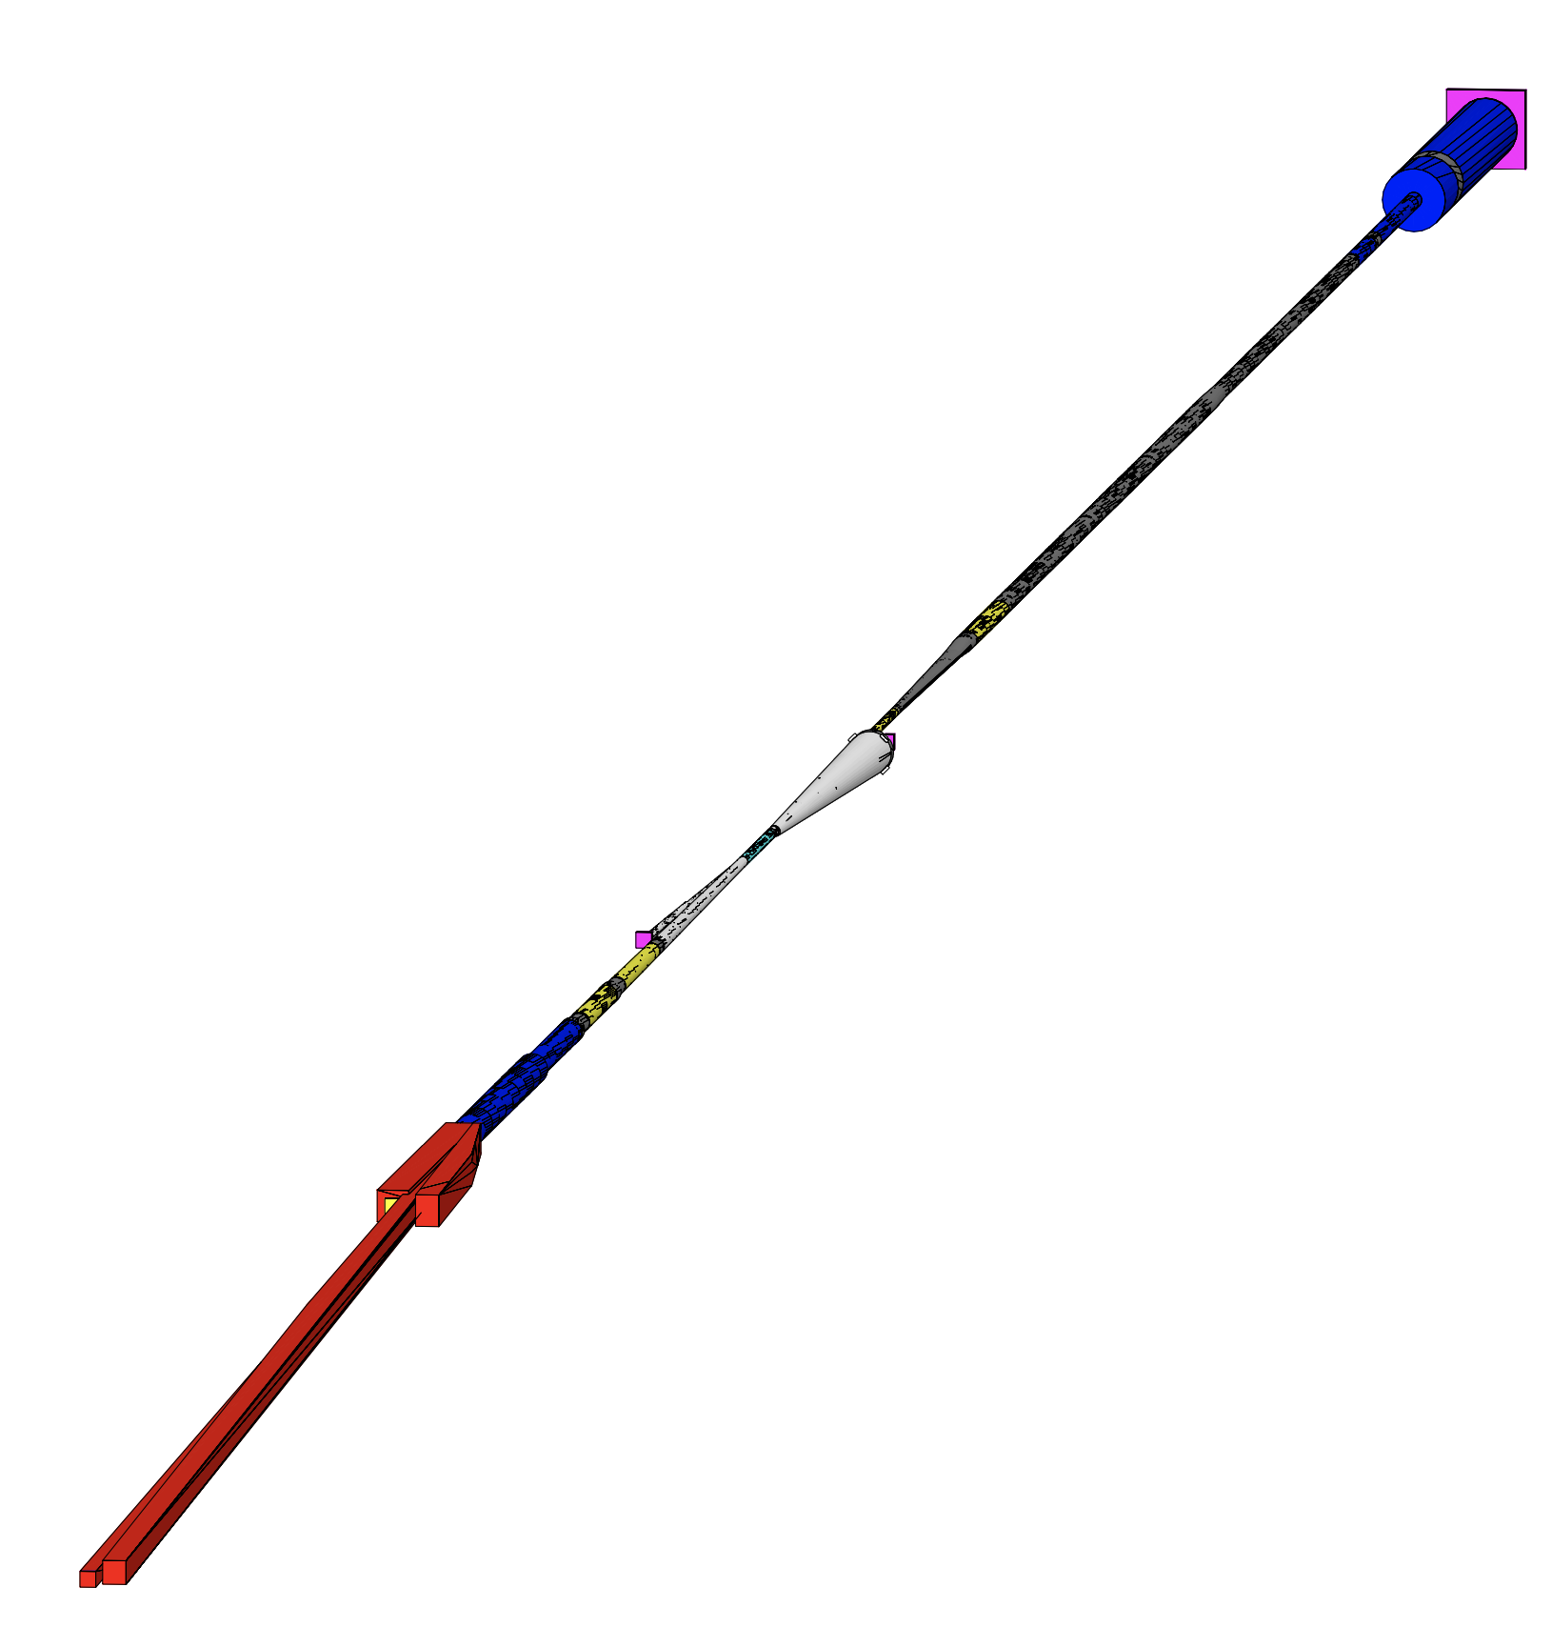
Eic-shell vs Geant4 simulation geometry
eic-shell
custom-built Geant4
e– beam
e– beam
see the heprep file for more details

Slide 33
SR photons causing detector hits
Although there are many SR photons hitting the IR beam pipe
Only a part of them passes through the beam pipe and reaches the detector-sensitive volume.
According to the MC particle analysis, SR photons with E_{𝛾} > 10 keV produce Vertex detector hits.
Let’s track the SR photons with E_{𝛾} > 10 keV that hit the IP beam pipe.
XY position of the VertexBarrel detector hits
Energy deposition of the VertexBarrel detector hits
Generated SR photon on the inner surface of the beam pipe

