Slide 1
Synchrotron Radiation (SR) background in ePIC at the EIC
Andrii Natochii
natochii@hawaii.edu
Outline
Executive summary
Synrad+ limitation
SR reflection in Geant4 (new physics process)
Benchmarking (debugging)
Beam tails (optional for this talk)
Summary and next steps

Slide 2
Executive summary
The SR background in the ePIC detector is considered one of the most dominant sources of inner tracker occupancy and damage.
A comprehensive understanding of the SR impact is essential for detector performance and safety.
So far, only preliminary estimates based on a simplified model have been discussed.
Using the Molflow+ software, one can accurately calculate gas pressure distribution in the IR.
However, the Synrad+ software is unsuitable for precise and convenient study of the SR background.
Therefore, the use of the Geant4 software is proposed and studied.
According to the first preliminary results, the newly developed code based on Geant4 is reliable and can be used for a comprehensive SR background study in ePIC at the EIC.
The code fairly successfully passed benchmark tests.
It demonstrated satisfactory performance in terms of computational time and resources.
After improving the IR beam pipe geometry in eic-shell, we can start working on the SR background mitigation using the new Geant4-based code.
Andrii Natochii | Dec 2023

Slide 3
Synrad+ limitation
Andrii Natochii | Dec 2023

Slide 4
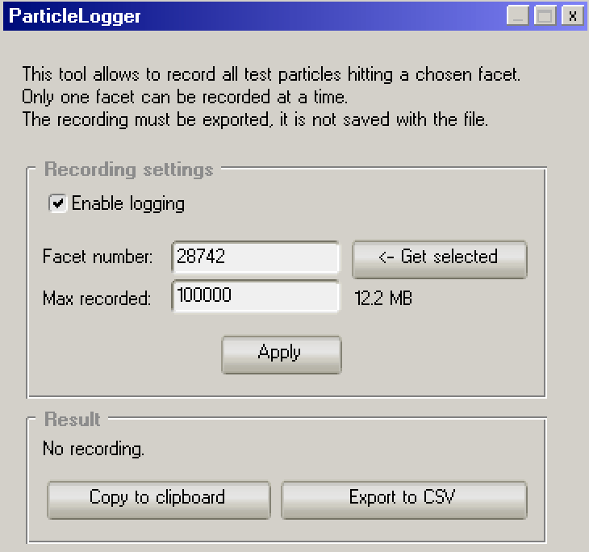
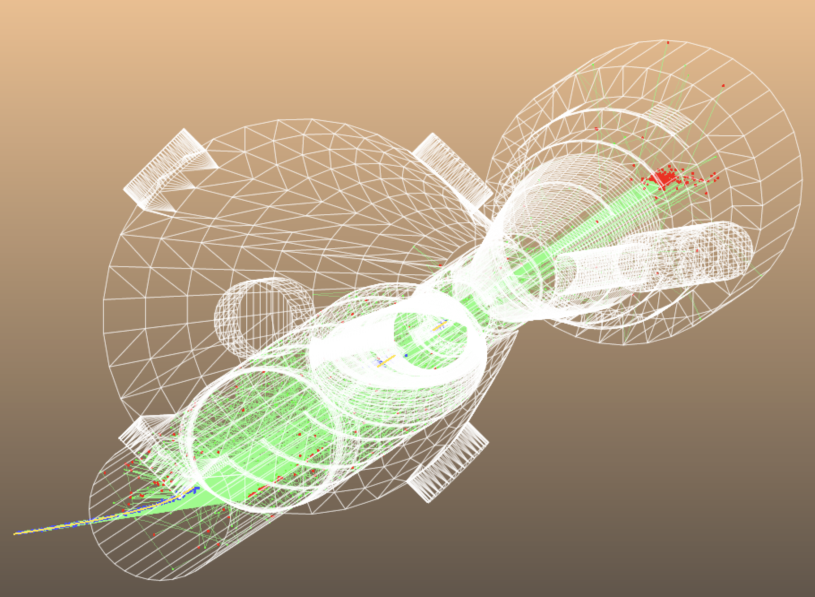
Synrad+ GUI limitation
The vacuum beam pipe geometry is made of an assembly of ~29k facets (triangles and rectangles) imported from 3D CAD.
Unfortunately, the GUI allows the information about the impinging photons hitting the beam pipe to be stored only for one facet at a time.
Although only up to 1k facets are hit by photons, storing this information for each is highly time-consuming.
Y
Z
X
Y
X
Andrii Natochii | Dec 2023

Slide 5
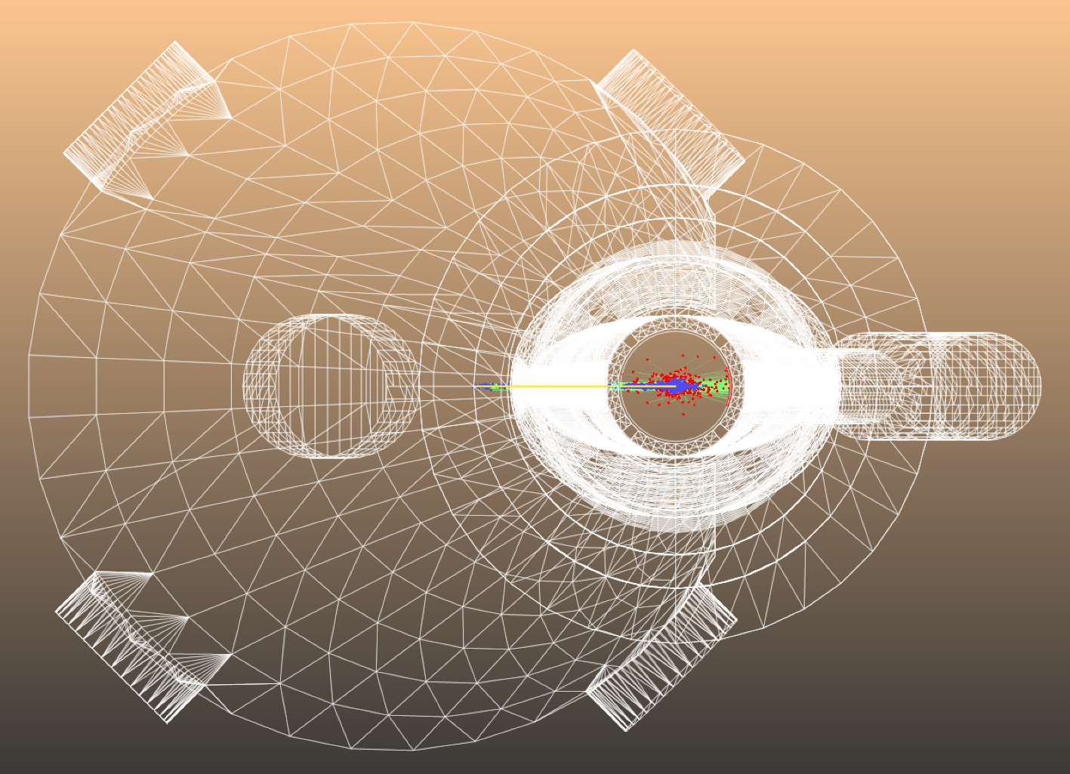
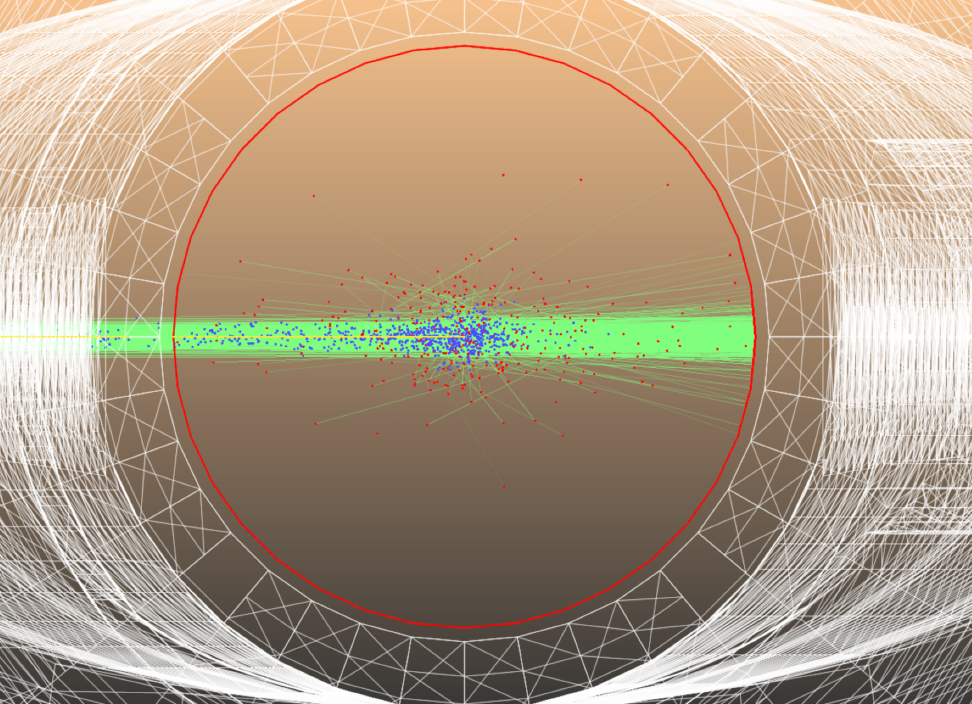
Possible solution
Instead of collecting photon data from ~1k facets, we can create a phantom/fake beam pipe (an ideal absorber → sticking = 1) with a simple geometry inside the actual pipe and collect the data.
Pros
Only 36 facets → easy to store the data (~40 min)
Cons
Detailed information about reflected photons is missing
Proposal
Use Geant4 instead of Synrad+ for the SR simulation
Phantom pipe
⌀ 4.4 cm
⌀ 4.2 cm
10º
Andrii Natochii | Dec 2023

Slide 6
SR in Geant4
Andrii Natochii | Dec 2023

Slide 7
Synrad+ → Geant4: Steps to be done
SR photons
Convert the vacuum beam pipe structure into the Geant4 model
Create magnetic regions with three dipoles and two quadrupoles
Implement the SR photon reflection from the vacuum-metal interface
Collect absorbed photon hits
vacuum beam pipe internal walls
electron beam
Andrii Natochii | Dec 2023

Slide 8
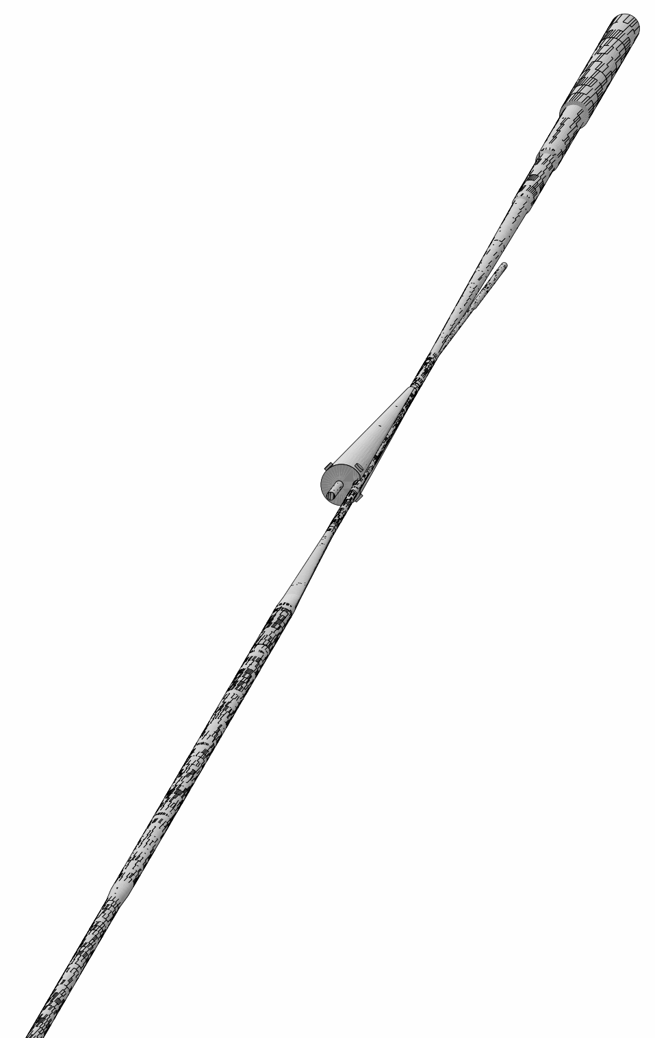
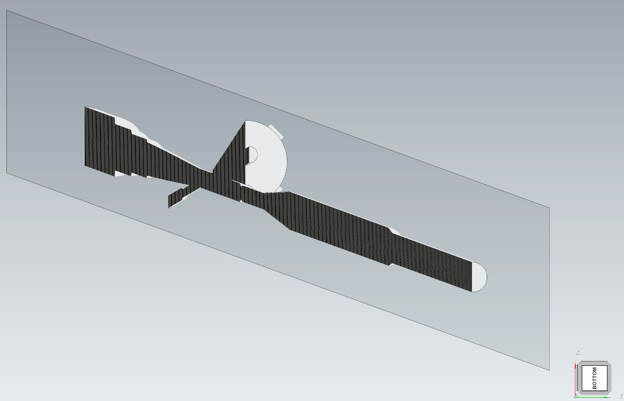
Vacuum modelling in Geant4
Geant4
STL-file from Charles Hetzel:
“Detector chamber 211004 mm.stl”
G4Solid made of vacuum
~50 m
IP6
Synrad+
~30 m
Vacuum volume
e– beam direction
Convert STL → OBJ
Built using CADMesh.hh
Andrii Natochii | Dec 2023

Slide 9
Magnetic field implementation (1)
In Geant4, the EM-field can be associated only with a logical volume (describes the element properties)
→ Assign the magnetic field to a part of the vacuum (locally)
Overlap with the magnet volume
Applied magnetic field to the intersection volume
Beam pipe vacuum volume
United beam pipe vacuum volume with the locally applied magnetic field
Overlap with the magnet volume
Subtracted magnet from the vacuum volume
Andrii Natochii | Dec 2023

Slide 10
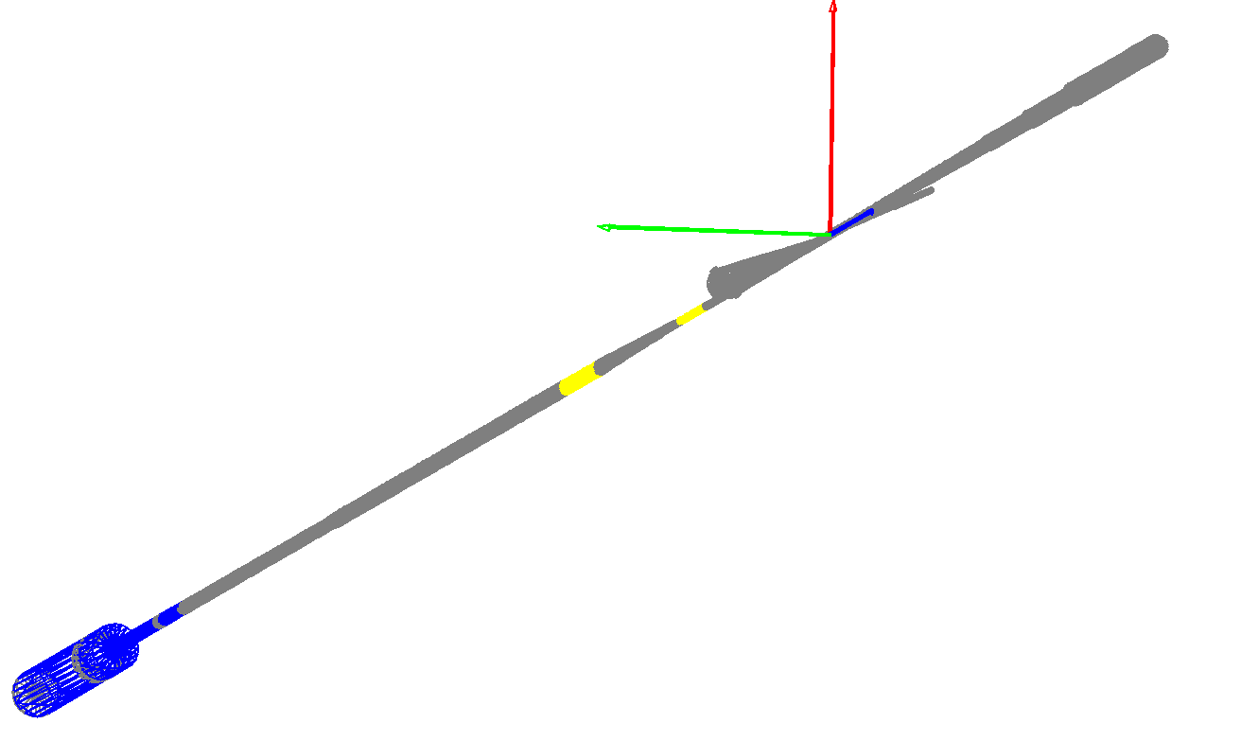
Magnetic field implementation (2)
Geant4
Vacuum pipe extension
FWD ESR lattice (Sep 2023)
Andrii Natochii | Dec 2023

Slide 11
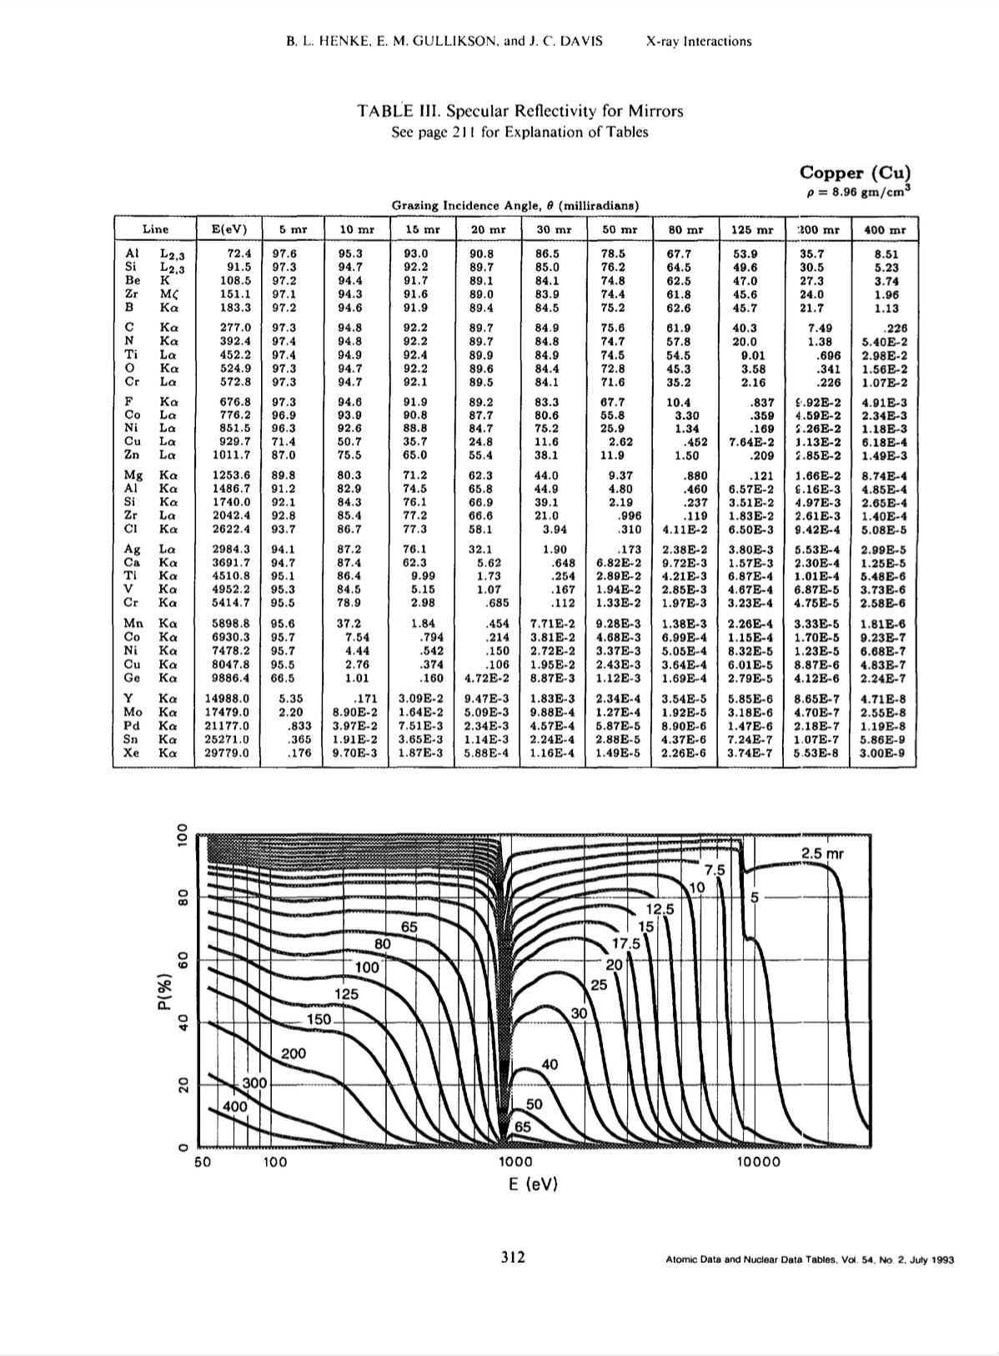
Reflection process
X-ray reflection process is not implemented in Geant4
It is available only for optical photons
Solution:
Create “new process” for gammas
Fresnel formulas for reflection probability
Use an extended CSV table from Synrad+
Specular reflection (mirror-like) including surface roughness [link]
https://doi.org/10.1006/adnd.1993.1013
vacuum
metal (Cu, Au)
reflection angles (ϴ, ɸ) are randomly offsetted
Geant4
Andrii Natochii | Dec 2023

Slide 12
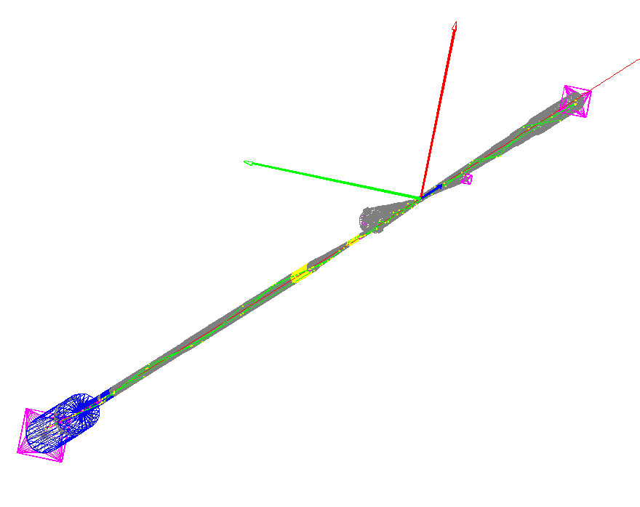
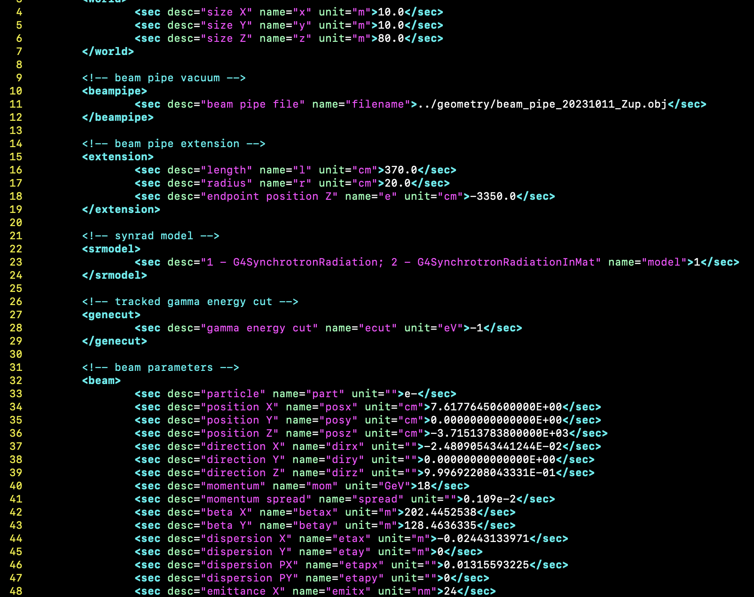
Geant4 simulation inputs and outputs
Geant4
The output ROOT file contains:
Initial electron coordinates (r, p, E)
Absorbed SR photons coordinates (r, p, E, t)
Absorbed SR photons production vertices
Simulation parameters (geometry configuration)
Geometry configuration is described in the XML file
Magnet settings
Beam parameters
Absorbers
Andrii Natochii | Dec 2023

Slide 13
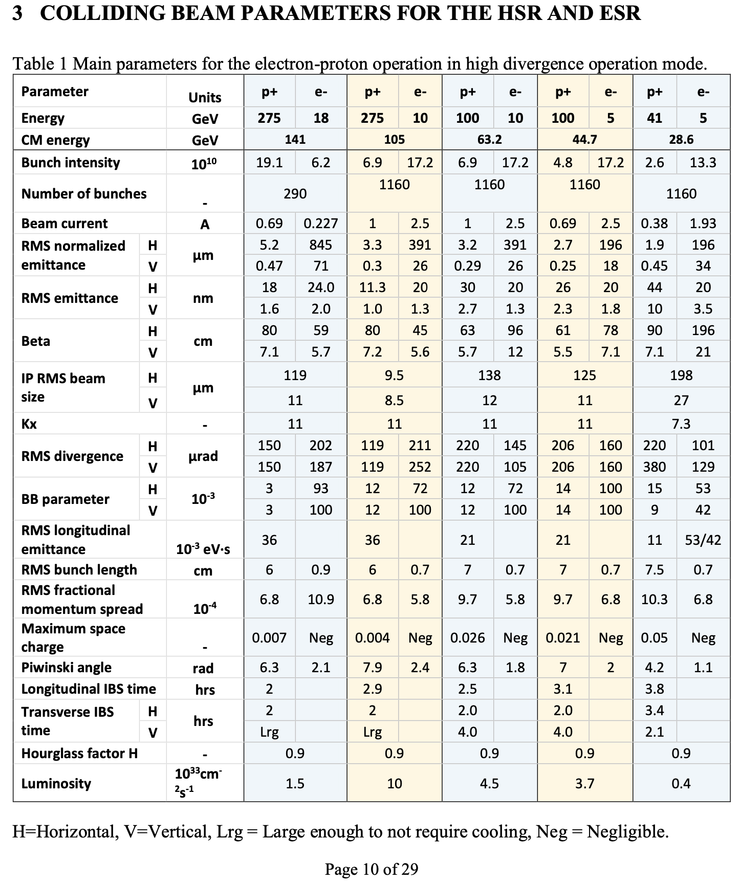
Master parameter table
Beam parameters used for the study
Andrii Natochii | Dec 2023

Slide 14
Benchmarking
Andrii Natochii | Dec 2023

Slide 15
Setup of magnet elements
survey_ir_6m.tfs and ir6forward.18GeV.twi (Sep 2023) are used for magnetic element positioning and field modeling
D2EF1
D2EF2
D1EF
Q1EF
Q0EF
Focusing in X
K1L (Twiss) > 0
Defocusing in X
K1L (Twiss) < 0
FWD ESR lattice (Sep 2023)
Andrii Natochii | Dec 2023

Slide 16
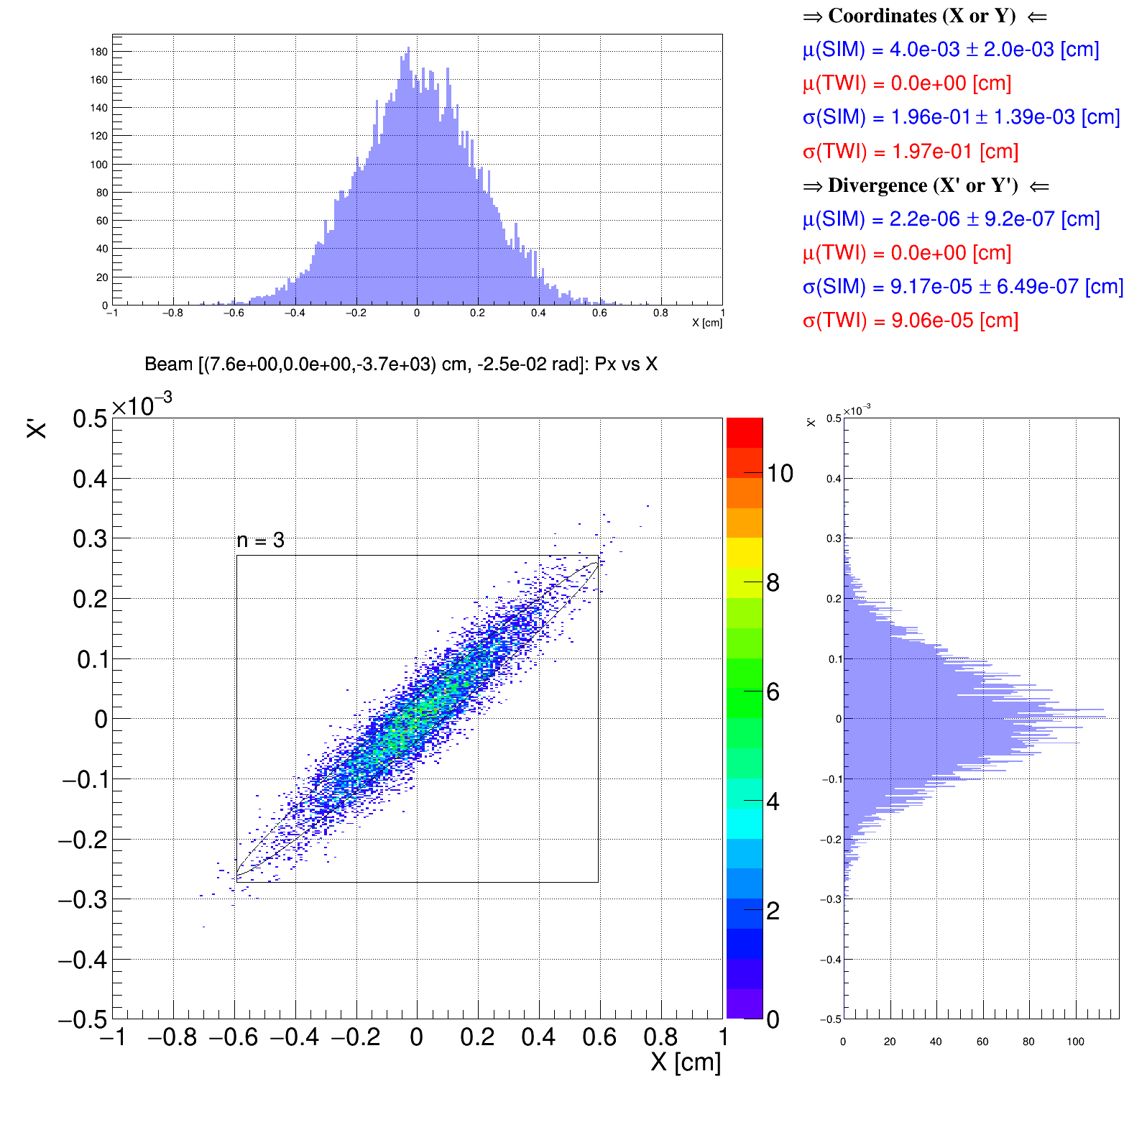
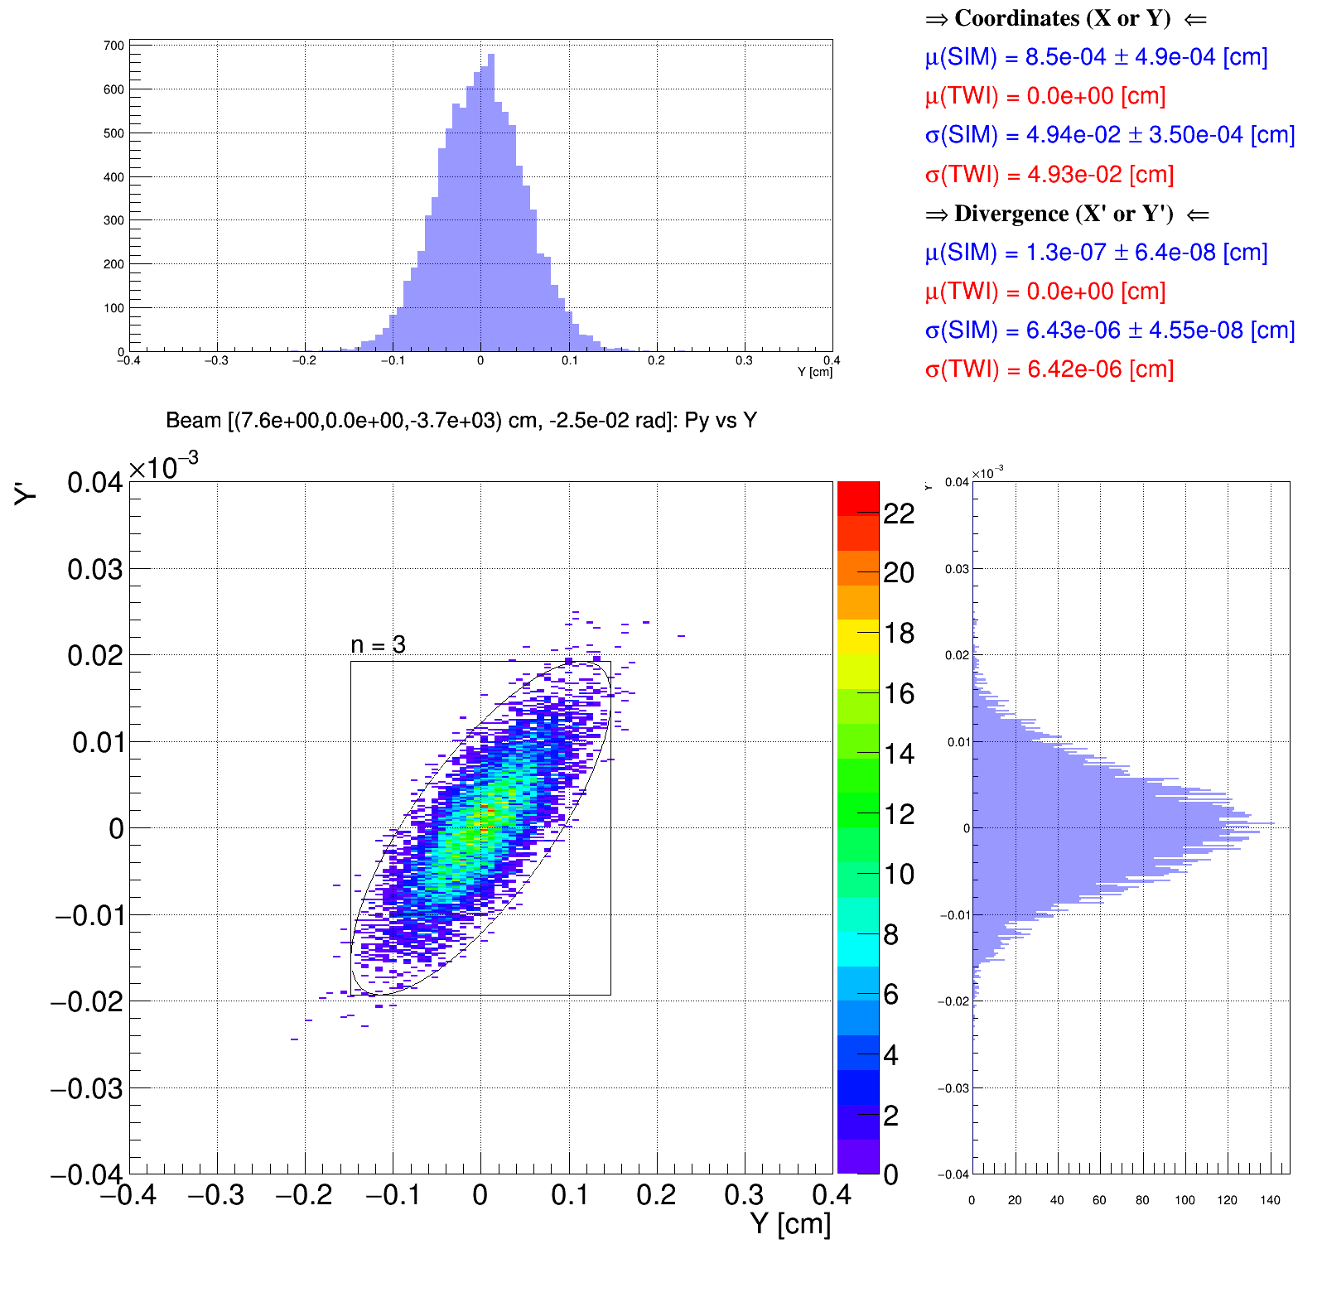
Benchmark: Initial beam distribution
D2EF1
Good agreement between generated beam distribution in Geant4 and Courant–Snyder (a.k.a. Twiss) parameters
D2EF2
D1EF
Q1EF
Q0EF
Geant4
Geant4
Horizontal phase space
Vertical phase space
Andrii Natochii | Dec 2023

Slide 17
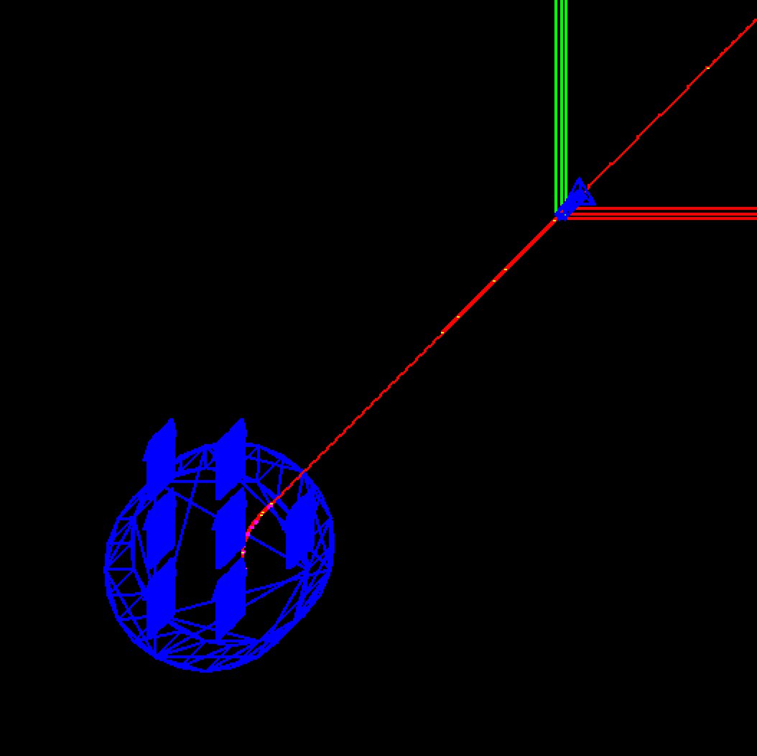
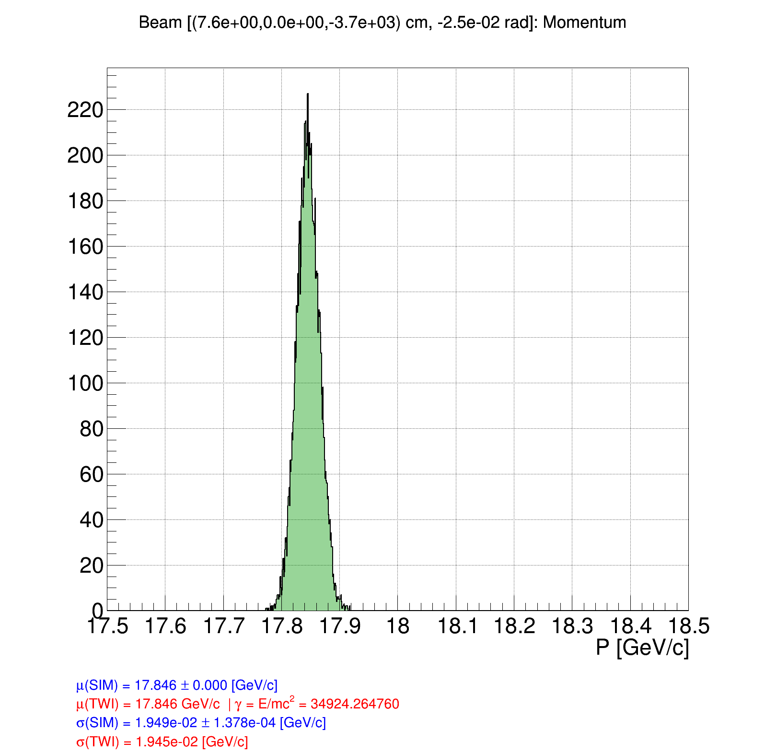
Benchmark: D2EF1 dipole field
D2EF1
Set a uniform magnetic field using G4UniformMagField
Twiss ANGLE > 0 → Geant4 ANGLE < 0
D2EF2
D1EF
Q1EF
Q0EF
Geant4
Y
Geant4
B_{y} – D-magnetic field
B[T]⍴[m] = 3.33564 pc[GeV]
⍴[m] = L[m]/(2sin[Θ/2]) RBEND
pc[GeV] = mc²[GeV](Ɣ²–1)
Z
X
Electron beam momentum at the magnet entrance
D2EF1
visualization is left-handed
Andrii Natochii | Dec 2023

Slide 18
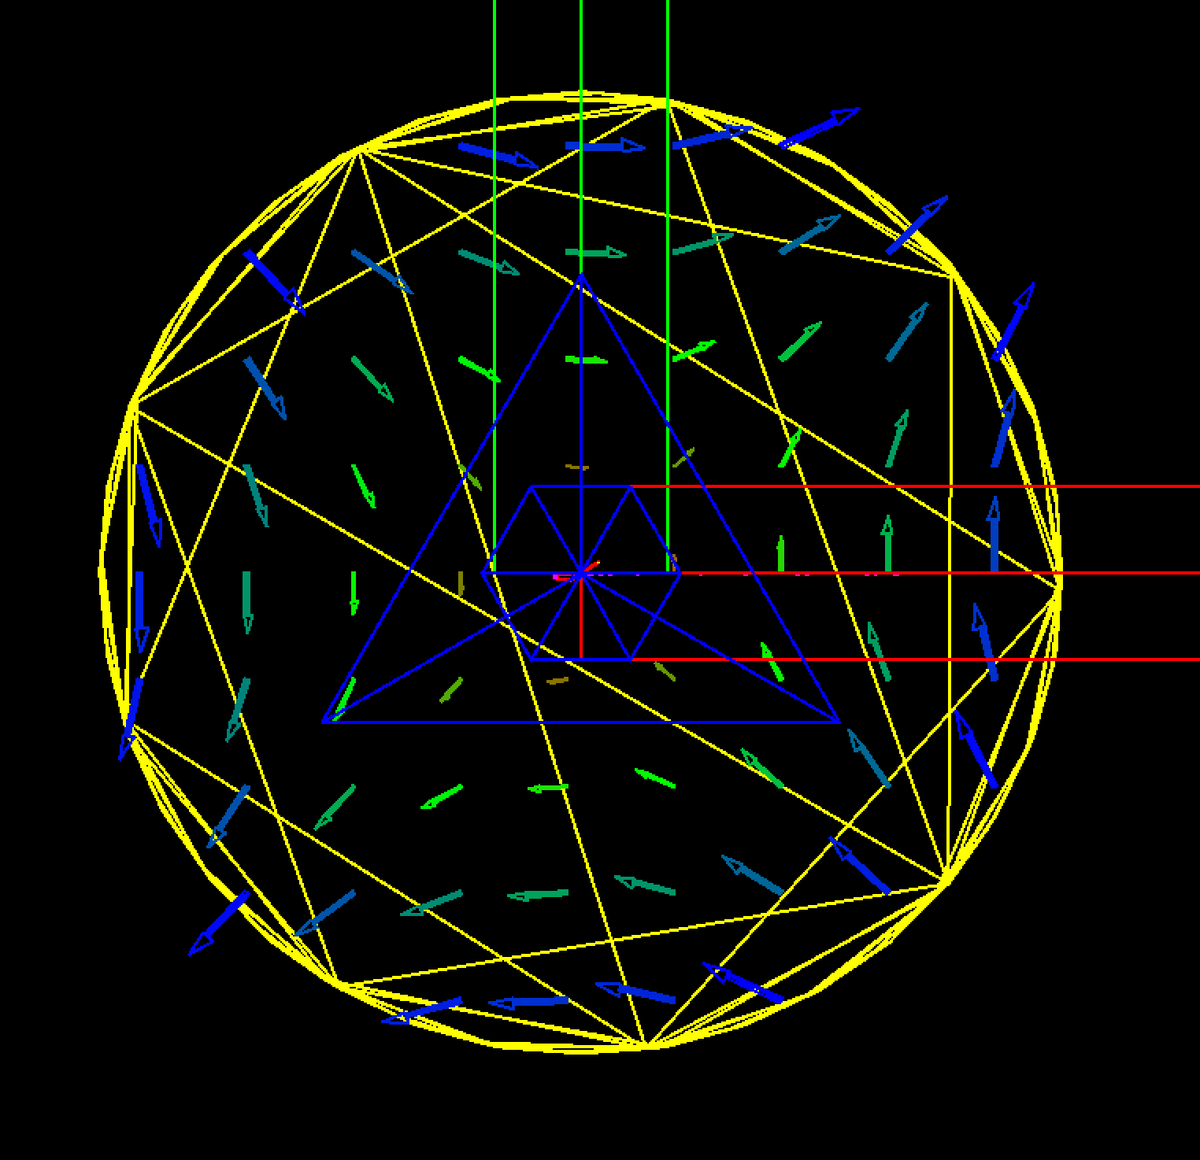
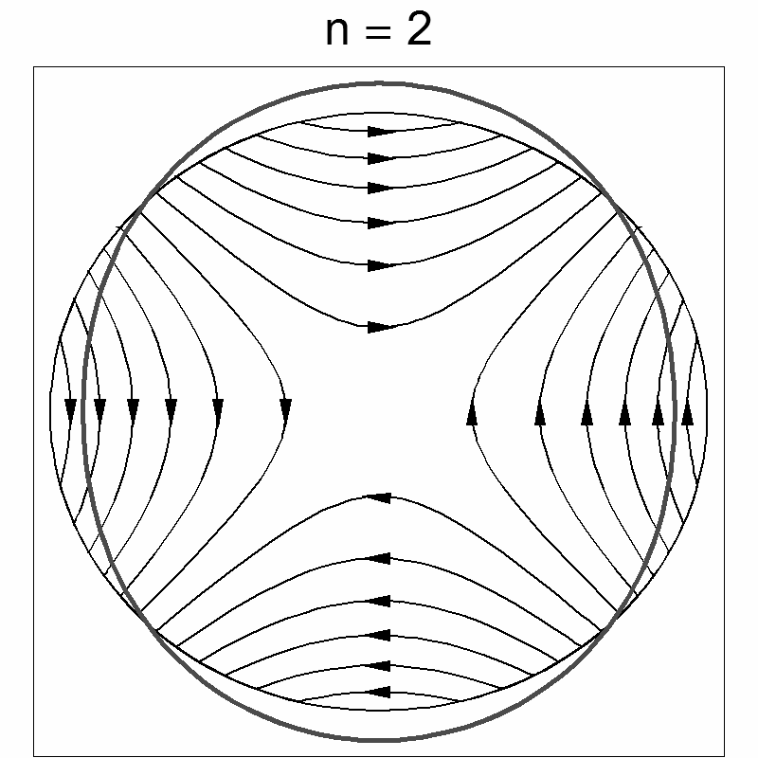
Benchmark: Q0EF quadrupole field
D2EF1
Set a quadrupole magnetic field using G4QuadrupoleMagField
Twiss K1L > 0 → Geant4 K1L < 0
D2EF2
D1EF
Q1EF
Q0EF
Geant4
Y
Q0EF
N
S
F_{L}
Z
F_{L}
F_{L}
X
F_{L}
g – quadrupole gradient
g[T/m] = 3.33564*K1[m^{–2}]*pc[GeV]
K1[m^{–2}] = K1L[m^{–1}]/L[m]
pc[GeV] = mc²[GeV](Ɣ²–1)
S
N
visualization is left-handed
Andrii Natochii | Dec 2023

Slide 19
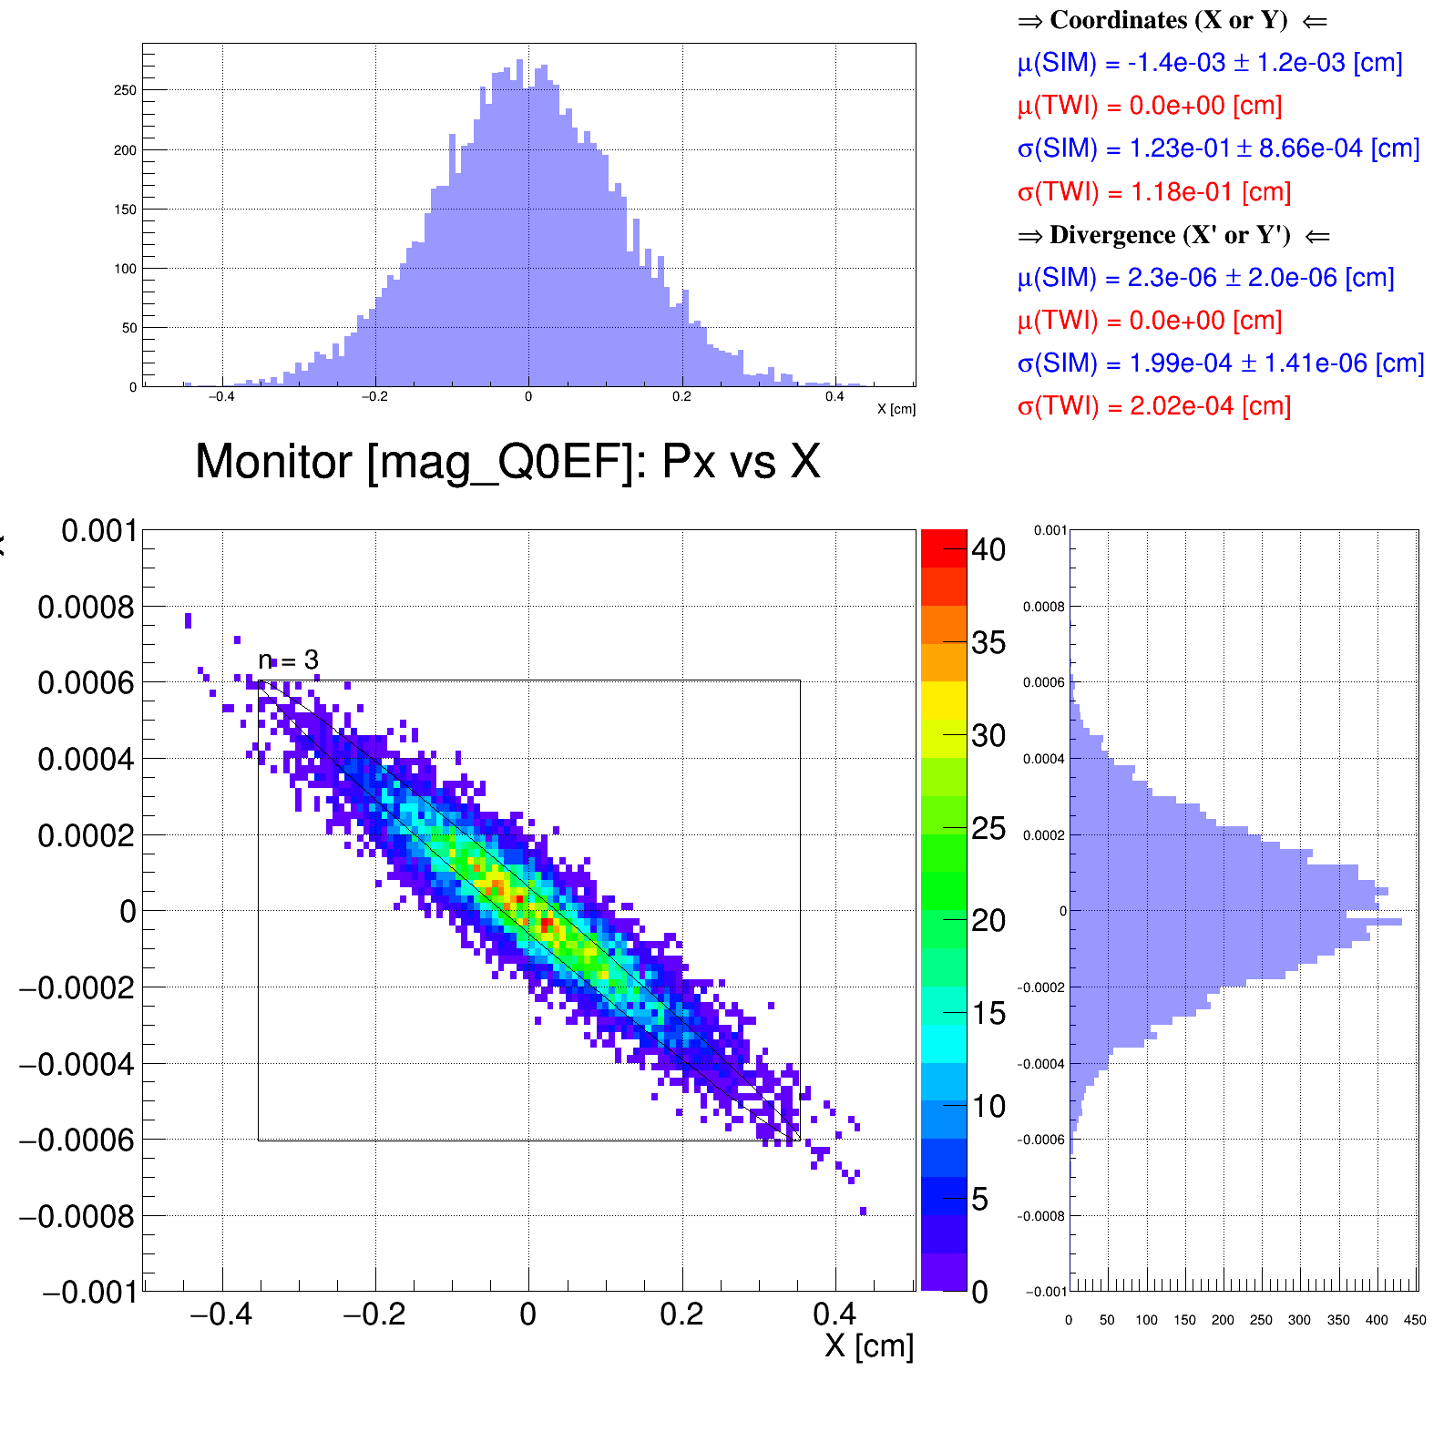
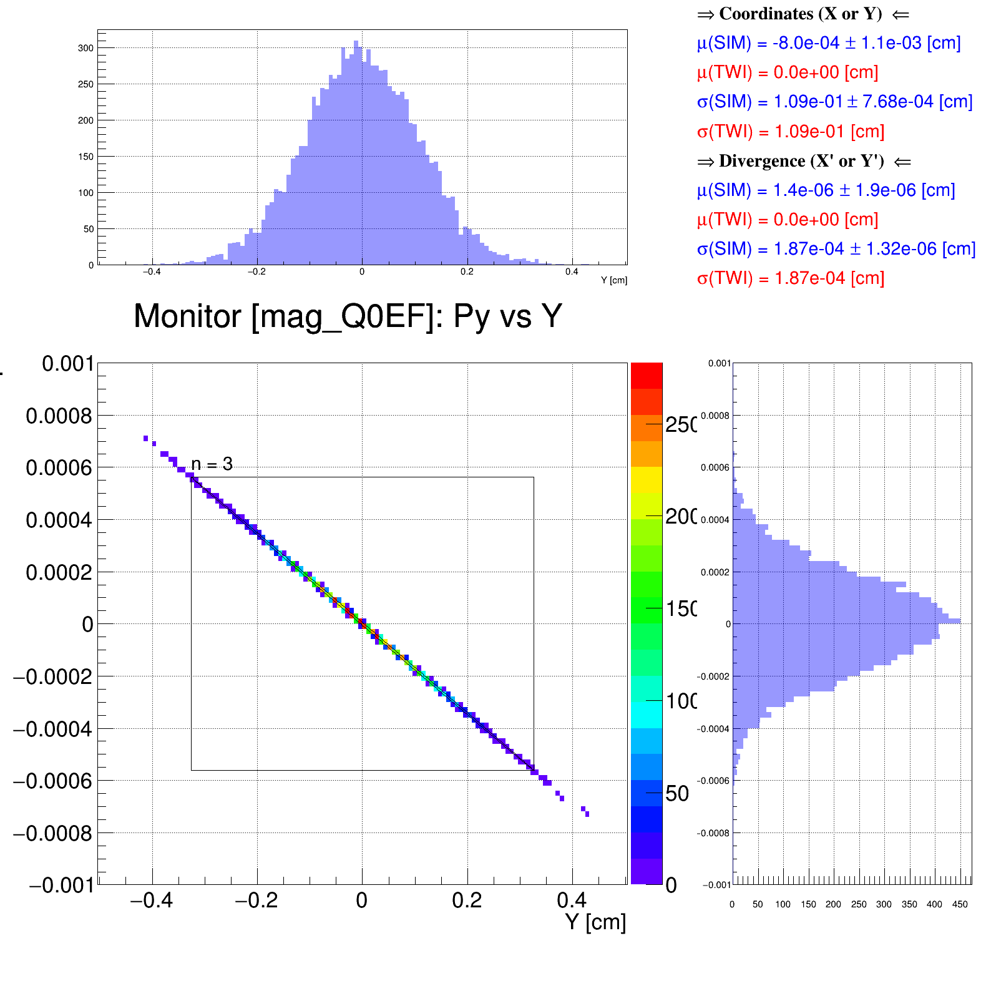
Benchmark: Beam distribution after Q0EF
D2EF1
Good agreement between tracked beam distribution in Geant4 and Courant–Snyder (a.k.a. Twiss) parameters
D2EF2
D1EF
Q1EF
Q0EF
Geant4
Geant4
Horizontal phase space
Vertical phase space
Andrii Natochii | Dec 2023

Slide 20
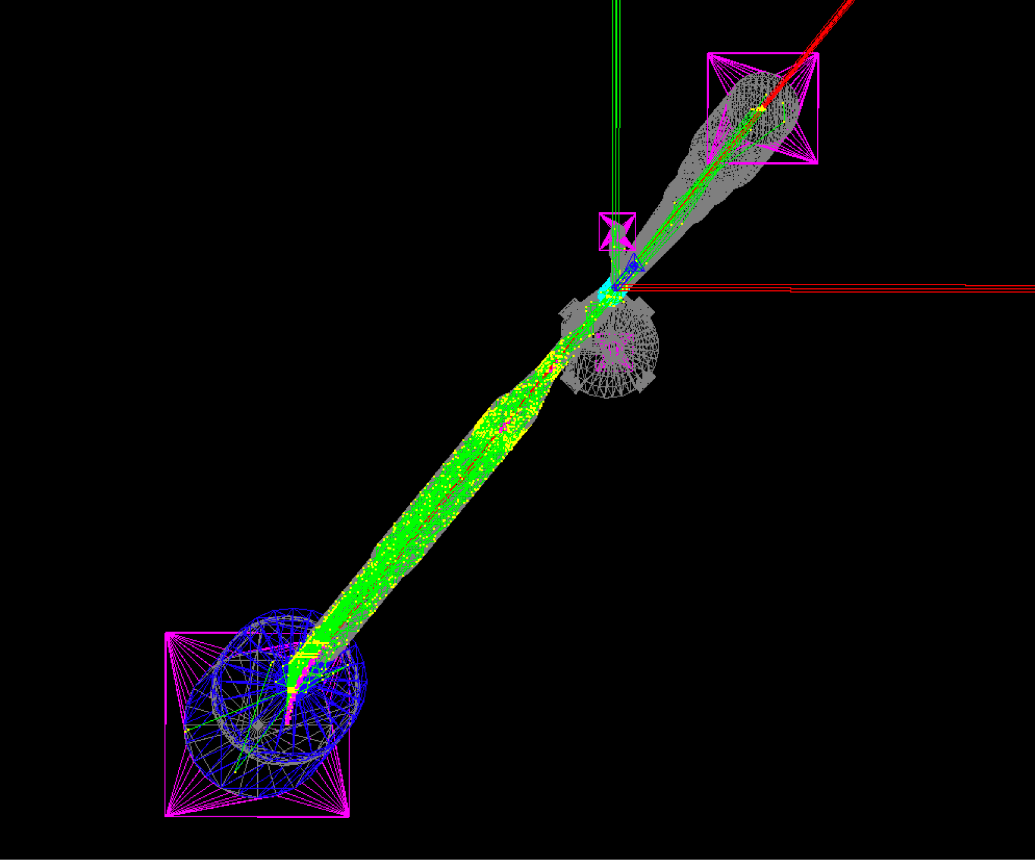
Benchmark: SR process
Turn on the SR production process using the G4SynchrotronRadiation class
Geant4
Synrad+
SR photons
SR photons
vacuum beam pipe internal walls
vacuum beam pipe internal walls
electron beam
electron beam
visualization is left-handed
visualization is right-handed
Andrii Natochii | Dec 2023

Slide 21
Benchmark: SR photons
Good agreement between simulated SR photon numbers/power per electron in Geant4 and analytical calculations (theory: )
D2EF1
D2EF2
D1EF
Q1EF
Q0EF
 | D2EF1 |  | D2EF2 |  | D1EF |  | Q1EF |  | Q0EF
 | <N_{Ɣ}> [ph/e–] | σ_{NƔ} [ph/e–] | <N_{Ɣ}> [ph/e–] | σ_{NƔ} [ph/e–] | <N_{Ɣ}> [ph/e–] | σ_{NƔ} [ph/e–] | <N_{Ɣ}> [ph/e–] | σ_{NƔ} [ph/e–] | <N_{Ɣ}> [ph/e–] | σ_{NƔ} [ph/e–]
Geant4 | 4.79 | 2.07 | 4.79 | 2.07 | 1.05 | 0.74 | 0.71 | 0.47 | 0.67 | 0.42
Theory | 4.29 |  | 4.29 |  | 0.55
 | <P_{Ɣ}> [μW/e–] | σ_{PƔ} [μW/e–] | <P_{Ɣ}> [μW/e–] | σ_{PƔ} [μW/e–] | <P_{Ɣ}> [μW/e–] | σ_{PƔ} [μW/e–] | <P_{Ɣ}> [μW/e–] | σ_{PƔ} [μW/e–] | <P_{Ɣ}> [μW/e–] | σ_{PƔ} [μW/e–]
Geant4 | 1.254 | 1.256 | 1.254 | 1.256 | 0.194 | 0.542 | 0.012 | 0.065 | 0.012 | 0.067
Theory | 1.254 |  | 1.254 |  | 0.194
Andrii Natochii | Dec 2023

Slide 22
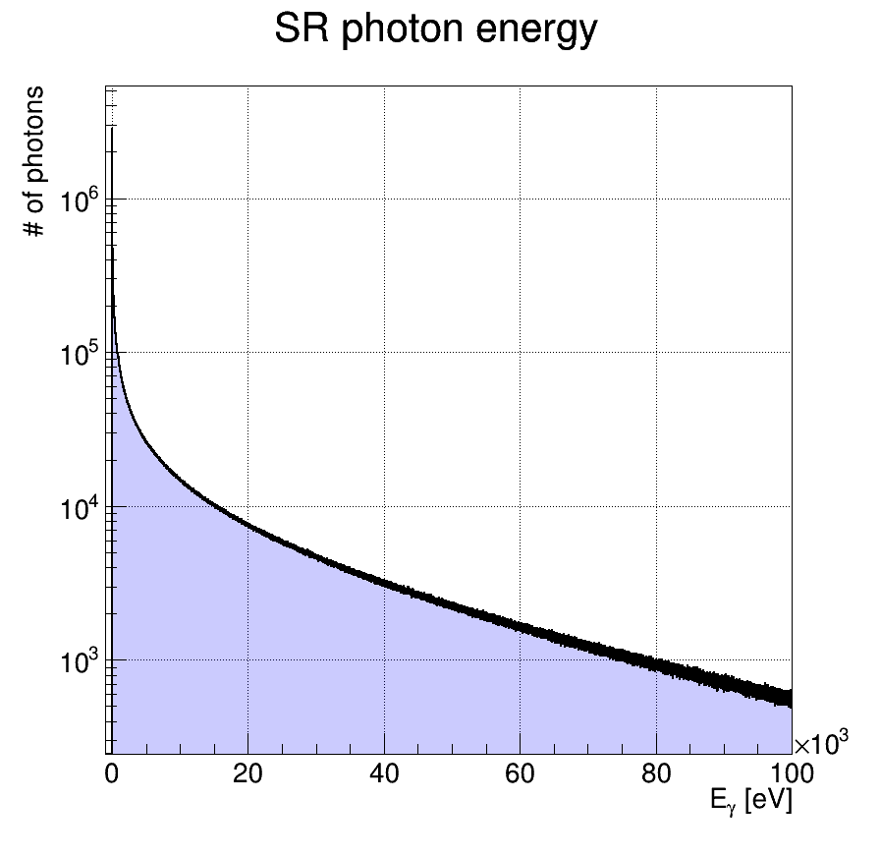
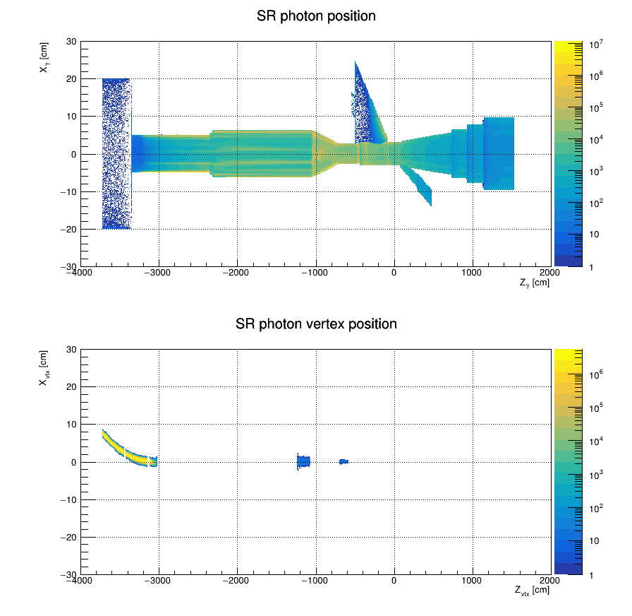
Geant4 SR simulation results
E_{𝛄} > 4 eV
Average simulation time is about 70 ms/event (1 event ≡ 1 electron)
Applying the E_{𝛄} cut significantly speeds up the simulation
IP6
Took ~1.6 hours for 10⁸ events using 1000 jobs (10⁵ events/job) on KEKCC
D2EF1
D2EF2
Q1EF
D1EF
Q0EF
Andrii Natochii | Dec 2023

Slide 23
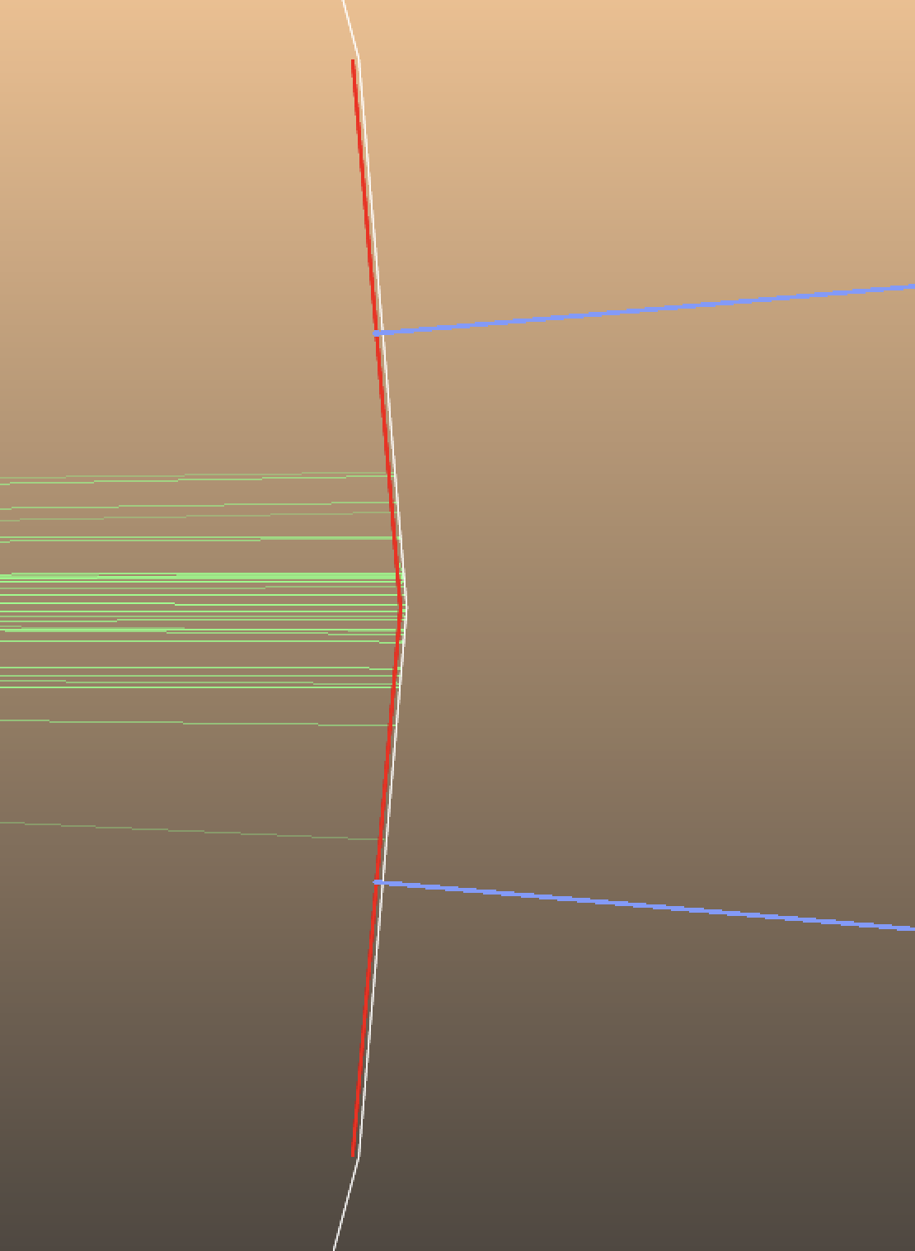
Synrad+ hack to collect the absorbed SR photon information at the reflecting facet
Facet #19
Reflector
Facet #39
Absorber
Discussion at the Molflow/Synrad forum: https://molflow-forum.web.cern.ch/t/unexpected-absorbed-sr-photon-distribution-in-synrad/584/11
Facet #40
Absorber
Facet #20
Reflector
Andrii Natochii | Dec 2023

Slide 24
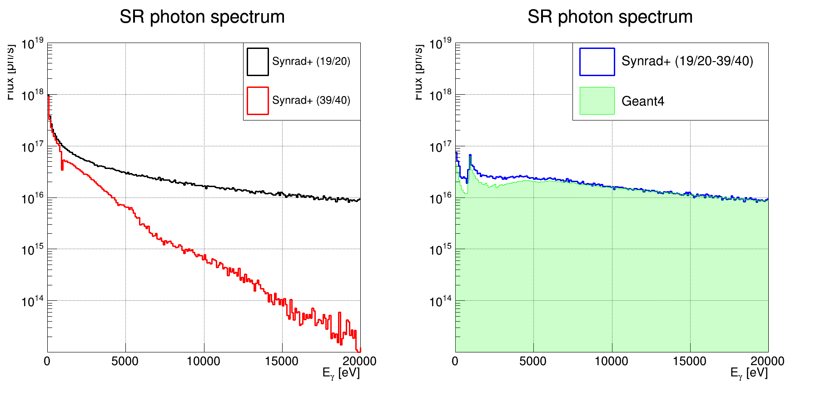
Benchmark: Energy spectrum of absorbed SR photons
There is a small disagreement for E_{𝛄} ≲ 5 keV
Incident to the beam pipe
Absorbed on the beam pipe
Reflected from the beam pipe
Andrii Natochii | Dec 2023

Slide 25
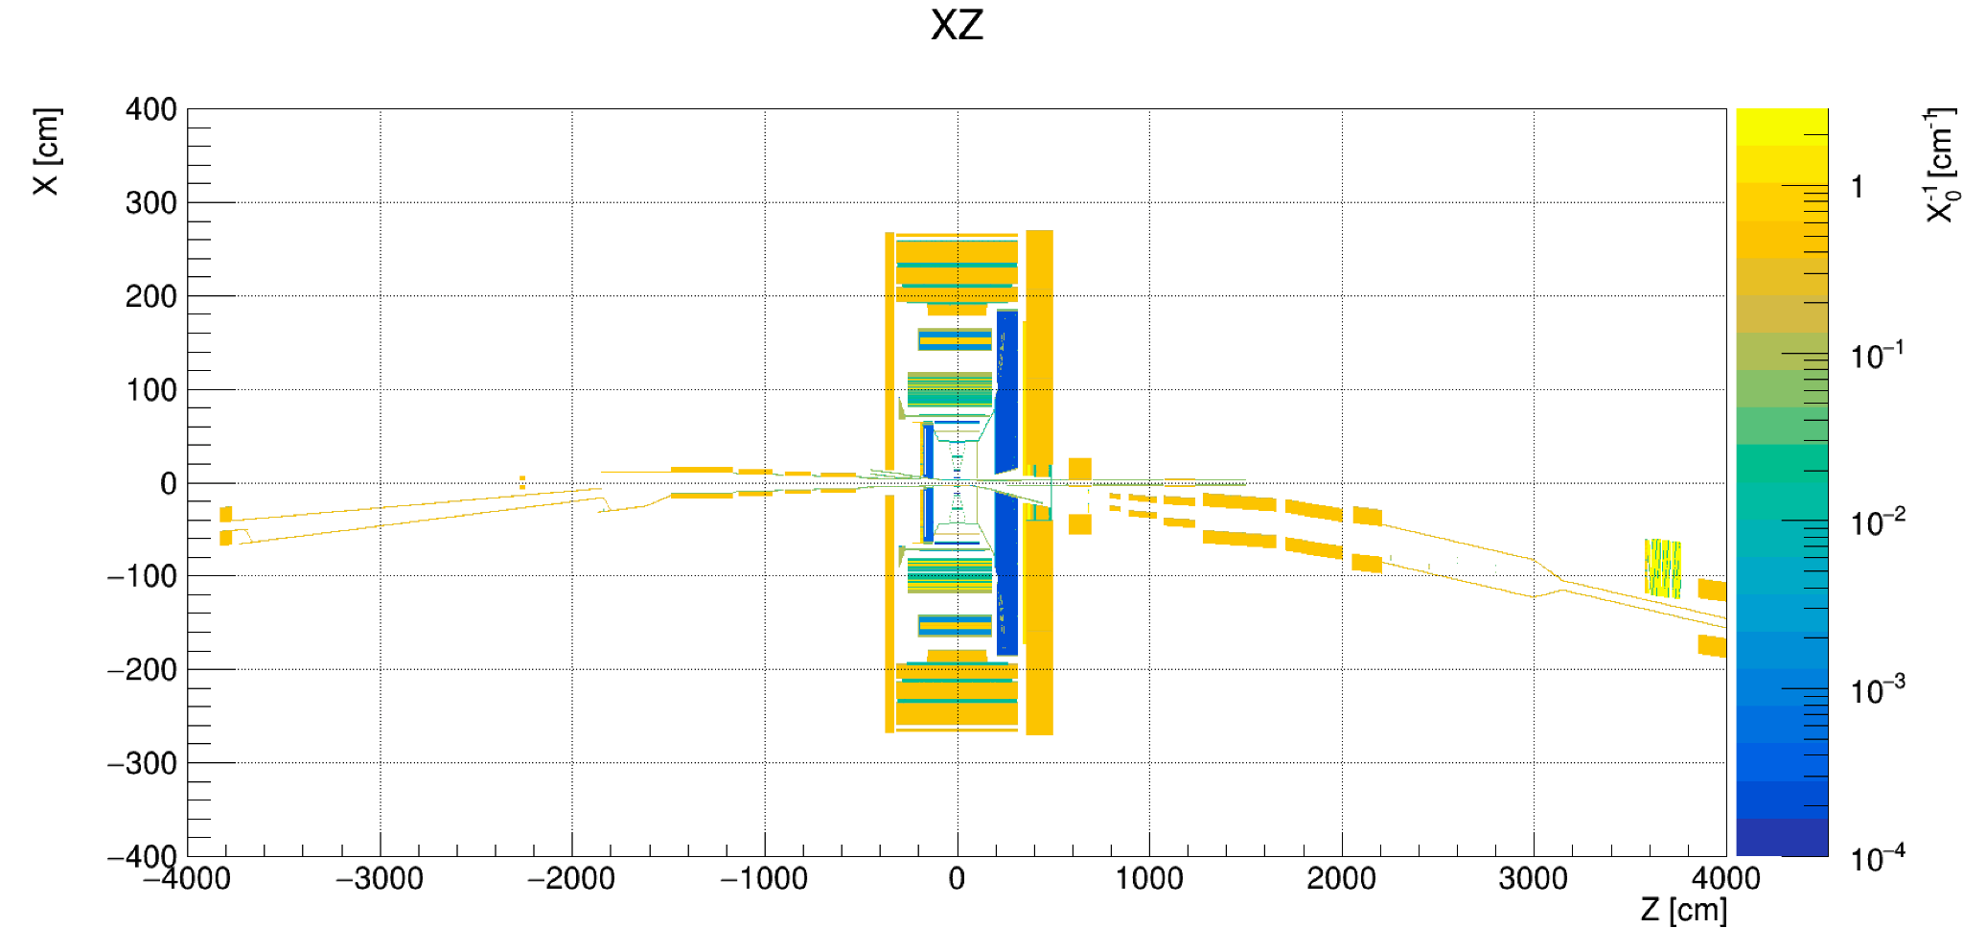
Material scan
EIC/ePIC
FWD end of the electron ring beam pipe
BWD end of the electron ring beam pipe
X, Z, Px, and Pz coordinates of SR photons should be flipped in HEPMC files before running the eic-shell simulation
Geant4
IP6
Andrii Natochii | Dec 2023

Slide 26
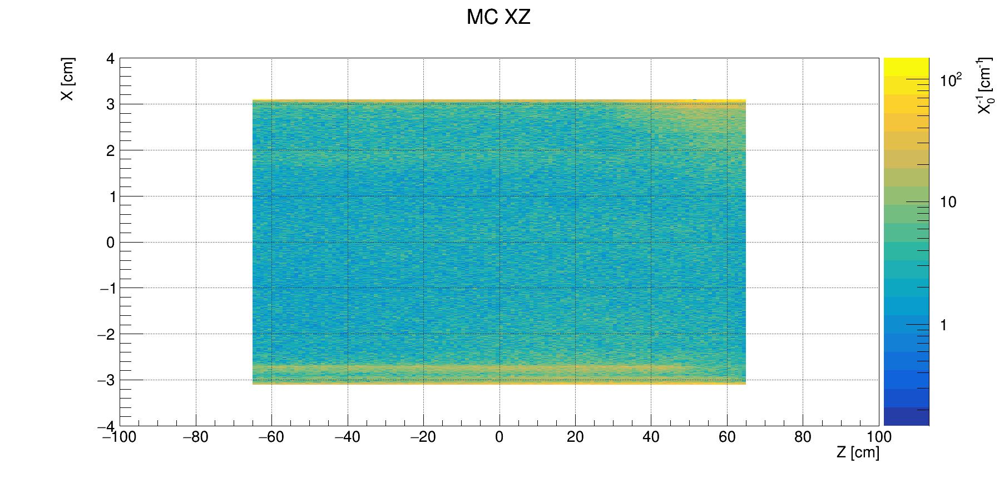
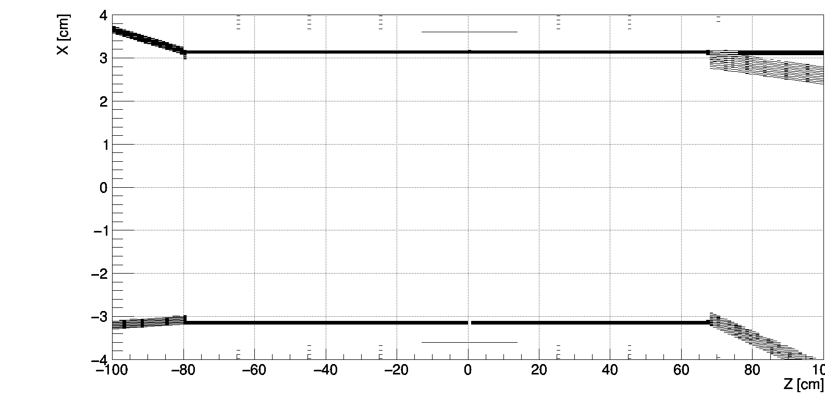
Material scan: IP6 beam pipe
|Z| < 65 cm
E_{𝛄} > 4 eV
Be beam pipe
MC particle (SR photons) vertices
Au layer
Geant4 SR hits fit the IP beam pipe aperture
e– beam
Andrii Natochii | Dec 2023

Slide 27
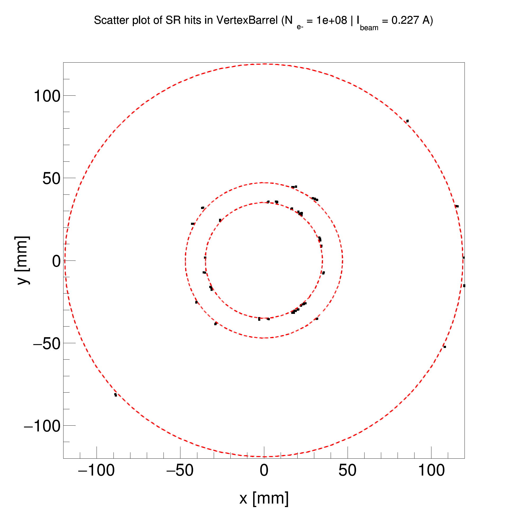
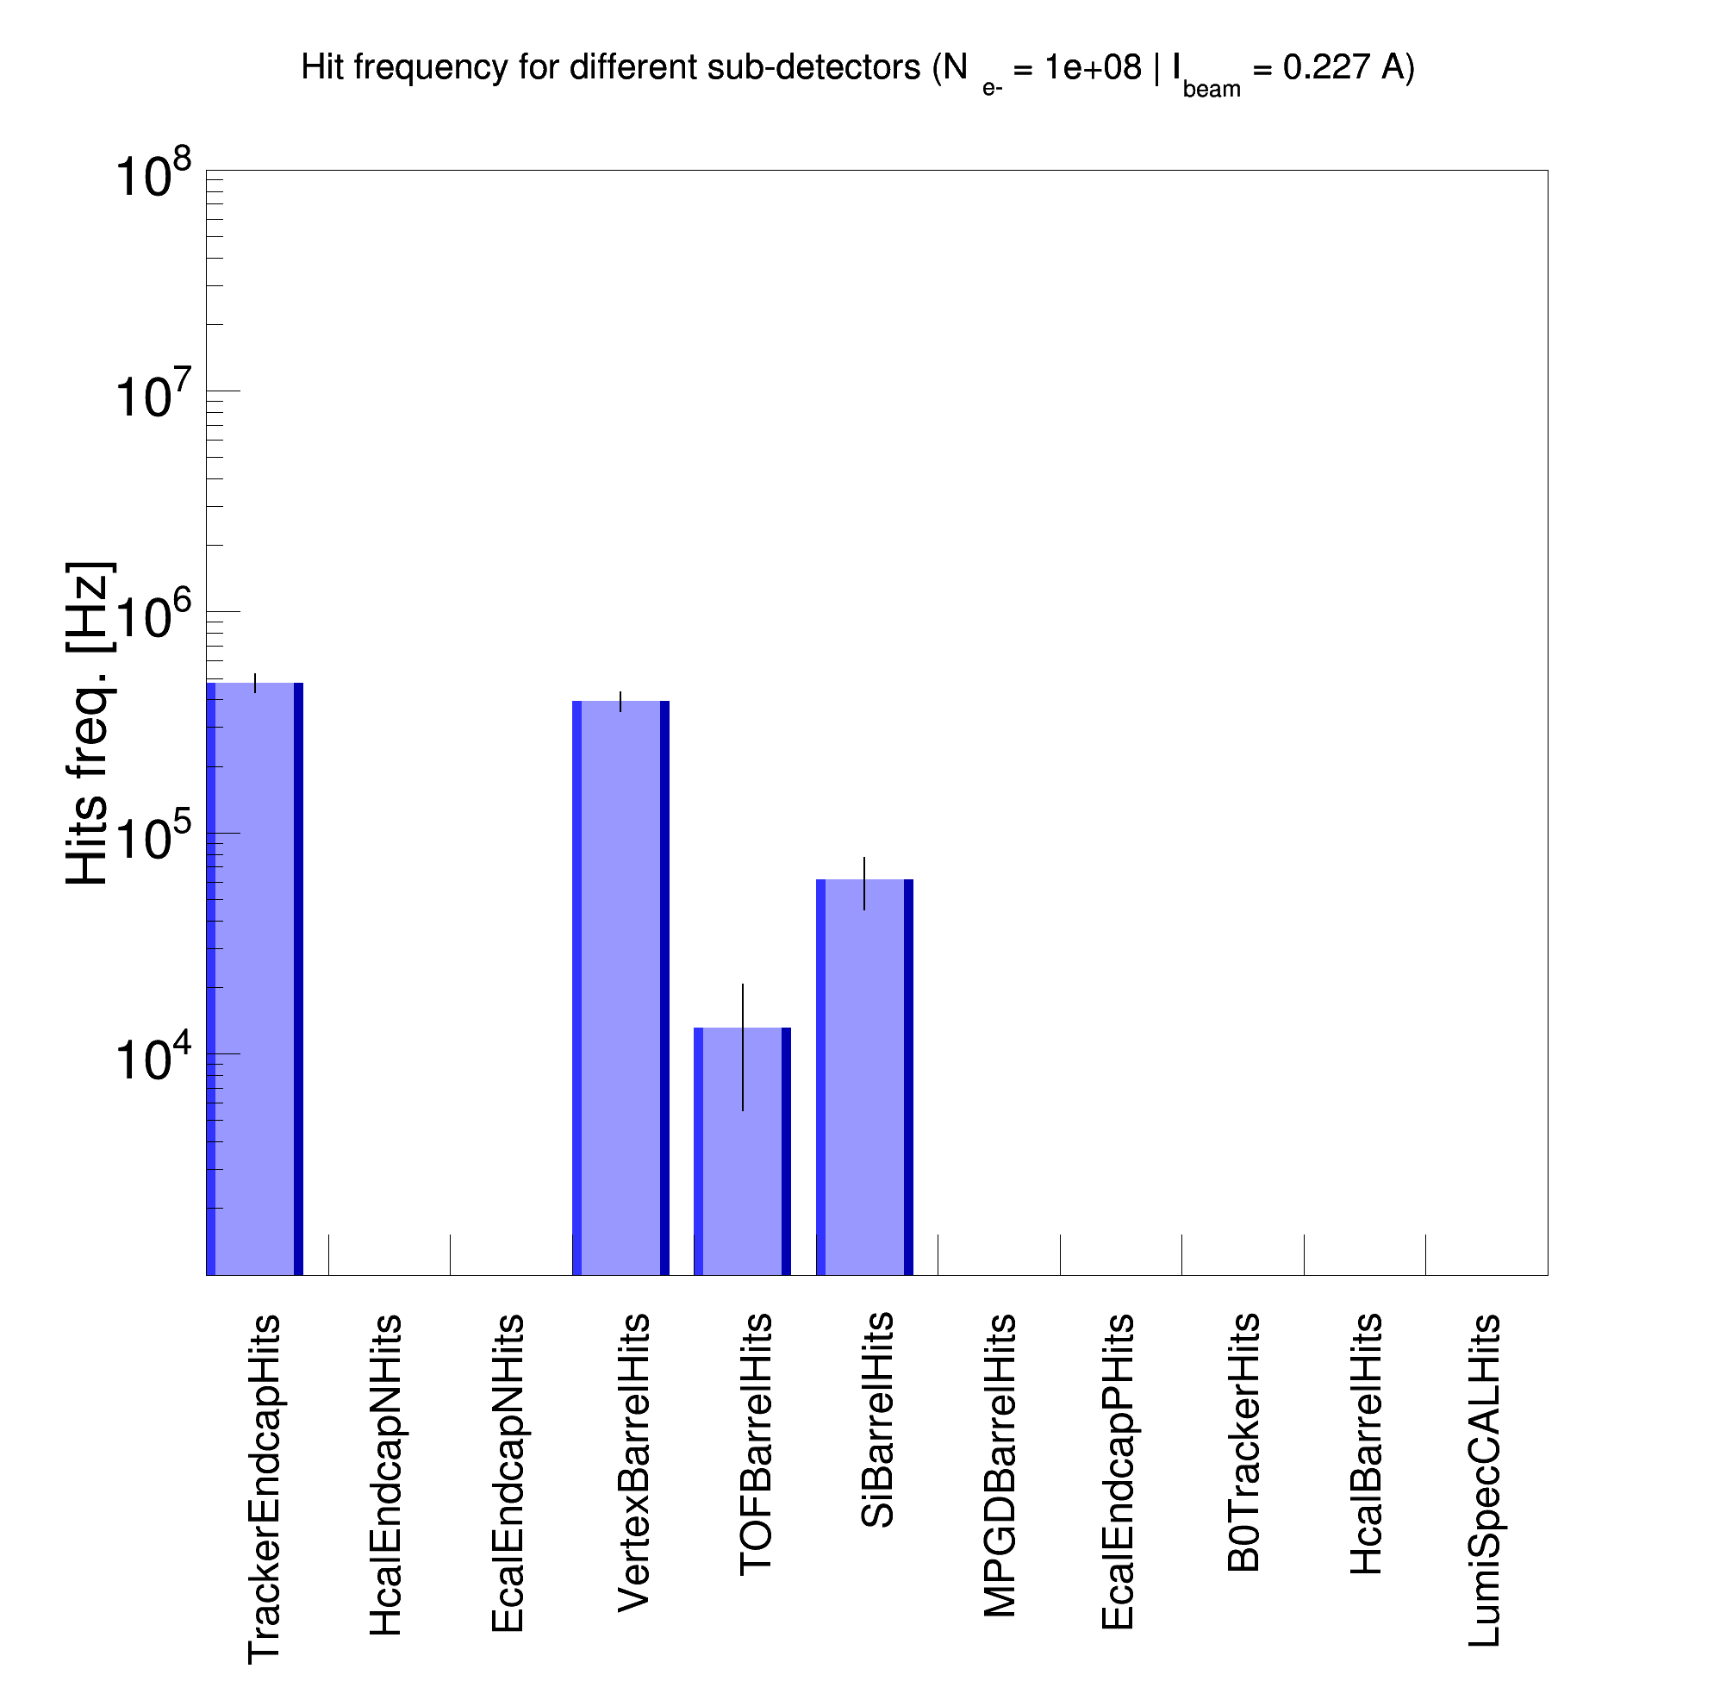
SR background in ePIC: Geant4 SR photon generator
|Z| < 65 cm
E_{𝛄} > 4 eV
Only for the IP beam pipe SR photons
Andrii Natochii | Dec 2023

Slide 28
|Z| < 10 m
E_{𝛄} > 4 eV
Beam pipe geometry inconsistency (1)
MC particle vertices
Geant4 SR photon generator using the vacuum geometry from Synrad+
X [cm]
Z [cm]
eic-shell material scan
|Y| < 0.1 cm
Andrii Natochii | Dec 2023

Slide 29
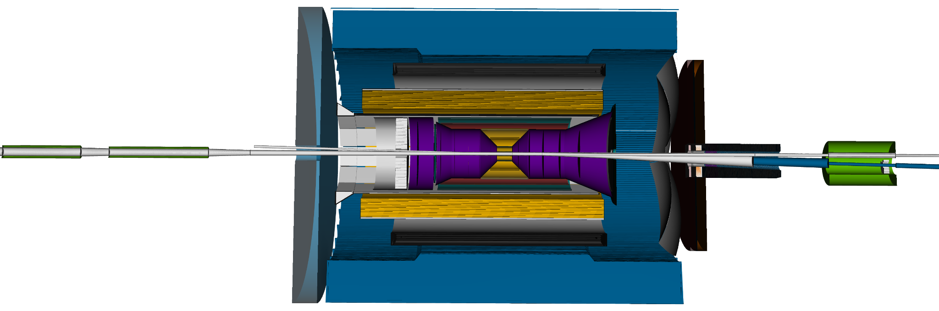
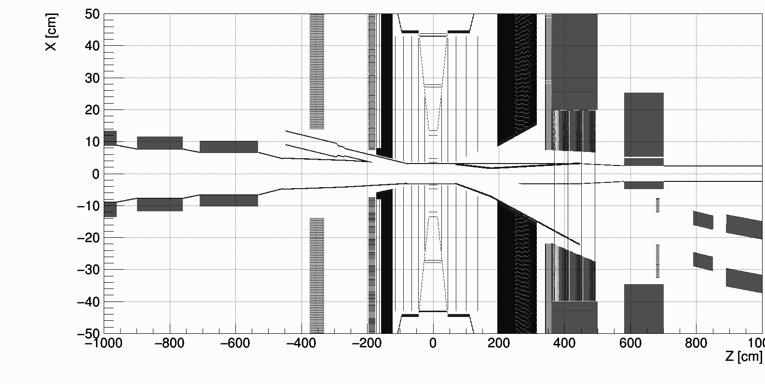
Beam pipe geometry inconsistency (2)
Andrii Natochii | Dec 2023

Slide 30
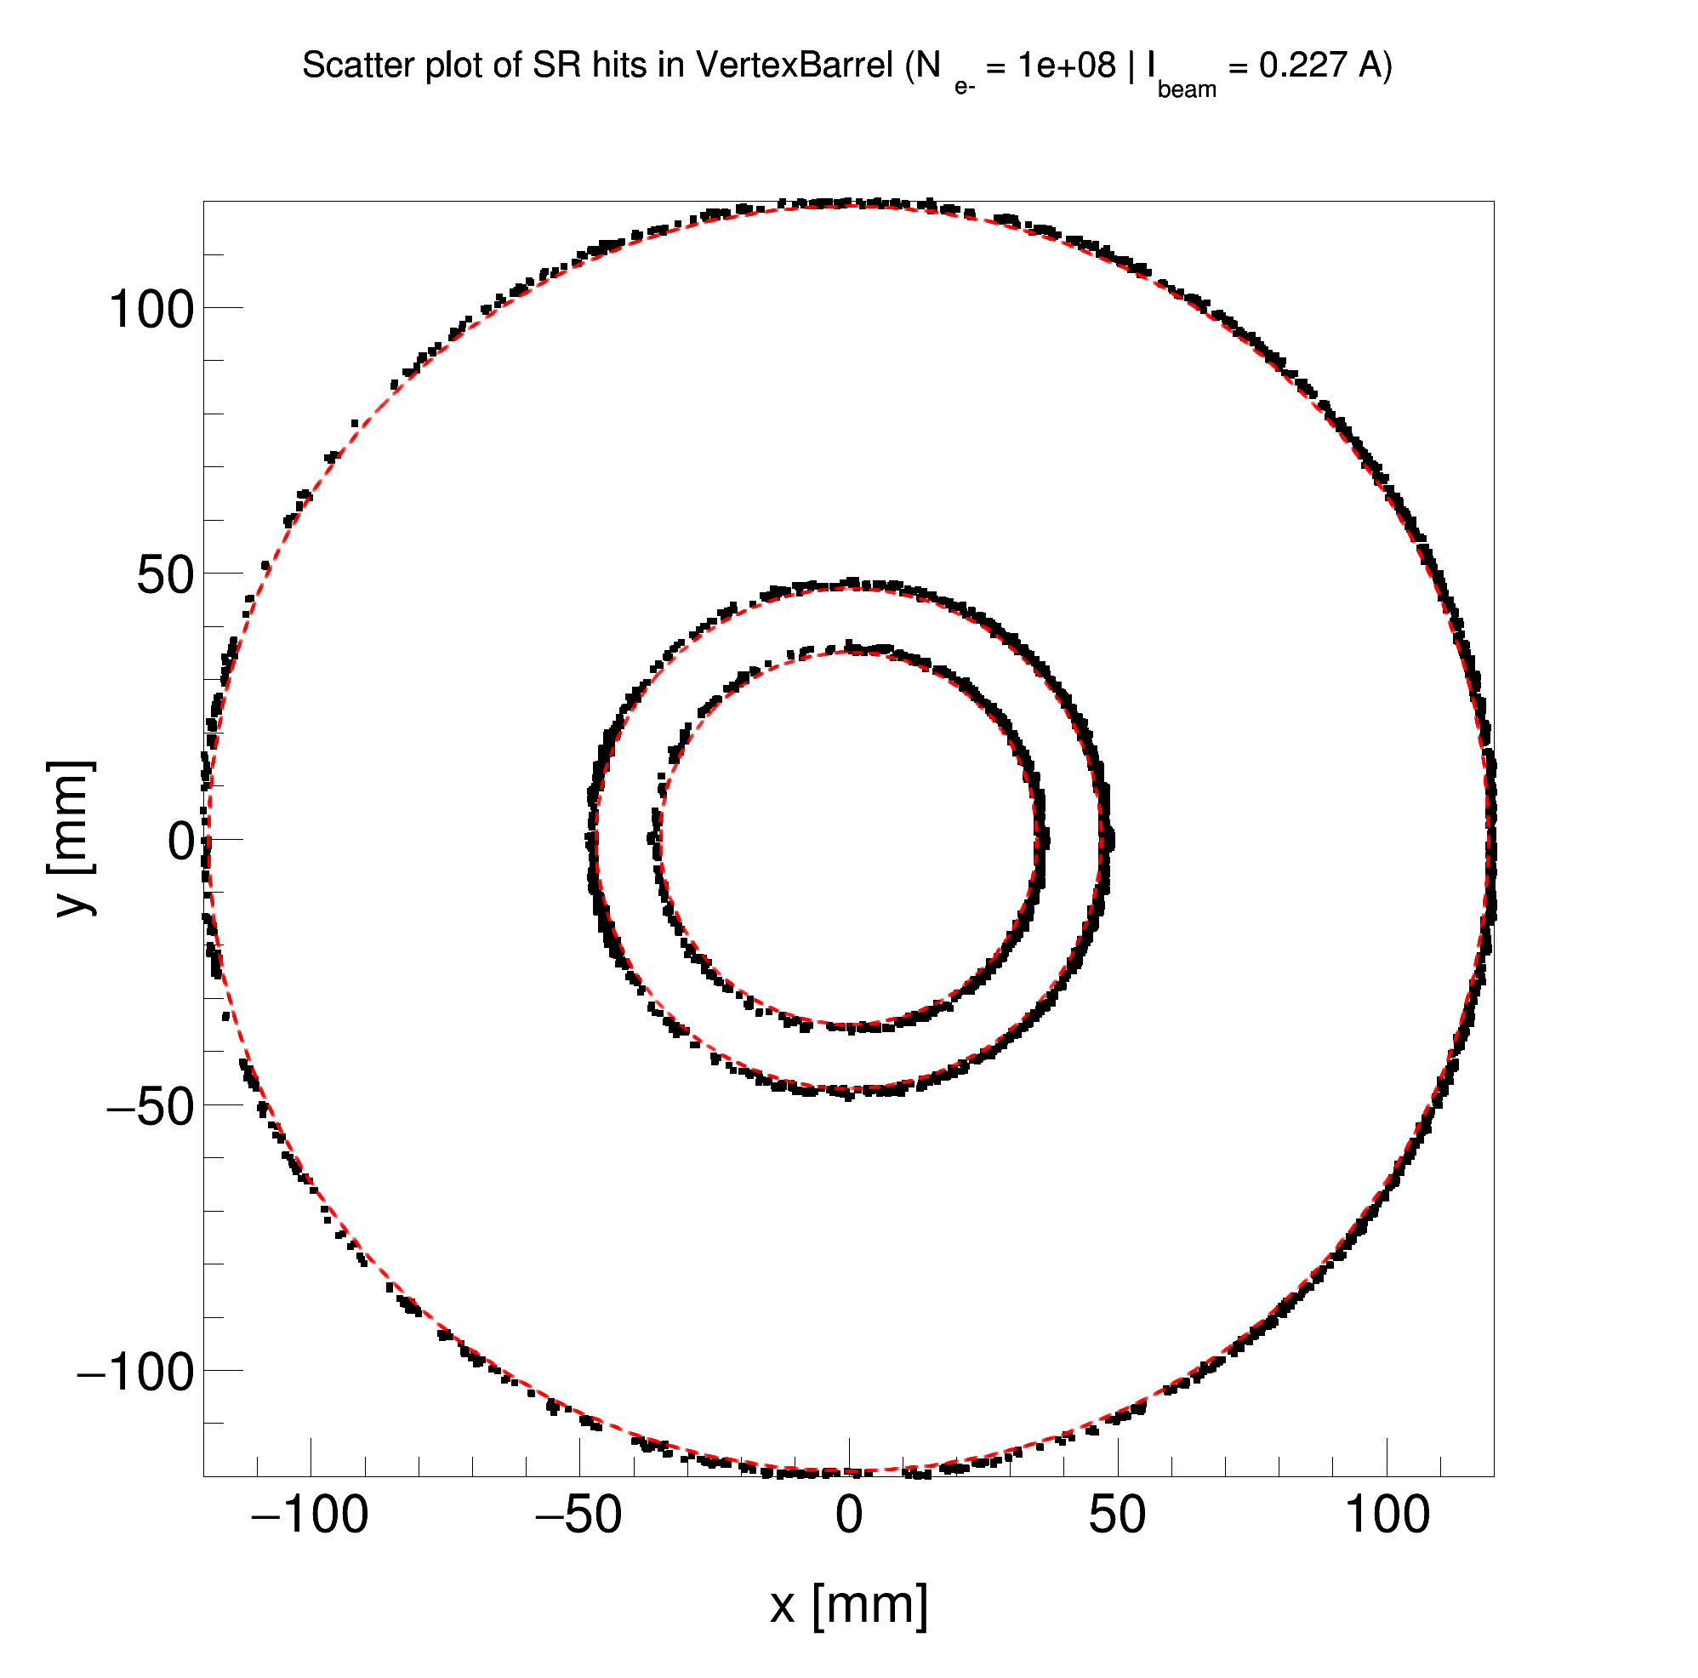
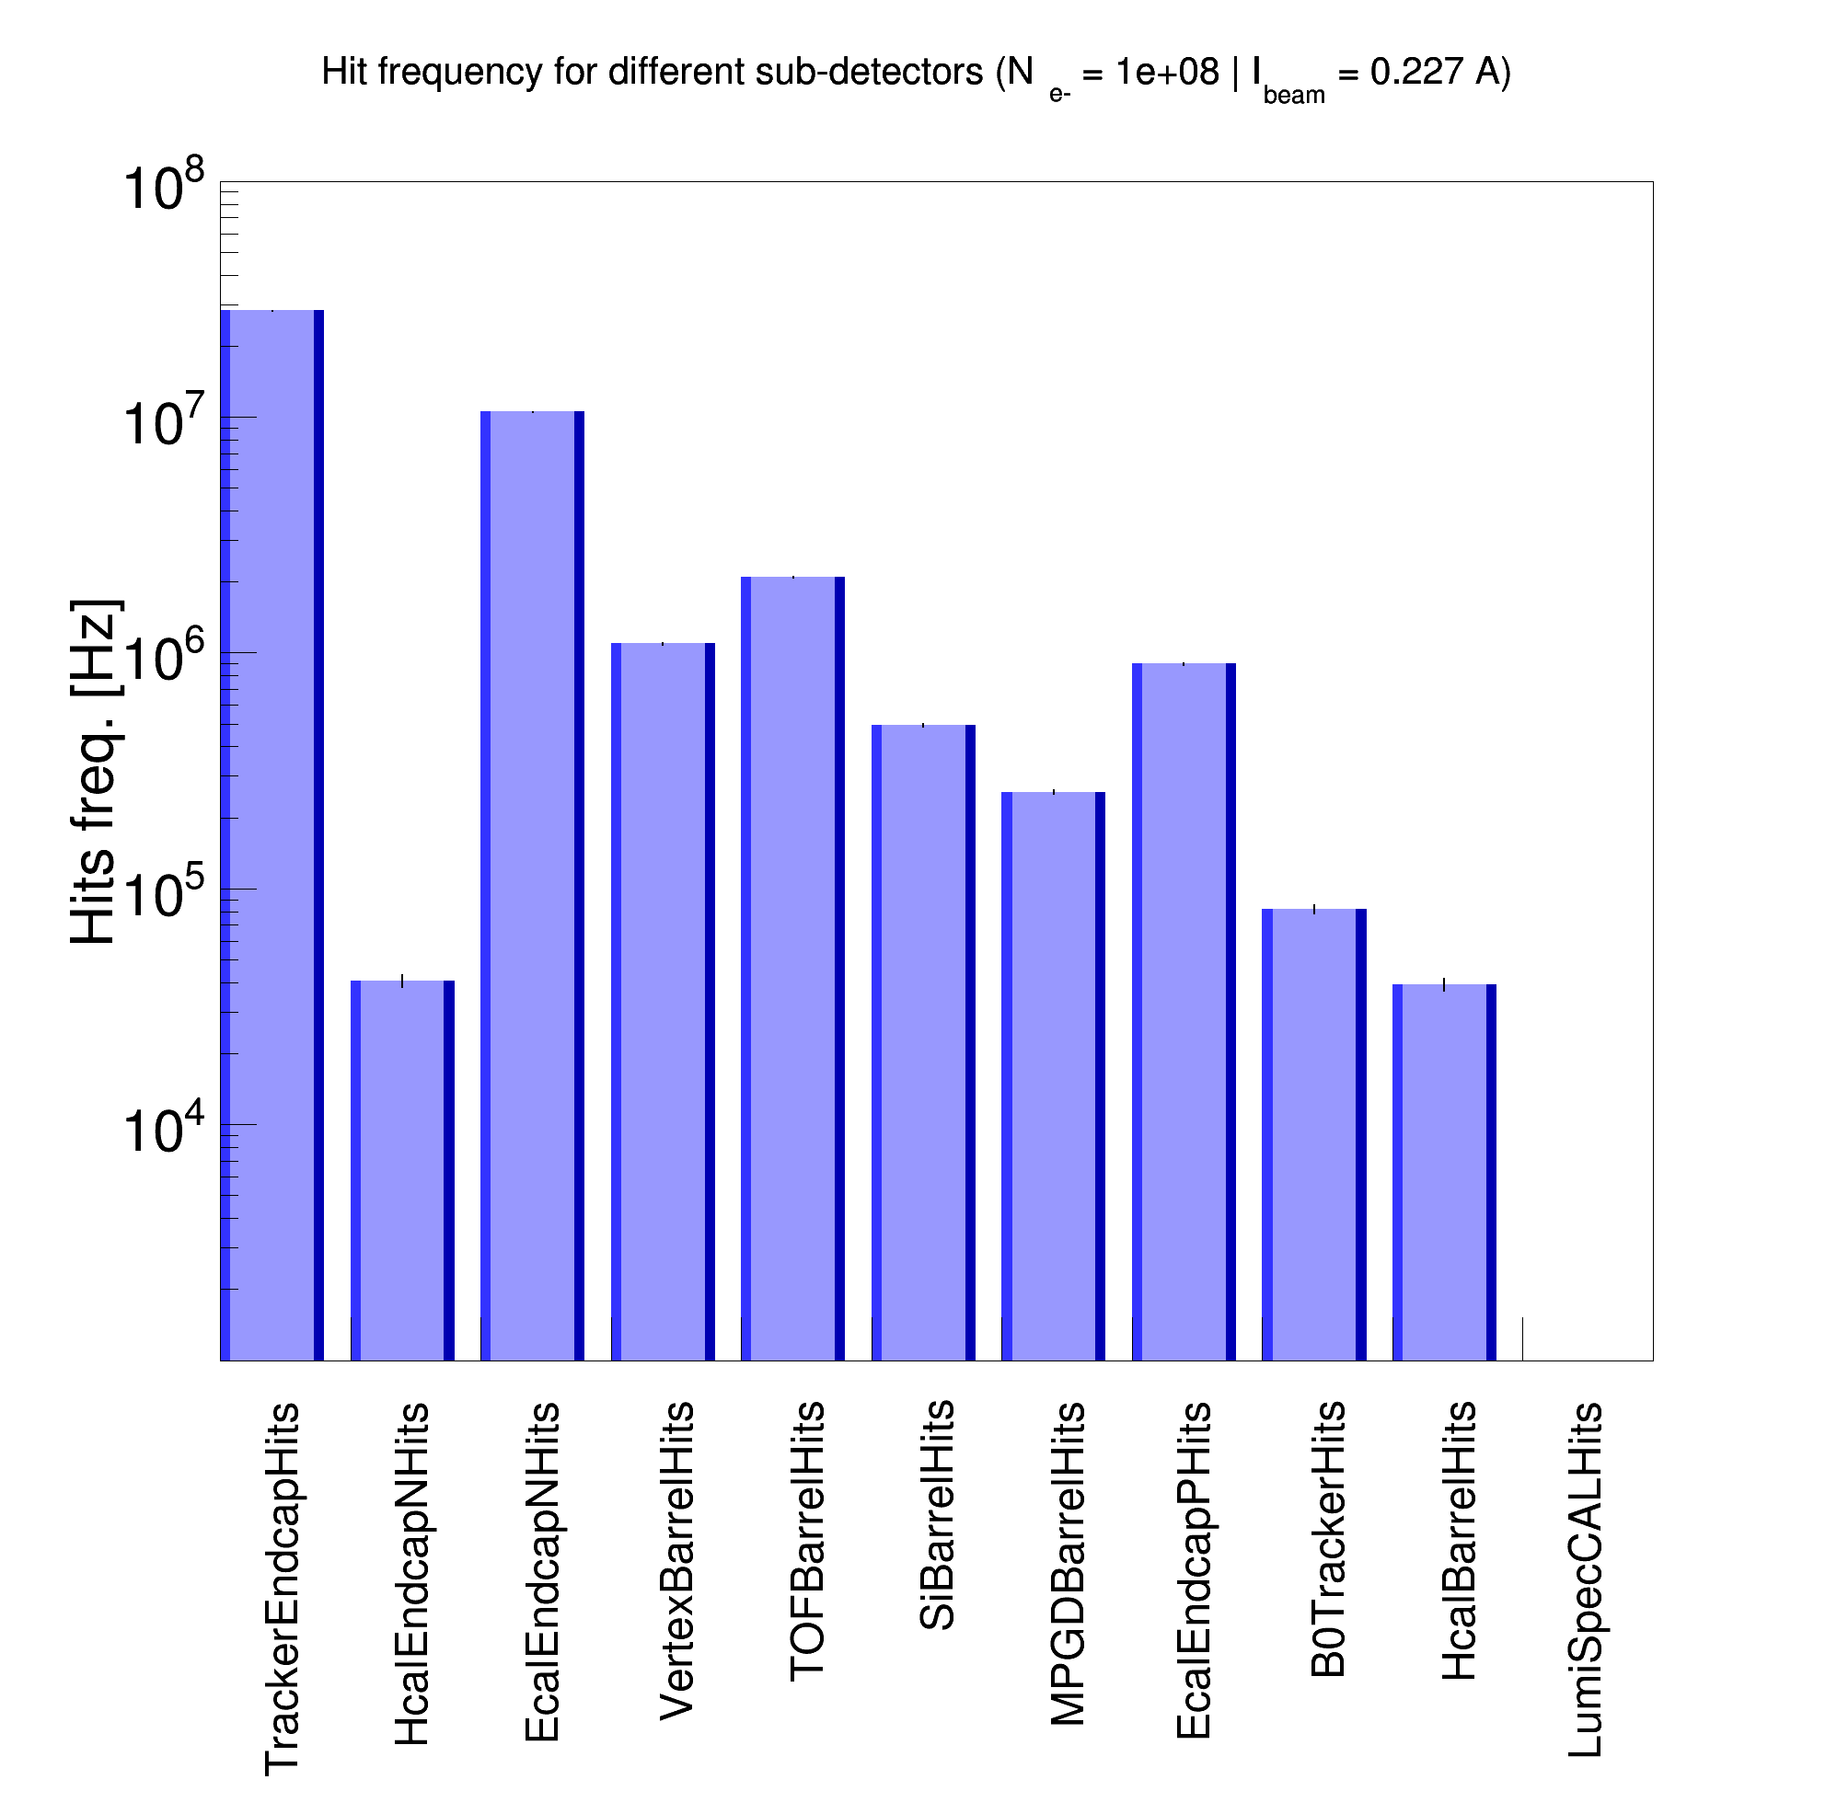
SR background in ePIC: Geant4 SR photon generator
|Z| < 10 m
E_{𝛄} > 4 eV
All SR photons within ±10 m from the IP
Beam pipe geometry issue is still here
PRELIMINARY
Andrii Natochii | Dec 2023

Slide 31
Beam tails
(Optional, if time allows)
Andrii Natochii | Dec 2023

Slide 32
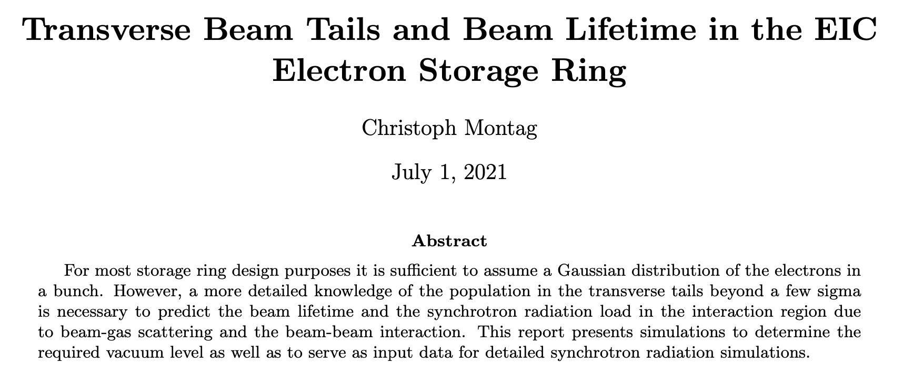
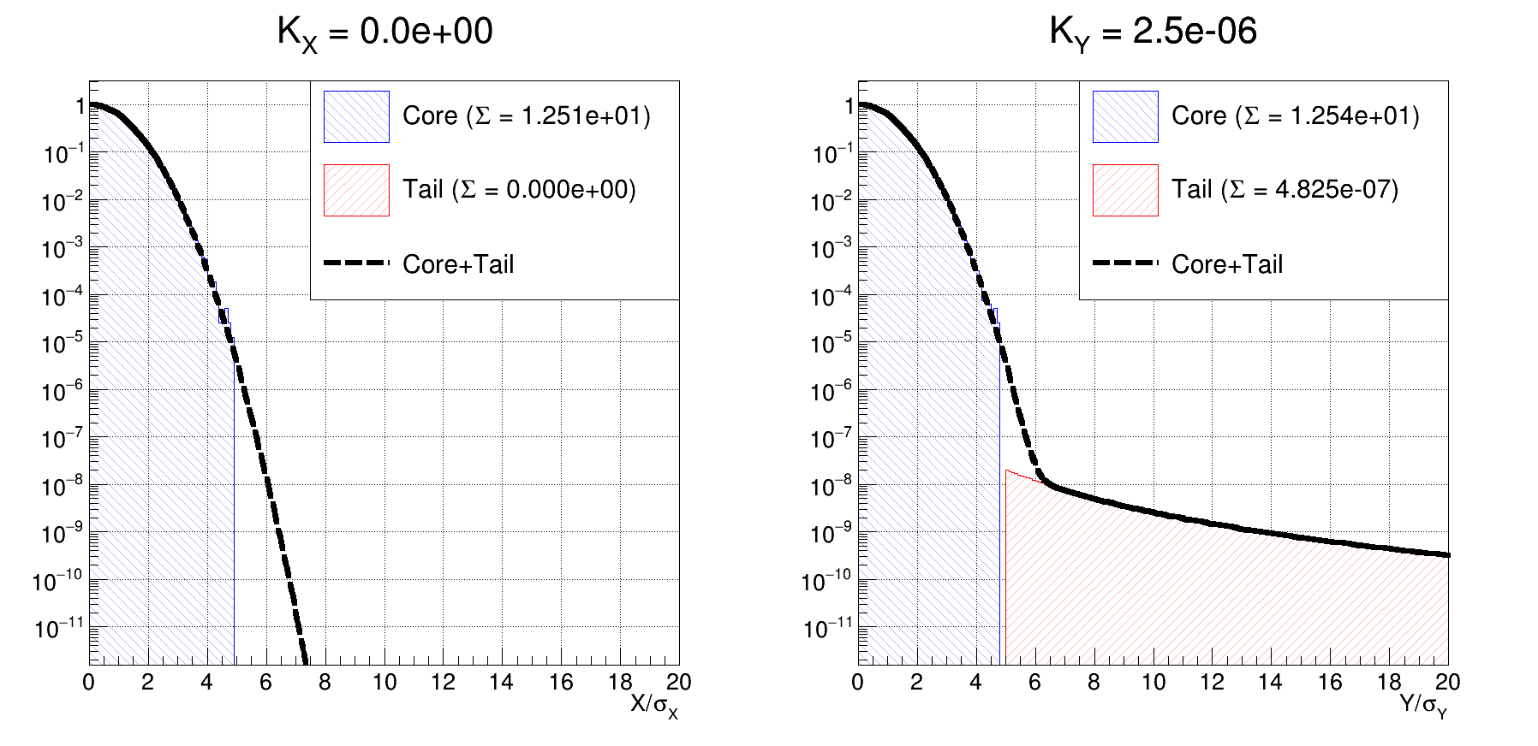
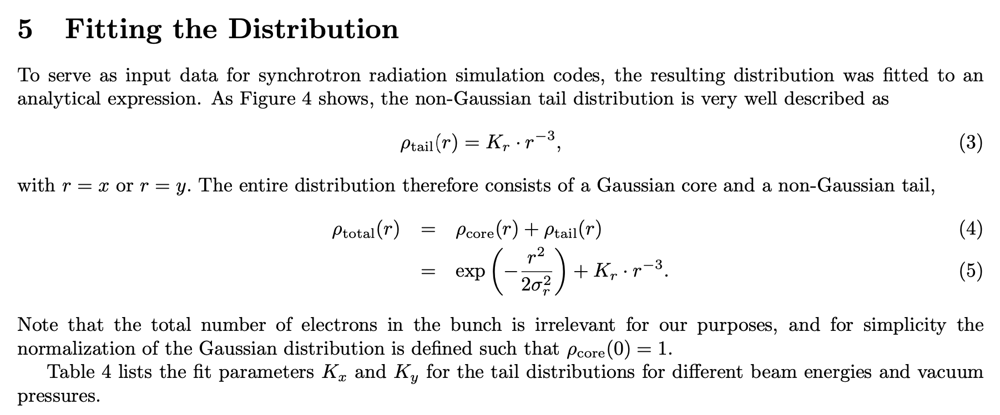
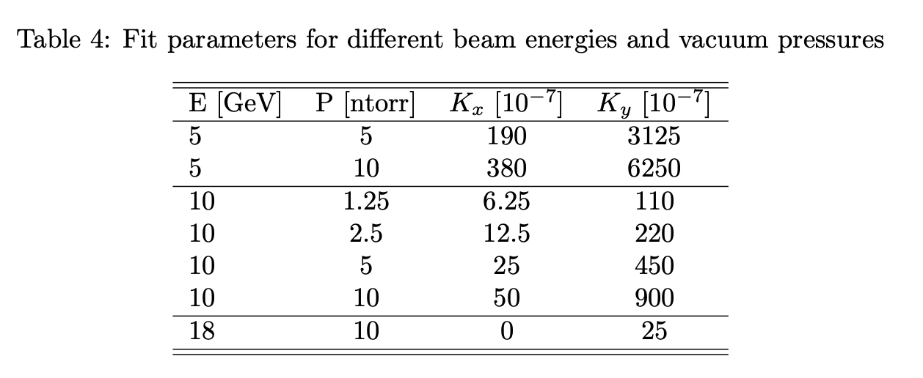
Beam tail model
18 GeV electron beam | P = 10 nTorr
Andrii Natochii | Dec 2023

Slide 33
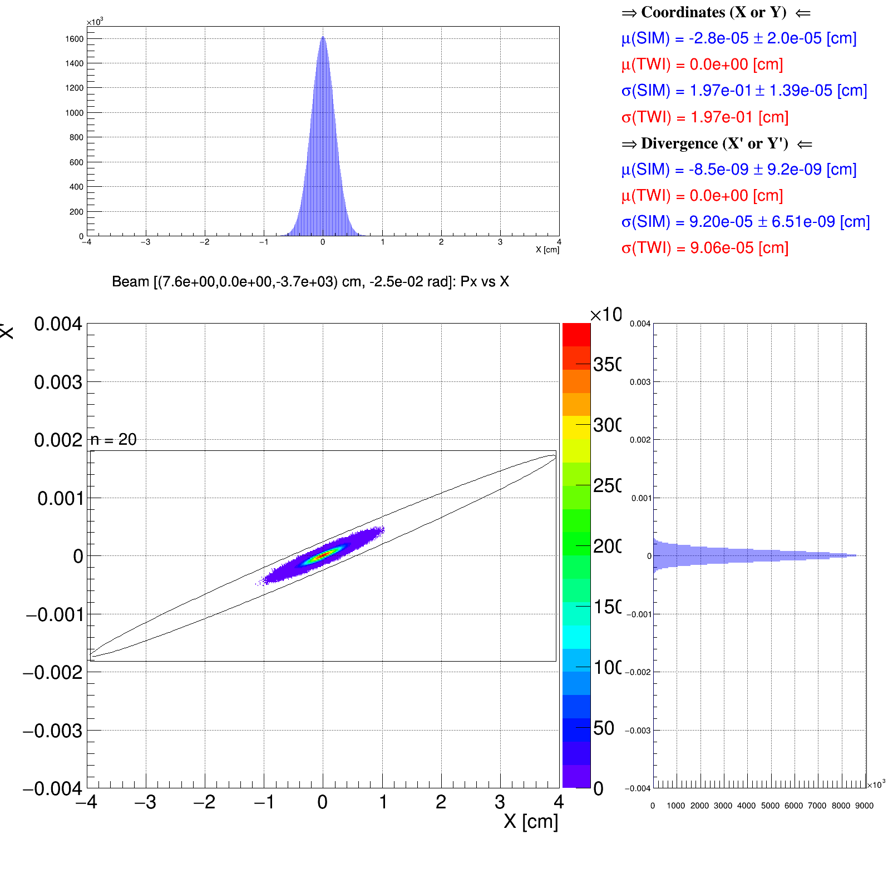
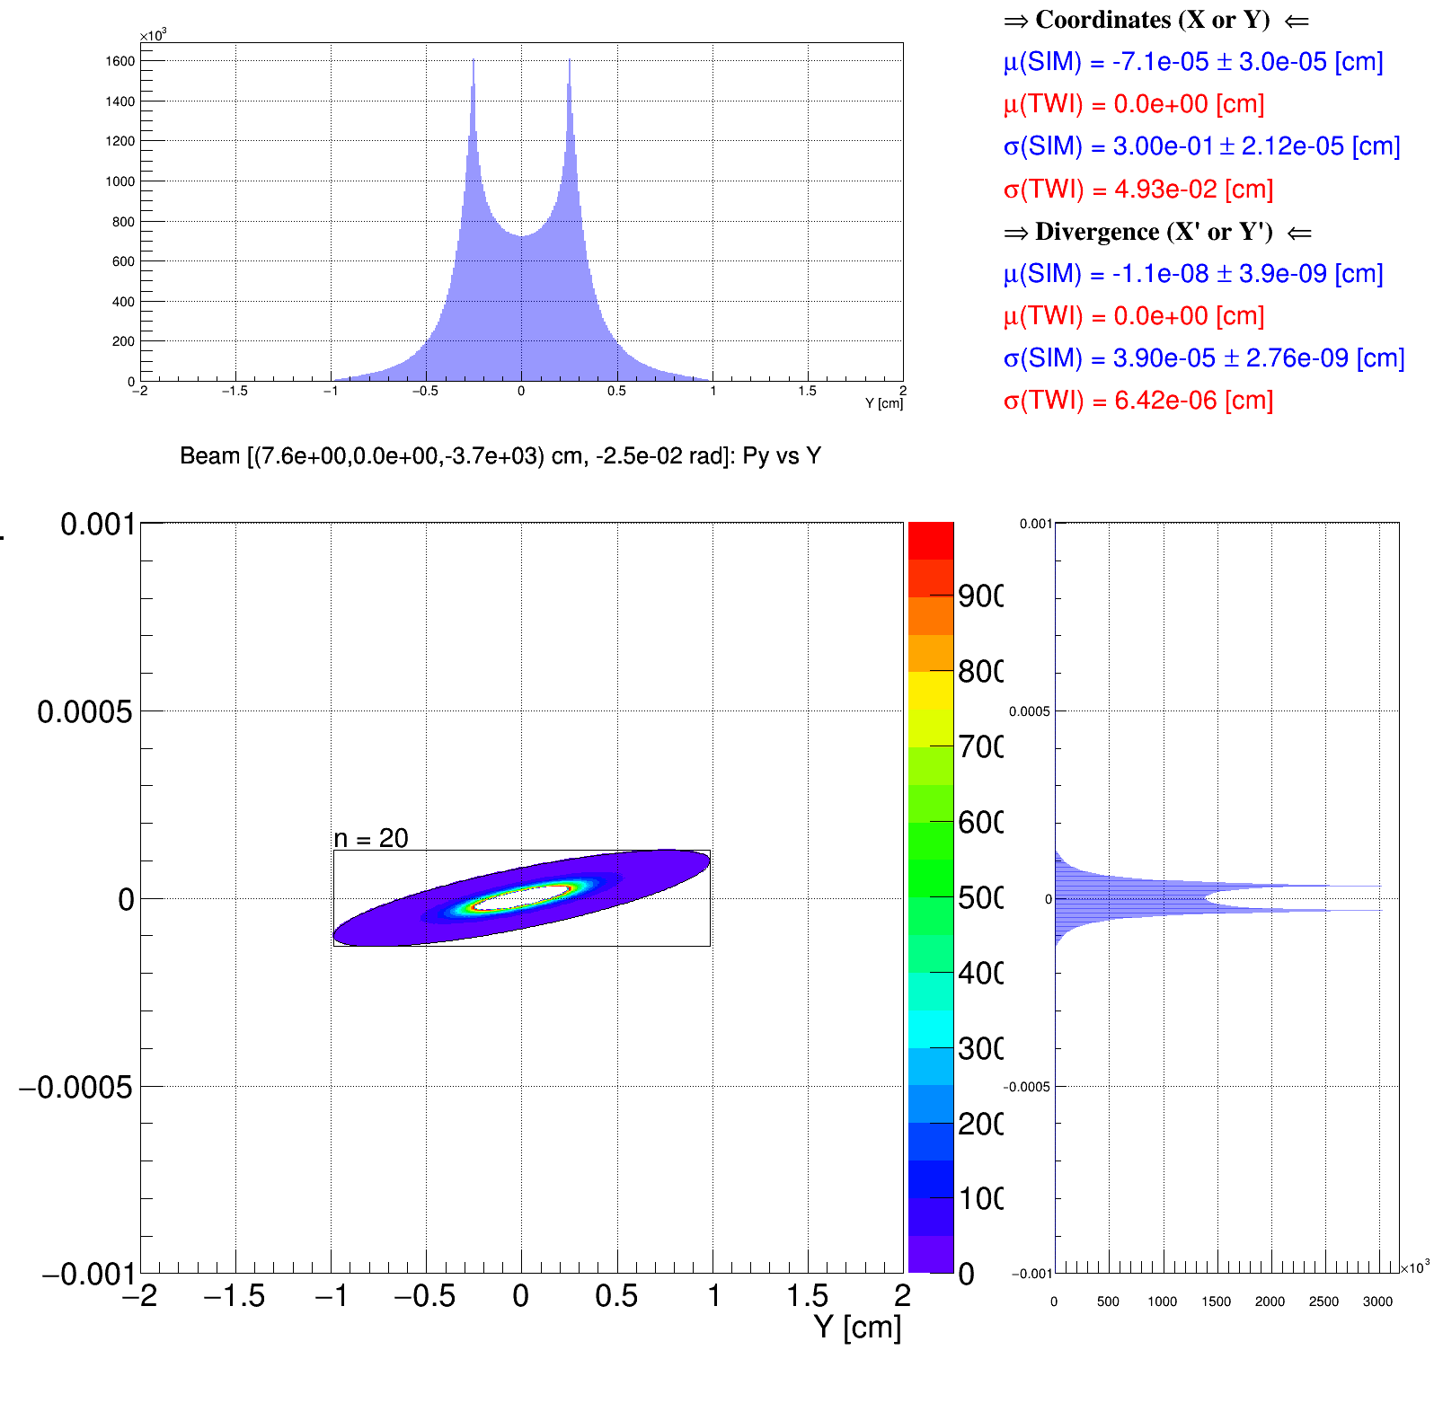
Beam tails: Initial beam distribution
Tails: 5 – 20σ
D2EF1
D2EF2
D1EF
Q1EF
Q0EF
Geant4
Geant4
Horizontal phase space
Vertical phase space
Andrii Natochii | Dec 2023

Slide 34
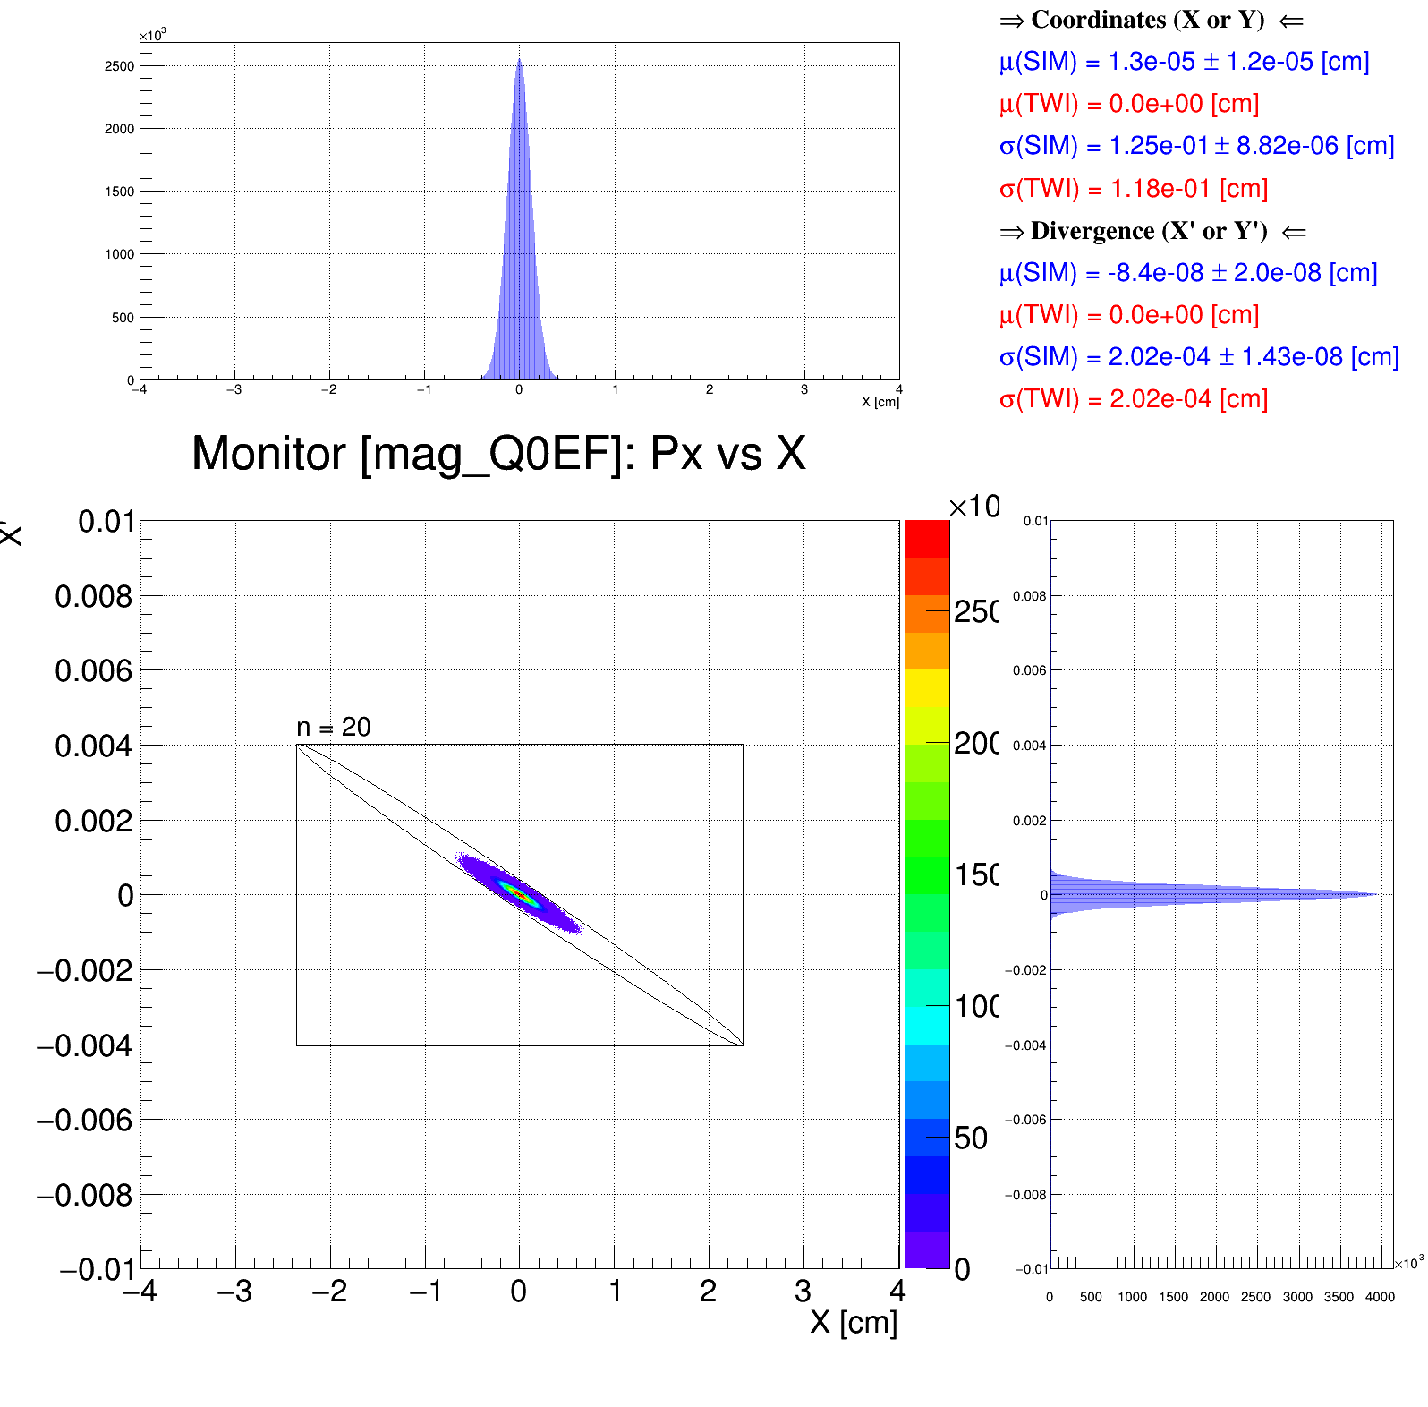
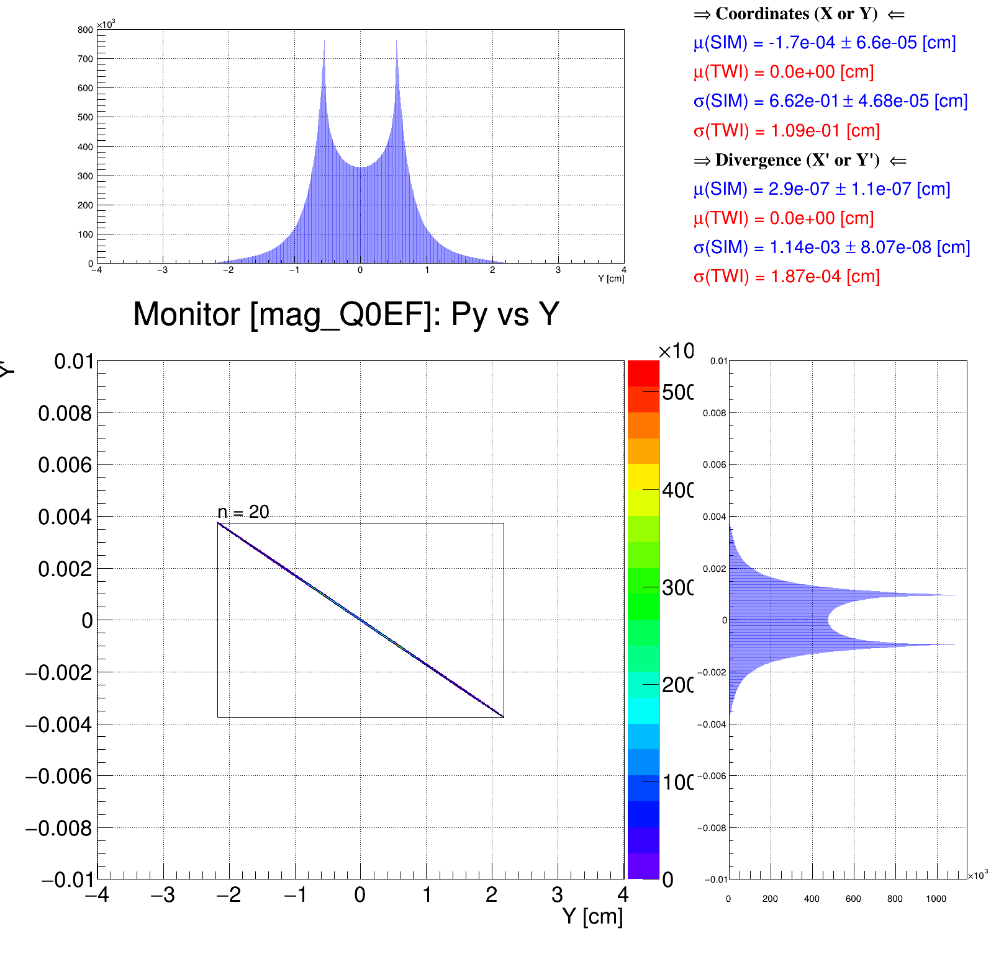
Beam tails: Beam distribution after Q0EF
Tails: 5 – 20σ
D2EF1
D2EF2
D1EF
Q1EF
Q0EF
Geant4
Geant4
Horizontal phase space
Vertical phase space
Andrii Natochii | Dec 2023

Slide 35
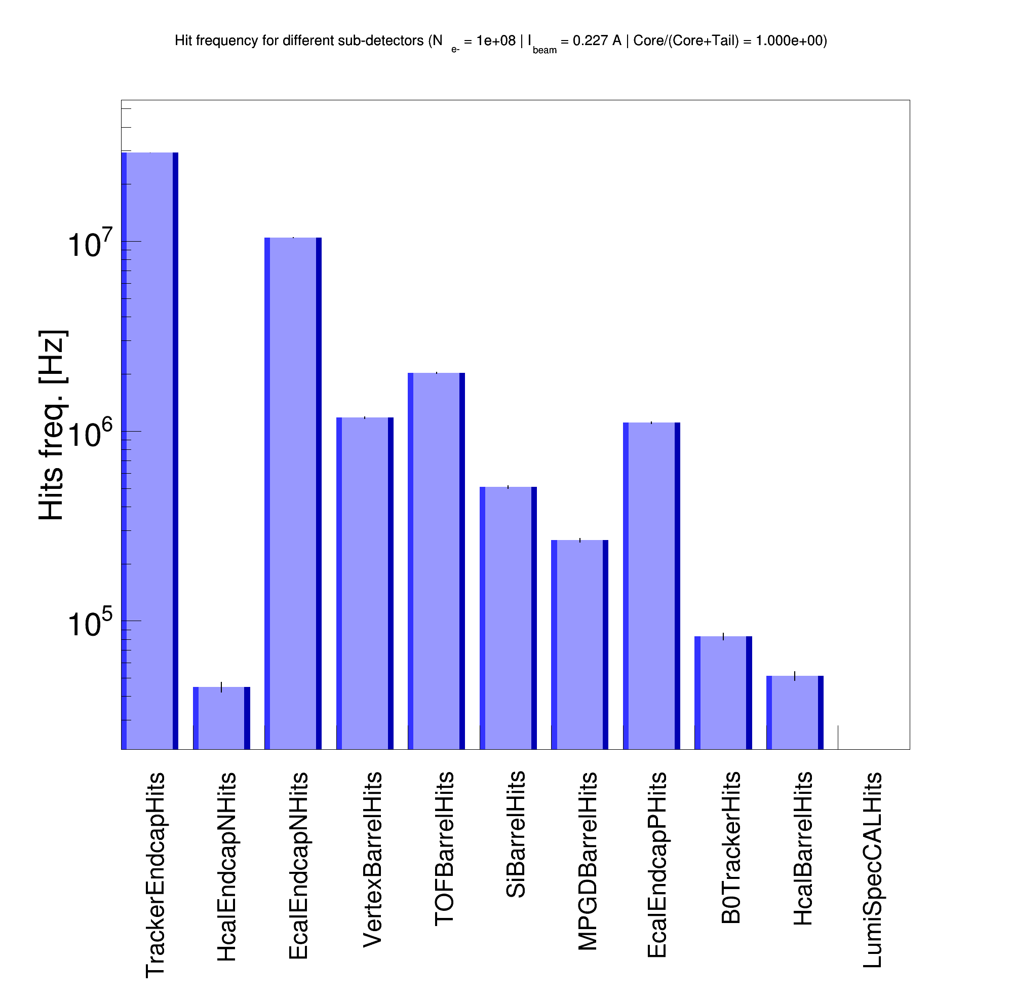
SR background in ePIC: Geant4 SR photon generator
|Z| < 10 m
E_{𝛄} > 4 eV
Beam pipe geometry issue is still here
Beam core
Beam tails
PRELIMINARY
PRELIMINARY
Andrii Natochii | Dec 2023

Slide 36
Summary
We revisited a new method to simulate the SR background in the ePIC detector.
It is based on a custom SR photon reflection process embedded in Geant4.
So now, all simulations (i.e., SR photon generation, tracking, and interaction with the beam pipe and detector) can be performed in the same software environment – Geant4.
The new code was tested and benchmarked (the most time-consuming part).
There is a fairly good agreement with Synrad+ calculation, especially for E_{𝛄} > 5 keV.
However, a significant inconsistency with the eic-shell beam pipe modeling was observed.
In addition, the first step toward the beam tail simulation was discussed.
The results suggest that the new Geant4-based tool is reliable for the SR background simulation in ePIC at the EIC.
However, further refinements are still needed.
Andrii Natochii | Dec 2023

Slide 37
Next steps and missing ingredients
Simulation improvements
The IR beam pipe modeling in eic-shell must be improved to fit the SR hits distribution that follows the actual vacuum beam pipe structure. [Who can be contacted for details?]
Beam tails should be clarified. [Who can be contacted for details?]
Implement the detector solenoid magnetic field. [Who can be contacted for details?]
SR background mitigation
Study a possible BG mitigation through the SR masking inside the vacuum.
Find the optimal energy cut for SR photon tracking to accurately study SR hit rates in ePIC and speed up the simulation for higher statistics.
Andrii Natochii | Dec 2023

Slide 38
Backup
Andrii Natochii | Dec 2023

Slide 39
Received on September 24th, 2023
Andrii Natochii | Dec 2023

Slide 40
SR data production and analysis scheme
Vacuum calculation
output: pressure profile data
Calculate the gas pressure profile using molflow+
SR photon production
output: .csv file with photons
Event generation
output: .hepmc file with events
Detector simulation
output: .root file with hits
Reconstruction and analysis
output: .root file with ntuples
Produce “technical” single photons (vertexes, momentums, and rate) using synrad+
Read synrad+ output files and prepare events that contain SR photons within the integrated time window (e.g., 100 ns) using photons’ weights (rates)
Run ddsim (actually npsim) using the input .hepmc file with generated SR photon events and the default ePIC detector geometry
Create a dedicated eicrecon plugin to store ntuples and histograms with the detector hit information
Plot the final figures
Let’s focus on this step
Andrii Natochii | Dec 2023

Slide 41
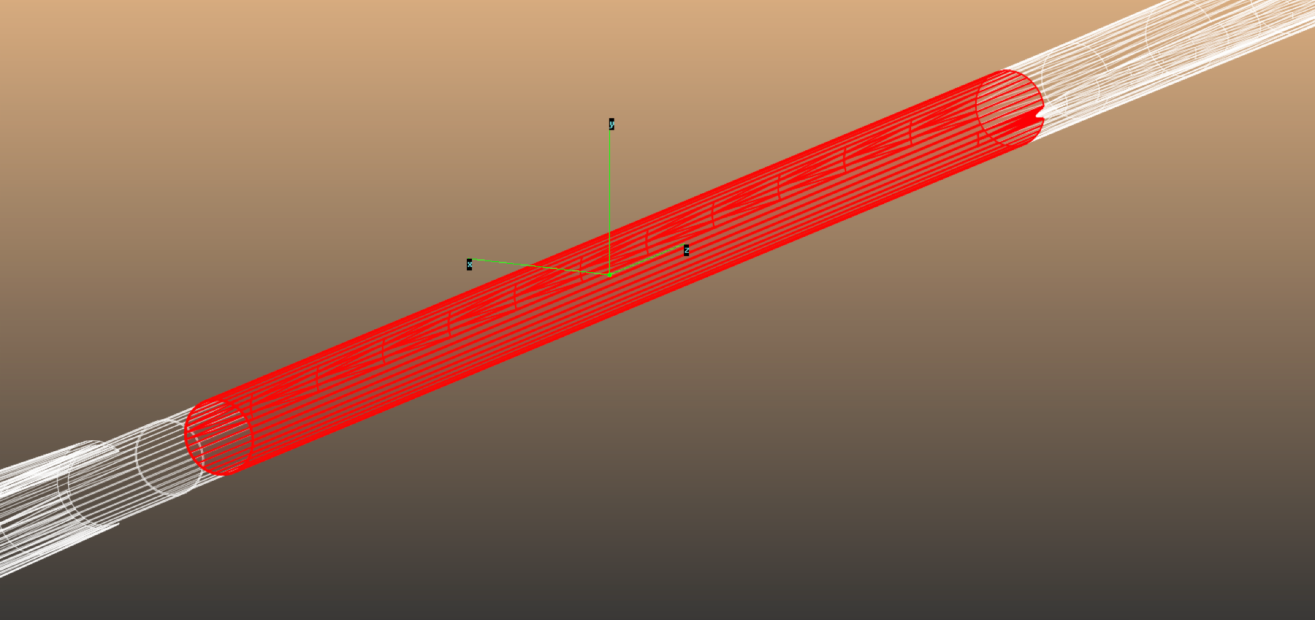
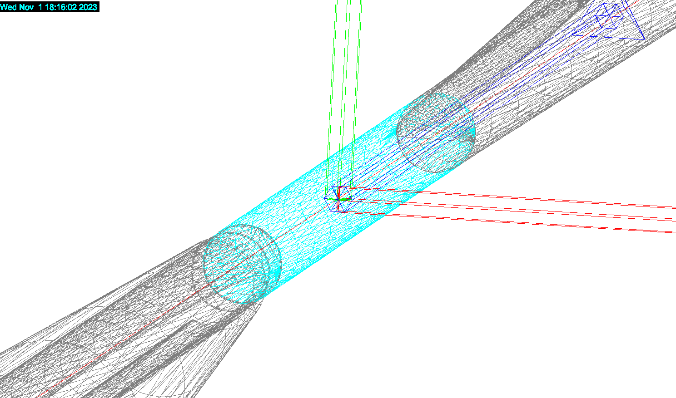
68.69231 cm
Beam pipe materials
Synrad+
Copper
Gold
–67 cm
Geant4
Copper
Copper
Gold
Copper
Andrii Natochii | Dec 2023

Slide 42
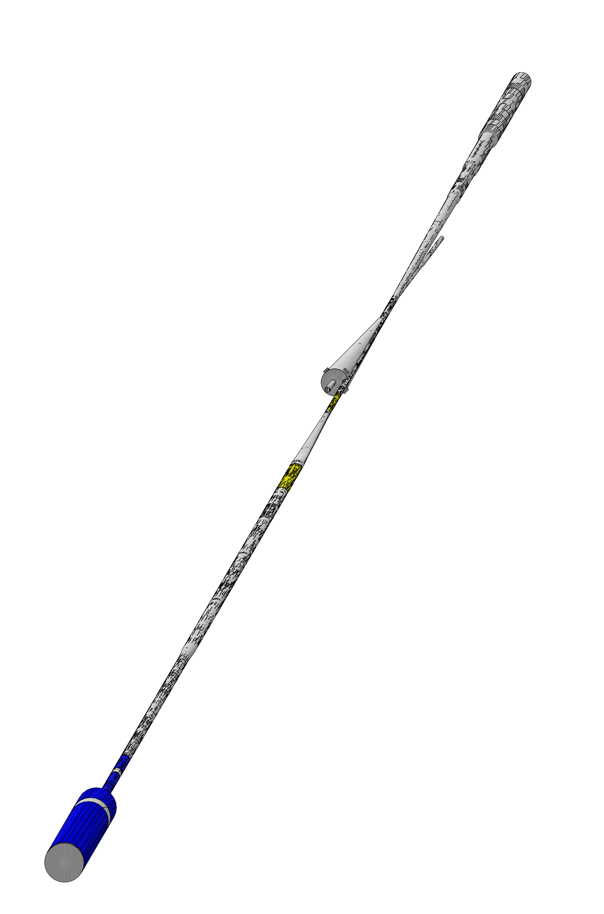
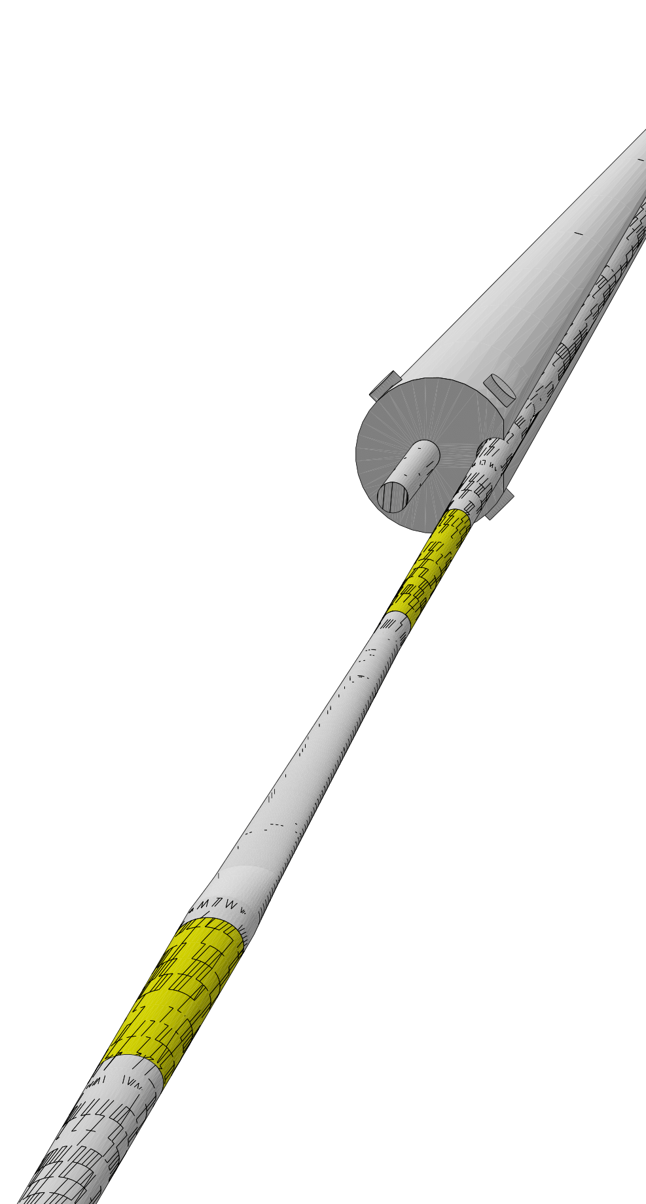
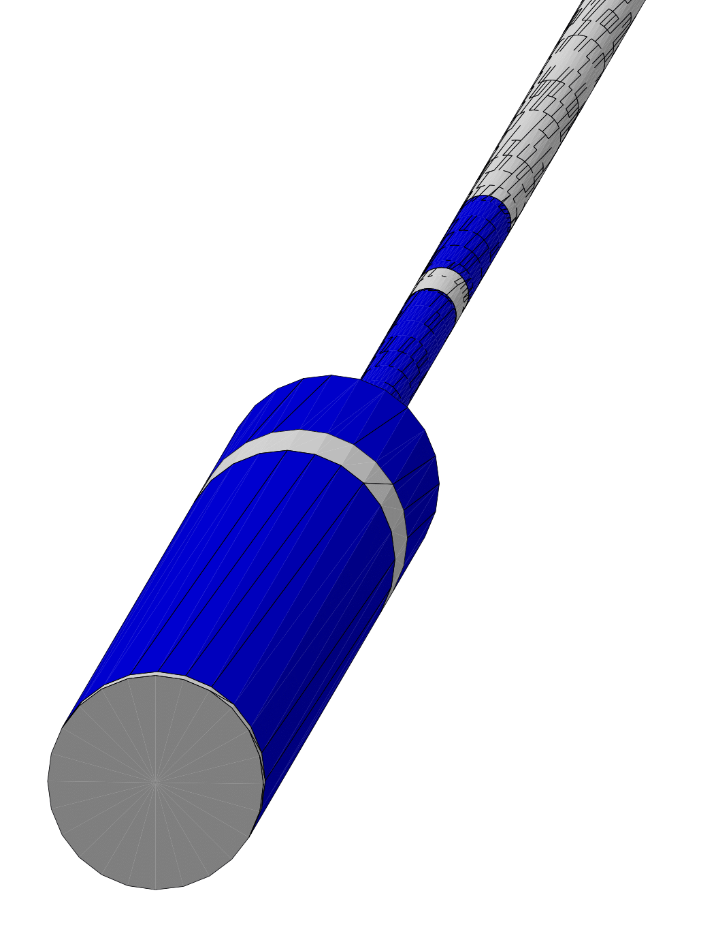
Closer look at magnets
Geant4
Andrii Natochii | Dec 2023

Slide 43
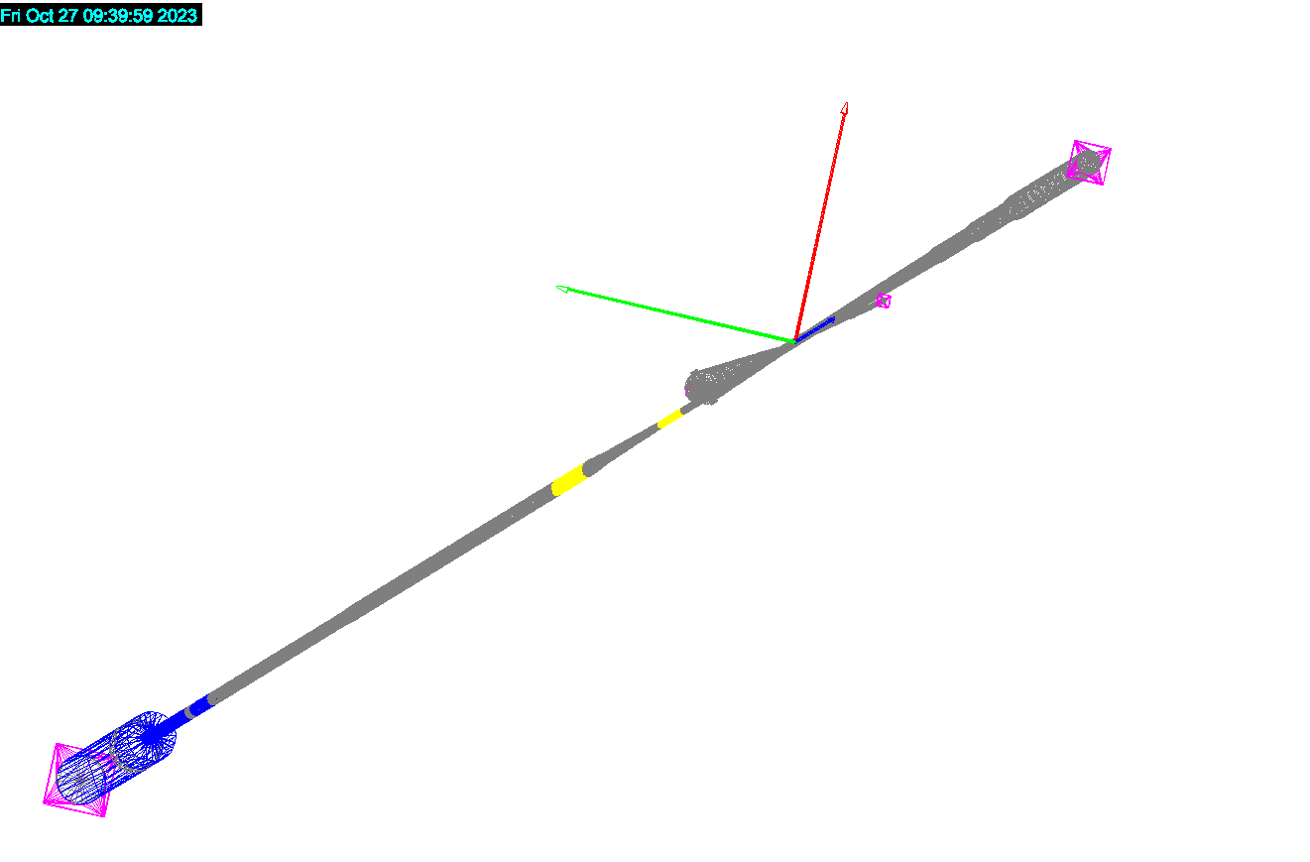
Stop photons at the end of the pipe
The geometry is visualized in the left-hand coordinate system
Y
Stop photons that escape the vacuum through the beam pipe ends
Do not add them to the output data (optional)
X
Photon absorbers
Z
Geant4
Beam pipe ends
Andrii Natochii | Dec 2023

Slide 44
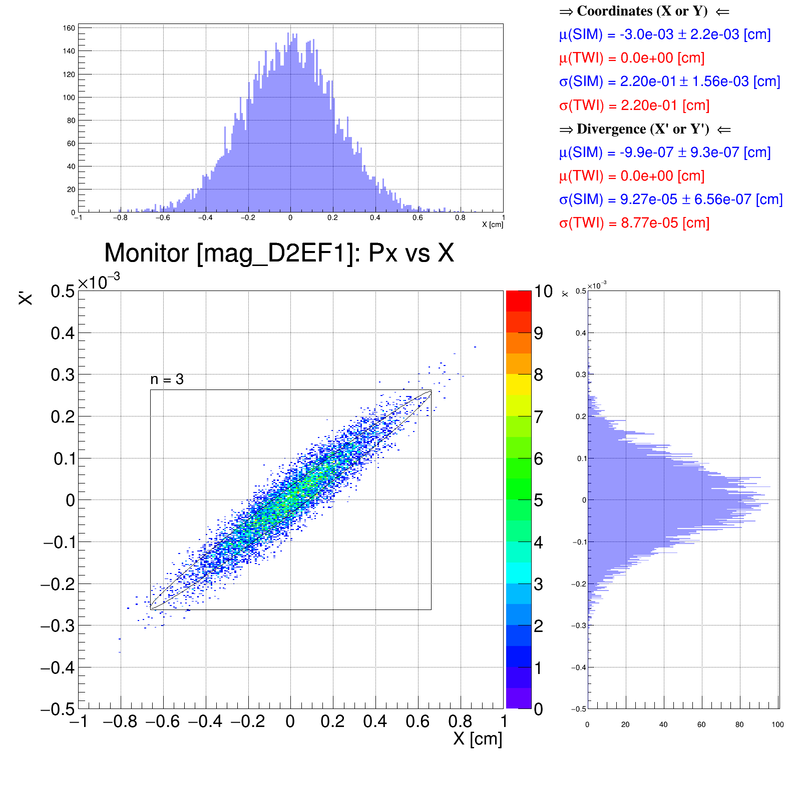
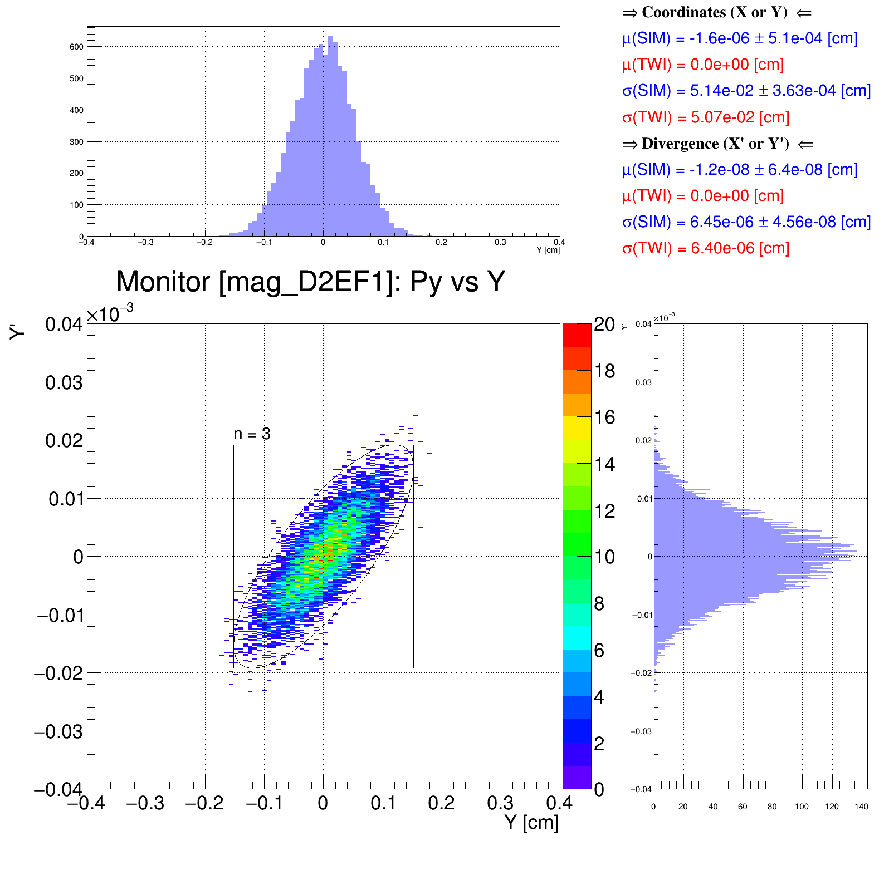
Benchmark: Beam distribution after D2EF1
D2EF1
Good agreement between tracked beam distribution in Geant4 and Courant–Snyder (a.k.a. Twiss) parameters
D2EF2
D1EF
Q1EF
Q0EF
Geant4
Geant4
Horizontal phase space
Vertical phase space
Andrii Natochii | Dec 2023

Slide 45
Benchmark: Beam distribution after D2EF2
D2EF1
Good agreement between tracked beam distribution in Geant4 and Courant–Snyder (a.k.a. Twiss) parameters
D2EF2
D1EF
Q1EF
Q0EF
Geant4
Geant4
Horizontal phase space
Vertical phase space
Andrii Natochii | Dec 2023

Slide 46
Benchmark: Beam distribution after D1EF
D2EF1
Good agreement between tracked beam distribution in Geant4 and Courant–Snyder (a.k.a. Twiss) parameters
D2EF2
D1EF
Q1EF
Q0EF
Geant4
Geant4
Horizontal phase space
Vertical phase space
Andrii Natochii | Dec 2023

Slide 47
Benchmark: Q1EF quadrupole field
D2EF1
D2EF2
D1EF
Q1EF
Q0EF
Set a quadrupole magnetic field using G4QuadrupoleMagField
TWISS K1L > 0 → Geant4 K1L < 0
Geant4
Y
Q1EF
S
N
F_{L}
Z
F_{L}
F_{L}
X
F_{L}
g – quadrupole gradient
g[T/m] = 3.33564*K1[m^{–2}]*pc[GeV]
K1[m^{–2}] = K1L[m^{–1}]/L[m]
pc[GeV] = mc²[GeV](Ɣ²–1)
N
S
visualization is left-handed
Andrii Natochii | Dec 2023

Slide 48
Benchmark: Beam distribution after Q1EF
D2EF1
Good agreement between tracked beam distribution in Geant4 and Courant–Snyder (a.k.a. Twiss) parameters
D2EF2
D1EF
Q1EF
Q0EF
Geant4
Geant4
Horizontal phase space
Vertical phase space
Andrii Natochii | Dec 2023

Slide 49
Benchmark: Synchrotron radiation photons (2)
Average number of generated SR photons per electron in the given magnet, <N_{Ɣ}>
D2EF1
D2EF2
D1EF
Q1EF
Q0EF
Average power of radiated SR per electron in the given magnet, <P_{Ɣ}>
Andrii Natochii | Dec 2023

Slide 50
Benchmark: Absorbed SR photon position along Z-axis
There is a small disagreement, presumably linked to the energy spectrum disagreement
Incident to the beam pipe
Absorbed on the beam pipe
Reflected from the beam pipe
Andrii Natochii | Dec 2023

Slide 51
Beam tail model
10 GeV electron beam | P = 5 nTorr
Andrii Natochii | Dec 2023

Slide 52
Beam tails: Initial beam distribution
Tails: 5 – 20σ
D2EF1
D2EF2
D1EF
Q1EF
Q0EF
Andrii Natochii | Dec 2023

