Slide 1
Synchrotron Radiation (SR) background in ePIC at the EIC
Andrii Natochii
natochii@hawaii.edu

Slide 2
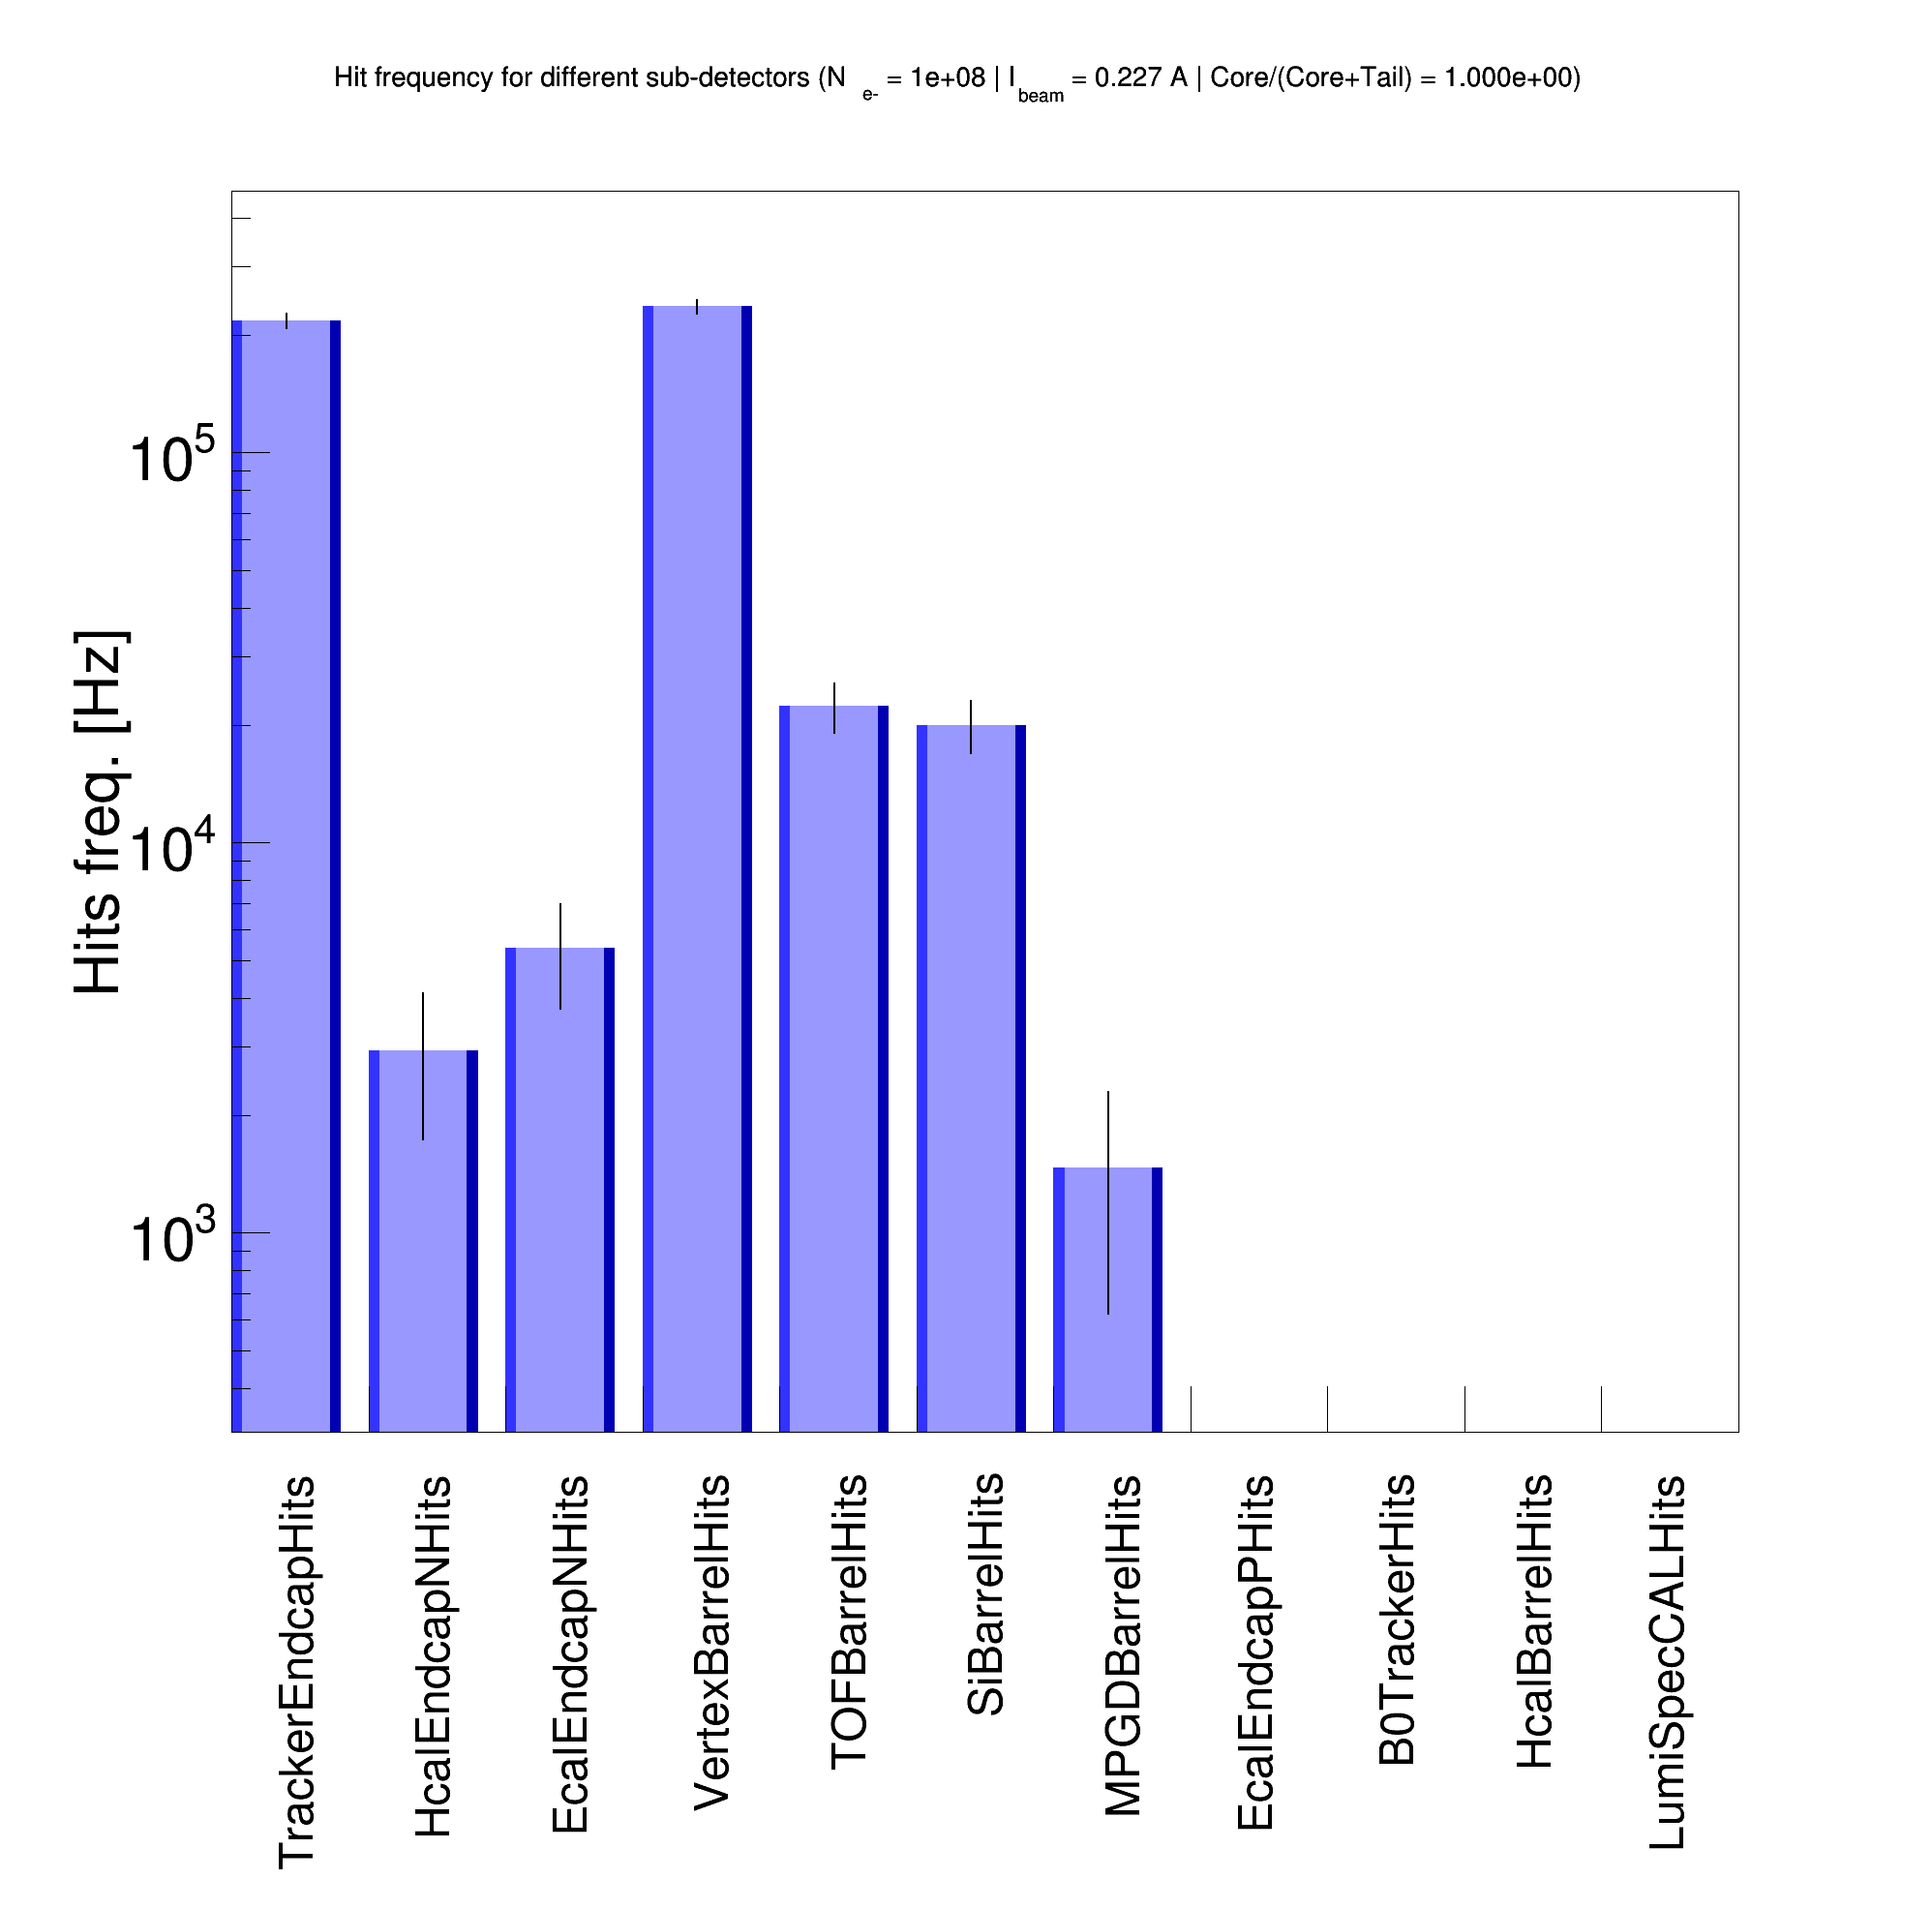
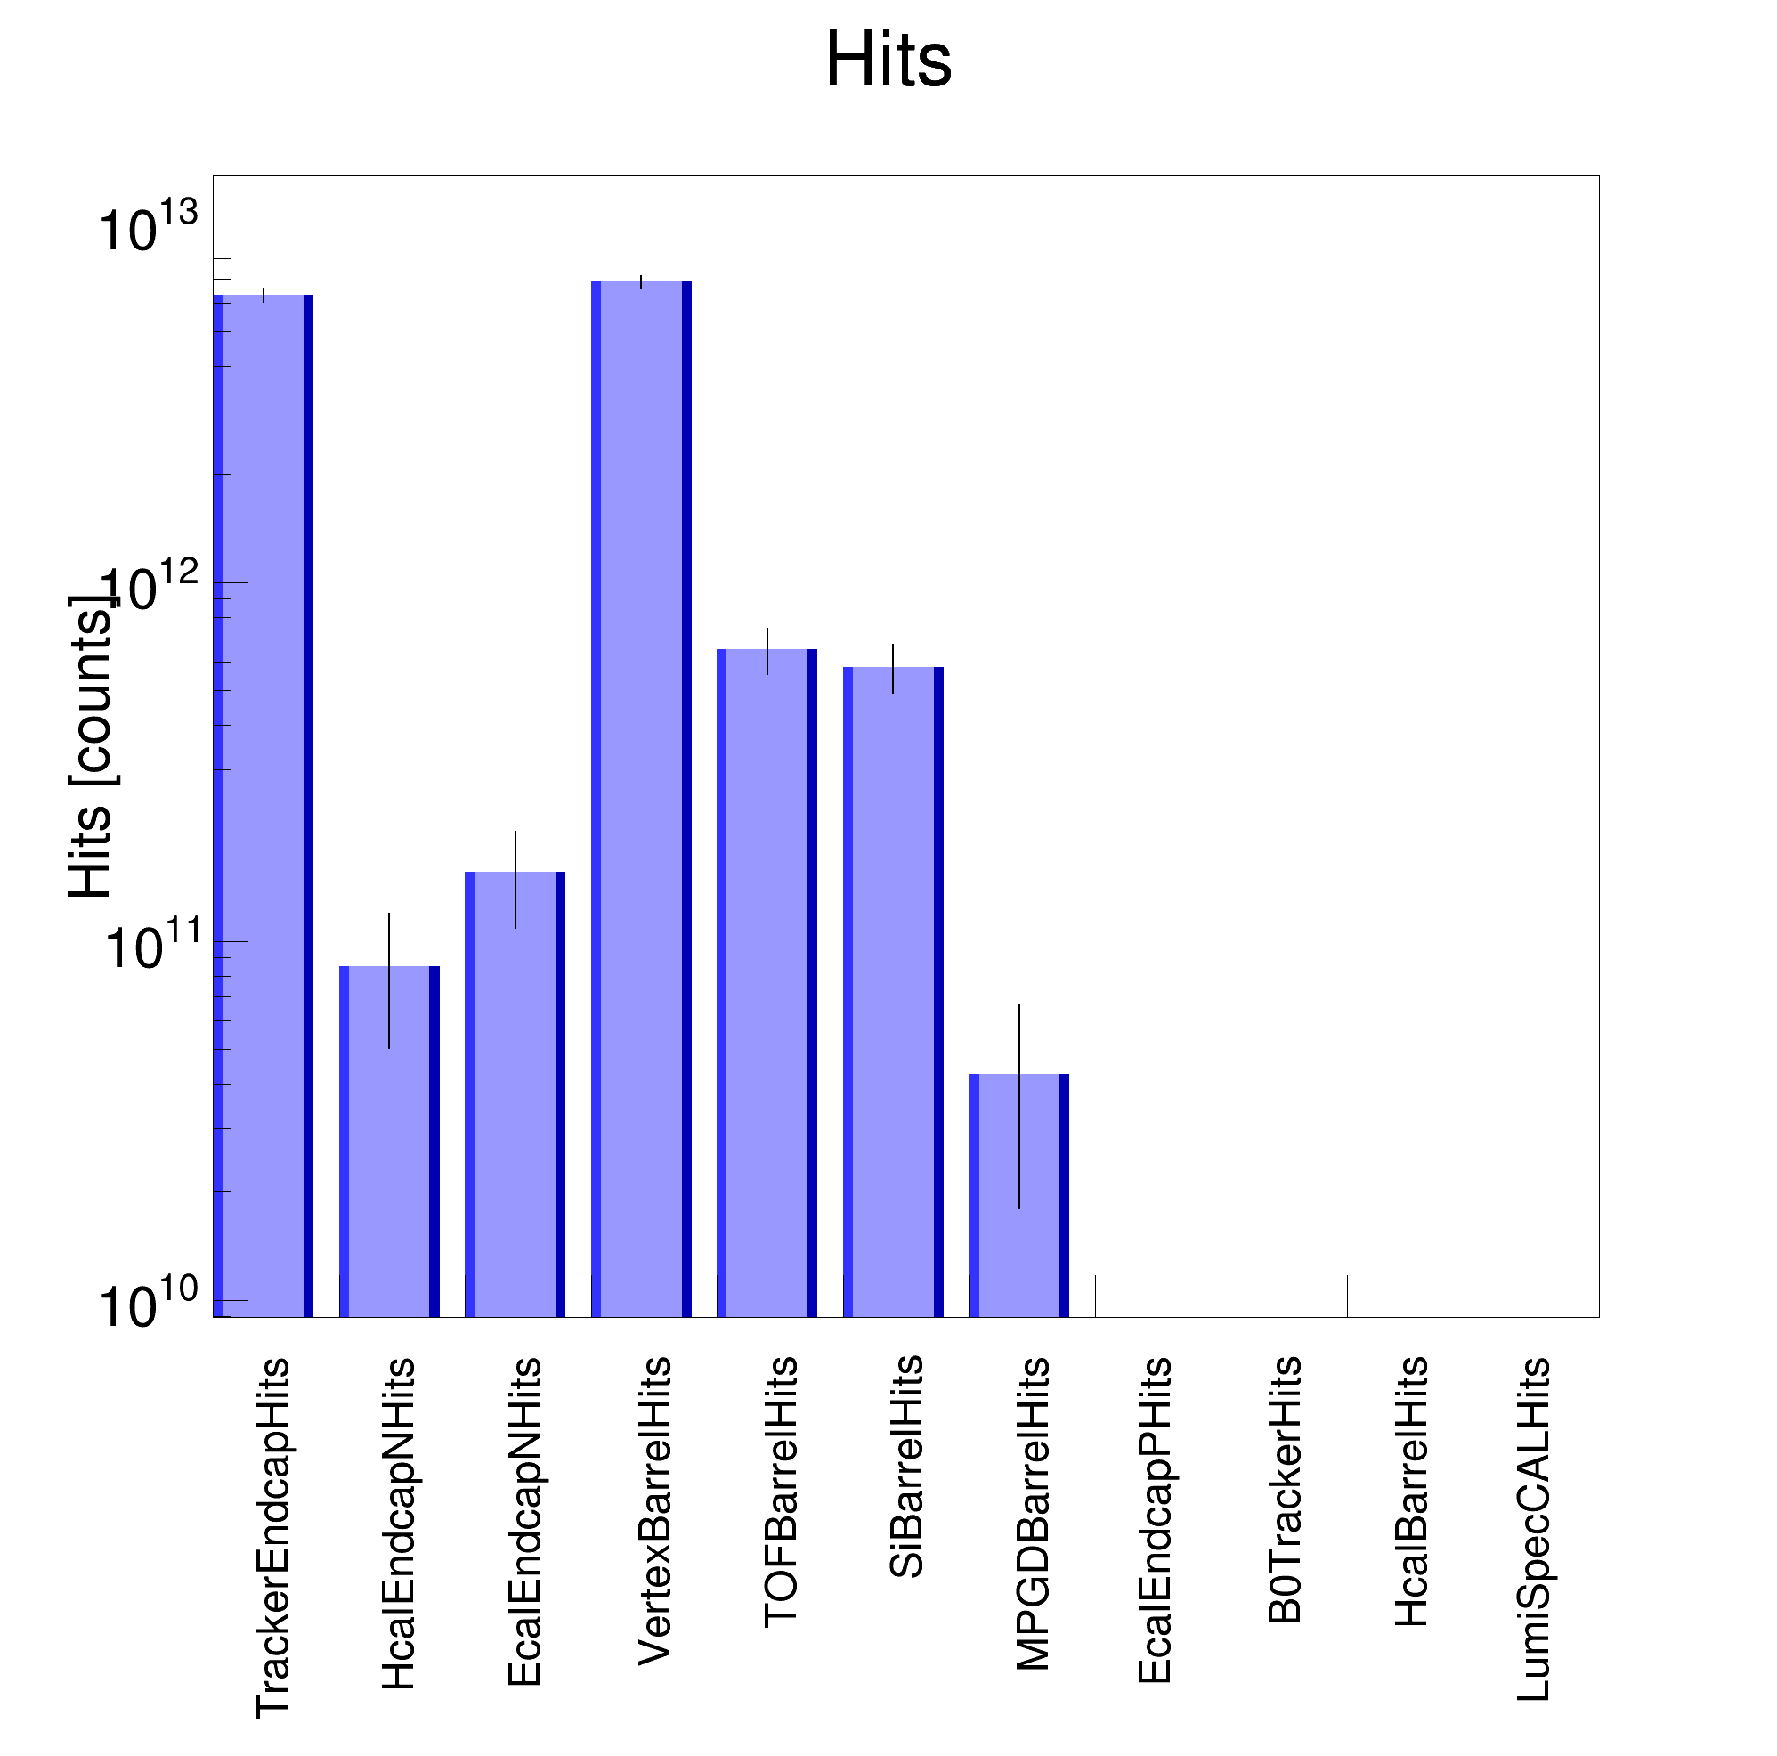
Detector SR background rate normalization update
Previously shown detector rates (~0.1 MHz) contained a bug in normalization.
The correct SR background rate is much higher by a factor of ~10⁶
Indicating there is direct SR hitting the detector beam pipe.
Electron beam lattice v6.2 (Jan. 2024)
SR photon generator: Custom-built Geant4 (same as the new Synrad+ model)
SimHit rate [Hz]
10¹³
SimHit rate [Hz]
10⁵
I = 0.227 A
-4m < z < 5m
E_{𝛄} > 30 eV
I = 0.227 A
-4m < z < 5m
E_{𝛄} > 30 eV

Slide 3
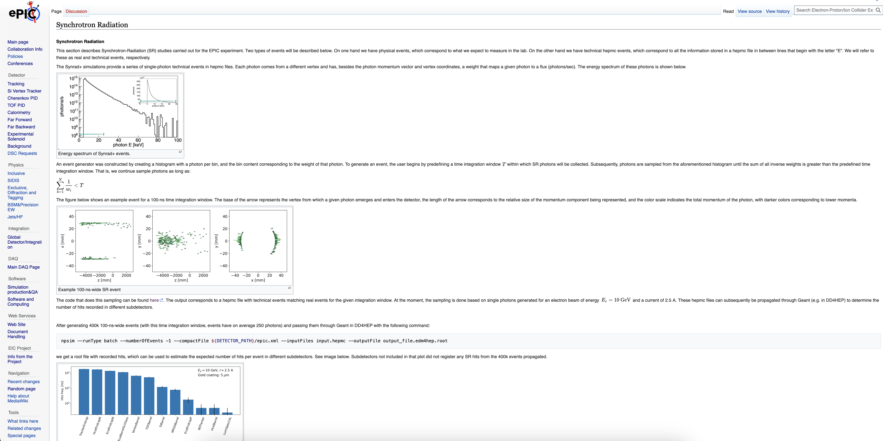
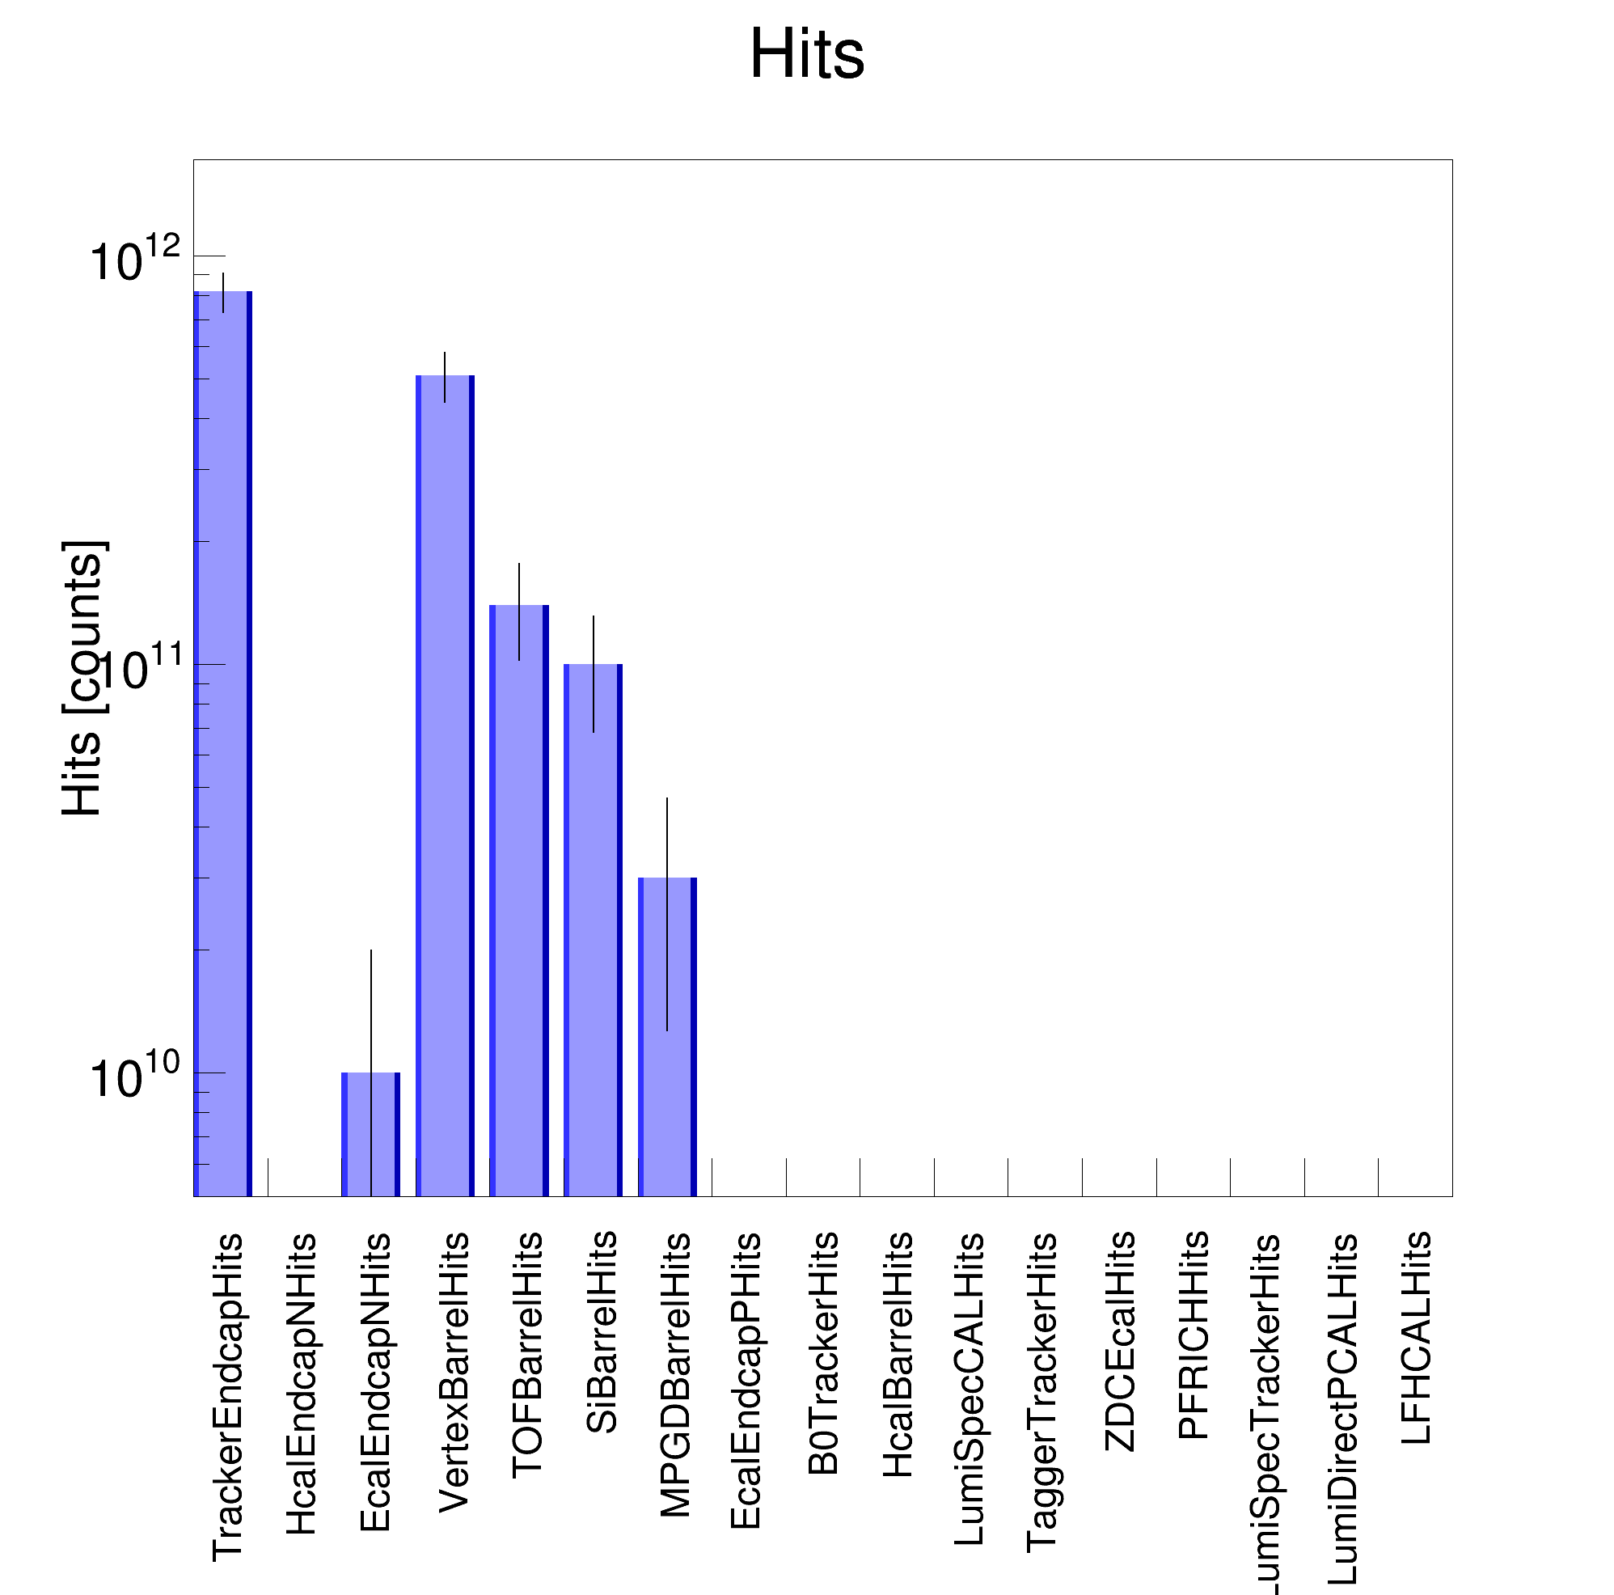
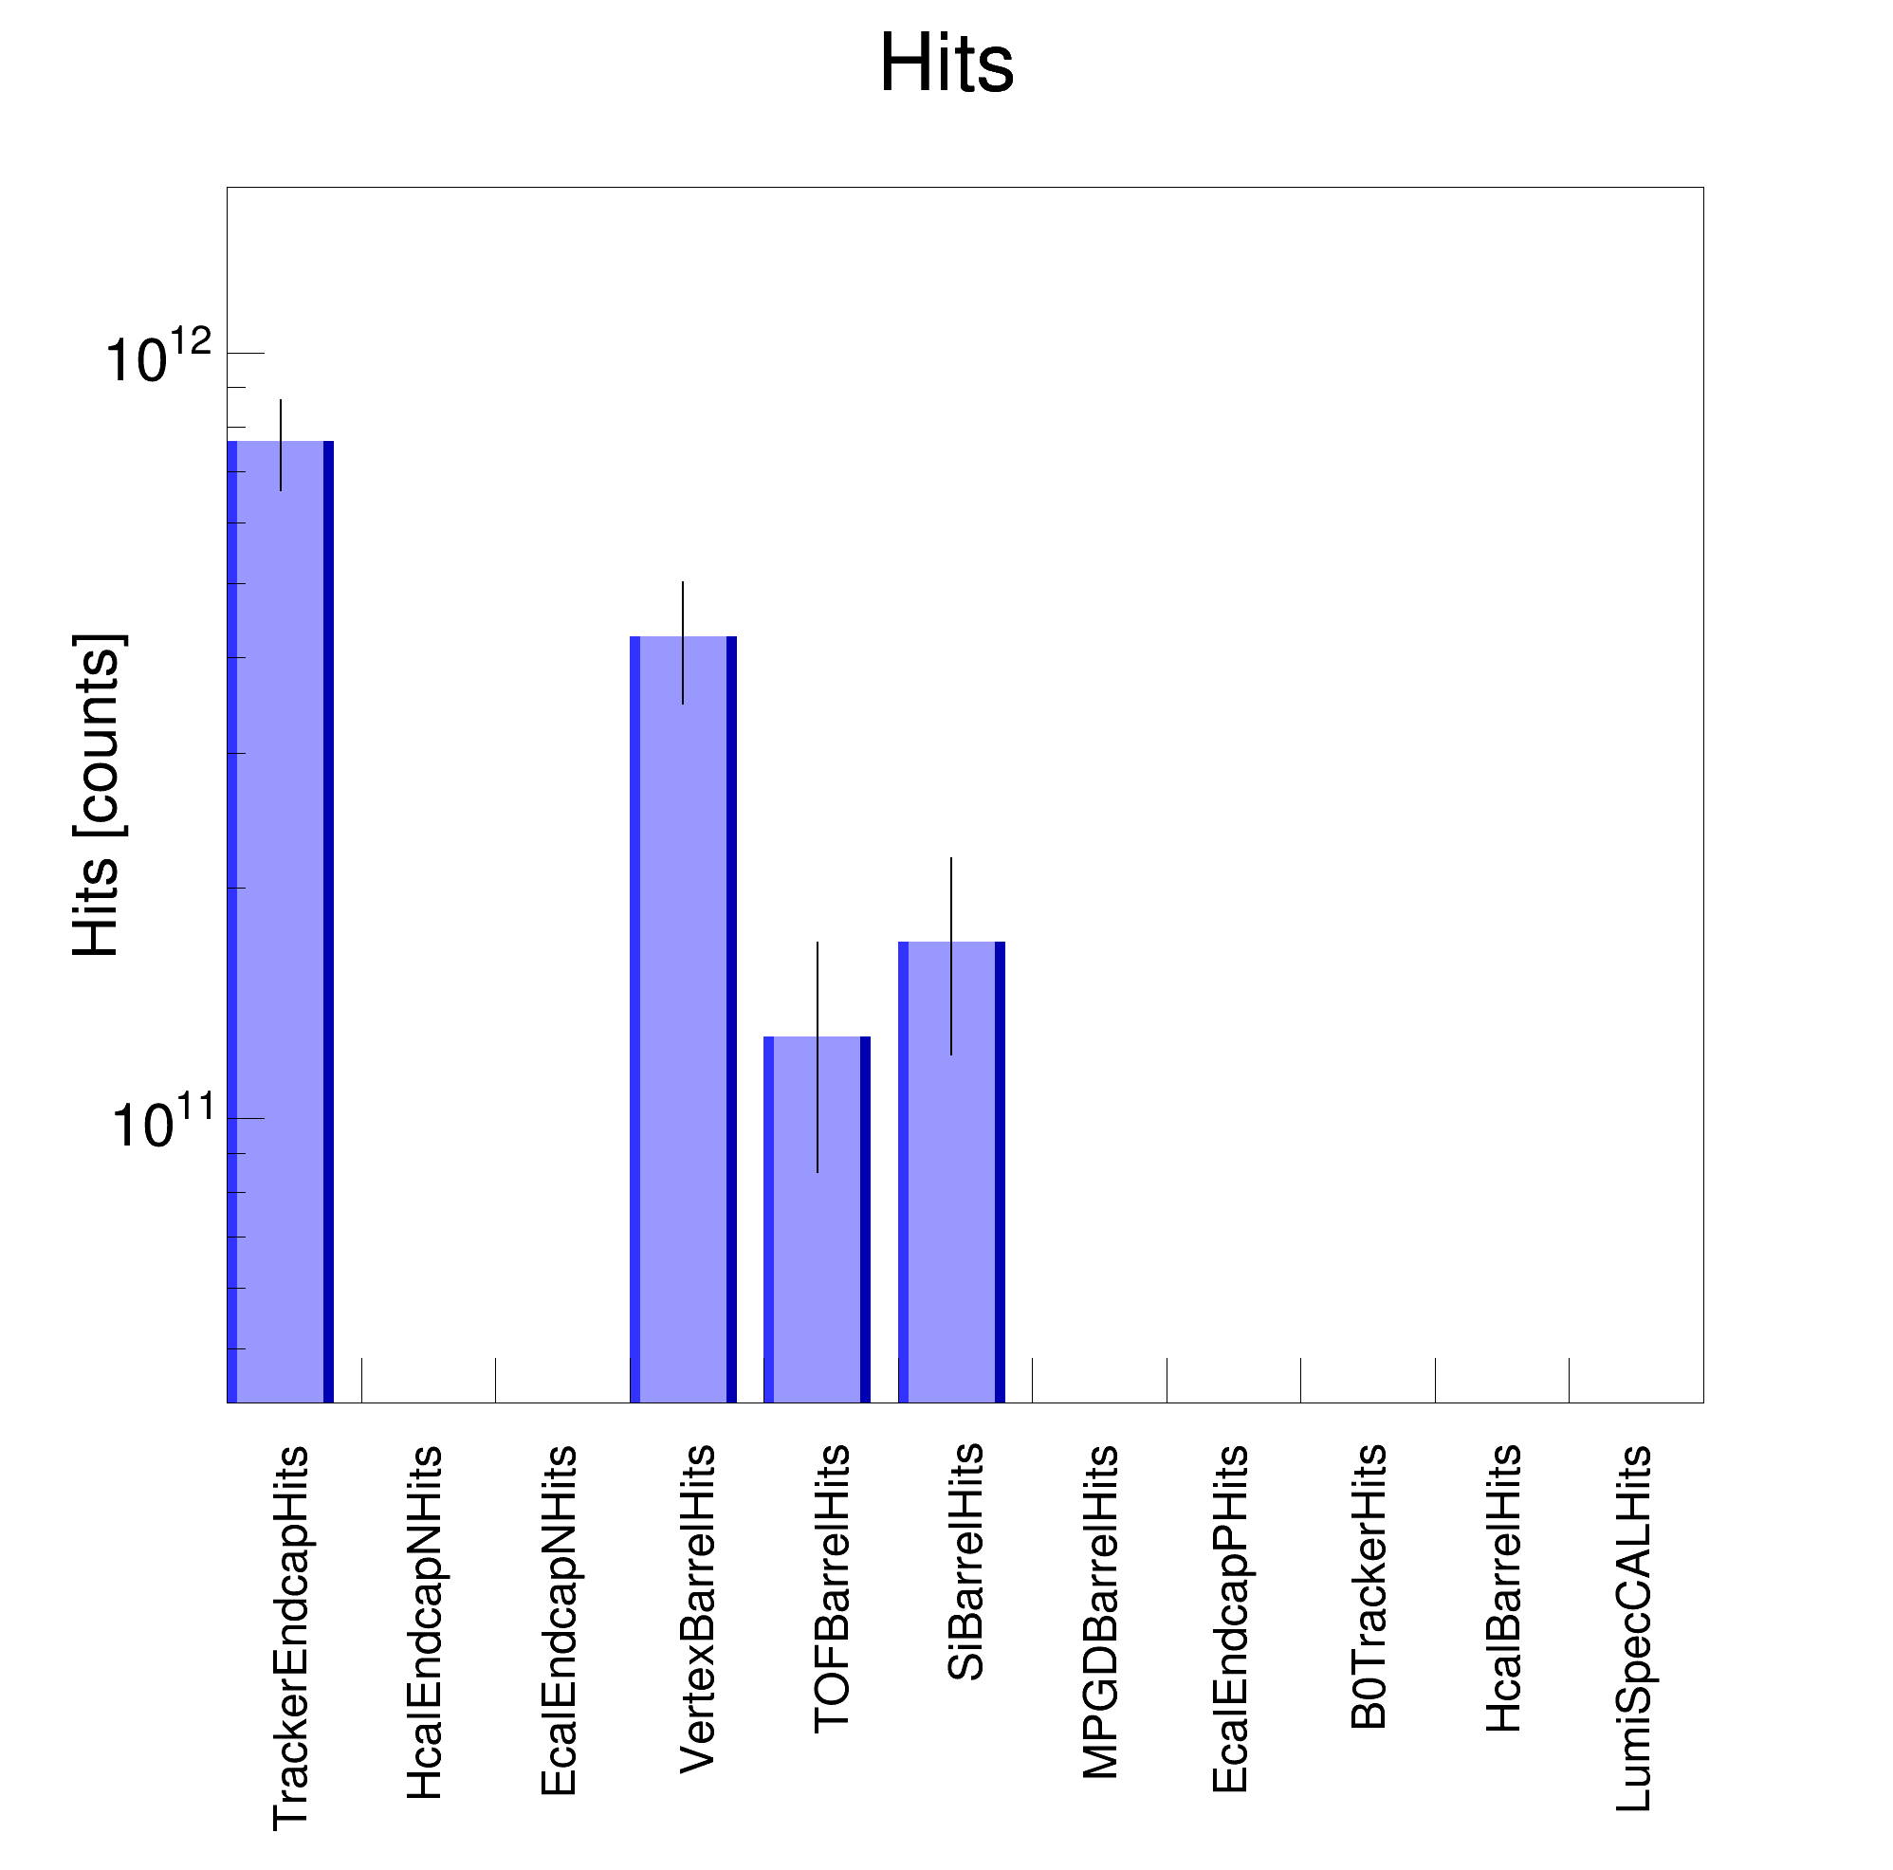
Cross-check with Synrad+ SR photon generator
Synrad+ SR photon generator gives the same absorbed SR photon distribution around the IP6 as the custom-built Geant4; see backup slides.
Moreover, it shows the same ePIC SR background hit rate.
Please note
The original Python script published on the ePIC Wiki page that was used for SR sampling in the past does not provide the correct hit rate estimation.
It shoots SR photons one by one, while in reality and custom-built Geant4, SR photons are simulated in a group following the expected photon rate.
Therefore, the Wiki Python script was improved to provide correct hit rate estimation based on Synrad+ results; see the left plot.
Synrad+
Custom-built Geant4
SimHit rate [Hz]
SimHit rate [Hz]
https://wiki.bnl.gov/EPIC/index.php?title=Synchrotron_Radiation
10¹²
10¹²
I = 0.227 A
IP beam pipe
E_{𝛄} > 30 eV
I = 0.227 A
IP beam pipe
E_{𝛄} > 30 eV
“... photons are sampled from the aforementioned histogram until the sum of all inverse weights is greater than the predefined time integration window ...”

Slide 4
Questions and subjects to be studied with the SR simulation in Geant4
Based on the recently released ESR lattice v6.2
Do we need to update the masks in front of ePIC?
What photons pass and hit the beam pipe?
Updated SR background rates?
SR photon files?
For the review of the ancillary detectors
SR background rates for low-Q² taggers and Luminosity monitor?
Yulia Furletova

Slide 5
SR photons causing detector hits
Although there are many SR photons hitting the IR beam pipe
Only a part of them passes through the beam pipe and reaches the detector-sensitive volume.
According to the MC particle analysis, SR photons with E_{𝛾} > 10 keV produce Vertex detector hits.
Let’s track the SR photons with E_{𝛾} > 10 keV that hit the IP beam pipe.
XY position of the VertexBarrel detector hits
Energy deposition of the VertexBarrel detector hits
Generated SR photon on the inner surface of the beam pipe

Slide 6
SR photon tracks with E > 10 keV that hit the IP beam pipe
Indeed, there is direct SR hitting the IR beam pipe and reflected SR hitting the IP beam pipe
→ predominantly from the closest dipole magnets.
D2EF1
D2EF2
Q1EF
Q0EF
D1EF
IP6
e– beam
Nᵧ = 7469 ph.

Slide 7
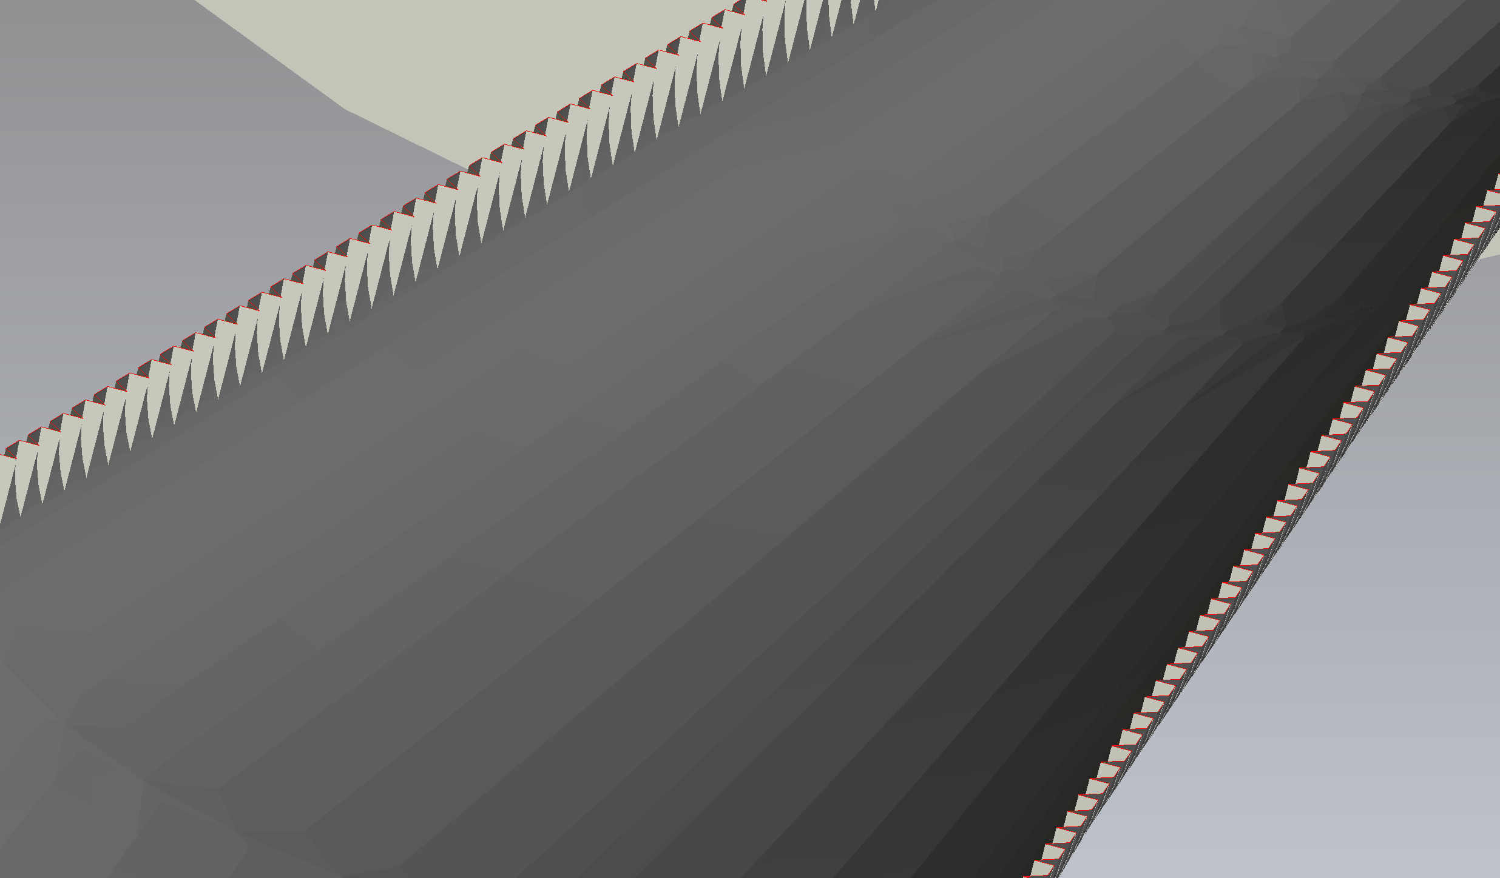
SR photon tracks with E > 10 keV that hit the IP beam pipe
We could stop them by adding the SR mask similar to the tapered part of the beam pipe.
tapered part
e– beam

Slide 8
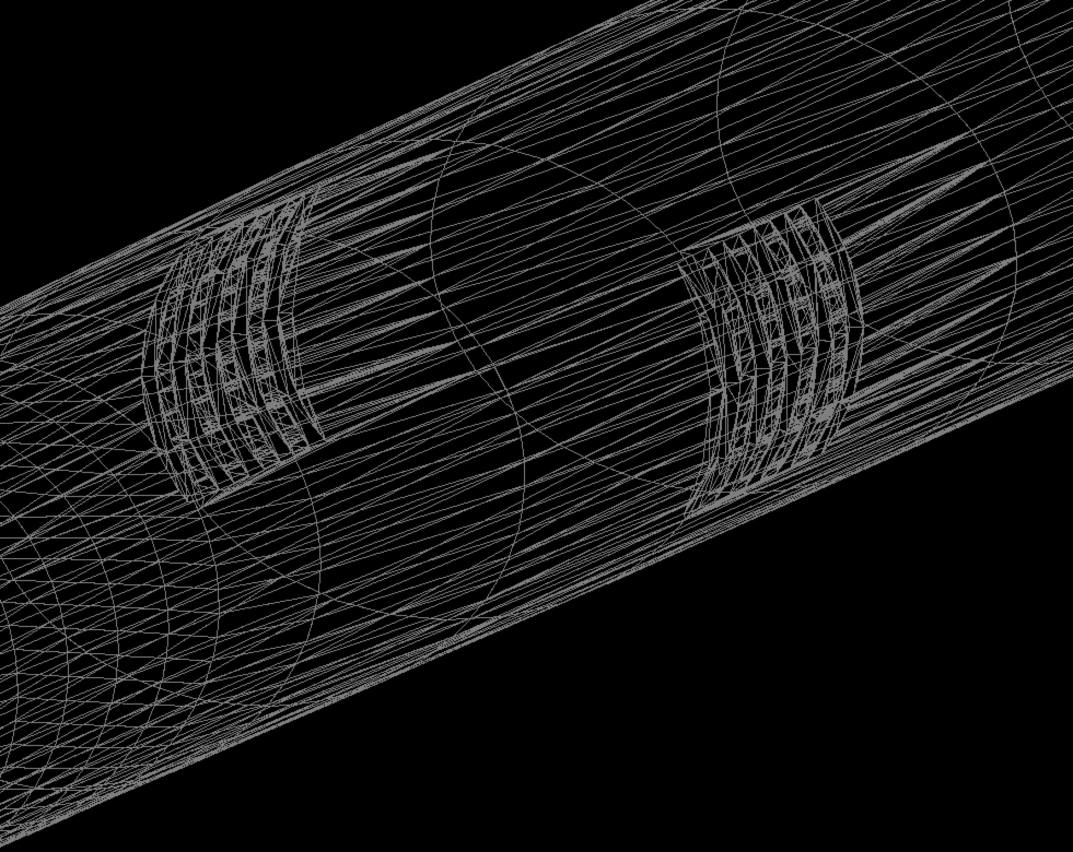
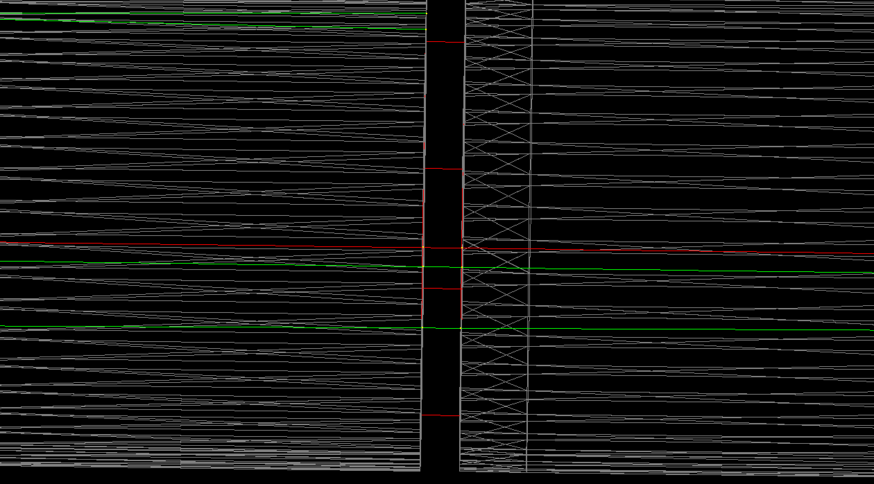
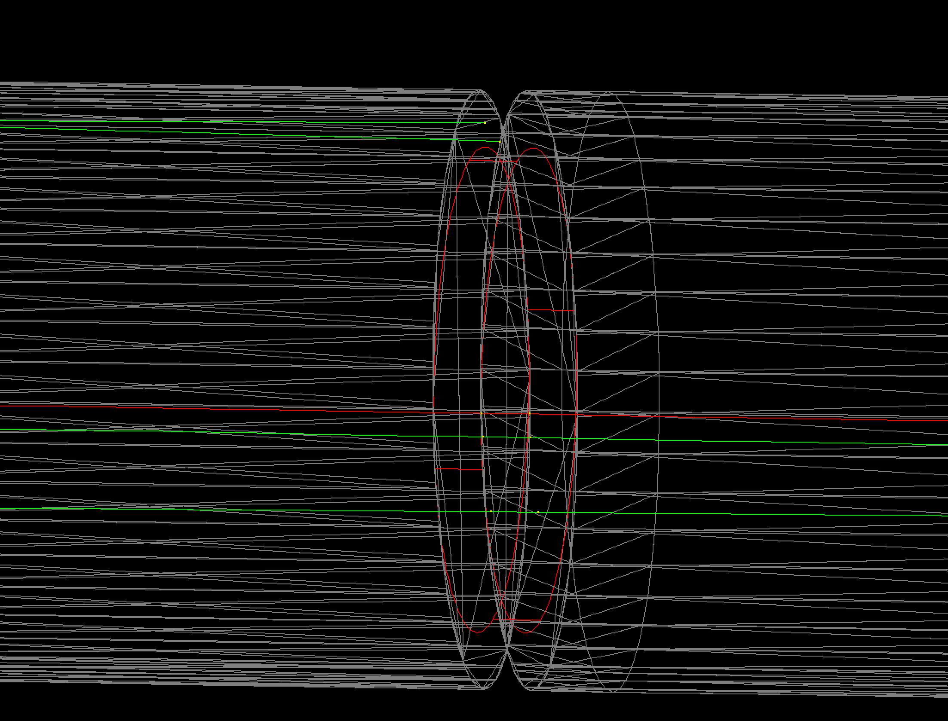
Ideally, we need something like this.
However, it uses a lot of CPU resources to build this structure using standard Geant4 objects.
So, we need a new 3D drawing STL file with this mask.
As a temporary solution, we use a simplified mask (shown in red) placed every 0.5 m.
SuperKEKB ridge surface of the IP beam pipe
EIC design

Slide 9
SR photon tracks with E > 10 keV that hit the IP beam pipe
The new mask helps partially reduce the SR photon flux hitting the IP beam pipe.
We can add one more mask closer to the IP.
D2EF1
D2EF2
Q1EF
Q0EF
D1EF
IP6
e– beam
Nᵧ = 3570 ph.

Slide 10
SR photon tracks with E > 10 keV that hit the IP beam pipe
With the two simple masks, the flux of SR photons hitting the IP beam pipe is reduced by a factor of ~40; see next slides for more details.
D2EF1
D2EF2
Q1EF
Q0EF
D1EF
IP6
e– beam
Nᵧ = 185 ph.

Slide 11
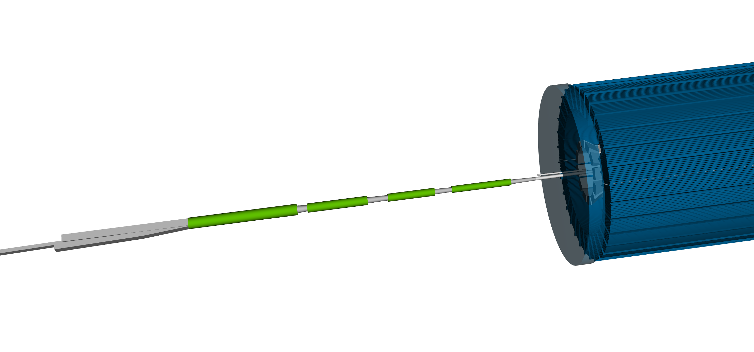
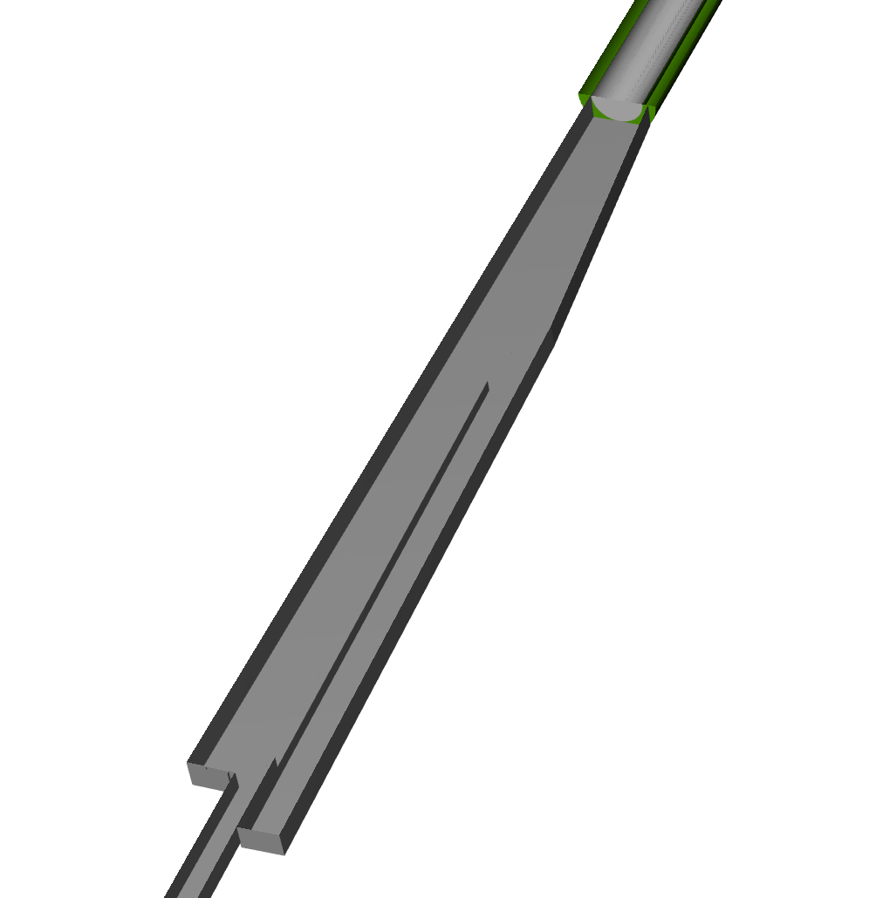
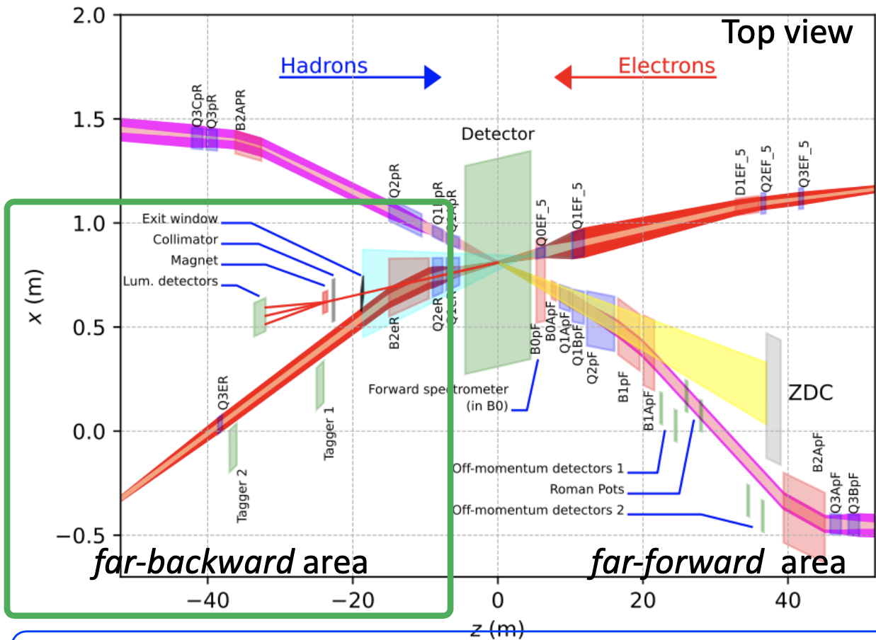
Beam pipe and magnets
Still missing:
Q1eR (~5m from the IP6), Q2eR (~8m), and B2eR (~10m) magnets in the SR generator code
An extended far-BWD electron beam pipe in the SR generator code (use the eic-shell modeling as a reference)
Improved BWD beam pipe geometry in the eic-shell and custom-built Geant4 (make them consistent)
The electron beam pipe geometry in the STL file (used in Synrad+) extends to only 33.5m and 15.3m in the forward (hadron-going) and backward (electron-going) directions, respectively.
The new lattice file contains only the B2BeR magnet
There is no B2AeR
Q1eR
Q2eR
B2AeR
B2BeR

Slide 12
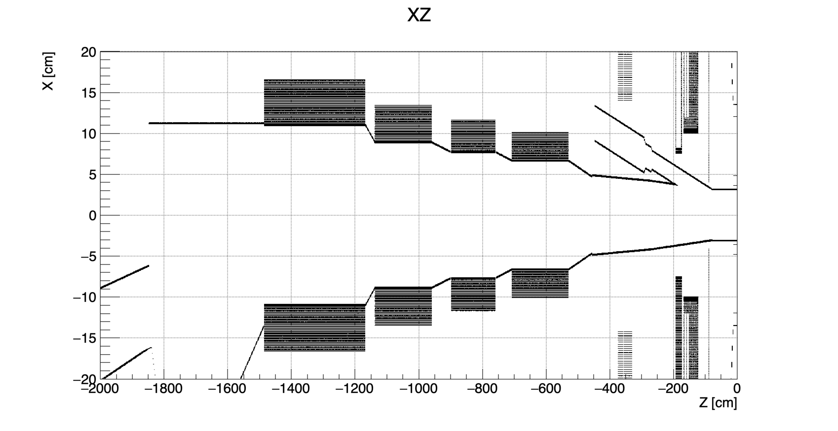
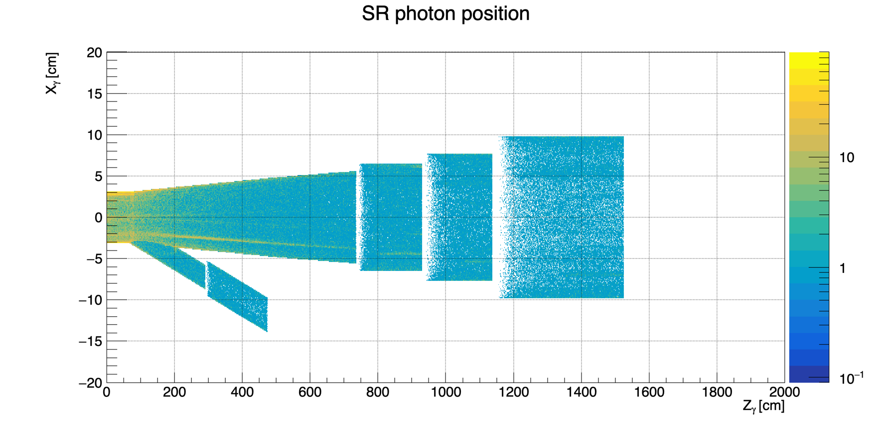
BWD beam pipe (before)
eic-shell material scan
B2BeR
B2AeR
Q2eR
Q1eR
e– beam
Geant4 simulated absorbed SR photons

Slide 13
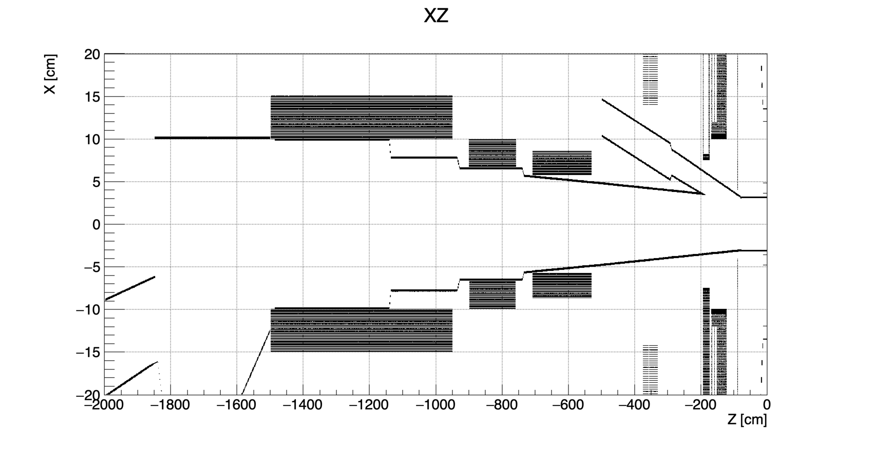
BWD beam pipe (after)
eic-shell material scan
B2BeR
Q2eR
Q1eR
e– beam
Geant4 simulated absorbed SR photons

Slide 14
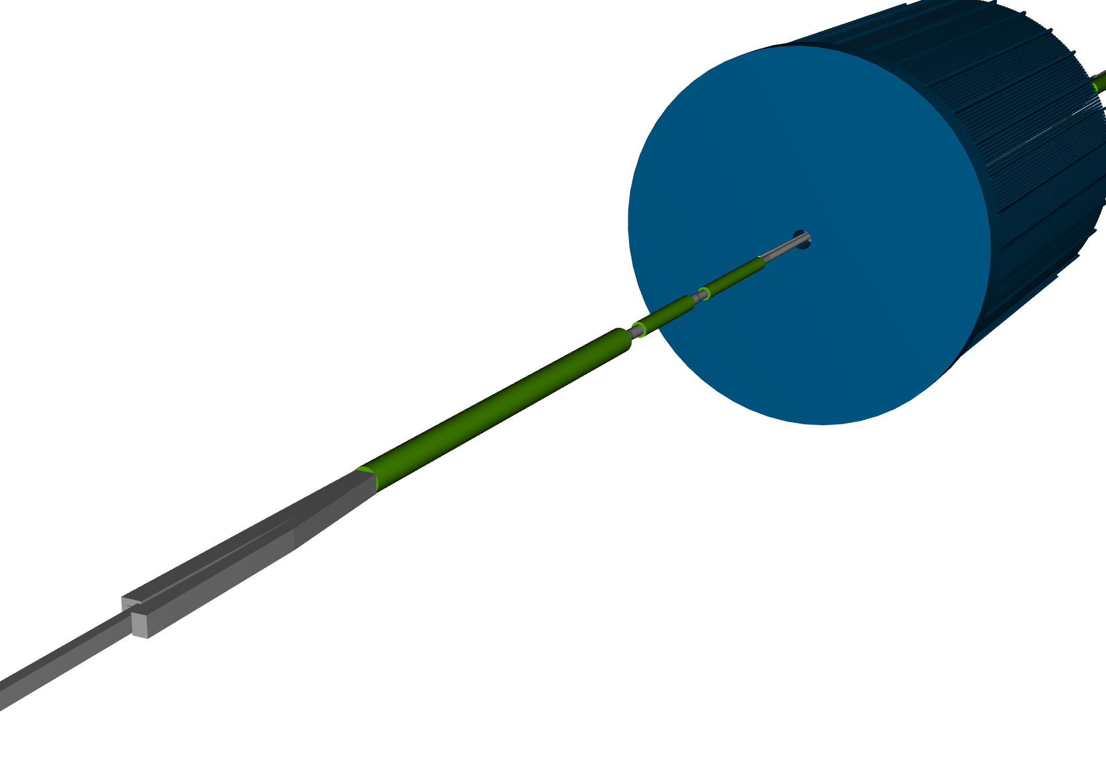
BWD beam pipe (after)
Eic-shell simulation geometry
BWD beam pipe (before)
Q1eR
Q1eR
Q2eR
Q2eR
B2AeR
B2BeR
B2BeR

Slide 15
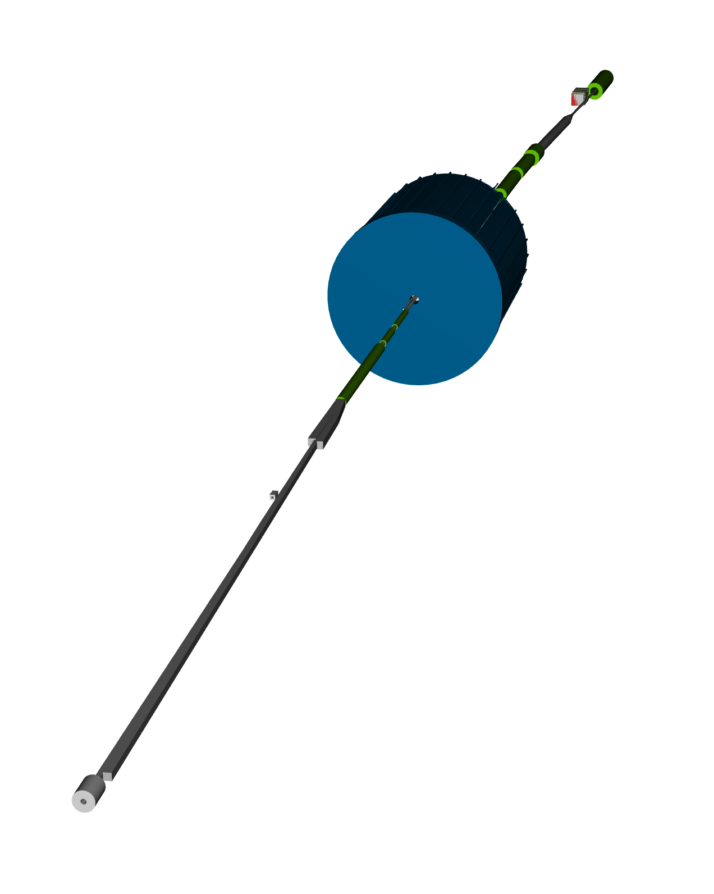
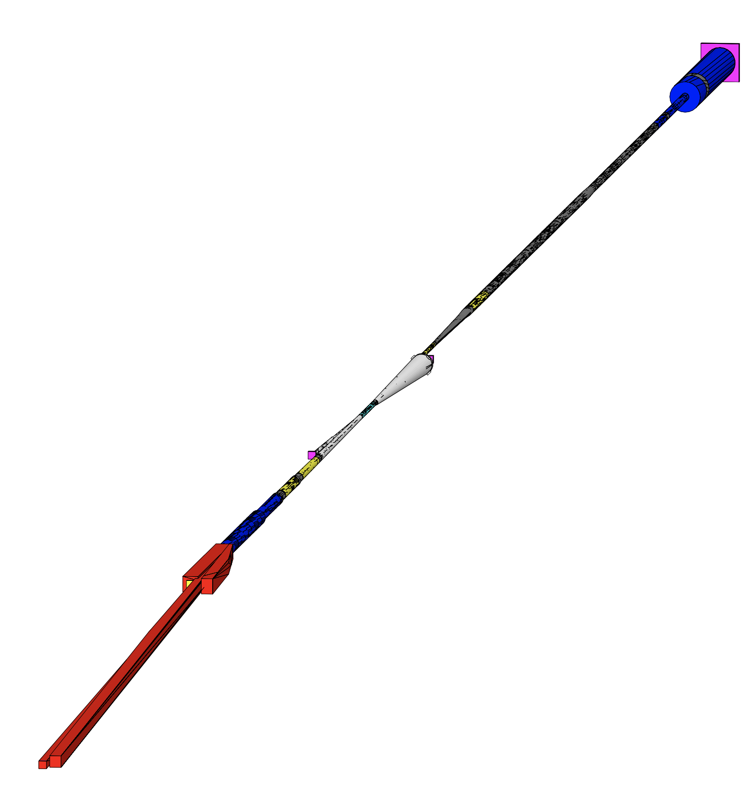
Eic-shell vs Geant4 simulation geometry
eic-shell
custom-built Geant4
e– beam
e– beam
see the heprep file for more details

Slide 16
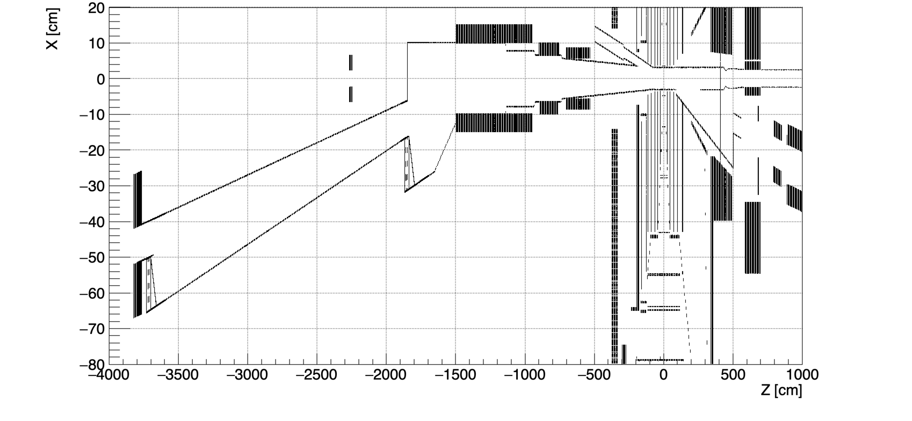
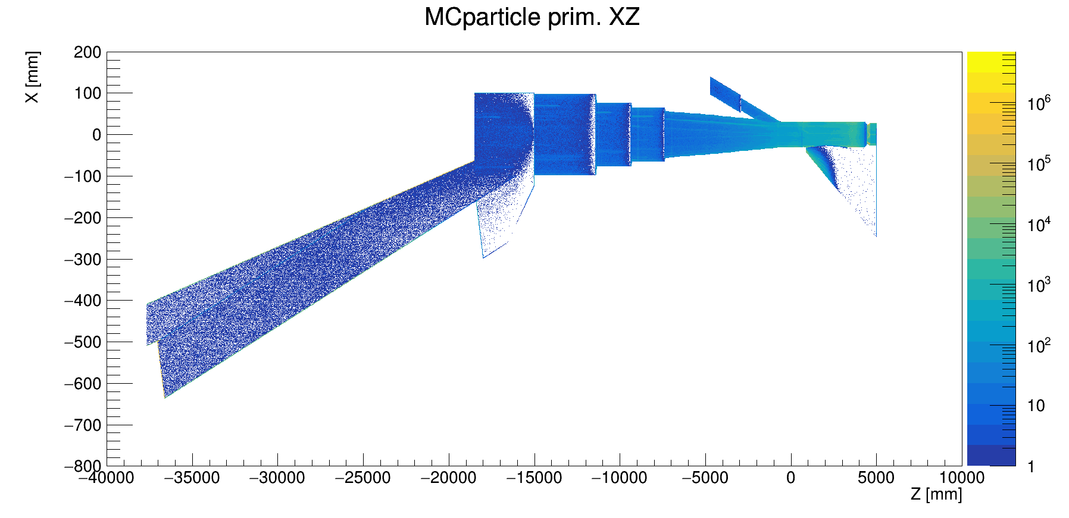
Improved eic-shell and Geant4 beam pipes
e– beam
eic-shell material scan
Geant4 simulated absorbed SR photons

Slide 17
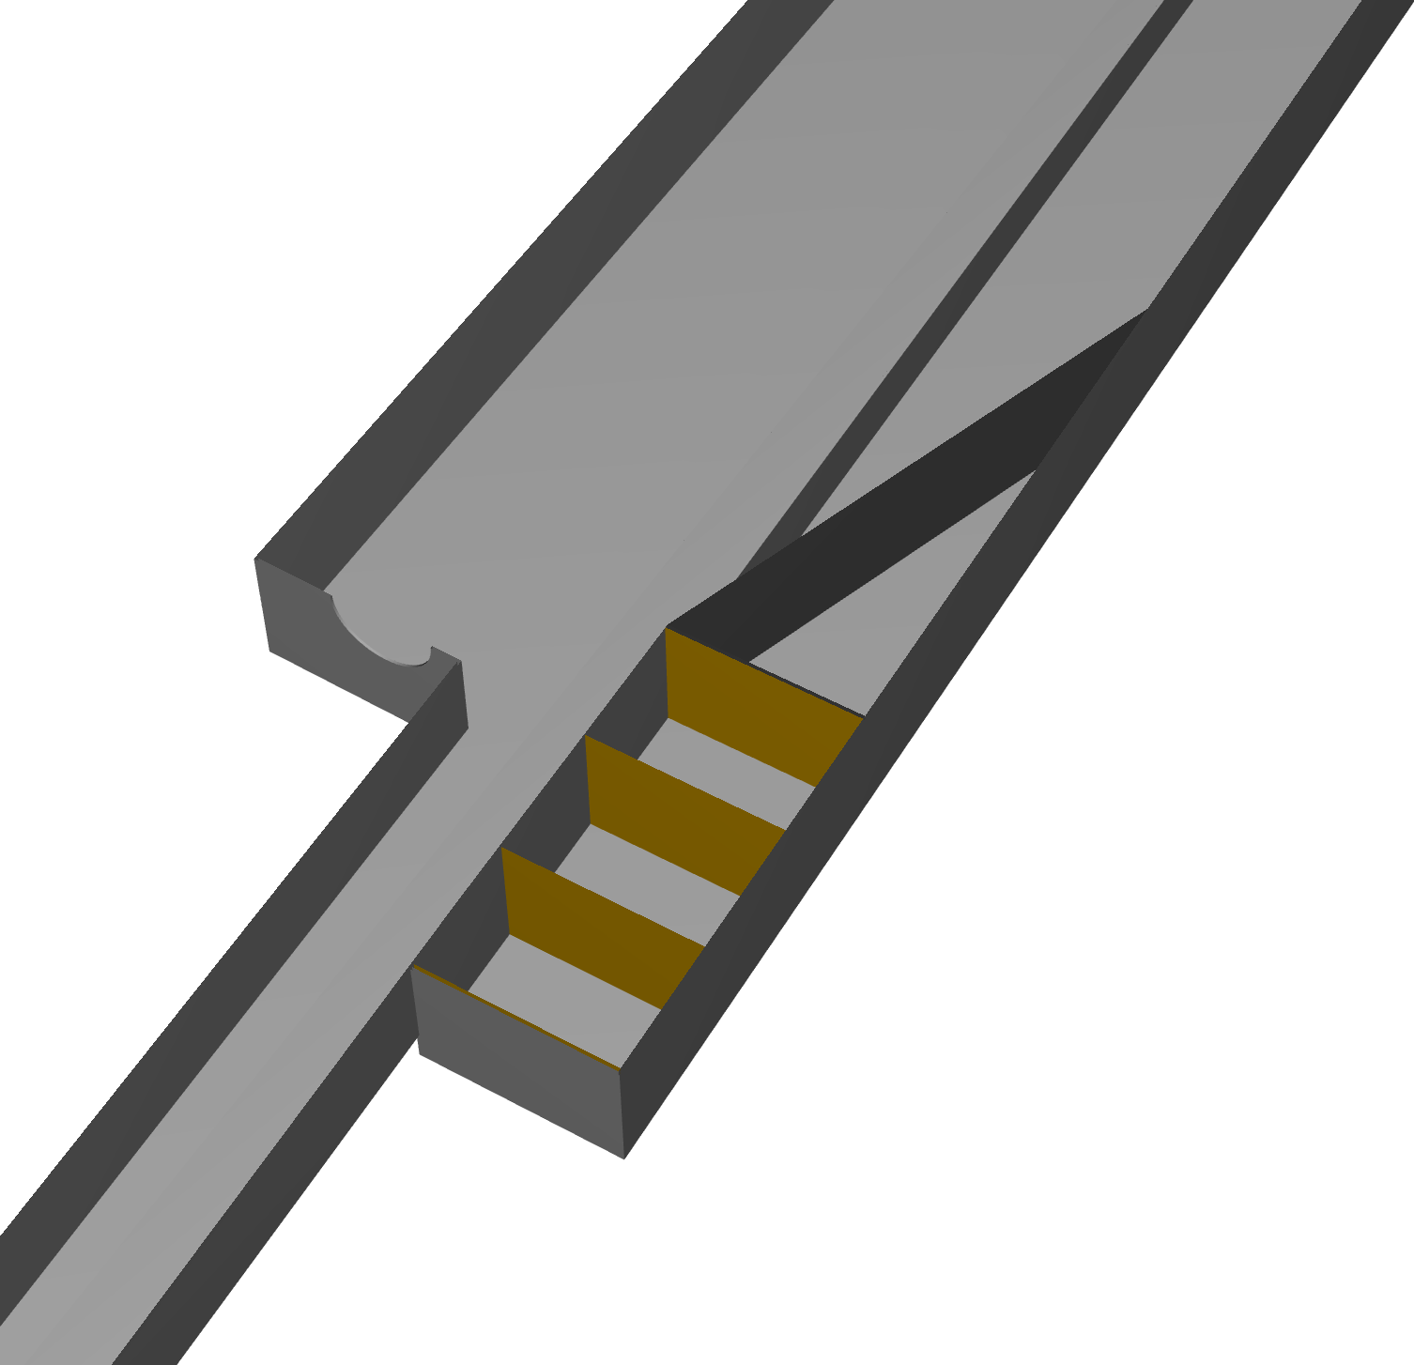
Improved eic-shell and Geant4 beam pipes
e– beam
eic-shell material scan
Geant4 simulated absorbed SR photons

Slide 18
Improved eic-shell and Geant4 beam pipes
Lumi exit window
(for Lumi monitor)
e– beam
eic-shell material scan
Tagger-1
Geant4 simulated absorbed SR photons
Tagger-2

Slide 19
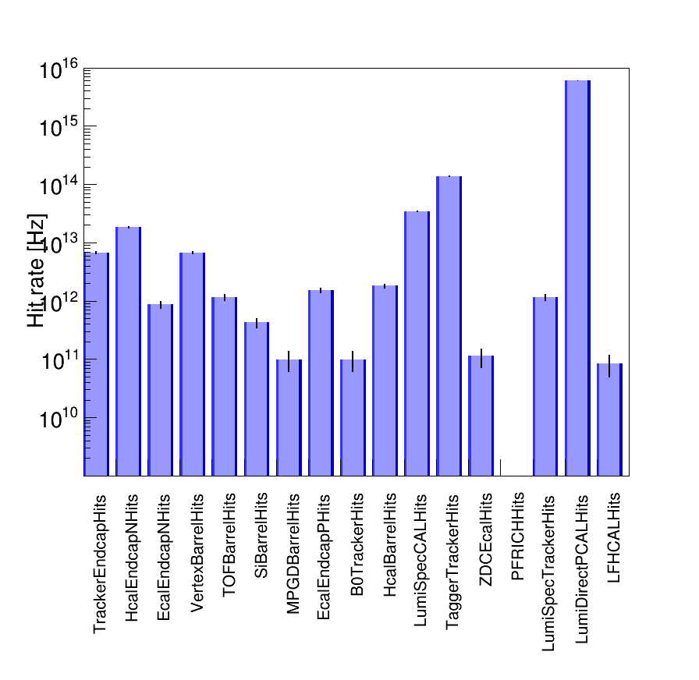
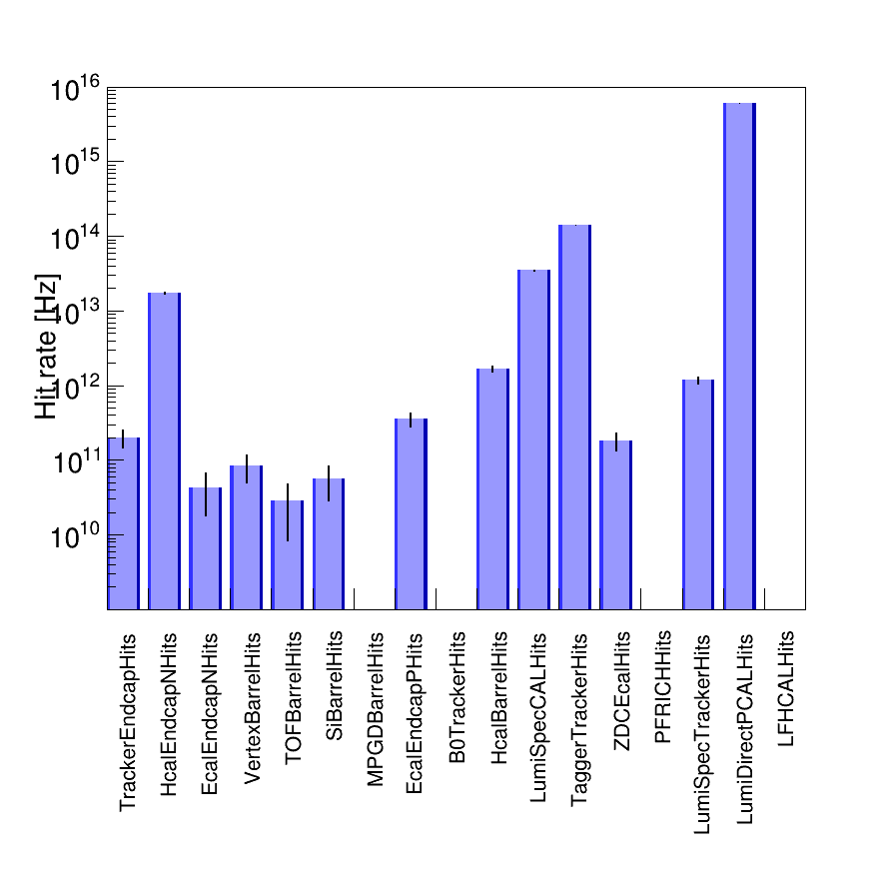
Detector hit rates: Electron beam lattice v6.2 (Jan. 2024)
The estimated SR background hit rate in the detector is very high.
A simple SR mask promises to reduce the hit rate for innermost vertex detectors by about two orders of magnitude.
W/o the SR mask
W/ the SR mask
I = 0.227 A
-37m < z < 5m
E_{𝛄} > 30 eV
I = 0.227 A
-37m < z < 5m
E_{𝛄} > 30 eV

Slide 20
Summary
After modeling improvements, the central, FWD, BWD, and far-BWD beam pipes are consistent in eic-shell and Geant4.
With the correct SR background normalization procedure, we estimated the detector hit rates:
All sub-detectors are expected to be exposed to a high radiation dose with a hit rate (~THz) due to the direct and single-reflected SR hitting the central beam pipe.
A dedicated SR mask and heavy metal shield should help reduce the SR background.
To speed up the computational time for the Geant4 simulation, a new STL file with the beam pipe 3D drawings containing the SR mask is required.
Further refinements and cross-checks are foreseen to seek possible bugs in the code.

Slide 21
Backup

Slide 23
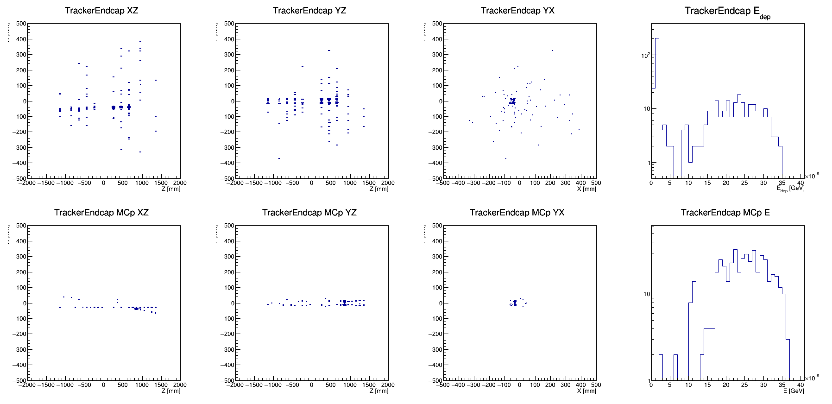

Slide 24
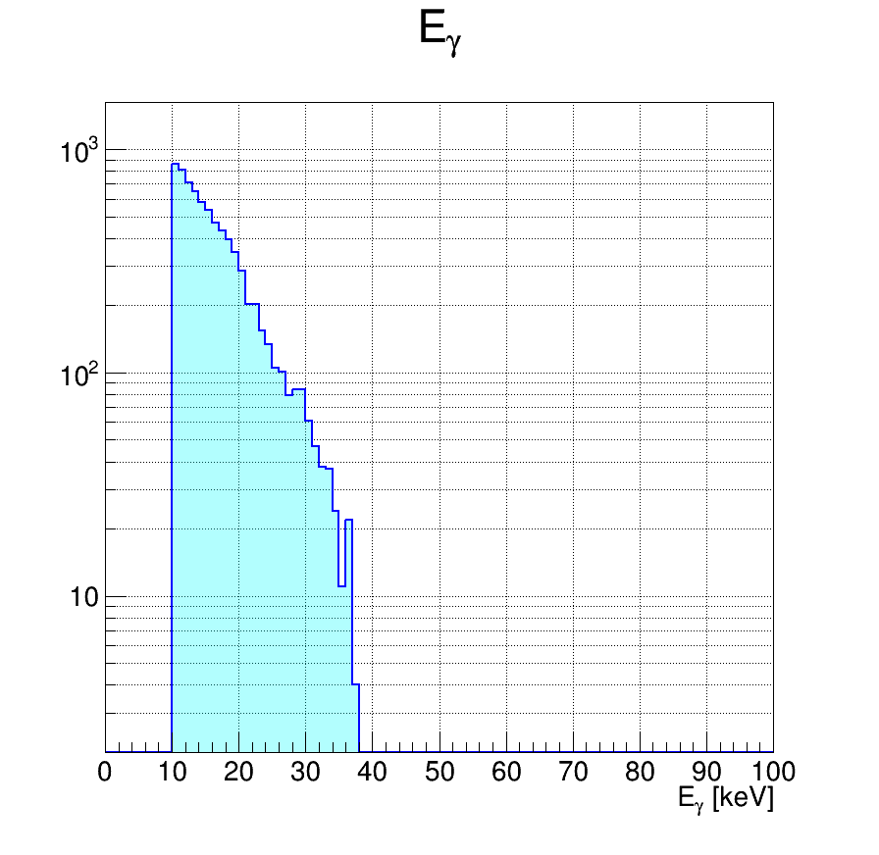
Without the SR mask (1000 x 1e4 e- )

Slide 25
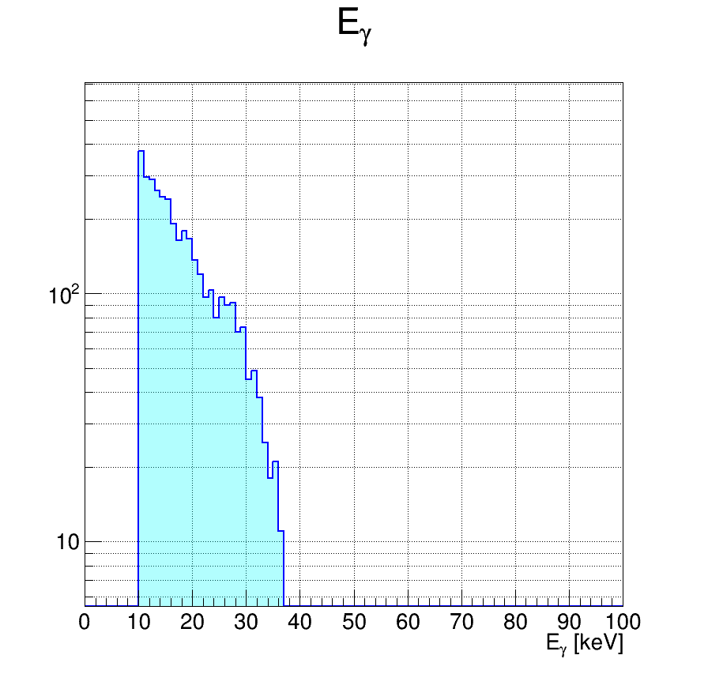
With the SR mask v0 (1000 x 1e4 e- )

Slide 26
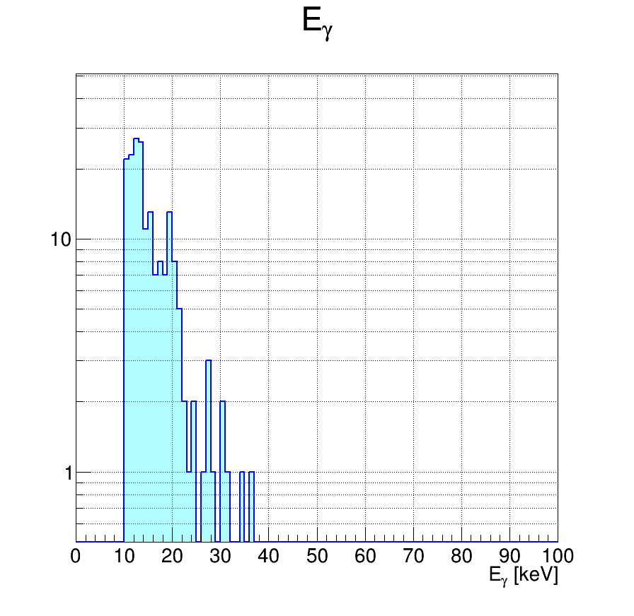
With the SR mask v1 (1000 x 1e4 e- )

Slide 27
Synrad+ vs Geant4 (IP SR photon hits)

Slide 28
Synrad+ vs Geant4 (IP SR photon hits)

Slide 29
Synrad+ vs Geant4 (IP SR photon hits)

Slide 30
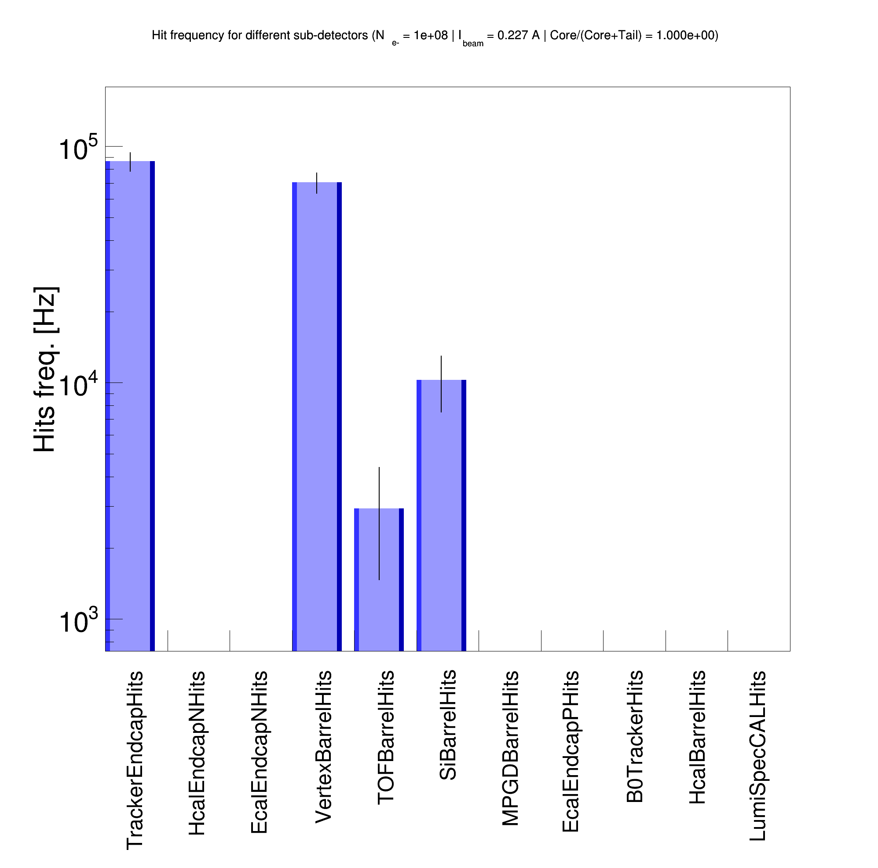
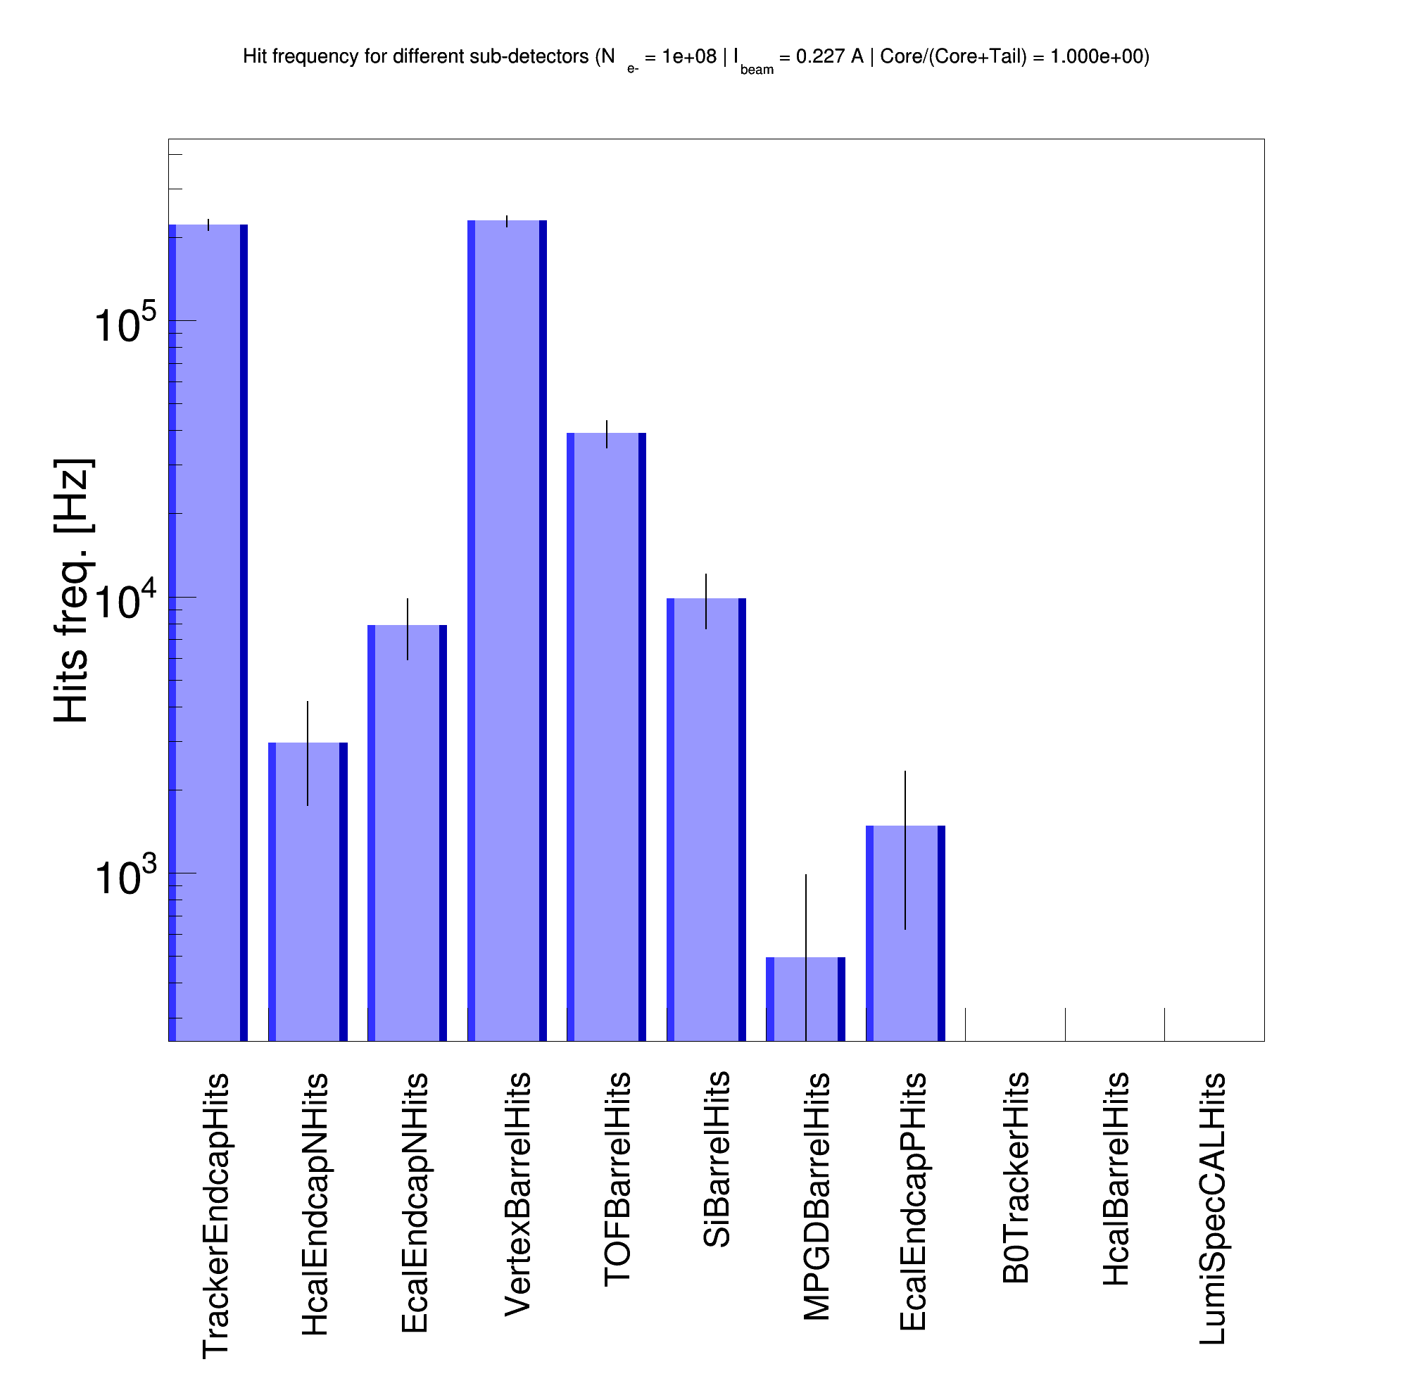
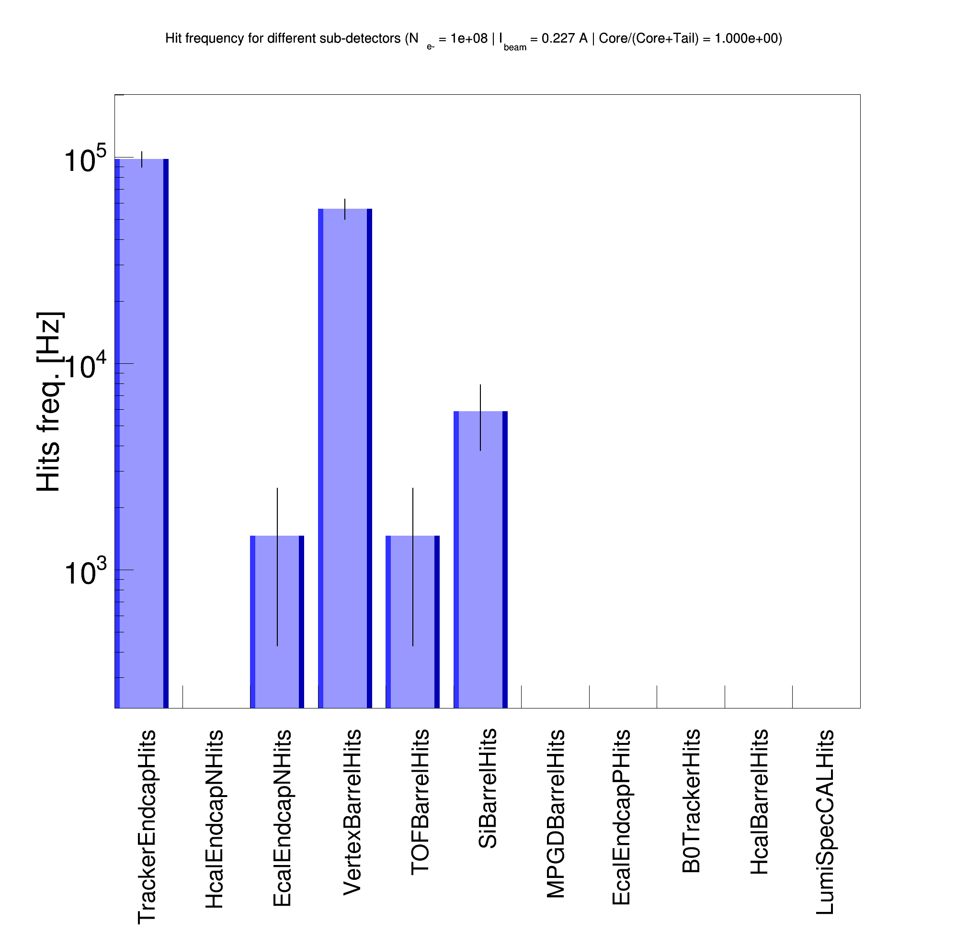
Wrong hit rate normalization
Old lattice v6.X (Sep. 2023)
New lattice v6.2 (Jan. 2024)
Custom-built Geant4
(like the old Synrad+ model)
Diffuse reflection
Custom-built Geant4
(like the new Synrad+ model)
Diffuse reflection
Custom-built Geant4
(like the old Synrad+ model)
Diffuse reflection
Custom-built Geant4
(like the new Synrad+ model)
Diffuse reflection
-4m < z < 5m
E_{𝛄} > 30 eV
-4m < z < 5m
E_{𝛄} > 30 eV
-4m < z < 5m
E_{𝛄} > 30 eV
-4m < z < 5m
E_{𝛄} > 30 eV

Slide 31
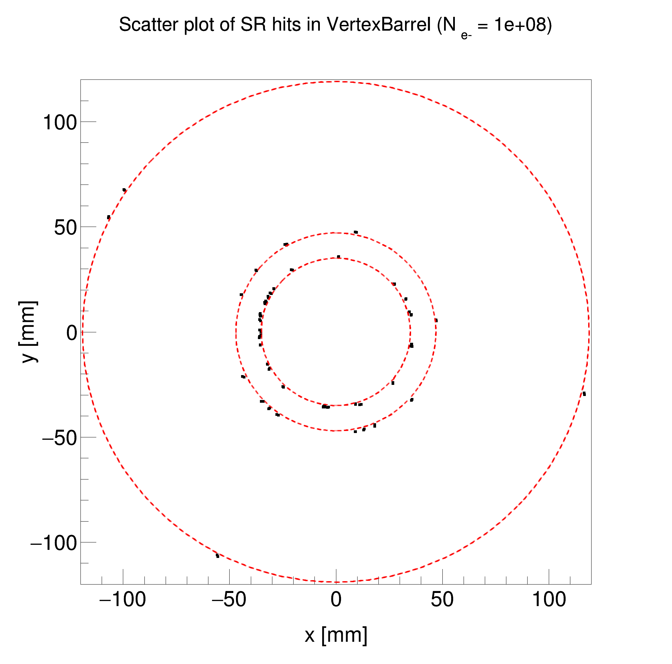
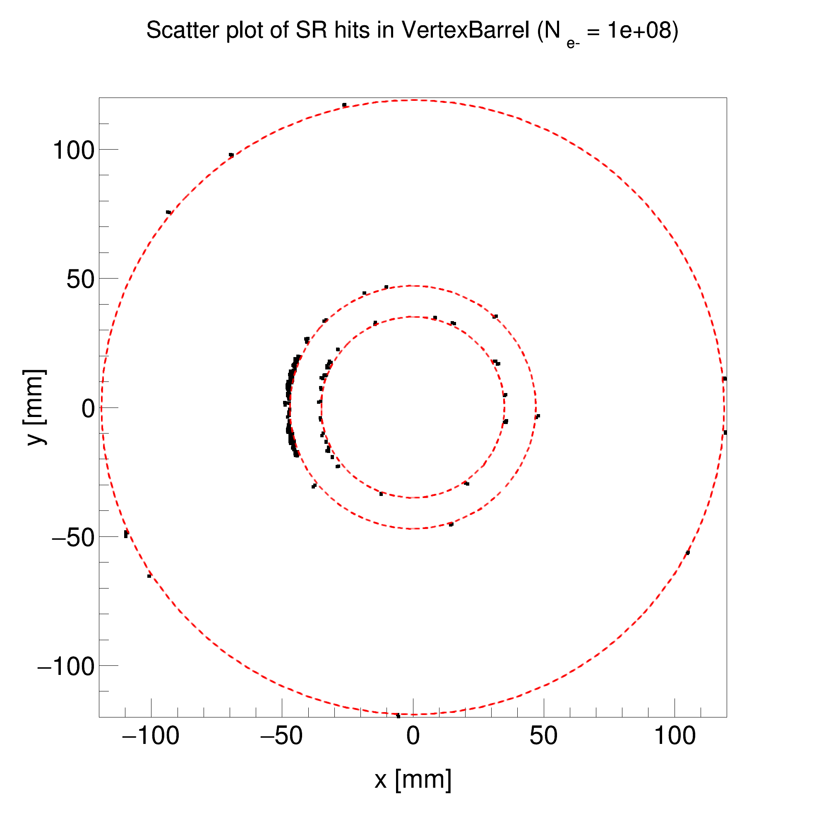
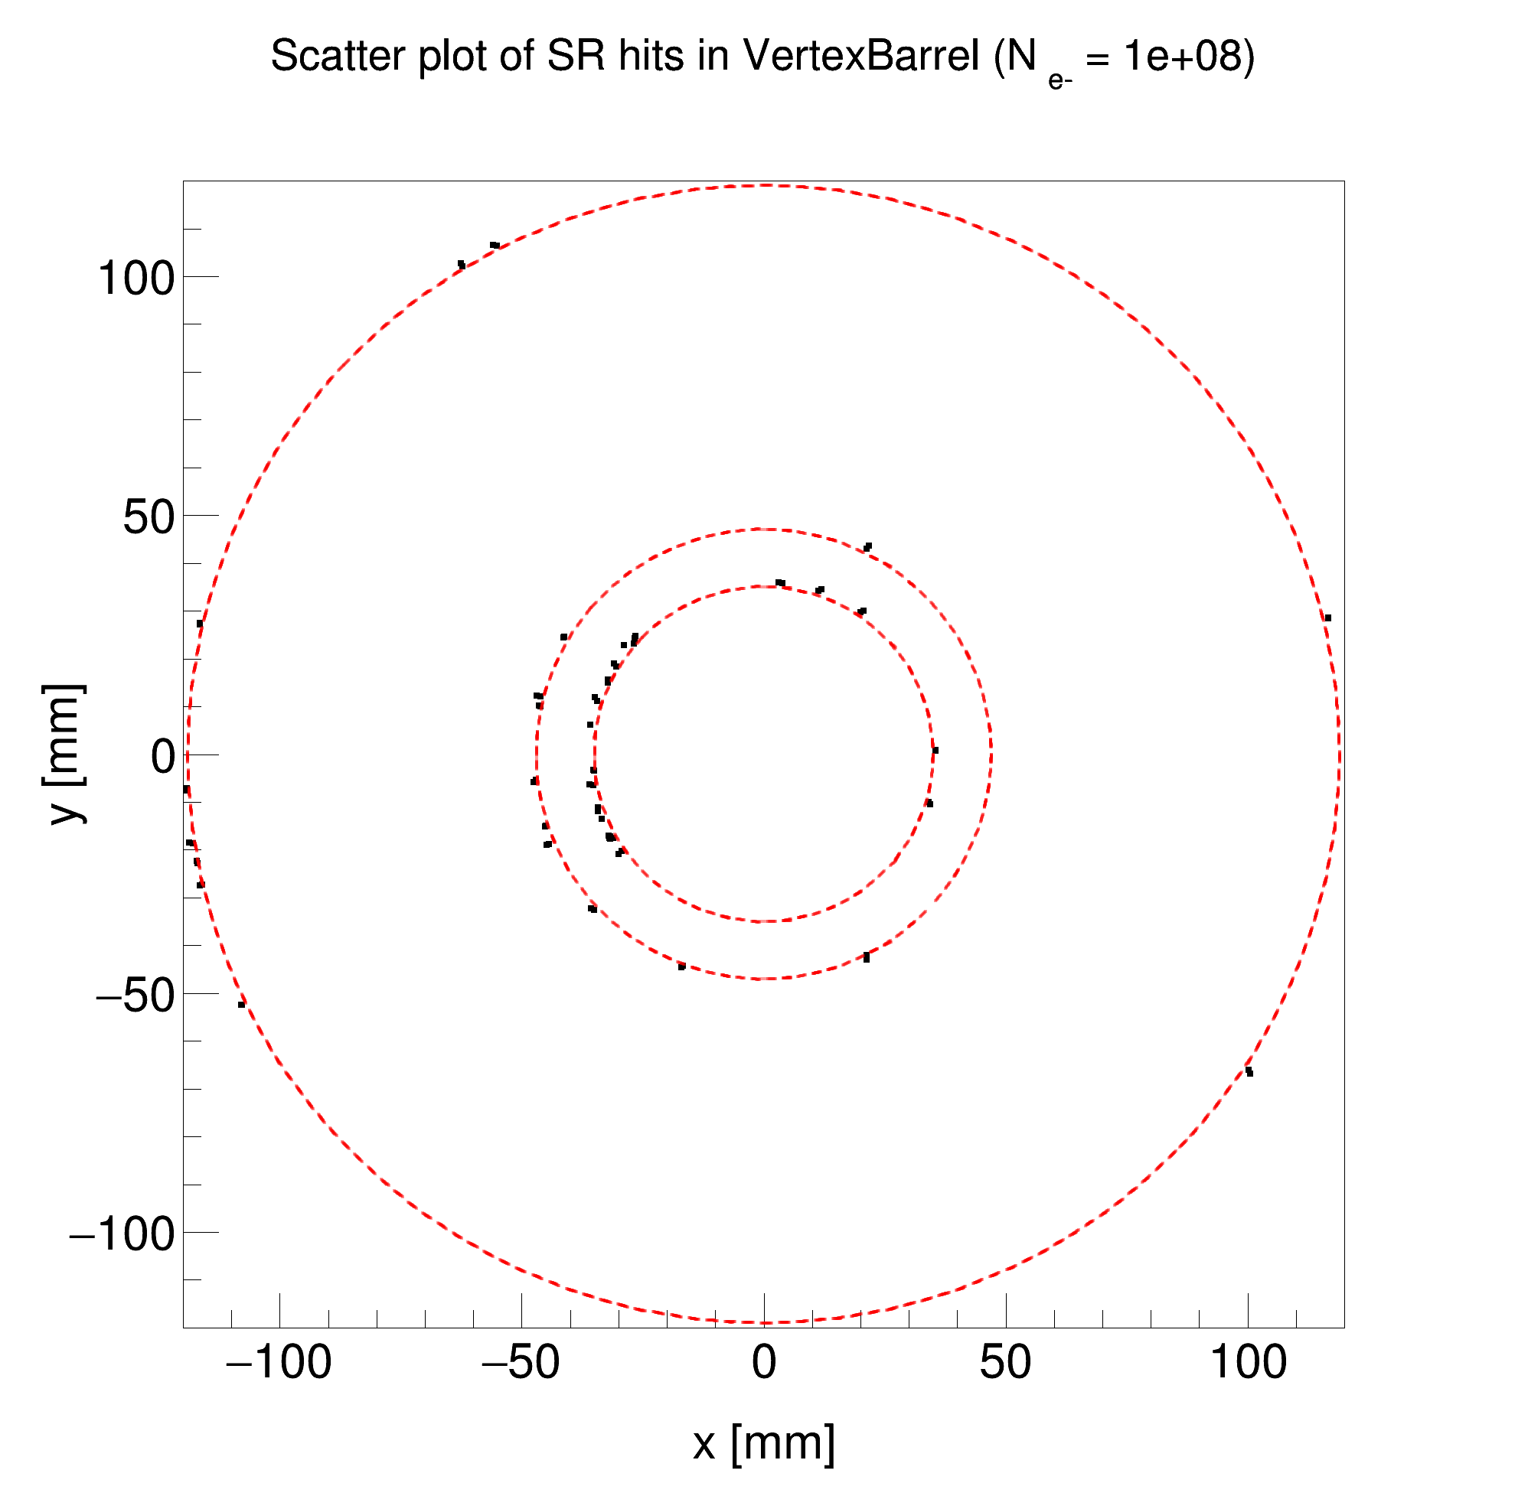
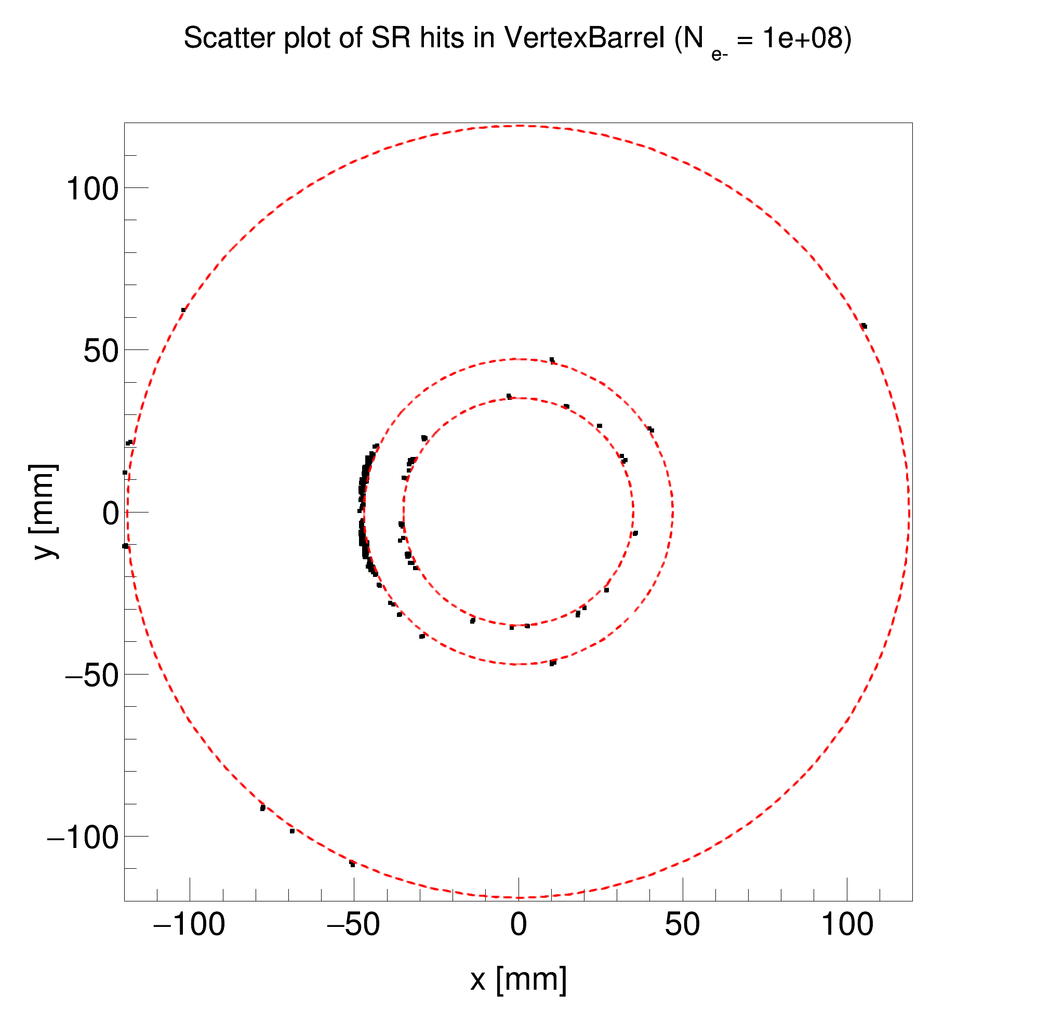
Old lattice v6.X (Sep. 2023)
New lattice v6.2 (Jan. 2024)
Custom-built Geant4
(like the old Synrad+ model)
Diffuse reflection
Custom-built Geant4
(like the new Synrad+ model)
Diffuse reflection
Custom-built Geant4
(like the old Synrad+ model)
Diffuse reflection
Custom-built Geant4
(like the new Synrad+ model)
Diffuse reflection
-4m < z < 5m
E_{𝛄} > 30 eV
-4m < z < 5m
E_{𝛄} > 30 eV
-4m < z < 5m
E_{𝛄} > 30 eV
-4m < z < 5m
E_{𝛄} > 30 eV

Slide 32
Ancillary detectors around IP6

Slide 33
Far-backward detectors
Yulia Furletova

