Slide 1
Synchrotron Radiation (SR) background in ePIC at the EIC
Andrii Natochii
natochii@hawaii.edu

Slide 2
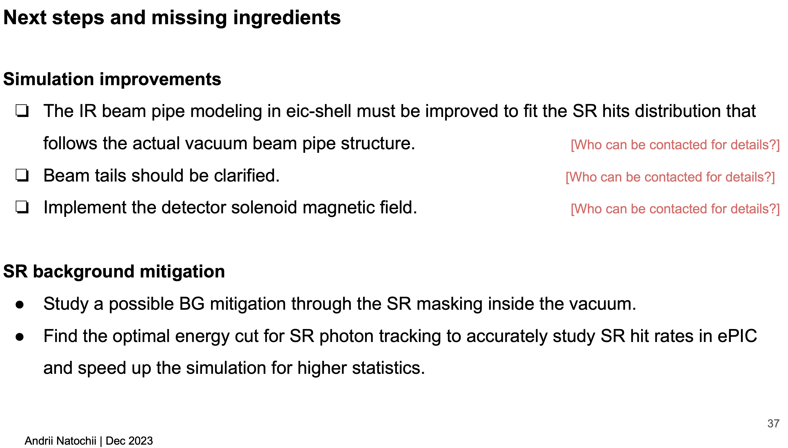
Recap
Received IR beam pipe drawings from Charlie Hetzel
Adjusted the eic-shell modeling
From Dec. 2023 meeting
Charlie plans to update the Synrad+ model in 2024
Mike Sullivan shared his calculation of EIC beam tails based on Gaussian approximation ← more conservative model
Plan to study the new model's impact on the EIC SR background
Implemented the detector solenoid field. Thanks Elke Aschenauer for providing the details

Slide 3
Solenoid field

Slide 4
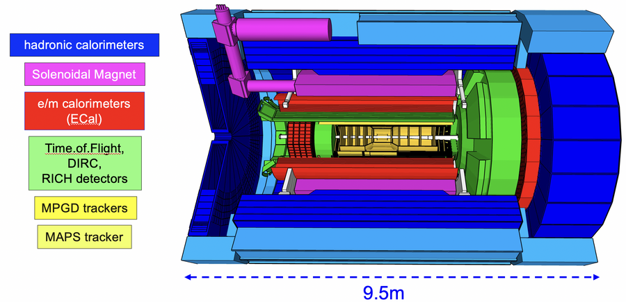
Solenoid magnet
For ePIC, a new solenoid is developed as the experimental magnet with a central field of 1.7 T with an operational range of up to 2 T. The Magnet has been named MARCO. From Ref. [link].
  Available field maps in a CSV format (as of Dec 2023): 1.7 T and 2.0 T (points are calculated every 2 cm)
  The solenoid field is off-centered by 8 cm towards the electron beam direction, i.e., its center is at (0;0;-8) cm
MARCO
R(cm) Z(cm) Br(T) Bz(T)
0.0 -800.0 0.0000 -0.0006
0.0 -798.0 0.0000 -0.0006
0.0 -796.0 0.0000 -0.0006
0.0 -794.0 0.0000 -0.0006
0.0 -792.0 0.0000 -0.0006
0.0 -790.0 0.0000 -0.0006
0.0 -788.0 0.0000 -0.0006
0.0 -786.0 0.0000 -0.0006
0.0 -784.0 0.0000 -0.0006
0.0 -782.0 0.0000 -0.0006
0.0 -780.0 0.0000 -0.0006
0.0 -778.0 0.0000 -0.0006
0.0 -776.0 0.0000 -0.0007
...

Slide 5
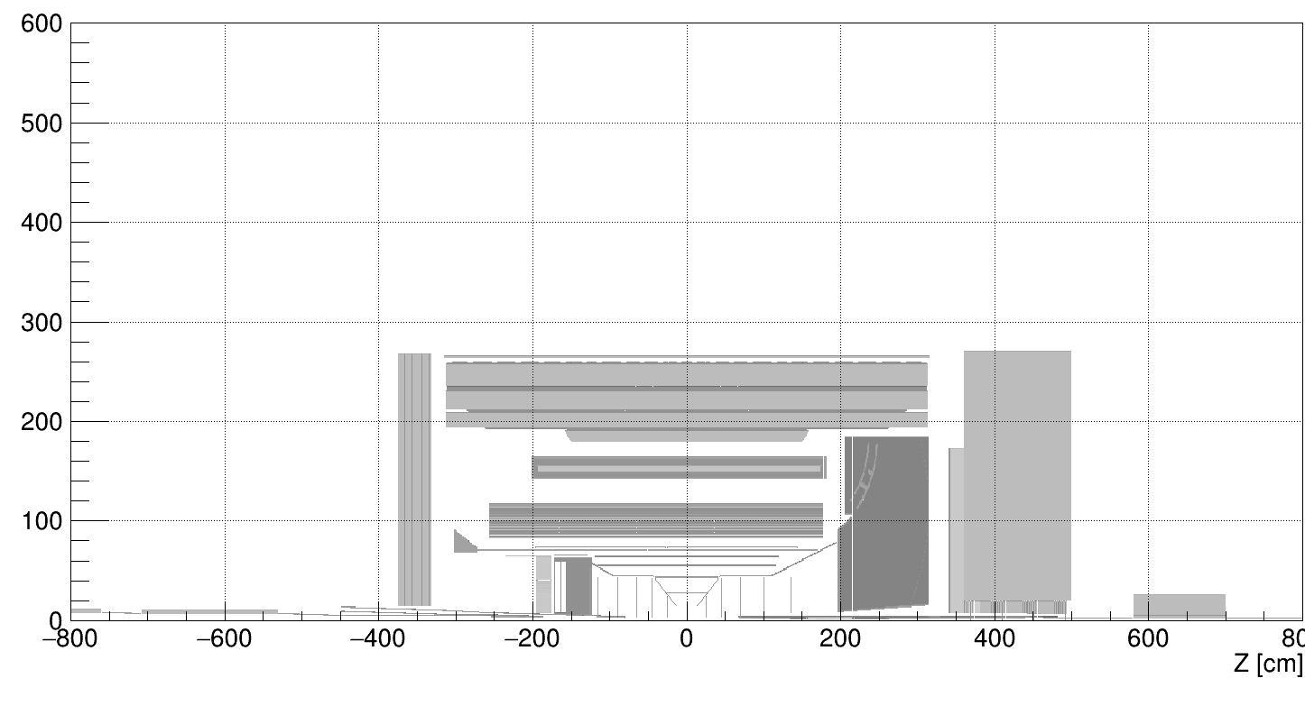
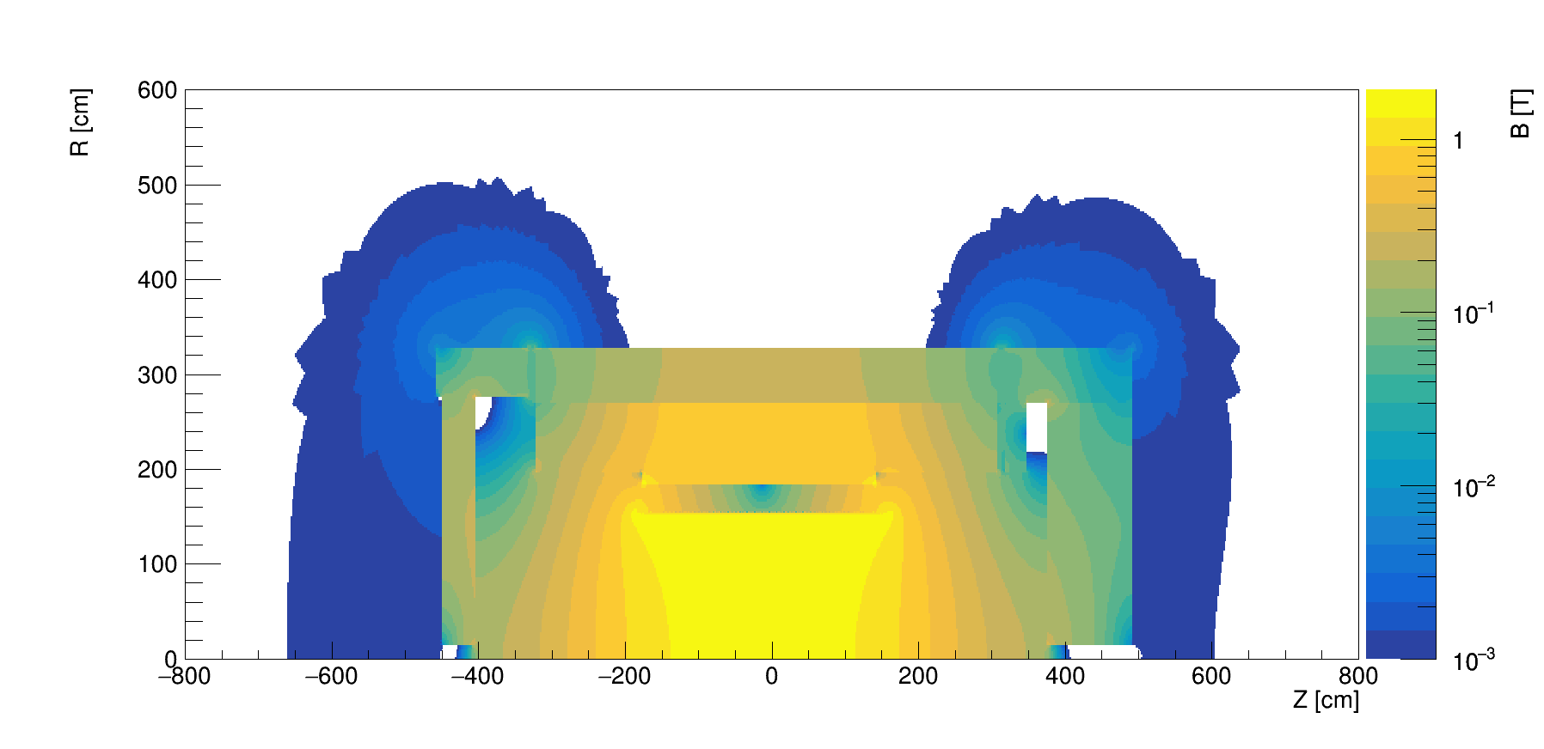
Material scan (black) vs solenoid field (color)
R [cm]
Hadron beam
Electron beam

Slide 6
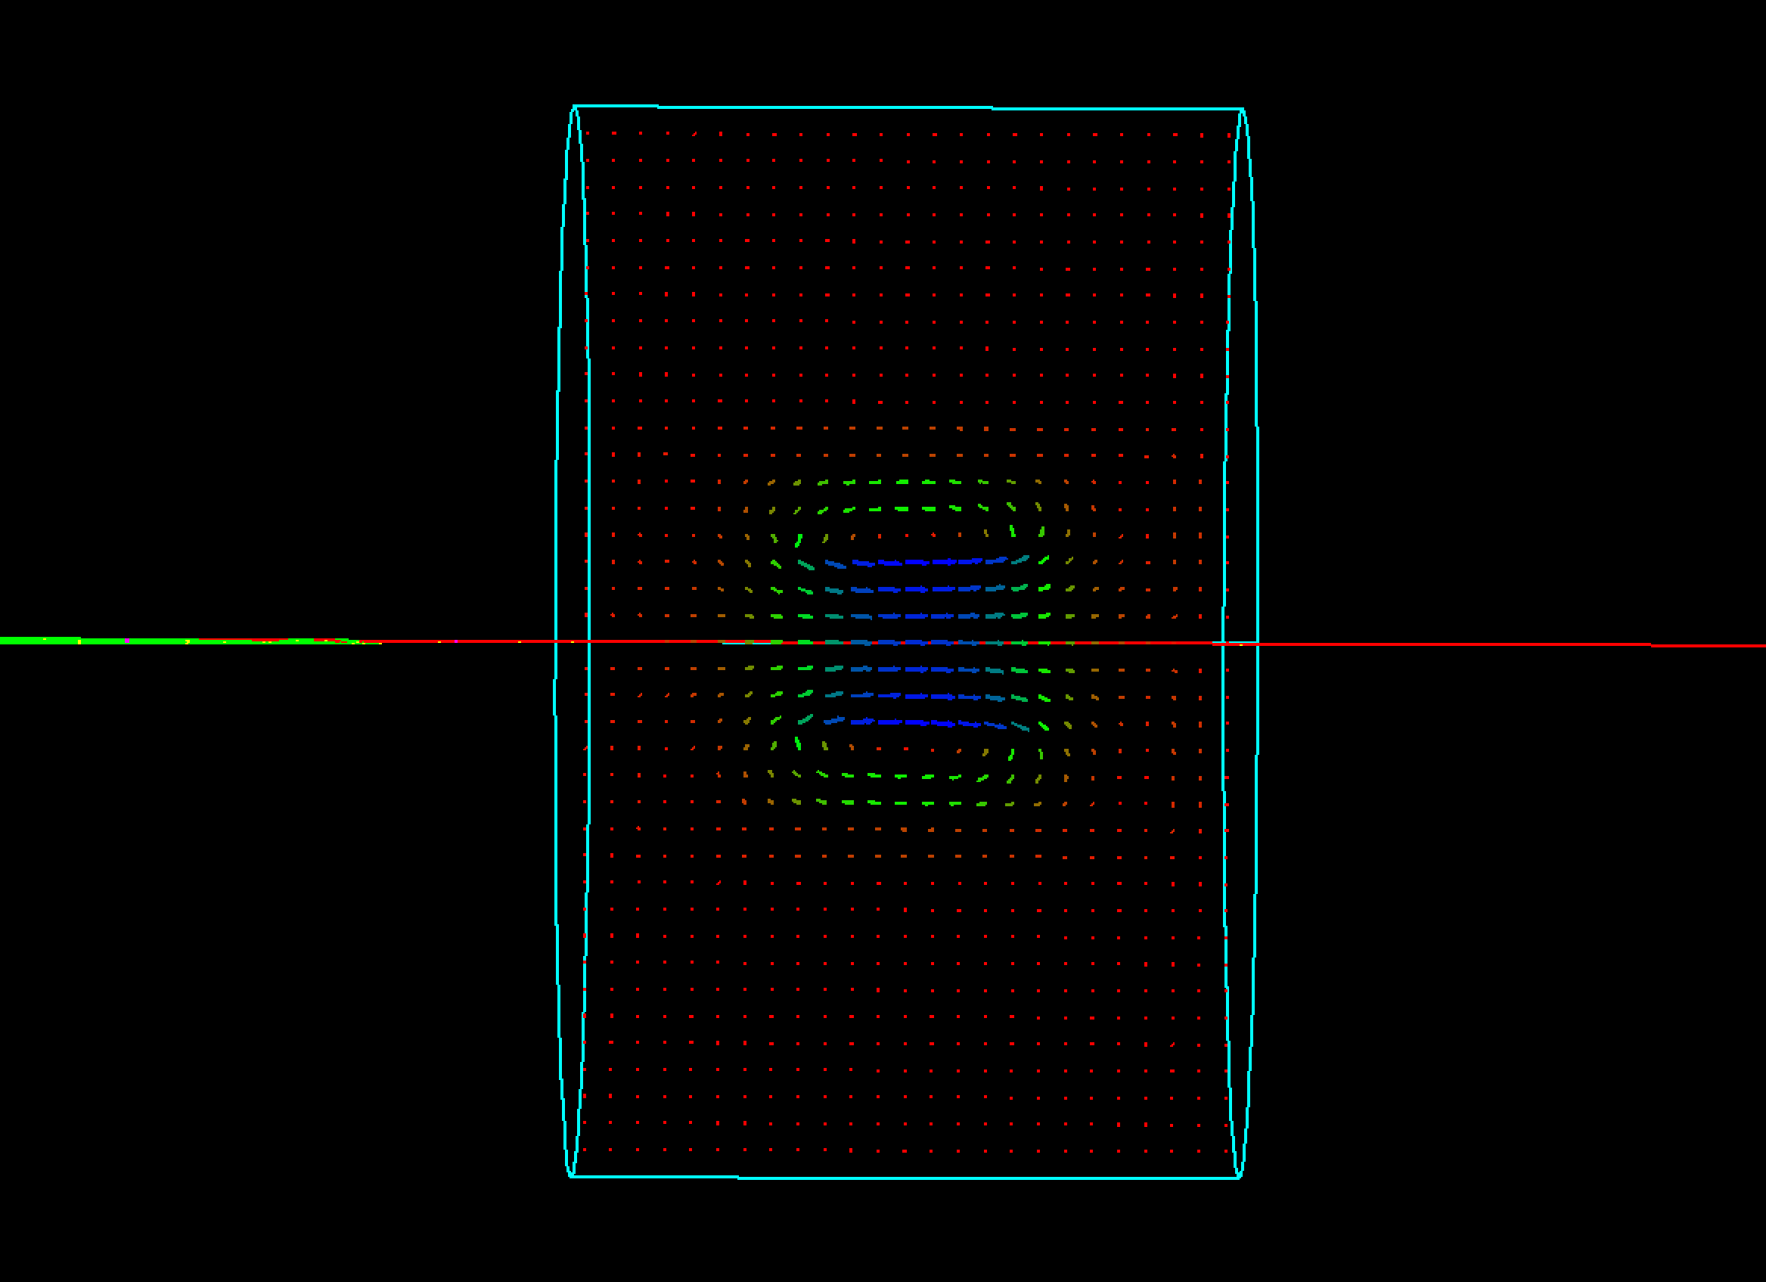
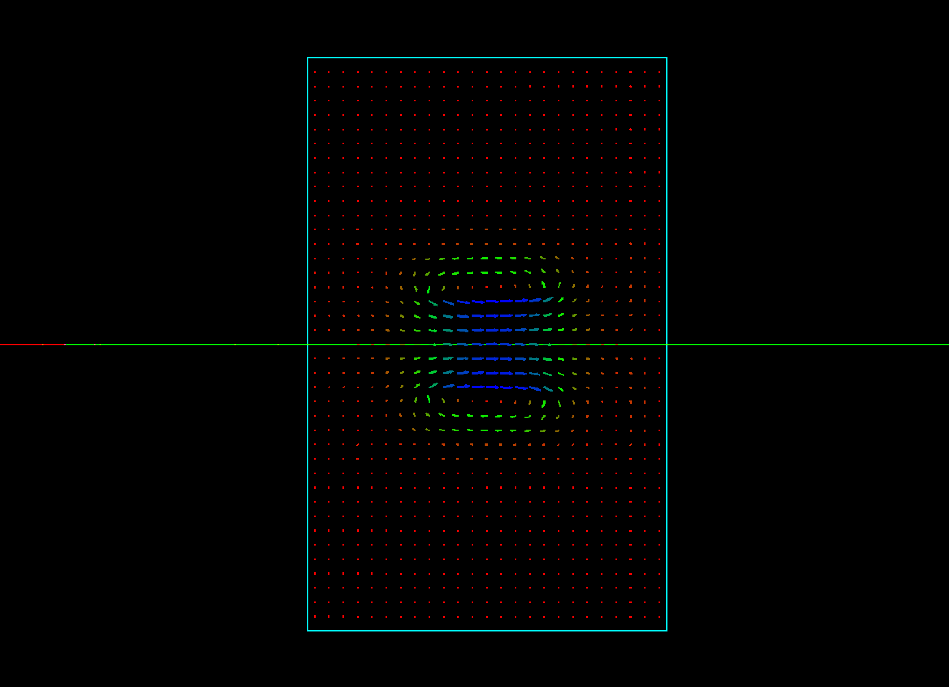
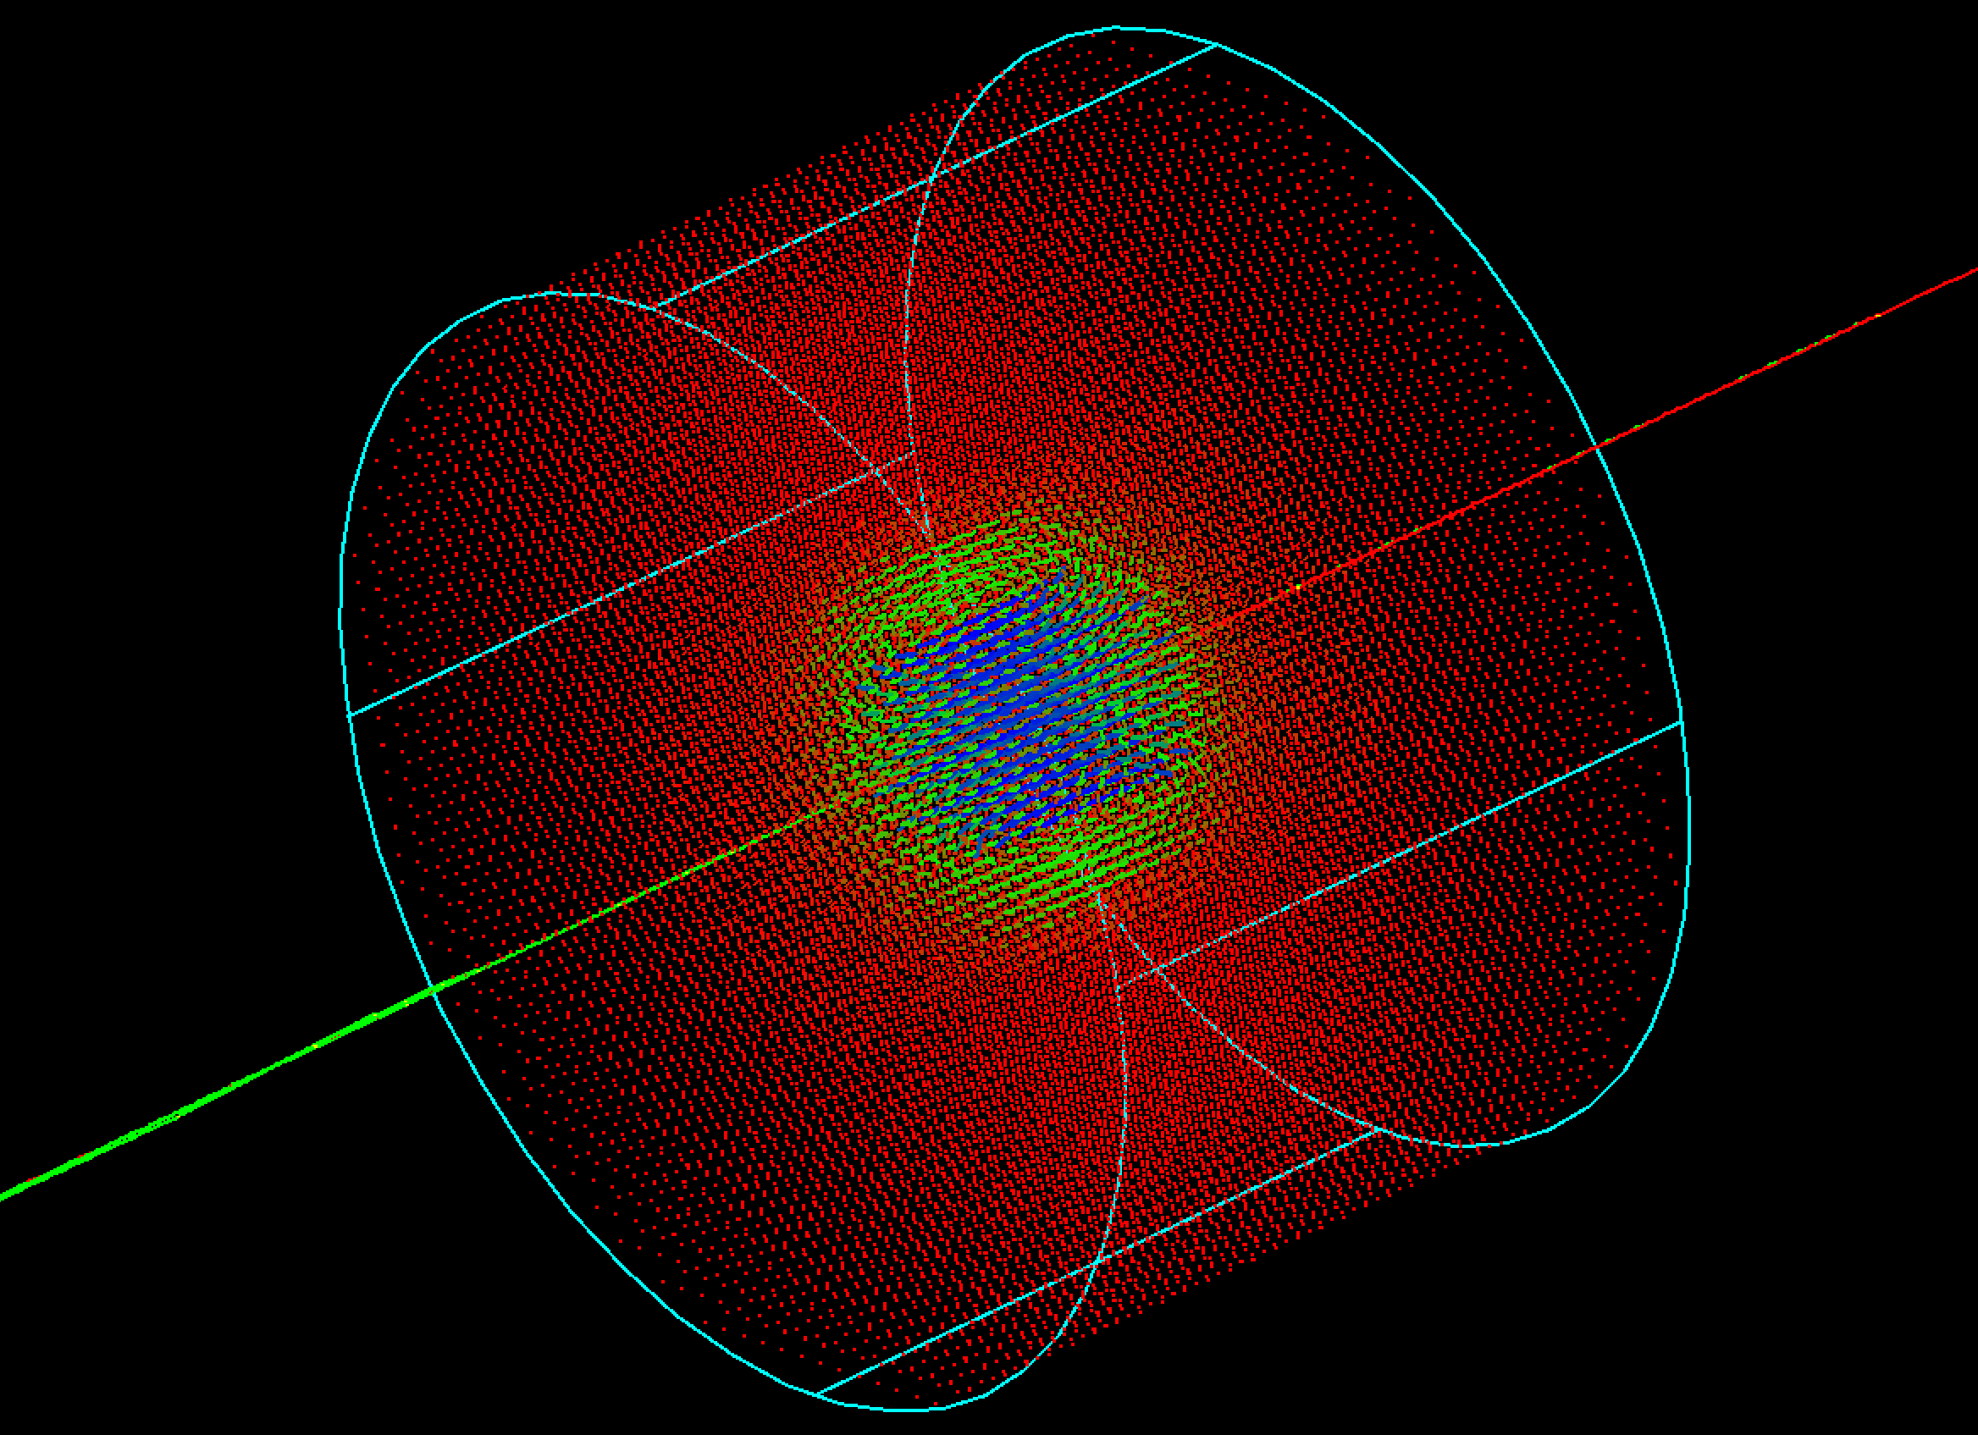
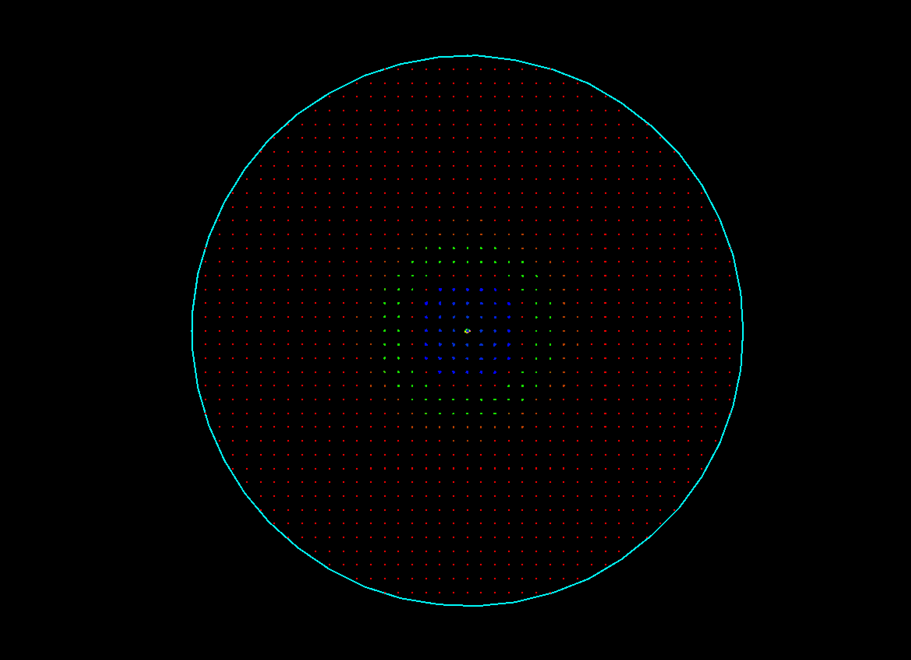
Detector solenoid field in the custom-built Geant4
X-Z (|Y| <= 2cm)
Y-Z (|X| <= 2cm)
X-Y-Z
Y-X (|Z| <= 2cm)

Slide 7
X-ray reflection process

Slide 8
X-ray reflection process in Geant4 (updates)
Since X-ray reflection as a standard gamma process was missing in Geant4, the Geant4 developers have recently (Dec. 2023) implemented this process; see #50 FCC-ee MDI meeting
  They use the same material reflection database (like Synrad+) prepared by B.L. Henke et al.
  Unfortunately, they consider only specular (mirror-like) reflection with an attenuation factor to include surface roughness
Compare the following codes developed for X-ray reflection
  Synrad+ (after recent discussions, bugfixes and new features have been implemented by the developers; see Synrad+/Molfow+ Forum) – diffuse reflection
    Old reflection model (based on Synrad [R.Kersevan, SSC 1993, 10.1109/PAC.1993.309821])
    New reflection model (based on Synrad3D [G.Dugan, D.Sagan, Cornell 2013, 10.5170/CERN-2013-002.117] )
  Custom-built Geant4 code
    With the Debye-Waller attenuation factor (similar to the geant4-release) – specular reflection
    With the reflection surface normal random tilt (similar to the old model in Synrad+) – diffuse reflection
  Geant4 release with the Névot-Croce attenuation factor – specular reflection

Slide 9
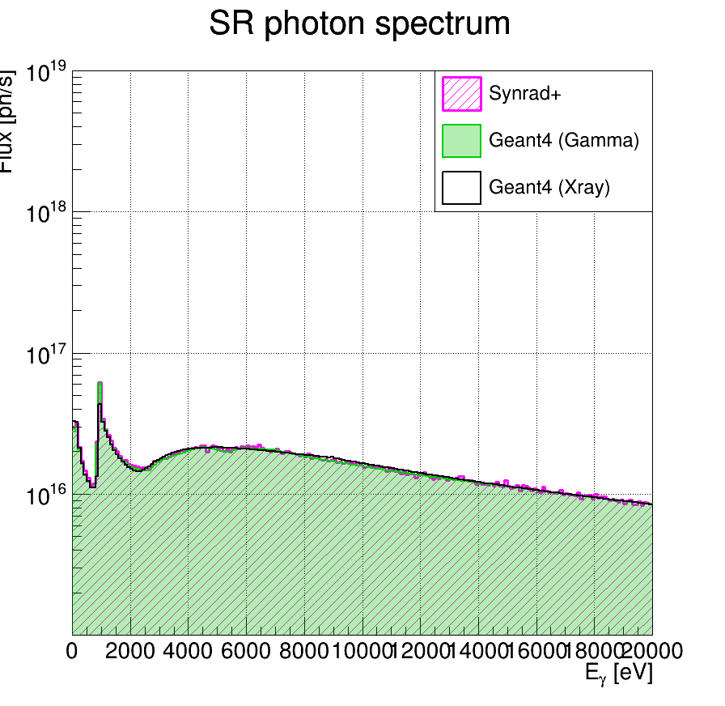
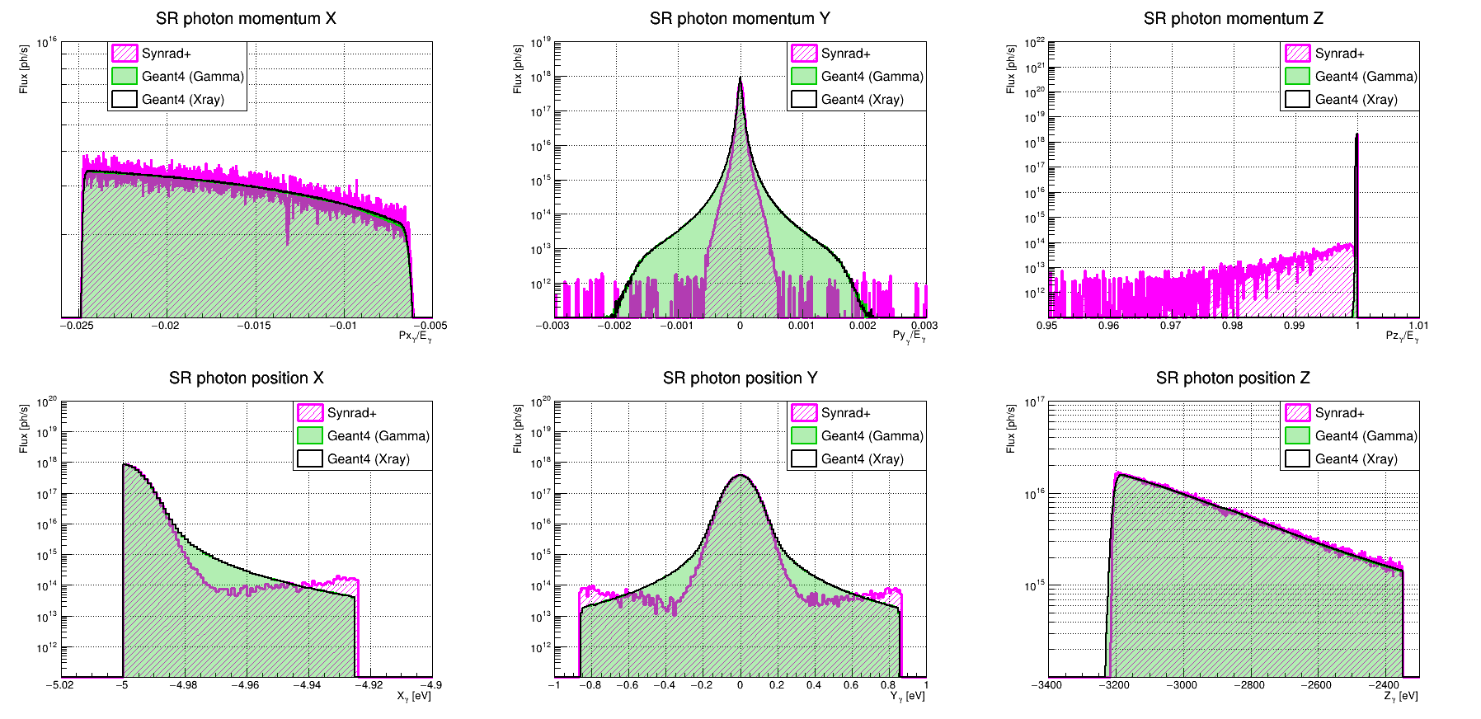
X-ray reflection process benchmark:
Synrad+ (v1.4.33/v1.4.34 bugfix) vs Geant4 (Gamma, custom-built) vs Geant4 (Xray, adobted from geant4-release-11.2.0)
Surface roughness RMS = 0 nm
Good agreement between all codes and models

Slide 10
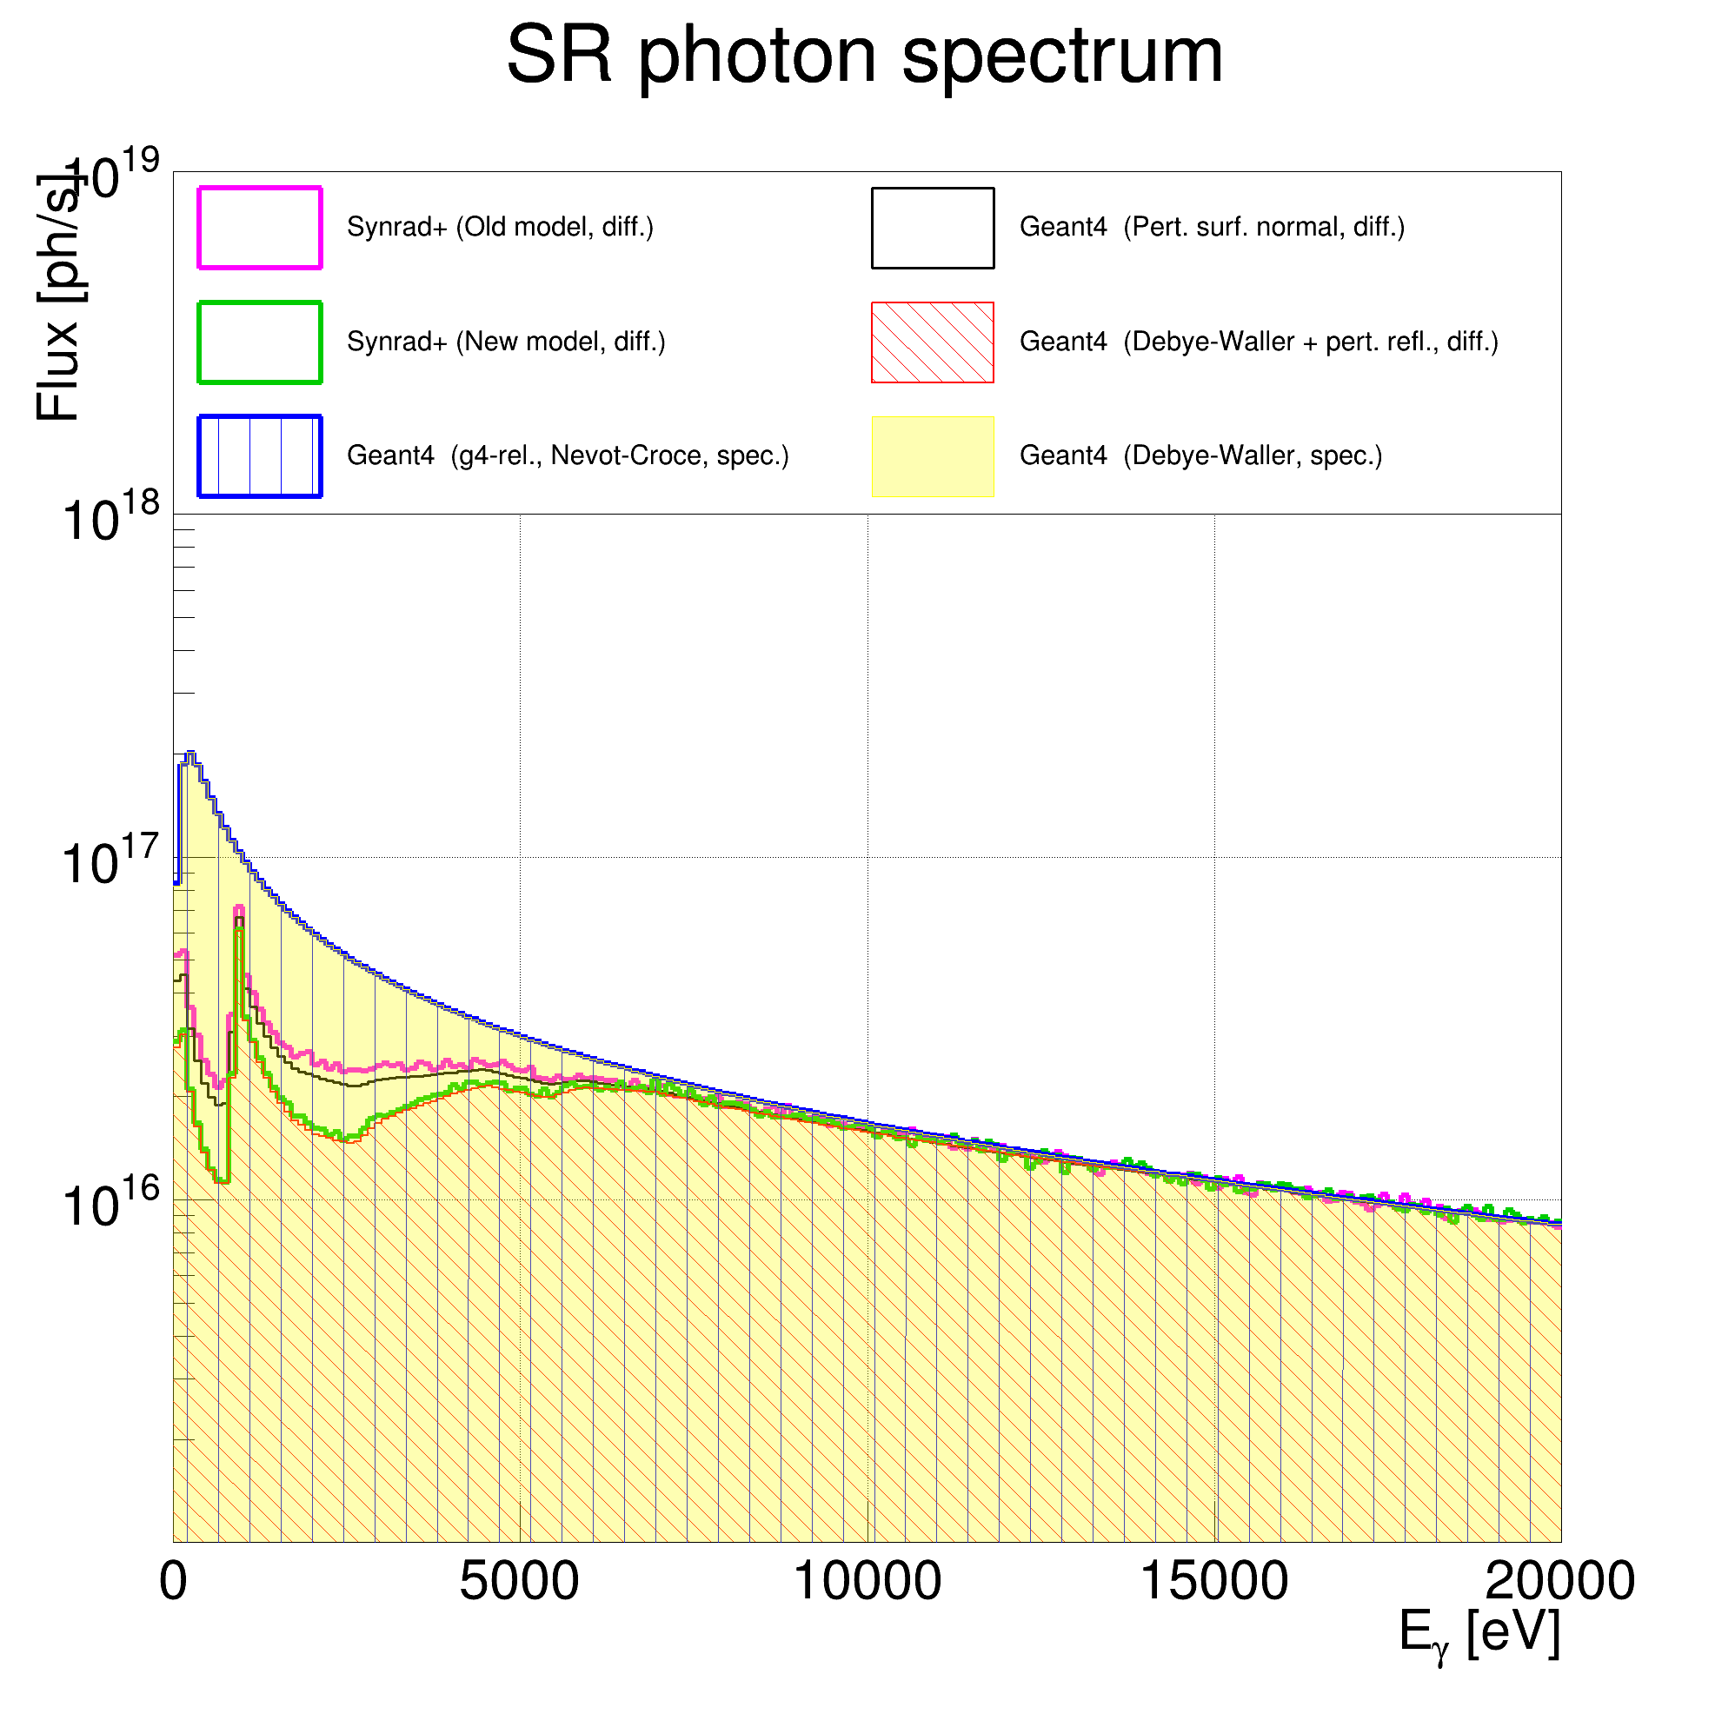
X-ray reflection process benchmark:
Synrad+ (v1.4.33/v1.4.34 bugfix) vs Geant4 (Gamma, custom-built) vs Geant4 (Xray, adobted from geant4-release-11.2.0)
Surface roughness RMS = 50 nm
Good agreement
between Geant4 codes for specular reflection
(blue and yellow)
old model Synrad+ vs Geant4 code for diffuse reflection
(magenta vs black)
new model Synrad+ vs Geant4 code for diffuse reflection
(green vs red)
More plots are in Backups

Slide 11
Beam pipe geometry

Slide 12
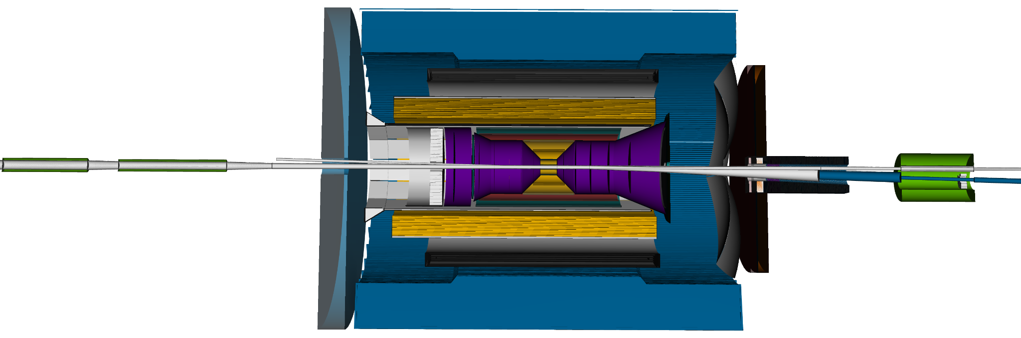
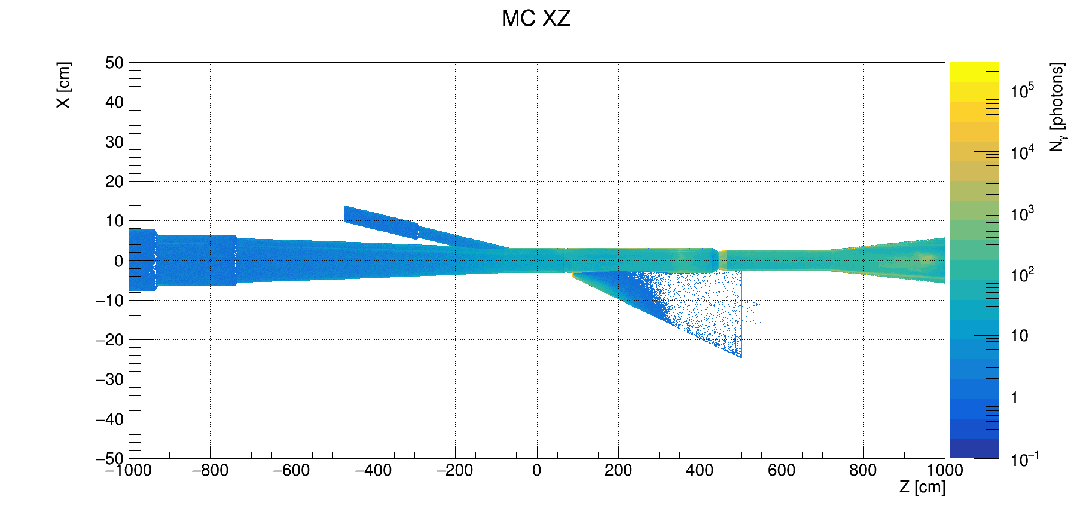
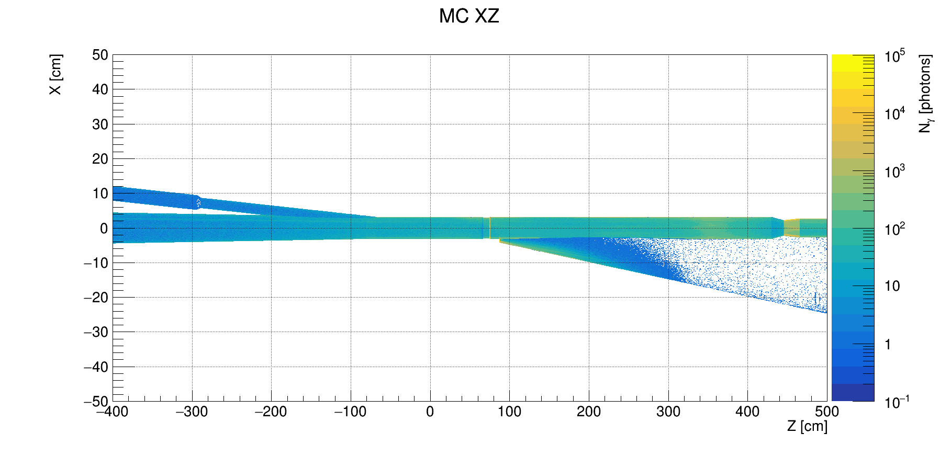
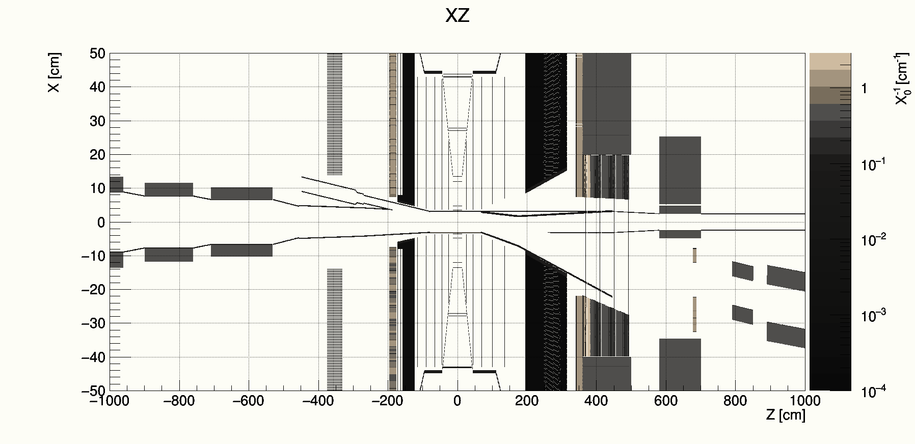
Beam pipe geometry inconsistency
It is unclear which beam pipe geometry is correct
Assumption: consider the Synrad+ vacuum model (prepared by Charlie) as a correct geometry since it is given as a single STL file (hard to modify)
→ MCparticles generated in eic-shell (color)
Material scan (black)

Slide 13
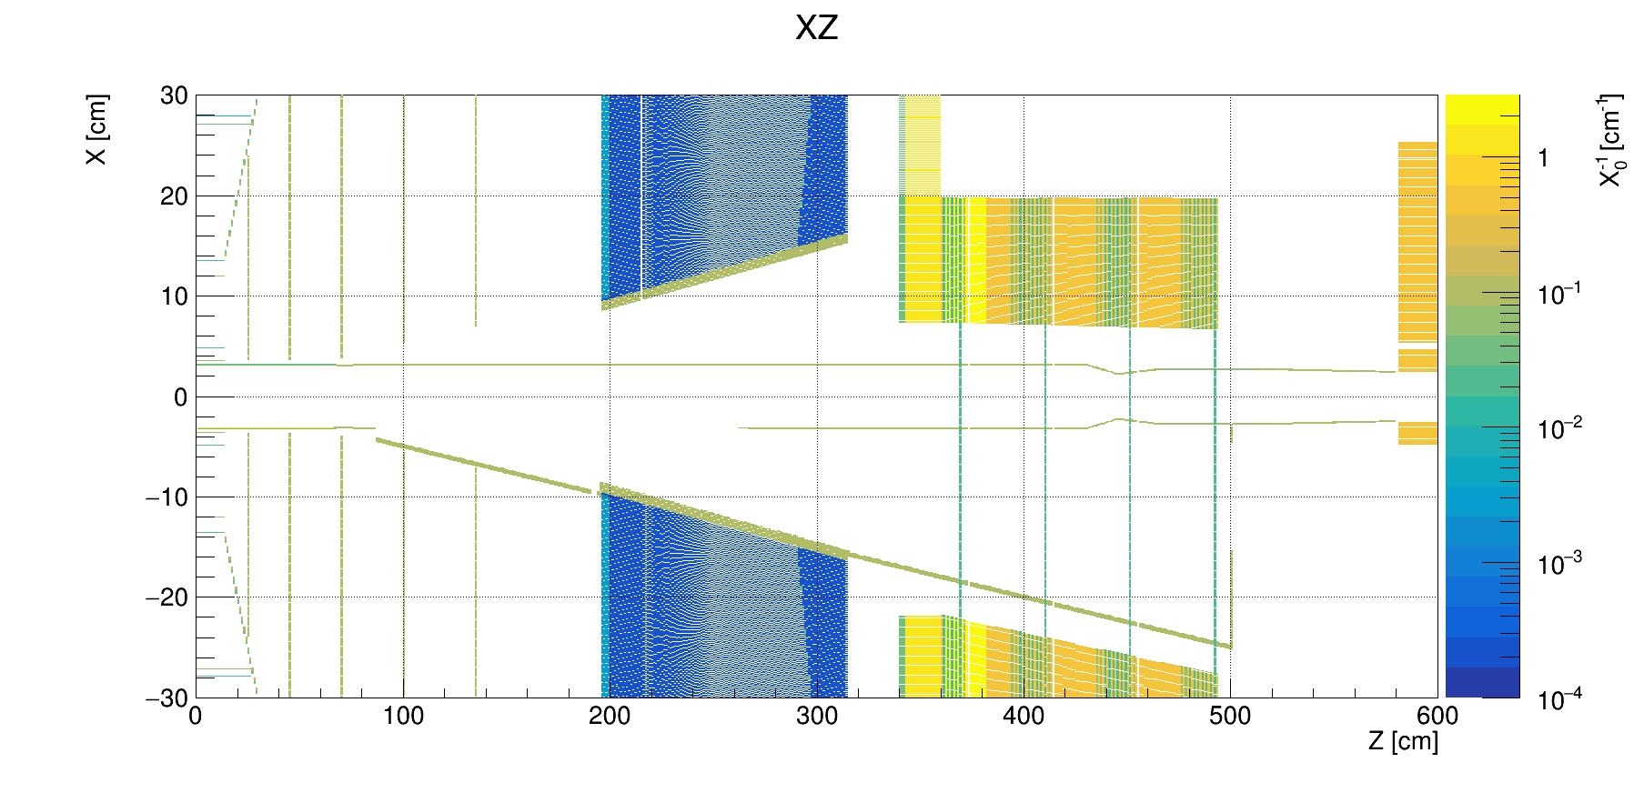
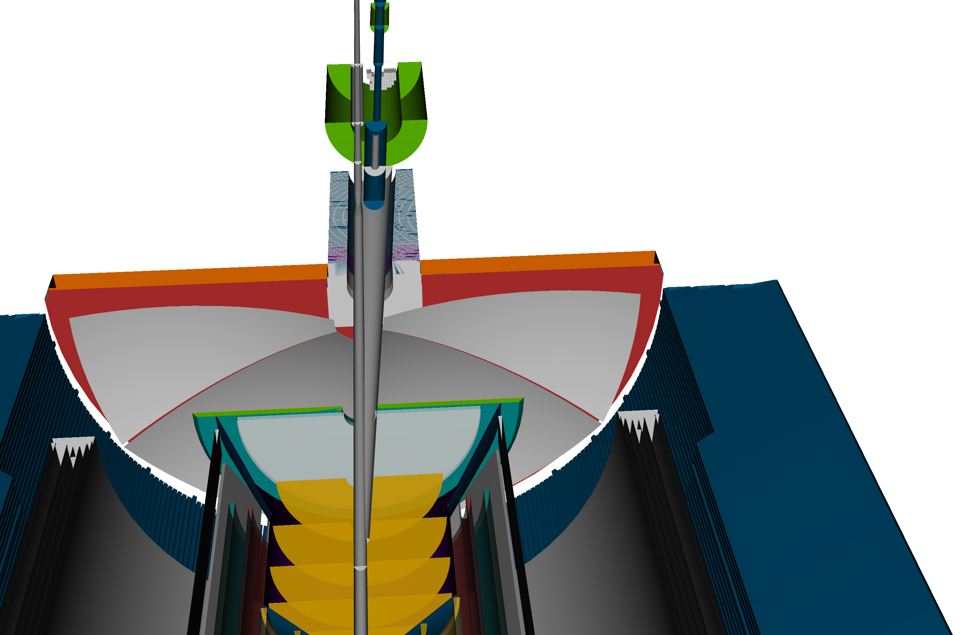
Adjusted beam pipe overlap with ePIC

Slide 14
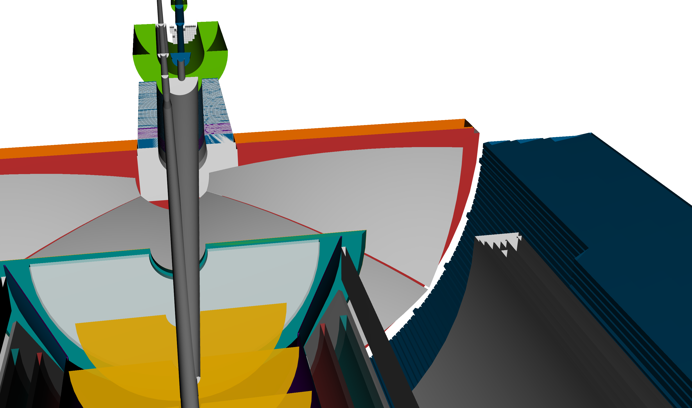
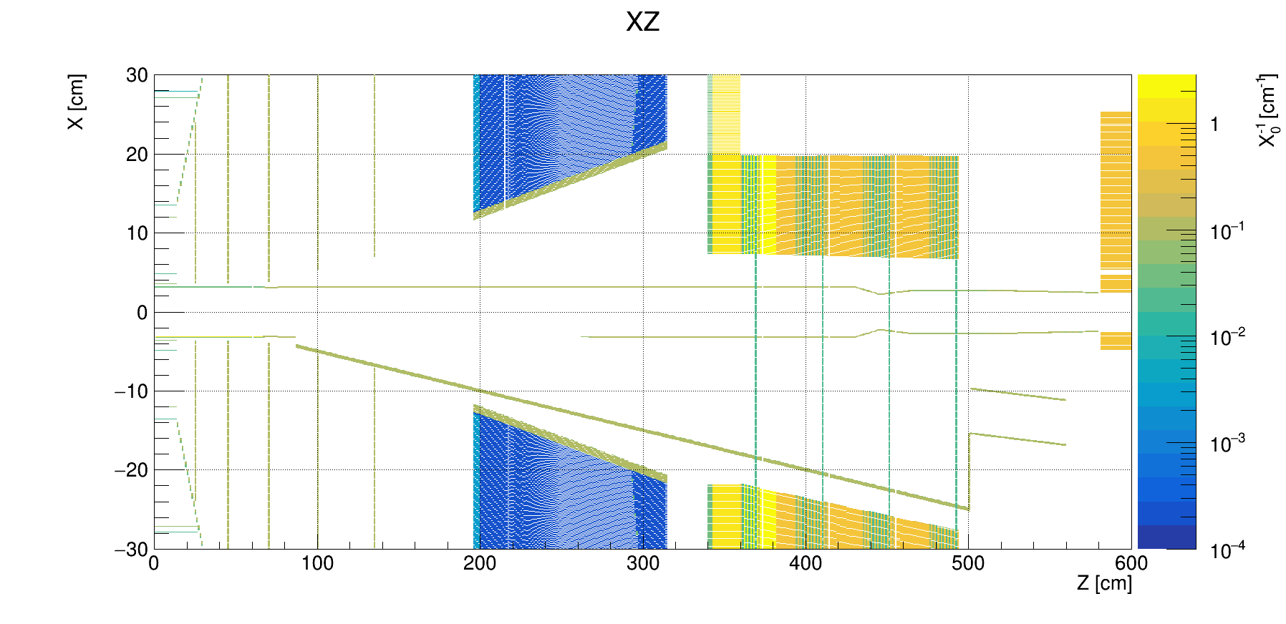
Adjusted ePIC geometry
Only as a temporary solution
compact/definitions.xml
<constant name="ForwardRICHRegion_tan1" value="CentralTrackingRegionP_tan * 0.88 1.20" />
<constant name="ForwardRICHRegion_tan2" value="Eta3_6_tan * 0.89 1.20" />
compact/tracking/definitions.xml
<constant name="ForwardTOFRegion_minR" value=”8 13*cm" />

Slide 15
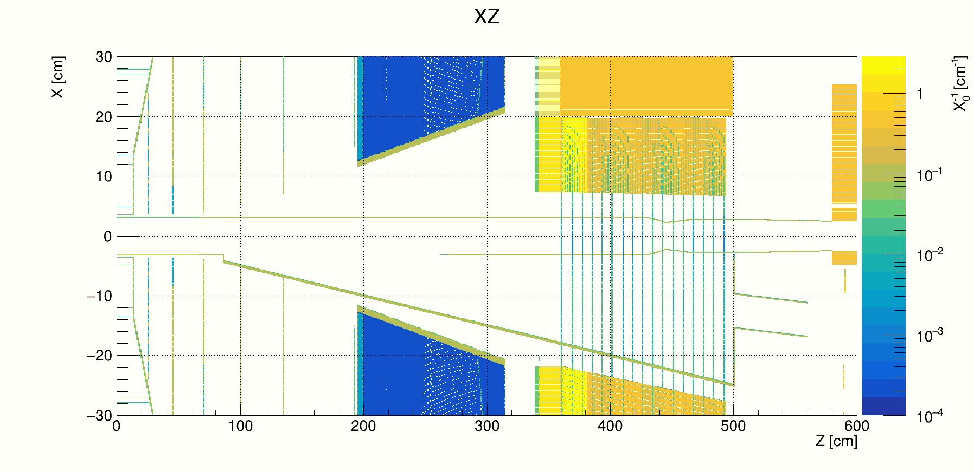
Beam pipe geometry modification
The new beam pipe modeling is now much closer to the Synrad+ geometry.
Although it might not be the final/recent beam pipe geometry, we define it as a reference to compare the simulated SR impact on the detector background.
BEFORE
AFTER
→ MCparticles generated in eic-shell (color)
Material scan (black)
More plots are in Backups

Slide 16
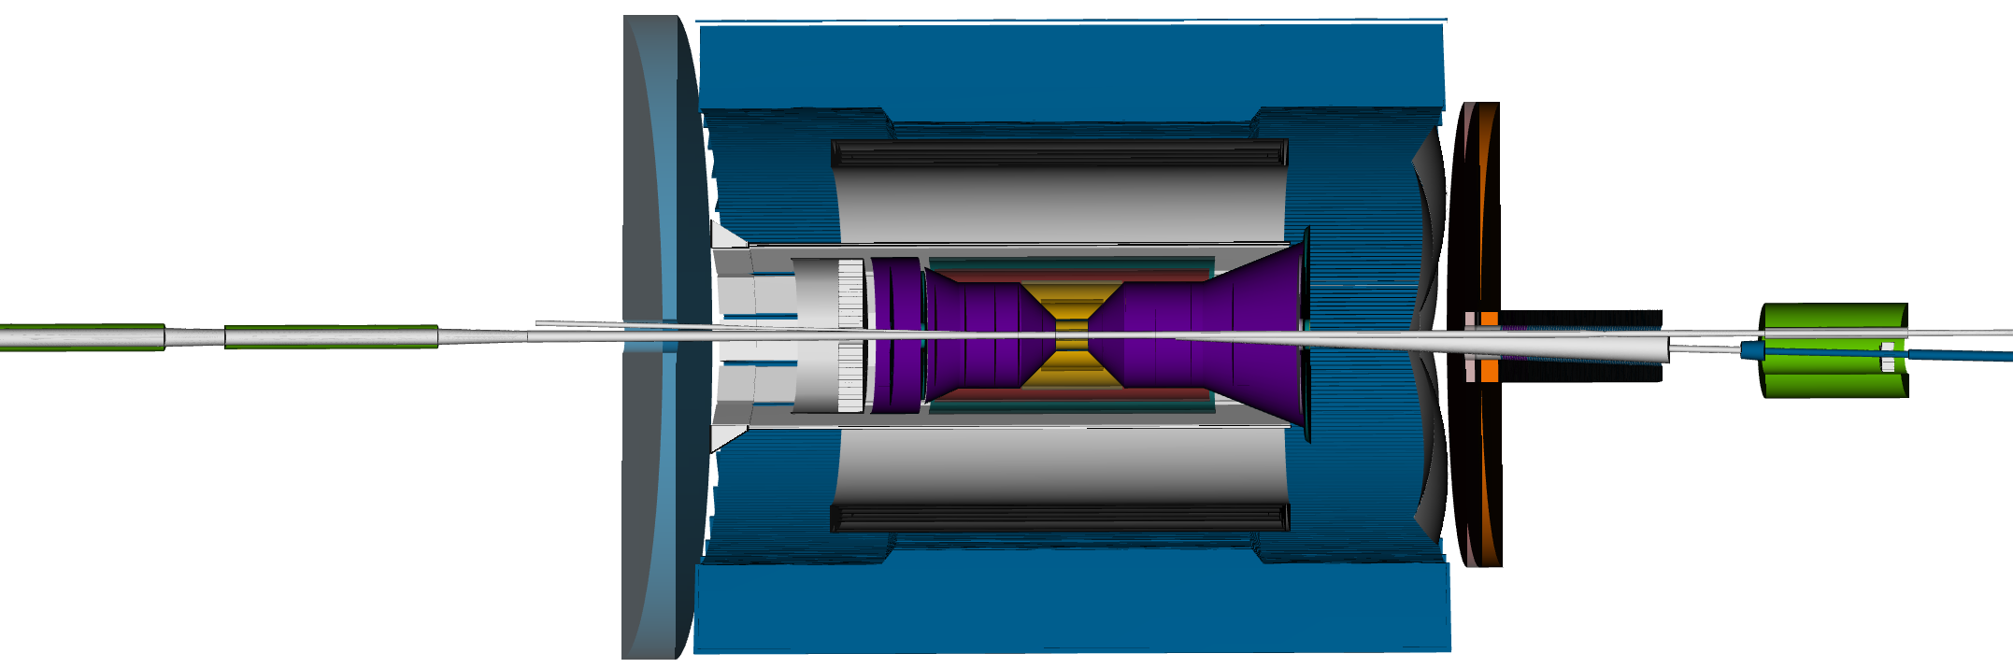
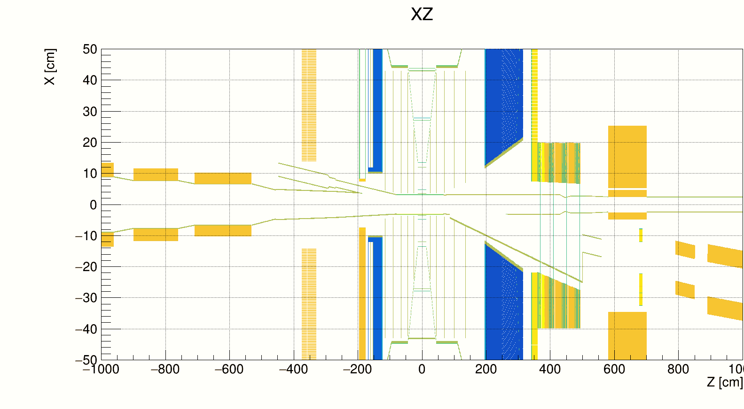
Adjusted beam pipe geometry
This part was not adjusted
→ MCparticles generated in eic-shell (color)
Material scan (black)
This part was not adjusted
Used for the ePIC SR background simulation

Slide 17
SR background simulation

Slide 18
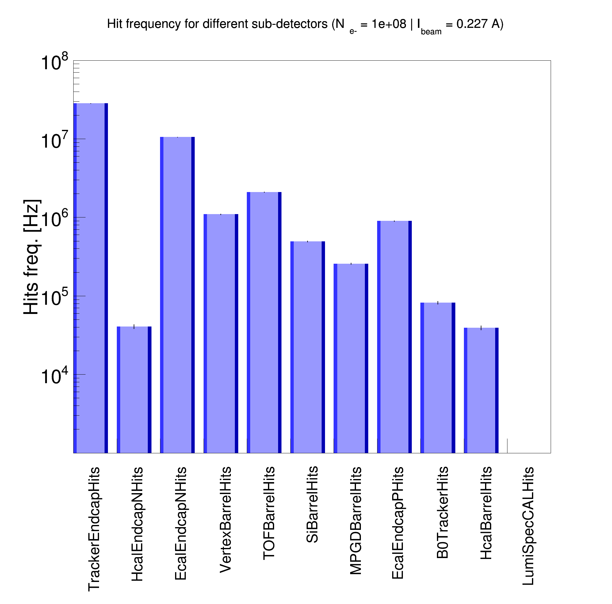
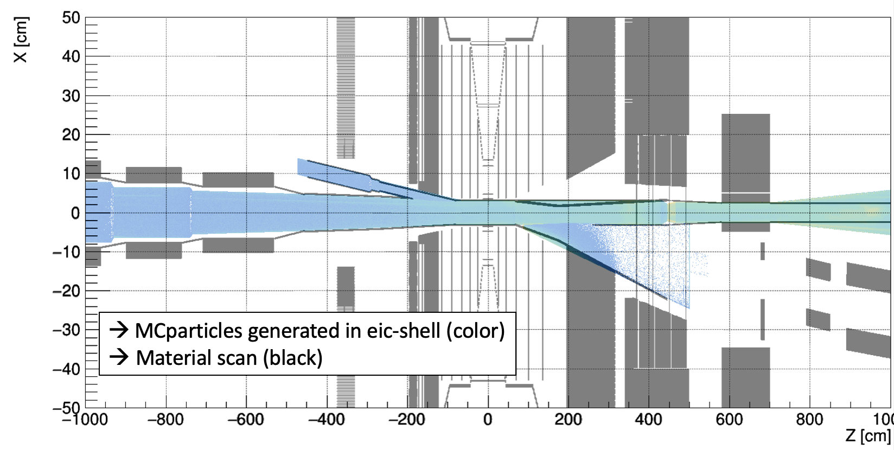
ePIC SR background: Rates with inconsistent geometries
High SR background rates (> 1 MHz) due to generated SR photons outside the vacuum beam pipe
-10m < z < 10m
E_{𝛄} > 4 eV
First custom-built Geant4 SR model
(contained bugs)
From Dec. 2023 meeting

Slide 19
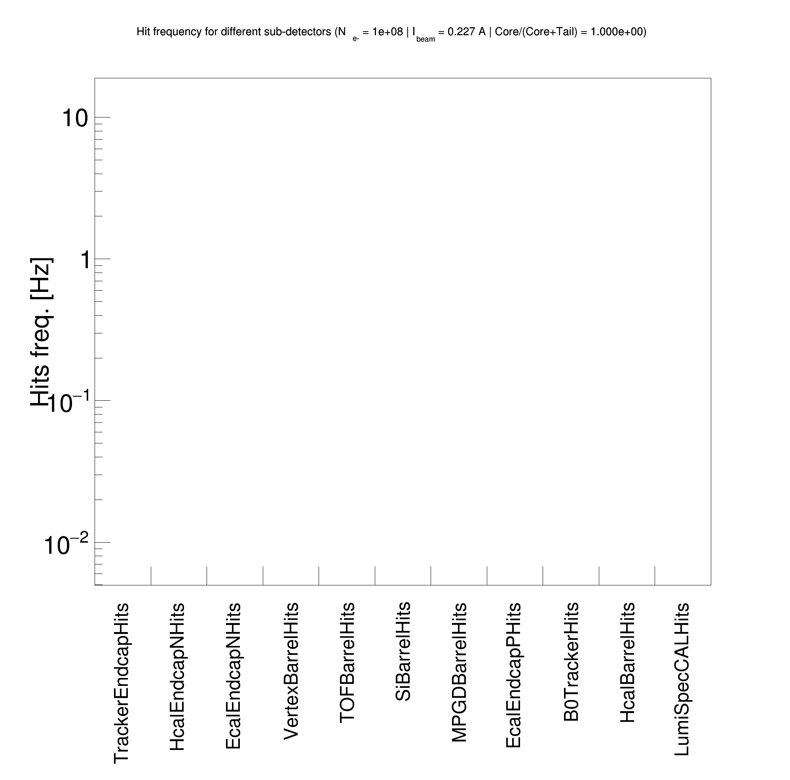
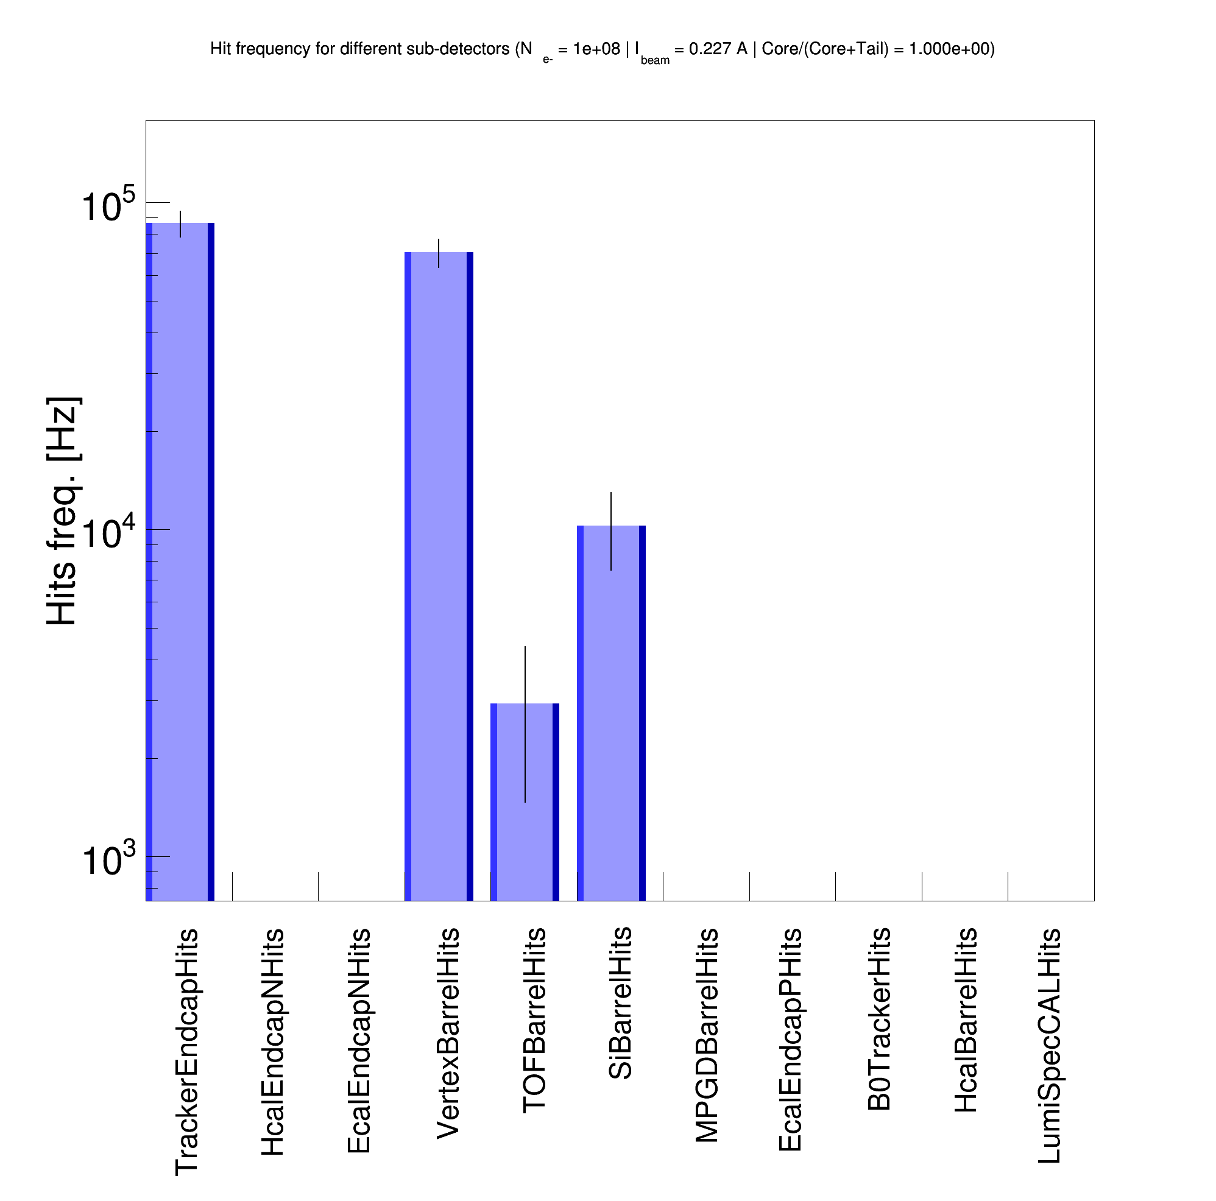
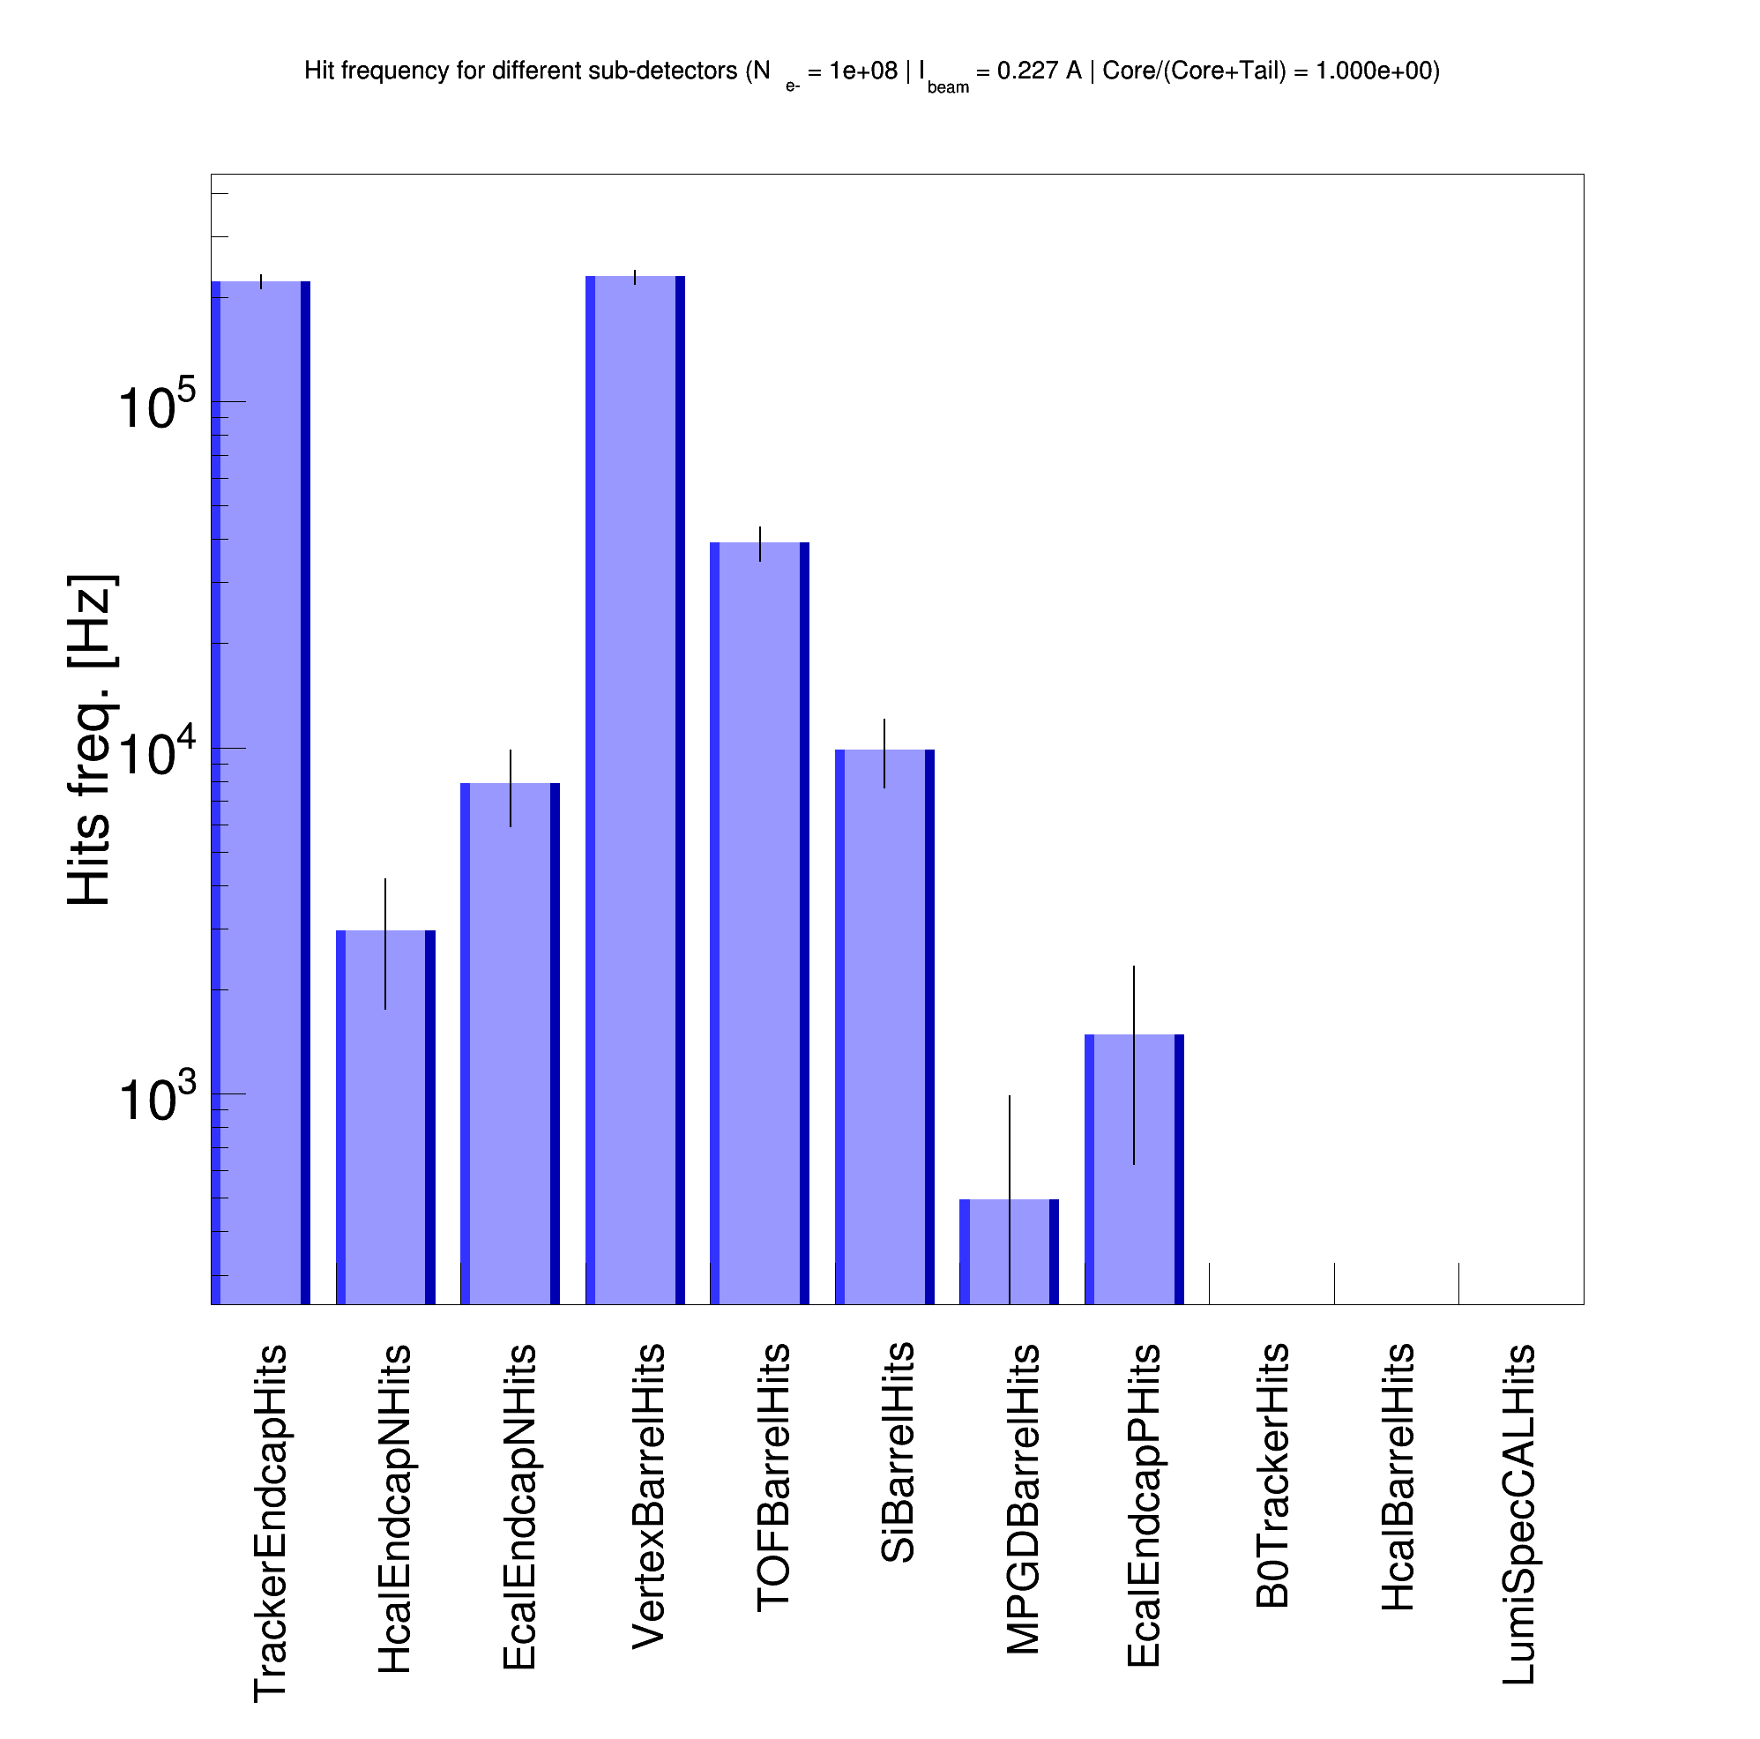
ePIC SR background: Rates with adjusted geometries
Improving the X-ray reflection process and tuning the beam pipe in the eic-shell to the CAD/STL model make the SR background in the ePIC detector more realistic with diffuse reflection, i.e., SR background rates ~ 0.1 MHz (e.g., electron beam-gas rates ~3 MHz [ref.])
Custom-built Geant4
(X-ray, Névot-Croce, adopted from geant4-release-11.2.0)
Specular reflection
Custom-built Geant4
(Gamma, Debye-Waller)
Specular reflection
Custom-built Geant4
(Gamma, surf. normal tilt, like the old Synrad+ model)
Diffuse reflection
Custom-built Geant4
(Gamma, Debye-Waller + perturbed reflection direction, like the new Synrad+ model)
Diffuse reflection
-4m < z < 5m
E_{𝛄} > 30 eV
-4m < z < 5m
E_{𝛄} > 30 eV
-4m < z < 5m
E_{𝛄} > 30 eV
-4m < z < 5m
E_{𝛄} > 30 eV

Slide 20
Beam tail modeling

Slide 21
Overview
The realistic/actual beam tail distribution modeling is a challenging task
  Usually, one has to include all possible beam-scattering processes with beam dynamics in the machine lattice, possible machine errors, and collimators
So far, we do not have a reliable multi-turn particle tracking code for the EIC
  Therefore, we have to rely on some assumptions and approximations
Christoph Montag’s model [optimistic]: ← first trial; see Dec. 2023 meeting
  Non-gaussian tails caused by beam-beam and beam-gas scattering events
  Enhancement of the electron beam population at large amplitude (beam tails) occurs predominantly in the vertical plane
  The core of the model – parametrized simulated beam tails
    No tails in the horizontal plane at E_{e-} = 18 GeV
    The vertical beam tail integral is about 10^{—8} of the beam core
Mike Sullivan’s model [conservative]: ← next step
  Gaussian beam tails as an equilibrium between beam lifetime (beam particles are scattered out of the core into the tails) and SR damping (beam tail particles are pulled back to the core)
    Especially true for the horizontal plane
  The integral of beam tails should not exceed a certain value to avoid luminosity degradation
    Arbitrary threshold: the tail integral is < 5% of the core integral

Slide 22
Summary
Last time, we reported on the first developments of SR photon reflection in Geant4.
Since then, several improvements and features to the code have been implemented.
  Solenoid field using MARCO magnetic field map.
  Spectral and diffuse reflection processes based on the recently released Geant4 and documented old/new Synrad+ models were implemented in the custom-built Geant4 code for the SR simulation.
Furthermore, we have identified significant inconsistencies in the vacuum electron beam pipe geometry between the eic-shell (used for the ePIC background rate simulation) and the custom-built Geant4 (CAD/STL drawings imported from Synrad+).
  Since the correct beam pipe geometry is unclear, we adjusted eic-shell modeling following CAD/STL drawings. → We need correct, up-to-date vacuum beam pipe drawings.
  This temporary solution allowed us to study the ePIC SR background rates for different X-ray reflection models.
According to the findings:
  Diffuse reflection based on old and new Synrad+ algorithms works well and gives a realistic estimation of the detector's SR background level (~0.1 MHz).
  We still need to understand which model is the best for our application; each model has pros and cons.
Several Synrad+ code updates (new features and bugfixes) were triggered during the new custom-built Geant4 code development; see the following slides.

Slide 23
Next steps
Beam tails
The first optimistic model with non-Gaussian tails was tested with a very low beam halo intensity.
A more aggressive model with Gaussian tails will be tested next.
New machine lattice
Recently, we have received a new machine lattice v6.2
Questions and subjects to be studied with the SR simulation in Geant4
  Do we need to update the masks in front of ePIC?
  What photons pass and hit the beam pipe?
  Updated SR background rates?
  SR photon files?
For the review of the ancillary detectors in February:
  What are the SR background rates for the low-Q² tagger and the Luminosity monitor?
    This item requires backward beam pipe geometry modification in both eic-shell and custom-built Geant4.

Slide 24
Synrad+ updates
The new custom-built Geant4 code development triggered a few updates to the official Synrad+ software.
An option to log absorbed particles by a given facet is now available.
The logged particle flux is now correctly normalized using the correct number of simulation scans.
Due to a bug in the code, the switch for the new reflection model did not work correctly in the GUI. Now, through global settings, one can switch between old and new reflection models with one click, and it will be correctly prepared to the simulation.
For more details, please refer to the Synrad+/Molflow+ Forum:
All features and bugfixes from above are implemented in the new release v1.4.34

Slide 25
Backup

Slide 26
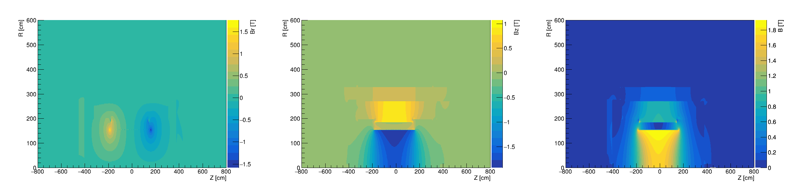
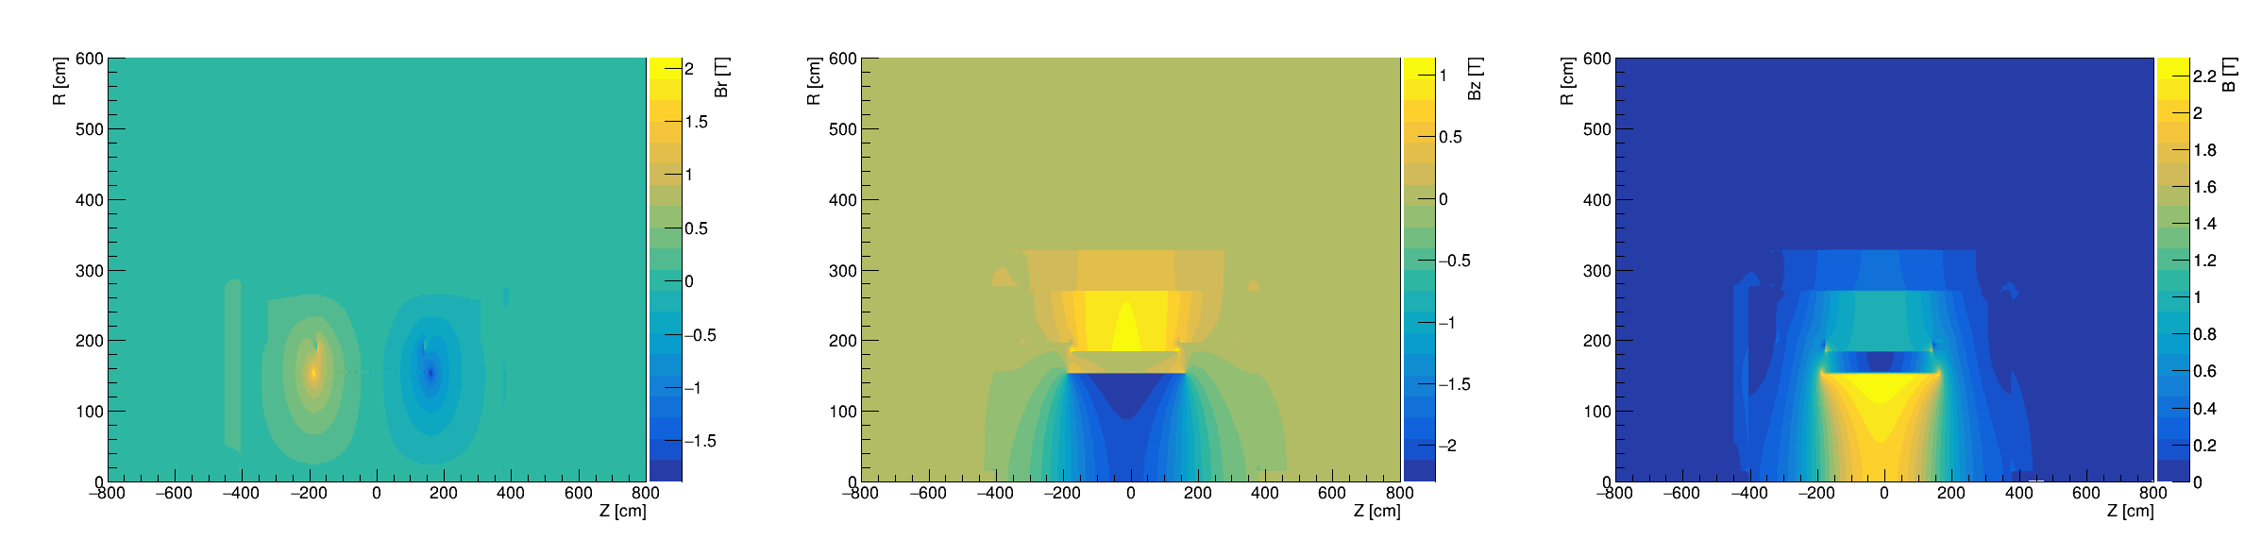
Solenoid field
B = 1.7 T
B = 2.0 T

Slide 27
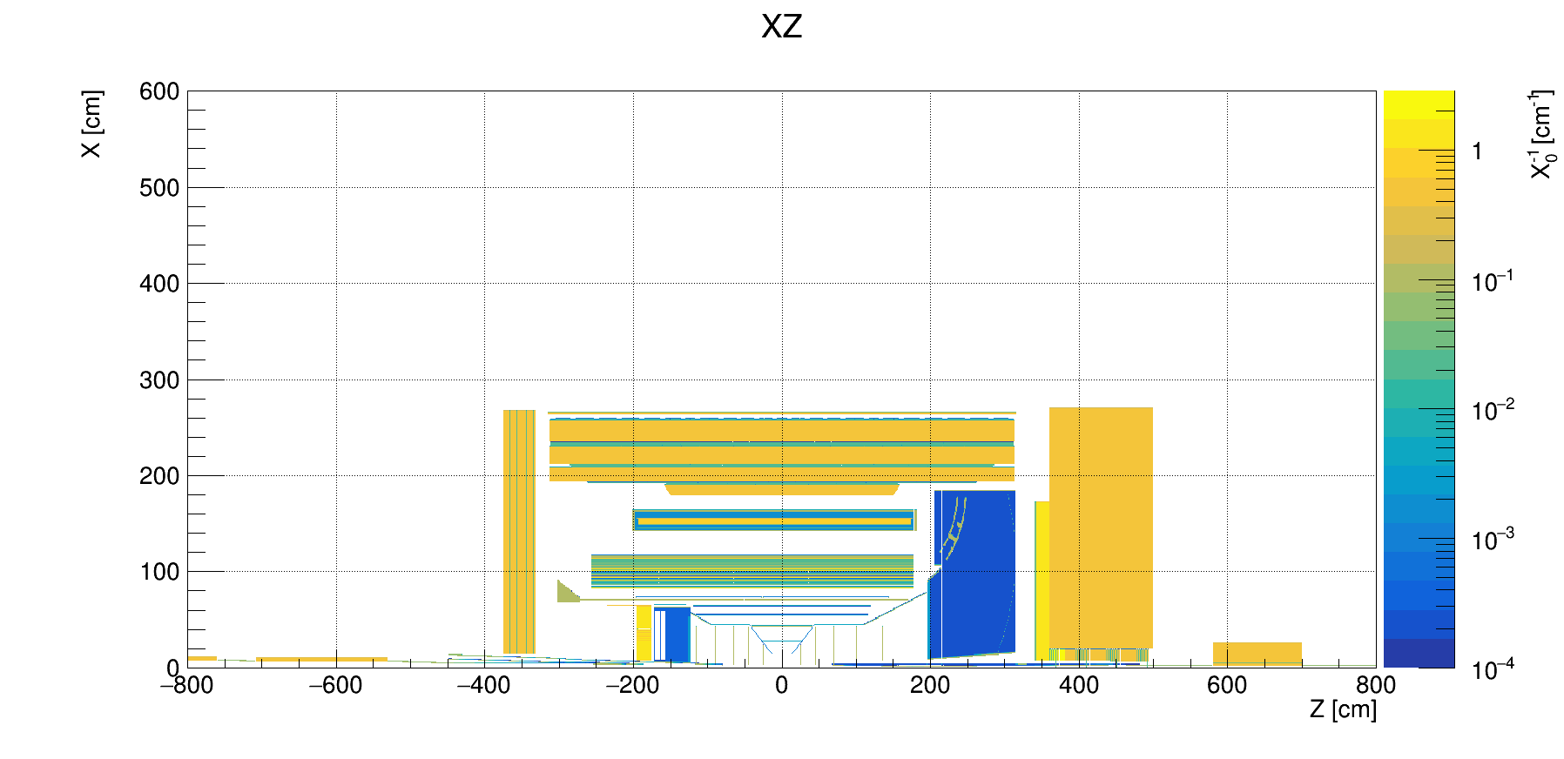
Material scan

Slide 28
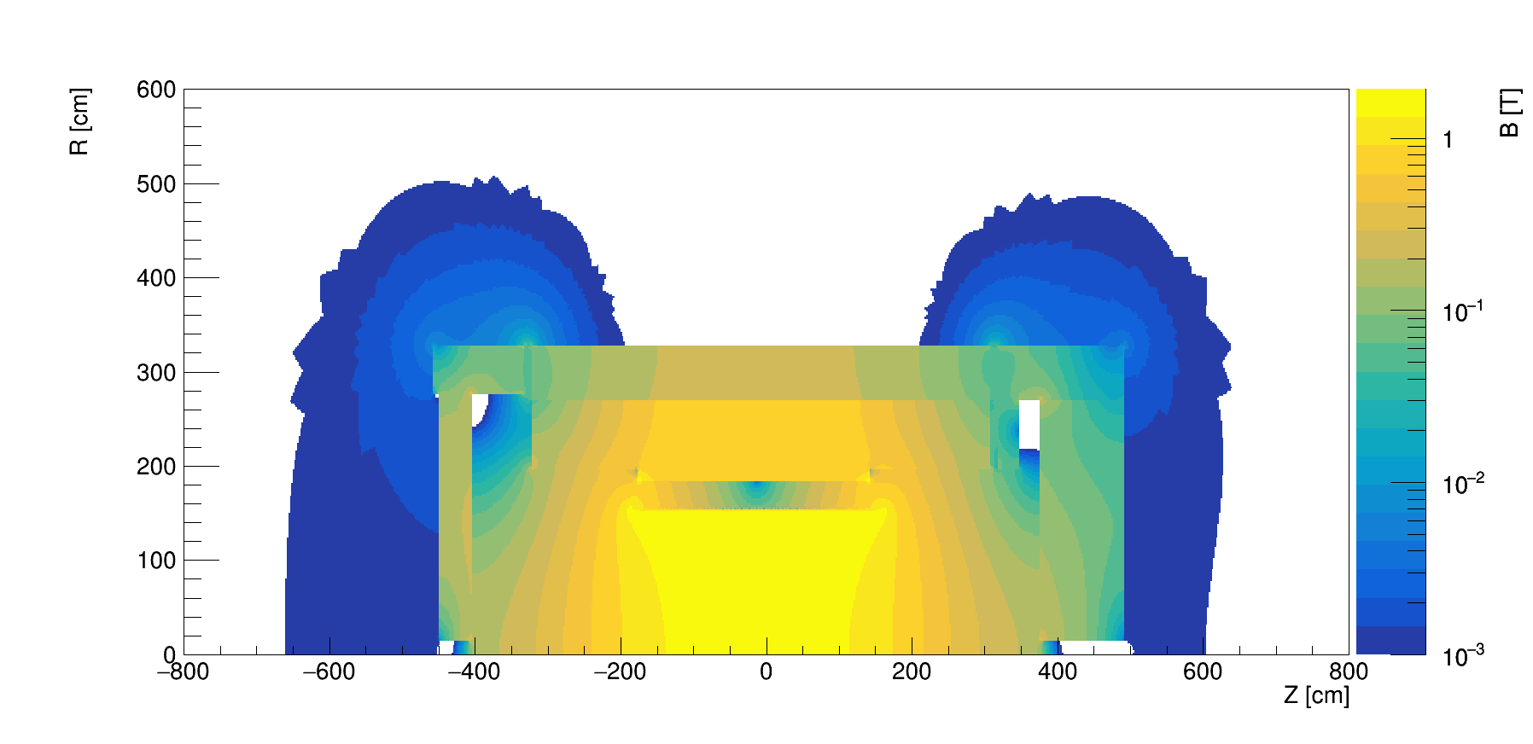
Solenoid field (1.7 T)

Slide 29
Surface roughness = 0

Slide 30
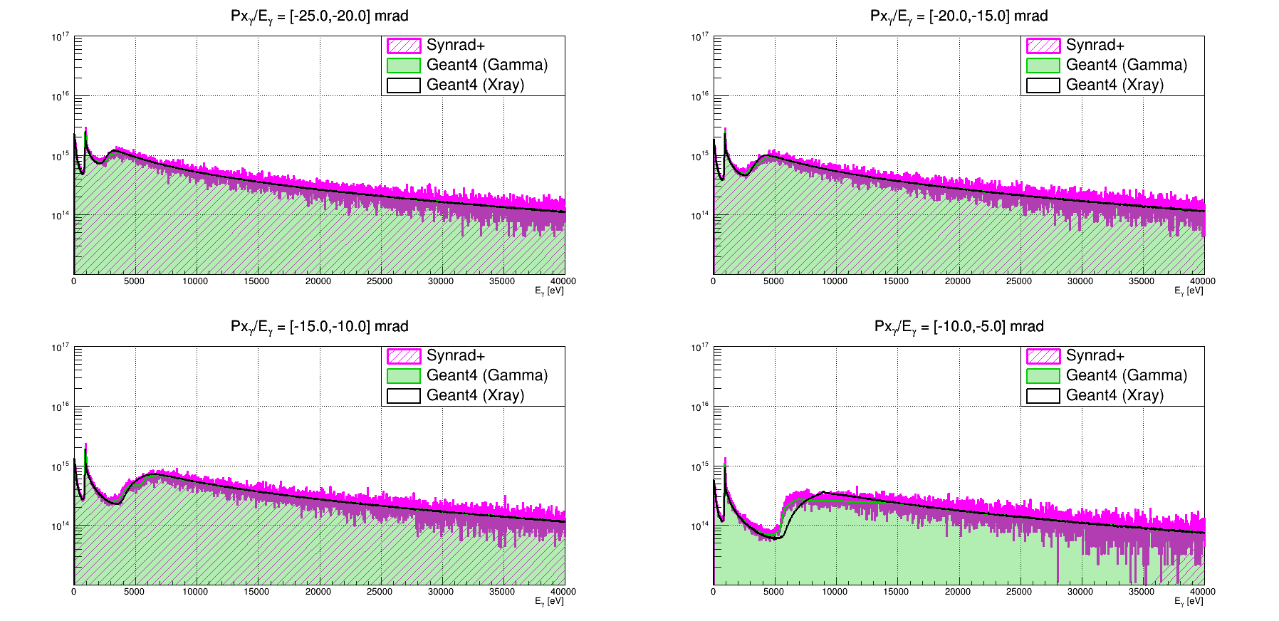
Surface roughness = 0

Slide 31
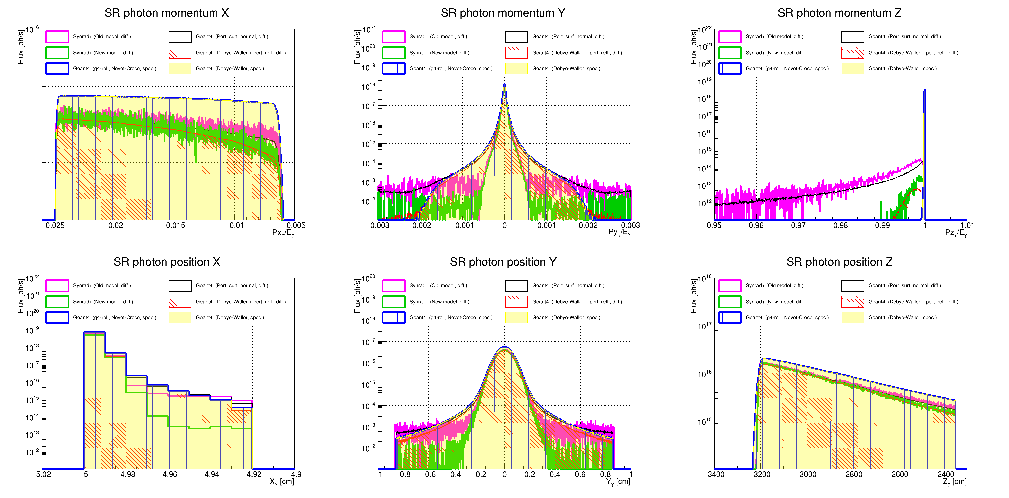
Surface roughness = 50 nm

Slide 32
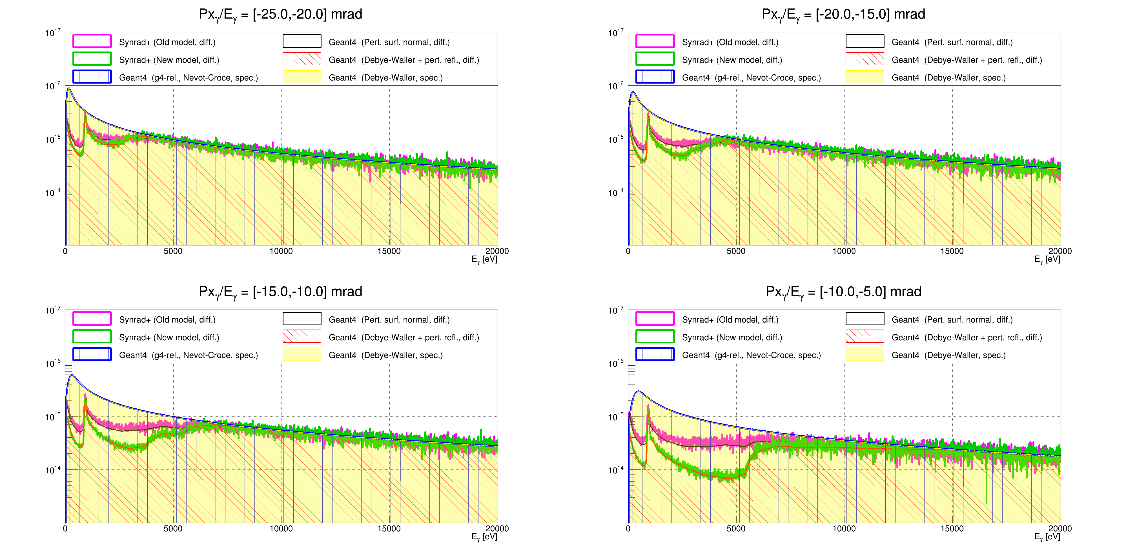
Surface roughness = 50 nm

Slide 33
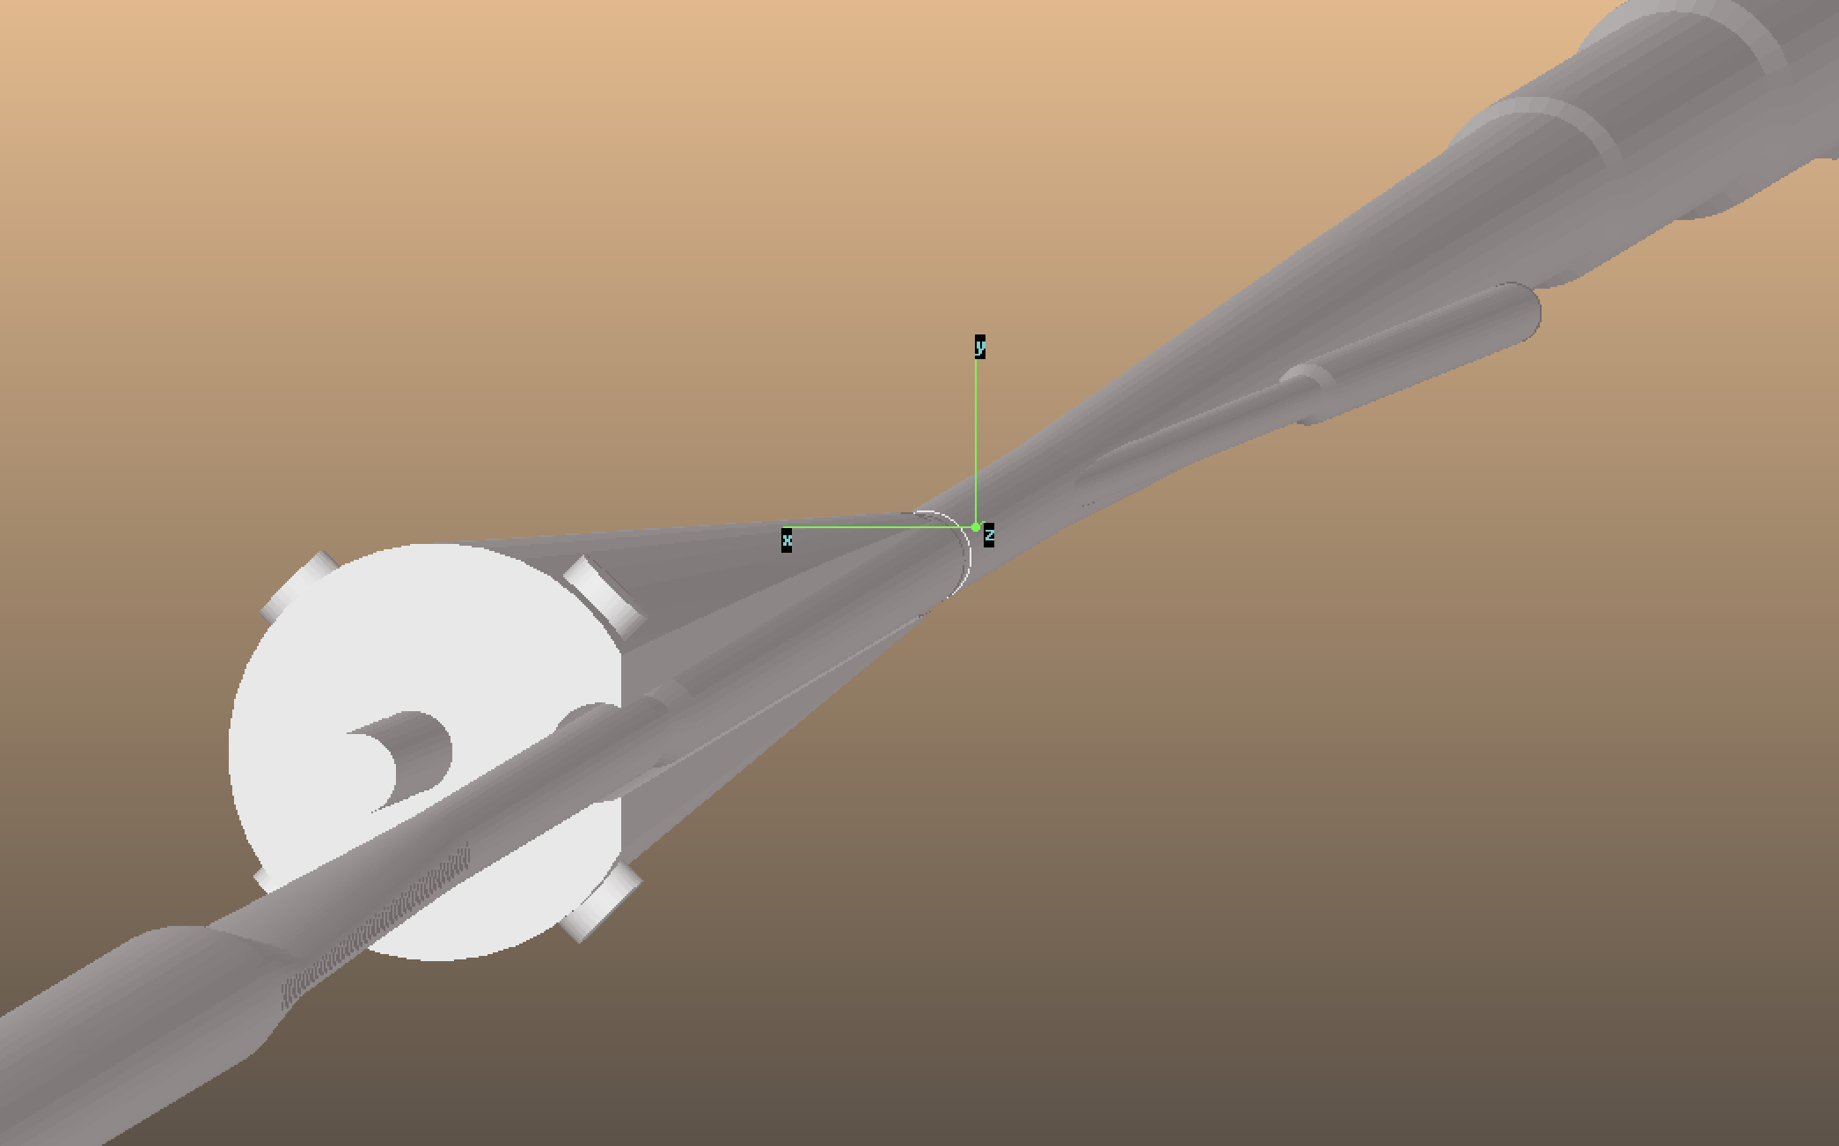
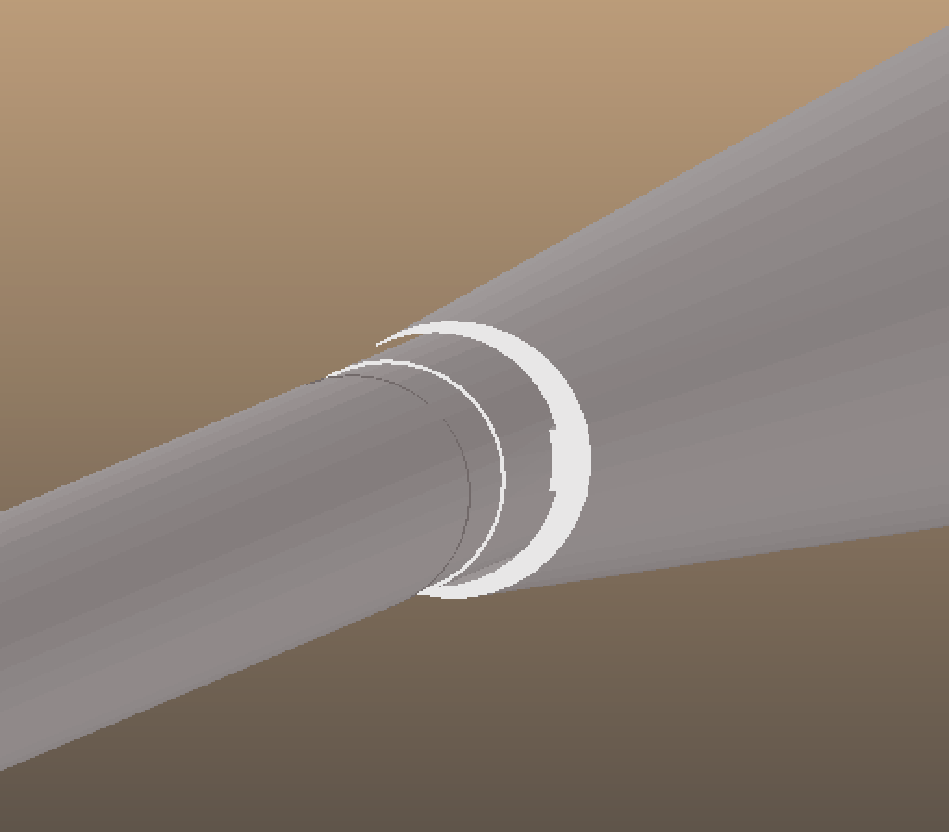
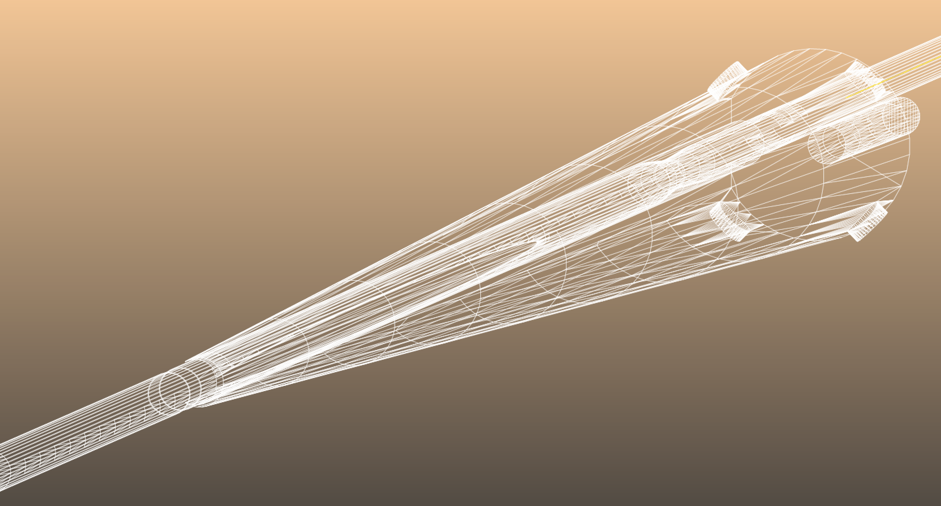
Synrad+ beam pipe geometry

Slide 34
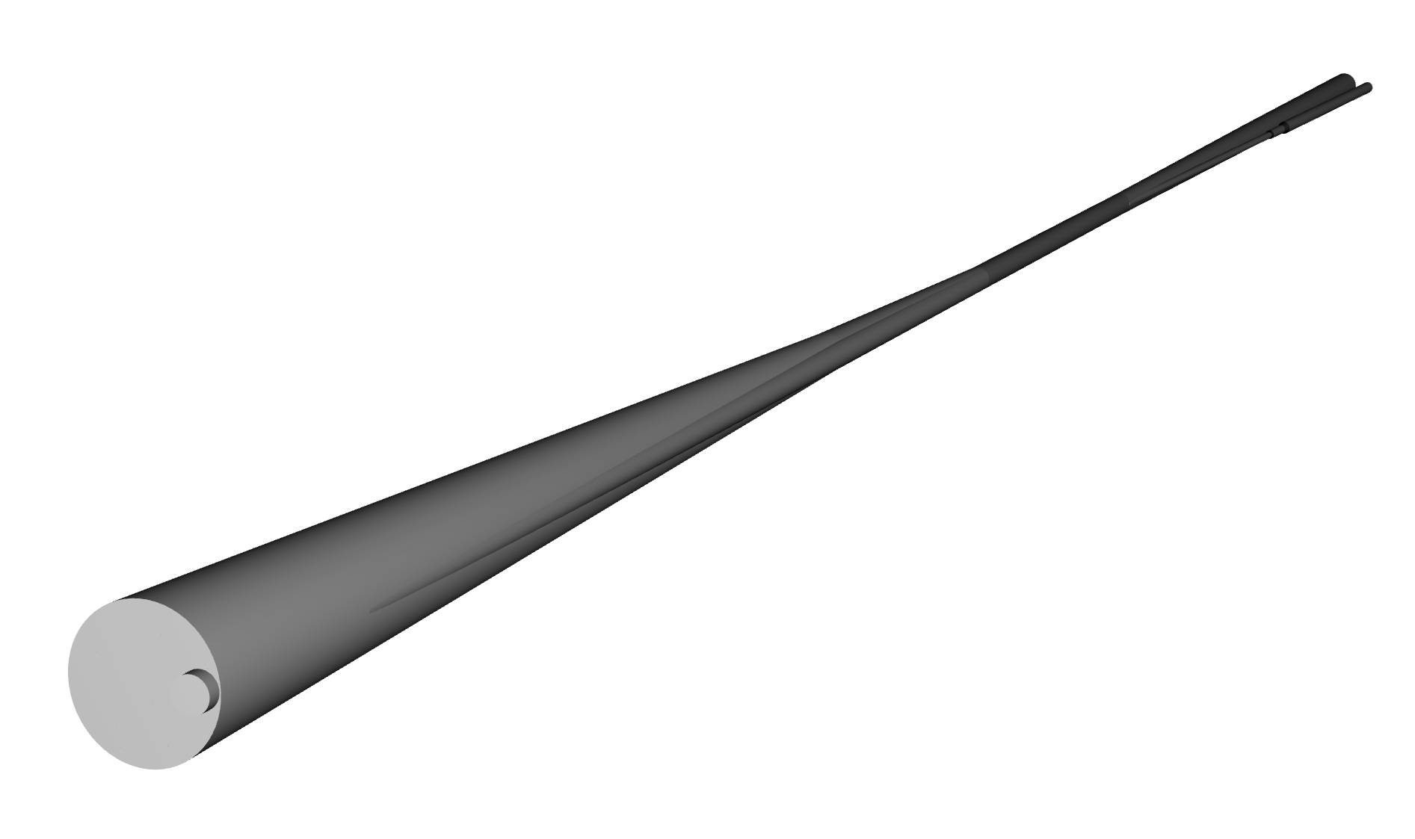
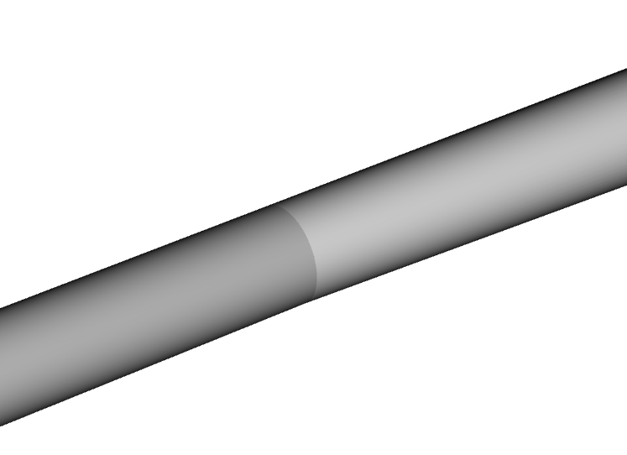
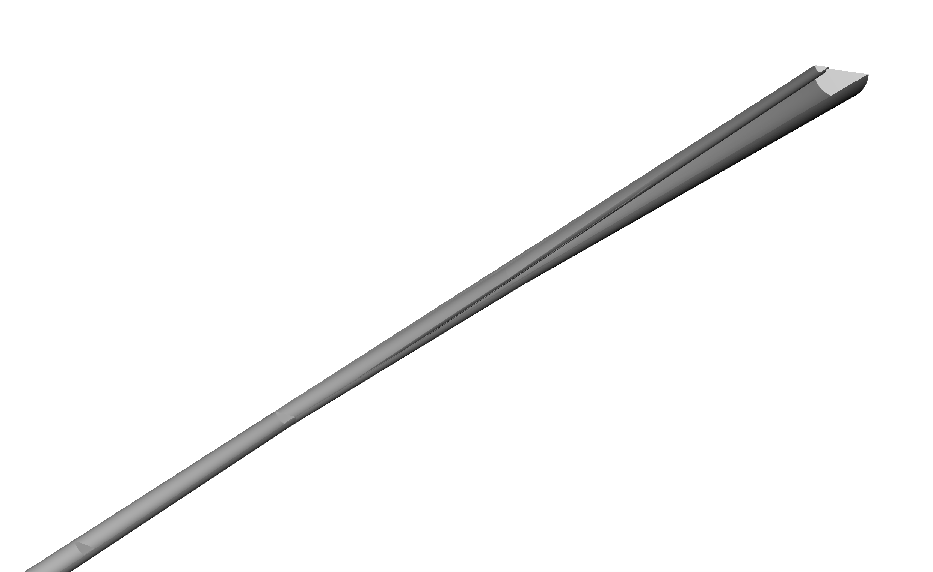
Default beam pipe geometry

Slide 35
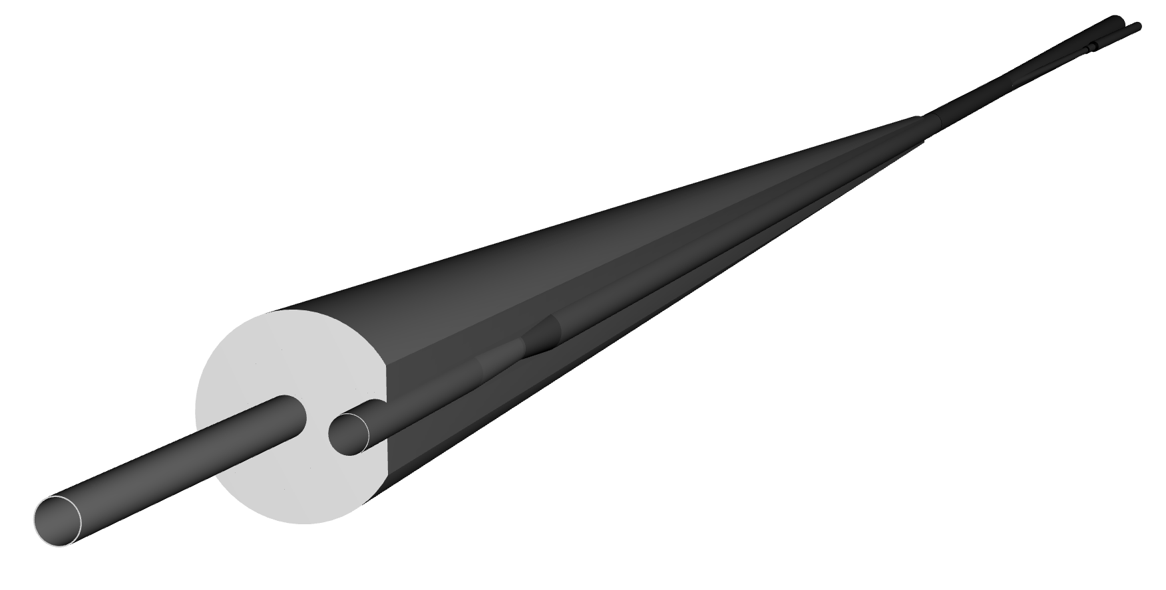
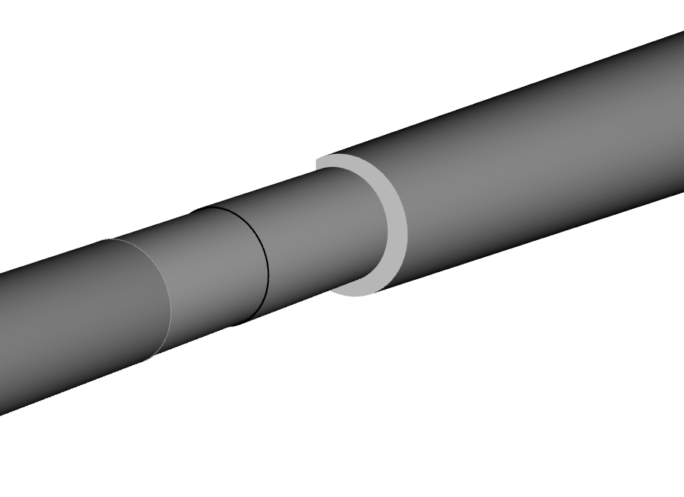
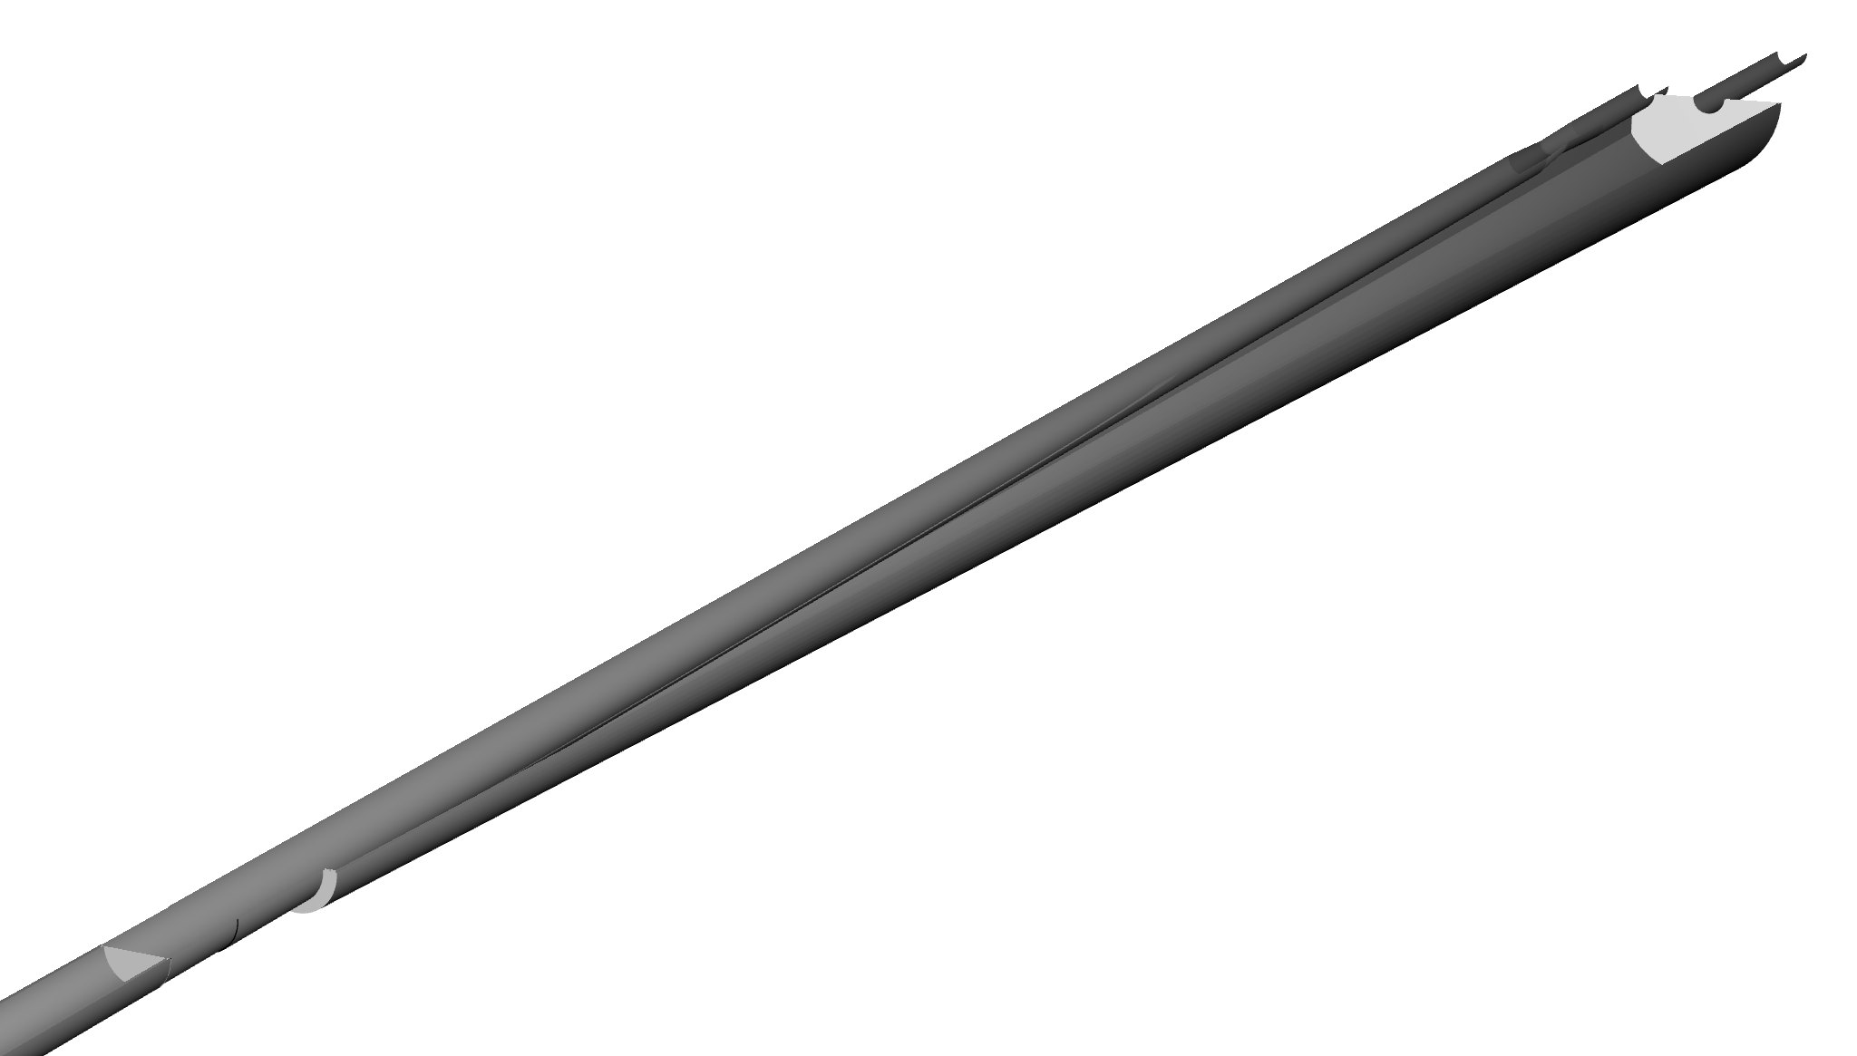
Adjusted beam pipe geometry

Slide 36
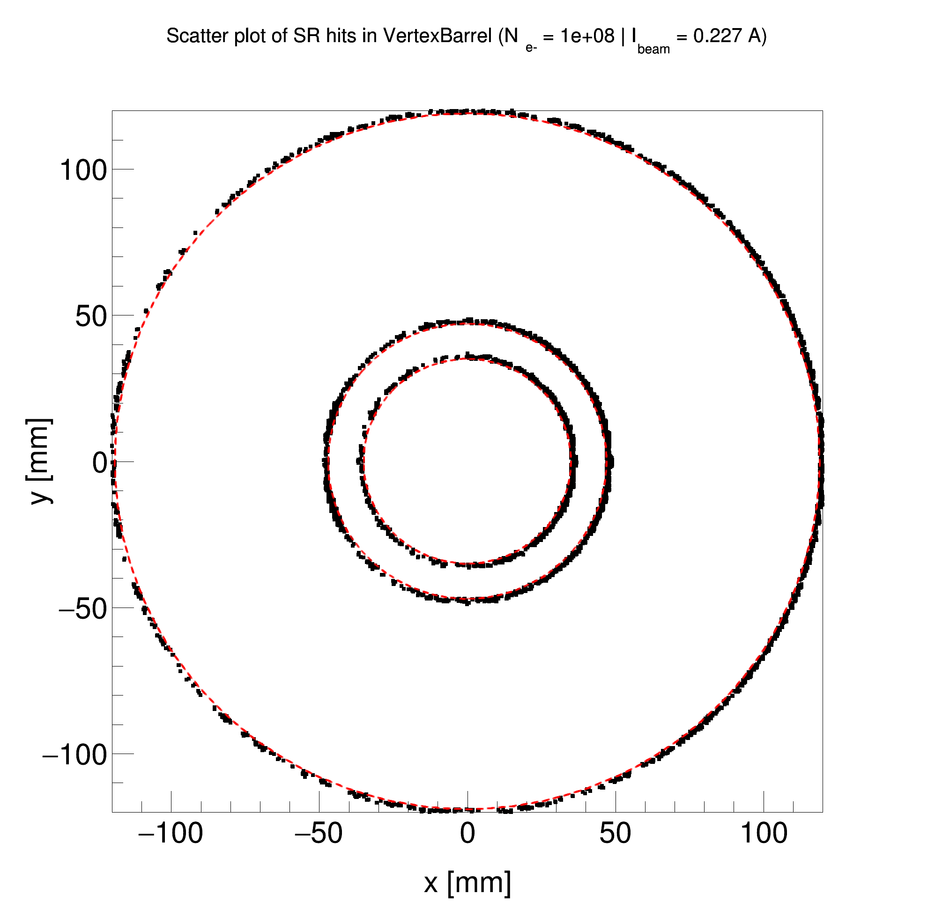
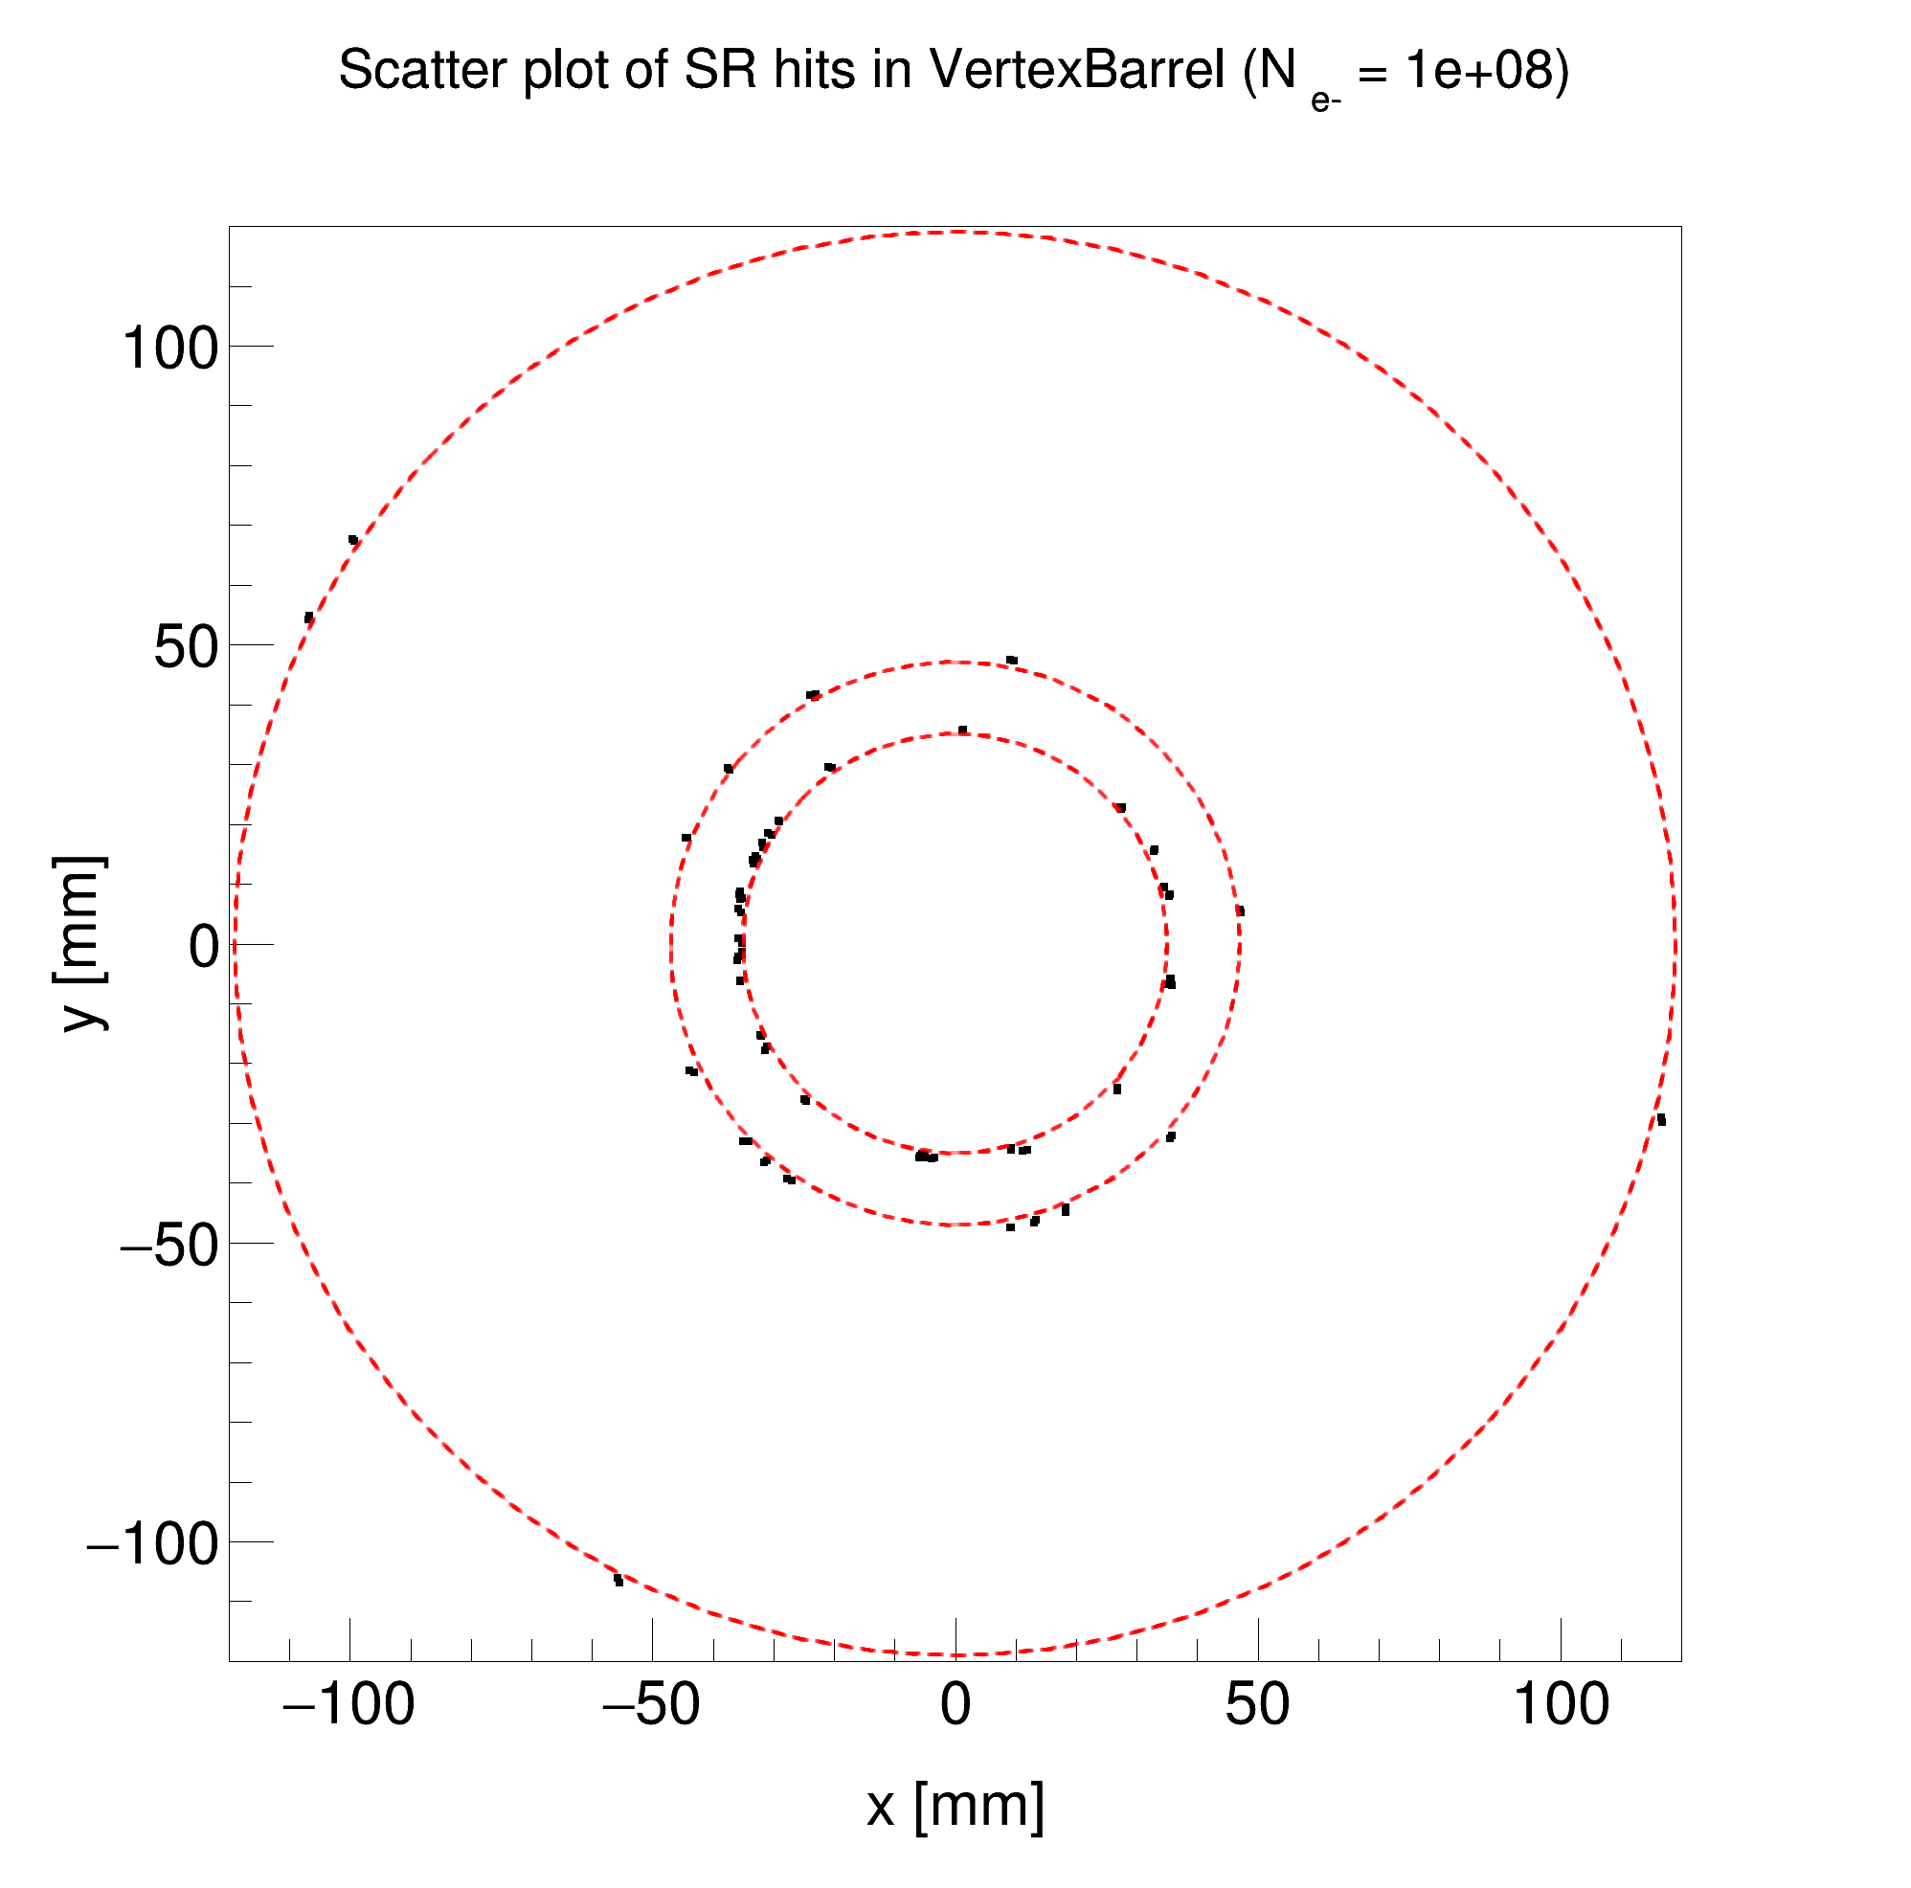
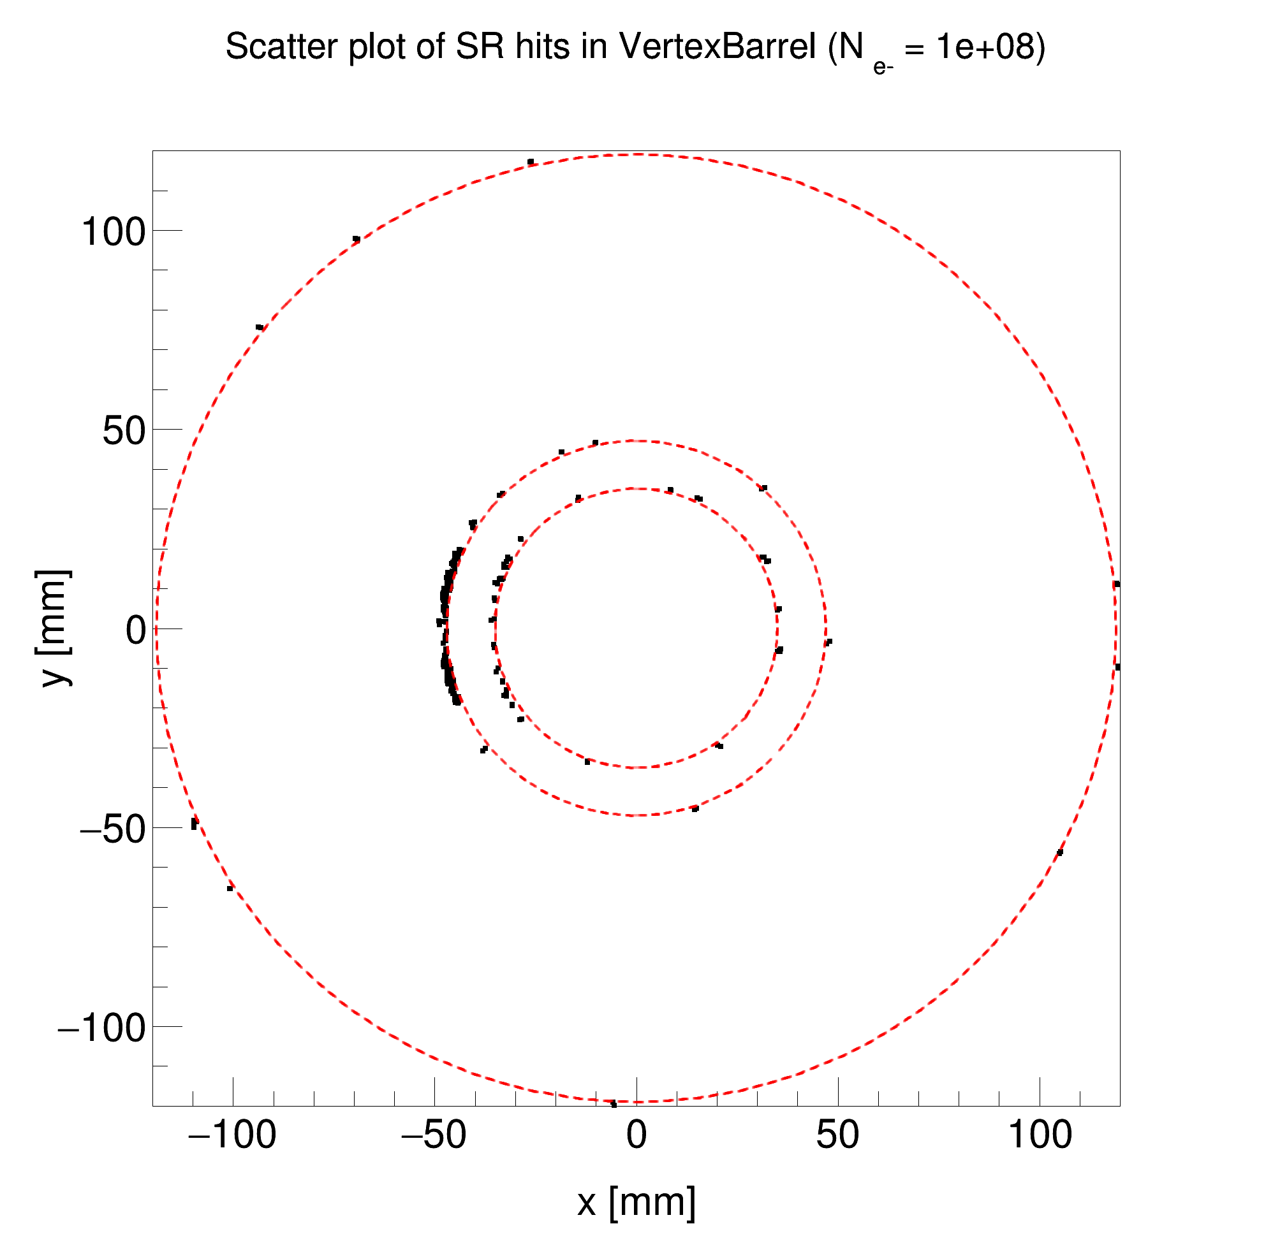
ePIC SR background: Vertex Barrel detector hits
First custom-built Geant4 SR model (contained bugs)
From Dec. 2023 meeting
Custom-built Geant4
(like the old Synrad+ model)
Custom-built Geant4
(like the new Synrad+ model)
-10m < z < 10m
E_{𝛄} > 4 eV
-4m < z < 5m
E_{𝛄} > 30 eV
-4m < z < 5m
E_{𝛄} > 30 eV

Slide 37
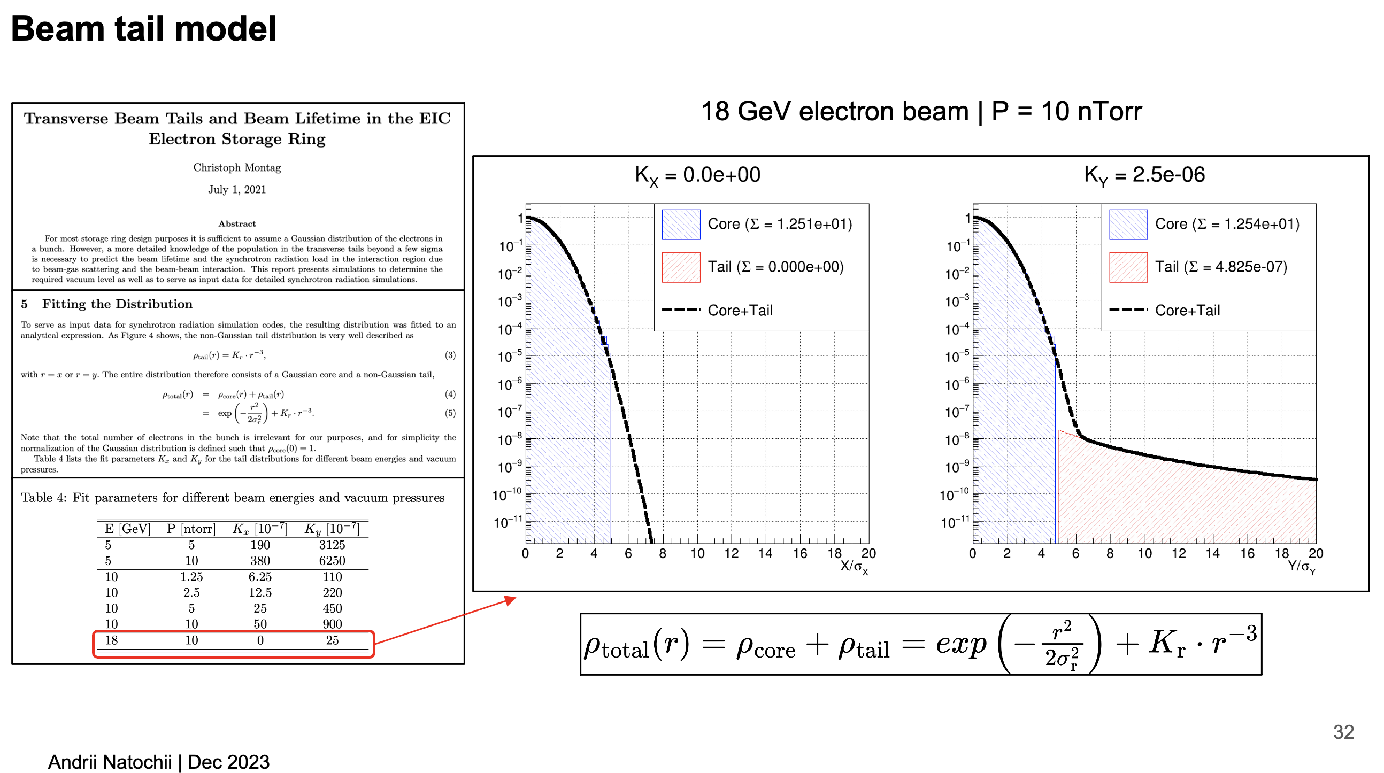
Optimistic model
From Dec. 2023 meeting
No tails in the horizontal plane
The vertical beam tail integral is about 10^{—8} of the beam core

Slide 38
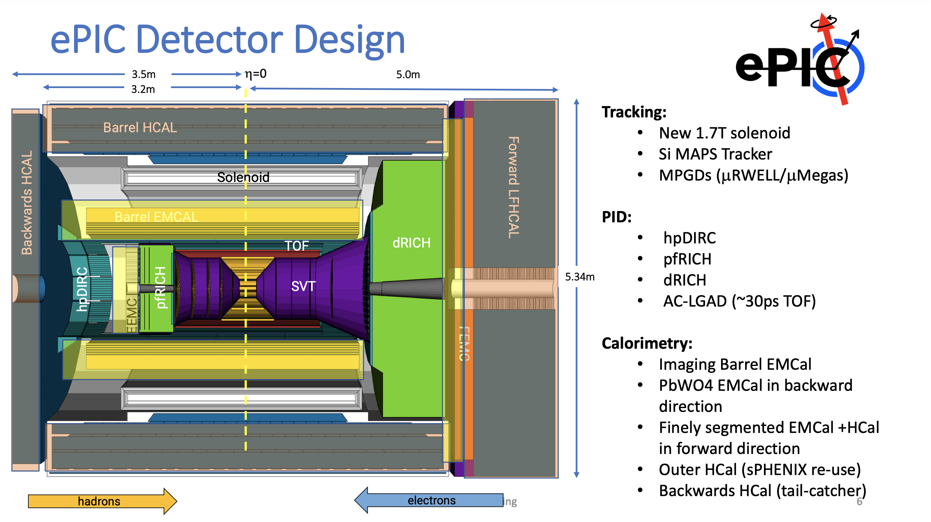
https://indico.jlab.org/event/714/contributions/12568/attachments/9944/14673/The%20ePIC%20Experiment%20-%20JLUO%20Split.pdf

Slide 39
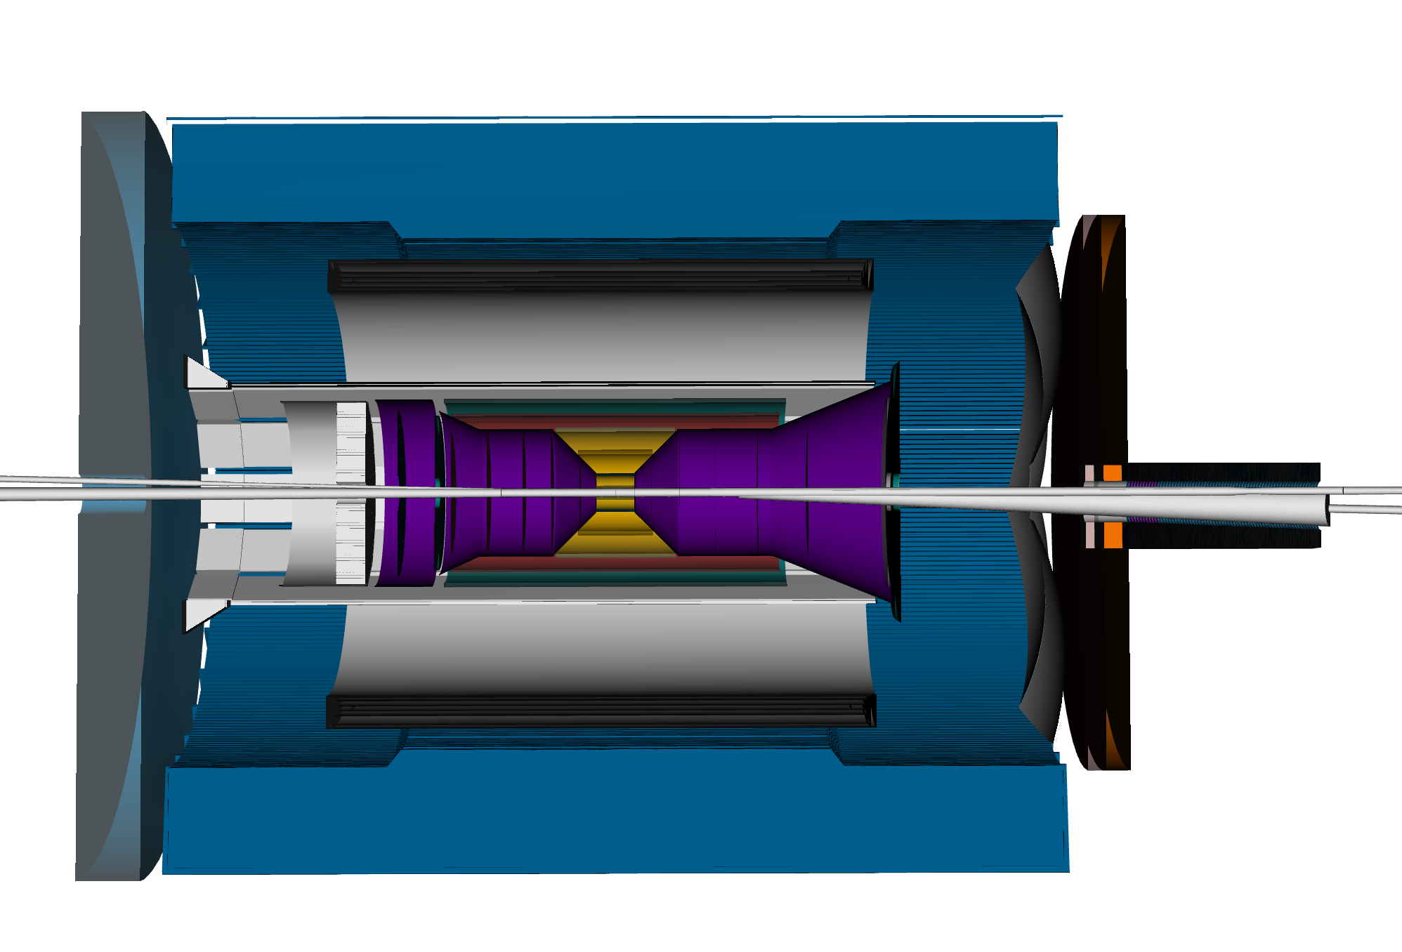
Y
X
Z
Z
From eic-shell/epic

