Slide 1
Data Volume for DAQ Status
Jeff Landgraf

Slide 2
The Task
I used simulations from Zhengqiao Zhang & Jakub Ceska
Type | Energies | File | Nominal Rate | Used Rate
DIS | 18x275 GeV | /gpfs/mnt/gpfs02/eic/zhangzq/EPIC/NewReco/analysis_DIS/all.tree.edm4eic.root | 83 kHz | 500 kHz (10x275 GeV)
Proton Beam Gas | 275 GeV | /gpfs/mnt/gpfs02/eic/zhangzq/EPIC/NewReco/analysis_ProtonGas/all_protonGas.eicrecon.tree.edm4eic.root | 32.6 kHz (10000Ahr) | 350.3 kHz (100Ahr)
Electron Beam Gas | 10 GeV? | /gpfs/mnt/gpfs02/eic/ceska/readout/podio_merged.root | 3.177MHz (10000Ahr) | 34.1 MHz (100 Ahr)
Hit Mapping. Heuristics are used for mapping hits (see my 2/27/24 presentation)
Heuristic function for each detector:
Map RecHits (x,y,z,cellID) → (channel, ASIC, RDO)
To do:
Change to RawHits (x,y,z,cellID) → (channel, ASIC, RDO)
Requires
Raw Hits to be stored in simulations
New maps?
Application of thresholds
Channel: Not used for ITS3/Asropix
ASIC: reticule for ITS3
Sensor for Astropix
FEB for non-asic dets
ASIC for asic based dets
RDO: For most, but not all detectors the FEB->RDO map can be set to minimize data rate variation. Avg rates matter here

Slide 3
Hit Sizes & Noise rates
Detector | Bits / hit (readout) | Bits / hit (tape) | Noise Hits (readout) (hz/channel) | Noise Hits (tape) (hz/channel) | Reduction Notes
MAPS | 2x64 | 2x64 | 1e-3 | 1e-3 | 64 bits per pixel, but hits likely to show up in adjoining 2usec frames
MPGD | 5x64 | 1x64 | 30 | 0 | Charge sharing, cluster finding for reduction
Most Calorimeter | 18x6x64 | 64 | 1000* | 0 | 18 channel segmentation in caloric, 6 time samples, feature finding for reduction, additional/noise reduction possible via cluster finding
Fwd/Back eCal | 6x64 | 64 | 1000* | 0 | 6 time sample estimate (possible onboard feature finding, but not yet assumed). Feature finding for reduction (additional/noise reduction possible via cluster finding)
Astropix | 64 | 64 | 0 | 0
Forward TOF | 9x64 | 64 | 30 | 0 | 3x3 asic segmentation & cluster finding
dRICH | 64 | 64 | (3000-)300,000 | 1500 | Software triggering
Default | 64 | 64
* Noise is going to be unavoidable, and for SiPM will increase with radiation. This will be addressed

Slide 4
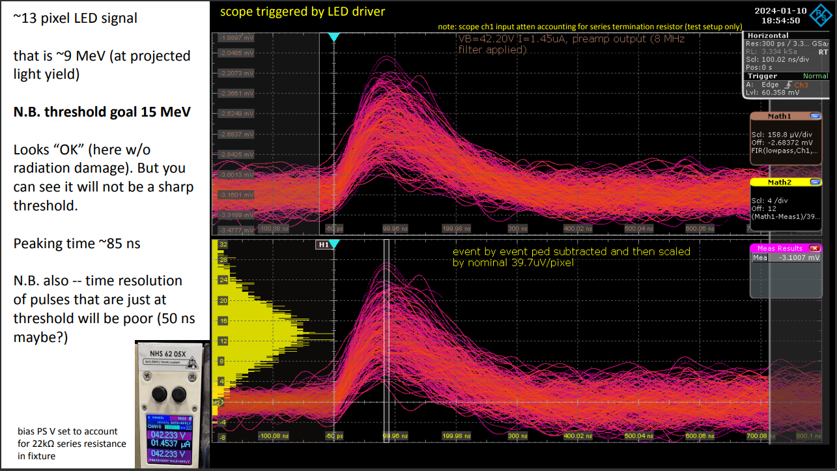
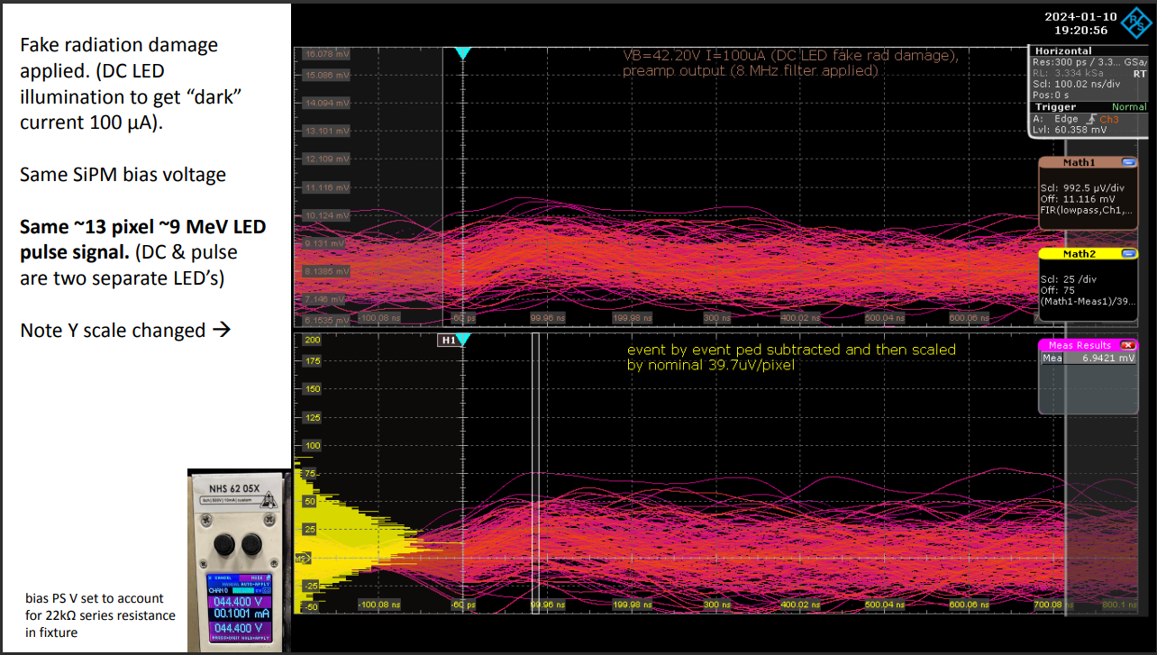
Noise
I do not believe my noise estimates:
Noise is going to be unavoidable, and for SiPM will increase with radiation. This will be addressed by raising thresholds, and therefore be seen as an increase of minimum threshold applied
The noise looks quite guassian, but the tails will matter a lot, and we are talking about 5-6 sigma threshold requirements for streaming readout with so many channels…

Slide 5
Noise
I do not believe my noise estimates:
Noise is going to be unavoidable, and for SiPM will increase with radiation. This will be addressed by raising thresholds, and therefore be seen as an increase of minimum threshold applied
The noise looks quite guassian, but the tails will matter a lot
The issue of noise cuts across many groups (Detector readout / DAQ / Analysis) and isn’t easy to characterize!
I propose to set some aggregate data volumes for each detector as “targets”, and then use this mechanics to define the “nsigma” noise target for each detector.
The detector groups can then determine whether their threshold requirements meet these noise targets or whether we need to modify readout, DAQ, or physics expectations…

Slide 6
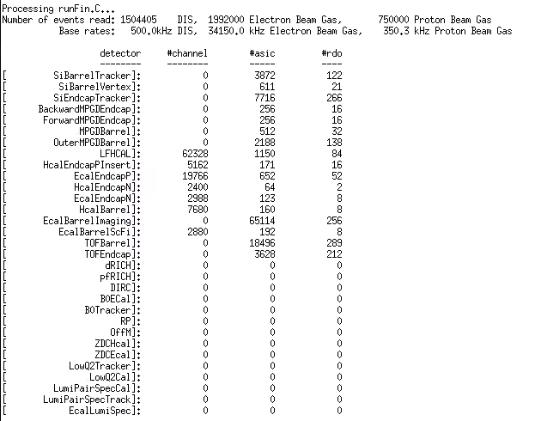
Results
What was processed
RICH detectors (no RecHits)
Far Backward: simulations don’t cover the driving physics, but have numbers from other methods
Far Forward: I didn’t finish coordinate maps (B0 at least should be done)
MPGD I should provide channel map, but was initially confused and didn’t correct

Slide 7
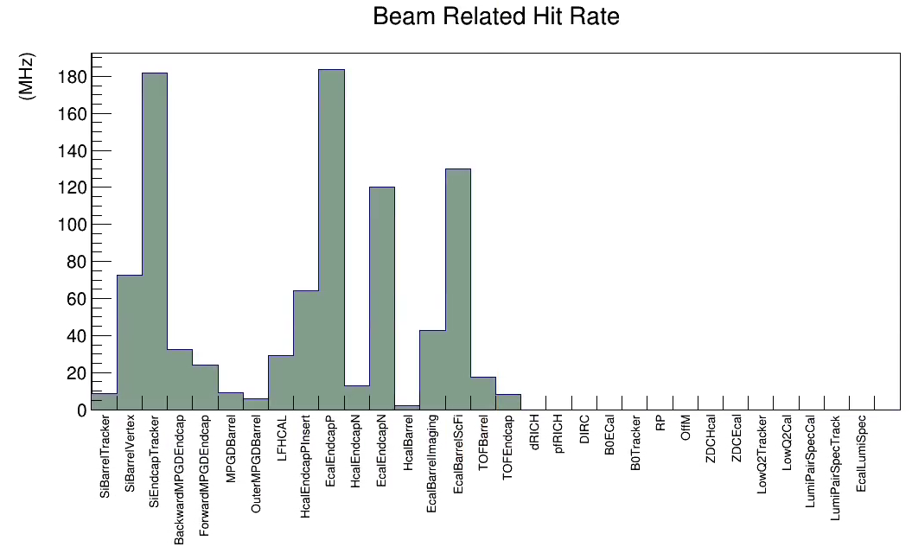
Hit Rates
DIS +
Proton Beam +
Electron Beam
(No noise added)

Slide 8
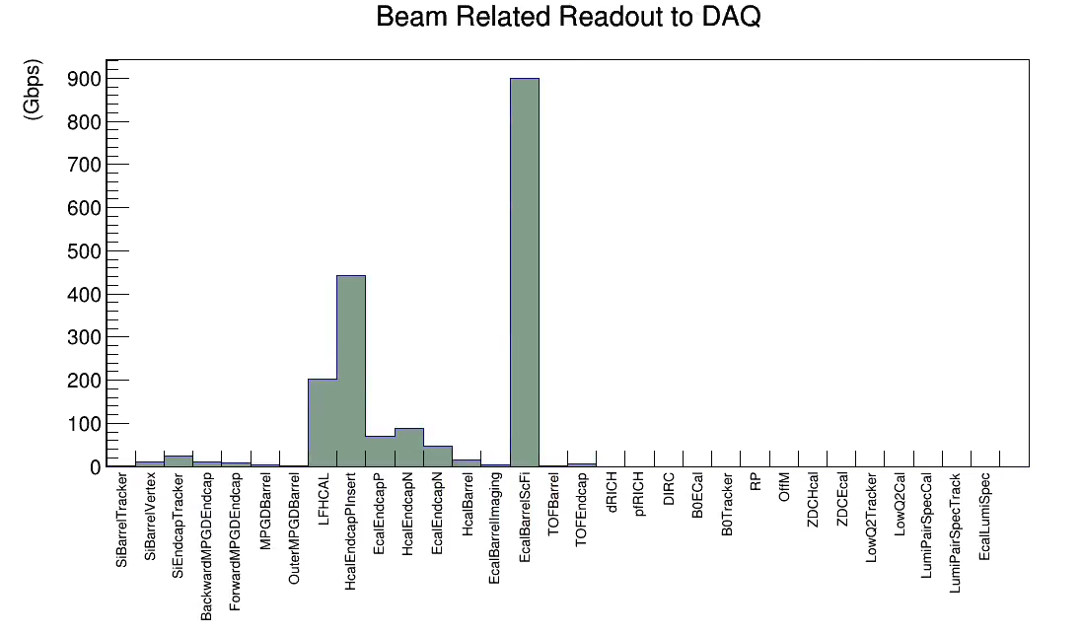
Data rate to RDO’s
DIS +
Proton Beam +
Electron Beam
(No noise added)

Slide 9
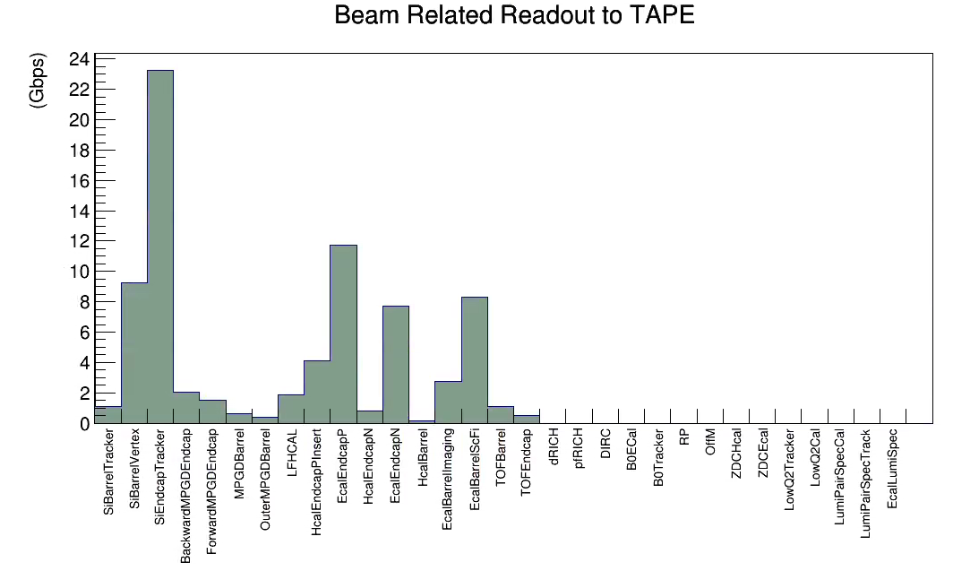
Data Rate to Tape
DIS +
Proton Beam +
Electron Beam
(No noise added)

Slide 10
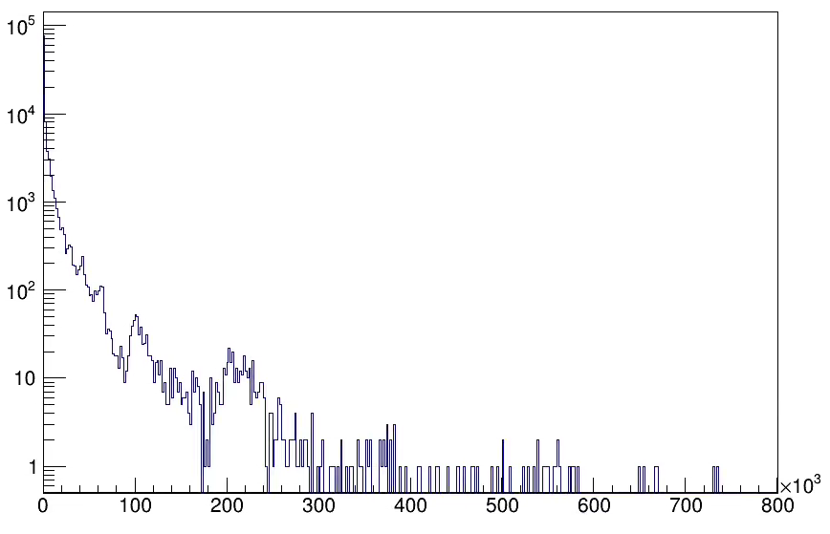
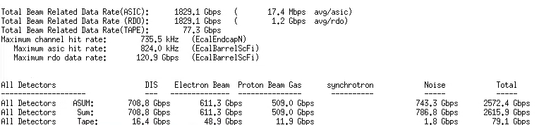
Channel Rates
Full Detector, channel rates
Counts
Hit Rate (Hz)

Slide 11
Channel Rates
Similar to previous rates, but missing detectors, so somewhat higher
Channel rates, All detectors
Counts
Hit Rate (Hz)

Slide 12
Channel Rates
Surprising !?!
Perhaps not, only 2880 channels covering full length of ECAL
Channel rates, All detectors
Counts
Hit Rate (Hz)

Slide 13
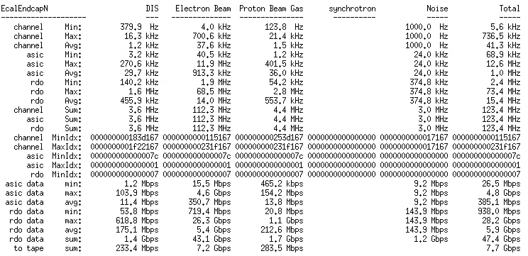
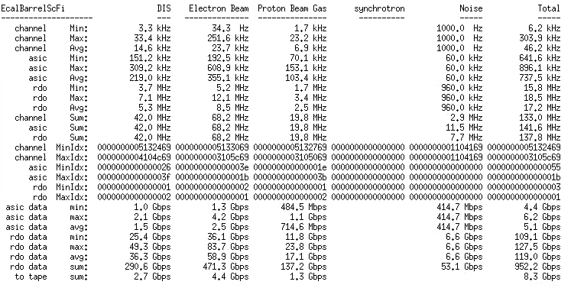
EcalEndcapN vs EcalBarrelScFi
Must Double check, but likely
-> Need to adjust FEB/RDO count
-> Need to have real discussions regarding noise

