Slide 1
Real-Time Information Distillation with Deep Neural Network-based Compression Algorithms
06-11-2024
Yi Huang
RHIC-AGS at BNL

Slide 2
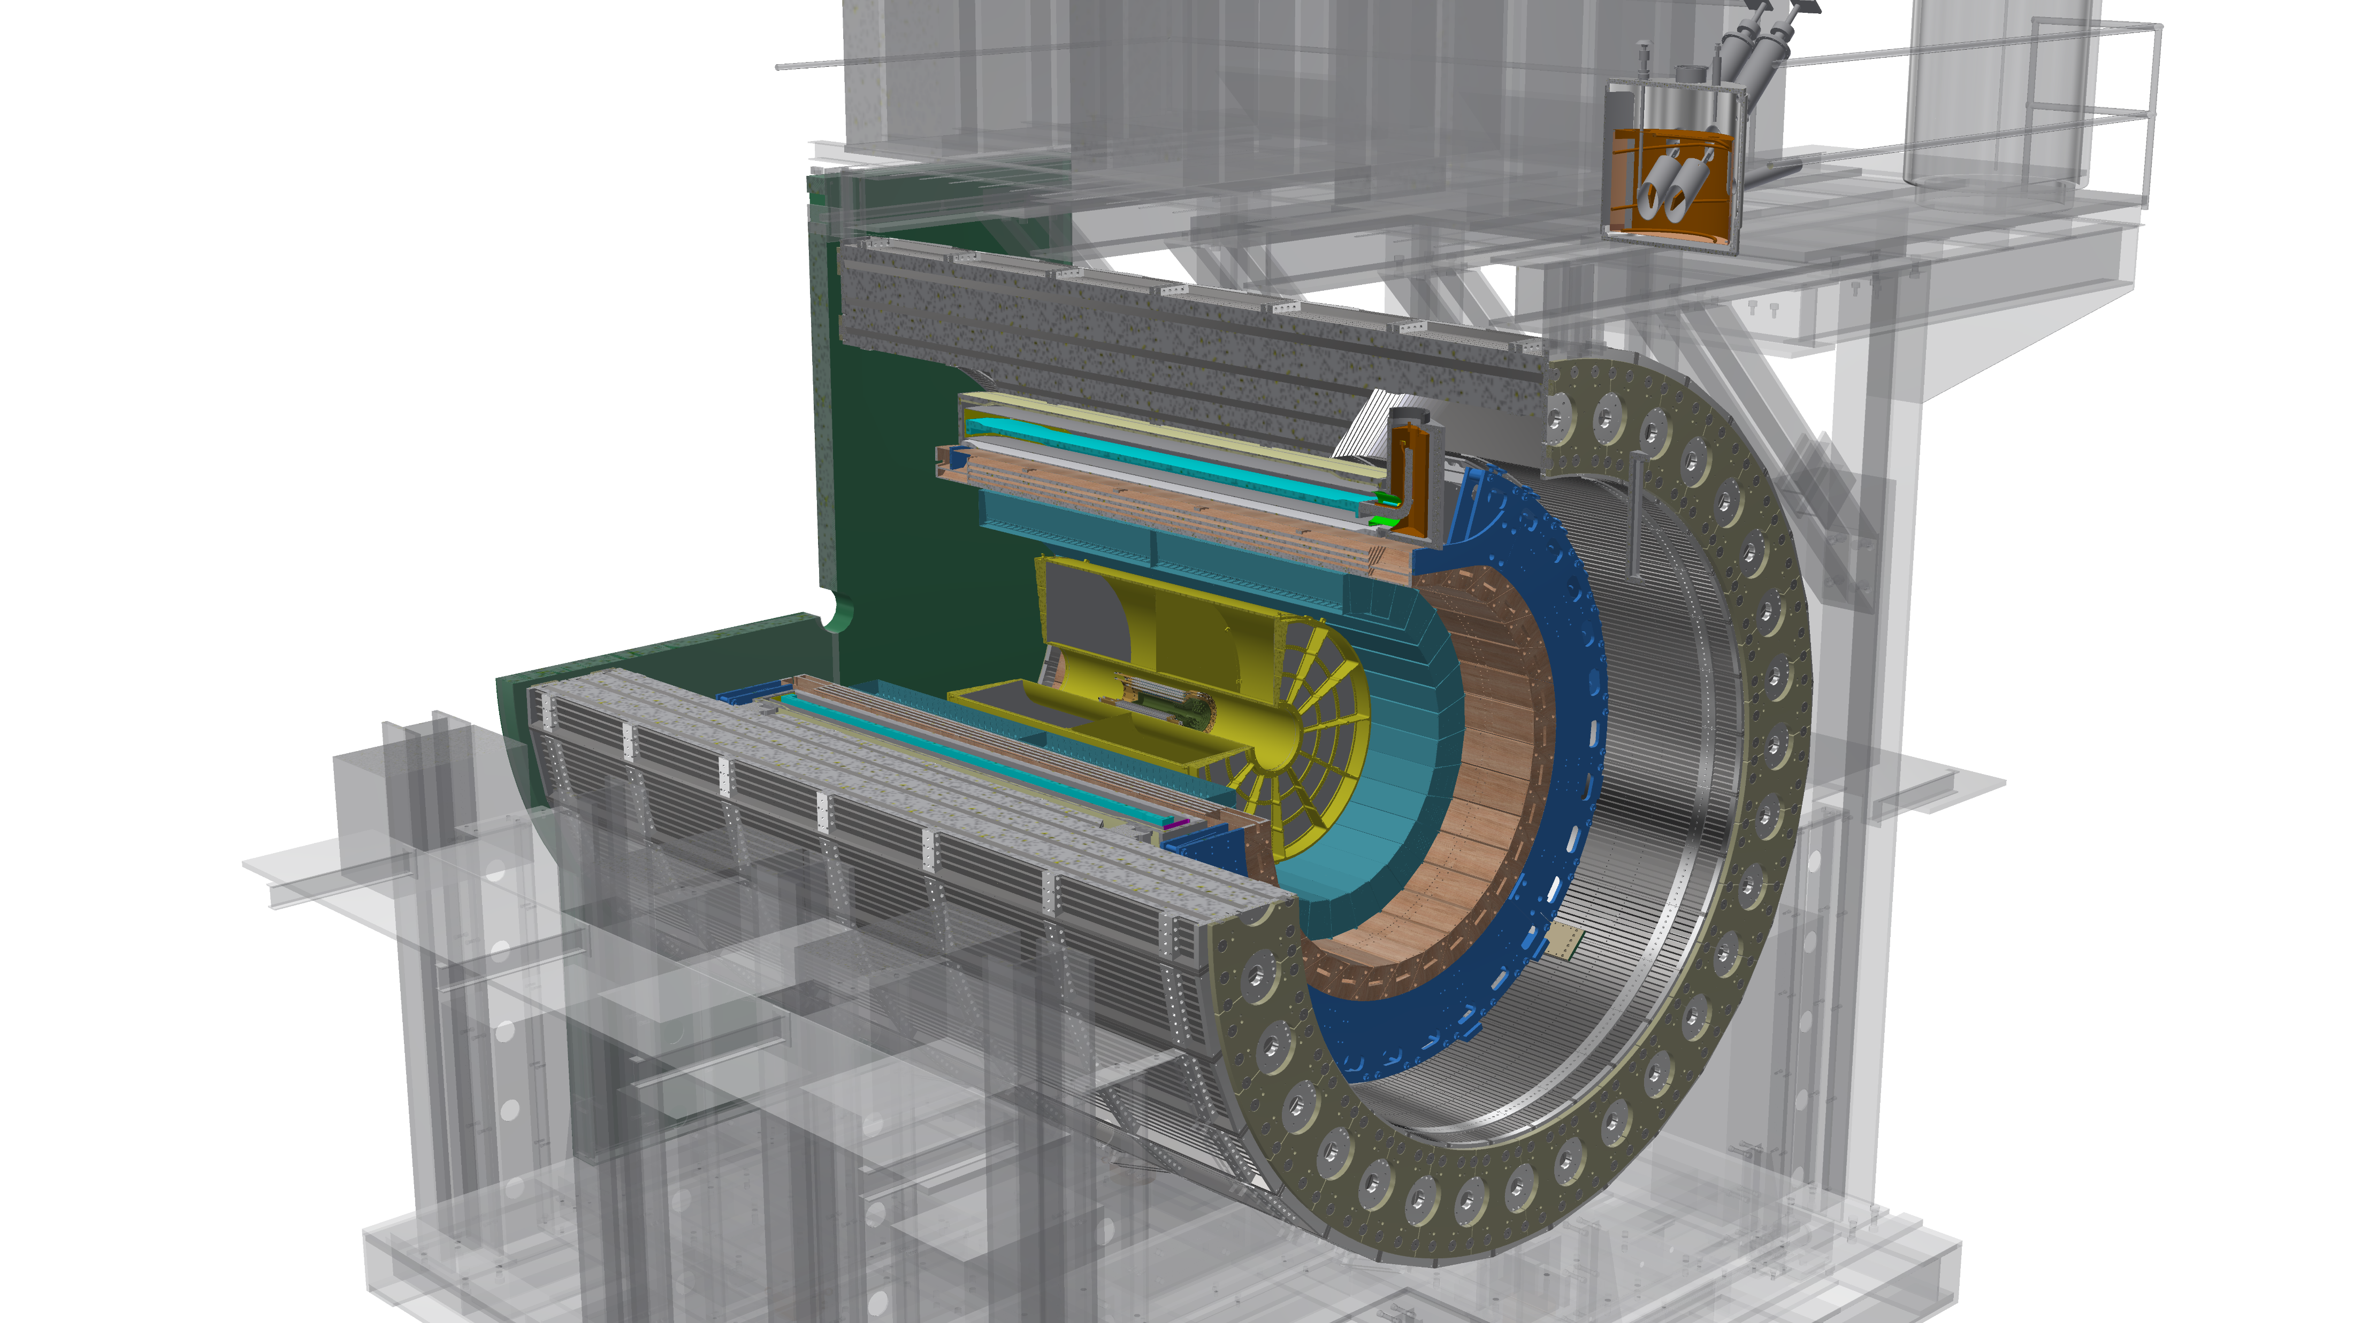
Time-Project Chamber Data Compression
Data: simulated 200 GeV Au+Au collisions from the sPHENIX experiment, high-pileup events
TPC

Slide 3
Time-Project Chamber Data Compression
In this study, we are going to focus on the outer layer group:
16 layers along the radial direction
2304 columns of sensor nodes along the azimuth direction
498 rows along the beam direction
Subdivided into 24 TPC wedges of shape (16, 192, 249)

Slide 4
TPC wedges of shape (16, 192, 249)
Input to the neural compression algorithm
Each sensor node output an analog-to-digit converter (ADC) value as an integer in [0, 1023].
All ADC values below 64 are suppressed to 0 to increase sparsity.
In this study, we use log scale ADC value, i.e. $\log_{2}\left(\text{ADC} + 1\right)$. A log scale ADC value is in [0, 10]. There is no value less 6 because of the zero suppression.
Fig. Log scale ADC value in a TPC wedge

Slide 5
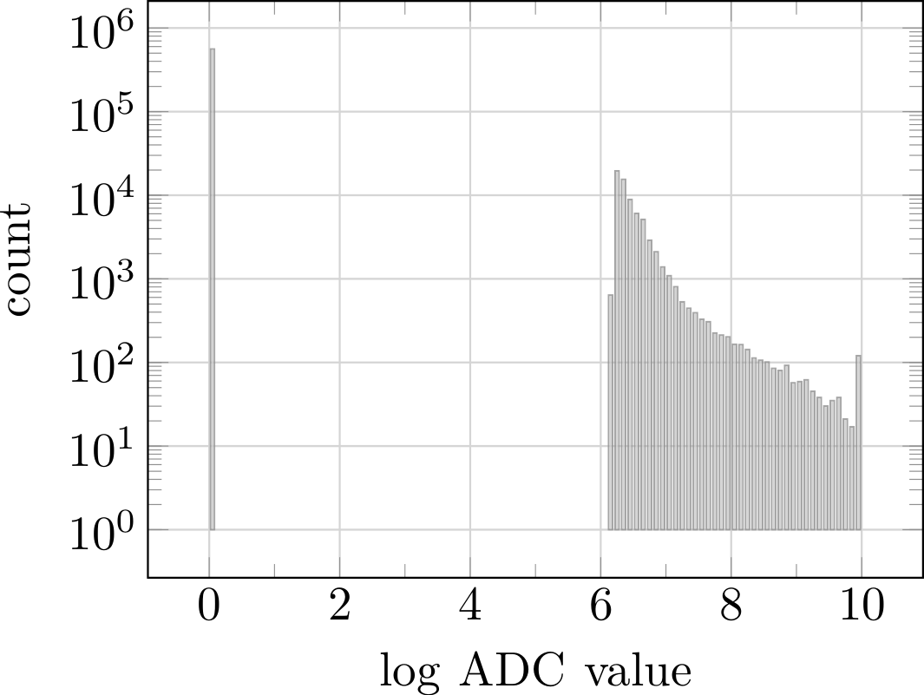
Acrophobia neural network
Sparse with curve-shaped objects
NNs like bell-shaped distribution

Slide 6
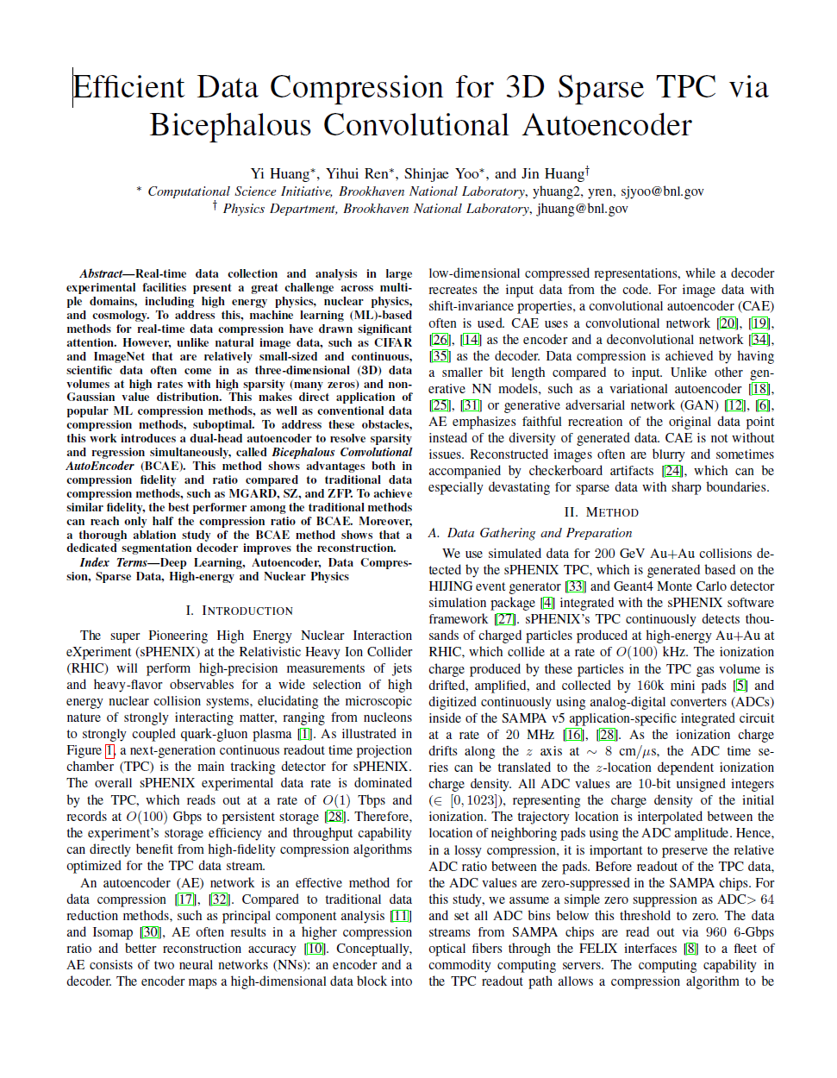
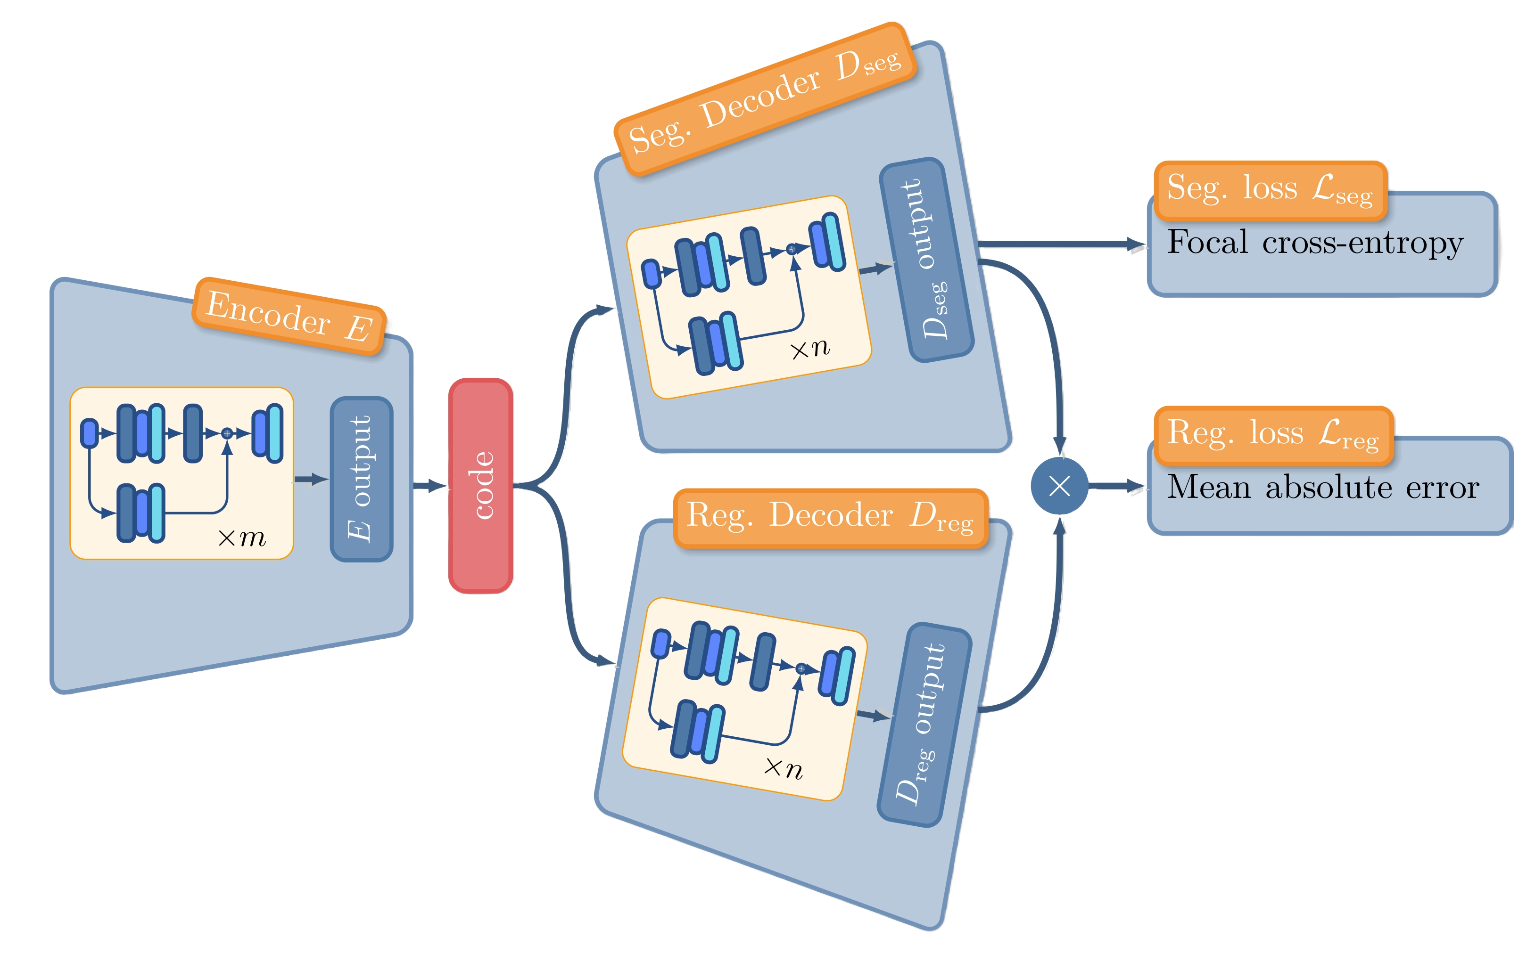
Online inference
https://arxiv.org/pdf/2111.05423.pdf
Offline reconstruction

Slide 7
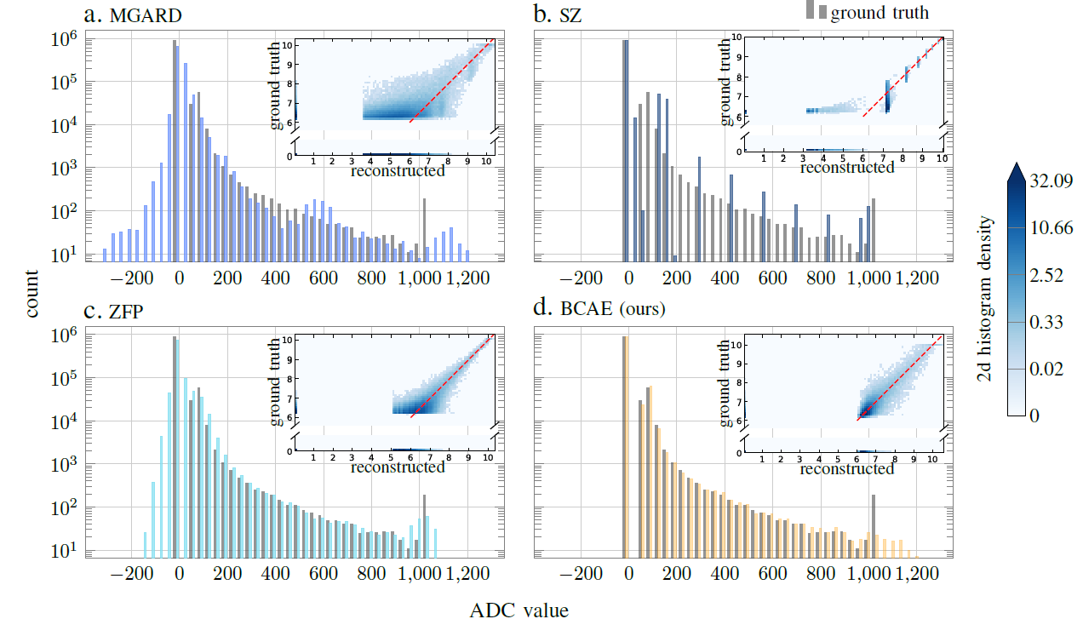
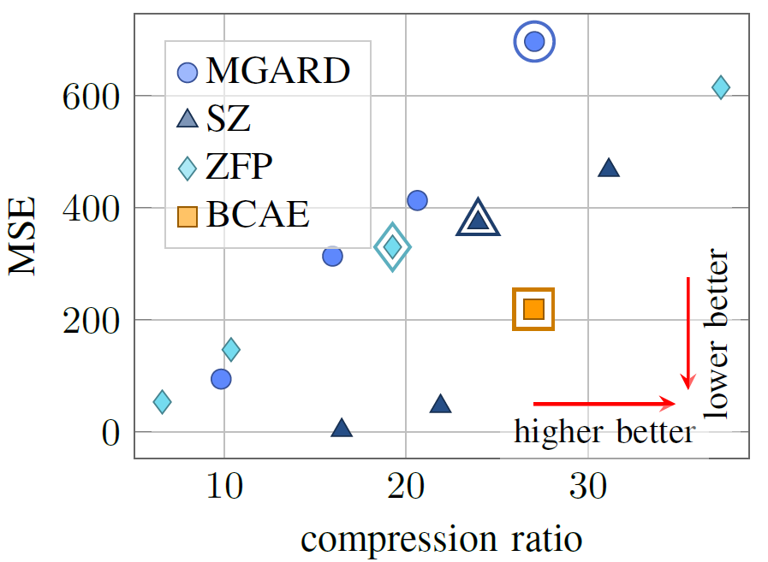
Performance of BCAE compared with off-the-shelf lossy compression algorithms

Slide 8
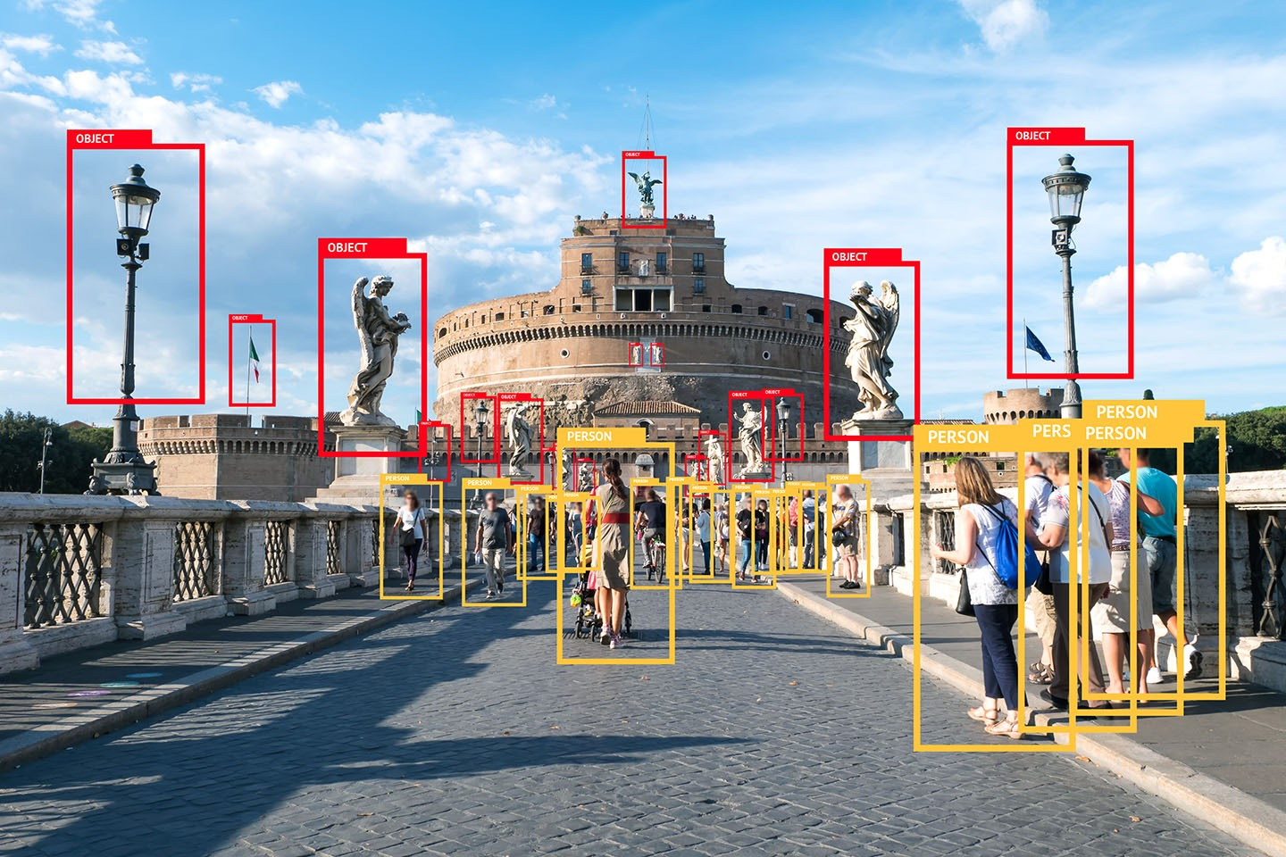
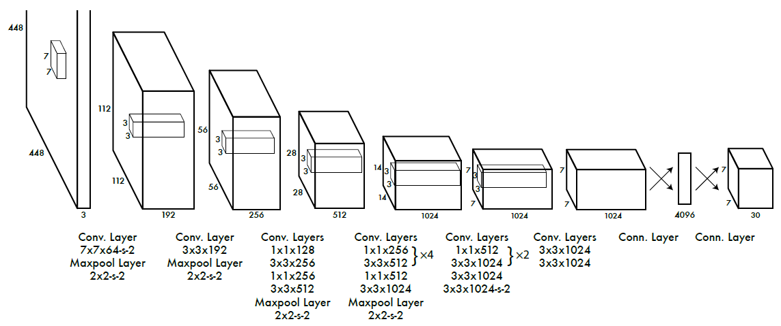
Ultra-deep yet fast Yolo Network for object detection
2D Convolution might be the key to speed!

Slide 9
Use 2D Convolution to make BCAE Faster
The TPC wedge data has shape (16, 192, 249). Comparing to the azimuth and horizontal direction, the radial dimension is thin.
We can treat the radial dimension as the feature dimension and use 2D convolutions
16 layers

Slide 10
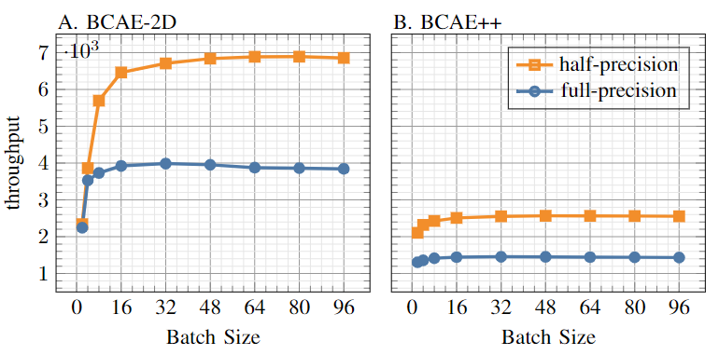
Speed or Performance, but NOT both
model | MAE $↓$ | PSNR $↑$ | Precision$↑$ | Recall $↑$ | Encoder size$↓$ | Compr. Ratio $↓$
BCAE-2D | 0.152 | 11.726 | 0.906 | 0.907 | 169.0k | 31.125
BCAE++ | 0.112 | 14.325 | 0.934 | 0.936 | 226.2k | 31.125
Fast but not accurate
More accurate but slow
(3D Conv. Model)

Slide 11
Can we have something Fast and Accurate?
For sparse convolution, sparse data is a bless, not a curse!

Slide 12
Comparing BCAE (dense convolution NN) with MinkowskiEngine Models
Model name | Recon. Loss type | Keep ratio | Comp. Ratio | Test reconstruction performance |  |  |  | Encoder size | Throughput
 |  |  |  | L1 | L2 | precision | recall
BCAE2D | L1 |  | 31.13 | 0.152 | 0.862 | 0.906 | 0.907 | 169,000 | 6.9k
BCAE++ | L1 |  | 31.13 | 0.112 | 0.617 | 0.934 | 0.936 | 226,200 | 2.6k
ME_20_005 | L2 | 0.128 | 35.06 | 0.056 | 0.100 | 0.997 | 0.990 | 382 | 5.6k (RTX 6000ADA)
ME_20_010 | L2 | 0.177 | 25.19 | 0.034 | 0.080 | 0.998 | 0.989
ME_30_005 | L2 | 0.119 | 37.70 | 0.052 | 0.163 | 0.994 | 0.976
ME_10_005 | L2 | 0.112 | 40.09 | 0.078 | 0.983 | 0.990 | 0.969
Sparse models

Slide 13
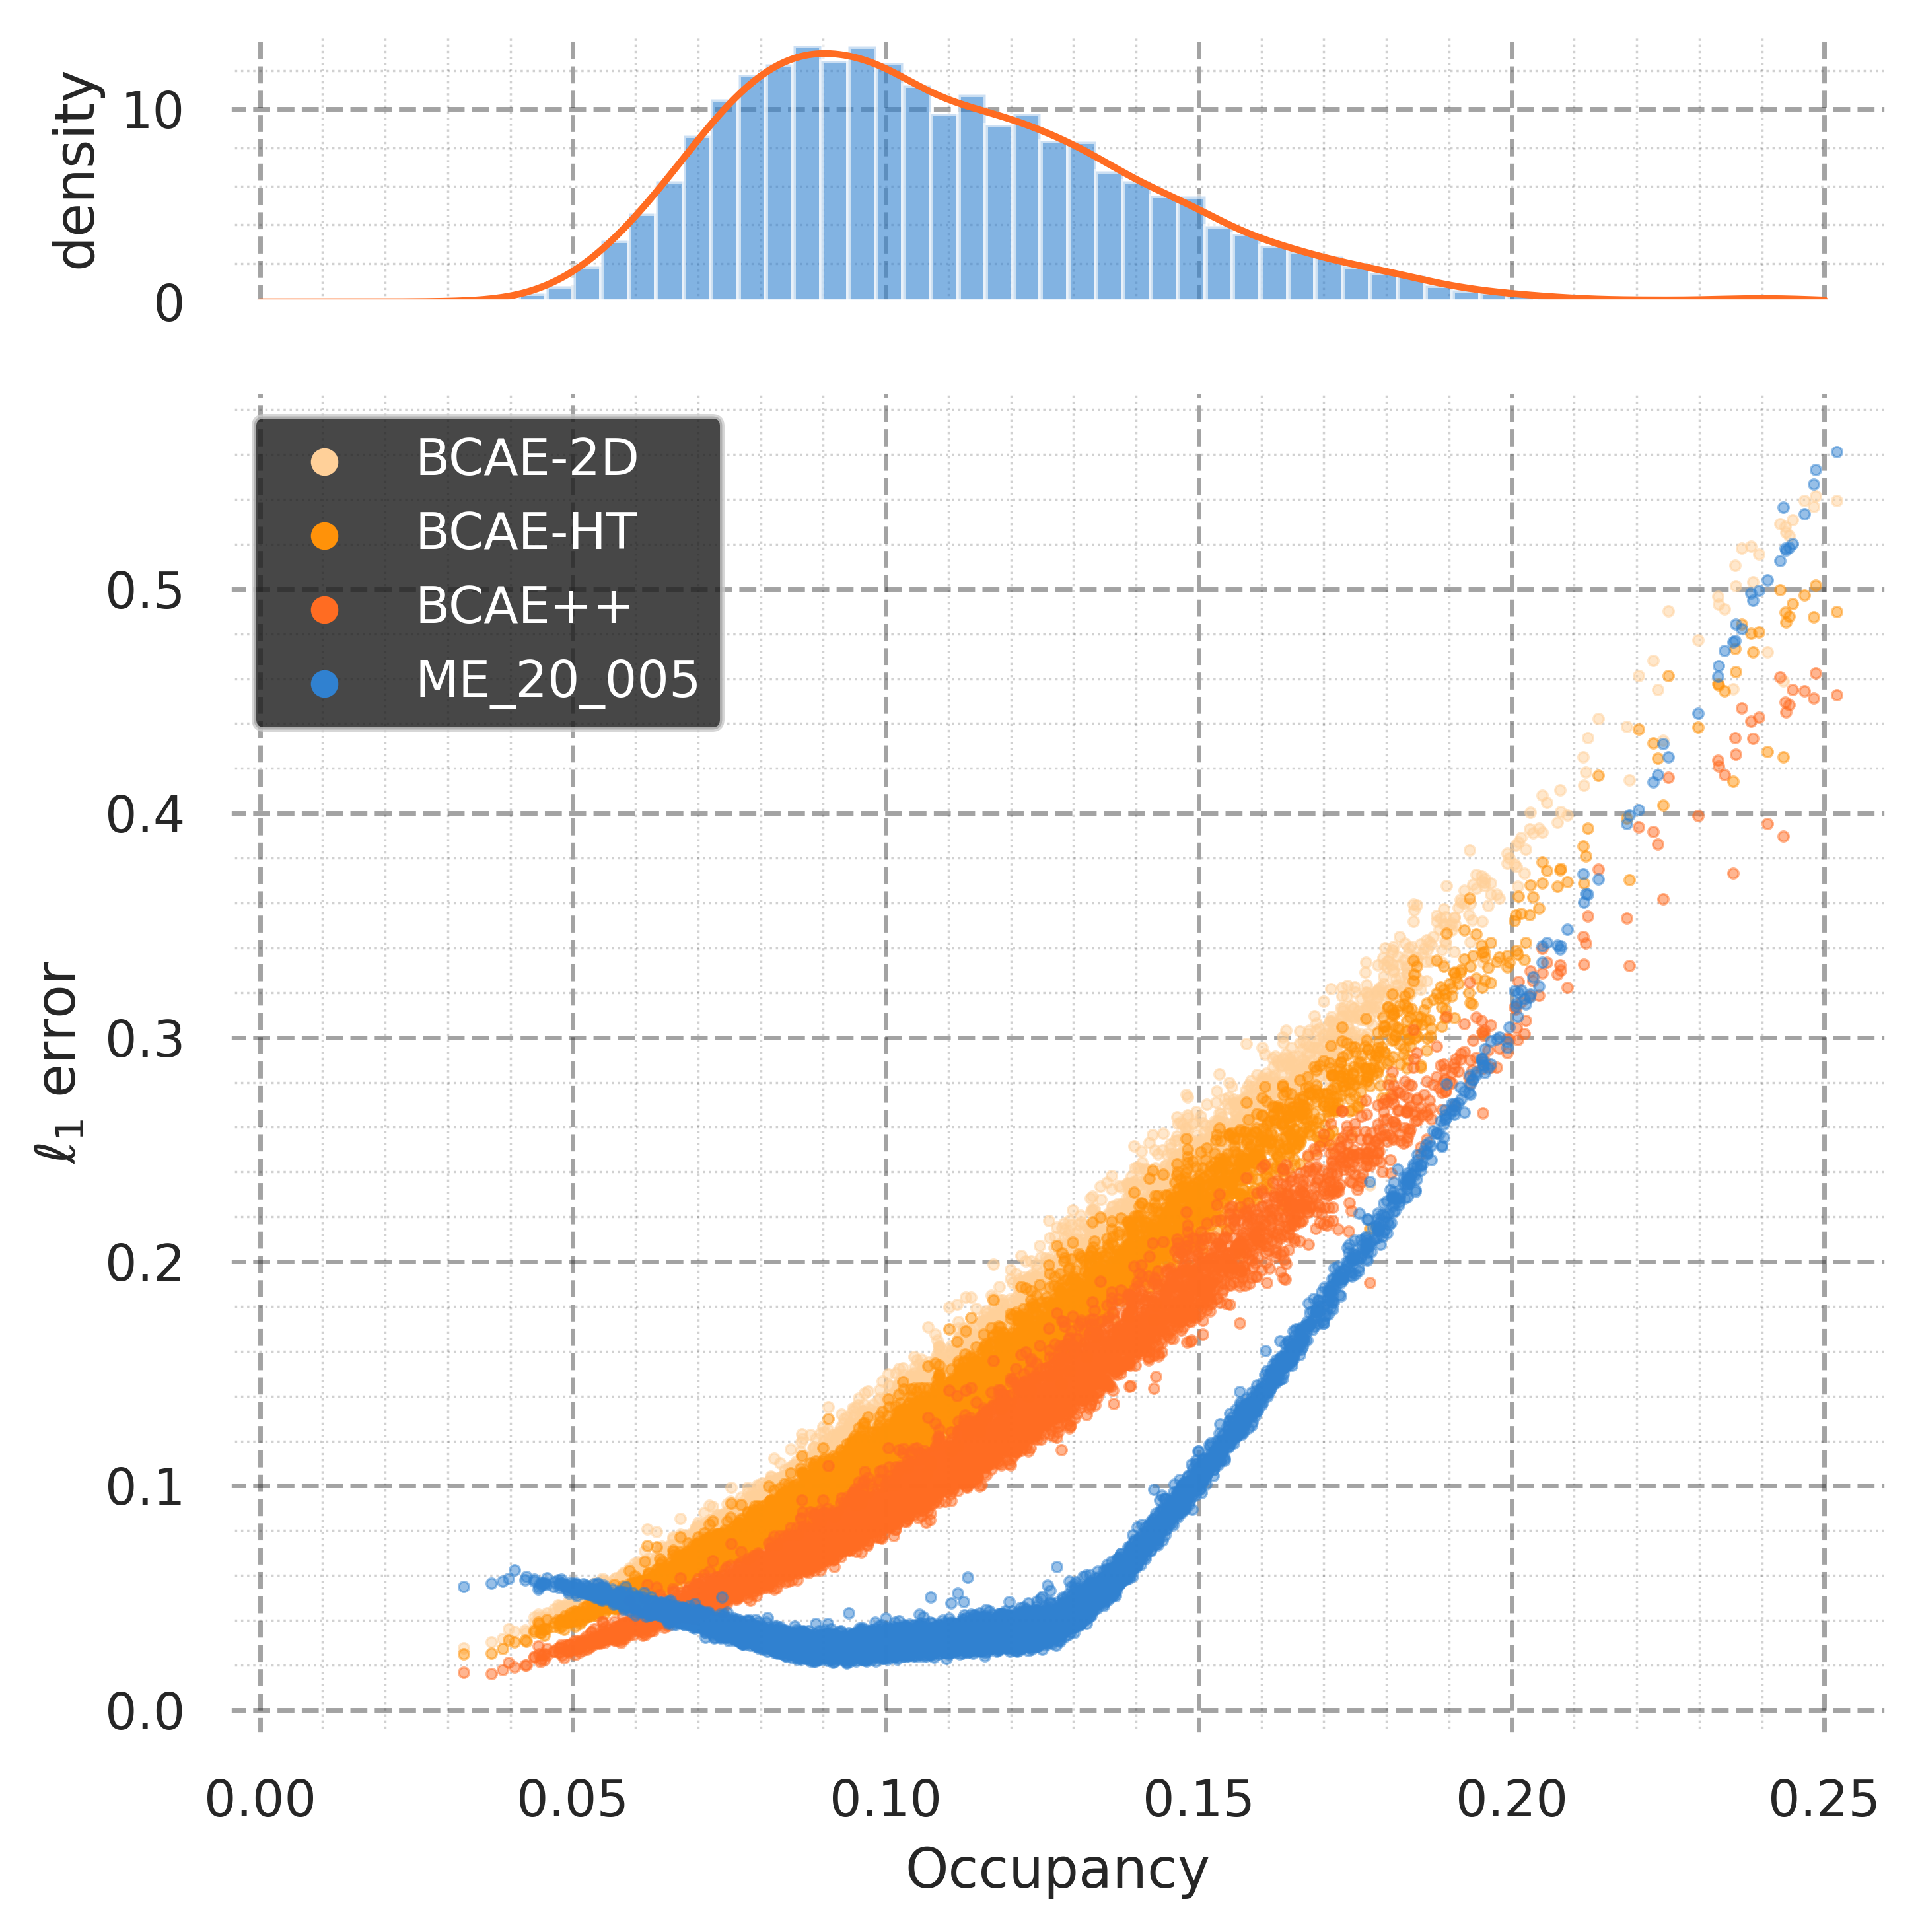
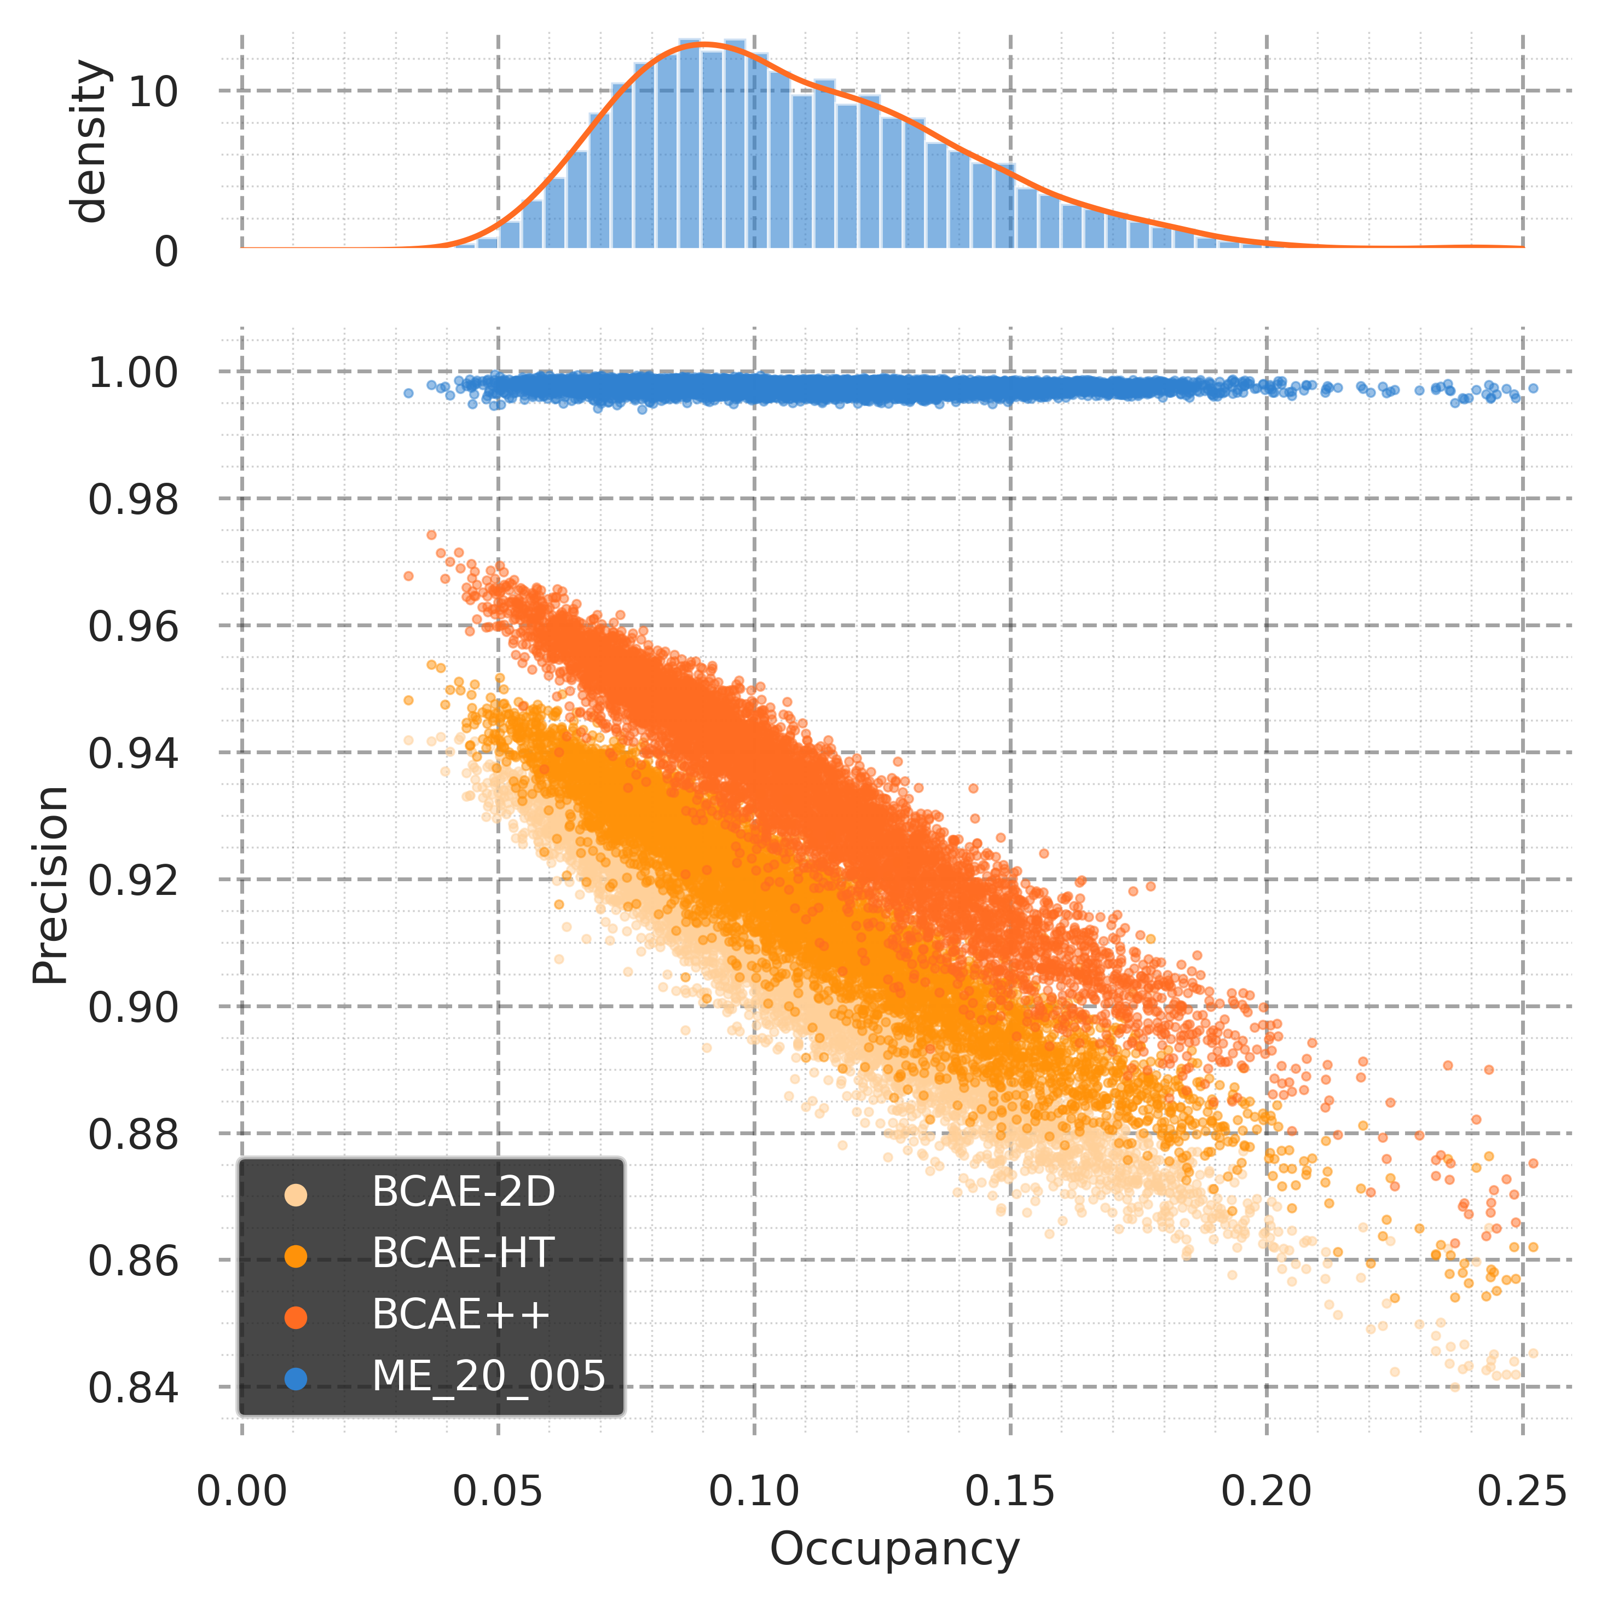
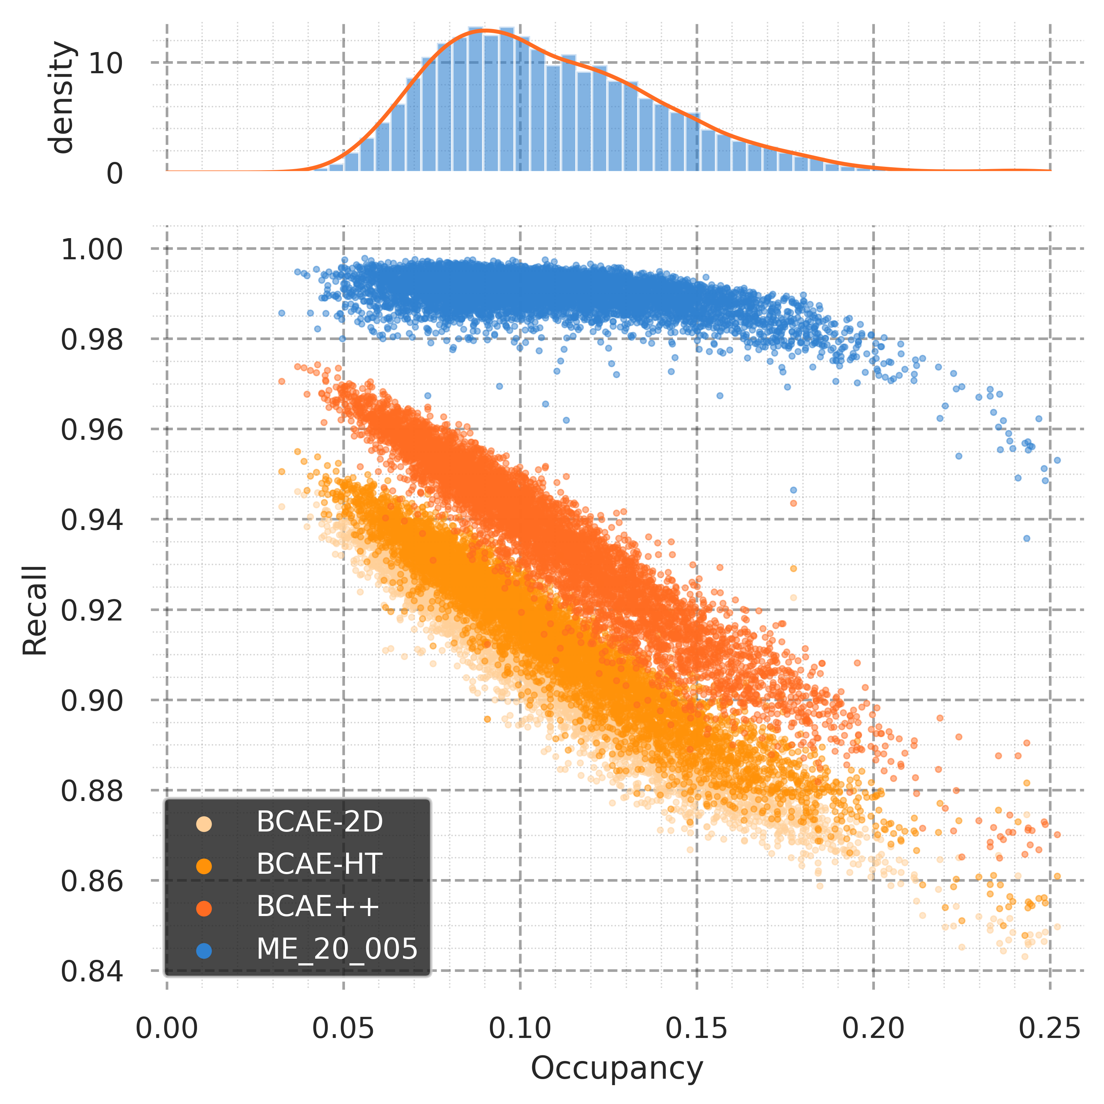
Reconstruction Performance vs. Occupancy
Comparison of dense and sparse models
Reconstruction error
Precision
Recall

Slide 14
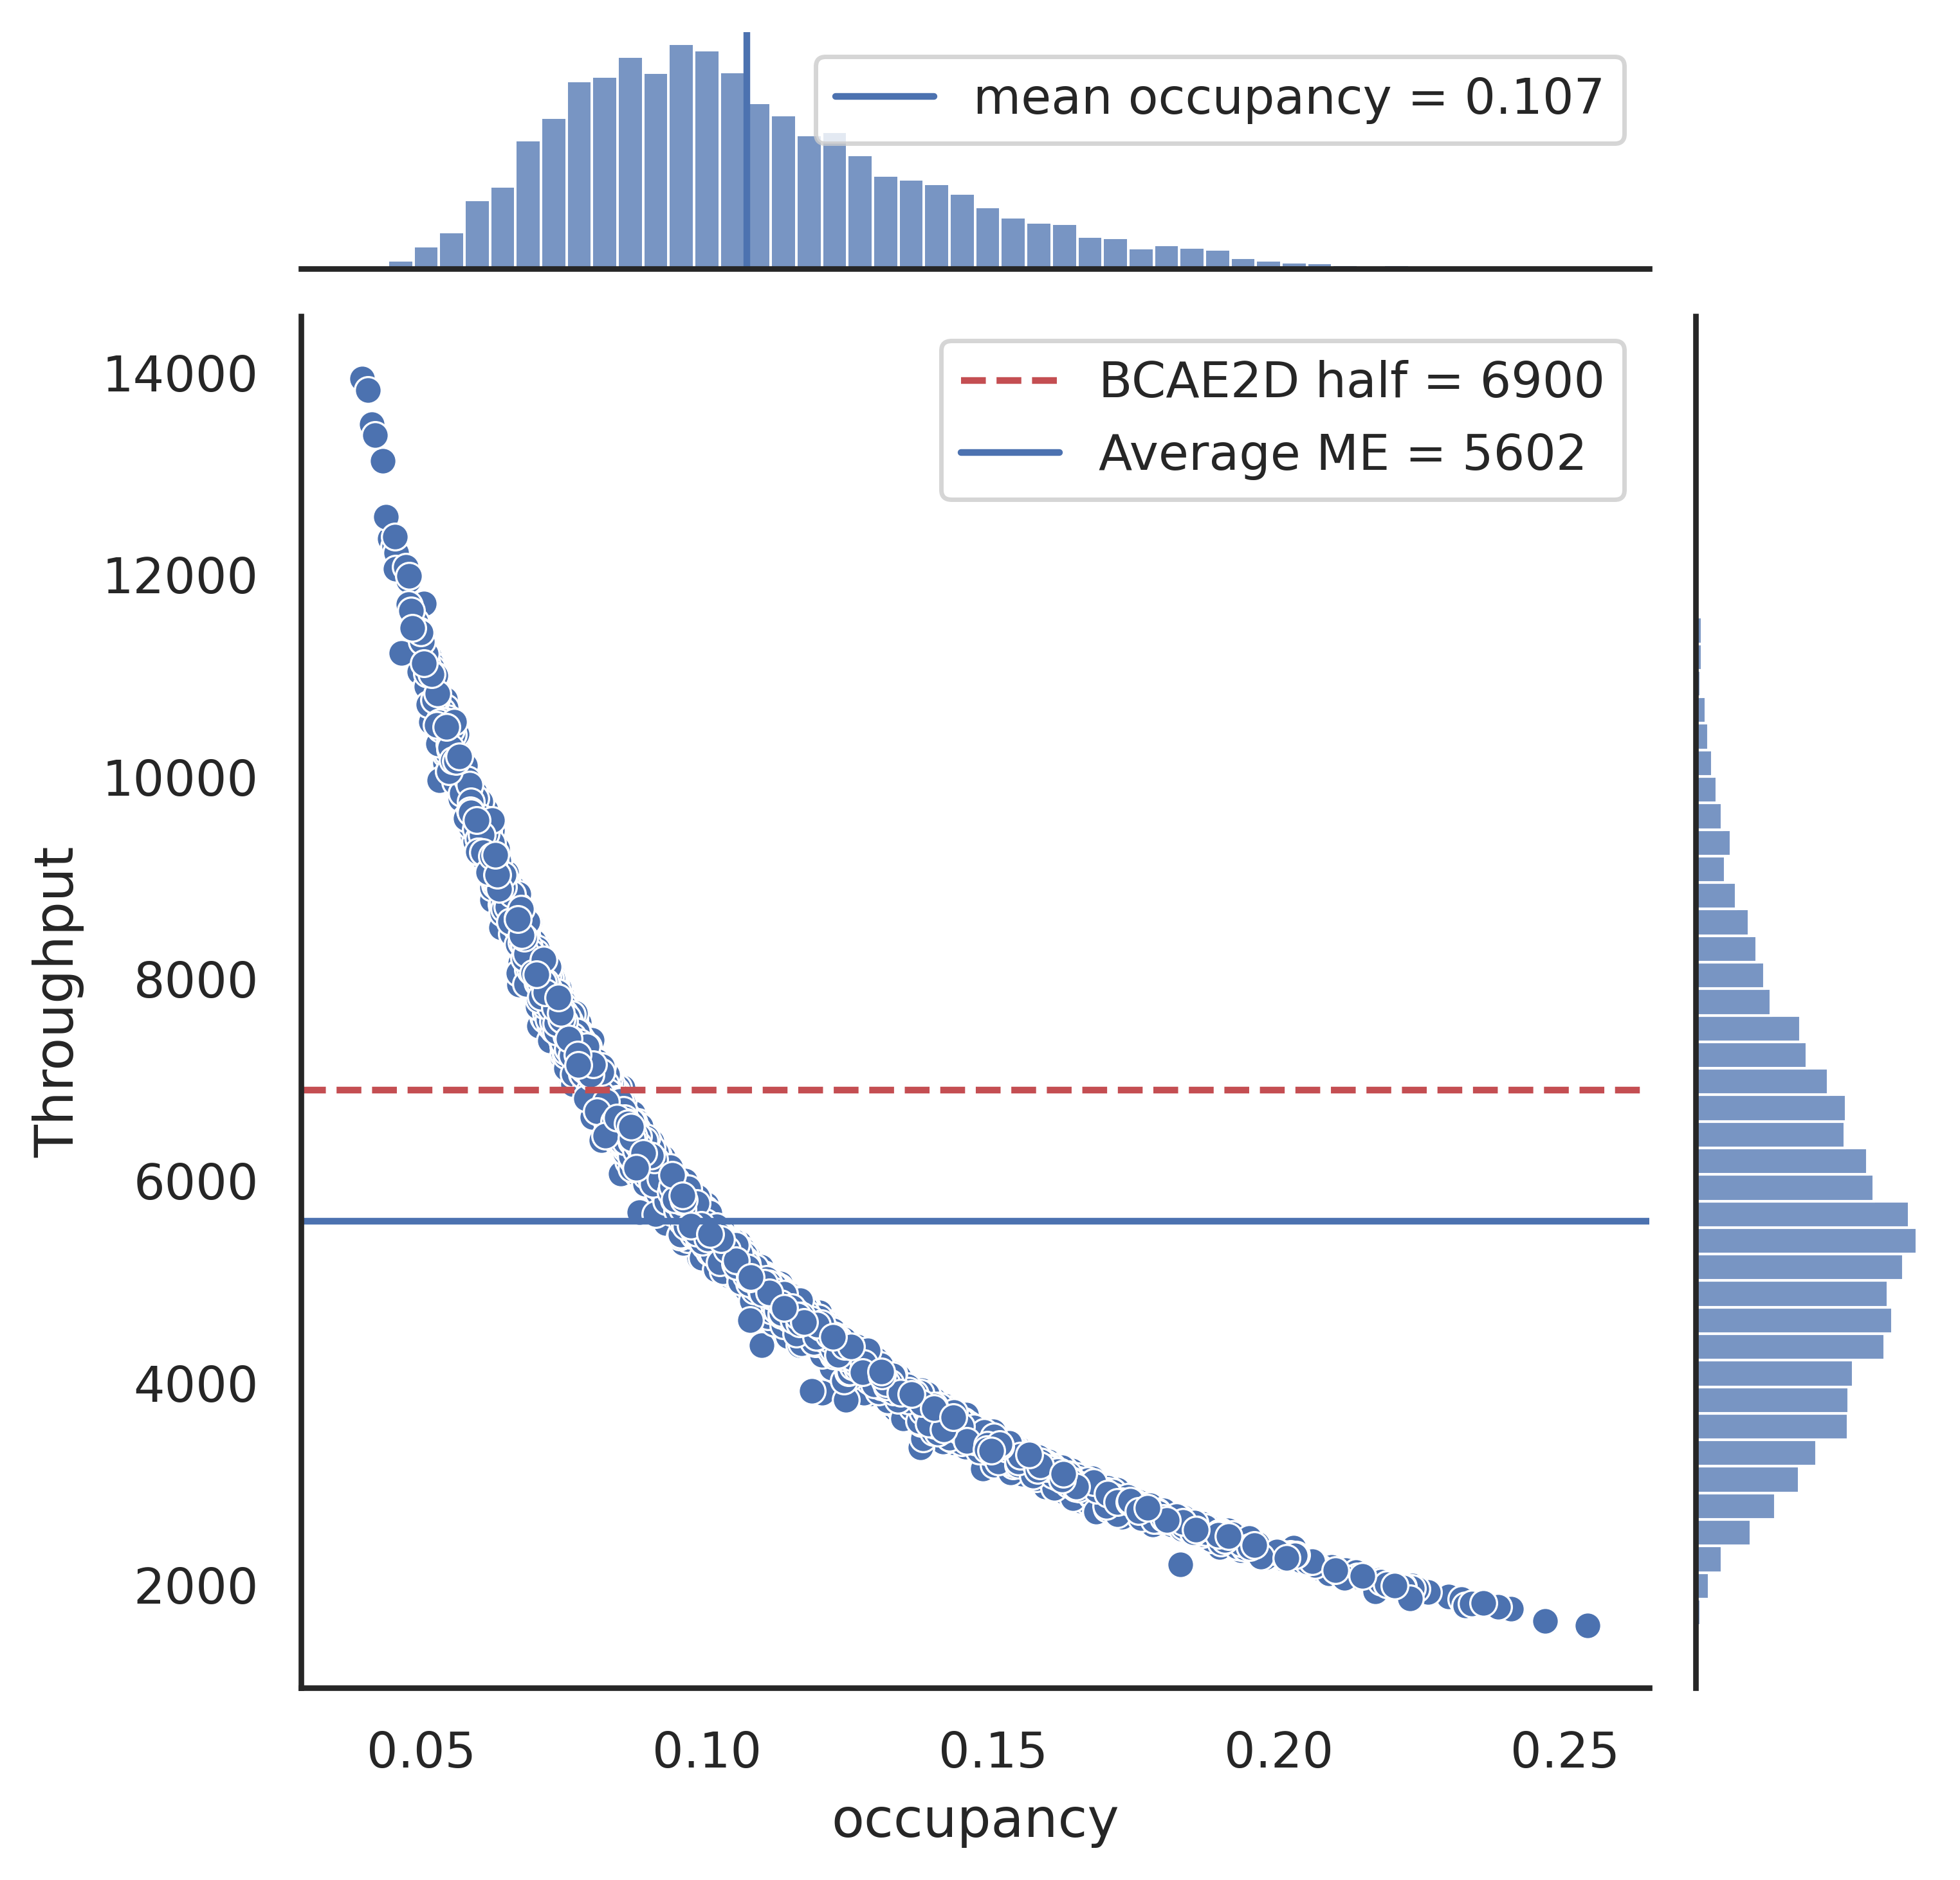
Throughput vs. Occupancy
Comparison of dense and sparse models

Slide 15
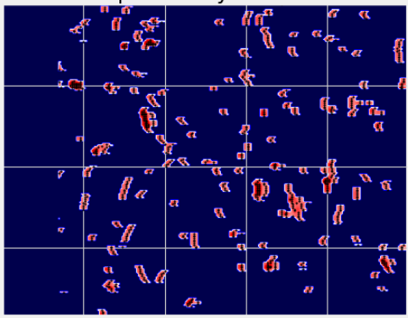
How Sparse Model Works
It works by finding the point of interest (PoI). The sparse model assign each voxel in the TPC a value. The higher the value the more valuable (or interesting) the voxel is. For compression, we only save those voxels that have higher value and discard lower-value ones, because we can confidently reconstruct with only high-value voxels.
The black dots (PoIs) are what the sparse model decided to save
Note: We can implement this idea with dense convolution. However, the sparse convolution engine (MinkowskiEngine) makes it much faster.

Slide 16
How Fast could Compression be on Alternative
AI Hardware Accelerators
GPUs (shared memory)
GraphCore and Groq (on-chip memory)

Slide 17
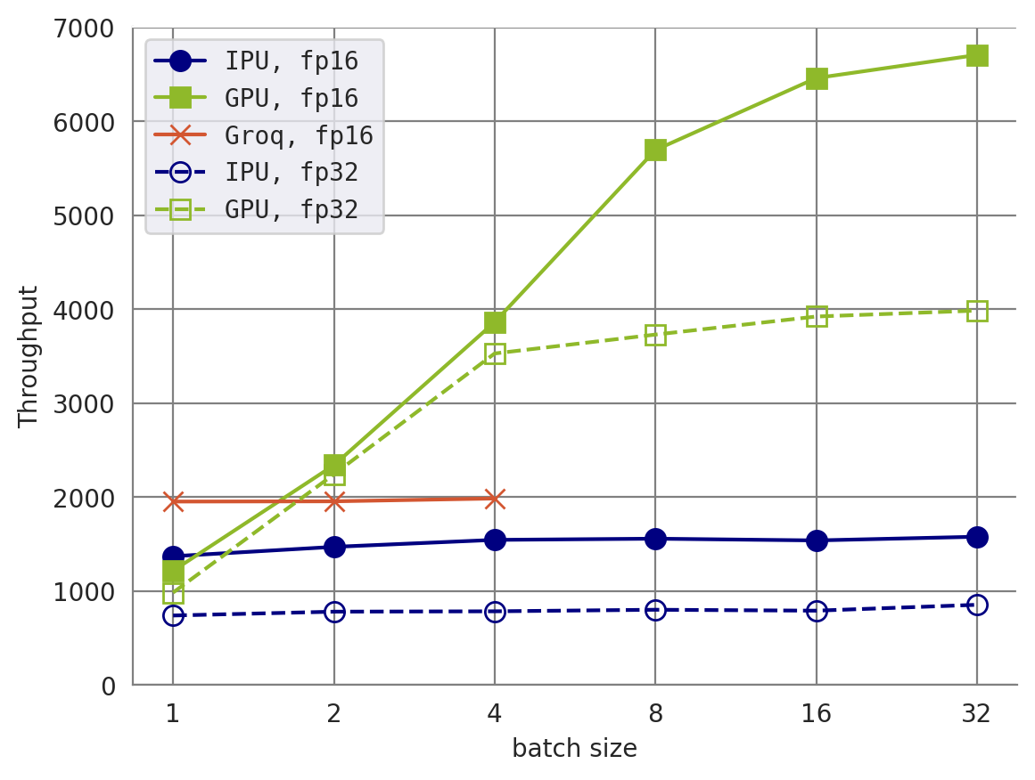
BCAE-2D Encoder

Slide 18
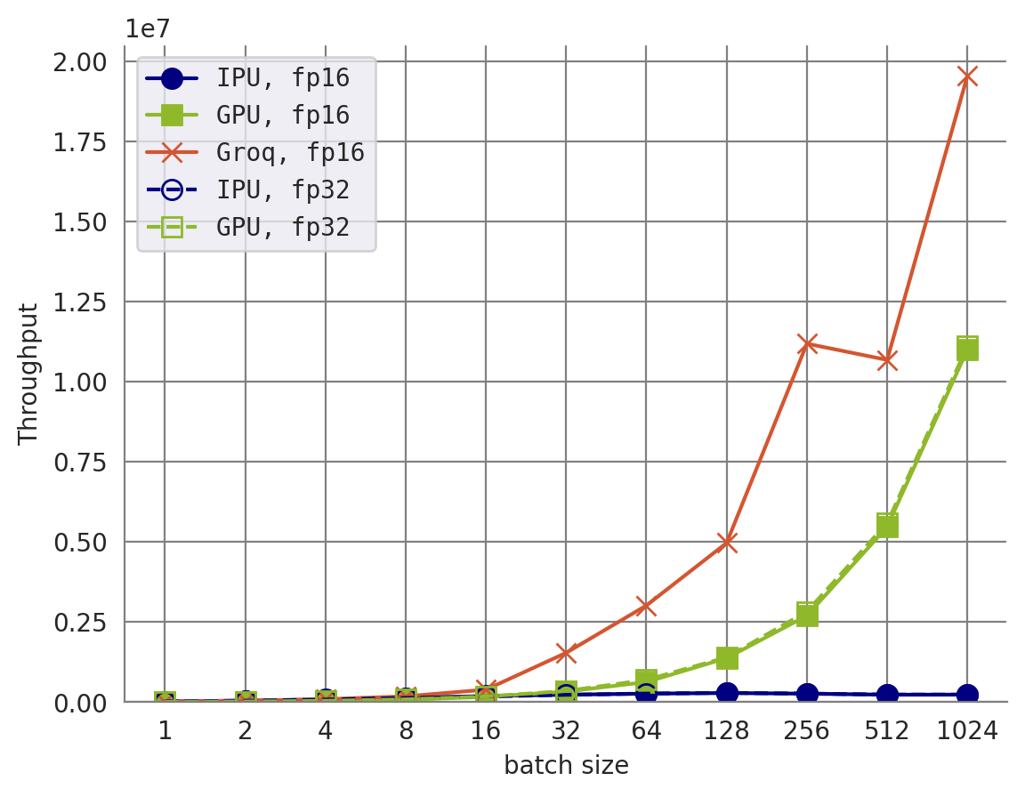
MLP

Slide 19
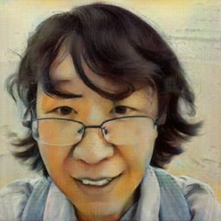
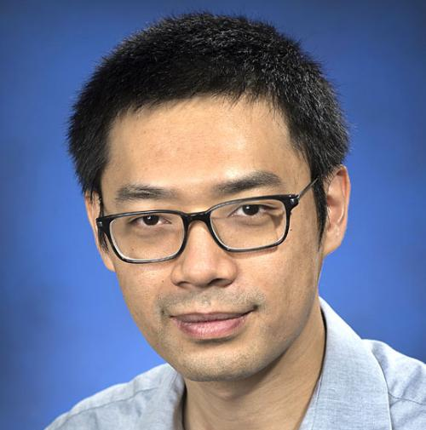
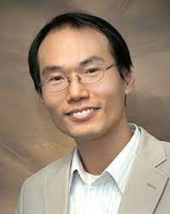
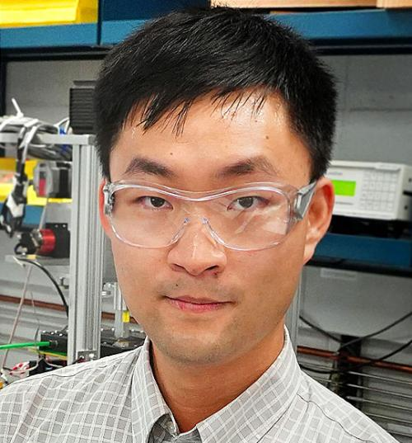
Summary
We can develop Deep Neural Network-based compression algorithm for Time-Projection Chamber data. And they works better than off-the-shelf untrainable compression algorithms
We can use the sparse convolution engine like the MinkowskiEngine to achieve both better accuracy and higher throughput.
AI hardware accelerators may help but we need to make them work better for more complicated neural networks.
Our Team
Yi Huang (me)
Yihui (Ray) Ren
Shinjae Yoo
Jin Huang (PI)

