Slide 1
Open Heavy Flavor Physics with sPHENIX
Thomas Marshall for the sPHENIX Collaboration
University of California - Los Angeles

Slide 2
Outline
sPHENIX Overview
Tracking Detector Status and Recent Results
Heavy Flavor Measurement Projections
Status and Outlook

Slide 3
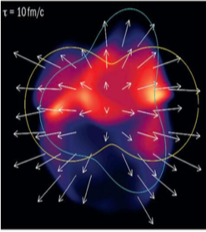
sPHENIX Physics Program
Bulk physics

Slide 4
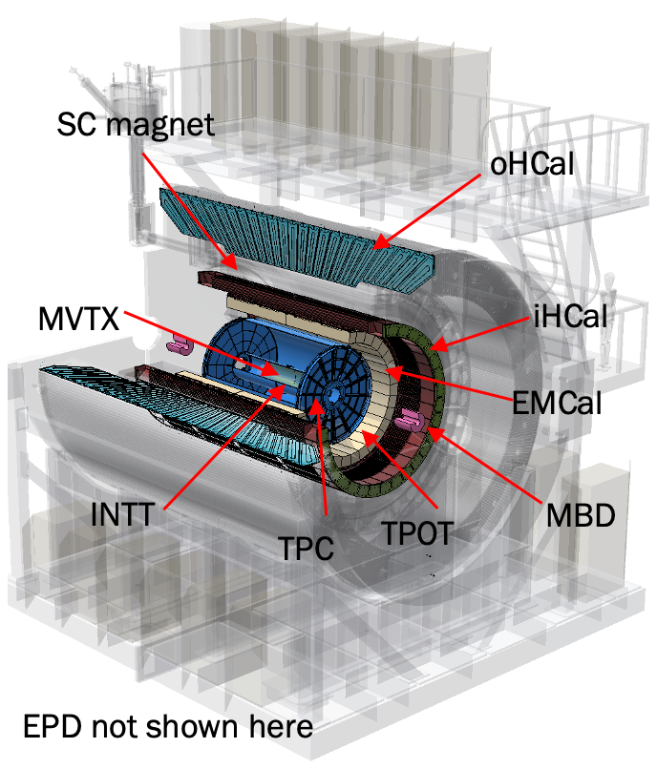
sPHENIX Detector
1.4 T Solenoidal B Field
15 kHz trigger and streaming readout
|η| < 1.1 and full 2π azimuthal coverage
All detectors critical for completion of our physics goals, tracking detectors most critical for execution of our HF program
sPHENIX BUP, 2022.

Slide 5
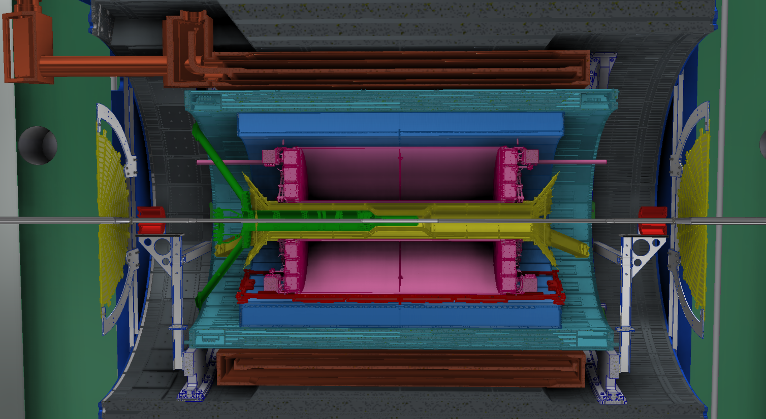
Tracking Detectors

Slide 6
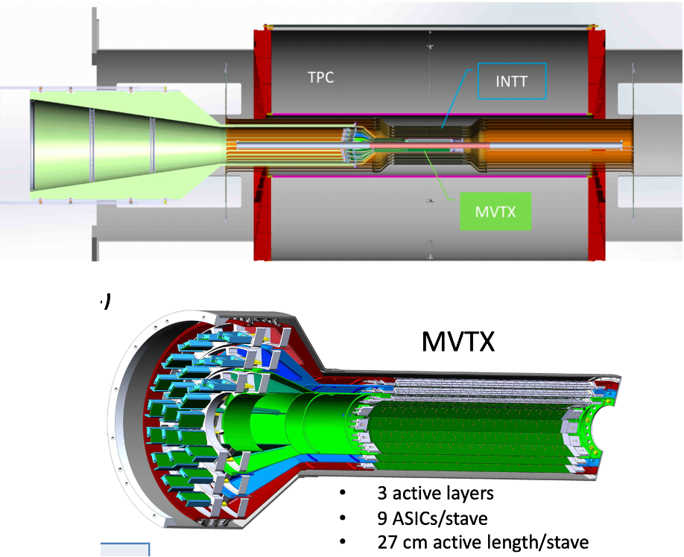
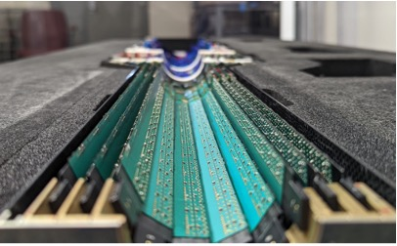
Tracking Detectors
MVTX
Precision vertexing
Technology from ALICE inner tracker
INTT
Fast detector to resolve bunch crossings
TPC
Primary tracker, crucial for momentum resolution
TPOT
Micromegas tracker for TPC space charge distortion calibration
MVTX

Slide 7
Tracking Detector Status

Slide 8
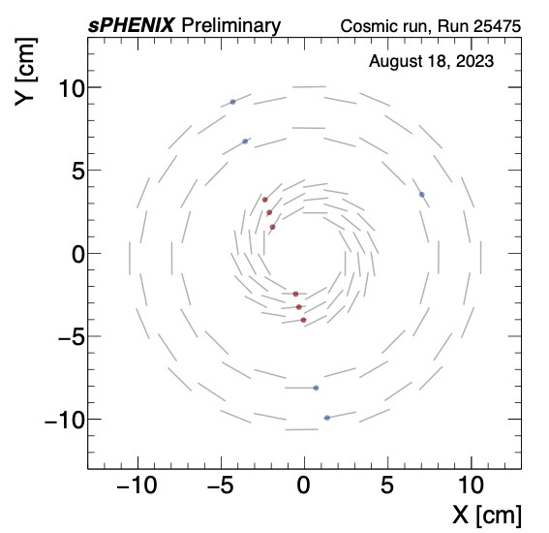
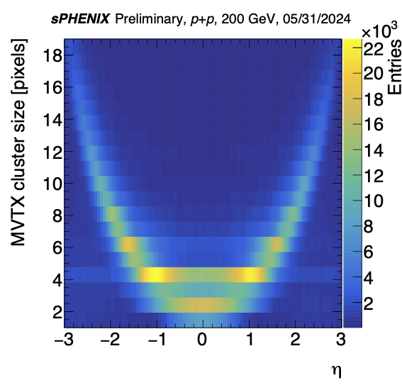
MVTX Status

Slide 9
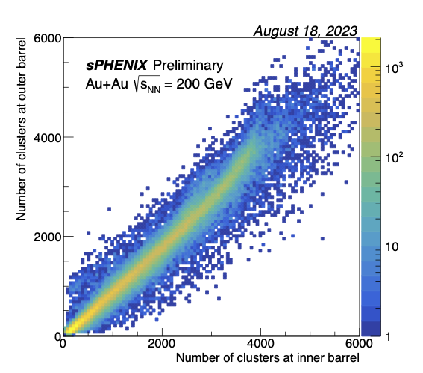
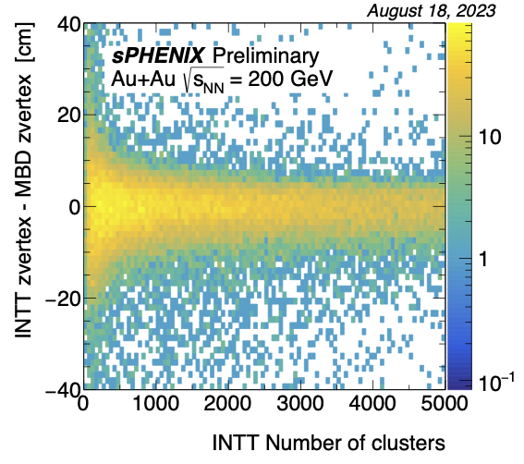
INTT Status

Slide 10
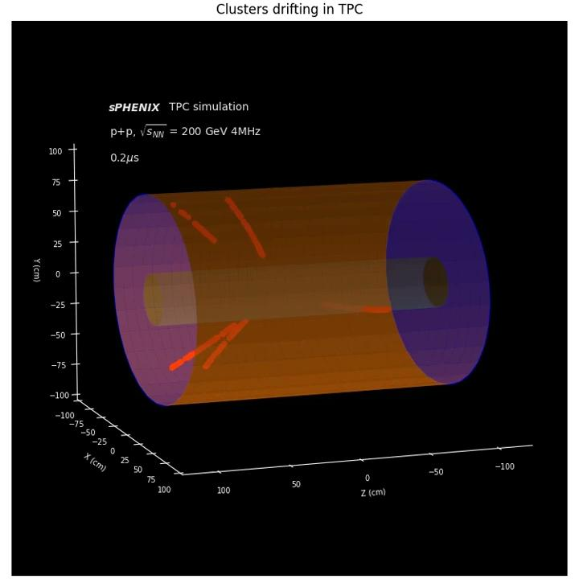
TPC Status

Slide 11
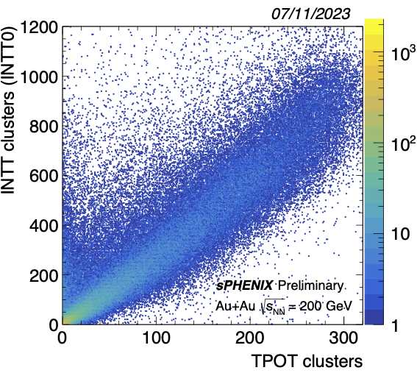
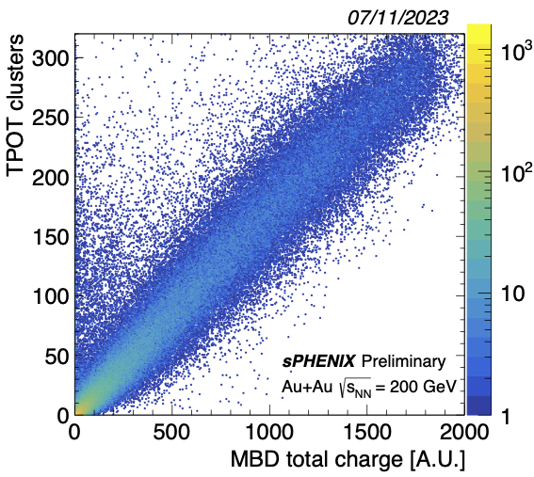
TPOT Status

Slide 12
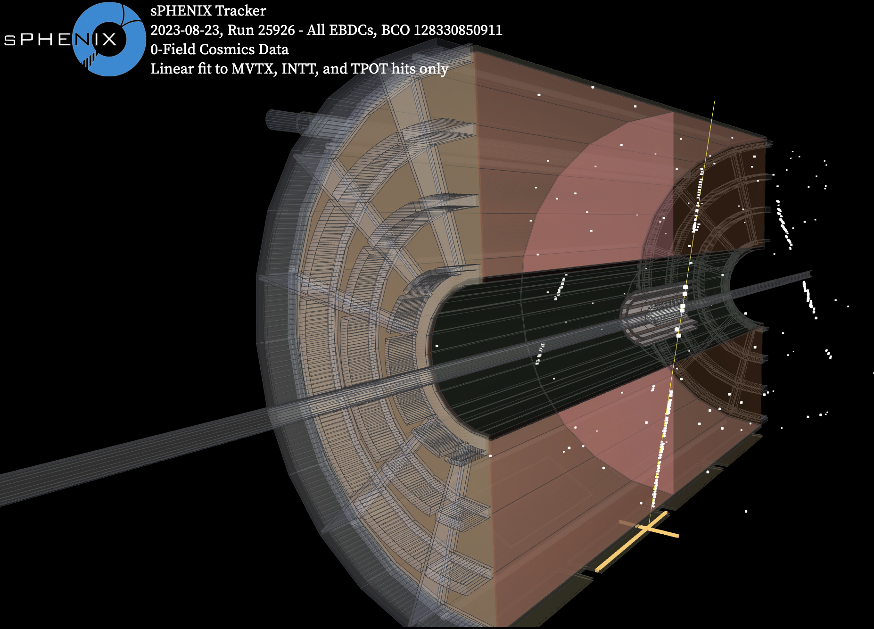
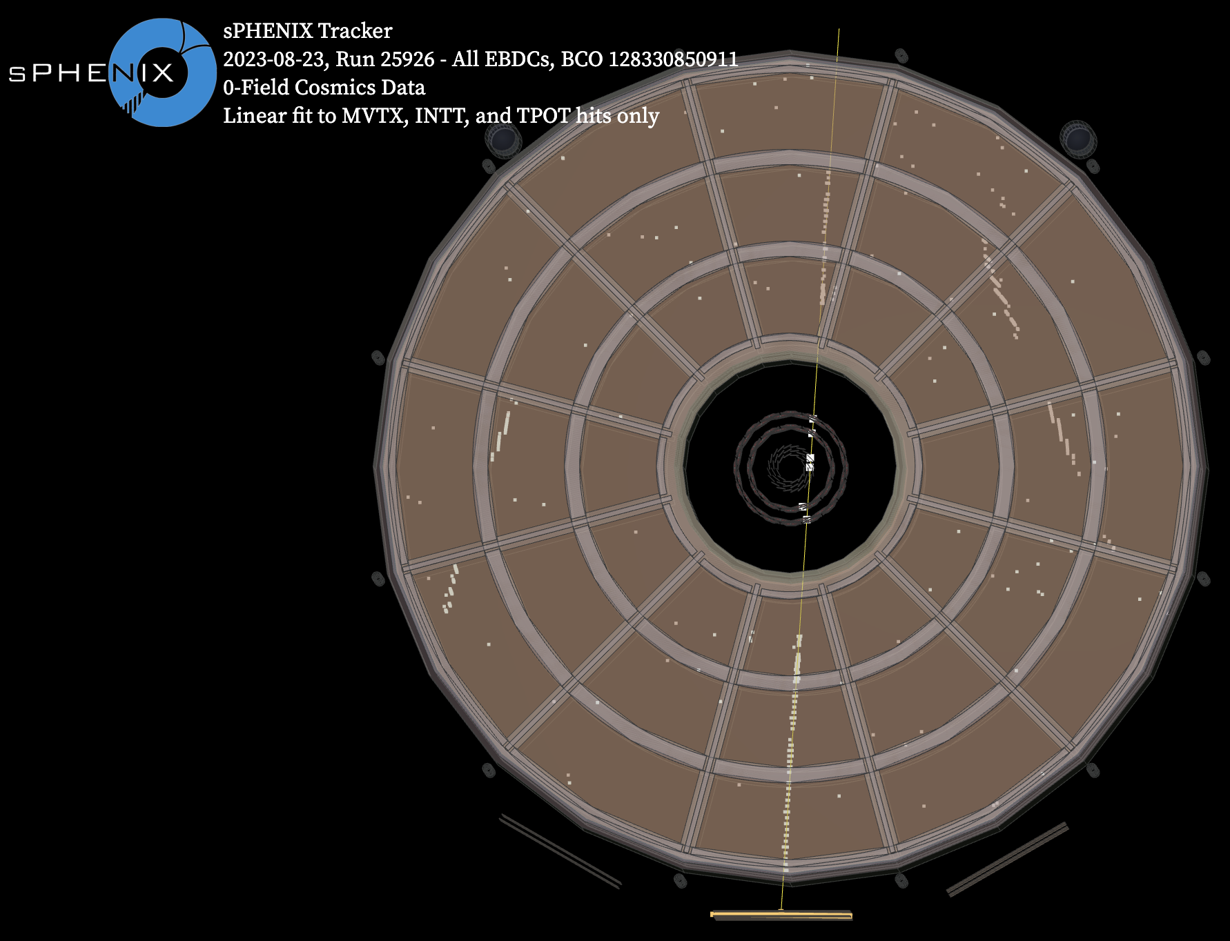
All Tracking Subsystems Event Display

Slide 13
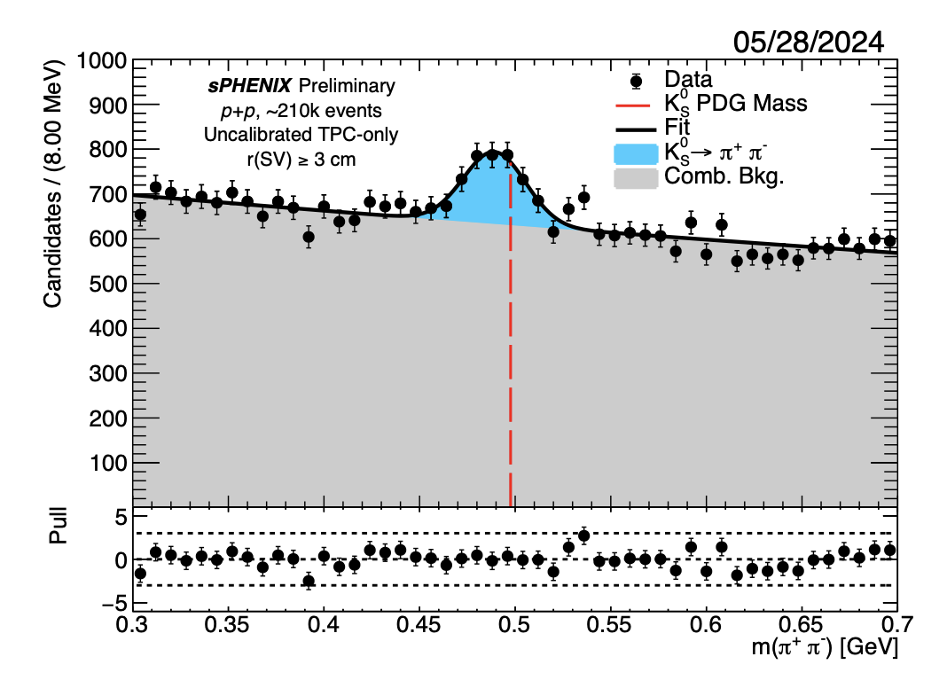
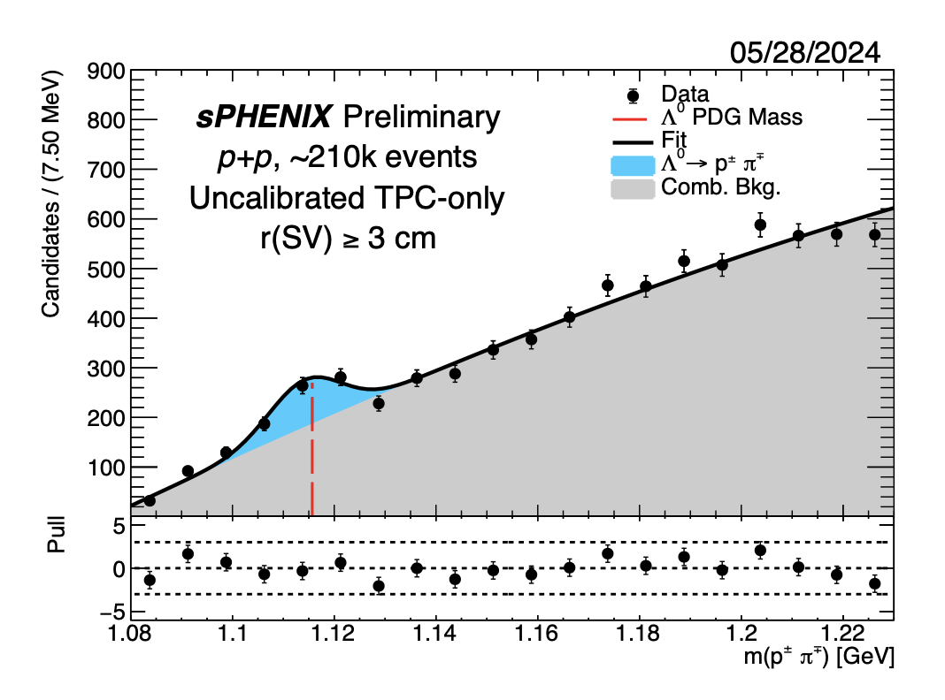
K_{S}⁰ and Λ⁰ Reconstruction with TPC
First TPC Data from Run 24 (~1s of planned physics production rate)

Slide 14
Projections

Slide 15
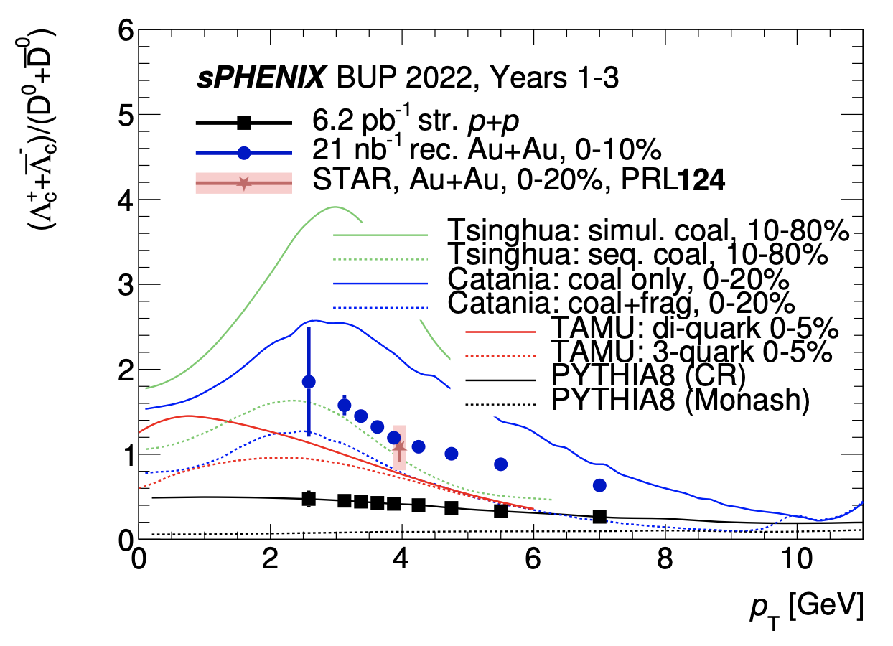
Λ_{c}⁺ Measurements and Hadronization
sPHENIX Simulation
RHIC and LHC data suggest a significant enhancement of the charm baryon to meson production ratio in sPHENIX collision systems (p+p, p+Au, Au+Au)
First ever p+p Λ_{c}/D⁰ measurement at RHIC energies
Increased understanding of charm hadronization in the QGP
Notes:
Emphasize streaming readout importance in terms of helping us improve the low pT statistics Coalescence, pool of quarks, baryon easier to produce, individual quarks need less energy to produce the same pT particle Should still work for heavier quarks if coalescence applies to heavy quarks

Slide 16
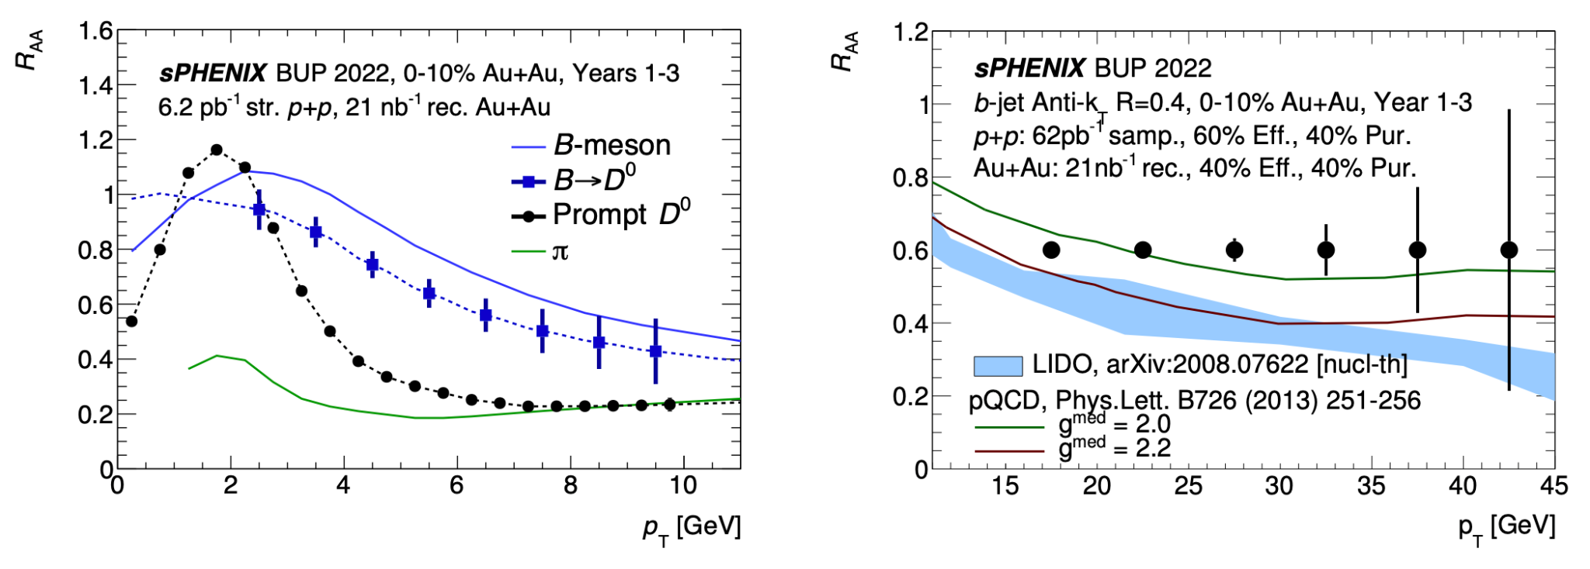
Energy Loss Measurements
sPHENIX Simulation
sPHENIX Simulation
See talk by Jakub Kvapil at 11:30!
Increased understanding of energy loss in the QGP
p+p data crucial for baseline
Notes:
Talk about definition of these observables, add formula to slides, how heavier quarks experience energy loss in the QGP

Slide 17
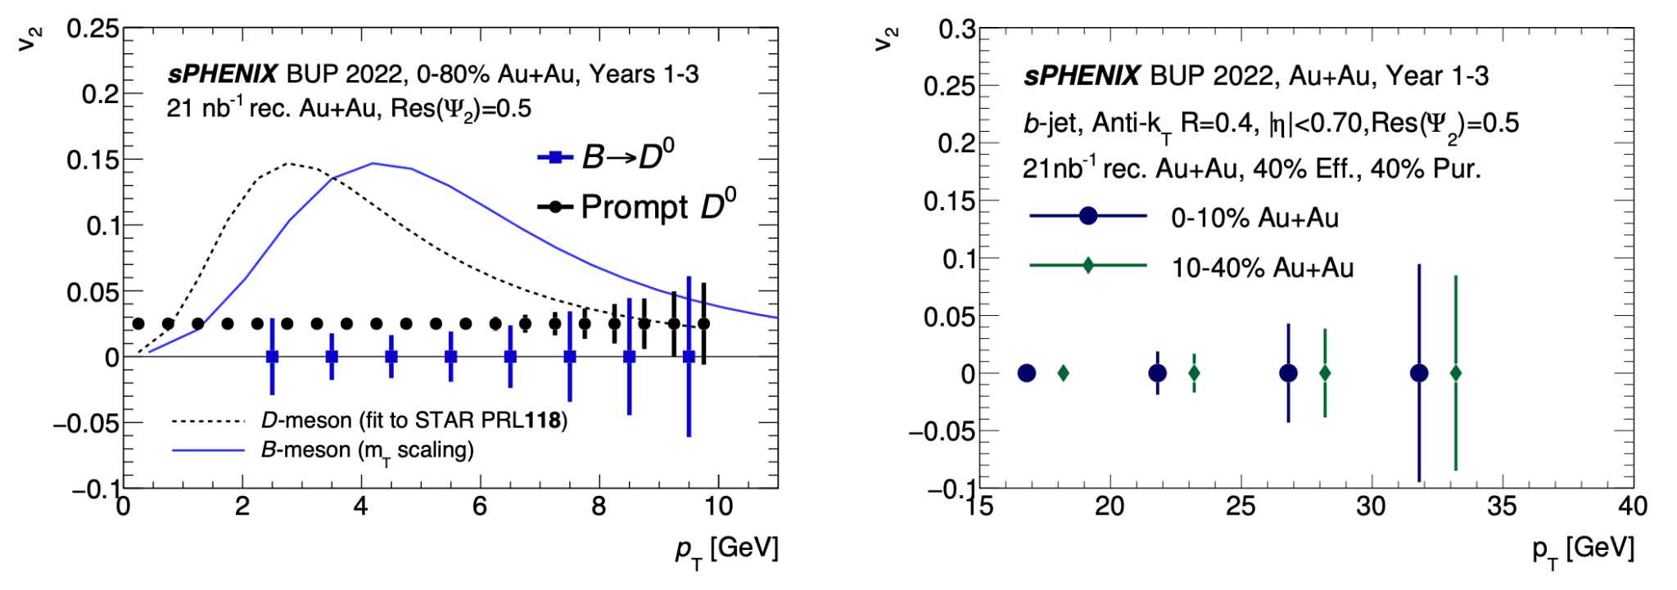
Collectivity
sPHENIX Simulation
sPHENIX Simulation
Enhanced understanding of HF collective motion through evolution of the QGP
Precision bottom measurements to constrain heavy quark diffusion transport parameter
Notes:
Talk about definition of these observables, add formula to slides Check on coalescence picture for heavy quarks B jet more looking at path length dependence of energy loss, in-plane vs out-plane path length is different, more energy loss out of plane that gives you a flow because it’s easier to stay in plane

Slide 18
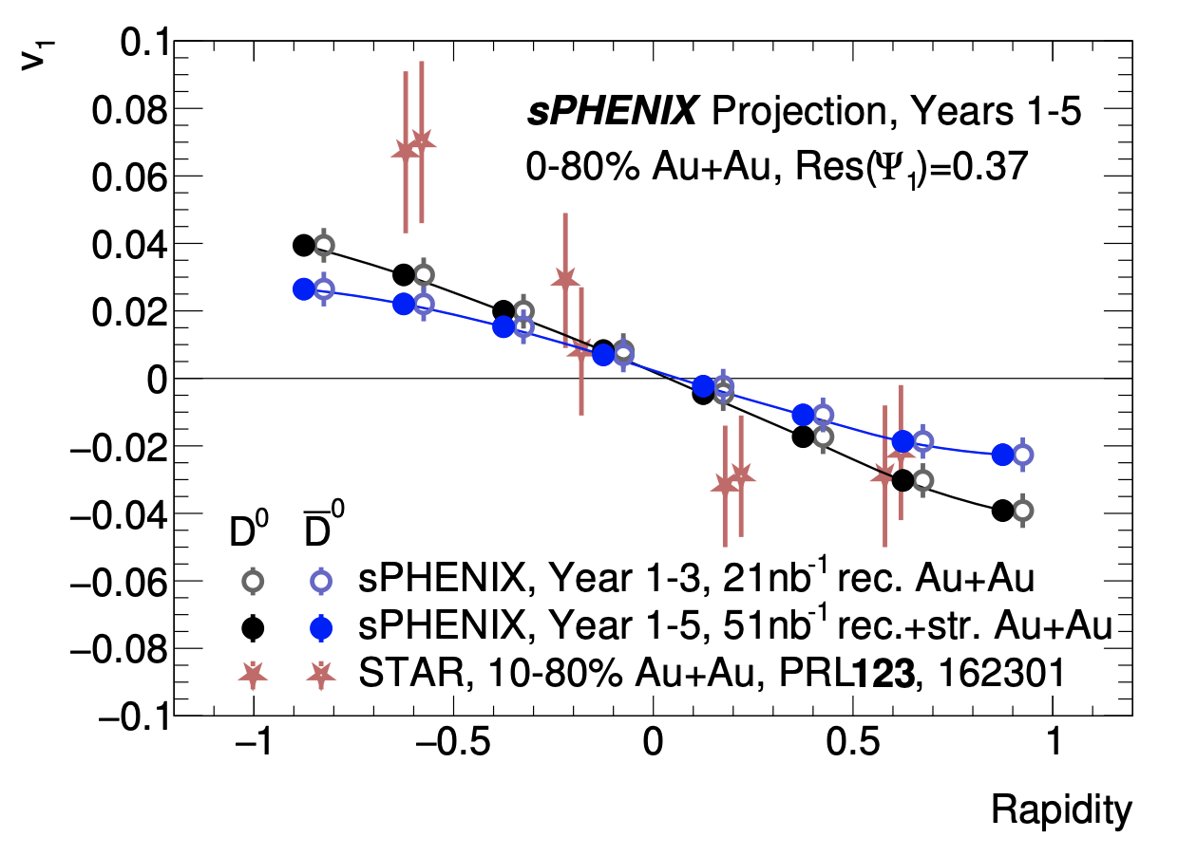
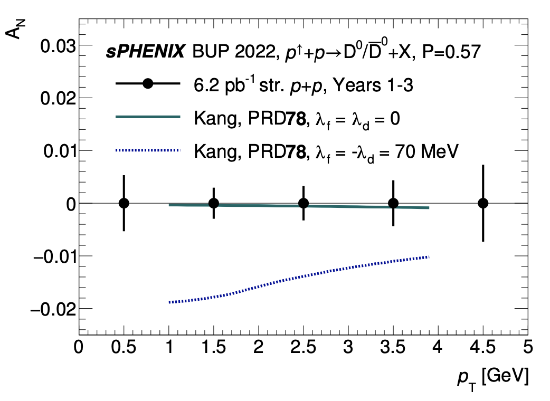
D⁰ v₁ and TSSA
sPHENIX Simulation
sPHENIX Simulation
Quantitative access to initial electromagnetic field strength in heavy ion collisions
Constraints on trigluon correlation function
Notes:
Talk about definition of these observables, add formula to slides Hall effect/Lorentz Force for D0, opposite effect from proton paper aditya wrote Two effects important at different times, Hall effect more important at earlier stage - heavy quarks Farady effect more important at later stages of QGP that could dominate for later particles like piKp Effects also differ at different centralities

Slide 19
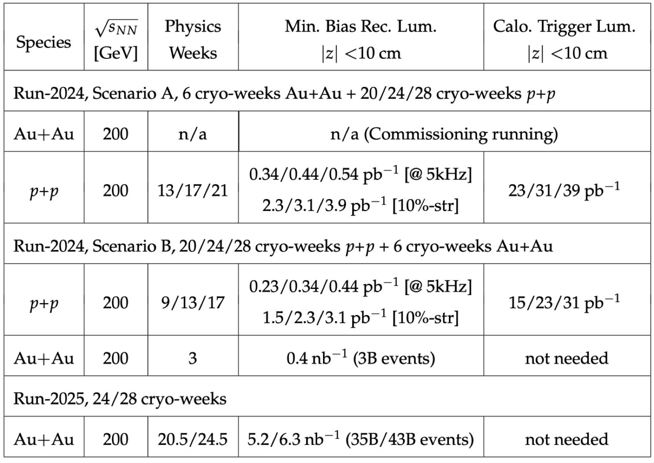
Conclusion and Outlook
Run24 p+p data-taking is ongoing!
Crucial time for HF program and baseline measurements for the entire heavy ion physics program
Exciting for the collaboration and looking forward to Au+Au running in 2025!
Full set of current and future sPHENIX results:
https://www.sphenix.bnl.gov/PublicResults

