Slide 1
Time Frame Contents and Expected Data Volumes
Jeff Landgraf
Time Frame Data Structure
Time Frame information contents
Conversion of simulation information to DAQ use
Time structure
Data Volumes, Background and Noise

Slide 2
Coordinate Systems
A minimum of 3 coordinate systems are going to be needed:
Detector System:
Implemented in dd4hep as 64 bit, user specified bit field
e.g. BarrelHCal: epic-23.12.0 <id>system:8,sector:5,tower:6,tile:3</id>
epic-nightly: <id>system:8,eta:5,phi:9</id>
DAQ:
DAM, RDO, FEB, ASIC, Channel
Global:
Detector, x, y, z
Combine and/or generalize.

Slide 3
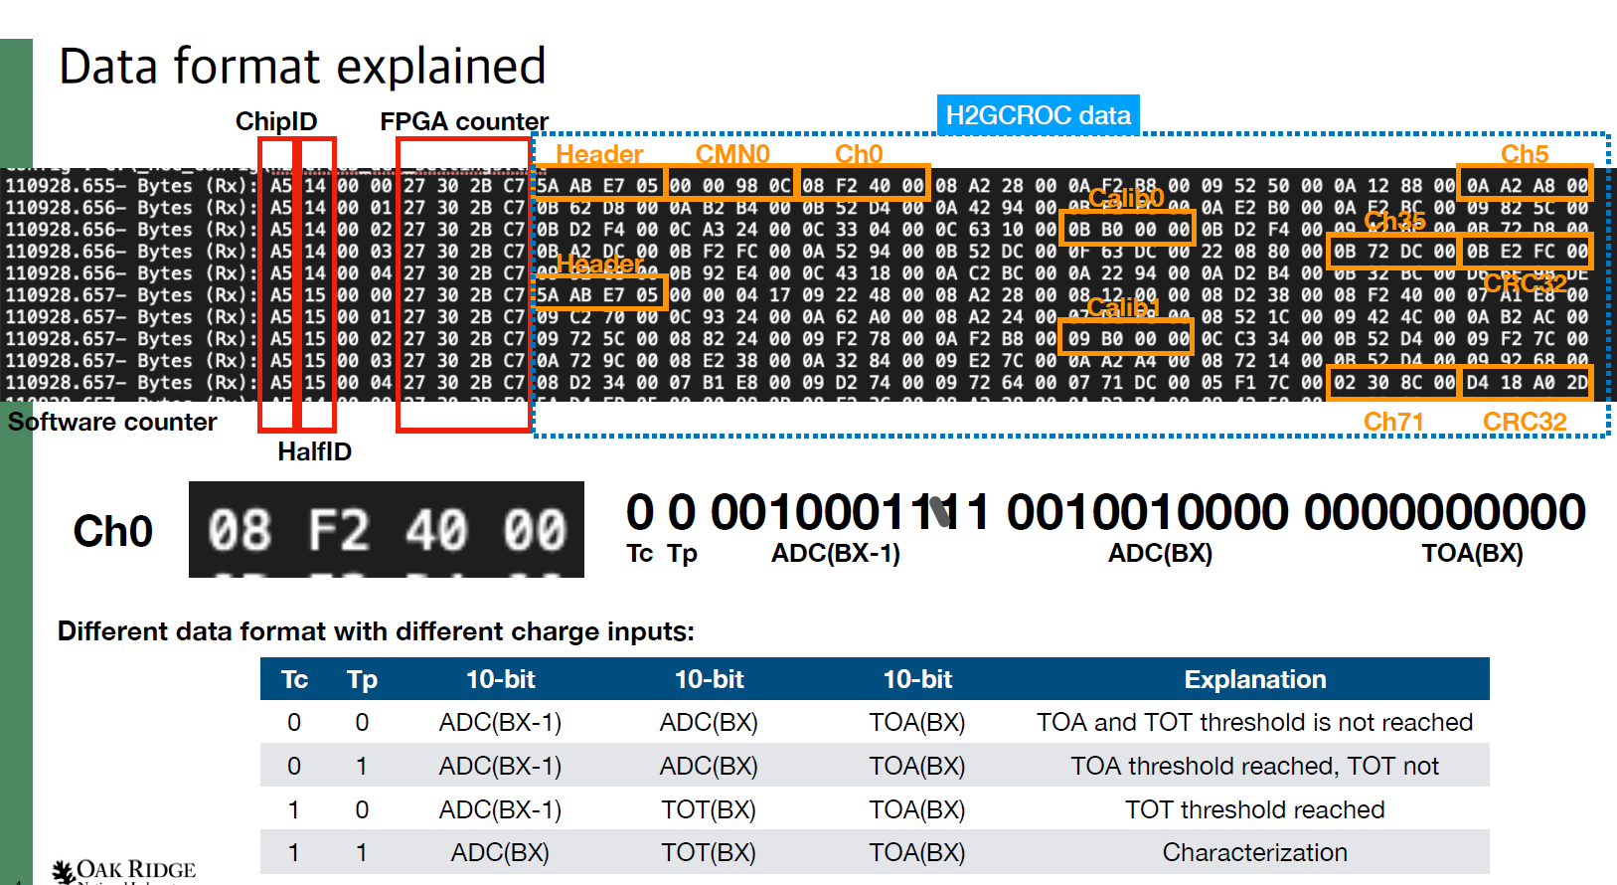
DAQ Computing: Data Format Case Study (H2GCROC3A)
This is the data format of a prototype ASIC – not the final ASIC, my points are conceptual! (N. Nowitski)
Potential interesting data:
Full ASIC data (despite containing up to 17 channels of data without hits) {RAW}
Channels without hits removed, but containing n samples for channels hit {CHANNEL}
Channels with samples suppressed and only TOA/TOT information {TOATOT}
Processed TOA/TOT information improved using sample information, but without saving samples {ENHANCED}
information
Data volume
Granularity of readout is 1/4 chip (18 channels).
Data is 3x10 bit words per sample, but the meaning of the three words depends on the Tc, Tp flags
Data is NOT pedestal subtracted, rather the pedestals are shifted via calibration to the same value
Can configure fixed # time samples read out
Can configure to disable certain Tc/Tp Combinations
Suppress Banks in some timeframes:
/TF#/NHCAL/DAM01/RAW (1 in 1000)
/TF#/NHCAL/DAM01/CHANNEL (1 in 10)
/TF#/NHCAL/DAM01/TOATOT (1 in 10)
/TF#/NHCAL/DAM01/ENHANCED (always)
Implications for data formats & readers
Generic named data navigation
Detailed bank reader plugins

Slide 4
DAQ File Organization (Example…)
Time Frame #1
Detector #1
DAM #1
RDO #1
RAW
TF_Head:
BX#1:
ASIC_1
ASIC_2
(…)
ASIC_N
BX#2:
ASIC_1
ASIC_2
ASIC_3
(…)
SC:
ASIC_1
(…)
BX#3
ASIC_1
ASIC_2
(…)
(…)
TF_Tail
Time Frame #2
Detector #2
(…)
RDO #2
Processed #1
Time Frame #3
Detector #3
DAM #N
RDO #3
(…)
Time Frame #3
(…)
Processed
Info #1
(…)
Processed #N
Time Frame #4
Detector #N
(…)
RDO #N
Time Frame #5
Slow Controls
Processed
Info #N
Processed
Info #1
Time Frame #6
Beam Info
(GTU)
(…)
Format by necessity
complex, extendable
& variable
Time Frame #7
Scalers
Processed
Info #N

Slide 5
DAQ File Organization (Example…)
Time Frame #1
Detector #1
DAM #1
RDO #1
RAW
TF_Head:
BX#1:
ASIC_1
ASIC_2
(…)
ASIC_N
BX#2:
ASIC_1
ASIC_2
ASIC_3
(…)
SC:
ASIC_1
(…)
BX#3
ASIC_1
ASIC_2
(…)
(…)
TF_Tail
Time Frame #2
Detector #2
(…)
RDO #2
Processed #1
Time Frame #3
Detector #3
DAM #N
RDO #3
(…)
Time Frame #3
(…)
Processed
Info #1
(…)
Processed #N
Time Frame #4
Detector #N
(…)
RDO #N
Time Frame #5
Slow Controls
Processed
Info #N
Processed
Info #1
Time Frame #6
Beam Info
(GTU)
(…)
Format by necessity
complex, extendable
& variable
Time Frame #7
Scalers
Processed
Info #N

Slide 6
Readers
Two distinct sets of readers needed
Data Bank Navigation
rdr = getBank(“NameOfBank”) or
rdr = getBank(TimeFrame, ”lfhcal/dam_3/rdo_6/raw”)
Detector Bank specific readers (presumably implemented as plugins)
hit = rdr->nextHit()
hit.bx
hit.highResTOA
hit.channel
hit.adc
Could, of course have multiple readers instantiated at a time for simultaneous decoding
One likely needs to fill intermediate data structure for processing, so time frame for DAQ and time frame for tracking need not be tied together!

Slide 7
Time Frame Data
I used simulations from Zhengqiao Zhang & Jakub Ceska
Type | Energies | File | Nominal Rate | Used Rate | Hits/Event
DIS | 18x275 GeV | /gpfs/mnt/gpfs02/eic/zhangzq/EPIC/NewReco/analysis_DIS/all.tree.edm4eic.root | 83 kHz | 500 kHz (10x275 GeV) | 485
Proton Beam Gas | 275 GeV | /gpfs/mnt/gpfs02/eic/zhangzq/EPIC/NewReco/analysis_ProtonGas/all_protonGas.eicrecon.tree.edm4eic.root | 32.6 kHz (10000Ahr) | 350.3 kHz (100Ahr) | 420
Electron Beam Gas | 10 GeV (highest beam current) | /gpfs/mnt/gpfs02/eic/ceska/readout/podio_merged.root | 3.177MHz (10000Ahr) | 34.1 MHz (100 Ahr) | 15.5
Hit Mapping. Heuristics are used for mapping hits
Heuristic function for each detector:
Map RecHits (x,y,z,cellID) → (channel, ASIC, RDO)
Software is in:
https://github.com/jml985/epicJTools
Files with the detailed results:
wiki -> Talks and Slide Library -> DAQ Directory Link ->
Data Volumes -> 240312-Simulated DataRates.txt
Channel: Not used for ITS3/Astropix
ASIC: reticule for ITS3
Sensor for Astropix
FEB for non-asic dets
ASIC for asic based dets
RDO: RDOs are associated with nearby ASICS. In final system most, but not all, detectors the FEB->RDO map can be set to minimize data rate variation. Avg rates matter here

Slide 8
Coordinate Systems In DD4HEP (23.12.0)
Detector | Coordinates | Implementation
SiBarrelVertex | System,Layer,Module,Sensor,x,y | System indicates layer, layer not used, module implemented, Grid represents pixels
SiBarrelTracker | System,Layer,Module,Sensor,x,y | Single system, Layer implemented, 128 modules in each layer (unphysical?), Grid represents pixels
SiBarrelEndcap | System,Layer,Module,Sensor,x,y | System+layer represents disk, 36 modules each in spokes, Grid represents pixels
Fwd/Back MPGDEndcap | System,Layer,Module,Sensor,x,y | 2 Layers represent disks, 48 modules represent spokes, grid represents detector resolution, not channels
MPGDBarrel | System,Layer,Module,Sensor,x,y | 128 modules represent staves, grid represents detector resolution not channels
OuterMPGDBarrel | System,Layer,Module,Sensor,x,y | Even modules Electron Side, Odd modules Hadron Side, grid represents detector resolution not channels
LFHCAL | System,ModX,ModY,TowX,TowY,rlayerz,layerz | All implemented, layerz are summed over
HCalEndcapPInsert | System,Layer,Slice,x,y | 65 layers, grouped into 13 for 8k channels (not grouped?) hex grid x,y values alternate even/odd only
EcalEndcapP/Insert | System,barrel,module,layer,slize,fiberx,fibery,x,y | Only grid used, but grid represents channels. Insert is not distinct detector, but x,y grid is shifted
HcalEndcapN | System,barrel,module,layer,slice,x,y | No combination of layer/grid resuls in 3256 channels!
EcalEndcapN | System,sector,module,x,y | No grid values set, but module count seems to represent channels
HCalBarrel | System,Sector,Tower,Tile | Fully implemented. 7680 Towers
ECalBarrelSiFi | System,Sector,Row,Towers | Implemented, but z positions are set, Also all hits need to are doubled because dual readout on east/west
ECalBarrelImaging | System,Sector,Layer,Slice,Grid,Fiber,z | No sensible values,
TOFBarrel | System,Layer,Module,Sensor | Modules are staves, Counts represent old channel counts
TOFEndcap | System,Layer,Module,idx,idy | Idxy even for inner layer, odd for outer layer, Counts represent old channel counts
dRICH
hpDIRC
pfRICH

Slide 9
Coordinate MAP to DAQ for Data Volume Tests
Detector | Coordinates | Implementation
SiBarrelVertex | System,Layer,Module,Sensor,xx,yy | Distribute evenly in Z for each layer (asics/rdo → 108/4, 144/5, 359/12)
SiBarrelTracker | System,Layer,Module,Sensor,xx,yy | Distribute evenly in Z for each layer (asics/rdo → 1578/50, 2294/72)
SiBarrelEndcap | System,Layer,Module,Sensor,xx,yy | Distribute evenly in R for each disk (asics/rdo → 313/10, 949/30, 977/31, 976/31, 972/31, 313/10, 949/30, 977/31, 969/31, 957/31)
Fwd/Back MPGDEndcap | System,Layer,Module,Sensor,xx,yy | Distribute evenly in R for each disk (asics/rdo → 128/8)
MPGDBarrel | System,Layer,Module,Sensor,xx,yy | Distribute evenly in Z (asic/rdo → 512/32)
OuterMPGDBarrel | System,Layer,Module,Sensor,xx,yy | Distribute evenly in Z for each panel (asics/rdo → 1084/69)
LFHCAL | System,ModX,ModY,TowX,TowY,rlayerz,layerz | Each module gets 1 asic (8 towersx7channels), RDO covers 8x4 grid of modules
HCalEndcapPInsert | System,Layer,Slice,xx,yy | Distribute 154/7 asic over x,y grid x 7 layers. Distribute 10 RDO over positional grid
EcalEndcapP/Insert | System,barrel,module,layer,slize,fiberx,fibery,xx,yy | Distribute channels over grid using 25x25 mm pitch, asics define by 8x4 grid, rdo defined by 32x16 grid
HcalEndcapN | System,barrel,module,layer,slice,xx,yy | Distribute 64 asic in R, 2 RDO in R
EcalEndcapN | System,sector,module,xx,yy | Distribute 125 asic in R, 8 RDO in R
HCalBarrel | System,Sector,Tower,Tile | 1 asic per tile, 4 asic per sector
ECalBarrelSiFi | Systen,Sector,Row,Towers | 1 asic per sector, 24 sector per rdo. Each asic/rdo doubled for hadron/electron side sensors
ECalBarrelImaging | System,Sector,Layer,Slice,Grid,Fiber,zz | Distribute evenly in grid by layer (asic/rdo -> 14537/52, 15827/57, 16429/59, 17719/63)
TOFBarrel | System,Layer,Module,Sensor | Distribute evenly in Z (asic/rdo → 18432/288)
TOFEndcap | System,Layer,Module,idx,idy | Distribute evenly in R for each layer (asic/rdo →1816/106)
dRICH
hpDIRC
pfRICH

Slide 10
Hit Sizes & Noise rates
Detector | Bits / hit (readout) | Bits / hit (tape) | Bits / Noise Hit (tape) | Noise Hit Rate Estimates (hz/channel) | Reduction Notes
MAPS | 2x64 | 2x64 | 2x64 | 1e-3 (~6.25σ) | 64 bits per pixel, but hits likely to show up in adjoining 2usec frames
MPGD | 5x64 | 1x64 | 0 | 30 (~4.5σ) | Charge sharing, cluster finding for reduction
Most Calorimeter (Caloroc) | 18x6x64 | 64 | 0 | 1000 (~3.7σ) | 18 channel segmentation in caloroc, 6 time samples, feature finding for reduction, additional/noise reduction possible via cluster finding
Fwd/Back eCal | 6x64 | 64 | 0 | 1000 (~3.7σ) | 6 time sample estimate (possible onboard feature finding, but not yet assumed). Feature finding for reduction (additional/noise reduction possible via cluster finding)
Astropix | 64 | 64 | ? | ?
Forward TOF | 9x64 | 64 | 0 | 30 (~4.5σ) | 3x3 asic segmentation & cluster finding
dRICH | 64 | 64 | 64/200 | 3000-300,000 (~2σ) | Software triggering
Default | 64 | 64 | ? | ?

Slide 11
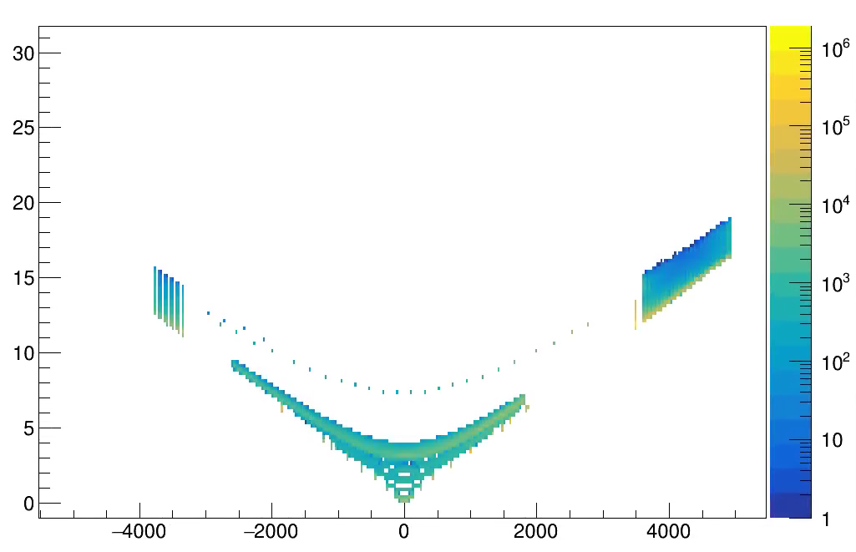
Event Timing (measured wrt actual collision T0)
Expectation
DIS
t(v=c) vs z
t (ns)
Z (mm)

Slide 12
Event Timing
Expectation
DIS
Electron Beam
t(v=c) vs z
t (ns)
Z (mm)

Slide 13
Event Timing
Expectation
DIS
Electron Beam
Proton Beam
t(v=c) vs z
t (ns)
Z (mm)

Slide 14
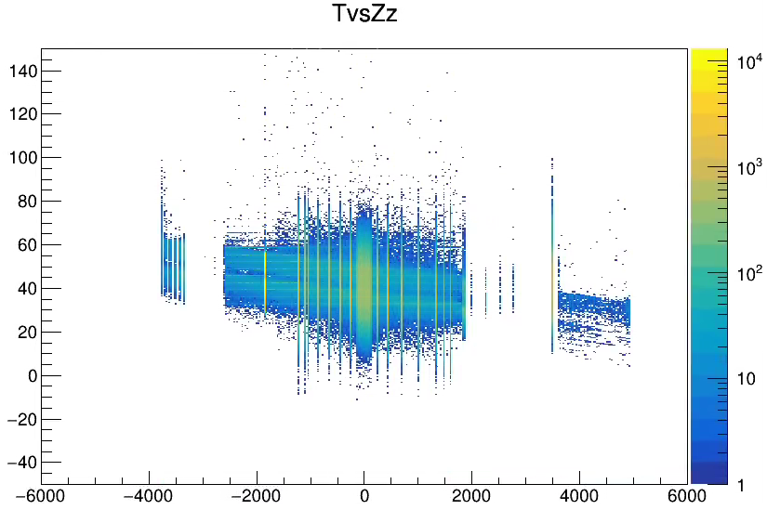
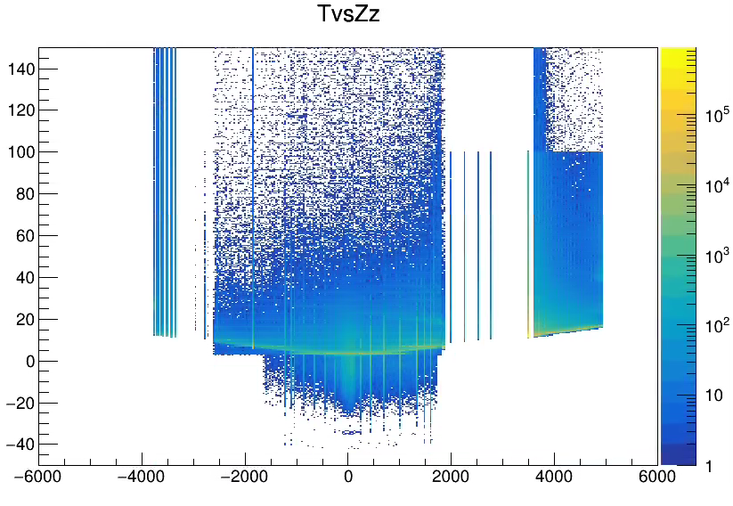
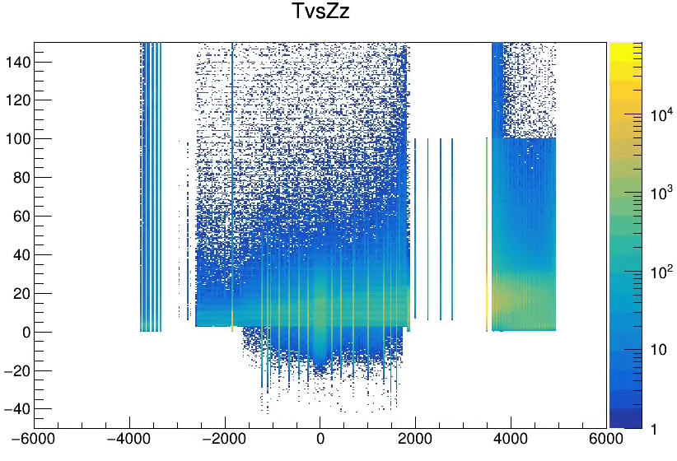
Event Timing
Electron Beam Gas
Simulation (RecHits)
DIS
Proton Beam Gas

Slide 15
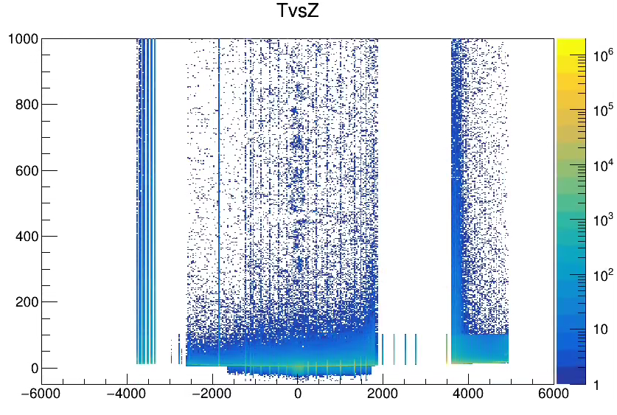
Event Timing
Electron Beam Gas
Simulation (RecHits)
DIS
Proton Beam Gas

Slide 16
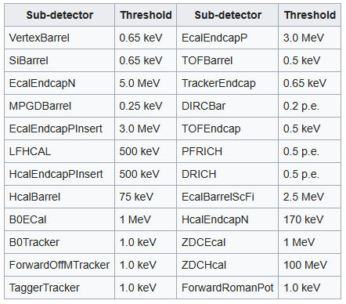
Event Timing
Electron Beam Gas
Simulation (RecHits)
DIS
Proton Beam Gas

Slide 17
Event Timing in the Simulations
DIS, Proton Beam Gas, Electron Beam Gas (eventual Synchrotron radiation) should be randomly distributed according to desired beam energies & intensities
The source of the extended times should be understood (if they are not already understood). If real, a simulated events hits should be distributed in time according to Thit = nominal event T0 + Thit_sim. For all detectors.
The hits for the MAP detectors need 2 special characteristics
The time should be set to the beginning of the 2us period it occurs within.
The hit should be replicated in either the prior or following 2us period depending on whether it is closer to the end of the hit period or closer to the beginning.
I would add noise only to the MAPS and dRICH. Assume that reasonable cluster finding in other detectors will suppress nearly all of the noise.

Slide 18
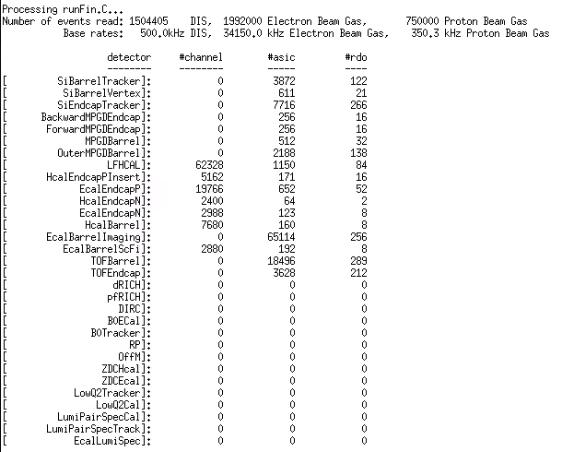
Results
What was processed
No RICH detectors (no RecHits)
No Far Backward: simulations don’t cover the driving physics, but have numbers from other methods
No Far Forward: I didn’t finish coordinate maps (B0 at least should be done)
MPGD/TOF should provide channel map, but was initially confused and didn’t correct

Slide 19
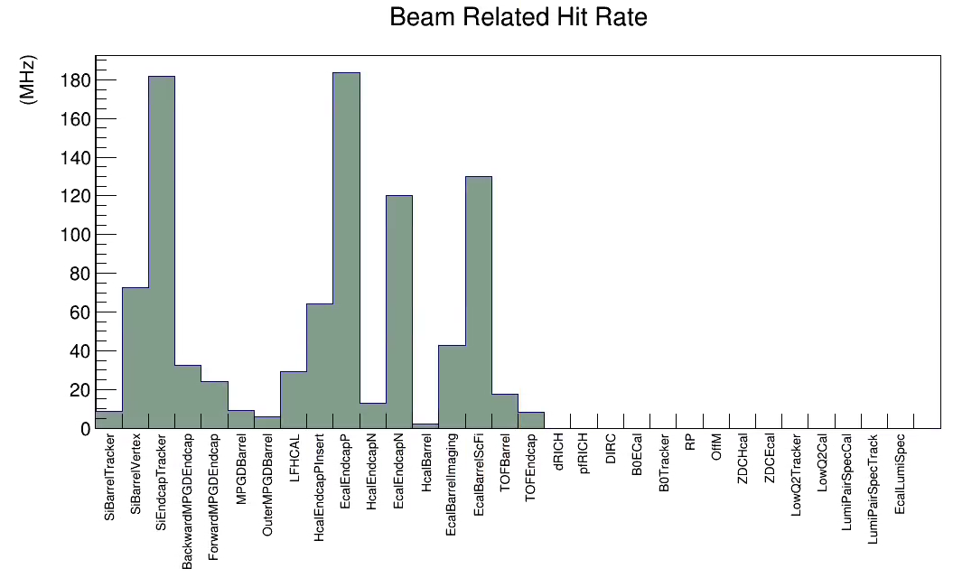
Hit Rates
DIS +
Proton Beam +
Electron Beam
(No noise added)

Slide 20
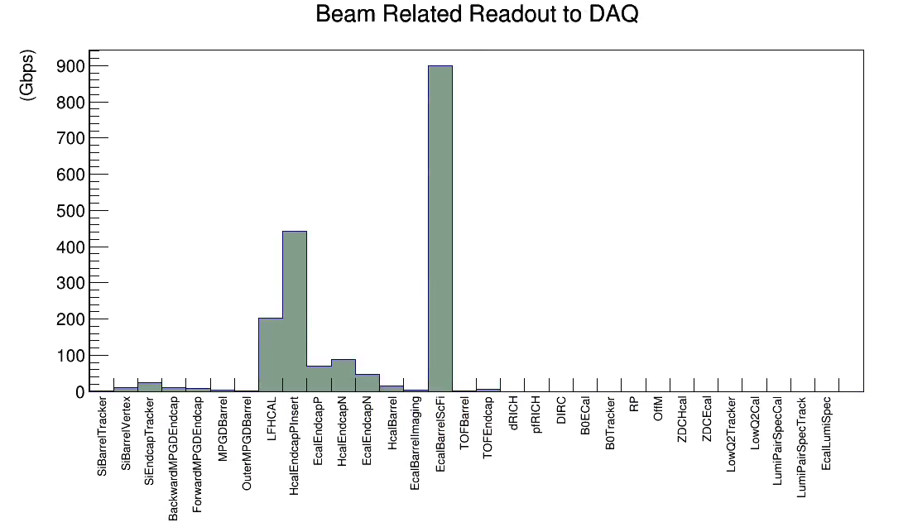
Data rate to RDO’s
DIS +
Proton Beam +
Electron Beam
(No noise added)

Slide 21
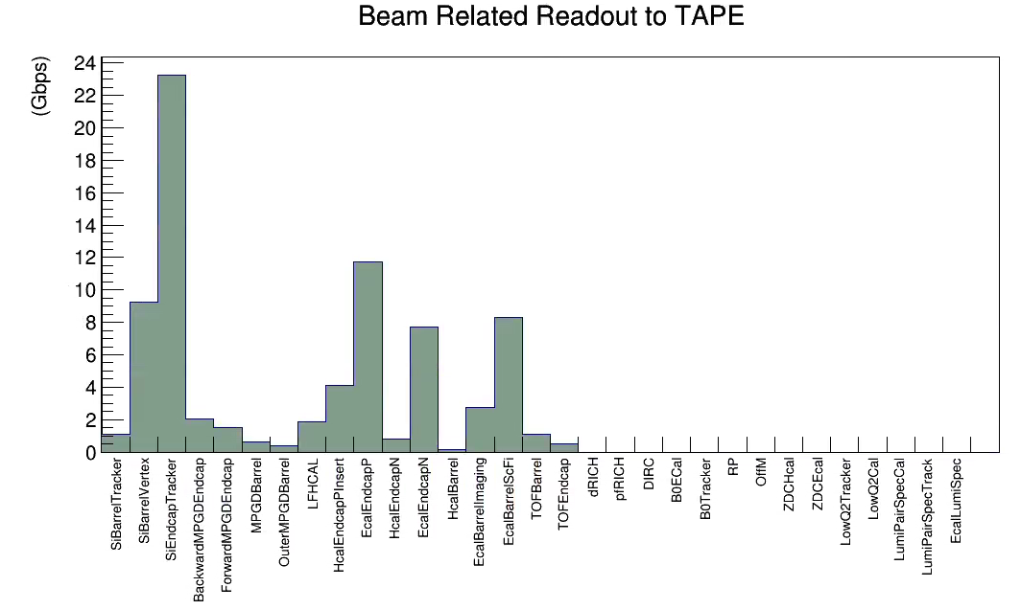
Data Rate to Tape
DIS +
Proton Beam +
Electron Beam
(No noise added)

Slide 22
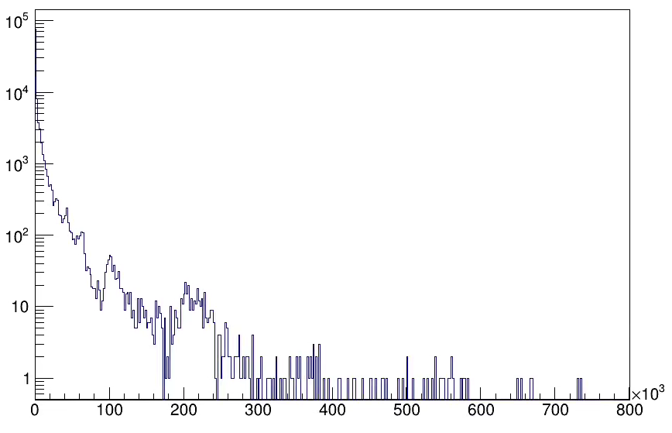
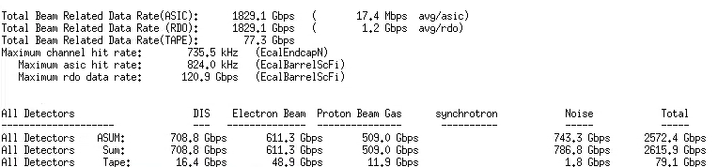
Channel Rates
Full Detector, channel rates
Counts
Hit Rate (Hz)

Slide 23
Channel Rates
Similar to previous rates, but missing detectors, so somewhat higher
Channel rates, All detectors
Counts
Hit Rate (Hz)

Slide 24
Channel Rates
Surprising !?!
Perhaps not, only 2880 channels covering full length of ECAL
Channel rates, All detectors
Counts
Hit Rate (Hz)

Slide 25
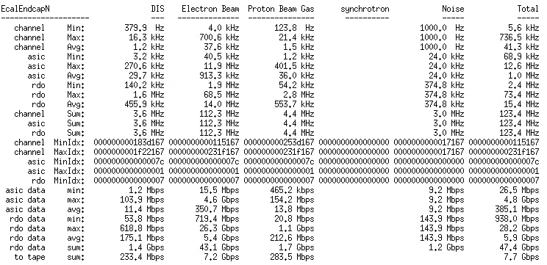
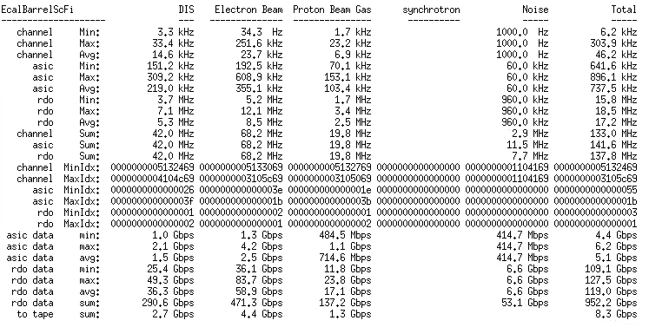
EcalEndcapN vs EcalBarrelScFi
Must Double check, but likely
-> Need to adjust FEB/RDO count
-> Need to have real discussions regarding noise

Slide 26
Rate Summaries
Detector | Max Channel Rate | Max ASIC Rate | Avg RDO Throughput | Beam Related Data To Tape (Gbps) | Noise Target (Gbps) | Threshold target (Sigma)
SiBarrelVertex |  | 359 kHz | 441 Mbps | 9.3 Gbps | 3 Gbps | >6.5
SiBarrelTracker |  | 3.5 kHz | 9.1 Mbps | 1.1 Gbps | 300 Mbps | >6.5
SiBarrelEndcap |  | 1.1 MHz | 87.4 Mbps | 23.3 Gbps | 8 Gbps | >6.5
ForwardMPGDEndcap |  | 3.0 MHz | 476 Mbps | 1.5 Gbps | ASIC limit
BackwardMPGDEndcap |  | 5.0 MHz | 644 Mbps | 2.1 Gbps | ASIC limit
MPGDBarrel |  | 21.5 kHz | 92.6 Mbps | 592 Mbps | ASIC limit
OuterMPGDBarrel |  | 5.1 kHz | 13.1 Mbps | 360 Mbps | ASIC limit
LFHCAL | 35.3 kHz | 801 kHz | 2.4 Gbps (needs balance) | 1.9 Gbps | ASIC/RDO limit
HCalEndcapPInsert | 101 kHz | 2.1 Mhz | 27.7 Gbps (needs more!) | 4.1 Gbps | ASIC/RDO limit
EcalEndcapP/Insert | 241 kHz | 5.8 Mhz | 1.4 Gbps (needs balance) | 11.8 Gbps | ASIC/RDO limit
HcalEndcapN | 408 kHz | 5.2 Mhz | 43.7 Gbps (needs more!) | 809.3 Mbps | ASIC/RDO limit
EcalEndcapN | 735 kHz | 12.6 MHz | 5.8 Gbps (needs balance) | 7.7 Gbps | ASIC/RDO limit
HCalBarrel | 2.2 kHz | 15.6 kHz | 1.9 Gbps | 139 Mbps | ASIC/RDO limit
ECalBarrelSiFi | 302.9 kHz | 836 kHz | 112 Gbps (Needs More!) | 8.3 Gbps | ASIC/RDO limit
ECalBarrelImaging |  | 4.4 kHz | 10.7 Mbps | 2.7 Gbps
TOFBarrel |  | 2.1 kHz | 3.9 Mbps | 1.1 Gbps | ASIC limit
TOFEndcap |  | 25 kHz | 21.9 Mbps | 516 Mbps | ASIC limit
dRICH |  |  |  |  | < 300 kHz
hpDIRC
pfRICH
SUM |  |  |  | 77.3 Gbps
Noise sensitivity is in ASIC readout speed & quality of data reduction via feature finding

Slide 27
Final Thoughts
At the last background meeting there was a presentation from Andrii Natochii. The synchrotron radiation, in the current beamline configuration floods the detectors with about 1e6 x the DIS and beam gas backgrounds. Current status is waiting to see to what extent this can be reduced.
The overall summary of the new simulations is that (Excluding Synchrotron Radiation) the data volumes are moderately higher than earlier expectations. I expect the full rate to top out around 150Gbps, assuming the synchrotron radiation can be brought under control.
There are several results that do impact our assumptions for RDO counts, and possibly expectations for ASIC/FEE performance. Lots of details to check!
There are several next steps
Incorporate RICHs
Move to RawHits rather than RecHits
Add Far Backward / Far Forward detectors
Evaluate the noise requirements
Check that the ASIC rates capabilities are consistent with the highest rate sections of the detector
Re-evaluate the RDO distributions for the detectors with high rates

