Slide 1
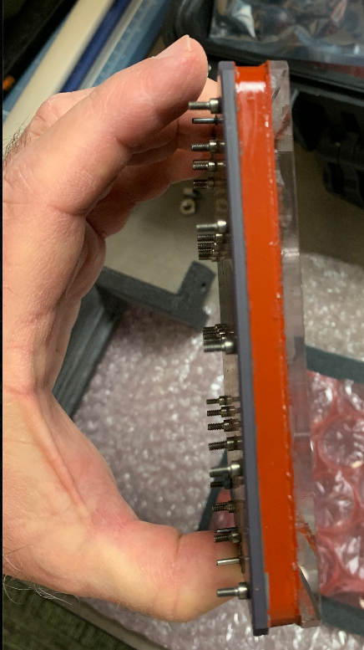
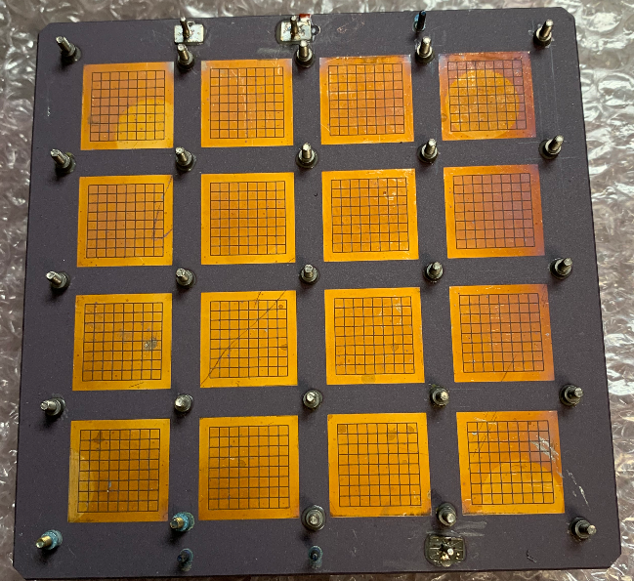
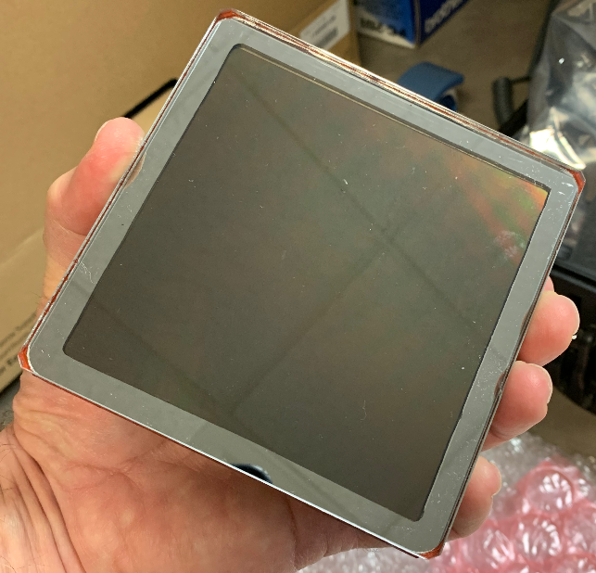
HRPPD Progress Report – March 21, 2024
HRPPD #15 – EIC #1
Arshak Asaturyan, Beni Zihlmann, Carl Zorn (presenter) - JLAB
Alexander Kiselev (BNL)
March 21, 2024

Slide 2
Initial JLAB Test Program
JLAB purchased 5 initial samples of current generation of HRPPD
@ JLAB ➔ Show that the device is “alive” so that it can “approved” and payment made to Incom
Collect data on all 1024 channels (if possible) and whatever other data can be collected in reasonable time frame
Then ship to BNL for full test program
Eventually JLAB will build full test station (Arshak Asaturyan)
Yale is also preparing full test station

Slide 3
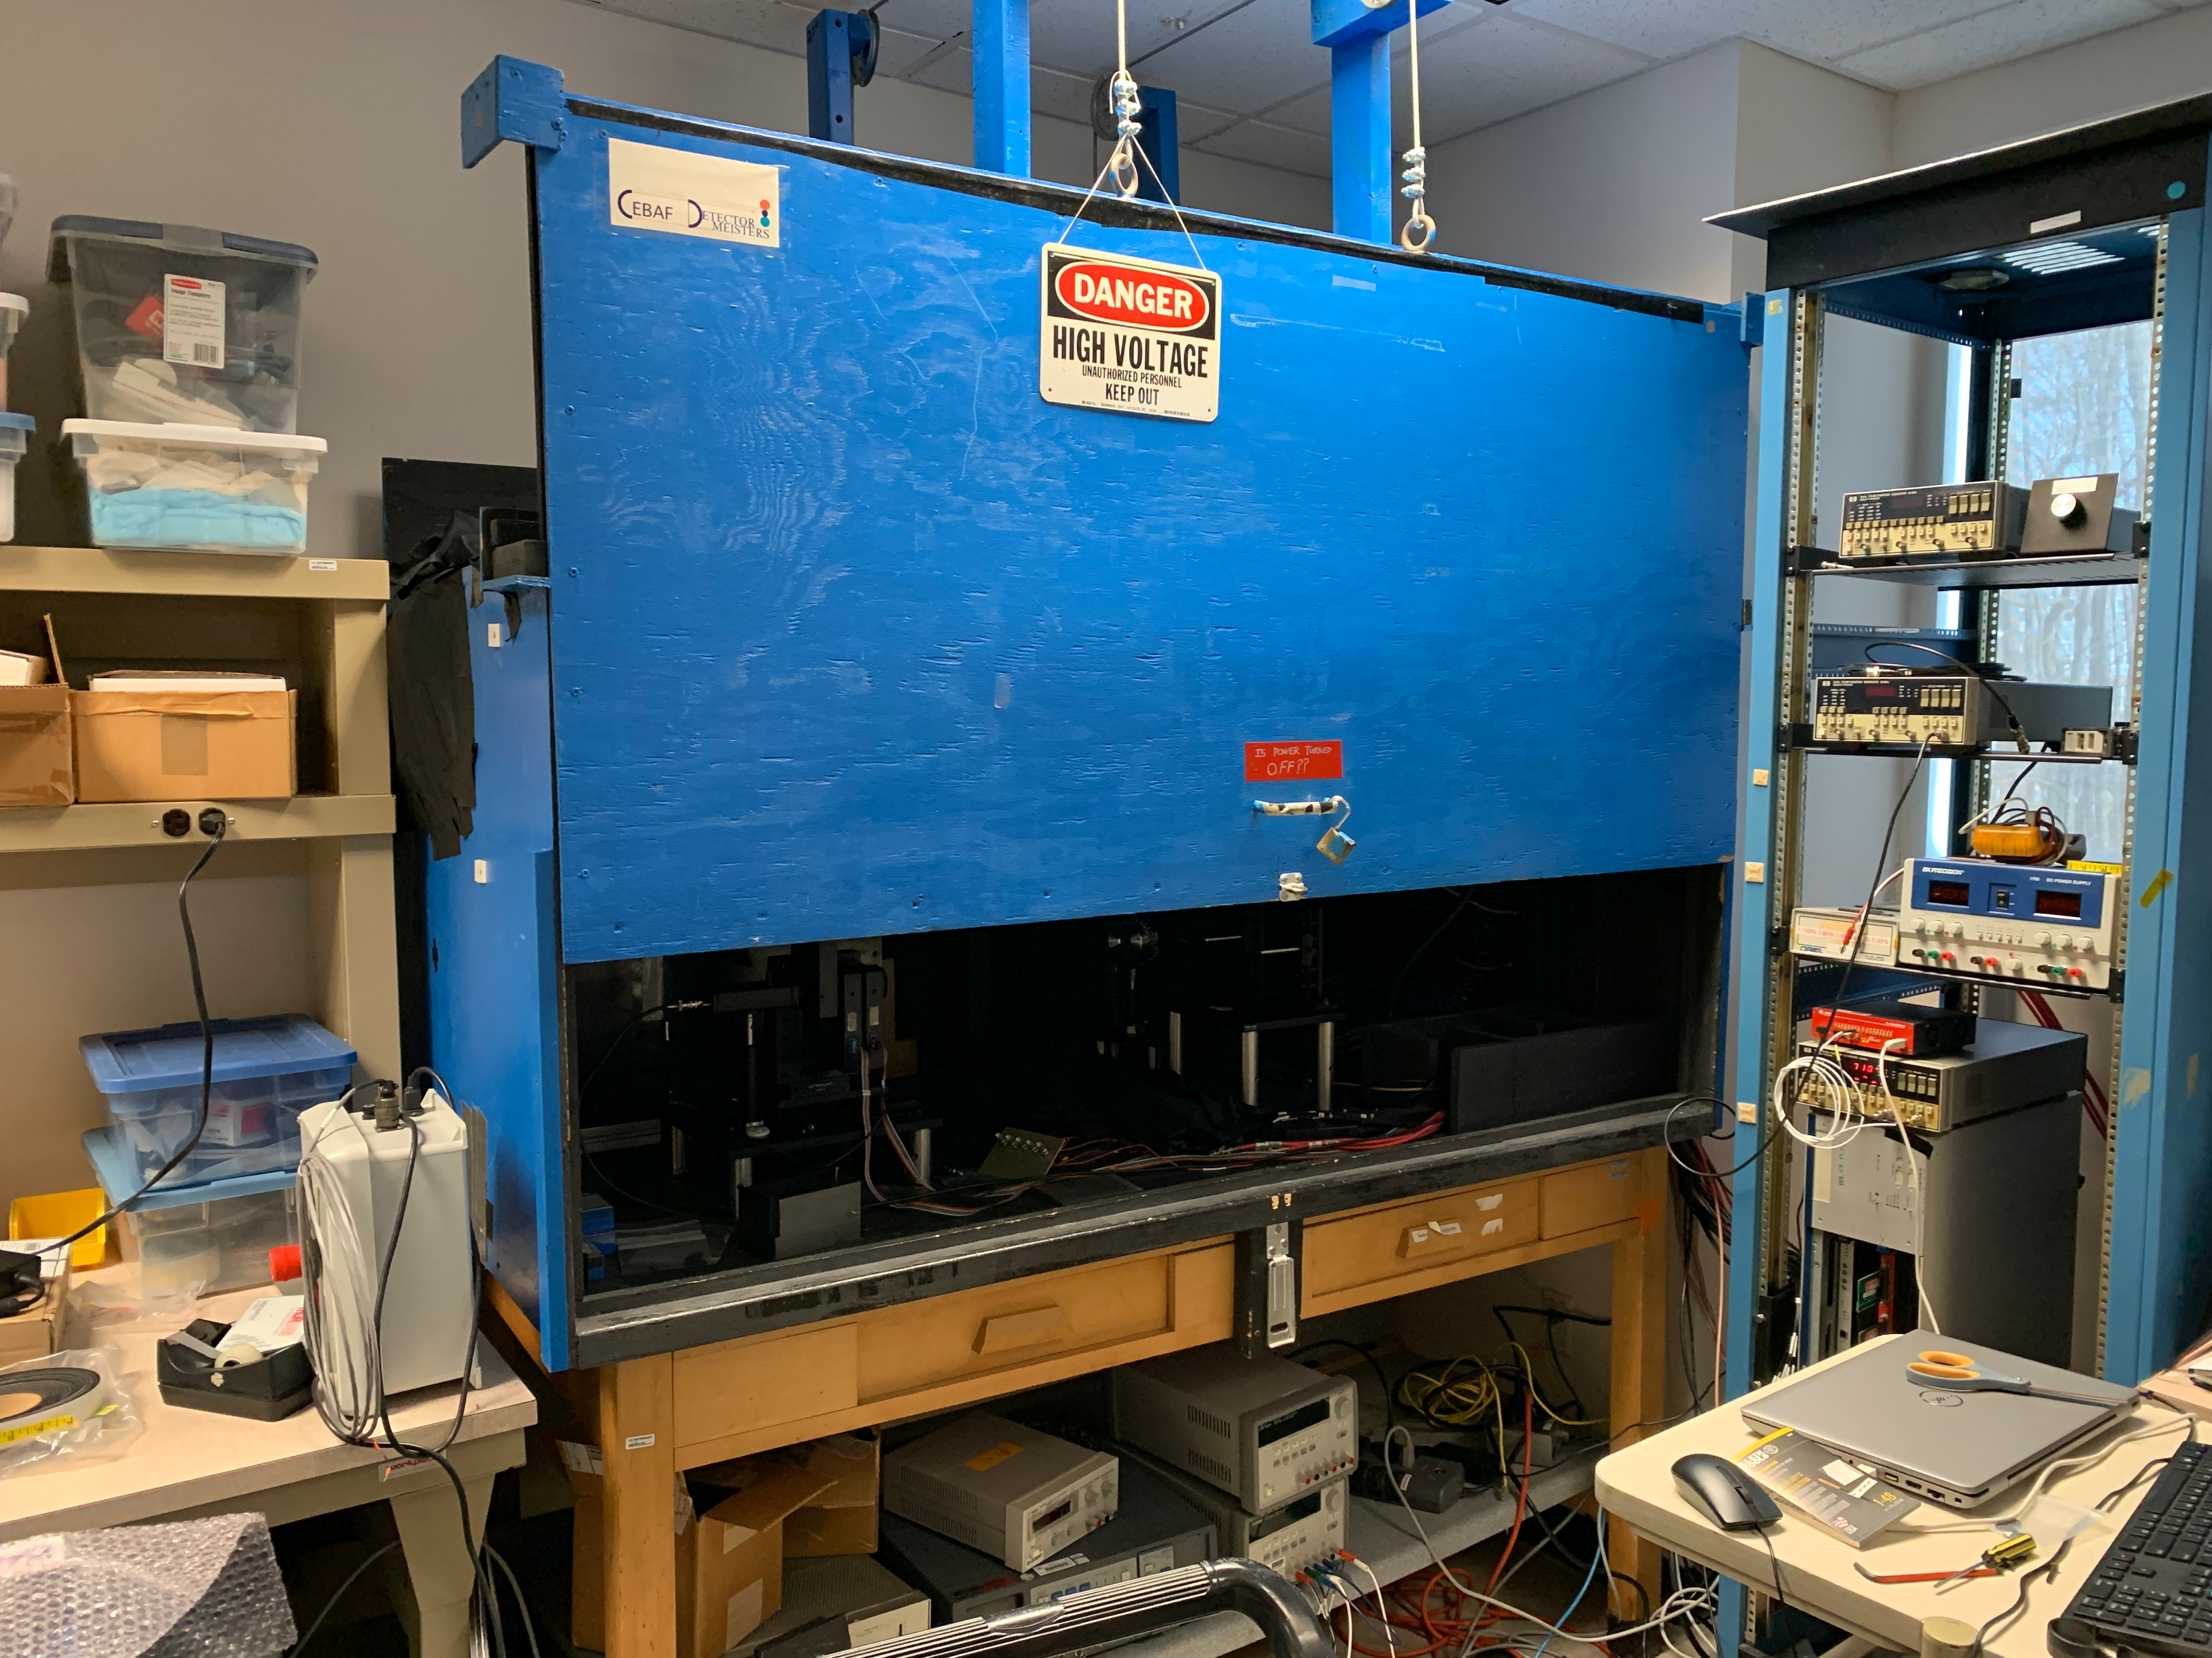
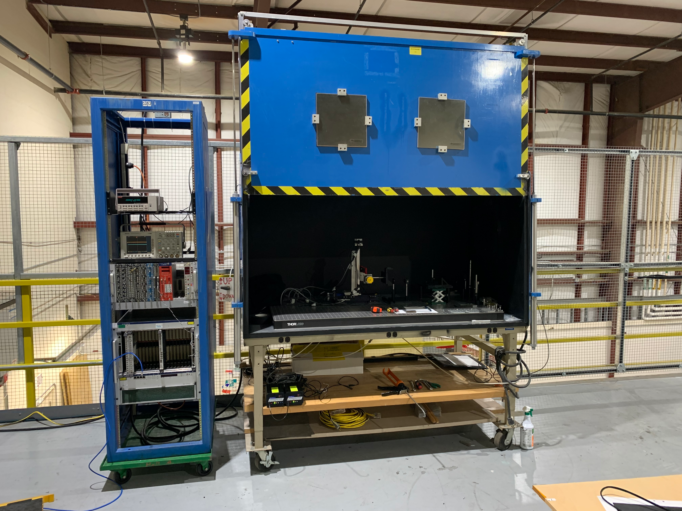
Two setups
Current – ARC L215 - Detector Group Lab
In preparation for future full test program

Slide 4
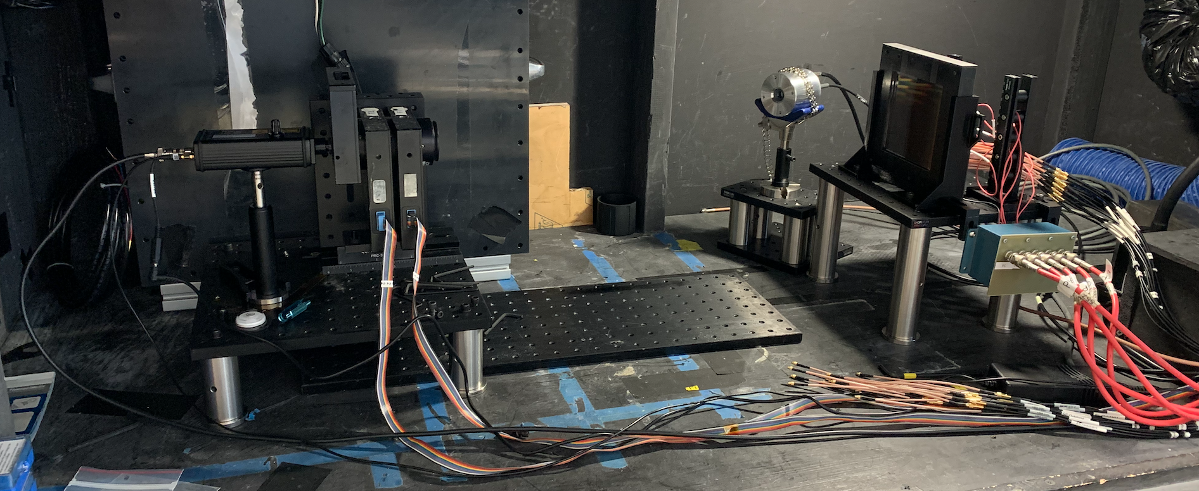
Current Test Setup
32 of 1024 channels readout
Photek MCP reference
3 filter wheels + diffuser
Pulsed 405 nm laser
HRPPD
HV distribution

Slide 5
Status of JLAB setup
Much of HRPPD readout equipment is on loan from BNL – HRPPD enclosure, 3D-printed parts, interposers, readout board + connectors, MMCX adapters, MCX cables – thank you Alexander
We have VME crate with QDC and new V1742 digitizer (both 32 channels) – but need JLAB DAQ personnel to finish the JLAB software/hardware setup
Have several oscilloscopes on hand
Initial data for now based on oscilloscope measurements (transit time variation) and dark rate studies with NIM electronics
Measurement test program is still evolving
Note – every HRPPD sample comes with test report generated by Incom
We have weekly Wednesday meetings with Incom to discuss status
For those with JLAB computer access https://logbooks.jlab.org/book/hrppd

Slide 6
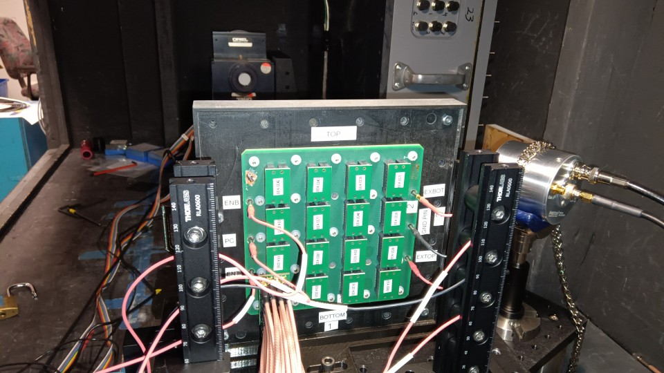
Setup in Darkbox

Slide 7
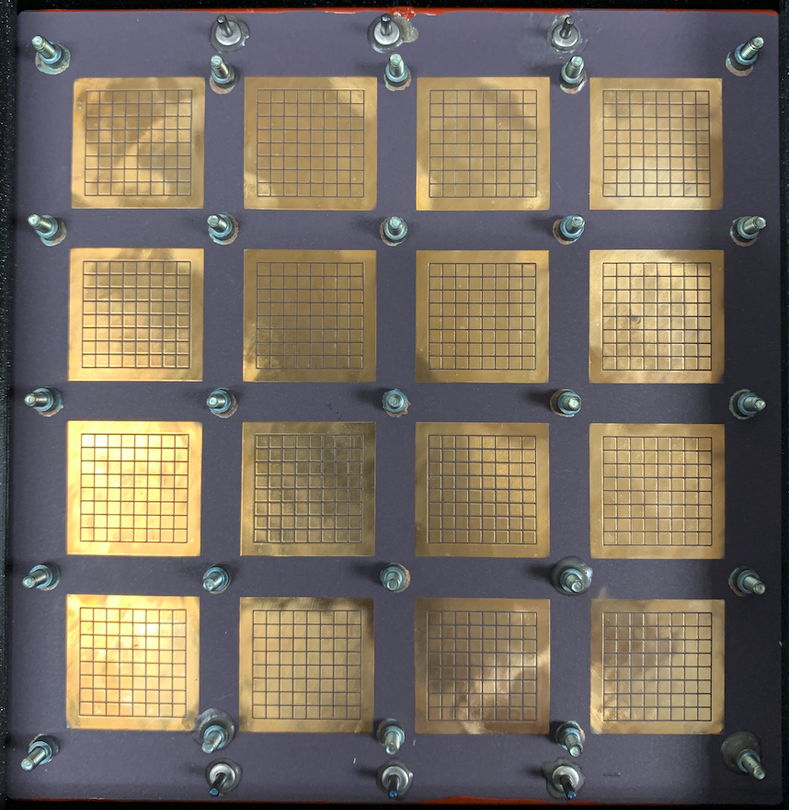
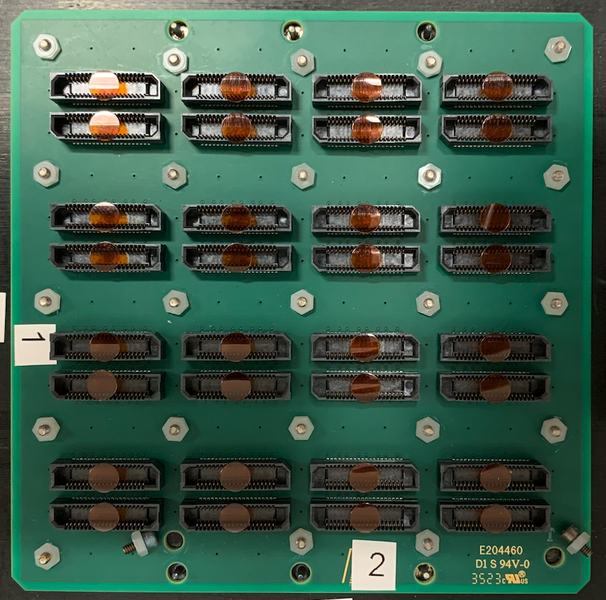
ENT
PC
ENB
ENT
PC
ENB
EXTOP
GRND
EXBOT
EXTOP
GRND
EXBOT

Slide 8
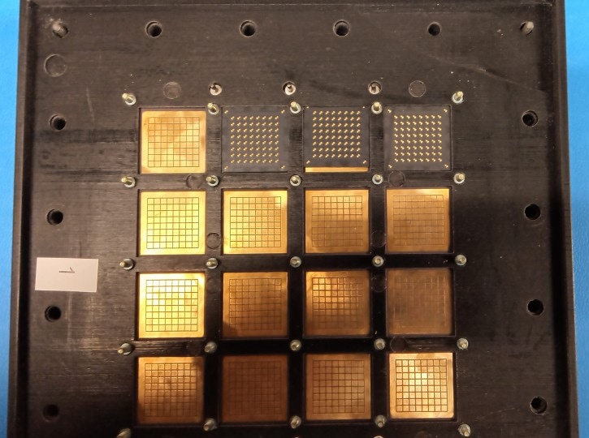
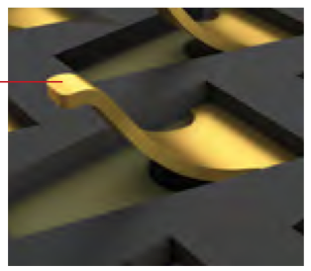
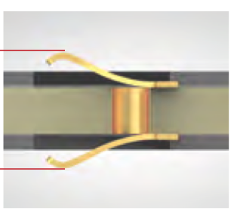
Install interposers between anode array and readout board
Samtec interposers

Slide 9
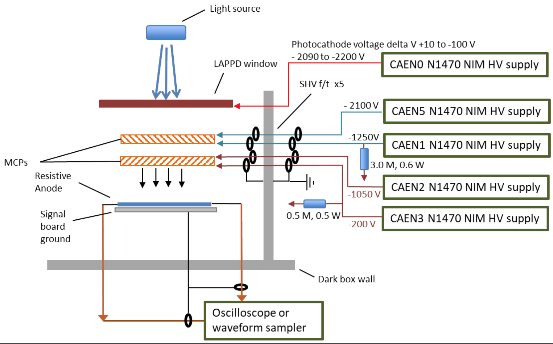
Incom HV scheme
PC
ENT
ENB
EXTOP
EXBOT
GROUND

Slide 10
Incom recommended HV values
 | HRPPD 15 (1) | HRPPD 16 (2) | HRPPD 17 (3) | HRPPD 18 (4)
PC | -2,150 | -2,100 | -1,950 | -2,200
ENT | -1,950 | -1,700 | -1,650 | -2,100
ENB | -1,175 | -1,050 | -1,025 | -1,250
EXTOP | -975 | -850 | -825 | -1,050
EXBOT | -200 | -200 | -200 | -200
PC MAX | -2,350 | -2,100 | -2,050 | -2,500

Slide 11
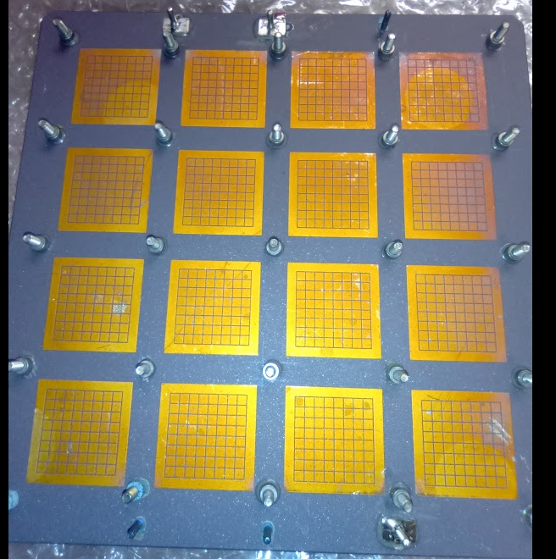
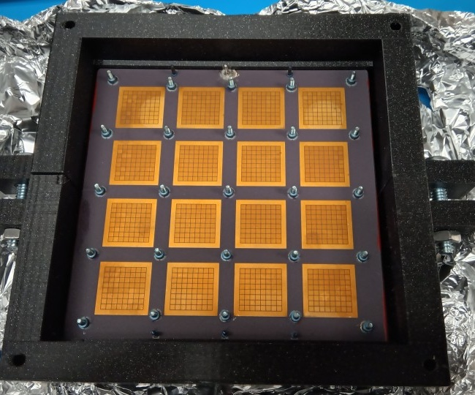
HRPPD 15
HRPPD 16

Slide 12
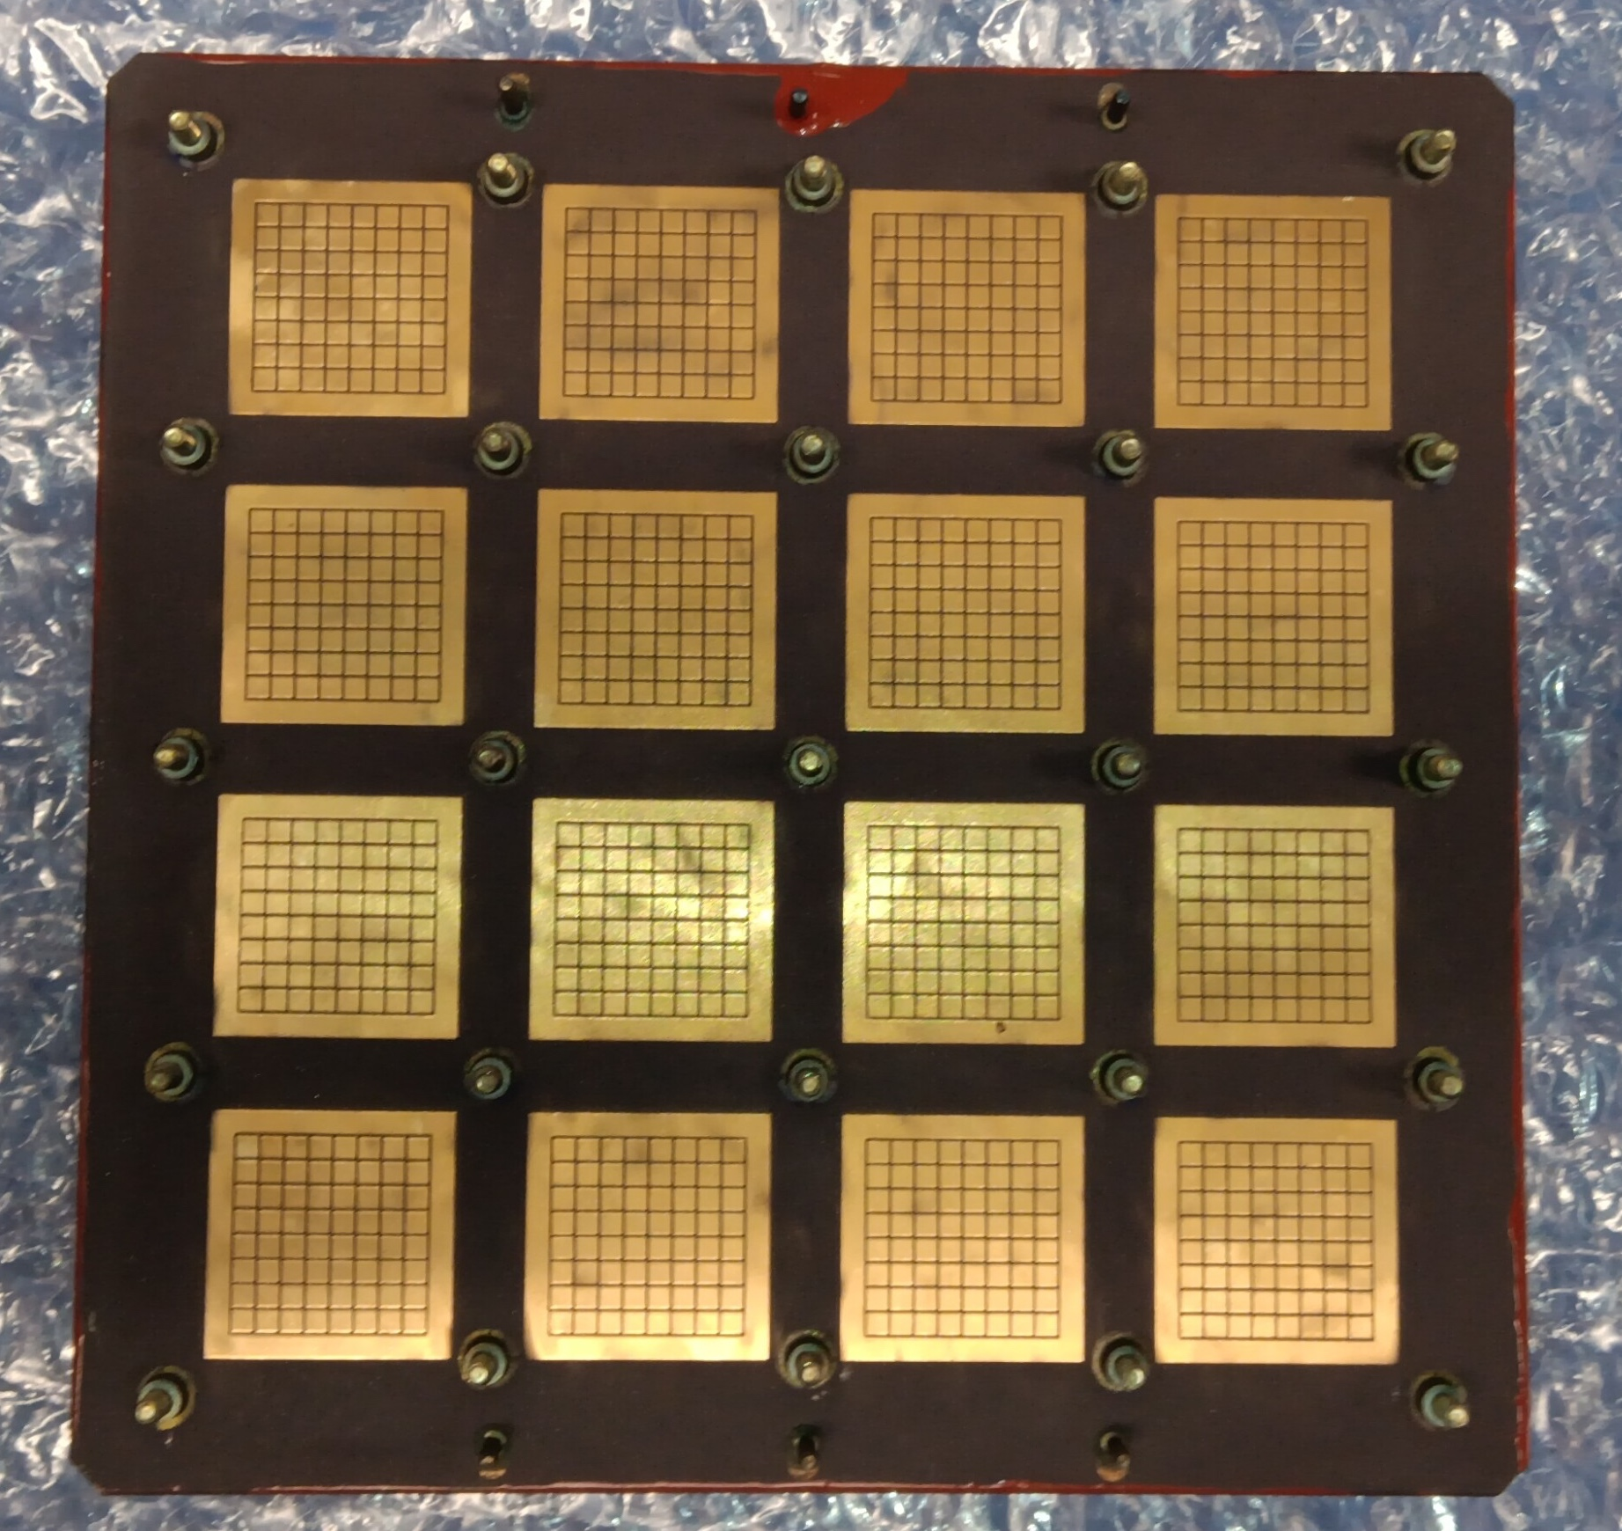
HRPPD 17
HRPPD 18

Slide 13
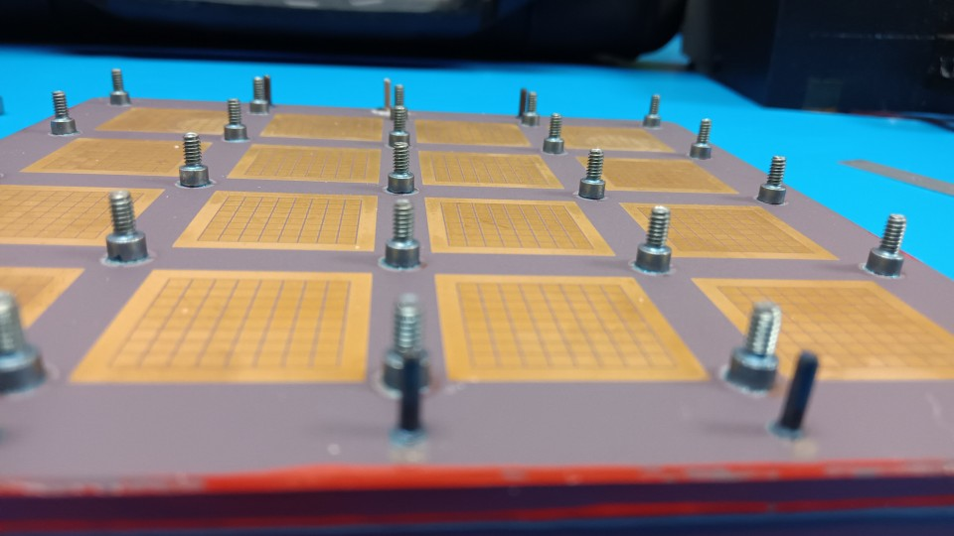
2-56 screws attached to ceramic

Slide 14
Some Notes for first four HRPPD samples
when tightening small nylon 2-56 nuts – found that several of the screws would simply pop off with very small torque
In addition – some HV power pins would also come off when installing or removing HV connections despite the care taken
First two (#15 & #16) shipped back for repairs
Third (#17) was operated and (noisy) signal seen despite ground pin broken – afterwards sent back to Incom for repair
Fourth (#18) is first to operated with minimum problem despite loss of some screws – and excessive glue made it difficult to attach readout board - it is also being returned to Incom (5 screws popped off)
Repaired #15 and #16 are back onsite - #15 operating successfully

Slide 15
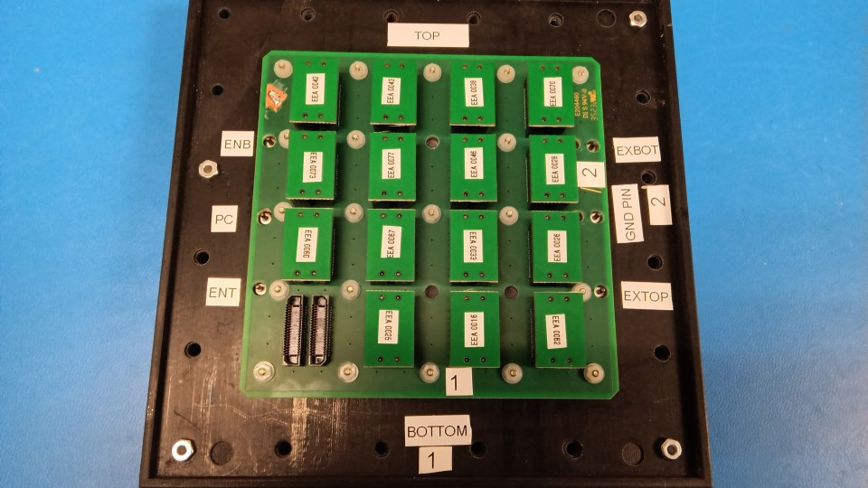
HRPPD 18
Missing
screws
Missing
screws

Slide 16
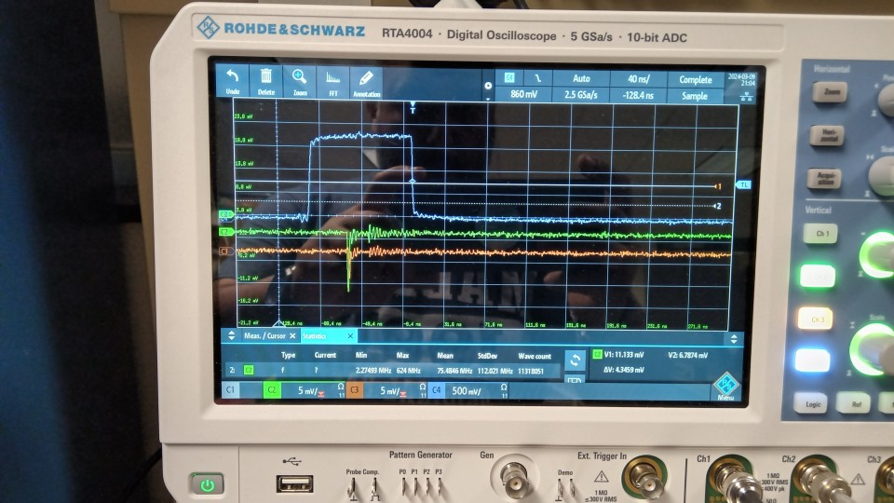
Example pulses
Laser trigger

Slide 17
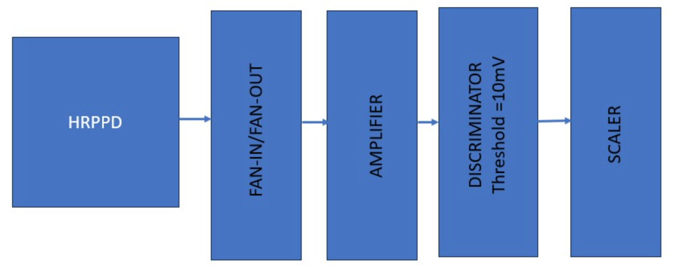
Dark Rate Measurements
Incom uses oscilloscope directly – measures the Trigger rate on dark pulses > 4 mV

Slide 18
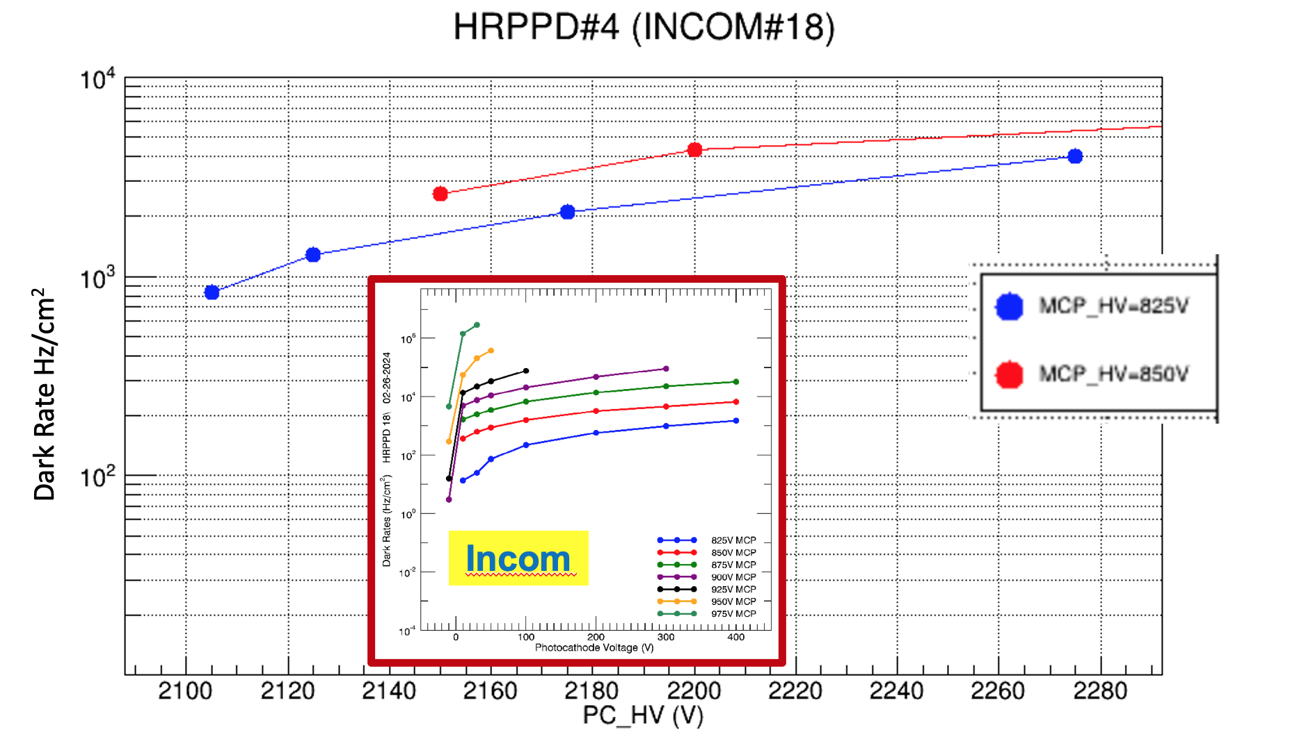

Slide 19
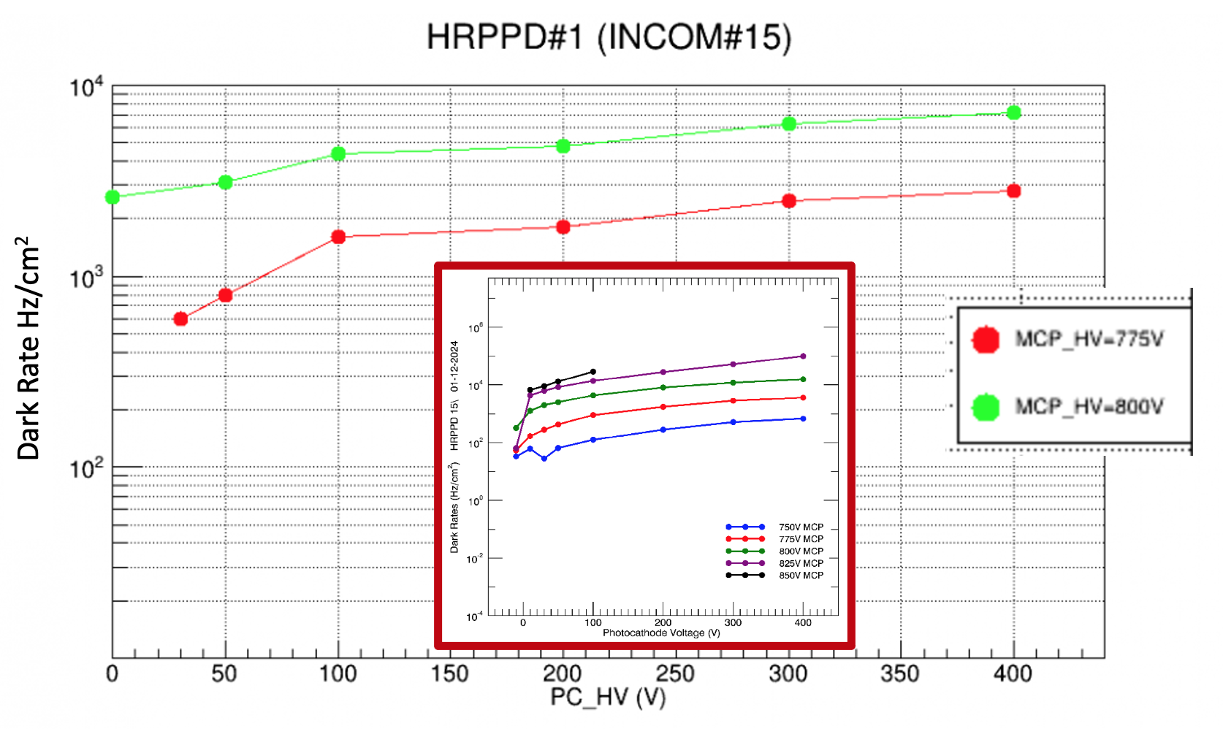

Slide 20
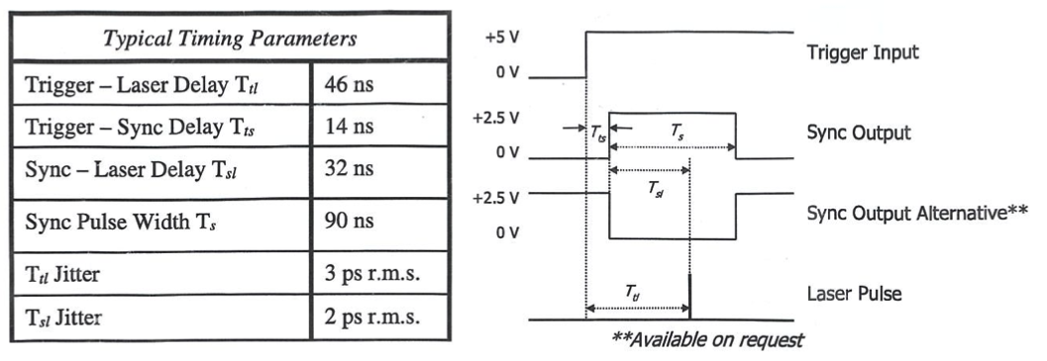
Transit time variation (TTV) measured with scope with SPE levels of light - laser intensity attenuated to 4x10⁻⁵ (neutral density filters) plus diffusion filter + black mask with 3 mm hole
Laser trigger rate = 3 kHz
TTV = 125 ps for HRPPD #17 and 102 ps for HRPPD #15
Laser Timing Parameters

Slide 21
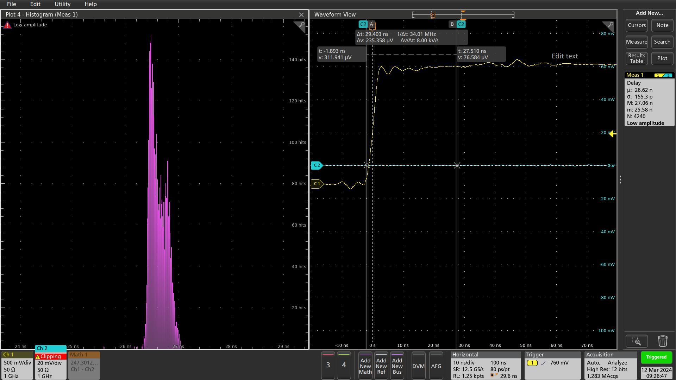
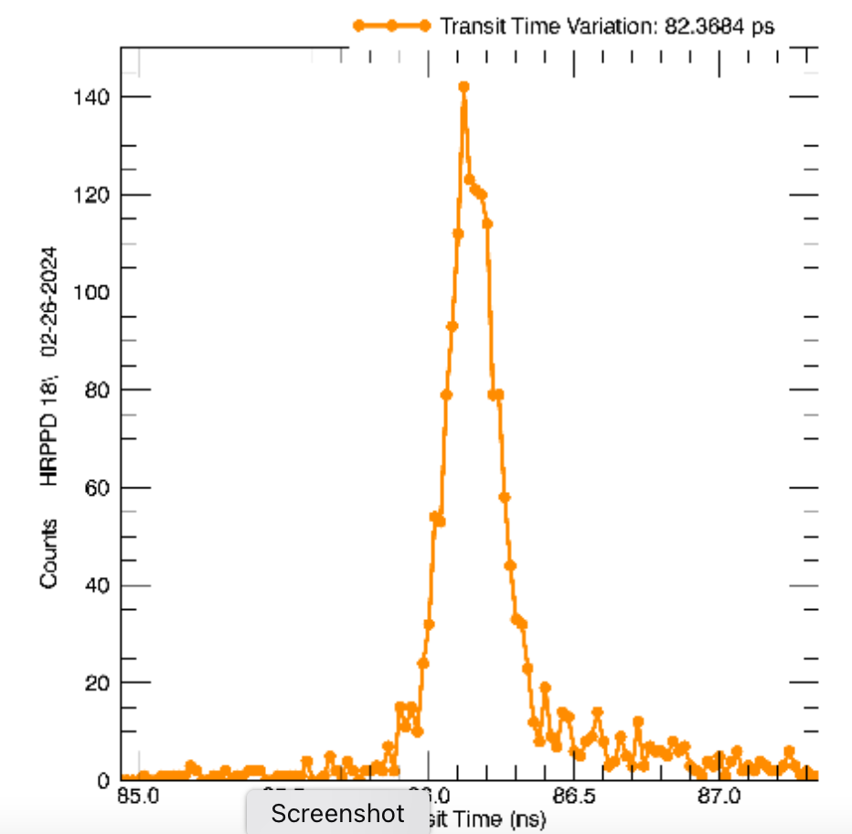
Transit Time Variation
HRPPD 18
125 ps
Incom
82 ps

Slide 22
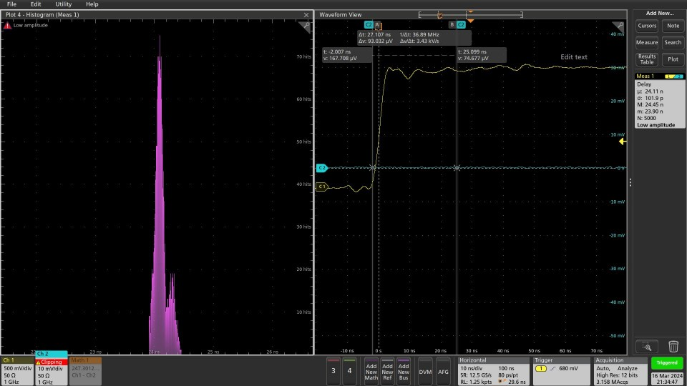
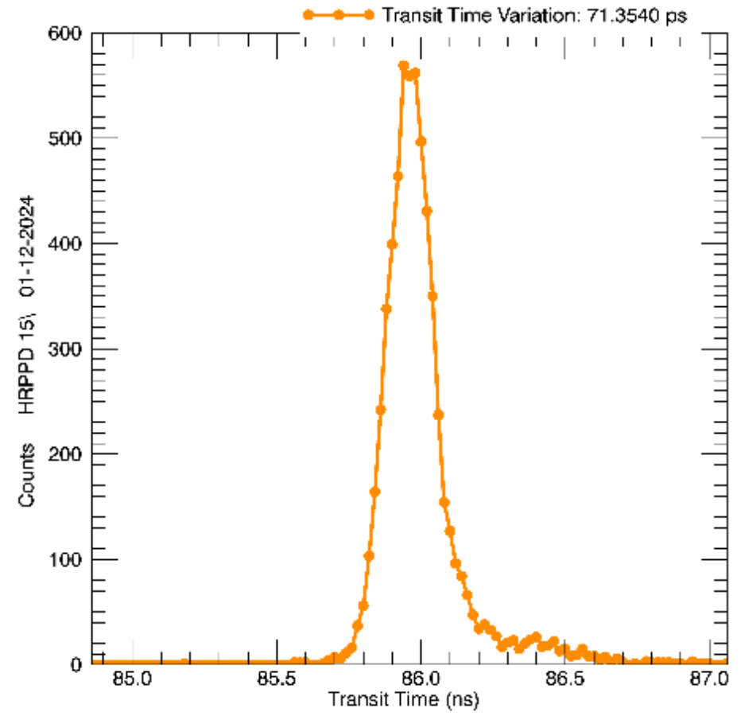
Transit Time Variation
HRPPD 15
102 ps
Incom
71 ps

Slide 23
Summary
Lots of time lost in dealing with initial mechanical problems – spending time on repair cycle - these issues needs to plateau at some point
Need to get full DAQ up and running for efficient test system
Need criteria for Pass/Fail of HRPPD for QA purpose ➔ pay for module before shipment to full test center (BNL) – BNL is very eager to start their program
Test signals from all 1,024 channels?

Slide 24
Appendix

Slide 25
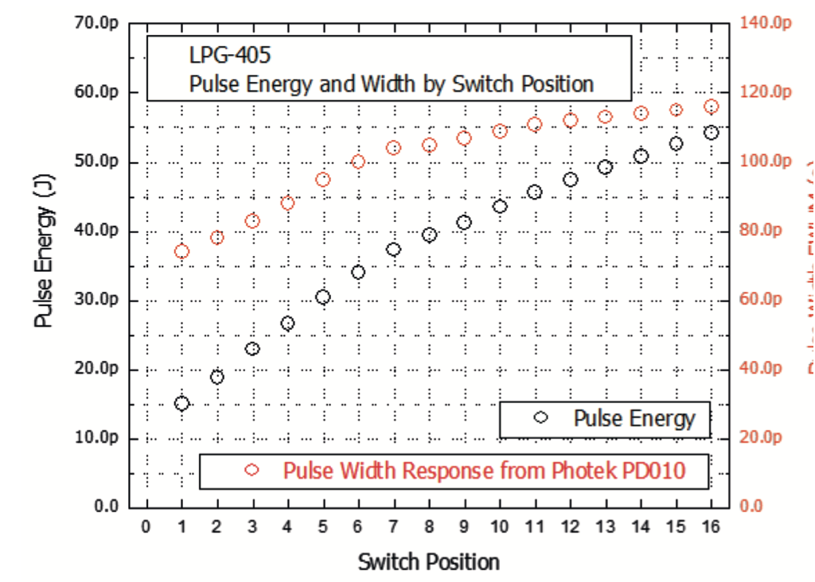
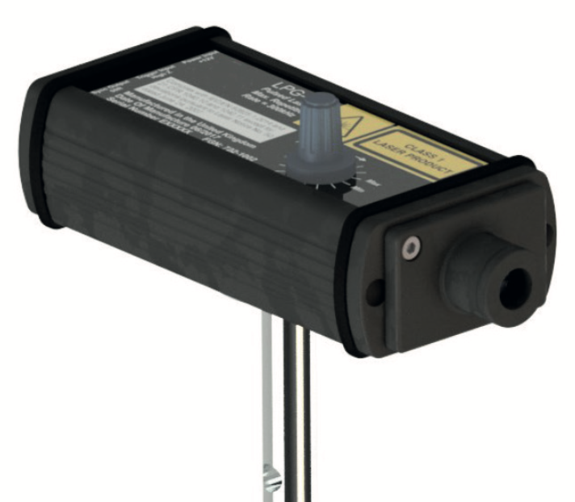
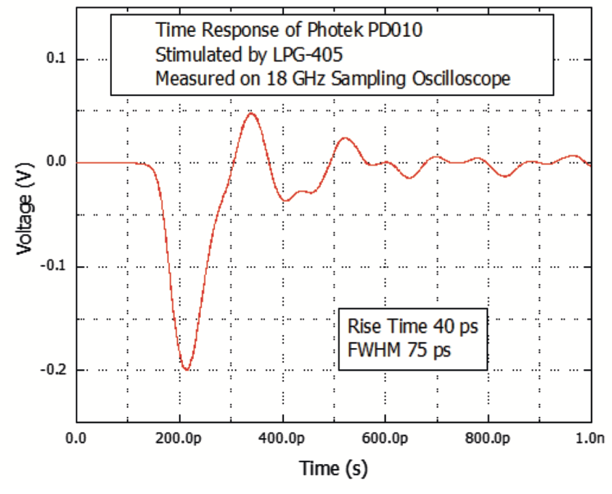
Photek LPG-405 pulsed laser
405 nm - pulse width = 75 ps
Freq range = single shot to 300 kHz
Class 1(!!!) – inherently eye safe

Slide 26
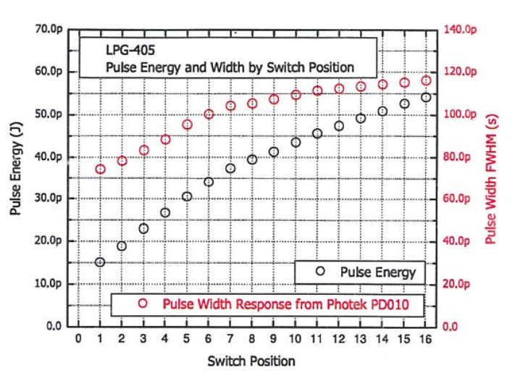

Slide 27
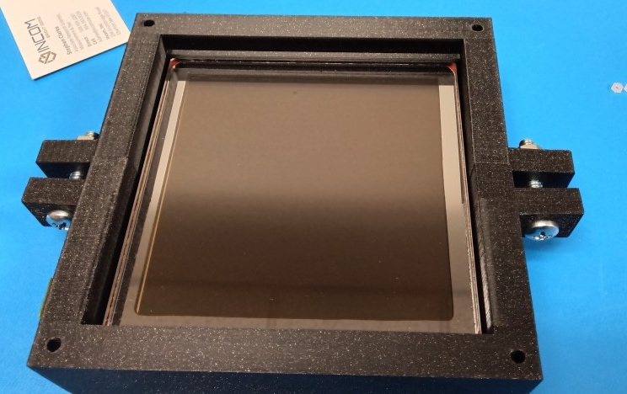
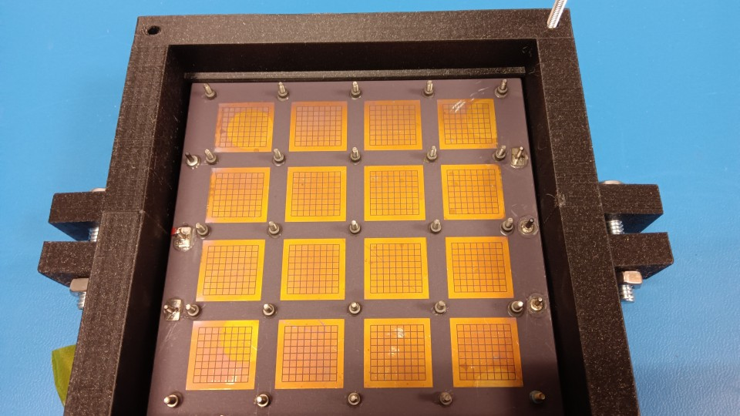
HRPPD 15 - repaired
Visual inspection
✅

Slide 28
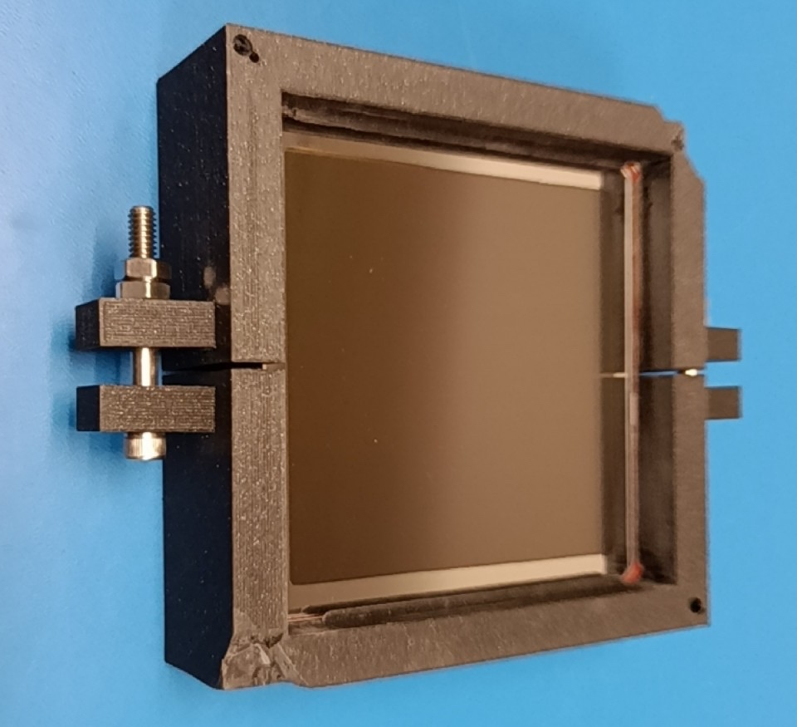
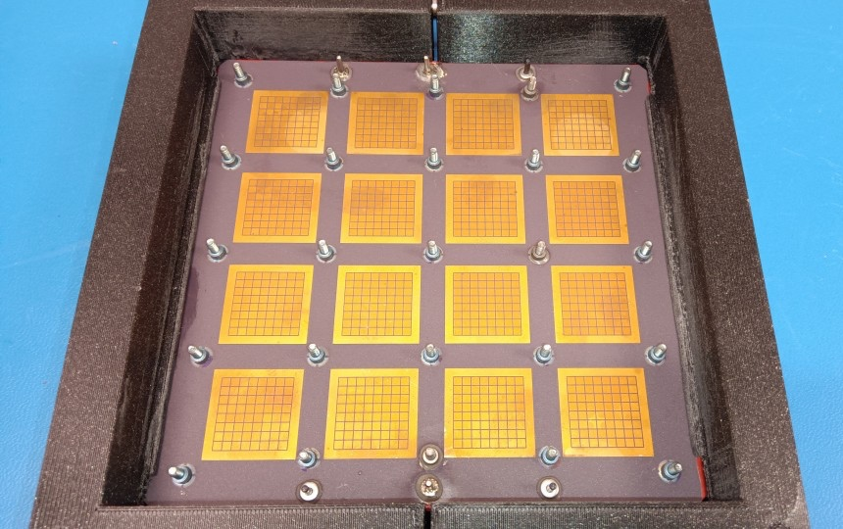
HRPPD 16 - repaired
Visual inspection
✅

Slide 29
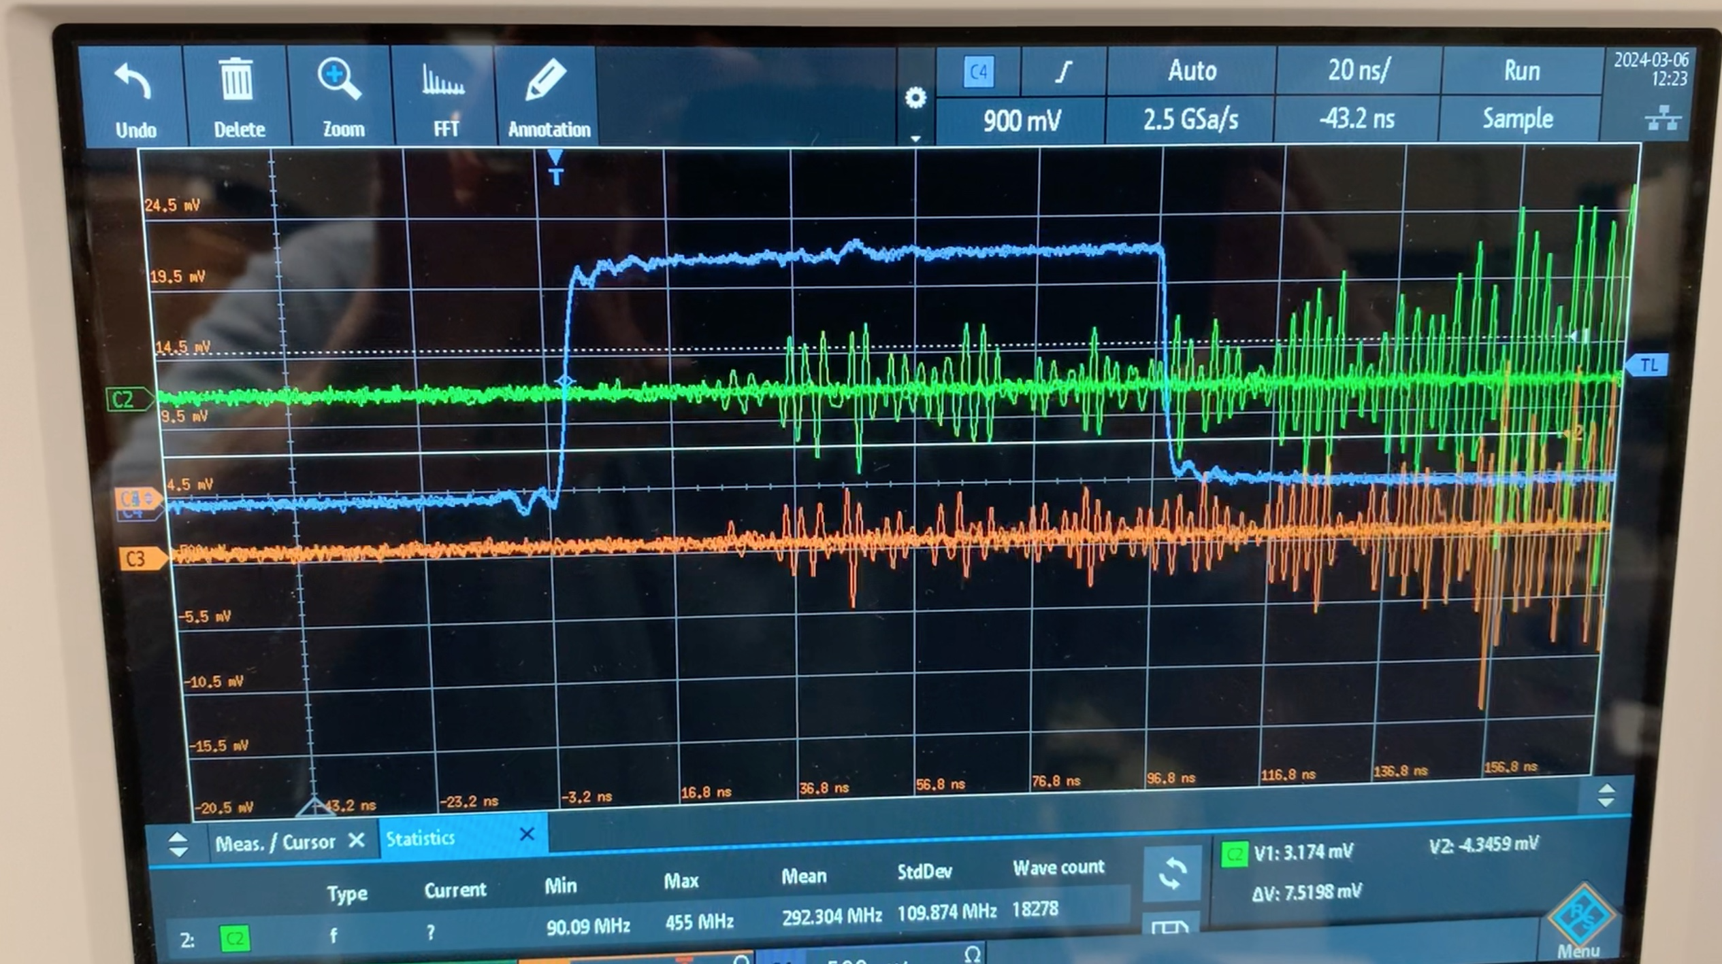
Occasional Noise

Slide 30
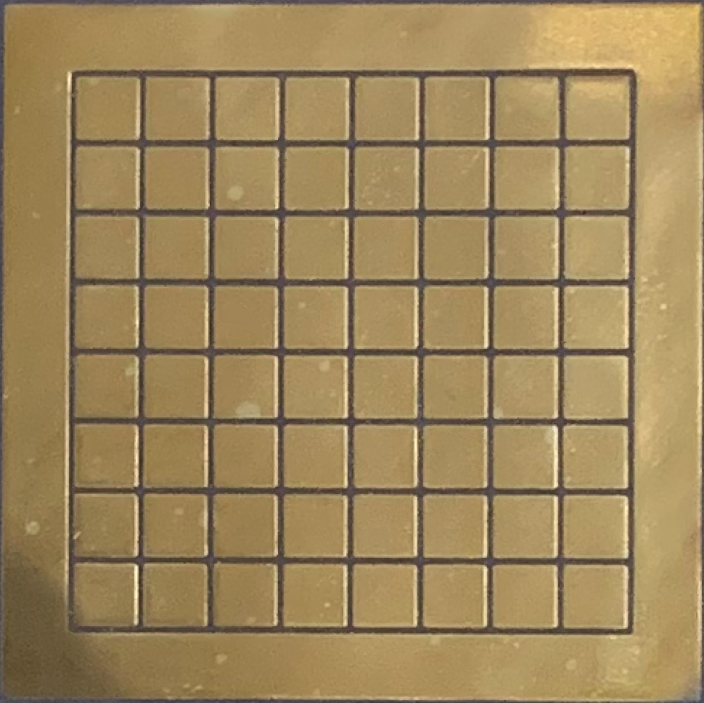
ENT
PC
ENB
A3
A8
A13
A18
B3
B8
B13
B18
A1
A4
A6
A9
A11
A14
A16
A19
C3
C8
C13
C18
A2
A5
A7
A10
A12
A15
A17
A20
D3
D8
D13
D18
B1
B4
B6
B9
B11
B14
B16
B19
GROUND
B2
B5
B7
B10
B2
B15
B17
B20
1
5
10
15
20
C1
C4
C6
C9
C11
C14
C16
C19
A
C2
C5
C7
C10
C12
C15
C17
C20
B
D1
D4
D6
D9
D11
D14
D16
D19
C
D2
D5
D7
D10
D12
D15
D17
D20
D
EXTOP
GRND
EXBOT
Readout Map

