Slide 1
OpFlash to WCT/BEE
Incorporate light to WCT
Haiwang
2024-03-21

Slide 2
vector<OpFlash> -> ITensorSet
https://sbnsoftware.github.io/doxygen/db/d3c/classrecob_1_1OpFlash.html
TensorSet
Tensor (nflash x nmpt+1)
 | time (f8) | col 0 (f8) | col 1 (f8) | ... | col 16
OpFlash 0
OpFlash 1
...

Slide 3
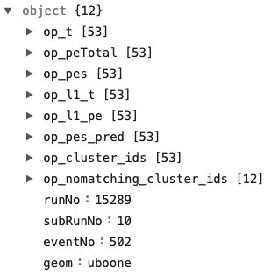
BEE format
https://github.com/WireCell/wire-cell-bee/blob/master/tools/wire-cell-to-bee/WCReader.cc#L106
https://www.phy.bnl.gov/twister/bee/set/uboone/lee/2021/wire-cell-gallery/event/0/op/

Slide 4
multiple event processing, need RSE info
run-subrun-event
Option 1: replace iface::ident() with run-event
  limitation 16 bit each (65536)
Option 2: dedicated WCT components to pass in RSE

Slide 5
RSE as ITensorSetSource
Can be removed
larwirecell
run-subrun-event
ITensorSet
RSE-BEE
json
larwirecell
OpFlashSource
ITensorSet
Op-BEE
json
Json-BEE
dump to BEE format on file
larwirecell
FrameSource
(SigProc)-Img-Clustering
ITensorSet
PointCloud
PC-BEE
+ 10 sec
json

Slide 6
RSE as Service, e.g., EmpiricalNoiseModel
larwirecell
run-subrun-event
larwirecell
OpFlashSource
ITensorSet
Op-BEE
json
larwirecell
FrameSource
(SigProc)-Img-Clustering
ITensorSet
PointCloud
PC-BEE
+ 10 sec
json

Slide 7
What I have now
larwirecell
OpFlashSource
ITensorSet
TensorFileSink
.tar.gz
WC-Python
.json
bee.json
debug out
larwirecell
FrameSource
(SigProc)-Img
Clustering
ITensorSet
PointCloud
TensorFileSink
dump
.tar.gz

Slide 8
Current status
larwirecell: https://github.com/HaiwangYu/larwirecell/tree/op
wc-python: https://github.com/WireCell/wire-cell-python
cfg: https://github.com/HaiwangYu/sbnd-op
BEE shows some results
https://www.phy.bnl.gov/twister/bee/set/db0b245c-2823-4bda-916a-7ff8712be4ef/event/1/
https://www.phy.bnl.gov/twister/bee/set/5ad5e915-f307-4c0e-a40e-a647546d2d78/event/1/

Slide 9
Next
Need mapping for the PMT/x-arapuca
Need imaging/clustering branch running ryncronized
Need some charge-light matching mechanism, even a placeholder one
  what will be most useful for now?
  even a simple placeholder algorithm?

Slide 10
other notes

Slide 11
larwirecell:
WCT
larwirecell
run-subrun-event
larwirecell
PMTSource
WCT
PMTDump
.json
Python
wirecell-img beeblob
larwirecell
FrameSource
WCT
ClusterDump
.json

Slide 12
https://sbnsoftware.github.io/doxygen/db/d3c/classrecob_1_1OpFlash.html
vector<OpFlash>
TensorSet
OpFlash:
  Tensor: scaler: 1 row x n col
  Tensor: vector: n row x 3 col fPEperOpDet
PMTSource
PMTDump
PMT ID Map
 | time (f8) | col 0 (f8) | col 1 (f8) | ... | col 16
OpFlash 0
OpFlash 1
...
col -> PMT map

Slide 13
IEventInfo

Slide 14
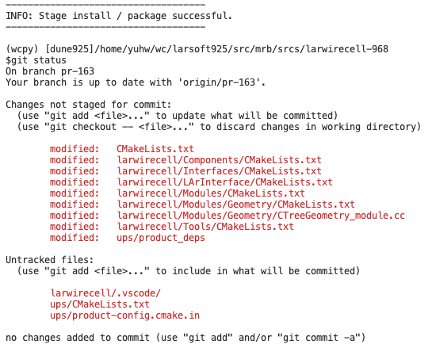
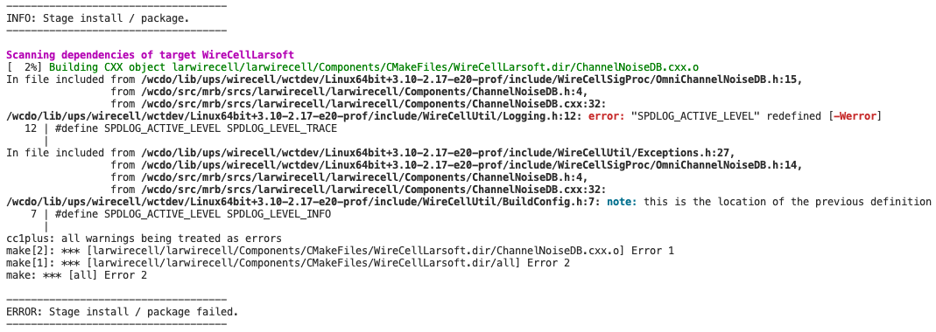

Slide 15
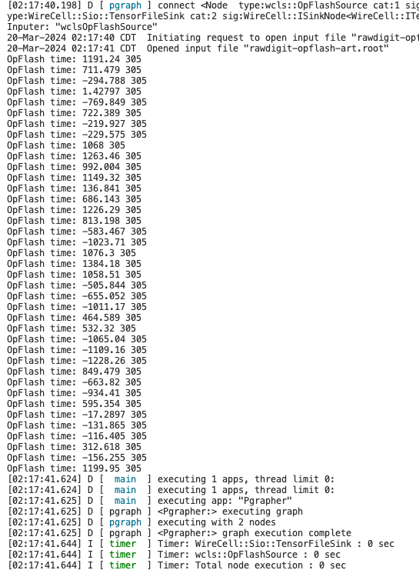

Slide 16
TODO:
confirm with Chao that direct json PMT is OK? Yes
  https://github.com/WireCell/wire-cell-bee/blob/master/tools/wire-cell-to-bee/WCReader.cc#L106
  https://www.phy.bnl.gov/twister/bee/set/uboone/lee/2021/wire-cell-gallery/event/0/op/
multiple event processing
  pass through full run/subrun/event information in WCT
    run: 6 digit
    event: 8 digit

