Slide 1
pfRICH Slow Controls Preliminary Assessment

Slide 2
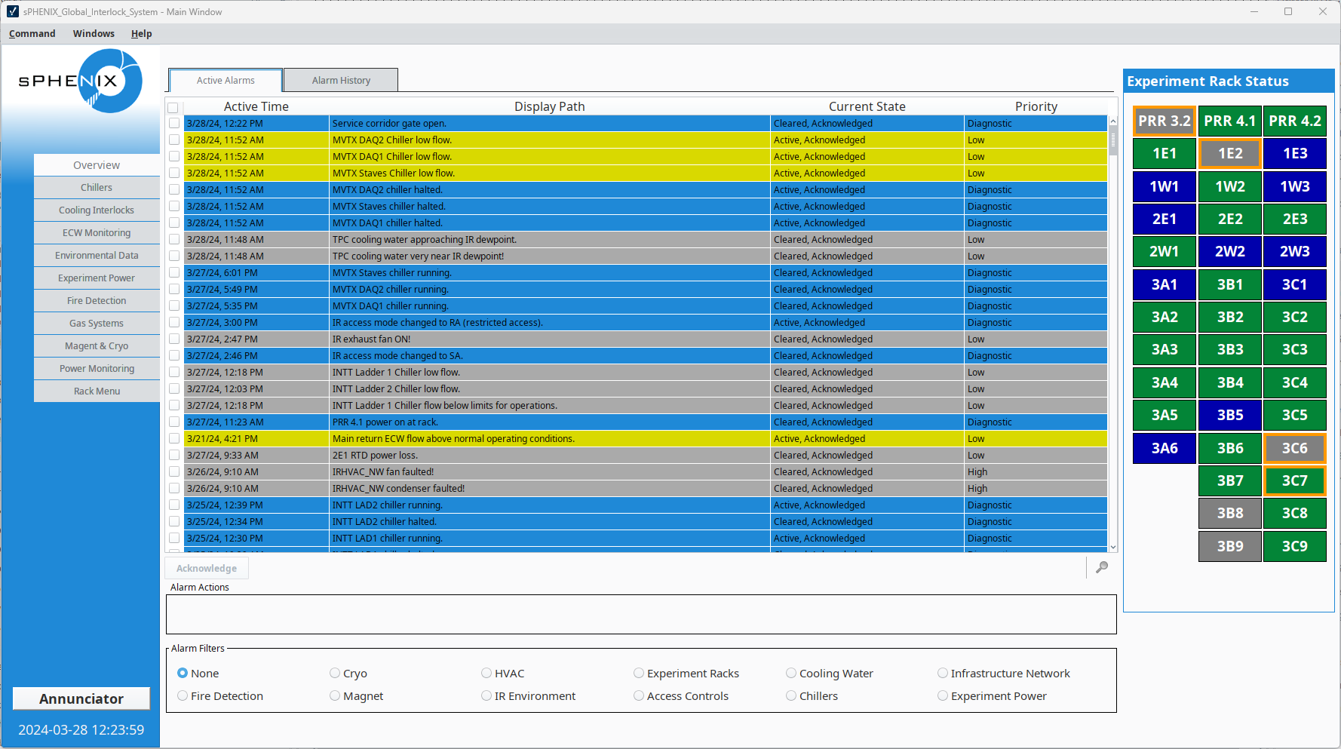
sPHENIX Slow Controls

Slide 3
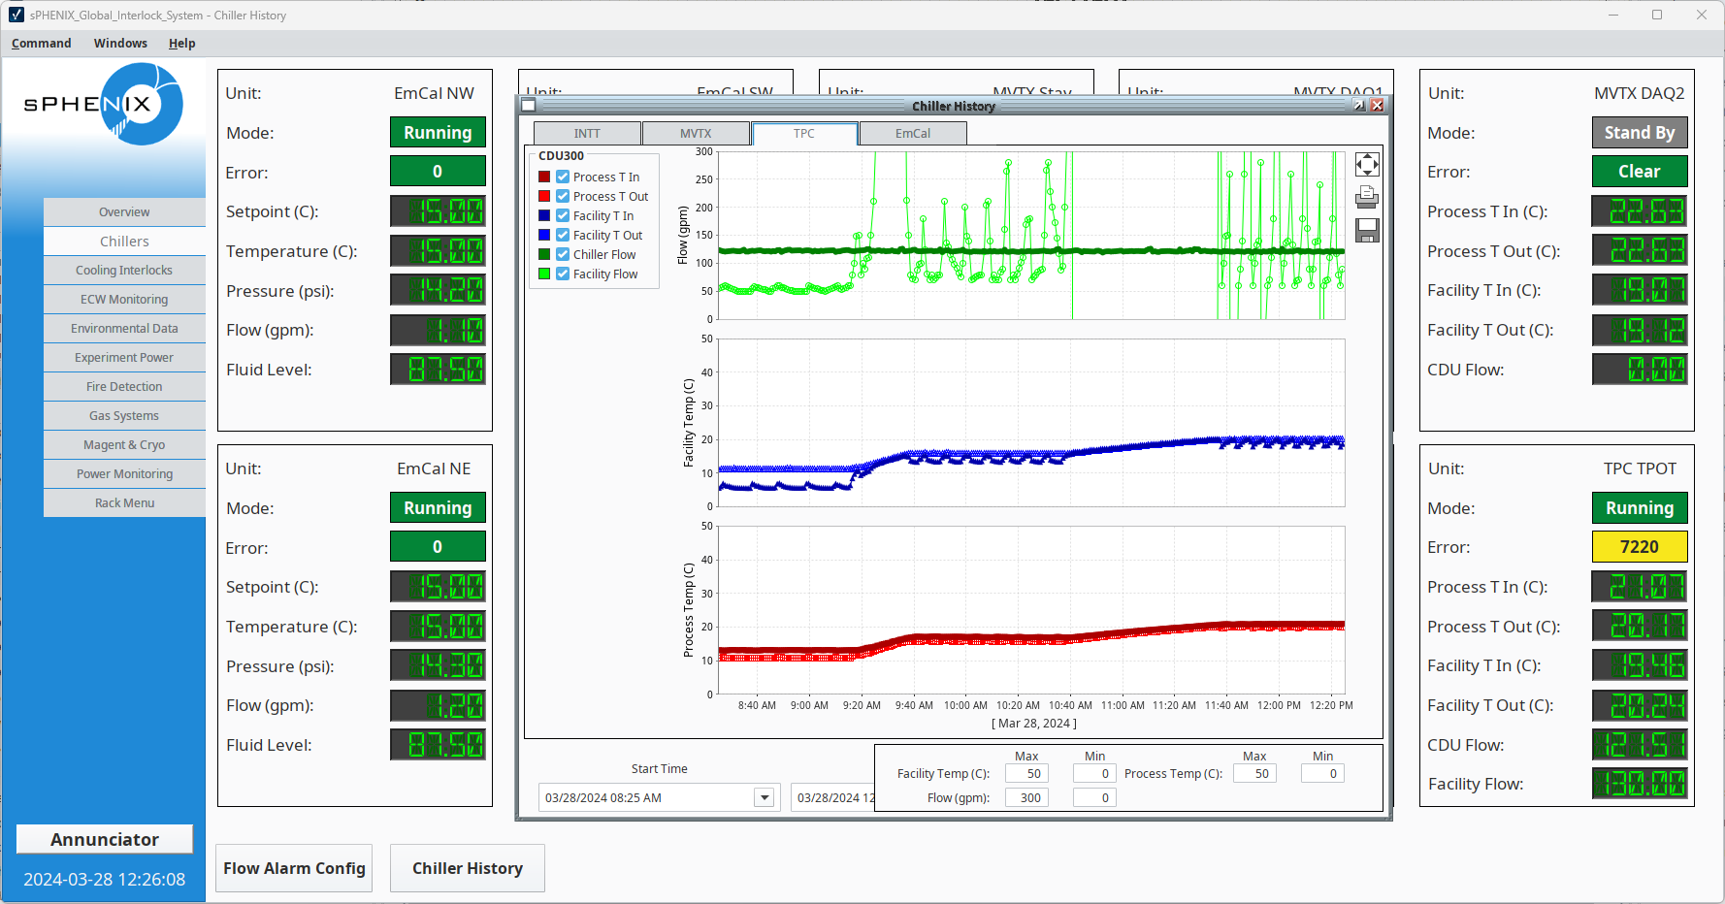
sPHENIX Slow Controls

Slide 4
System Diagram
FEEs
I2C
RDOs
CAEN
HV System
Slow Controls
EPICs Server
Light
Monitoring
SNMP
Weiner
LV System
OPCUA
ASCII/
USBTMC
Polyscience
Chiller
Slow Controls
Database Server
PLC
Gas System
Sensors
HTTP
Server
Chilldyne
Circulator

Slide 5
Parameters to Monitor
FEEs
Temperature
Power
High voltage power
Low voltage power
Cooling
Flow
Temperature
Reservoir level (Polyscience only)
Gas
Pressure
Flow
Temperature
Light

Slide 6
Equipment Considerations
UPS for HV module
Gateway for Polyscience chiller
PLC for generic sensor integration
May fall in line with larger ePIC strategy

