Slide 1
ePIC BIC: Interface Requirements Follow-up
April 26, 2024
Global Mechanical Interfaces

Slide 2
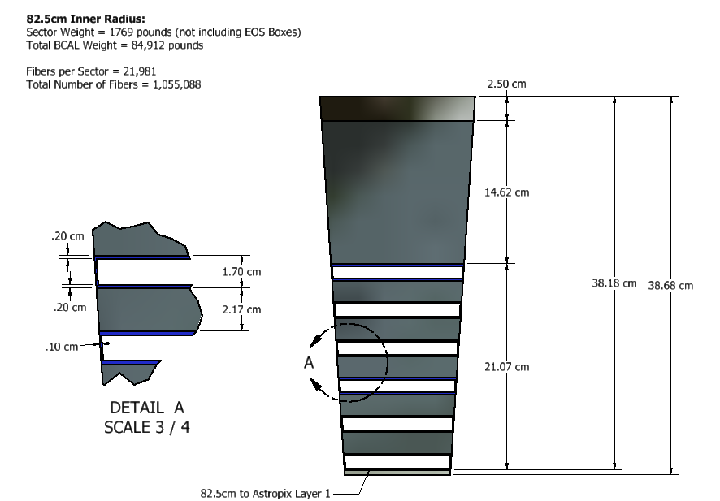
BIC Sector, End View:

Slide 3
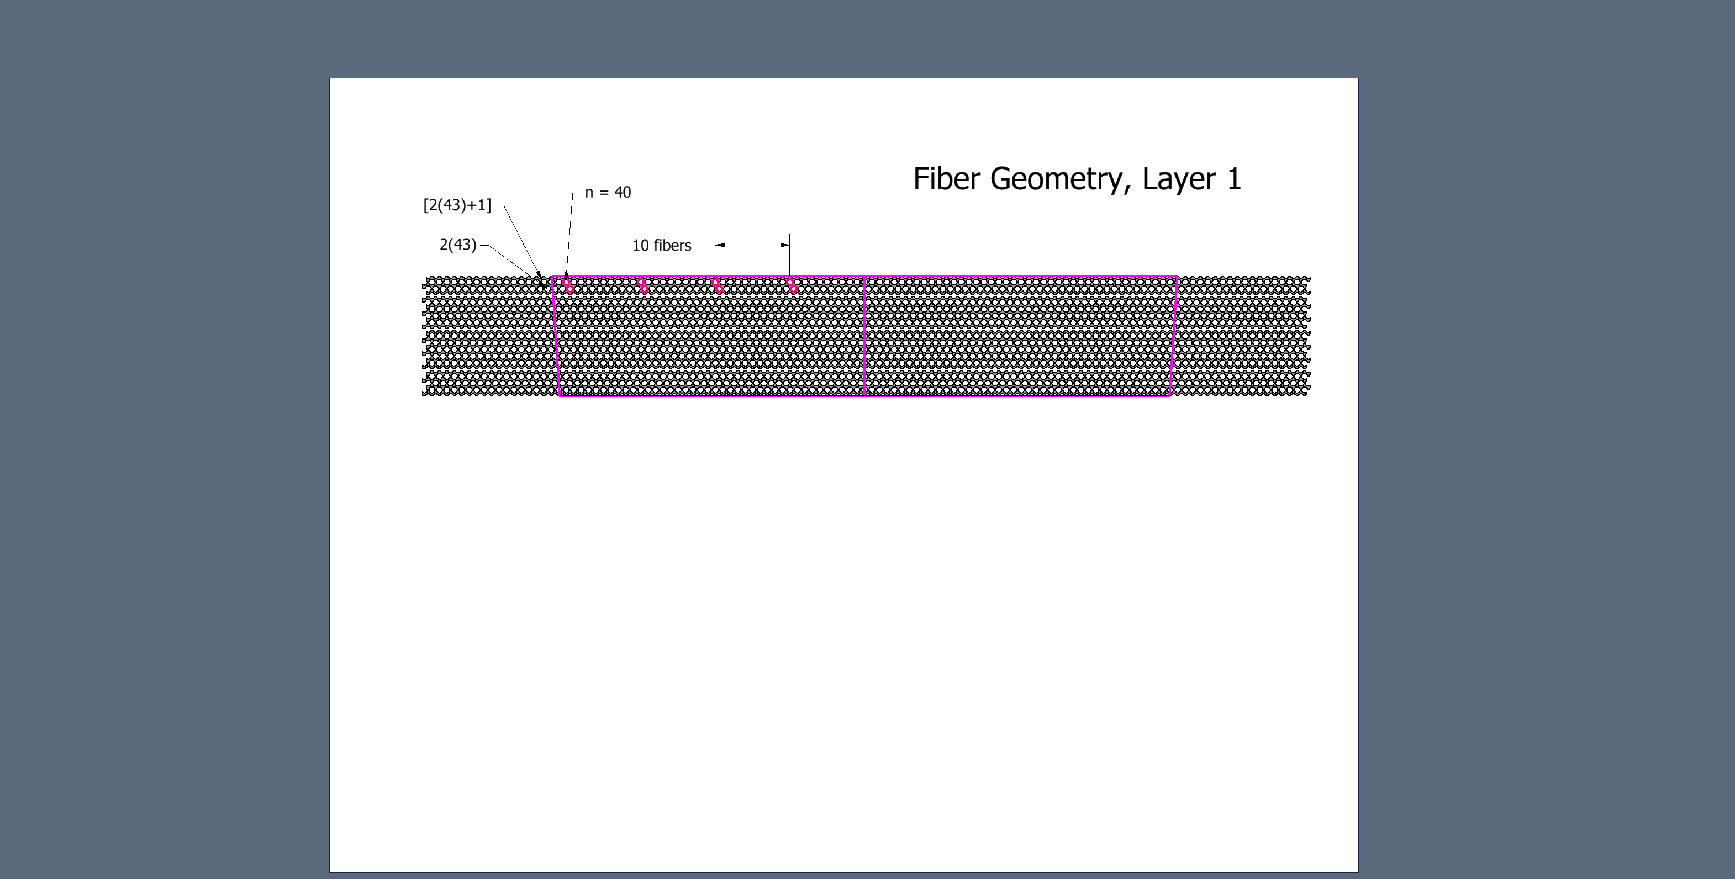
Fiber Geometry, Layer 1 17 Levels
 | Scheme | Fibers
Layer 1 | [2(43)+1] x 9 levels | 783
 | [2(43)] x 8 levels | 688
 |  | 1471 | for Layer 1

Slide 4
Fiber Geometry, Layer 1, closer look
 | Scheme | Fibers
Layer 1 | [2(43)+1] x 9 | 783
 | [2(43)] x 8 | 688
 |  | 1471 | for Layer 1

Slide 5
Fiber Totals*
 | Scheme | Fibers
Layer 1 | [2(43)+1] x 9 | 783
 | [2(43)] x 8 | 688
 |  | 1471 | for Layer 1
Layer 2 | [2(45)+1] x 9 | 819
 | [2(45)] x 8 | 720
 |  | 1539 | for Layer 2
Layer 3 | [2(47)+1] x 9 | 855
 | [2(47)] x 8 | 752
 |  | 1607 | for Layer 3
Layer 4 | [2(48)+1] x 9 | 873
 | [2(49)] x 8 | 784
 |  | 1657 | for Layer 4
Layer 5 | [2(50)+1] x 9 | 909
 | [2(51)] x 8 | 816
 |  | 1725 | for Layer 5
Non-Imaging | [2(58)+1] x 60 | 7020
 | [2(59)] x 59 | 6962
 |  | 13982 | for Non-Imaging Layer
TOTAL FIBERS PER SECTOR = 21981
*assumes non-imaging layer built with uniform width (117 levels)
segmenting into two widths saves about 500 fibers

Slide 6
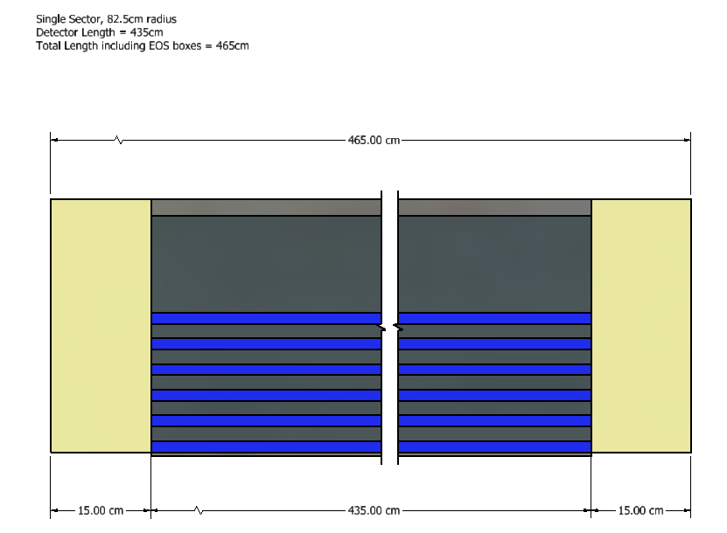
BIC Length:

Slide 7
Changes from April 12:
Reduce active length from 440cm to 435cm
Change offset from -38.75cm to -41.25
Rotated barrel 3.75 degrees to put edge of sector on vertical plane

Slide 8
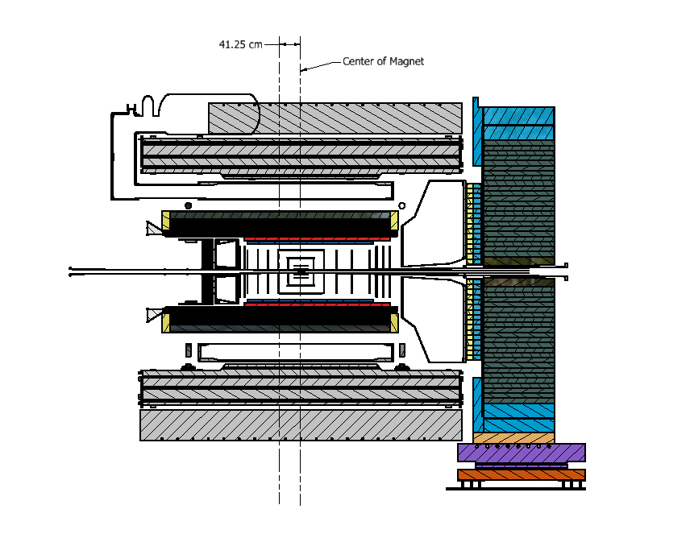
BIC Placement in Global Model:
Facing North
West (-Z)
East (+Z)
Interference
w/DIRC
6.75cm gap to
DRICH

Slide 9
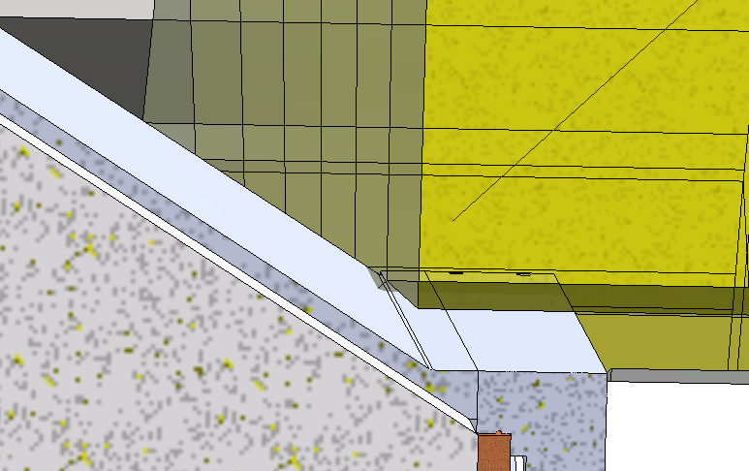
DIRC Interference:
4.74cm
unchanged from 4/12

Slide 10
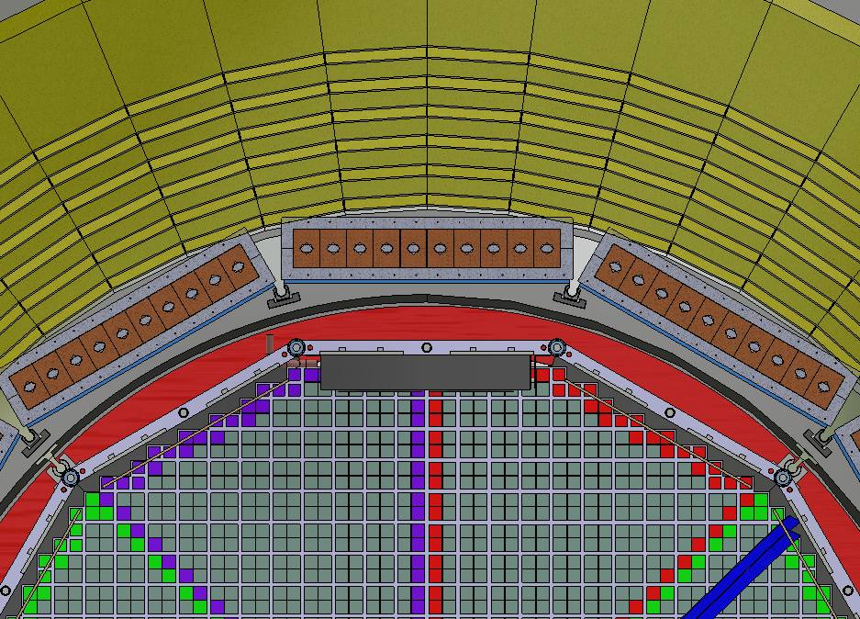
DIRC Interference, end view:
New orientation

Slide 11
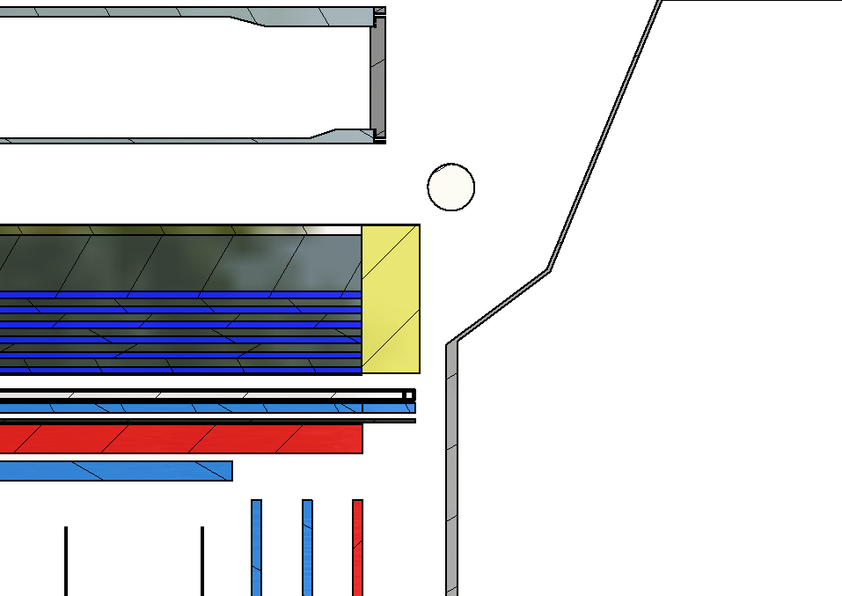
DRICH End:
6.75cm gap to DRICH
1.25cm beyond DIRC Bar

Slide 12
Next Steps for Global Interface:
Finalize length of astropix staves
Adjust length of ScFi/Pb to match astropix
Resolve interference with DIRC

