Slide 1
AC-LGAD sensor production at BNL
Gabriele Giacomini
April 3rd 2024
ePIC AC-LGAD TOF DSC Weekly Meeting Wednesday - https://indico.bnl.gov/event/22912/

Slide 2
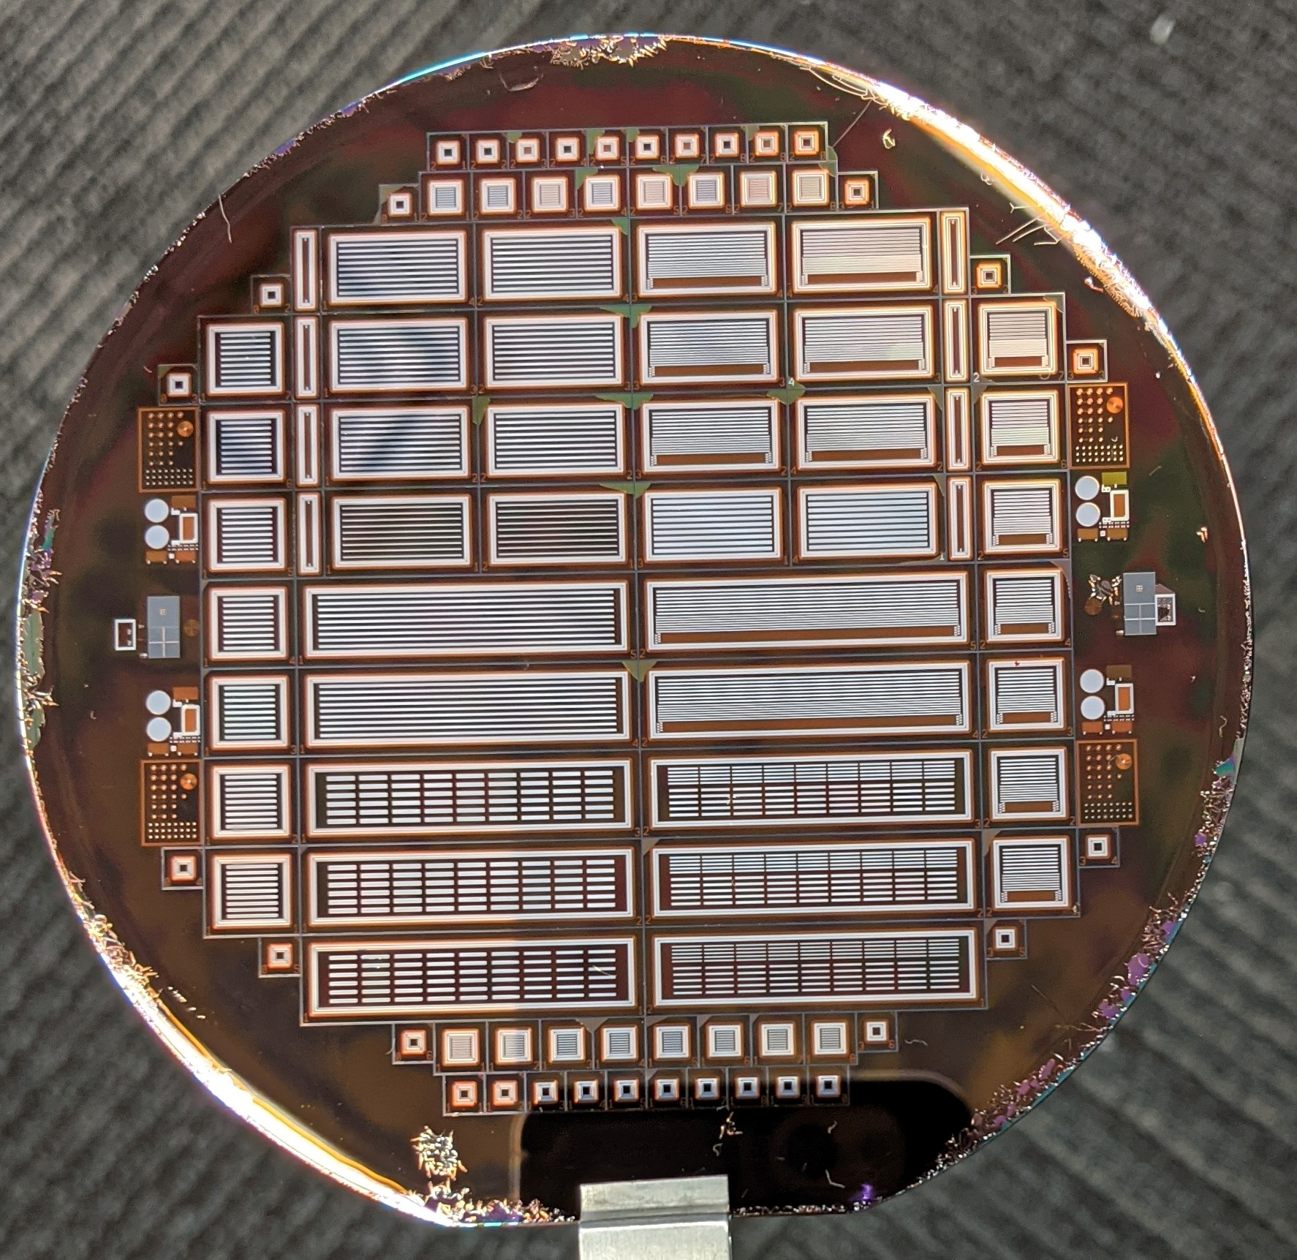
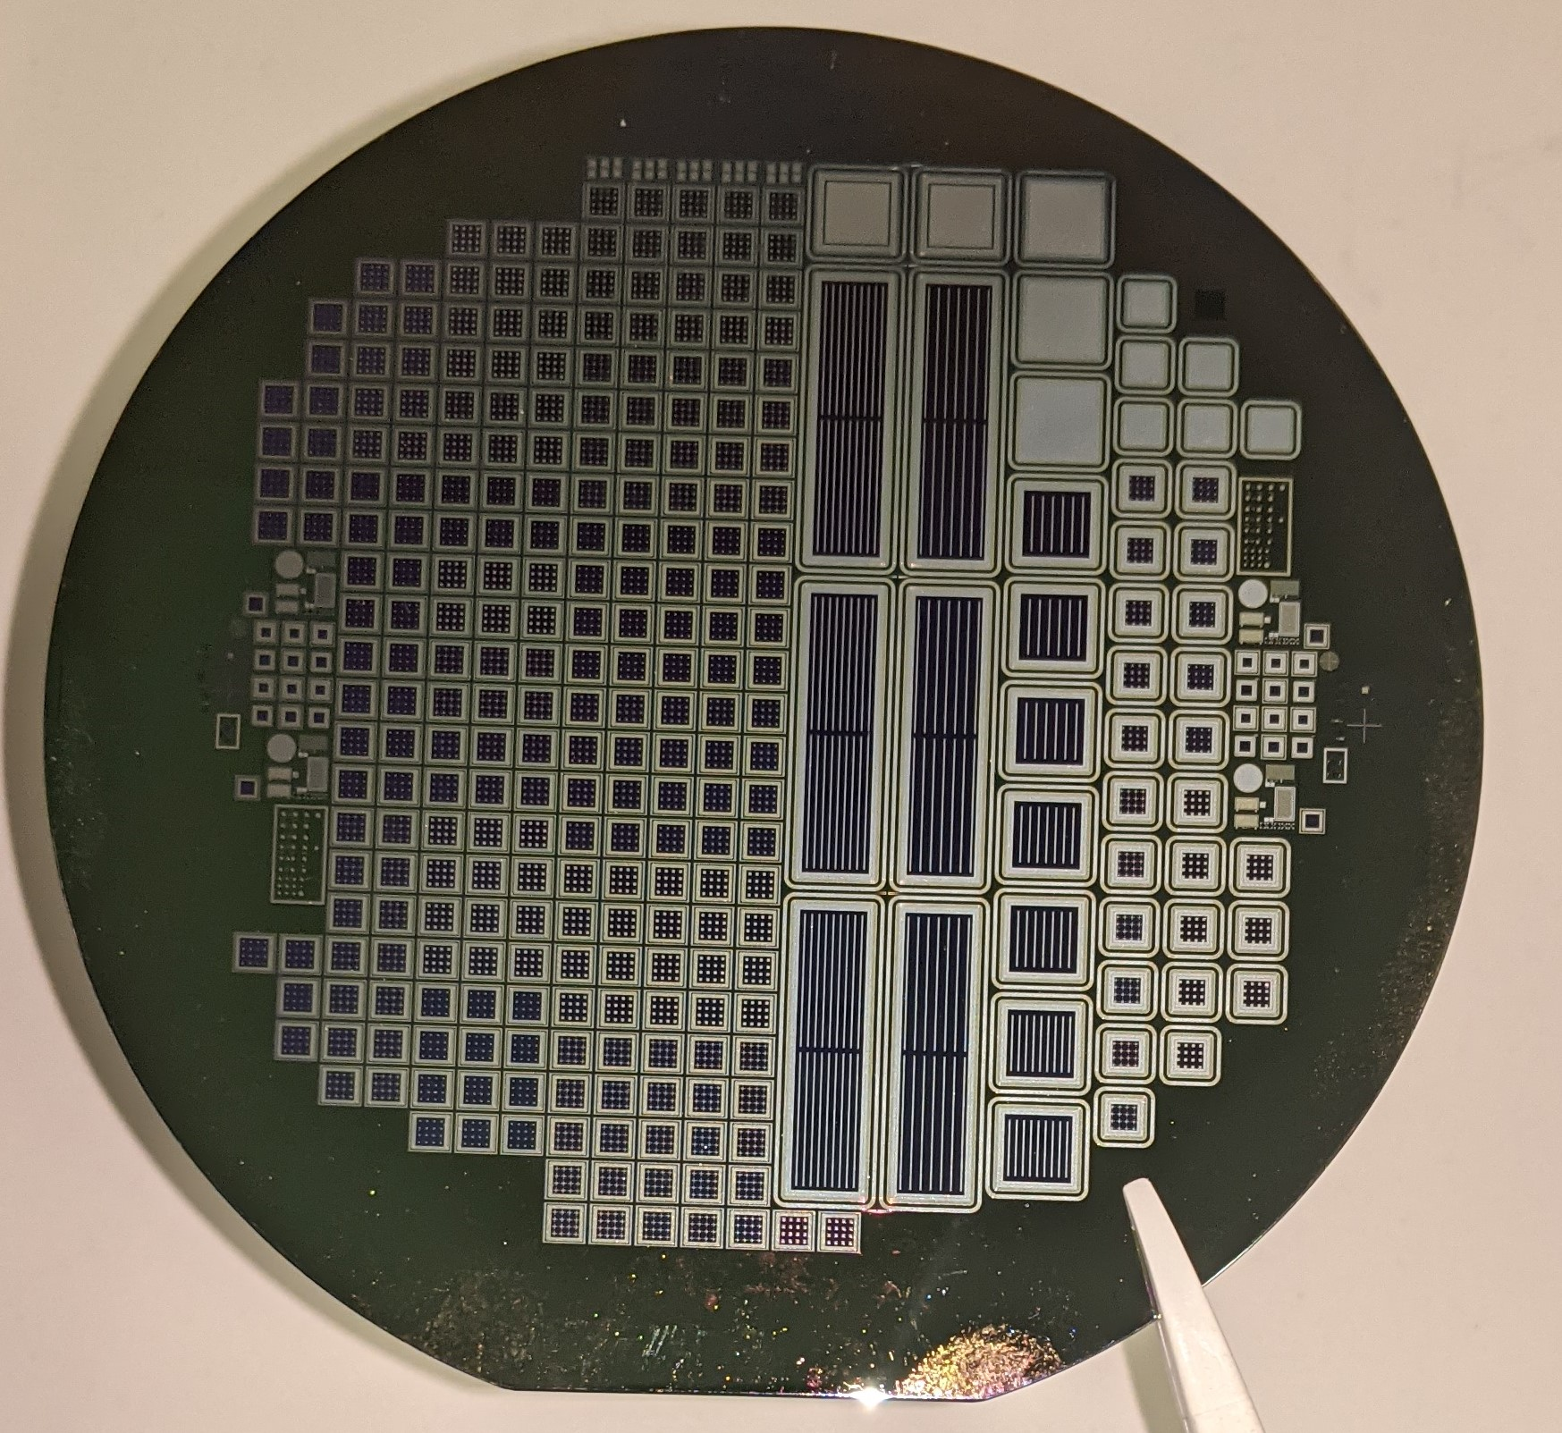
AC LGAD strip
Strips of 0.5, 1, 2.5 cm
EICROC
Compatible with arrays of 4x4 pixels
Wafers are on hold, ready to go with the first lithography: how many per type?
Metal geometries can be decided later on.
We can also do a fabrication with brand new photomasks

