Slide 1
Controlled projection using generative AI and its application to XAS
Xiaohui Qu
Research Staff 4
Theory & Computation group
Center for Functional Nanomaterials
Brookhaven National Lab
Apr 9, 2024

Slide 2
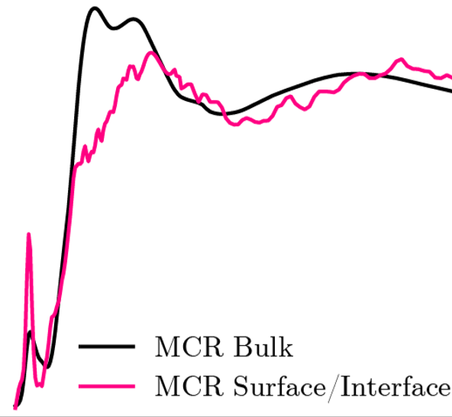
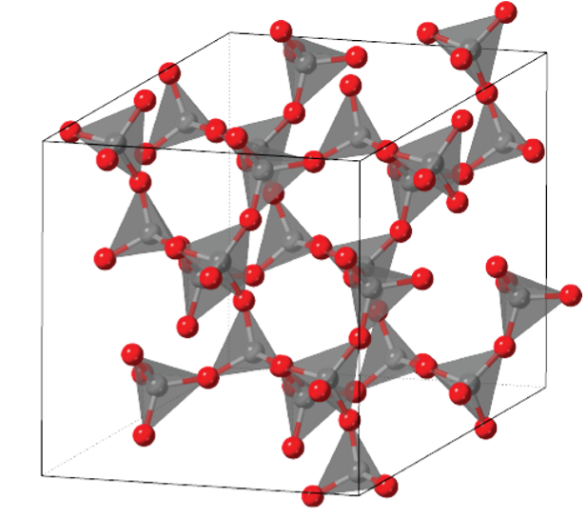
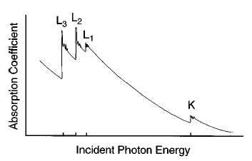
X-ray Absorption Spectroscopy
Element specific
Sensitive to electronic structure
Sensitive to local symmetry, coordination number and charge state
Great time/energy resolution
In-situ Experiment
X-ray absorption near edge structure (XANES)
Rehr & Albers, RMP 2000
X. Qu et al, Chem. Matt. 2021

Slide 3
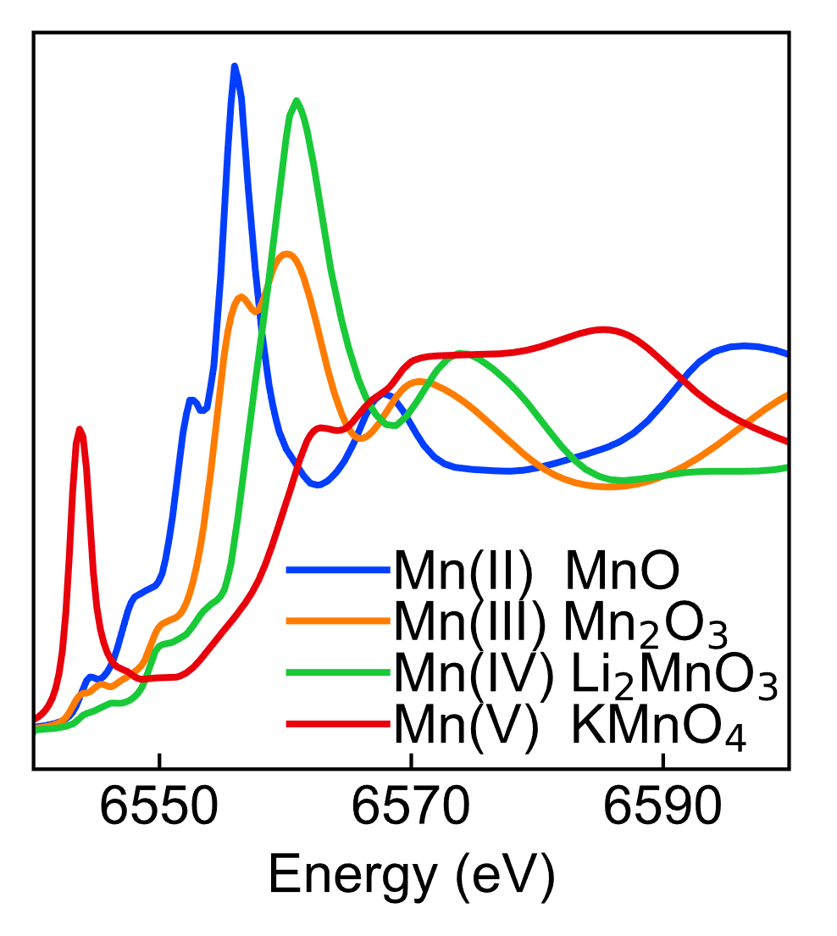
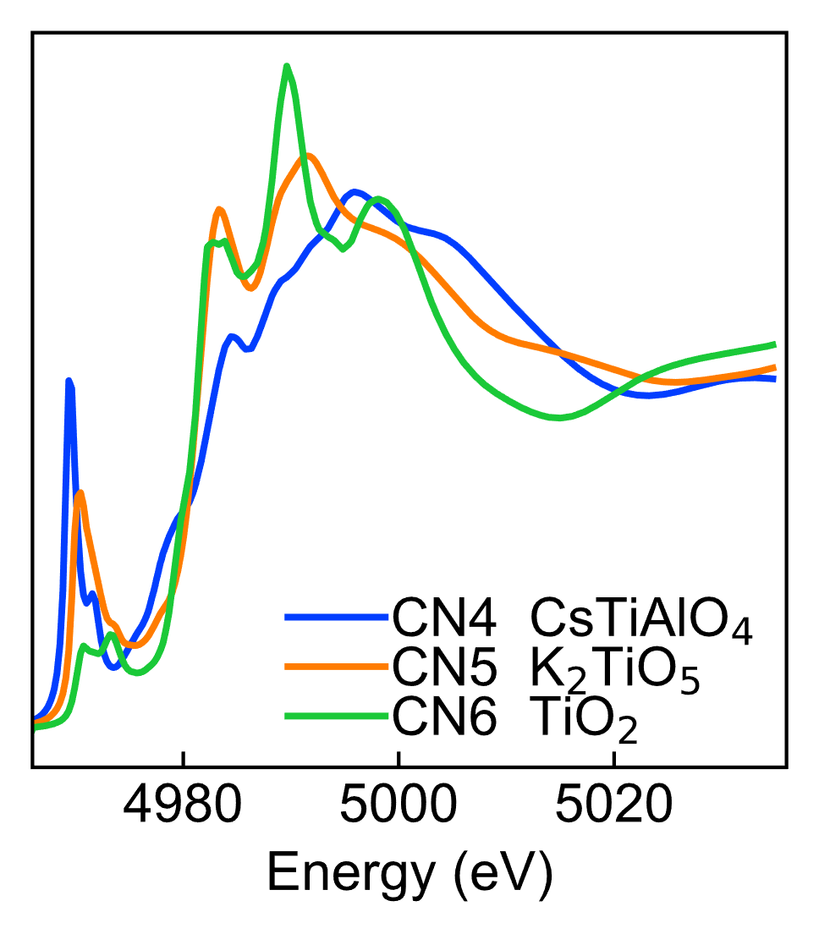
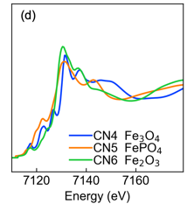
Structure-Spectrum Relationship
Some are clear
But not aways
Charge State
Ti Coordination Number
Fe Coordination Number

Slide 4
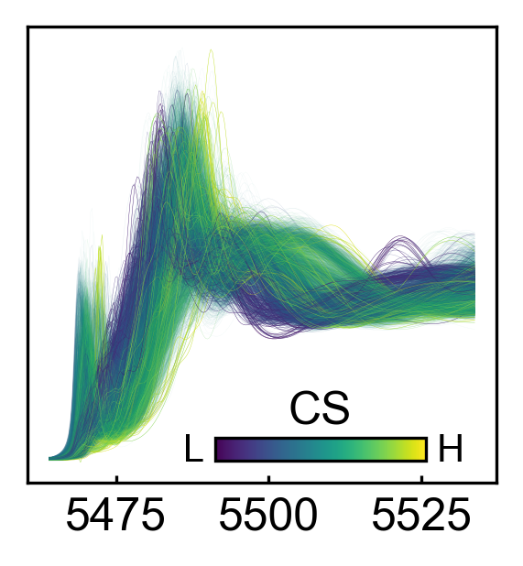
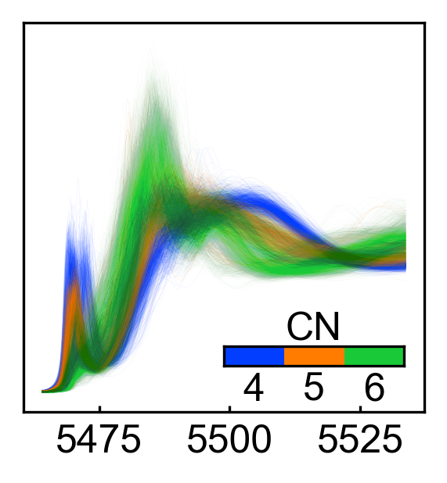
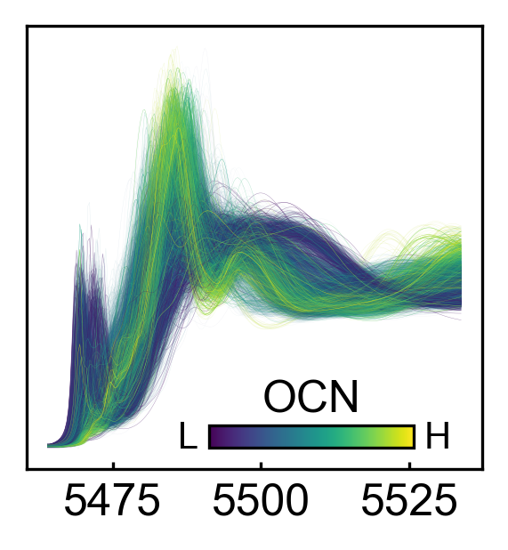
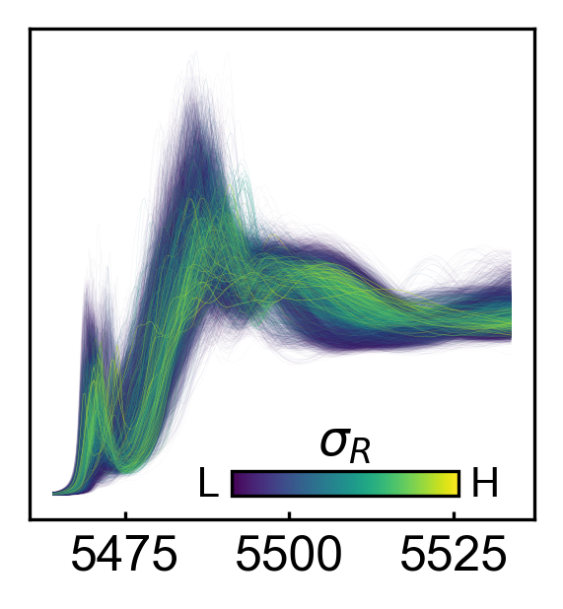
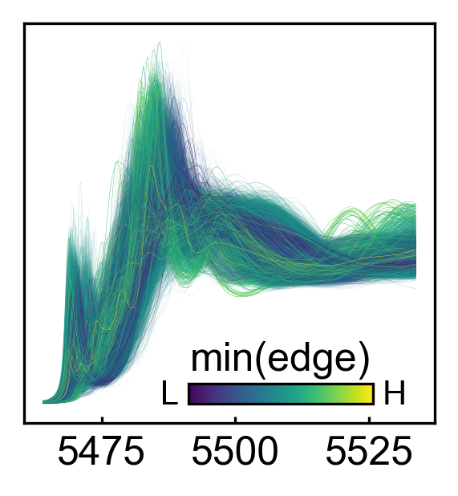
Even More For A Large Diverse Data Set
Vanadium oxides
K-edge XANES
FEFF Simulation
O
OS: Oxidation State
CN: Coordination Number
OCN: Oxygen Coordination Number
NNRS: mean square distortion
MOOD: oxygen-oxygen distance minimum
NNRS
MOOD
Is there a tool to see structure-spectrum relationship clearly?

Slide 5
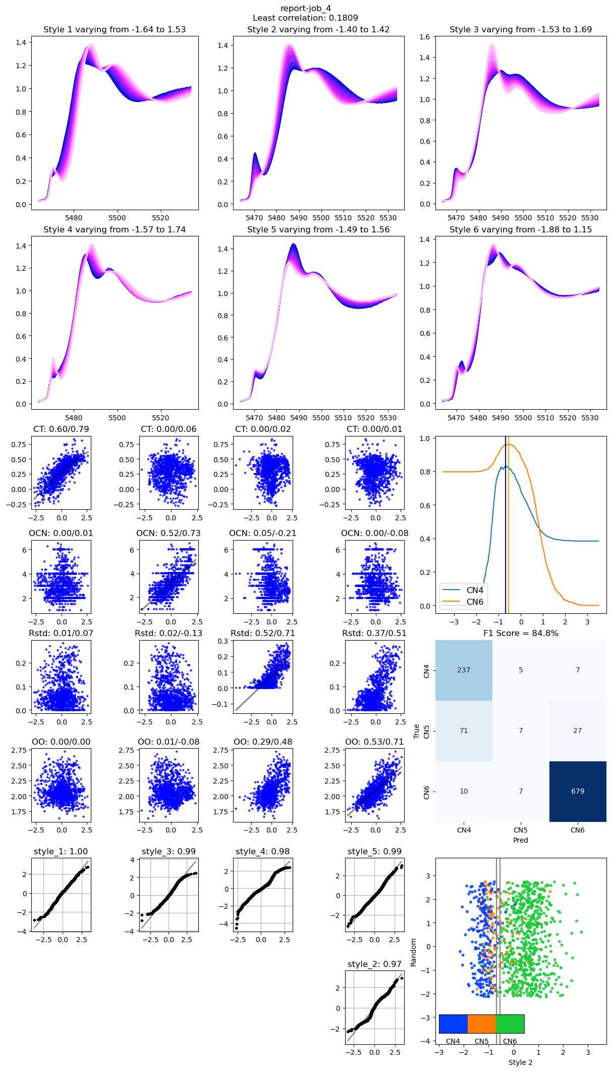
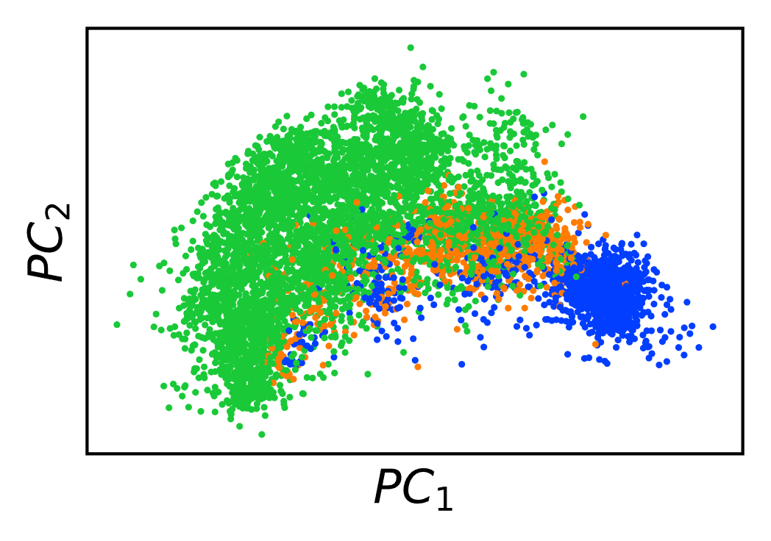
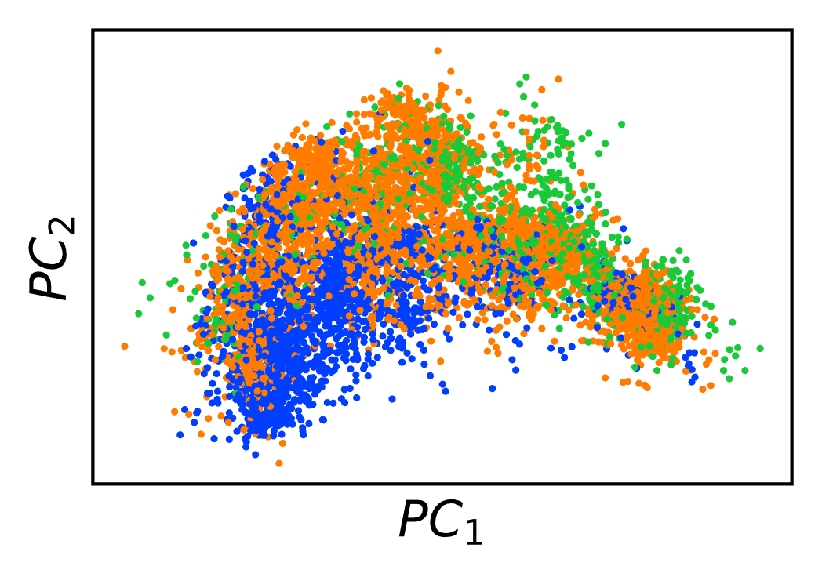
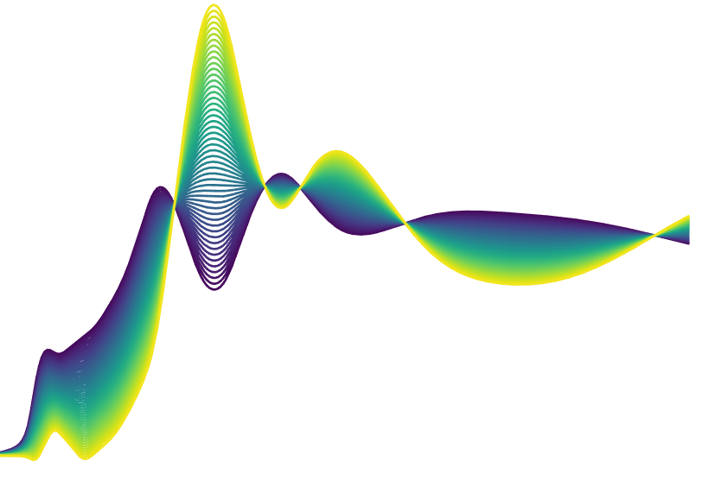
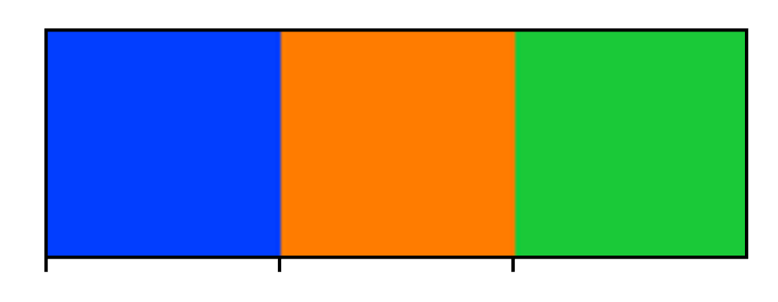
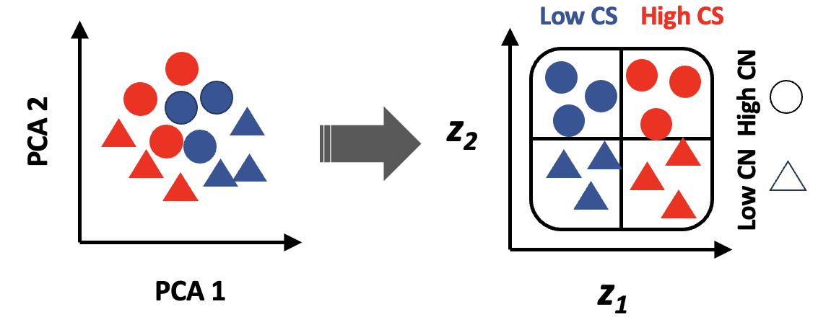
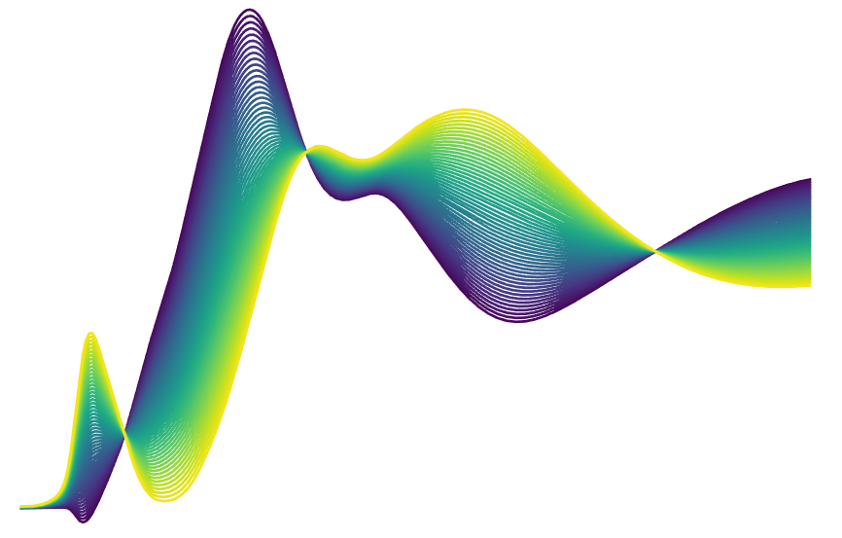
Dimension Reduction (PCA)
Expected
PCA Analysis of V Oxides Spectra (~7000)
Colored by CN
Colored by charge state
Reconstructed Spectrum
Along PC₁
4
5
6
The PCA coordinates are reduced representation of the spectra.
The aggregation data points shows some pattern, but it doesn’t relate the spectrum to structure directly.
The aggregation doesn’t happen on single axis only, a reconstruction of the spectrum along a principal axis mixes the contribution multiple structure descriptor.
PCA Reconstruction has some negative part --- unphysical.
Reconstructed Spectrum
Along PC₁
Reconstructed Spectrum
From An Ideal Dimension Reduction Algorithm

Slide 6
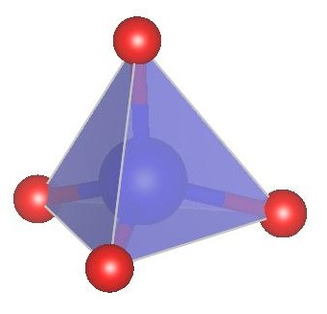
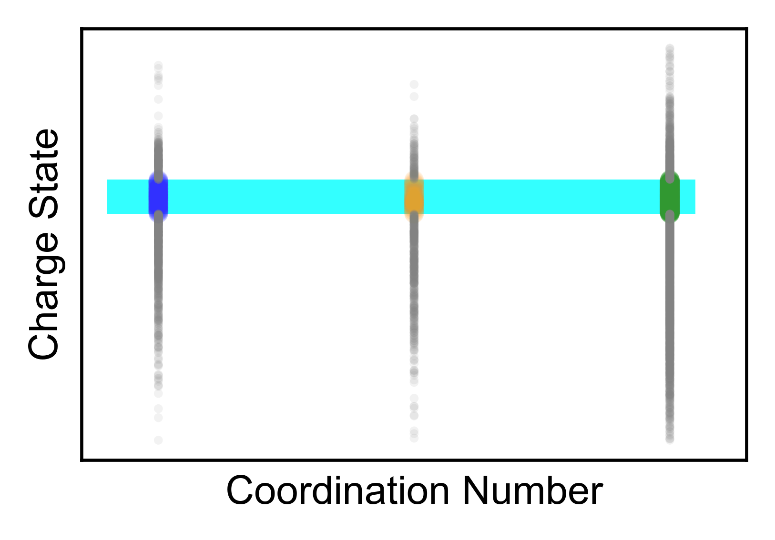
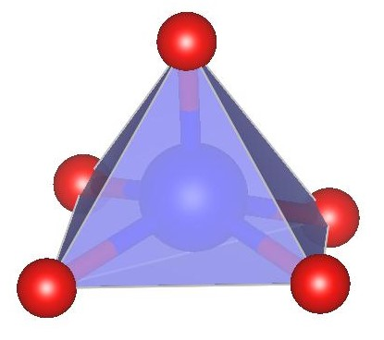
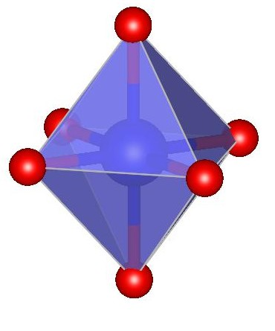
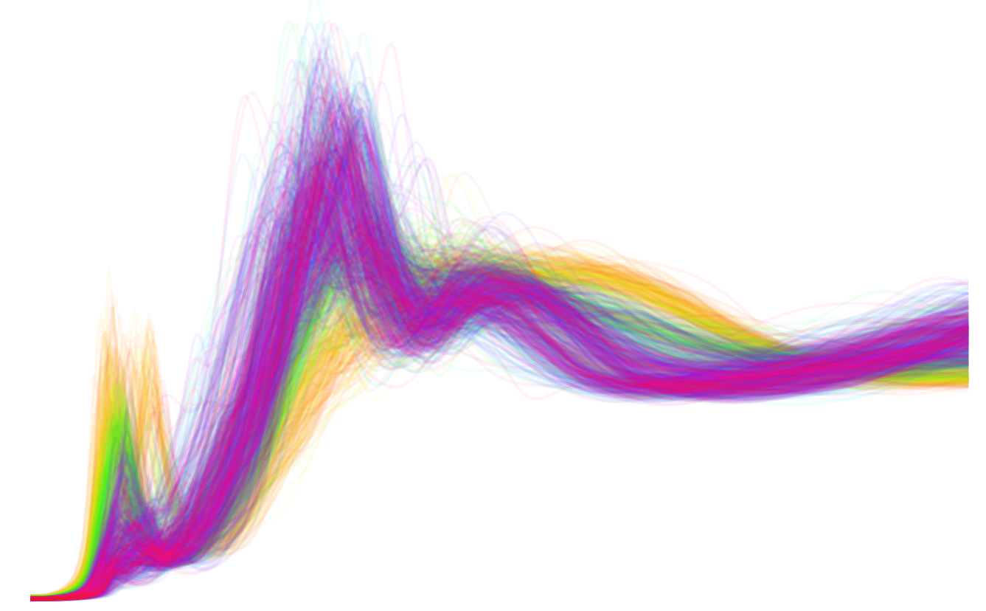
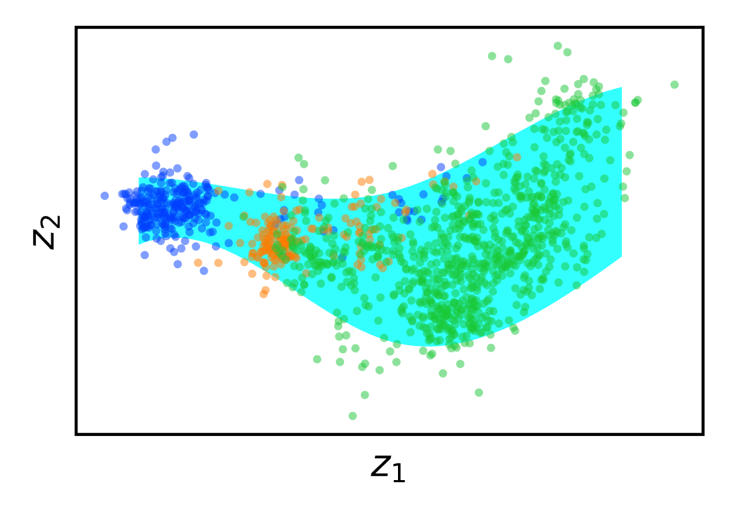
Space Misalignment In Dimension Reduction
Structure
Space
Select a specific oxidation state
A narrow distribution
Oxidation State
The same data points are not necessarily a well-defined band if we look at them from the spectrum space
Spectrum
Space

Slide 7
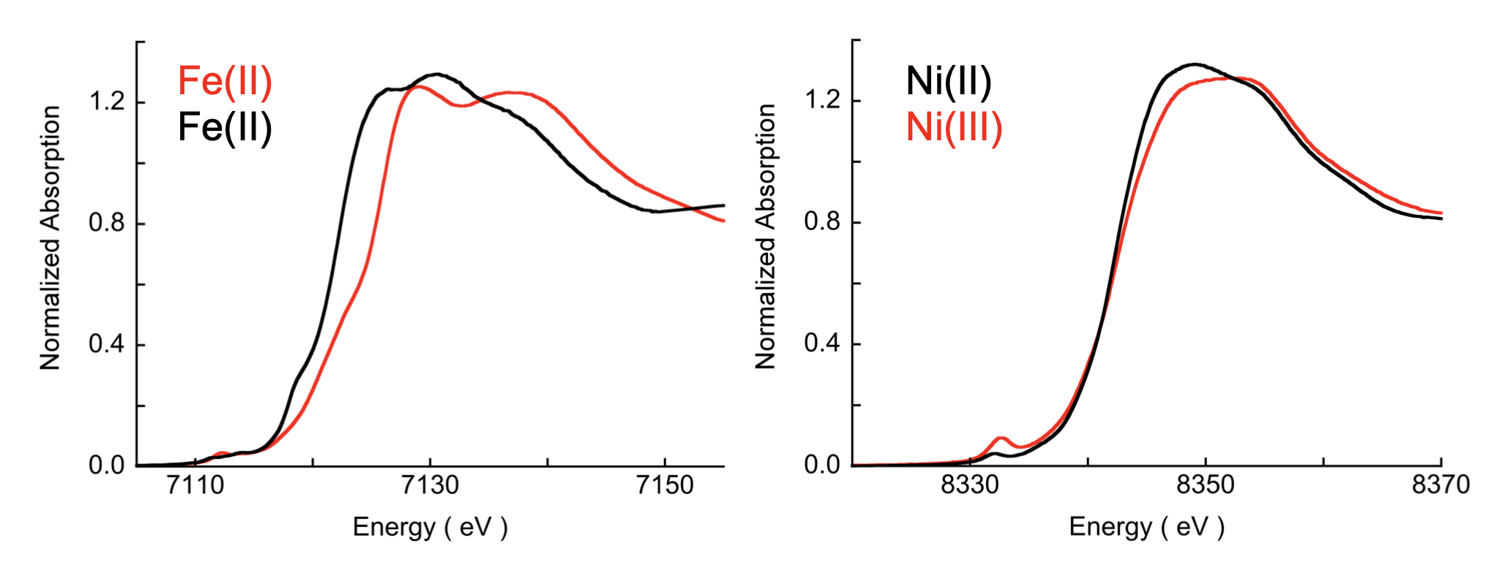
Examples of complex trend
Same Charge State
Different Edge Shift
Different Charge State
Same Edge Shift
https://www-ssrl.slac.stanford.edu/conferences/workshops/srxas2011/presentations/sarangi_xanes_2011.pdf
How the edge position is determined is an intertwined result of the multiple structure descriptors

Slide 8
Properties Required
Always generate a physical spectrum (generative model).
Latent space organized according to structure descriptors.

Slide 9
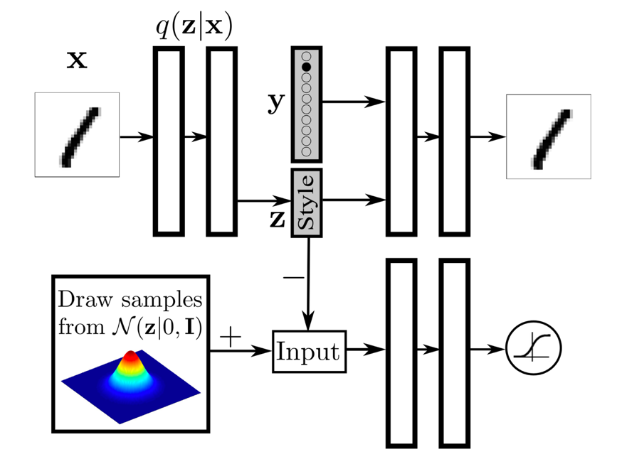
Adversarial AutoEncoder
Image
Image
Network structure
Makhzani et. Al. Adversarial Autoencoders. arXiv:1511.05644v2
A generative model
Except the image reconstruction, what does the adversarial part (shaded) do?

Slide 10
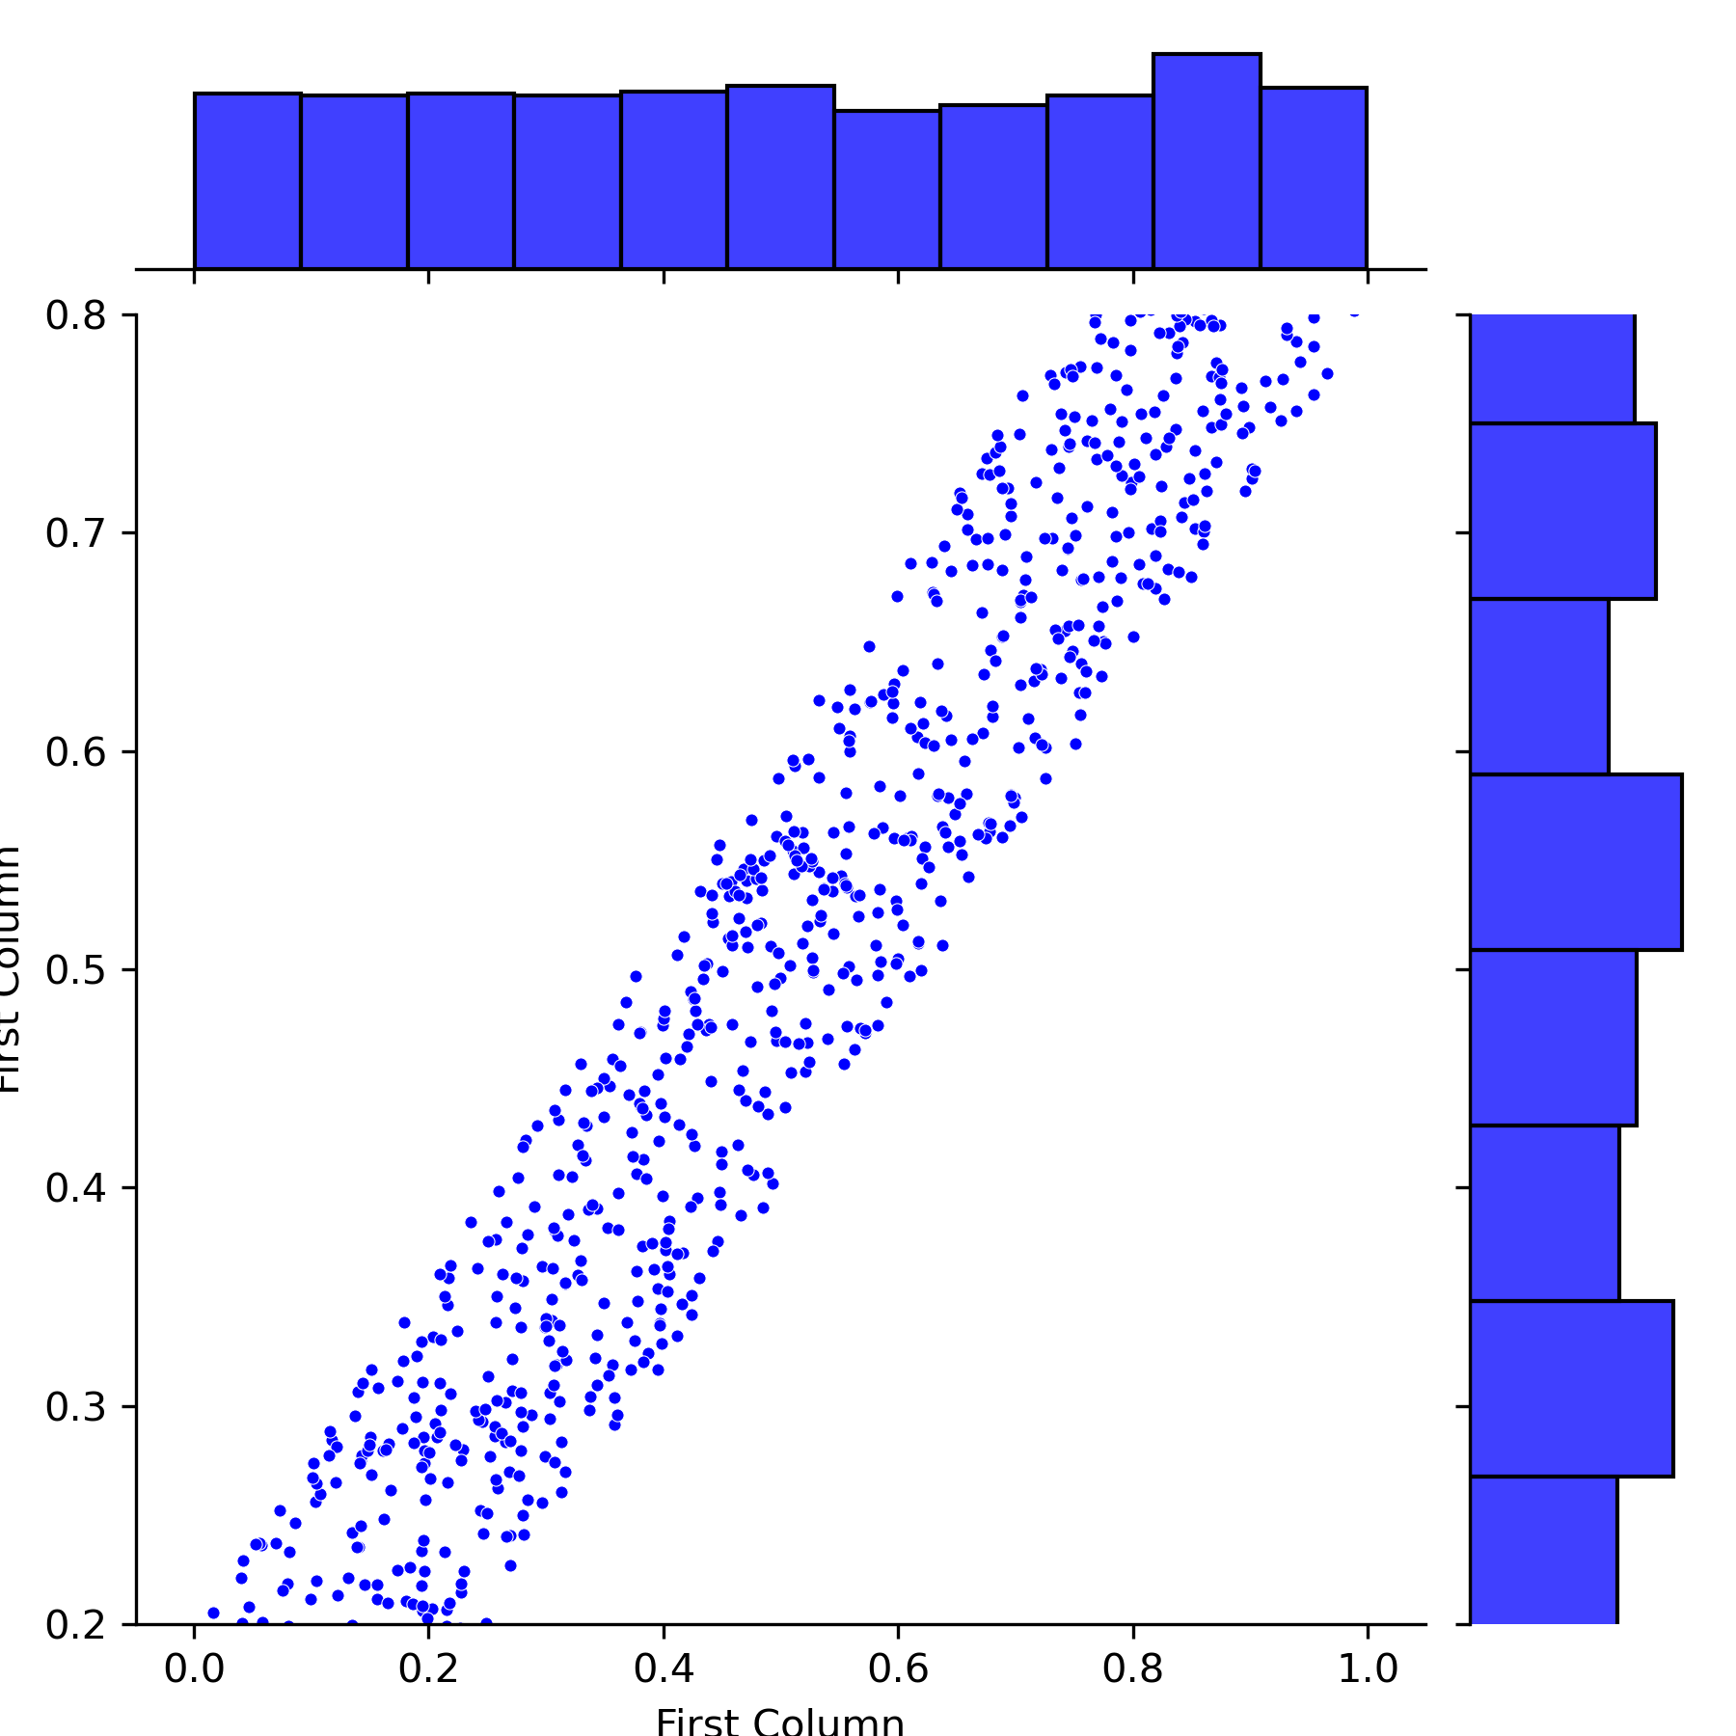
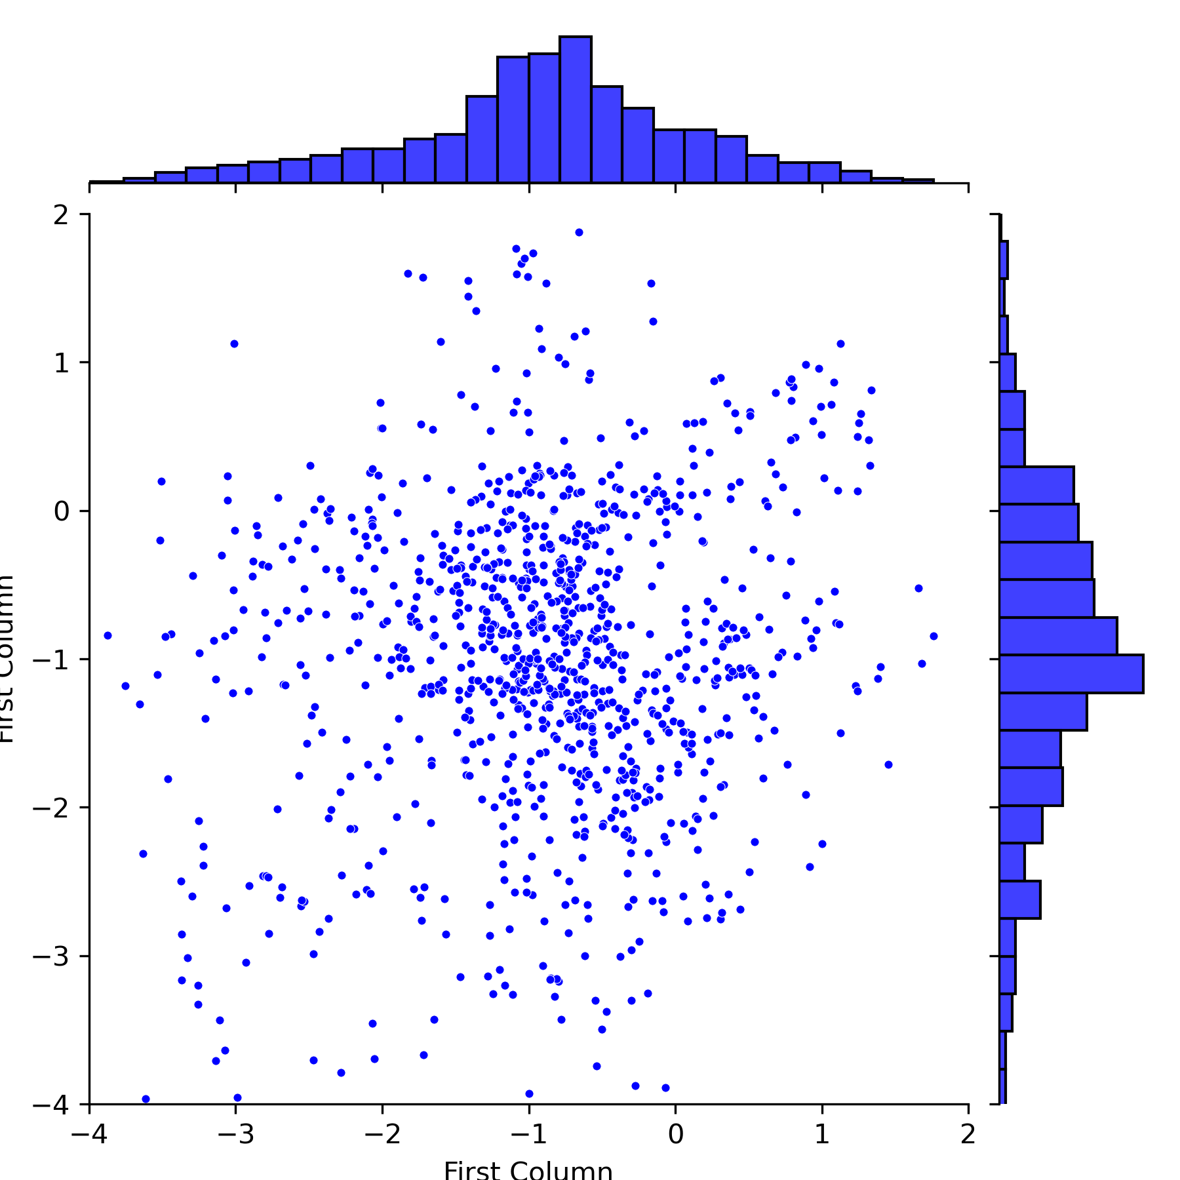
Test the Effect of Adversarial Part Using a Hypothetical Variable
A variable, x, is generated using a random number of uniform distribution with dimensions (1000, 2).
Only keep adversarial training.
Adversarial training compares x with a multivariate Gaussian distribution by a learned discriminator function.
Gradient reversal.
x ends up with Gaussian distribution.
The first column and the second are decorrelated.
The latent space can be disentangled, but how to align each dimension to the change of structure descriptors?
x

Slide 11
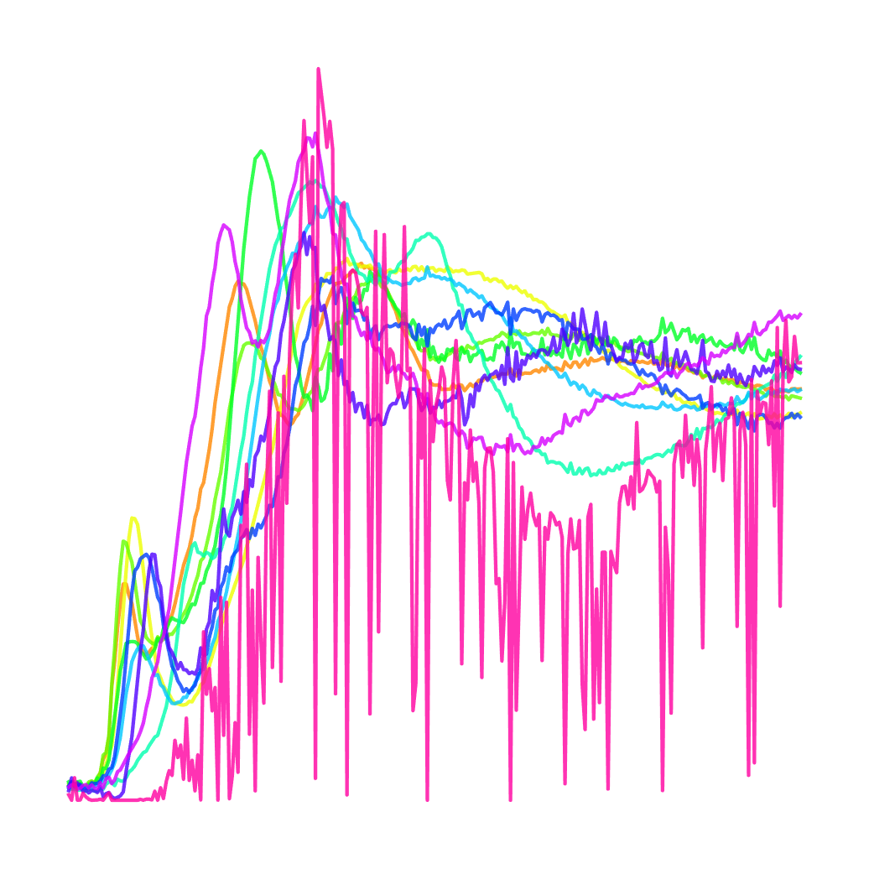
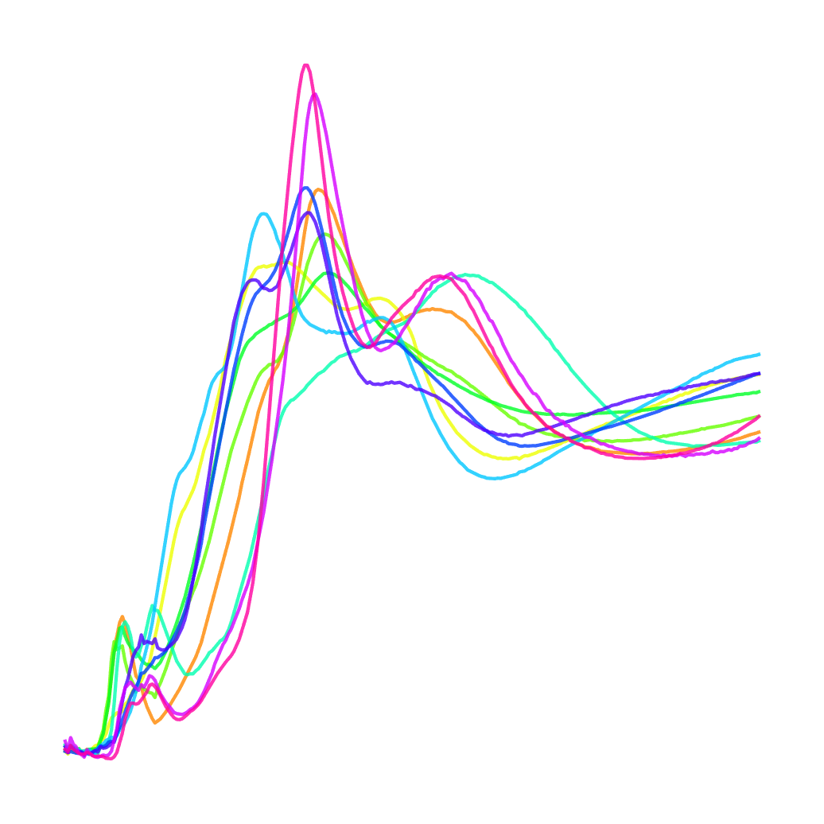
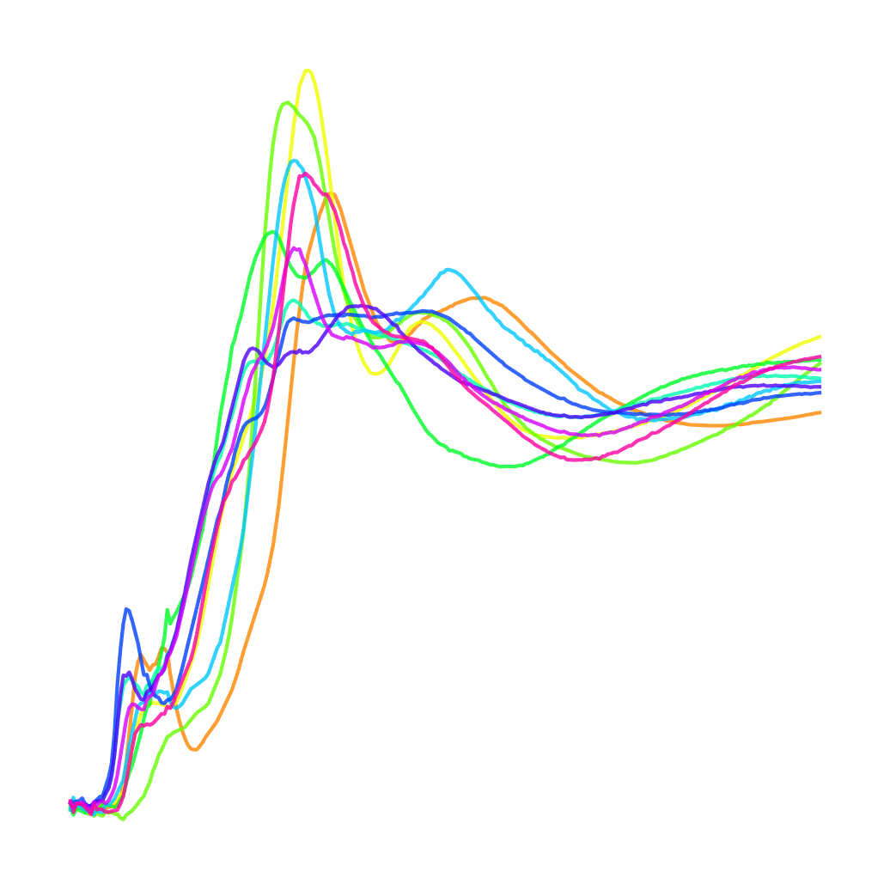
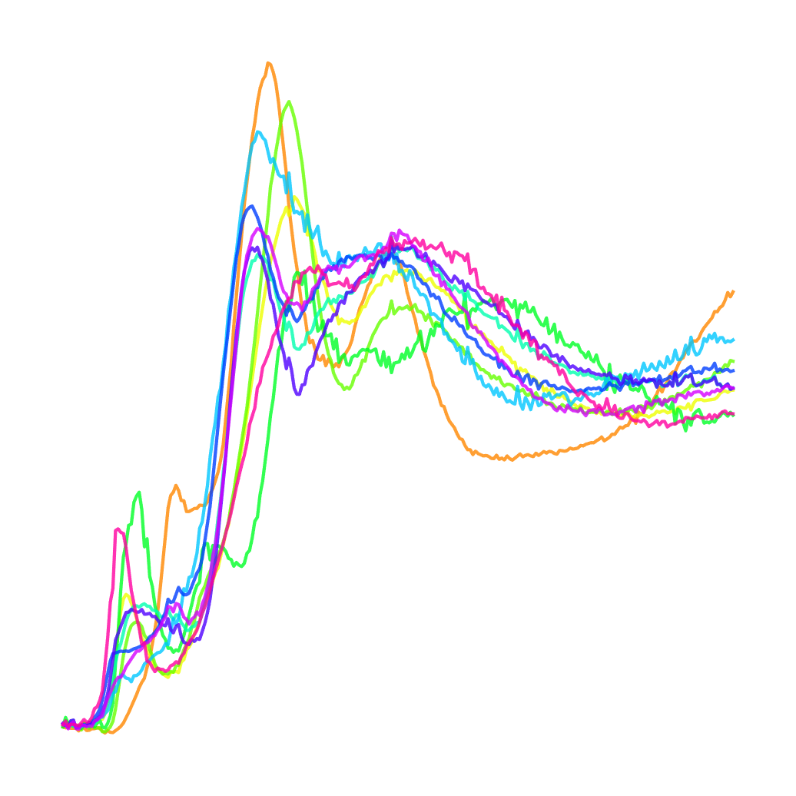
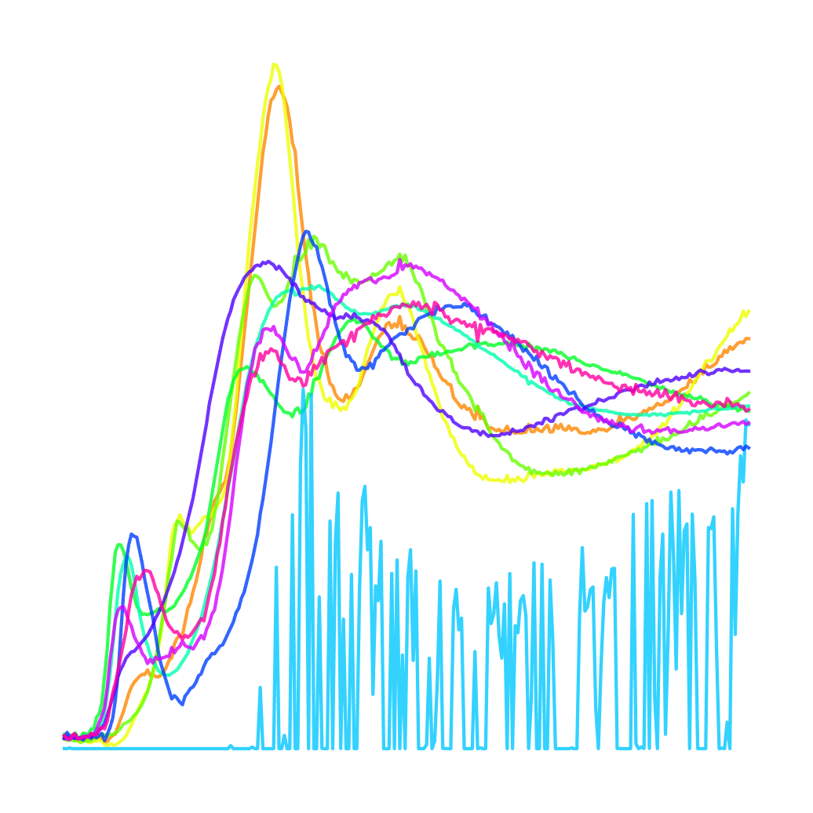
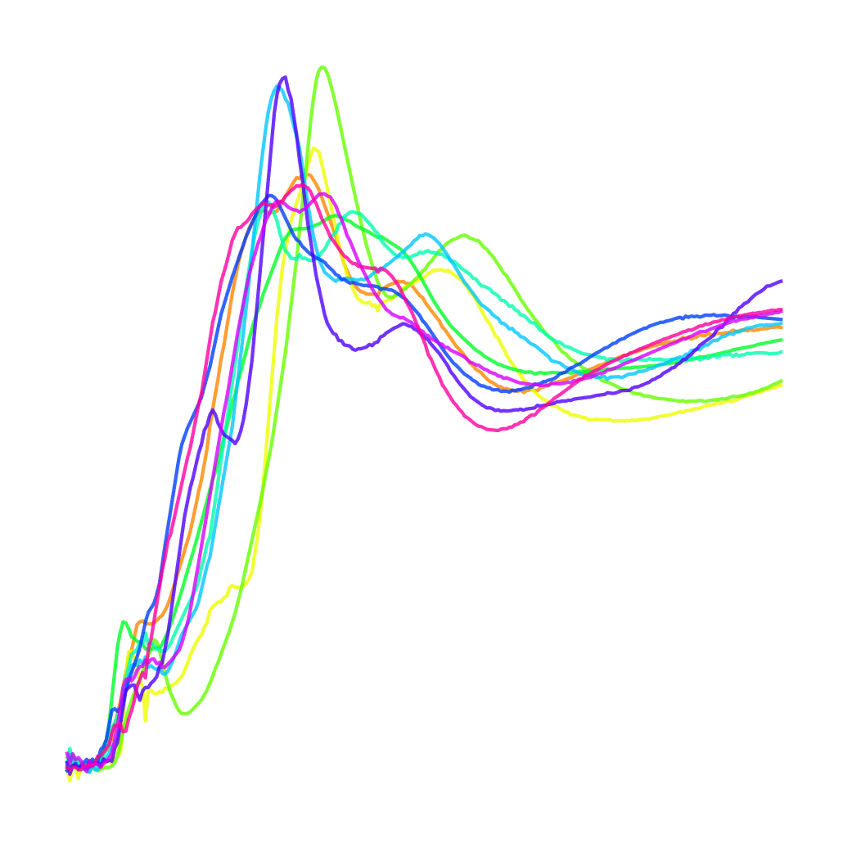
Effect of Adversarial Training for spectrum
Image
Image
Network structure
But, the discrete label (one hot vector) sometimes leads unphysical spectrum
Vanilla Autoencoder
AAE
AAE gaurantees a generated spectrum is physical.

Slide 12
Use AAE for Spectrum Trend?
AAE convert it to a low dimensional representation
AAE generates physical spectra
Still required: Organize the latent space to have a physical meaning at each dimension

Slide 13
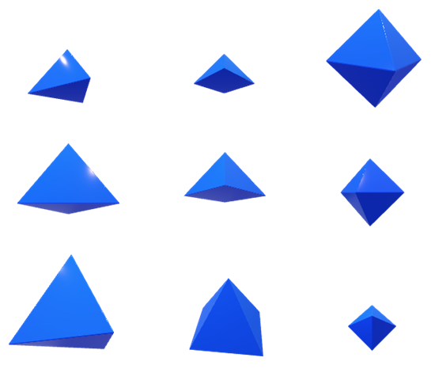
Add a constraint to organized the latent space
Discriminator
AAE: Adversarial AutoEncoder, generative AI for XAS spectrum.
Rank Constraint: developed in this work, organizes the latent space to make each dimension have a physical meaning.
Spectrum
Encoder
Latent
Decoder
Spectrum
Rank Constraint
Rank Penalty
Z. Liang et al., PRM, 2023, 7, 053802.
Notes:
Make picture larger, explain what rank constraint does, without involving details, Mark the part we developed., breaks to two steps: AAE -> RankAAE

Slide 14
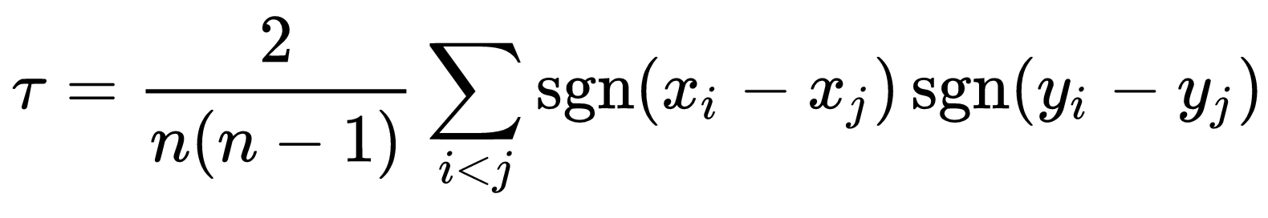
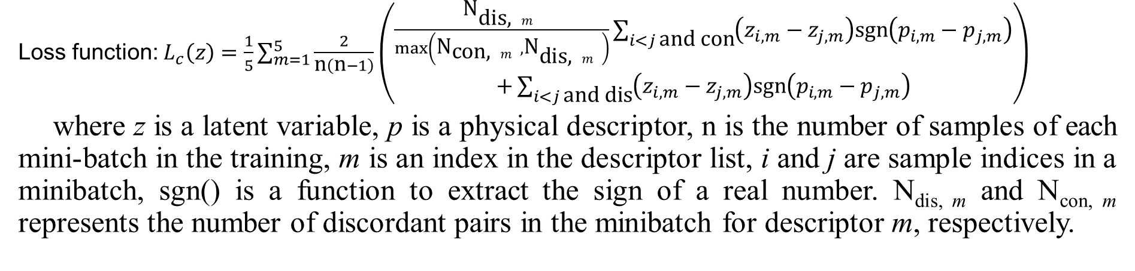
Rank Constraint
Kendal rank correlation coefficient:
Loss function: $L_{c}\left(z\right)=\frac{1}{5}\sum_{m=1}^{5}{\frac{2}{\text{n}\left(\text{n}−1\right)}\left(\begin{aligned}\frac{{\text{N}}_{\text{dis}\text{, }m}}{\max\left({\text{N}}_{\text{con}\text{, }m},{\text{N}}_{\text{dis}\text{, }m}\right)}\sum_{i<j \text{and} \text{con}}{\left(z_{i,m}−z_{j,m}\right)\text{sgn}\left(p_{i,m}−p_{j,m}\right)} \\ +\sum_{i<j \text{and} \text{dis}}{\left(z_{i,m}−z_{j,m}\right)\text{sgn}\left(p_{i,m}−p_{j,m}\right)}\end{aligned}\right)}$
where z is a latent variable, p is a physical descriptor, n is the number of samples of each mini-batch in the training, m is an index in the descriptor list, i and j are sample indices in a minibatch, sgn() is a function to extract the sign of a real number. N_{dis, m} and N_{con, m} represents the number of discordant pairs in the minibatch for descriptor m, respectively.
Z. Liang et al., PRM, 2023, 7, 053802.

Slide 15
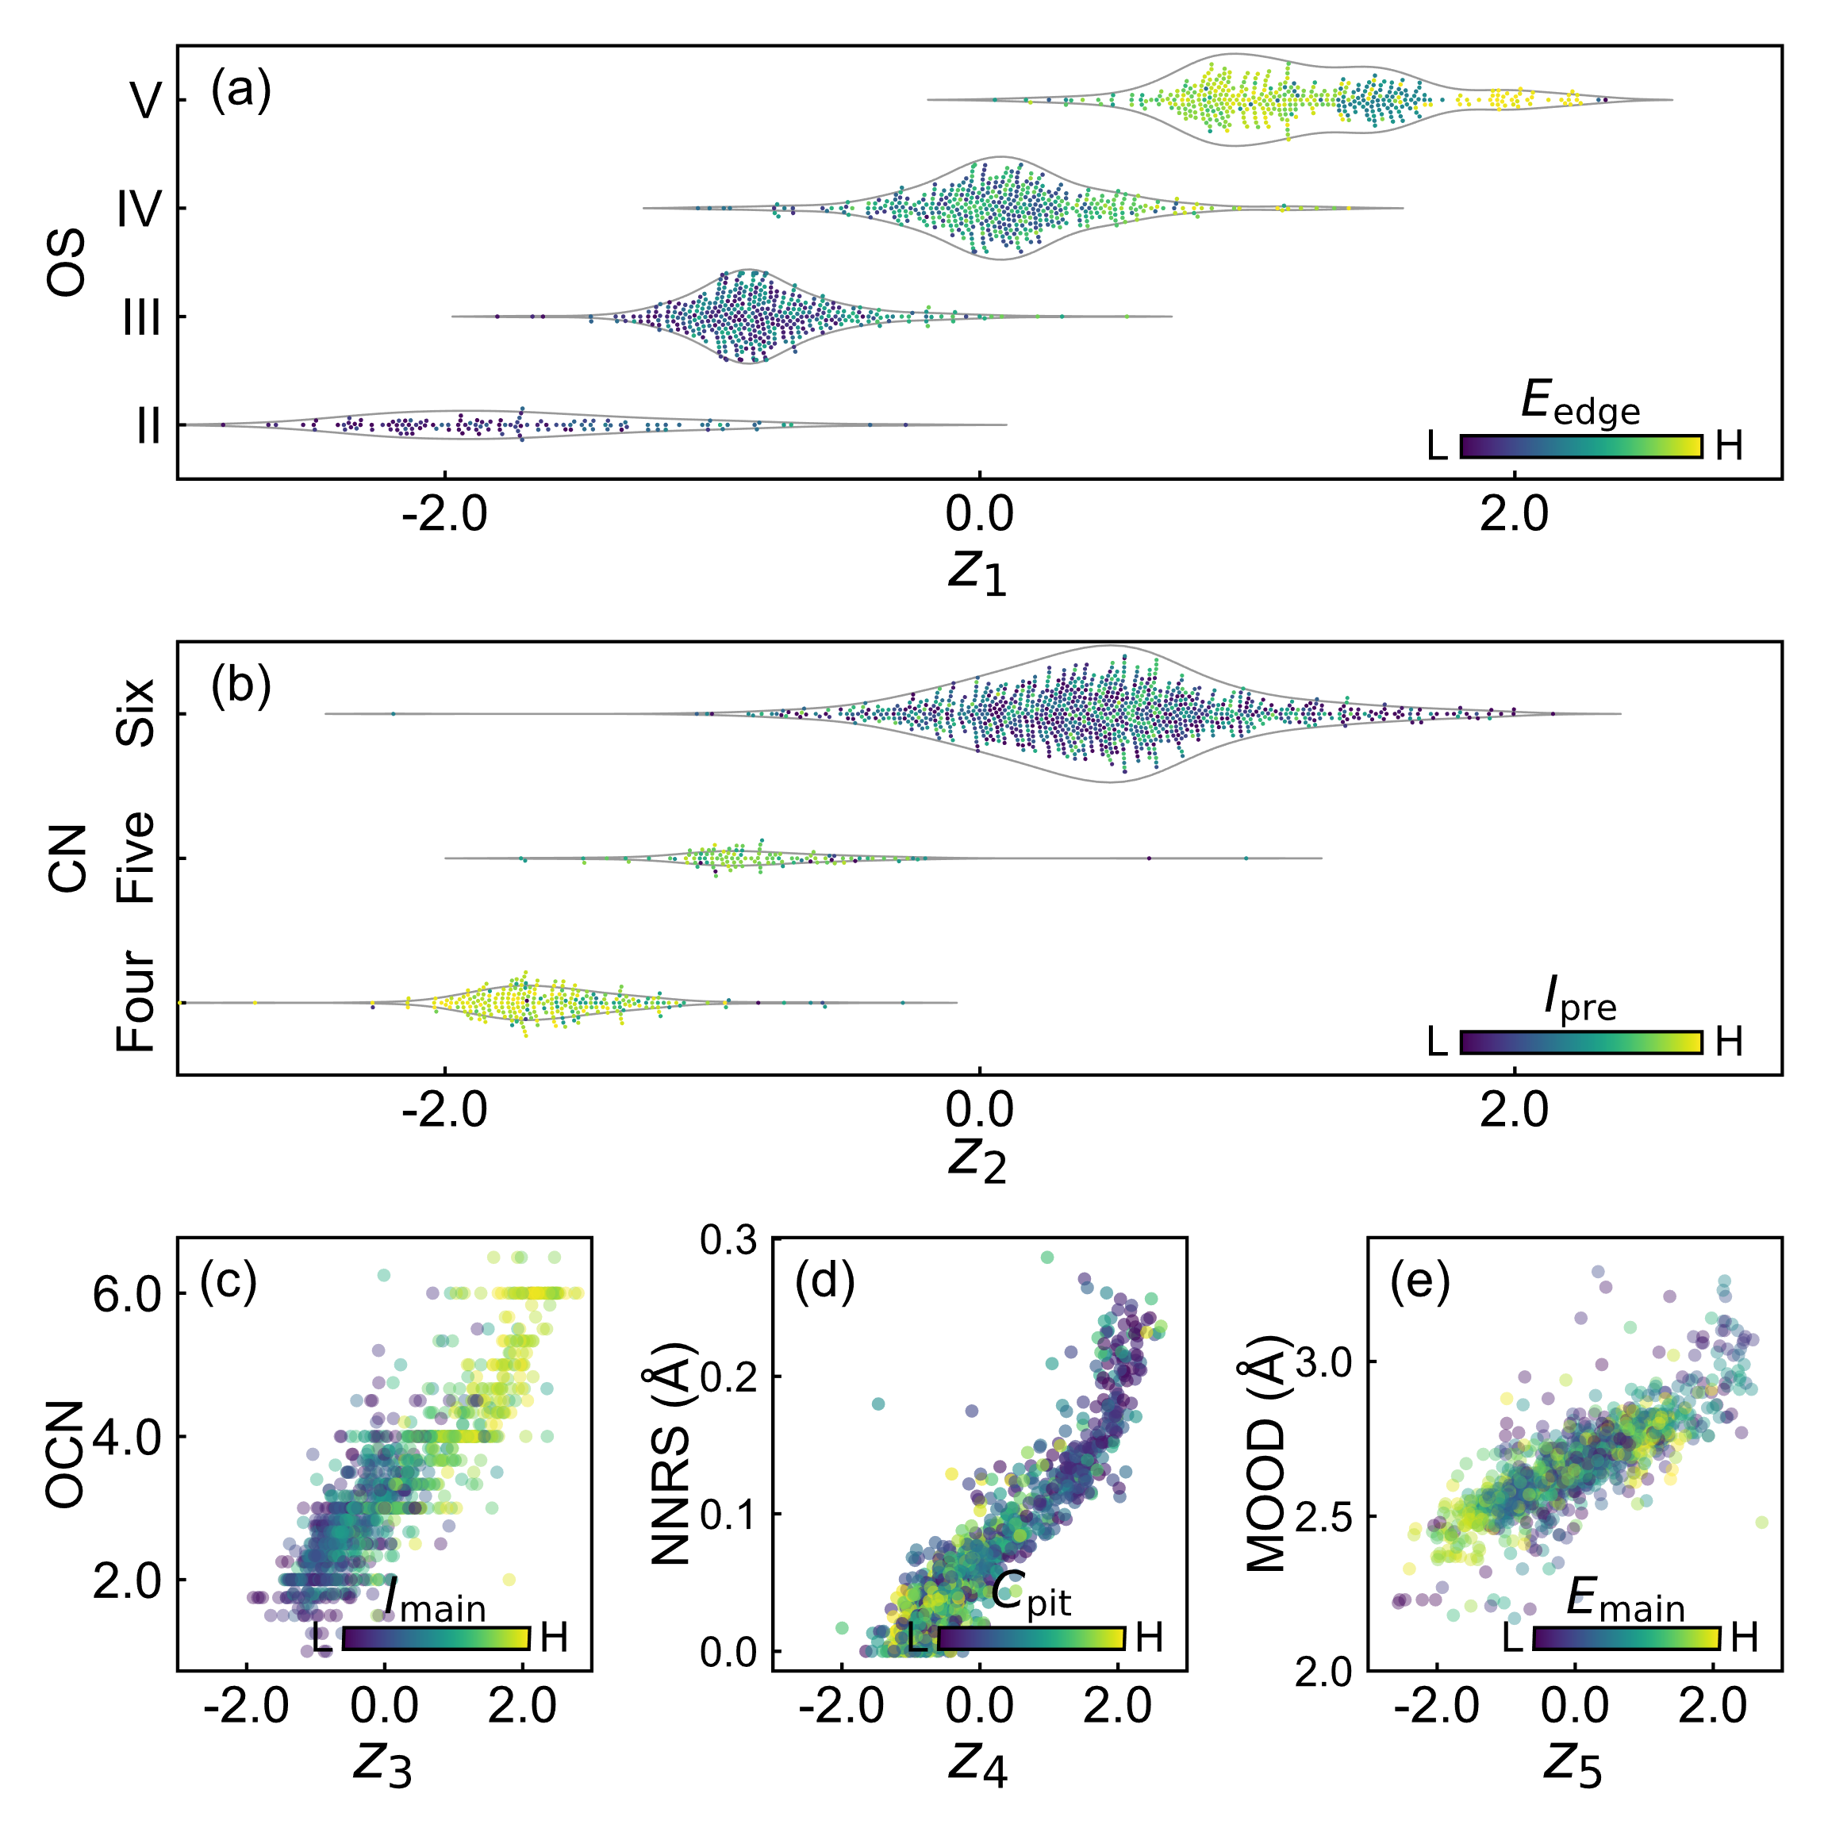
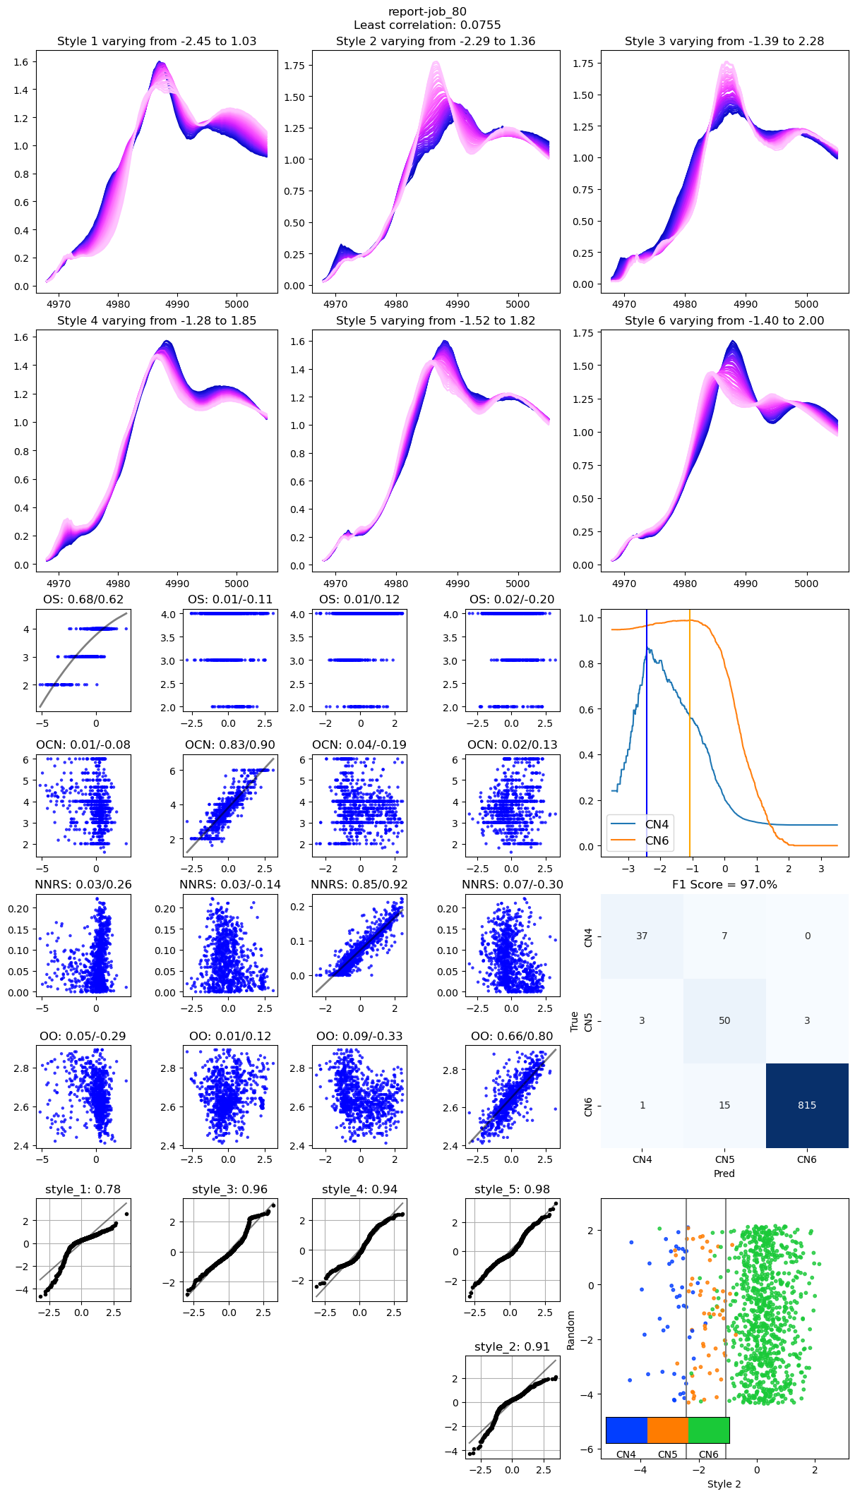
RankAAE: Each Dimension in The Latent Space Has a Physical Meaning
2 + 3 New Structure Descriptors
Controlled axes
1:1 mapping to descriptors
Latent Space
X
One-hot vector no longer used
Unified rank constraint
Retains the generative ability for categorial variables
Z. Liang et al., PRM, 2023, 7, 053802.

Slide 16
Result w/wo Rank Constraint
Latent Space with Rank Constraint
Latent Space without Rank Constraint
z₁
z₁
z₂
z₂
Color: Coordination Number

Slide 17
The Styles are “Orthogonal”
Oxidation state
OCN
CN
Spectral variation pattern of decorrelated styles in line with physical descriptors

Slide 18
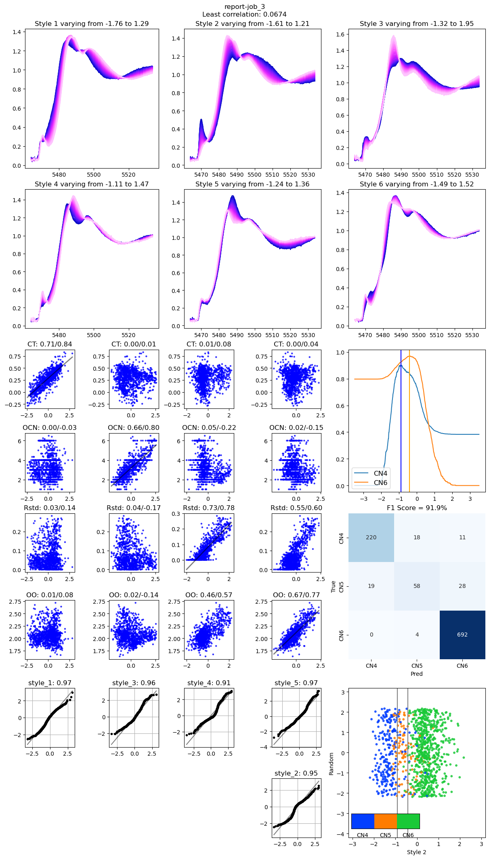
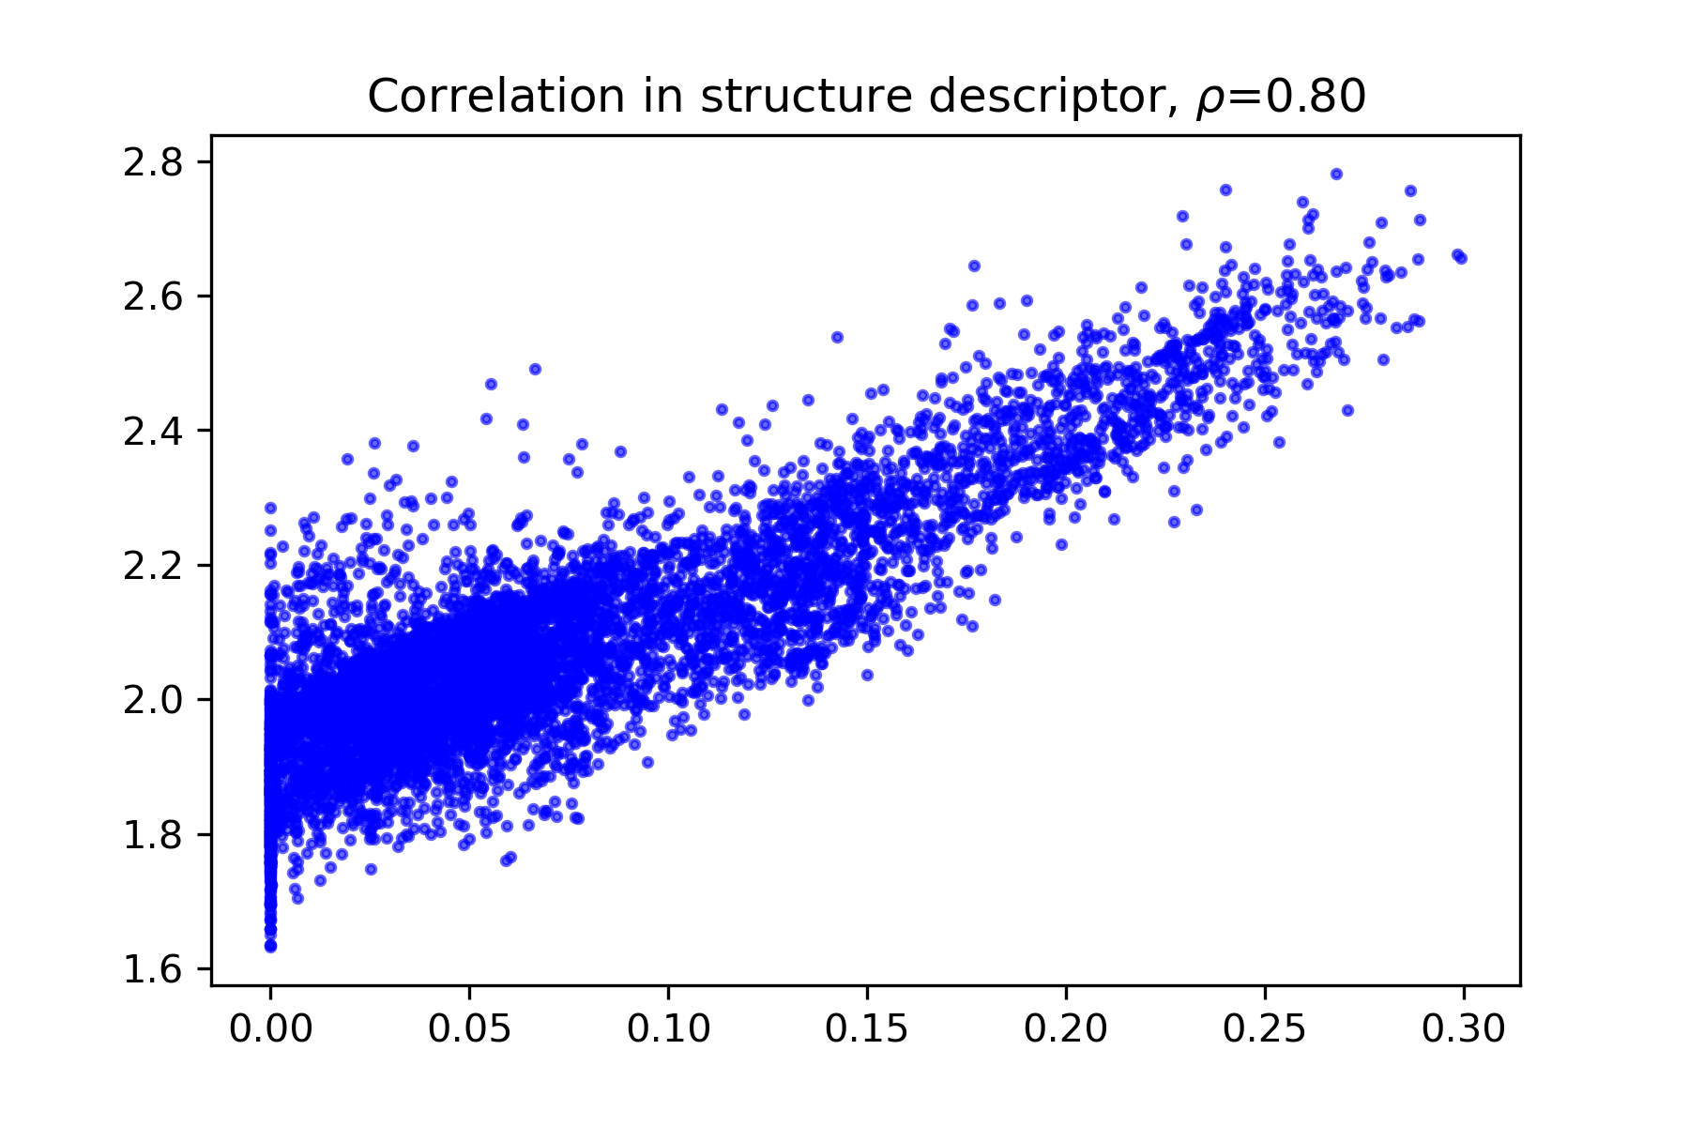
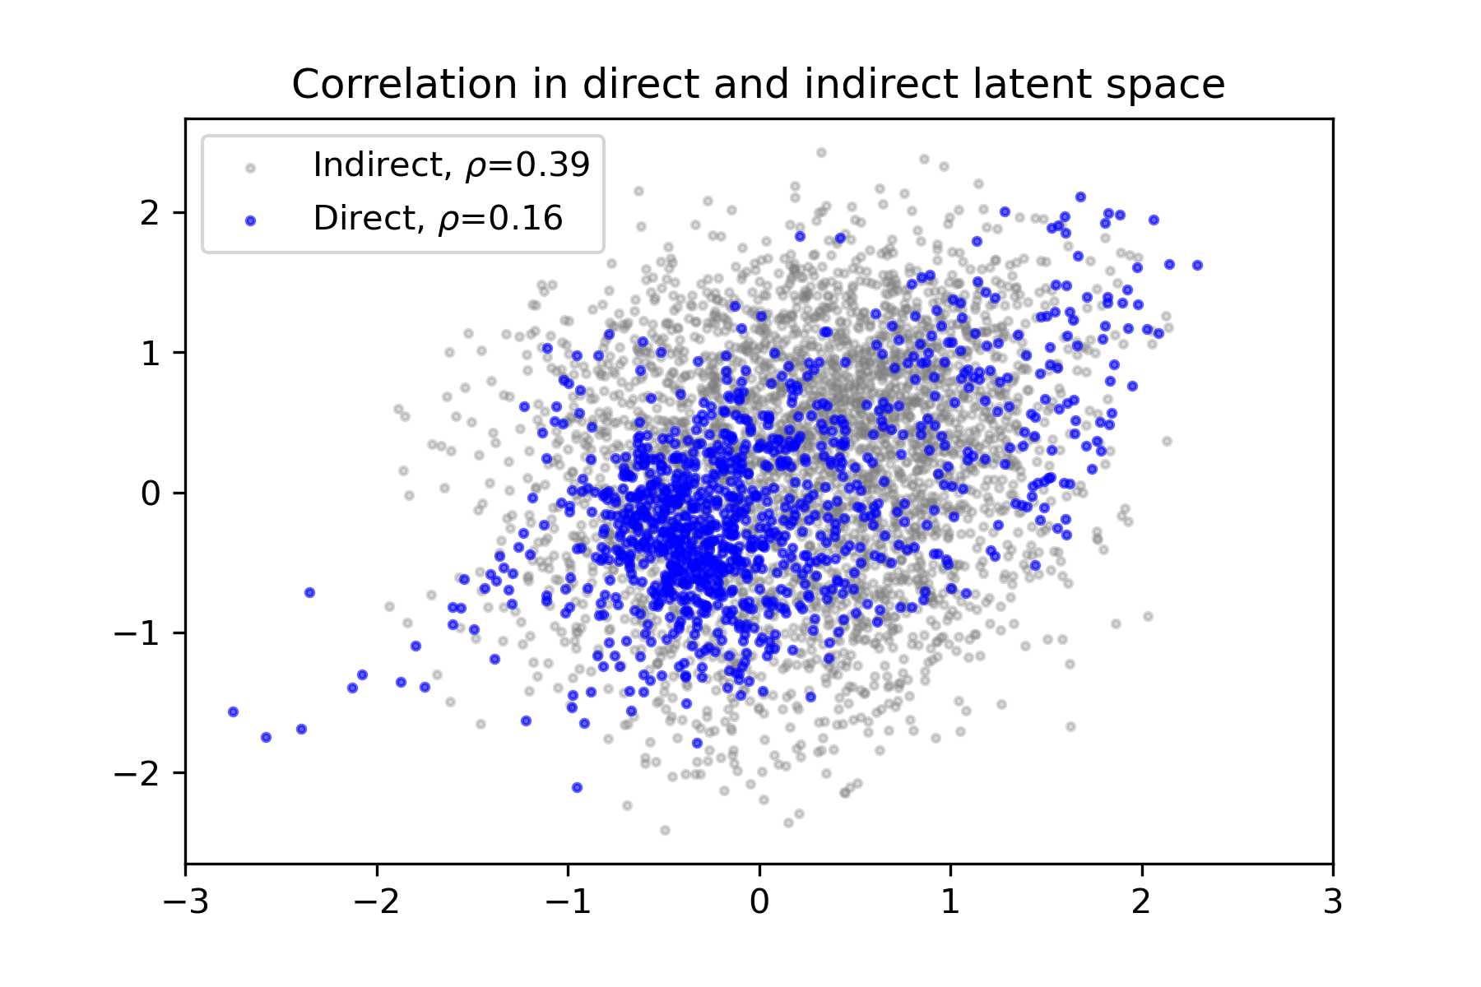
If structure descriptors are correlated, can latent space be disentangled?
Intentionally mix 30% of one structure descriptor (Rstd) to another (OO)
Rstd
OO
z₁
z₂
OO
Random sampling
Training set
Rstd
z₁
Latent space is disentangled
Missing combinations from real data

Slide 19
Generate Spectrum Trend
Changing only one dimension of the latent space.
Z. Liang et al., PRM, 2023, 7, 053802.

Slide 20
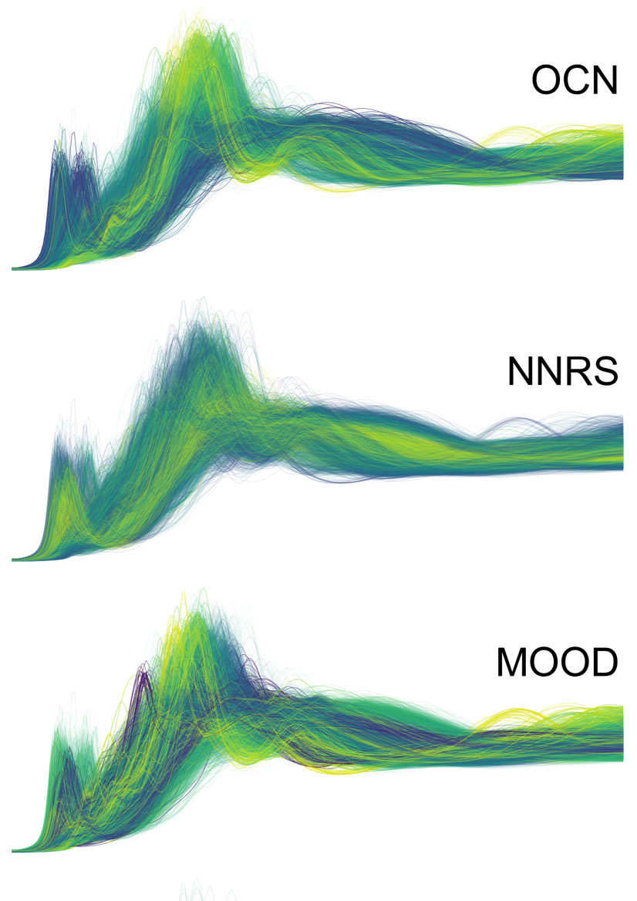
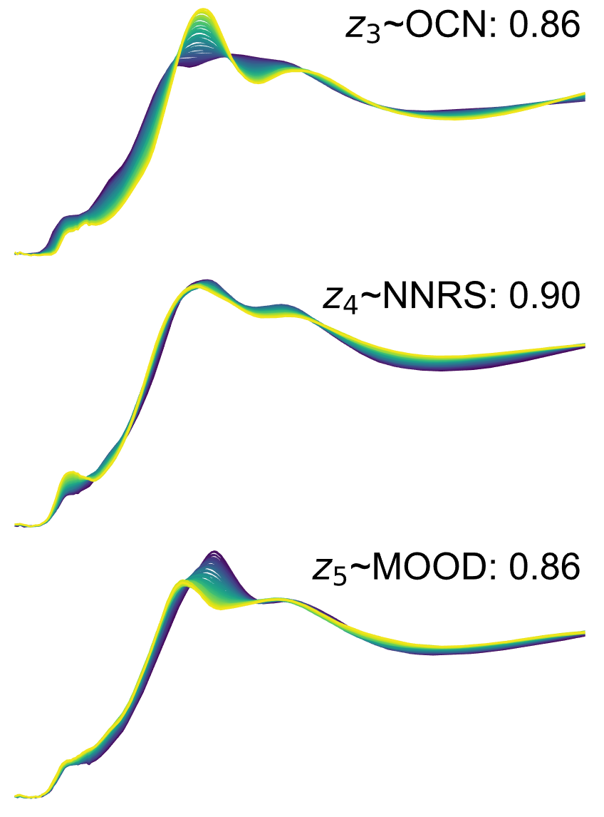
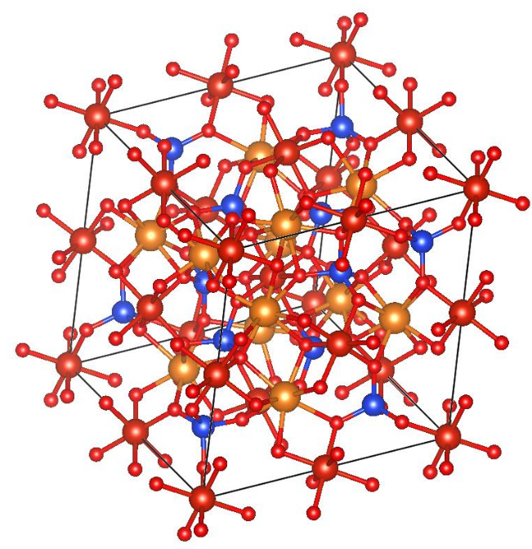
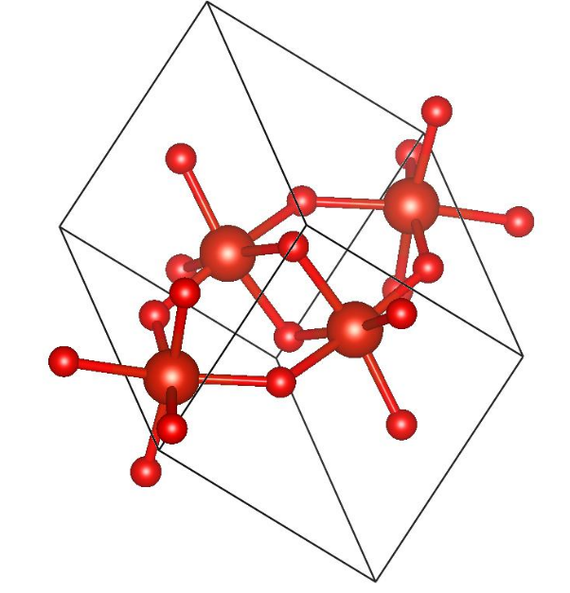
RankAAE Makes Trend Easier to See
Directly Color 5000 Spectra
RankAAE
5000
Material Structures
Z. Liang et al., PRM, 2023, 7, 053802.
Notes:
Make slide number clear to see
Too much
Animation to Zoom in each part, only one or two of them to walk audience though
Font too small, use to many labels that were not defined
The legend on blue spectrum not legible
Spend too much time on a single slide make audience lost.
Point out the part is taking about.
Use Fe CN as a successful example
Explain the physical meaning of latent space
Show material structure
Focused on one descriptor
Split to two/three slides

Slide 21
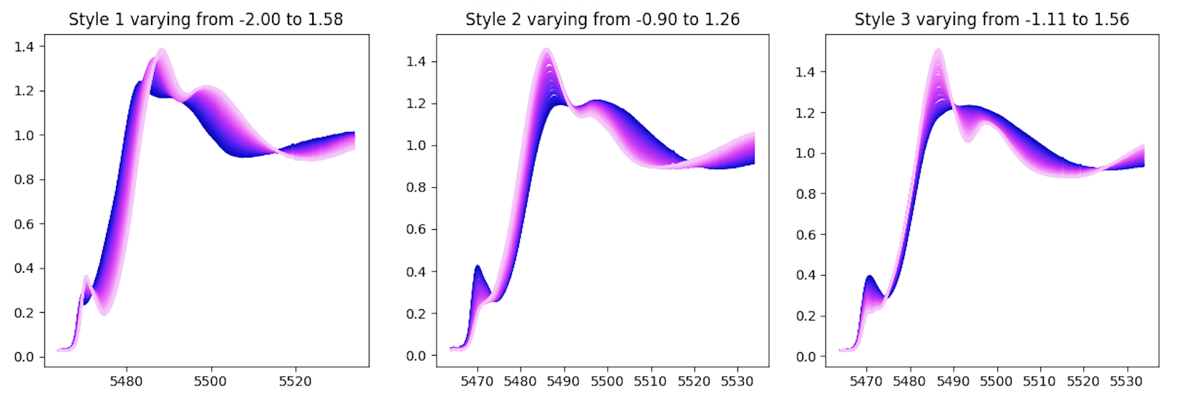
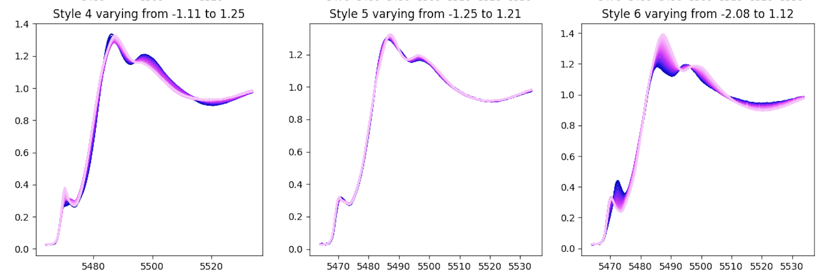
If we use noise as a structure descriptor
Noise
AAE seems not introduce significant artefacts.
Z. Liang et al., PRM, 2023, 7, 053802.

Slide 22
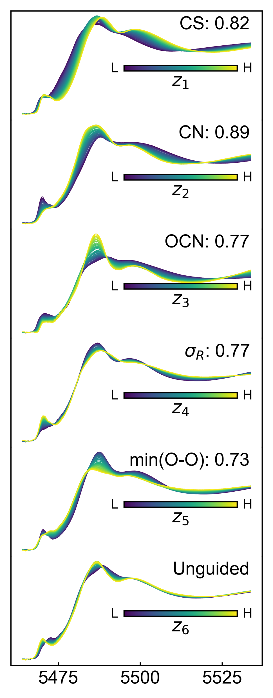
The trend is physical meaningful
Cation
Anion
SS1
SS2
NNRS
MS
OCN
MOOD
Scattering path length and number of atoms determines the oscillation structure
Still requires expert knowledge
RankAAE makes this progress more effective.
Z. Liang et al., PRM, 2023, 7, 053802.

Slide 23
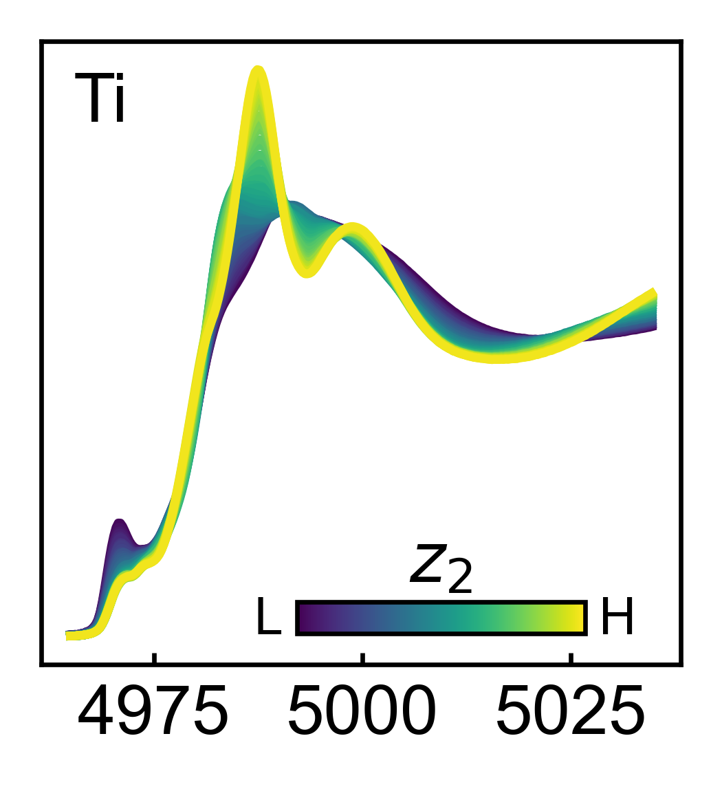







Spectral variation trend about CN for 8 first-row transition metals
K-edge XANES
FEFF Simulation
Coordination number
Pre-peak variation is known
Variation above the edge is new
Z. Liang et al., PRM, 2023, 7, 053802.

Slide 24








Spectral variation trend about OCN (oxygen coordination number) for 8 first-row transition metals
K-edge spectrum is from metal, CN here is for oxygen
Z. Liang et al., PRM, 2023, 7, 053802.

Slide 25
Conclusion
RankAAE makes the spectral variation trend easy to see, which otherwise would have been barely identifiable.
Enables a controlled projection approach to transform complex data onto expected axes.

Slide 26
Acknowledgement
Team
Postdoc:
Zhu Liang
Collaborator:
Matthew Carbone, Deyu Lu,
Wei Chen, Eli Stavitski,
Mark Hybertsen
(Brookhaven National Lab)
DOE User Facility Program
Nanoscale Science Research Centers
DOE Office of Science
AI/ML Program
Center for Functional Nanomaterials
An Office of Science User Facility
Xiaohui Qu <xiaqu@bnl.gov>
Notes:
Add contract number

