Slide 1
ePIC Synchronization and Clock distribution
William Gu*
EIC beam (crossing) structure
Overall hardware design
Detailed signal implementations
Clock distribution test results
Current status
To do
* Credits give to all the community

Slide 2
EIC beam (crossing) structure
 | Electron Storage Ring (ESR) | Hadron Storage Ring (HSR) (N_{b}=290) | HSR (N_{b}=1160)
Circumference C [m] | 3833.940 | match T_{rev} | match T_{rev}
Revolution period T_{rev}=C/c [µs] | 12.7886
RF harmonic number h [-] | match HSR | 2520 | 7560
RF bucket spacing T_{b}=T_{rev}/h [ns] NOT bunch spacing!!! | match HSR | 5.075 | 1.692
Number of bunches N_{b} | match HSR | 290 | 1160
Bunch spacing T_{bun} [ns] | match HSR | 40.599 | 10.150
Gap length [ns] | match HSR | 1015 | 1015
Beam crossing: 98.5MHz
Orbit period: 12.7886 µs
 | ESR | HSR
RMS bunch length σ_{z} [mm/ps] | 7-9/23-30 | 75-60/250-200
RMS momentum spread [10⁻⁴] | 5.8-10.9 | 10.3-6.8
RMS horiz beam size σ_{x} [um] | 100-250
σ_{z}/σ_{x} ratio [-] | 28-90 | 240-750
Electron Beam Energy: 5 – 18 GeV
Proton Beam Energy: 41, 100, 275 GeV
Luminosity: 10³⁴ cm⁻²s⁻¹

Slide 3
EIC beam (crossing) structure
Streaming Data
Time Slice M-1
Time Slice M
Time Slice M+1
Time Slice M+2
Time Slice M+3
Time Slice M+4
Time Slice M+5
Beam crossing ( * electron ion collision )
* * * * * * * *
* * * * * * * *
* * * * * * * *
1 1 1 1
1 1 1 1 1 1 1 1 1 1 1 1
1 1 1 1
2 2 2 2
1 1 1 1 1 1 1 1 1 1 1 1
2 2 2 2
5 5 5 6
5 5 5 5 5 5 5 6 6 6 6 6
5 5 5 6
7 8 9 0
1 2 3 4 5 6 7 8
3 4 5 6 7 8 9 0 1 2 3 4
7 8 9 0
1 2 3 4
1160 (all or 1/4 with beam)
100 (no-beam /gap)
Orbit period: 1260*10.150 ns = 12.7886 µs
SRO data header:
Packet number,
Data source ID,
Starting orbit count
SRO data trailer:
Ending orbit count
Sync/Error/buffer status
Total word count
The natural streaming readout time slice: N*12.7886 µs
*If this is used, there will be less data overlapping in between the time slice (the overlap can still occur if the detector response time is longer than 1 µs). There will be easier synchronization check.

Slide 4
ePIC
2. ePIC Design - general structure
System Clock: 98.5 MHz (100MHz nominal)
GTU: Global Timing Unit
  control encoding, status decoding.
  The interface for machine clock source,
  Data acquisition control and monitor etc.
DAM: Data Aggregation Module:
  The clock/control fanout, and status/busy accumulation.
  local control over the RDO boards connected, though the main function of the DAM is for Data Acquisition.
RDO: optical interface of detector ReaDOut
  control decoding, status encoding.
  The clock/control interface to the front end electronics.
  Data collection from Frontend boards, and data transmission to the DAM
FEB:
  Detector dependent Front End / ASIC carrier boards.
Online computer
Status
GTU
GTU (O)1
Control
EIC
Common
Platform
Clock
Data Acquisition
DAM
(O)100
DAM
DAM
RDO
(O)1000
RDO
RDO
RDO
RDO
FEB
FEB
FEB
4

Slide 5
2. Overall hardware design
Online computer
Run control
2.1 GTU
EIC
COMMON PLATFORM
EIC/ePIC clock & beam orbit info
GT
Clock buffers
1 : ~200
FPGA
RDO (TOF)
SFP
GTU
RunControl
CLOCK
STATUS
RDO (TOF)
DAM
DAM
DAM
Could be a separate clock fanout PCB, if needed
RDO
RDO
RDO
RDO
May be needed, RDO(TOF) , DAM(dRICH)

Slide 6
2. Overall hardware design
2.2 DAM (FLX155, ATLAS FELIX upgrade)
CLOCK
98.5MHz
Clock
buffer
LTI
FireFly
Tx/Rx
GTU
RunControl
Fabric
Clock
RefClks
STATUS
FireFly
TX
RDO
TXs
RunControl
RDO/FEE config
GTYs
(24/48)
FireFly
RX
Status merging
DataProcessing
RXs
RDO
RJ45
GigaBitEth
FPGA
Xilinx Versal
PCIexpress GEN4x16
2* GEN5x8
100 GBE
Host Computer/DAQ
Network Switch/DAQ

Slide 7
2. Overall hardware design
2.3 RDO
Zero Delay FB
optional emergency circuit I²C
IN3
OUT
(N/M)* 98.5 MHz
O1
pseudoClock
98.5 MHz
O1
O2
optional clock buffer
1:2 fanout
Si53x5
Fiber
RX
197 or
394 MHz
IN
FEB
DAM
Optic transceiver
O0
O2
TX
Phase difference detection
RX
RxRECclk
FEB
GTY
control
TX
ClkRef
GENIO
FPGA
RDO

Slide 8
3. Detailed signal implementations
3.1 Clock Distribution
EIC
common platform
RunControl computer
3.2 RunControl and DAQ
Ethernet
PCB and fanouts:
Additive Jitter <1ps
Phase: fixed
System clock
(98.5MHz)
Two-level fanouts
Beam orbit
Beam Orbit synchronized RunControl
RunControl: Run_Start/Stop, Run_type, config, Reset, Synchronization, SRO time_start/stop, Trottling…
GTU
Status: Buffer busy, out of sync …
Fiber cable:
Additive Jitter <1ps
Phase: fixed
Host PC
PCB and fanouts:
Additive Jitter <1ps
Phase: fixed
Clock fanout
(optional jitter cleaner)
DAM
Control config, status
DAQ
RunControl: forward or ‘hijack’ the GTU control;
DAM, RDO, FEB/ASIC configuration, readout backpressure
RefClk
TX/RX
Status: Buffer, sync, etc.
GTY
Optic fiber cable:
Additive Jitter <1ps
Phase: fixed
GTY REC Clock:
Additive Jitter <3ps
Phase: stable, but NOT fixed;
Automatic Reset to fix.
Clock recovery
(optional iitter cleaner)
Clock fanouts
RefClk
TX/RX
Control
Config
DAQ
Config synchronized with beam orbit, FEB/ASIC readout and control
RecClk
GTY
RDO
Status: Buffer, sync, etc.
FEB/ASIC
Beam Crossing phase aligned
Beam orbit phase aligned

Slide 9
3. Detailed signal implementations
3.3: Synchronization and Buffer control
DAM/RDO to implement time measurement, so that RDOs can compensate the fiber length delay to within one clock period;
GTU broadcasts the orbit counter periodically for sync check
GTU/DAM/RDO to keep a 11-bit beam crossing counter (terminates at 1260), synchronization check with streaming readout time slice (start/stop) commands; online/offline check with beam orbit structure (collision or no collision); RDO to keep a beam orbit counter: 5-bit (min. ~409ms), 21-bit (preferred, ~26seconds), or 32-bit (over 15 hours);
GTU and DAM should keep a larger beam orbit counter (at least 32-bit);
RDO to keep a 16-bit (min), or 32-bit (preferred) time slice counter. This counter should not overflow for a run (start/stop).
RDO should assert buffer high_marker no later than ( ~1 µs) before it is full and starts to lose data.
RDO starts a new data packet upon receiving time-slice_start, and end the current packet upon receiving time-slice_end or upon receiving a new time-slice_start (time-slice-restart).
RDO to hold data if the DAM is busy (potential buffer full), and the DAM to hold data if the host computer/Network switch is busy.
The GTU can record dead time by sending TimeSlice_end, and holding TimeSlice_start in responding to RDO busy.
RDO should generate one packet on every readout time slice. The RDO can discard detector data to avoid buffer overflow, or out of synchronization, but this occurrence must be recorded in the data package/trailer.
GTU
Data flow
DAQ
Data Buffer ‘FULL’ backpressure
DAM
Status accumulation:
Data Buffer conditions, Out of Sync, Reset_request, etc.
Run_control:
SRO_time_start/stop, RESETs, etc.
RDO

Slide 10
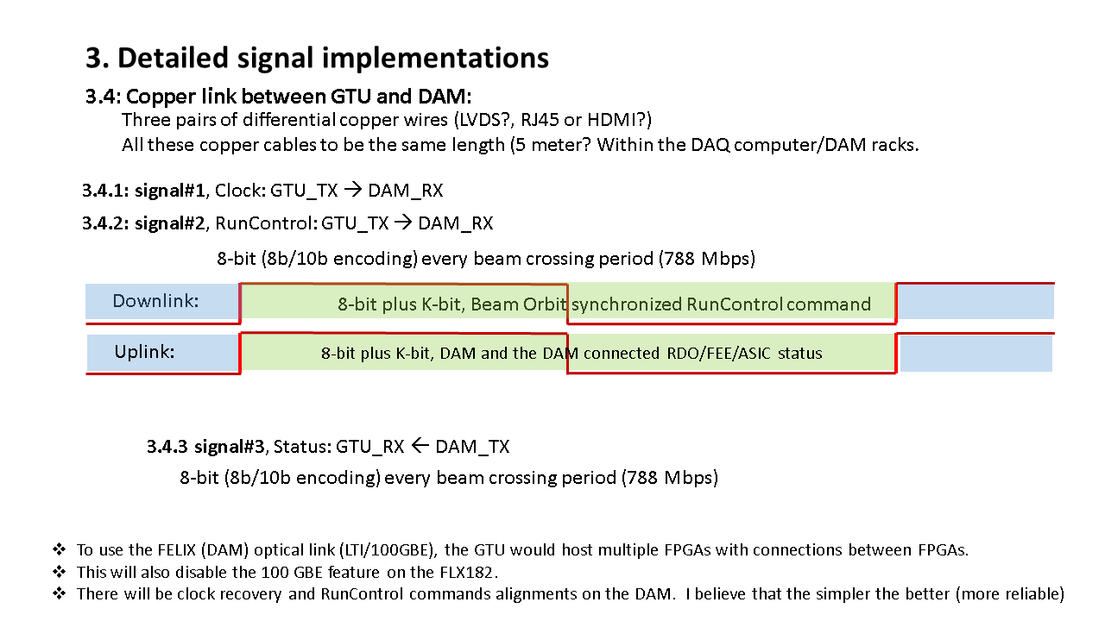
3. Detailed signal implementations
3.4: Fiber link between GTU and DAM:
Clock @ 98.5 MHz
Transmitters
Receivers
Downlink
GTU_CONTROL, 8-bits (+ 1 k_bit) @ 98.5 MHz
GTU
DAM
Uplink
DAM/RDO Status, 8-bits (+ 1 k_bit) @ 98.5 MHz
Receivers
Clock feedback @ 98.5 MHz, 197 MHz, or maybe 394 MHz
Transmitters
Using FireFly TX/RX modules will save power than regular QSFP optic transceivers, but the fiber connection/mapping can be challenging (easy to make mistake).

Slide 11
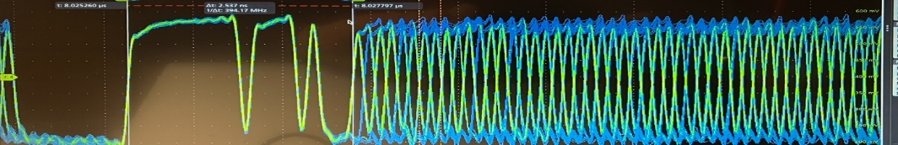
3. Detailed signal implementations
3.5: Fiber link between DAM and RDO:
One pair (two) of optic fibers (850nm Multimode), less than 150 meters
Fiber length/signal delay to be measured, and delay compensated on RDO
MGT_TX
DOWNLINK @ 7.88 Gb/s (80 bits @ 98.5 MHz)
MGT_RX
1:2
Pseudo_Clock: 0x0000_0003_FFFF_FFFF_FC00 (LSB first)
CONTROL: DAM3_DAM2_DAM1_DAM0_GTU_ENABLE_FFC00
* DAMn, GTU, ENABLE are 8b10b encoded
Rx_REC_Clk
System Clock Generation
(and Phase
Detection)
DAM
CDR_reset
RDO
UPLINK @7.88 Gb/s (80bits @98.5 MHz)
MGT_RX
MGT_TX
IDLE: 0x0000_0003_FFFF_FFFF_FC00 (LSB first)
STATUS: STAT3_STAT2_STAT1_STAT0_STAT_ENABLE_FFC00
DATA: 64-bit Frontend data with 8b10b encoding
FEB/ASICs
RunControl (from GTU) is guaranteed every beamcrossing cycle (98.5MHz). It can be hijacked by the DAM for sub-system test
The RDO/FEB configuration depends on the specific DAM (which comes from the host computer).

Slide 12
3. Detailed signal implementations
3.5.1: DAM_RX ← RDO_TX
Uplink:
98.5 MHz clock (or maybe other frequencies) , Serial speed at 7.88 gbps.
FEB data
64-bit
Status
32-bit + K-code
Data:
time-slice packaged data
Can have K-code package header/trailers
Status:
I2C/SPI returned data,
BUSY
Fifo/buffer status
……
Higher priority
MUX
The Data and Status are recovered by the FPGA’MGT
By DAM board
8B/10B encoding
98.5 MHz clock
80-bit per clock cycle for 7.88 Gbps (Data, Status, or idle/no_useful_data)
It is possible to use 64B/66B or other encoding for high efficient data link…, or higher clock frequencies
If the uplink works at 98.5MHz, the DAM can potentially use the uplink and monitor the clock shift (most likely) caused by the fiber temperature changes.

Slide 13
3. Detailed signal implementations
3.5.2: SRO time window
Streaming ReadOut time windows:
START
RE-START
RE-START
RE-START
STOP
START
RE-START
RE-START
RE-START
Whole detector dead time
RE-START: STOP and START at the same Beam Crossing
The time intervals do not need to be uniform, as long as all the RDOs do the same. For example, shorter window at the beginning, and longer window at the end of beam life.
The START, STOP, and RE-START are not necessarily on the first BX in the orbit, but it helps in signal overlap if utilizing the 1 us no-BX.
I hope that “Whole detector dead time” will never happen, but the DAQ may be more efficient if the data rate is too high that the DAM/RDO loses so much data that deems the data is un-usable

Slide 14
4. Clock distribution test results
Setup

Slide 15
4. Clock distribution test results
EIC/Common Platform/GTU clock: Si5344H as reference;
Clk_98.6
Beam Crossing/Reference Clock
Si5344H
FLX182
CH#3
CH#1
CH#2
1:2
DAM MGT_TX output: FLX182/KCU105 pseudoClock
Encoded Clock
Fiber_7.89
ClkPD_98.6
Phase
Detect
MGT
RDO/FEB Recovered Clock: XEM8320/KCU105 plus Si5394A
ClkSys_98.6
Si5394A
KCU105
Recovered Clock
RxRecClk_197.3
Phase/Jitter easuring method using a scope (Tektronix MSO64):
Phase difference == WIDTH of the difference of the two signals
Jitter == uncertainty of the WIDTH of the difference of the two signals assuming the reference clock is perfect.
CH#3
Oscilloscope Probes

Slide 16
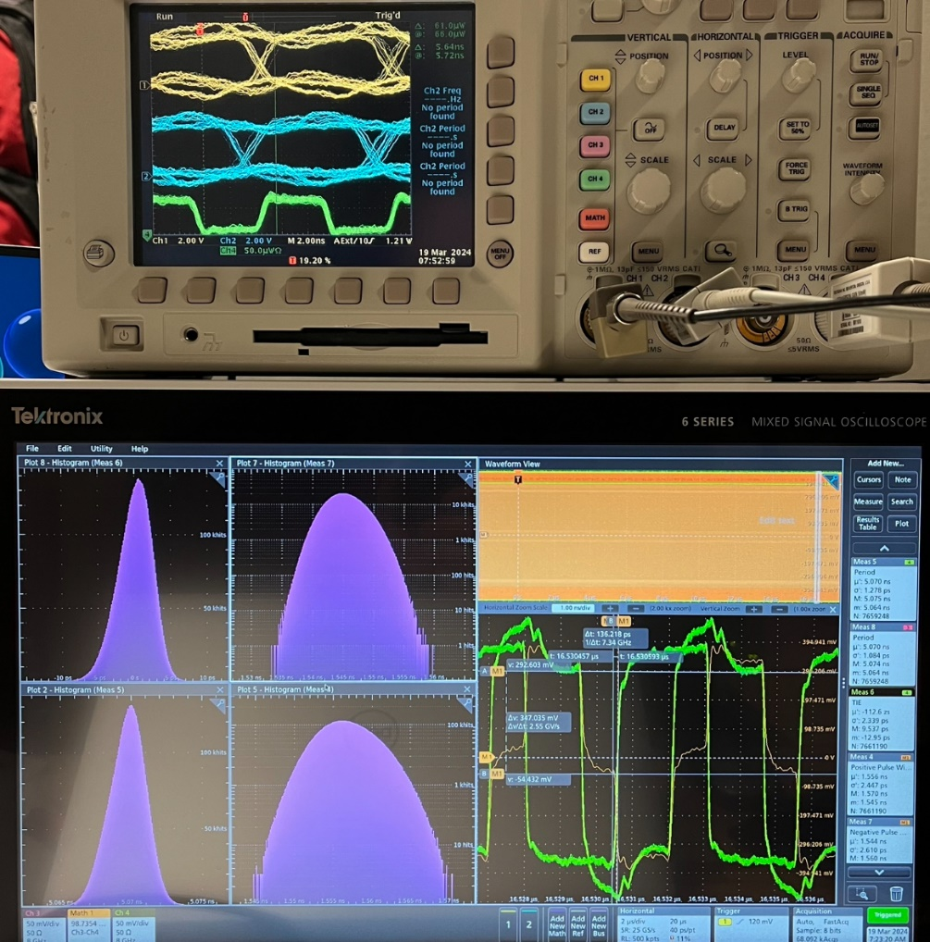
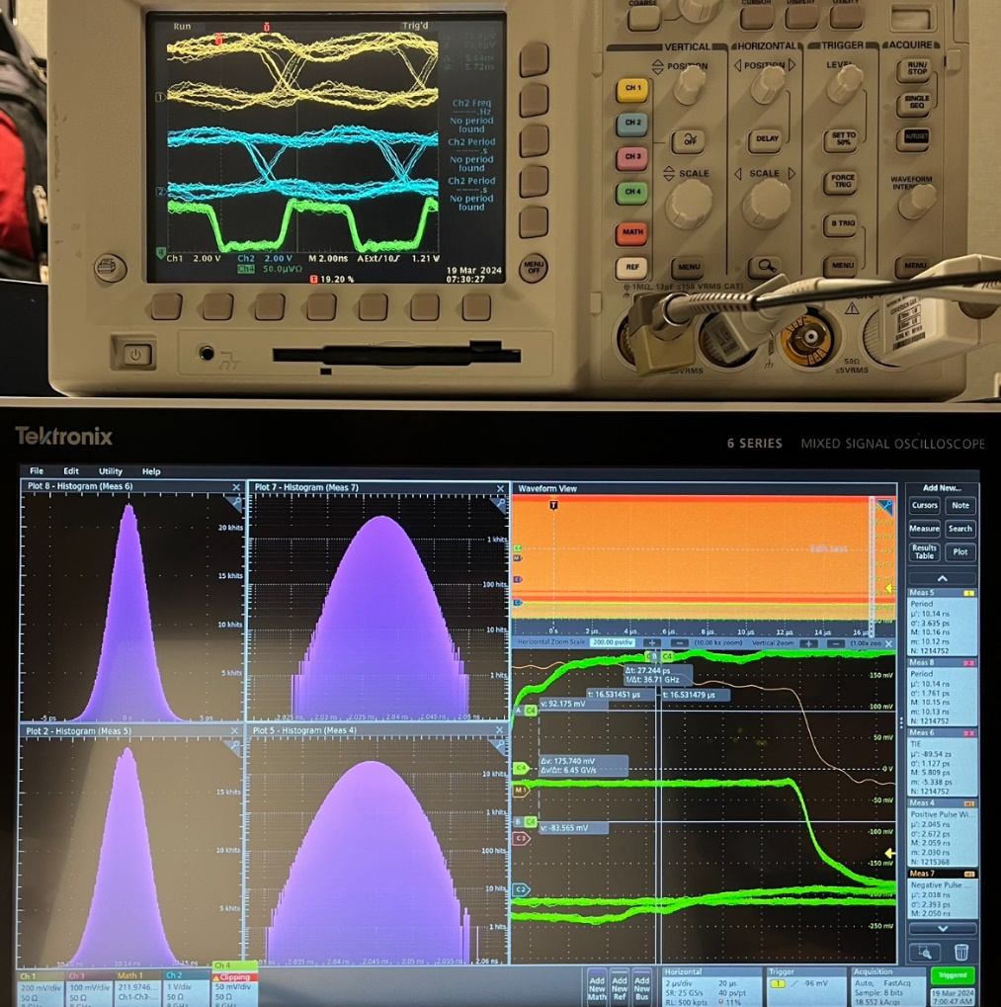
4. Clock distribution test results
Jitter: < 3 ps,
Phase is stable (16 µs range with > hour accumulation)
4.1: RDO recovered Clock
RxRECclk, without jitter cleaner
Si5394A jitter cleaned, and frequency regenerated
RxRECclk vs ReferenceClock at 197 MHz:
Positive Width: 1556 ± 2.5 ps
Negative Width: 1545 ± 2.6 ps
RxRECclk Period: 5070 ± 1.3 ps
RxRECclk jitter cleaned vs ReferenceClock at 98.6 MHz:
Positive Width: 2044 ± 2.7 ps
Negative Width: 2038 ± 2.4 ps
Period: 10.14ns ± 3 ps
William GU @Jlab

Slide 17
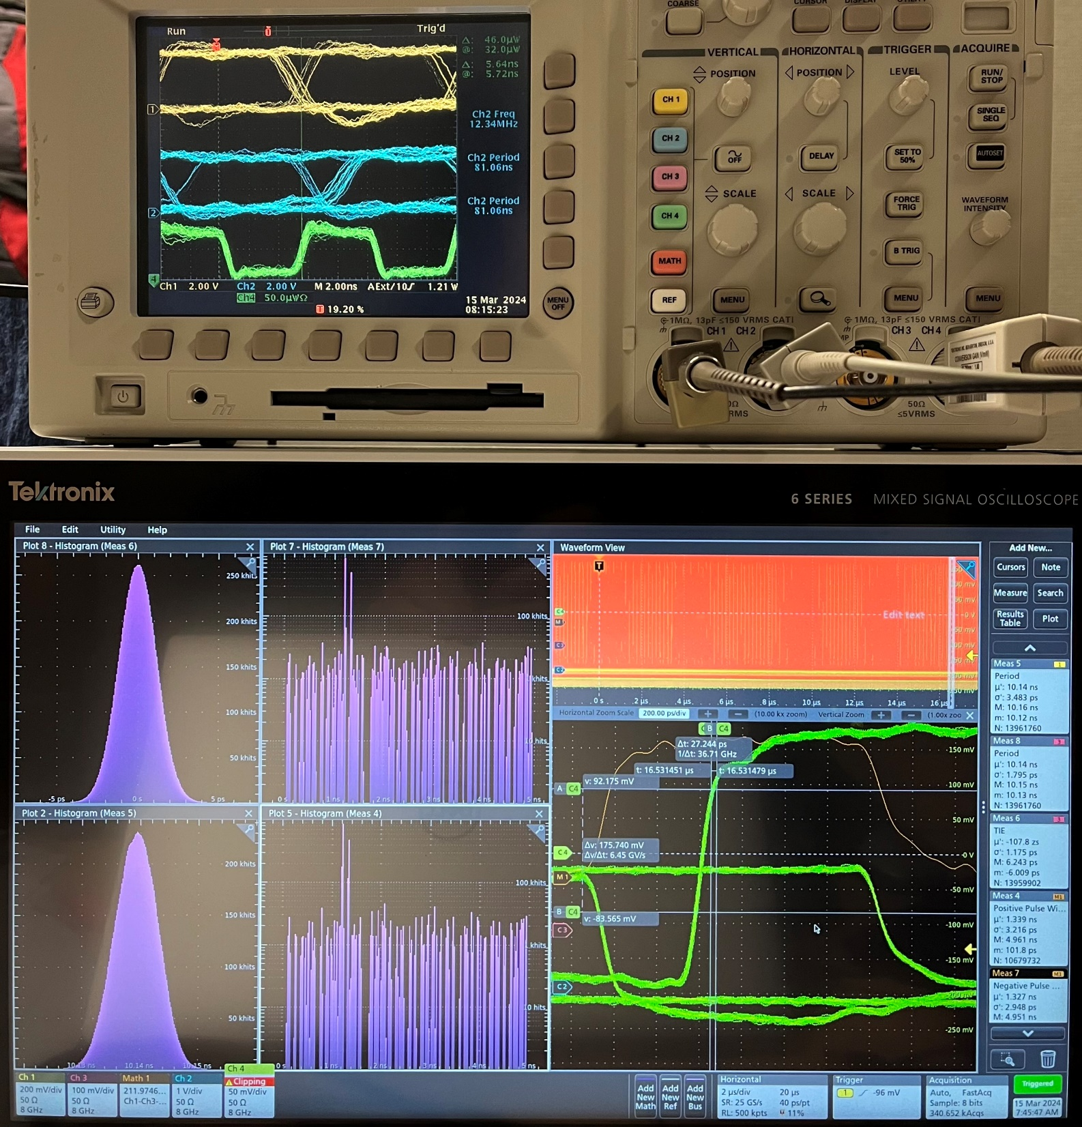
4. Clock distribution test results
4.1: RDO recovered Clock: The RESET stability
There is a N*UI (UI = 126.73ps) on RESET;
The automatic re-reset logic initiated by the FPGA’s internal phase difference measurement (precision of ~10ps) logic can set the RDO recovered clock phase to a predetermined value (N).
RxRECclk: Recovered CLOCK directly from MGT
Jitter: < 3 ps,
Phase is determined after resets: ~ps

Slide 18
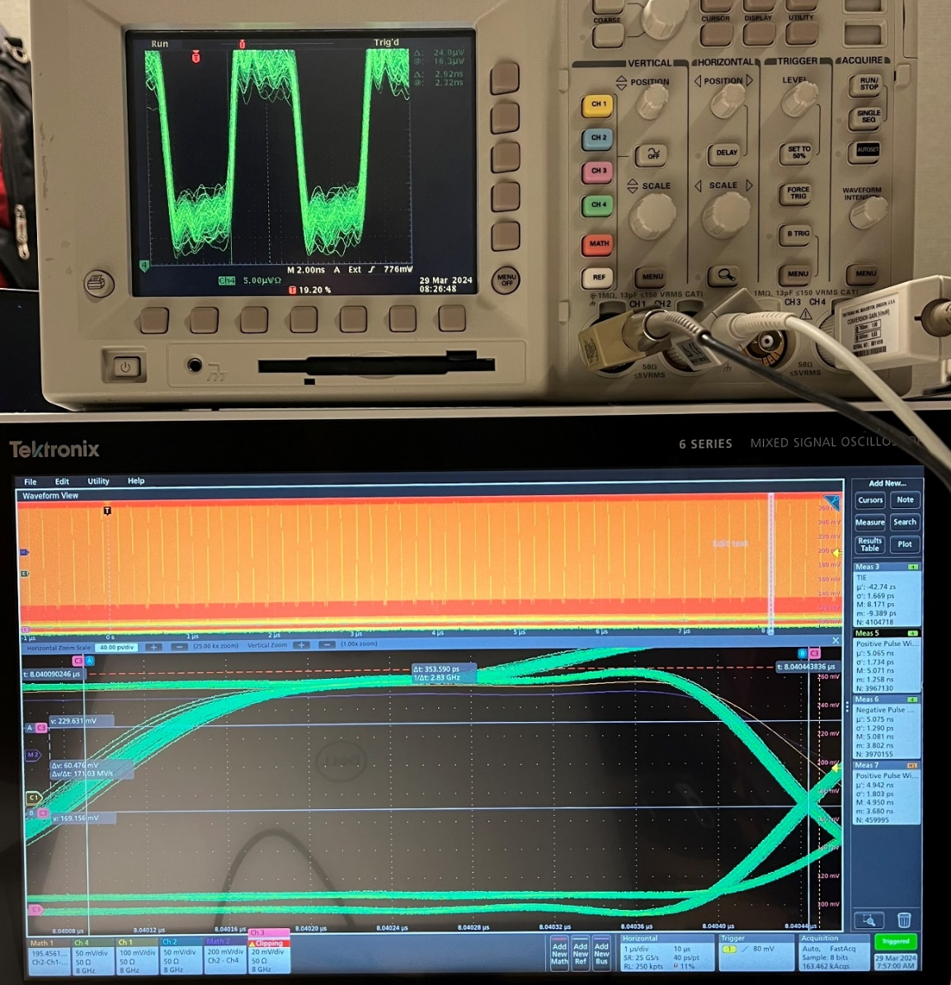
4. Clock distribution test results
4.2: DAM MGT_TX output vs Reference clock.
The kcu105 is used as DAM, because of its SMA connectors
MGT Tx signal is very nice, and pretty stable (drift < 2ps in hours).
The positive width of Tx_serial-ReferenceClolk: 4.942ns ± 1.8ps. This means very low jitter and determined TX signal (relative to the Refernce Clock).
The PCS_ClockOutput has a larger jitter (wider spread than the TX_P/TX_N in the scope photo).
ClkOut_PCS
40 ps
TX_P/TX_N
Reference Clock
Ch#1 scope trigger
William GU @Jlab

Slide 19
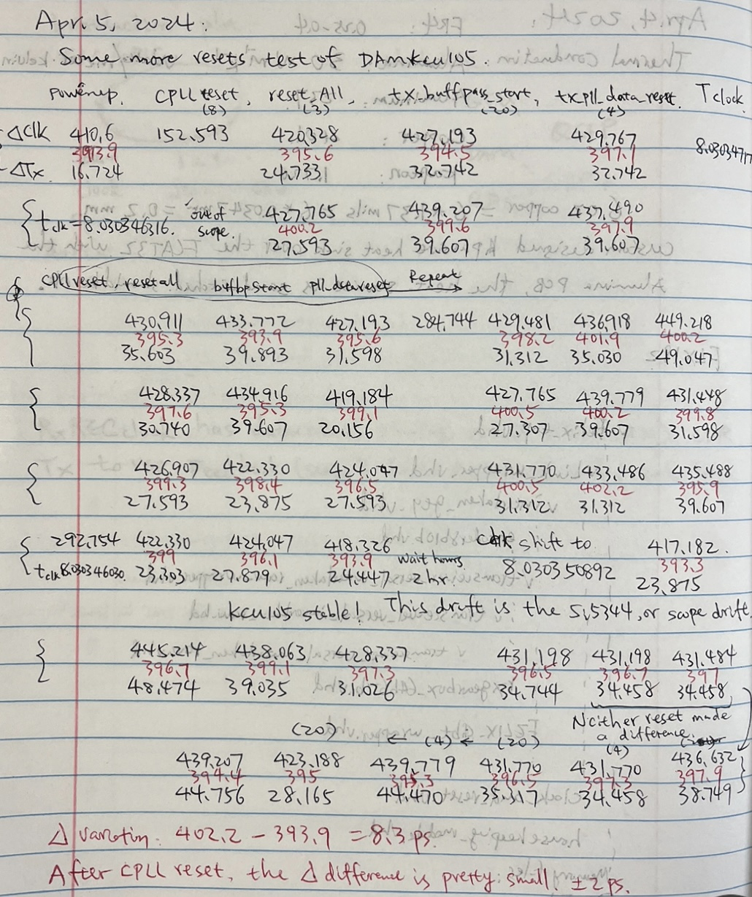
4. Clock distribution test results
4.2: DAM MGT_TX output vs Reference clock: The RESET stability
The kcu105 is used as DAM, because of its SMA connectors
After CPLL reset, the Txoutput phase and the PCS_ClkOut phase could be anywhere;
After PMA alignment, both the Txoutput phase and the PCS_ClkOut phase is roughly aligned to the reference clock (within 20% 0f one UI, ~30ps), and jumping around on PMA re-alignment;
But, the phase difference between Txoutput and PCS_ClkOut is relatively small (P_P: ~8 ps).
More to do: on the FLX182, not the kcu105
1. To understand the phase difference between Txoutput and PCS_ClkOut;
2. Implement phase difference measurement logic to initiate PMA re-alignment, (automatically) until the pre-determined phase reached.

Slide 20
5. Current status
5.0 JLAB 12 GeV program
Jlab’s 12 GeV upgrade program proved that the dedicated clock distribution through fibers is viable;
Jlab’s 12 GeV upgrade program proved that the DAQ (BUSY) feedback is viable.

Slide 21
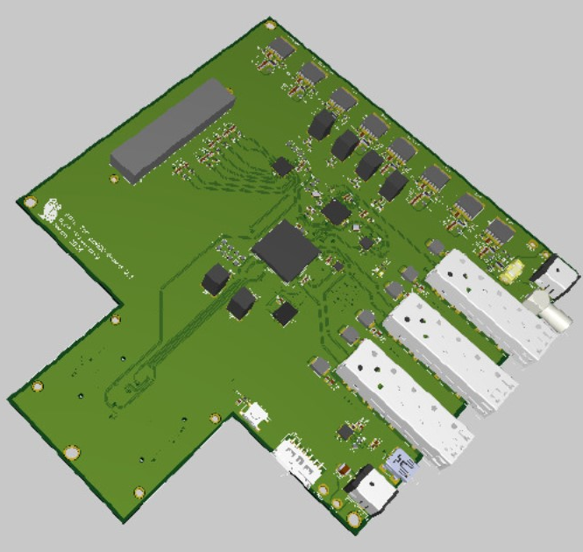
5. Current status
5.1 ppRDO is expected soon
5.2 prototype FLX155 is expected by the end of the year

Slide 22
6. To Do
6.1 FLX182 ←→ ppRDO, then FLX155 ←→ ppRDO/pRDO
6.2 Define the data format
  6.2.1 define the 8-bit (plus K) RunControl commands,
  6.2.2 define the status word,
  6.2.3 define the (DAM→RDO/FEB/ASIC) configure protocols,
  6.2.4 define the data format,
6.3 Subsystem DAQ setup (one DAM plus many RDOs)
6.4 GTU prototyping, and the full system setup

