Slide 1
A possible TPC tracker for DET-II@IP8
Klaus Dehmelt
Open Detector-II Meeting & Discussions
April 09, 2024

Slide 2
time projection chamber
A Time Projection Chamber for DET-II@IP8
  TPC can serve multi purposes
    Tracking
    Pattern recognition
    Momentum determination
    Particle identification

Slide 3
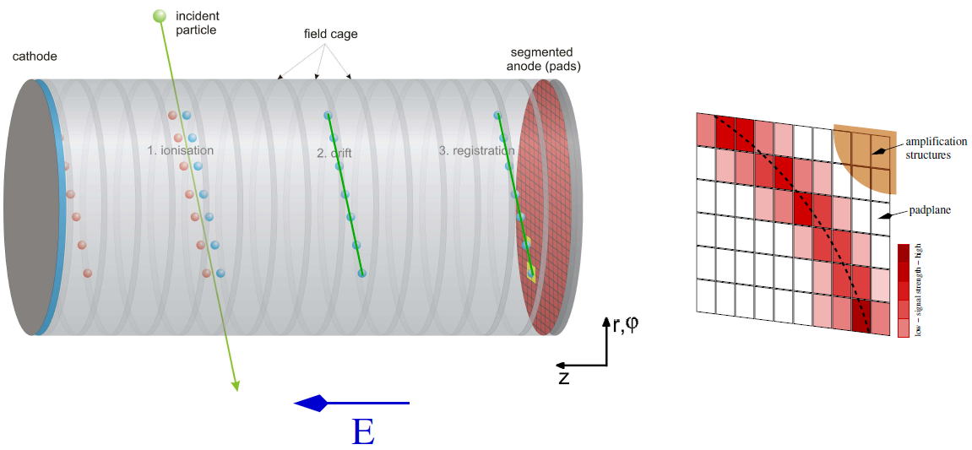
time projection chamber
A Time Projection Chamber for DET-II@IP8
    Gas ionization Y drift Y amplification Y sampling on pads
    Reconstruction of z-coordinates from drift time
    Electric field homogeneity important for undisturbed projection

Slide 4
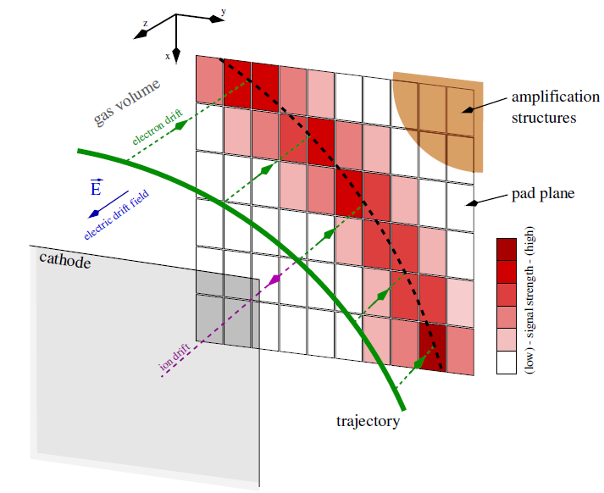
time projection chamber
A Time Projection Chamber for DET-II@IP8

Slide 5
time projection chamber
A TPC for DET-II@IP8
  What are the constraints on length and outer radius?
  What field uniformity is required?
  What are the limitations on angular resolution
    At the vertex?
    At r_{max}?
  What PID capabilities are possible?
  What are the material budgets?
  Integration issues with other detectors?

Slide 6
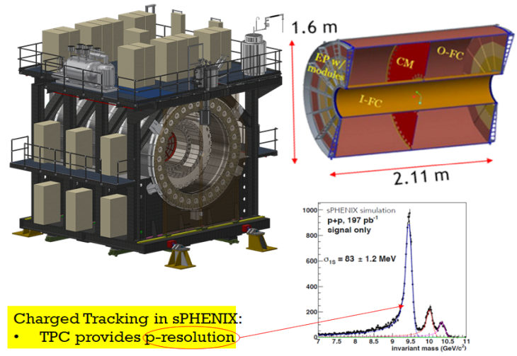
time projection chamber
A TPC for DET-II@IP8
  What are the constraints on length and outer radius?
  Typically, one wants to cover central rapidity η ≈ ± 1 Y diameter ≈ length – constraint is magnet
sPHENIX within
Babar magnet

Slide 7
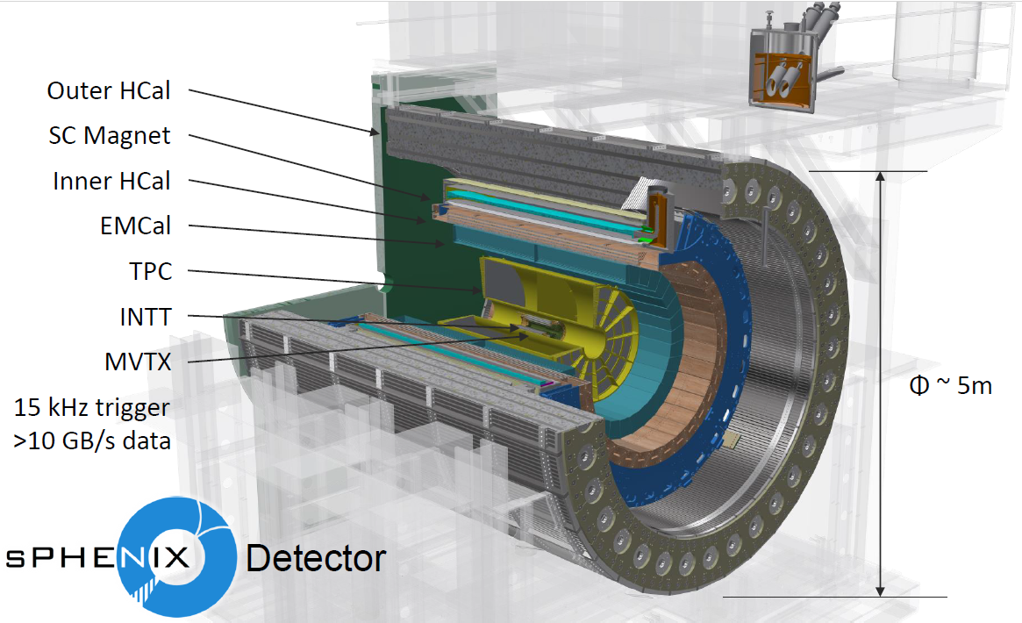
time projection chamber

Slide 8
time projection chamber
A TPC for DET-II@IP8
  What field uniformity is required?

Slide 9
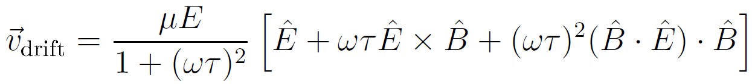



time projection chamber
A TPC for DET-II@IP8
  What field uniformity is required?
    Two field configurations to be considered
      Magnetic field
      Electric field
, : unit vectors along B/E-field

Slide 10
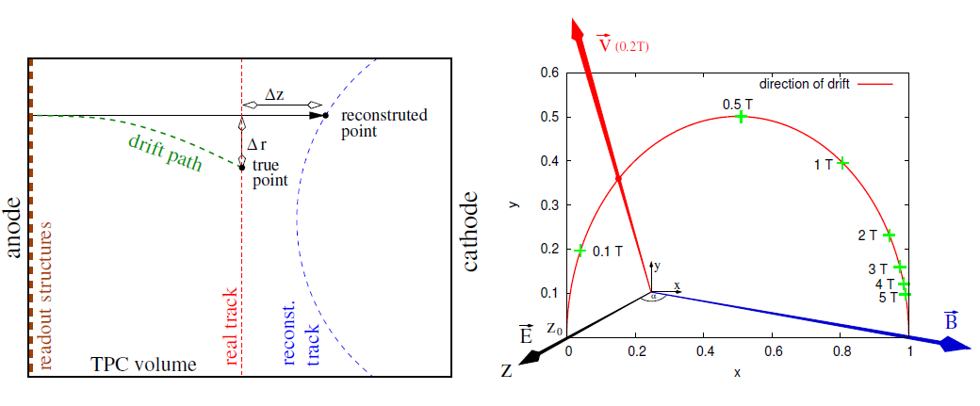
time projection chamber
A TPC for DET-II@IP8
  Effect of non-parallel alignment of E- and B-field

Slide 11
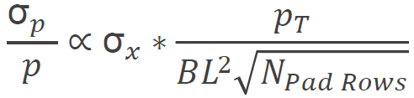
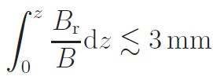

time projection chamber
A TPC for DET-II@IP8
  Momentum resolution dictates space point resolution
  Space point resolution (in a TPC) dictates field homogeneity
  Typically, modern experiments require σ_{x} of 100 μm or better
  Resolution degradation of at most 5% require
Fixed

Slide 12
time projection chamber
A TPC for DET-II@IP8
  What are the limitations on angular resolution
    At the vertex?
    At r_{max}?

Slide 13
time projection chamber
A TPC for DET-II@IP8
  A TPC has a multitude of point measurements
    ~50 in the sPHENIX TPC
    O(200) in the ALICE TPC
  A TPC measures space points with a ten-fold worse resolution as compared to Si-detectors
  A TPC is a slow readout device
    Distortion of z-position
    Can have impact on entrance/exit point determination in the TPC
    Can be circumvented with the introduction of “fast” entrance/exit point measurement

Slide 14
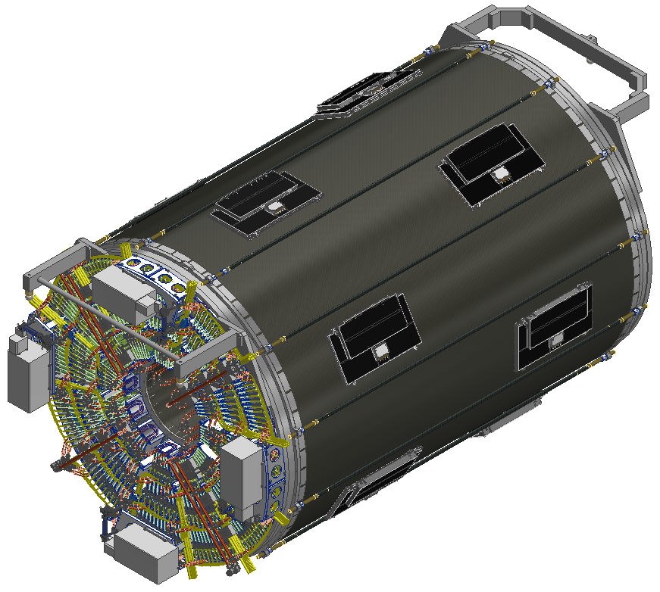
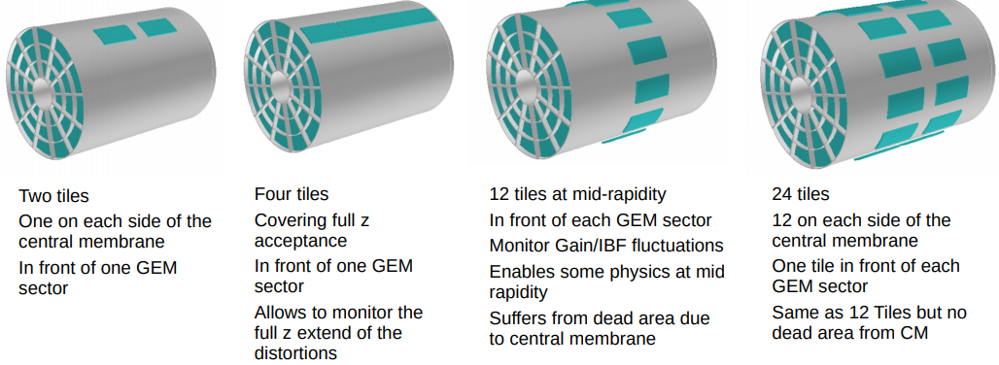
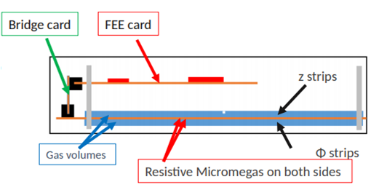
time projection chamber

Slide 15
time projection chamber
A TPC for DET-II@IP8
  What PID capabilities are possible?

Slide 16
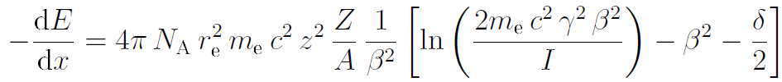
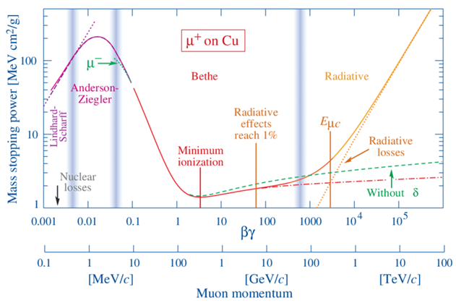
TPC – PID capabilities
Particle Identification via velocity measurement
    Velocity dependent interaction with the detector Y specific ionization

Slide 17
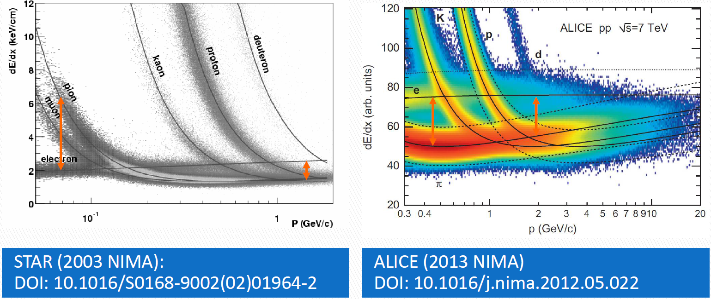
TPC – PID capabilities
Particle Identification via velocity measurement
    Velocity dependent interaction with the detector Y specific ionization

Slide 18
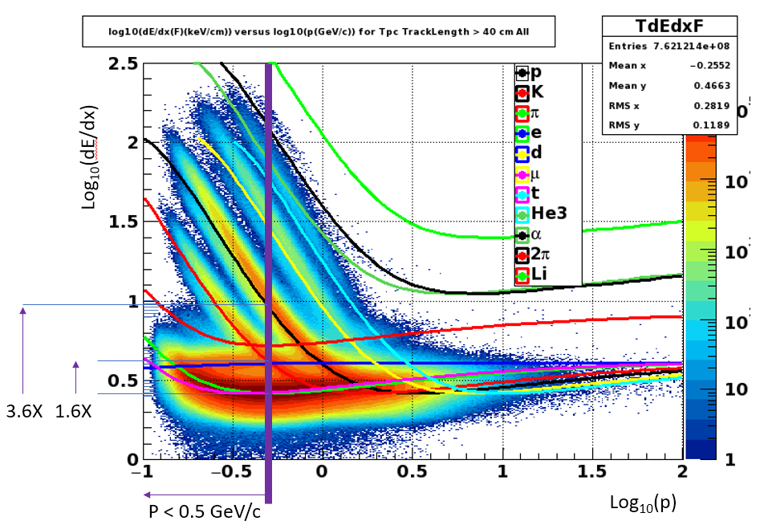
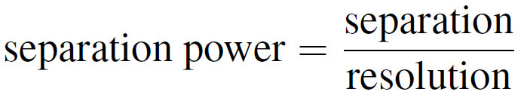
TPC – PID capabilities
Particle Identification via velocity measurement
    Velocity dependent interaction with the detector Y specific ionization

Slide 19
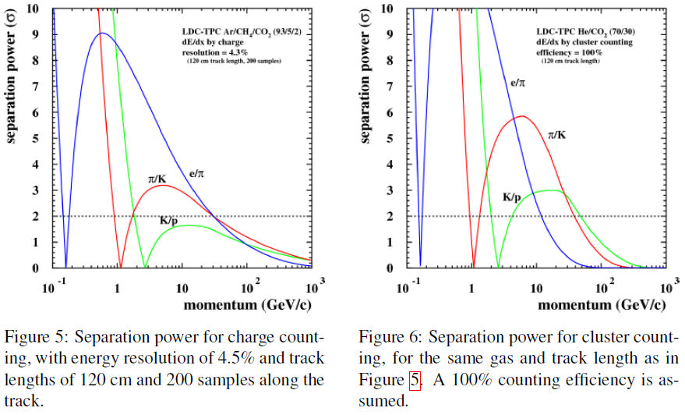
TPC – PID capabilities
Particle Identification via velocity measurement
    Traditional charge counting vs cluster counting

Slide 20
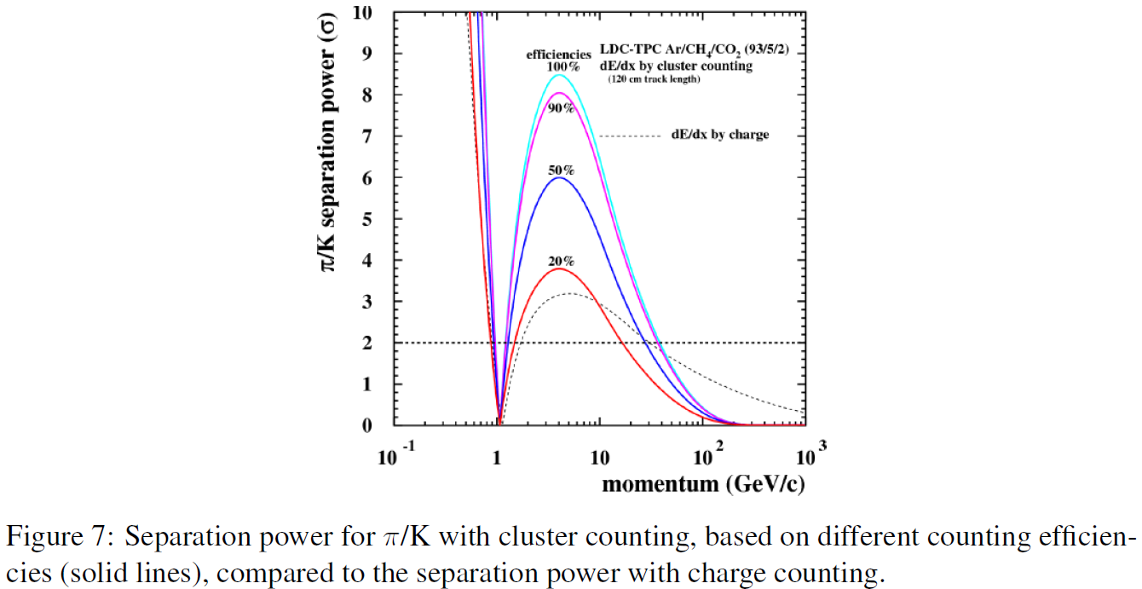
TPC – PID capabilities
Particle Identification via velocity measurement
    Traditional charge counting vs cluster counting

Slide 21
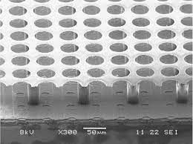
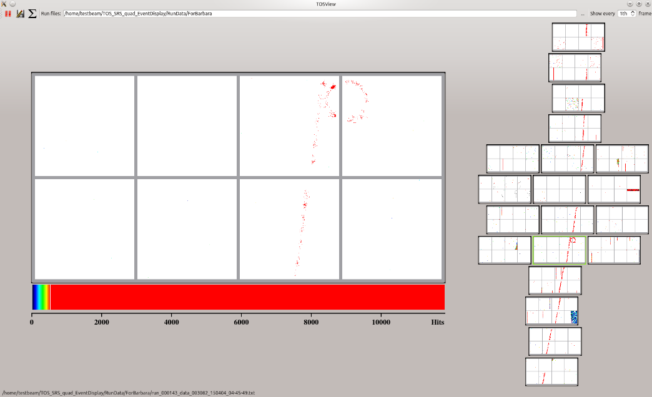
TPC – PID capabilities
Particle Identification via velocity measurement
    Count each electron Y GridPix
Ultimate dE/dx device.
  Avalanche grid in front of 55 x 55 μm² pixels.
  >90% efficiency for single electrons.
  Goals:
    Enough diffusion to get every electron into a different hole.
    Count electrons one-by-one.
  Three generations of development and continuing.
Small area is not particularly expensive.
  1800 chips (order/produce/test 3600) = $716k
  Careful: 1.2-5.4 kW of power (occupancy dependent).

Slide 22
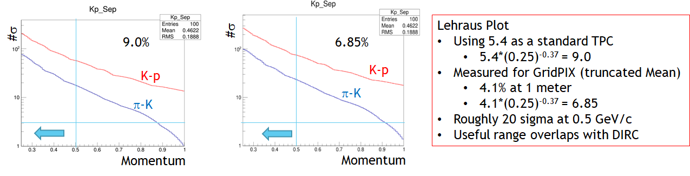
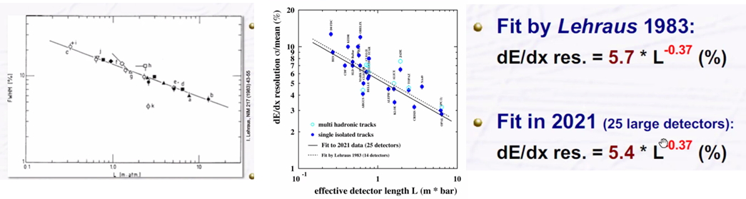
TPC – PID capabilities
Particle Identification via velocity measurement
    Count each electron Y GridPix
    Anticipated dE/dx resolution

Slide 23
A TPC for DET-II@IP8
  What are the material budgets?
    Keep material budgets at minimum to avoid multiple scattering, secondary particle production, …

Slide 24
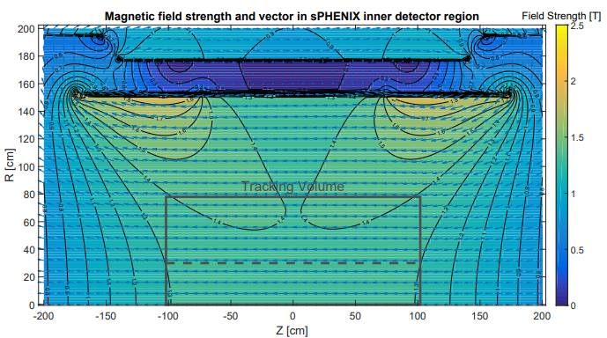
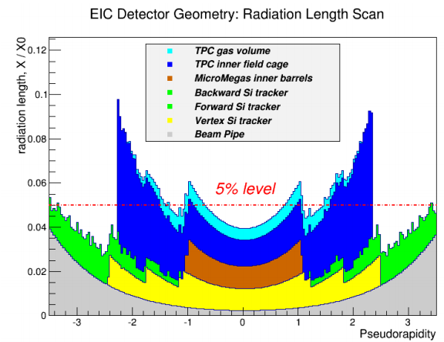
Babar Magnet and TPC - Material Budget

Slide 25
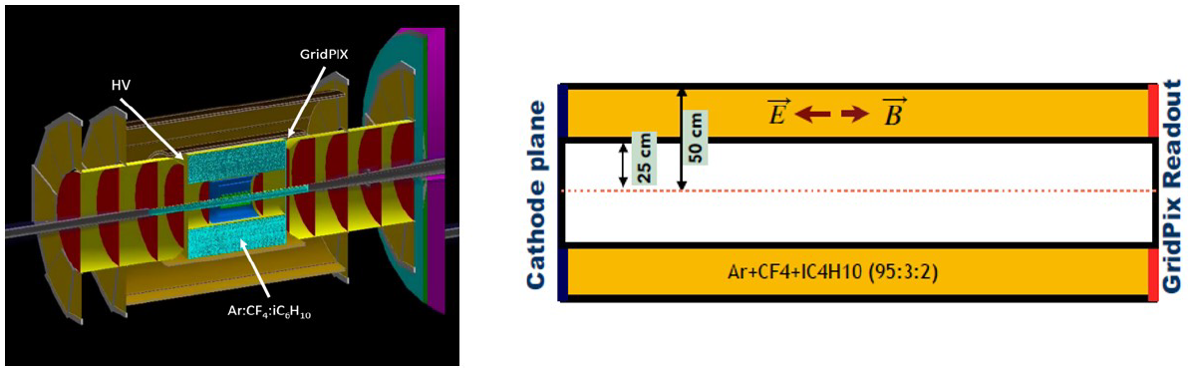
A TPC for DET-II@IP8

Slide 26
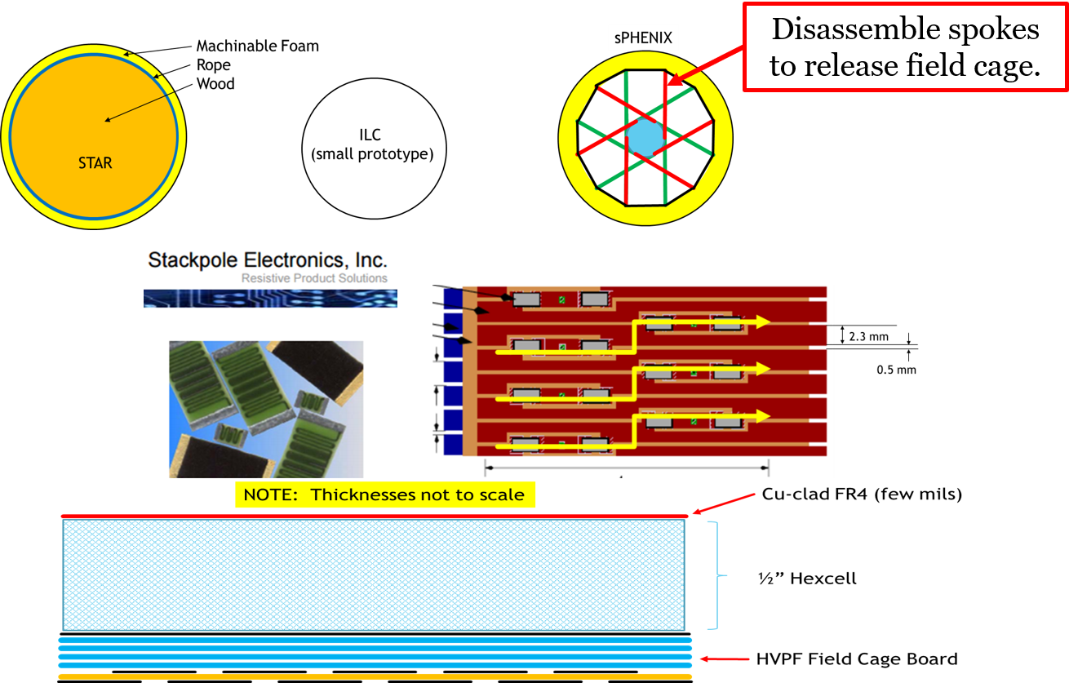
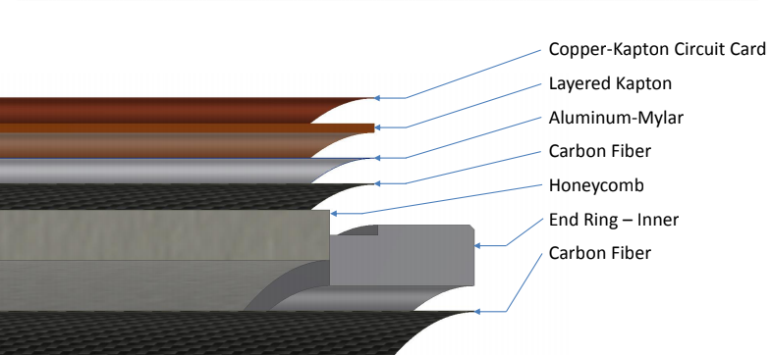
TPC - Material Budget
Field Cage → Inner/Outer for sPHENIX
  Hybrid between STAR and ILD

Slide 27
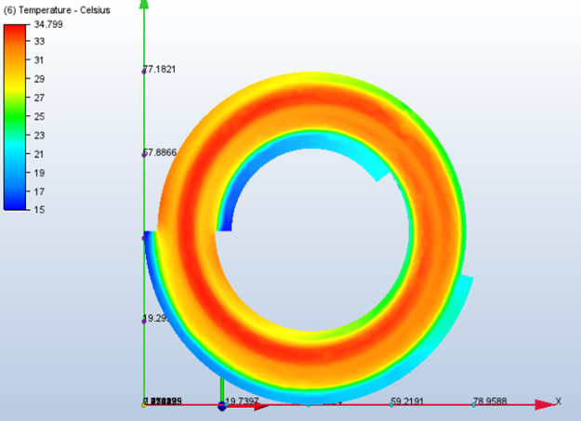
Gridpix TPC - Material Budget
Barrel:
End Cap:
sPHENIX:
45 kV & 18 layers kapton.
EIC:
10 kV & 5 layers kapton.
Temperature Profiles: 3 kW
Coolant above the dew point
  Conventional Cooling OK at 4%
  CO₂ cooling promises ~2% ?

Slide 28
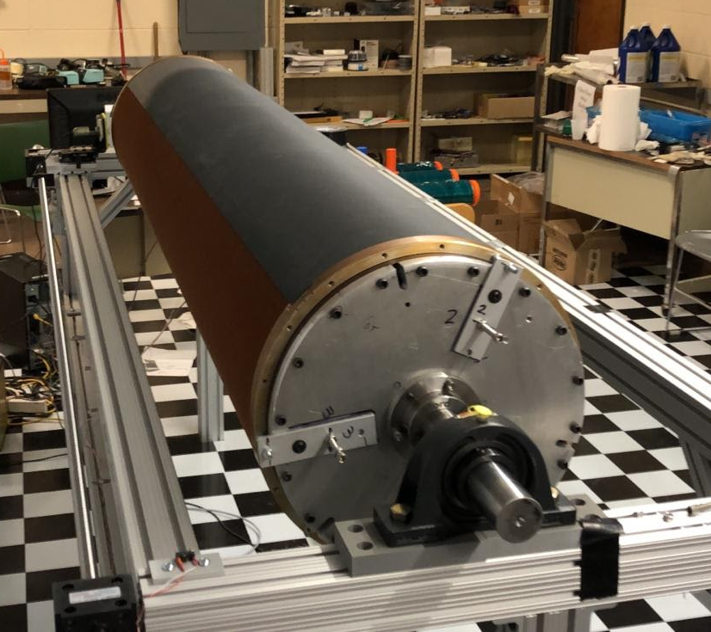
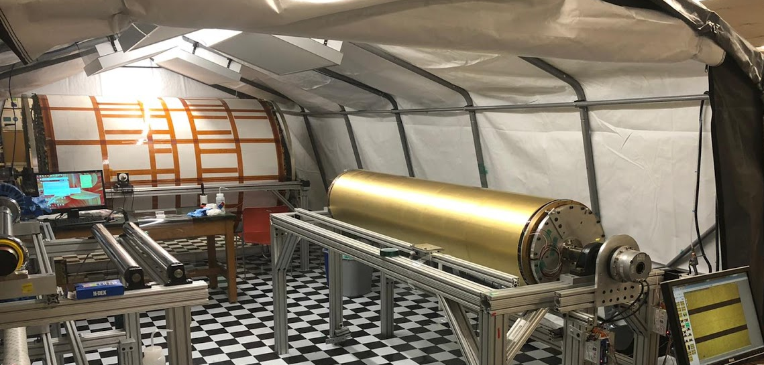
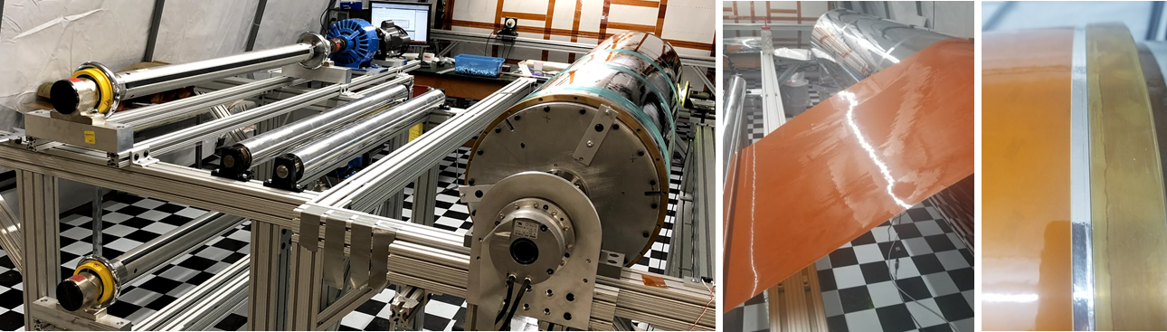
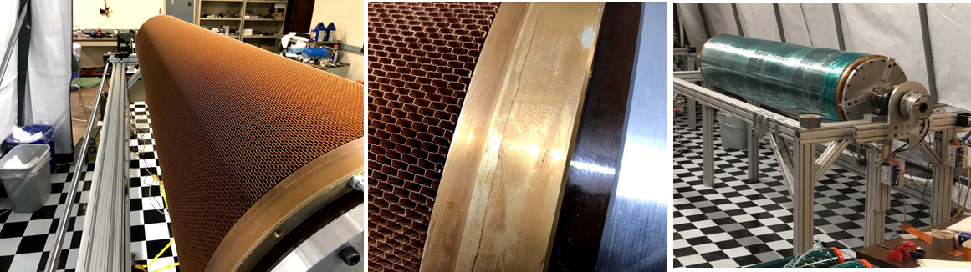
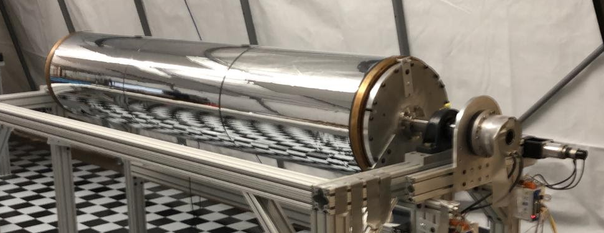
Sphenix TPC construction
Ready for take-off

Slide 29
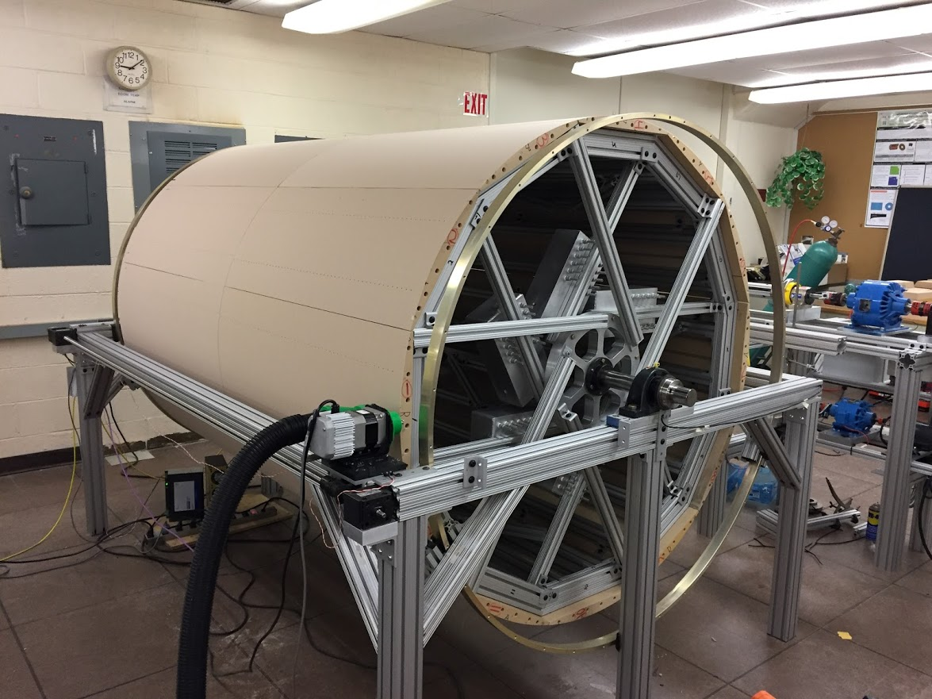
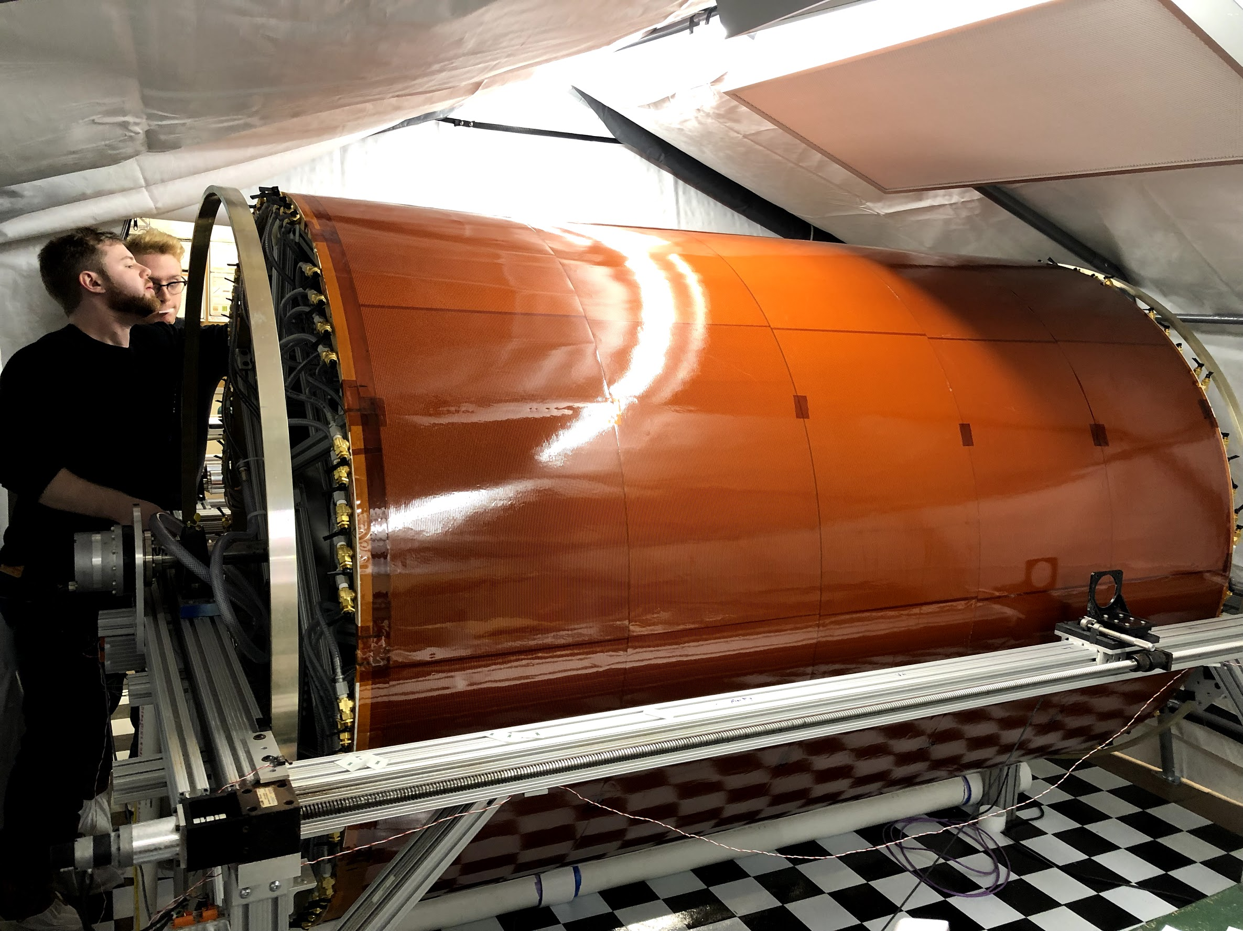
Sphenix TPC construction
We are also building the TPC
  Mandrel
    Inner FC
    Outer FC

Slide 30
time projection chamber
A TPC for DET-II@IP8
  Integration issues with other detectors?

Slide 31
Integration issues for a time projection chamber

Slide 32
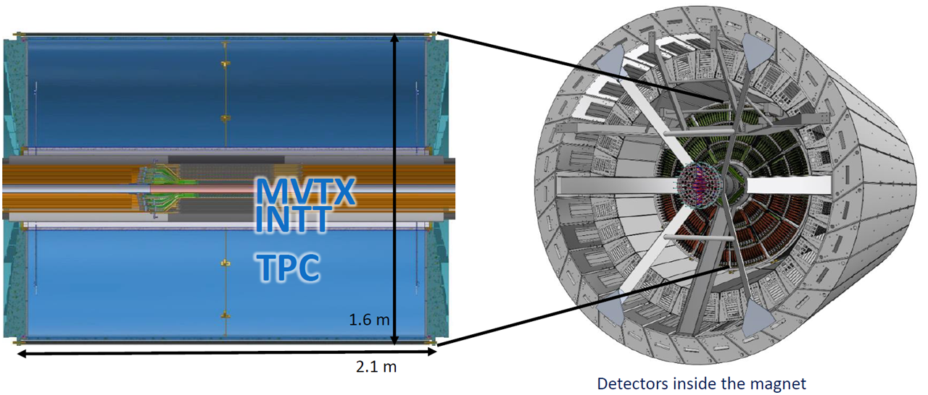
Integration issues for a time projection chamber

Slide 33


