Slide 1
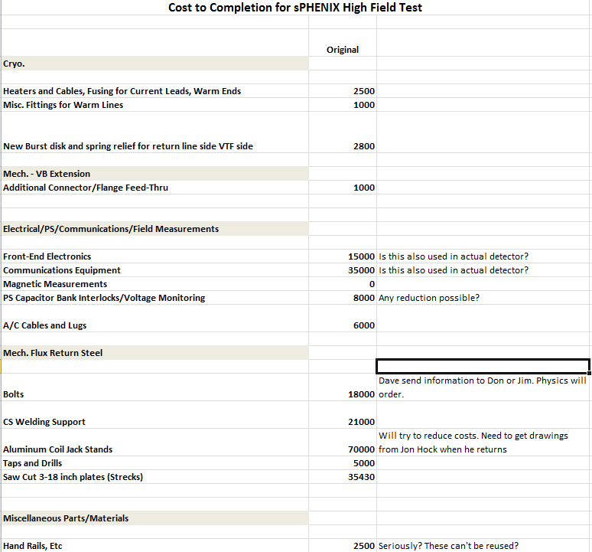
Full Field Test Cost to Complete

