Slide 1
ANSYS 2D Magnetostatic and Structural Analysis of sPHENIX Coil at Full Current
John Cozzolino
August 3, 2016

Slide 2
ANSYS Maxwell Analysis of sPHENIX Coil
  2D Magnetostatic FE analysis of complete coil
    Geometry and current densities are taken from Wuzheng Meng’s magnetic data – 6/17/2015.
      Coil center is shifted 3cm north relative to the iron.
      Coils are divided into 24 blocks, each with corresponding current densities at maximum power (4600 A).
    Iron enclosure is approximated by an axisymmetric cylinder, capped at both ends.
        Cylinder weight is equal to the actual iron weight (approximately 1,323,000 lb).
        Pole iron thickness and axial distance from coil ends is the same as the actual.
        Iron cylinder I.D. is set to the sidewall radial distance closest to the coil.
    Lorentz forces are calculated using ANSYS Maxwell and then exported to the mechanical model.

Slide 3
Labels on 24 Solenoid Coils
(Not to Scale)
W. Meng, 6/17/15
Coil-package ctr.
3.0 cm
Rout=155.06cm
Rin=150.98cm
(solenoids/yoke/poles common Axis)
Z
(Yoke axial ctr.)
Z=0

Slide 4
sPHENIX 24-Coils Information (W. Meng, 6/17/15)
 |  | Axial Center Zc (cm) |  | Coil Axial Length | Current Density
Coil No. | Rc (cm) | shift=0 | shift=3cm | dz (cm) | J (A/cm^2)
1 | 152.00 | -35.56 | -32.56 | 71.12 | 2502.564
2 | 154.04 | -37.12 | -34.12 | 74.23 | 2519.067
3a | 152.00 | -155.12 | -152.12 | 12.90 | 4205.118
3b | 152.00 | -168.02 | -165.02 | 12.90 | 4205.118
4 | 152.00 | -135.75 | -132.75 | 25.81 | 4205.118
5 | 152.00 | -109.90 | -106.90 | 25.81 | 4205.118
6 | 152.00 | -84.05 | -81.05 | 25.81 | 4205.118
7a | 154.04 | -155.65 | -152.65 | 12.53 | 4204.423
7b | 154.04 | -168.17 | -165.17 | 12.53 | 4204.423
8 | 154.04 | -136.86 | -133.86 | 25.05 | 4204.423
9 | 154.04 | -111.81 | -108.81 | 25.05 | 4204.423
10 | 154.04 | -86.76 | -83.76 | 25.05 | 4204.423
11 | 152.00 | 35.56 | 38.56 | 71.12 | 2502.564
12 | 154.04 | 37.12 | 40.12 | 74.23 | 2519.067
13a | 152.00 | 155.12 | 158.12 | 12.90 | 4205.118
13b | 152.00 | 168.02 | 171.02 | 12.90 | 4205.118
14 | 152.00 | 135.75 | 138.75 | 25.81 | 4205.118
15 | 152.00 | 109.90 | 112.90 | 25.81 | 4205.118
16 | 152.00 | 84.05 | 87.05 | 25.81 | 4205.118
17a | 154.04 | 155.65 | 158.65 | 12.53 | 4204.423
17b | 154.04 | 168.17 | 171.17 | 12.53 | 4204.423
18 | 154.04 | 136.00 | 139.00 | 25.05 | 4204.423
19 | 154.04 | 111.81 | 114.81 | 25.05 | 4204.423
20 | 154.04 | 86.76 | 89.76 | 25.05 | 4204.423
System Origin is Located at Center of sPhenix Yoke Coil thickness is about 2 cm (for inner or outer layer)

Slide 5
ANSYS FE Structural Analysis of sPHENIX Coil
  2d Axisymmetric Steady-State FE Analysis of Complete Coil
    Includes external aluminum bobbin and G-10 end fillers
    Lorentz forces are imported directly from the ANSYS Maxwell Magnetostatic FE model at 4600 A.
    Thermal stresses during cool-down from RT to 4K are included.
    Mechanical properties vs. temperature are included.
      Coil properties E and CTE are adjusted for percentage of insulation vs. conductor (Ref Ansaldo Dwg# 620RM07142, pg. 1).
        Radial direction 2.0% insulation (all coils)
        Axial direction 4.7% (middle coils)
        Axial direction 8.1% (end coils)
    All connections (contacts) are bonded.
    Tensile and shear stresses are studied throughout the coil
      Shear stress limit: 30 MPa (4350 psi)
      Tensile stress limit: 30 MPa

Slide 6
ANSYS FE Structural Analysis of sPHENIX Coil (cont’d)
    Stresses and deflections will be compared to those derived in the previous analysis from 7/16/15.
      Lorentz forces were first calculated by W. Meng using Opera.
      They were then input by hand as coil face pressures into an ANSYS static structural model.
      Direct mapping of these forces from ANSYS Maxwell to a static structural model should provide more accurate results.
      What follows is a side-by-side comparison of results from the two analyses.

Slide 7
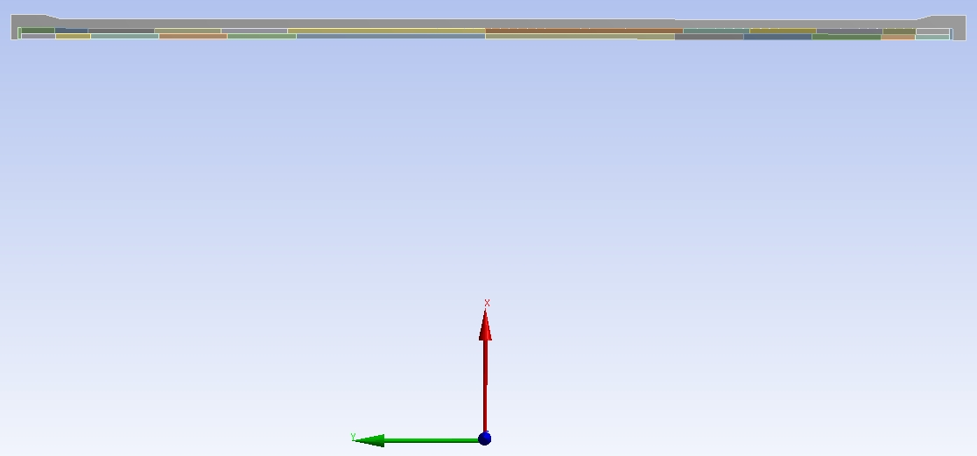
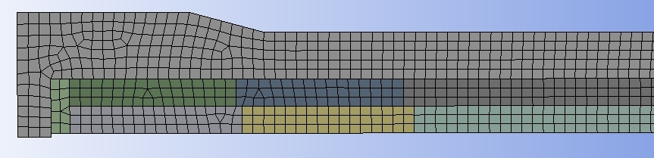
Full Coil Geometry
Aluminum Bobbin
Outer Coil
Inner Coil
G-10 Filler
FE Mesh for Static Structural Model (Lead “South” End)

Slide 8
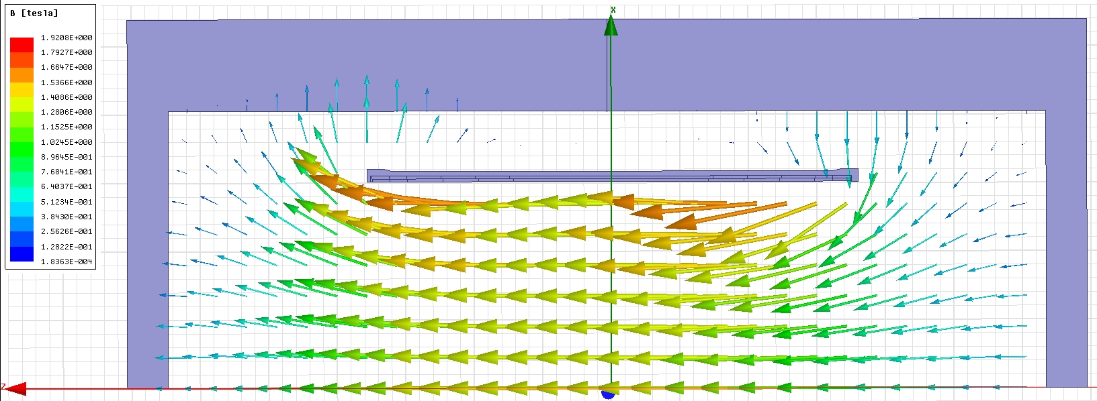
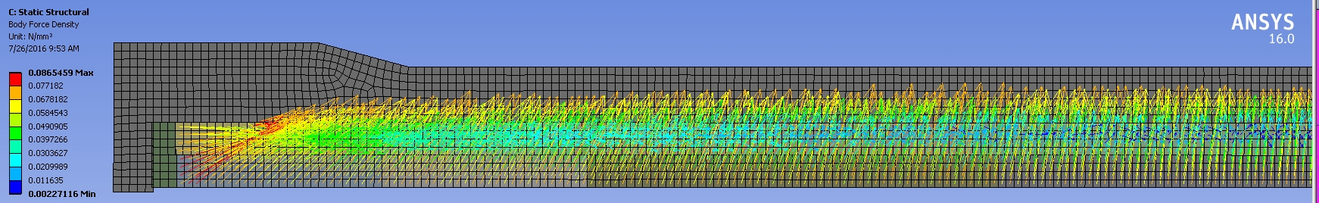
Magnetic Flux Vectors at 4600 A (ANSYS Maxwell)
Iron Cylinder
Coil
1.39 T
Coil Lorentz Force Vectors @LE

Slide 9
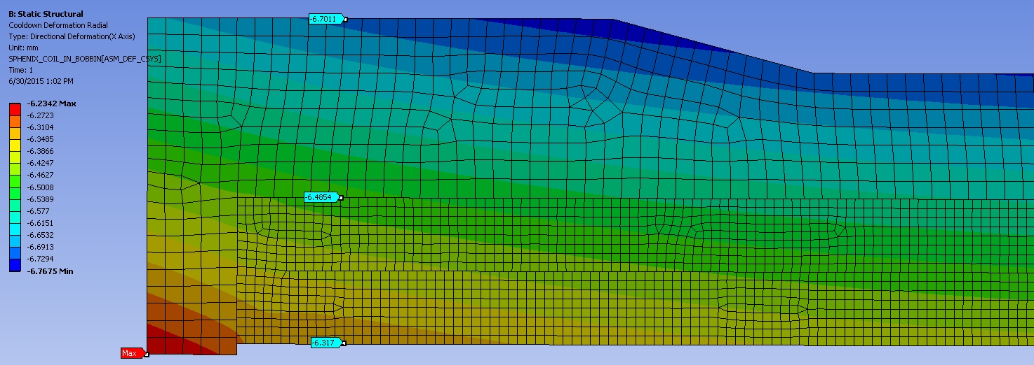
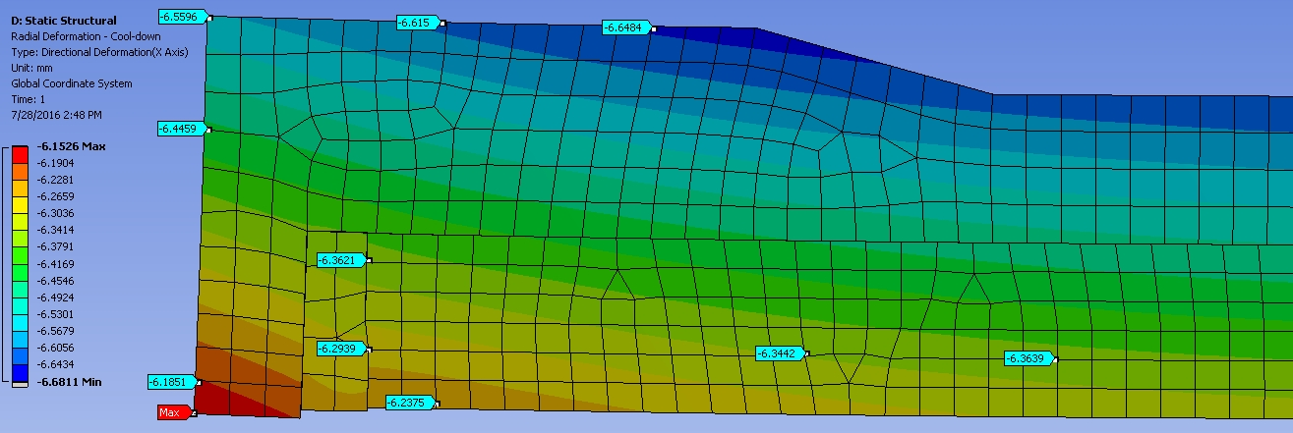
Radial Deflection @ Cool-down (LE view - mm) 7/16/2015
-6.7 mm
Radial Deflection @ Cool-down (LE view - mm) 7/28/2016
-6.6 mm

Slide 10
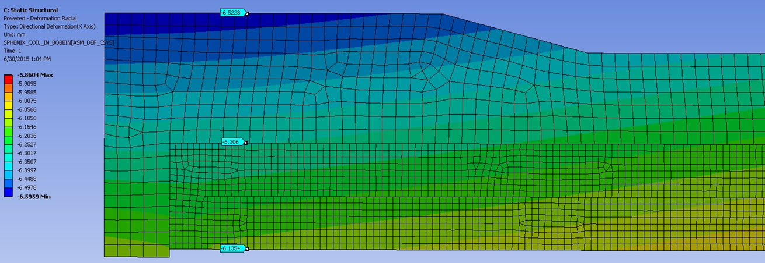
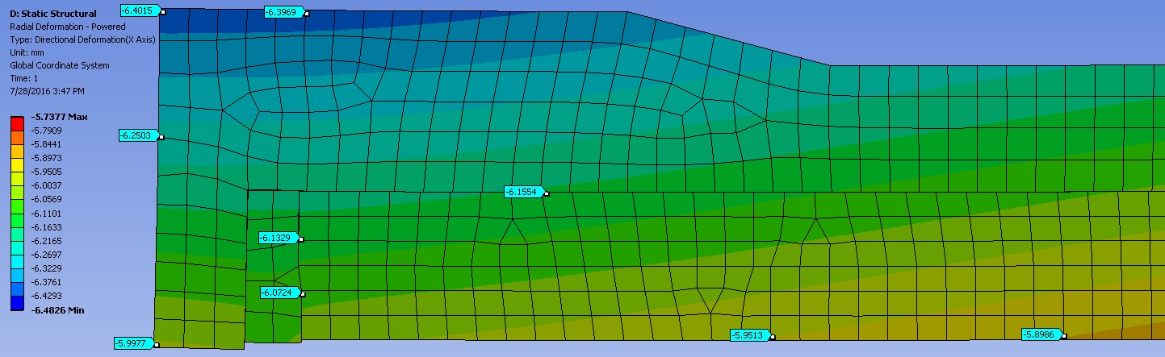
Radial Deflection @ Max Current (LE view - mm) 7/16/2015
-6.5 mm
-6.3 mm
Radial Deflection @ Max Current using MAXWELL (LE view - mm) 7/28/2016
-6.4 mm
-6.2 mm

Slide 11
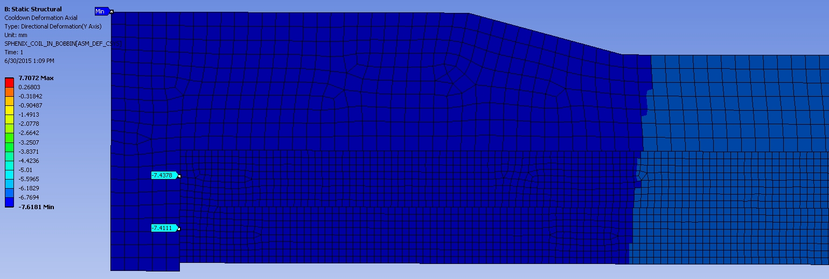
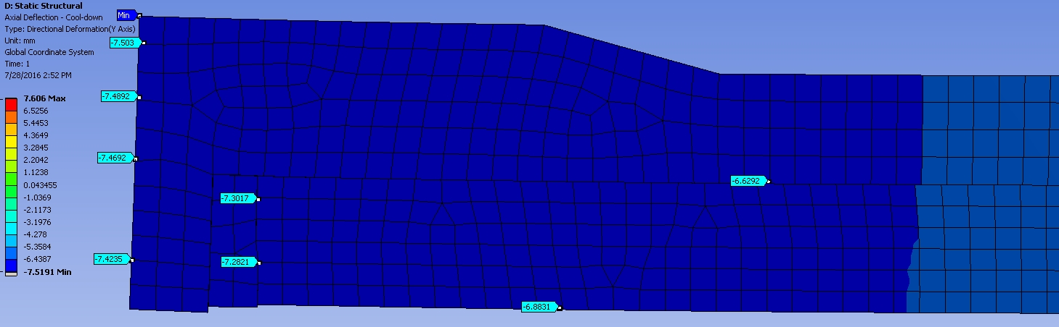
Axial Deflection @ Cool-down (LE view - mm) 7/16/2015
+Y
-7.6 mm min.
Axial Deflection @ Cool-down (LE view - mm) 7/28/2016
-7.5 mm min.
-7.47 mm

Slide 12
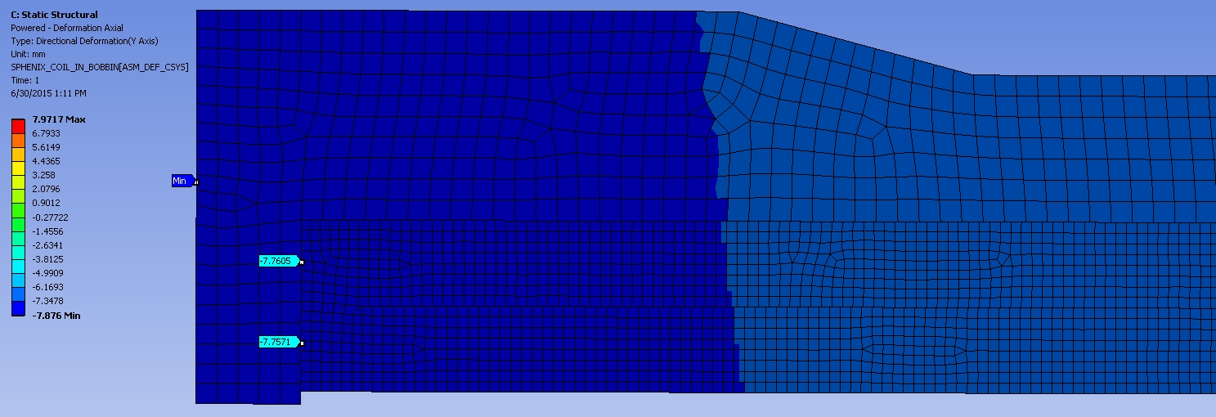
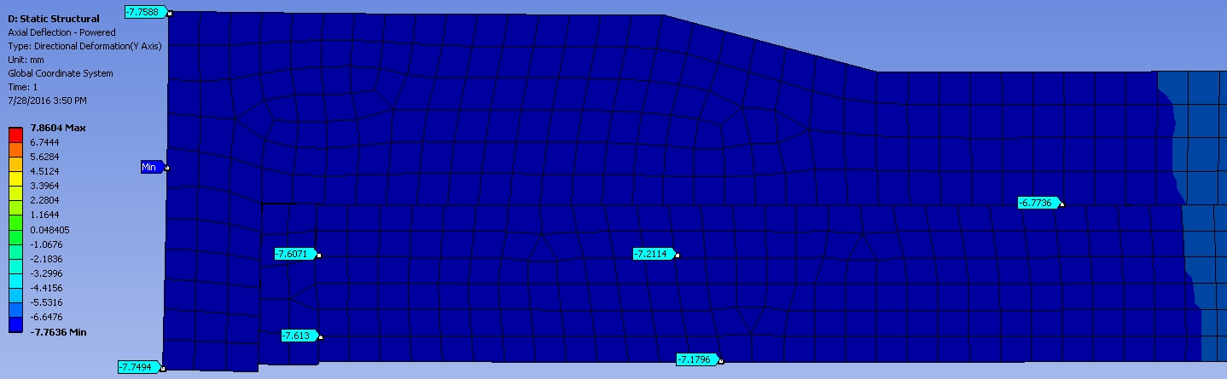
Axial Deflection @ Max Current (LE view - mm) 7/16/2015
+Y
-7.9 mm
Axial Deflection @ Max Current using MAXWELL (LE view - mm) 7/28/2016
-7.8 mm

Slide 13
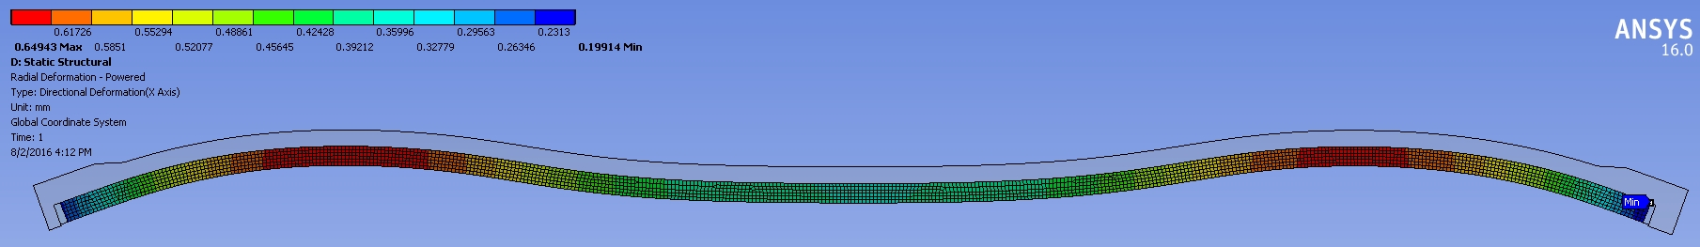
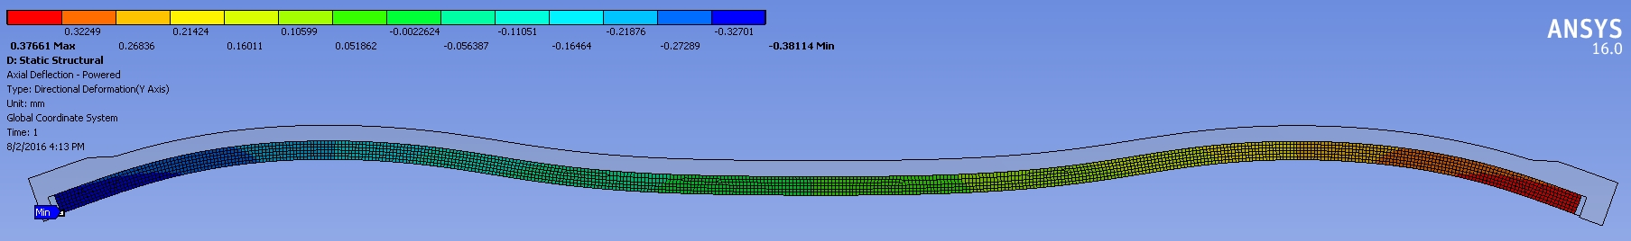
Radial Deflection @ Max Current w/o Cool-down Effects (LE view - mm) 7/28/2016
.65 mm max
Axial Deflection @ Max Current w/o Cool-down Effects (LE view - mm) 7/28/2016
+Y
-.38 mm min

Slide 14
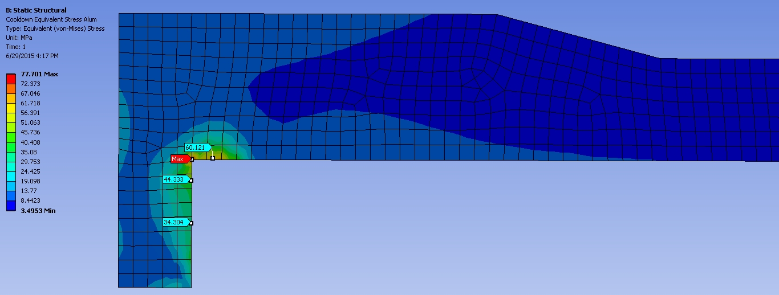
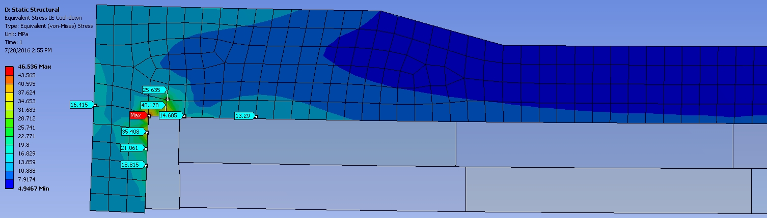
Equivalent Stress in Aluminum Bobbin @ Cool-down (LE view - MPa) 7/16/2015
78 MPa Max
Equivalent Stress in Aluminum Bobbin @ Cool-down (LE view - MPa) 7/28/2016
47 MPa Max

Slide 15
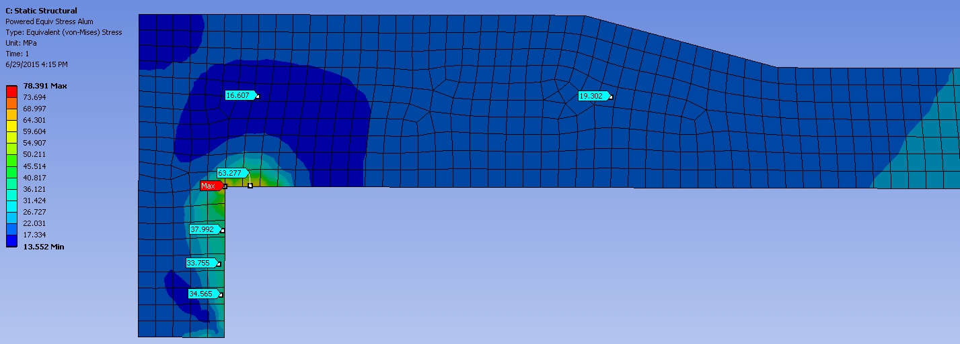
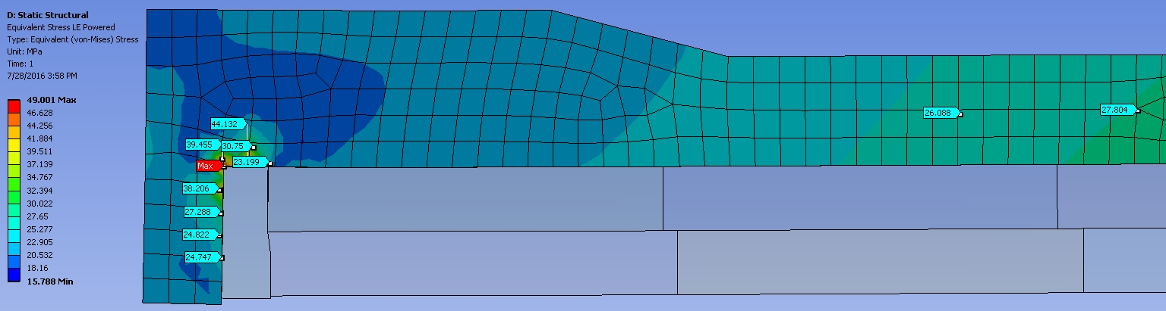
Equivalent Stress in Aluminum Bobbin @ Max Current (LE view - MPa) 7/16/2015
78 MPa Max
Equivalent Stress in Aluminum Bobbin @ Max Current (LE view - MPa) 7/28/2016
49 MPa Max

Slide 16
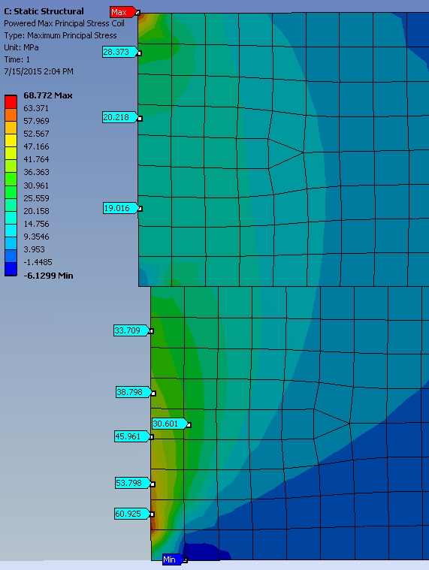
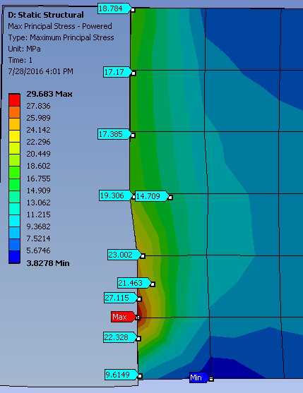
Coil Lead End Maximum Tensile Stress @ Full Power (MPa)
7/16/2015
7/28/2016 (MAXWELL)

Slide 17
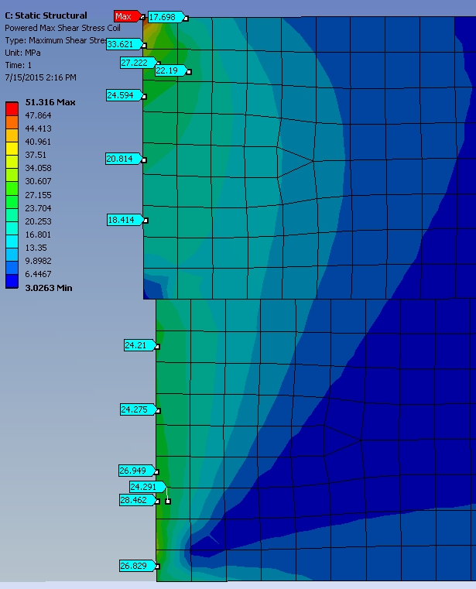
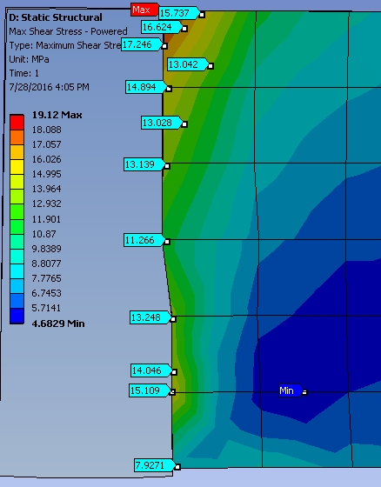
Coil Lead End Maximum Shear Stress @ Full Power (MPa)
7/16/2015
7/28/2016 (MAXWELL)

Slide 18
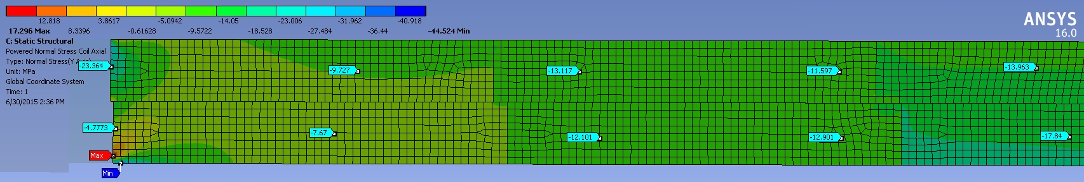
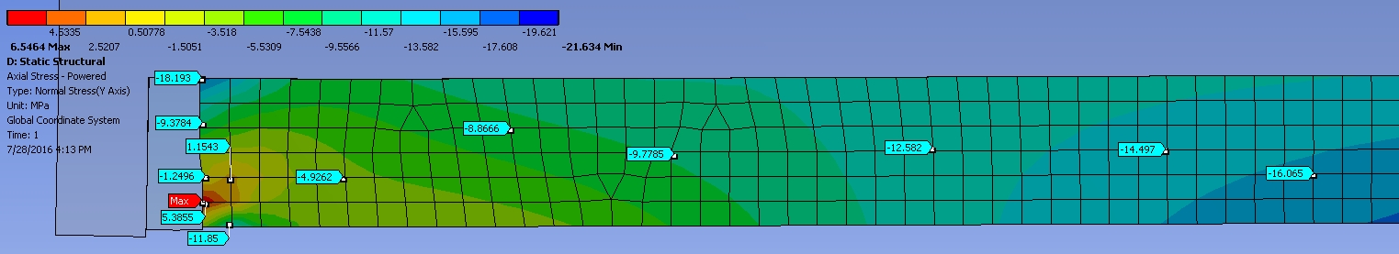
Coil Lead End Axial Stress at Full Power (MPa) – 7/16/2015
-23 MPa
+Y
Lead End Axial Stress at Full Power (MPa) using MAXWELL – 7/28/2016
-9 MPa

Slide 19
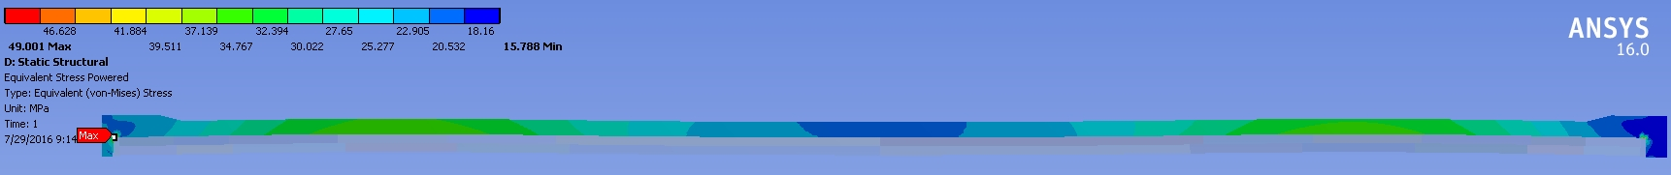
Coil Stresses and Deflections at Full Power using MAXWELL – 7/28/2016
Equivalent Stress in Aluminum Bobbin (MPa)
Max Tensile Stress in Coil
Max Shear Stress in Coil
Radial Deflection of Coil (mm)
+Y
Axial Deflection of Coil
Axial Normal Coil Stress

Slide 20
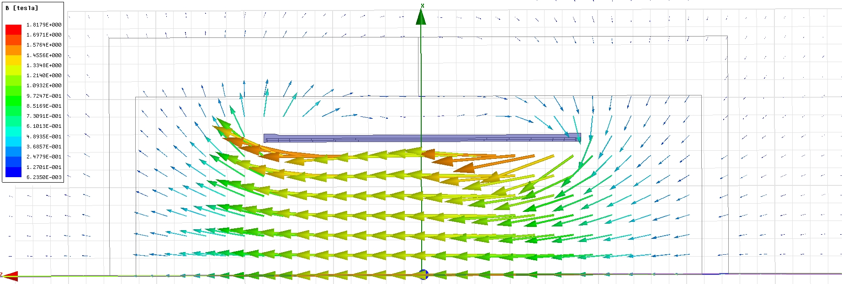
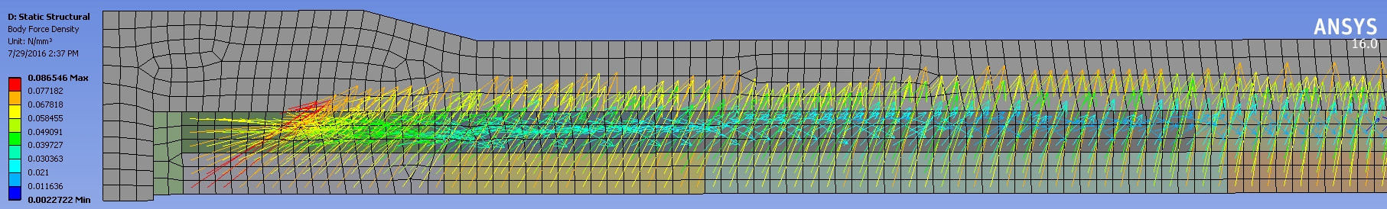
Magnetic Flux Vectors at 4600 A – No Iron
1.25 T
Coil Lorentz Force Vectors – No Iron

Slide 21
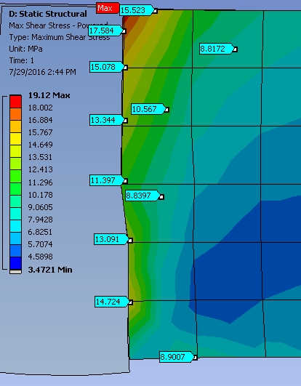
Coil Lead End Maximum Shear Stress @ Full Power (MPa) Iron vs. No Iron 7/28/2016
With Iron
No Iron

Slide 22
Summary & Conclusions
  Generally good agreement between both FE analyses
  Latest analysis calculates stresses that are lower than previous results
    Cool-down and Lorentz forces will not yield the aluminum bobbin.
      Assuming 5083-0 (annealed) YP= 110 MPa (16 kpsi)
    Tensile stress at the coil ends approaches the allowable limit (30 MPa) at maximum operating current (at the extreme end in a small area).
      Based on the maximum principal stress (σ1)
    Shear stress at the coil ends is below the allowable limit (30 MPa) at maximum operating current.
    Axial compressive stresses at the coil ends do not exceed the yield point of 99.5% pure aluminum (~30 MPa).
    The completion of a 3D FE analysis may be the next logical step in this study.
      Some 3D studies have already been successfully run to exhibit iron deflection.

Slide 23
Backup Slides

Slide 24
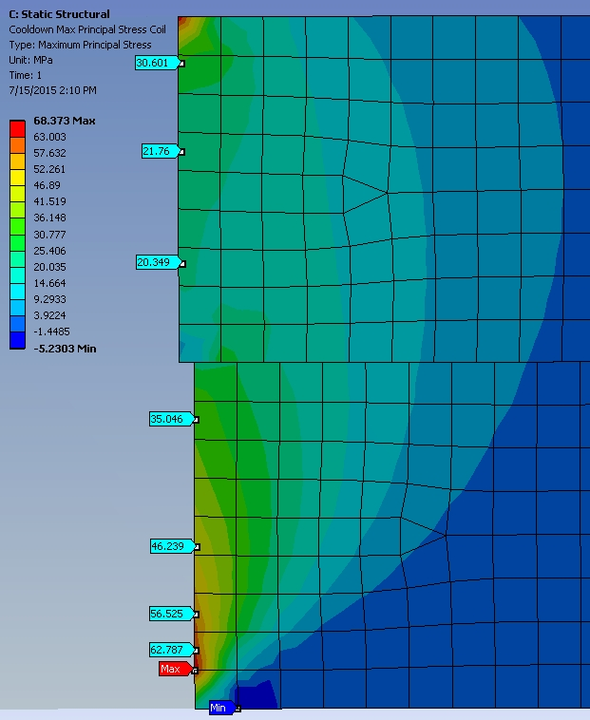
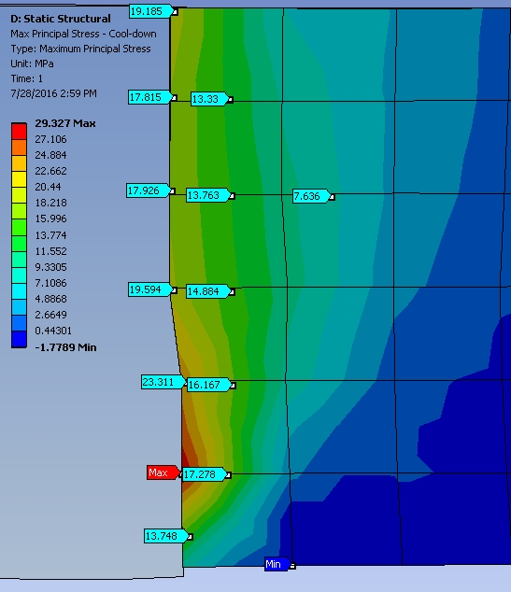
Lead End Max Tensile Stress @ Cool-down (MPa)
7/16/2015
7/28/2016

Slide 25
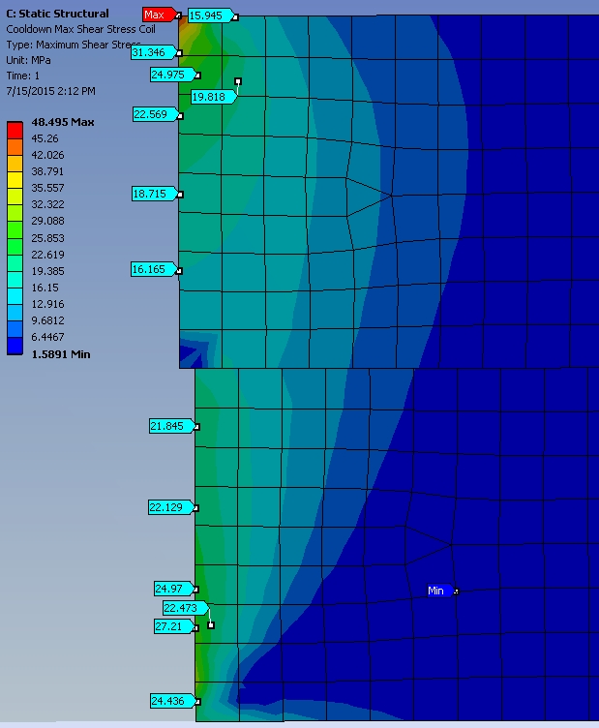
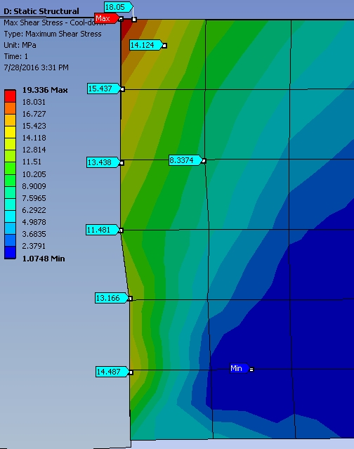
Lead End Maximum Shear Stress @ Cool-down (MPa)
7/16/2015
7/28/2016

Slide 26
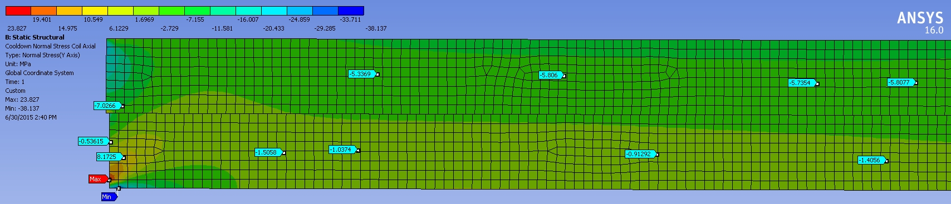
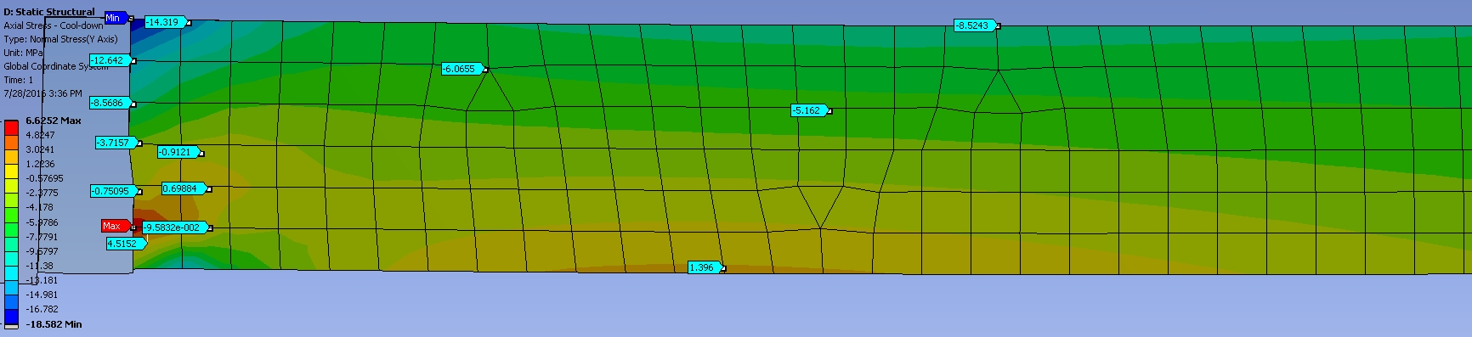
Lead End Axial Stresses at Cool-down (MPa)
7/16/2015
7/28/2016

Slide 27
ANSYS Structural Analyses of sPHENIX Magnet Coil at Full Current
(superceded on 7/28/2016)
John Cozzolino
July 16, 2015

Slide 28
ANSYS FE Structural Analysis of sPHENIX Coil
  2d axisymmetric steady-state FE analysis of complete coil
    Includes external aluminum bobbin and G-10 end fillers
    Geometry and forces taken from Wuzheng Meng’s magnetic model – 6/17/2015
      Coil center is shifted 3cm north relative to iron
      Coils divided into 24 blocks, each with corresponding radial and axial pressures due to the Lorentz forces at maximum current
    Thermal stresses from cool-down to 4K included
    Mechanical properties vs. temperature are included
      Coil properties E and CTE adjusted for percentage of insulation vs. conductor (Ref Ansaldo Dwg# 620RM07142, pg. 1)
        Radial direction 2.0% insulation (all coils)
        Axial direction 4.7% (middle coils)
        Axial direction 8.1% (end coils)
    All connections (contacts) are bonded
    Tensile and shear stresses are studied throughout the coil
      Shear stress limit: 30 MPa (4350 psi)
      Tensile stress limit: 30 MPa

Slide 29
Labels on 24 Solenoid Coils
(Not to Scale)
W. Meng
Coil-package ctr.
3.0 cm
Rout=155.06cm
Rin=150.98cm
(solenoids/yoke/poles common Axis)
Z
(Yoke axial ctr.)
Z=0

Slide 30
Radial Pressure (outward-force per unit area) Table (W. Meng):
 | Coils Ave. Ctr. | (MPa) | (PSI) | (MPa) | (PSI) | (MPa) | (PSI)
 | Zc (cm) | Inner | Inner | Outer | Outer | Inner+Outer | Inner+Outer
Coils 3b +7b | -165.10 | 0.7867 | 114.07 | 0.0032 | 0.46 | 0.7899 | 114.53
Coils 3a + 7a | -152.38 | 0.8978 | 130.19 | 0.0149 | 2.17 | 0.9128 | 132.35
Coils 4 + 8 | -133.30 | 0.9708 | 140.77 | 0.0751 | 10.89 | 1.0459 | 151.66
Coils 5 + 9 | -107.85 | 1.0461 | 151.68 | 0.1502 | 21.77 | 1.1962 | 173.45
Coils 6 + 10 | -82.40 | 1.0286 | 149.15 | 0.1677 | 24.32 | 1.1964 | 173.47
Coils 1 + 2 | -33.34 | 0.4864 | 70.53 | 0.1534 | 22.24 | 0.6398 | 92.76
Coils 11 + 12 | 39.34 | 0.4863 | 70.51 | 0.1532 | 22.22 | 0.6395 | 92.72
Coils 16 + 20 | 88.40 | 1.0275 | 148.98 | 0.1664 | 24.13 | 1.1939 | 173.12
Coils 15 + 19 | 113.85 | 1.0426 | 151.18 | 0.1463 | 21.21 | 1.1889 | 172.40
Coils 14 + 18 | 139.30 | 0.9004 | 130.55 | 0.0693 | 10.05 | 0.9697 | 140.61
Coils 13a + 17a | 158.38 | 0.9004 | 130.55 | 0.0180 | 2.61 | 0.9184 | 133.16
Coils 13b +17b | 171.10 | 0.7944 | 115.19 | 0.0095 | 1.38 | 0.8039 | 116.57

Slide 31
Axial Force Table (W. Meng):
 | Coils Ave. Ctr. | Fz (N) | Fz(Lb) | Fz (N) | Fz(Lb) | Fz (N) | Fz(Lb)
 | Zc (cm) | Inner | Inner | Outer | Outer | Inner+Outer | Inner+Outer
Coils 3b + 7b | -165.10 | 1.23E+06 | 2.771E+05 | 1.22E+06 | 2.73E+05 | 2.45E+06 | 5.505E+05
Coils 3a + 7a | -152.38 | 7.84E+05 | 1.761E+05 | 7.84E+05 | 1.76E+05 | 1.57E+06 | 3.520E+05
Coils 4 + 8 | -133.30 | 1.01E+06 | 2.258E+05 | 1.03E+06 | 2.30E+05 | 2.03E+06 | 4.560E+05
Coils 5 + 9 | -107.85 | 4.10E+05 | 9.196E+04 | 4.47E+05 | 1.00E+05 | 8.57E+05 | 1.924E+05
Coils 6 + 10 | -82.40 | -2.97E+05 | -6.675E+04 | -1.96E+05 | -4.41E+04 | -4.94E+05 | -1.108E+05
Coils 1 + 2 | -33.34 | -3.33E+05 | -7.479E+04 | -3.98E+05 | -8.93E+04 | -7.31E+05 | -1.641E+05
Coils 11 + 12 | 39.34 | 3.32E+05 | 7.449E+04 | 3.96E+05 | 8.89E+04 | 7.28E+05 | 1.634E+05
Coils 16 + 20 | 88.40 | 2.96E+05 | 6.638E+04 | 1.94E+05 | 4.36E+04 | 4.90E+05 | 1.100E+05
Coils 15 + 19 | 113.85 | -4.10E+05 | -9.212E+04 | -4.49E+05 | -1.01E+05 | -8.59E+05 | -1.928E+05
Coils 14 + 18 | 139.30 | -9.91E+05 | -2.225E+05 | -1.01E+06 | -2.27E+05 | -2.00E+06 | -4.490E+05
Coils 13a + 17a | 158.38 | -7.71E+05 | -1.730E+05 | -7.69E+05 | -1.73E+05 | -1.54E+06 | -3.457E+05
Coils 13b + 17b | 171.10 | -1.22E+06 | -2.749E+05 | -1.21E+06 | -2.71E+05 | -2.43E+06 | -5.462E+05
 |  |  |  |  | Total Fz = | 7.00E+04 | 1.57E+04 |  | (with 3 cm Shift)
 |  |  |  |  |  | (N) | (Lb)

Slide 32
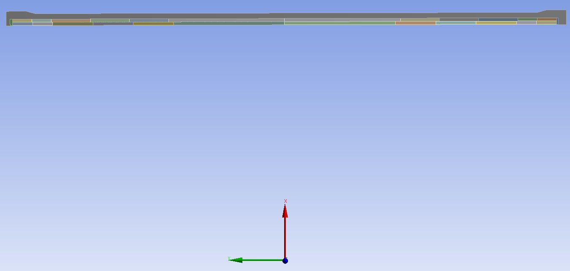
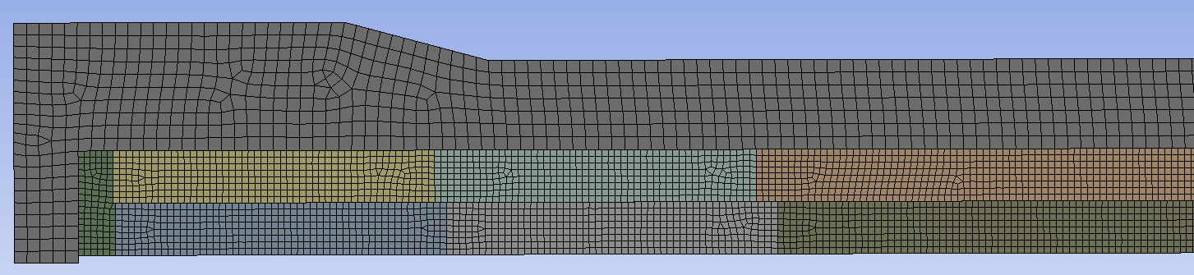
Full Geometry
Aluminum Bobbin
Outer Coil
Inner Coil
G-10 Filler
FE Mesh (Lead End)

Slide 33

Radial Deflection @ Cool-down Followed by Max Current (LE View)

Slide 34
Axial Deflection @ Cool-down Followed by Max Current (LE View)

Slide 35
Equivalent Stress in Aluminum Bobbin @ Cool-down & Max Current (LE View)

Slide 36
Lead End Max Tensile Stress @ Cool-down & Full Power

Slide 37
Lead End Max Shear Stress @ Cool-down & Full Power

Slide 38
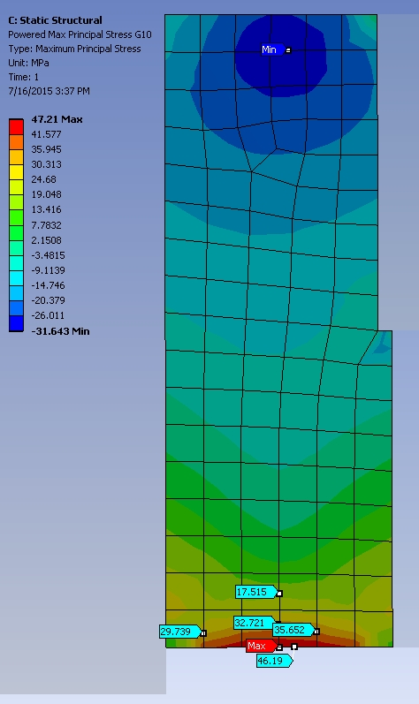
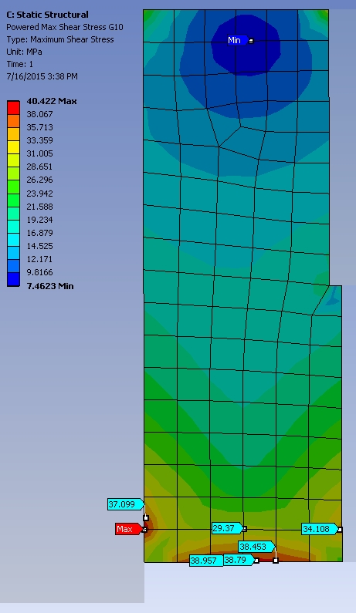
Lead End G-10 Max Tensile & Shear Stress @ Full Power

Slide 39
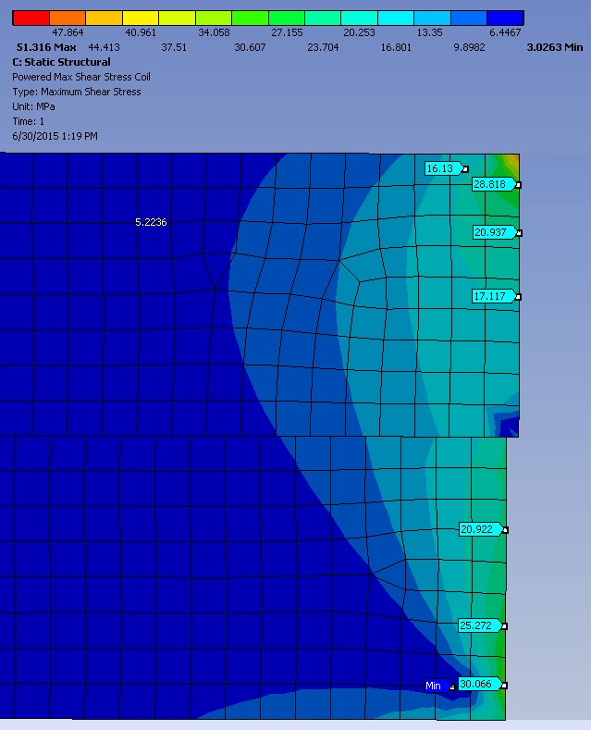
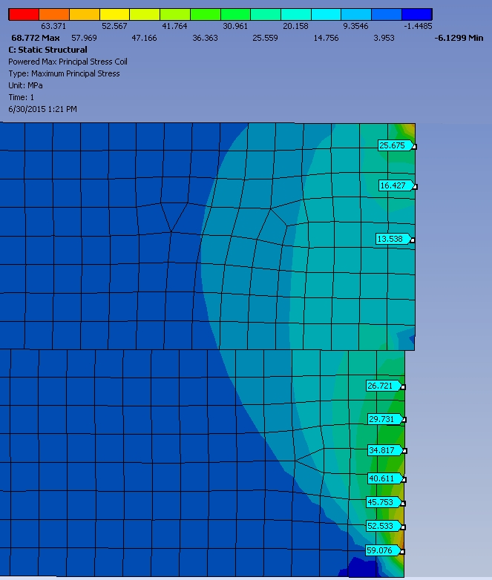
Non-Lead End Max Shear and Tensile Stresses @ Full Power

Slide 40
Lead End Axial Compressive Stresses at Cool-down & Full Power (MPa)

Slide 41
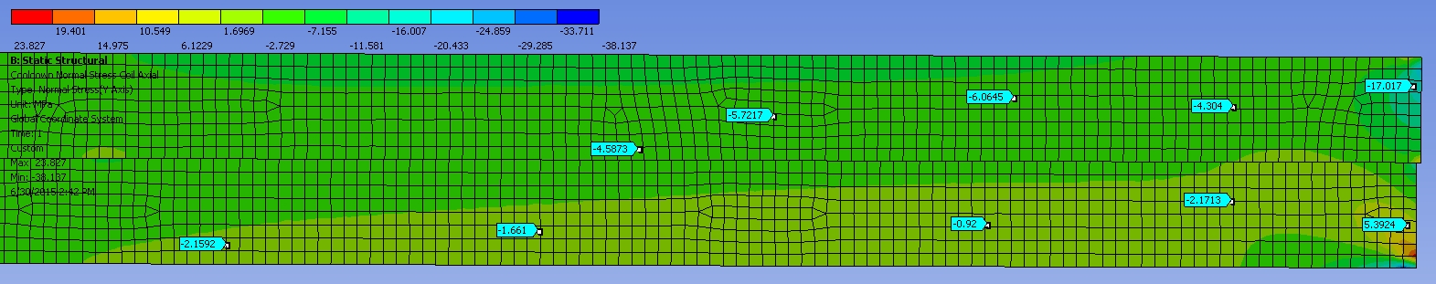
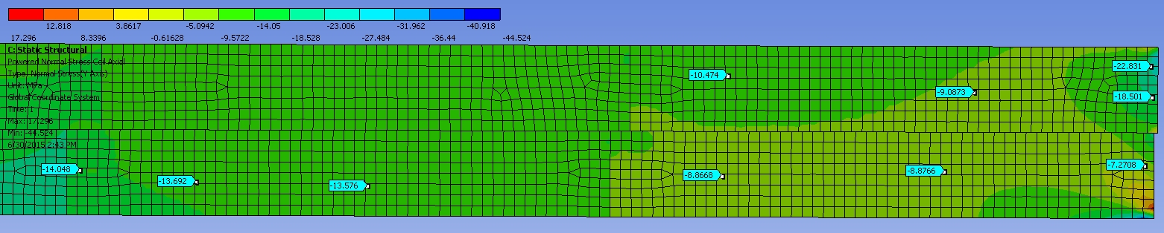
Non-Lead End Axial Compressive Stresses at Cool-down & Full Power (MPa)

Slide 42
Summary & Conclusions (superceded on 7/28/2016)
  Cool-down and Lorentz forces will not yield the aluminum bobbin.
    Assuming 5083-0 (annealed) YP= 110 MPa (16 kpsi)
  Tensile stresses at the coil ends exceed the allowable limit (30 MPa) at maximum operating current.
    Based on the maximum principal stress (σ1)
  Shear stresses at the coil ends are at the allowable limit (30 MPa) at maximum operating current.
  Axial compressive stresses at the coil ends do not exceed the yield point of 99.5% pure aluminum (~30 MPa).

