Slide 1
TAKE FIVE for Safety-
Work Planning and Control
Frank Craner
April 16, 2024

Slide 2
Work Planning and Control during Operational Periods
Work Control Coordinator
Screens the work per Work Planning and Control Subject Area Screening Tool:
  Worker Planned
  Permit Planned
  Prescribed
Screens the work for USI per OPM 1.10.1
If the work involves Electrical Hazards:
Electrical Competent Person completes Electrical Planning and Briefing from SBMS

Slide 3
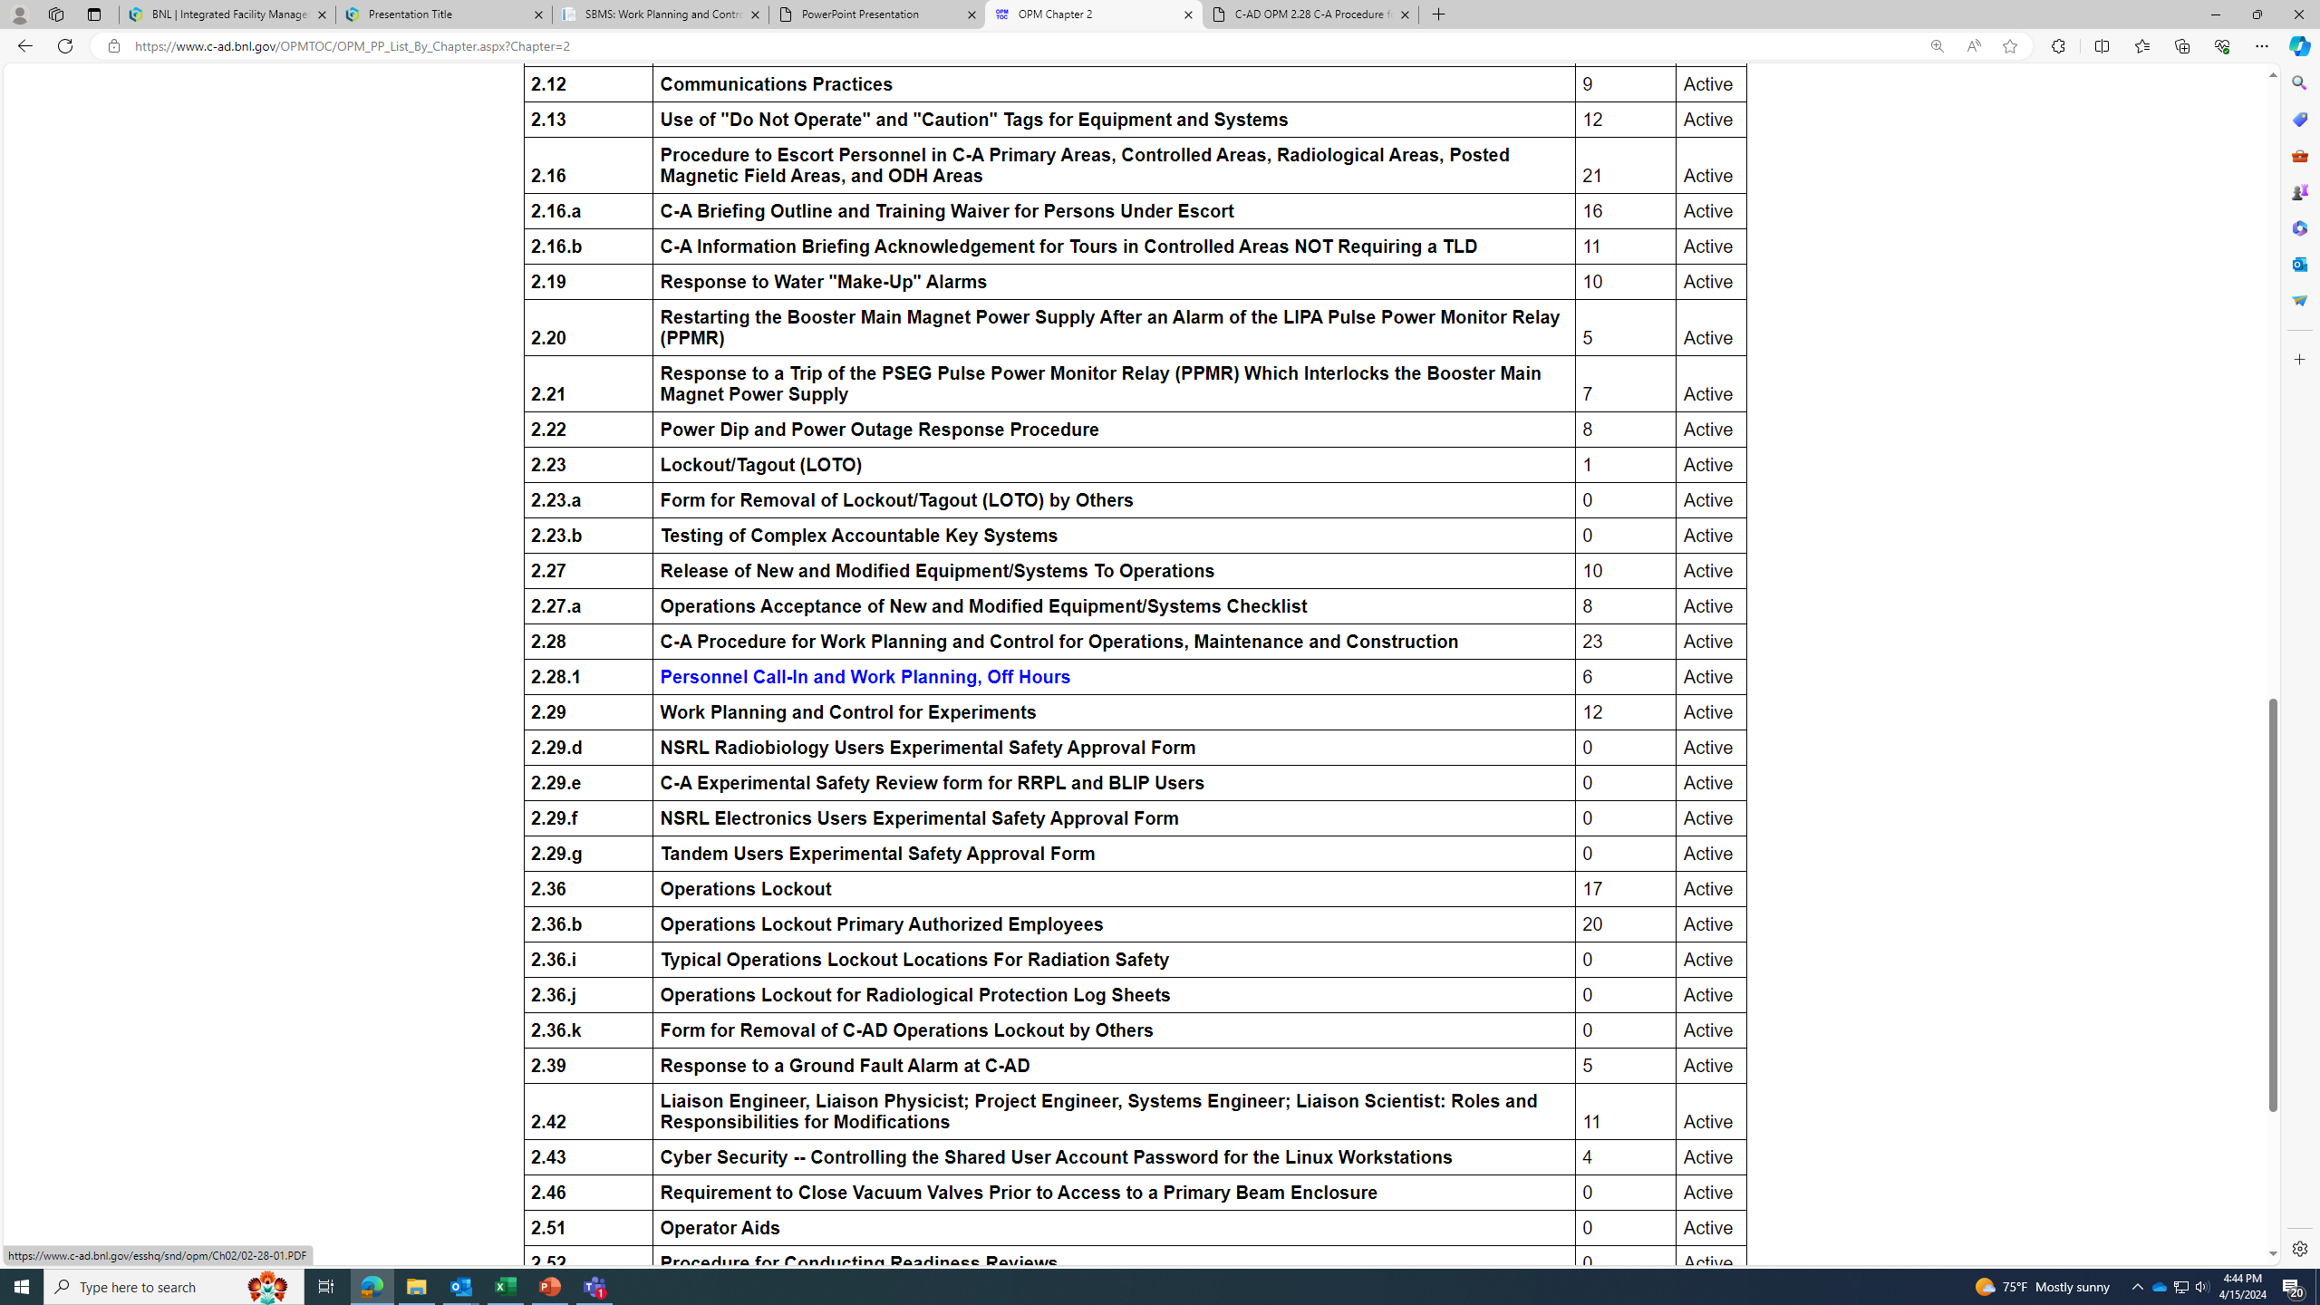
Off-Hours Work- OPM 2.28.1

Slide 4
Safe Conduct of Research in Rapid-Turnaround Work Planning
Everyone is personally responsible for ensuring safe operations.
Staff raise safety concerns because trust permeates the organization.
Cutting-edge science requires cutting-edge safety.
A questioning attitude is cultivated.
Hazards are identified and evaluated for every task, every time.
A healthy respect is maintained for what can go wrong.

Slide 5
Key Messages
The Planning must ensure conformance with complex requirements in SBMS, including (but not limited to) Work Planning and Control, Accelerator Safety, Electrical Safety, Lockout-Tagout.
The screening and planning process is the same, regardless of the time of day, or urgency of the need.
The time pressure during operating periods is a significant stressor; The Work Planning rules do not adjust for this.
ESSHQ shares the desire to minimize down-time.
SBMS/C-AD Procedures provide no short cuts.

