Slide 1
Preinjectors Status
D. Raparia
Time Meeting
April 16, 2024

Slide 2
Tandem
External Users :
-Last week: GE Research
- This week access control certification

Slide 3
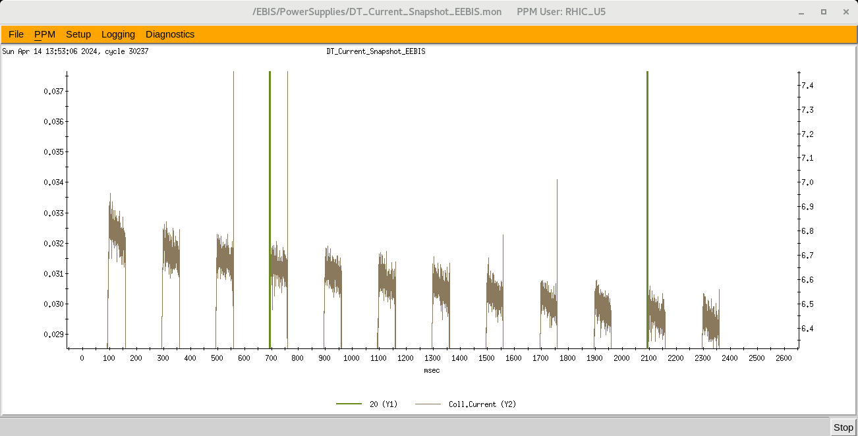
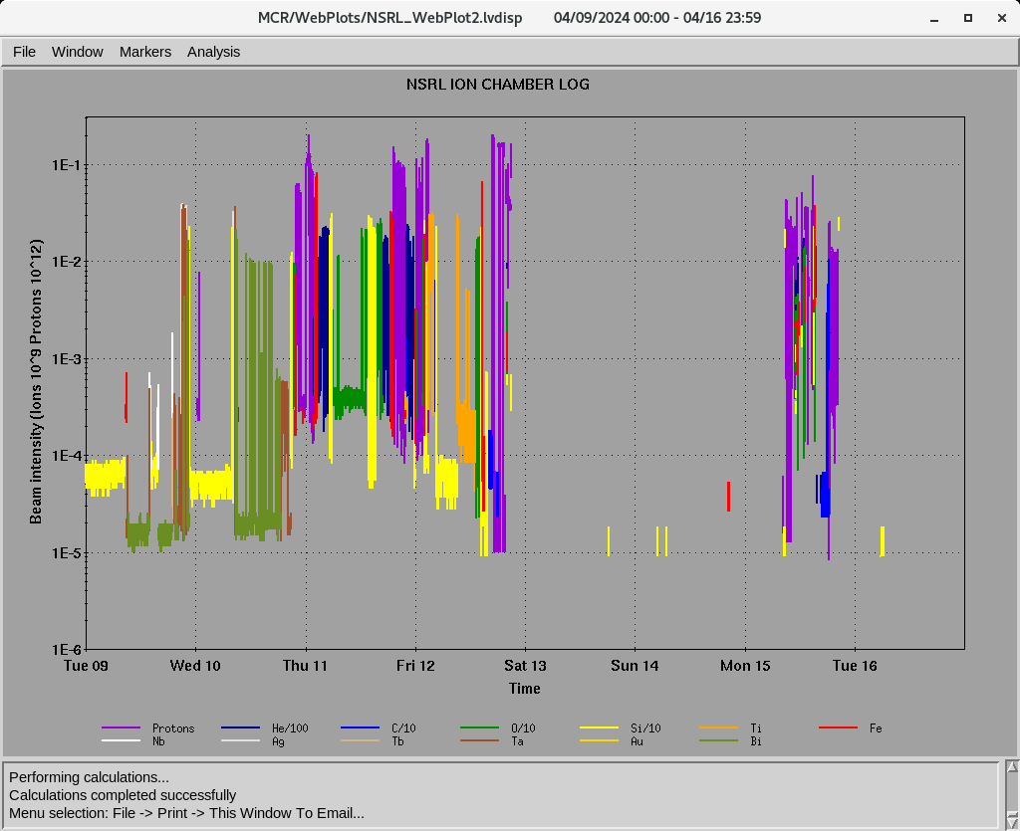
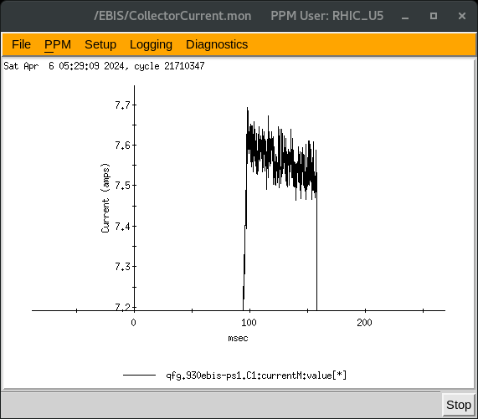
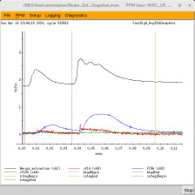
EBIS
Au development for RHIC
Multi-pulses
- Working night and weekend only
Last week ions for NSRL : He⁺² ,C⁺⁵, O⁺⁷, Si^{+11 ,} Ti^{+27 ,} Nb^{+23,} Fe⁺²⁰, Ag⁺²⁹ Tb⁺³⁵ , Ta⁺³⁸
16hours/day , 6 days/week
7.1 A e-current
Ion to NSRL

Slide 4
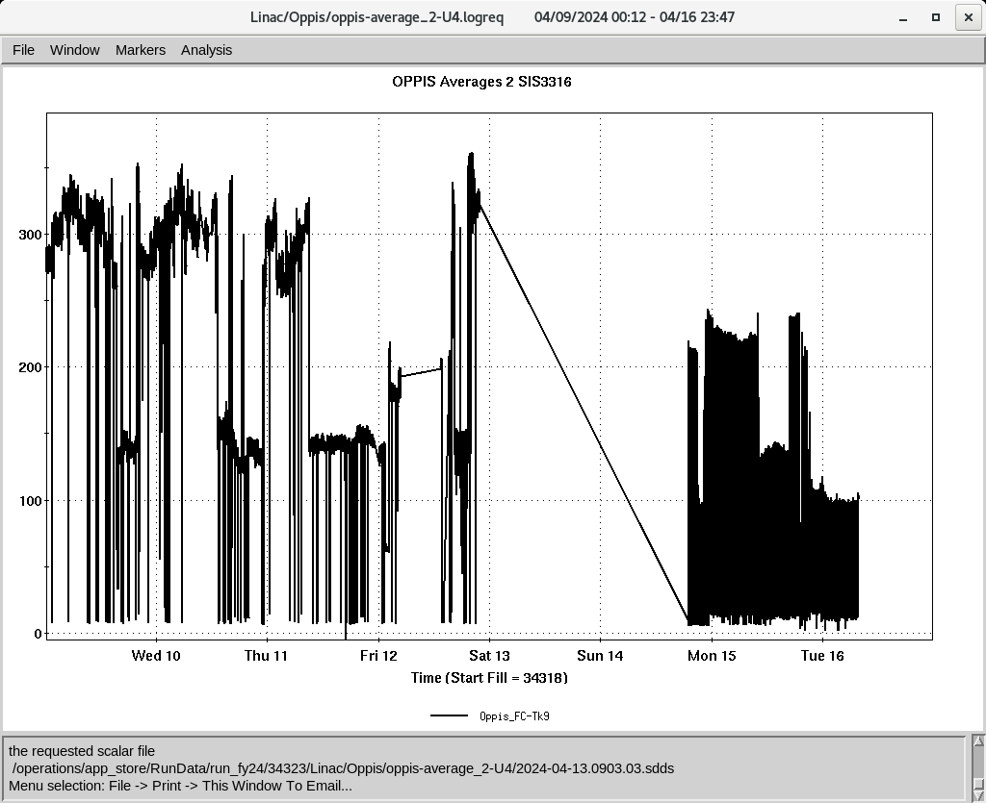
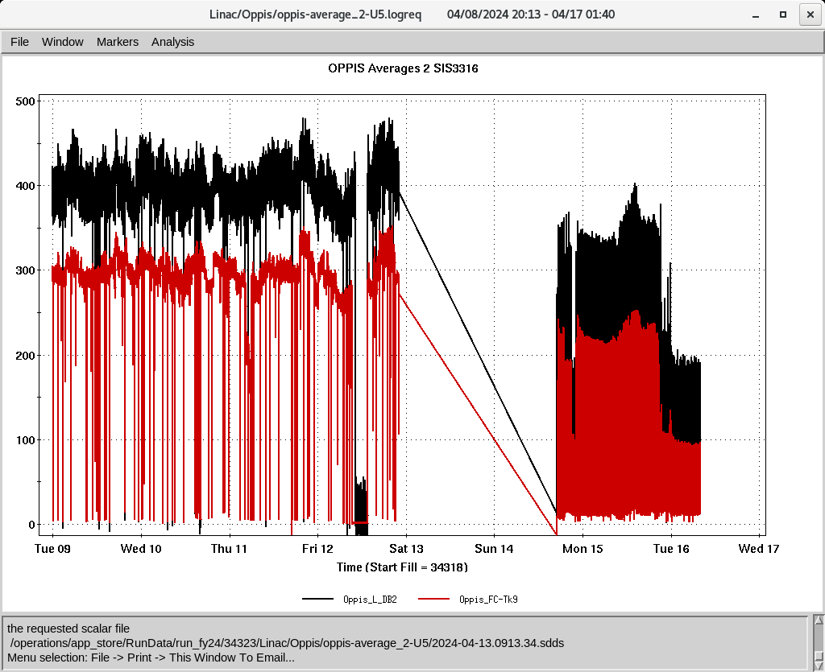
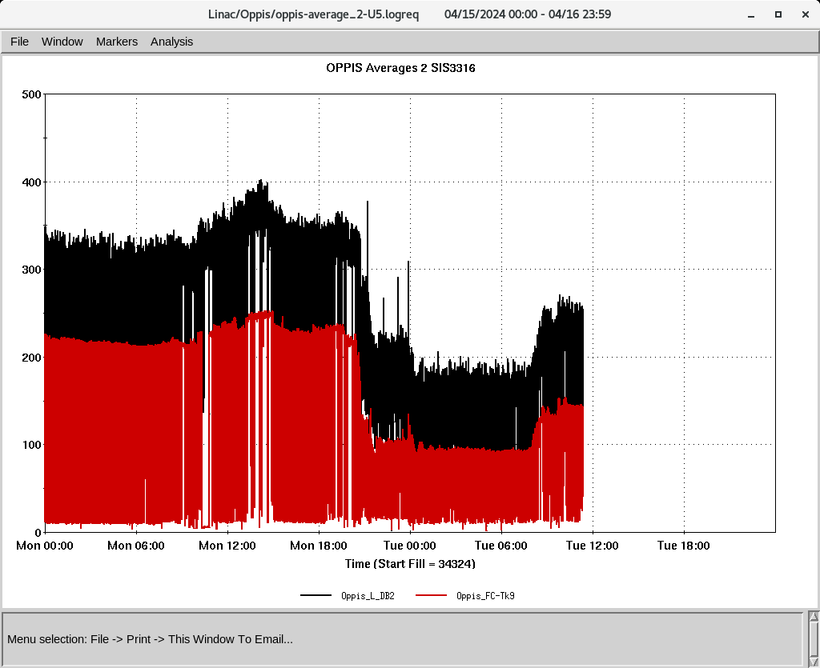
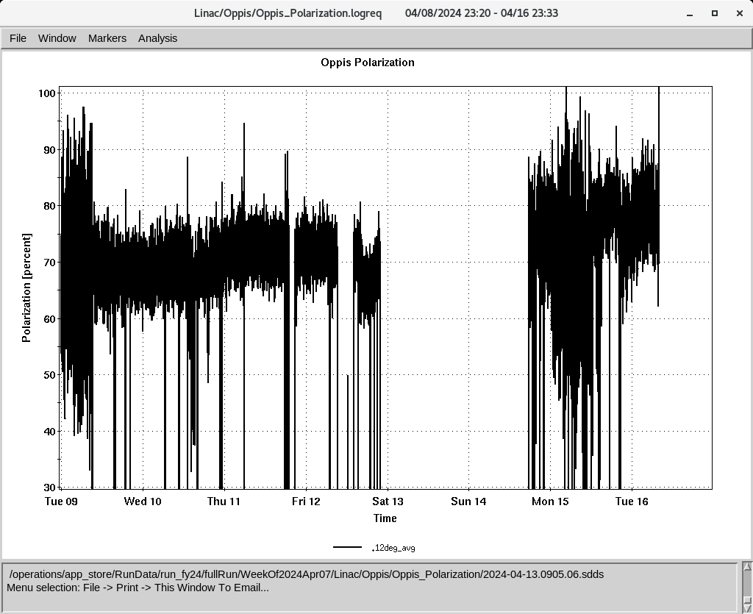
Linac 200 MeV Beam to BLIP , NSRL, Booster , AGS
BLIP
- La irradiation end on 4/12
4/22-5/2: Th, 200 MeV, 150 𝞵A, Tar-Th
polarized H-
To Booster
OPPIS
Suspect solenoid field , recharge current
- Open Rb cell cleaned and change o-ring and magnetic screws , Pol ~ 80%
Providing beam for AGS setup
To 200 MeV Polarimeter
Down time ( ~10 HRS)
-4/11: Tk1-Q35 set point. (30 Min)
-4/11 Power dip ( 1HRS)
-4/15: MOD 9 RF (1 HRS)
Polarization @ 200 MeV

