Slide 1
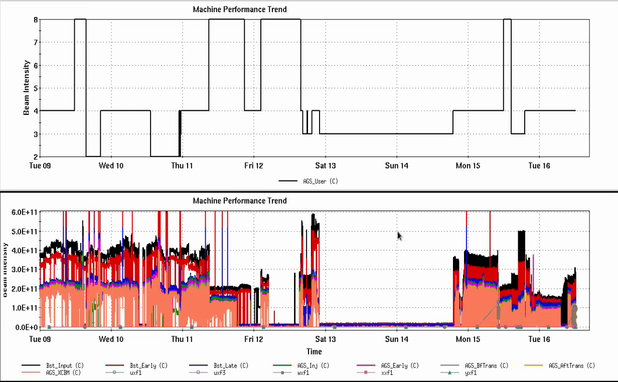
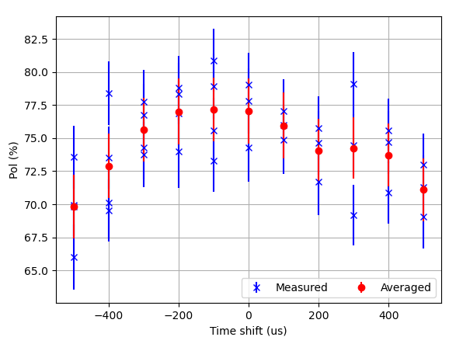
Injector status meeting, 4/16/24
OPPIS polarization
Cooldown and restart 4/12 to 4/14: replacement of magnetic screws
Polarization on restart high 70’s (better than at turn off), conditioning continues
AGS user 4 (standard tune jump operation)
Jump quad on/off polarization 71.8/66.7 +/- 1%, gain of about 7.8% relative (intensity 1.7e11)
Beam extracted to W-dump, ready for injection into RHIC
Extraction bump supply repaired this morning
Optimization scans continue
Development users
Resonance correction (skew quads)
Orbit improvements continue to allow higher strength operation
Dual Linac pulses
Beam established and merged on AGS flattop
Transverse emittances quite large (ε_{x} ~4-5 um)
AGS User
Intensity
Tune jump timing scan
I = 0.7x10¹¹

