Slide 1
sPHENIX status
Kin Yip
sPHENIX Director of Operations
Time meeting
Apr. 16, 2024

Slide 2
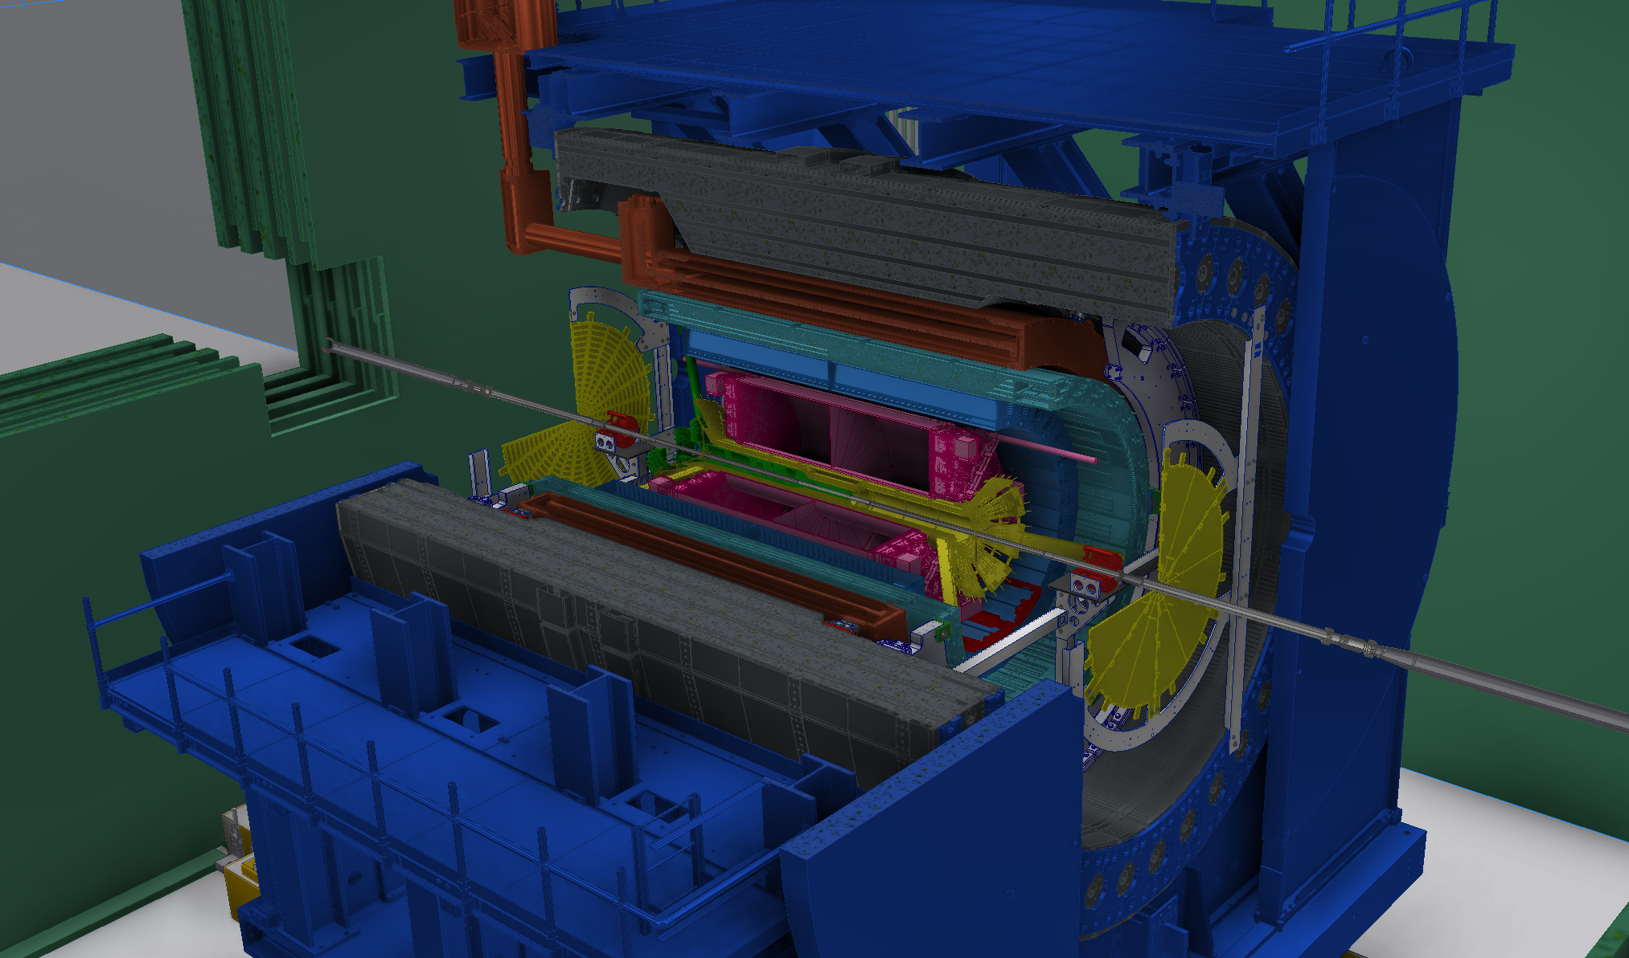
sPHENIX Status
All detectors have been installed,
generally ready for beam collisions. All
detectors have some form of online
monitoring but have run at different rates.
HCAL & EMCAL have got zero-suppression working and running at 15 kHz.
All trigger cards are in place, and we have done synchronization tests with the Level 1 trigger boards.
But TPC still doesn’t have zero-suppression working yet and it has been running at about 30 Hz.
The firmware development to facilitate zero-suppression etc. is ongoing.

Slide 3
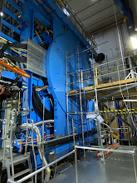
sPHENIX status
Magnet pole-tip doors were closed last Thursday.
Cooled down to ~4.9 K
Hipot done (successfully) this morning
To finish the Power Supply interlock checks etc.
Plan to ramp up the Power Supply/Magnet on Wed. or Thur.
If we can finish the above by Thursday, we don’t need to any more time for the Magnet/Power Supply test.

