Slide 1
Data courtesy C. Naylor

Slide 2
Data courtesy C. Naylor

Slide 3
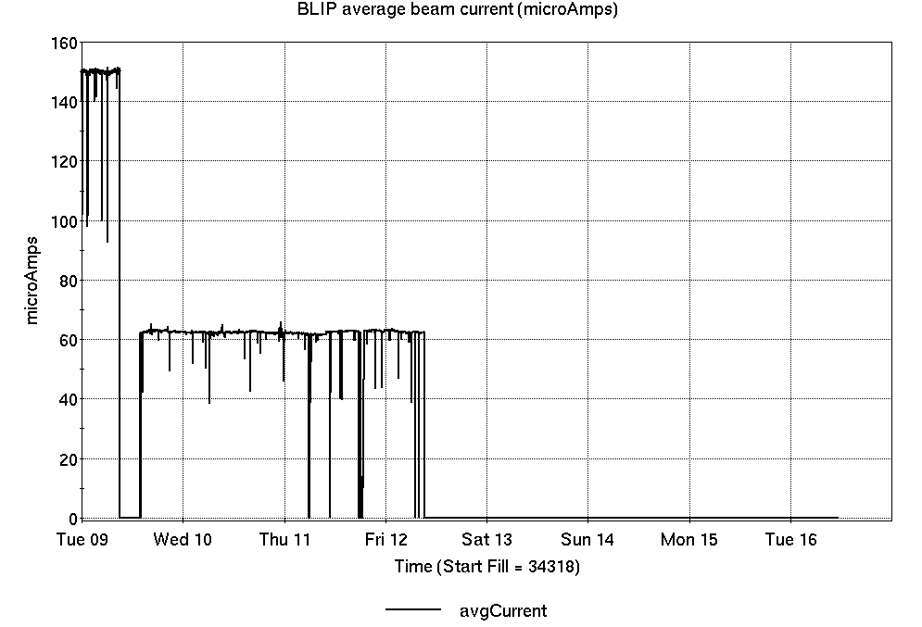
Operations for BLIP
4/9-16/2024:
BLIP 200 MeV production concluded, followed with 117 MeV run ending Friday.
66.63 hr Production
0.58 hr setup
1.47 hr Failures
Availability: 97.9%
No BLIP
this past week

Slide 4
NSRL activity past week: 4/9-16/2024 (as of 0800)
NSRL: User setup and running past week; Following, setup for this week’s NASA biology
Protons, 11 EBIS ions in use. (He, C, O, Si, Ti, Fe, Nb, Ag, Tb, Ta, Bi)
Run 24-A/B schedule updates continue; running 8 Jan - 21 May.
Run 24-C schedule posted; beam into November
Availability: 98.4%

Slide 5
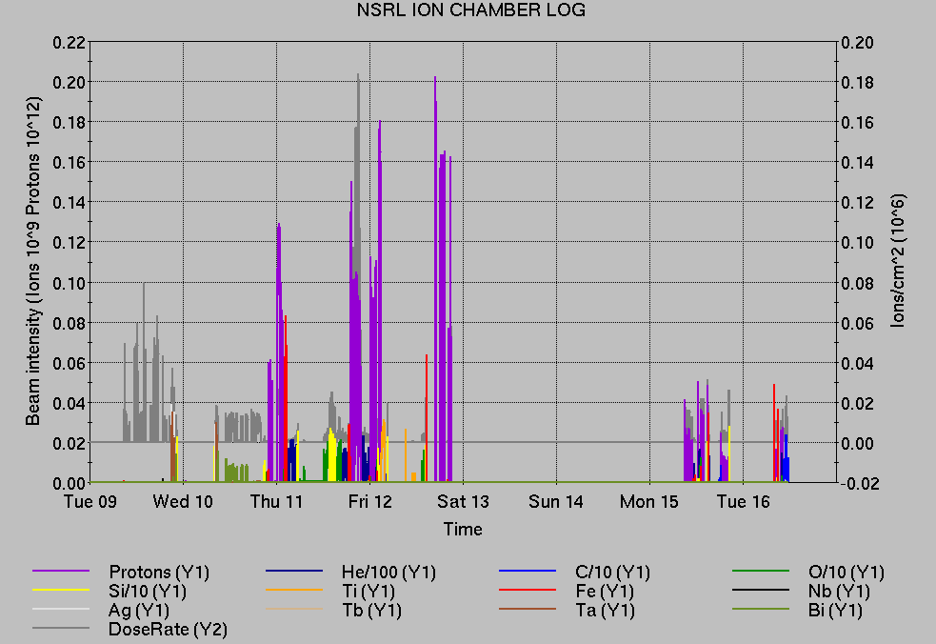
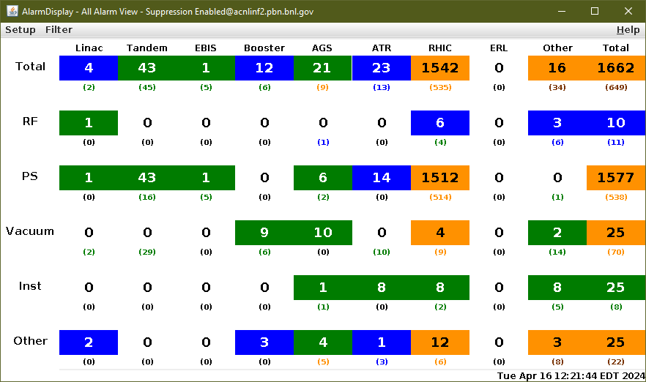
Notes from Operations
Notable failures (>1 hr)
Power dip, affecting Linac, EBIS, AGS cold snake, and various other systems.
AGS g09 extraction BLW failure
Linac Mod 9 mispulsing, signal noise; retuned
HEBT corrector PS trip, water fault (no alarm).
AGS j5 tune jump PS failure, repair
AGS multipole room cooling failure, pumps reset
Other notes
Setup paused for OPPIS work
RHIC injection kickers/scopes not ready
Various AGS RF low-level tuning
Various Linac, EBIS, other PS trips/resets
2,311 things to do today

Slide 6
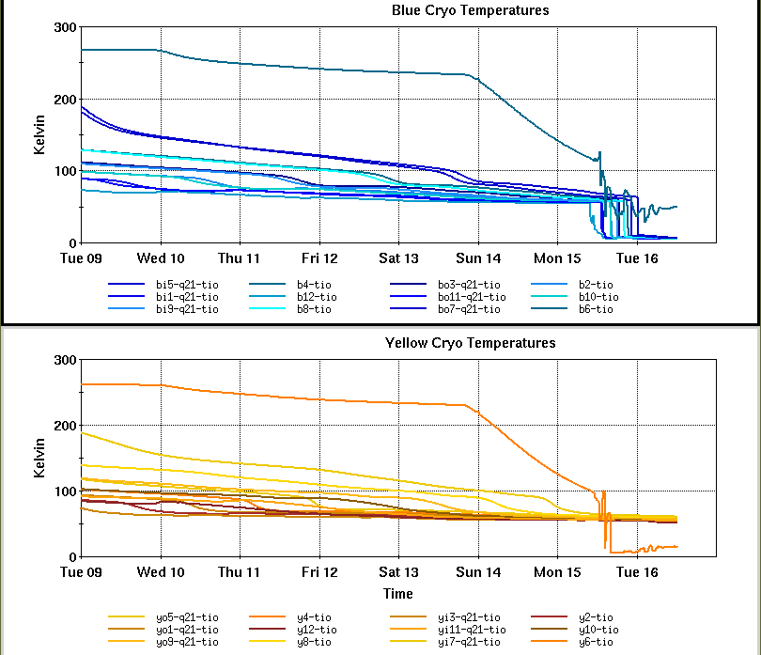
Reminder from Operations
MCR continues Operations for:
BLIP - resuming 22 April.
NSRL user running continues Mon-Sat, NASA Biology this week.
AGS/Booster polarized proton setup continues, over 100 additional hours this week.
Polarization scans in progress, evaluating OPPIS polarization
Setting up multiple (proton) AGS PPM Users. Injector Au setup as yet untested.
Skew quad testing continues.
Preparation for RHIC beam.
Protons established to W-dump.
Remember to coordinate with MCR. Start-up is here!
CHECK AND EDIT YOUR OWN CONTACT INFO
http://directory.pbn.bnl.gov/
CHECK YOUR CALLIN LIST: WCC and ECP updates needed
https://www.cadops.bnl.gov/Operations/personnel/call_in_lists/

Slide 7
Data courtesy C. Naylor

Slide 8
Availability, expected beam hours
$$Availability=\frac{actual beam time}{scheduled beam time}≡\frac{Beam use time}{Calendar time−scheduled interruptions}$$
$$RHIC \\ Availability=\frac{Physics+Machine Development+Machine Setup+Experiment Setup+Accelerator Experiments}{(Physics+Machine Development+Machine Setup+Experiment Setup+Accelerator Experiments)+Failures}$$
$$\text{DOE} \text{expected} \text{beam} \text{hours}=(\# of weeks −1 week overhead)×\left(\frac{160 available hours}{1 week}\right)×0.8$$
Notes:
Normally hidden. Explains how the 85% from DOE comes in to play & general availability metrics

