Slide 1
APEX Report
RHIC Time Meeting, April 16, 2024

Slide 2
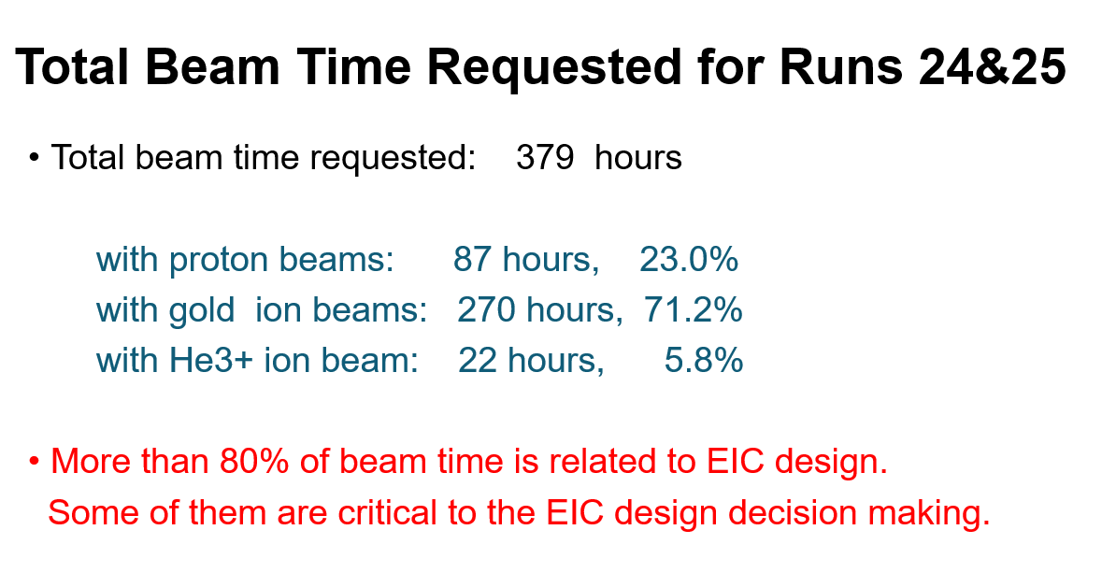

Slide 3
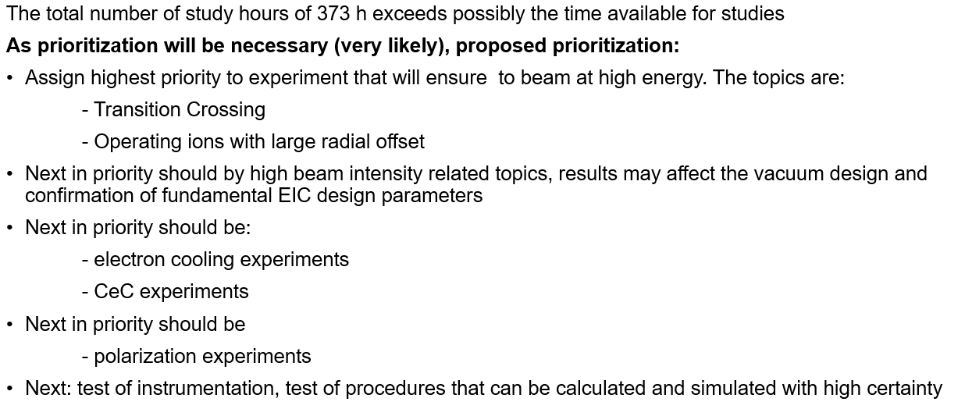
Priority of APEX Proposals
@Ferdinand

Slide 4
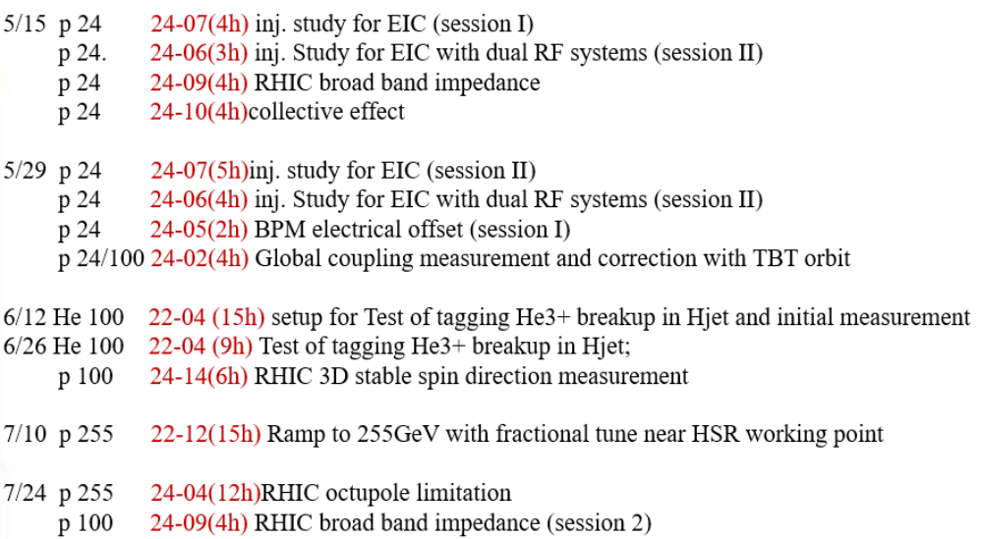
Draft APEX Schedules
@Haixin

