Slide 1
TAKE FIVE for Safety-
Frank Craner
April 23, 2024

Slide 2
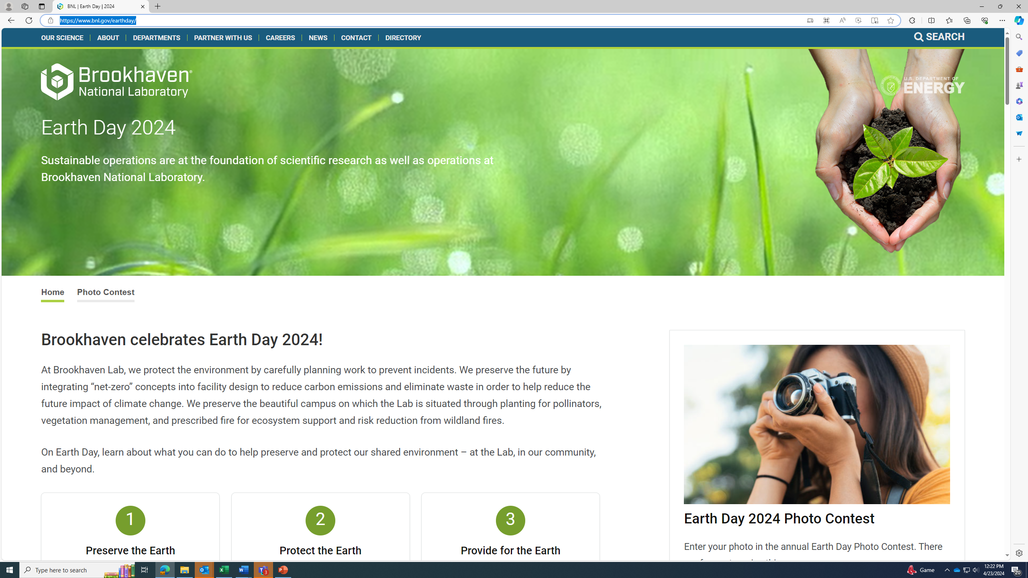
Brookhaven Celebrates Earth Day
BNL | Earth Day | 2024

Slide 3
Environmental Management System
BNL Implements and Certifies to the ISO 14001 Environmental Management System
The EMS is designed to:
  Protect the environment
  Eliminate, reduce, or control environmental risks and impacts
  Ensure compliance with regulatory requirements
  Achieve clean-up goals
  Conserve resources
  Achieve and demonstrate environmental excellence.

Slide 5
Examples of Processes with Potential or Actual Impacts to the Environment
Cooling Water Use and Discharge
Oil-Filled Equipment Operation/Maintenance
Bulk Chemical Storage and Chemical Use
Energy Use
Activation of Soil, Water, components
Waste Generation, Accumulation and Disposal
Greenhouse Gas Use

Slide 6
C-AD FY24 Environmental Objectives/Initiaves
Regulatory Compliance:
  Zero notices of regulatory and permit violations
Pollution Prevention Evaluation/Improvement:
  AGS/Booster/Linac Water Systems
  BLIP Emissions
  Pursue gas recirculation to reduce greenhouse gas releases

