Slide 1
Preinjectors Status
D. Raparia
Time Meeting
April 23, 2024

Slide 2
Tandem
External Users :
- Last week: Access control certification
- This week: Two internal user and GVS

Slide 3
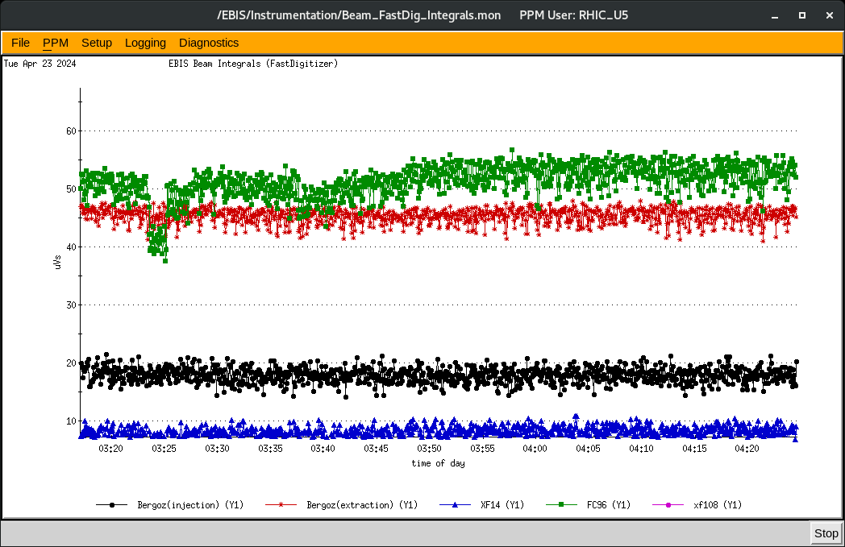
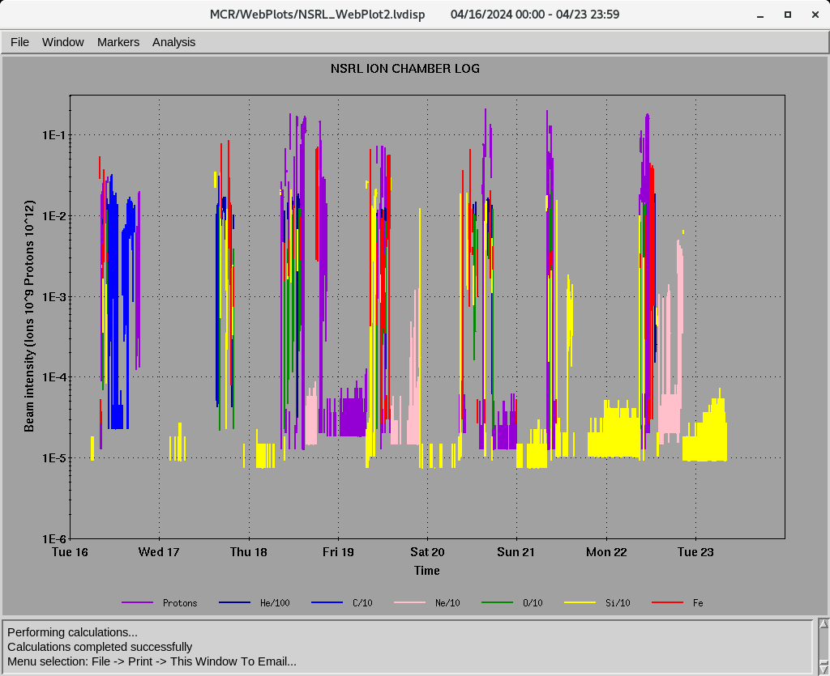
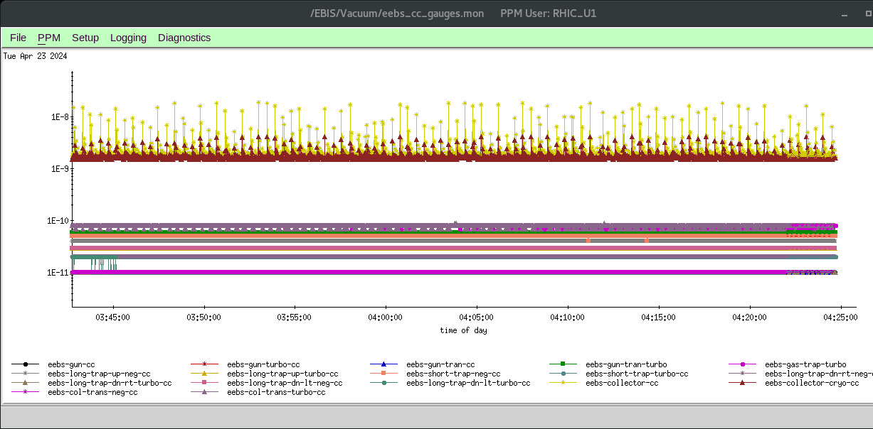
EBIS
Au development for RHIC
Multi-pulses
- Working night and weekend only
Last week ions for NSRL : H, He⁺² ,C⁺⁵, O⁺⁷, Ne⁺⁸ Si^{+11 ,} Fe⁺²⁰,
16hours/day , 6 days/week
6.5 A e-current
Power –dip
Ne development
Ion to NSRL

Slide 4
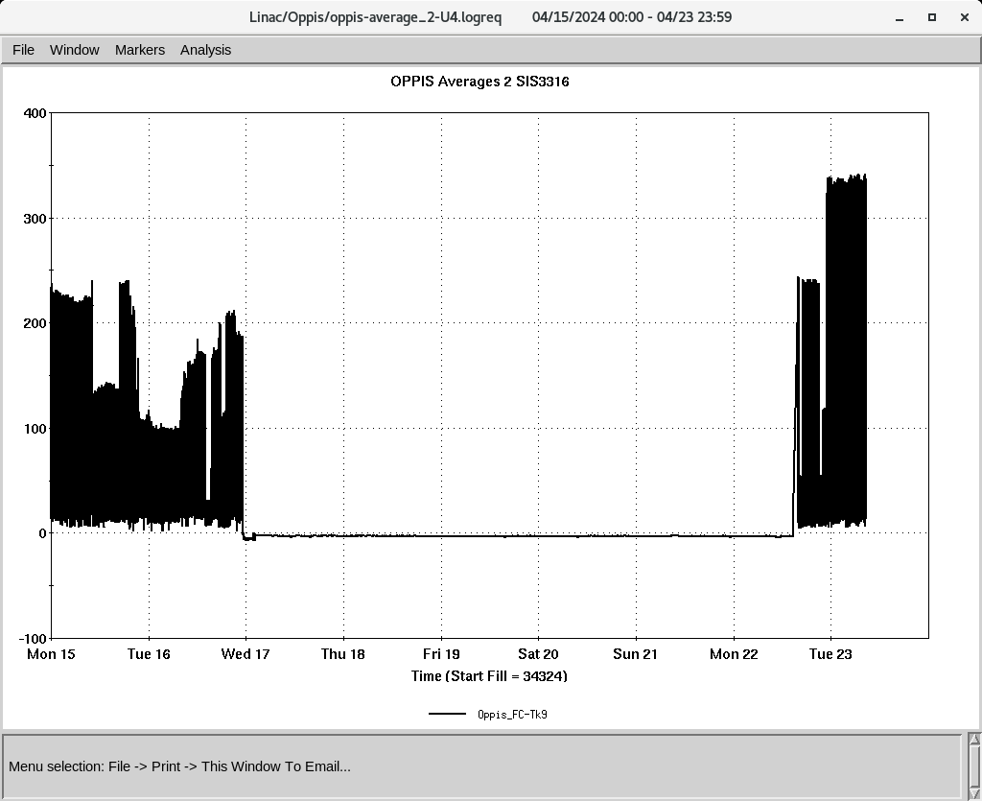
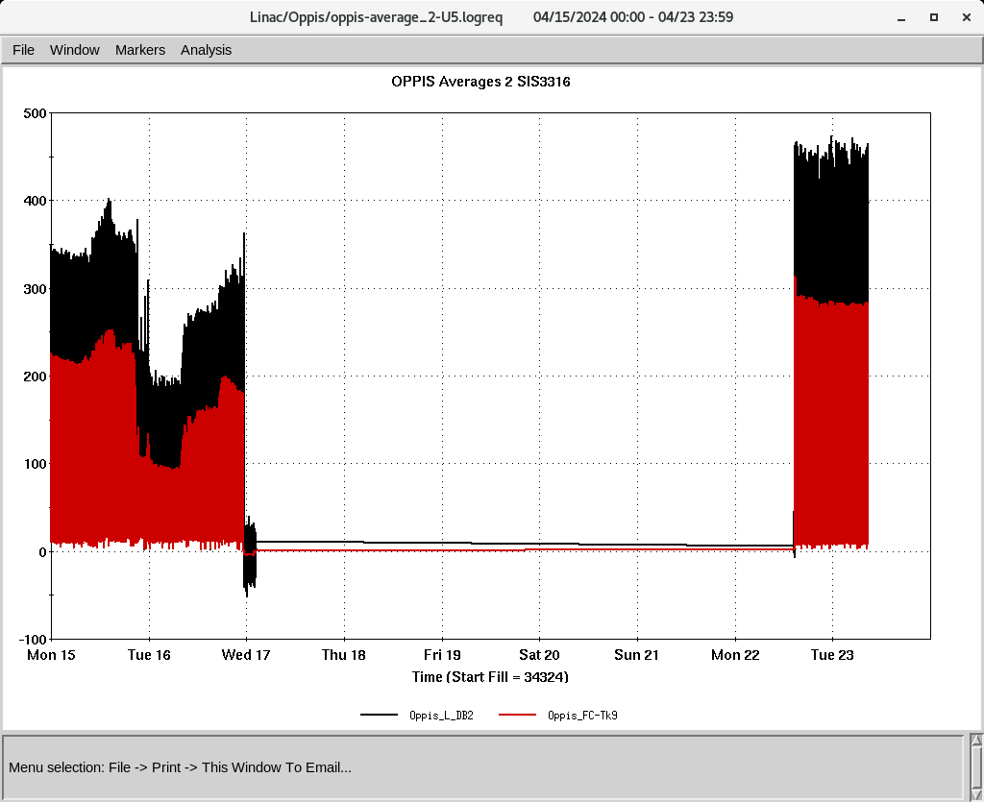
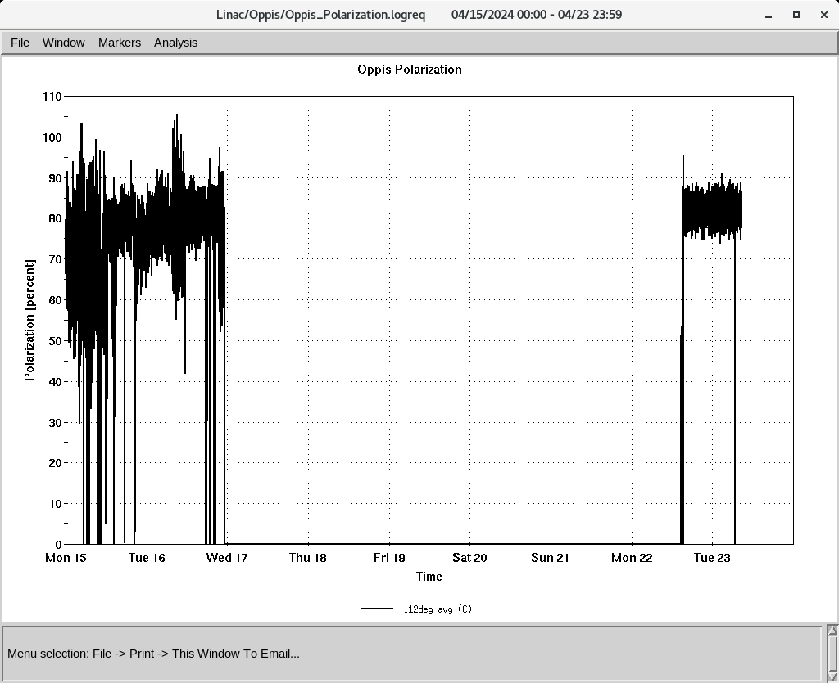
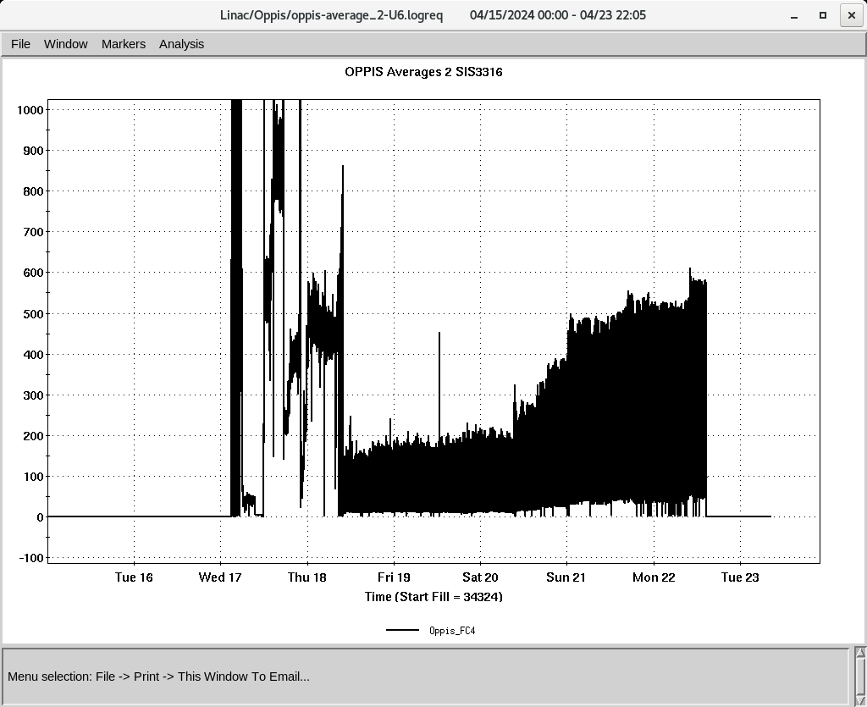
Linac 200 MeV Beam to BLIP , NSRL, Booster , AGS
BLIP
4/22-5/2: Th, 200 MeV, 140 𝞵A, Tar-Th
polarized H-
To Booster
OPPIS
Recovered from Last week power-dip
Pol. ~ 82 % , current 320 uA@ tank 9
To 200 MeV Polarimeter
Down time
-4/16: power dip
-4/17: mod 7 , mod 6
-4/18: Mod 6
-4/19: mod 7, 8616 replaced , mod 6
-4/20-4/23: mod 6 , change tube 4cw2500
Polarization @ 200 MeV
OPPIS recovery

