Slide 1
sPHENIX status
Kin Yip
sPHENIX Director of Operations
Time meeting
Apr. 23, 2024

Slide 2
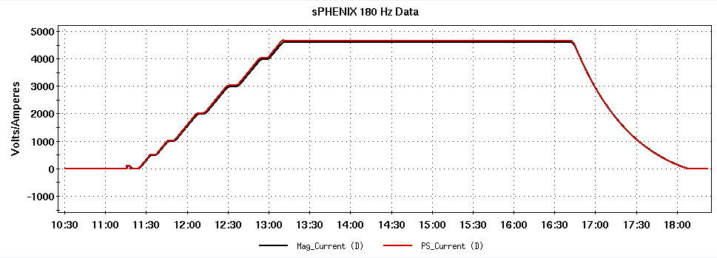
sPHENIX status (Magnet)
Last Thursday (Apr. 18),
after completing all the tests /
checks, we ramped up the
magnet to the top, ~4600 A
at the first attempt. It’s
~completed around 13:12.
Done !
But before 17:00, Roberto (Cryo) called and informed me that there was a valve problem in the 400 L reservoir (in 1008-IR) and I needed to ramp down the Magnet. 😥
It turned out that we needed to warm up the reservoir vessel over the weekend and fixed the valve on Monday afternoon/evening.
The stem was found to be bent and was straightened out and a new seat was installed. Calibrations was completed this morning and cooling has started.

Slide 3
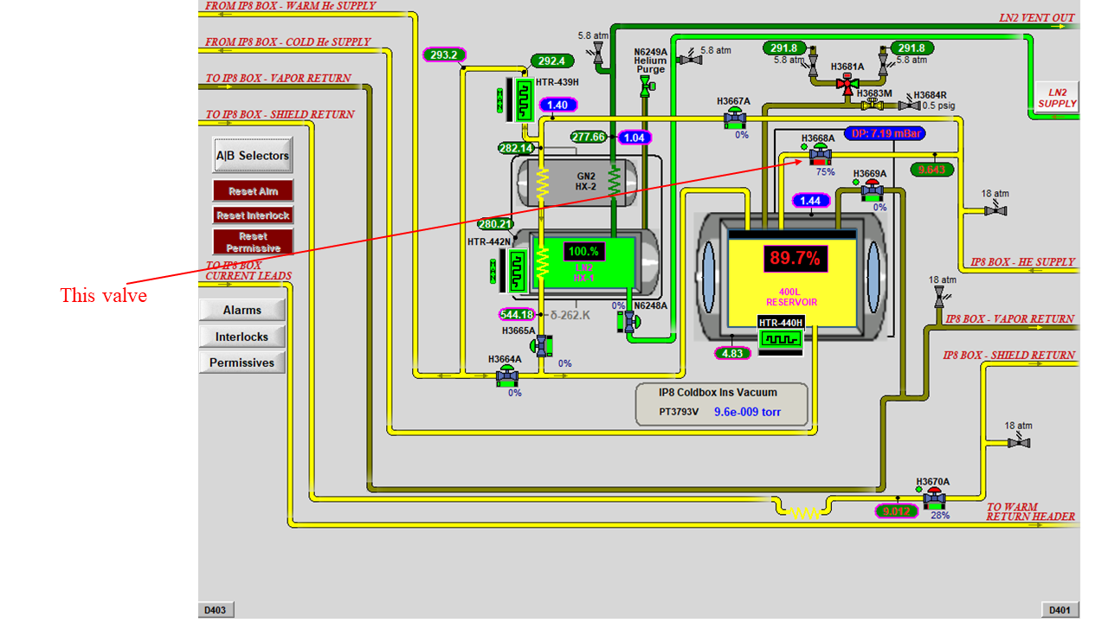
sPHENIX status (Magnet)
The 400L reservoir
is outside and on top
of the Magnet in
1008-IR top platform.

Slide 4
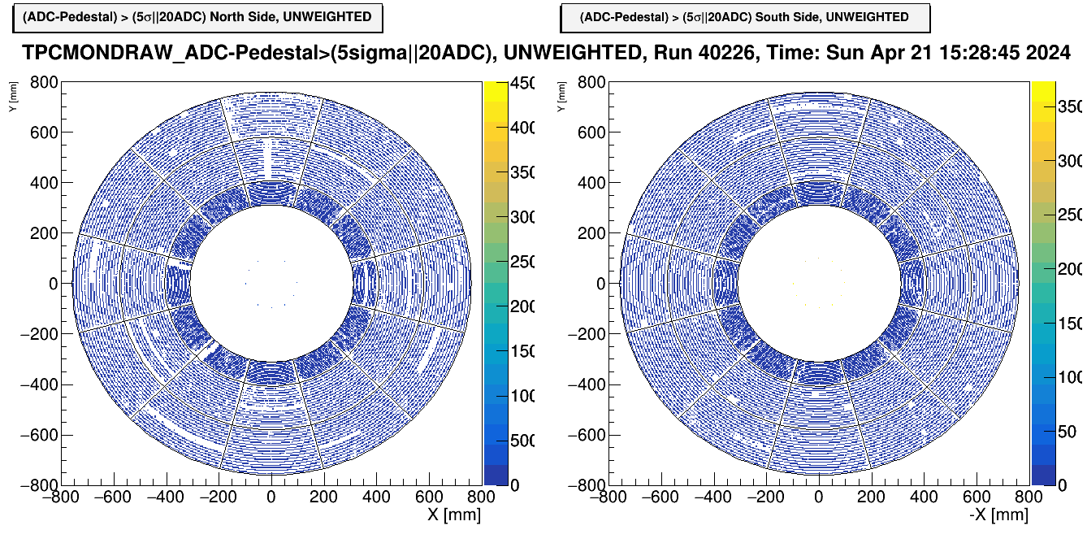
sPHENIX Status
TPC firmware status:
86% of the sort-out-box channels are
functional (for downloading firmware to
Front-End-Electronic cards)
New firmware with features needed
for physics is being tested on one
off-detector sector and one sector of the TPC
Features include activating zero suppression in the SAMPA, clock
synchronization, and busy return to Global-Level-1/Global-Timing-Module
Before you start to enter and work in 1008-IR/Assembly-Hall, please inform our Shift Leader in the 1008 Control Room.

