Slide 1
Data courtesy C. Naylor

Slide 2
Data courtesy C. Naylor

Slide 3
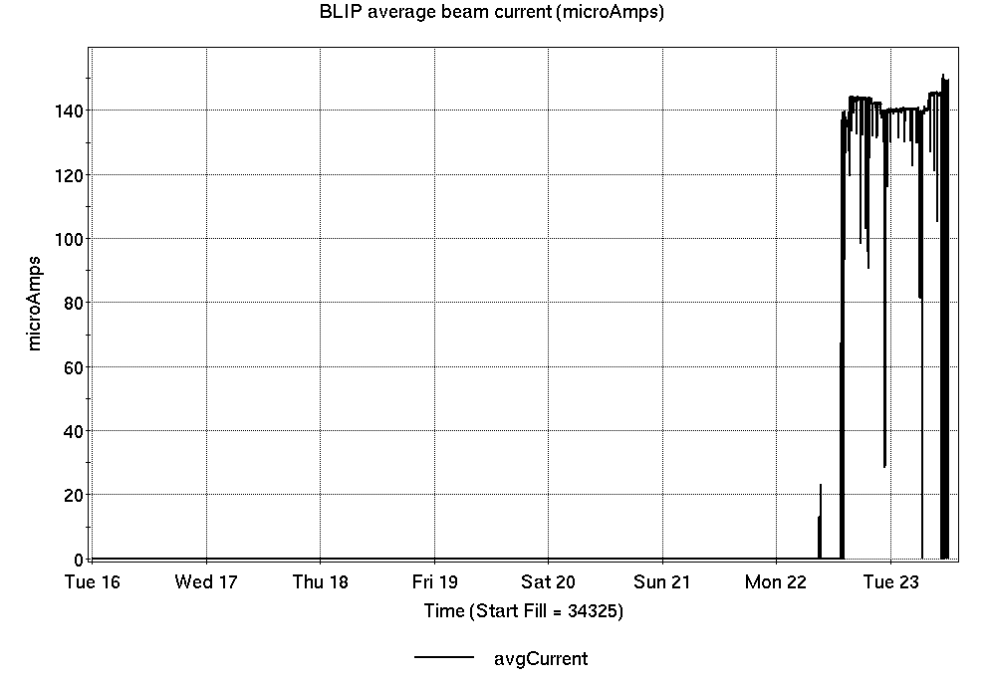
Operations for BLIP
4/16-23/2024:
BLIP 200 MeV production began Monday, although later than scheduled.
17.83 hr Production
0.59 hr Setup
No Failures
Availability: 100%
(with degraded performance)
No BLIP
this past week

Slide 4
NSRL activity past week: 4/16-23/2024 (as of 0800)
NSRL: NASA biology continues, as primary user in GCR mode; delays with proton availability required make up days for some users.
Protons, 6 EBIS ions in use. (He, C, Ne, O, Si, Fe)
Run 24-A/B schedule updates continue; running 8 Jan - 21 May.
Run 24-C follows 22 May. Schedule posted, details forthcoming; beam into November.
Availability: 77.8%

Slide 5
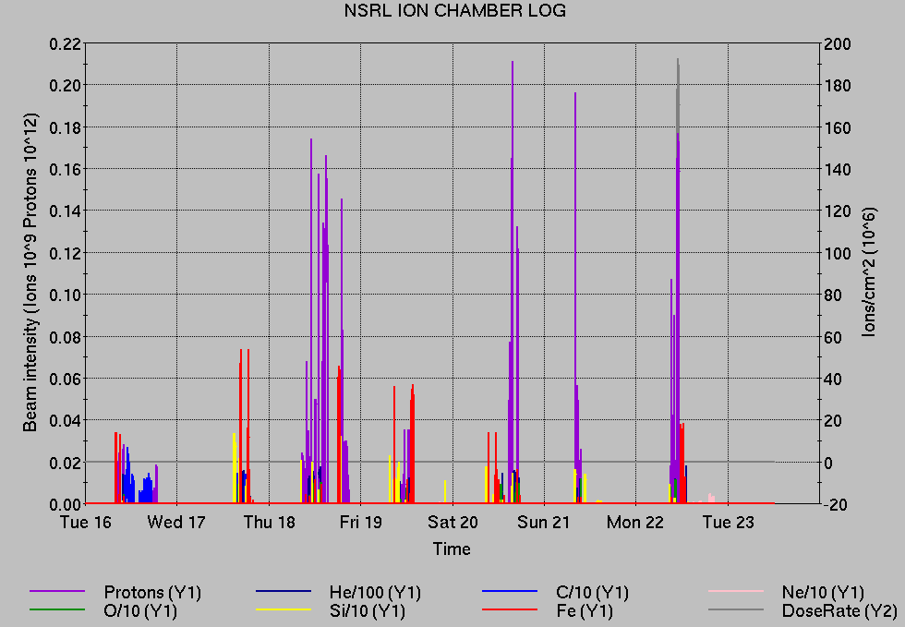
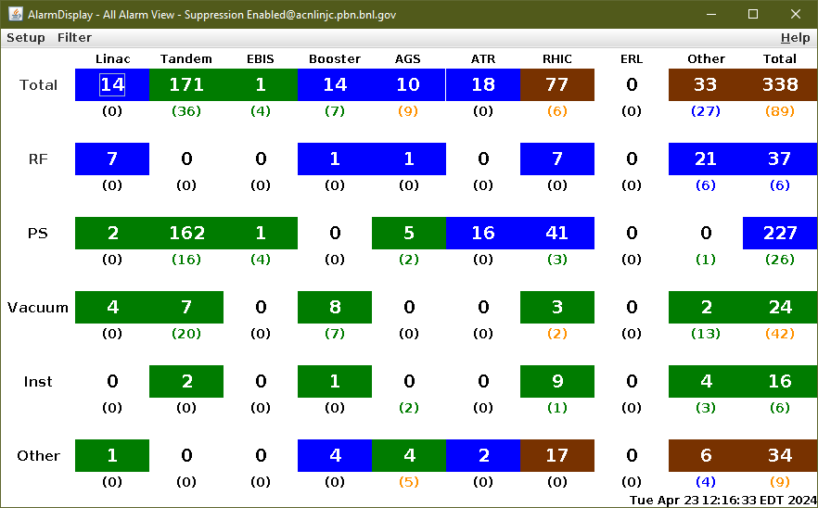
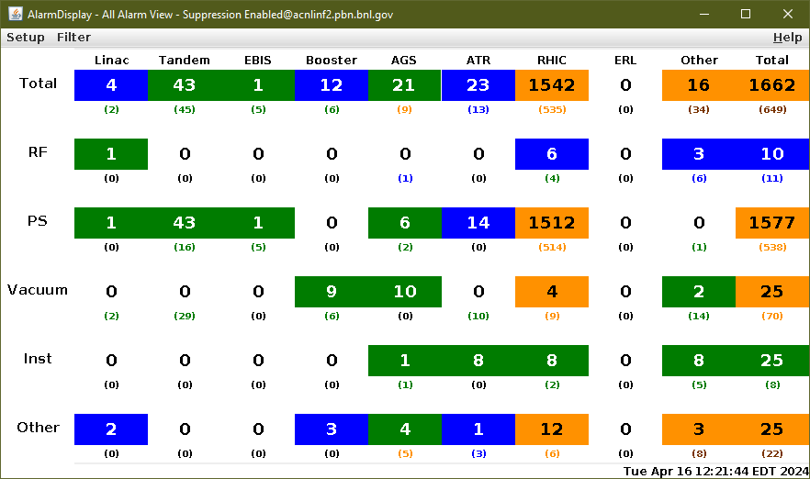
Notes from Operations
Notable failures (>1 hr)
Significant power dip across the C-AD complex; Recovery extended across and beyond scheduled Maintenance period. snake, and various other systems.
Polarized beam unavailable from OPPIS (reconditioning now complete).
Linac Mod 6 failure; reduced performance, NSRL delays.
Blue injection kicker failure, ongoing.
Other notes
Access as required for PS, Cryo, RF, Vacuum, CeC, Experiments
Setup halted for lack of available systems (3x)
Various other trips, resets
2,311 alarms last week; 427 today

Slide 6
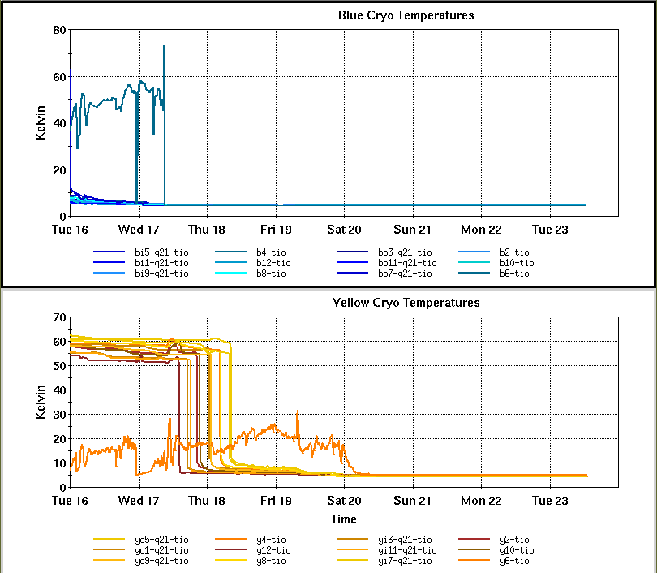
Reminder from Operations
MCR continues Operations for:
BLIP – continues through 3 May.
NSRL user running scheduled Mon-Fri, NASA Biology this week and next.
AGS/Booster polarized proton setup continues, additional to RHIC setup.
Polarization scans in progress, evaluating OPPIS polarization
Setting up multiple (proton) AGS PPM Users. Injector Au setup as yet untested.
Skew quad testing continues.
RHIC beam setup.
Protons injected in Blue; Yellow injection pending.
Remember to coordinate with MCR. We need proper contacts when systems require experts
CHECK AND EDIT YOUR OWN CONTACT INFO
http://directory.pbn.bnl.gov/
CHECK YOUR CALLIN LIST: WCC and ECP updates needed
https://www.cadops.bnl.gov/Operations/personnel/call_in_lists/

Slide 7
Data courtesy C. Naylor

Slide 8
Availability, expected beam hours
$$Availability=\frac{actual beam time}{scheduled beam time}≡\frac{Beam use time}{Calendar time−scheduled interruptions}$$
$$RHIC \\ Availability=\frac{Physics+Machine Development+Machine Setup+Experiment Setup+Accelerator Experiments}{(Physics+Machine Development+Machine Setup+Experiment Setup+Accelerator Experiments)+Failures}$$
$$\text{DOE} \text{expected} \text{beam} \text{hours}=(\# of weeks −1 week overhead)×\left(\frac{160 available hours}{1 week}\right)×0.8$$
Notes:
Normally hidden. Explains how the 85% from DOE comes in to play & general availability metrics

