Slide 1
TAKE FIVE for Safety- C-AD LOTO Events in 2024
Wolfram Fischer
April 30, 2024

Slide 2
2024 Events related to LOTO
CAD has had 3 LOTO events in the last 4 months.
LOTO Lock not re-applied after completion of maintenance (January 29);
Damaged Wires Discovered on Power Supply (April 3);
Inadequate Electrical Pre-Job Briefing (April 26)

Slide 5
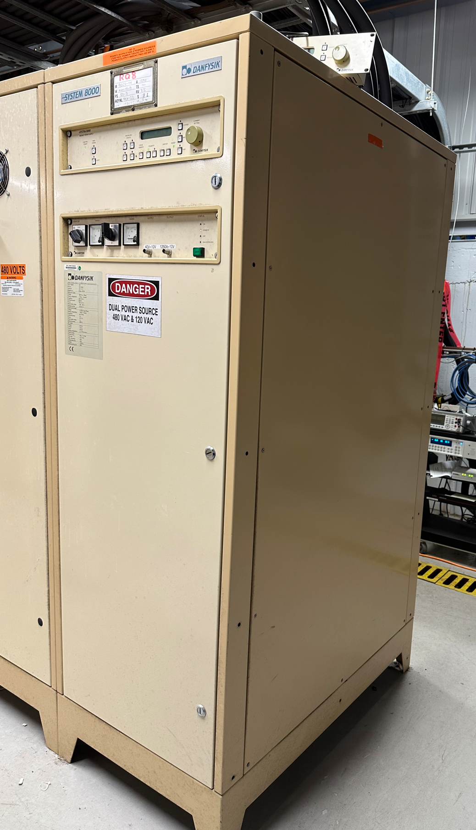
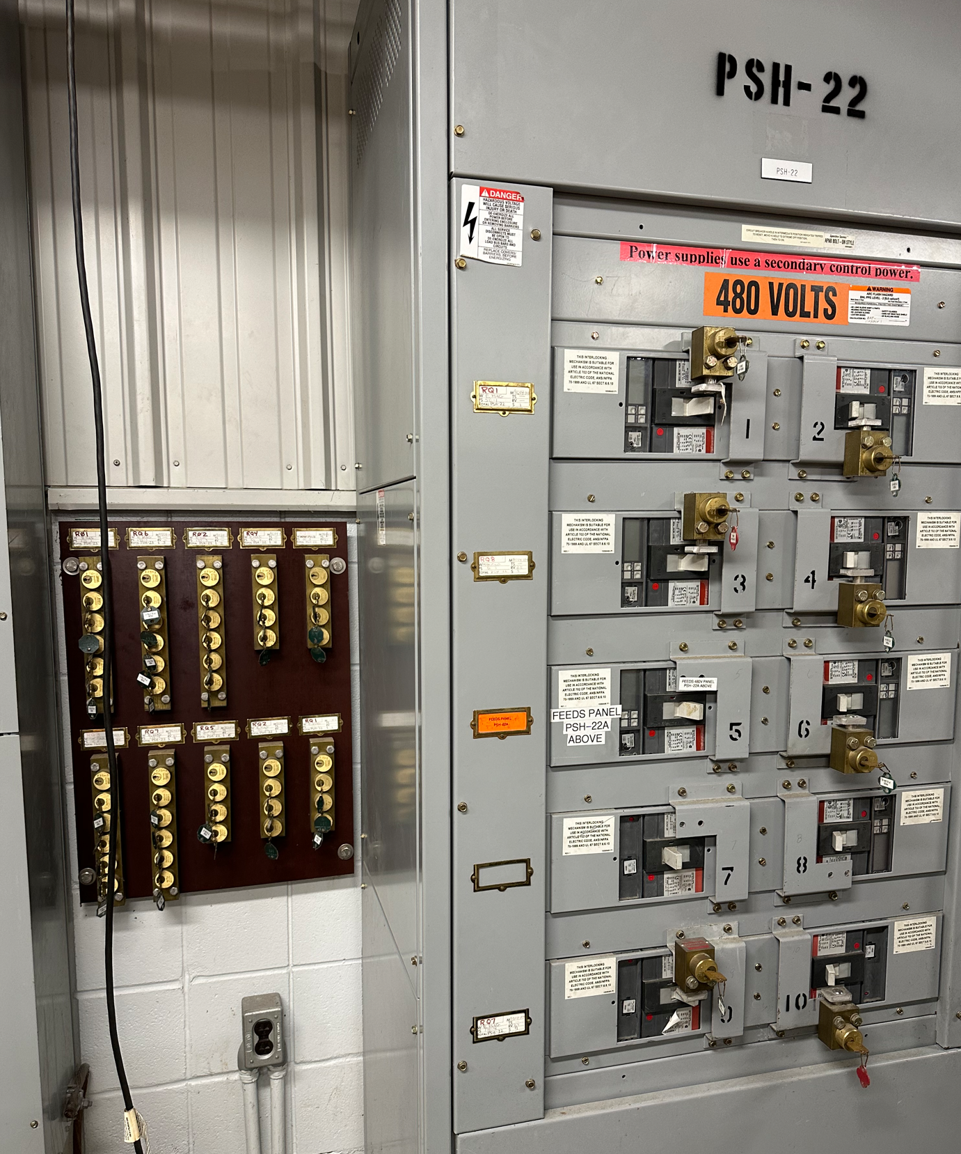
TITLE: Inadequate Electrical Pre-Job Briefing
SCBNL: E-01849 Date: 26 April 2024
Description & Categorization Level: On April 23, at 8:20 AM, the Collider-Accelerator Support team responded to a power supply malfunction in Building 957. Unable to fix the issue, they consulted the system expert. An electrical briefing took place but was not documented. The team safely (wearing PPE) disconnected the power using the 480 volt disconnect. A Kirk key system for lockout/tagout (LOTO) procedures were implemented. The diagnosis involved multiple cycles of energizing and de-energizing the supply. It is not clear at the time of this report if required zero energy checks were performed each time. The problem was traced to a defective motor in the polarity reversing switch, which restricted the supply's functionality. Repairs were completed the next day, and no injuries were reported.
Potential Cause(s): Work Planning Less than Adequate.
Immediate/Containment Actions:
Notification made to ORPS Categorizer.
Personnel Interviewed.
Investigation to begin.
Point of Contact: David Chan

Slide 6
Common Causes and Themes
All three events related to LOTO procedures not being properly followed:
Lock removed for testing and not re-applied as required.
Grounding straps not removed prior to removal of locks and powering equipment.
Questions about properly performed zero-energy checks and inadequate pre-job briefings.
All events involved experienced employees.
One event (4/3) resulted in damage to equipment.
No injuries resulted.

Slide 7
Executing LOTO
The LOTO Process includes several procedural steps (notifications, setup, and removal) in addition to isolation, verification, Lock and Tag.
All steps, including pre-LOTO and post-LOTO, must be completed to have a safe and compliant LOTO.
Meticulous execution of all of the LOTO steps is needed to assure elimination of hazards to workers, and it is required by BNL SBMS.
C-AD has many dozens of LOTO procedures. We are improving the quality of those procedures, but they MUST be followed.
If there are any questions regarding LOTO, the ESSHQ Division is here to help!

Slide 8
The Take Away Message
Following LOTO procedures is necessary to ensure a safe work environment for all.
Not following proper LOTO procedures can result in injuries or equipment damage.
Not following proper LOTO procedures impacts our ability to deliver a quality science program.
The ESSHQ Division is here to help.
NOT following LOTO procedures is NOT acceptable and will NOT be tolerated.

