Slide 1
Preinjectors Status
D. Raparia
Time Meeting
April 30, 2024

Slide 2
Tandem
External Users :
- Last week: Two internal user and GVS
- this week: no user

Slide 3
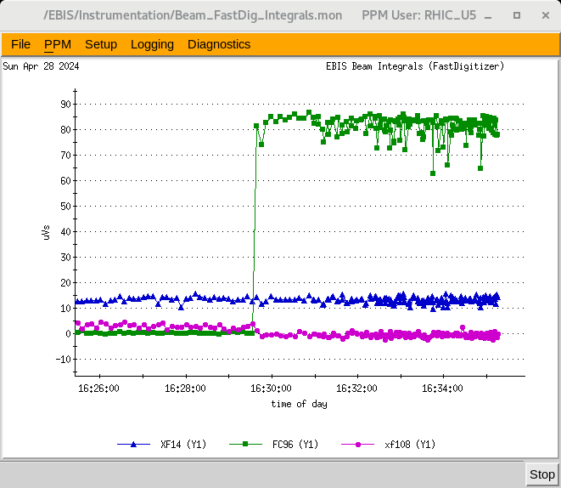
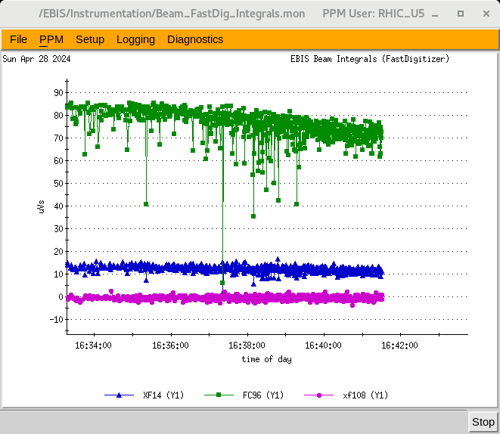
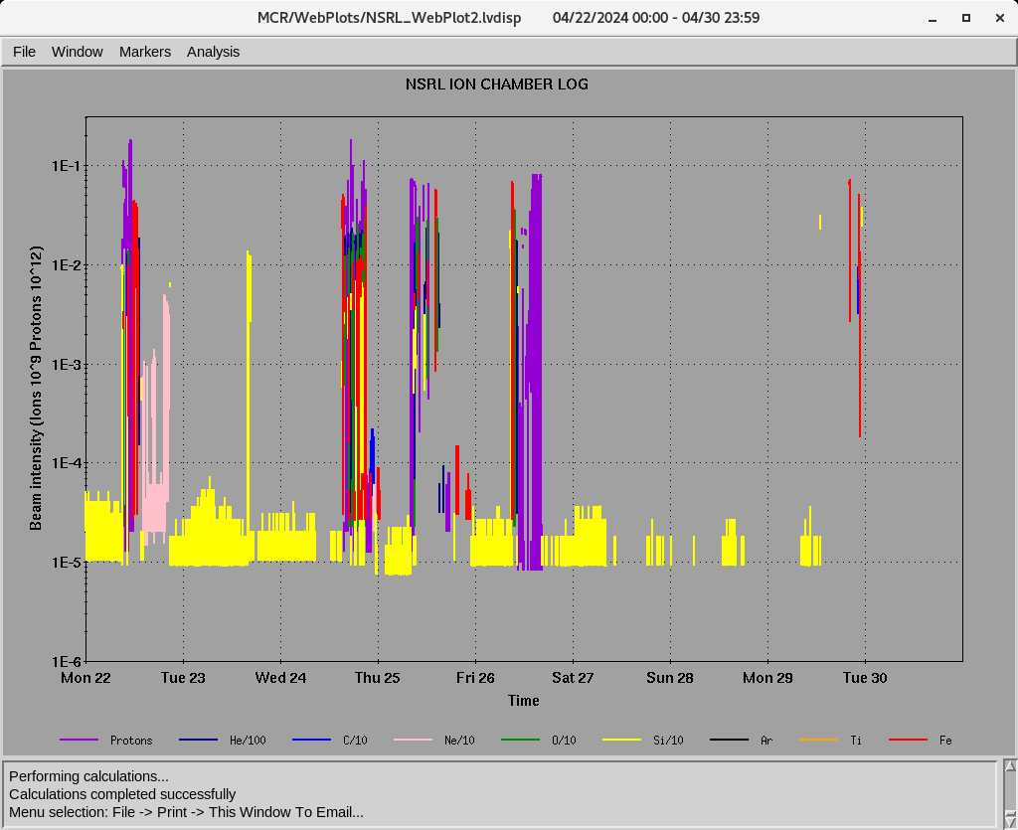
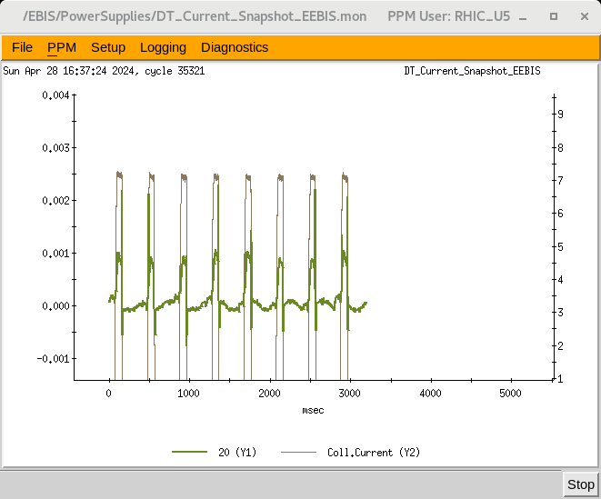
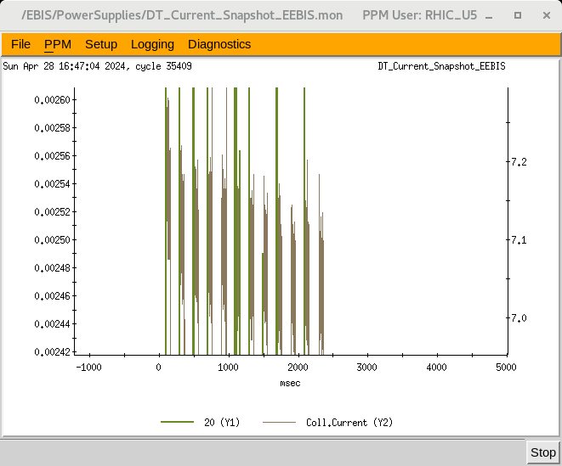
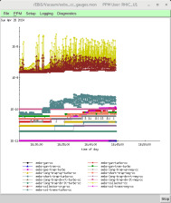
EBIS
Au development for RHIC
Multi-pulses (good progress)
1 p , almost at the goal
12 p at 400 ms , stable , ~80% of goal
No runaway vacuum 12 pulses with no e-beam
Last week ions for NSRL : H, He⁺² ,C⁺⁵, O⁺⁷, Ne⁺⁸ Si^{+11 ,} Fe⁺²⁰,
16hours/day , 6 days/week
7.1 A e-current
8 P , 800 ms
12 P, 200 ms
Ion to NSRL
12 P, 200 ms

Slide 4
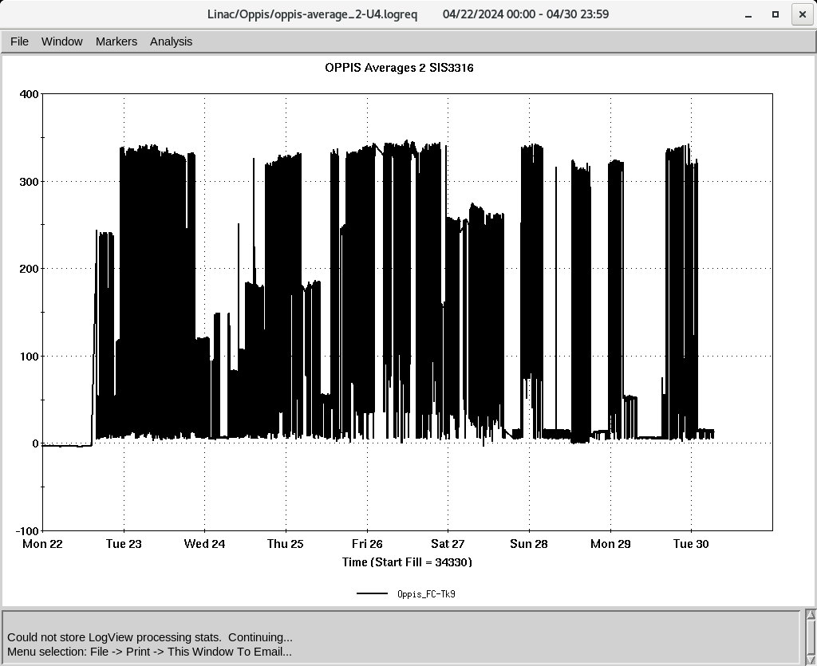
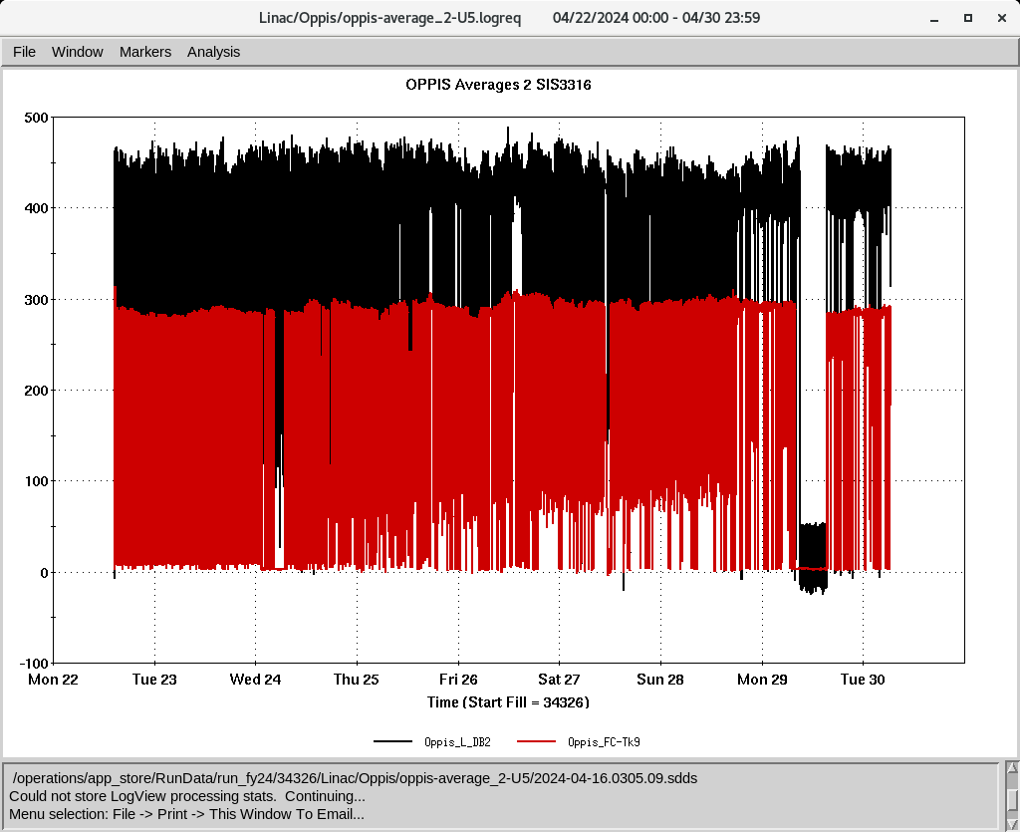
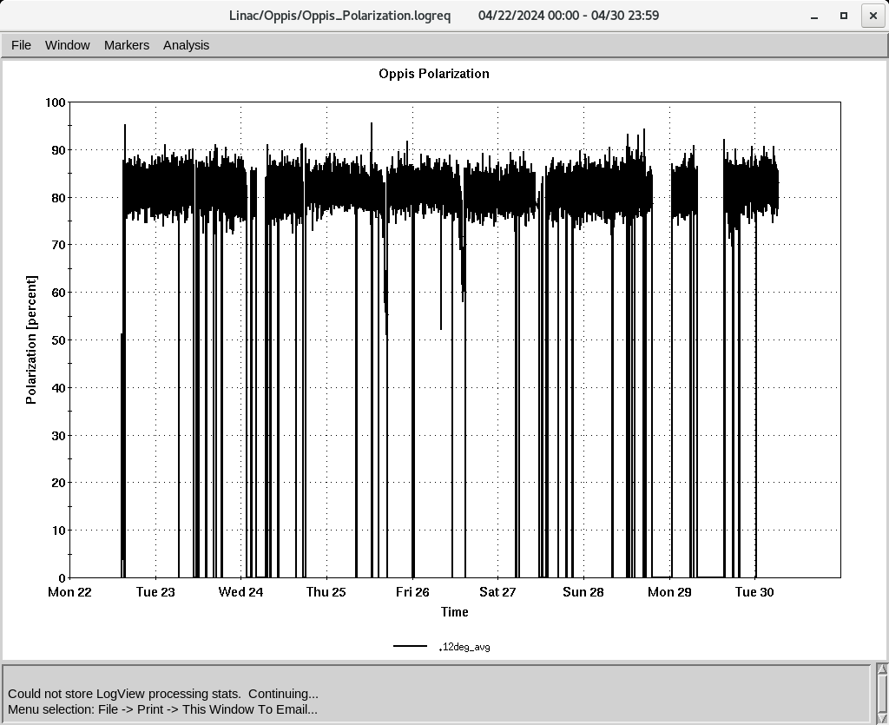
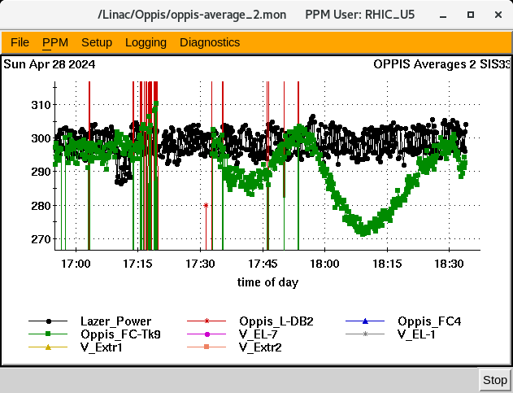
Linac 200 MeV Beam to BLIP , NSRL, Booster , AGS
BLIP
4/22-5/3: Th, 200 MeV, 150 𝞵A, Tar-Th
5/7-7-10: La, 117 MeV, 62 𝞵A
polarized H-
To Booster
OPPIS
Pol. ~ 82 % , current 330 @ 𝞵A tank 9
Rb temp ~82 C, increase temp causing spark
by increasing He-g3 and we not gain current
(need more time to condition )
Down time (~ 14 HRS)
-4/24: Mod 6, replaced 8616 tube (4.5 HRS)
-4/29:Diagnosis and repair of the compressed air leak in the BLIP spur. (7 HRS)
To 200 MeV Polarimeter
Polarization @ 200 MeV

Slide 5
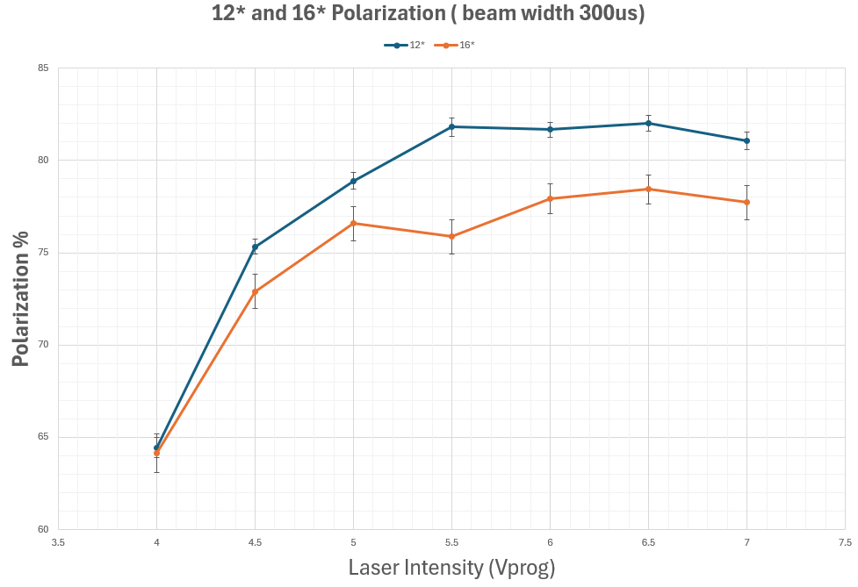
OPPIS Parameters Scans
Polarization vs Beam Width
Polarization vs Laser power

