Slide 1
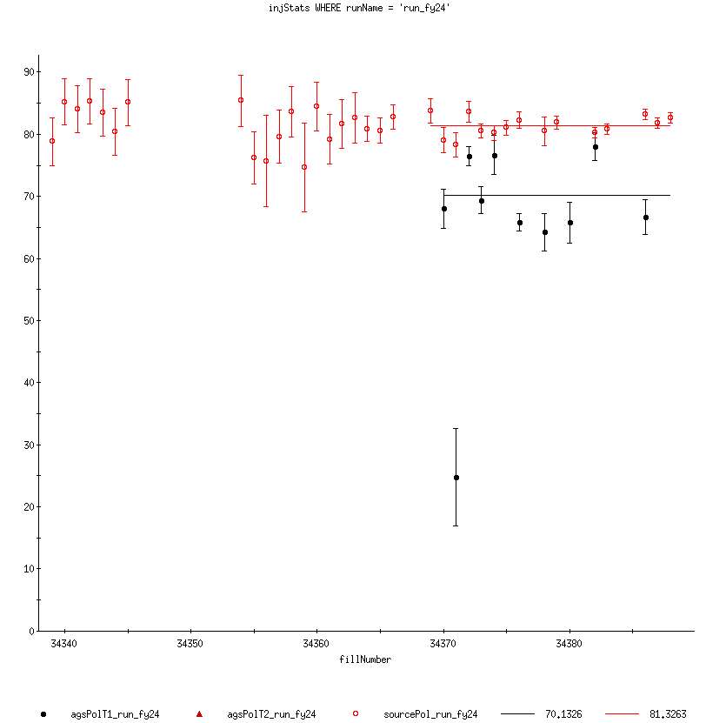
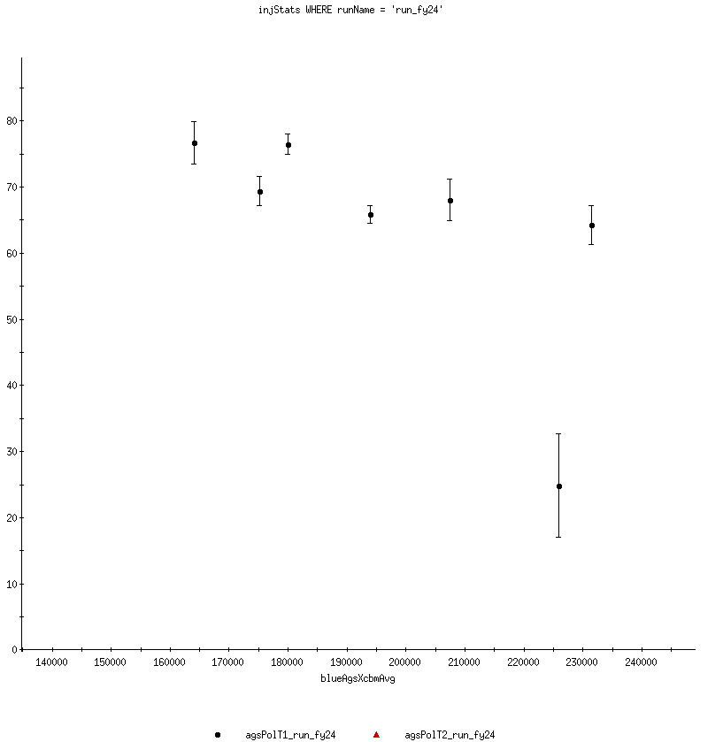
Injector Status Update Time Meeting 4/30/24
AGS Pol by Fill
Fill avg
80.3%
70.1%
Delivering beam for RHIC setup/ramp up
OPPIS intensity limited by source conditioning
Affects downstream emittance (less scraping available)
Booster main magnet stability improved
Working on ”bucket hopping” in Booster to AGS transfer
Failed fire alarm panel in AGS RF building
Repaired during Maintenance on 4/29
Repair avoids additional complications to safe operation of AGS RF
Thanks for the quick work!
Development
Single resonance experiments planned for skew quads on user 8 to measure effects of individual correctors
Polarization (%)
200 Mev
AGS
Fill number
AGS Pol by intensity
80%
70%
60%
Polarization (%)
1.5x10¹¹
2x10¹¹
Intensity per bunch (10⁶)

