Slide 1
sPHENIX status
Kin Yip
sPHENIX Director of Operations
Time meeting
Apr. 30, 2024

Slide 2
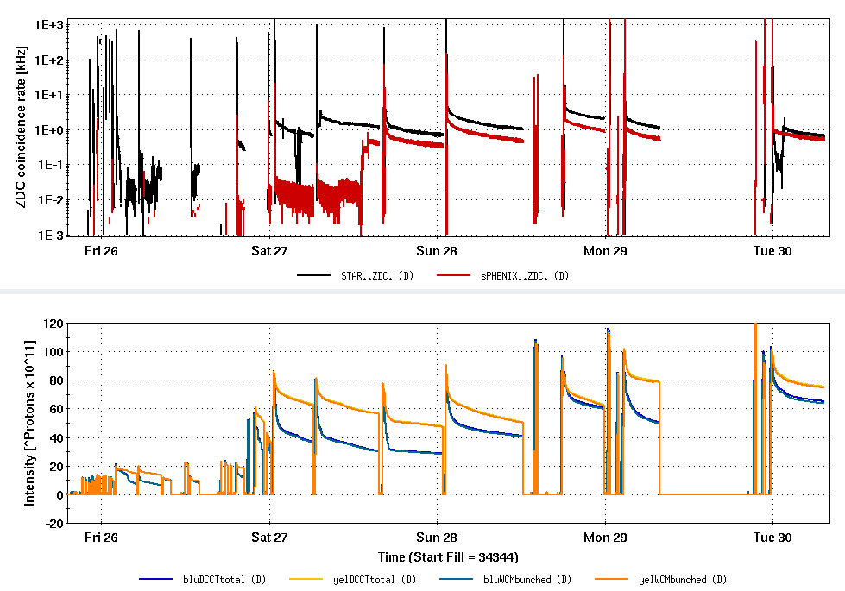
sPHENIX Status: “Commissioning”
The ZDC settings of 2015/pp run and wrong discriminator thresholds gave us a few Hz at store initially. After correction, the ZDC rates have become reasonable.
All detectors have taken some data at store.
We’ve resolved the issue of synchronization in global trigger/timing.
We are also improving shift instructions for detectors for various beam scenarios: injection, store, dump etc.

Slide 3
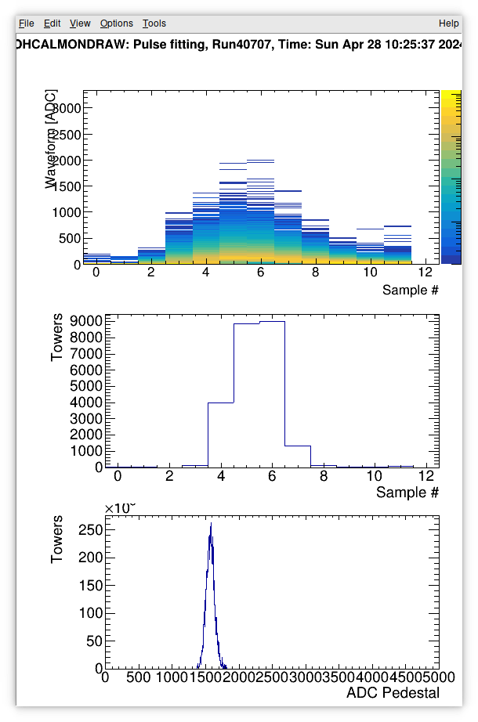
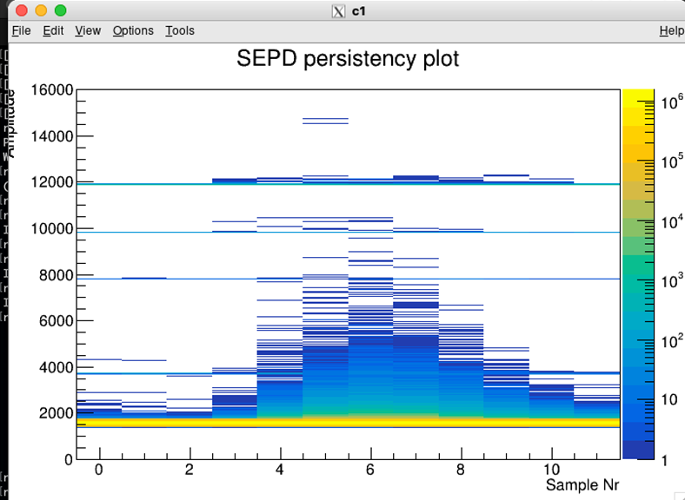
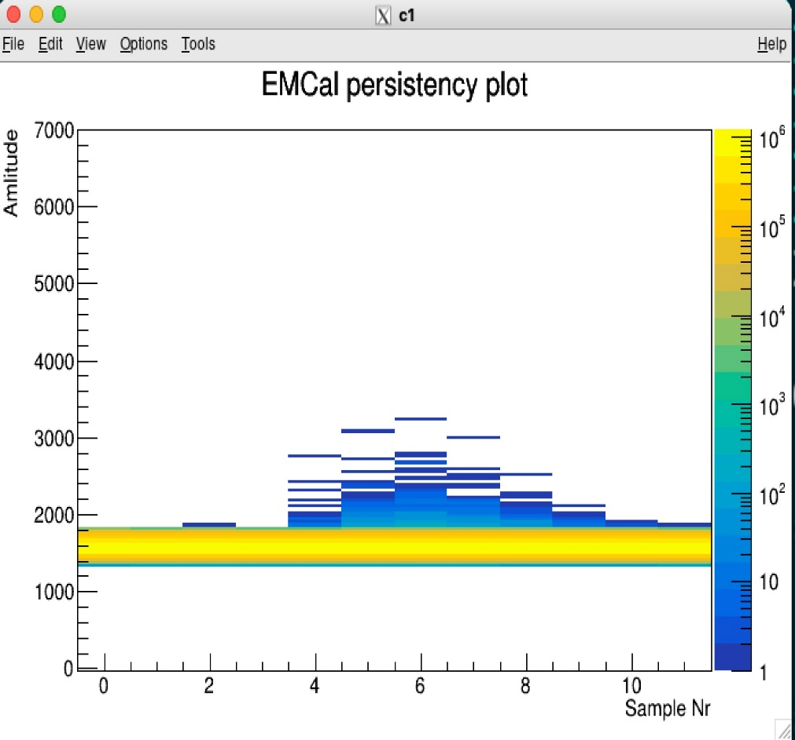
For example, HCAL, EMCAL, sEPD … all timed in to “sample 6” ~ Apr. 28, 2024.
HCal
sEPD
EMCal

Slide 4
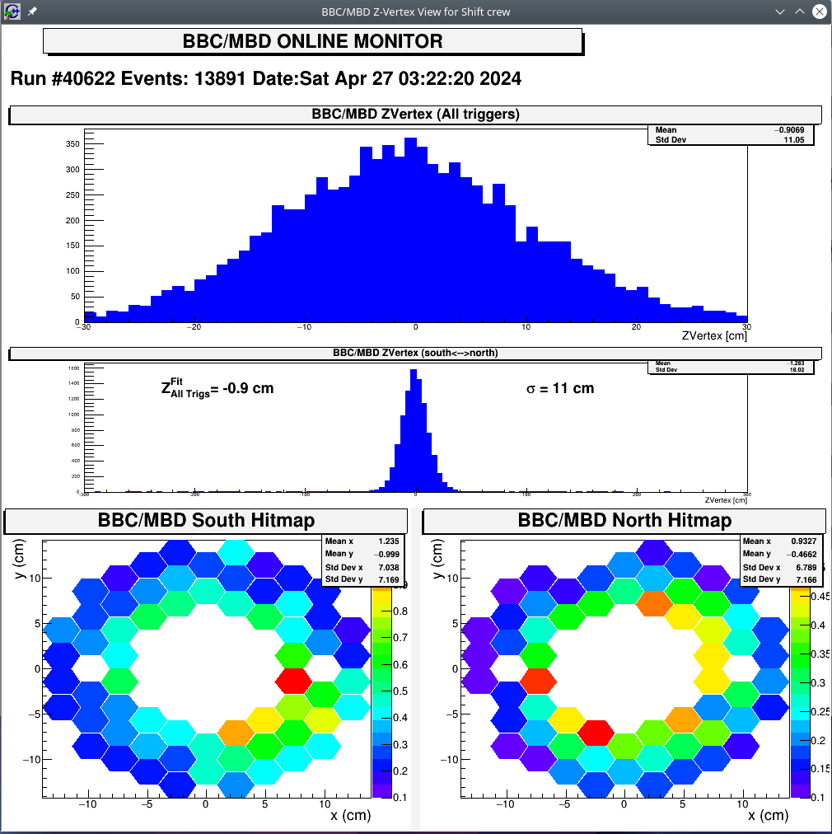
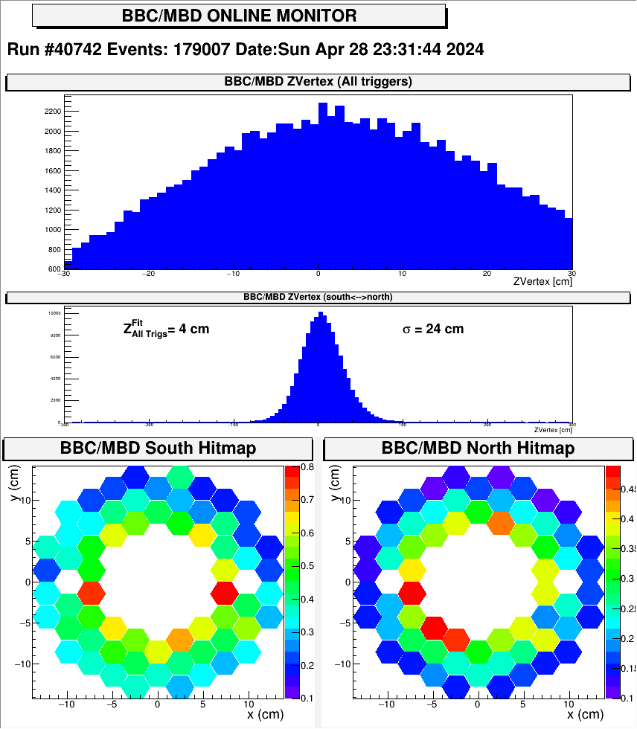
1 mrad
2 mrad

