Slide 1
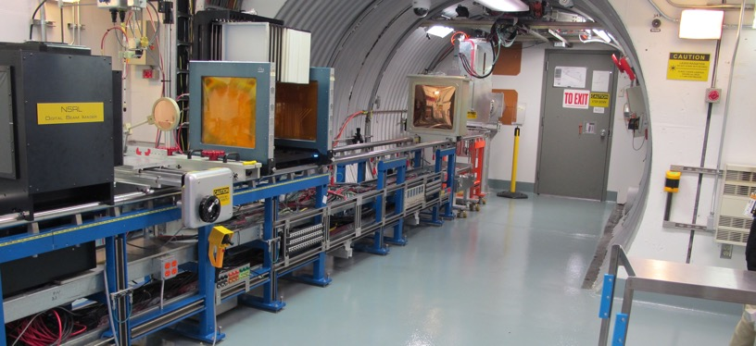
NSRL Time Meeting Report
30 April 2024
Michael Sivertz

Slide 2
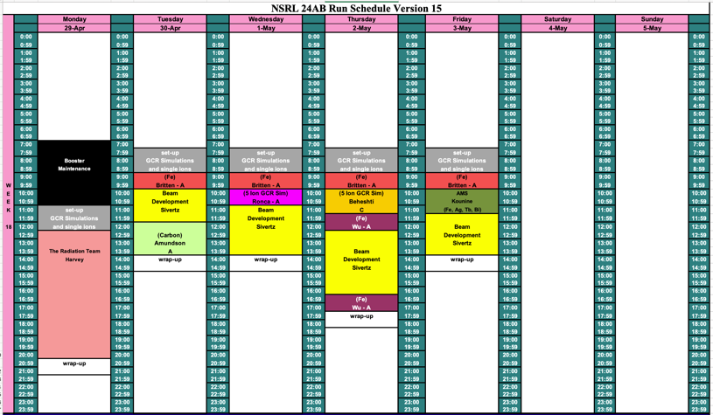
Schedule for this week

Slide 3
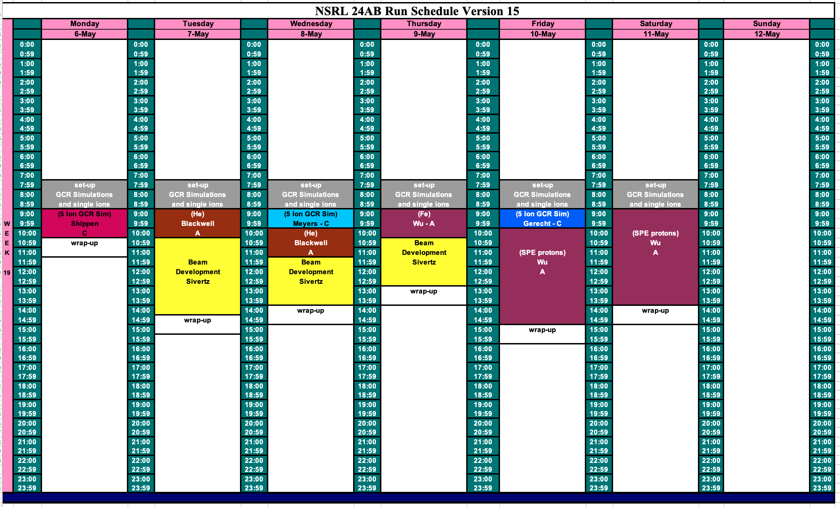
Schedule for next week

Slide 4
Future Schedule
Additional beam development time available in August (13 – 25 August Shutdown) for noble gas ions from EBIS and a few days of proton beam from EBIS.
NASA Radiobiology runs from now through 1 June.
Electronics testing again until the end of September.
NSRL Shutdown from 13 – 25 August 2024.
NASA Radiobiology in October – November.
Booster Shutdown December – January.

