Slide 1
Data courtesy C. Naylor

Slide 2
Data courtesy C. Naylor

Slide 3
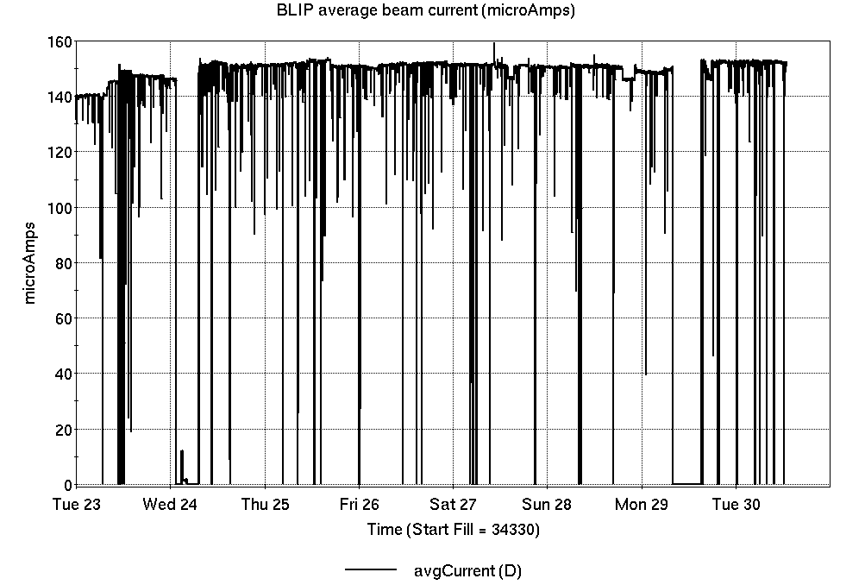
Operations for BLIP
4/23-30/2024:
BLIP 200 MeV target production continued throughout the week (requisite beam current was reestablished).
152.07 hr Production
0.13 hr Setup
8.47 hr Failure
7.33 hr Maintenance
Availability: 94.7%
No BLIP
this past week

Slide 4
NSRL activity past week: 4/23-30/2024 (as of 0800)
NSRL: NASA biology continues, as primary user in GCR mode; additional users this week.
Protons, 11 EBIS ions in use. (He, C, Ne, O, Si, Fe, Ag, Tb, Ta, Bi, Au)
Run 24-A/B schedule continues until 21 May.
Run 24-C follows 22 May. Schedule posted, details forthcoming; beam into November.
Availability: 70.2%

Slide 5
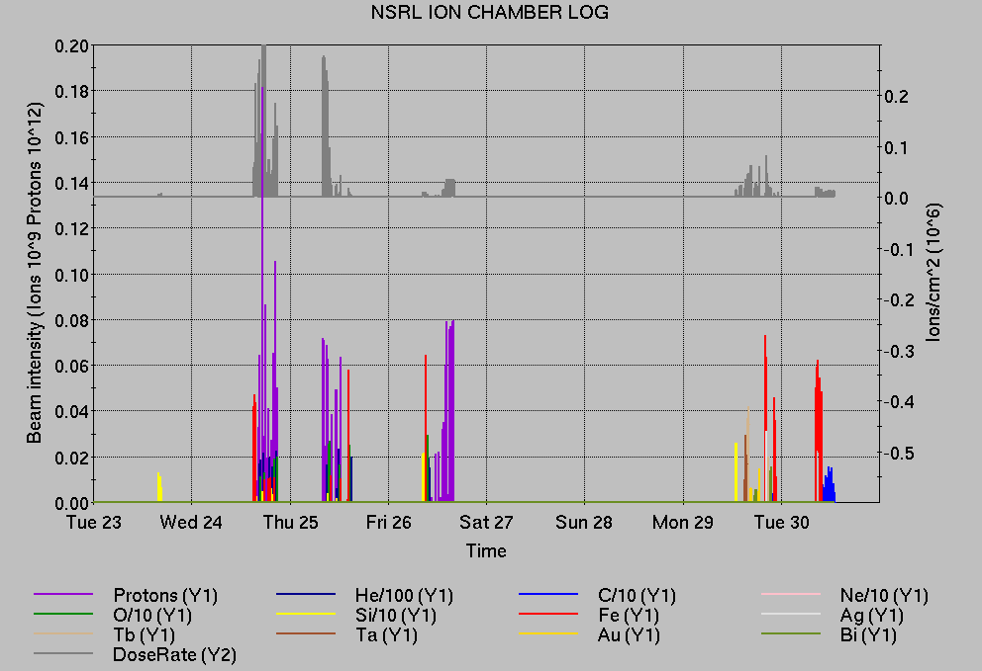
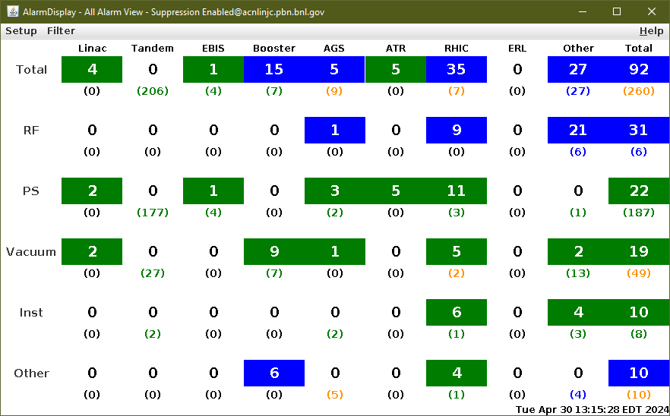
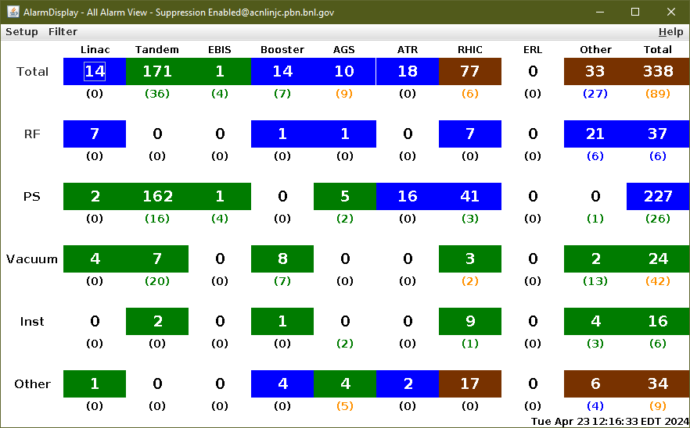
Notes from Operations
Notable failures (>1 hr)
Linac Mod 6 RF failures (4x). 8618 replacement was major repair.
Blue injection kicker mispulse failures, repairs to module #3.
Access for PS, other repairs
Access for bo11-th6-ps
Blue QLI
AGS LLRF bucket hop issues
Blue bi4-tq5 trip, replaced PS
R-line PS failure
Proton intensity issues
Other notes
Various trips, resets and concurrent work
427 alarms last week; 352 today

Slide 6
Reminder from Operations
MCR continues Operations for:
BLIP – continues through 3 May.
NSRL user running scheduled Mon-Fri, NASA Biology this week and next.
AGS/Booster polarized proton setup continues, additional to RHIC setup.
Setting up multiple (proton) AGS PPM Users, polarization scans.
Injector Au setup as yet untested.
Skew quad testing continues.
RHIC beam setup.
Working towards Physics stores.
Remember to coordinate with MCR. We need proper contacts when systems require experts
CHECK AND EDIT YOUR OWN CONTACT INFO
http://directory.pbn.bnl.gov/
CHECK YOUR CALLIN LIST: WCC and ECP updates needed
https://www.cadops.bnl.gov/Operations/personnel/call_in_lists/

Slide 7
Data courtesy C. Naylor

Slide 8
Availability, expected beam hours
$$Availability=\frac{actual beam time}{scheduled beam time}≡\frac{Beam use time}{Calendar time−scheduled interruptions}$$
$$RHIC \\ Availability=\frac{Physics+Machine Development+Machine Setup+Experiment Setup+Accelerator Experiments}{(Physics+Machine Development+Machine Setup+Experiment Setup+Accelerator Experiments)+Failures}$$
$$\text{DOE} \text{expected} \text{beam} \text{hours}=(\# of weeks −1 week overhead)×\left(\frac{160 available hours}{1 week}\right)×0.8$$
Notes:
Normally hidden. Explains how the 85% from DOE comes in to play & general availability metrics

